Slide 1


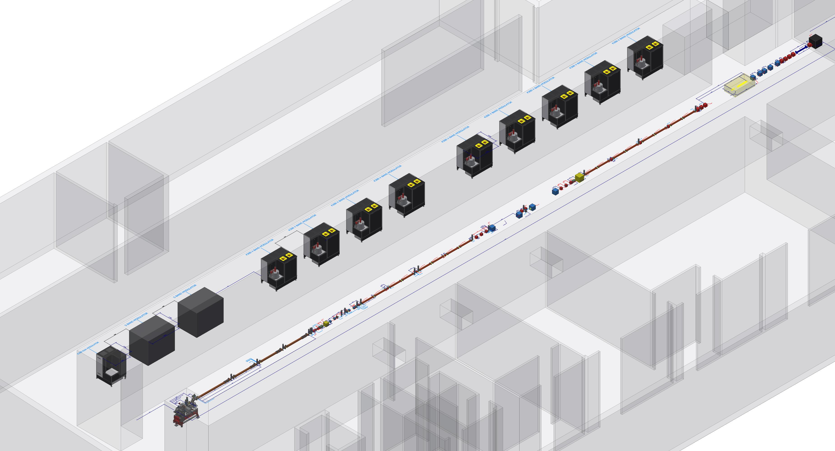
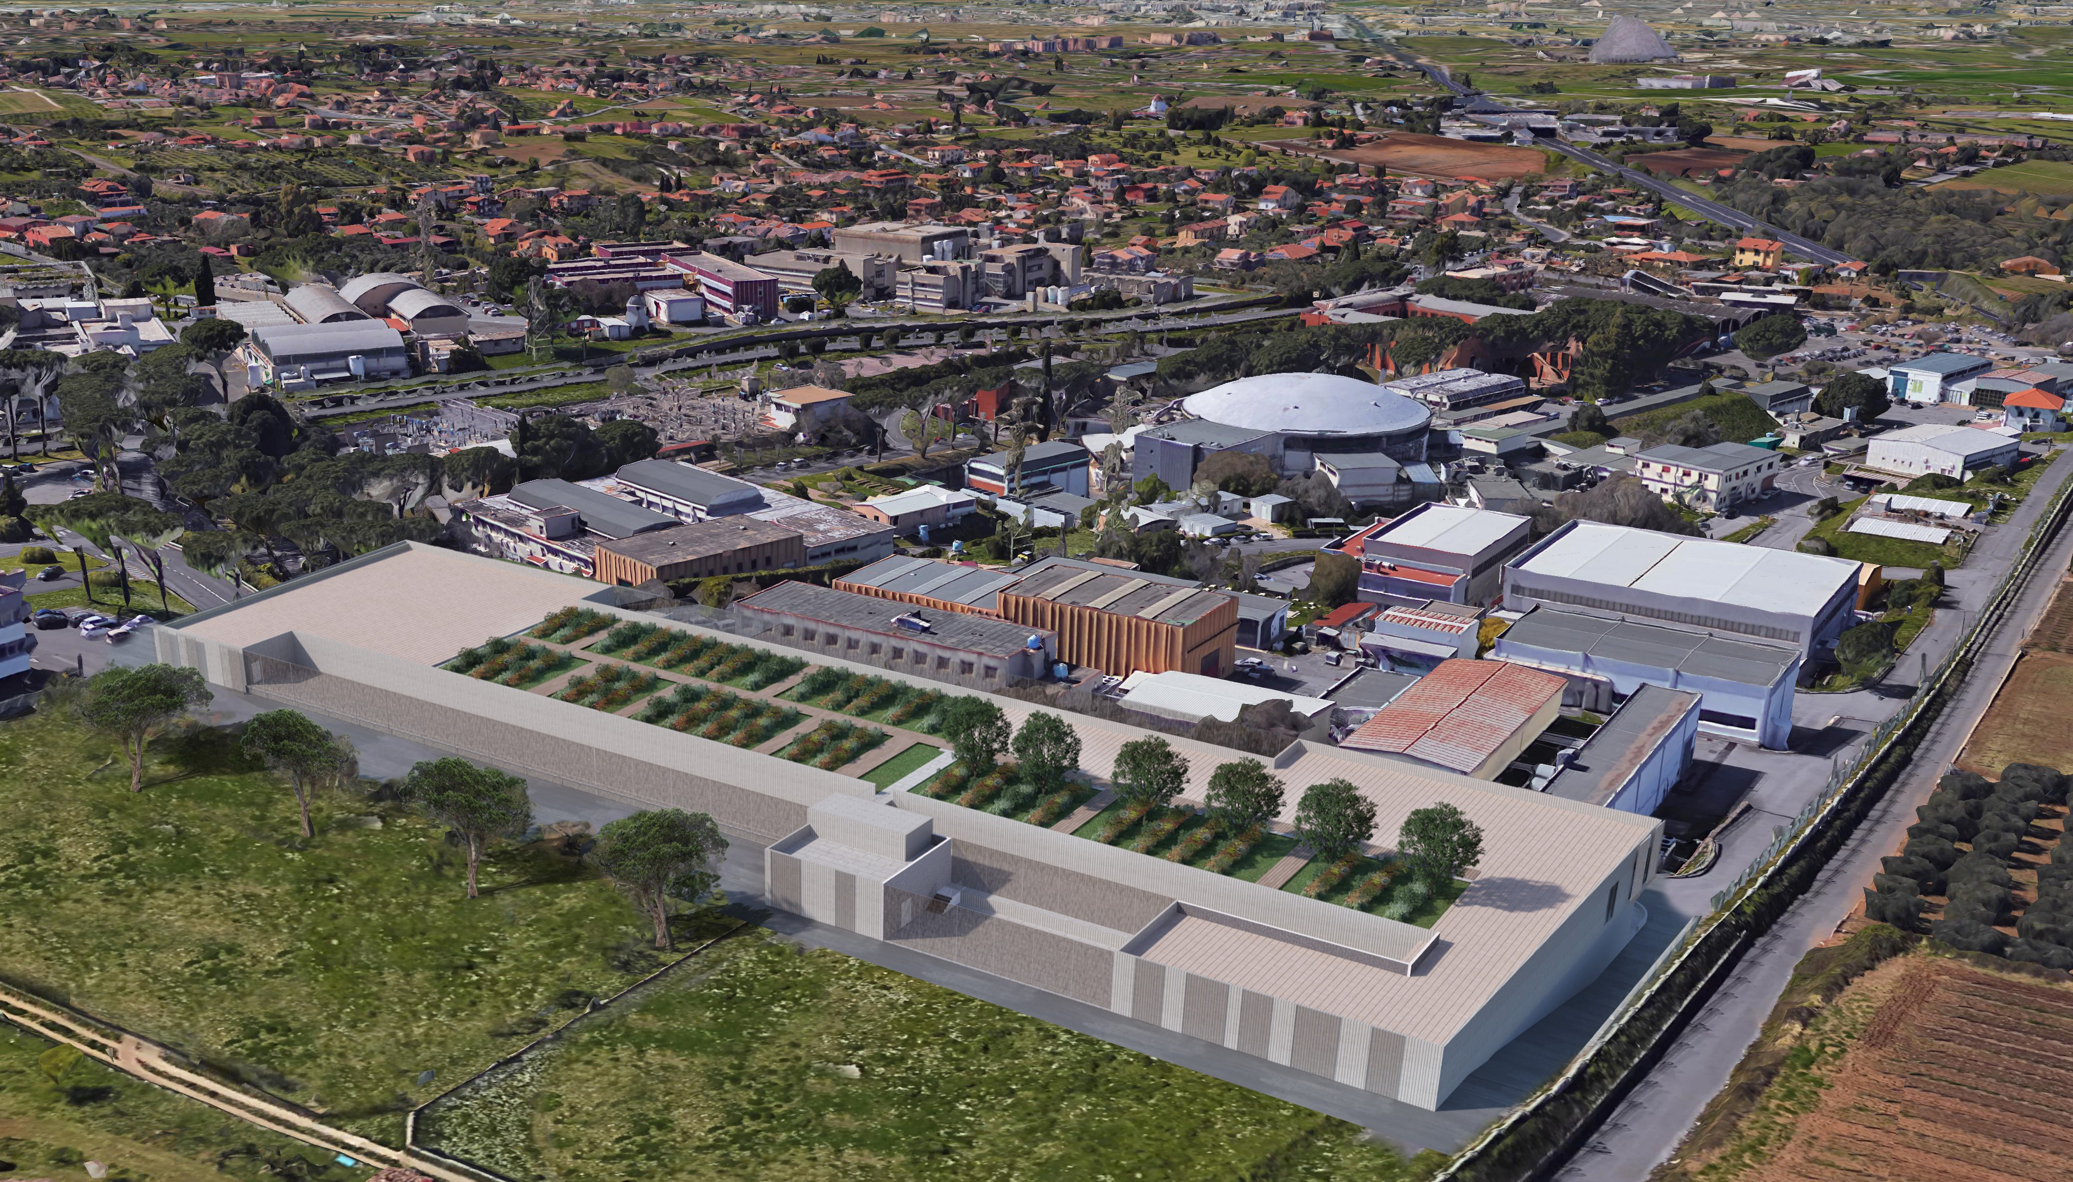
EuPRAXIA@SPARC-LAB:
Machine Layout
Andrea Ghigo on behalf of
EuPRAXIA@SPARC-LAB collaboration
EuPRAXIA Review Committee A.Ghigo Frascati 6 June 2022

Slide 2
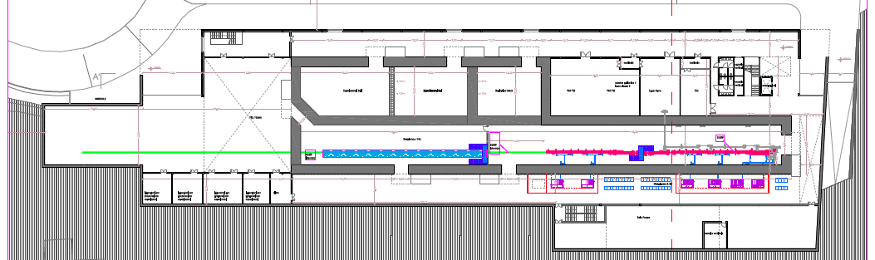
Functional description
of the areas
Laser & THz clean rooms
Particle experimental halls
Photon user experimental hall
Undulators tunnel
Plant gallery
Accelerator tunnel
Klystron&modulators
Power supplies gallery
EuPRAXIA Review Committee A.Ghigo Frascati 6 June 2022

Slide 3
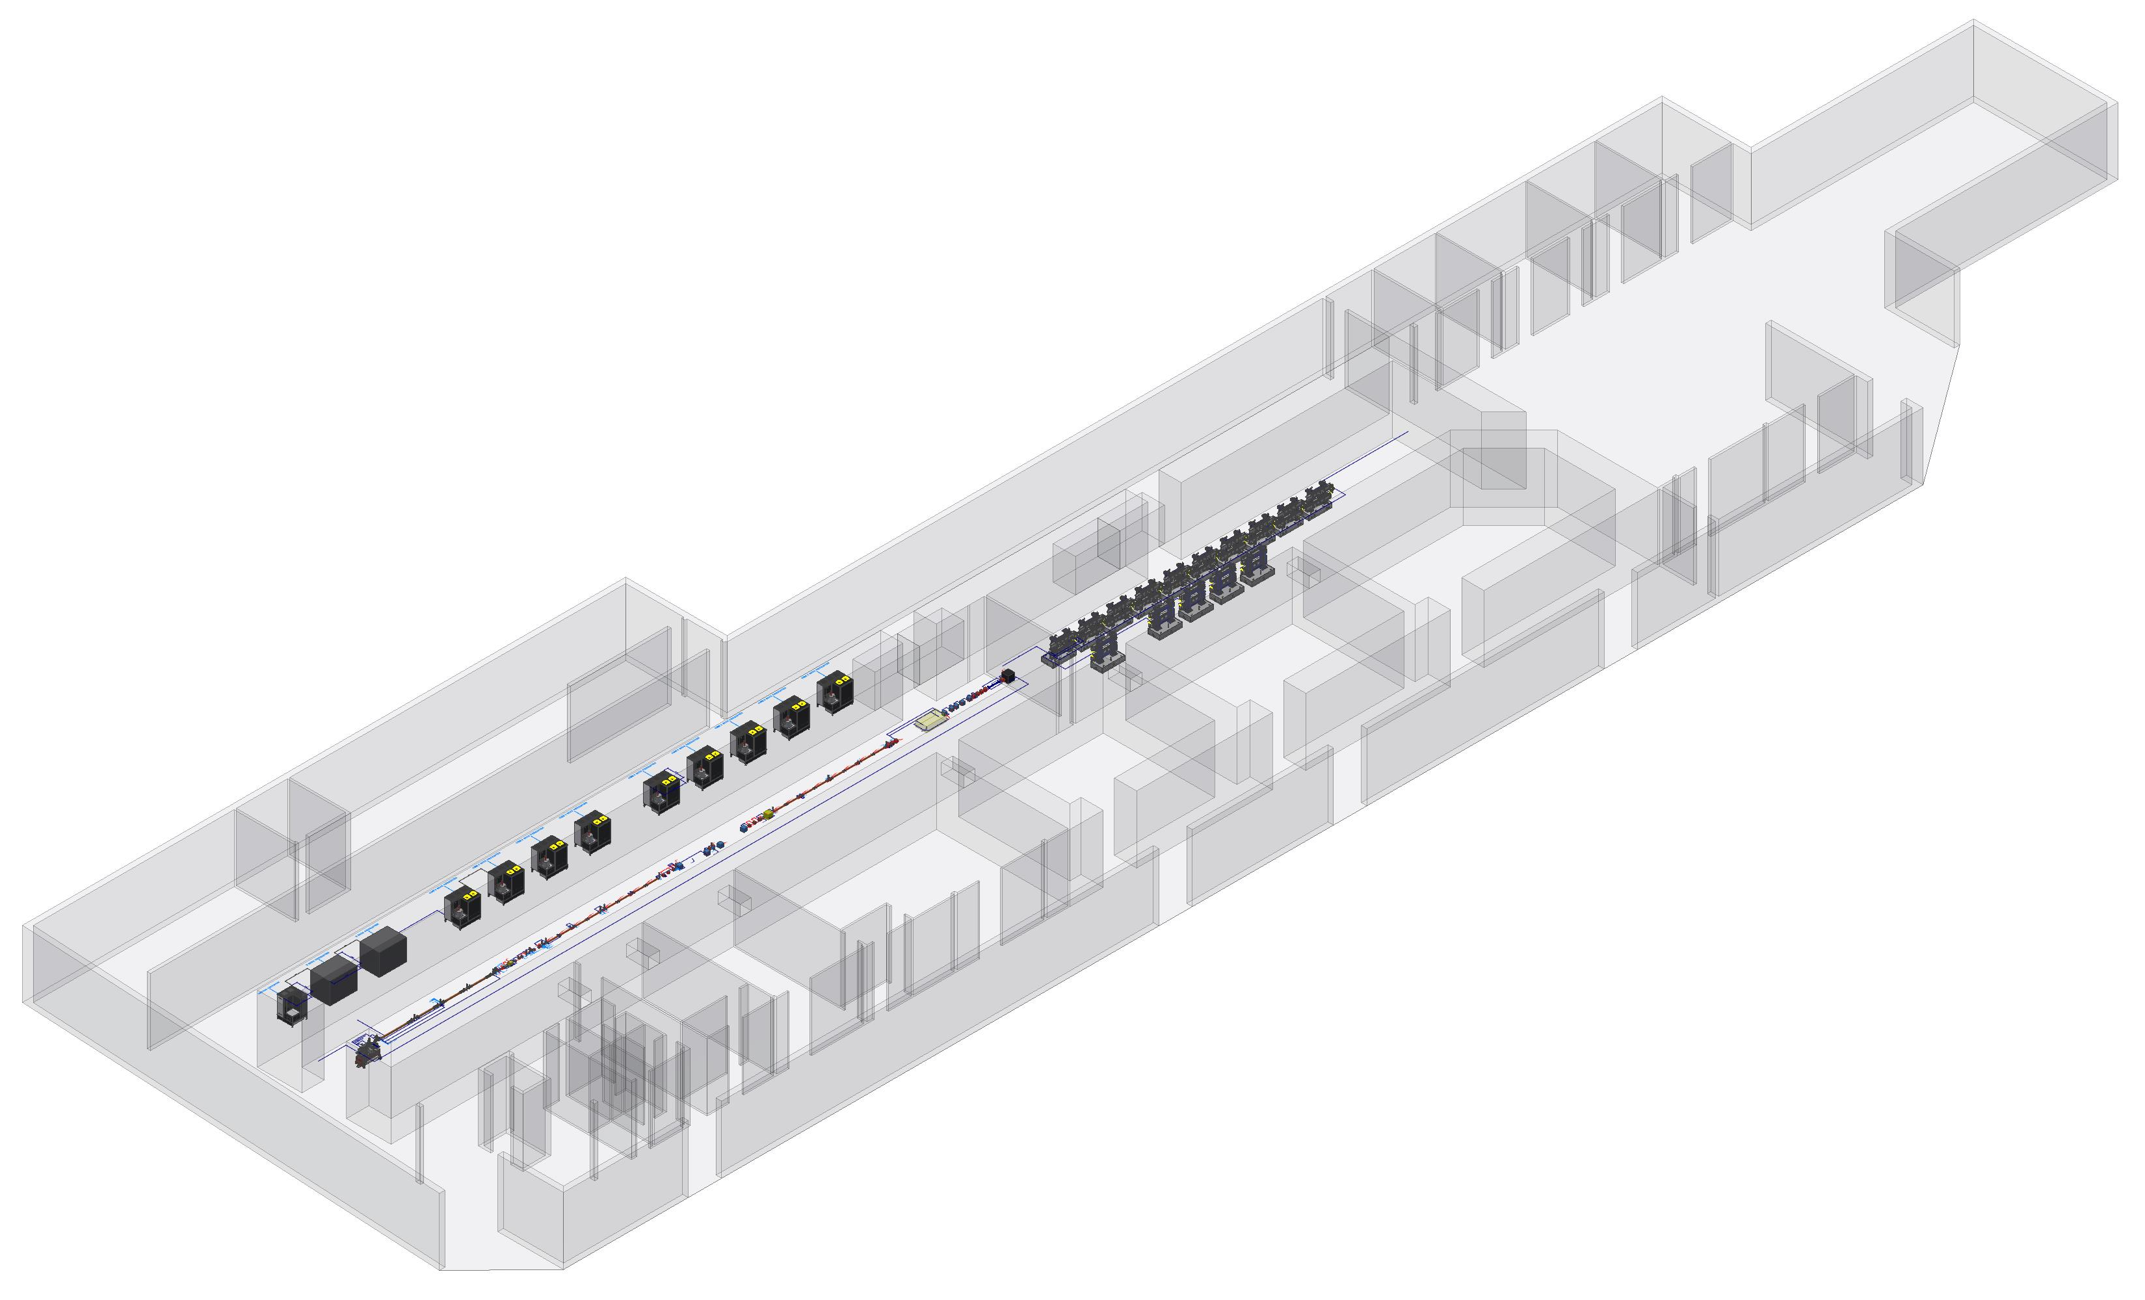
Linac & undulators 3D
in the building
EuPRAXIA Review Committee A.Ghigo Frascati 6 June 2022

Slide 4
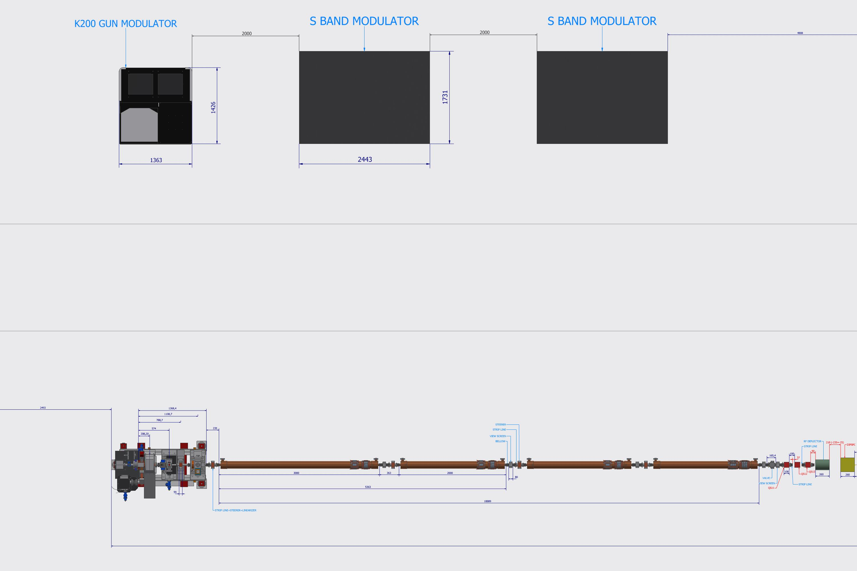
Injector
3 S-Band RF power station
Gun + 4 RF S-Band accelerating structure:
the first 3m long, the other 2m long
EuPRAXIA Review Committee A.Ghigo Frascati 6 June 2022

Slide 5
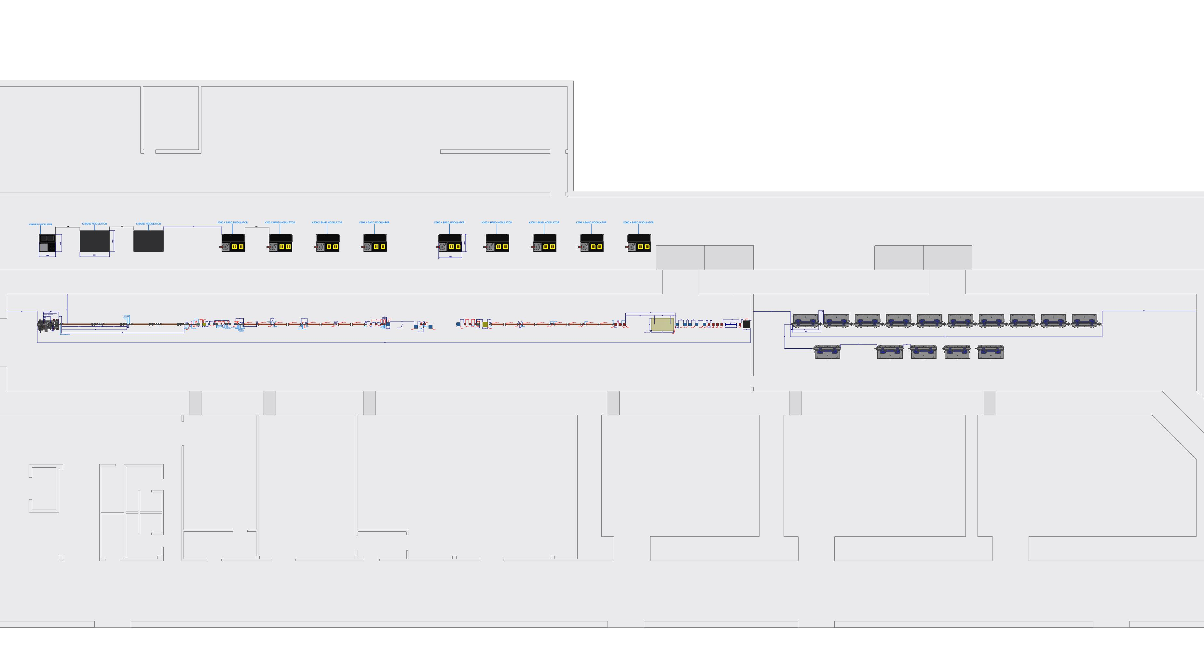
The LINAC
Low energy linac: 8 X-Band accelerating structures
Bunch compressor : magnetic chicane
High energy linac: 8 X-Band accelerating structures
Plasma acceleration module
EuPRAXIA Review Committee A.Ghigo Frascati 6 June 2022

Slide 6
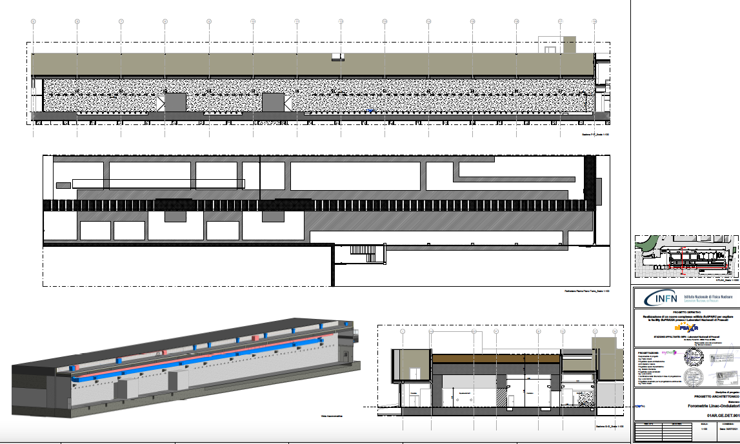
Diagram of the openings of the building
EuPRAXIA Review Committee A.Ghigo Frascati 6 June 2022

Slide 7
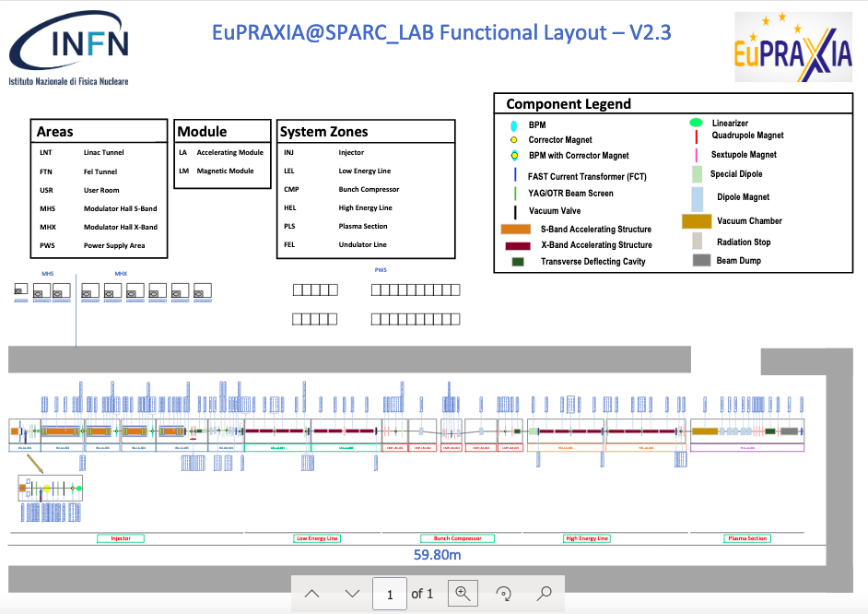
EuPRAXIA Review Committee A.Ghigo Frascati 6 June 2022

Slide 8
AQUA and ARIA
undulators lines
AQUA: 10 undulator modules 2m long
ARIA: 5 undulator modules + dispersive section
EuPRAXIA Review Committee A.Ghigo Frascati 6 June 2022

Slide 9
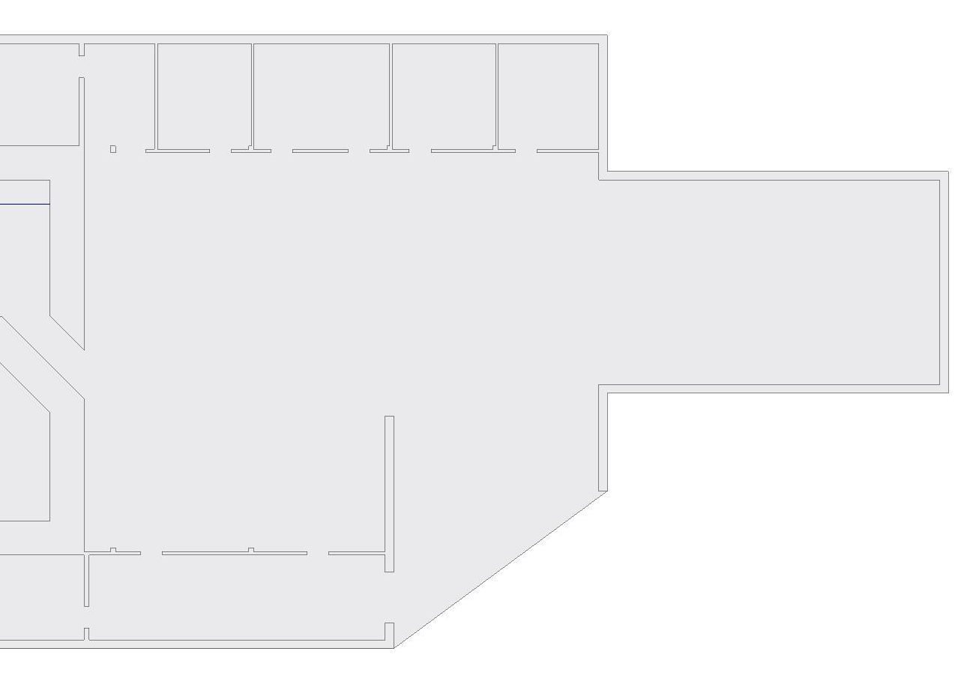
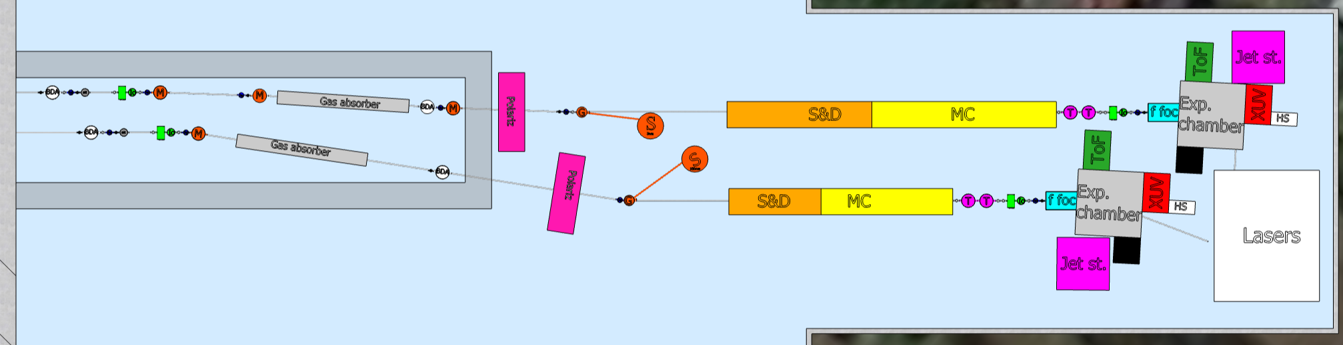
User area schematic
Beam lines:
  Defining apertures
  Mirror and focusing
  Filter and attenuators
  Monochromator
  Split & delay
Diagnostic:
  Beam position monitors
  Intensity monitors
  Spectrometer
  Transverse dimension
  Longitudinal dimension & time arrival
  Wavefront measurement
  Polarization measurement
  Coherence measurement
EuPRAXIA Review Committee A.Ghigo Frascati 6 June 2022

Slide 10
Linac & undulators layout
Accelerator + 2 undulator lines + beam dumps
EuPRAXIA Riunione Giunta Esecutiva INFN A.Ghigo Roma 18 Maggio 2022

Slide 11
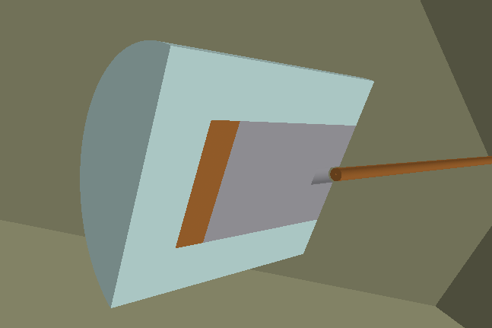
Electron
beam dump
Intermediate dumps
1 Hz for beam diagnostic
Same design for 300, 800, 1200 MeV
F.Chiarelli courtesy
EuPRAXIA Review Committee A.Ghigo Frascati 6 June 2022

Slide 12
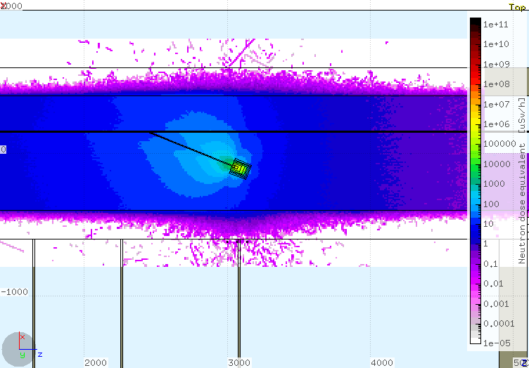
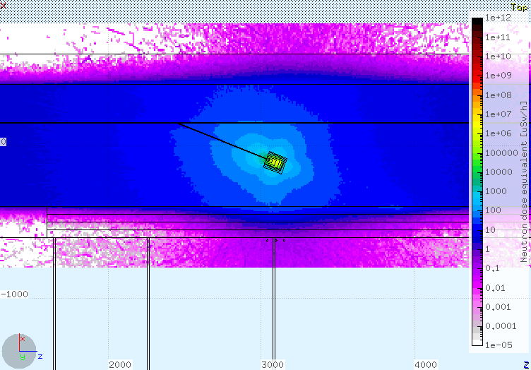
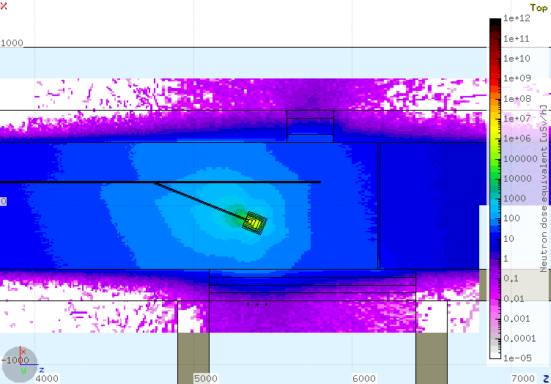
Electro beam
dump simulations
300MeV
Dose rate in external area < 1 μS/year
800MeV
1200MeV
EuPRAXIA Review Committee A.Ghigo Frascati 6 June 2022

Slide 13
Thanks for the attention
EuPRAXIA Review Committee A.Ghigo Frascati 6 June 2022

