Slide 1
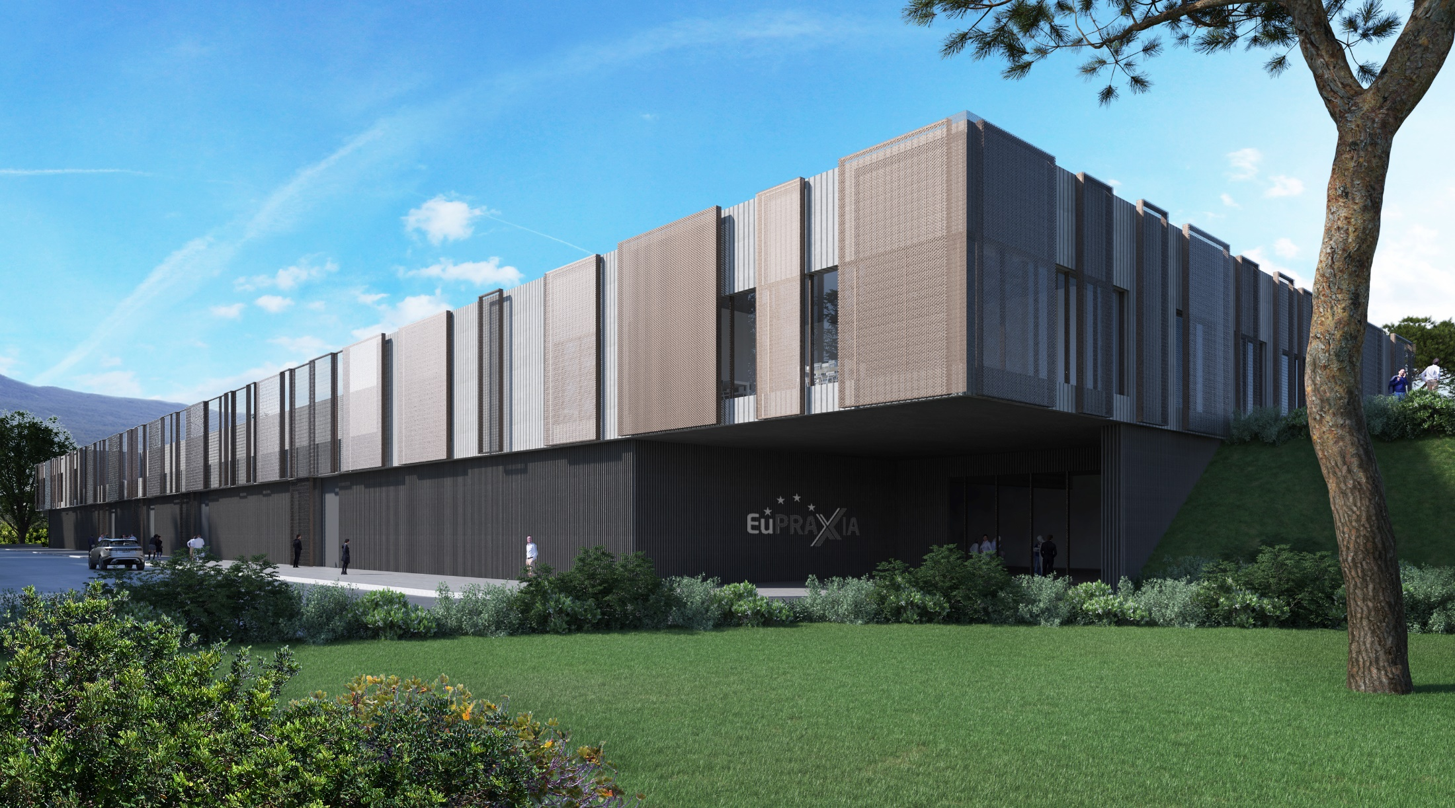


EuPRAXIA@SPARC_LAB Project update and related R&D activities
Massimo.Ferrario@LNF.INFN.IT

Slide 2
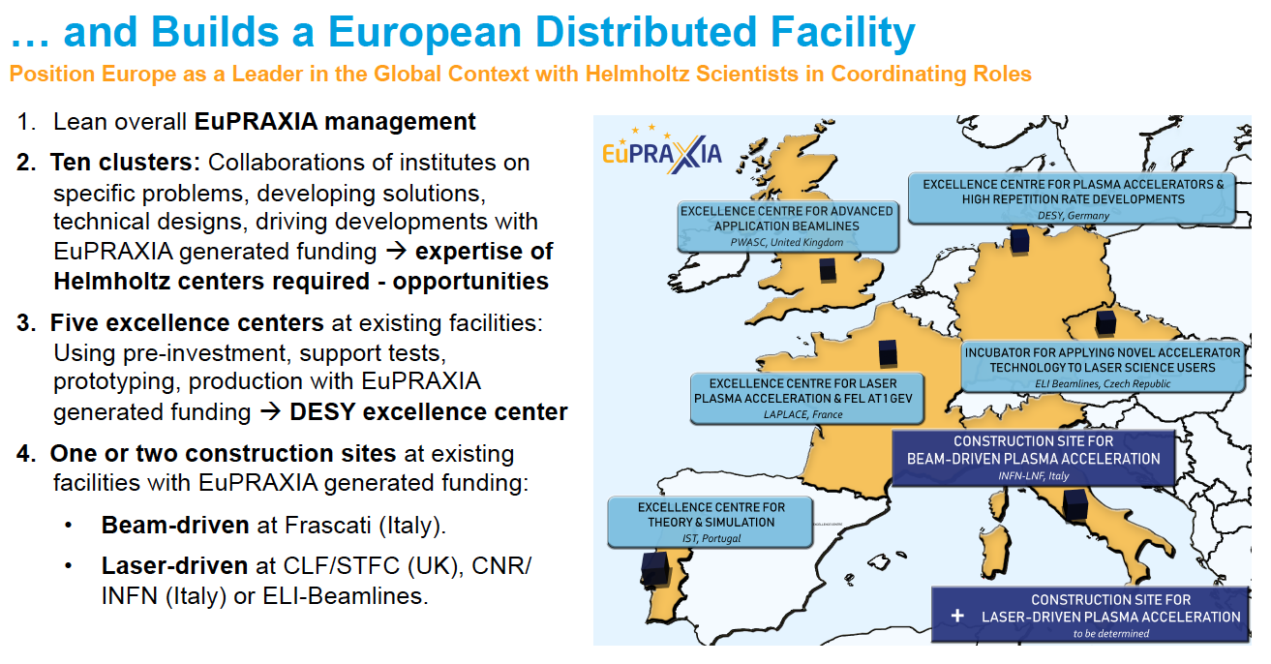
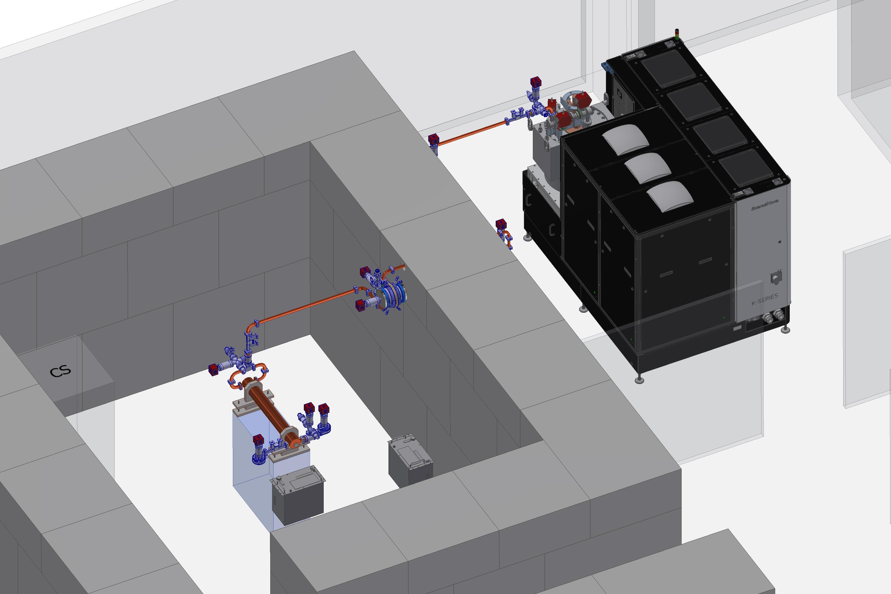
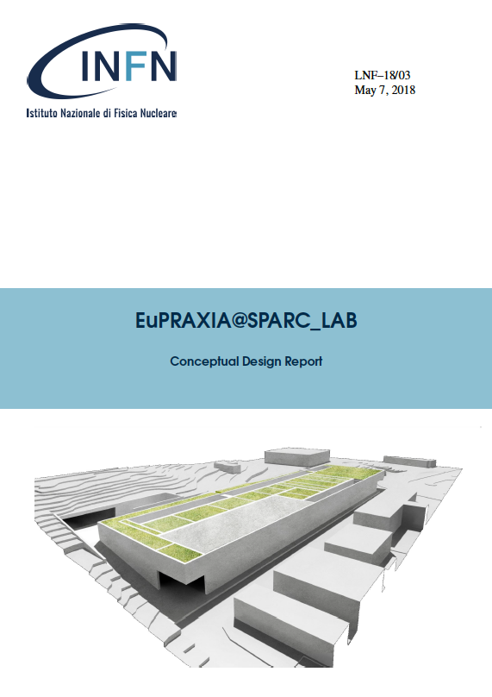
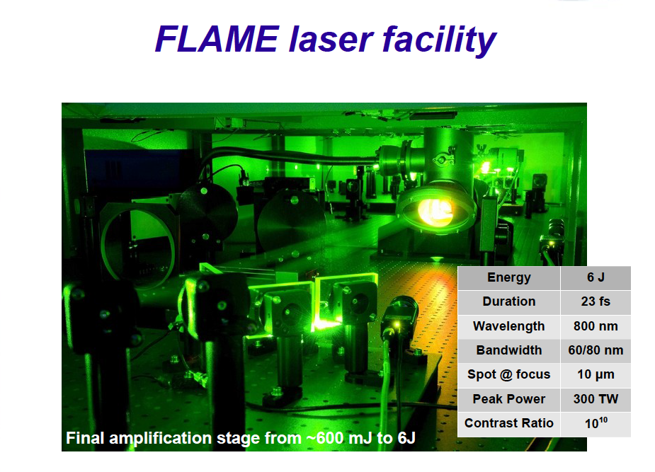
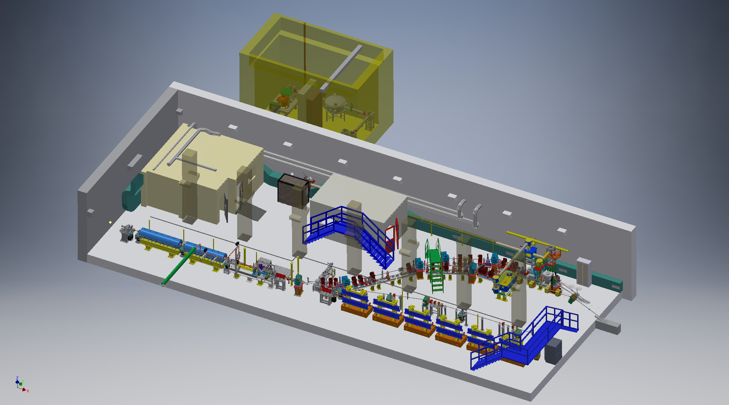
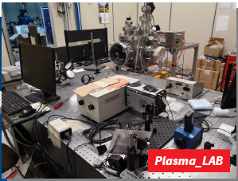
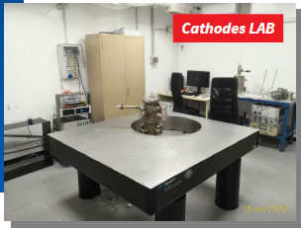
HEAD QUARTER @LNF
EuPRAXIA@SPARC_LAB
TEX
Technical Design Report
SPARX
NTA->CSN_5
EUROFEL
PLASMAR
SPARC_LAB
SABINA
SPARC_LAB

Slide 3
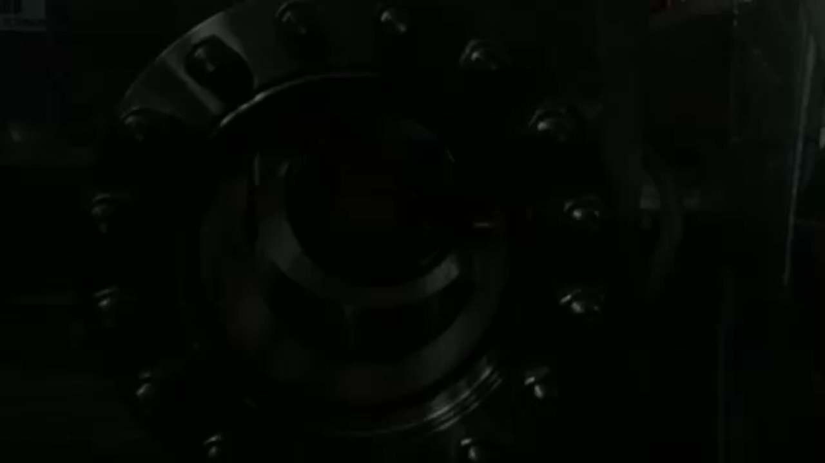
EuPRAXIA@SPARC_LAB
Undulators
1 GeV LINAC
Plasma module
RF power modules
FEL user area @3nm
Secondary
Sources
Beam user areas
0.5 PW Laser
http://www.lnf.infn.it/sis/preprint/pdf/getfile.php?filename=INFN-18-03-LNF.pdf

Slide 4
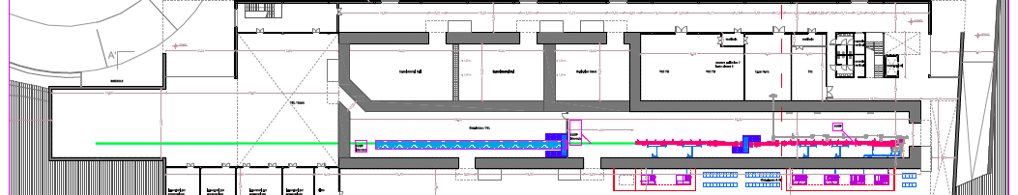

Next Workshop:
Opportunities for Collaborations at EuPRAXIA@SPARC_LAB
Laser & THz clean rooms
experimental halls
Photon user experimental hall
2
5
4
3
1
Undulators tunnel
Plant gallery
Accelerator tunnel
Klystron&modulators
Power supplies gallery

Slide 5
Significant progress for ALL WA and WP:
Project Management, schedule, milestones and risk management update, manpower needs => A. Falone
Progress in the building design finalization and authorization process => U. Rotundo
Progress on the beam dynamics studies, approaching the critical milestone of the intermediate layout approval (end 2022) => C. Vaccarezza, A. Ghigo
Injector layout – Cost Benefit Analysis performed for different options => E. Chiadroni
Compact Beam Position Monitor prototype designed and built => A. Cianchi
Long plasma capillary (40cm) production and testing (under-schedule) => A. Biagioni
Ondulator strategy concluded -> Possible 2 beamlines => Giannessi, Petralia, Nguyen
RF power source strategy concluded and procurement in progress => S. Pioli
SAT of X-Band tube completed successfully (50MW reached) => S. Pioli
The framework of the Control System has been definitively finalized. EPICS to control with our !CHAOS system for back-end services => A. Stecchi dedicated talk at the next Meeting
First Lasing Nature paper published => R. Pompili
Successful Submission of Eu and National Proposals

Slide 6

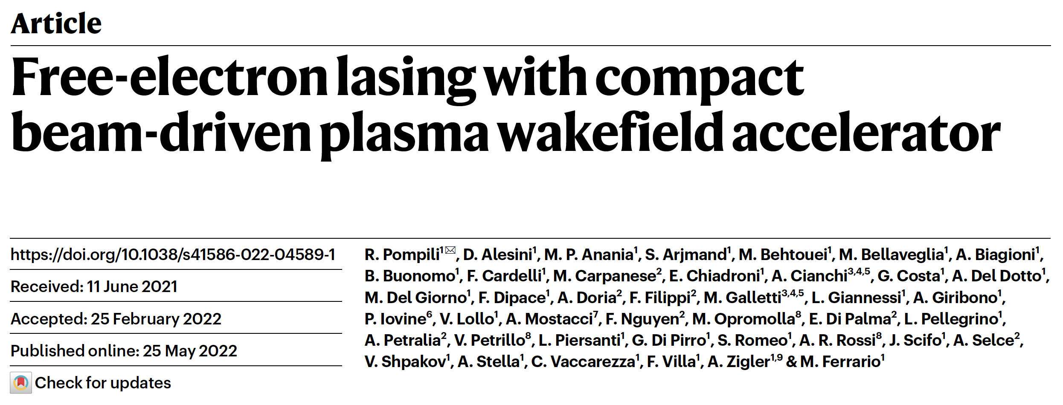

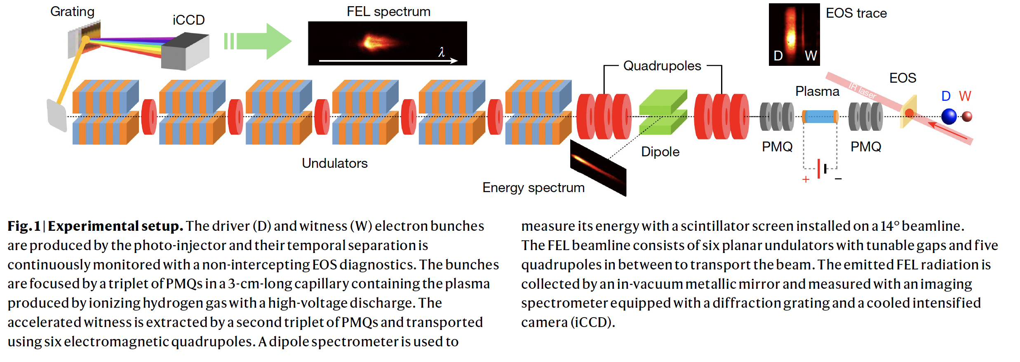

Slide 7
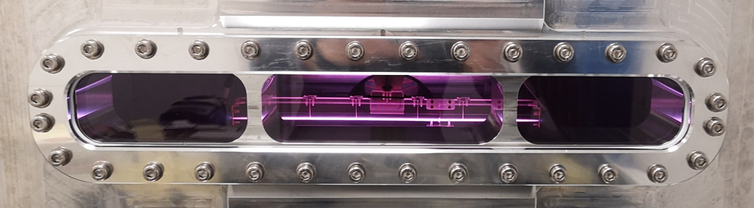
March 2022 - First discharge in EuPRAXIA @ SPARC_LAB plasma acceleration module turned on
Image captured during the formation of plasma in the capillary 40 cm long and 2 mm in diameter, installed inside a vacuum chamber specially created to accommodate large plasma sources. The applied voltage pulse is 9 kV and the peak current reaches about 500 A.
Courtesy Angelo Biagioni

Slide 8
EuPRAXIA related proposal
MSCA Doctoral Network on EuPRAXIA
EuPRAXIA Preparatory Phase
EuPRAXIA Advanced Photon Sources (PNRR)
Compact and Resource-Efficient Accelerator TEchnologies (CREATE) (H2020)

Slide 9
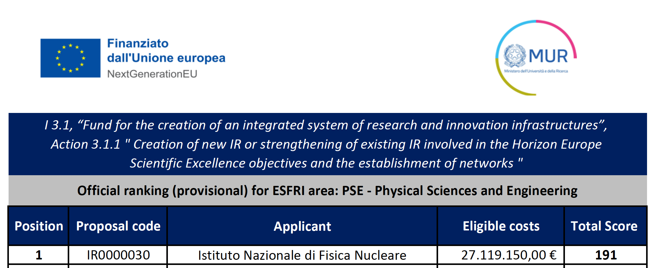
EuPRAXIA Andvanced Photon Sources

Slide 10
Eu
Scientific Coordinator: M. Ferrario (INFN-LNF)
EuPRAXIA Project Integration: R. Assmann (DESY & INFN)
WP1
MANAGEMENT & DISSEMINATION
A. Falone (LNF)
Scientific Advisory Committee
WP4
HIGH REPETITION RATE
LASER
BEAM LINE
L. Labate (CNR-INO)
Operating Units Board
WP3
HIGH POWER LASER
BEAM LINE
P. Cirrone (LNS)
WP2
BETATRON RADIATION
SOURCE
Cianchi
(Uni-ToV)
Scientific and Technical Board

Slide 11
Abstract: Advanced Photon Sources are key components for the successful operation of the EuPRAXIA facilities. They act, for example, as drivers for plasma waves in ultra high-gradient accelerators or as plasma-based sources of ultra-short pulses of high intensity x-rays. Those developments enable the production of unique ultra-short particle and photon beams with a variety of applications in ultra-fast science, highly accurate medical imaging, material diagnosis and medical treatment. The proposed EuPRAXIA Advanced Photon Sources “EuAPS” project bundles several frontier science aspects in this domain, to be pursued in Italian research centers and universities. Several Italian facilities will be set up, strengthening and ensuring international competitiveness of the involved institutes and its users.
The proposal includes a laser-driven “betatron” X Ray facility to be tested and put in operation at the SPARC_LAB test facility. This already proven concept, part of the EuPRAXIA science goals, has inherent advantages in resolution due to the short (point-like) emission lengths in a plasma. Advanced photon diagnostics tools will be developed at CNR-ISM to fully characterize x-ray betatron radiation, while University of Tor Vergata will provide the compact and integrated user end station. EuAPS includes the development of the required drive lasers. The work towards High Power (up to 1 PW) and High Repetition Rate (up to 100 Hz) is spear-headed by the CNR-Pisa and INFN-LNS-Catania laboratories, offering a platform for advanced ultrafast laser-based industrial developments. At CNR-Pisa the consortium will establish user access to the next generation of kW scale high repetition rate laser operation. At INFN-LNS-Catania the focus will be placed on high charge secondary particle production with innovative high power lasers. The project will enable the creation of new advanced photon test facilities in both places that operate at internationally competitive levels and will support users from medical applications or other domains. The work in EuAPS plays a crucial role in complementing the EuPRAXIA construction project at Frascati, further developing and strengthening the EuPRAXIA high technology, its use case and user basis in Italy and beyond.

Slide 12
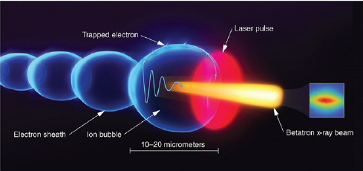
Betatron Radiation Source

Slide 13
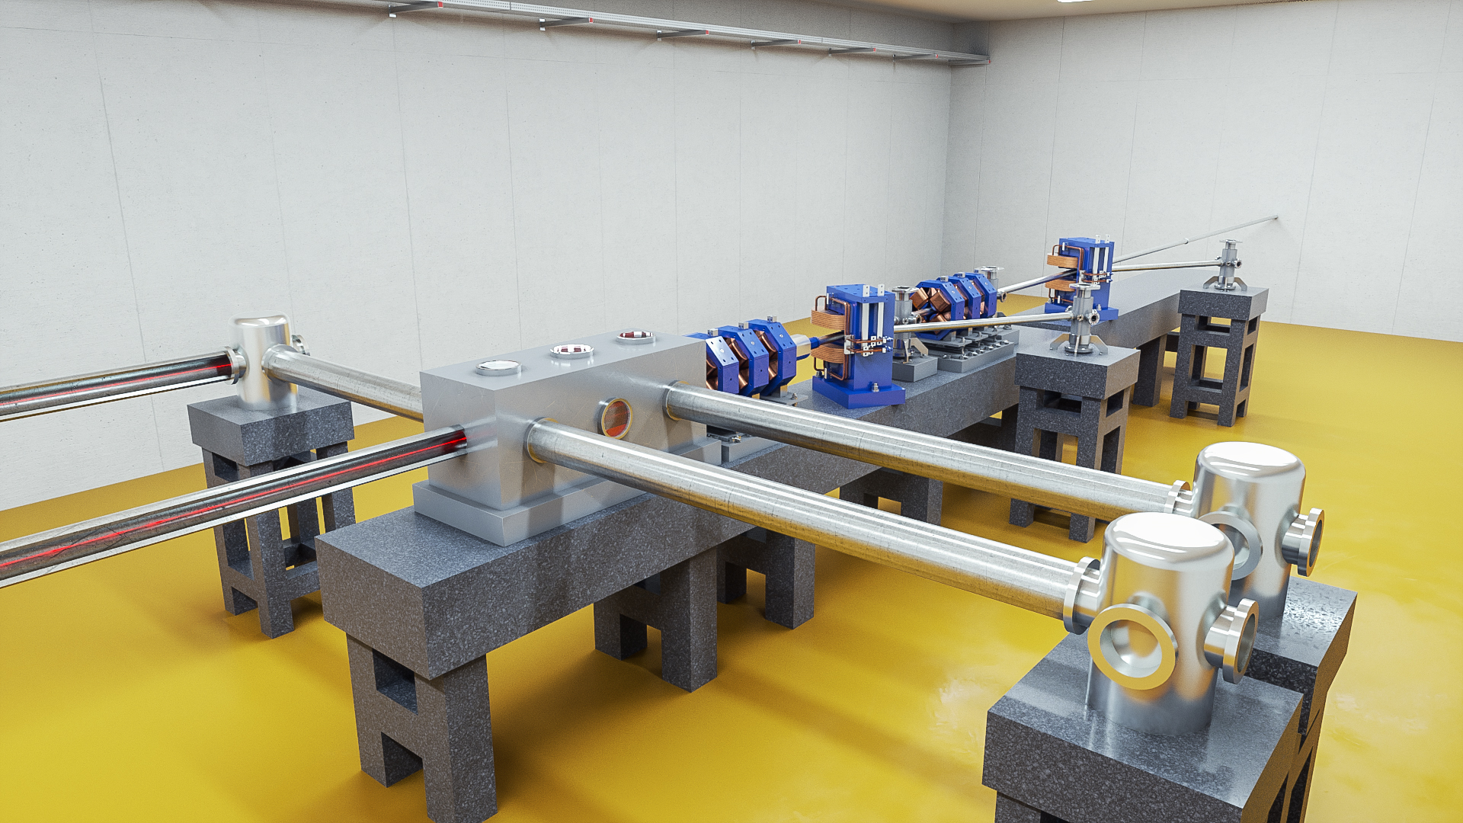


Betatron X Rays: Design Compact Medical Imaging Line
Fully plasma-based beamline for generating betatron radiation as a compact X-ray source for medical imaging and material analysis. The user area is behind the wall on the right.
Added value
It fits new locations, close to users, patients, bridges, …
Strengthening the European research area!
Also: applications cultural heritage (XAS technique), …
Electron beam from this compact setup can be used in longer term for VHEE radiation therapy involving FLASH and grid mini-beam concepts
EuPRAXIA facility rendering picture
Notes:
Massimo

Slide 14
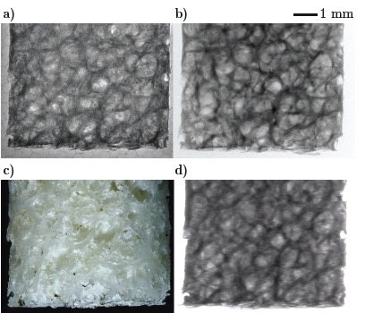
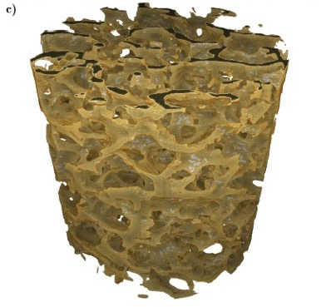
Betatron X Rays: Compact Medical Imaging
J.M. Cole et al, “Laser-wakefield accelerators as hard x-ray sources for 3D medical imaging of human bone”. Nature Scientific Reports 5, 13244 (2015)
Physics & Technology Background:
Small EuPRAXIA accelerator → small emission volume for betatron X rays.
Quasi-pointlike emission of X rays.
Sharper image from base optical principle.
Quality demonstrated and published, but takes a few hours for one image.
Advancing flux rate with EuPRAXIA laser by factor > 1,000!
EuPRAXIA technology
μCT Scanner
Added value
Sharper images with outstanding contrast
Identify smaller features (e.g. early detection of cancer at micron-scale – calcification)
Laser advance in EuPRAXIA → fast imaging (e.g. following moving organs during surgery)
3D tomography of human bone
EuPRAXIA laser advance (industry)
will push rate from 1/min to 100 Hz.
Ultra-compact source of hard X rays → exposing from various directions simultaneously is possible in upgrades
Macro-photography
Radioactive source
FOOD & HEALTH
Notes:
Massimo

Slide 15
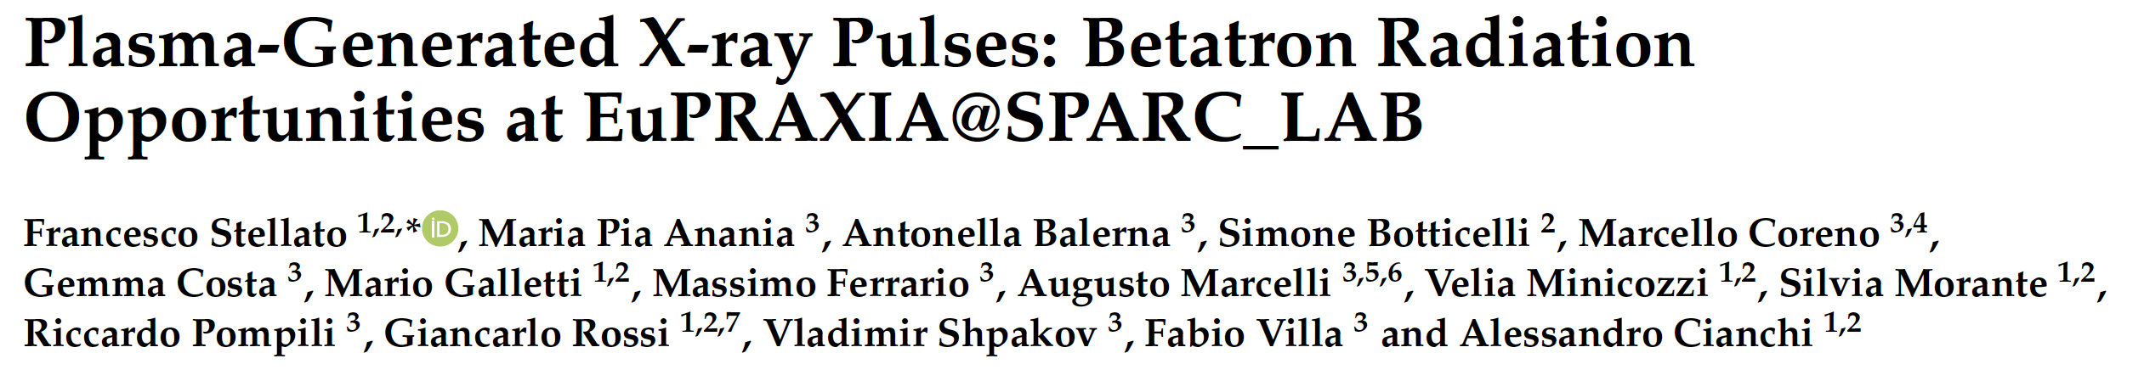
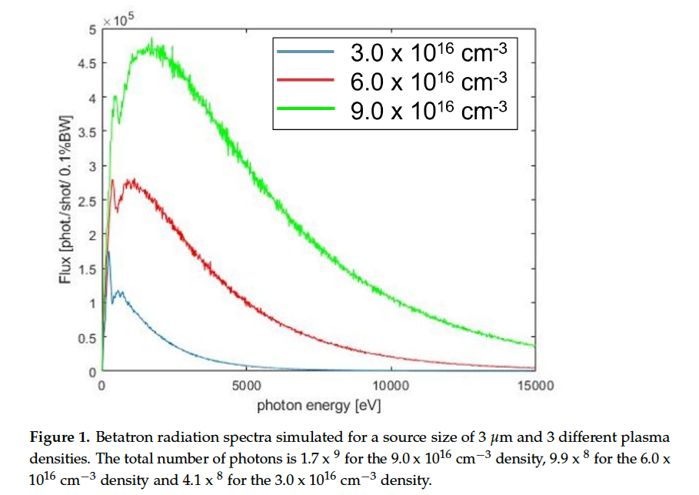
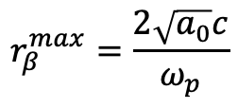

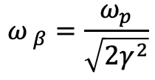

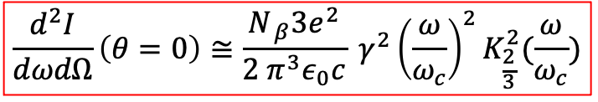
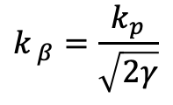
$$\frac{d^{2}I}{dωdΩ}\left(θ=0\right)≅\frac{N_{ β}3e^{2}}{2 π^{3}ε_{0}c} γ^{2}{\left(\frac{ω}{ω_{c}}\right)}^{2}K_{\frac{2}{3}}^{2}(\frac{ω}{ω_{c}})$$
$$ω_{ β}=\frac{ω_{p}}{\sqrt{2γ^{2}}}$$
$$ω_{c}=3K_{β}γ^{2}ω_{β}$$
$$r_{β}^{max}=\frac{2\sqrt{a_{0}}c}{ω_{p}}$$
$$k_{ β}=\frac{k_{p}}{\sqrt{2γ}}$$
$$K_{β}=γk_{β}r_{β}$$
According to our simulations, the expected EuPRAXIA betatron radiation spectrum will range from about 1 nm down to the hard X-ray region (less than 1 Å), as shown in Figure 1.

Slide 16

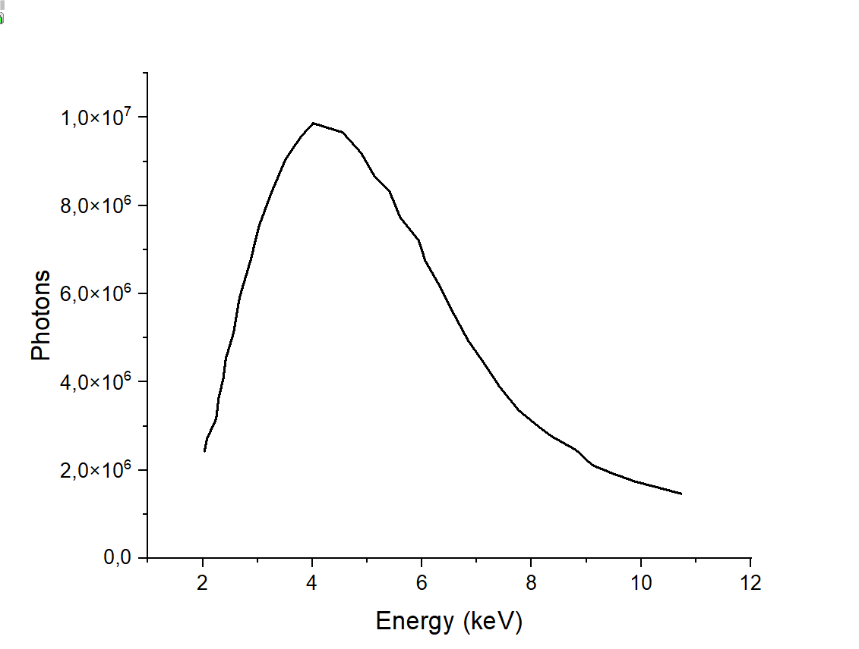
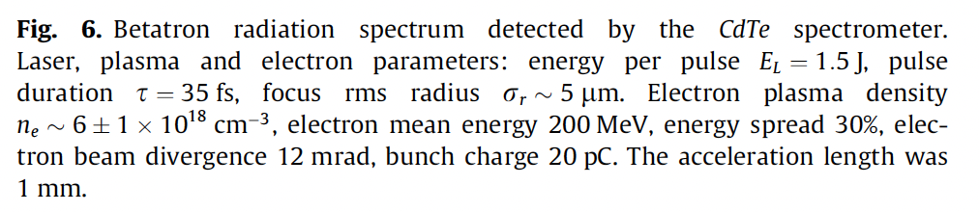
a_{o}=4
N_{p}~10⁹

Slide 17
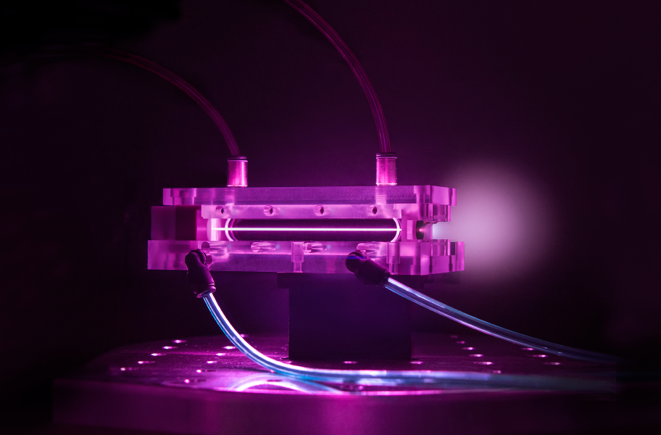
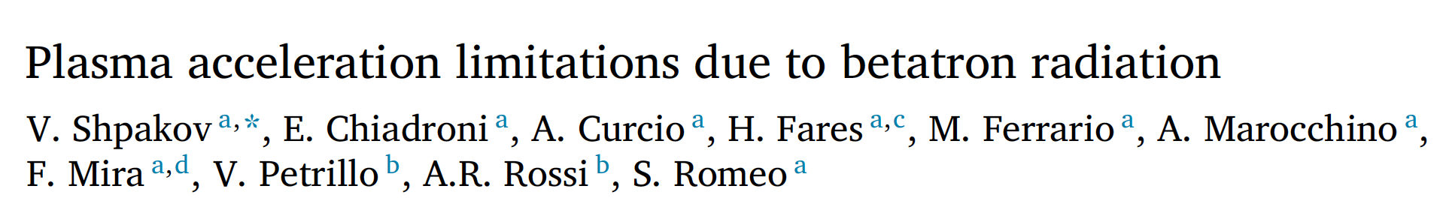
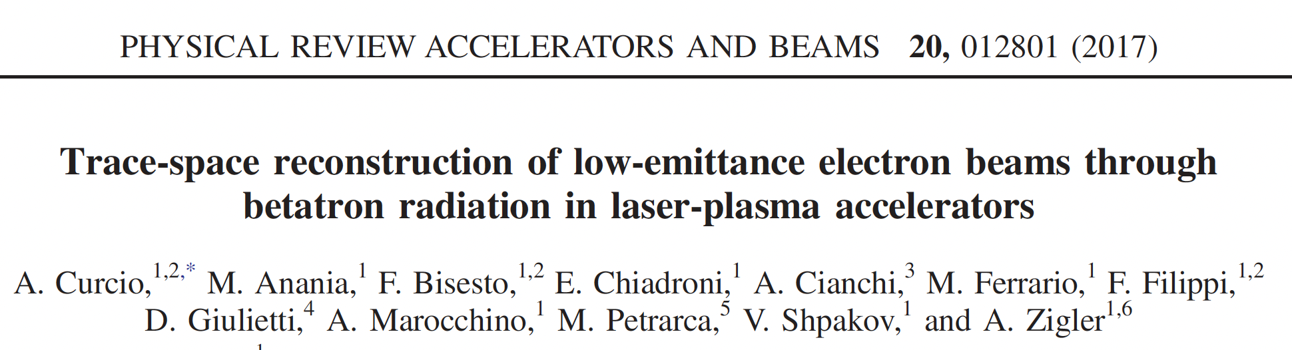
Betatron Radiation

Slide 18
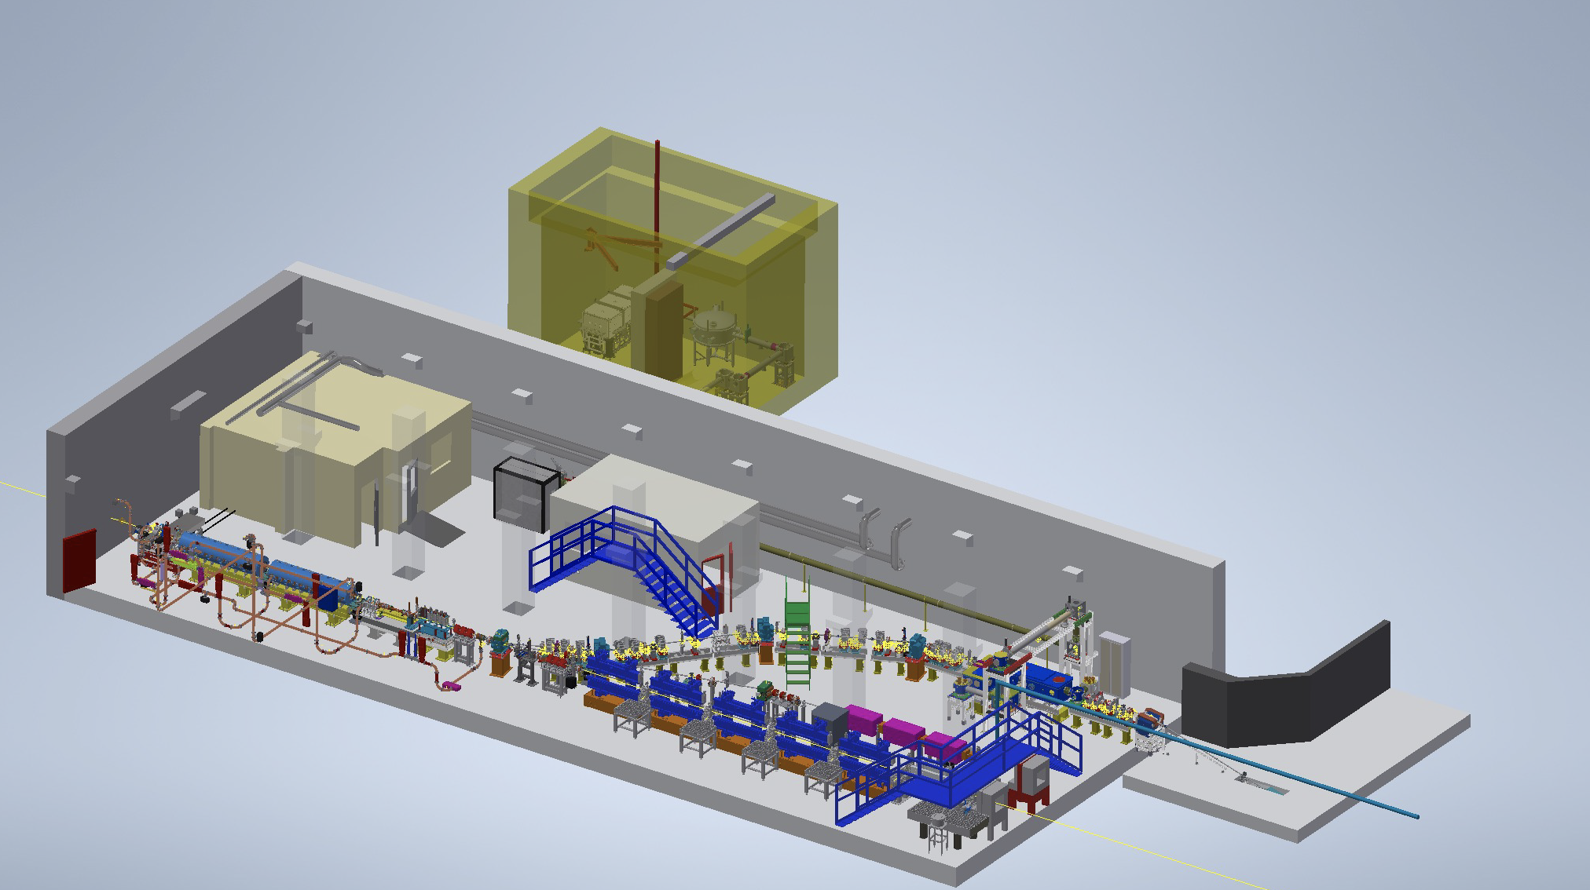
SPARC_LAB is the test and training facility at LNF for Advanced Accelerator Developments (since 2005)
LWFA
TNSA
Betatron
PWFA
LWFA
FEL
THz

Slide 19
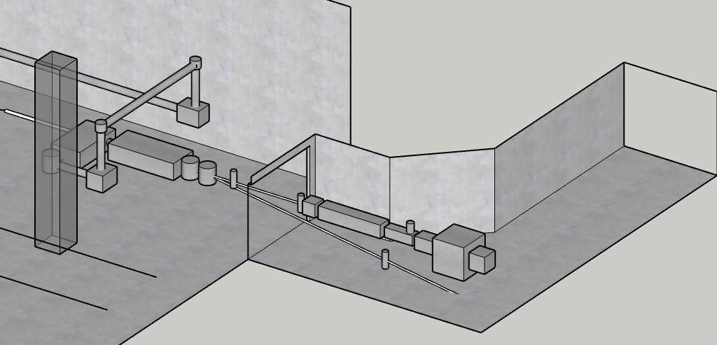

Slide 20
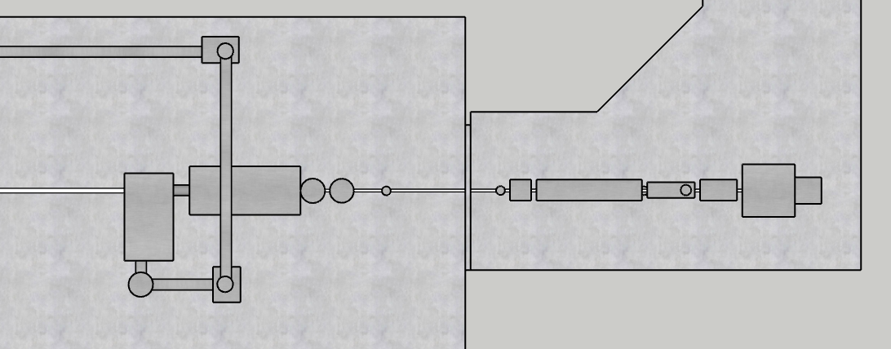
1 m
Plasma chamber
Perm. mag.
dipole
BPM
Ion. chamber
Monochrom..
Focusing chamber
High res.
cameras
HP laser in
YAG Screen
Exp. chamber
HP laser out

Slide 21
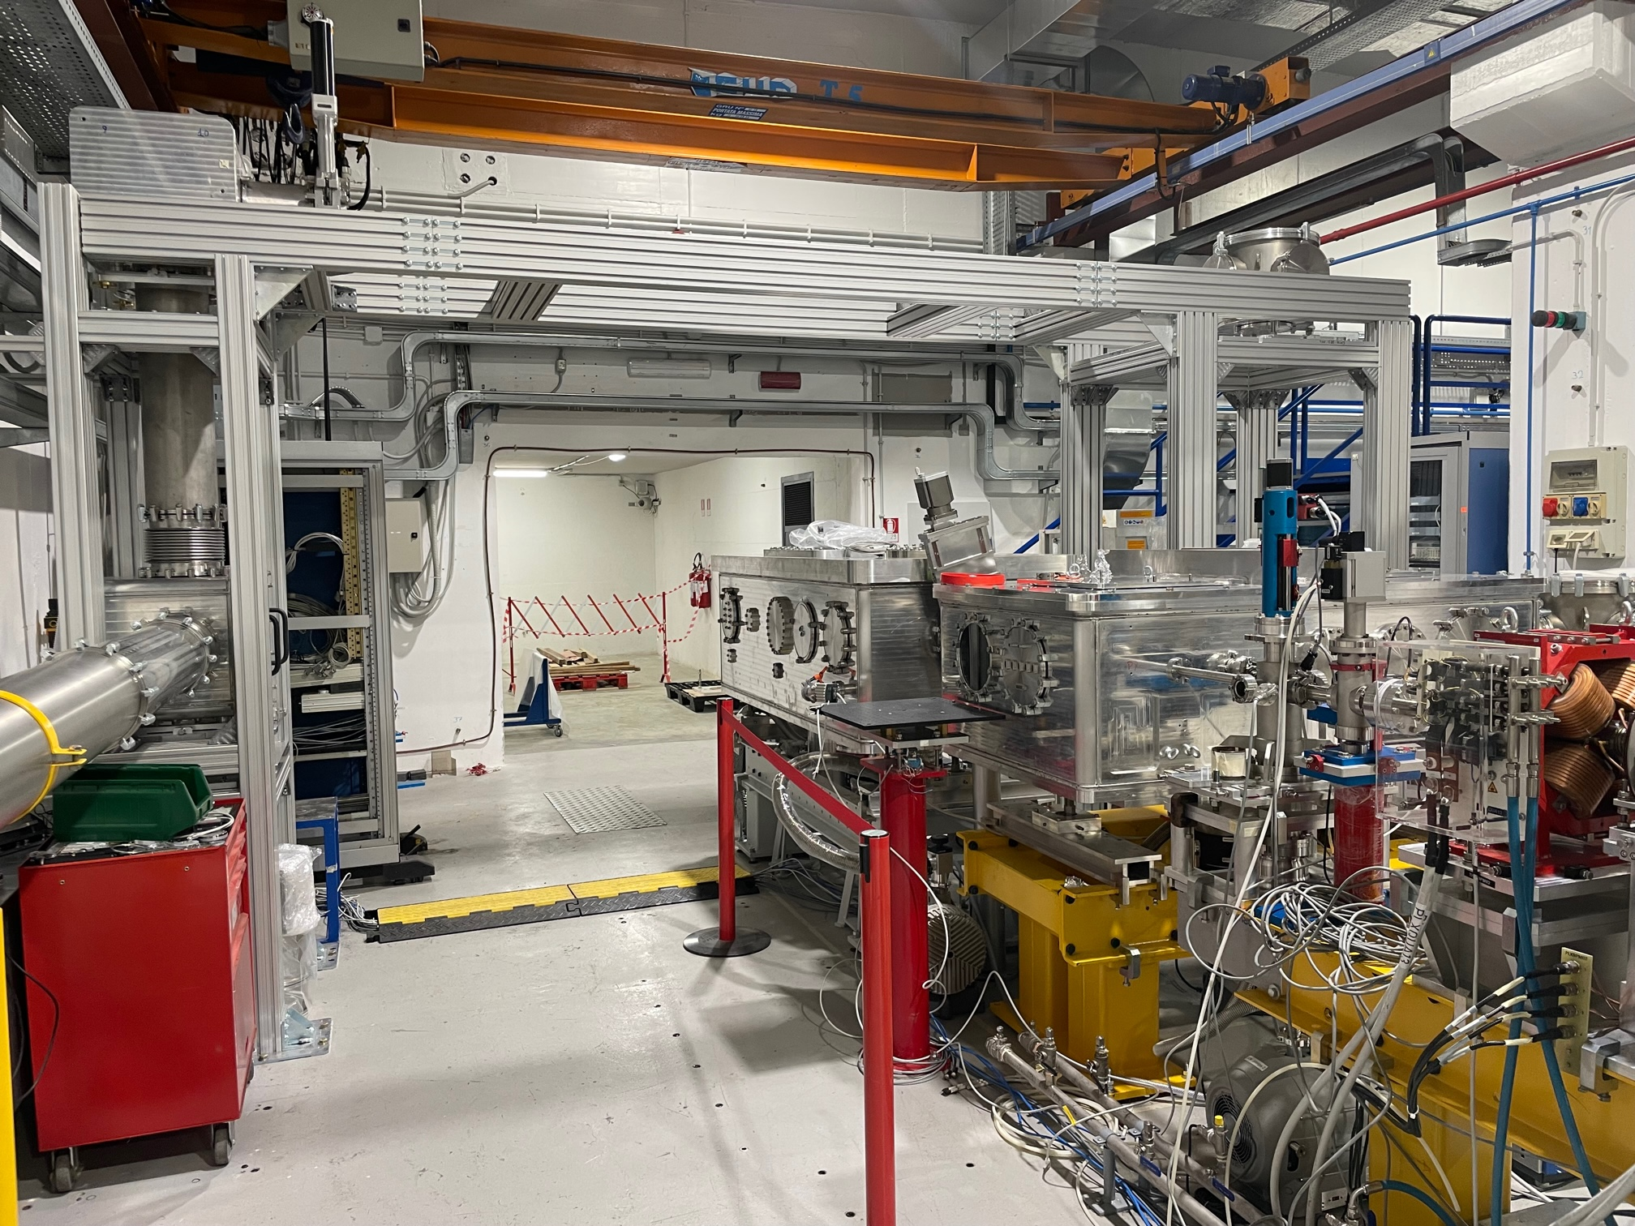
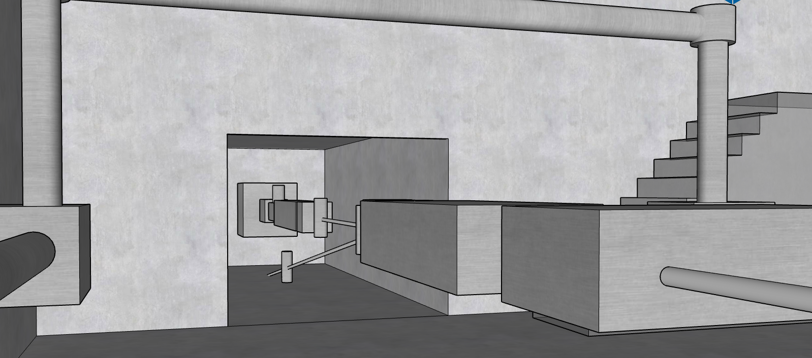

Slide 22
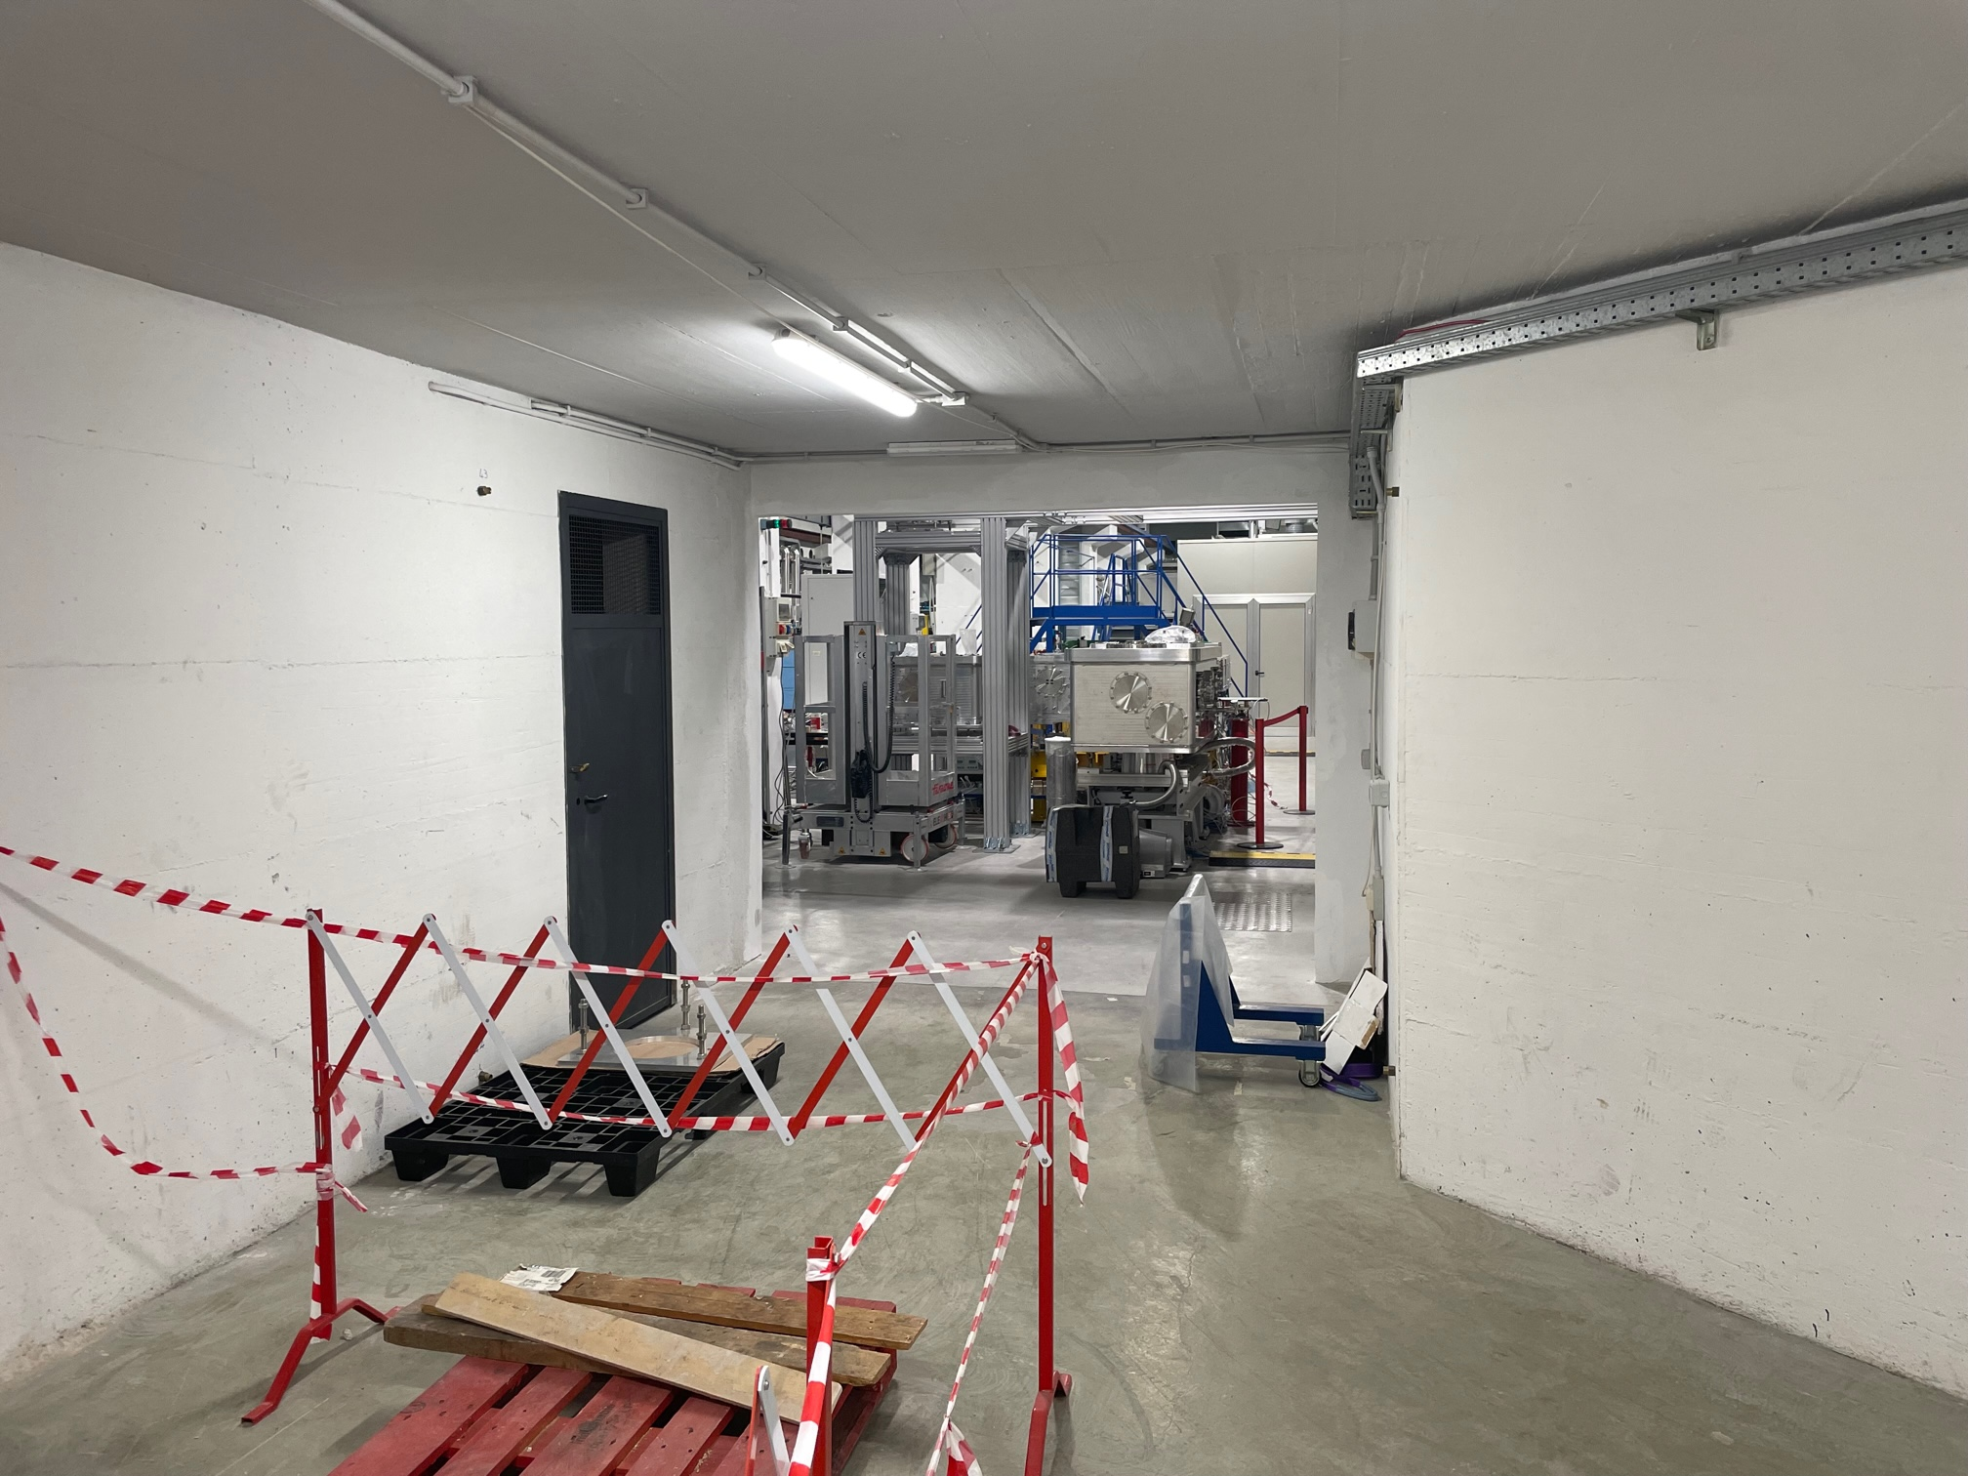
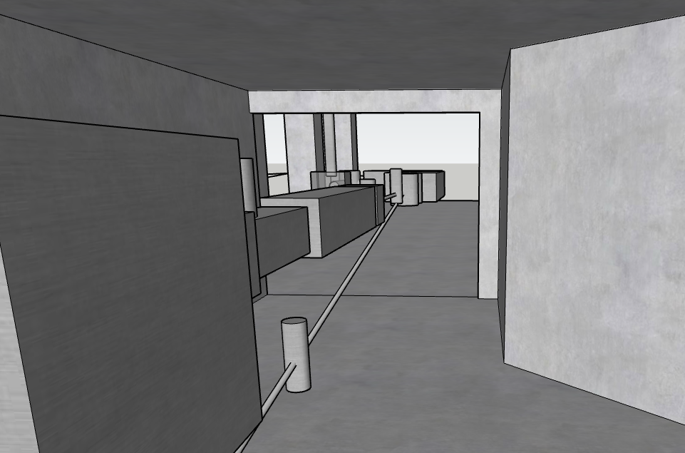

Slide 23
Thank for your attention

