Slide 1
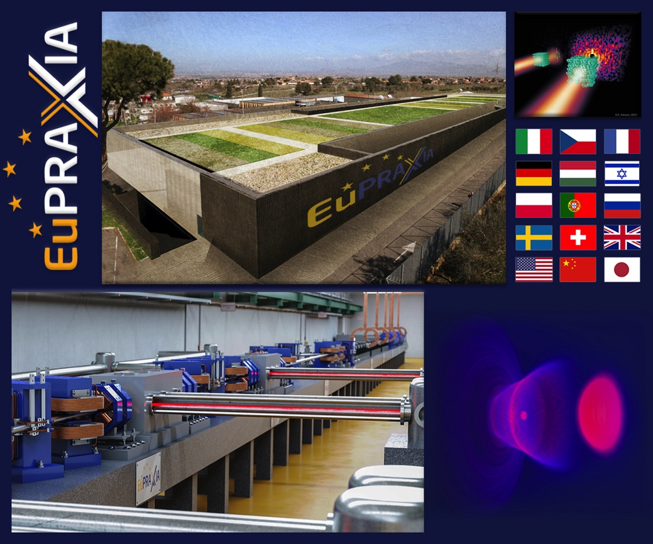
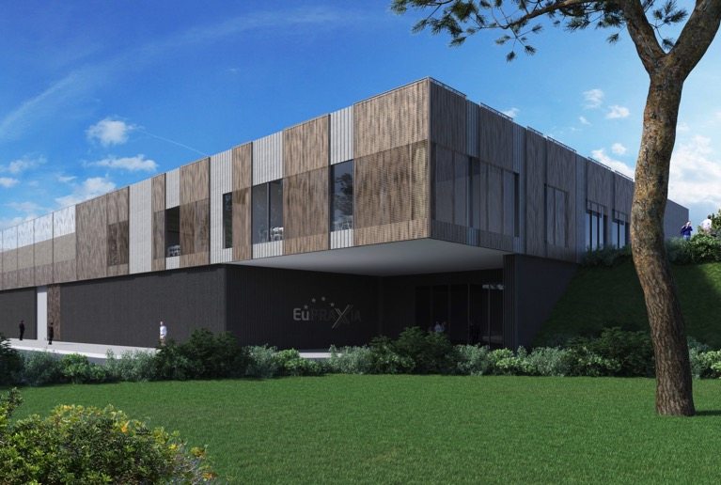

EuPRAXIA – ESFRI and Preparatory Phase Project
Ralph W. Aßmann, Coordinator
(INFN and DESY)
EuPRAXIA@SPARClab Review
LNF/INFN, 6 June 2022
Notes:
Ralph

Slide 2
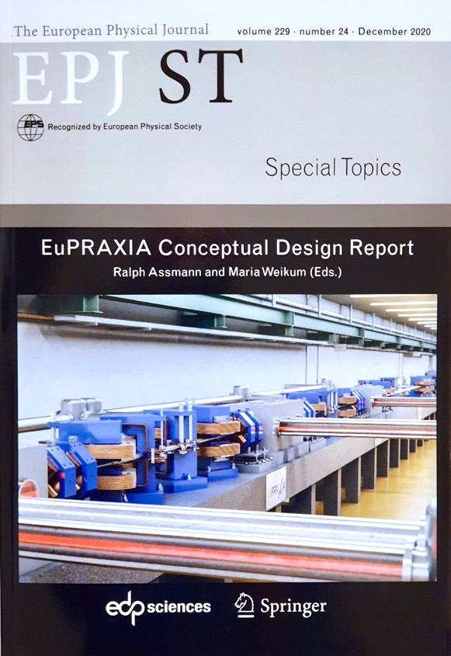


EuPRAXIA – A Project of Many “Firsts“
Project “firsts”:
  First world-wide conceptual design report of a plasma accelerator facility, funded by EU Horizon2020 program. Completed by 16+25 institutes.
  First plasma accelerator project selected and placed on the European ESFRI roadmap (and first accelerator project since HiLumiLHC).
  First EU funded preparatory phase (PP) project on a plasma accelerator facility. Negotiations almost finished (3rd interation, EU almost happy). Consortium of 34 institutes (Greece and Spain new) for PP. Plus another 18 institutes.
Technical “firsts”:
  First start-to-end simulations for plasma FEL facility in CDR.
  First modular solution for energy spread compensation scheme, plus others.
  First FEL lasing with an electron beam from a beam-driven plasma acc (Nature).

Slide 3
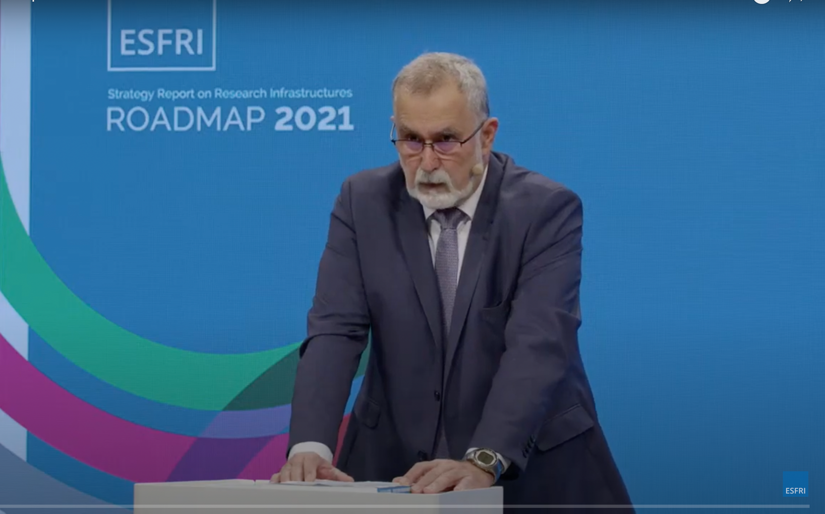
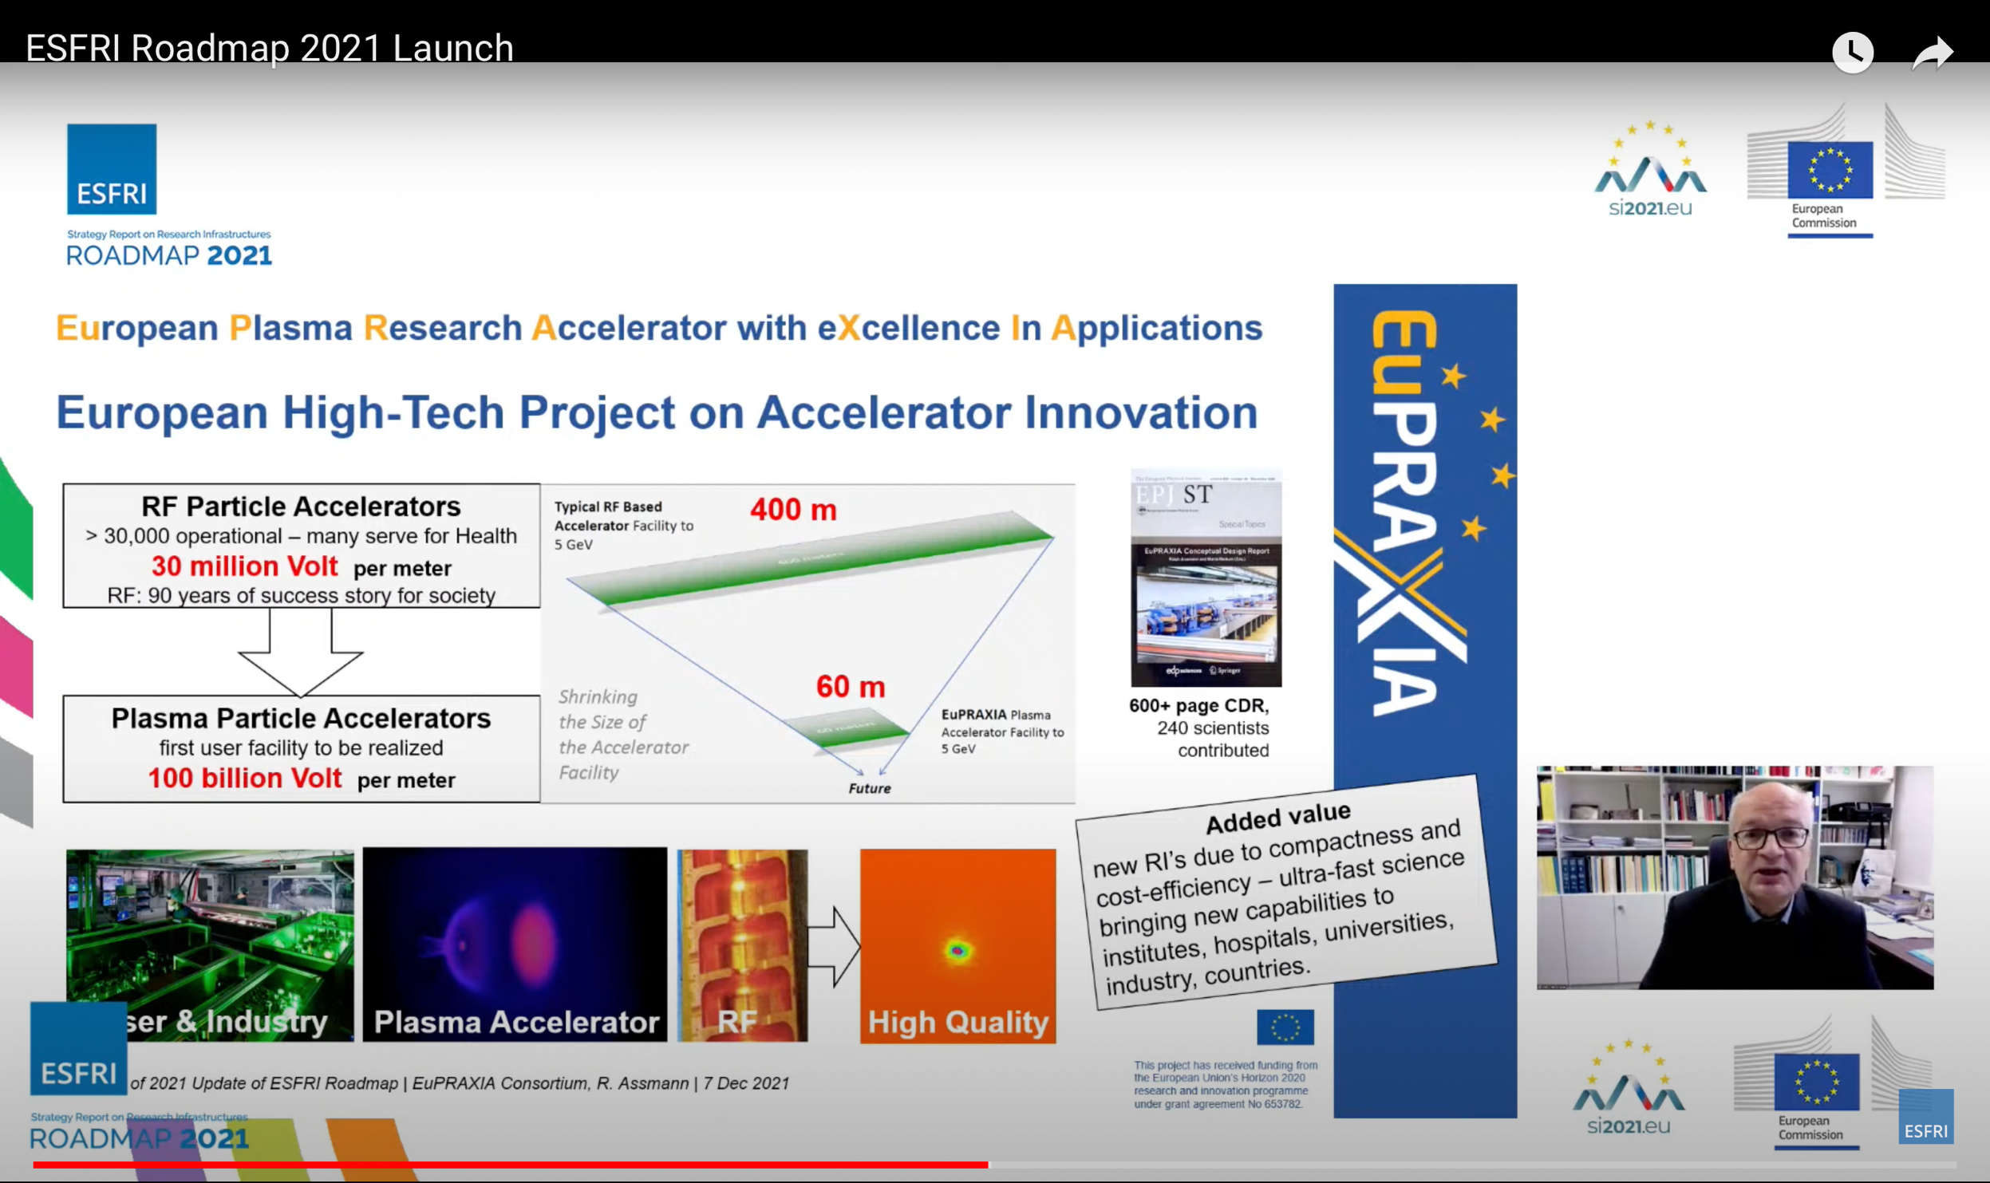
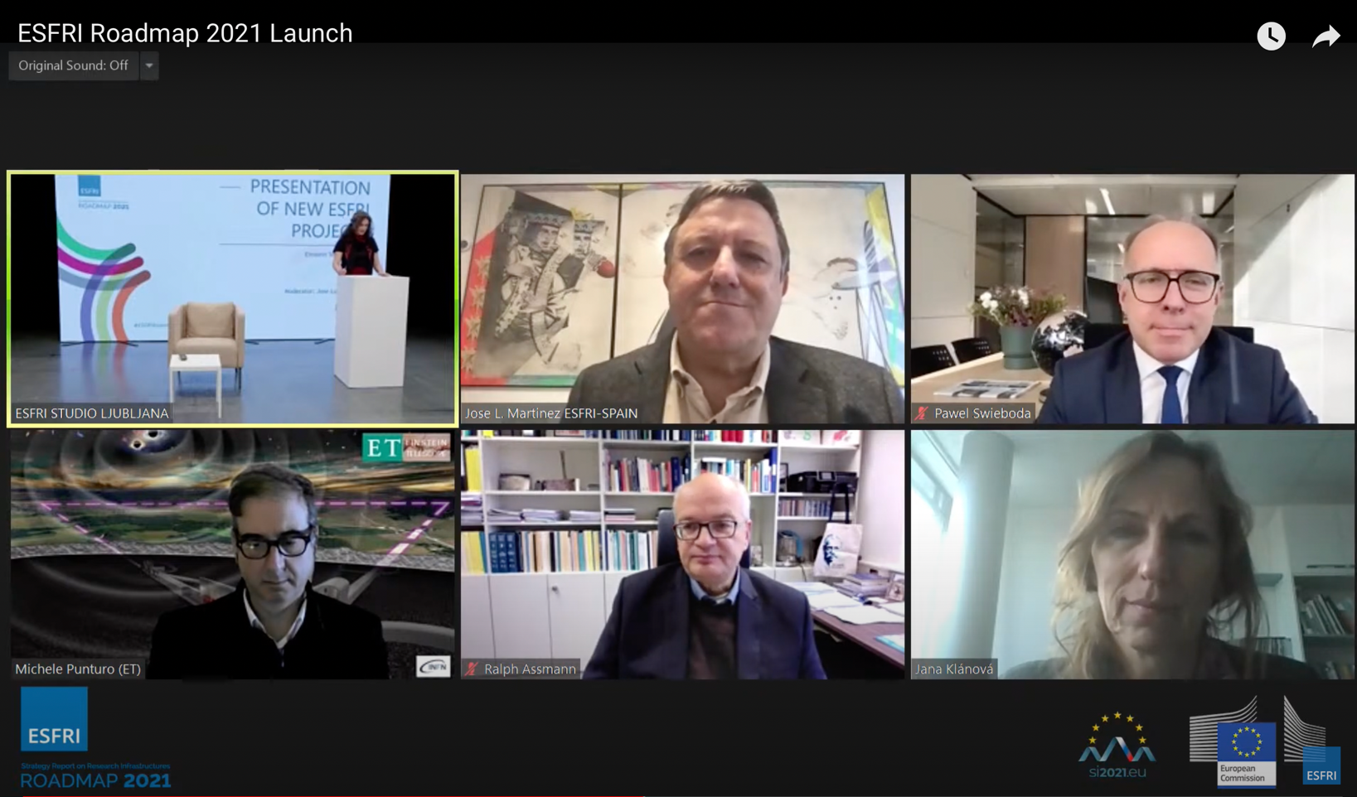
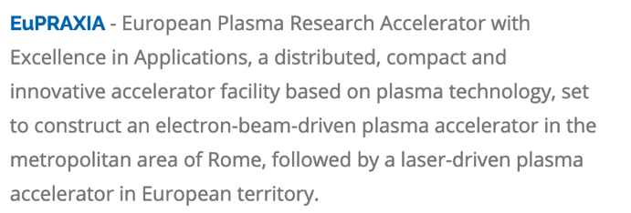
Launch 2021 ESFRI Roadmap 7 Dec 2021
https://www.esfri.eu/latest-esfri-news/new-ris-roadmap-2021

Slide 4
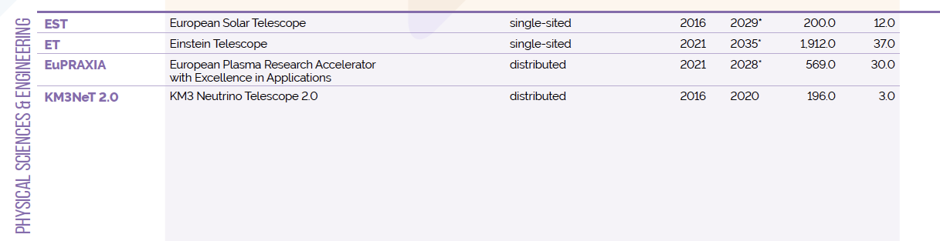

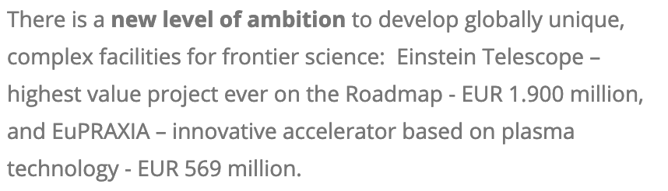
ESFRI Projects Roadmap 2021
Two new entries in 2021: Einstein Telescope (ET) and EuPRAXIA
EuPRAXIA is the only accelerator facility selected in the last 5 years
https://roadmap2021.esfri.eu

Slide 5
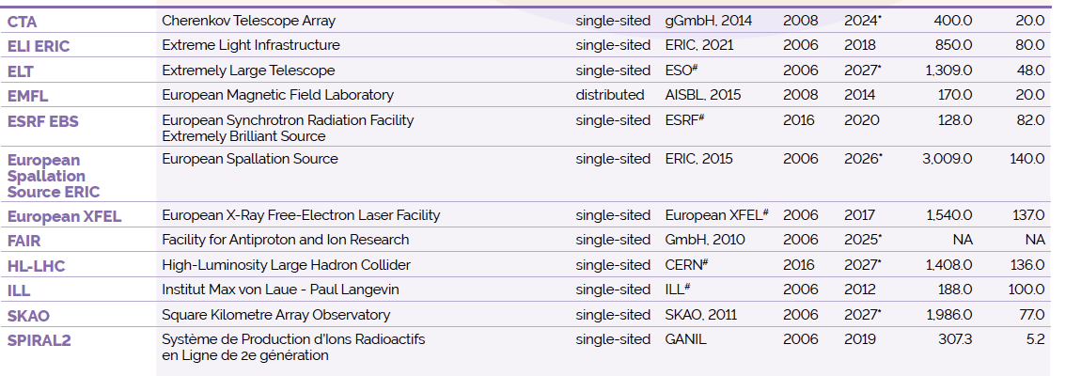
ESFRI Landmarks Roadmap 2021
(Physical Sciences & Engineering)
https://roadmap2021.esfri.eu

Slide 6


ESFRI Roadmap 2021
(Physical Sciences & Engineering – Projects Red Triangles)
Accelerator Facilities
10.1 B€ invest
730 M€ OP / year
Telescopes
6.0 B€ invest
197 M€ OP / year
Laser Facilities (ELI)
0.85 B€ invest
80 M€ OP / year
Reactor neutrons (ILL)
0.19 B€ invest
100 M€ OP / year
Magnet lab (EMFL)
0.17 B€ invest
20 M€ OP / year
Average project duration: 12.4 years
Average project cost: 1.08 B€

Slide 7
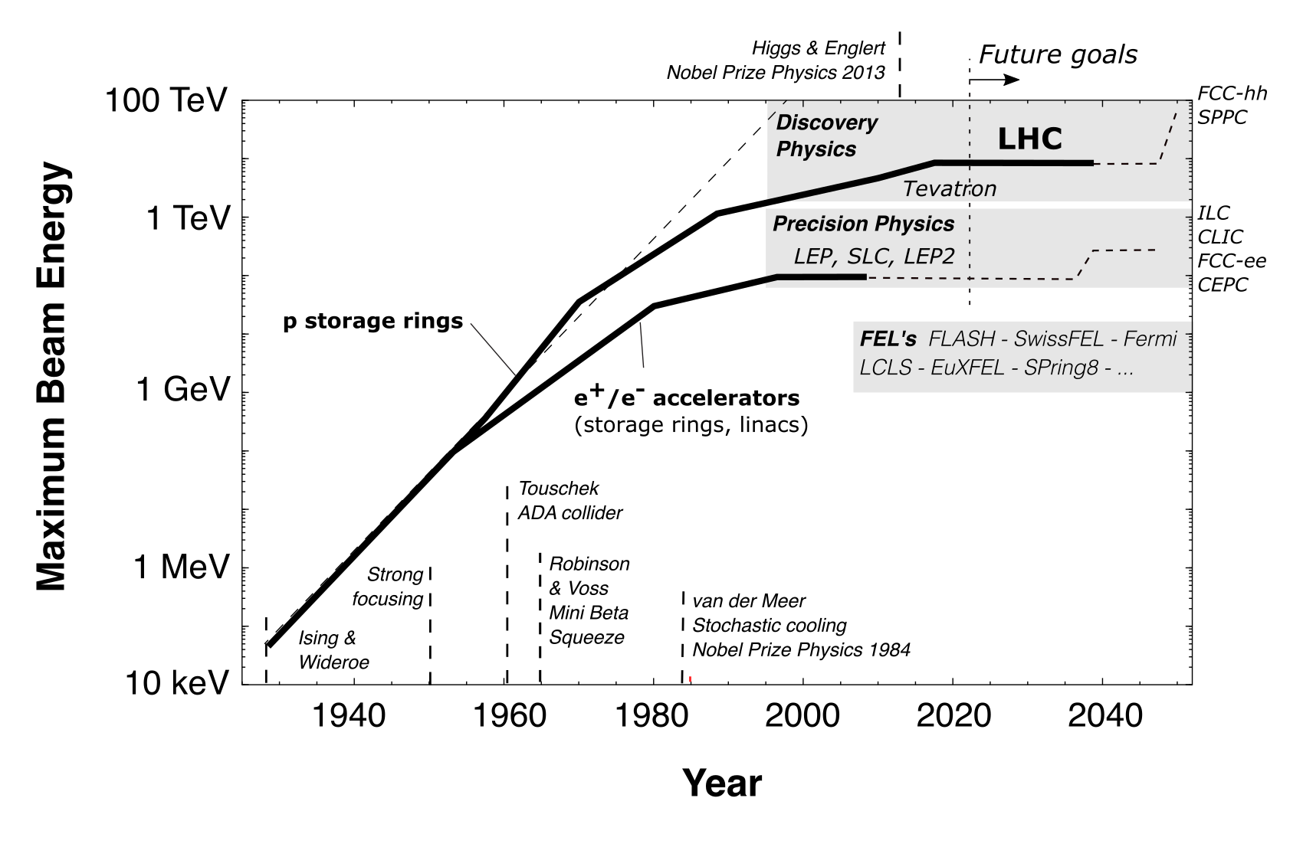
Progress in Particle Accelerators

Slide 8
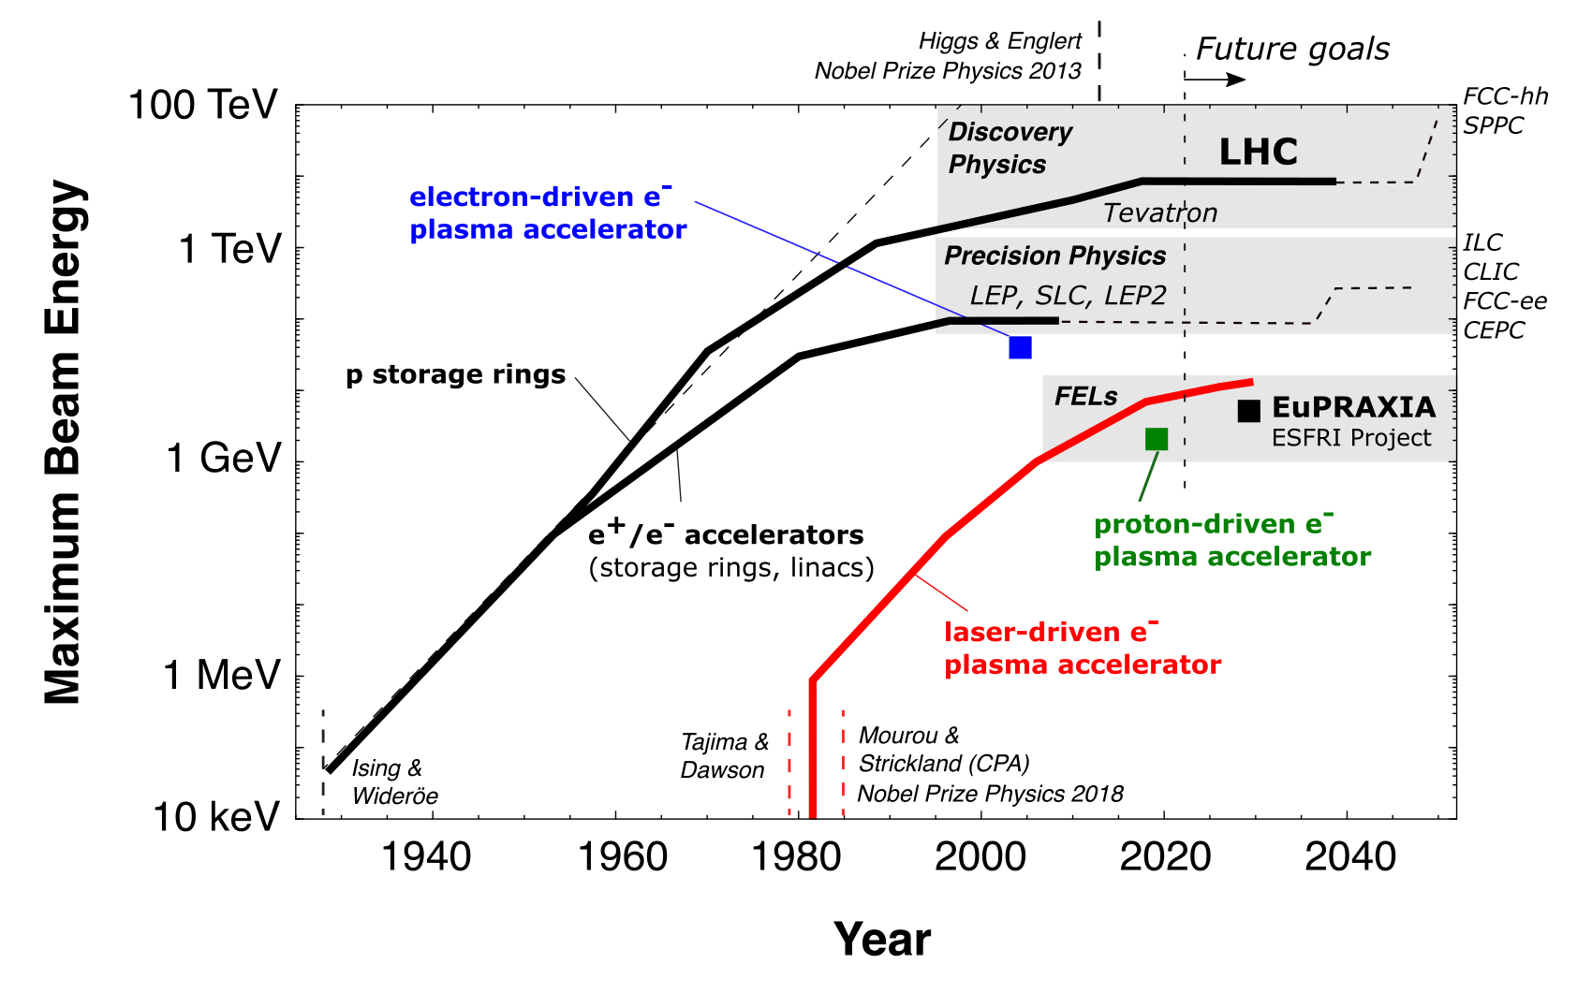

EuPRAXIA: Build a Compact & New Facility

Slide 9
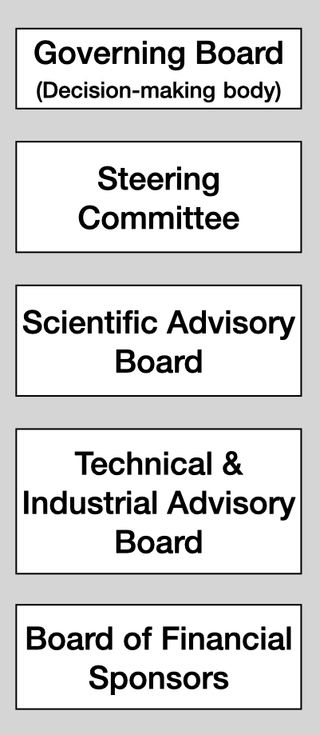
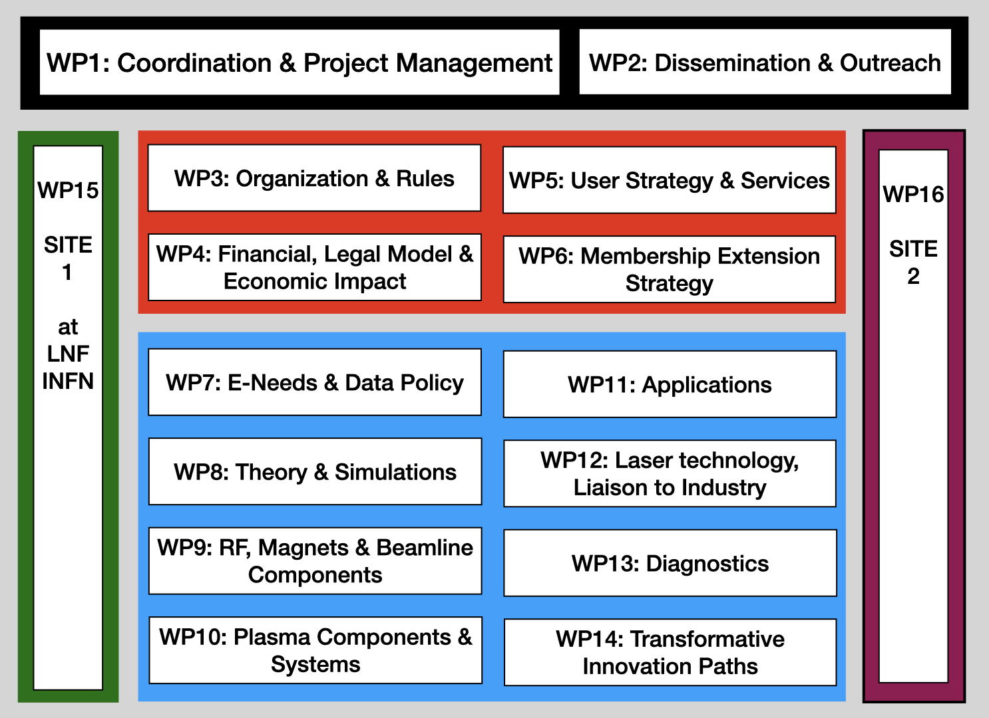
Preparatory Phase Project
Towards Full Implementation
Overall project ma-nagement, commu-nication and out-reach
WP on implemen-tation as ESFRI RI (organization, legal model, financing, users)
WPs on technical implementation
WP on construction site 1 at LNF/INFN
WP on construction site 2

Slide 10














EuPRAXIA-PP Consortium I
ITALY
Coordinator
GERMANY

Slide 11














EuPRAXIA-PP Consortium II
UK
CZECH REP
FRANCE
INTERNATIONAL

Slide 12









EuPRAXIA-PP Consortium III
PORTUGAL
SPAIN
HUNGARY

Slide 13









EuPRAXIA-PP Consortium IV
SWITZERLAND
GREECE
ISRAEL
USA
Complemented by institutes in EuPRAXIA ESFRI consortium: additional 17 institutes from France, Germany, Poland, Sweden, United Kingdom, China, Japan, United States. Russia presently suspended from EuPRAXIA.
is in EuPRAXIA doctoral network, funded by EU

Slide 14

Distributed RI Concept

Slide 15
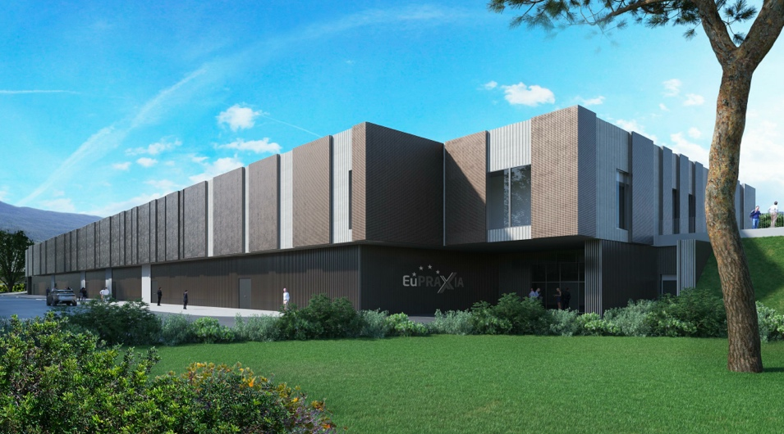
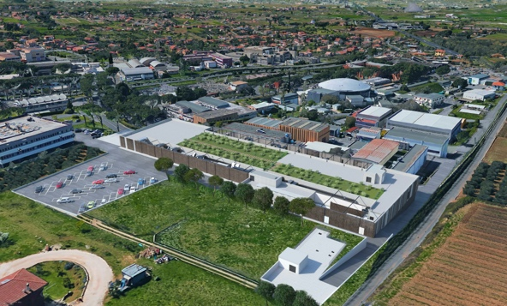
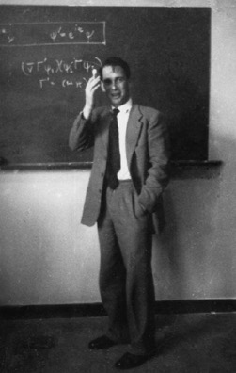
Headquarter and Site 1: EuPRAXIA@SPARClab
Frascati`s future facility
> 108 M€ invest funding
Beam-driven plasma accelerator
Europe`s most compact and most southern FEL
The world`s most compact RF accelerator (X band with CERN)

Slide 16
LNF Hosts EuPRAXIA Management Office
(Preparatory Phase Project Drives Overall EuPRAXIA Scheme)
Total PP project volume (including in-kind): 8.3 M€
EU funding: 2.49 M€, UKRI guarantee funding 0.51 M€, Swiss funding 0.69 M€ plus in-kind person power
16 Work Packages, 34 participating organizations from 12 countries, LNF-INFN as coordinator and location of headquarter
Project dates: 1 Nov 2022 – 31 Oct 2026
Establish “Board of Financial Sponsors“ with representatives of funding agencies.
Due date (months from start)
Preparatory Phase:
Responsible institute
D1.1 | Data Management Plan | 1 | INFN | R | Public | 6
D1.2 | Description of updated implementation scheme after site decision | 1 | INFN | R | Public | 24
D1.3 | EuPRAXIA-RI Implementation Plan | 1 | INFN | R | Public | 48
D4.1 | Report on benchmark of financial and legal models of comparable RI | 4 | INFN | R | Public | 12
D4.2 | Cost Implementation and service preliminary assessment | 4 | INFN | R | Public | 24
D4.3 | EuPRAXIA Socio-economic Impact assessment | 4 | INFN | R | Public | 40
D4.4 | Report (R) on final EuPRAXIA financial and legal mo-del including RI governance and management (M46) | 4 | INFN | R | Public | 46

Slide 17
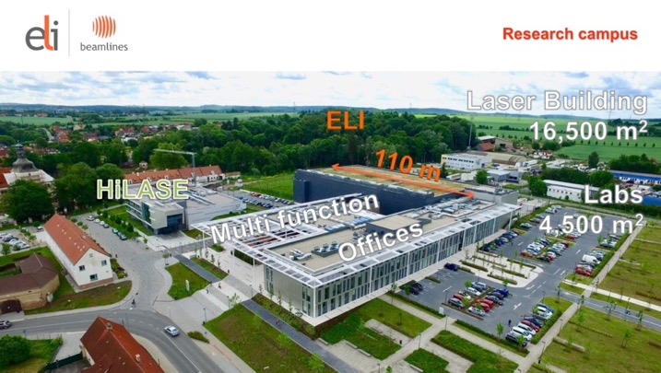
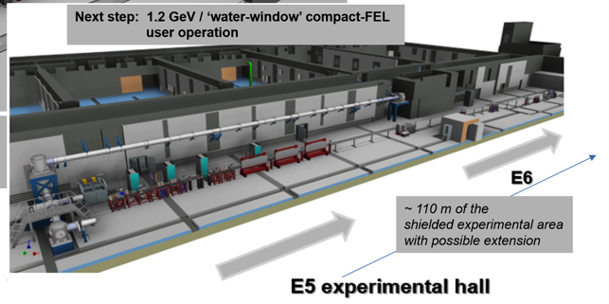


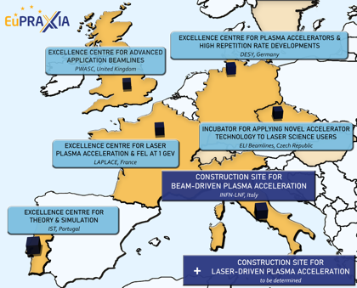



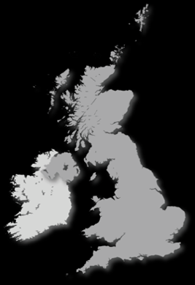

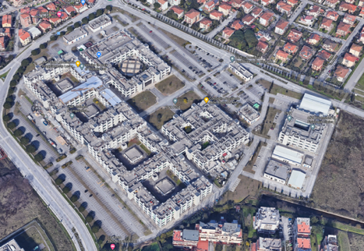


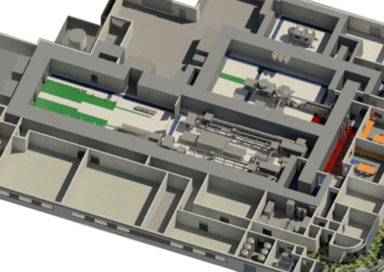









Candidate 2nd Sites from CDR
Prague, Czech Republic
↑
@ EPAC
Rutherford, STFC, UK
PWASC
CNR Campus Pisa
Notes:
Maria

Slide 18
Selection 2nd EuPRAXIA Site
(date for decision legally defined: June 2024)
Legal/Political | Technical | Financial
Compliance of host institution with EuPRAXIA Access Policy | Site provides sufficient space (about 175 m x 35 m) | Commitment to sustainability of EuPRAXIA (host lab covers site operation costs)
Compliance of host institution with EuPRAXIA Open Innovation and Open Science Policy | Laboratory has infrastructures in one or several of RF accelerators, laser installations, user access. | Previous investments into local infrastructures of relevance for EuPRAXIA (leverage effect)
Agreement of host institution with the long-term scientific agenda of EuPRAXIA | Site provides required services and facilities for support of external users, including E infrastructure | Existence of one or a mix of funding sources able to finance implementation of the site
Laboratory has existing groups in place to guarantee safety requirements (laser, radio-protection, access control) and rules
Note: approach reduces cost (pre-invest) and risks of cost-overun.
Preparatory Phase:
D3.1 | Criteria and methodology for 2nd site selection | 3 | CNRS | R | Public | 18
D3.2 | Report on the decision on the 2nd site | 3 | CNRS | R | Public | 20
D3.3 | Report on the distributed RI concept including organization and rules | 3 | CNRS | R | Public | 42
Notes:
Maria

Slide 19
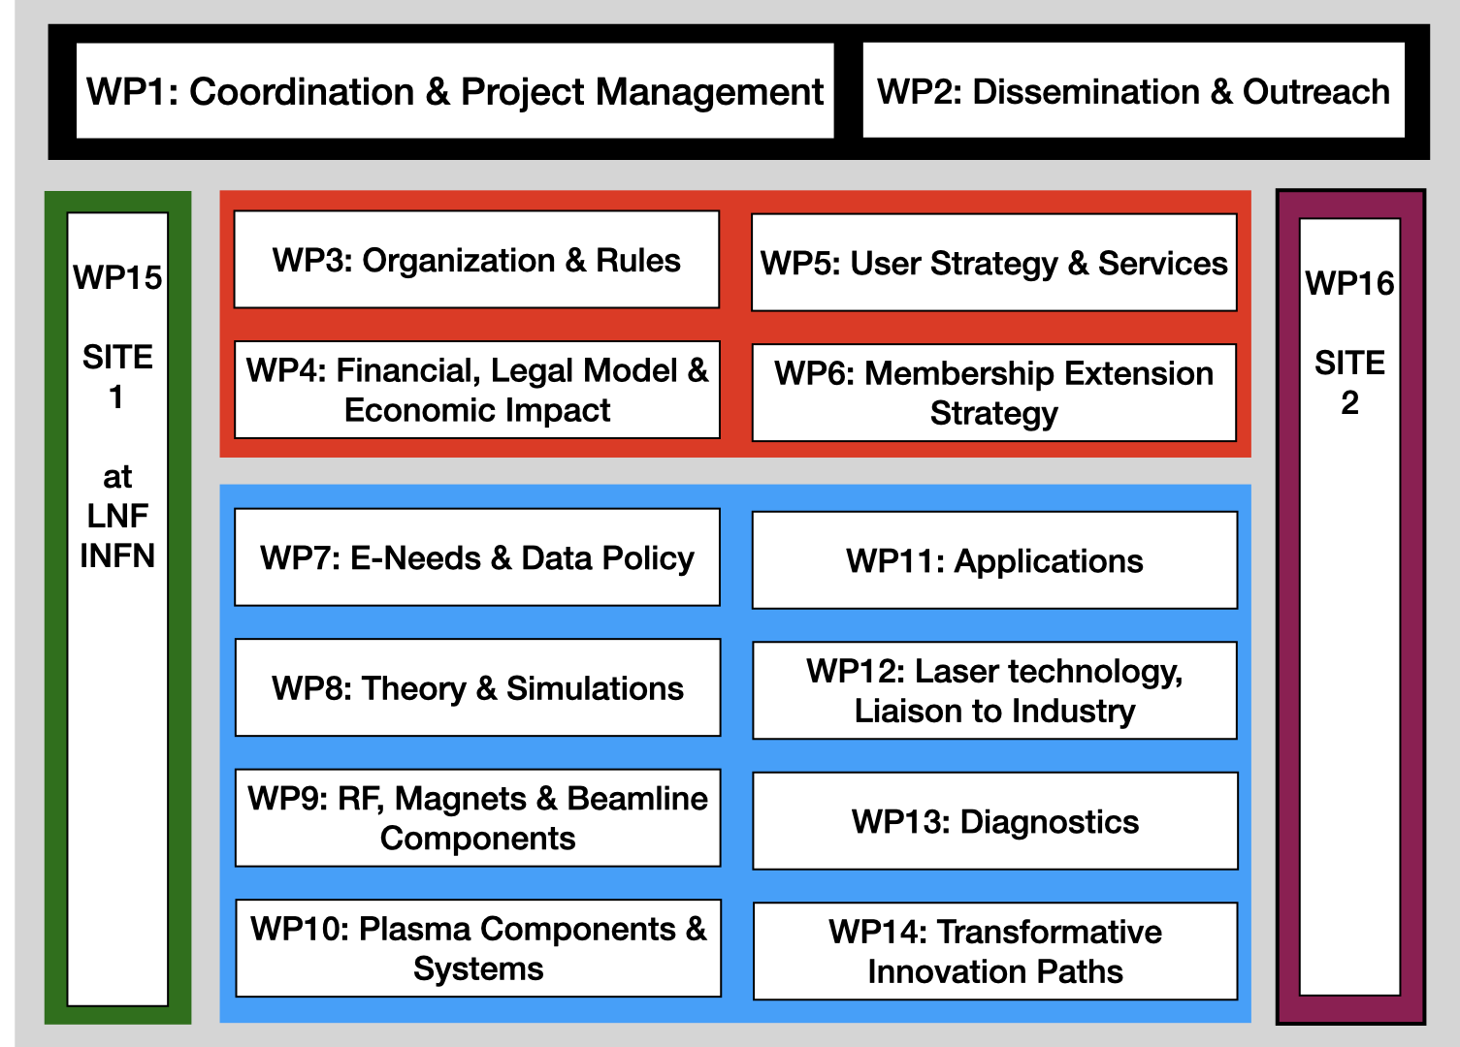
Construction Sites Integrated in PP Project
SITE 1 = WP15
SITE 2 = WP16
Preparatory Phase:
D15.1 | Progress report of implementation plan for site 1- EuPRAXIA@SPARC_LAB | 15 | INFN | R | Public | 12
D15.2 | Mid-term report on TDR status for EuPRAXIA@SPARC_LAB | 15 | INFN | R | Public | 24
D15.3 | Report on TDR status for EuPRAXIA@SPARC_LAB | 15 | INFN | R | Public | 42
D16.1 | Update on EuPRAXIA plans for selected site 2 | 16 | IP-ASCR | R | Public | 24
D16.2 | Report on TDR status for EuPRAXIA@Site 2, laser driven | 16 | IP-ASCR | R | Public | 42

Slide 20
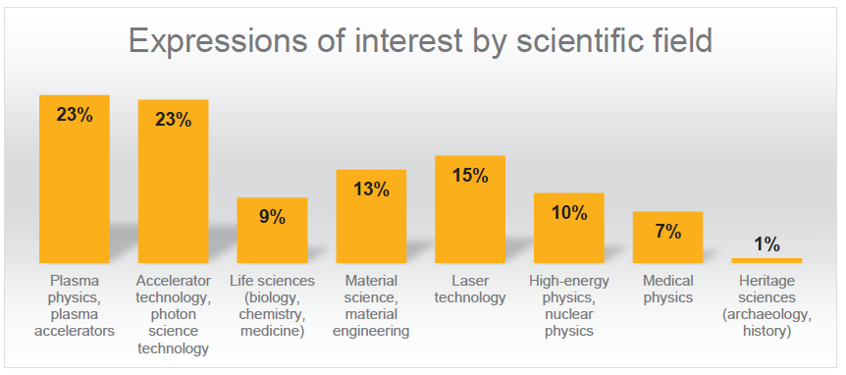
EuPRAXIA Deliverables and User Interests
EuPRAXIA is designed to deliver at 10-100 Hz ultra-short pulses of
Electrons (0.1-5 GeV, 30 pC)
Positrons (0.5-10 MeV, 10⁶)
Positrons (GeV source)
Lasers (100 J, 50 fs, 10-100 Hz)
Betatron X rays (5-18 keV, 10¹⁰)
FEL light (0.2-36 nm, 10⁹-10¹³)
Expressions of interest from 95 research groups representing several thousand scientists in total.
Preparatory Phase:
D2.4 | EuPRAXIA Symposium and outreach event | 2 | ULIV | DEC | Public | 24
D2.5 | EuPRAXIA Open innovation forum & 2nd Symposium | 2 | ULIV | DEC | Public | 46
D5.1 | Report (R) on EuPRAXIA-RI demand analysis | 5 | UNITOV | R | Public | 32
D5.2 | Report (R) on EuPRAXIA-RI terms of services | 5 | UNITOV | R | Public | 42

Slide 21
EuPRAXIA Data and E-Infrastructure Concept
Data Source | Data rate | Data / exp for online analysis | Reduced data / exp for long term storage | Long term storage (reduced data) | Exchange (derived data and meta data)
Modeling and simulations (3D) | 300 TB / case | 900 TB | 1 TB | 0.1 PB/y | 12 TB/y
Machine monitoring | 20 TB / h | 2.4 PB | 5 TB | 0.17 PB/y (A) 0.33 PB/y (B) | 20 TB/y
End user exp. (e.g. PCO Edge at 8 MB @ 100 Hz) | 2.9 TB / h | 207 TB | 20 TB | 0.66 PB /y (A) 1.32 PB/y (B) | 100 TB/y
Total |  |  |  | ≈ 2.6 PB/y | ≈ 132 TB/y
Preparatory Phase:
D7.1 | Data management plan | 7 | IST-ID | R | Public | 12
D7.2 | Report integration into European facility landscape and standards | 7 | IST-ID | R | Public | 30
D7.3 | Final report e-needs and Data Policy | 7 | IST-ID | R | Public | 42

Slide 22
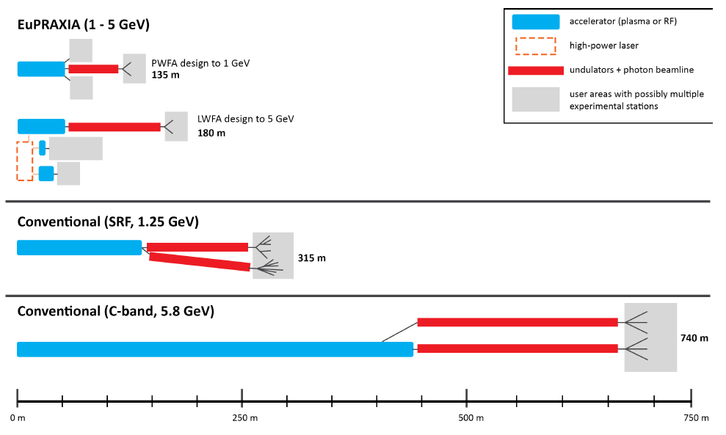
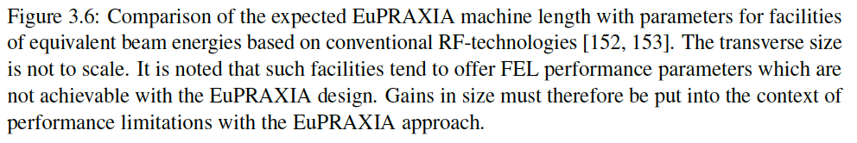
EuPRAXIA Facility Size
Design will be updated in technical WP`s towards the TDR, defining distributed construction also

Slide 23
Phased Implementation of Construction Sites
 | Laser-driven | Beam-driven
Phase 1 | FEL beamline to 1 GeV + user area 1 Ultracompact positron source beamline + positron user area | FEL beamline to 1 GeV + user area 1 GeV-class positrons beamline + positron user area
Phase 2 | X-ray imaging beamline + user area Table-top test beams user area FEL user area 2 FEL to 5 GeV | ICS source beamline + user area HEP detector tests user area FEL user area 2 FEL to 5 GeV
Phase 3 | High-field physics beamline / user area Other future developments | Medical imaging beamline / user area Other future developments
INFN (Italy):
Facility for beam-driven plasma accelerators
Beamline BB-A: Radiation sources
FEL user area 1
Undulator
Undulator
1
Plasma Accelerator
FEL user area 2
RF Injector
RF Accelerator
ICS X-ray source user area (BU3)
HEP detector test user area
laser
Plasma Accelerator
Conversion & conditioning
2
GeV-class positron user area
electrons
positrons
Beamline BB-B: GeV-class positrons & HEP detector test stand
Beamline LB-C: X-ray imaging – life sciences & materials
Facility for laser-driven plasma accelerators
Plasma Injector
Life-science & materials X-ray imaging user area
Beamline LB-B: Positron beam source & table-top test beam
Table-top test beam user area
Plasma Injector
Plasma Accelerator
Conversion & conditioning
Ultracompact positron source user area
1: INFN-LNF construction funding 108 M€
2: INFN/CNR/TorVer demo facility 27 M€ (PNRR)
Laser
Plasma Accelerator
FEL user area 1
Undulator
Undulator
RF Injector
Beamline LB-A: FEL
FEL user area 2

Slide 24
Towards Full Funding I
So far worked on:
EU funding for EuPRAXIA CDR (completed, 3 – 6 M€), EuPRAXIA-PP (approved, 3 – 8 M€), EuPRAXIA-DN (approved, doctoral network, 2.6 M€), CREATE (applied for together with CERN, ELI, CompactLight, 10M€).
Italian national funding: 108 M€ (running)
Italian EU-PNRR funding: EuAPS, 27 M€ (invited to negotiation, best evaluation in PSE)
Technical WP`s (8-14) will update design, advance technical design but in first year will define budget proposals:
D8.1 | Report on structures to be funded from national/bilateral/European level for simulation & theory | 8 | IST-ID | R | Public | 12
D9.1 | Report on structures to be funded from national/bilateral/European level for RF, Magnets and beamlines components | 9 | DESY | R | Public | 12
D10.1 | Report on structures to be funded from national/bilateral/European level for plasma components | 10 | CNRS | R | Public | 12
D11.1 | Report on structures to be funded from national/bilateral/European level | 11 | QUB | R | Public | 12
D12.1 | Report on structures to be funded from national/bilateral/European level for laser technology | 12 | CNR | R | Public | 12
D13.1 | Report on structures to be funded from national/bilateral/European level for diagnostics systems | 13 | UNITOV | R | Public | 12
D14.1 | Report on structures to be funded from national/bilateral/European level for hybrid plasma accelerators | 14 | USTRATH | R | Public | 12

Slide 25
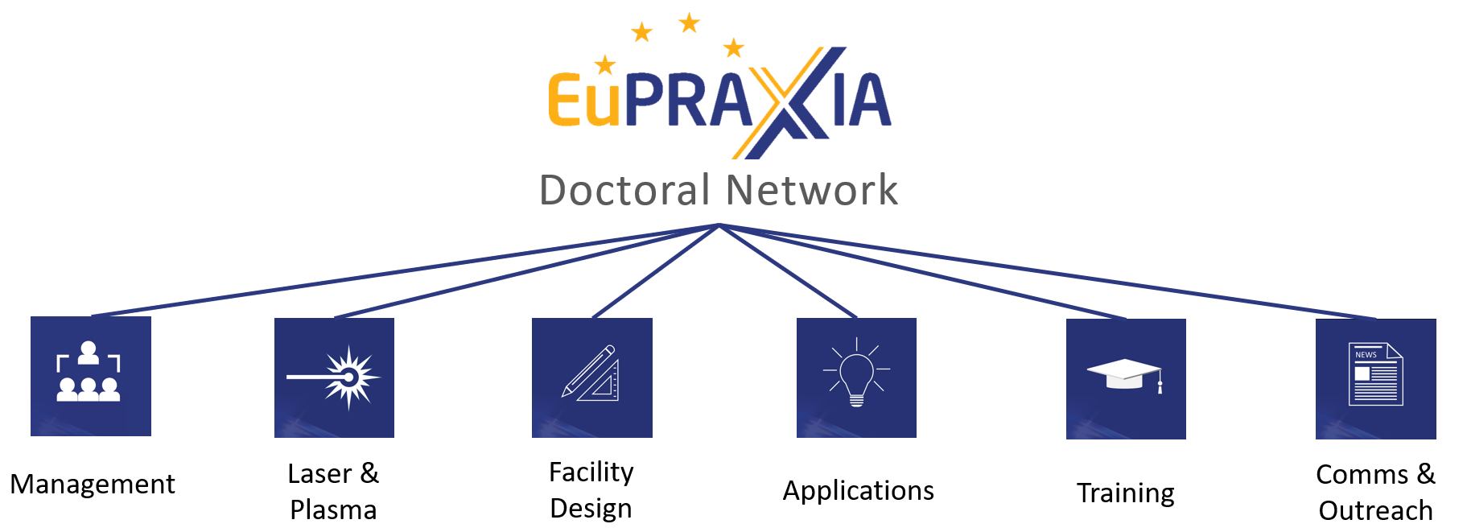
EuPRAXIA Doctoral Network (2023 – 2027)
2.6 M€ EU funding, 10 MSCA Fellows - Start date: 1 Jan 2023
Coordinated by U Liverpool (C. Welsch) and INFN

Slide 26
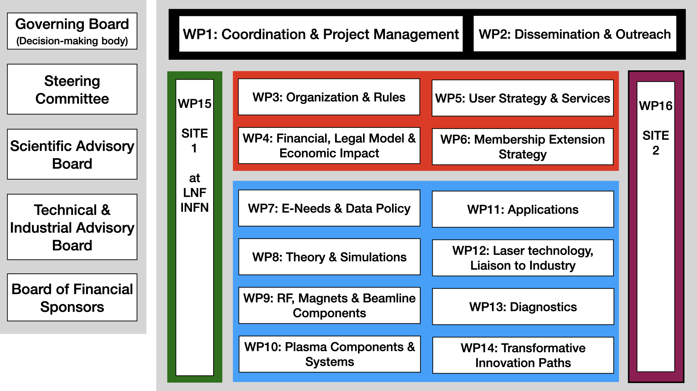
Towards Full Funding II
Need about 440 M€ plus personnel. Missing for full implementation: about 300 M€ at present.
The preparatory phase project is designed to support optimally the full implementation of this distributed RI.
At the same time the political impact from the ESFRI success shall be optimally leveraged.
At the moment: ad-hoc funding applications.
With PP deliverables: Coherent full funding lobby effort starting January 2024 – matched to funding agencies requests.

Slide 27





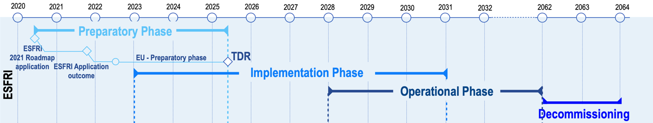

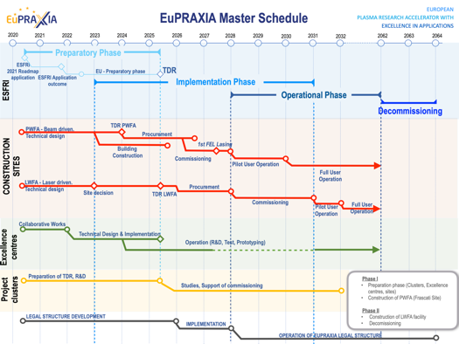
EuPRAXIA Schedule
European World-Class RI on compact accelerators for the end of the 2020‘s to the beginning of the 2060‘s
More detail in Master Schedule
SUCCESS – ON TRACK

Slide 28

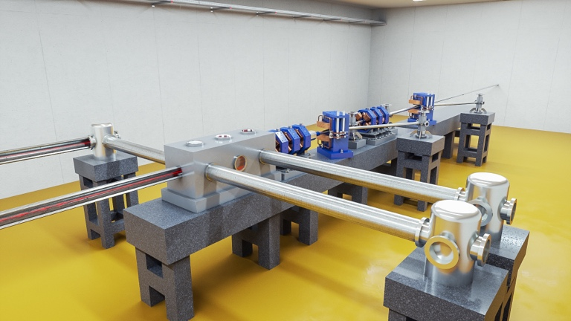
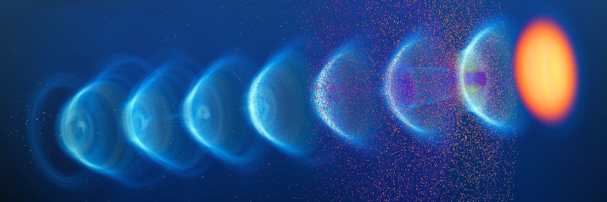
Conclusion
We consider it a major success that EuPRAXIA was selected for the 2021 update of the ESFRI Roadmap (besides Einstein Telescope the only project from physical sciences). We think it reflects on quality and readiness of our work and technology.
EuPRAXIA is the first ever plasma accelerator project with a Conceptual Design Report.
EuPRAXIA is the first ever plasma accelerator project on the ESFRI roadmap.
Being on the ESFRI roadmap: Just approved EuPRAXIA-PP project will establish a fully European project, with European shareholders.
We hope to make it an example of European innovation, bringing science to new applications and new areas. Following inspiration of particle physics detectors.
Full coherence and synergy with EuPRAXIA@SPARClab.
Start-up mode for preparatory phase with 1,540 person months … Two more countries joining: Spain and Greece.

Slide 29
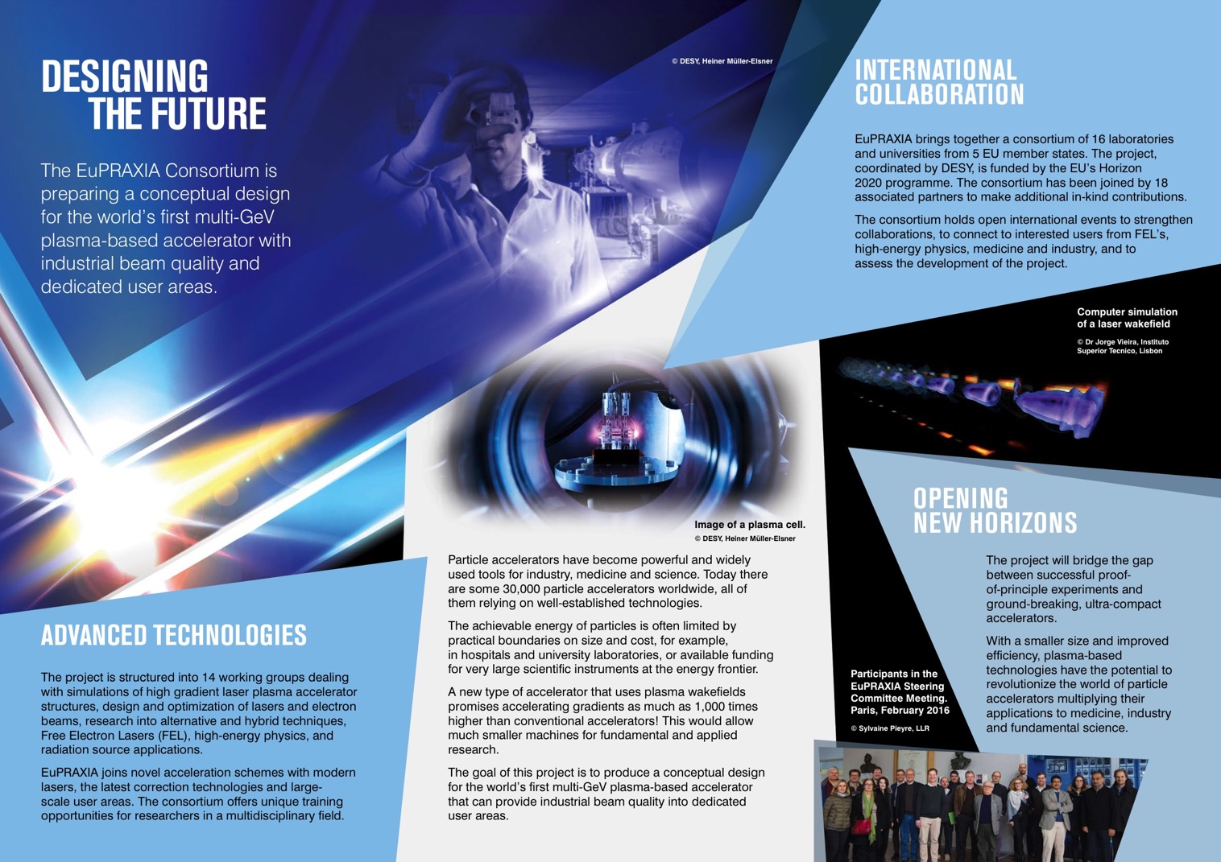
Thank You for Your Kind Attention

Slide 30

Additional Slides
ralph.assmann@lnf.infn.it
ralph.assmann@desy.de

Slide 31
Estimated Investment Costs

