Slide 1
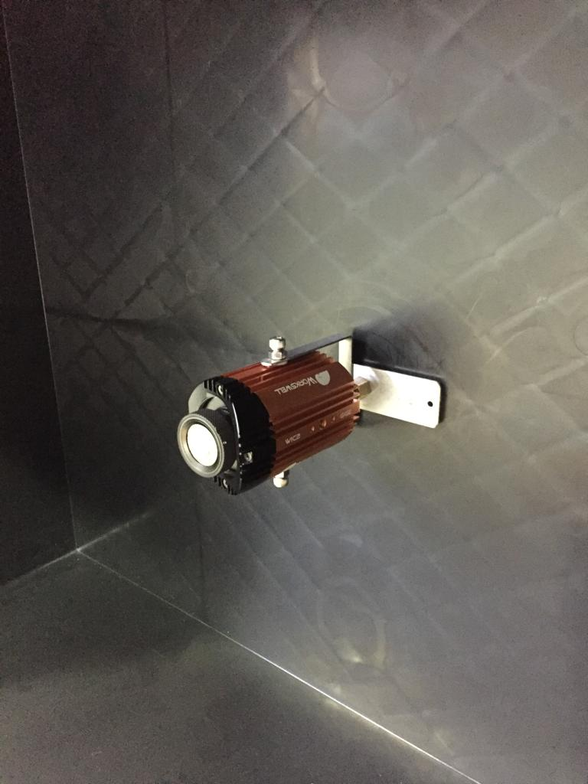
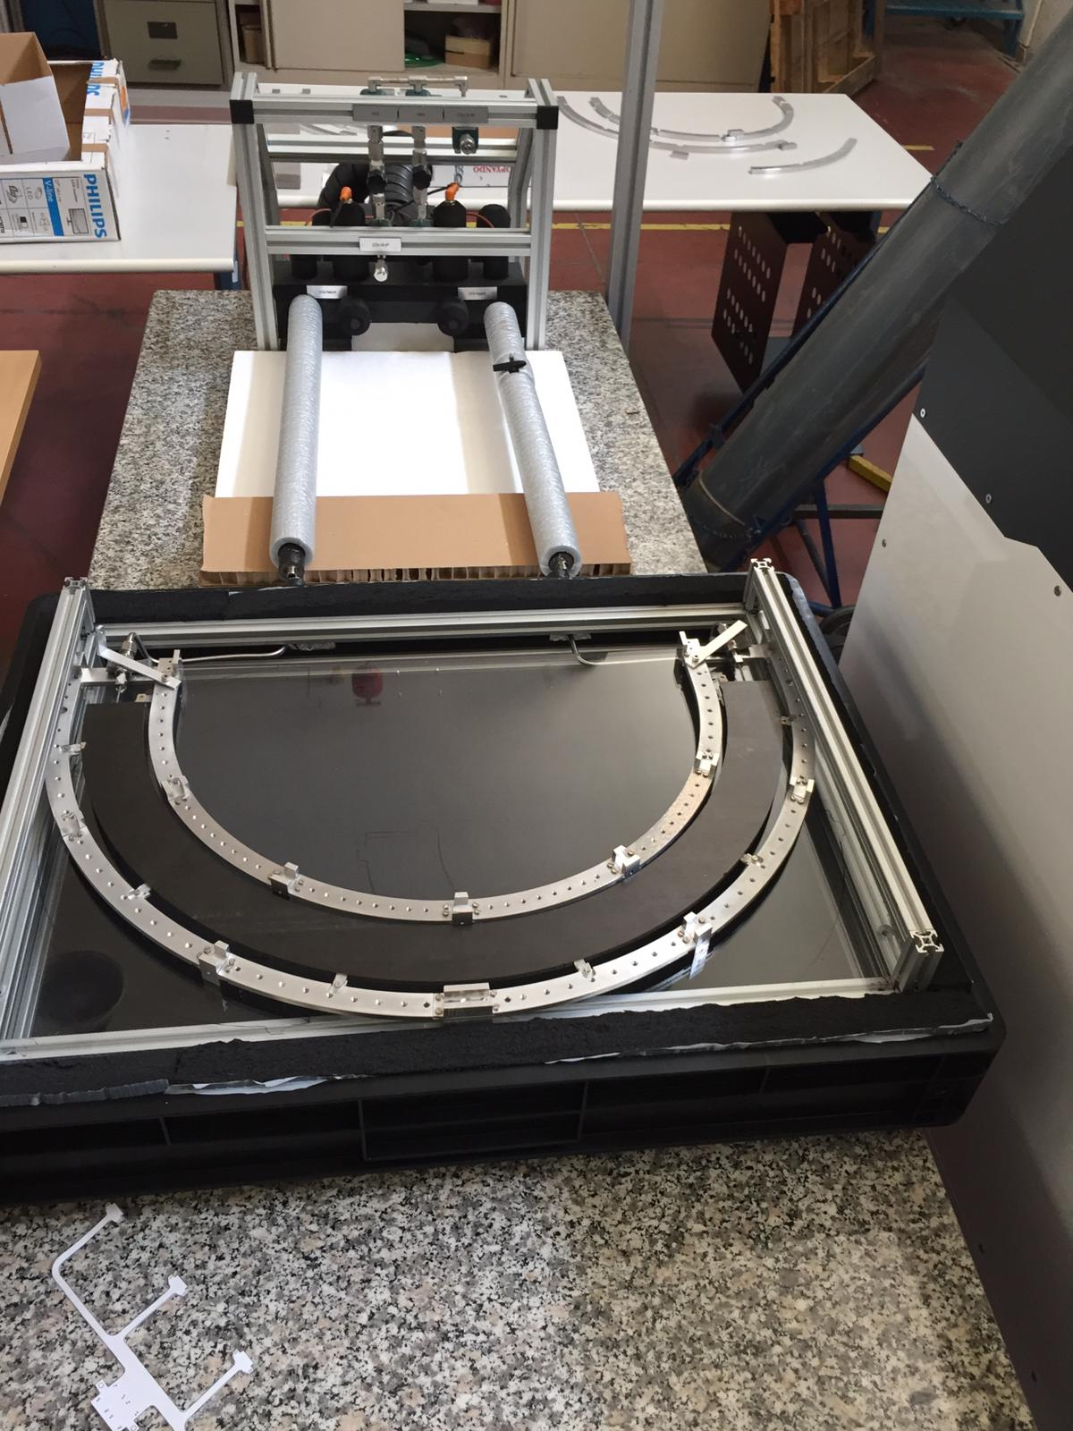
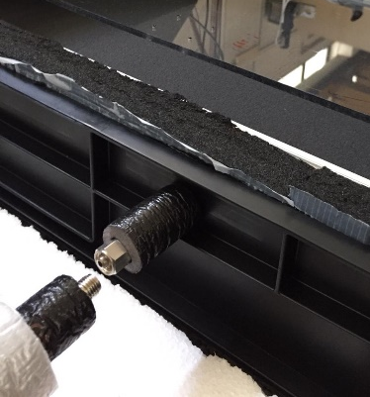
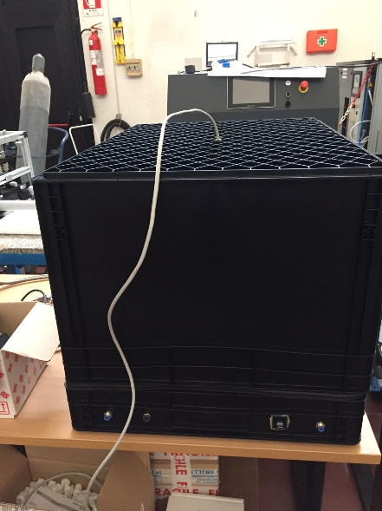
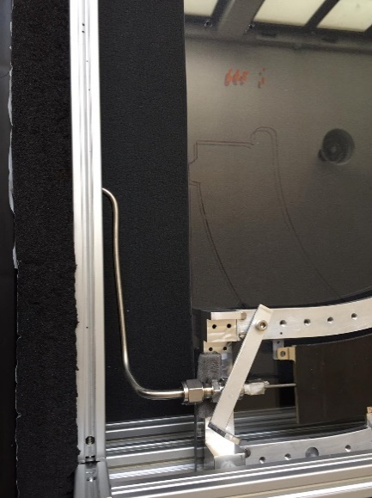
SYSTEM TEST and TRANSPORT BOX
Infrared Camera
Critical point 2
Test box
Critical point 1
Test box ready to be connected to MARTA cooling System
Infrared Camera fixed inside a new box cover (higher than the usual in order to have a full field of view)
To be done
Connect the half-ring to the cooling system
Turn-on MARTA

