Slide 1
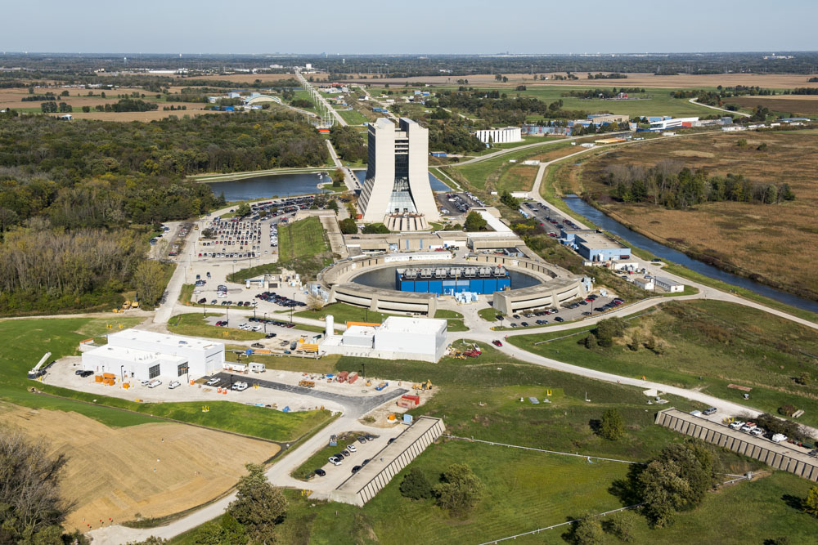
Mu2e/Mu2e-II and future muon
programs @ FNAL
S. Miscetti, LNF INFN
Workshop on status and perspectives of physics at high intensity
Laboratori Nazionali di Frascati
11 November 2022

Slide 2
Talk summary
The CLFV processes in the muon sector
The conversion process
Physics Reach of Mu2e
Mu2e technique and Mu2e status
Mu2e-II prospects
Far future for high intensity Muons @ FNAL

Slide 3

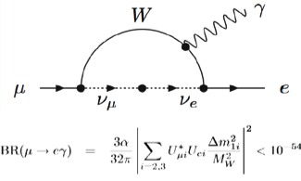
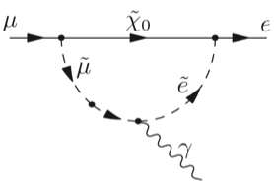
CLFV processes in muon sector - I
Neutral lepton flavor violation (i.e. neutrino mixing) implies Charged Lepton Flavor violation (CLFV) through neutrino mixing
CLFV processes are strongly suppressed in the Standard Model. In the muon sector (μN→eN, μ→ eγ, μ →eee) rates are O( 10⁻⁵⁴ ) i.e. negligible
Broad array of New Physics models predict rates observable at next generation CLFV experiments
Any observation of CLFV in the muon sector
would be unambiguous evidence of New Physics

Slide 4
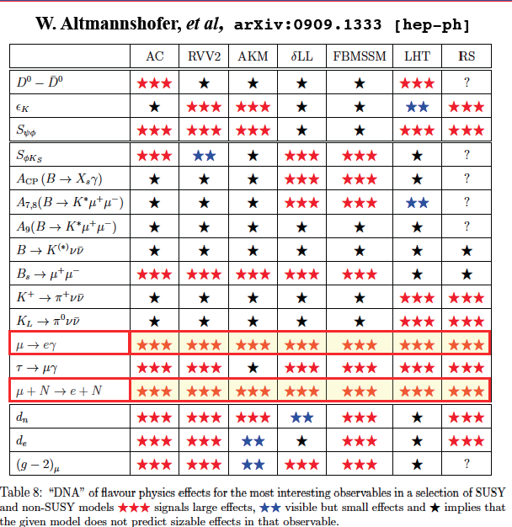
CLFV processes in muon sector-II
Most promising CLFV measurements are based on muons:
  clean topologies, sensitive to many NP models + LARGE RATES
CLFV@Mu2e (FNAL) /COMET (Japan): coherent neutrino-less conversion of a muon to an electron in the field of a nucleus, similar but complementary to μ→ eγ and μ → eee
Table of many SUSY
and not SUSY models
to express “potentiality”
Of observe new physics
★★★
★★
★
Large effects
Visible but small
No sizeable effect

Slide 5
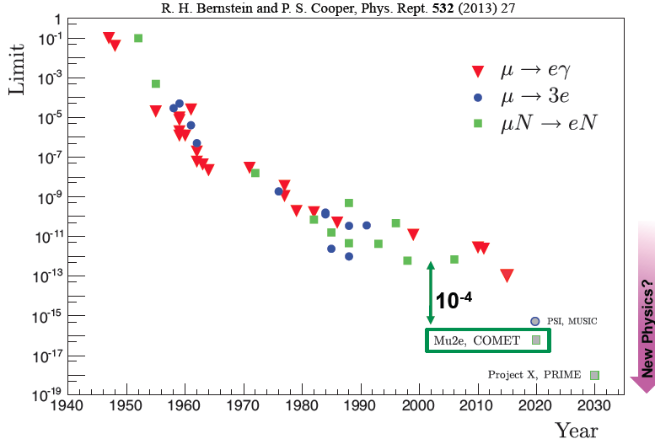


CLFV history in muon sector
Current best limits:
MEG-2016
BR(μ→eγ)
< 4.2 x 10⁻¹³
SINDRUM-1988
BR(μ→3e) < 1 x 10⁻¹²
SINDRUM-II 2006
R_{μe} < 6.1 x 10⁻¹³
MEG-upgrade
< 4.2 x 10⁻¹⁴
▽
MEG Upgrade
MU2E GOAL:R_{μe} = 8 x 10⁻¹⁷
Mu2e-2 @ PIP-2
Mu2e (FNAL) and COMET (JParc) aim to improve by 10⁴ current sensitivity

Slide 6
Mu2e/Mu2e-II reach
LOOP TERM
CONTACT TERM
Mu2e-II
MEG-II
Exploring mass scale up to 10.000 TeV

Slide 7
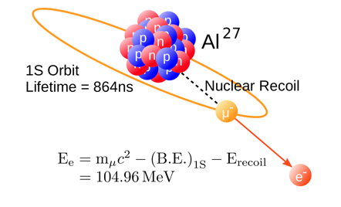
Muon conversion/capture/ decay processes
Beam of low momentum muons
Muons stopped in Al target
Muons trapped in orbit around the nucleus
Look for μ⁻N(A,Z) ➙ e⁻N(A,Z) events:
mono-energetic e⁻ with E ∼ M_{μ}, produced
Normalize to muon captures counting
emitted muonic X and γ rays
τ_{μ}^{Al} = 864 ns
Muonic atom at rest can undergo to:
Nuclear capture ∼ 61%
Decay In Orbit (DIO) ∼ 39%
Conversion < 10⁻¹²
Normalization factor
Background
Signal
Mono-energetic conversion
electron (CE) with E ∼ M_{μ}
Slow neutrons and protons + γ’s from muon capture create a lot of random hits in the detector

Slide 8
μN →eN: key experimental concepts
Concepts of the Mu2e/COMET experiments proposed by Lobashev and Djilkibaev in 1989 for the MELC experiment at INR, Russia [Sov.J.Nucl.Phys. 49, 384 (1989)]
Key ideas – increase muon beam intensity + pulsed muon beam
Very intense muon beam
Soft pions confined with solenoidal B
field
Strong gradient to increase the yield
through magnetic reflection
proton beam
proton beam
Pulsed beam
Delayed live gate to suppress
prompt backgrounds (RPC)
Narrow proton pulses
> 10¹⁰ out-of-time protons
suppression (EXTINCTION)

Slide 9
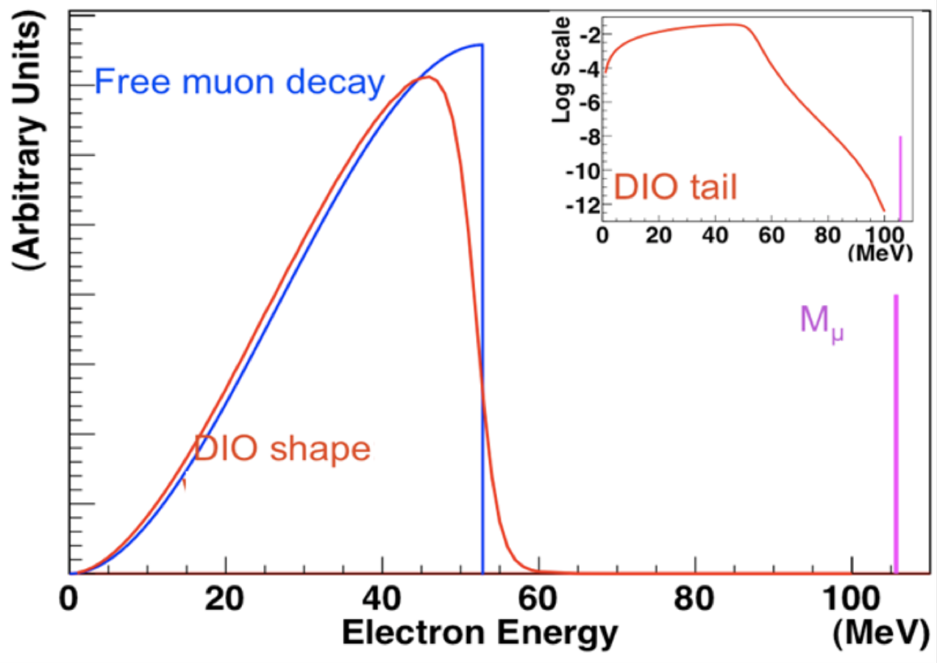
μN →eN: main backgrounds
Muon decays in orbit
Nuclear modifications push DIO spectrum near conversion electron (CE)
DIO and CLFV signal, may overlap due to detector resolution
Signal
CLFV signal
DIO (39% of μ captures)
e⁻ detection with a momentum resolution ≲ 180 keV required
Cosmic Ray events
Cosmic μ
Cosmic Ray muons can fake
signal conversion events at 1 ev/day
These events are proportional to the running
time higher beam intensity is preferrable
105 MeV e⁻
Detector region covered by Cosmic Ray Veto counters: 10⁻⁴ inefficiency required

Slide 10
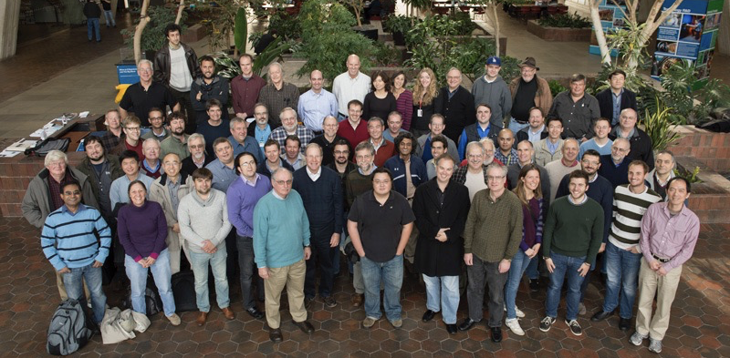
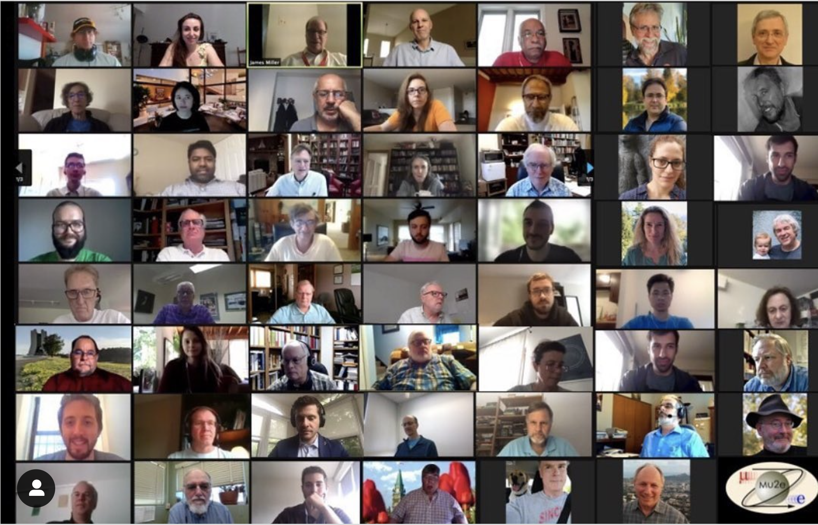

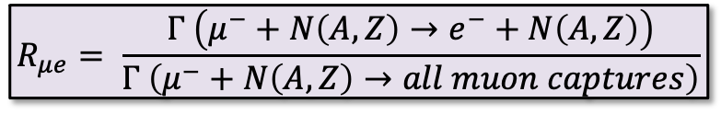
The Mu2e collaboration
Pre-COVID-era meetings
COVID-ERA meetings
220+ members, 38 inst, 310 M$ cost
CD-3 in 2016, rebaselined 2022
Goal: improvement by a factor of 10⁴ on the measurement of
$$R_{μe}= \frac{Γ \left(μ^{−}+N\left(A,Z\right)→e^{−}+N\left(A,Z\right)\right)}{Γ \left(μ^{−}+N\left(A,Z\right)→all muon captures\right)}$$
Current best limit set by Sindrum-II
R_{μe}< 7 x 10⁻¹³
reaching a final single-event-sensitivity of 3 ×10⁻¹⁷ through different running phases
10¹⁸ stopped muons
high background suppression (N_{bckg} < 0.5)
This requires:

Slide 11
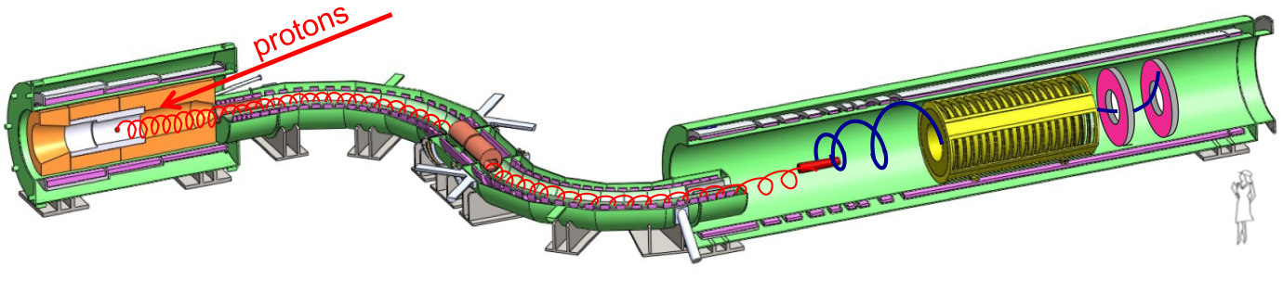
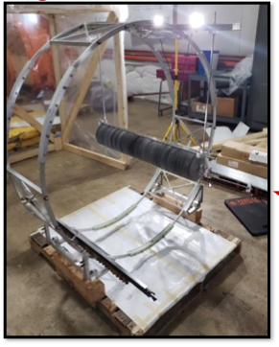
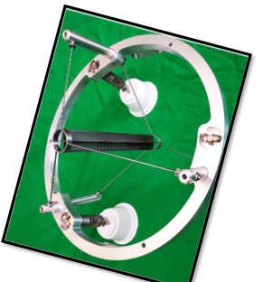
The Mu2e experimental layout
low momentum μ⁻ selection + antiproton absorber
8 kW, 8 GeV
p beam
2.5T
1T
4.6T
2T
25 m long beam line
Detector Solenoid
Muon capture on Al target
Tracker, EM Calorimeter
Production (PS) and Transport Solenoids
Production, selection and transport of low momentum muon beam
Tungsten production
Target
5.7 10¹² POT/sec
Max T = 1100 C
Gaps and fins
for heat dissipation
Production Target
  8.6×10⁹ μ/sec stops
  on Alluminum Target
Stopping Target

Slide 12
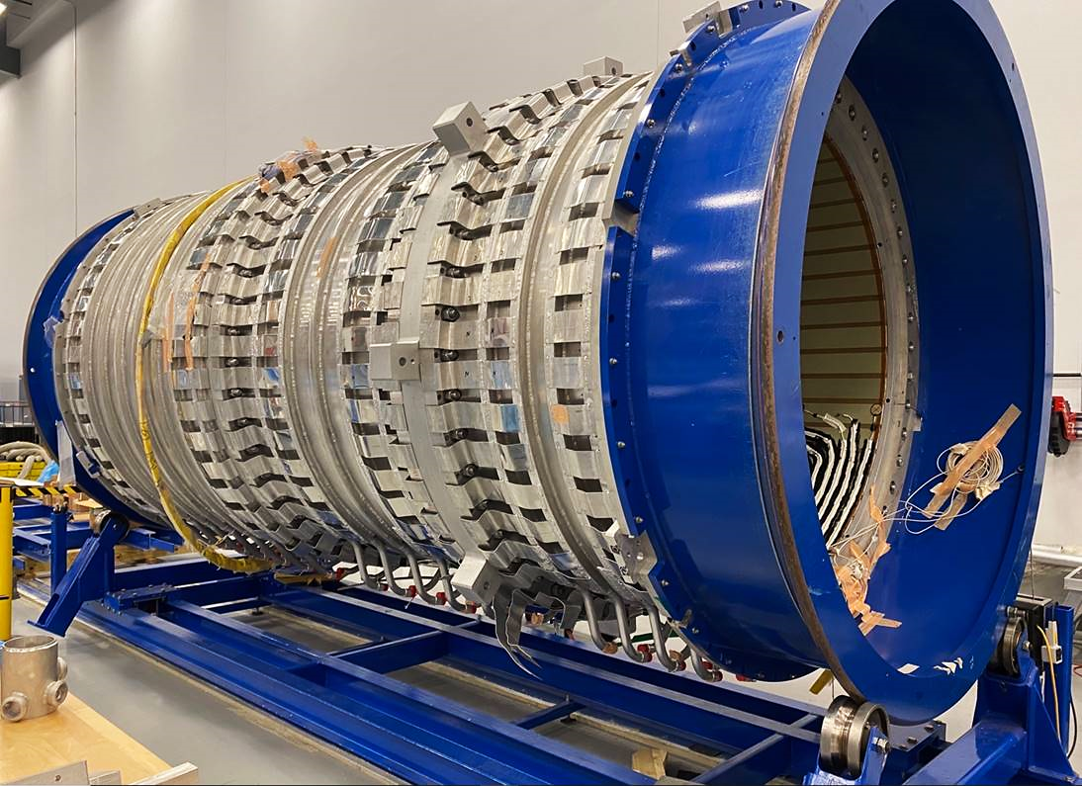
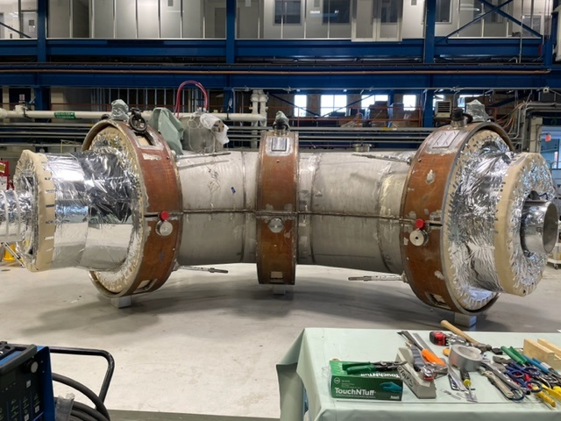
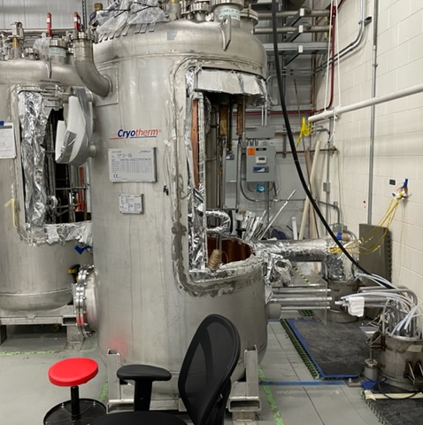
Mu2e construction: Solenoids
Production Solenoid (3 units):
  PS coils completed and assembled
  Cold Mass cryo assembly 75% complete
Transport Solenoid (14 units):
  TSu cryostat, TSd thermal shield in place
  Successful TS testing campaign
Detector Solenoid (11 units):
  8 coils completed, remaining 3 in fabrication
PS COLD MASS
PS1
PS2
PS3
PS coils assembled into coldmass
Upstream TS: outer cryostat in place
DS2 Coil inserted in shell
Cryo feedboxes

Slide 13
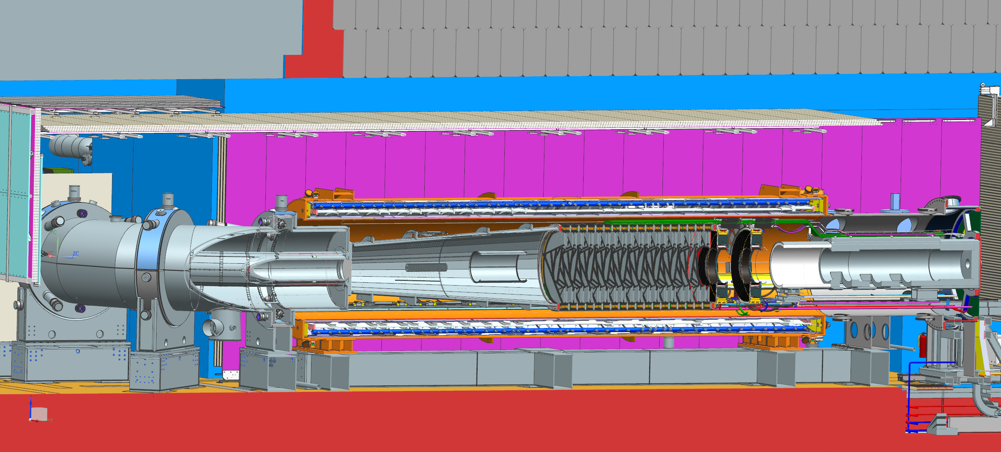

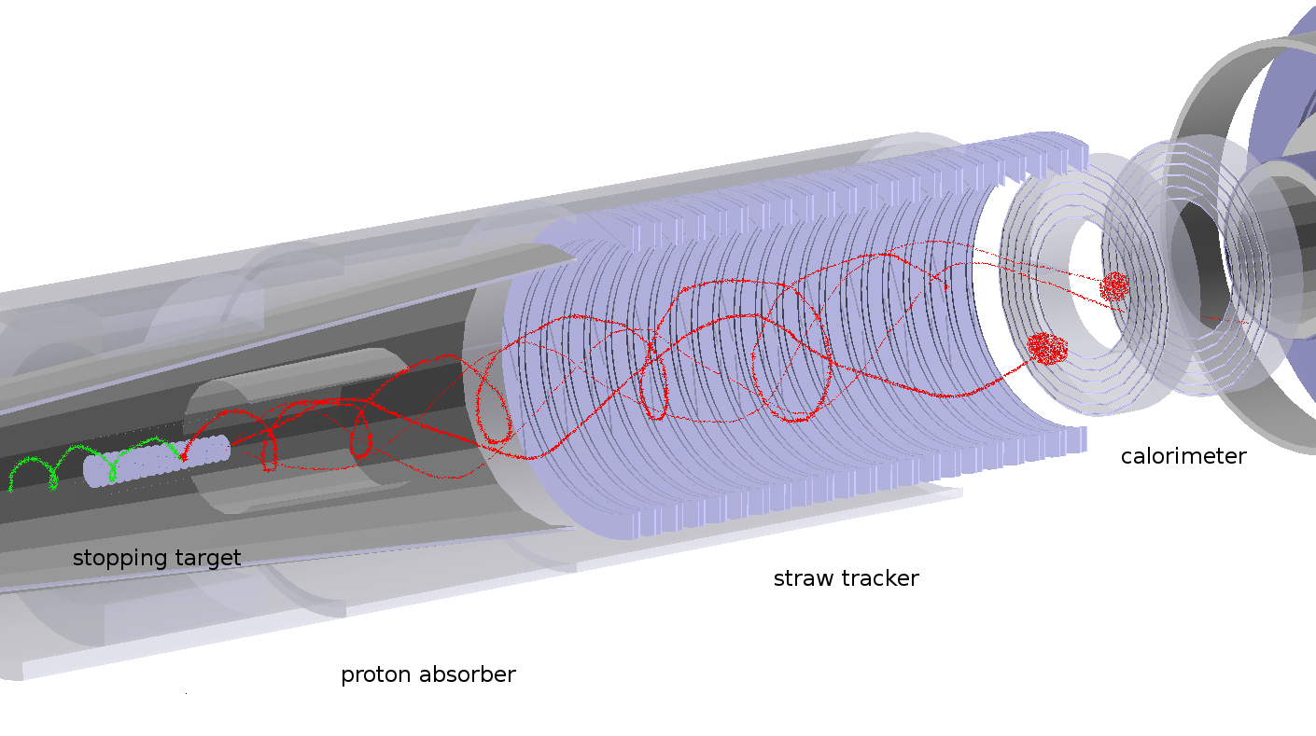
Detector Solenoid Layout
Detector Solenoid Cryostat
Cosmic Ray Veto
Shield Blocks
Transport Solenoid
Proton Absorber
Floor
Collimators
Tracker
Calorimeter
Muon Beam Stop
Stopping Target
10⁻⁴ Torr vacuum to avoid muon capture on gas
Max TID of O( 10²- 10³ ) krad on tracker/calo
Max n-flux of O (10¹² - 10¹³ n/cm²) on tracker/calo
All DS surrounded by Cosmic Veto system
Notes:
Aluminum target
37 Al foils with a 100 μm thickness; the material choice is a compromise between the μ life time and E_{CE}
Proton absorbers
made of high-density polyethylene; designed in order to reduce proton flux on the tracker and minimize energy loss
Tracker
Identify and make precision momentum measurement of ~105MeV/c electrons
Calorimeter
2 disks of CsI crystals; used for Particle Identification; σE<10%
Muon Beam Stop
several concentric cylindrical structures of stainless steel and high density polyethylene; absorbs beam particles at the end of DS

Slide 14
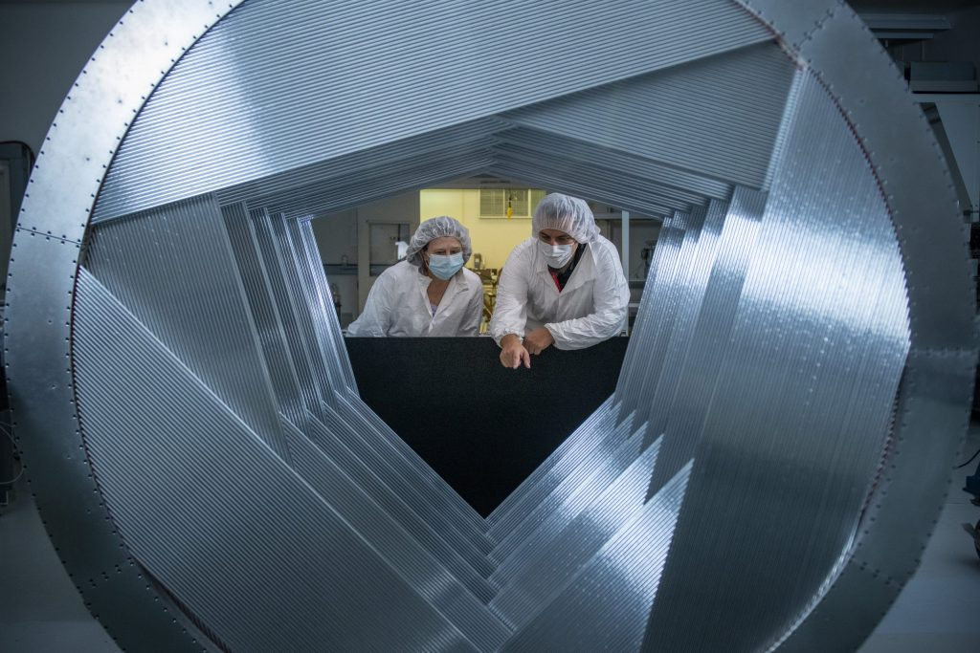
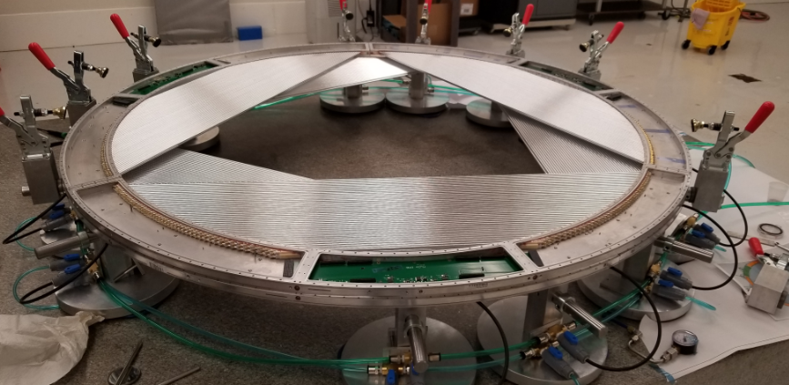
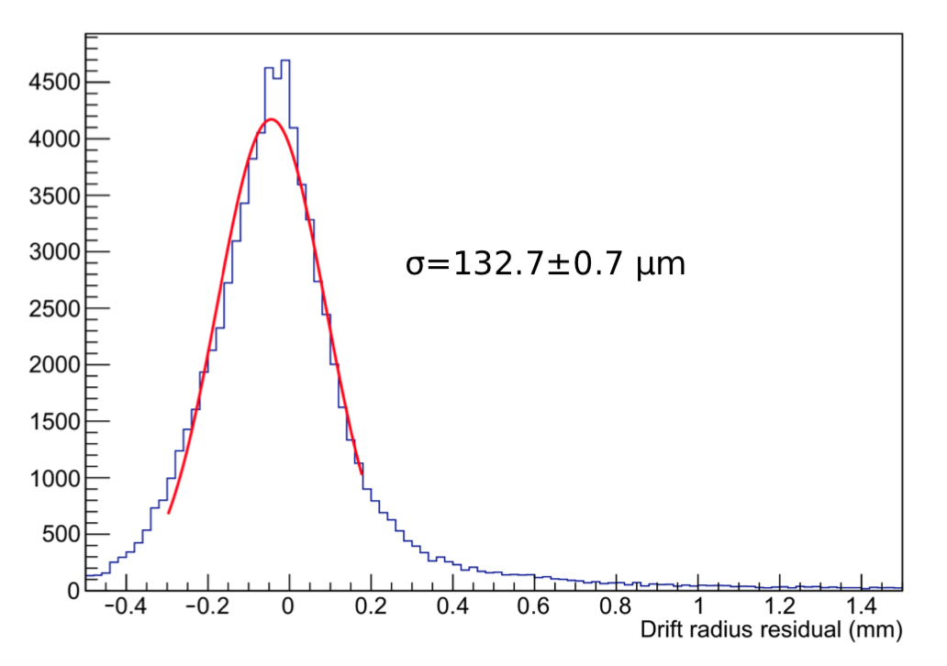
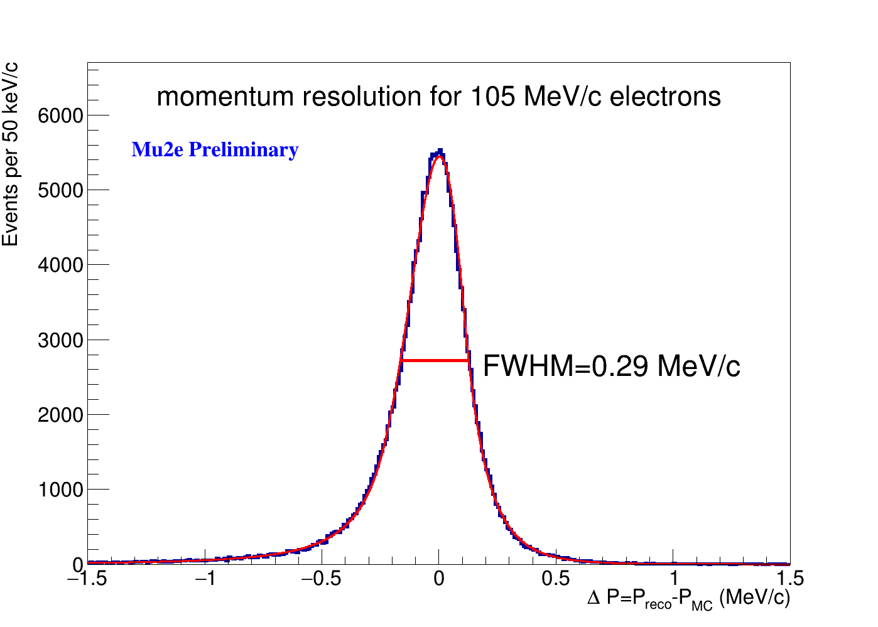
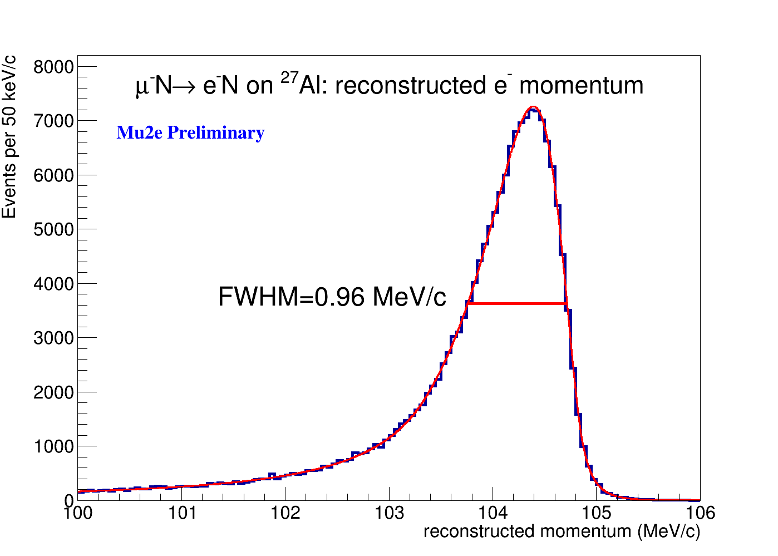
The Mu2e Tracker
A 3m long detector composed of 20000 ”hyper-thin” straw tubes (15 um thick)
Organized in 18 stations of 6 panels/each
Each panel double layers of staggered straws
Dual ended readout for position along wire
> Tracker plane prepared for VST
> 95% panels and 60% of planes assembled
VST data samples
Fully simulated and reconstructed data
Notes:
Aluminum target
37 Al foils with a 100 μm thickness; the material choice is a compromise between the μ life time and E_{CE}
Proton absorbers
made of high-density polyethylene; designed in order to reduce proton flux on the tracker and minimize energy loss
Tracker
Identify and make precision momentum measurement of ~105MeV/c electrons
Calorimeter
2 disks of CsI crystals; used for Particle Identification; σE<10%
Muon Beam Stop
several concentric cylindrical structures of stainless steel and high density polyethylene; absorbs beam particles at the end of DS

Slide 15
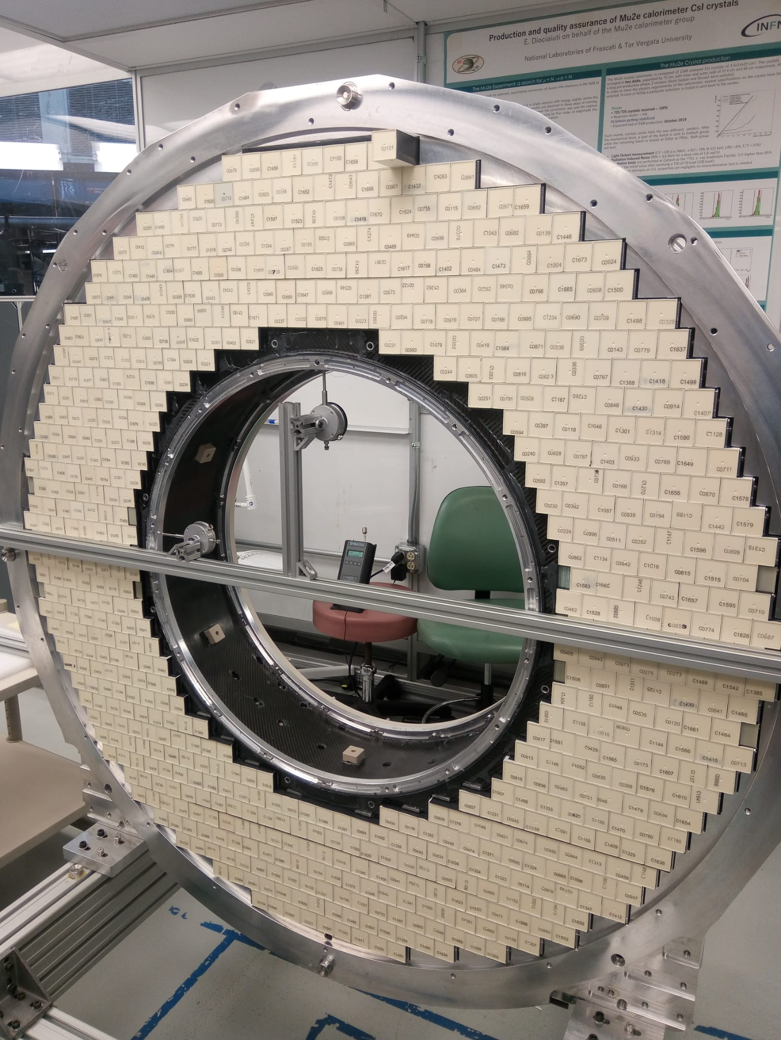
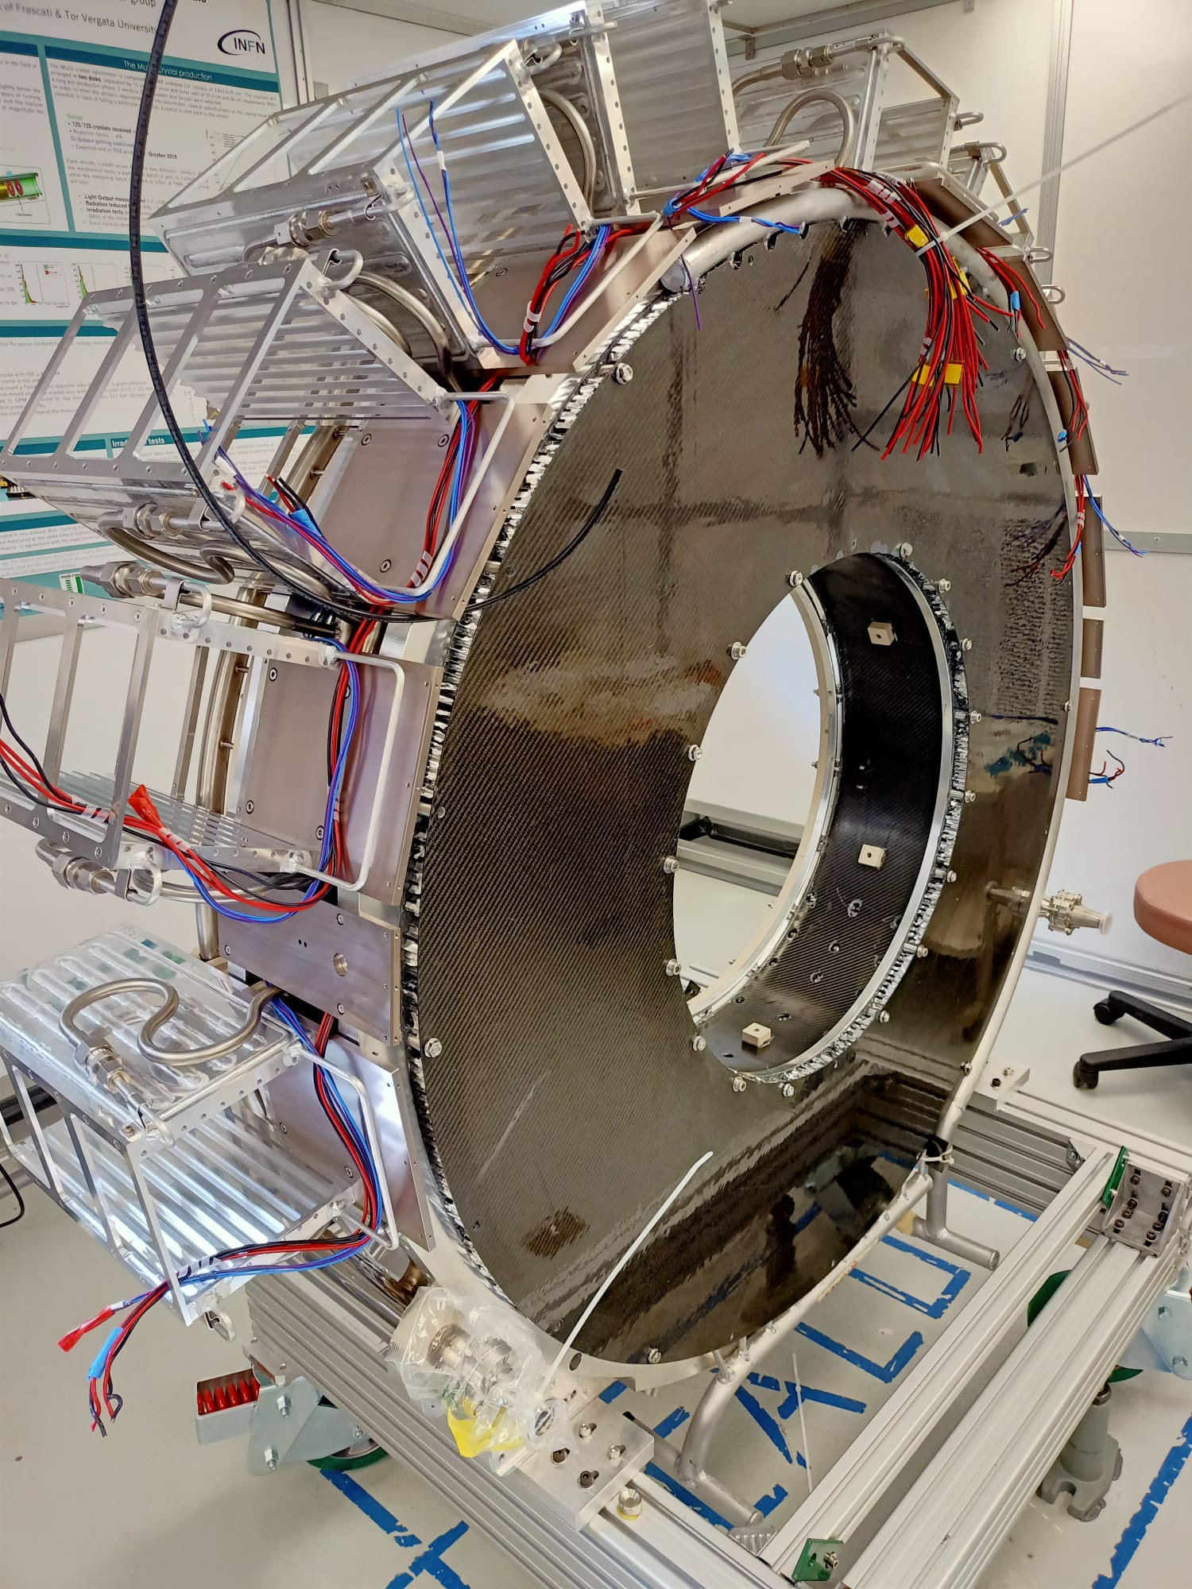
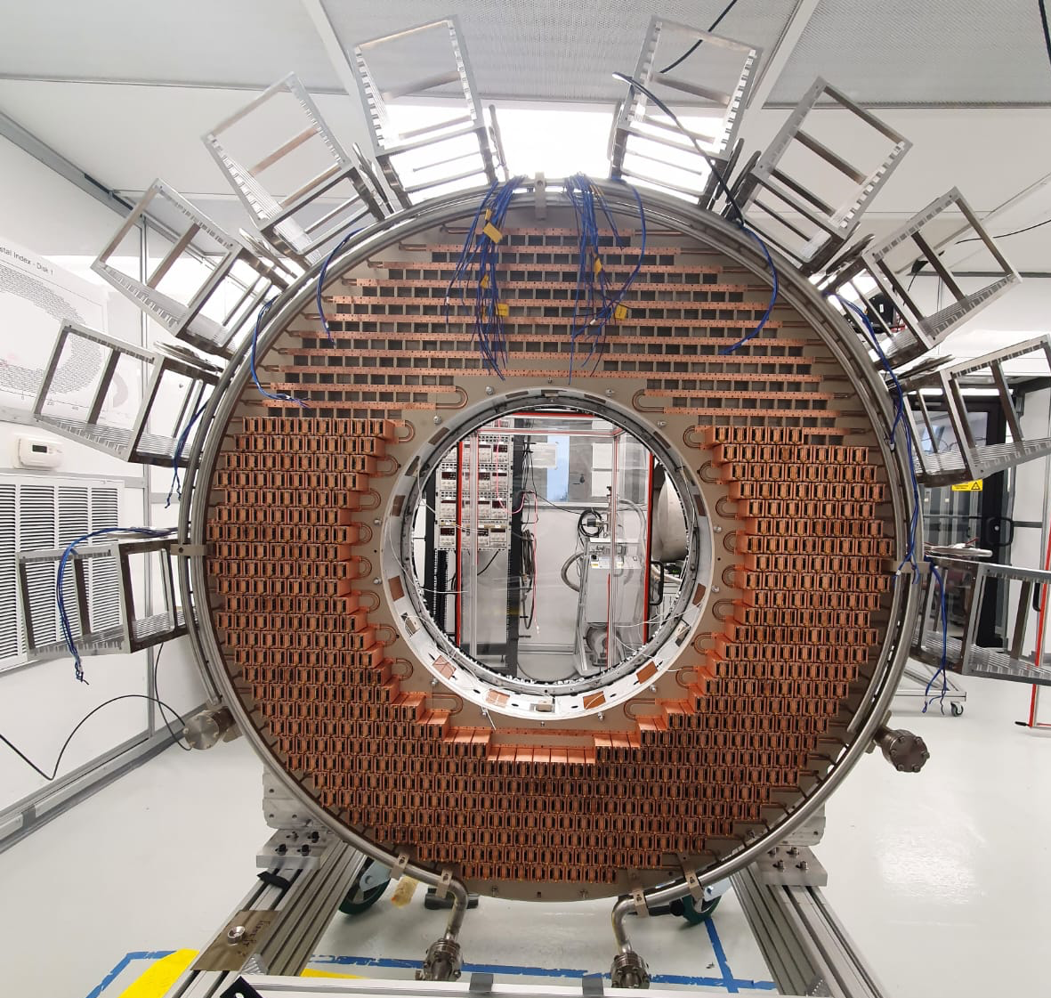
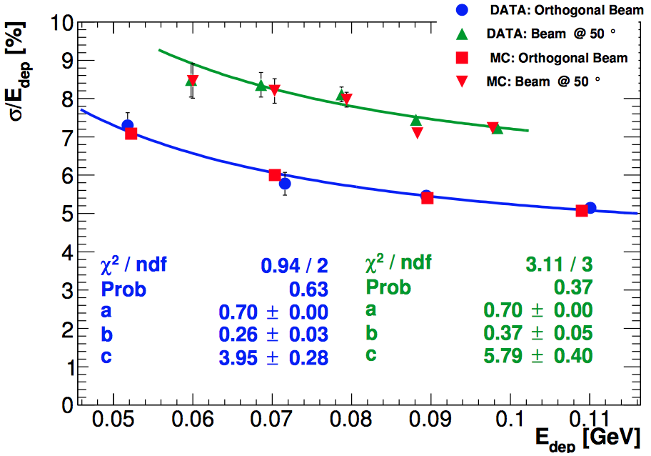
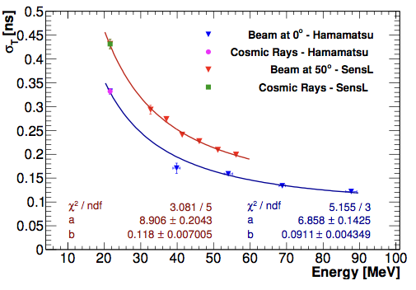
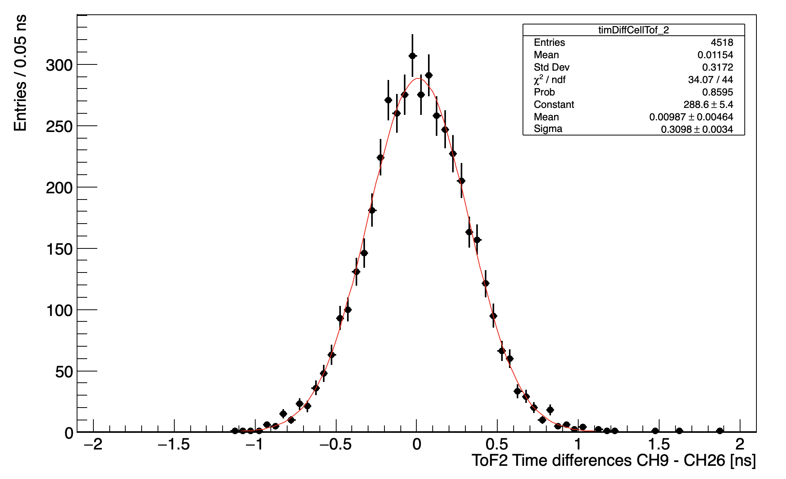
The Mu2e Calorimeter
Crystals stacked on Disk-1
2/3 of Readout SiPM/FEE
Front panel and crates
2 annular disks of 674 pure CsI + SiPMs
FEE on SiPM pins + digital readout on crates
Complement the tracker for μ/e PID +
triggering and support on track-seeding
Requirements for 100 MeV electrons
  → < 10% energy resolution
  → < 500 ps timing resolution
  < 1 cm position resolution
Disk 1 at FNAL, Disk 0 @ LNF being shipped
Large area prototype (Module- 0 results)
Test beam with electrons at LNF BTF: Eres 5-7%, Tres ~100 ps @ 100 MeV
Results improved with Module-0 CR data: Tres = 210 ps/MIP
Notes:
Aluminum target
37 Al foils with a 100 μm thickness; the material choice is a compromise between the μ life time and E_{CE}
Proton absorbers
made of high-density polyethylene; designed in order to reduce proton flux on the tracker and minimize energy loss
Tracker
Identify and make precision momentum measurement of ~105MeV/c electrons
Calorimeter
2 disks of CsI crystals; used for Particle Identification; σE<10%
Muon Beam Stop
several concentric cylindrical structures of stainless steel and high density polyethylene; absorbs beam particles at the end of DS

Slide 16
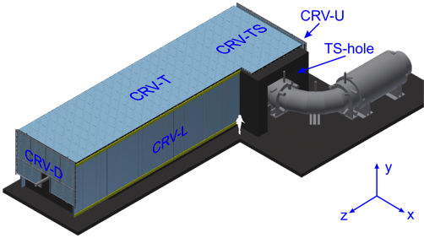
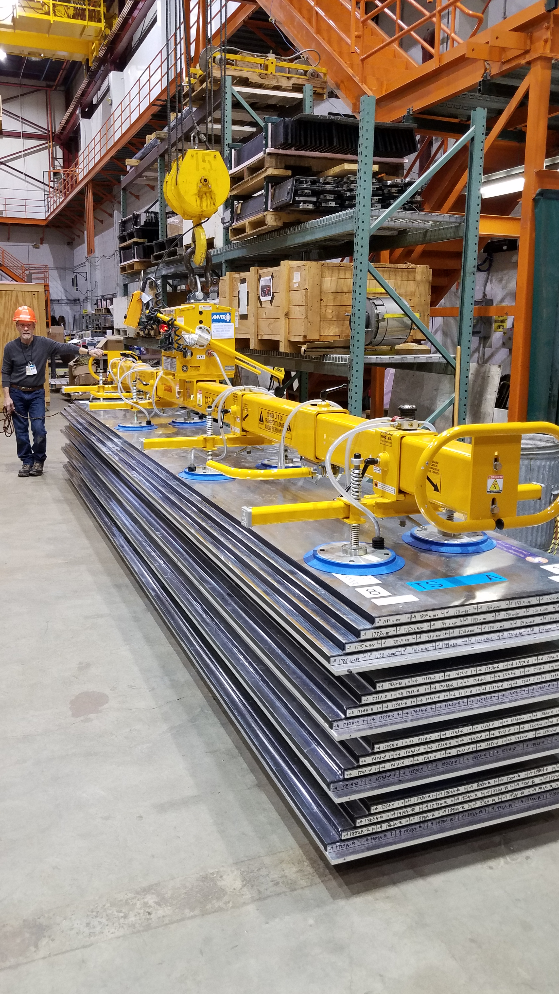
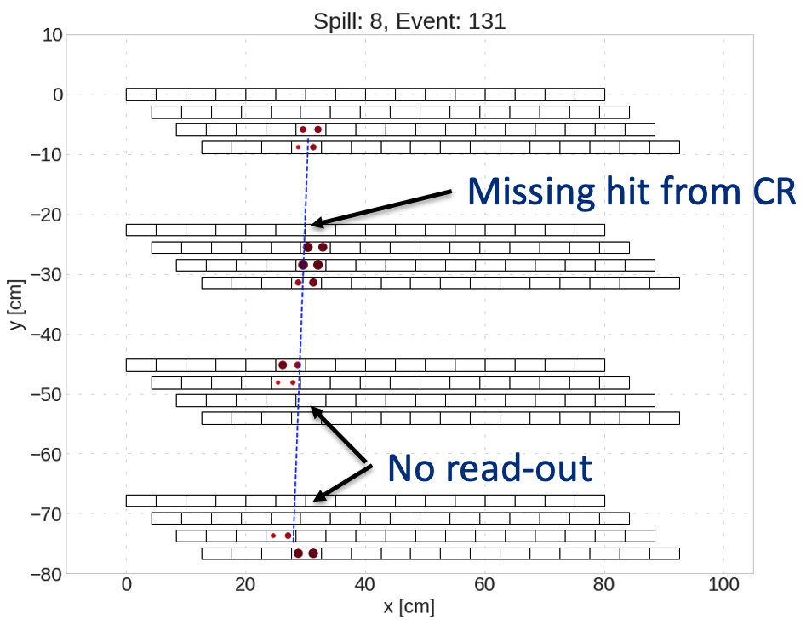
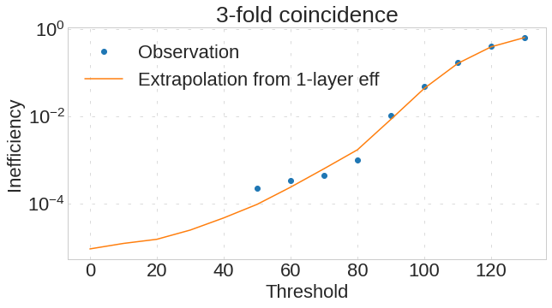
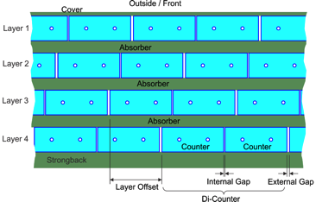
The Cosmic Ray Veto system
CRV covers the entire Detector Solenoid
and half Transport Solenoid (335 m²)
Four layers of extruded plastic scintillator
(5×2×85÷690) cm³ + aluminum absorber
2 WLS fibers (1.4 mm diameter)
+ (2×2) mm² SiPM readout
3/4 layers hit: 125 ns veto
  ε_{CRVplane} = 99.6%
  ➛ ε_{CRV} = 99.99%
84% of modules built
Notes:
Aluminum target
37 Al foils with a 100 μm thickness; the material choice is a compromise between the μ life time and E_{CE}
Proton absorbers
made of high-density polyethylene; designed in order to reduce proton flux on the tracker and minimize energy loss
Tracker
Identify and make precision momentum measurement of ~105MeV/c electrons
Calorimeter
2 disks of CsI crystals; used for Particle Identification; σE<10%
Muon Beam Stop
several concentric cylindrical structures of stainless steel and high density polyethylene; absorbs beam particles at the end of DS

Slide 17
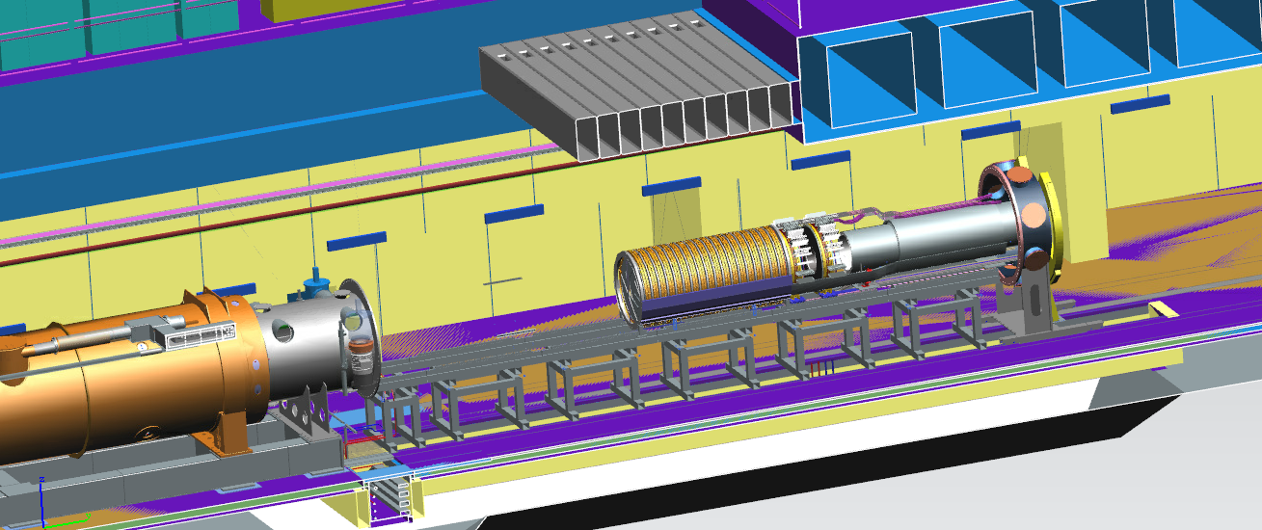
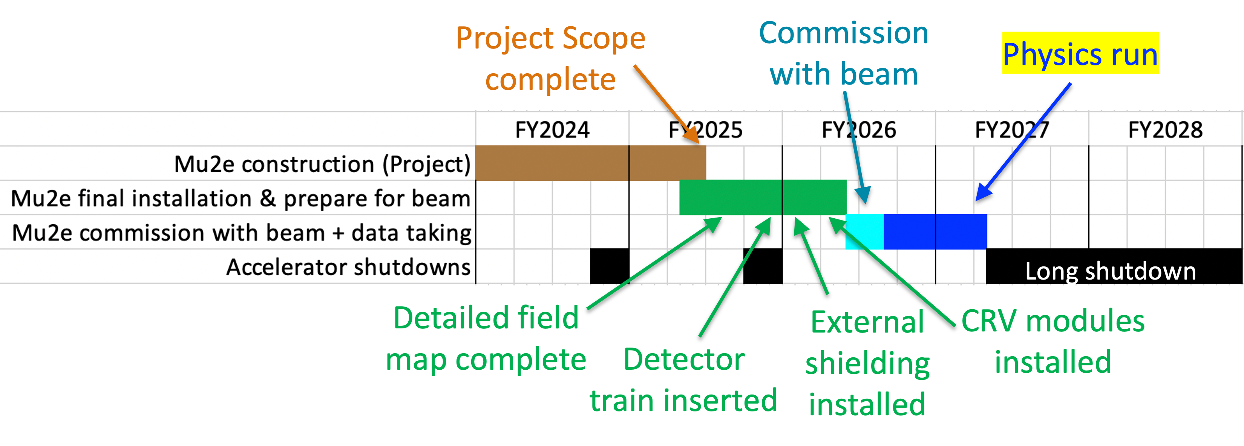
Mu2e commissioning and first run
Detector commissioning
phase will begin in 2024
In the Mu2e hall in
DS extracted position
Joint CR test with
Tracking/Calo/CRV
planned for early 2025
RunI
From 3x10²⁰ POT
→ 3x10¹⁹ POT

Slide 18
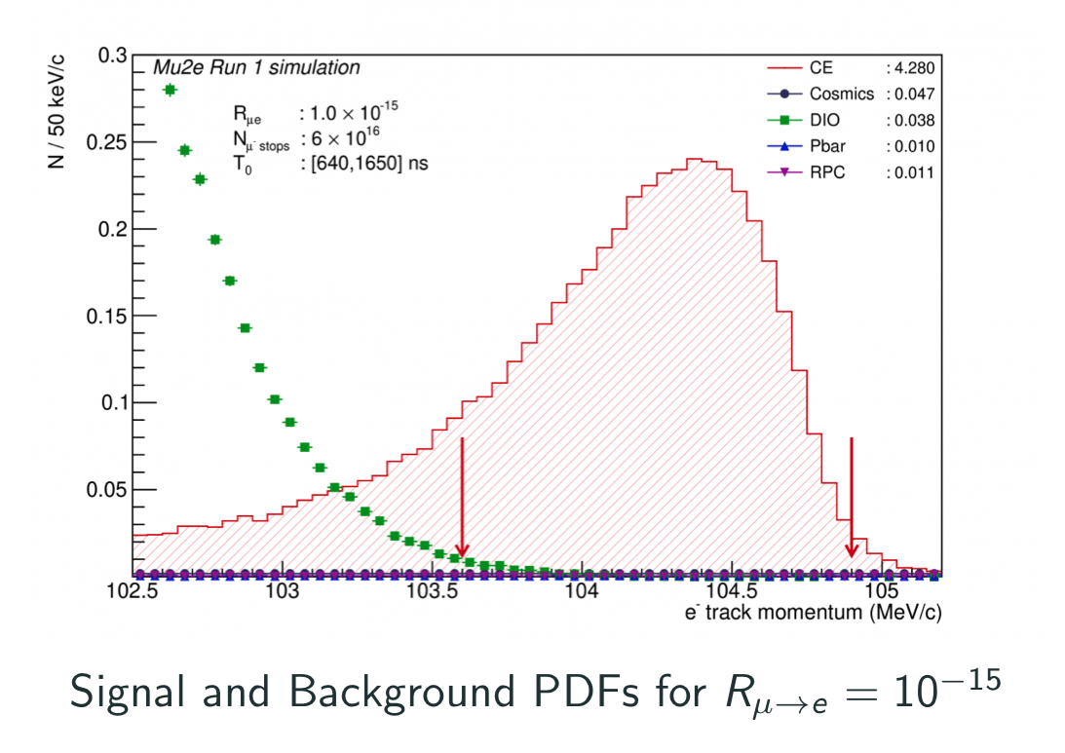
Mu2e sensitivity for Run-I
Recent sensitivity estimate for 3.8 × 10¹⁹ POT (first running phase) using detailed simulation
- 6x10¹⁶ stopped muons (running mostly at half proton beam intensity )
5σ discovery R_{μe} = 1.1 × 10⁻¹⁵
90% CL R_{μe} < 5.9 × 10⁻¹⁶
×1000 better than SINDRUM-II limit
Full simulation of RunI carried out
submitted on MDPI Universe
ArXiv:2210.1130 (hep-ex)
Total background: 0.11 ± 0.03_{stat.+syst.} evt
  Cosmics = 0.05 ± 0.01 events
  DIO = 0.04 ± 0.02 events

Slide 19
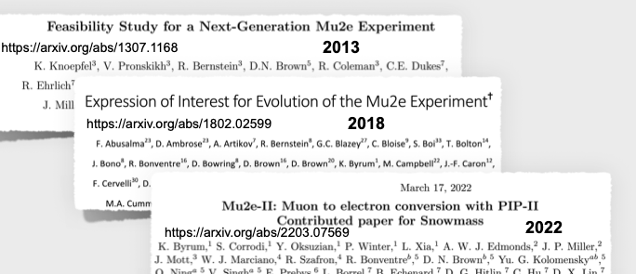
Mu2e-II perspectives
if approved, Mu2e-II will use 100 kW of proton beam from PIP-II to increase > x10 the Mu2e muon beam intensity (5x10¹⁹ of total stopped muons)
PIP-II is the new linac under construction for the neutrino program at FNAL (DUNE-LBNF).
PIP-II Construction expected to complete for end of this decade
Growing interest expressed with LOI and 12 presentations at SNOWMASS 2021 (summer 2022)

Slide 20
Mu2e-II hot items and reach
Foreseen and planned as an upgrade, Mu2e-II will recycle most of the existing infrastructure
However large changes/progresses have to be done both on the detector and
on the beam structure, to tolerate x 10 more beam power (i.e. heat, TID and neutrons)
A new design of the target station and related cooling system is needed;
The Heat Radiation shield has to be changed from Bronze to Tungsten to reduce the
radiation dose on the PS superconducting coil;
Proton beam from 8 GeV to 800 MeV. Optimization of location for beam entering the PS
The tracker momentum resolution has to improve:
→ “hard” candidate is reducing straw tube thickness from 15 to 8 um
→ Alternatives are being proposed
Calorimeter has either to change crystals and/or drastically change sensors/FEE
CRV has to improve shielding and reconstruction efficiency
Rad-Hardness of electronics and sensors have to be brought up to many Mrad level
→ If Mu2e has not observed a signal, Mu2e-II will increase by a large factor the sensitivity
→ If Mu2e has observed a signal, a better statistical determination will be carried out
→ Exploring options of conversion on a different target (see next slide)

Slide 21
Mu2e-II and target choice
In Mu2e-II the test will be limited to Ti/Li since the decay time decrease quickly with Z.
Bound muon lifetime goes from 825 to ~ 300 ns on Ti, close to beam pulse sizes and too
close to the RPC background. Tuning of beam expected to handle these cases
However, it will be impossible to test the “golden” cases (Au/Pb) where signal rate differs substantially among different models.
New strategy needed.
We need to improve muon beam statistics with short pulses reducing the prompt background

Slide 22
AMF: a new generation muon program
Next generation Muon Faciliy (AMF=Advanced Muon Facility)
ArXiv: 2203.08278 [Hep-ex] Mar 2022
Use PIP-II accelerator to create the most intense μ-/μ+ beams in the world.
Synergy with muon collider work for accelerator point of view and possibility to build @ FNAL:
Experiments for muon CLFV
Muonium-antimuonium transition
A storage ring for muon EDM
For CLFV all three CLFV muon modes considered:
- Proton beam of 1 MW (cfr 8 kW/100 kW Mu2e, Mu2e-II)
Two new small rings for conversion, high Z targets (long storage time)
and rate x100 Mu2e i.e. muon conversion sensitivity at levels of 10⁻¹⁹
mu/sec rates x 100-1000 of HIMB, both for μ ◊ eγ, μ ◊ eee
Hope to get high priority level from next P5
Snowmass reports are all published now

Slide 23
Conclusions
The muon conversion experiments, and in general CLFV searches in the muon sector, are excellent tools to look for new physics (BSM) since SM rates are NEGLIGIBLE
(10⁻⁵² mu, 10⁻¹⁴ tau) and muons are copiously produced;
They belong to the Intensity Frontier searches and are complementary to searches @ high-energy colliders exploring a not directly accessible mass-scale of hundreds of TeV
Mu2e experiment is under construction and the commissioning and data taking
phases are approaching (2025-2027): Run I will improve existing limit of 1000,
Run-II (> 2029) will go for 10000;
Mu2e-II will offer another improvement > 10 on the reach but it will require to solve many problems and will limit the target scans to Titanium/Lithium.
A new facility is being proposed to run for very high intensity (AFM) looking for muon
beams for conversion for sensitivity down to 10⁻¹⁹.
→ future particle physics US planning will surely look at this proposal
→ extreme option for very high intensity muon beams also at surface
Many opportunities for developing early stages collaborations

Slide 24
ADDITIONAL
MATERIAL

Slide 25
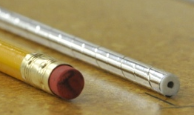
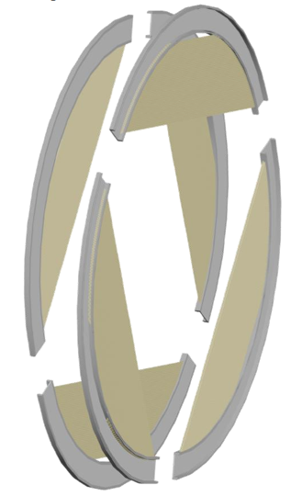
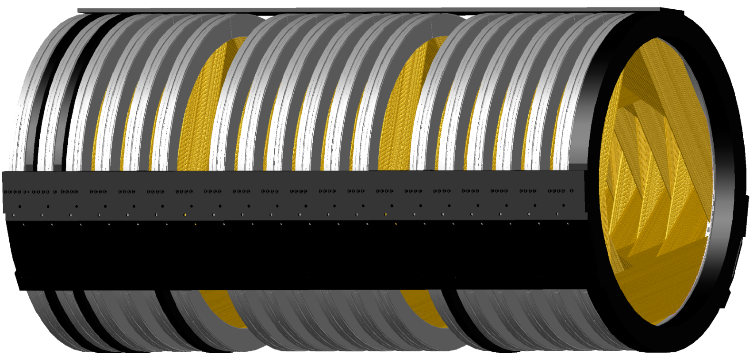
Tracker information
Detector requirements:
Small X₀
σ_{p} < 180 keV @ 105 MeV
Good rate capability (20 kHz/cm² in live window, beam flash of 3 MHz/cm² )
dE/dx capability to distinguish e⁻/p
> 20,000 low-mass straw tubes, 5 mm ∅, 33 − 117 cm length
15 μm Mylar wall, 25 μm Au-plated W wire, 80:20 Ar:CO₂ @ 1 atm
Dual-ended readout ➤ position along wire
Self-supporting panel consists of 2×48 straws, two staggered layers
Rotation of panels (stereo reconstruction) arranged in planes on stations
Trk panel
Tracker Plane:
6 panels
Tracker Station:
2 rotated planes
Tracker: 18 stations
panel
3.2 meters
38 cm
70 cm

Slide 26
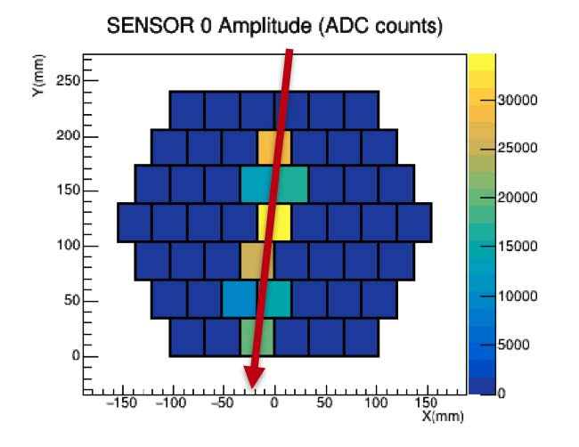
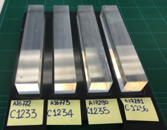
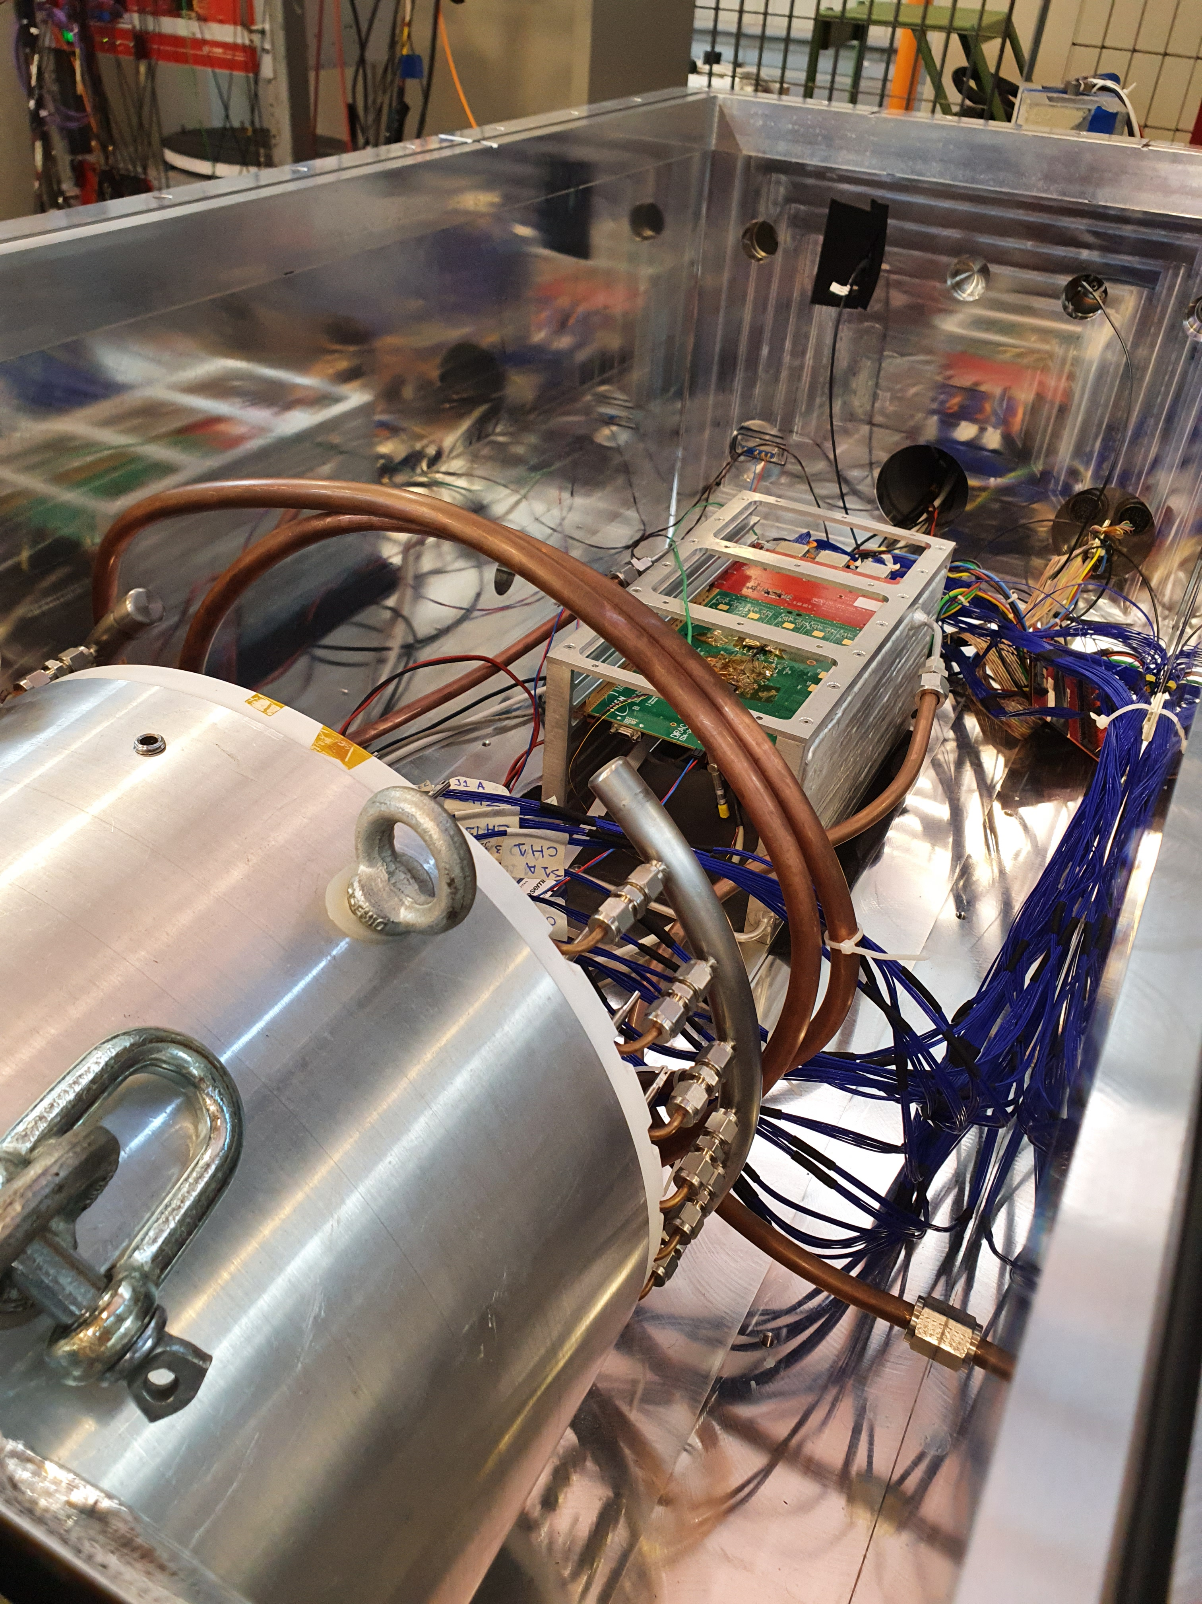
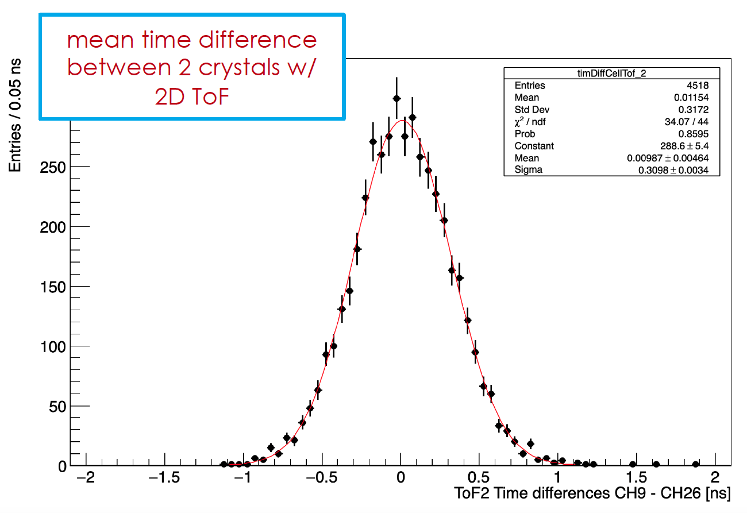
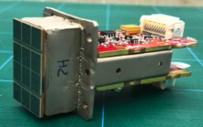
Calorimeter information
Assembling
  1st calorimeter disk fully loaded with crystals
  Procurements well advanced for source/laser
Electronics
  Readout units being assembled and tested
  MB in production, digitizer prototype tested
Vertical Slice Test
  Runs in vacuum, low temp., irradiated SiPMs
  E, T calibration algo validated, σ_{T} exceed requirements
MIP charge distribution
Cell mean time resolution:
σ_{ΔT/2} ∼ 210 ps
MB+DIRAC Module-0 VST in vacuum
Disk 1 crystal stacking
Notes:
MIPs: Plot: sigma((Ta+Tb)/2-(Tb+Tb)/2) -> sigma()/SQRT(2) = Cell mean time resolution ~ 210 ps - 100 ps for 100 MeV electrons (see test beam results)

Slide 27
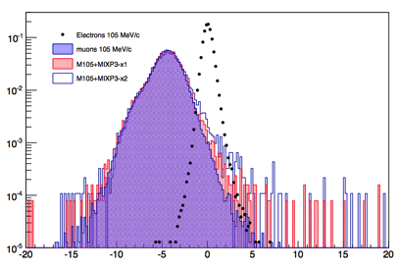
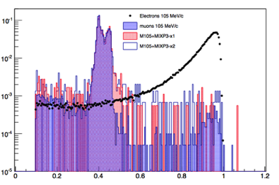
PID calorimeter-tracker – basic idea
Compare the reconstructed track and calorimeter information:
  E_{cluster}/p_{track} & ∆t= t_{track} – t_{cluster},
  Build a likelihood for e- and mu- using distribution on E/p and ∆t
  Use the likelihood ratio:
E/p
∆t = t_{track} – t_{cluster}

Slide 28
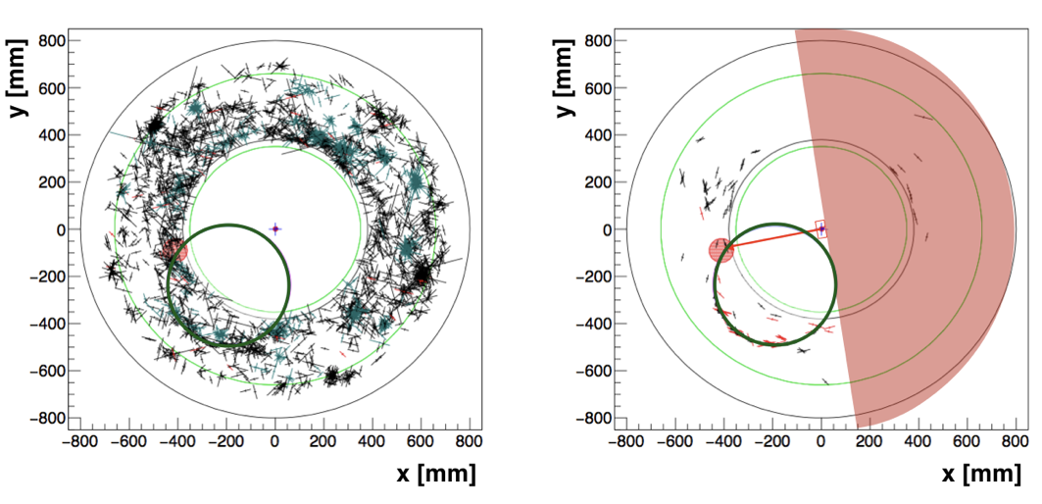
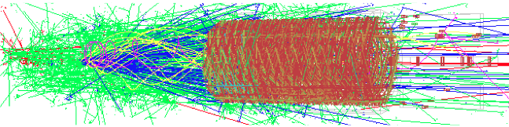
Tracking seeding – basic idea
no selection
500 – 1695 ns window
calorimeter selection
The speed and efficiency of tracker reconstruction
is improved by selecting tracker hits compatible
with the time ( |ΔT| < 50 ns ) and azimuthal
angle of calorimeter clusters →
simplification of the pattern recognition

Slide 29
AMF: basic ideas
Very aggressive idea based on PRISM model
Short pulse beam (10 ns) with well
defined momentum muon beams,
Very high intensity
→ Phase 1) 100 kW
With better targets radiator
→ Phase 2) 1 MW with R&D needed.
Joint effort with muon collider
→ Time line .. After 2035
P5 report will be fundamental
to start this program

Slide 30
COMET vs Mu2e
COMET
Mu2e
Phase-α planned for end of JFY2022
Phase-I detector ready by end 2023
Facility ready for Phase-I on April 2024
  10² improvement over SINDRUM-II
No official Phase-II schedule from KEK
Beam on target late 2024
Run1: 2026 (from half to full intensity)
  4.5×10⁹ → 8.57×10⁹ stopped μ/s
  10³ improvement over SINDRUM-II
PIP-II/LBNF shutdown: end of 2026
Run2: early 2029
  10⁴ improvement over SINDRUM-II by the end of the decade
Current schedule for experiment’s startup:
 | 2023 |  |  |  | 2024 |  |  |  | 2025 |  |  |  | 2026
COMET Phase-α
COMET Phase-I
Mu2e Run1
SES 3×10⁻¹⁵
SES 3×10⁻¹⁶
Notes:
Half → full intensity p beam power: 3.8 kW → 7.3 kW

Slide 31




Mu2e Beam Line progresses
Resonant Extraction Magnets installed and tested with beam
  Electrostatic Septum (ESS) prototype completed
Beamline diagnostic absorber operational
  w\ instrumentation, controls and safety system
  8 GeV proton beam transported to beamline diagnostic absorber on 14 April 2022, with 90% transmission
Production Target assembled
  Handling Remote System fabrication completed, ready to be installed into PS
Stopping Target assembled
ESS prototype
Production target
Stopping target
Notes:
ESS: dipolar electric field device to extract the beam. Vertical and horizontal beam profile measurements from the M4 beamline profile monitors upstream of the diagnostic absorber shortly after beam was established to the diagnostic absorber (it is on the Mu2e beam line (from delivery ring to Mu2e building)

Slide 32


COMET phase-alfa
8-GeV low-intensity (260 W) proton beam delivery to COMET
15-day run in April 2023
  Proton beam line commissioning
  Direct extinction measurements at the COMET area
  Demonstration of the muon transport system
  Estimation of backward pions/muons production yields
  Measurement of yields of secondary particles, others
1. Beam loss
on target
2. Beam profile
measurement

Slide 33

The COMET experiment
Phase-I
Phase-II
Pion capture solenoid (5T)
Pion capture solenoid (5T)
e spectrometer solenoid (1T)
Muon transport solenoid (3T)
stopping target
stopping target
Detector solenoid (1T)
Muon transport solenoid (3T)
Detector solenoid (1T)
3.2 kW, 8 GeV p beam, graphite p target
1.2×10⁹ stopped μ/s
5 months data taking
CLFV search: SES = 3.1×10⁻¹⁵
Direct measurement of the muon beam with prototypes of Phase-II detectors
56 kW, 8 GeV p beam, tungsten p target
2×10¹¹ stopped μ/s
1 year data taking
Vertical B field to steer desired charge and momentum along beam centre
CLFV search: SES = 2.7×10⁻¹⁷
Studies underway to further improve sensitivity
Notes:
Staged implementation – Production target: graphite (Phase-I), tungsten (Phase-II)
B filed similar to Mu2e> 5T PS ->3T TS -> 1T DS
Phase-I (II) : 0.032 (0.32) background events

Slide 34


Mu2e physics reach & goal
Sensitivity reach:
10⁴ improvement by means of 4 handles:
Rate (Intensity)
Out of Time extinction
Delayed gate
Precise Resolution
${ R}_{μe}= \frac{Γ \left(μ^{−}+N\left(A,Z\right)→e^{−}+N\left(A,Z\right)\right)}{Γ \left(μ^{−}+N\left(A,Z\right)→all muon captures\right)}$ < 8xE⁻¹⁷ @ 90% CL

Slide 35

Specific Example: SUSY
SUSY GUT in an SO(10) framework
Probe SUSY through loops
If SUSY seen at LHC → rate ~10⁻¹⁵
Implies O(40) reconstructed signal events with negligible background in Mu2e for many SUSY models.
~
μN → eN (tanβ = 10)
χ ⁰
Neutrino-Matrix Like (PMNS)
Minimal Flavor Violation (CKM)
μ
~
~
l_{i}
l_{j}
e
γ
current
q
q
CR(μ→ e) x 10¹²
Mu2e
Project X
M_{1/2} (GeV)
L. Calibbi et al., hep-ph/0605139
Complementary with the LHC experiments
while providing models’ discrimination

Slide 36

SUSY benchmark points vs LHC
These are SUSY benchmark points for which LHC has discovery sensitivity
Some of these will be observable by MEG/Belle-2
All of these will be observable by Mu2e

Slide 37

Other CLFV Predictions
M.Blanke, A.J.Buras, B.Duling, S.Recksiegel, C.Tarantino
arXiv:0909.5454v2[hep-ph]
Relative rates are model dependent
Measure ratios to pin-down theory details

Slide 38
MU2E vs MEG-upgrade
Yellow line, limit by SINDRUM-II
Grenn lines, MEG and MEG-upgrade
Mu2e covers all parameter space
Red line → MEG-upgrade
Blue line → MU2E

Slide 39

Extinction monitor

