Slide 1

Future Prospects at LNF
Fabio Bossi INFN-LNF
Workshop on status and perspectives of physics at high intensity
Frascati, 9-11 April 2022

Slide 2
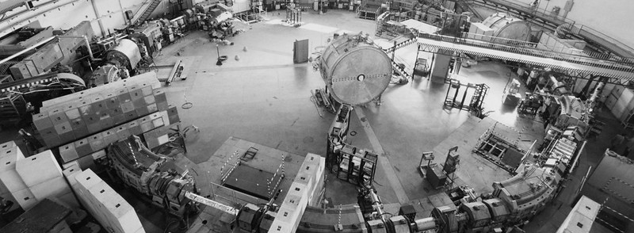
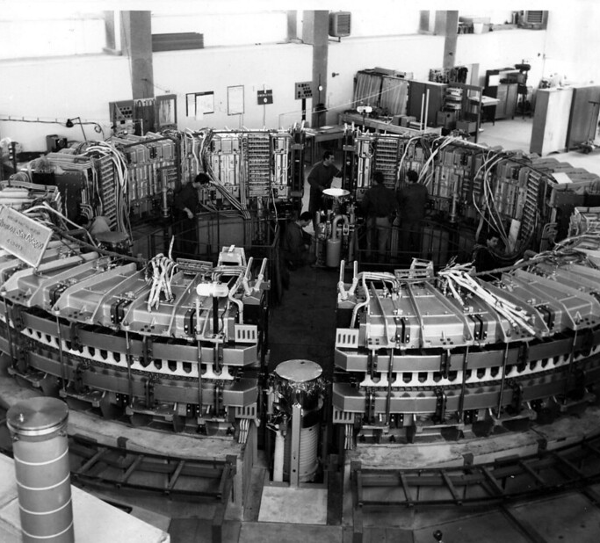
Adone 1969-1993
Since its foundation, in 1954, the Frascati National Laboratory of INFN (LNF) has been devoted to the design, construction and operation of particle’s accelerators and detectors for HEP
Electro-syncrotron 1959-1969

Slide 3
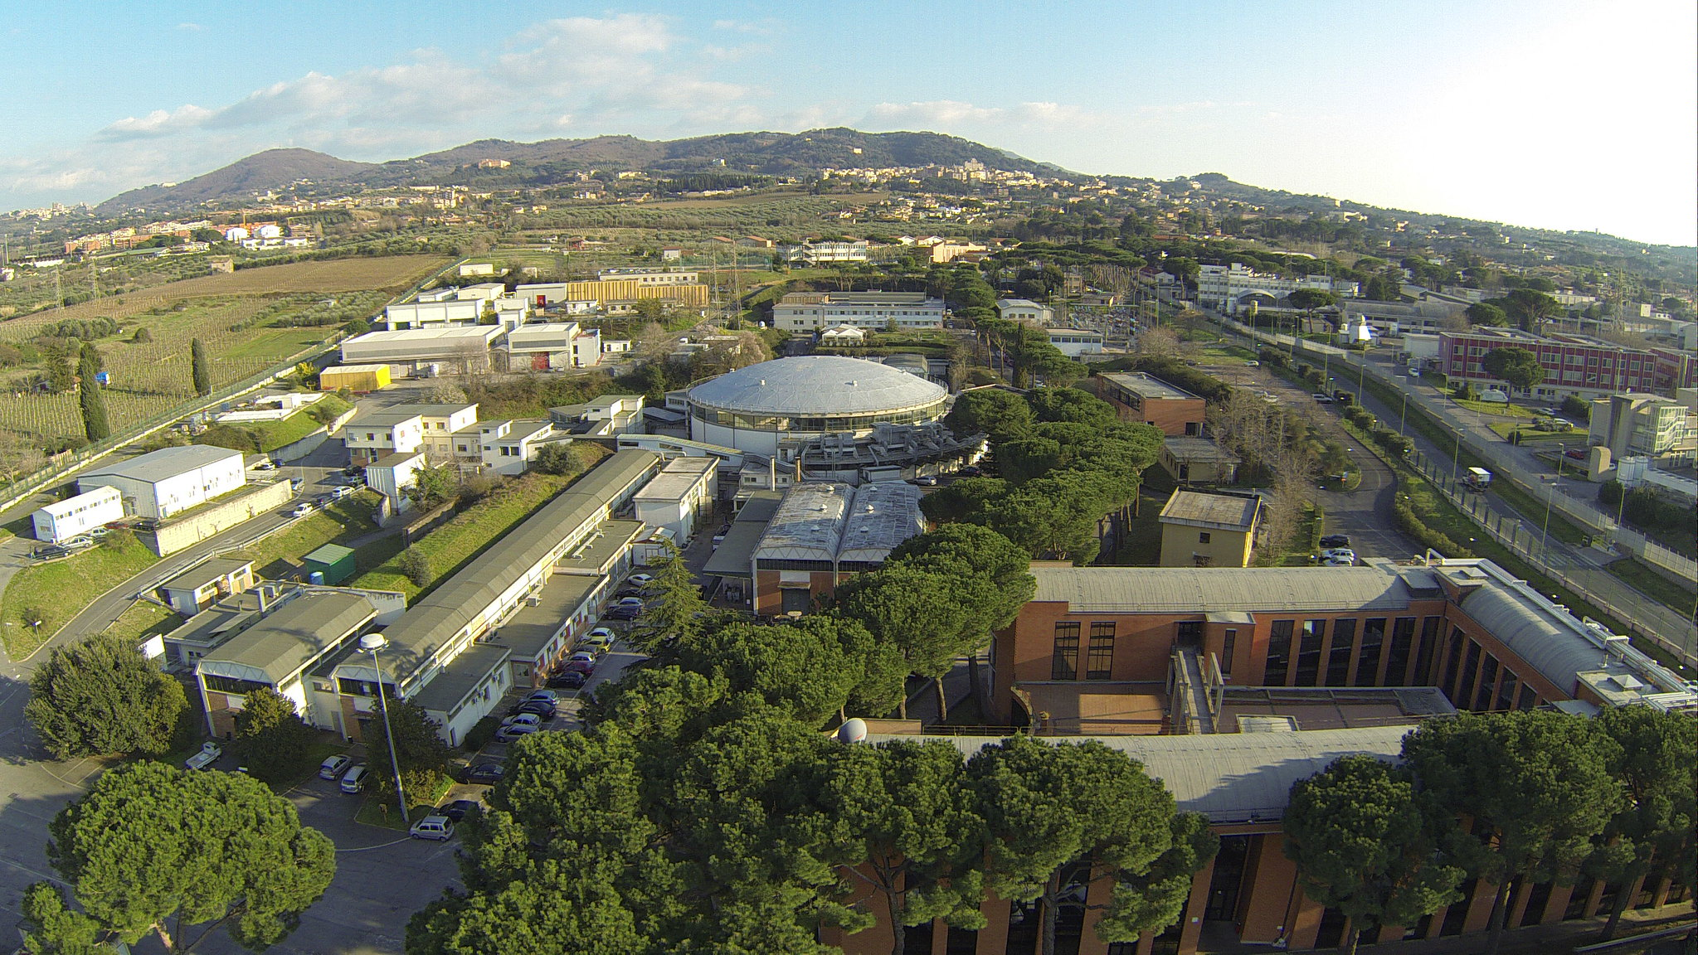
At present we have two running accelerators, DAΦΝΕ and Sparc_Lab, and operate several technical infrastructrures devoted to accelerators R&D
SPARC_LAB
TEX and Plasma lab
Vacuum and RF lab
Magnet lab
DAΦNE hall
BTF
DAΦNE Linac
We are here
Workshop Nazionale Acceleratori Milano, 7-8 Aprile 2022

Slide 4
DAΦNE Collider Operations
The DAΦNE collider has entered into operations in year 2000, and has provided luminosity since then to 6 different particle and nuclear physics experiments
Experiment | Data Taking period | Int. Luminosity (pb-1)
KLOE | 2000-2006 | 2500
DEAR | 2003 | 60
FINUDA | 2003-2007 | 1200
SIDDHARTA | 2008-2009 | 600
KLOE-2 | 2012-2018 | 5000
SIDDHARTA-2 | running | 800 (goal)
After Crab-waist insertion

Slide 5
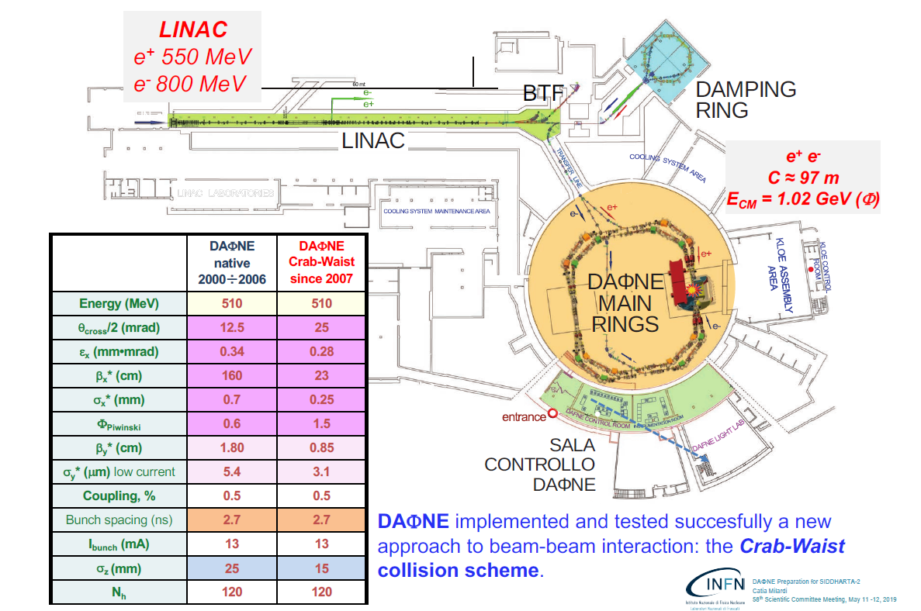
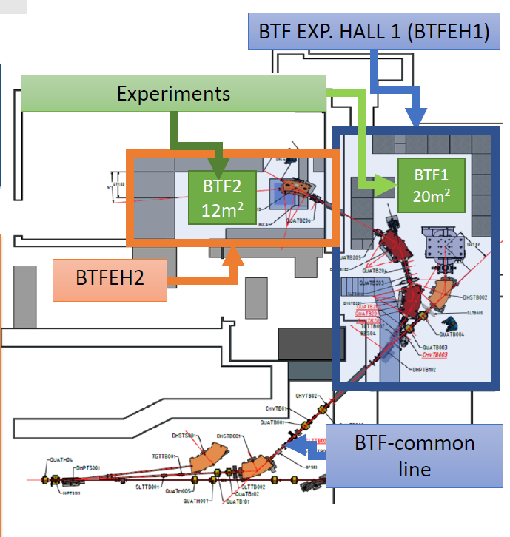
The DAΦNE Complex
BTF #1/2
L_{peak} = 4x10³² cm⁻²s⁻¹

Slide 6
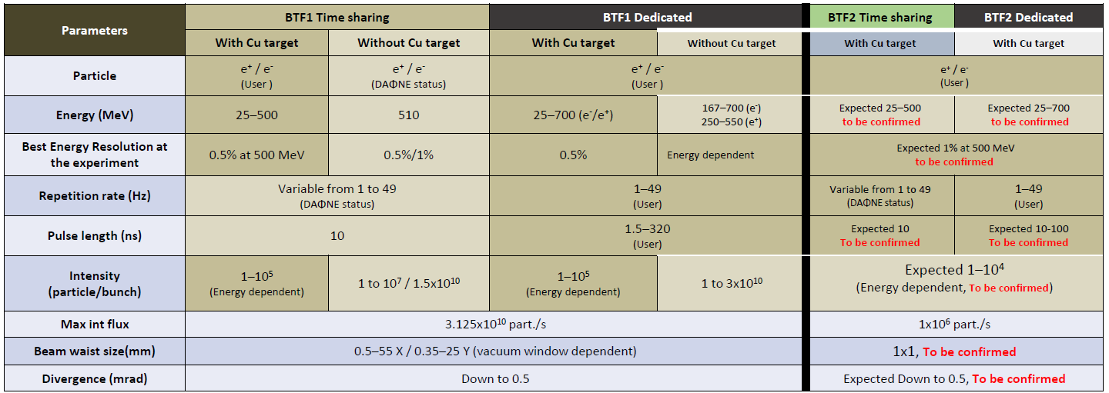
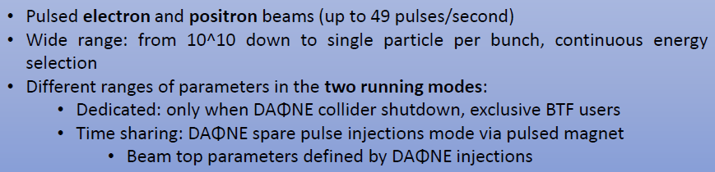
Beam Test Facility

Slide 7
What future for DAΦNE?
As previously stated, the DAΦNE complex is more than 20 years old.
If we want to extend the collider operation beyond the completion of the SIDDHARTA-2 run (2023-24), important hardware consolidation works must be programmed
A first estimate of the budgetary cost for these opertions amounts to ∼5 M€ for the main rings and ∼3 M€ for the LINAC+BTF (most likely due in any case).
Besides the cost, the impact on manpower is relevant and worrying. We are talking about 12-24 months of work, involving a relevant part of the available technical staff of the AD and TD. This conflicts with the preparation/installation work of the currently leading construction project: EuPRAXIA (see later on)

Slide 8
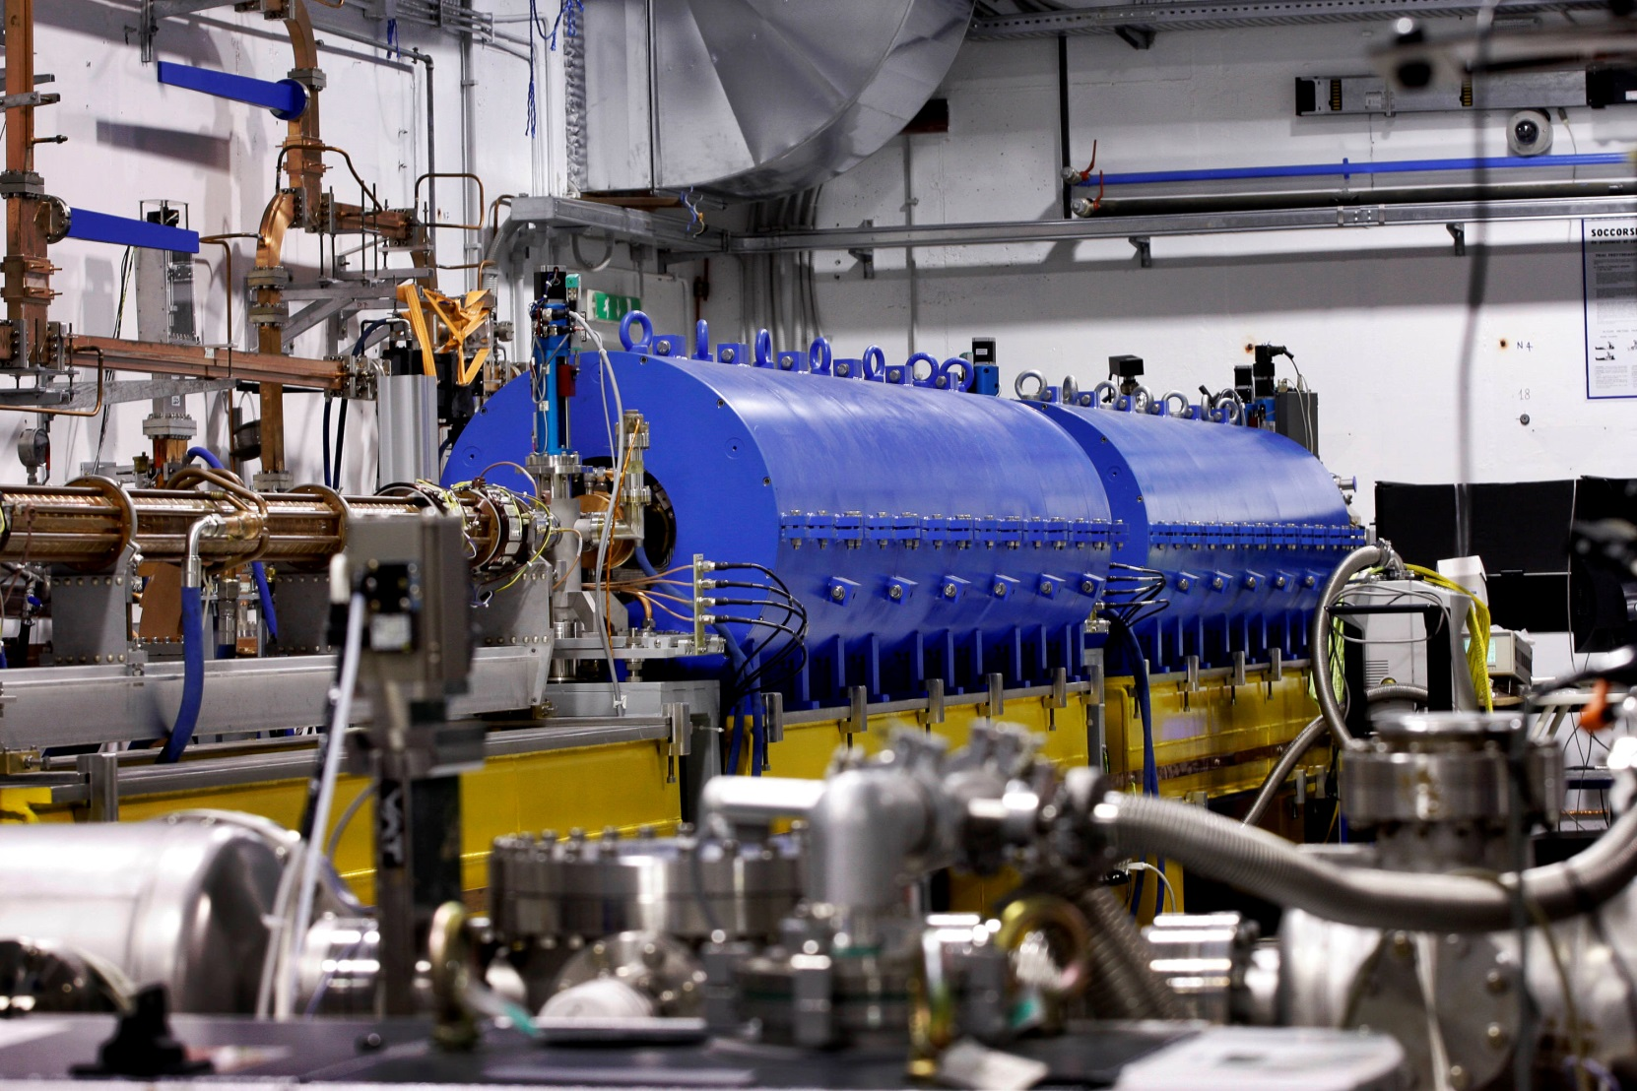
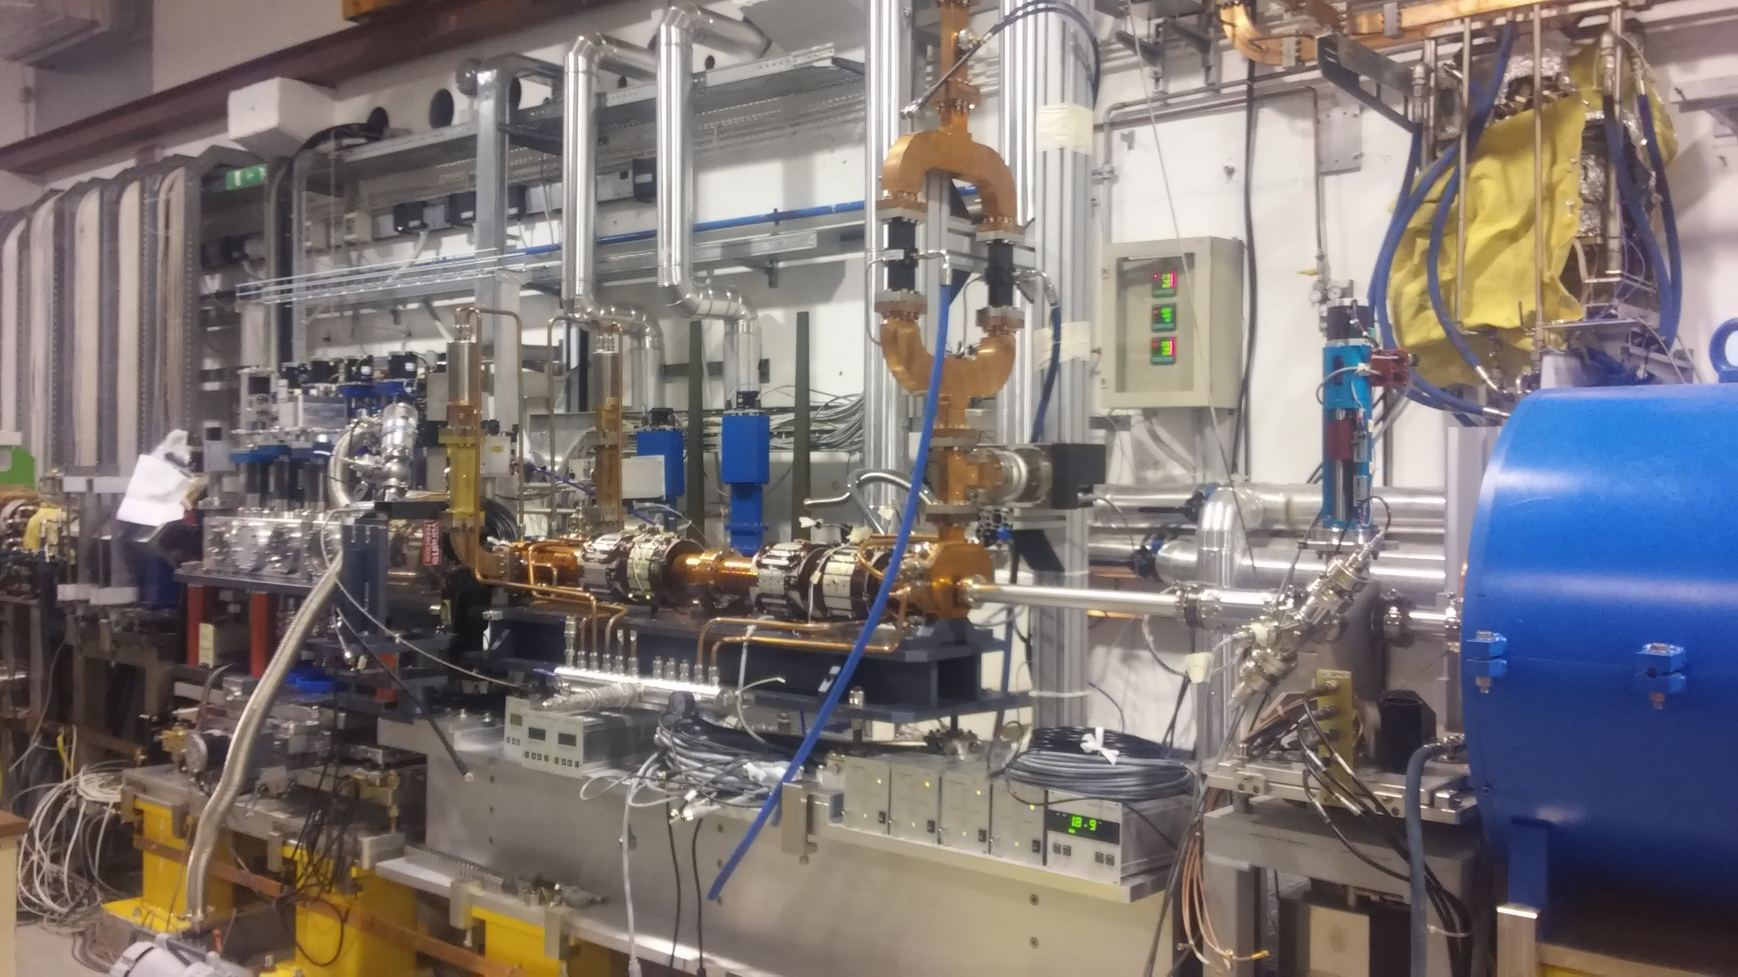
SPARC_LAB
In 2005 the facility SPARC_LAB was put into operation as a test and training facility for advanced accelerator developments
It consists of a high-brightness RF photoinjector, SPARC, and a multi-hundred terawatt laser, FLAME, and was initially focussed on performing FEL experiments and in general on the production of new radiation sources
In recent years a dedicated effort has been put on the research on very high acceleration gradients with the plasma wake field technique
Photoinjector
Plasma Vacuum Chamber

Slide 9
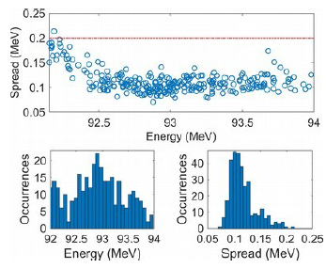
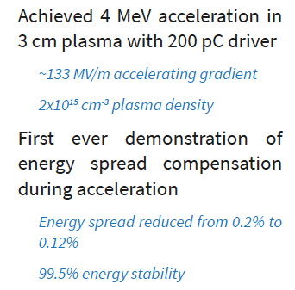
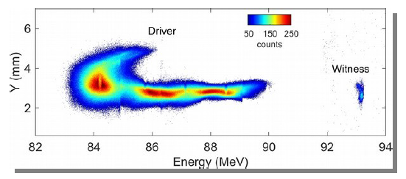
SPARC_LAB Results
Nature Phys 17, 499-503 (2021)

Slide 10
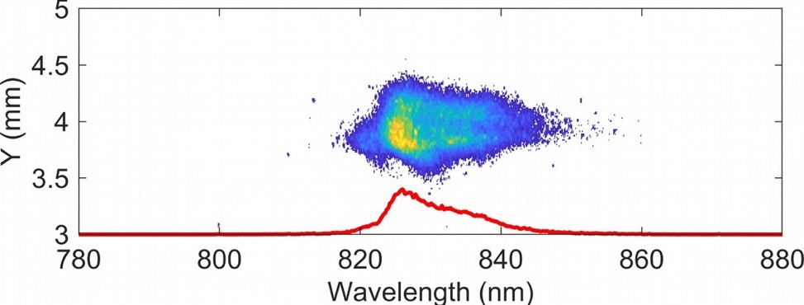
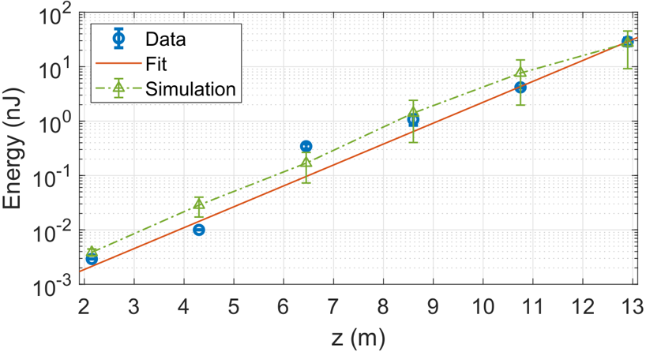
Single Spike SASE spectrum
Nature 605, 659-662 (2022)
First SASE-FEL Lasing at SPARC_LAB in a beam-driven plasma accelerator
A similar result has been obtained in China with a laser wakefield accelerator
Nature 595, 516-520 (2021)

Slide 11
The EuPRAXIA Project
The operation and success of SPARC_LAB is the natural preparation for the next big scientific enterprise of the Laboratory: EuPRAXIA@SPARC_LAB
This is the LNF branch of a multi-national project (EuPRAXIA) aimed at building two plasma driven FEL user facilities by the end of this decade.
LNF has already been granted a 108 M€ funding by the Italian Government for the construction of the Frascati site, while the entire project has entered the ESFRI roadmap and has received EU funding for the preparatory phase

Slide 12

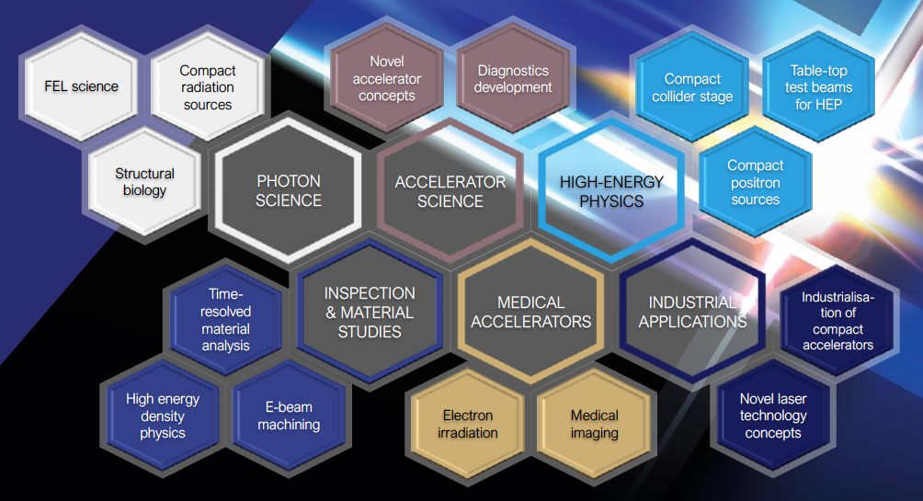

European Plasma Research Accelerator with eXcellence In Applications
Versatile – Designed for Users in Multiple Science Fields
Delivers 10-100 Hz ultra-short pulses
Electrons
(0.1-5 GeV, 30 pC)
Positrons
(0.5-10 MeV, 10⁶)
Positrons (GeV source)
Lasers
(100 J, 50 fs, 10-100 Hz)
Betatron X rays
(1-110 keV, 10¹⁰)
FEL light
(0.2-36 nm, 10⁹-10¹³)
Topics of research: proteins, viruses, bacteria, cells, metals, semiconductors, superconductors, magnetic materials, organic molecules
This project has received funding from the European Union’s Horizon 2020 research and innovation programme under grant agreement No 653782.
Trasparency stolen from R. Assmann

Slide 13
Concept of a distributed RI

Slide 14

The EuPRAXIA-PP consortium
Preparatory Phase
34 Institutes from 12 countries. Complemented by EuPRAXIA-ESFRI Consortium, other 17 Institutes, Russian institutes presently suspended

Slide 15
EuPRAXIA@SPARC_LAB Building
The final design for the building has been delivered. We are now working on the authorisation procedures
Overall cost of the building estimated to be 32 M€, including all the accessory plants. We plan starting construction by the fall of 2024
Eupraxia Area

Slide 16
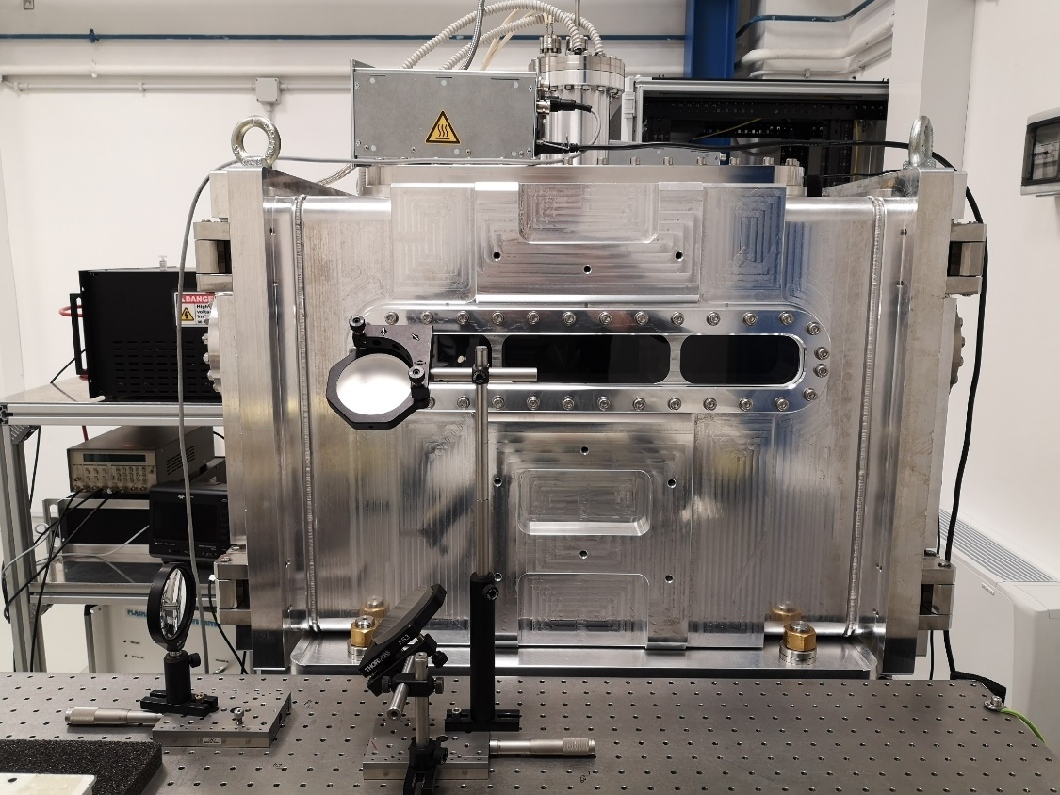
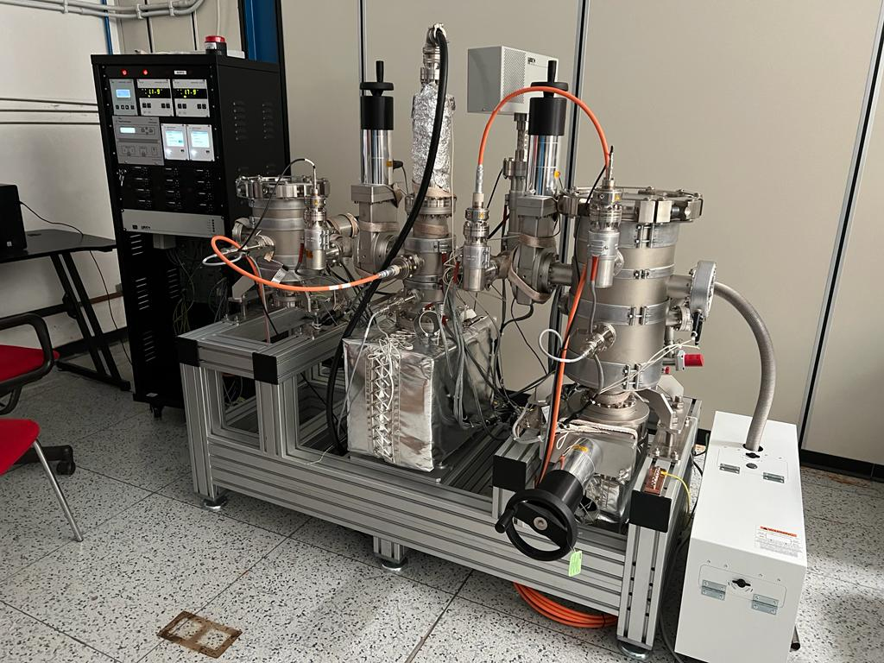
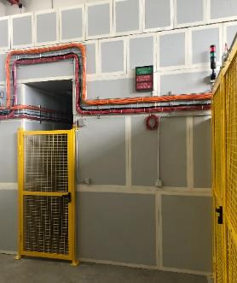
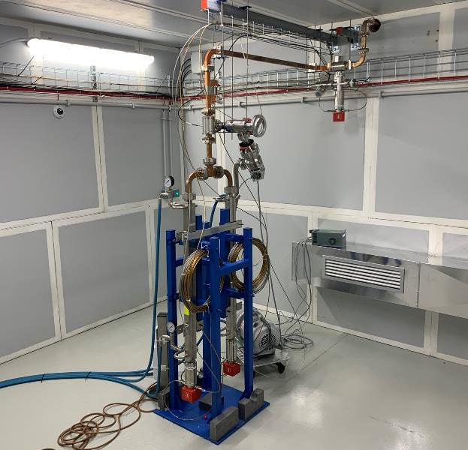
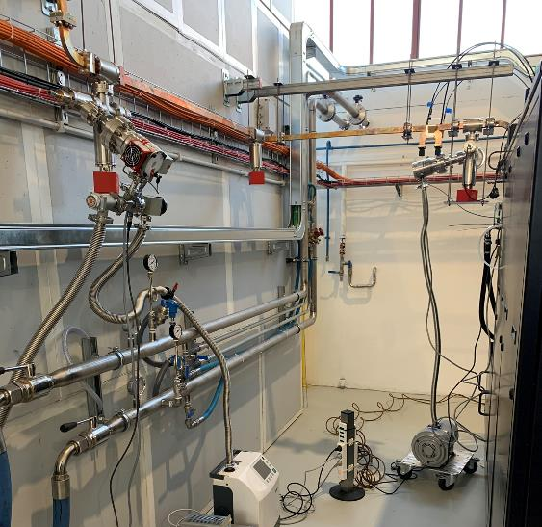
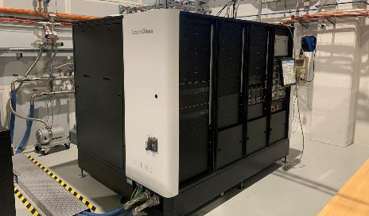
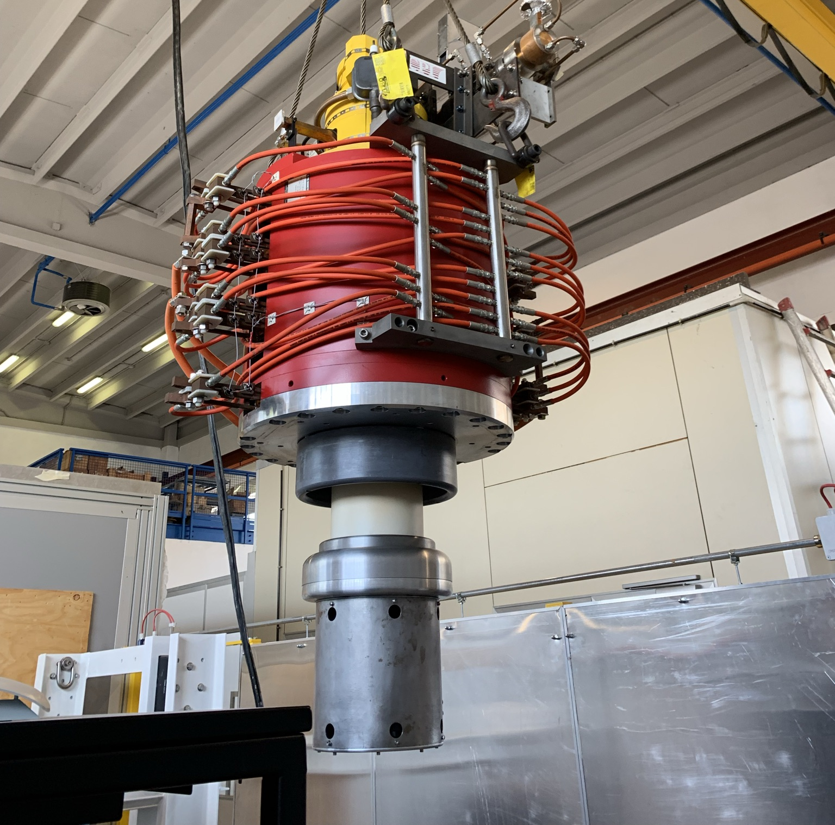
EuPRAXIA@SPARC_LAB R&D
An intense R&D work is being carried out, to test all of the key techniques required for the succesfull EuPRAXIA operation
Vacuum Lab
Plasma Lab
X-band RF test facility

Slide 17



EuPRAXIA schedule
2021
2022
2023
2024
2025
2026
2027
EuPRAXIA@SPARC_LAB Design Phase
Preliminary layout
Intermediate layout
Final layout & beam parameters
User case defined
Plasma technology validated
X-Band technology validated
EuPRAXIA@SPARC_LAB
Machine design
Final design FEL
TDR Released
TDR Approved
EuPRAXIA@SPARC_LAB Implementation Phase
Planning
Procurement
Implementation
EuAPS
Procurement
Implementation
Eu-APS
Commisioning
Building design & construction
Final design
Permitting Request
Exec. Design
Validation
EuPRAXIA@SPARC_LAB
Building
Tender for Validation
Tender
Building Construction
Utilities executive design
Tender
Implementation
Acceptance
Building ready
Application
to prep.phase
Preparatory phase
🇪🇺
EuPRAXIA - EU
Outcome ESFRI application
2-nd Site Decision
Eupraxia-EU TDR

Slide 18
Conclusions
By the end of the present decade, EuPRAXIA will be the main operating machine of the Laboratory
Unless new, innovative, ideas spring out, it will serve a wide community of users not linked to HEP. This constitutes a big change in the laboratory’s skin
Parallel operation of DAΦNE in very unlikely, unless a major upgrade of the Laboratory in terms of funding and manpower is put in place
The Laboratory will however continue supporting HEP by contributing to major international enterprises both on machine and on detectors development and construction

