Slide 1
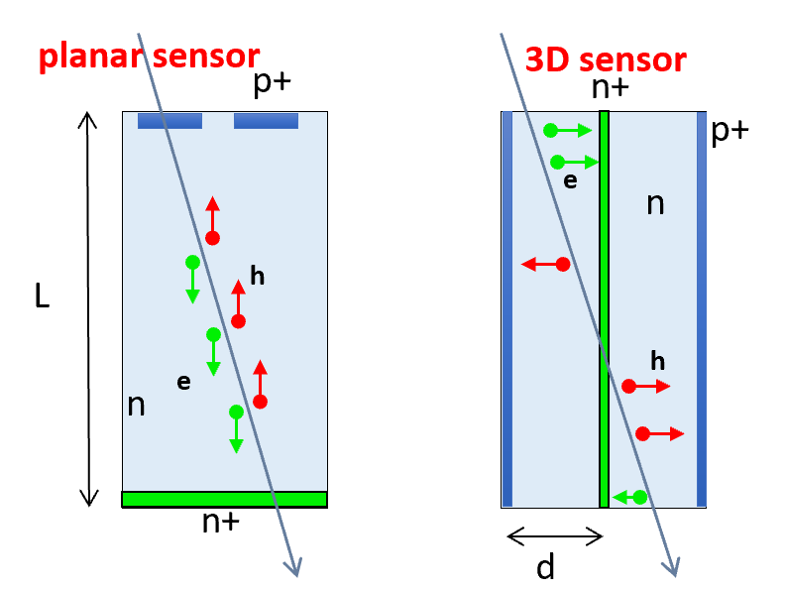
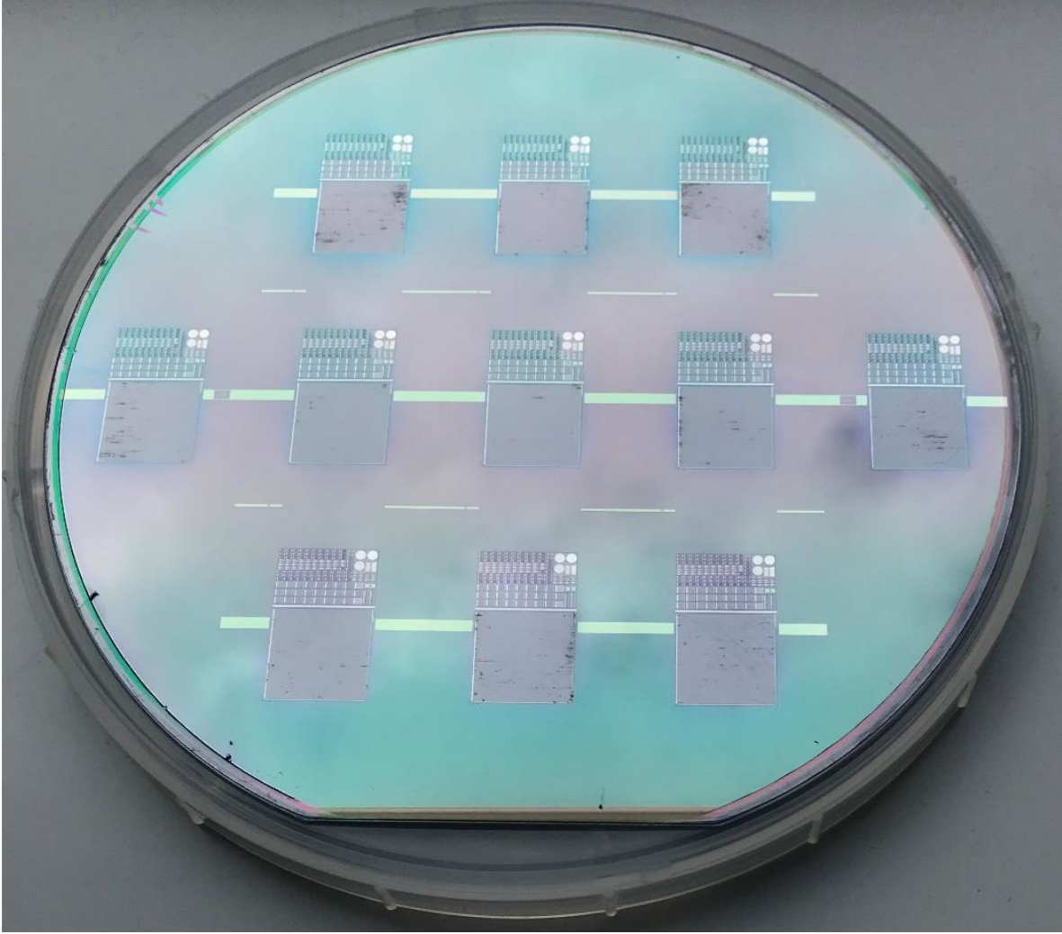
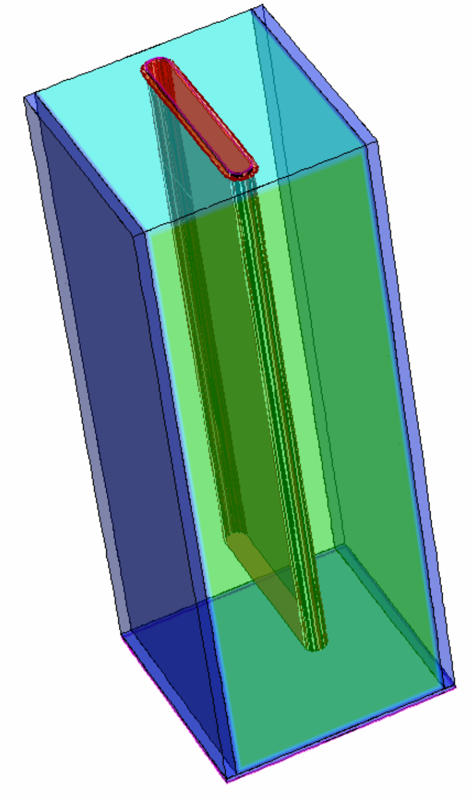
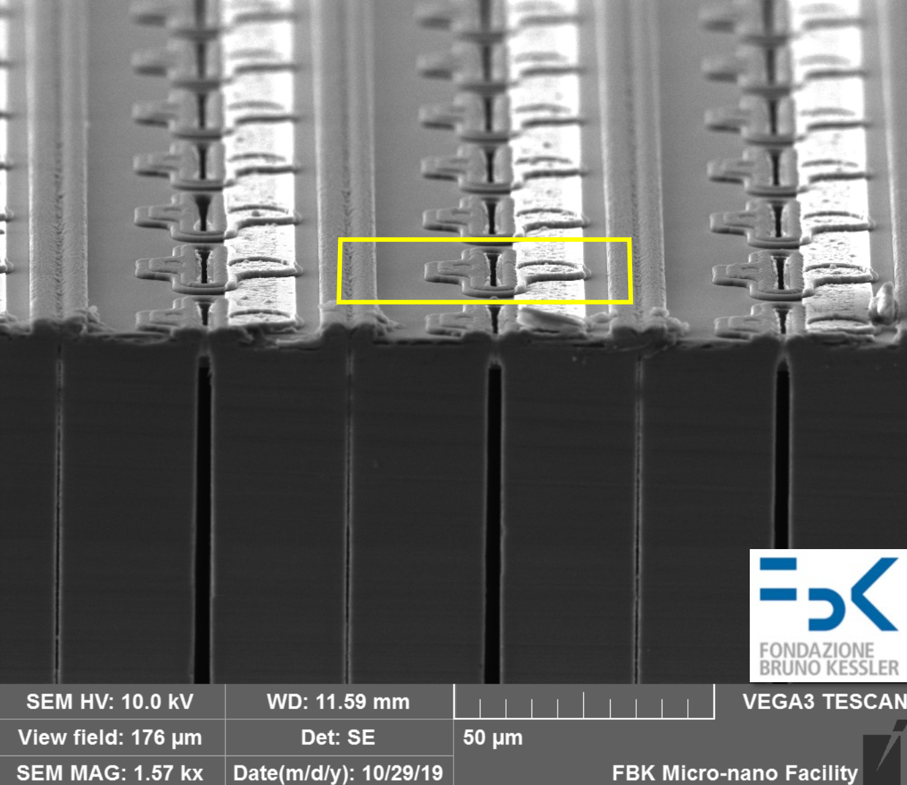
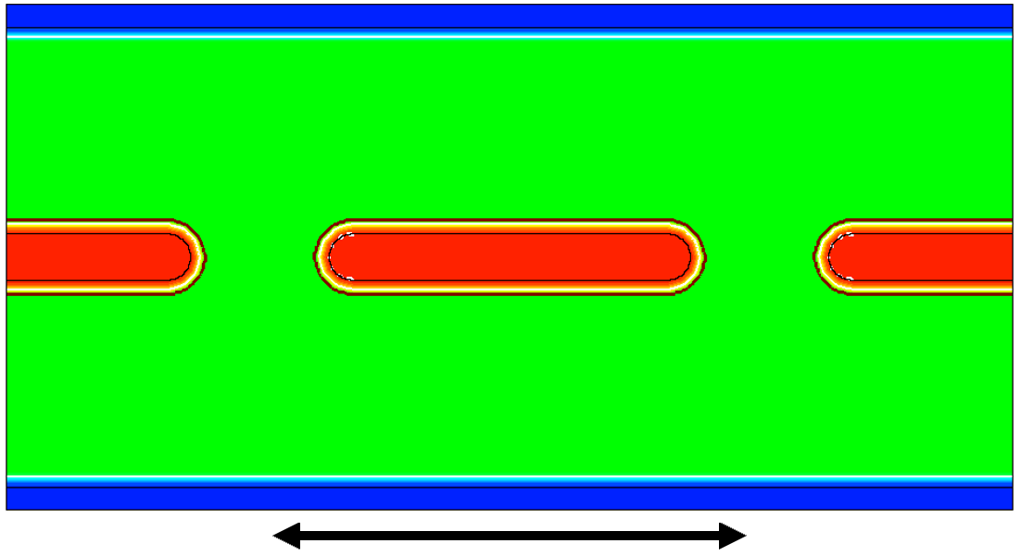
Technology and design
The approach within TimeSPOT was to use 3D silicon (and Diamond) sensors to achieve fast timing
  Reducing inter-electrode distance
    Reducing charge collection time
      As well improving intrinsic time resolution
    Increasing radiation hardness
First TimeSPOT batch, produced by FBK
TCAD model of the selected geometry
The final geometry selected for the fast timing 3D sensor is the “parallel-trench”
  Already produced in two batches (2019 and 2021) by FBK
Cut along a parallel trench device based strip sensor
150 μm
55 μm
40 μm
130 μm
55 μm
For more A. Loi https://iris.unica.it/handle/11584/284136

Slide 2
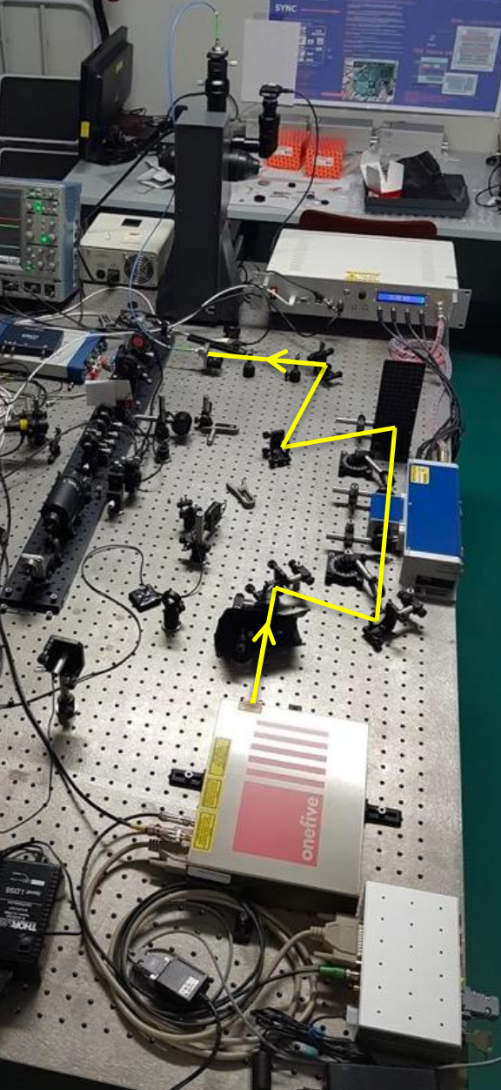
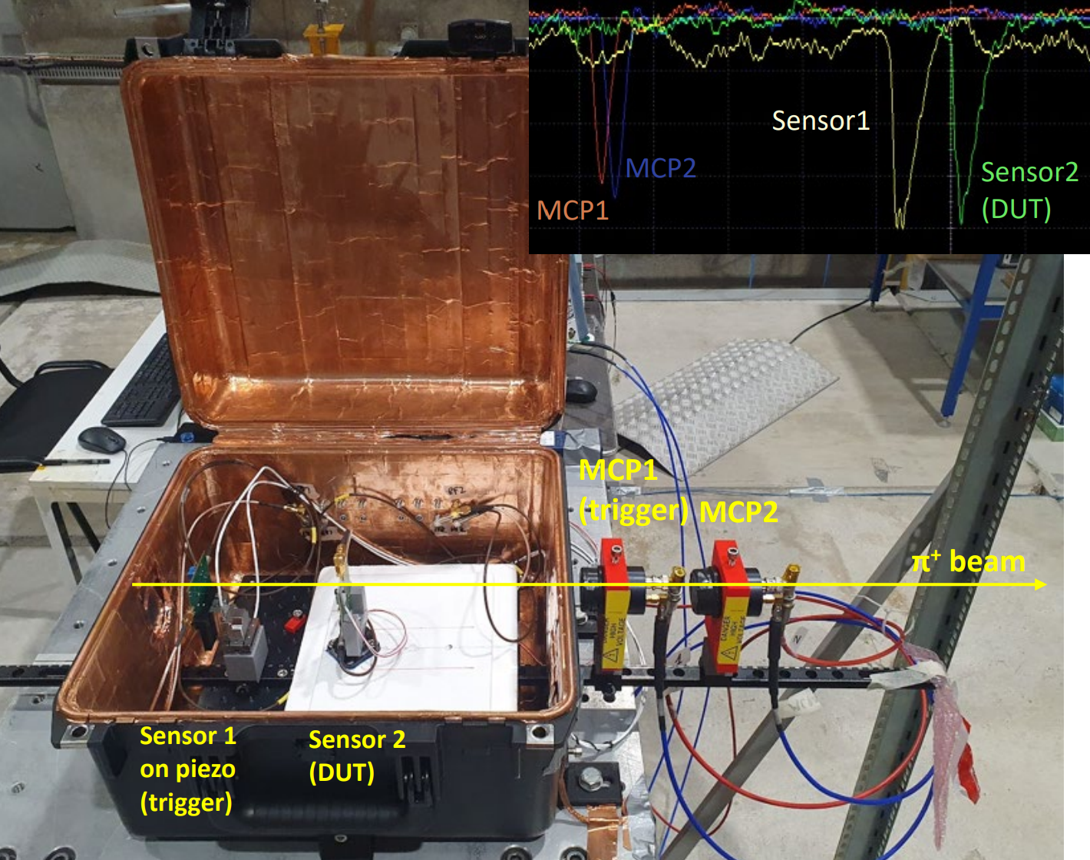
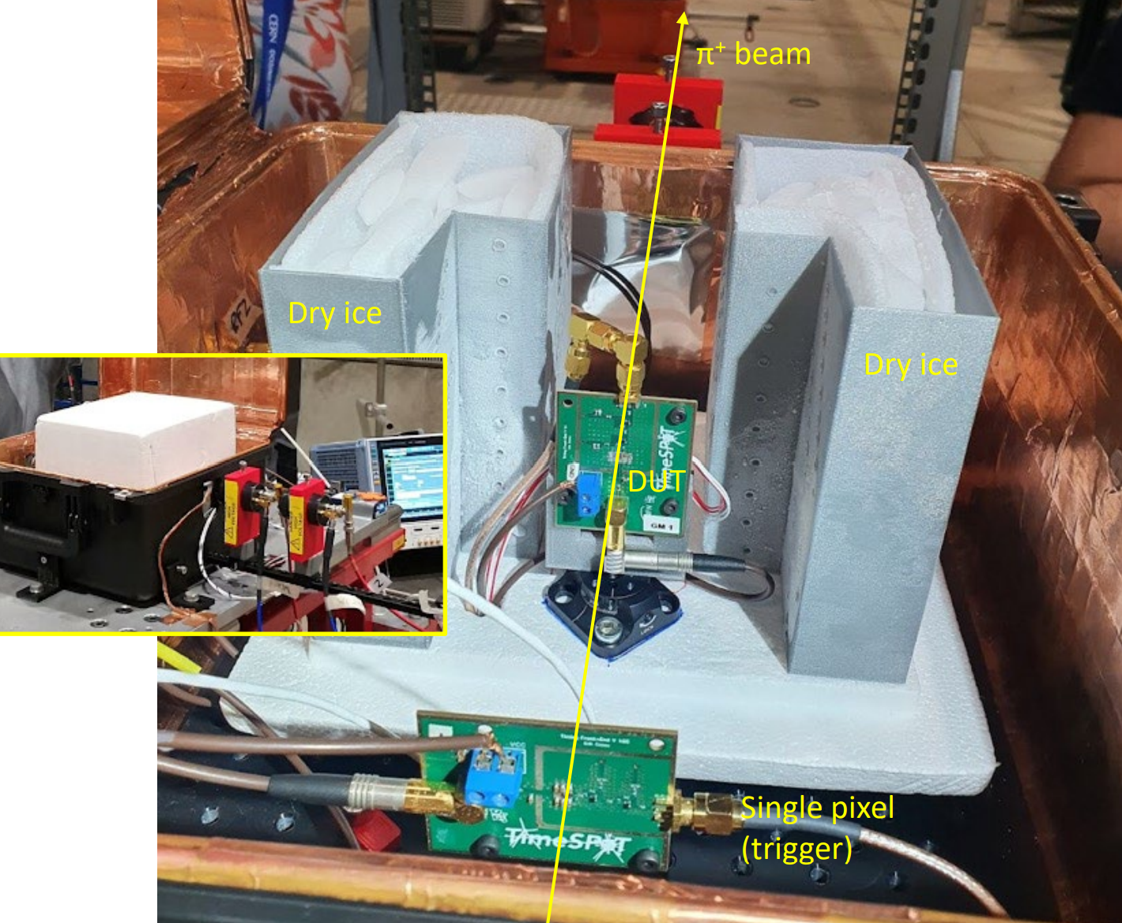
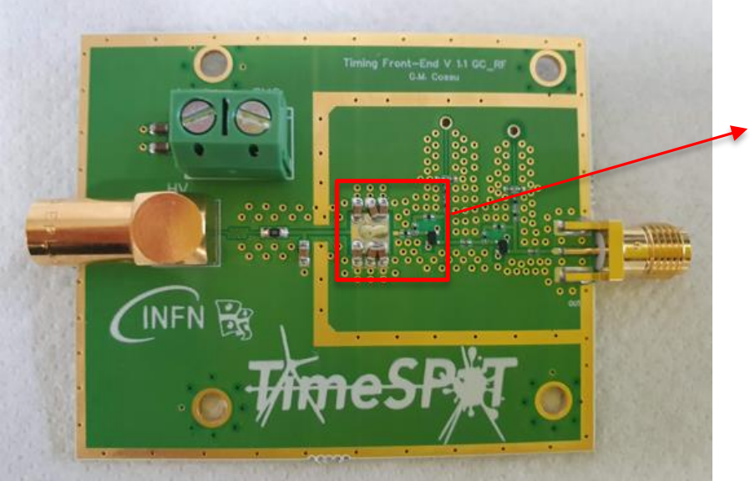
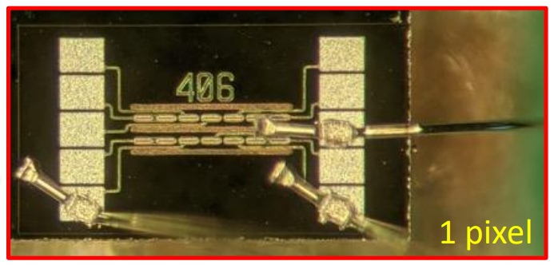
Measurements
TimeSPOT TCT setup
Test beam setup for intrinsic time resolution characterisation
Sensor has been characterised
  Test beams (10/2019, 10/2021 and 5/2022) →
    Intrinsic time resolution
    Performance by tilting the device
    Sensor Efficiency
    Performance after radiation
  ← Own constructed TCT setup in Cagliari
Customised fast readout has been developed in order to fully explore sensor performance ↓
Dry ice enclosure for rad hard measurements
TimeSPOT fast-electronics
Single pixel test device
For more G.M. Cossu https://arxiv.org/pdf/2209.11147.pdf

Slide 3
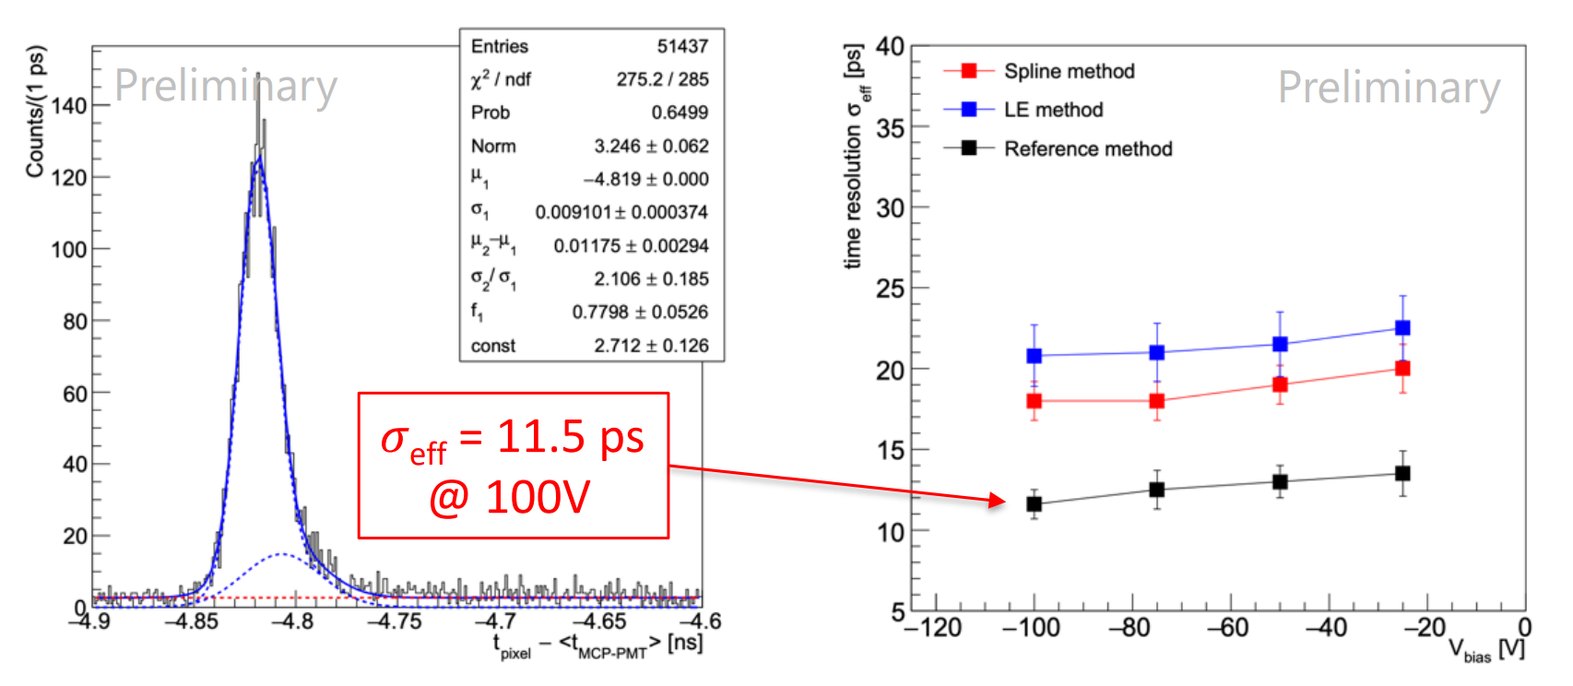
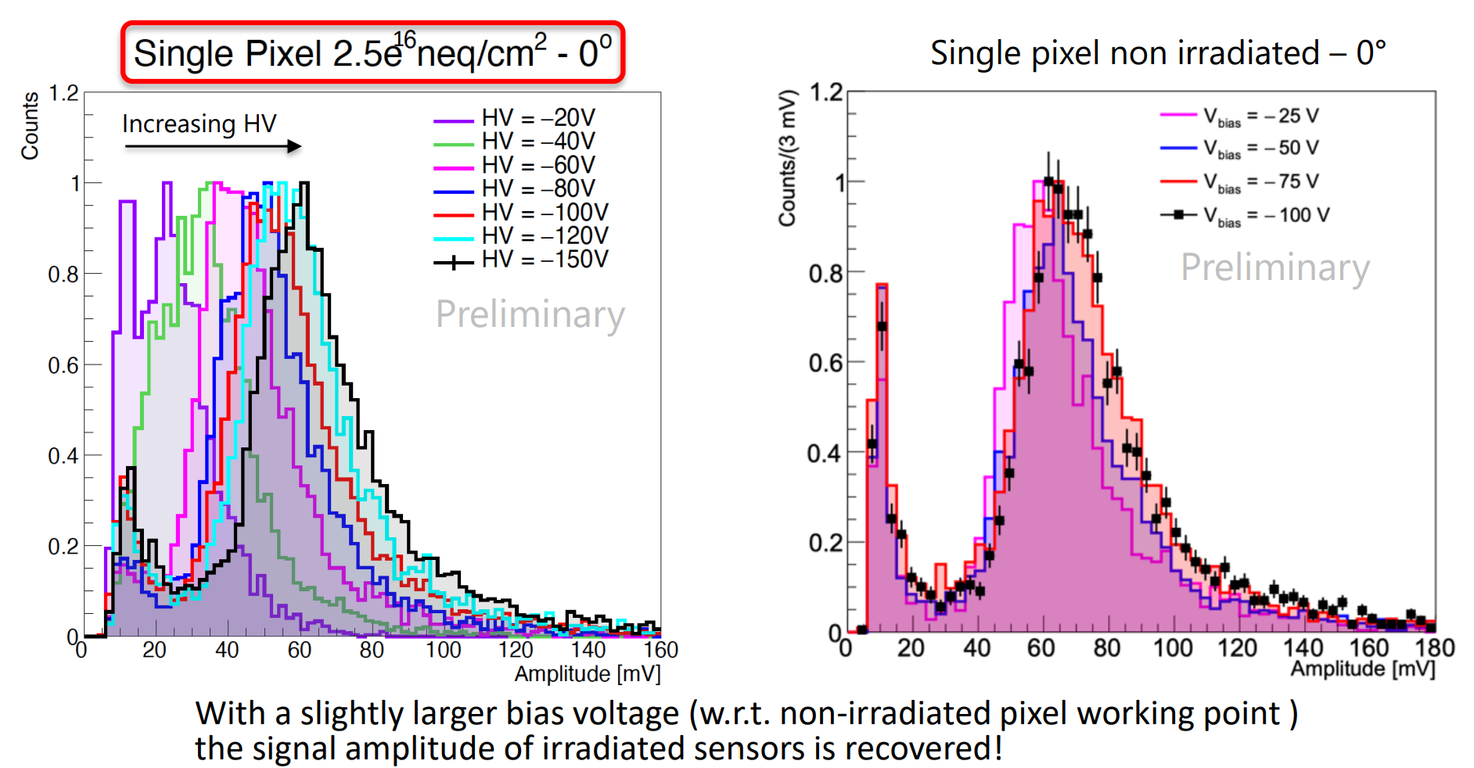
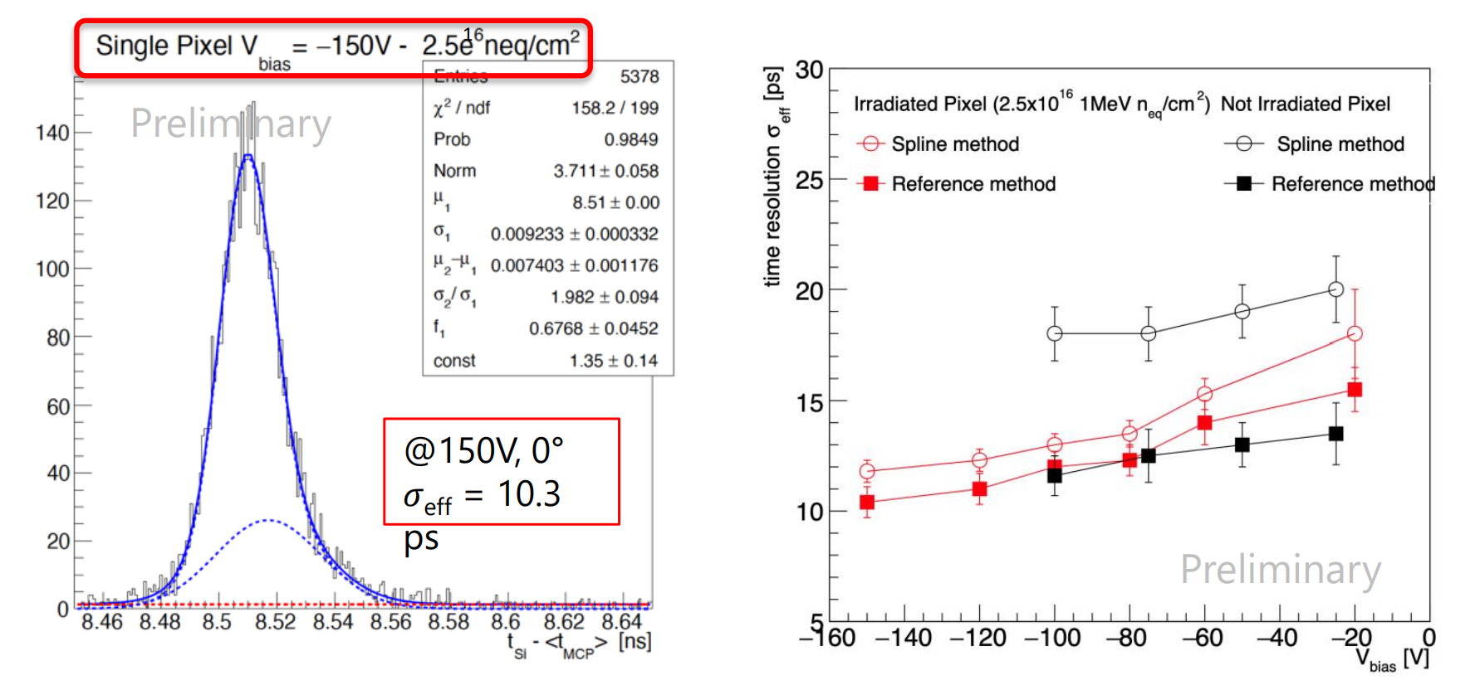
Results (1)
No rad damage
Intrinsic time Resolution before and after radiation damage above 10¹⁶ n_eq
After rad damage ↓
For more info: A. Lampis https://indico.cern.ch/event/1120714/contributions/4867208/attachments/2472539/4242526/Andrea_Lampis_iworid2022.pdf
https://indico.cern.ch/event/1127562/contributions/4954529/attachments/2511647/4317271/TimeSPOT_TWEPP2022_Final.pdf

Slide 4
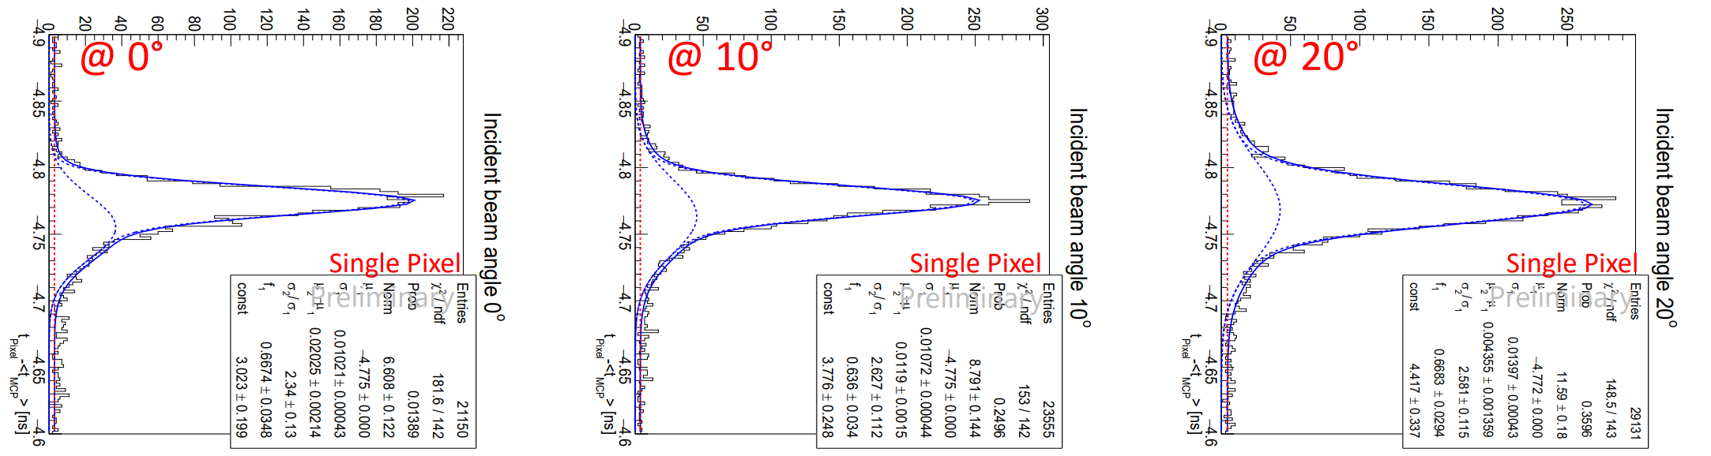
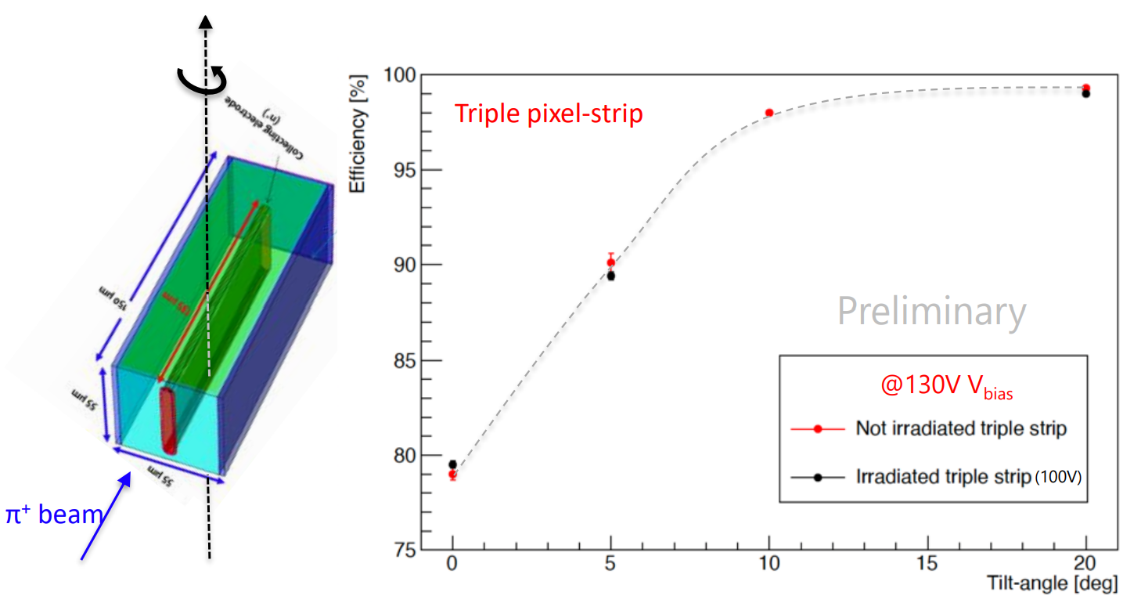
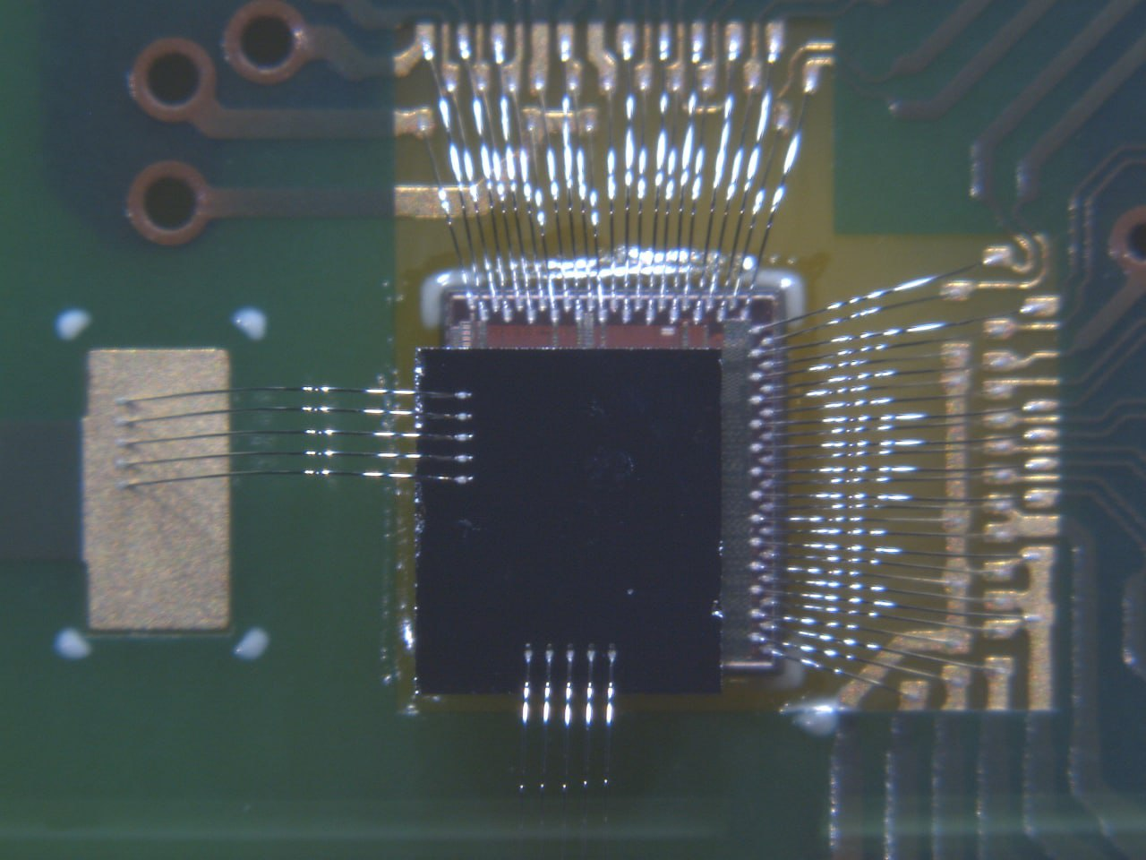
Results (2) and outlook
Sensor behaviour has been studied also by tilting it
  ToA distribution at 20° becomes more gaussian
  The inefficiency (at normal incidence) due to the dead-area of the trenches is fully recovered by tilting the sensors around the trench axis
    It also works for irradiated sensors
Outlook:
  32x32 pixel matrix has been bump-bonded on the TimeSPOT-1 ASIC and currently tested. Future 4D tracking detector and its components are under test and caracterisation (more about it on Lorenzo’s slides)

