Slide 1
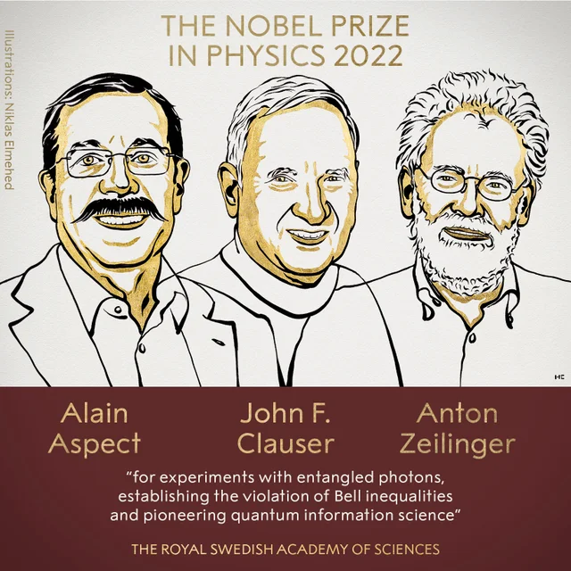
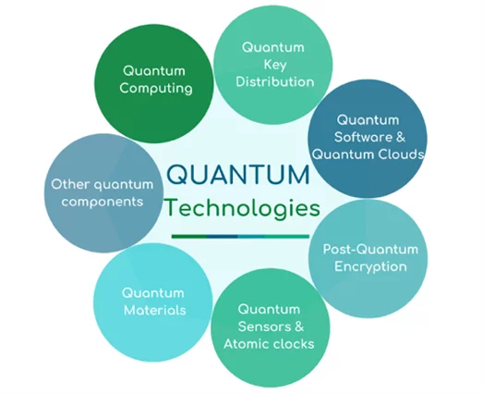
Fundamental symmetries
Nuclear Physics Mid Term Plan in Italy - LNGS Session
11 October 2022
By using NUCLEAR AND ATOMIC PHYSICS techniques and technologies (at LNGS)

Slide 2
Fundamental symmetries & Applications
Nuclear Physics Mid Term Plan in Italy - LNGS Session
11 October 2022
What we do:
Snowmass 2021 Topical Report on Synergies in Research at Underground Facilities
C. Curceanu, D. Elsworth,
J. Formaggio , J. Harms, D. Robertson,
W. Roggenthen, H. Wang
Oct 10, 2022
e-Print:2210.03145
Quantum physics (beyond standard model)
Marciano
Piscicchia
Napolitano
J-PET, Space
& more
Quantum Gravity, CPT
PEP Violation
Foundation QM
Collapse
Quantum Applications
Technology
Phys. Rev. Lett. 129, 131301 (2022)
Nature Physics 17, pages 74, (2021)
Nature Com. 12, Art: 5658 (2021)
Experiments at LNGS:
VIP-2, VIP-3
Ge detectors
R&D Future
Experiments at LNGS:
BEGe
Ge future
R&D Future
J-PET - J.U. (Cracovia)
TEQ – quantum optics…

Slide 3
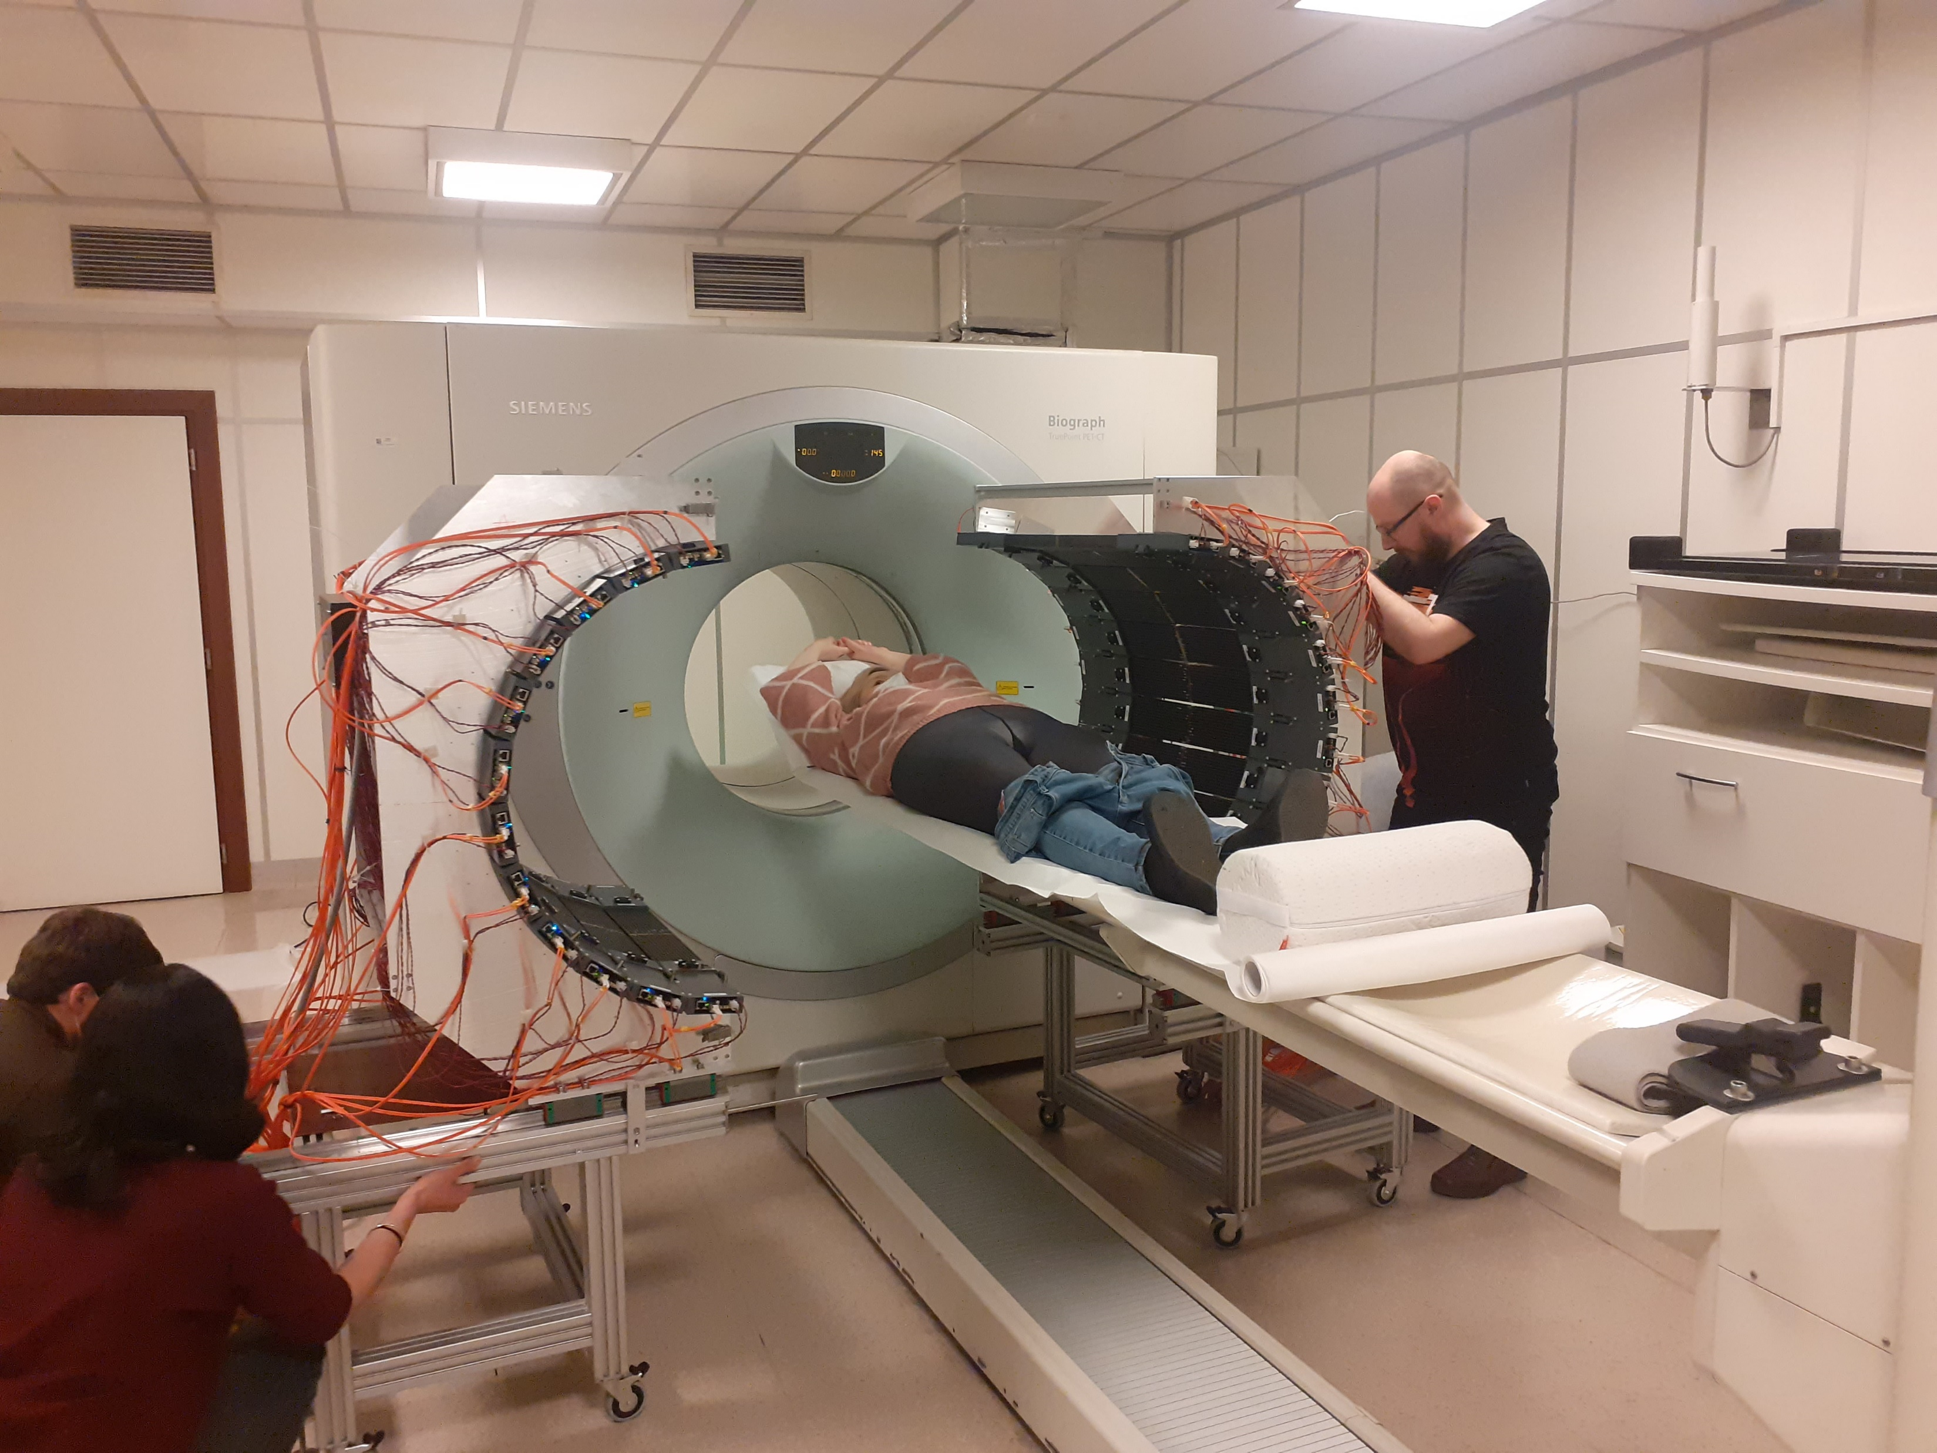
J-PET (Cracovia): PET with quantum entanglement – CPT, Lorentz

Slide 4
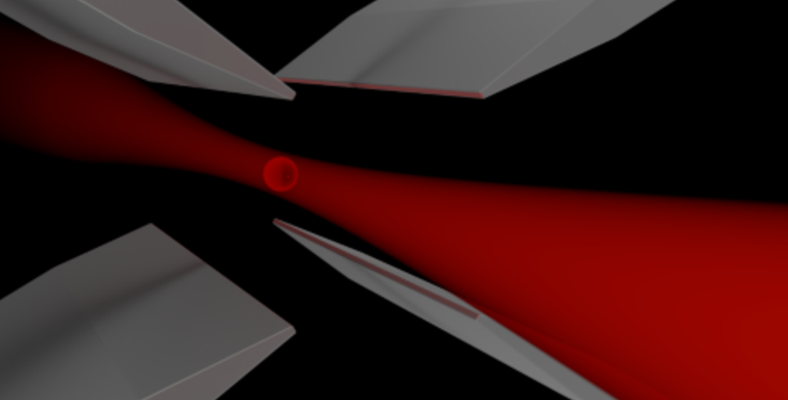
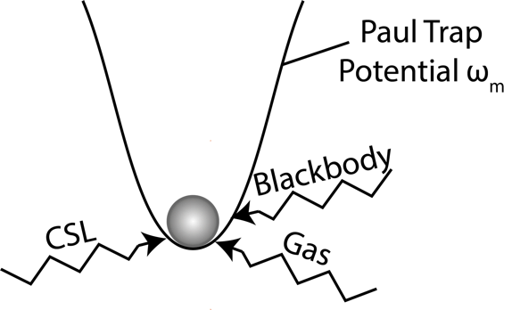
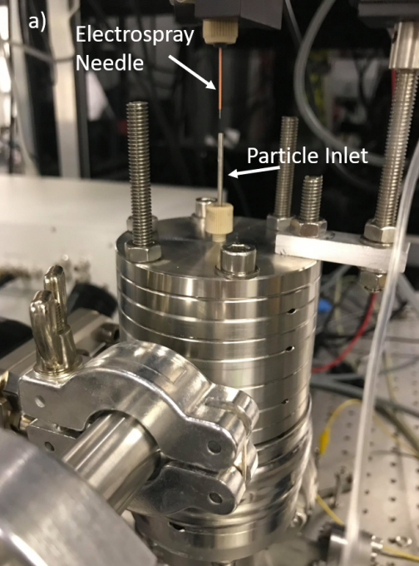
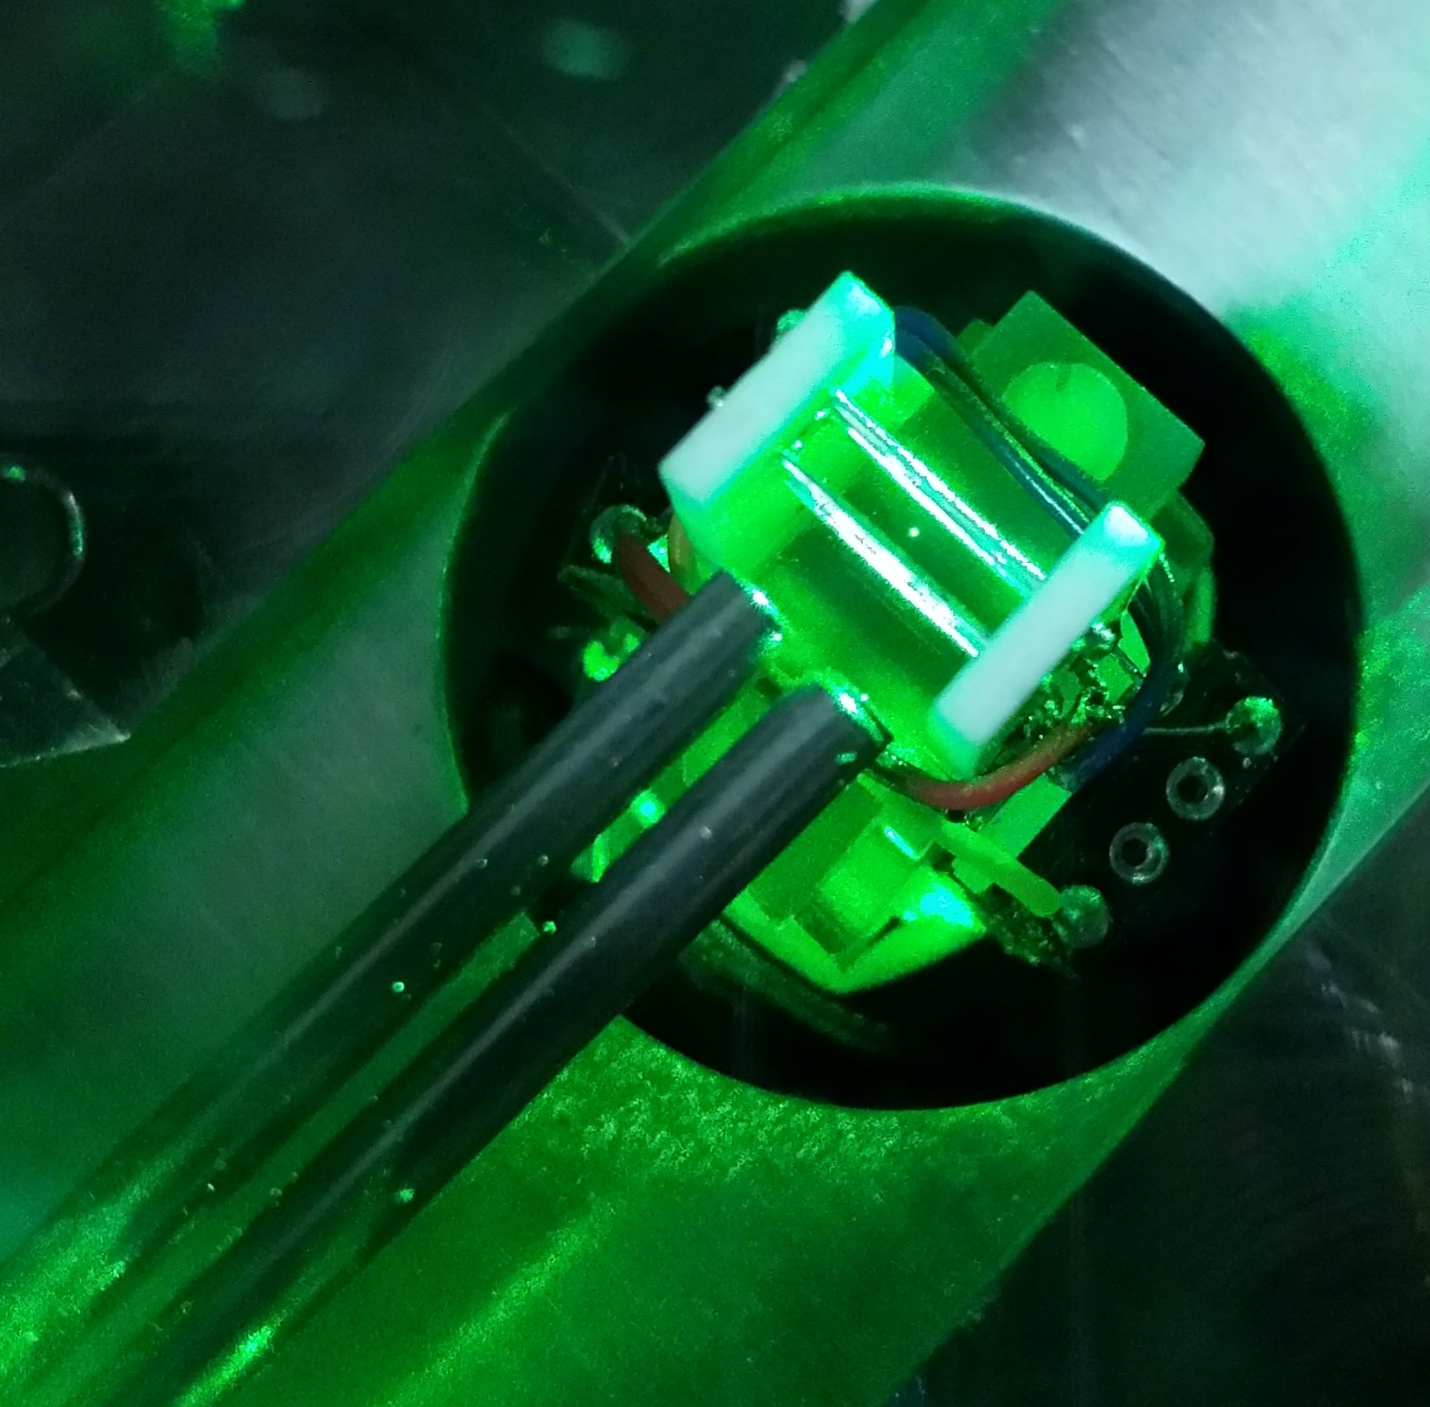
Quantum Collapse, Dark Matter and Quantum Sensors (TEQ)
Using electrodynamics traps for exploring fundamental physics
testing collapse models
Dark Matter
Quantum Gravity
Quantum Sensors
Eventually in space (MAQRO)

Slide 5
Structure of WP1 LNGS document:
Introduction
Quantum Gravity, CPT, Lorentz (Marciano, Piscicchia) – plan for: next 2 years; up to 4-5 years; Mid Term: up to 7/8 years
Quantum collapse and technologies (Napolitano, Curceanu) – plan for: next 2 years; up to 4-5 years; Mid Term: up to 7/8 years
Short Section: Technologies and Impact (Catalina)
Conclusions
Ganttchart (timeline); pert charts; financial?

