Slide 1


Deep underground direct measurements
WG2: Direct measurement for nuclear astrophysics
Contributions from:
Aliotta, Bemmerer, Best, Boeltzig, Bruno, Caciolli, Ciani, Corvisiero, deBoer, Depalo, Di Leva, Gyurky, Guglielmetti, Gustavino, Imbriani, Marcucci, Masha, Morales, Piatti, Rapagnani, Santonastaso, Skowronski, Wiescher, Zavatarelli
Marialuisa Aliotta
School of Physics and Astronomy - University of Edinburgh, UK
Scottish Universities Physics Alliance
VIII International Nuclear Physics in Astrophysics Conference, 22 June 2017 – Catania, Italy

Slide 2
F. Cavanna
Introduction
NUCLEAR ASTROPHYSICS @ LUNA-400 AND 3.5-MV
C-burning (3.5-MV)
Heavy elements nucleosynthesis: neutron sources (3.5-MV)
He-burning (LUNA-400 and 3.5-MV)
H-burning (LUNA-400 and 3.5-MV)
Big Bang Nucleosynthesis (LUNA-400 and 3.5-MV)
….Many reactions can be studied with the production of γ-rays, neutrons or charged particles
Mid Term Plan workshop, LNGS
Notes:
In 20 years he has established the THM as a world renowned approach in NA

Slide 3
Skype meeting | 17 July 2014
Underground measurements

Slide 4
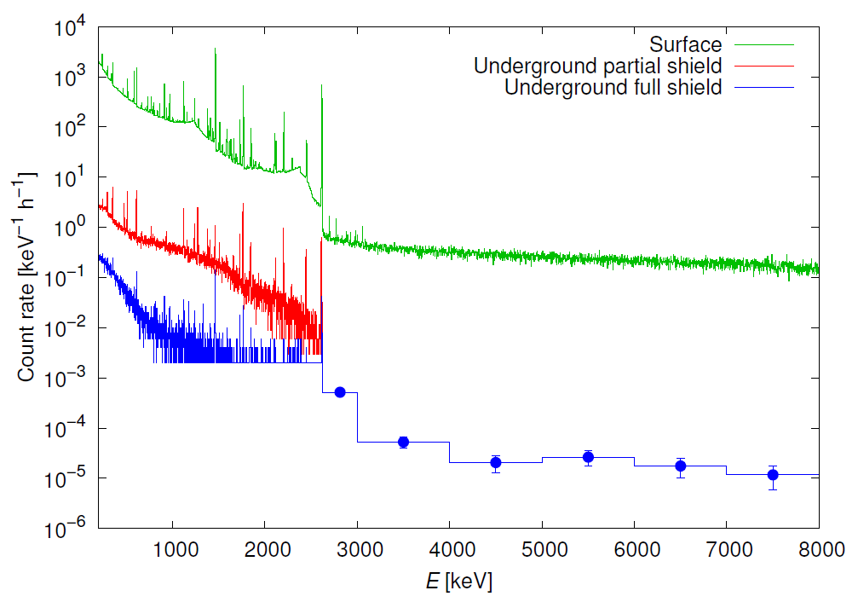
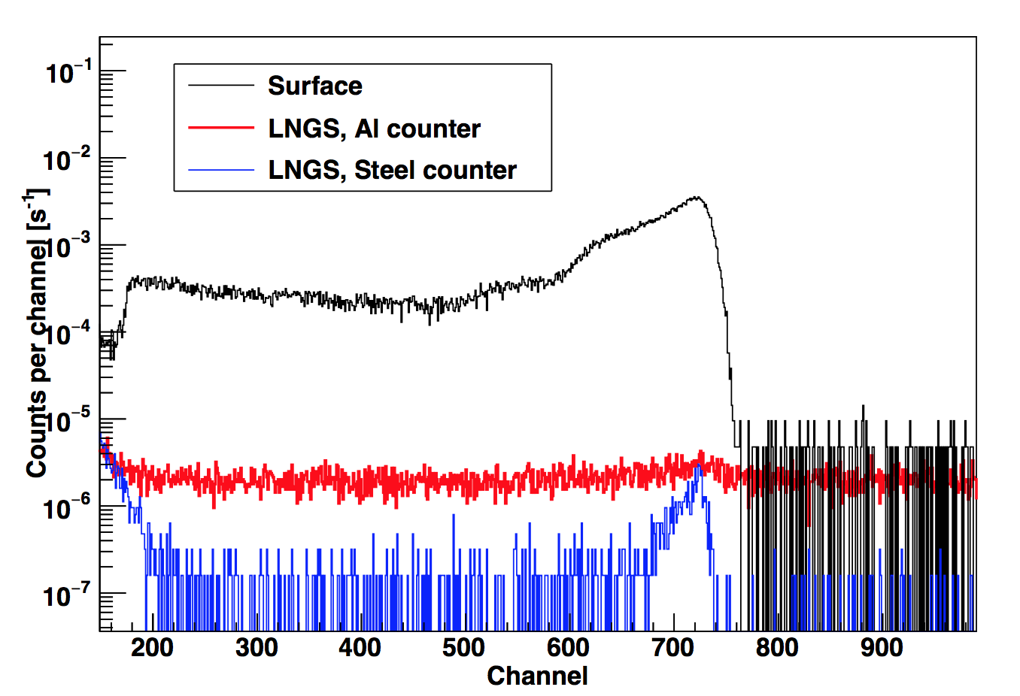
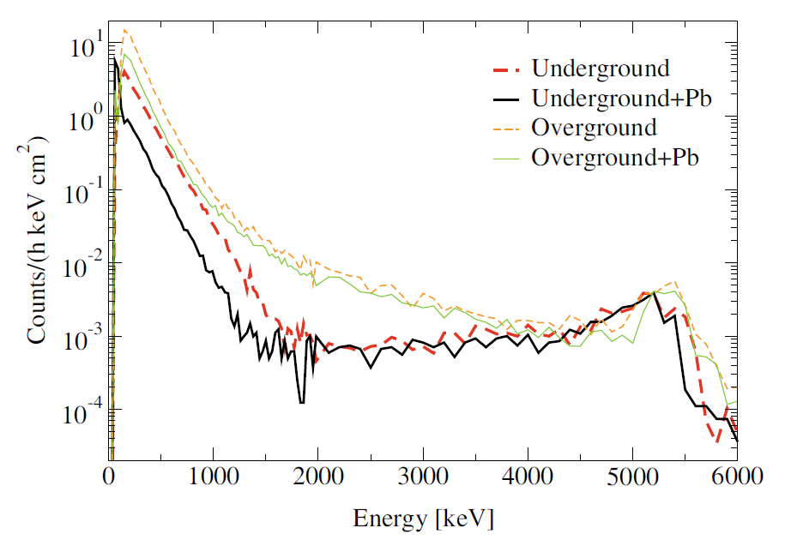
F. Cavanna
Direct measurements in underground laboratories
GAMMA DETECTION
NEUTRON DETECTION
PARTICLE DETECTION
Mid Term Plan workshop, LNGS
Notes:
In 20 years he has established the THM as a world renowned approach in NA

Slide 5
Skype meeting | 17 July 2014
C-burning
¹²C(¹²C,α)²⁰Ne
¹²C(¹²C,p)²³Na

Slide 6
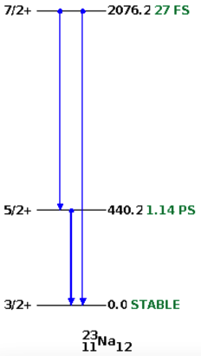
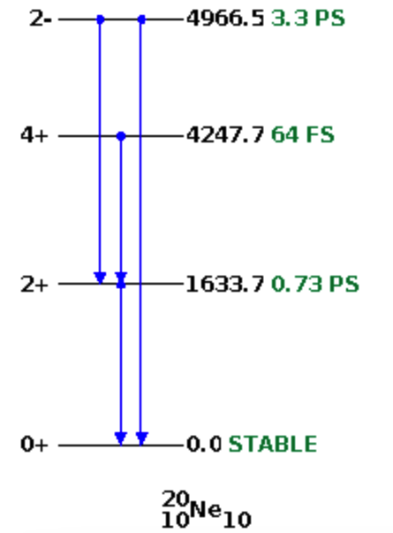
F. Cavanna
C-burning
MEASUREMENT STRATEGY
¹²C + ¹²C -> ²⁰Ne + α + γ
¹²C + ¹²C -> ²³Na + p + γ
Measurement down to E = 1500 keV at the 3.5 MV machine
¹²C target characterization: reduction of residual H and D impurities
Gamma measurement with a new ultra pure HPGe with 158% efficiency and proper shielding
Setup for particle measurement: two options are being tested
Mid Term Plan workshop, LNGS
Notes:
In 20 years he has established the THM as a world renowned approach in NA

Slide 7
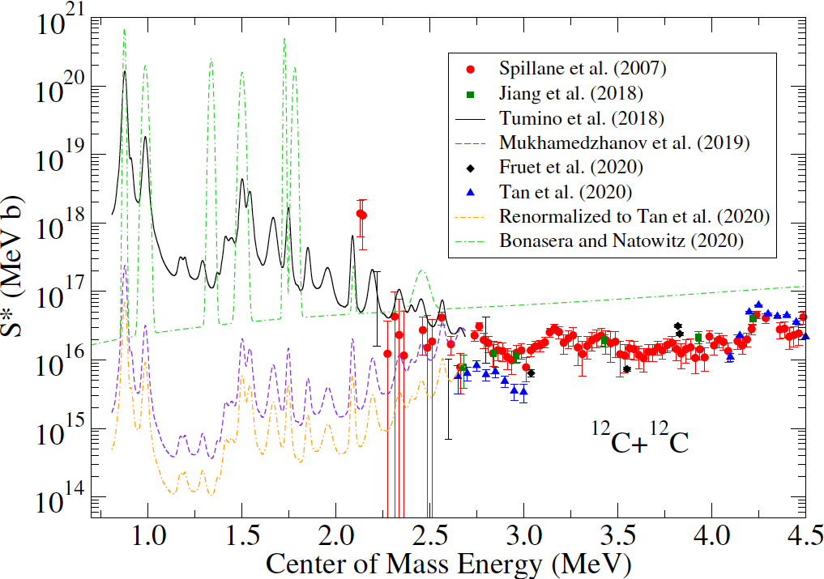
F. Cavanna
C-burning
STATE OF THE ART
Mid Term Plan workshop, LNGS
Notes:
In 20 years he has established the THM as a world renowned approach in NA

Slide 8
F. Cavanna
C-burning
sensitivity for different shielding setups
u/g + 15 cm Pb u/g + 25 cm Pb u/g + 25 cm Pb + N₂ flush
Tumino (left)
Non-Resonant (center)
Mukhamedzhanov (right)
Mid Term Plan workshop, LNGS
Notes:
In 20 years he has established the THM as a world renowned approach in NA

Slide 9
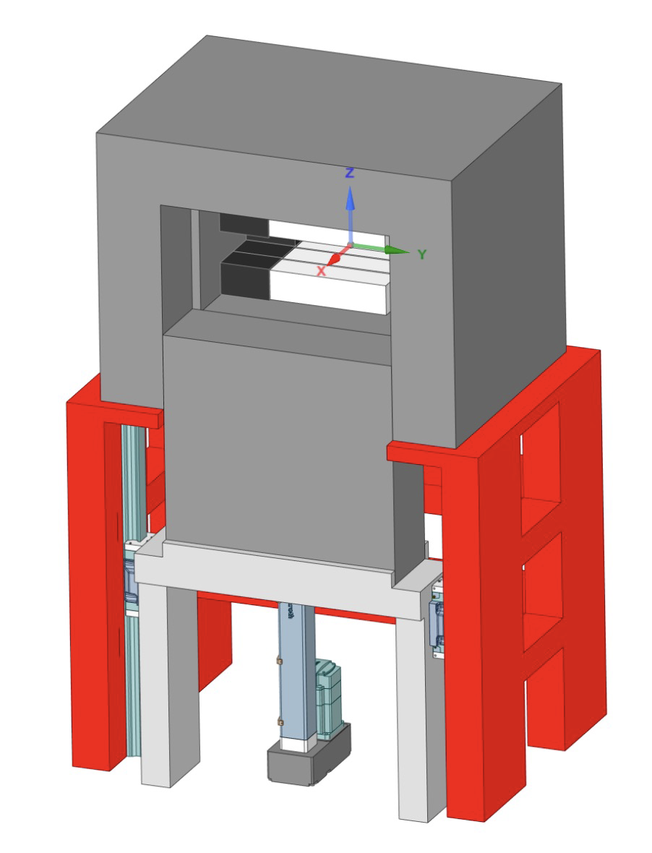
F. Cavanna
C-burning
GAMMA MEASUREMENT
HPGe detector
1 cm copper
for suppression of neutron induced background
9 NaI
25 cm thick lead
for suppression of γ background
lead holder
Aperture
for target replacement
and detector
maintenance
Automatic Hydraulic Elevator
for easy access to detectors and target area
Mid Term Plan workshop, LNGS
Notes:
Mention also the development of the particle channel

Slide 10
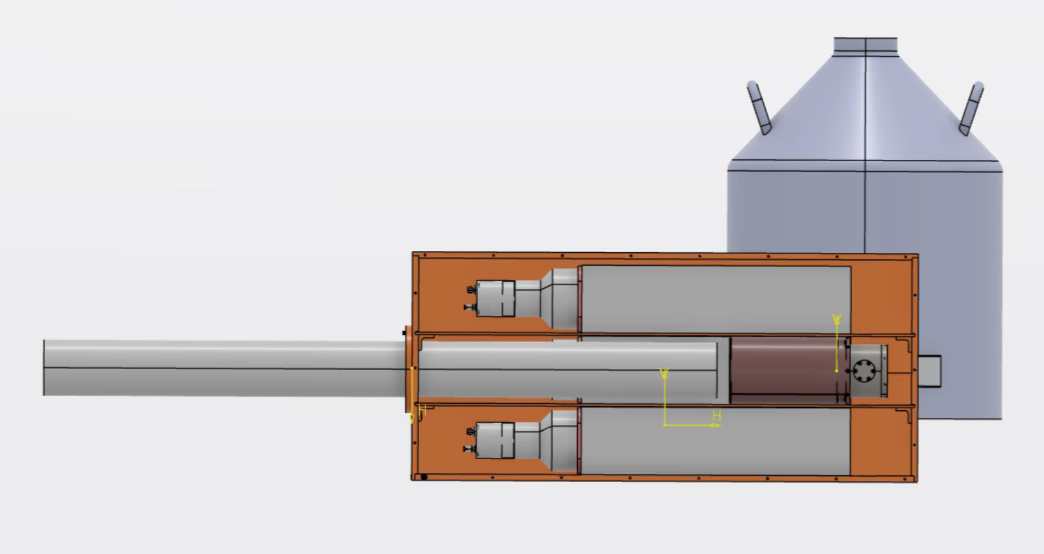
F. Cavanna
C-burning
GAMMA MEASUREMENT
HPGe dewar
9 NaI Scintillators
4π configuration for anti-Compton (²³Na) and efficiency improvement (²⁰Ne)
1 cm copper
Retractable beam line
for targets replacement
Target holder
cooled – cold finger
HPGe detector
Mid Term Plan workshop, LNGS
Notes:
Mention also the development of the particle channel

Slide 11
Skype meeting | 17 July 2014
Heavy elements nuclesynthesis:
neutron sources
¹³C(α,n)¹⁶O
²²Ne(α,n)²⁵Mg

Slide 12
Skype meeting | 17 July 2014
Heavy elements nuclesynthesis:
neutron sources
¹³C(α,n)¹⁶O
²²Ne(α,n)²⁵Mg

Slide 13

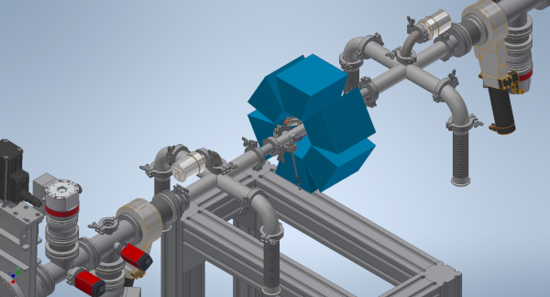
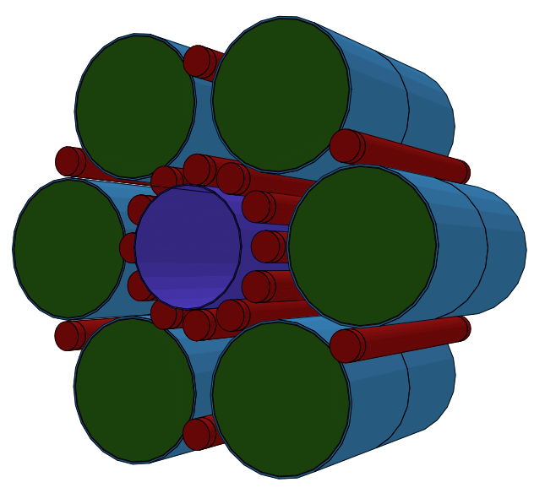
F. Cavanna
Heavy elements nucleosynthesis: neutron sources
STUDY OF THE ²²Ne(α,n)²⁵Mg REACTION
Scintillator-³He Array for Deep-underground Experiments on the S-process: ERC starting grant. (P.I. A. Best, Uni Na)
Need to measure very low event rate
Measurement @ 3.5 MV machine
Hybrid detector array: ³He counters and liquid scintillators
High efficiency and energy sensitivity
Mid Term Plan workshop, LNGS
Notes:
Anticoincidence between the signal of the liquid scintillators and ³He counters to reject beam induced background

Slide 14
Skype meeting | 17 July 2014
He-burning
⁶Li(α,γ)¹⁰B
⁷Li(α,γ)¹¹B
¹⁰B(α,d)¹²C
¹⁰B(α,p)¹³C
¹⁰B(α,n)¹³N
¹¹B(α,n)¹⁴N
²²Ne(α,γ)²⁶Mg
¹⁴N(α,γ)¹⁸F
¹⁵N(α,γ)¹⁹F
¹⁷O(α,γ)²¹Ne
¹⁸O(α,γ)²²Ne
¹²C(α,γ)¹⁶O

Slide 15
Skype meeting | 17 July 2014
He-burning
⁶Li(α,γ)¹⁰B
⁷Li(α,γ)¹¹B
¹⁰B(α,d)¹²C
¹⁰B(α,p)¹³C
¹⁰B(α,n)¹³N
¹¹B(α,n)¹⁴N
²²Ne(α,γ)²⁶Mg
¹⁴N(α,γ)¹⁸F
¹⁵N(α,γ)¹⁹F
¹⁷O(α,γ)²¹Ne
¹⁸O(α,γ)²²Ne
¹²C(α,γ)¹⁶O

Slide 16
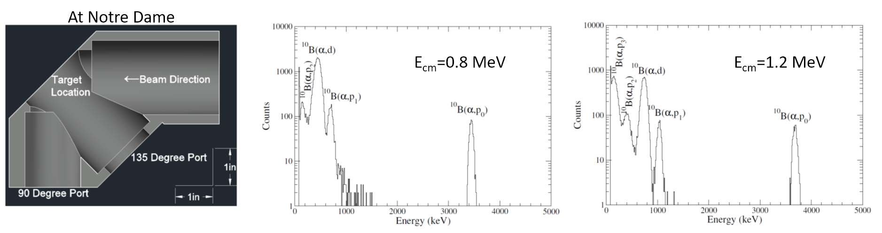
F. Cavanna
He-burning
CHARGED PARTICLE DETECTORS FOR ¹⁰B(α,p)¹³C and ¹⁰B(α,d)¹²C
Proposed for LUNA-400, taking advantage of background reduction with an optimized redesign of Edinburgh detector with 15% overall efficiency. Boron targets can be made in Notre Dame
Bruno EPJA 51 (2015) 94
Mid Term Plan workshop, LNGS
Notes:
Sample spectra acquired in Notre Dame with the experimental setup shown in the picture; one possibility is to use those detectors or alternatively to use detectors which will be developed by Carlo or …

Slide 17
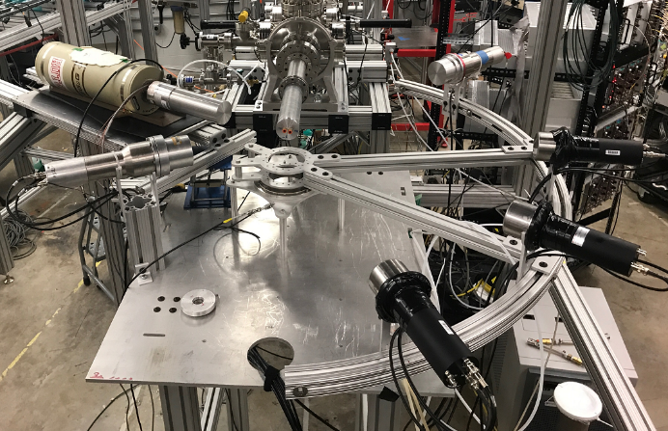
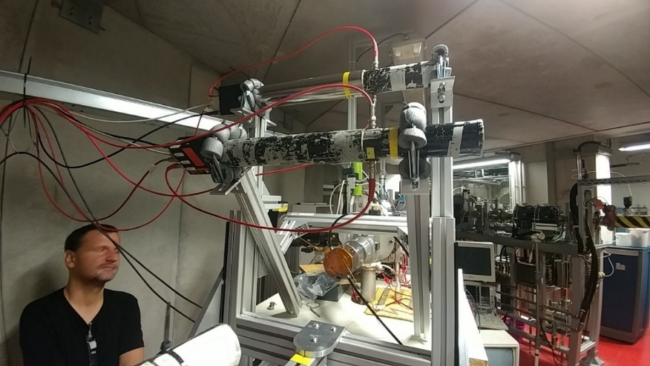
F. Cavanna
He-burning
NEUTRON DETECTORS FOR ^{10,11}B(α,n)^{13,14}N
Combination of different detector types to separate and identify ¹⁰B(α,n) and ¹¹B(α,n) neutron components
³He counters for thermalized neutrons are insufficient because they cannot distinguish between neutron background components!
³He spectrometers presently
tested at Naples
EJ301D neutron detectors at ND
Thermal
neutrons
E_{α}=1.557 MeV
Natural boron target
¹¹B(α,n)
Deuterated scintillators
³He spectrometers
¹⁰B(α,n)
Mid Term Plan workshop, LNGS
Notes:
In 20 years he has established the THM as a world renowned approach in NA

Slide 18
Skype meeting | 17 July 2014
H-burning
¹⁴N(p,γ)¹⁵O
²³Na(p,α)²⁰Ne
²⁷Al(p,α)²⁴Mg
³⁰Si(p,γ)³¹P
¹⁹F(p,α)¹⁶O
¹⁹F(p,γ)²⁰Ne

Slide 19
Skype meeting | 17 July 2014
H-burning
¹⁴N(p,γ)¹⁵O
²³Na(p,α)²⁰Ne
²⁷Al(p,α)²⁴Mg
³⁰Si(p,γ)³¹P
¹⁹F(p,α)¹⁶O
¹⁹F(p,γ)²⁰Ne

Slide 20
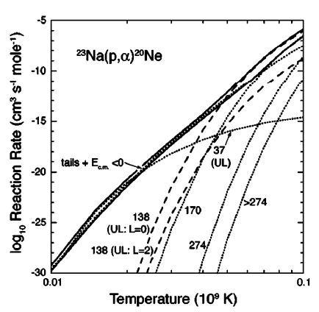
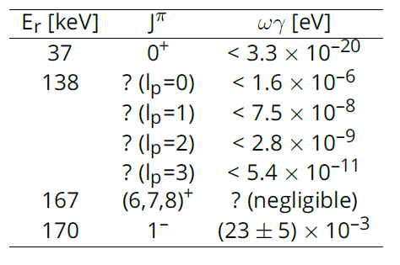
F. Cavanna
H-burning
²³Na(p,α)²⁰Ne
Mid Term Plan workshop, LNGS
Notes:
Problem of globular clusters including several generations of stars. Secondary generations show CNO processing, but constant metallicity. There’s one model able to address all these questions but it predicts that O and Na are correlated but they are instead anti-correlated. There’s one reaction which could it’s own dominate the reaction rate and contributes to the destruction of 23Na. The reaction rate is dominated by the resonance at 138 keV; the spin parity is unknown and depending on the adopted value the upper limit on the wg changes

Slide 21
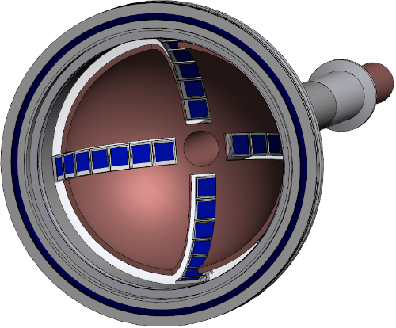
F. Cavanna
H-burning
ERC-STG ELDAR (PI CG Bruno, U. Edinburgh)
Measurement @ LUNA-400
Design work for a new beamline has just started. The mounting of the new chamber is foreseen for May 2023
1 year expected to be required for mounting, commissioning and measuring
Beam
Silicon
detectors
Mid Term Plan workshop, LNGS
Notes:
Silicon detectors at backward angles.

Slide 22
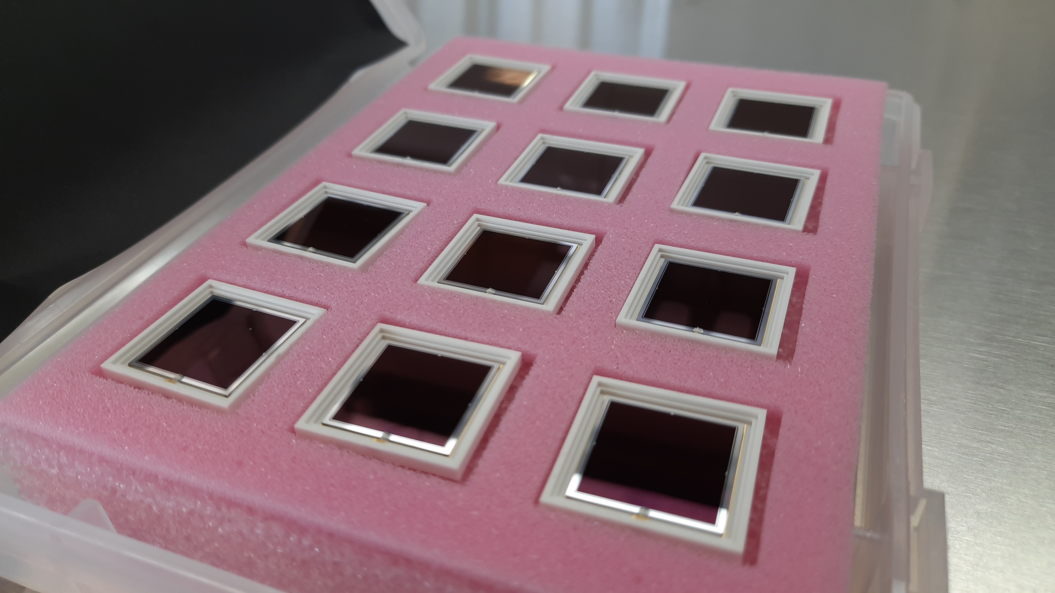
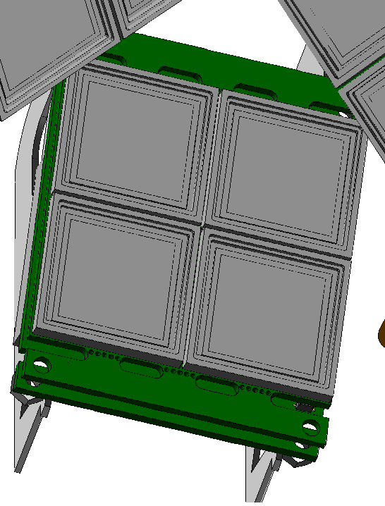
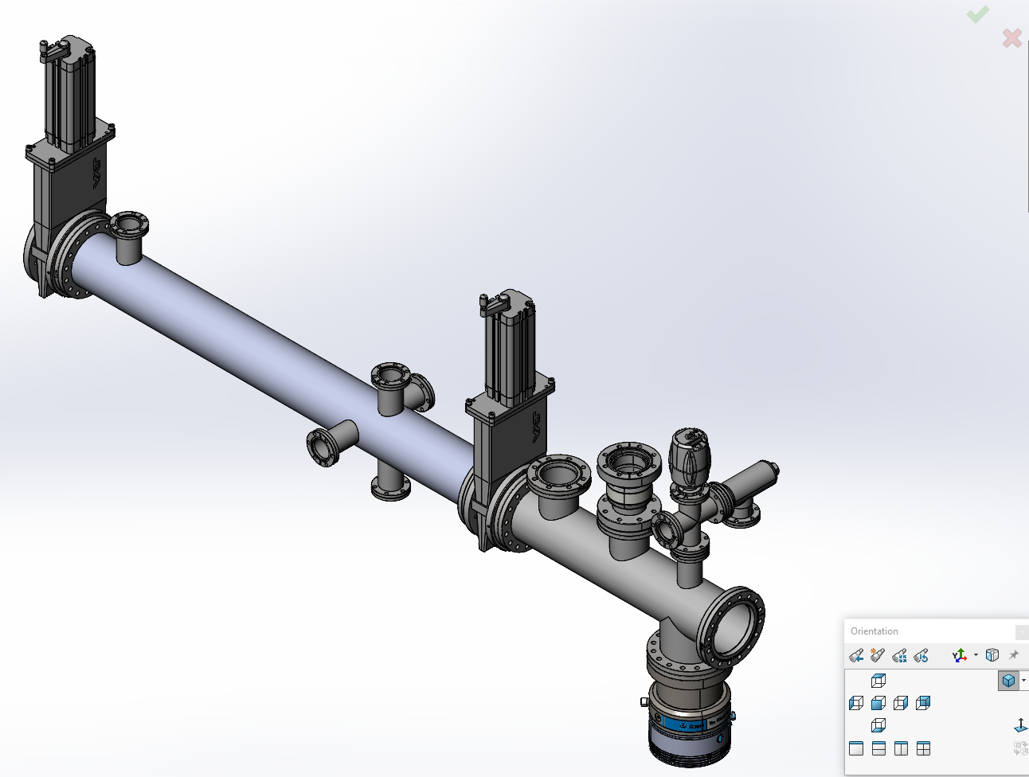
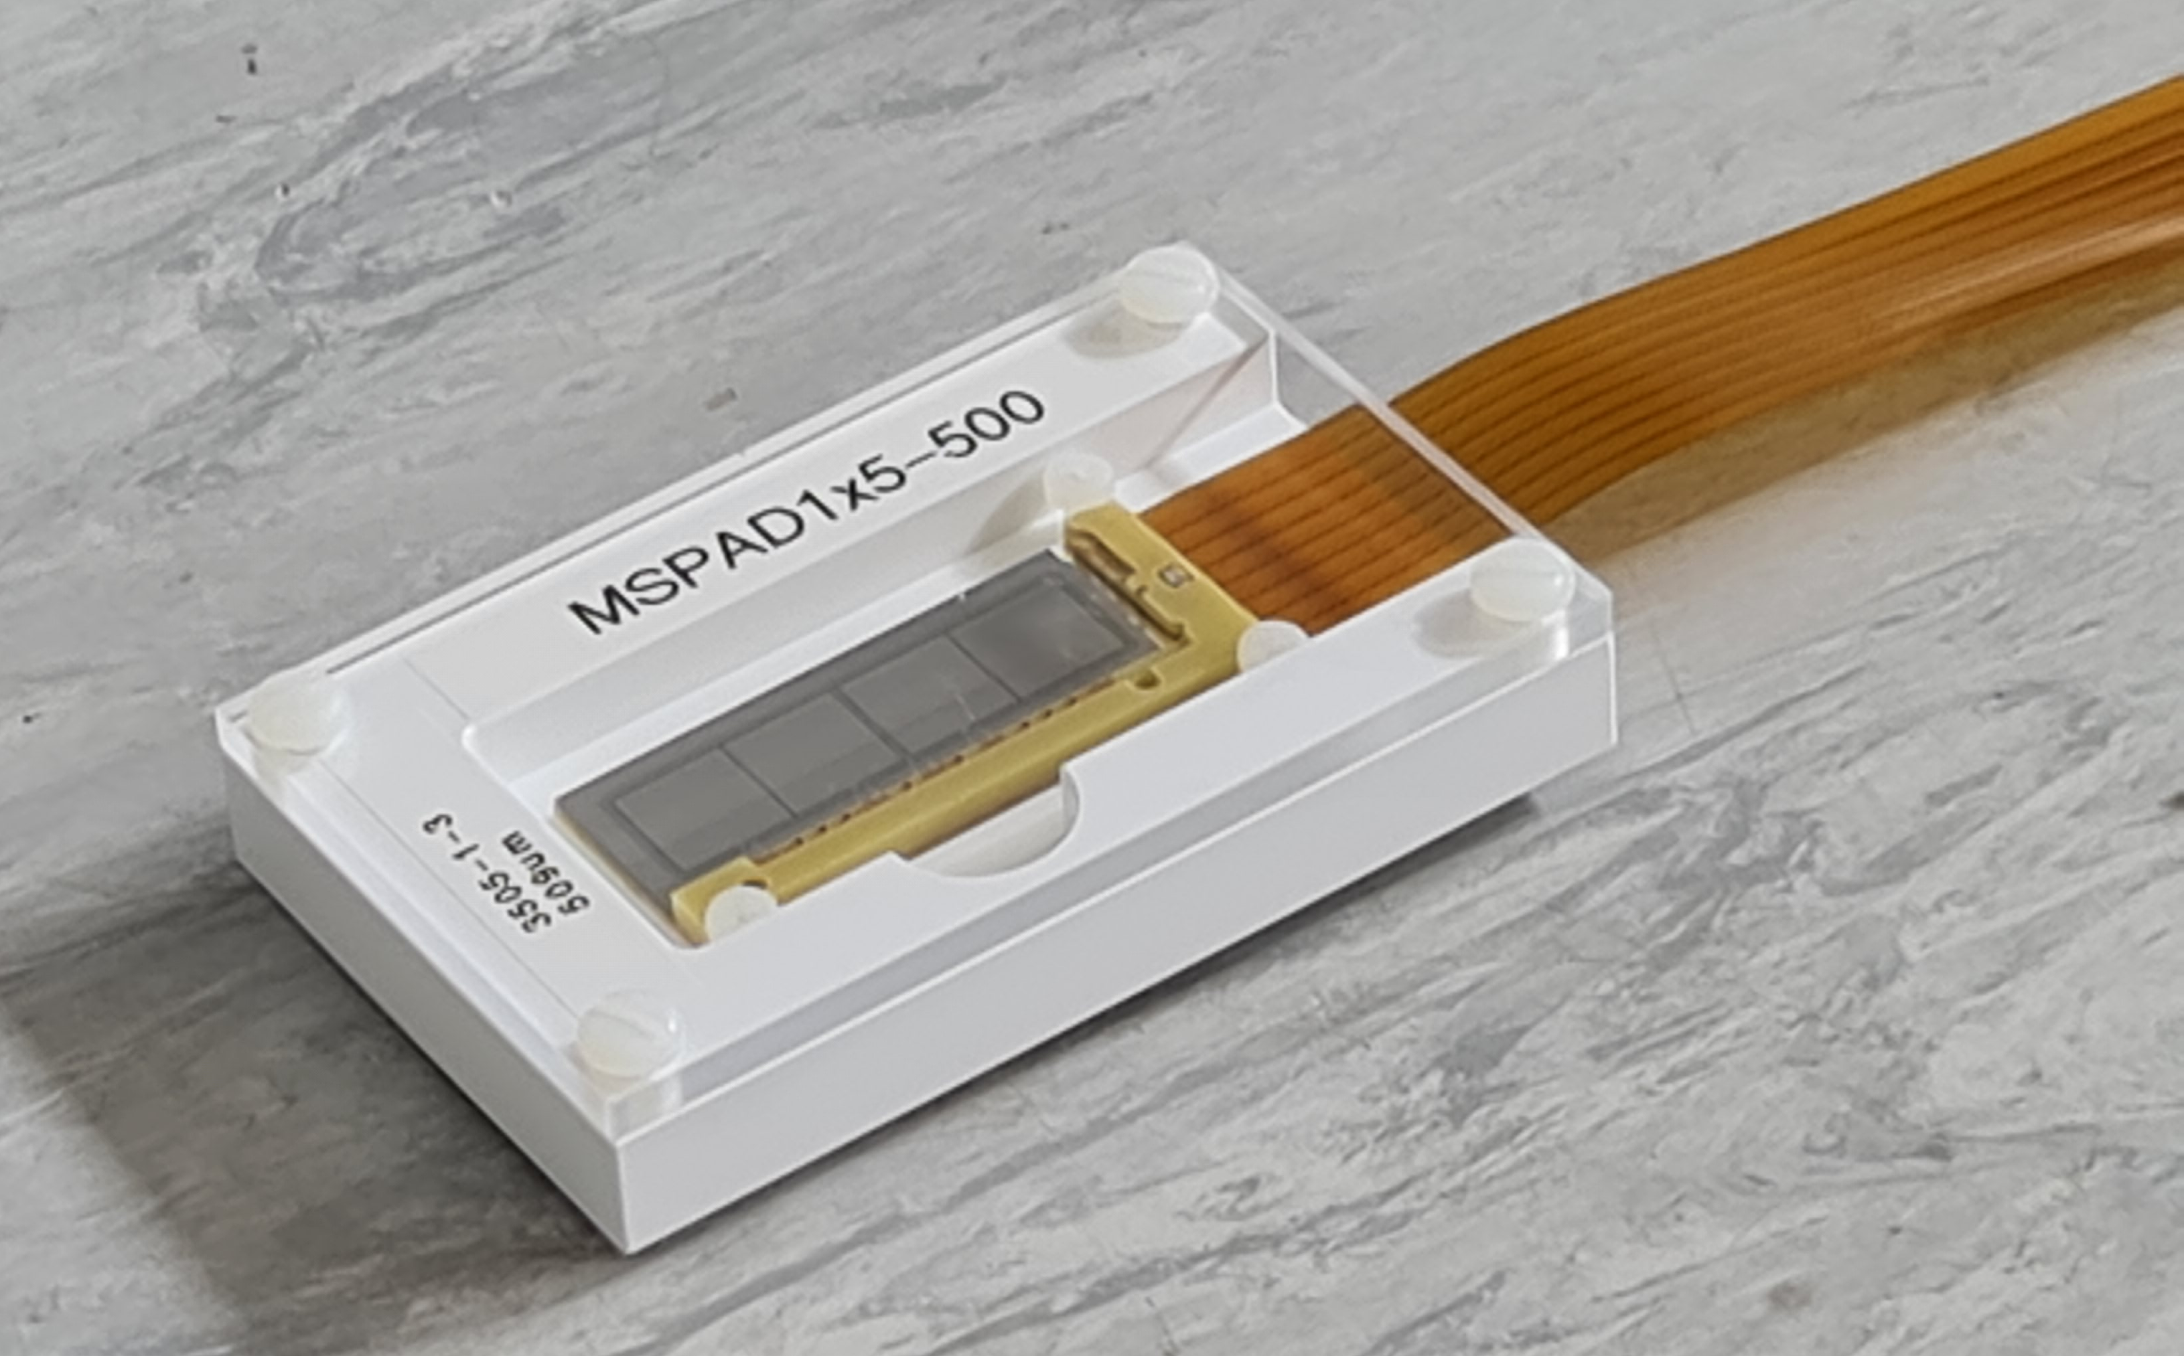
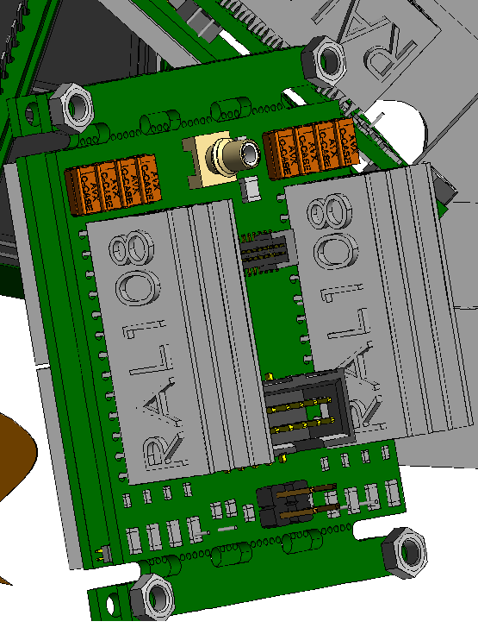
F. Cavanna
H-burning
DESIGN OF THE DETECTORS AND BEAM LINE
Front
Preamplifiers
Back
Mid Term Plan workshop, LNGS
Notes:
Si detectors from Hamamatsu 20x20 mm. Very compact and can work under many conditions. They have very low electronic noise and can be mounted very close to the are-amplifier which will be under vacuum. Much better energy resolution and low electronic noise. There will be space in the dome for a couple of MSPAD to test them and get PSA. Array of neutron Transmutation Doped (nTD) Si detectors. Pulse shape to discriminate particles (and background!).
Beam line on the left.

Slide 23
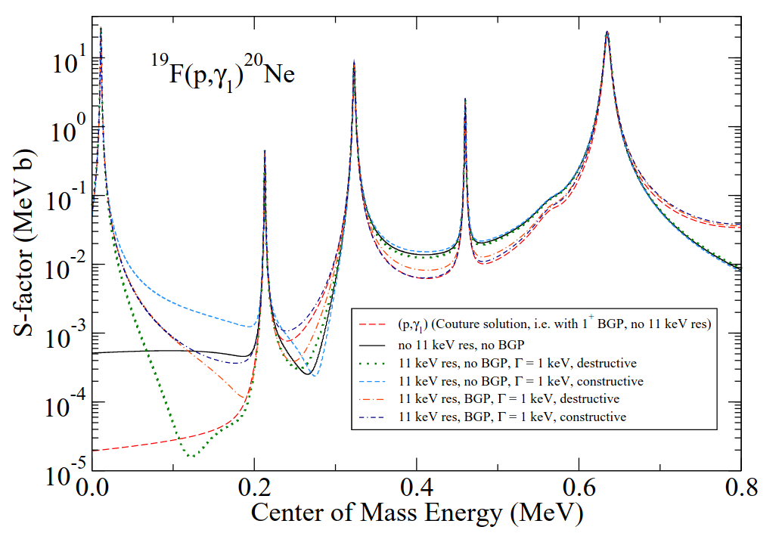
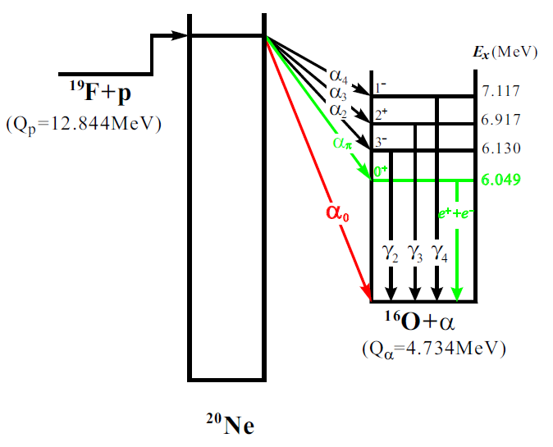
F. Cavanna
H-burning
STUDY OF THE ¹⁹F(p,α)¹⁶O, ¹⁹F(p,αγ)¹⁶O and ¹⁹F(p,γ)²⁰Ne REACTIONS
The observed ¹⁹F abundance in the Galaxy is still puzzling
CNO burning leak by (p,γ) channel [O.Clarkson and F.Herwig, MNRAS (2020)]
For the (p,α₁) channel no data available below 600 keV
For the (p,αγ) channel still debated contribution of the 11 keV and subthreshold resonances on the S-factor (recent measurement at JUNA)
For the (p,γ) channel available data at 300-760 keV
R.J. deBoer et el. PRC (2021)
Mid Term Plan workshop, LNGS
Notes:
The case of the Er = 215 keV resonance -> only upper limits available 10⁻⁷-10⁻⁶ eV
Measurements are difficult because of the (p,αγ) background

Slide 24
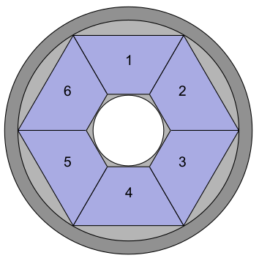
F. Cavanna
H-burning
PROPOSED EXPERIMENTAL SETUP
Measurement @ LUNA-400
Solid targets: CaF₂ evaporated or ¹⁹F implanted targets
Need for a devoted campaign to study the best strategy
How to monitor target degradation?
Checking γ-yield on top of 323 keV resonance
Periodic check via elastic backscattering at different proton energies
Detectors:
For charged particles new detectors are under development -> ²³Na(p,α)²⁰Ne
New highly segmented detector for:
  α₁ channel -> 511 keV gammas
  (p,γ) channel problem of beam induced background from the (p,αγ) channel
511
e⁺ annhil
511
Mid Term Plan workshop, LNGS
Notes:
The case of the Er = 215 keV resonance -> only upper limits available 10⁻⁷-10⁻⁶ eV
Measurements are difficult because of the (p,αγ) background

Slide 25
Skype meeting | 17 July 2014
Big Bang Nucleosynthesis
D(p,γ)³He
D(α,γ)⁶Li
³He(⁴He,γ)⁷Be

Slide 26
Skype meeting | 17 July 2014
Big Bang Nucleosynthesis
D(p,γ)³He
D(α,γ)⁶Li
³He(⁴He,γ)⁷Be

Slide 27
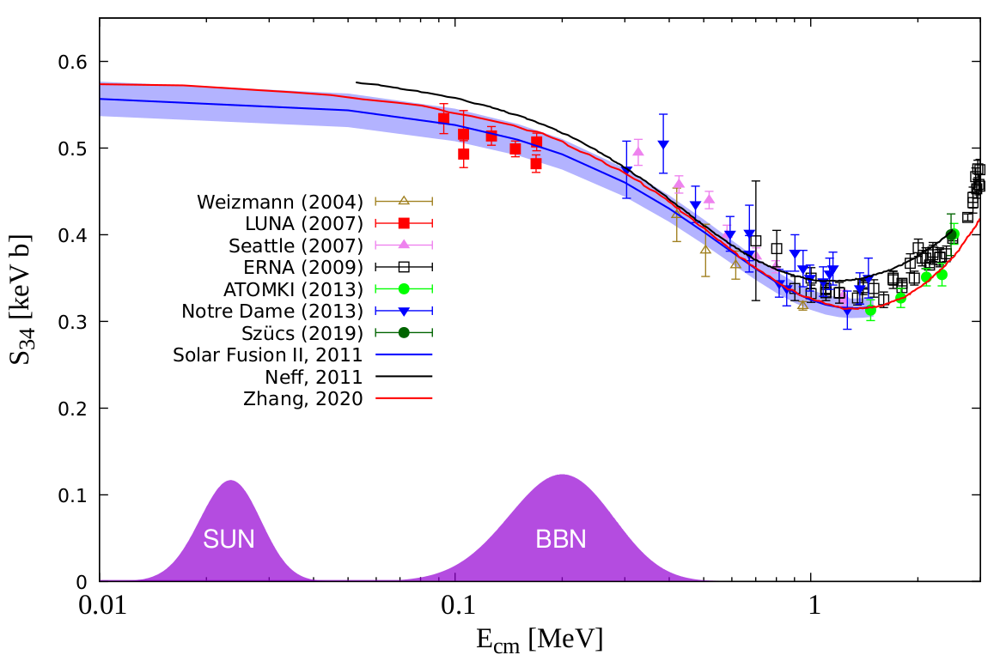
F. Cavanna
Big Bang Nucleosynthesis
SCIENTIFIC CASE AND POSSIBLE SETUP
Close collaboration with Felsenkeller and CIRCE laboratories
Solid or gas target
Measurement at LUNA-400 and 3.5 MV machines
Si detector
20 cm
Beam
45°
Beam axis
90°
LN2 cooled
HPGe
180%
Mid Term Plan workshop, LNGS

Slide 28

F. Cavanna
Conclusions
SUMMARY AND FUTURE PROSPECTS
The schedule for direct underground measurements at LUNA-400 and 3.5 MV machine is already well defined for the next 2-3 years
Many proposals are on the table for the mid (and long) term plan
Development of new detectors and targets are still needed for the mid term plan
Mid Term Plan workshop, LNGS
Notes:
In 20 years he has established the THM as a world renowned approach in NA

Slide 29
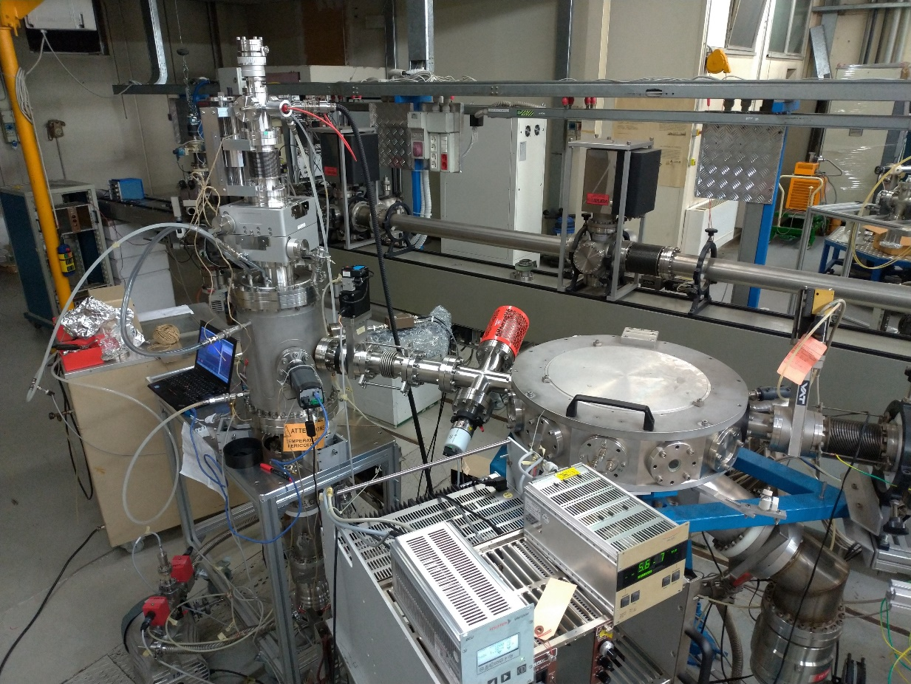
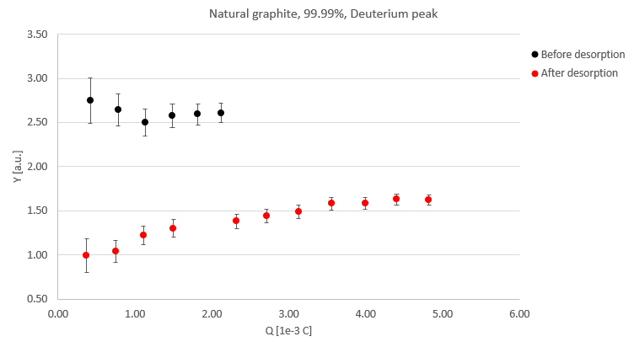
F. Cavanna
C-burning
the HEAT EXPERIMENT @ LNL
(Hydrogen dEsorption from cArbon Targets)
Reduce hydrogen contamination through controlled heating up to 1200°C
H contamination level before/after desorption through Ion Beam Analysis
³He beam, E = 1 MeV on natural graphite target
Heating system
Water-cooled chamber with automated vacuum control system
Si detectors
Vacuum pump with H getter
beam
PRELIMINARY RESULTS
Thermal camera
Mid Term Plan workshop, LNGS
Notes:
In 20 years he has established the THM as a world renowned approach in NA

Slide 30
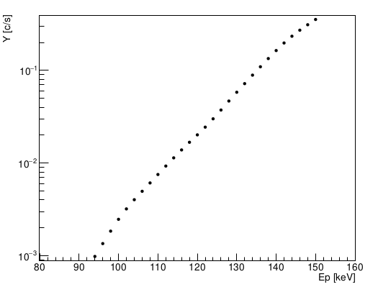
F. Cavanna
H-burning
COUNT RATES
¹⁹F(p,α₀)¹⁶O channel:
Er [keV] | Target | ωγ [eV] * | Current[μA] | Reaction/s
113 | CaF₂ | 1.25 x 10⁻⁰⁶ | 100 | 1
* = from I. Indelicato et al., ApJ 845 (2017)
¹⁹F(p,αγ)¹⁶O channel:
Assuming CaF₂ evaporated target, 30μg/cm² thick [I.Lombardo et al. 2015]
100 μA current
Assuming the S-factor reported in Zhang et al. PRL 127 (2021)
Range Ep ~ 150-90 keV
¹⁹F(p,γ)²⁰Ne channel:
Er [keV] | Target | ωγ [eV] * | Current [μA] | Reaction/s
215 | CaF₂ | <8.3 x 10⁻⁶ | 100 | 4.5
Measurement hampered by the background from the (p,αγ) channel
* = from R.J. deBoer, PRC 103 (2021)
6
Mid Term Plan workshop, LNGS

Slide 31
Phase A
Reaction | Luna-400 | 3.5 MV
¹⁴N(p,γ)¹⁵O
²³Na(p,α)²⁰Ne
²⁷Al(p,α)²⁴Mg
²²Ne(α,n)²⁵Mg
¹³C(α,n)¹⁶O
¹²C+¹²C (γ-channel)

Slide 32
Phase B
Reaction | Luna-400 | 3.5 MV
¹²C+¹²C (γ-channel)
¹⁹F(p,α)¹⁶O ¹⁹F(p,αγ) ¹⁶O ¹⁹F(p,γ)²⁰Ne
¹⁴N(p,γ)¹⁵O
²²Ne(α,γ)²⁶Mg
¹²C+¹²C (p,α-channel)
^{14,15}N(α,γ)^{18,19}F
¹⁸O(α,γ)²²Ne
³⁰Si(p,γ)³¹P

Slide 33
Phase C
Reaction | Luna-400 | 3.5 MV
¹²C+¹²C (p,α-channel)
^{10,11}B+α
^{6,7}Li(α,γ)
²H(p,γ)³He
²H(α,γ)⁶Li
³He(α,γ)⁷Be
¹⁷O(α,γ)²¹Ne
¹²C(α,γ)¹⁶O

