Slide 1
Reactions of interest for stellar nucleosynthesis.
Oscar Straniero
Contributions:
Co-writers: Carlos Abia, Inma Dominguez, Daniele dell’ Aquila, Alessandro Chieffi, Marco Pignatari, Andreas Best + discussions within the WG (35 partecipants).

Slide 2
Premise 1
Short term: reactions already in the LUNA/ERNA programs; mostly reactions belonging to the H-burning (pp & CNO), NeNa and MgAl cycles
Mid-term: reactions already considered for direct capture experiments; it includes advanced burnings (He, C) and , heavy elements nucleosynthesis (neutron sources)
Long term: new ideas for demanding science cases (see next slide)
(p,γ) & (p,α)
(α,n) & C burning
New ideas
In the following I will illustrate some science cases for LNGS and CIRCE lab

Slide 3
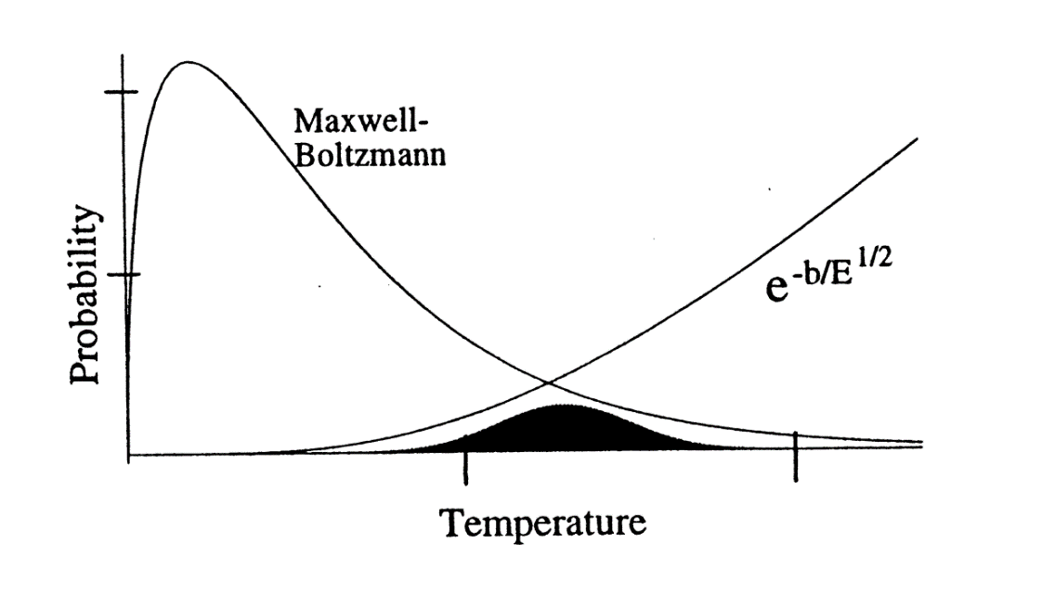
Premise 2 (stellar T vs lab E):
Stellar temperatures are fixed by a bunch of key reactions, such as: p(p,e⁺ν)d (H burning in low mass stars), ¹⁴N(p,γ)¹⁵O (H burning in intermediate and massive stars), triple-α (He burning), ¹²C+¹²C (C burning), ¹⁶O+¹⁶O (O burning),……..
The reaction rate is:
Maxwell-Boltzmann E distr.
Penetration factor.
Where:
GAMOW’s window
Astrophysical factor
(contains nuclear structure insights)
The most probable energy range at which a reaction takes place depends on T, X_{j,k}, Z_{j,k}, and μ.

Slide 4
Gamow’s peak energy in different environments:
T = 16 MK (Sun)
p+p 5 KeV
3He+3He 20 KeV
3He+4He 21 KeV
14N+p 25 KeV
T = 70 MK (shell-H, RGB)
14N+p 65 KeV
T = 200 MK (He-burning)
12C+α 300 KeV
T = 500 MK (C-burning)
12C+12C 1.5 MeV
T = 1 GK (BBN)
p+d 100 KeV

Slide 5
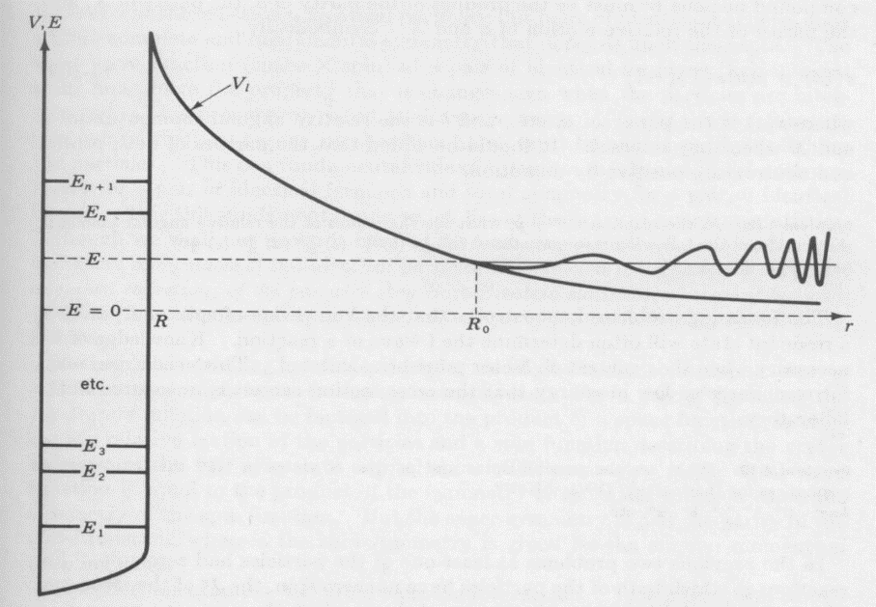
Resonances modify S(E)
(Kindly provided by C. Iliadis)
Narrow resonance (if nearby the Gamow’s peak) or broad resonances may enhance the stellar reaction rate.
Possible interferences between resonances should be also carefully considered.

Slide 6
Method already applied to important reactions, e.g., ¹²C(a,γ) ¹⁶O de Boer+ 2018 (RMP), ¹³C(α,n)¹⁶O Ciani+ 2021 (PRL).
Step 1: collect all the available experimental data sets, with their statistical and systematic errors. Mainly, nuclear structure parameters, such as energy, spin, parity, Γ, ωγ of resonant states.
Step 2: R-matrix fit of the astrophysical factor. In most cases, a low-energy extrapolation is required to reach the stellar conditions (shaded area).
Step 3: Evaluate the S(E) global uncertainty by means of a Monte Carlo analysis. It consists in a series of parameter extractions and R-matrix fits, to obtain the S(E) probability distribution.

Slide 7
Science cases
How to bridge the A=5,8 mass gaps: triple-α and other reaction chains
Final fate of massive stars and leading reactions for C and O burnings
Neutron-Capture nucleosynthesis AGB and massive stars

Slide 8
How to bridge the A=5,8 mass gaps: triple-α and other reaction chains

Slide 9
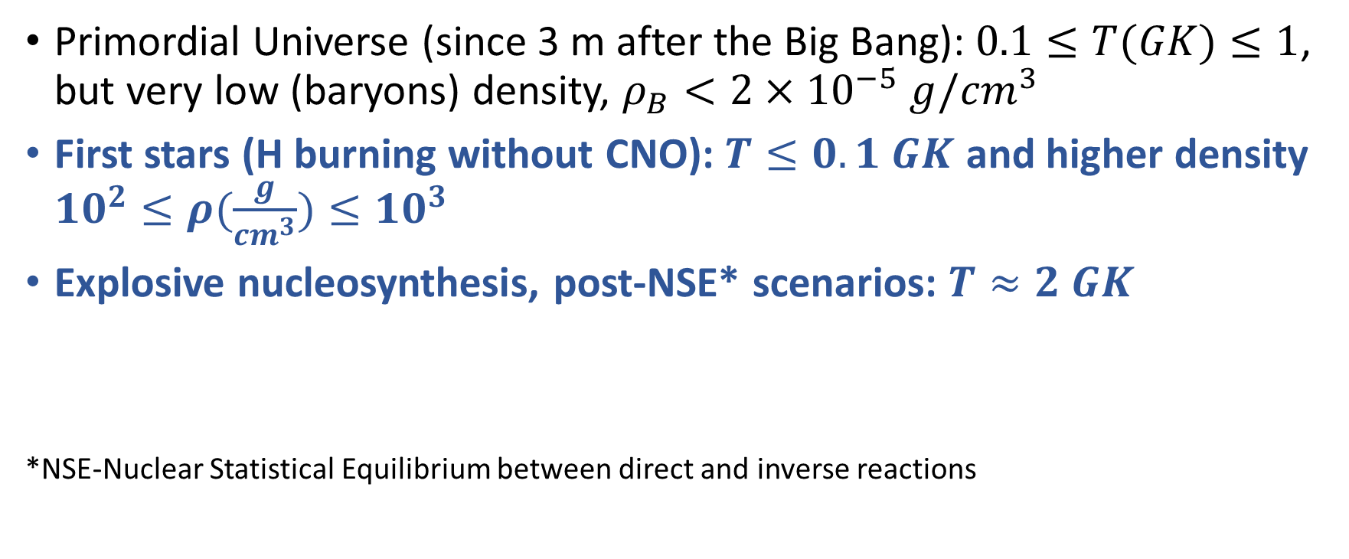
Astrophysical environments:
Primordial Universe (since 3 m after the Big Bang): $0.1≤T(GK)≤1$, but very low (baryons) density, $ρ_{B}<{2×10}^{−5} g/{cm}^{3}$
First stars (H burning without CNO): $T≤0.1 GK$ and higher density ${10}^{2}≤ρ(\frac{g}{{cm}^{3}})≤{10}^{3}$
Explosive nucleosynthesis, post-NSE* scenarios: $T≈2 GK$
*NSE-Nuclear Statistical Equilibrium between direct and inverse reactions

Slide 10
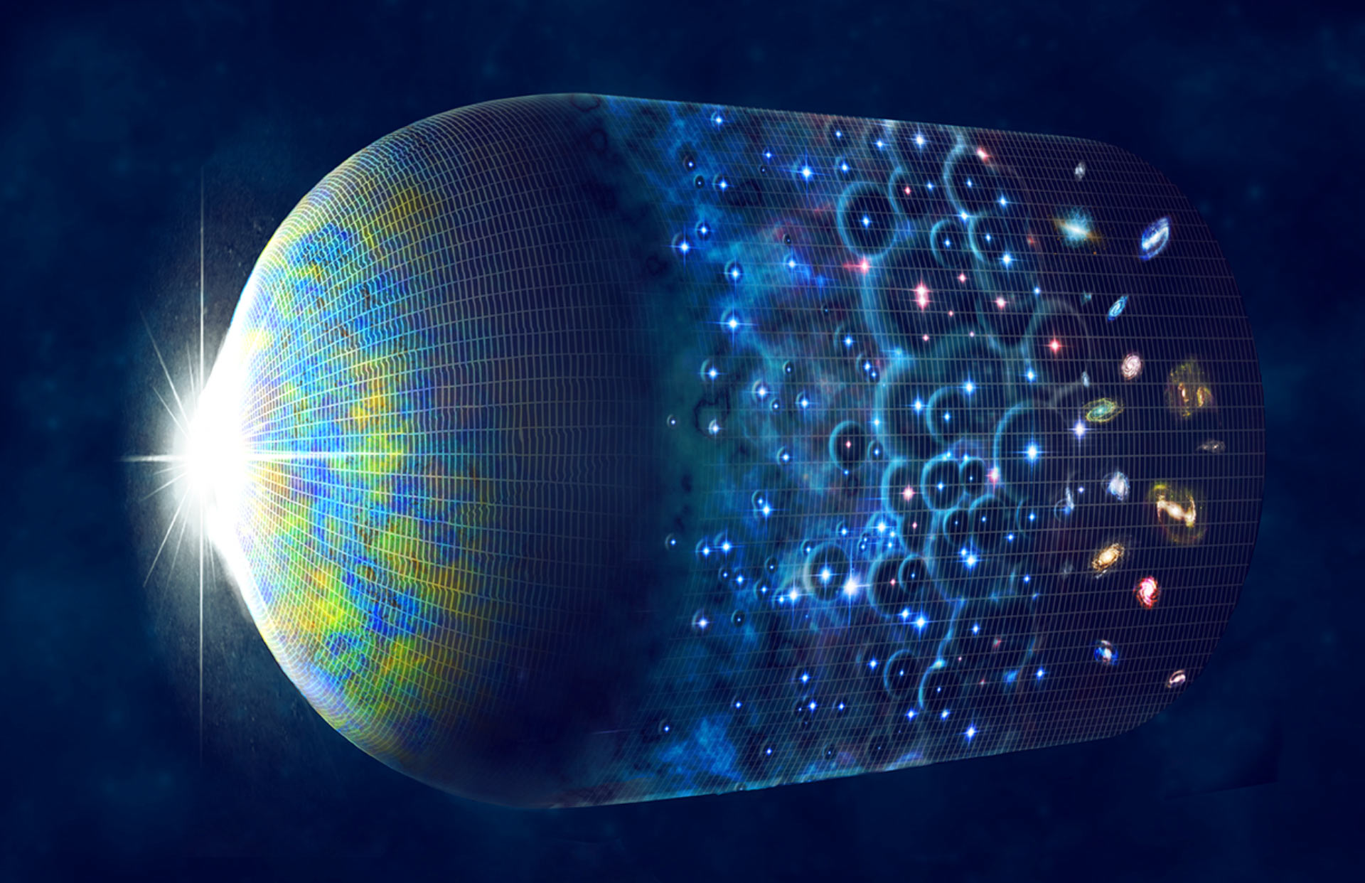
The cosmic dawn
The ultraviolet light emitted by the first stellar generation was responsible for the re-ionization of the Universe. These stars were also the first producers of C and heavier elements.
0.38
200
800
Time (Myr)

Slide 11
A peculiar H burning.
There was a lack of C, N, O and heavier elements in the gas from which primordial stars form.
At larger metallicities, massive stars would burn H through the CNO cycle, but owing to the peculiar chemical composition, the H burning proceeds through the pp chain, which is, however, insufficient to replace the energy loss (stellar luminosity).
So, after the H ignition, the core contraction never stops and part of the released gravitational energy is spent to increase the thermal energy. As the temperature increases, the triple-α reactions start producing some C, until the CNO cycle can be activated and the core temperature is eventually stabilized.
Then, the rate of the triple-α at T<0.1 K is a critical ingredient to model these first stars. It has been also supposed that other reactions, alternative to or in parallel to the triple-α, might had helped to overcome the A=5,8 mass gaps.

Slide 12
The Hoyle resonance
At the thermal energy of a core-He-burning star, the triple-α rate is dominated by the famous Hoyle resonance (0⁺ state at 7.65 MeV).
In practice, the reaction proceeds as a two-step process, strongly enhanced by two low-lying s-wave (l= 0) resonances,
α + α -> ⁸Be(gs) ; α + ⁸Be(gs) -> ¹²C(Hoyle)
However, in case of H-burning first stars, at temperatures <0.1 GK, the thermal energy is too small, so that the reaction proceeds directly by some three-body mechanism.

Slide 13
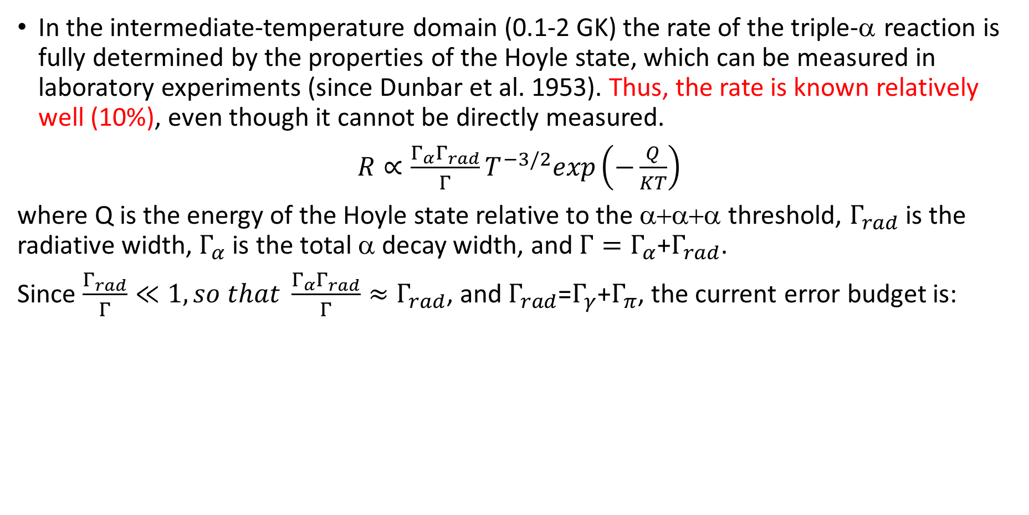
In the intermediate-temperature domain (0.1-2 GK) the rate of the triple-α reaction is fully determined by the properties of the Hoyle state, which can be measured in laboratory experiments (since Dunbar et al. 1953). Thus, the rate is known relatively well (10%), even though it cannot be directly measured.
$R∝\frac{Γ_{α}Γ_{rad}}{Γ}T^{−3/2}exp\left(−\frac{Q}{KT}\right)$
where Q is the energy of the Hoyle state relative to the α+α+α threshold, $Γ_{rad}$ is the radiative width, $Γ_{α}$ is the total α decay width, and $Γ=Γ_{α}$+$Γ_{rad}$.
Since $\frac{Γ_{rad}}{Γ}≪1, so that \frac{Γ_{α}Γ_{rad}}{Γ}≈Γ_{rad}$, and $Γ_{rad}$=$Γ_{γ}$+$Γ_{π}$, the current error budget is:

Slide 14
The determination of the reaction rate is far more complicated in the low- and high-temperature domains.
In the low-temperature domain (< 0.1 GK) sophisticated three-body models are necessary to calculate the rate.
Full three-body calculations were carried out by several authors with different technics> Ogata et al. use the continuum-discretized coupled-channel (CDCC) method, Nguyen et al. the hyperspherical harmonics R-matrix (HHR) method, Ishikawa jse the Faddeev three-body formalism, and Akahori et al. the imaginary-time formalism. Finally, Suno et al. 2015, solve the Schrodinger equation by using hyperspherical coordinates and an expansion of the wave function on the adiabatic channel functions.
The red circle identifies the T range of the H-burning in the core of primordial stars

Slide 15
Post-NSE in explosive nucleosynthesis.
In a hot explosive environment, at T > 4 GK, baryons are efficiently photo-disintegrated into n, p and α particles (NSE). Then, when the ejecta expand and their temperature drops, heavier elements can be rebuild by fusion reactions, up to the iron peak and beyond.
However, this process is initially hampered by the A=5,8 mass gaps that should be bridged, in some way.
Also in this case, the triple-α and/or other three-body reactions should play a fundamental role.

Slide 16
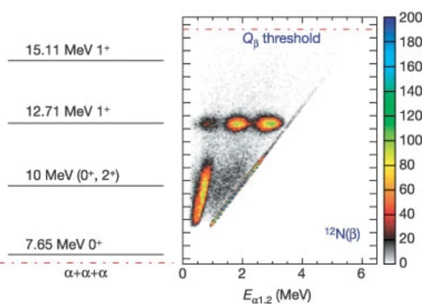
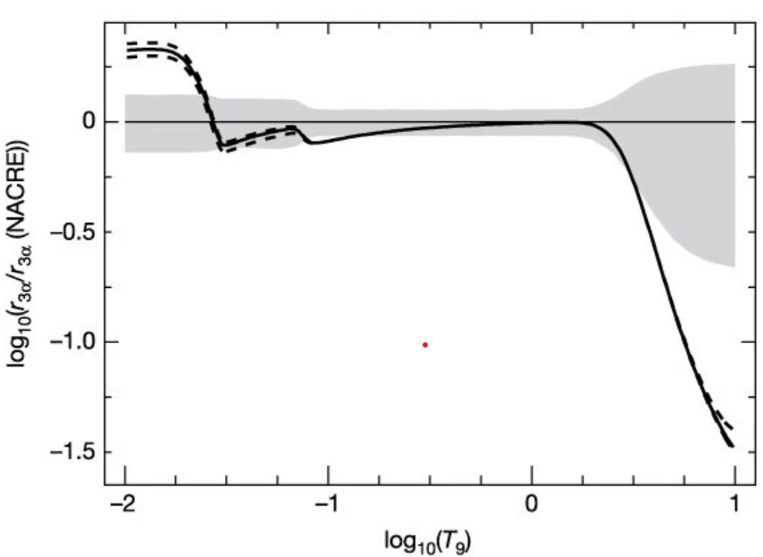
In the high-temperature domain (T>1 GK) higher energy states (and their interferences with the Hoyle resonance) must be taken into account. (Fymbo et al. 2005, Nature 433).
High energy resonances observed in 12N -12C decay. The contour plots (number of counts per pixel) show the excitation energy in ¹²C, plotted against the energy of individual α-particles; Q_{β}, energy released by nucleus in β-decay. The 7.65 MeV resonance (Hoyle) is below the detection threshold. Note that a resonance at 9.1 MeV, width 0.56 MeV, is assumed by NACRE. No evidences for such a resonance were found.
Rate dominated by Hoyle res.
T>2 GK: high energy resonances
T<0.1 GK: direct three-body processes

Slide 17
Alternative reaction chains:
In H-burning first generation stars, C and/or N can be alternatively produced through the following reactions:
  ⁶Li(α,γ)¹⁰B, folowed by ¹⁰B(α,d)¹²C, ¹⁰B(α,p)¹3C, ¹⁰B(α,n)¹³N,
  ⁷Li(α,γ)¹¹B, followed by ¹¹B(α,n)¹⁴N
On the other hand, in a supernova explosion, when the temperature drops below T~3 GK, heavy nuclei are produced starting from neutrons, protons and α particles. In this case, the recombination of two α-particles and a neutron into ⁹Be (⁴He(αn, γ)⁹Be) likely plays a key role in this scenario as it can bridge the A=5,8 mass gaps.

Slide 18
Leading reactions in the C and O burning

Slide 19
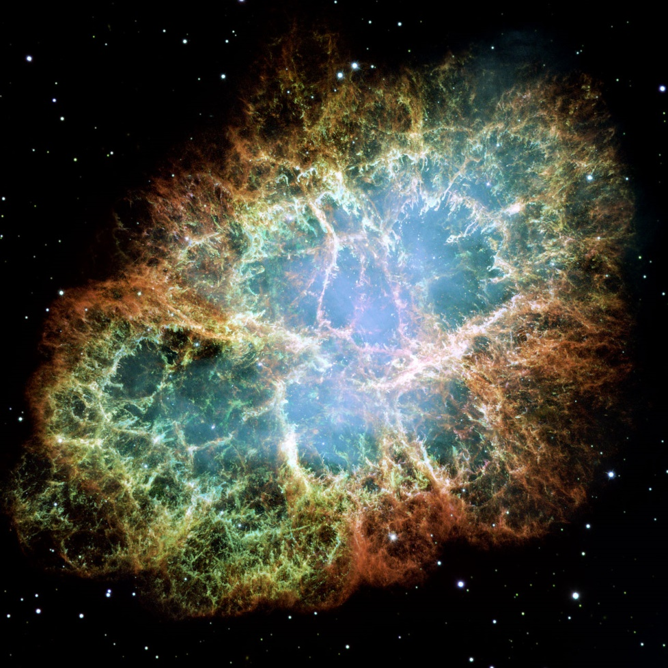
The final fate of massive stars is far from being firmly established. At the end of their evolution, all stars develop a fully degenerate core, whose mass and composition also depend on the efficiency of some key nuclear reactions: ¹²C+α, ¹²C+¹²C, ²⁰Ne+γ, ¹⁶O+¹⁶O
SN 1054, CRAB Nebula
Progenitor mass ~10 Mꙩ

Slide 20
The final fate of massive stars
Mass (Mꙩ)
7.5
9
10
12
30
No C burning
CO WDs
(SNe Ia)
Off center
degenerate
C burning
CONe WDs
Off center
degenerate
C burning
ONe WDs
or
EC SNe?
Central C burning,
off center degen.
Ne/O/Si burnings
Core collapse
SNe IIP?
Central
C/Ne/O/Si
burnings
Core collapse
SNe IIP
Central
C/Ne/O/Si burnings
SNe Ib/Ic
These mass ranges substantially depend on the efficiency of a few critical reactions. In the advanced phase of the evolution, the increasing pressure of degenerate electrons hampers the core contraction and, in turn, the core heating. Therefore a further burning phase may start only if the ignition condition are attained before the development of full degeneracy.

Slide 21
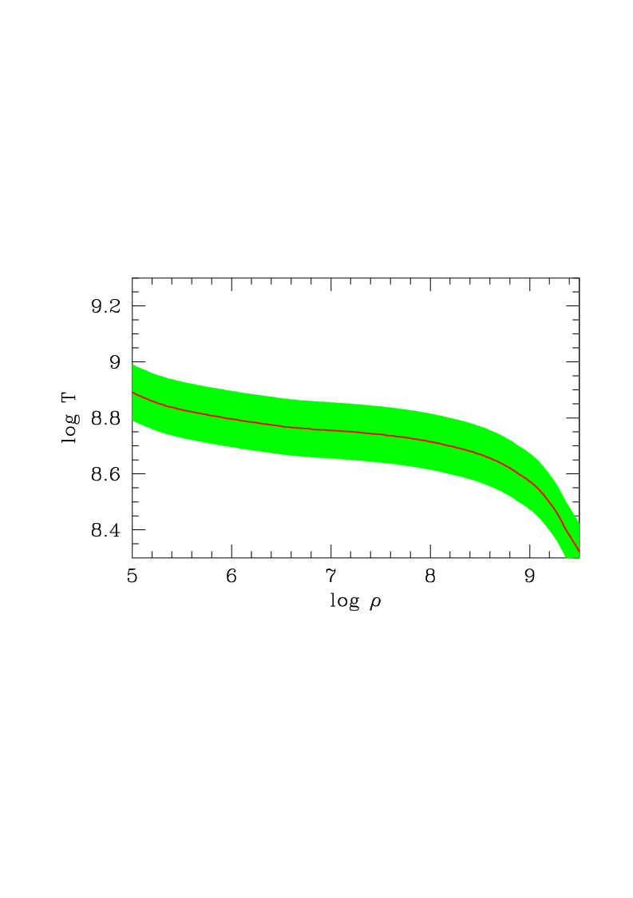

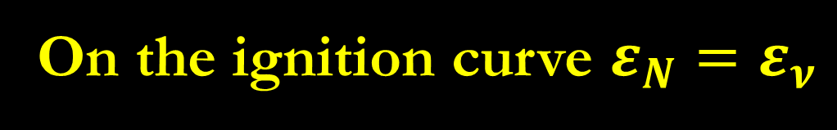

CARBON IGNITION CURVE
$$ε_{N}=Q×\frac{1}{2}Y_{{}_{}^{12}C}^{2}N_{A}^{2}ρ<σv>_{{12}_{C}{12}_{C}}$$
$ε_{ν}=ε_{plasma}$+$ε_{compton}$+$ε_{pair}$
On the ignition curve $ε_{N}=ε_{ν}$
C ignition may occur by:
a) Heating (massive stars);
or
b) Compression (SNe Ia)
ε_{neutrinos} = ε_{nuclear}
The green band shows possible variations of the ignition curve as due to ¹²C+¹²C reaction rate uncertainty
M>M_{up}
SNe Ia

Slide 22
The pre-explosive mass-radius relation depends on the C/O left by the He burning, which is determined by the relative efficiency of the triple-α and the ¹²C+α . It affects the explodability (supernova or collapse into a BH?) and the SN outcomes, such as the light curve, the electromagnetic spectrum and the nucleosynthesis yields.
From Imbriani et al. 2001, ApJ 558, 903

Slide 23
The synthesis of heavy nuclei
s process main component: low neutro density -10⁷ neutrons per cm³ , but high neutron exposure. Site → low mass AGB !!!!,
s process weak component: low neutron exposure. Sites → massive stars, core-He burning (10⁶ n per cm³), and shell-C burning (10¹¹ n per cm³) (?)
r process: Rapid neutrons – n_{n}>10²⁰ cm⁻³c. Site → NS mergers !!!, core-collapse SNe (?)
p process: γ process on s or r seeds. Site →SNe ??????
i process: intermediate neutron density (10¹⁵ cm⁻³). Proton ingestions in He burning convective zones. Site→extremely meal poor stars (RGB or AGB), late thermal pulse in post-AGB, mixing induced by fast rotation….????

Slide 24
Relevant temperature/energy
Temperature (10⁸ K)
1
3 4
10
Weak s
i process
Low mass AGB
Massive stars C-shell
Low mass AGB
p ingestions
Massive AGB
Main
&
Strong s
8
25 35
100
Thermal Energy (keV)

Slide 25
Neutron sources:
s process (main component): ¹³C(α,n)¹⁶O , low energy (200 keV), studied at LUNA400
s process (weak component): ²²Ne(α,n)²⁵Mg, broad range of energy (300 keV to 1 MeV). Parallel study on the competitor reaction, ²²Ne(α,γ)²⁶Mg, would be welcome.
i process: ¹³C(α,n)¹⁶O or ²²Ne(α,n)²⁵Mg, rather high energy.
State of the art:
²²Ne(α,n-γ)^{25,26}Mg. Several low-energy resonances, never detected so far (upper limits only).
¹³C(α,n)¹⁶O: discrepancy among available high-energy measurements (systematic errors!). New measure covering a large energy range to confirm the low-energy extrapolation (R-matrix model) and for a firmer determination of the reaction rate for weak s-process and i-process calc.

