Slide 1
Neptune-WP2 imaging The Rome Group: V. Bocci, S. Capuani, D. Carlotti, A. Ciardiello, A. Cruciani, R. Faccini, L. Ficcadenti, E. Furfaro, S. Giagu, F. Iacoangeli, G. Macioce, C. Mancini Terracciano, A. Messina, L. Milazzo, D. Rotili, C. Voena, F. Vulcano
+ S. Pacifico
& Caserta group
+ S. Bortolussi
I. Postuma
& Pavia group

Slide 2
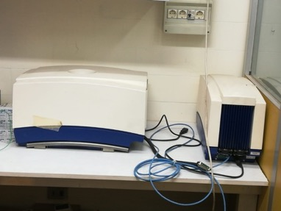
Goals of WP2 (imaging)
Evaluate bio-distributions of fluorinated tracers using ¹⁹F-MRI
¹⁹F-MRI performances limited by low SNR ratio
Possible hardware improvements to ¹⁹F-MRI
- low noise RF coil
- software defined radio technology
for signal digitization
- new pre-amp & cooling
Possible sofware improvements to ¹⁹F-MRI
- use of deep learning to denoise and analyse images
Choice of fluorinated molecules
- tests on animals to have samples
with correct concentrations
test-stand: 0.35 T scanner
9T spectrometer

Slide 3
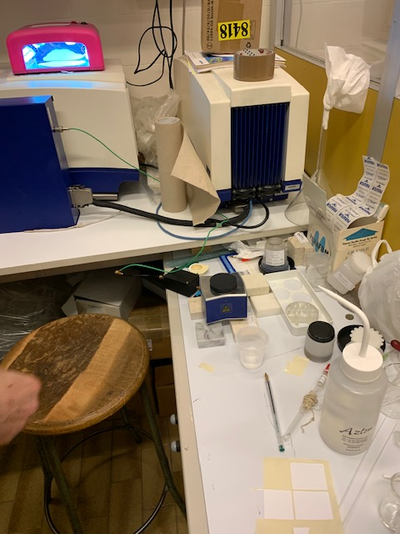
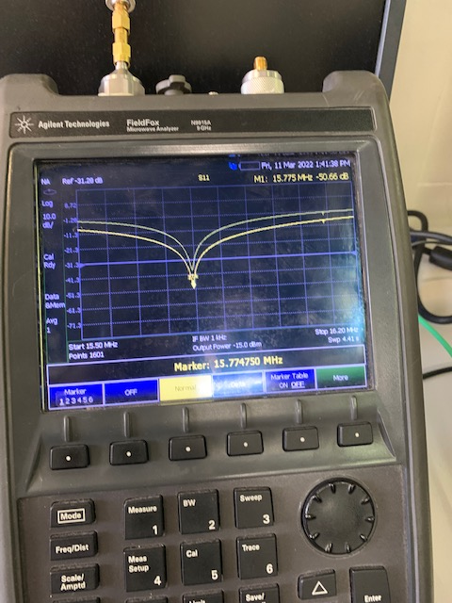
Status of HW Improvements: Antenna
Built and tested on proton first (2 loop and 3 loop)
Seems properly tuned and matched
We tried 1H-MR first: we don't find signal => try to improve EM shielding and mechanical stability (vibrations) => ask help from LABE
Brucker
and
new antenna
resonance frequency
Antenna
circuit
Reference
sample
Permanent
magnet and
antenna box

Slide 4
Status of HW Improvements: SDR
Already at the beginning of Neptune we realized that the FID is not accessible from the scanner (only processed signal)
SDR was bought and installed
SDR and computer is at Daniele's home
The only way to use it is
1) generate the NMR sequence through SDR
2) receive the signal through new antenna and read it through SDR
=>
1) requires some work (Daniele's comment, he is now working in a hospital....undergrad student?)
2) can be implemented by Daniele, requires antenna is working

Slide 5
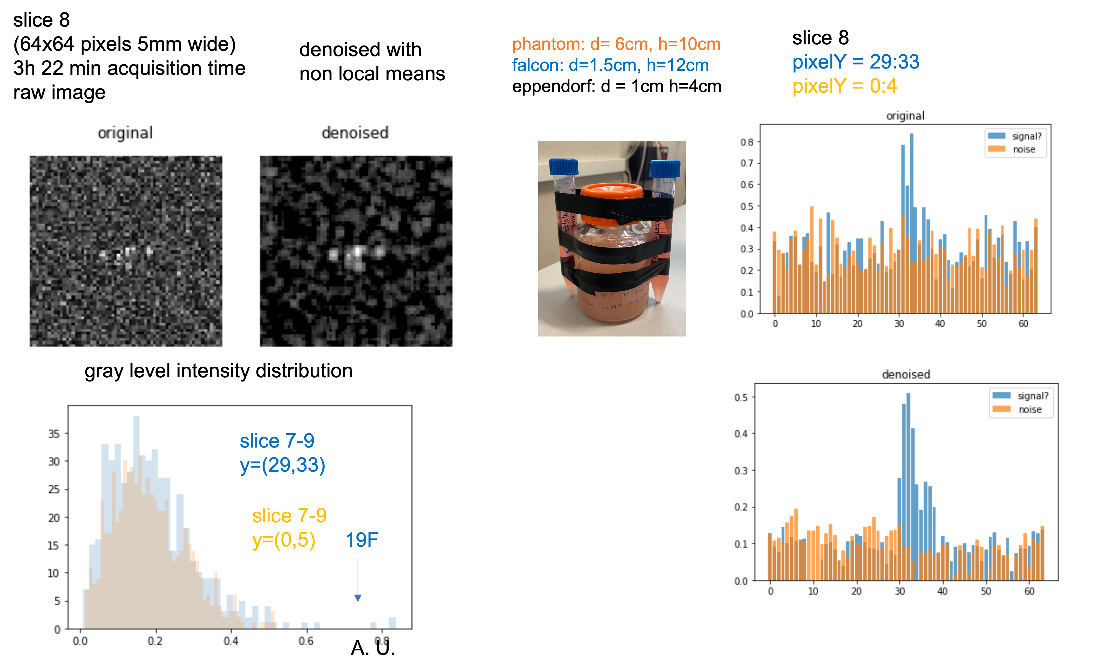
Status of Software Improvements: Denoiser
Denoiser in K-space developed by Andrea
- residual learning scheme
- trained and validated on protonic images (knees) where noise was artificially added
We are taking 19F MRI and 1H MRI (for re-training) data at Santa Lucia (collaboration with F. Giove)

Slide 6
Status of Software Improvements
PANC cell line has been selected as use case (radioresistant tumor)
FBPA has been selected as tracer after some studies
- BPA used in BNCT
- some promising in vivo-studies
- internalized in PANC cells
We realized it is not optimal for the pancreas case (uptake in the healty pancreas)
In vitro-tests
- 19F-MRS assessed ~50% internalization fraction (@4h, 13.6 mM, typical of BNCT)
- we repeated the measurement with improved protocol
- we are testing F-LDOPA preload in c6 cellular line
Today:
Micol
Ex vivo/in vivo tests (MR+ neutron autoradiography)
- first ex-vivo test feb 2021 (9T MRS)
- new tests at ISS (7T Scanner, R. Canese)
j
Analysis underway

Slide 7
