Slide 1
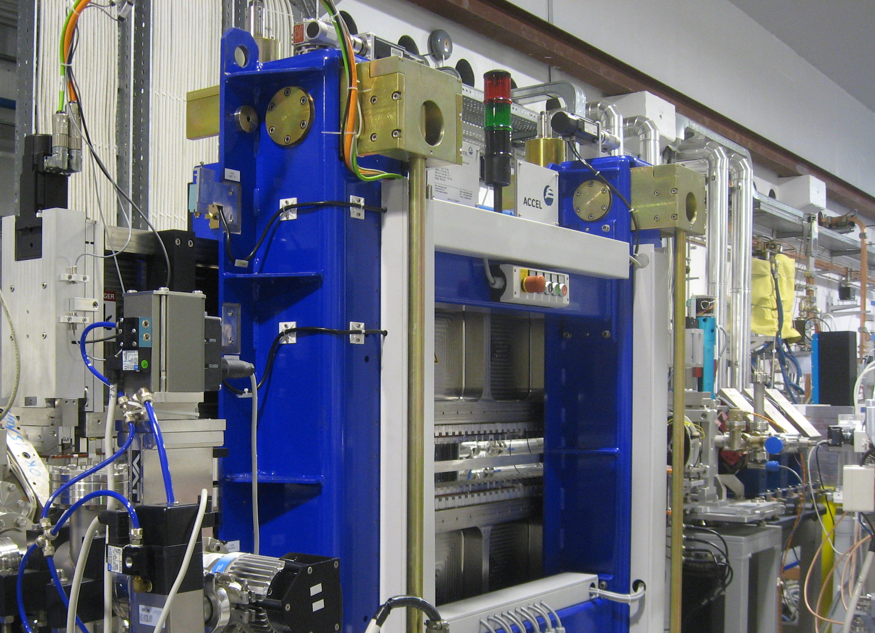



WA6 Report
FEL Schemes for EuPRAXIA@SPARC_LAB
L. Giannessi
on behalf of the WA6 collaboration team

Slide 2
Recall from last meeting: Two beamlines
  1) AQUA: Soft-X ray SASE FEL – Water window 3 nm shortest wavelength
  2) ARIA: VUV seeded HGHG FEL beamline for gas phase (not in the baseline)
Modulator
Radiators
Seed
Dispersive section
26/10/2021 – L. Giannessi

Slide 3
AQUA
26/10/2021 – L. Giannessi

Slide 4
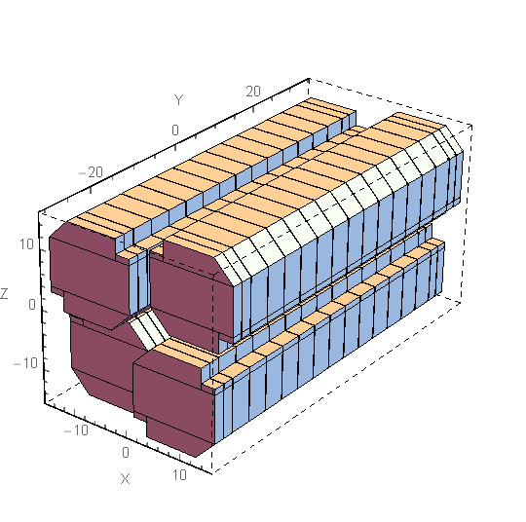
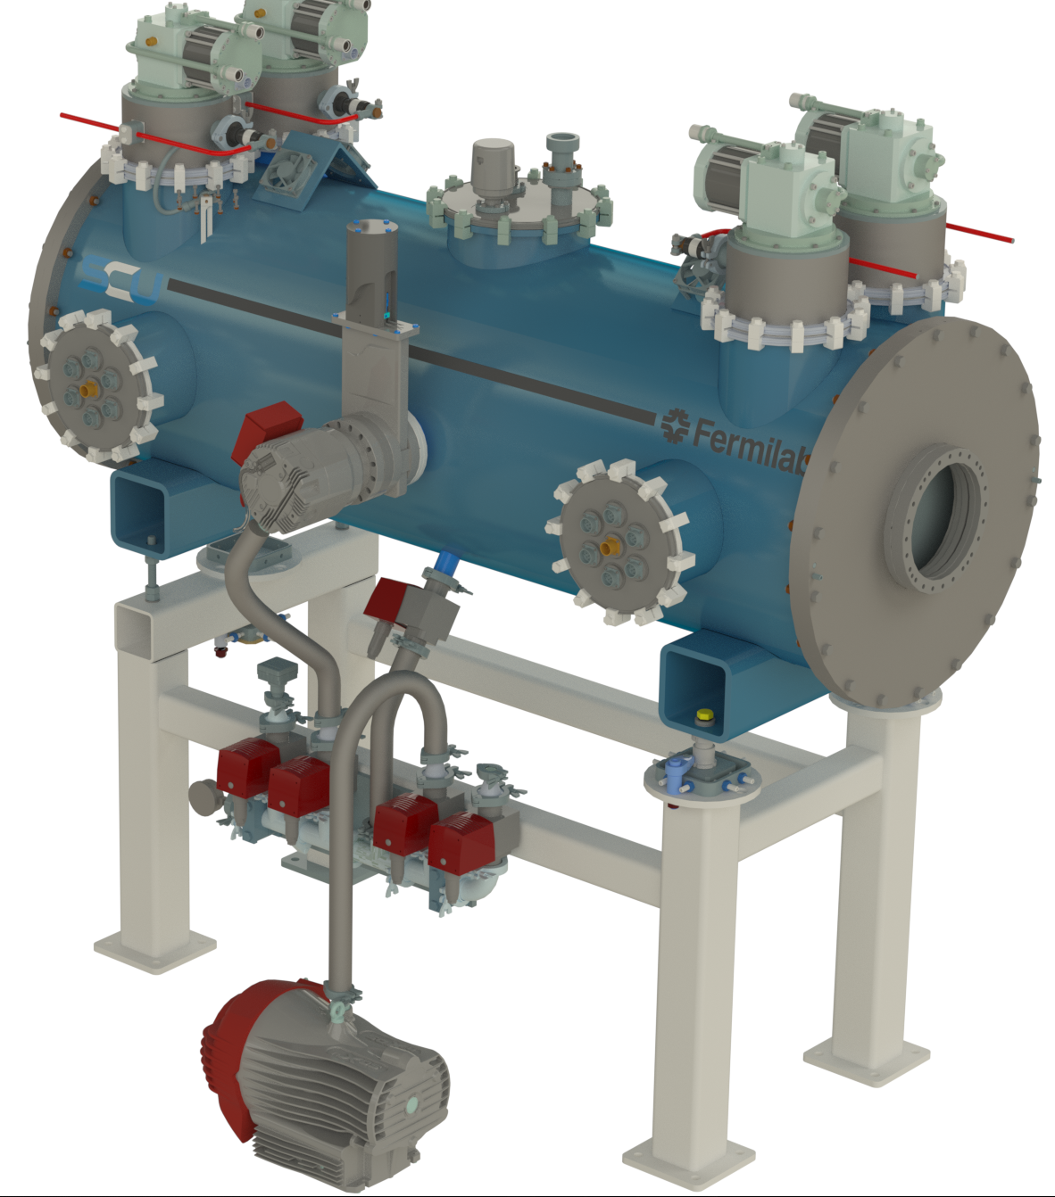
Undulator technology
Superconducting Undulator
Permanent Magnet Undulator
Respons. A. Petralia (ENEA)
Apple X - Variable gap, variable polarization
New poles design, scaled from SABINA (LNF- THz FEL) undulator
Period increased to 18 mm to increase tuning range.
Unconventional undulator design: Is prototyping required ?
(Advice from the committee welcome)
Observers in the LEAPS – INNOV: several labs investing in this kind of devices.
Alternative: sacrifice the tuning range - fixed gap PMU – less expensive, but poor flexibility
Responsible C. Boffo (FNAL)
Agreement with FNAL signed 1y ago
Development plan 4 ys – 2024 prototype in Frascati
Costs for the entire undulator in excess of the baseline for the project
26/10/2021 – L. Giannessi

Slide 5
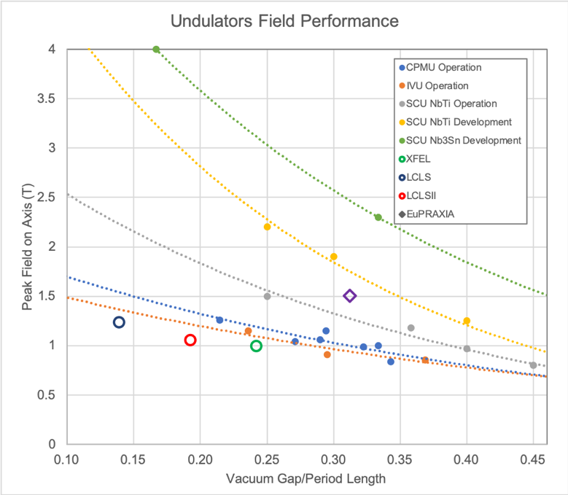
SC Undulators potential
Courtesy of C. Boffo | FNAL
Higher peak field on axis for the same vacuum gap and period length in operation with electron beam.
Demonstrated higher radiation resistance compared to permanent magnet undulators.
Full potential of superconductivity not yet exploited, margins on NbTi and increased potential of Nb₃Sn and HTS.
Chart based on: https://doi.org/10.1016/j.nima.2018.03.069
26/10/2021 – L. Giannessi

Slide 6
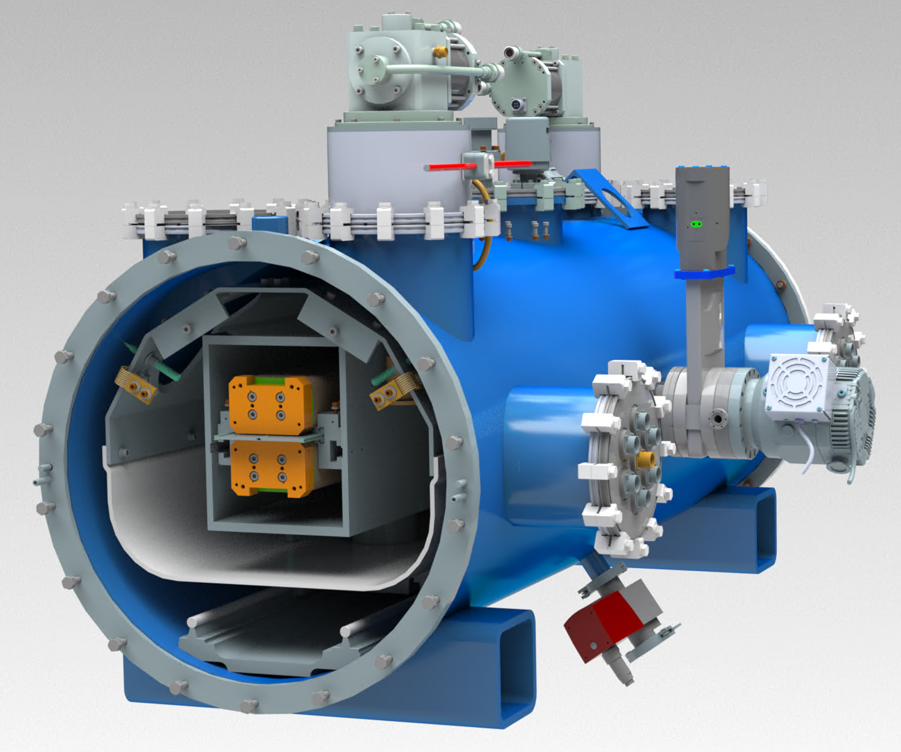
Modular Design
Courtesy of C. Boffo | FNAL
Cooling: 2+2 1.8 W GM coolers
Reduced vessel diameter to minimize: costs, used space and radiation input at 50K
Current leads optimized for higher current/heat load. Hybrid HTS phosphor bronze system
Integrated G11 support posts as in LHC magnets combined with railing system as PIP-II cryomodules
Heat load | Shield 50k | Magnet 4.2k
Radiation | 4.6 | 0.20
Conduction | 9.6 | 0.28
Current Leads | 50 | 0.21
Instrumentation | 1 | 0.01
Dynamic losses |  | 0.47
Total | 65.2 W | 1.17 W
26/10/2021 – L. Giannessi

Slide 7
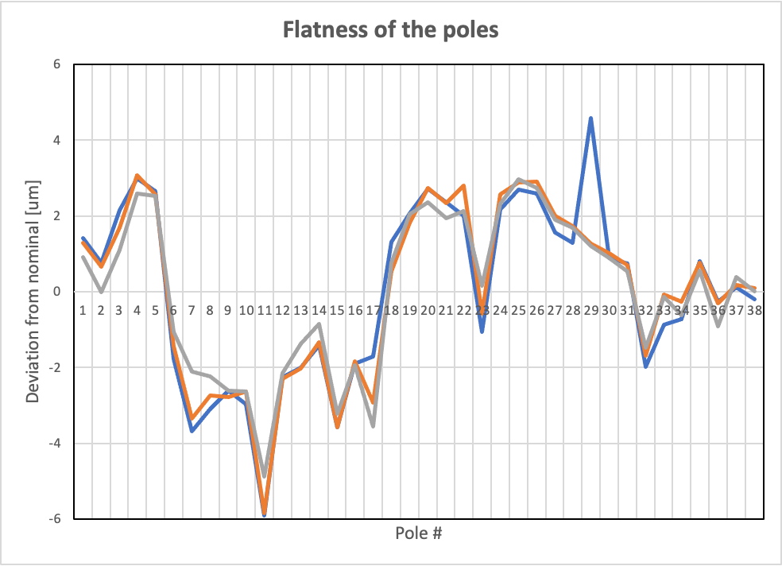
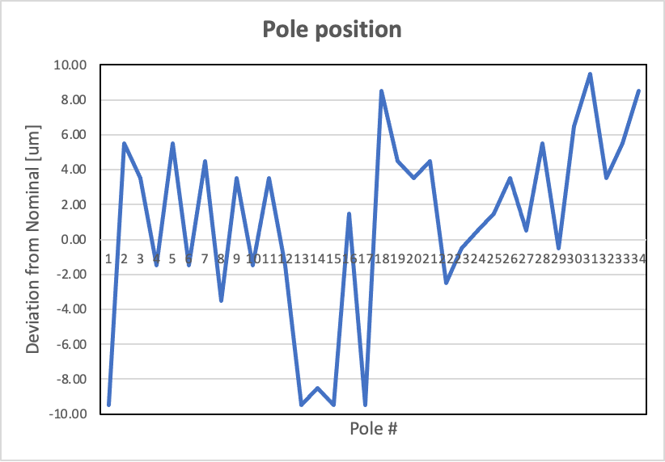
Coil Prototyping
Courtesy of C. Boffo | FNAL
Manufacturing of yokes was successful – two supplier qualified
Optimization of insulation parts is completed
Started dummy winding, superconductor winding to follow
26/10/2021 – L. Giannessi

Slide 8
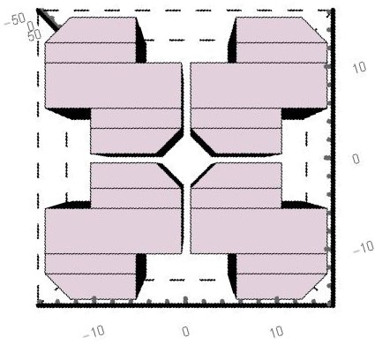
Permanent Magnet undulator design
Courtesy of A. Petralia
Q2
Q1
φ Stay clear 5.347 mm
φ Pipe 5 mm
Gap 1 mm
Q3
Q4
y
x
26/10/2021 – L. Giannessi

Slide 9
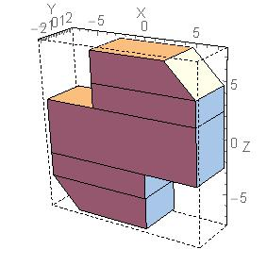
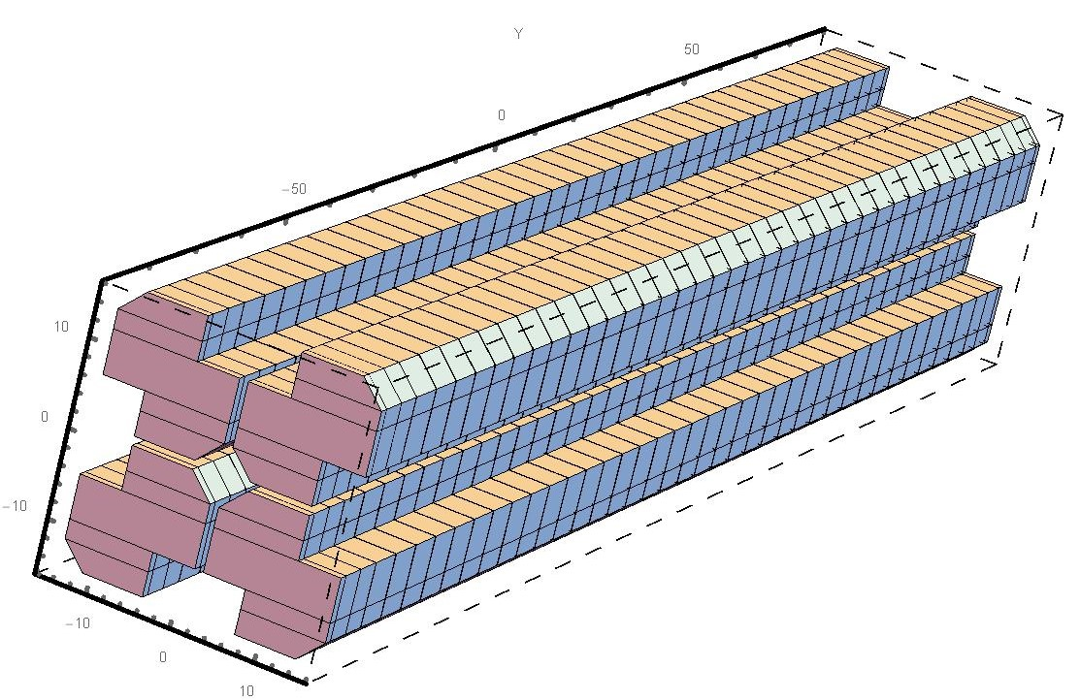
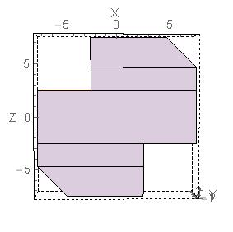
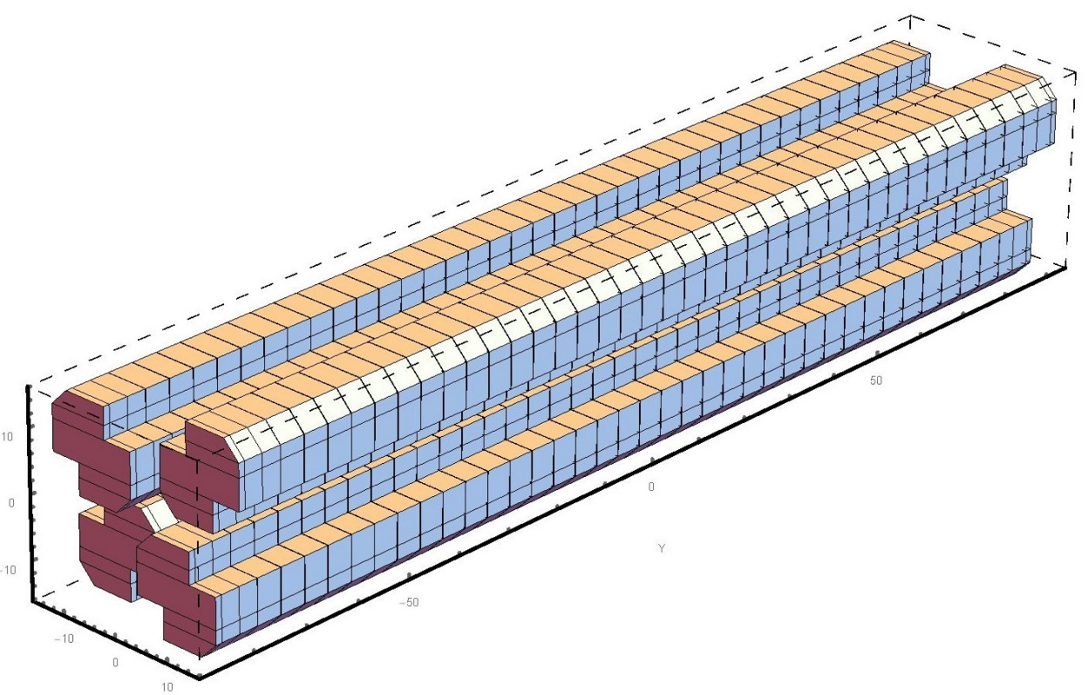
Magnet size and orient.
Courtesy of A. Petralia
Linear
Δz = 0
15 mm
5 mm
lz
15 mm
Lz = period/4 – 0.1 mm
Magnetization
Period 18 mm
Blocks sep. 0.1 mm
4 blocks / period
# periods 110
2.8 mm
2.8 mm
Circular
Δz = 0.25 * periodo (c.a)
26/10/2021 – L. Giannessi

Slide 10
Tunability and perf. @ 1 GeV*
Best period in lin. pol (LH) is 16 mm, but very limited tuning range and circular polarization (CR) not available
Period of 18 mm ensures good performances at 4 nm, critical at 3 nm (with the available beam parameters)
Period length (mm) | Polarization | Kmax (Br=1.35T) | *Max λ (nm) | *Min λ (nm) K >0.7
16 | LH | 1.44 | 3.5 | 2.1
18 | LH | 1.81 | 6.2 | 2.9
16 | CR | 0.59 | 2.3 | 2.1
18 | CR | 0.77 | 3.7 | 2.9
26/10/2021 – L. Giannessi

Slide 11
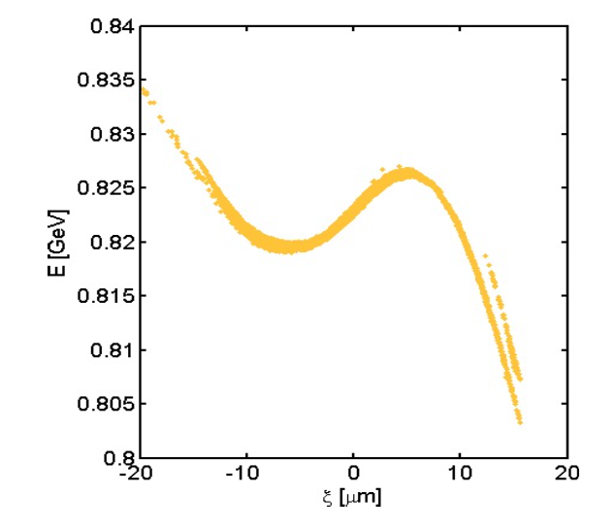
FEL performances
Beam parameters from WA1 – Beam dynamics
 | High charge High current Short pulse | High charge Low Current Flat-top | Low charge Ultrashort (linac) | Low charge Ultrashort (plasma)
AQUA | A | Not interesting | C | D,E
ARIA | Not interesting | B | C | D,E
LINAC
LINAC + PWA
Parameter | Symbol | Units | A | B | C | D (CDR) | E
Charge | Q | pC | 200 | 200 | 30 | 30 | 30
Energy | E | GeV | 0.996 | 1 | 1 | 1 | 1
Peak current | I_{peak} | kA | 1.6 | 0.7 | ? | 1.8 | 800
Bunch length | 𝝈_{z} | μm | 18.3 | 100 | ? | 4 | 5
Proj. norm. emittances (x/y) | 𝜺_{n,x,y} | mm-mrad | 1.85 | ? | ? | 1.7 | 3/4
Slice, norm. emittances (x/y) | 𝜺_{n,x,y} | mm-mrad | 0.5 | 0.5 | ? | 0.8 | 3/4 (1/1.2 at linac)
Proj. energy spread | 𝝈_{𝜹p} | % | 0.09 | ? | ? | 0.95 | 1.5
Slice Energy spread | 𝝈_{𝜹s} | % | 0.02 | 0.01 | ? | 0.05 | 0.06
AQUA
ARIA
AQUA/ARIA
26/10/2021 – L. Giannessi

Slide 12
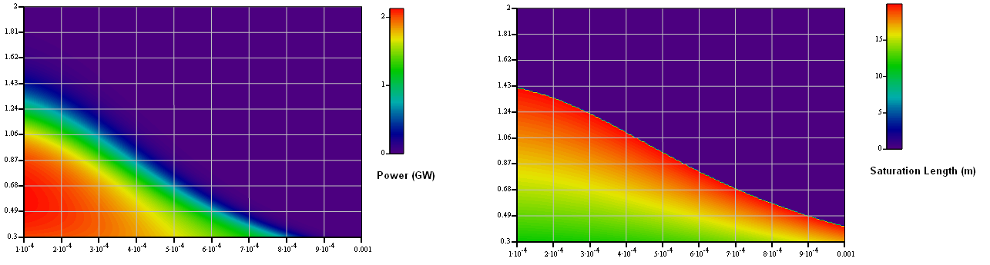
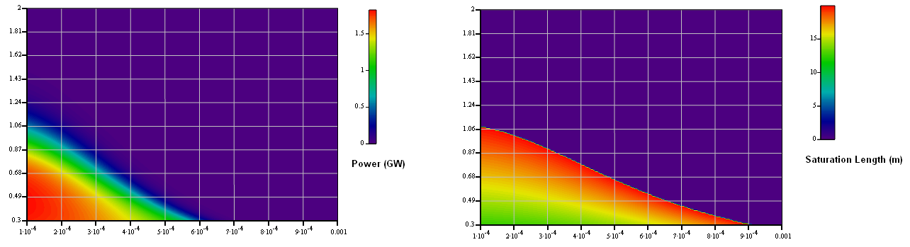
FEL performance map
Other parameters:
Polarization Linear
Peak current 1.6 kA
Beta functions 8 m
Case A ensures lasing in both conditions
Case D (CDR parameters with current 1.6 kA): energy spread critical
4 nm – 18 mm period
Emittances (mm-mrad)
D
D
A
A
3 nm – 16 mm period
Emittances (mm-mrad)
D
D
A
A
Energy spread (relative)
Energy spread (relative)
26/10/2021 – L. Giannessi

Slide 13
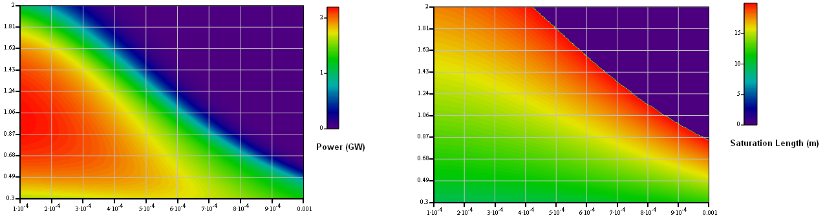
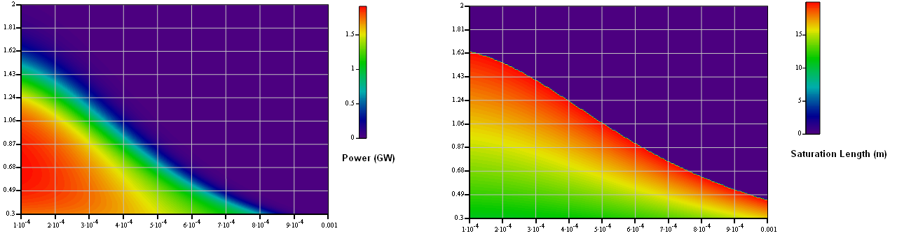
FEL performance map at longest wavelength (1 GeV)
The longest wavelength that can be achieved:
with 18 mm period is 6.1 nm
with 16 mm period is 3.7 nm
18 mm period solution is less sensitive to e-beam parameters
6.1 nm – 18 mm period
Emittances (mm-mrad)
D
D
A
A
3.7 nm – 16 mm period
Emittances (mm-mrad)
D
D
A
A
Energy spread (relative)
Energy spread (relative)
26/10/2021 – L. Giannessi

Slide 14
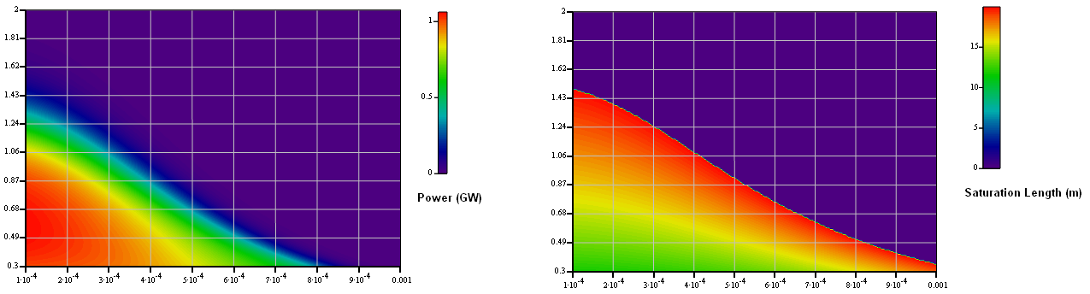
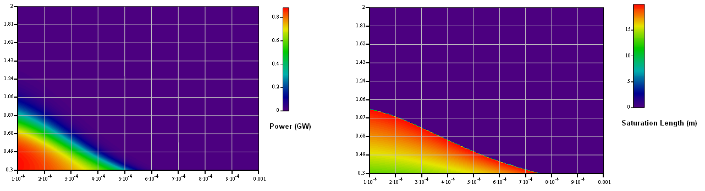
Beam E: Peak current 0.8 kA
Beam “E” parameters are still critical, even with 18 mm period
4 nm – 18 mm period
Emittances (mm-mrad)
E
E
3 nm – 16 mm period
Emittances (mm-mrad)
E
E
Energy spread (relative)
Energy spread (relative)
26/10/2021 – L. Giannessi

Slide 15
ARIA
26/10/2021 – L. Giannessi

Slide 16
ARIA
SEEDED FEL line – Full coherence – Short/Long pulses – Close to FT Limit
Modulator
Radiators
Seed
Dispersive section
High-Gain Harmonic Generation seeded FEL: modulator – dispersive section – 4 radiators
Wavelength range 50 nm (then 30 nm) – 180 nm – continuously tunable – 10-100 uJ pulse energy
Apple II Undulators: variable polarization (circular left/right, horizontal and vertical)
Ready for users since the first commissioning phase. Would contribute to establish a user community for the EupraXia at SparcLab user facility
26/10/2021 – L. Giannessi

Slide 17
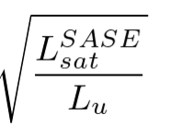


Two operating modes
Long seed/ Long e-bunch mode:
  Narrow linewidth, eventually in combination with a monochromator.
  The presence of a “long” seed transfers seed coherence properties to the e–beam and maximizes the coupling with the spectral acceptance of the monochromator
Short e-bunch mode:
  Electron bunch shorter than the coop. length: single long. mode
  Pulse duration limited by gain bandwidth ∼10 fs
  Deterministic system, second order coherence provided by the seed - > stable in intensity and central wavelength
The gain bandwidth in a FEL amplifier is proportional to the parameter and to the ratio when
ARIA operates in the VUV with a beam “designed” for the water window” -> large
ARIA is seeded: the presence of the seed ensures:
The ARIA seeded FEL can generate ultrashort pulses in the VUV when driven by a high current, high brightness, short electron bunch
26/10/2021 – L. Giannessi

Slide 18
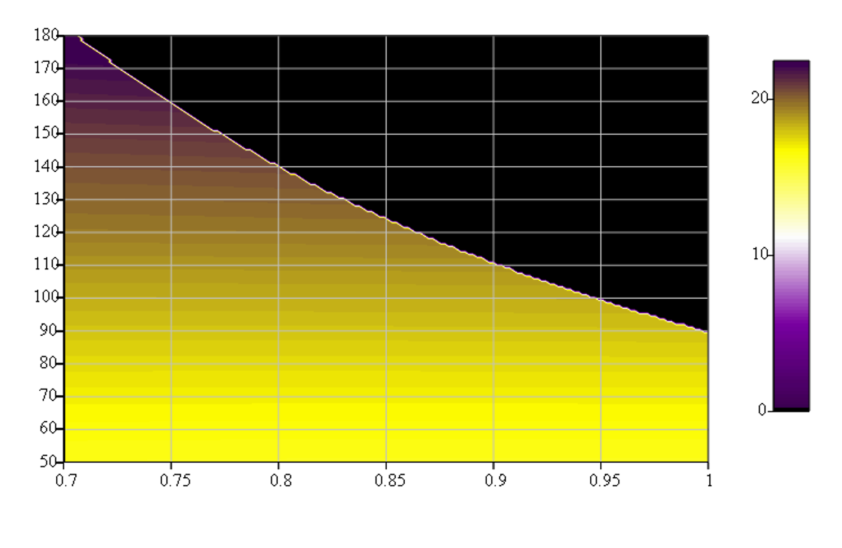
Pulse duration
Estimated as the FT Limit of the bandwidth calculated with the Xie scaling relations (Beam D)
Pulse duration limit due
to gain bandwidth (fs)
Wavelength (nm)
Beam Energy (GeV)
e-bunch duration 15 fs – circular polarization – Aria beam parameters D
26/10/2021 – L. Giannessi

Slide 19
GENESIS 1.3 simulations (courtesy of M. Opromolla/V. Petrillo ∼beam D parameters)
153nm (nh=3)
92nm (nh=5)
66nm (nh=7)
51nm (nh=9)
26/10/2021 – L. Giannessi

Slide 20

GENESIS 1.3 simulations (courtesy of M. Opromolla/V. Petrillo ∼beam D parameters)
Rad. Properties | nh |  | 3 | 4 | 5 | 7 | 9
Wavelength | nm | 153 | 115 | 92 | 66 | 51
Seed energy | μJ | 1.2 | 8 | 8 | 30 | 30
Photon energy | μJ | 22 | 27 | 24.7 | 12 | 5
Duration (FWHM) | fs | 25 | 23 | 17 | 18 | 18
Bandwidth | % | 0.85 | 0.71 | 0.63 | 0.43 | 0.4
Size | mm | 1.2 | 1.11 | 1.17 | 1.07 | 0.8
Divergence | mrad | 0.68 | 0.48 | 0.38 | 0.27 | 0.2
23 fs
17 fs
25 fs
E ($μJ$)
18 fs
18 fs
λ (nm)
26/10/2021 – L. Giannessi

Slide 21
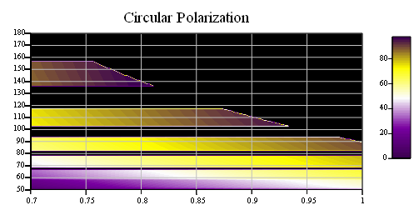
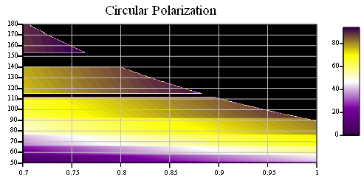
ARIA Seed laser system
Forbidden bands
Seed requirements
Pulse energy > 20 μJ
Spectral range 410-460 nm.
Pulse duration 200 fs
Can be realized with commercial OPA amplifiers. A limited seed tuning range results in forbidden bands in the FEL spectral range. However, the choice of a long wavelength seed simplifies the switch between two OPA processes allowing to cover the full range (after 2ndHG) with harmonic orders 3-9
Seeding at shorter wavelengths is possible, but lower harmonics require a wider tuning range. Dispersion affects the optics and replacement of mirrors from one range another might be required. Shorter wavelength seed (es THG of Ti:Sa) can be considered for operation at shorter wavelengths.
Seed range 410-470 nm
Wavelength (nm)
Energy (μJ)
Energy (GeV)
Seed range 460-560 nm
Wavelength (nm)
Energy (μJ)
Energy (GeV)
26/10/2021 – L. Giannessi

Slide 22
Special modes of operation
The flexibility of this source can be used in a number of ways
e-beam
Multiple
FEL
pulses
Radiator
Seed
Seed +
Double e-bunch
Short & high current e-bunch, long seed.
Pulse duration limited by e-bunch duration & large gain bandwidth
(Flexible: can produce multiple phase-locked pulses)
Radiator tuned at
different harmonics
Chirped Seed +
Multicolor
FEL
pulses
e-beam
Double e-bunch
Seed
Some already explored !!
V. Petrillo, et al., Phys. Rev. Lett. 111, 114802 (2013) <- SPARC experiment in 2012
Ferrari, E., et al. Widely tunable two-colour seeded free-electron laser source for resonant-pump resonant-probe magnetic scattering. Nat Commun. 7, 10343 (2016).
Multiple pulses on a chirped seed: amplification of separated colors. Different colors can be further separated by amplification of different harmonics in the modulator (see ref. 3)
26/10/2021 – L. Giannessi

Slide 23
Conclusions
AQUA – FEL in the water window requires high quality beam
Simulation work is in progress: freezing the configuration still requires some work on the layout
This beamline is also demanding from the point of view of the undulator technology. A SC undulator would ensure best performances and photon energy range extension.
An Apple X PM undulator would still provide a sufficient tuning range, but is technologicaly challenging. The beam stay clear region would also be reduced.
ARIA - The VUV FEL in a seeded configuration is more tolerant in terms of beam quality.
ARIA is seeded by near UV/blue laser. A tuneable seed source delivering few tens of microjoules in the range 410-560 nm covers the full range required by the source (operating at harmonics 3 - 9 of the seed)
ARIA can be combined to a synchronized HHG Source for UV-pump UV-probe experiments, and is a promising resource to build a user community from the early startup of the facility.
From the ESUW21 workshop: The ARIA FEL fills a niche in the world FELs scenario (F. Stellato talk)
26/10/2021 – L. Giannessi

Slide 24
Extra slides

Slide 25
Complementarity with FERMI*
* In the FERMI 2.0 scenario (after upgrade)
AQUA
ARIA
FERMI FEL-1*
FERMI FEL-2*
High Harmonics
λ (nm)
248
49.5
24.8
8.2
4.1
2.48
1.24
0.83
0.63
h𝜈 (eV)
5
25
50
150
300
500
1000
1500
2000

