Slide 1


Francesco Stellato
University of Rome Tor Vergata & INFN on behalf of the WA8 collaboration team
@
EuPRAXIA@SPARC_LAB
WA8 - Users
October 26th, 2021

Slide 2
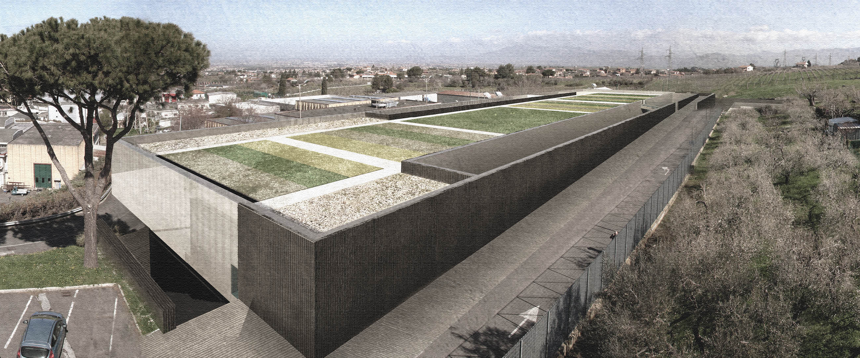
EuPRAXIA@SPARC_LAB – Where we stood
Parameter | Value
Wavelength | ∼3-4 nm
Photons/pulse | 10 ¹⁰ - 10 ¹¹
Pulse duration | < 50 fs
Repetition rate | 10 Hz
Focal spot | ∼6 µm
EuPRAXIA@SPARC_LAB conceptual design report
Ferrario et al. Nucl. Instr. Met. (2018)
Villa et al. Nucl. Instr. Met. (2018)

Slide 3
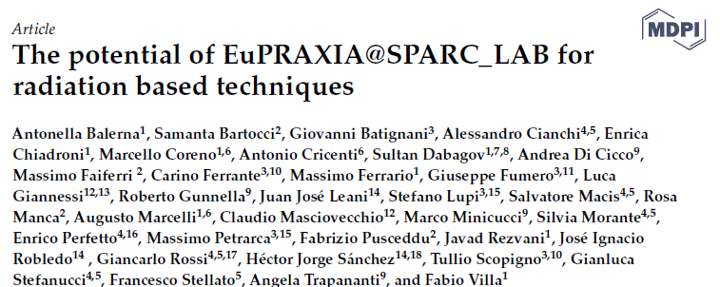
AQUA - CDR Scientific case
A scientific case
@ 3 nm, 10 Hz
for
AQUA
was assembled and published.
Contributions from ~15 different institutions
Balerna et al. Condensed Matter 4, 30 (2019)

Slide 4
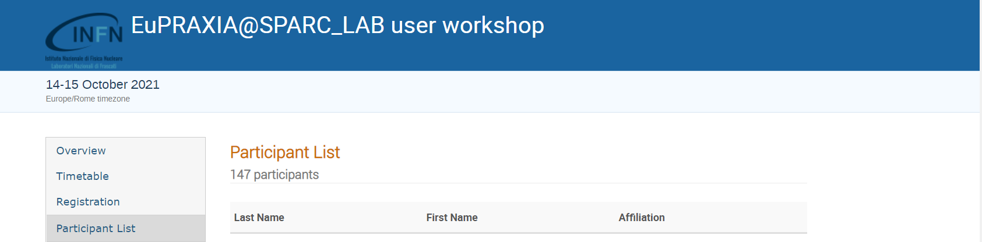
AQUA - A growing community
The first EuPRAXIA@○SPARC_LAB user workshop
More than 140 registrants from 9 countries and ̴30 institutions
https://agenda.infn.it/event/27926/overview

Slide 5
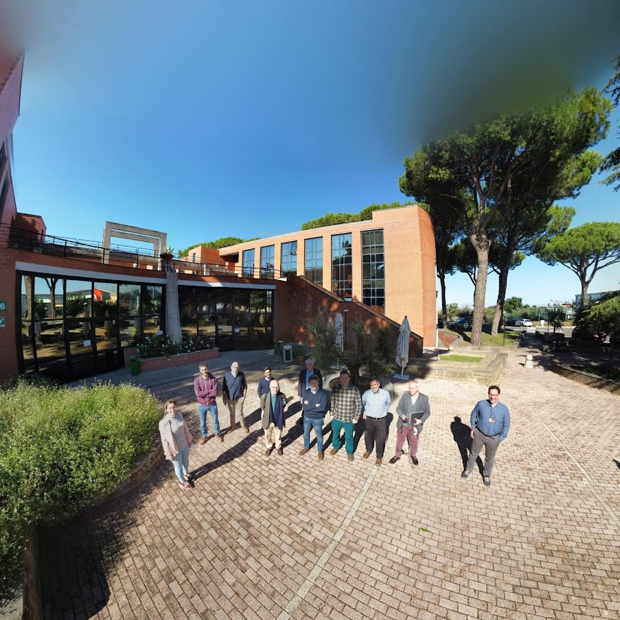
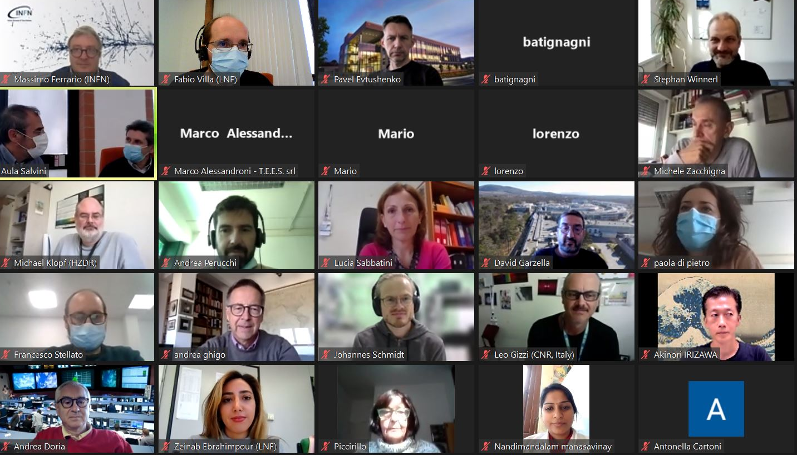
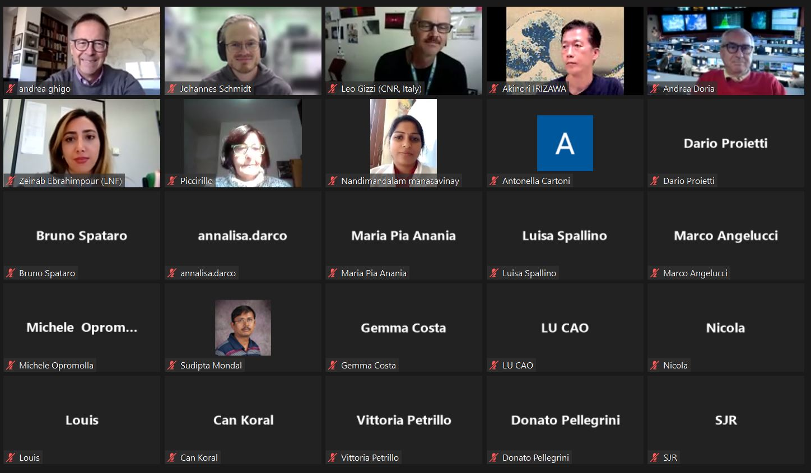
A growing community

Slide 6
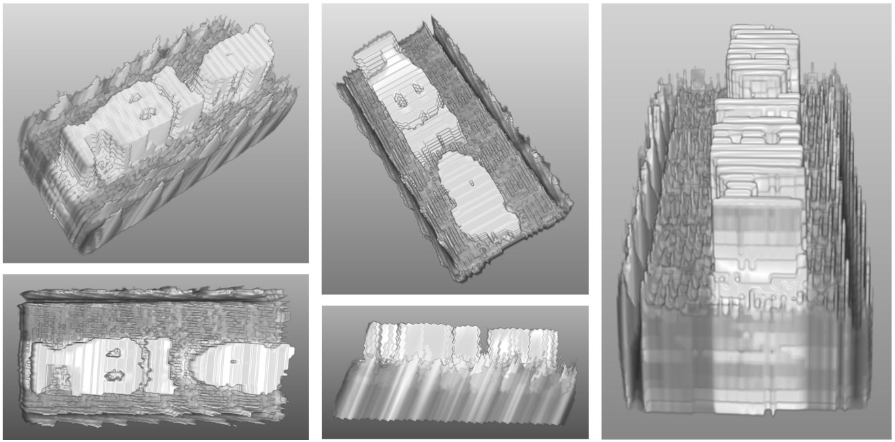
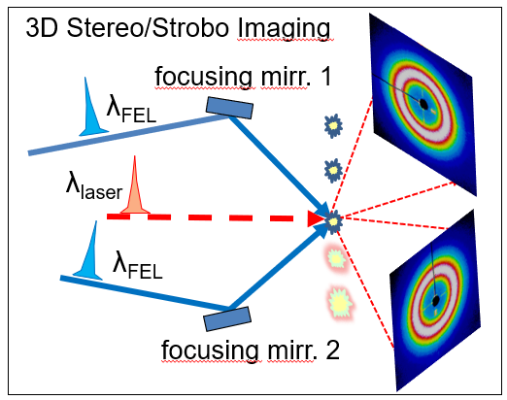
AQUA - A growing scientific case
Spectroscopy: transition metals L-edge, light atoms K-edge, photoemission, electron
Imaging: large protein complexes, viruses
(in hydrated environment),
3D imaging, holography
Courtesy of Flavio Capotondi (Fermi)
3D reconstruction performed in collaboration with by M. Ippoliti, F.Billè, G.Kourousias, D. Fainozzi

Slide 7
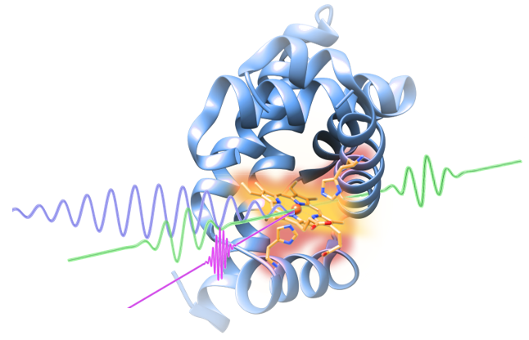
AQUA - Techniques & Samples @ 4 nm
Experimental techniques and typology of samples
Coherent imaging (advanced methods)
3D Imaging
Holography
4 nm is still OK for water-window experiments
Soft X-ray pump-probe spectroscopy
(400 Hz would be a benefit:
same dataset in 40x less time)
Photo-induced phase transitions
Band structure engineering
Ultrafast magnetism
Light-induced superconductivity
Raman spectroscopy
Protein dynamics

Slide 8
ARIA - An emerging scientific case @ 50-180 nm
RC comment
… a possible option that would increase the scientific reach of the facility would be to extend the facility with a second beamline covering another wavelength range…
science case for this FEL needs to be developed further and a user community should be established.
ARIA is a seeded FEL which spans a wavelength region (50-180 nm) not covered by other FEL sources (besides Dalian in China)
Tolerant about beam quality (see Luca Giannessi’s talk)
Main inputs from the users’ community:
Gas-phase chemistry
Astrochemistry
Surface spectroscopy
Photoemission spectroscopy
Biomolecules dissociation

Slide 9
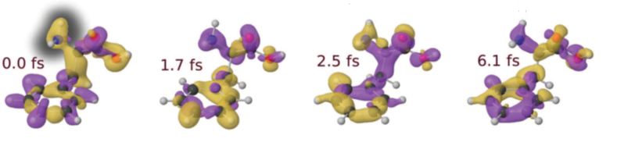
ARIA - Techniques & Samples @ 50-180 nm
Defining experimental techniques and typology of samples (and applications)
Photoemission
Spectroscopy
Raman spectroscopy
Photo-fragmentation of molecules
Time of Flight Spectroscopy
Gas phase & Atmosphere
(Earth & Planets)
Aerosols
(Pollution, nanoparticles)
Molecules & gases
(spectroscopies, time-of-flight)
Proteins
(spectroscopies)
Surfaces
(ablation e deposition)
Villa et al. Cond. Mat. (in preparation)

Slide 10
External Radiation Sources
Time-resolved pump-probe experiments require (besides split&delay) coupling to an external radiation sources :
Lasers
1- Tunable, for the experiments requiring an intensity of the order of few TW
2- High-power, hundreds of TW –
Detailed scientific case definition and technical feasibility study ongoing
THz radiation
!!! Coupling with lasers and THz radiation might be the real facility strongest asset !!!

Slide 11
Other Radiation Sources
X-ray betatron radiation is emitted with a synchrotron-like (wiggler) process within a narrow cone.
Ultra-fast spectroscopies exploiting ultra-short betatron pulses
FEL simulator – ultra-fast X-ray pulses to setup ultra-bright experiments
Phase Contrast Imaging – EuPRAXIA@SPARC_LAB is a source itself, but can contribute to technology development of compact betatron sources
Paroli & Potenza Adv Phys X 2017
Stellato et al. Cond. Mat. (submitted)

Slide 12
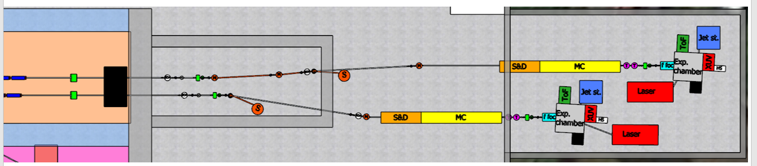
EuPRAXIA@SPARC_LAB Photon Science Program
Lasers pump-FEL probe
THz pump-FEL probe Lasers experiments
THz experiments
Courtesy of Fabio Villa
Lasers
THz
Betatron
X-rays experiments
+
FEL tests

Slide 13
Scientific Case & Endstation(s)
Intermediate Deliverables on the road to the TDR
Scientific Case & Endstation(s)
Intermediate Deliverables on the road to the TDR
AQUA - Scientific case @ 3/4 nm
- User Science: enrichment of the AQUA experimental program
- Details of instrumentation (detector, sample delivery) for the experimental endstation from CDR to TDR level
ARIA - Scientific case @ 50-180 nm
User Science: definition of the ARIA SASE FEL experimental program
Users’ community commitment
- Evaluation of instrumentation for the experimental endstation from scratch to a TDR level
AQUA + ARIA
- Connections with correlated services and other photon sources (lasers and THz)
- Costs evaluation

Slide 14
WA 8 (Users) R&D Financial Requests
Optical Element prototypes
Diffractive Optics (e.g. Multi-channel plates) 15 k€
Robot (for optical elements manipulation in vacuum chamber) 50 k€
HV mechanic elements 30 k€
Workstation & remote controls 10 k€
Sample delivery R&D 105 k€
Pilot experiments @ various facilities 15 k€
____________________________________________________________
225 k€

Slide 15
The HV manipulator is an exapod system characterized by a high precision motion, six degrees of freedom and large travel ranges.
The motion ranges are: ±25 mm (X,Z), ±6.25 mm (Y) and ±5° (θX, θY, θZ). This sample positioning offers a bidirectional repeatability of ±0.5 μm (X,Y,Z) and ±20 μrad (θX, θY, θZ) working at the minimum operating pressure of 10⁻⁷mbar
Tests @ Elettra
–
CiPo beamline
Experiments to develop equipment and train young scientists

Slide 16
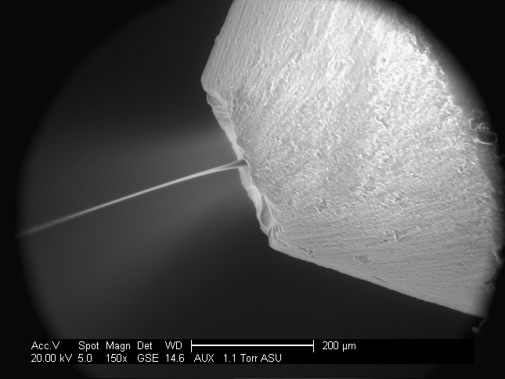
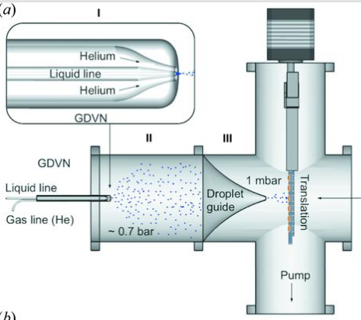
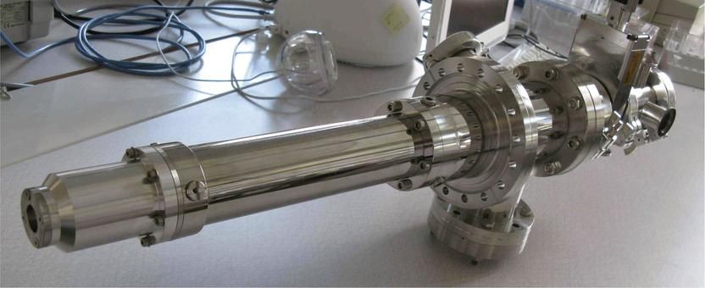
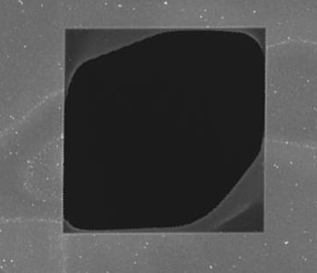
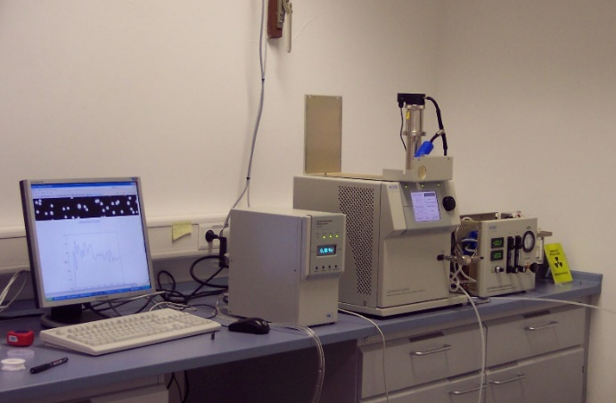
Sample Delivery – R&D for AQUA + ARIA
Liquid Jets
Aerosols
Graphene -Si₃N₄ membranes
Electrospray
10 μm

Slide 17
Timescale
Year 1
Inputs from a broad FEL community: first users’ workshop ESUW21
First dedicated post-doc
Inputs from (and to) FEL group for both AQUA and ARIA FELs
Inputs from (and to) laser group
Year 2
Commitment of the FEL users’ community: second users’ workshop ESUW22
Preliminary Beam transport & Optical elements simulations
Optical elements & detectors (0D, 2D, ions) R&D
Optical elements tests at other radiation sources + simulations
Year 3
Beam transport & Optical elements design
Optical elements & detector tests
Sample delivery R&D
Mechanical components design

Slide 18
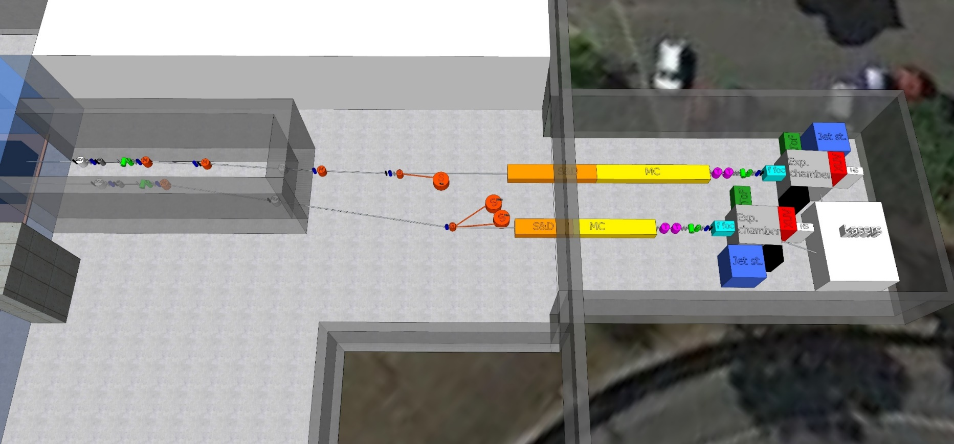
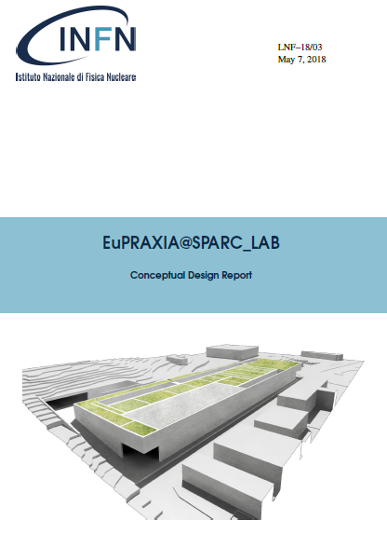
A step forward to bring this picture from CDR to TDR level
From CDR to TDR
Technical Design Report

Slide 19

Many thanks for the attention
Questions and comments are
(and will be)
more than welcome

