Slide 1


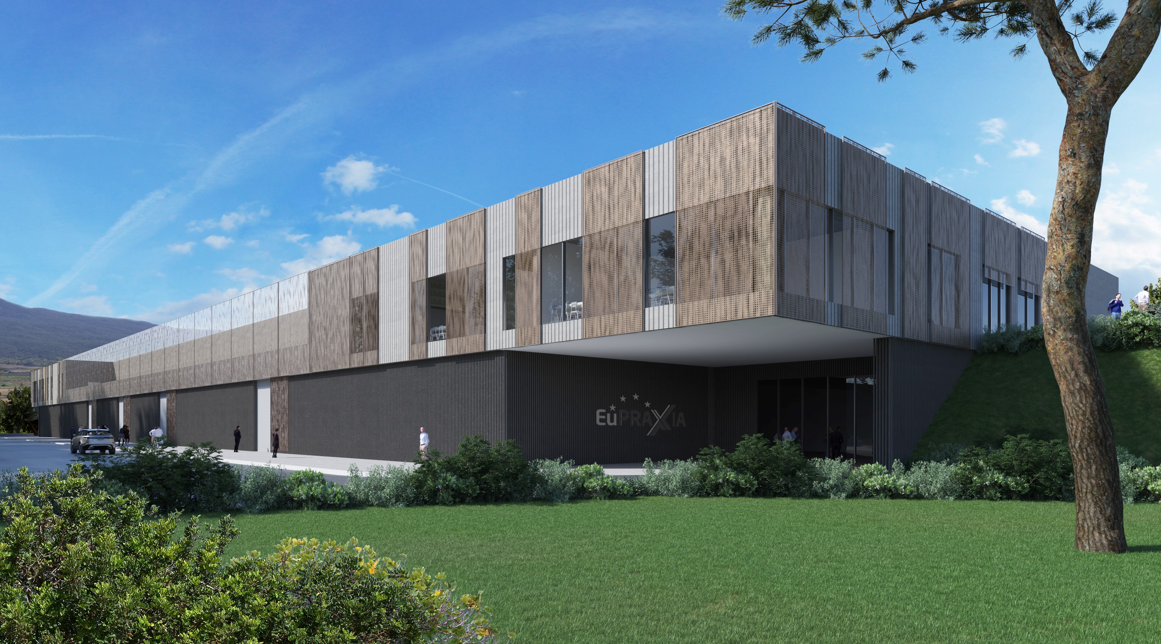
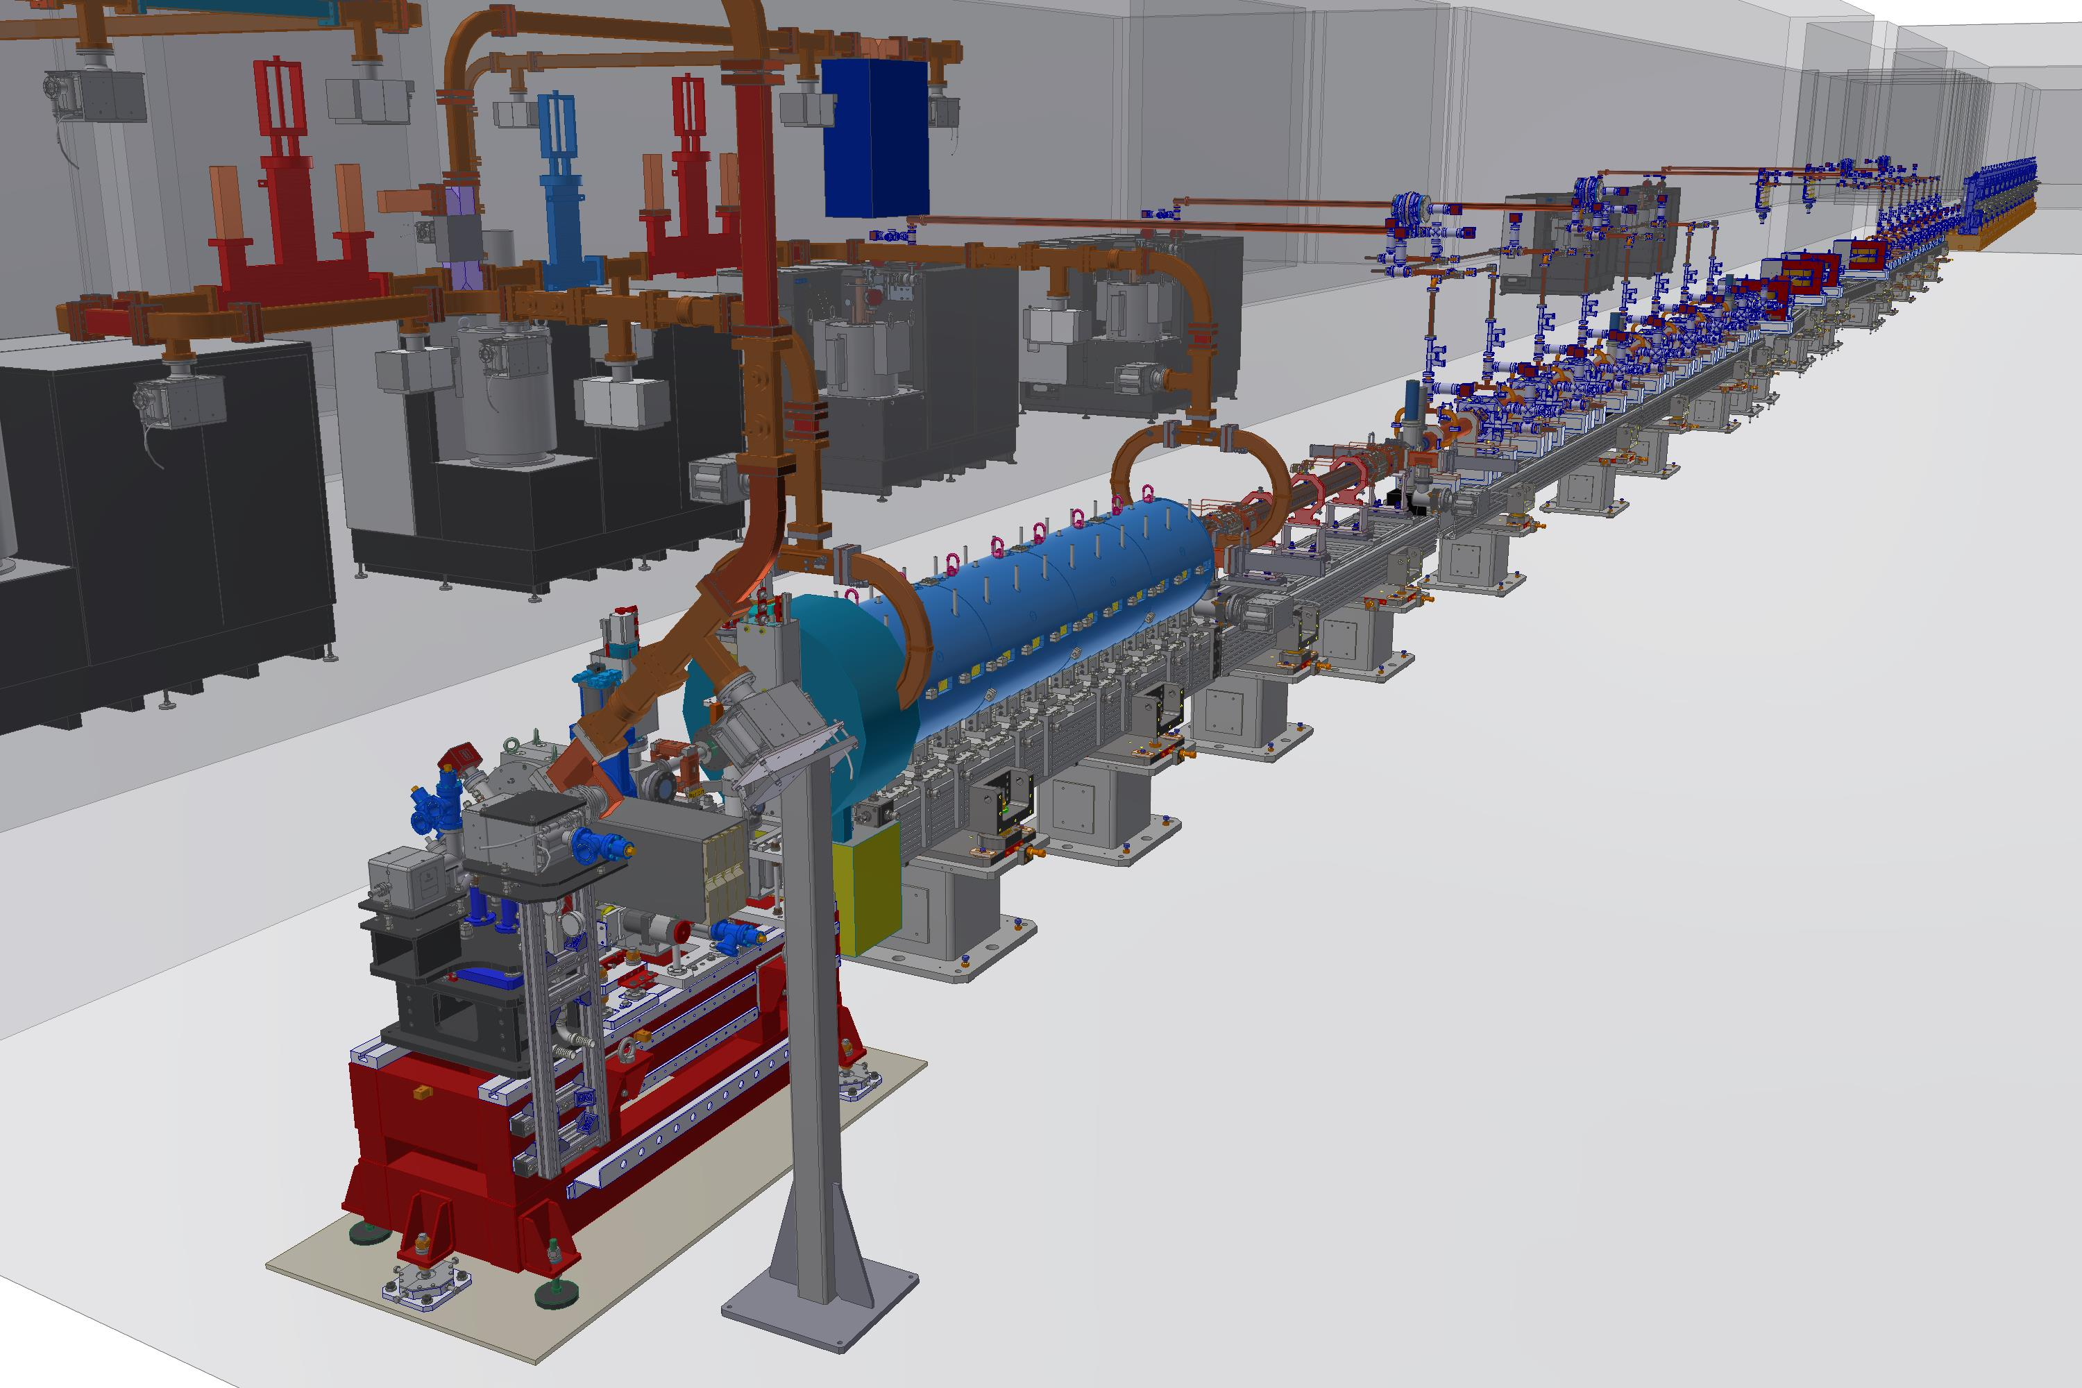
EuPRAXIA@SPARC-LAB:
Machine Layout
Andrea Ghigo on behalf of
EuPRAXIA@SPARC-LAB collaboration
EuPRAXIA@SPARC_LAB TDR Rev.Committee A.Ghigo Frascati October 26, 2021

Slide 2
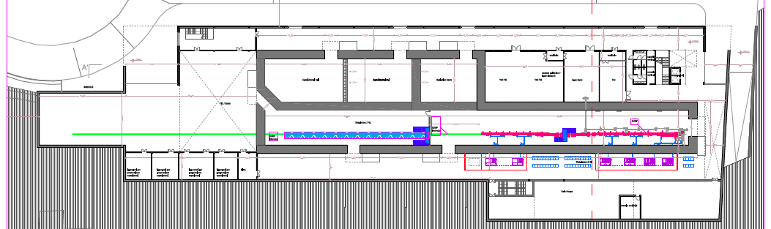
Functional area distribution: ground floor
Particle experimental halls
Photon users experimental hall
Laser & THz clean rooms
S.Incremona
Users labs
Accelerator tunnel
Plant gallery
Undulators tunnel
Klystron&modulators
Power supplies gallery
EuPRAXIA@SPARC_LAB TDR Rev.Committee A.Ghigo Frascati October 26, 2021

Slide 3
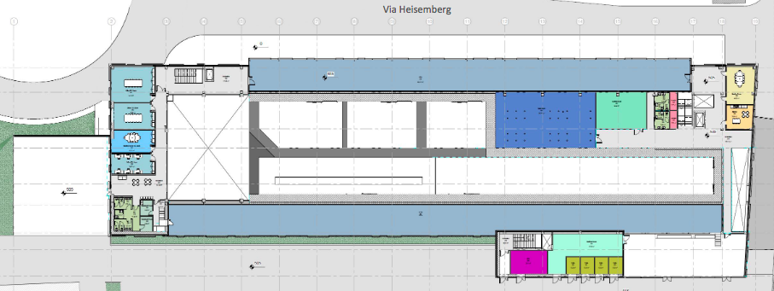
Functional area distribution: first floor
Laser Power
Supplies Room
Meeting Room
Control Room
Plants ext. corridors
Plants Gallery
User offices
EuPRAXIA@SPARC_LAB TDR Rev.Committee A.Ghigo Frascati October 26, 2021

Slide 4

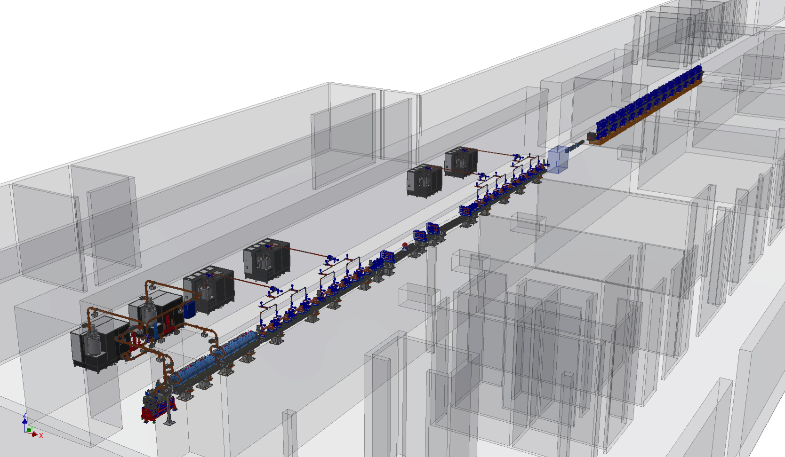
Linac & undulators 3D layout (February)
E.Di Pasquale
EuPRAXIA@SPARC_LAB TDR Rev.Committee A.Ghigo Frascati October 26, 2021

Slide 5
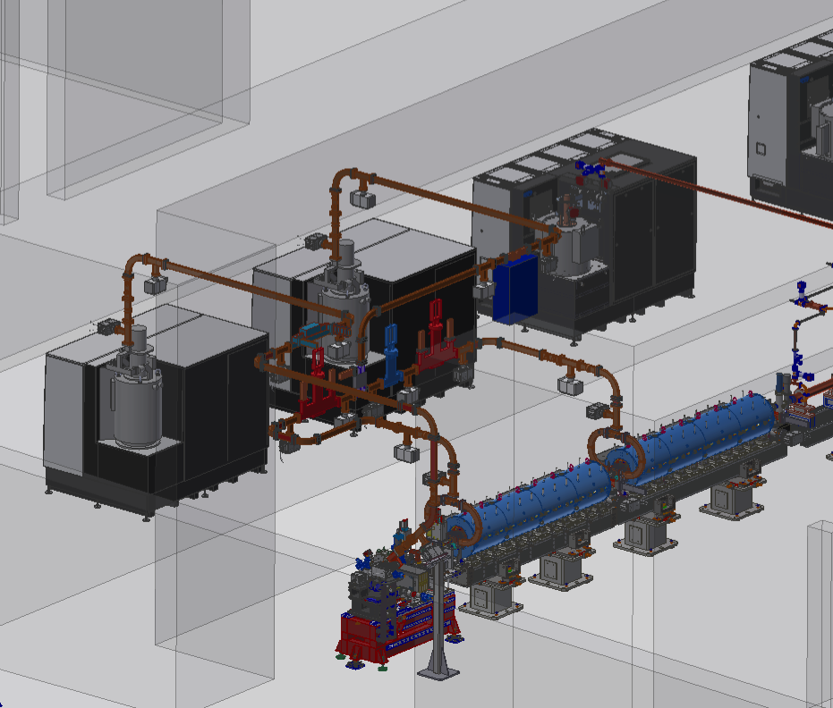
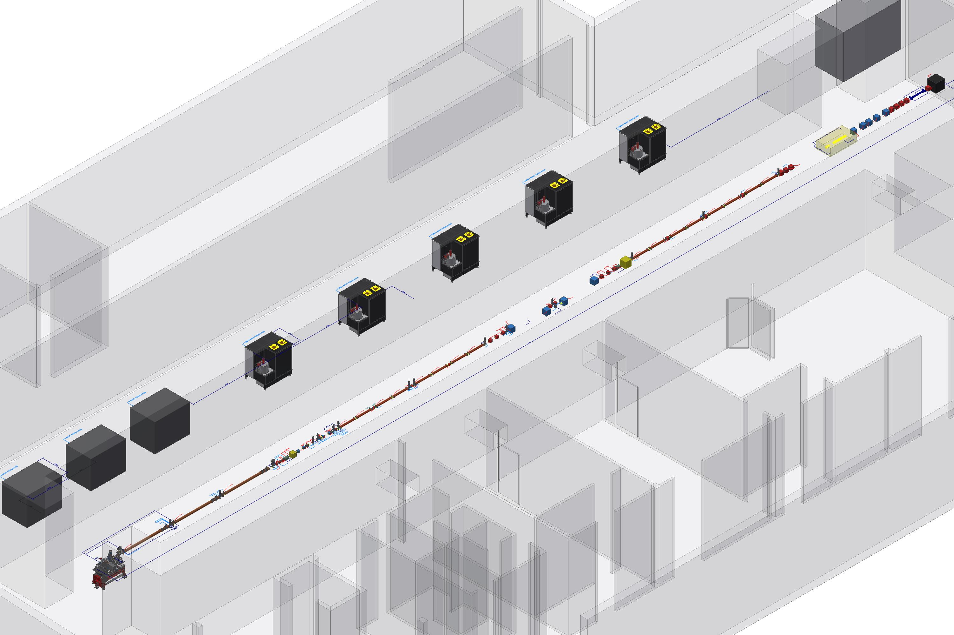
New RF photoinjector
RF Gun + Three 3m S-Band RF accelerating structures
RF Gun + Two 3m S-Band RF accelerating structures
See E.Chiadroni Talk
EuPRAXIA@SPARC_LAB TDR Rev.Committee A.Ghigo Frascati October 26, 2021

Slide 6
Schematic layout of the linac and klystron gallery
50 MW X-band modulator & klystron
See A.Gallo talk
EuPRAXIA@SPARC_LAB TDR Rev.Committee A.Ghigo Frascati October 26, 2021

Slide 7
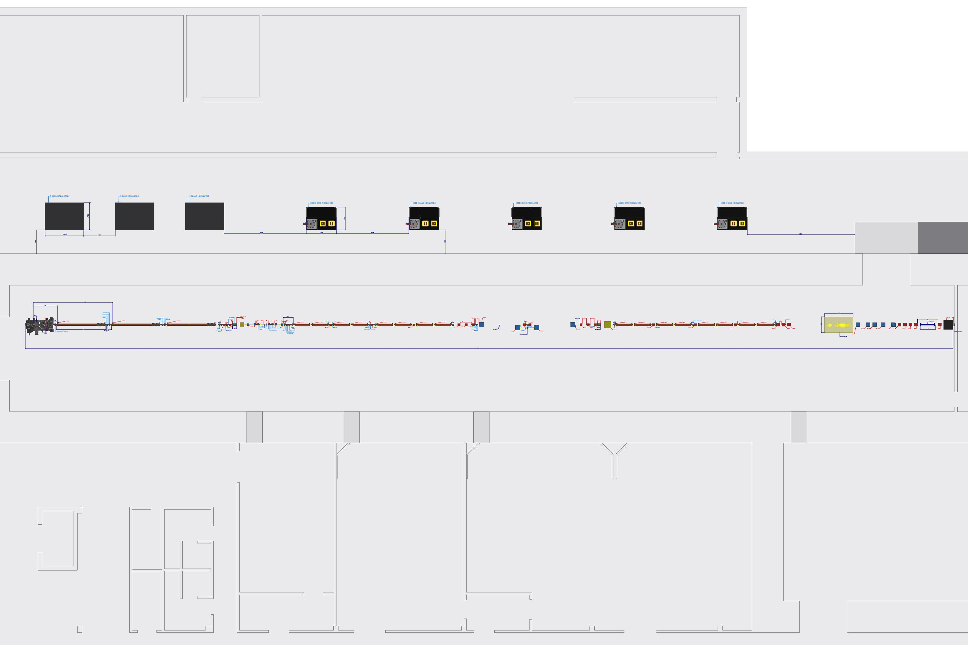
Modulator & Klystron in the gallery
50 MW X-band modulator & klystron
< 4.5mm >
< 5.2m >
< 2m >
EuPRAXIA@SPARC_LAB TDR Rev.Committee A.Ghigo Frascati October 26, 2021

Slide 8
50 MW X-band distribution
1 modulator&klystron -> 4 RF accelerating structures
EuPRAXIA@SPARC_LAB TDR Rev.Committee A.Ghigo Frascati October 26, 2021

Slide 9
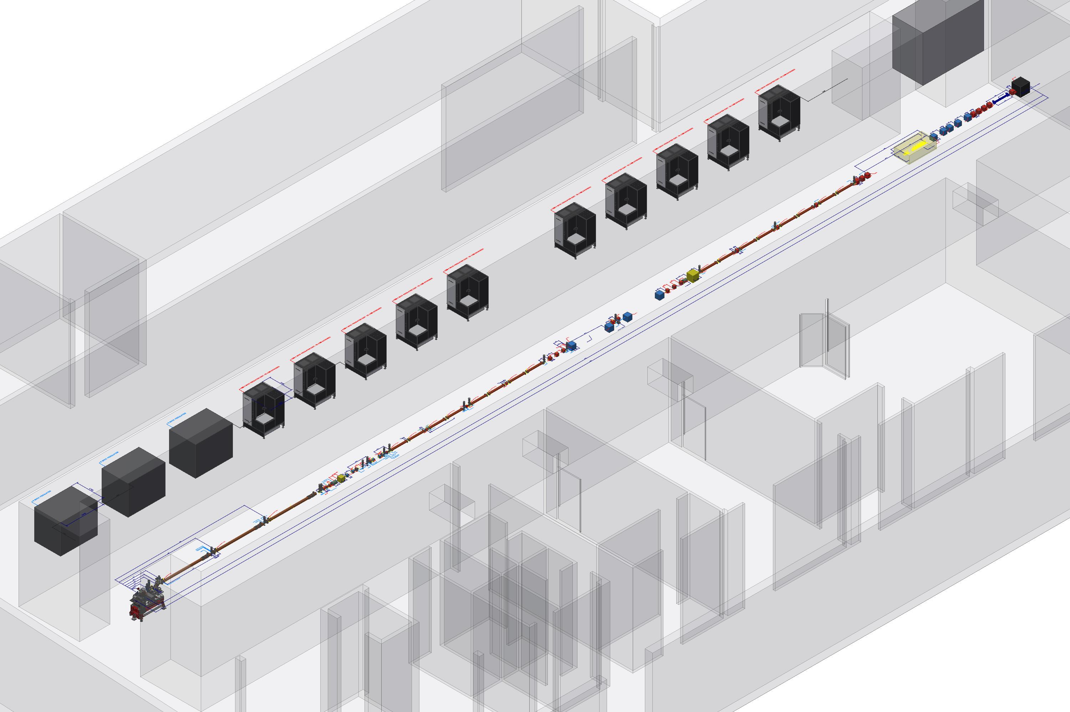
Schematic layout of the machine and klystron gallery
25 MW X-band modulator & klystron
EuPRAXIA@SPARC_LAB TDR Rev.Committee A.Ghigo Frascati October 26, 2021

Slide 10
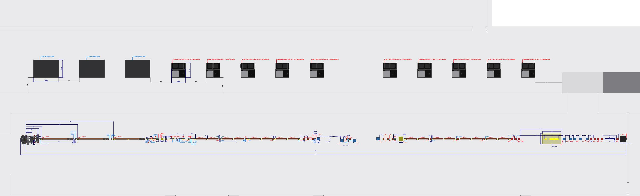
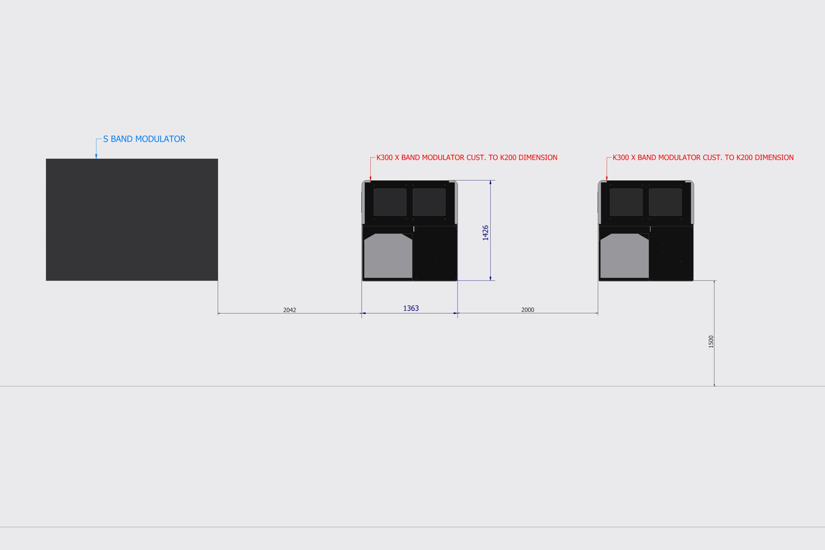
Schematic layout of the machine and klystron gallery
25 MW X-band modulator & klystron
< 2m >
< 2m >
< 1.5m >
EuPRAXIA@SPARC_LAB TDR Rev.Committee A.Ghigo Frascati October 26, 2021

Slide 11
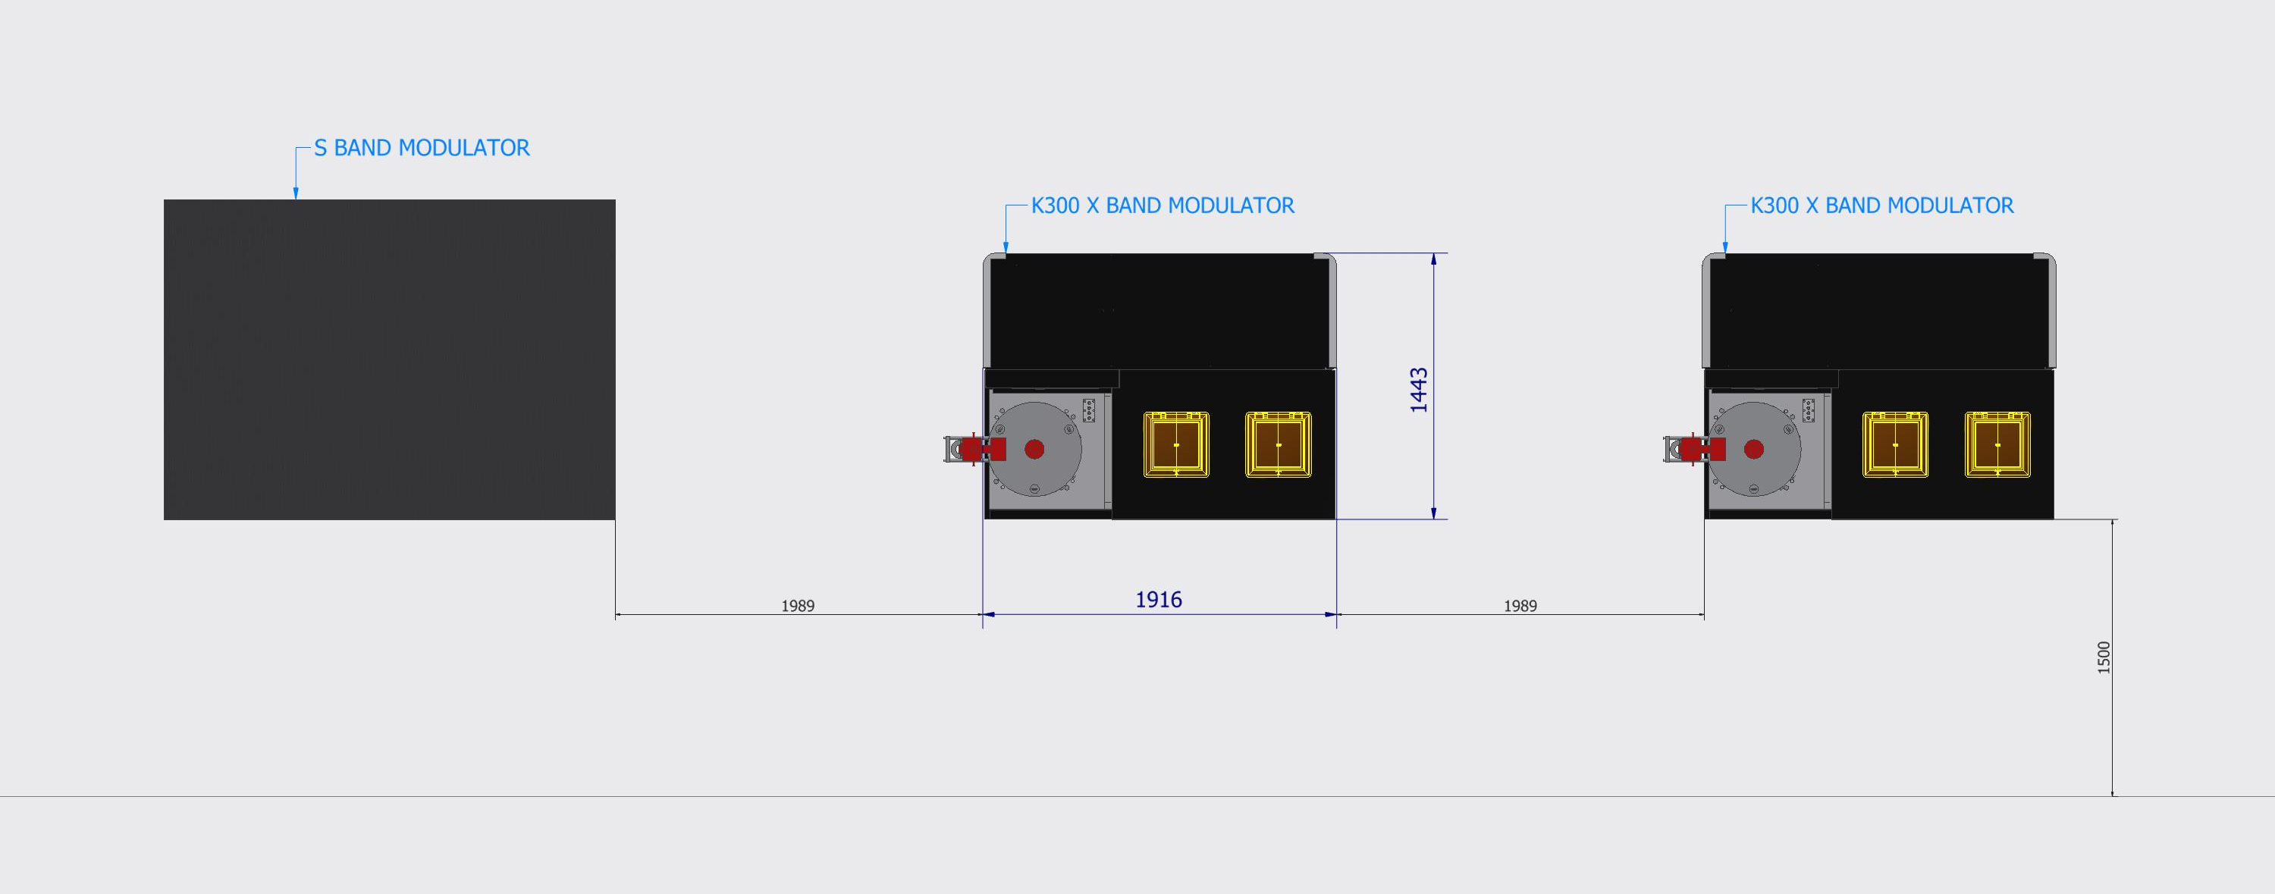
Footprint comparison for standard and compact
25 MW modulator
Standard modulator for 25 MW klystron
Reduced footprint modulator for 25 MW klystron
EuPRAXIA@SPARC_LAB TDR Rev.Committee A.Ghigo Frascati October 26, 2021

Slide 12
25 MW X-band distribution
1 modulator&klystron ->
2 RF accelerating structures
F.Cardelli
EuPRAXIA@SPARC_LAB TDR Rev.Committee A.Ghigo Frascati October 26, 2021

Slide 13
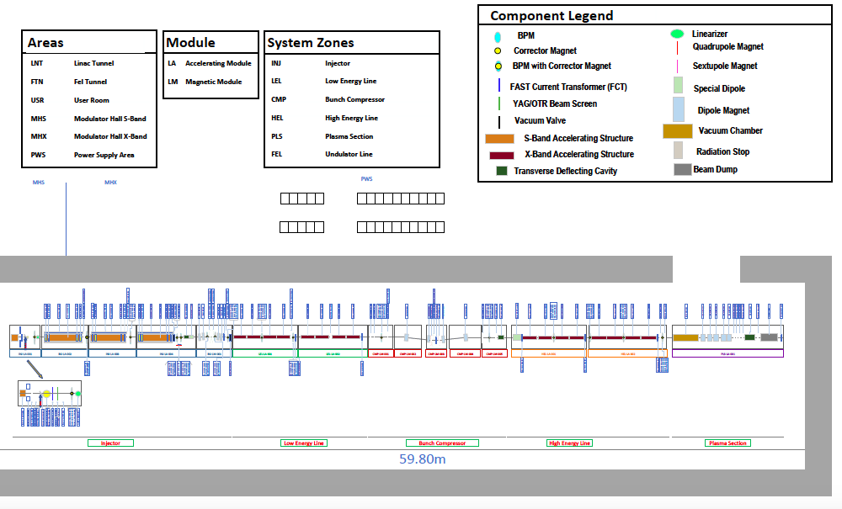
EuPRAXIA@SPARC-LAB Functional layout
EuPRAXIA@SPARC_LAB TDR Rev.Committee A.Ghigo Frascati October 26, 2021

Slide 14
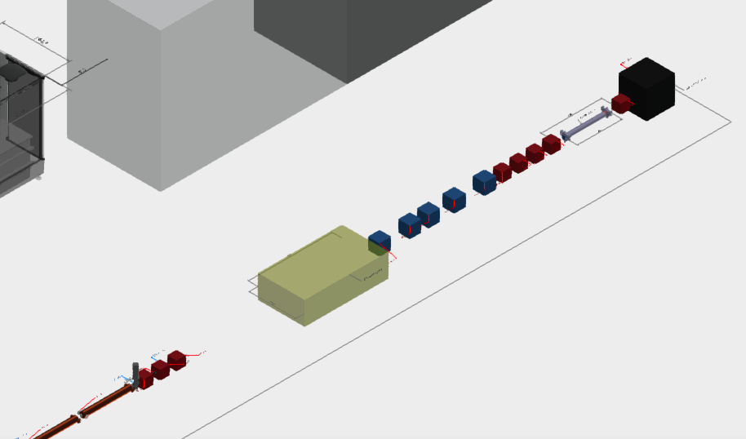
Plasma module region
First optics design completed with input and output matching sections
The design of the plasma module box started
EuPRAXIA@SPARC_LAB TDR Rev.Committee A.Ghigo Frascati October 26, 2021

Slide 15
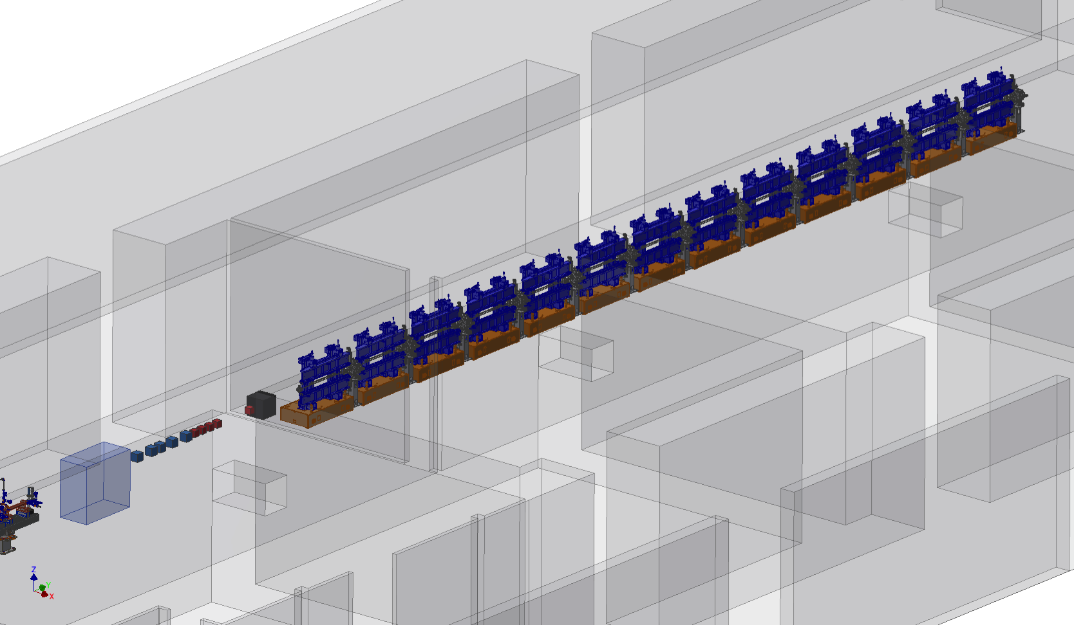
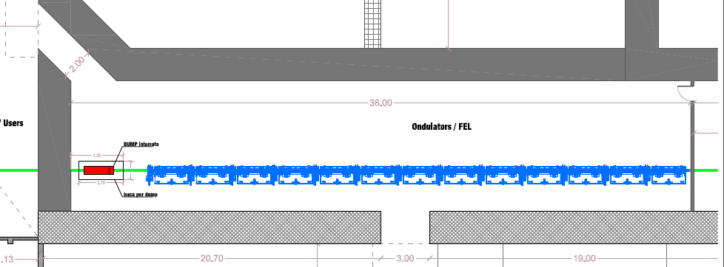
Permanent Magnet Undulators
22m active length + diagnostics sections: 25m total length
Optimized length for undulator module: 2.2 m
A structure with walls close to the undulator is foreseen to stabilize the temperature (XFEL solution)
Combination of SC and NC undulator is under study
See L.Giannessi talk
EuPRAXIA@SPARC_LAB TDR Rev.Committee A.Ghigo Frascati October 26, 2021

Slide 16
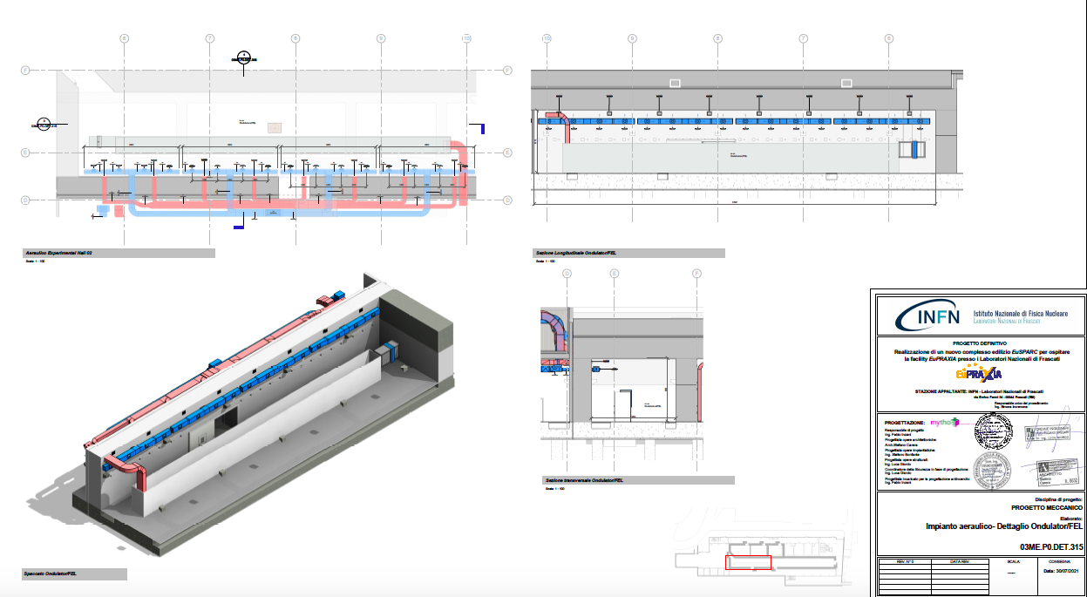
Undulators cooling
EuPRAXIA@SPARC_LAB TDR Rev.Committee A.Ghigo Frascati October 26, 2021

Slide 17
Thanks for the attention
EuPRAXIA@SPARC_LAB TDR Rev.Committee A.Ghigo Frascati October 26, 2021

