Slide 1
Prospects for EuPRAXIA in the Framework of the ESFRI Road Map
Ralph W. Aßmann, Coordinator EuPRAXIA, DESY & INFN
EuPRAXIA@SPARClab Review Committee
LNF Frascati, Rome
26 October 2021

Slide 2
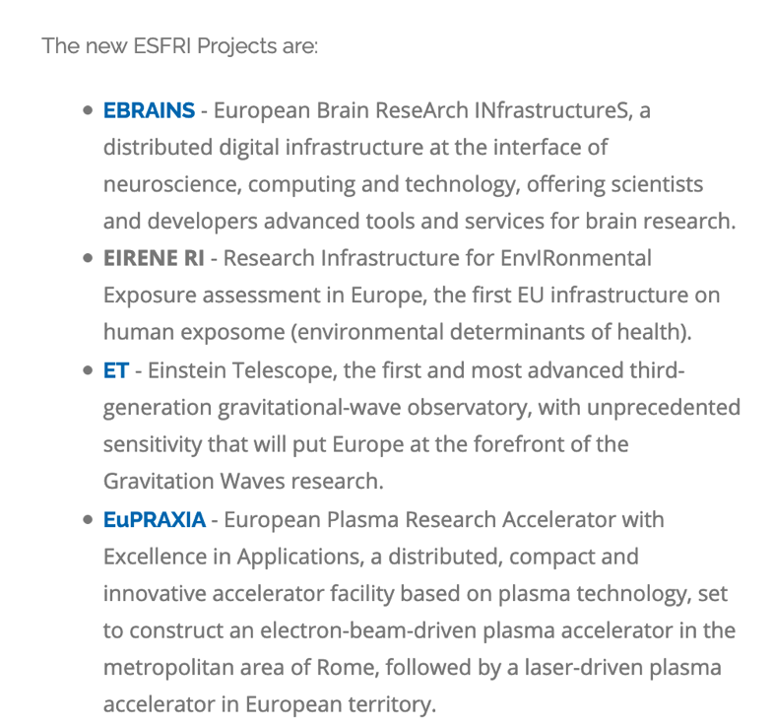
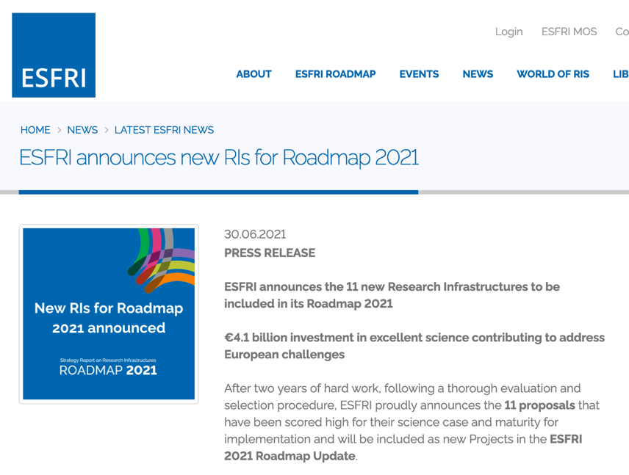
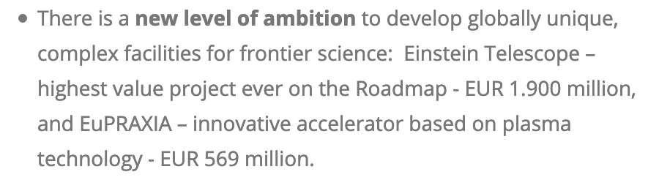
Press Release ESFRI 30.6.21
https://www.esfri.eu/latest-esfri-news/new-ris-roadmap-2021

Slide 3
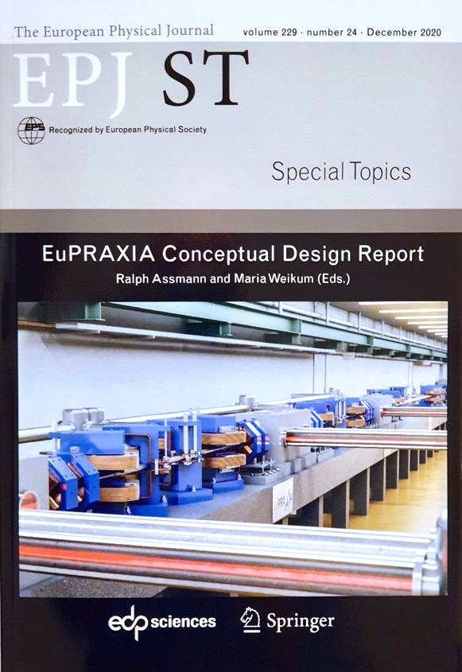
The EuPRAXIA Project
http://www.eupraxia-project.eu/
First ever international design of a plasma accelerator facility.
Challenges addressed by EuPRAXIA since 2015:
  How can plasma accelerators produce usable electron beams?
  For what can we use those beams while we increase the beam energy towards HEP and collider usages?
CDR for a distributed research infrastructure funded by EU Horizon2020 program. Completed by 16+25 institutes.
Next phase consortium with 40 partners + 10 observers.
600+ page CDR, 240 scientists contributed

Slide 4
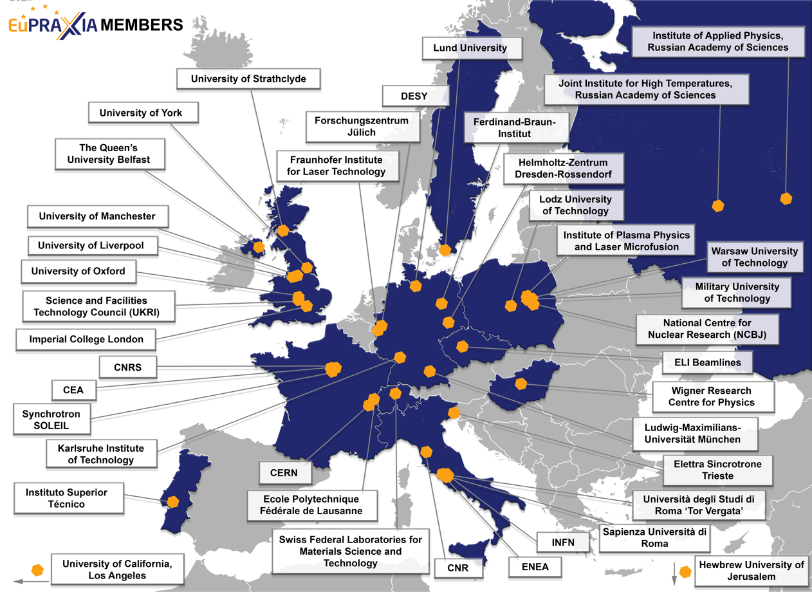
Consortium
(from 16 to 40 members in new Dec 2020 consortium)
40 Member institutions in:
Italy (INFN, CNR, Elettra, ENEA, Sapienza Università di Roma, Università degli Studi di Roma “Tor Vergata”)
France (CEA, SOLEIL, CNRS)
Switzerland (EMPA, Ecole Polytechnique Fédérale de Lausanne)
Germany (DESY, Ferdinand-Braun-Institut, Fraunhofer Institute for Laser Technology, Forschungszentrum Jülich, HZDR, KIT, LMU München)
United Kingdom (Imperial College London, Queen’s University of Belfast, STFC, University of Liverpool, University of Manchester, University of Oxford, University of Strathclyde, University of York)
Poland (Institute of Plasma Physics and Laser Microfusion, Lodz University of Technology, Military University of Technology, NCBJ, Warsaw University of Technology)
Portugal (IST)
Hungary (Wigner Research Centre for Physics)
Sweden (Lund University)
Israel (Hebrew University of Jerusalem)
Russia (Institute of Applied Physics, Joint Institute for High Temperatures)
United States (UCLA)
CERN
ELI Beamlines

Slide 5
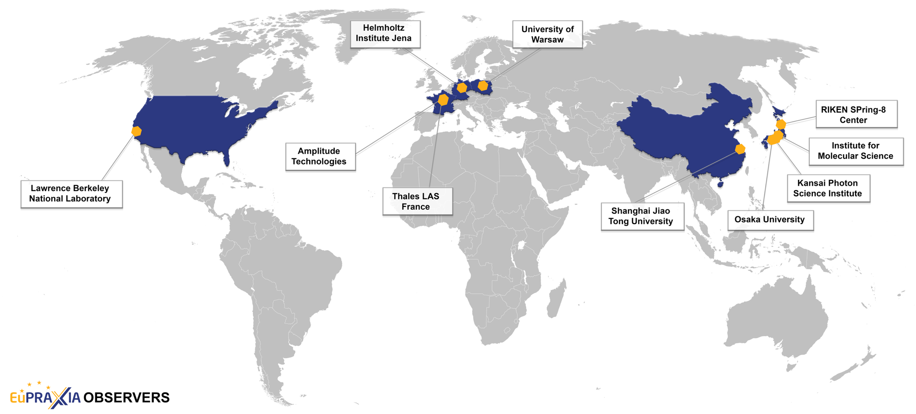
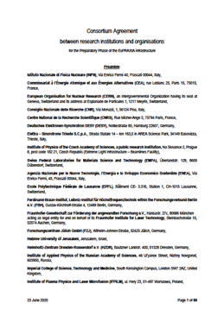
Consortium
(10 observer institutes)
10 Observer institutions in:
France (Amplitude Technologies, Thales LAS France SAS)
Germany (Helmholtz-Institut Jena)
Poland (University of Warsaw)
United States (LBNL)
China (Shanghai Jiao Tong University)
Japan (Institute for Molecular Science, Osaka University, Kansai Photon Science Institute, RIKEN SPring-8 Center)

Slide 6
Concept Distributed Research Infrastructure

Slide 7
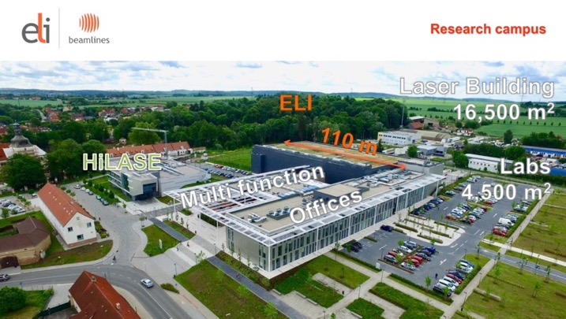
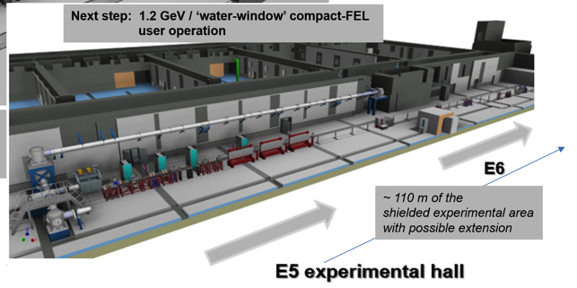


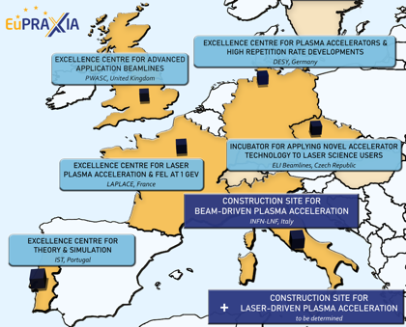



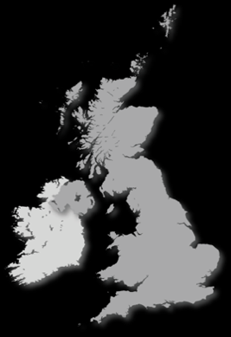

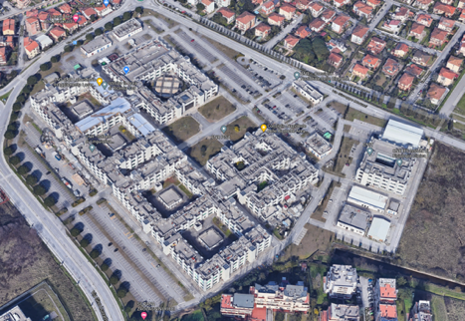


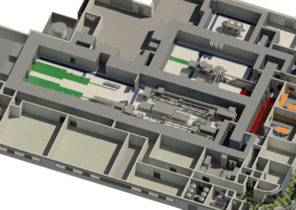









Reminder: Candidate 2nd Sites from CDR
Prague, Czech Republic
@ EPAC
Rutherford, STFC, UK
PWASC
CNR Campus Pisa
Notes:
Maria

Slide 8
Selection Criteria 2nd EuPRAXIA Site
(from CDR, fulfilled by 1st Site LNF/INFN)
Legal/Political | Technical | Financial
Compliance of host institution with EuPRAXIA Access Policy | Site provides sufficient space (about 175 m x 35 m) | Commitment to sustainability of EuPRAXIA (host lab covers site operation costs)
Compliance of host institution with EuPRAXIA Open Innovation and Open Science Policy | Laboratory has infrastructures in one or several of RF accelerators, laser installations, user access. | Previous investments into local infrastructures of relevance for EuPRAXIA (leverage effect)
Agreement of host institution with the long-term scientific agenda of EuPRAXIA | Site provides required services and facilities for support of external users, including E infrastructure | Existence of one or a mix of funding sources able to finance implementation of the site
Laboratory has existing groups in place to guarantee safety requirements (laser, radio-protection, access control) and rules
Note: approach reduces cost (pre-invest) and risks of cost-overun.
Notes:
Maria

Slide 9
Organization

Slide 10
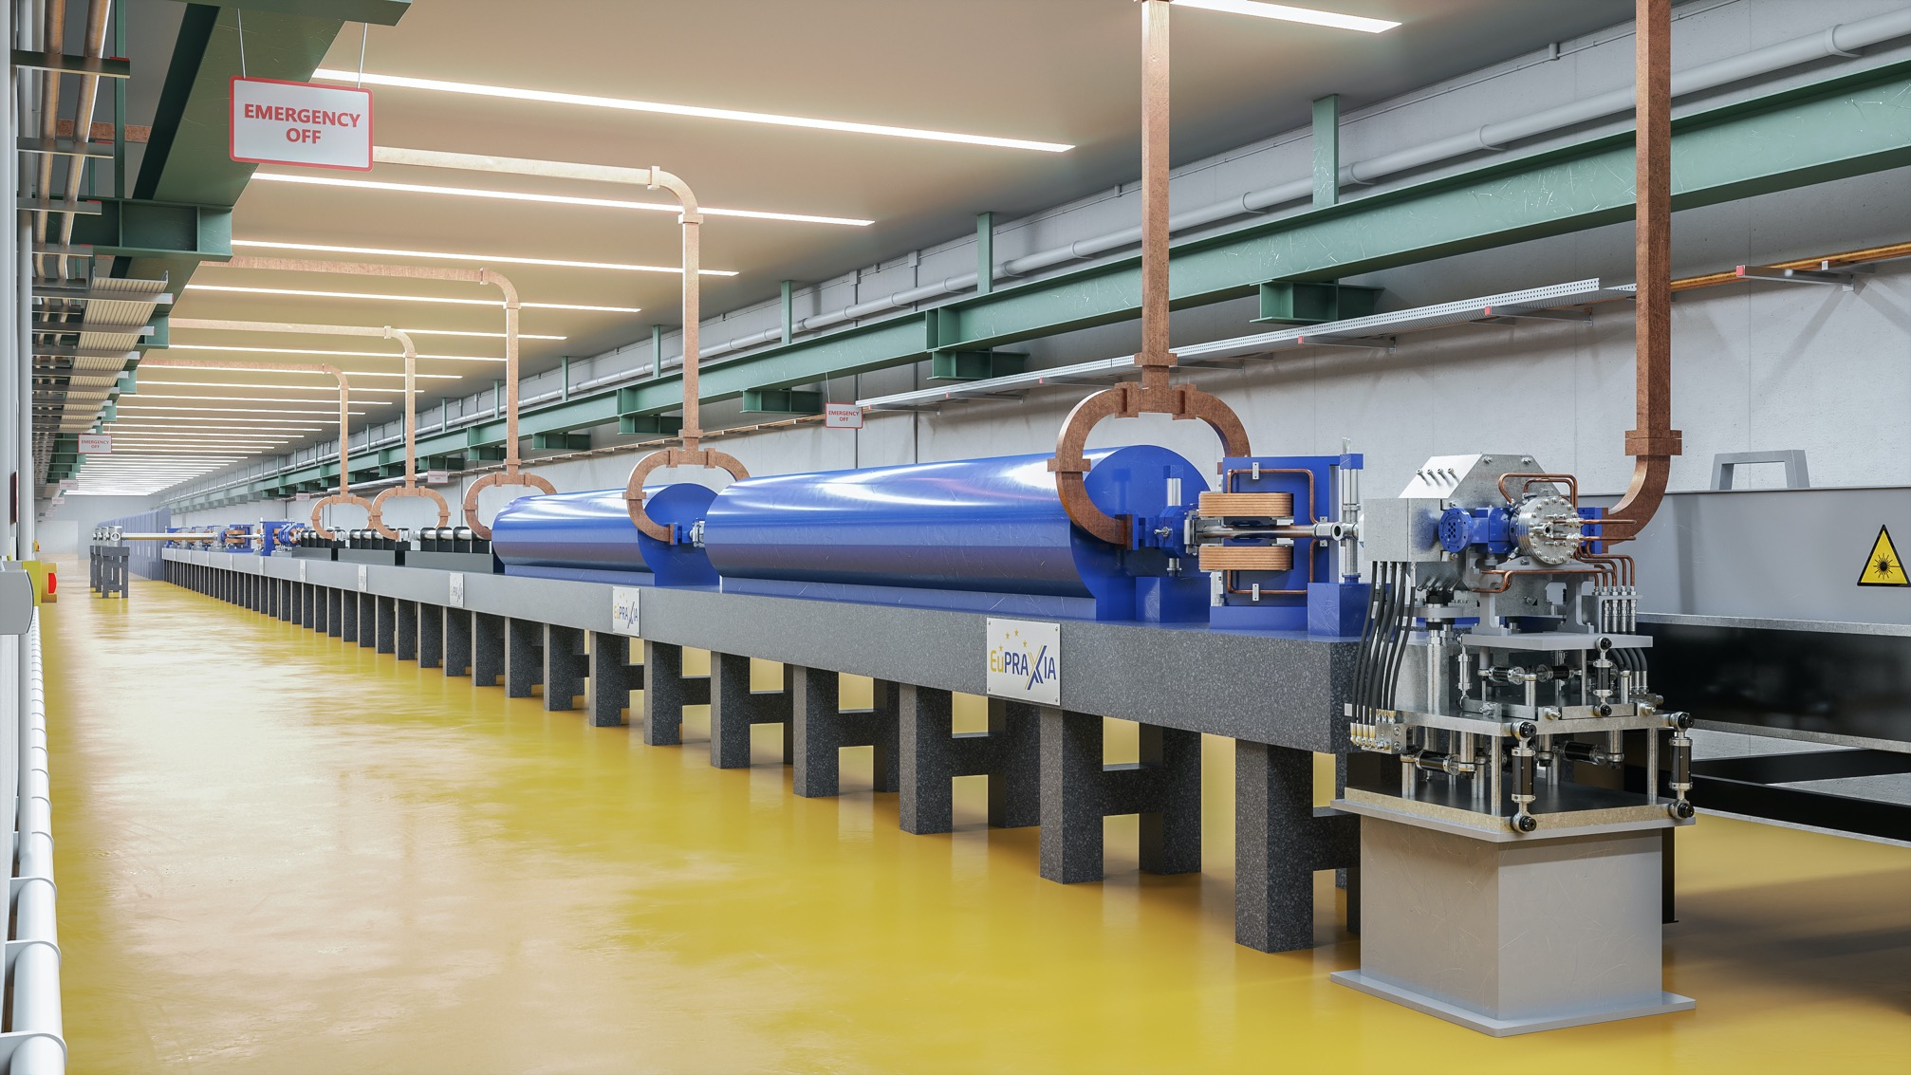
  IMPORTANT: EuPRAXIA design includes RF injectors, transfer lines, undulator lines, shielding, ...
Realistic intermediate goals at established labs:
  150 MeV → 1 GeV → 5 GeV (FEL + other applications)
  1 plasma stage → 2 plasma stages → multiple
  factor 3 facility size reduction → factor 10 → ...
  Low charge, 10 Hz apps of e- (+ positron generation)
  → high charge, 10 Hz applications (FEL) → 100 Hz

Slide 11





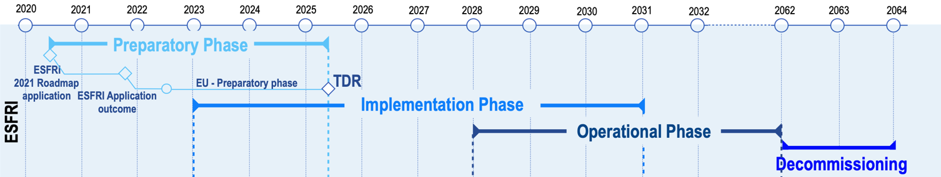

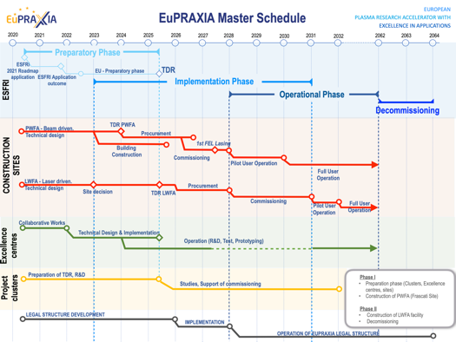
EuPRAXIA Schedule
European World-Class RI on compact accelerators for the end of the 2020‘s to the beginning of the 2060‘s
More detail in Master Schedule
SUCCESS – ON TRACK

Slide 13
EuPRAXIA
and
EuPRAXIA@SPARClab

Slide 15
Different Responsibilities and Overlaps
Responsibility of EuPRAXIA@SPARClab local project team:
Preparation and setup of local facility at Frascati:
  Define and construct local infrastructure on-schedule and on-budget
  Define and construct EuPRAXIA@SPARClab building on-schedule and on-budget
  Prototyping, testing and procurement of local technical equipment (X band RF, undulators, …) on-schedule and on-budget
  Local project management (earned value management, planning, project resources including FTE, procurement)
  Preparation of TDR (site Frascati) – Scientific management
  Project oversight committees and reporting
Responsibility of EuPRAXIA consortium and HQ office:
Preparation and management of EuPRAXIA as European (ESFRI) research infrastructure, including Frascati site:
  Preparation and definition of legal model for EuPRAXIA RI
  Definition and management of access to EuPRAXIA facilities (includes all user access, user infrastructure, computing facilities, …)
  Definition and management of collaborative work, including shared design work, prototyping and construction
  Preparation of funding model for full facility
  Preparation of TDR (site Frascati, site 2, collaborative projects) – Scientific management
  Consortium meetings, EuPRAXIA advisory boards (scientific, user, …)
European projects that involve EuPRAXIA at any level:
  Preparation of funding applications at EU and national level that aim at EU funding
  Management of EU projects

Slide 16
Complementarity in Work Areas / Packages
EuPRAXIA@SPARClab Work Areas
EuPRAXIA Clusters / WP’s
Beam Physics
Injector
Linac
Integration
Infrastructures
Plasma
FEL
Users
High Power Laser
WP: Beam diagnostics
Theory & Simulation
RF Technology
Magnets & Other Beamline Components
Plasma Components & Systems
Applications (PP)
Implementation, Layout, Users (PP)
Laser Technology
Diagnostics
Training, Outreach & Dissemination (PP)
Transformative Innovation Paths

Slide 17
Added Value EuPRAXIA in ESFRI
Physical sciences and accelerators have a long history of fruitful collaboration in Europe and world-wide. Working together makes us stronger and more competitive!
Preparatory phase project with funding to define important aspects of a European research infrastructure.
Well defined, formal legal model of final Research Infrastructure (RI) including European shareholders with rights and duties.
Defined access models according to European standards: excellence and access.
Open innovation model (European approach) versus closed innovation.
Prospects for EuPRAXIA in the Framework of the ESFRI Road Map:
EuPRAXIA@SPARClab as a truly European RI with outreach to many other countries (interest of Spain and Greece to join).

Slide 18
Important ESFRI Aspects
  Collaborative work in open innovation approach
  Legal model for EuPRAXIA RI (includes all user access, user infrastructure, computing facilities, …)
  Data policy and digital infrastructure
  Funding model for full facility, including preparation of funding applications at EU and national level that aim at EU funding
  Definition and management of access to EuPRAXIA facilities

Slide 19
Important ESFRI Aspects
  Collaborative work in open innovation approach
  Legal model for EuPRAXIA RI (includes all user access, user infrastructure, computing facilities, …)
  Data policy and digital infrastructure
  Funding model for full facility, including preparation of funding applications at EU and national level that aim at EU funding
  Definition and management of access to EuPRAXIA facilities

Slide 20
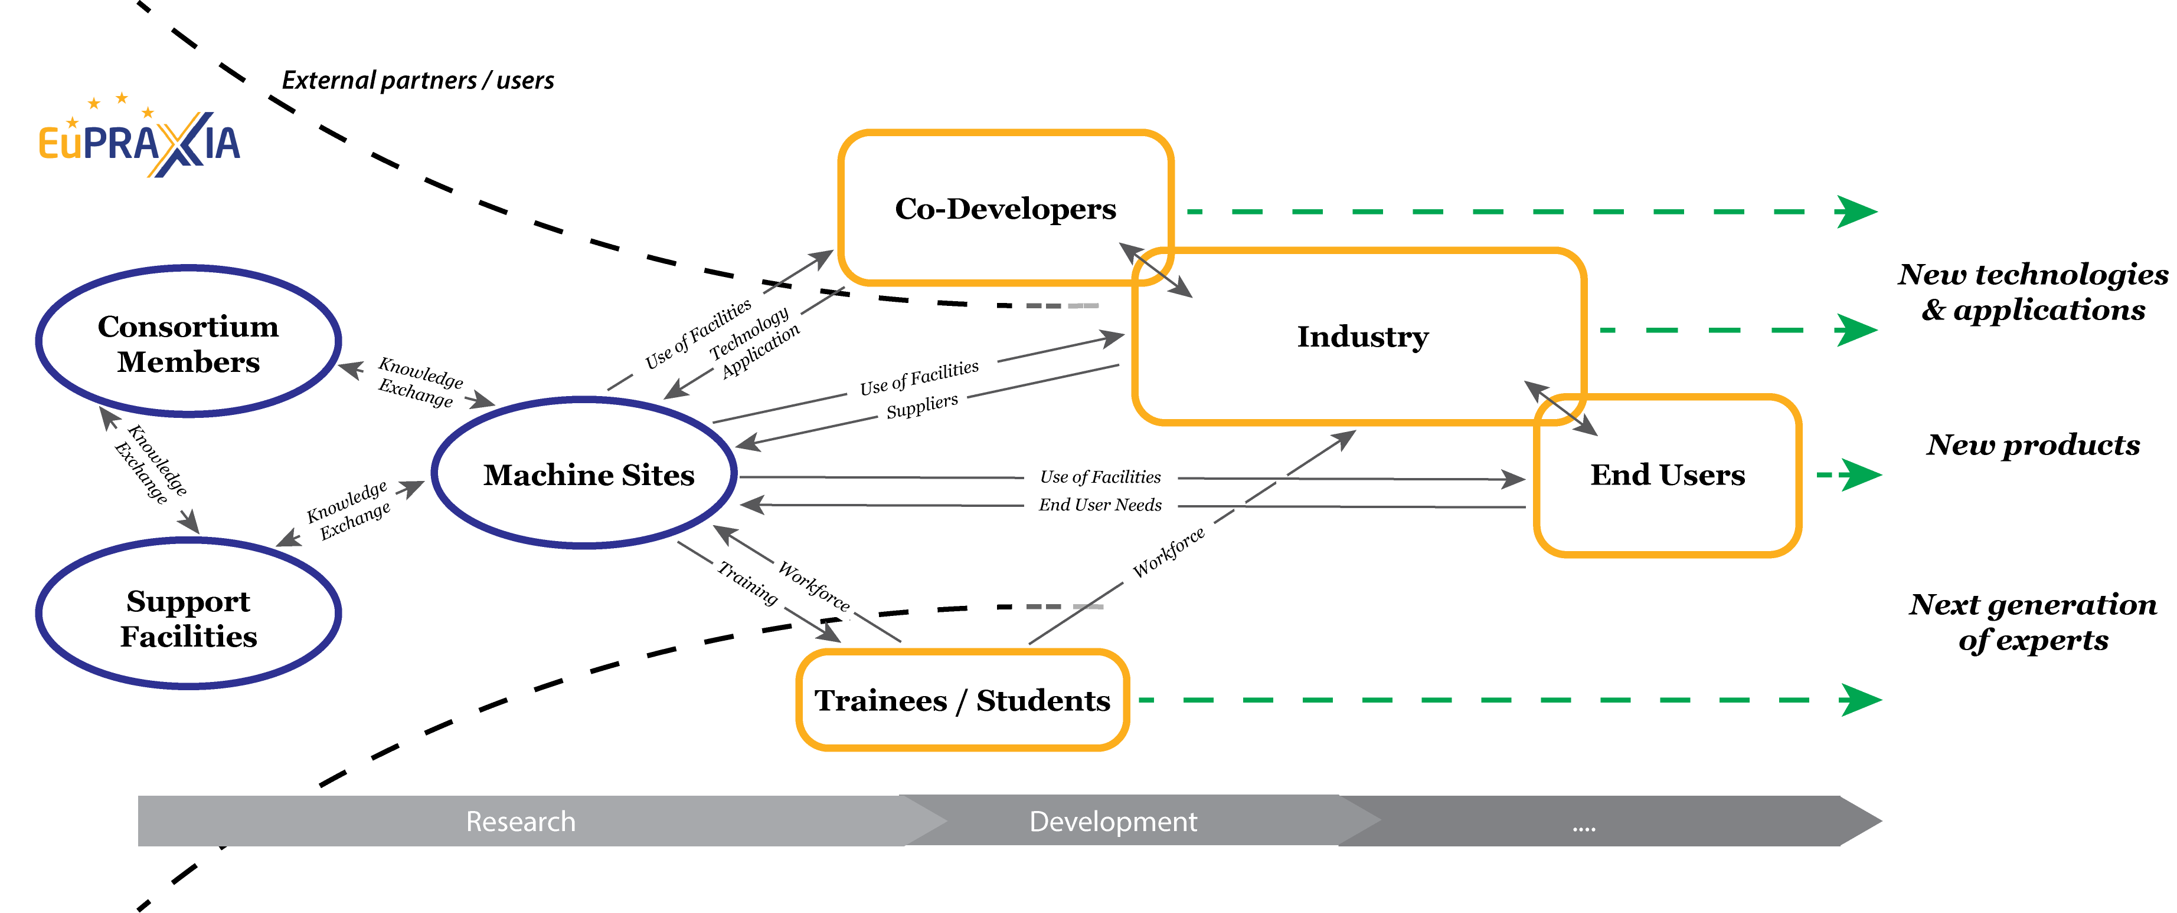
EuPRAXIA Open Innovation Concept
share the work, share the publication, share the innovation
Recent example of success for open innovation:
Fighting COVID-19
Mechanical Ventilator Milano
INFN plus industry project
Robust, low-cost design → half the cost
In 1 year from the concept to > 6,000 ventilators in stock
Canada-sponsored production, also for less developed countries
EuPRAXIA open innovation concept involves all nodes and stake-holders of the project, for example excellence centers as support facilities, end users, industry, trainees, … in a well-defined open and effective approach
EuPRAXIA follows open innovation/science developments and learns from it →
Notes:
Massimo

Slide 21
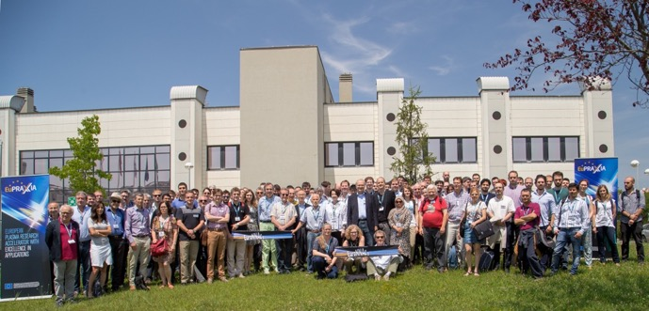
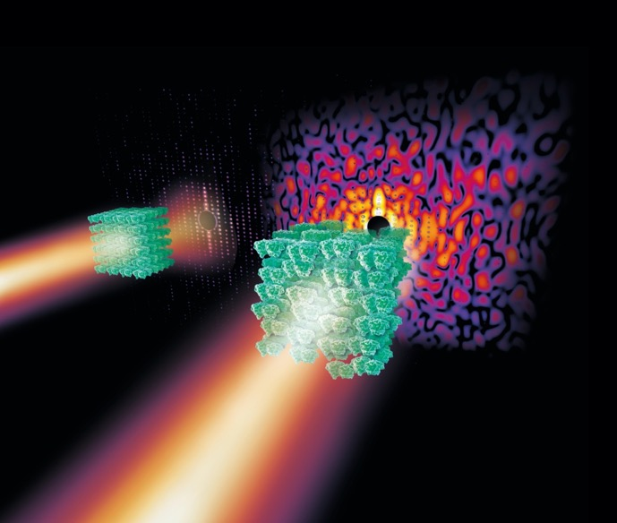
Long-Term Benefits: Share in IP, Privileged Access
EuPRAXIA partners within the future EuPRAXIA legal entity (ERIC or else) will benefit from:
Overcoming of local limits in funding and facility size
Increased visibility and impact on an international scale
Decision power in the EuPRAXIA legal entity’s Collaboration Board (or equivalent)
Opportunities to participate in technological developments at EuPRAXIA (with co-developers)
Direct access to technology and knowledge generated by the EuPRAXIA Consortium
Privileged access to beamlines through the quota-based access
Notes:
Massimo

Slide 22
Important ESFRI Aspects
  Collaborative work in open innovation approach
  Legal model for EuPRAXIA RI (includes all user access, user infrastructure, computing facilities, …)
  Data policy and digital infrastructure
  Funding model for full facility, including preparation of funding applications at EU and national level that aim at EU funding
  Definition and management of access to EuPRAXIA facilities

Slide 23
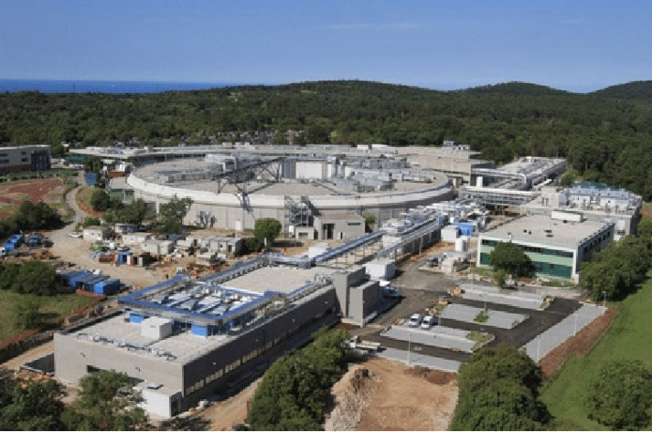
Experiments in Two EuPRAXIA User Sites
 | Beam-Driven Site (A - Frascati) | Laser-Driven Site (B)
Access unit (AU) definition | 1 AU = 12 h | 1 AU = 12 h
Operation mode | 24/7 | 24/7
Access end users / year | 168 days | 168 days
Machine studies / year | 63 days | 63 days
Maintenance/shutdown / year | 134 days | 134 days
End-user access total / year | 336 AU | 672 AU
Typical experiment duration (including 4 AU machine preparation) | 10 AU | 10 AU
Annual number of end-user experiments | 33 | 66
FEL experiment based on experience with fully RF based free-electron lasers like FERMI (see above), FLASH and FELBE.
NOTE: EuPRAXIA laser-based facility provides enhanced parallel operation, therefore twice as many experiments.
Notes:
Ralph

Slide 24
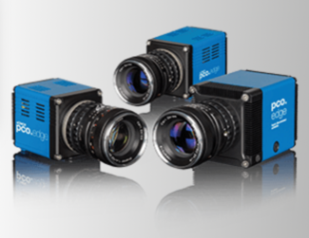
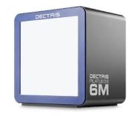
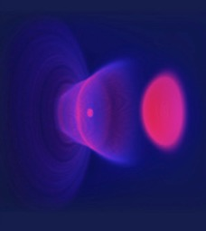
Data Rate and Networking Capacity
(numbers refer to maximum rate operation at 100 Hz)
Data Source | Data rate | Data / exp for online analysis | Reduced data / exp for long term storage | Long term storage (reduced data) | Exchange (derived data and meta data)
Modeling and simulations (3D) | 300 TB / case | 900 TB | 1 TB | 0.1 PB/y | 12 TB/y
Machine monitoring | 20 TB / h | 2.4 PB | 5 TB | 0.17 PB/y (A) 0.33 PB/y (B) | 20 TB/y
End user exp. (e.g. PCO Edge at 8 MB @ 100 Hz) | 2.9 TB / h | 207 TB | 20 TB | 0.66 PB /y (A) 1.32 PB/y (B) | 100 TB/y
Total |  |  |  | ≈ 2.6 PB/y | ≈ 132 TB/y
Networking capacity 10 Gbit/s sufficient for data rates
Exists at Frascati (LHC computing needs) and the EuPRAXIA candidate sites – benefit of existing sites
Specified for 1 PB high performance parallel file system (online analysis) and 100 GBE → see E-Infrastructure slide)
Notes:
Ralph

Slide 25
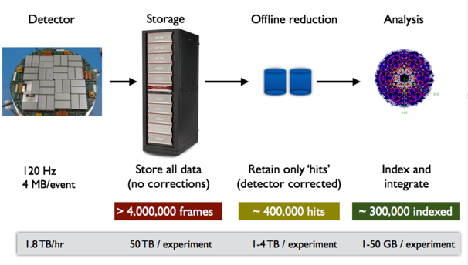
Data Archiving and Data Openness
Will define living data object catalogue and dedicated data policy. Data management plans shaped to maximize data and scientific software reuse across scientific domains and across institutional boundaries
Store only absolutely necessary primary data, use online analysis for data reduction and derived data generation: Stored data must make experiment and simulation reproducible
Store mostly derived data and meta data from experiment and simulation
Long-term, F.A.I.R.-compliant data object storage, work together with EOSC projects such as ESCAPE on data management. International best practices for data and metadata standards (ISO), in line with other European RI’s.
Figure from Steve Aplin, Eu-XFEL, LEAPS Data WG Co-Chair
EuPRAXIA CDR
Notes:
Ralph

Slide 26
E Infrastructure Concept and Scale
Level | Plans for Resource Use
Institutional | 1 PByte high performance parallel file system 100 GBE network connection on site ~ 8192 cores, 32 TByte main memory for cloud hardware with Infiniband connect 16 GPUs for Machine Learning / fast image analysis Open Source cloud infrastructure (Open Stack + scalable data analytics via e.g. Jupyter Hub, Apache Kafka, ..)
Regional | Tier 3 centers at universities for offline data analysis and small-scale simulations Tier 2 centers at laboratories for data analysis and capacity simulations
National | Tier 1 and especially Tier 0 systems such as MARCONI→LEONARDO, both for full-scale 3D capability simulations but also for high performance data analysis of selected data sets, especially when developing AI surrogate models of the accelerator
International | Build on EuPRAXIA partner links to WLCG and the EGI Federation EuPRAXIA will contribute to and exploit EOSC in its digital infrastructure PRACE (Partnership for Advanced Computing in Europe) for large-scale simulations & AI learning
Notes:
Ralph

Slide 27
Important ESFRI Aspects
  Collaborative work in open innovation approach
  Legal model for EuPRAXIA RI (includes all user access, user infrastructure, computing facilities, …)
  Data policy and digital infrastructure
  Funding model for full facility, including preparation of funding applications at EU and national level that aim at EU funding
  Definition and management of access to EuPRAXIA facilities

Slide 28
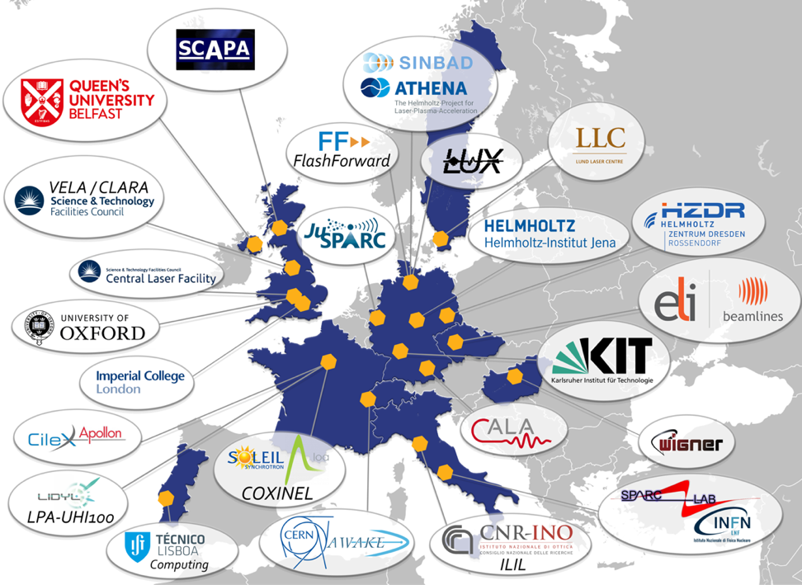

Single-Entry Point for Access, Alignment of European Resources
Bringing benefits of compact technology to external users
Alignment of scientific goals & resources
Single point of access under EuPRAXIA rules
Policy of open innovation and open science
Defending and strengthening EU leadership in this field (world-wide 1st RI concept of this kind)
Notes:
Massimo

Slide 29
Targeted User Communities
EuPRAXIA provides particle and photon beams with exceptionally short duration and small size – ideal for the study of complex systems and ultrafast processes:
Biology structural biology, research on understanding molecular structures and biochemical processes
Chemistry crystallography, research on understanding molecular structures and chemical processes
Medicine pharmacological developments, research on understanding underlying mechanisms of drug
operating modes and delivery, diseases, etc.
Material science crystallography, research on understanding molecular structures and processes, e-beam machining, material analysis
Physics crystallography, research on understanding structures and processes
Archaeology & history non-destructive testing, material analysis
Beyond those applications various use cases of co-development including accelerator R&D, photon science technologies, compact and industrial applications, plasma-based acceleration and secondary sources for high-energy physics.

Slide 30
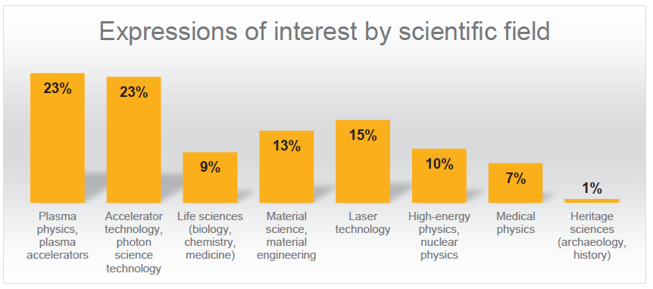
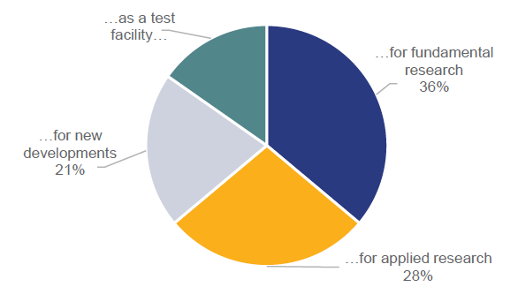
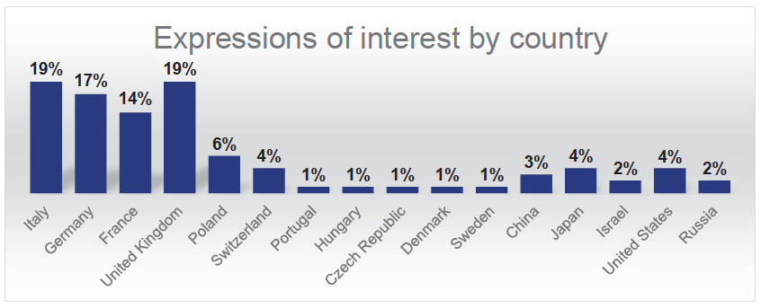
EuPRAXIA Deliverables and User Interests
EuPRAXIA is designed to deliver at 10-100 Hz ultra-short pulses of
Electrons (0.1-5 GeV, 30 pC)
Positrons (0.5-10 MeV, 10⁶)
Positrons (GeV source)
Lasers (100 J, 50 fs, 10-100 Hz)
Betatron X rays (5-18 keV, 10¹⁰)
FEL light (0.2-36 nm, 10⁹-10¹³)
Expressions of interest from 95 research groups representing several thousand scientists in total.

Slide 31

User Access Plan and Choice of Beamlines
Facility access and experiment selection:
Access strategy fully compliant with European Charter for Access to Research Infrastructures.
Five experimental access modes, majority of access driven by scientific excellence.
Yearly user meeting to present results and discuss future experiment themes.
Users answer open calls and submit proposals through single-entry-point web-based system.
Research Program Advisory Committee (independent, international experts) evaluates proposals.
Feasibility review and experiment scheduling with User Support Team.
Excellence-driven access (60%)
Feasibility Review
Evaluation & proposal acceptance
Quota-based access (22%)
Feasibility Review
Evaluation & proposal acceptance
ACCESS
Market-driven access (5%)
Feasibility Review
Contract
Scheduling
Training access (10%)
Feasibility Review
Long- or short-term agreement
Fast-track access (3%)
Evaluation of urgency + Feasibility review
Wide access (i.e. access to data)
Choice of beamlines:
  Basic design in CDR, finalized in preparatory phase, technical design report.
  Selection driven by (1) user needs and priorities, (2) existing demand and competition.
Notes:
Maria

Slide 32
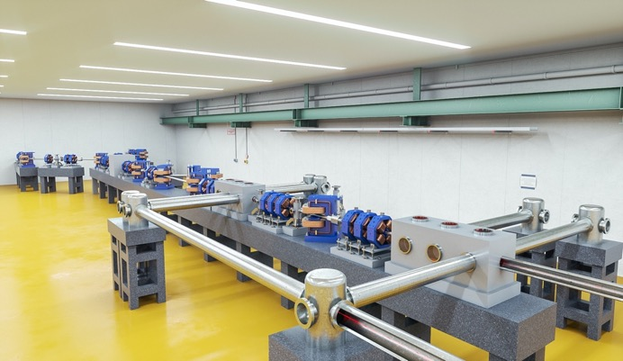

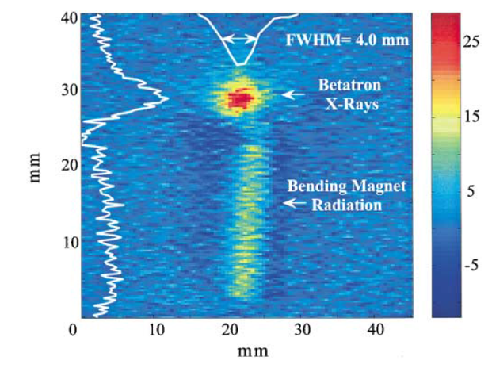
Performance Benchmarking and Comparison
Yearly report of performance to governance and advisory committees, as well as funding agencies.
KEY PERFORMANCE INDICATOR (main)
Number of users supported
User satisfaction
Electron/photon/FEL pulse intensities delivered to users (peak/integrated)
Machine uptime versus scheduled
Number of publications
Number of patents
Number of PhD’s produced
Number of spin-off companies
Cost efficiency (scientific output per investment)
Extended list of for performance / benchmarking parameters as KPIs in Q9.6, ESFRI application
Notes:
Maria

Slide 33
Conclusions
We consider it a major success that EuPRAXIA was selected for the 2021 update of the ESFRI Roadmap (besides Einstein Telescope the only project from physical sciences). We think it reflects on quality and readiness of our work and technology.
EuPRAXIA is the first ever plasma accelerator project with a Conceptual Design Report.
EuPRAXIA is the first ever plasma accelerator project on the ESFRI roadmap.
Being on the ESFRI roadmap: EuPRAXIA with EuPRAXIA@SPARClab as one of its two flagships will be a fully European project, with European shareholders.
We hope to make it an example of European innovation, bringing science to new applications and new areas. Following inspiration of particle physics detectors.
Heavy effort on funding applications (we do not complain), but major work ahead for legal model, user access, data policy, digital infrastructure, … in parallel to TDR work.
Still in start-up mode…

Slide 34
Thank you for your attention

