Slide 1
qq’H→qq’ bb
Summarizing the status:
120.000 signal events produced at 7 TeV with CMSSW_3_8_5
first signal plots but until now no serious selection
some background samples identified, even if not
QCD MadGraph in bin di ht: #eventi sigma(pb) lumi(pb-1)
/QCD_TuneD6T_HT-100To250_7TeV-madgraph/Fall10-START38_V12-v1 10M 7e+6 1.42
/QCD_TuneD6T_HT-250To500_7TeV-madgraph/Fall10-START38_V12-v1 4.5M 171e+3 26.3
/QCD_TuneD6T_HT-500To1000_7TeV-madgraph/Fall10-START38_V12-v1 7M 5.2e+3 1346.
/QCD_TuneD6T_HT-1000_7TeV-madgraph/Fall10-START38_V12-v1 1.5M 83e+3 18+e3
some initial code written: an analyzer that produces rootuples and a C++ program to run on them
linkst o the code and to some plots are at
https://twiki.cern.ch/twiki/bin/view/CMS/HiggsVBFbbPisa

Slide 2
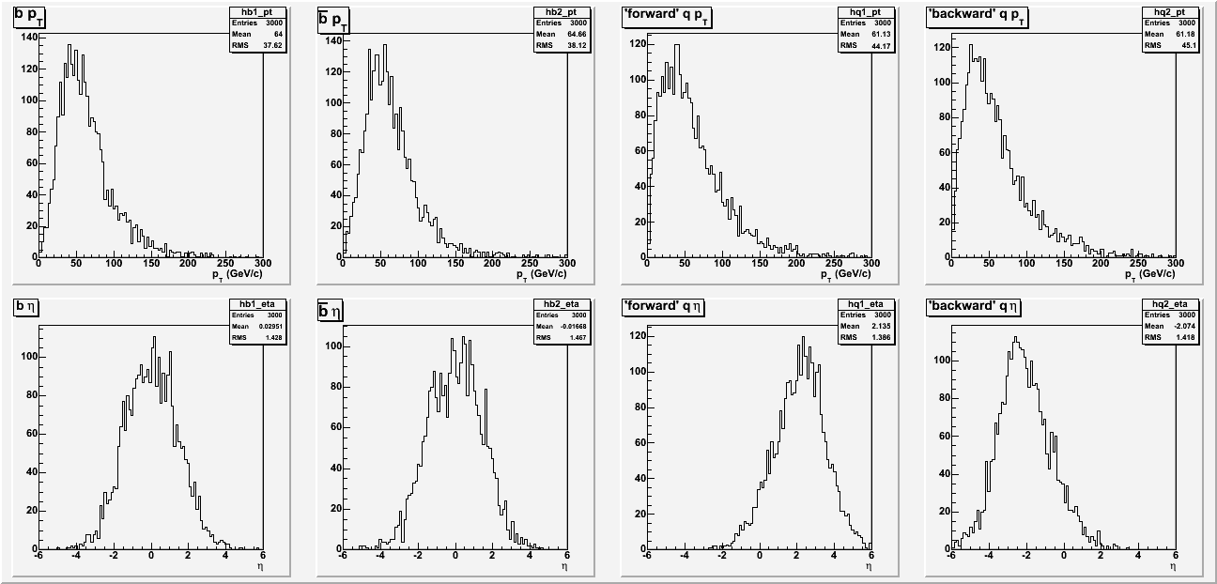
qq’H→qq’ bb
PT of quarks at hard interaction level
b
q
η of quarks at hard interaction level
b
q
Pt ~ 60 GeV
b more central but light quarks not so forward…

Slide 3
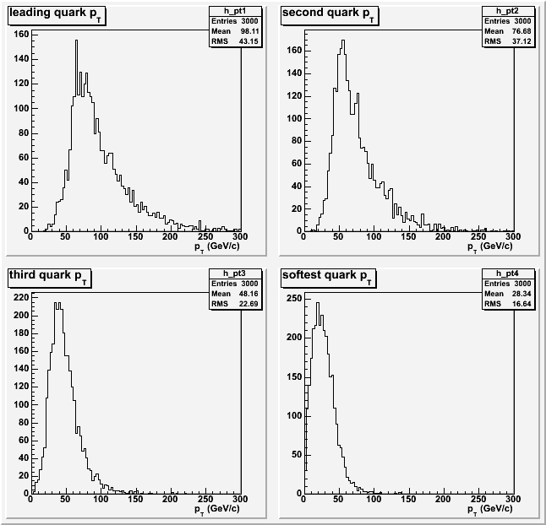
qq’H→qq’ bb
Sorted in Pt:
Leadinq quark pt>50 GeV
Softest quark is very soft
<Pt> ~28 GeV

Slide 4
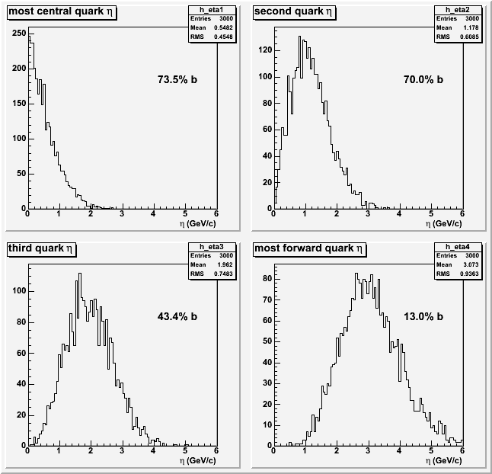
qq’H→qq’ bb
Sorted in η:
The most central parton is a b (from the higgs decay) only 3/4 of the times.
In pairs, the two most central partons can be: the two b-quarks (45%),one b-quark and one
associated-quark (54%), the two associated-quarks (1%).

Slide 5
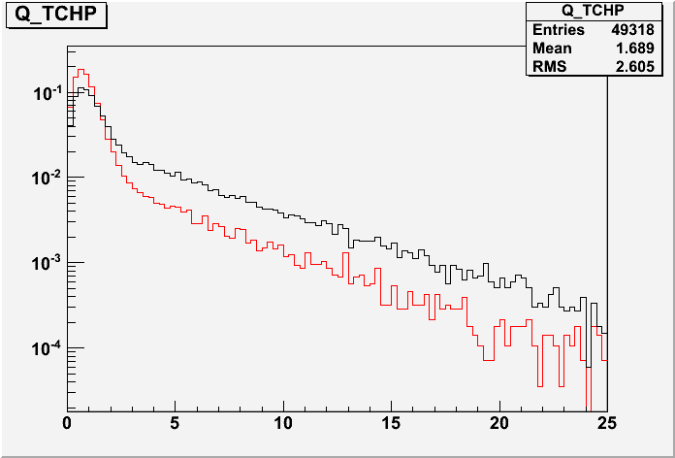
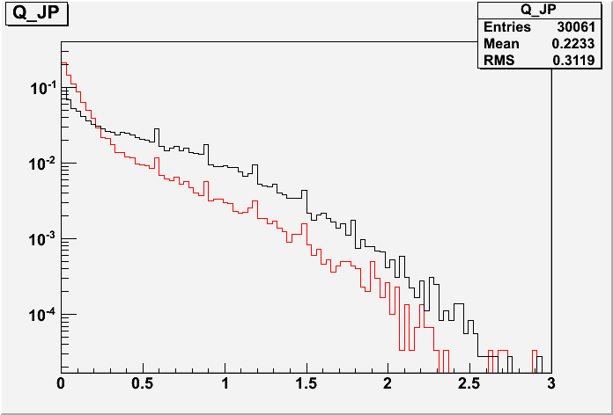
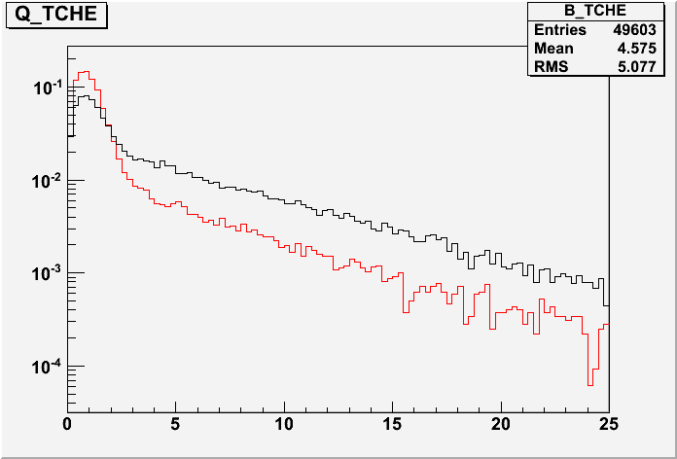
qq’H→qq’ bb
B tagging discriminator on b-jet in the
signal (black) and light-quarks jet in the
signal (red) for TCHP, TCHE and JP algorithm

