Slide 1
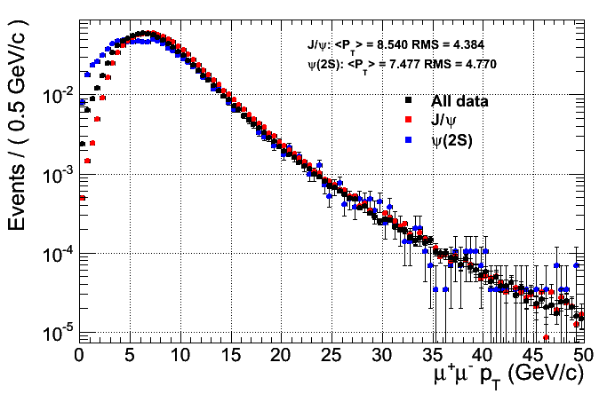
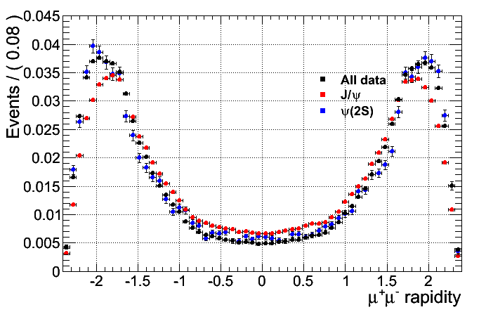
Kinematic variables
pT and Rapidity of J/psi and Psi(2S) in invariant mass window of 100 MeV around respective peaks (3.097 and 3.68 GeV)

Slide 2
Aim
To measure the Psi(2S) to Jpsi ratio in the same bins of the Jpsi cross section paper
Possibly a fast paper given that the acceptance and efficiencies factor out
To be checked
Independent fits of the Jpsi and Psi(2S) mass shapes or some correlations from fixing some parameters?
Also to be checked that the b-fraction fit does correctly the job
Avoid correlations coming from choosing the same mass range for the side bands fits.

Slide 4
Mass Fits
A first try of mass fits in bins very similar to theose used in lifetime fits in J/psi paper
3 Y bins with boundaries: (0,1.2,1.6,2.4)
10 pT bins with boundaries: (0,1.25,2,2.75,3.50,4.50,6.50,10,20,30,50)
Fit functions:
CB+Gauss for the J/psi
CB for the psi(2S)
Exponential for the background
An unbinned likelihood fit is used, to fix some parameters to resonable values a prefit is performed on:
Bkg in the sidebands (only to give a resonable starting point)
Jpsi peak in range (than fix alpha and n in CB)
Psi(2S) peak (than fix n in CB)
For technical problems only the Global-Global dimuons are considered (the analysis will use all the dimuon types)
The selection criteria are the same as for the J/psi paper
A total of 28 1/pb of data is used

Slide 5
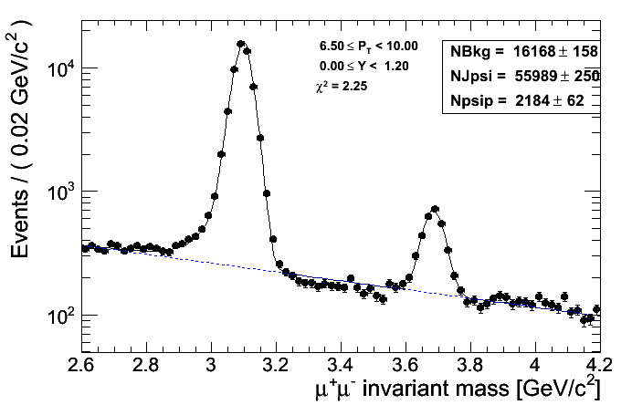
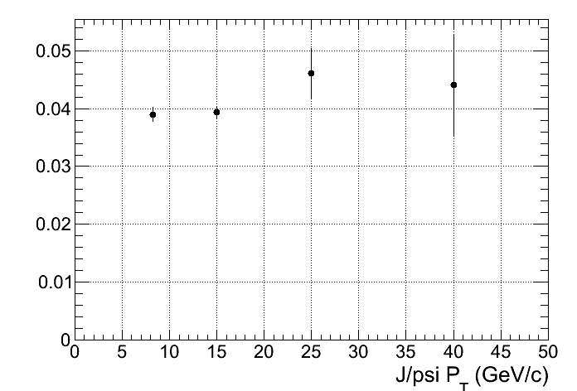
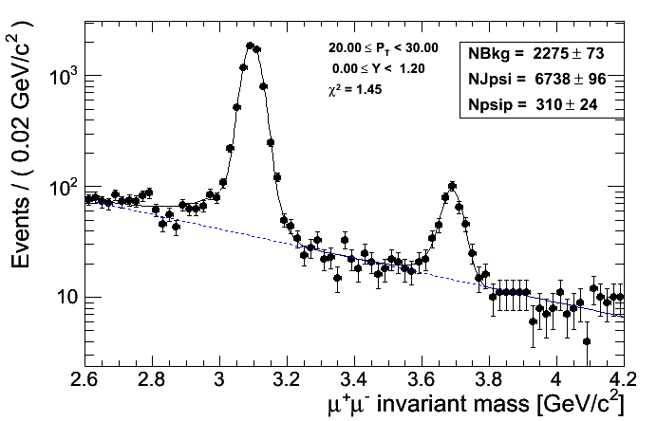
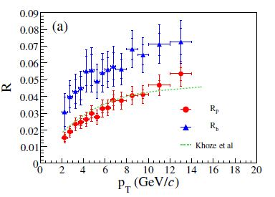
Some examples ...
Barrel region (i.e |Y| < 1.2
The exponential fit tends to overestimate bkg between the two peaks, at higher pT seems better but the errors are larger
#Psi(2S) / #J/psi ( not corrected for acc. and eff.
CDF |Y| < 0.6

Slide 6
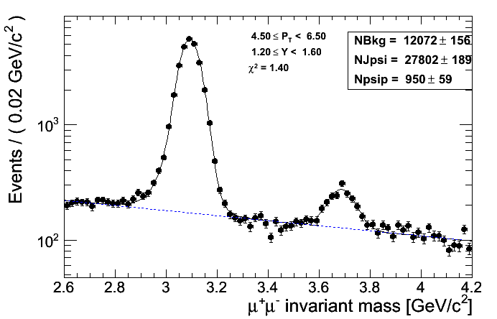
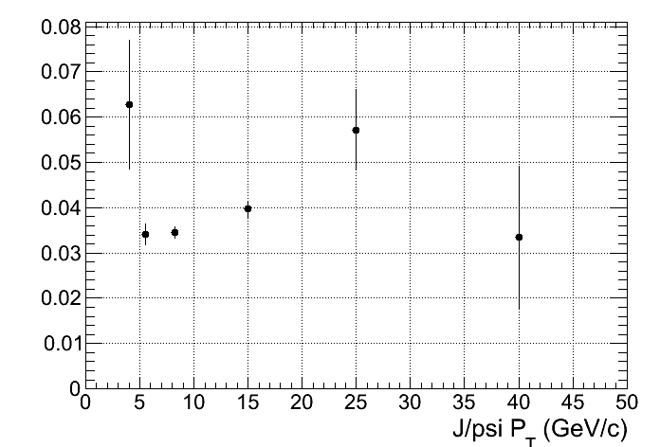
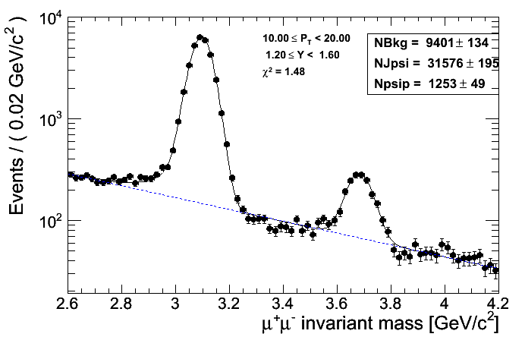
Some examples ...
Mid region (i.e 1.2 < |Y| < 1.6
Same as before, but seems that things improve with statistics
#Psi(2S) / #J/psi ( not corrected for acc. and eff.

Slide 7
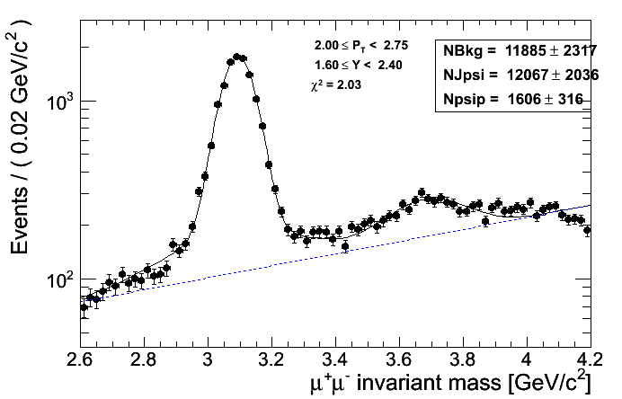
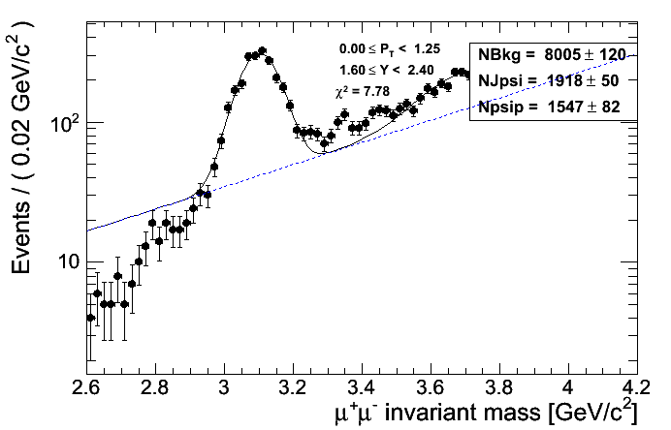
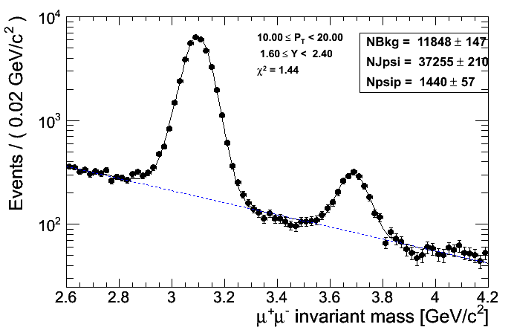
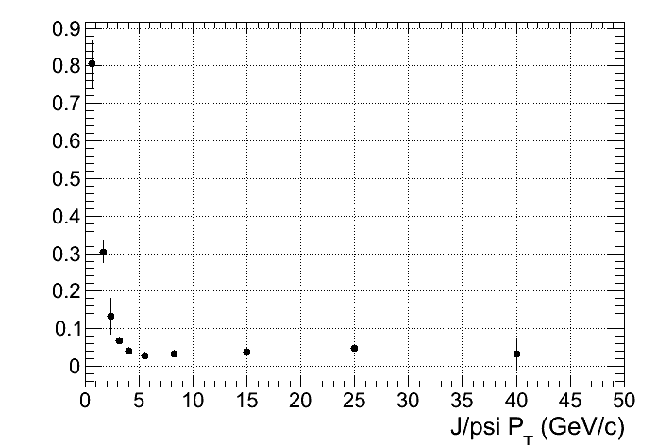
Some examples ...
Forward region (i.e |Y| > 2.4
Lowest pT bin
☹
Problematic background modelling, much worse at lower pT
#Psi(2S) / #J/psi ( not corrected for acc. and eff.
At higher pT all goes better
bad fits here

