Slide 1
Sensor Size on new design
Rui Qiao, Wenxi Peng, Ke Gong
Strcture by RuiJie Wang

Slide 2
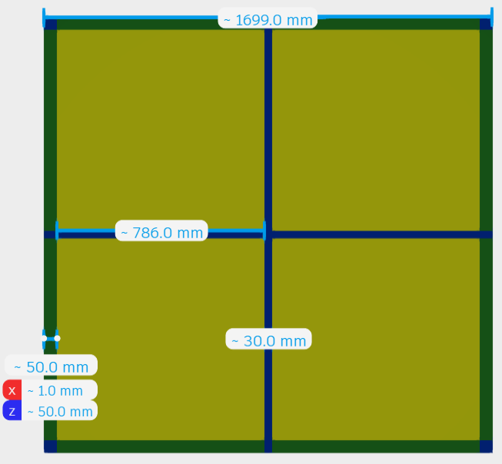
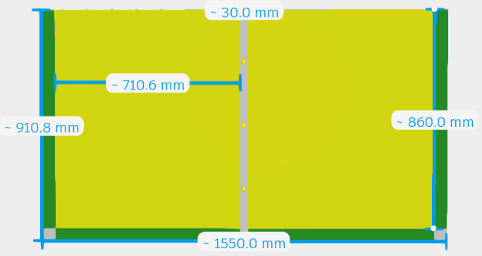
Preliminary size @20220518
Row1
Row2
Row1
Row2
Row3
Row4
Top SCD
Side SCD
Add cross support for top SCD. Four rows each layer.
Add vertical support for side SCD. Two rows each layer
The sensor size is under determined.
Notes:
来源：G:\keyan\HERD项目文档\结构\20220518-PSD+SCD.stp 和 20220518-PSD+SCD-top.stp

Slide 3
Layout of ladder and Sensor
Row
Ladder
Ladder
Ladder
Ladder
Ladder
Ladder
Ladder
Several ladders on one row, with 200um safe gap.
Several sensor on one ladder, with 100um safe gap.

Slide 4
The baseline (Alberto & Giovanni)
Module | Layers | Rows /Layer | Row length (m) | Row width (m) | Ladders /Row | Sensor /Ladder | Total Ladders | Total Sensors
Top | 4 | 2 | 0.9 | 1.8 | 18 | 9 | 288 | 2592
Side(H) | 16 | 2 | 0.8 | 1.1 | 11 | 8 | 352 | 2816
Side(V) | 16 | 1 | 1.1 | 1.6 | 16 | 11 | 256 | 2816
Total |  |  |  |  |  |  | 896 | 8224
Notes:
来源：G:\keyan\HERD项目文档\工作策划\SCD_Alberto_20220124.pdf

Slide 5
The new design
Module | Rows /Layer | Row length (m) | Row Width (m) | Ladders /Row | Sensor /Ladder
Top | 2 | 0.9 | 1.8 | 18 | 9
Side(H) | 2 | 0.8 | 1.1 | 11 | 8
Side(V) | 1 | 1.1 | 1.6 | 16 | 11
Alberto &
Giovanni
@20220124
Module | Rows /Layer | Row length (m) | Row Width (m) | Ladders /Row | Sensor /Ladder
Top | 4 | 0.786 | 0.786 | ??? | ???
Side(H) | 2 | 0.71 | 0.86 | ??? | ???
Side(V) | 2 | 0.86 | 0.71 | ??? | ???
RuiJie Wang
@20220518

Slide 6
Criteria of sensor size
Criteria
Unique
Active area
Cost
Restriction
Unique: Only one sensor size for the whole payload.
Active area: The total active area of the whole payload as large as possible.
Cost: The counts of wafer as small as possible.
Restriction : The diameter of 13.95 cm; safe gap between sensor & ladder; dead area 1 mm.

Slide 7
6-inch wafer limit
Total diameter: 14.95 cm
Additional surrounding: 0.5 cm

Slide 8
Choose the best sensor size
Row
Row
sensor
Row
sensor
sensor
sensor
sensor
sensor
sensor
sensor
sensor
sensor
CASE 1: Sensor too large
CASE 2: Sensor too small
CASE 3: Sensor match

Slide 9
Solution procedure
Loop sensor size within 6-inch
Solve
the
baseline
Finish
Loop
Loop
Next
Try to place sensors on rows
Choose the best sensor size
Solve
New
design
Calculate: active area & wafer counts

Slide 10
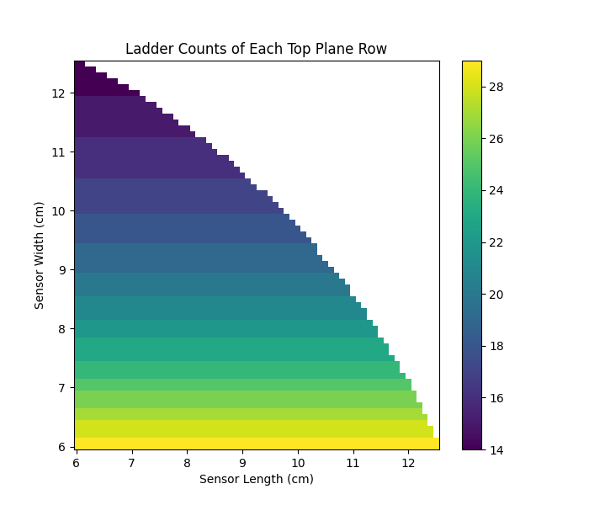
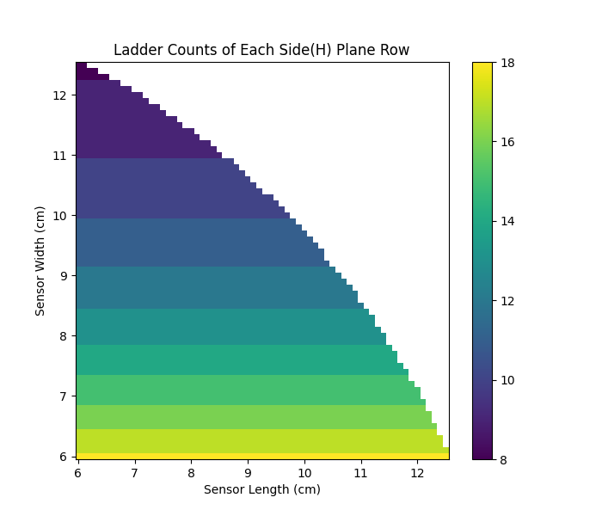

Solve the baseline: Ladder counts per row
Top SCD:
Ladder counts per row (Z)
on sensor size (X,Y)
Side(H) SCD:
Ladder counts per row (Z)
on sensor size (X,Y)
Side(V) SCD:
Ladder counts per row (Z)
on sensor size (X,Y)
With smaller sensor width (Y-axis), the ladder counts increase.
The ladder counts independent to sensor length (X-axis)
Notes:
来源：G:\keyan\HERD项目文档\结构\20220524_硅片尺寸计算器\20220124\png_step1\

Slide 11
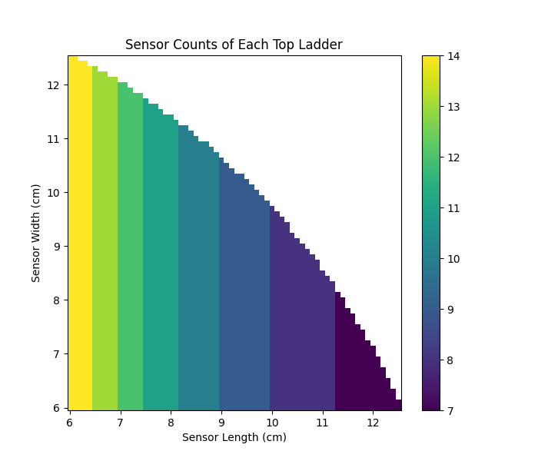
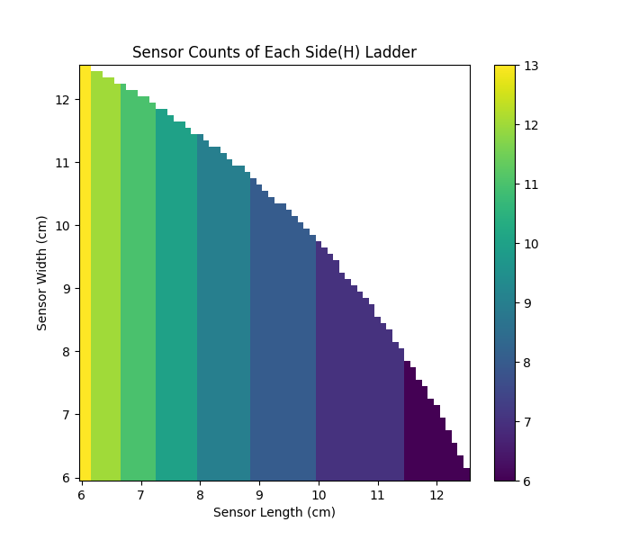
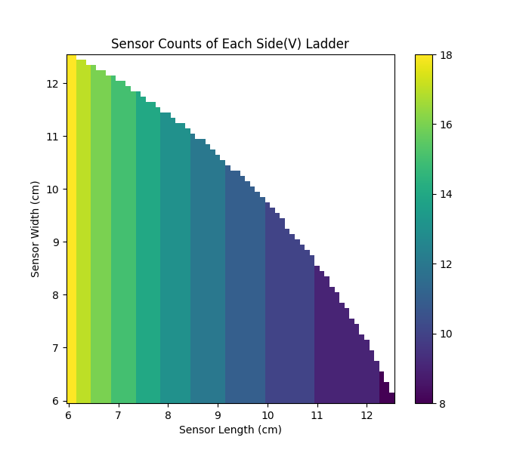
Solve the baseline: Sensor counts per ladder
Top SCD:
Sensor counts per ladder (Z)
on sensor size (X,Y)
Side(H) SCD:
Sensor counts per ladder (Z)
on sensor size (X,Y)
Side(V) SCD:
Sensor counts per ladder (Z)
on sensor size (X,Y)
With smaller sensor length (X-axis), the sensor counts increase.
The sensor counts independent to sensor width (Y-axis)
Notes:
来源：G:\keyan\HERD项目文档\结构\20220524_硅片尺寸计算器\20220124\png_step1\

Slide 12
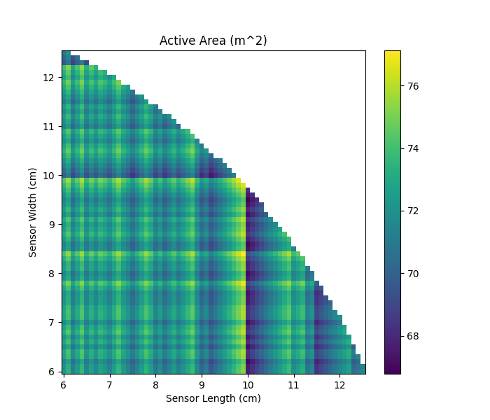
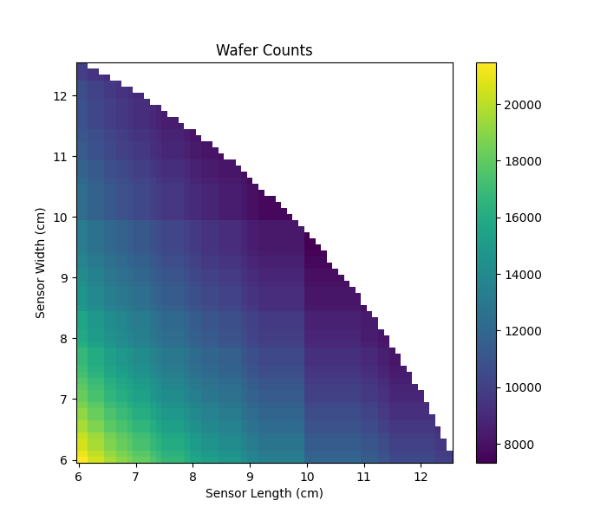
Solve the baseline: active area & wafer counts
Active area (Z)
on sensor size (X,Y)
Wafer counts(Z)
on sensor size (X,Y)
Notes:
来源：G:\keyan\HERD项目文档\结构\20220524_硅片尺寸计算器\20220124\png_step1\

Slide 13
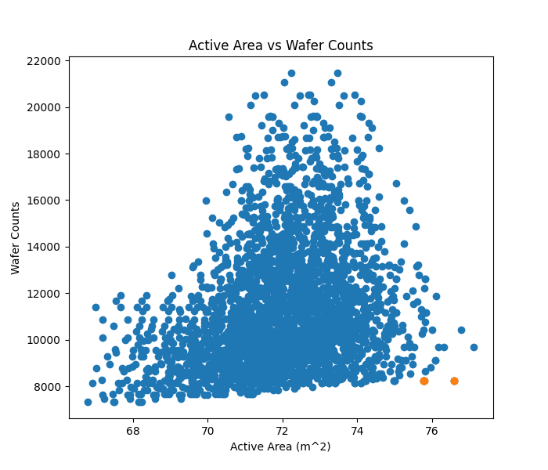
Solve the baseline: active area & wafer counts
Unit | Rows per Layer | Ladders per Row | Wafers per Ladder | Total Ladders | Total Sensors
Top | 2 | 18 | 9 | 288 | 2592
Side[H] | 2 | 11 | 8 | 352 | 2816
Side[V] | 1 | 16 | 11 | 256 | 2816
Total |  |  |  | 896 | 8224
Wafer counts as small as possible
Sensor Size: 9.85*9.85 cm²
Active area as large as possible
Notes:
来源：G:\keyan\HERD项目文档\结构\20220524_硅片尺寸计算器\20220124\png_step1\
G:\keyan\HERD项目文档\结构\20220524_硅片尺寸计算器\20220124\csv\

Slide 14
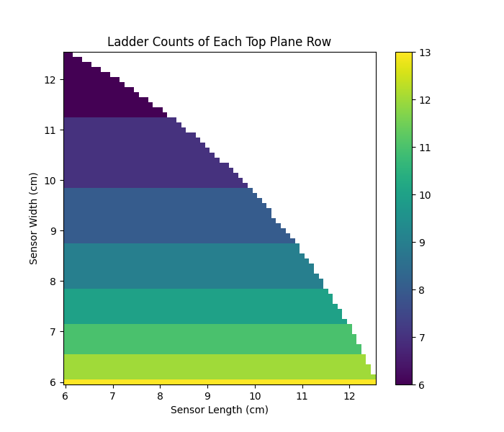

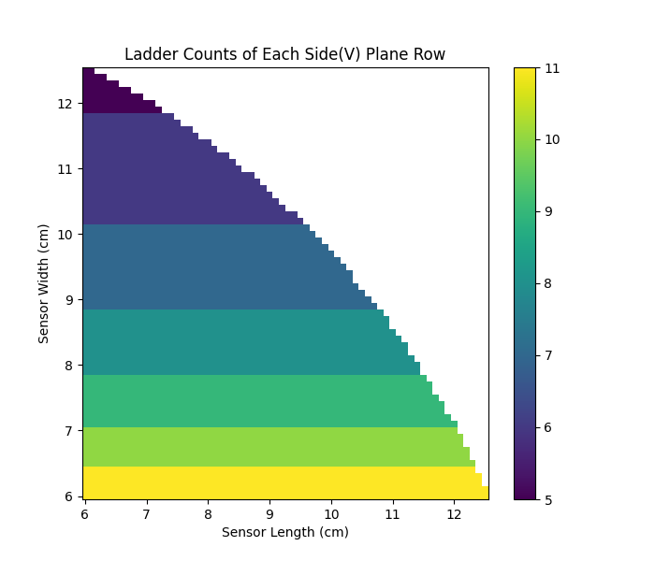
Solve the new design: Ladder counts per row
Top SCD:
Ladder counts per row (Z)
on sensor size (X,Y)
Side(H) SCD:
Ladder counts per row (Z)
on sensor size (X,Y)
Side(V) SCD:
Ladder counts per row (Z)
on sensor size (X,Y)
With smaller sensor width (Y-axis), the ladder counts increase.
The ladder counts independent to sensor length (X-axis)
Notes:
来源：G:\keyan\HERD项目文档\结构\20220524_硅片尺寸计算器\20220518\png_step1\

Slide 15
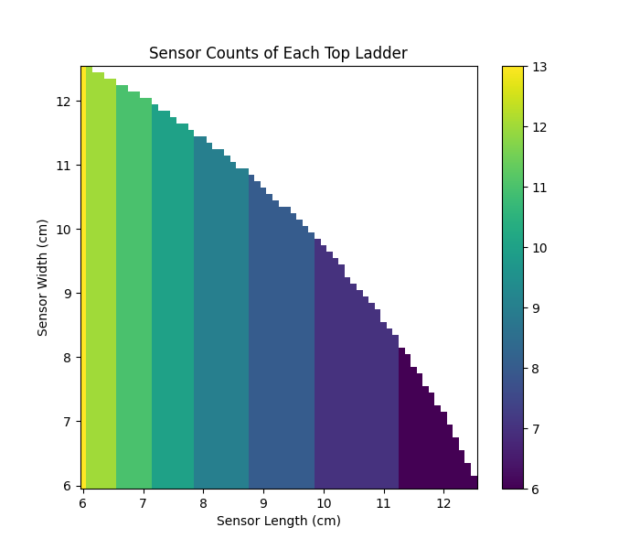
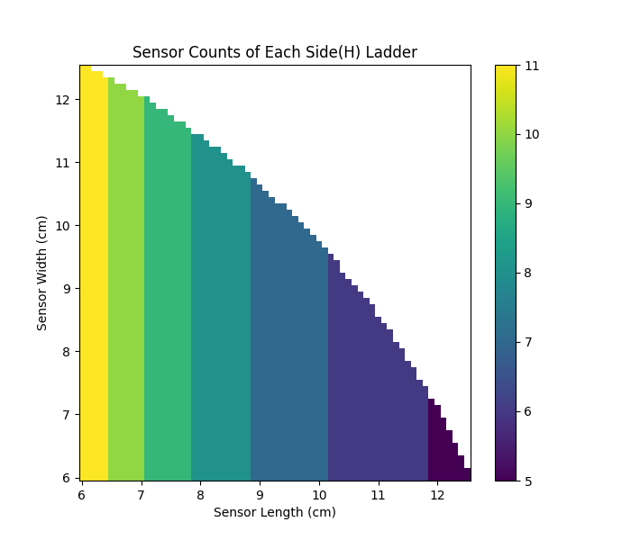

Solve the new design: Sensor counts per ladder
Top SCD:
Sensor counts per ladder (Z)
on sensor size (X,Y)
Side(H) SCD:
Sensor counts per ladder (Z)
on sensor size (X,Y)
Side(V) SCD:
Sensor counts per ladder (Z)
on sensor size (X,Y)
With smaller sensor length (X-axis), the sensor counts increase.
The sensor counts independent to sensor width (Y-axis)
Notes:
来源：G:\keyan\HERD项目文档\结构\20220524_硅片尺寸计算器\20220518\png_step1\

Slide 16

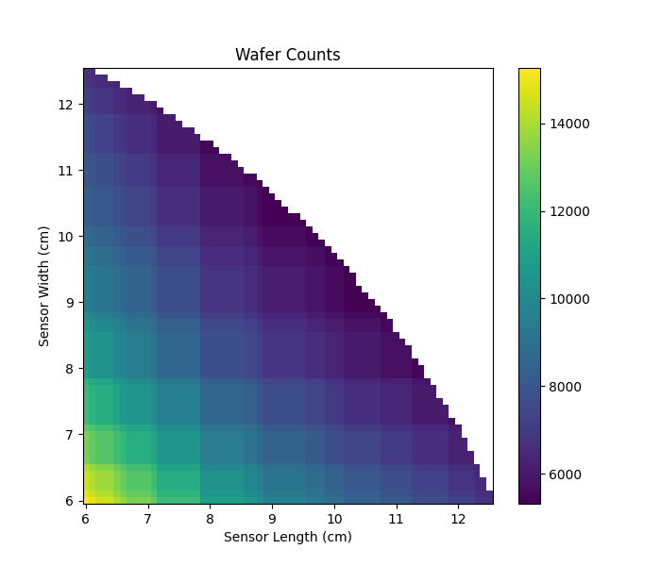
Solve the new design: active area & wafer counts
Active area (Z)
on sensor size (X,Y)
Wafer counts(Z)
on sensor size (X,Y)
Notes:
来源：G:\keyan\HERD项目文档\结构\20220524_硅片尺寸计算器\20220518\png_step1\

Slide 17
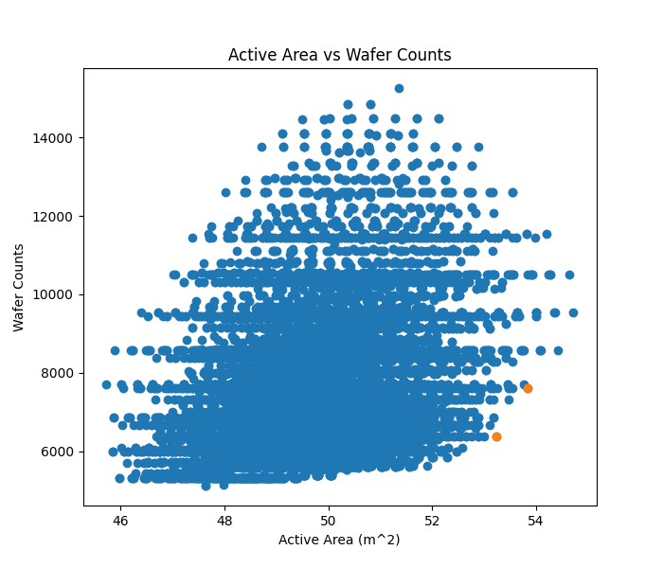
Solve the new design: active area & wafer counts
Unit | Rows per Layer | Ladders per Row | Wafers per Ladder | Total Ladders | Total Sensors | Coverage Rate
Top | 4 | 7 | 10 | 224 | 2240 | 99.0%
Side[H] | 2 | 7 | 9 | 224 | 2016 | 90.1%
Side[V] | 2 | 6 | 11 | 192 | 2112 | 94.4%
Total |  |  |  | 640 | 6368
Sensor Size: 7.8*11.2 cm²
Active Area: 53.2 m²
Wafer counts as small as possible
Unit | Rows per Layer | Ladders per Row | Wafers per Ladder | Total Ladders | Total Sensors | Coverage Rate
Top | 4 | 8 | 10 | 256 | 2560 | 96.0%
Side[H] | 2 | 9 | 9 | 288 | 2592 | 98.3%
Side[V] | 2 | 7 | 11 | 224 | 2464 | 93.4%
Total |  |  |  | 768 | 7616
Active area as large as possible
Sensor Size: 7.8*9.5 cm²
Active Area: 53.8 m²
Notes:
来源：G:\keyan\HERD项目文档\结构\20220524_硅片尺寸计算器\20220518\png_step1\
G:\keyan\HERD项目文档\结构\20220524_硅片尺寸计算器\20220518\csv\

Slide 18
Improve the coverage rate with 3 sensors
1 sensor
Low cost
Lower coverage rate
3 sensors
Extra 500k ¥
Larger coverage rate

Slide 19
Solve the new design with 3 sensors
Unit | Rows per Layer | Ladders per Row | Wafers per Ladder | Sensor Length (cm) | Sensor Width (cm) | Coverage Rate (Area) | Total Ladders | Total Sensors
Top | 4 | 8 | 8 | 9.8 | 9.8 | 99.4917 | 256 | 2048
Side[H] | 2 | 8 | 8 | 8.85 | 10.7 | 99.2545 | 256 | 2048
Side[V] | 2 | 8 | 8 | 10.7 | 8.85 | 99.2545 | 256 | 2048
Total |  |  |  |  |  |  | 768 | 6144
Top SCD sensor is square; Side SCD sensor is rectangle.
Side(H) & Side(V) SCD sensors have the same size, with different strip direction.
The coverage rate > 99%.

Slide 20
Conclusion
Develop a <sensor size calculator>, which correctly solve the baseline.
There are three solutions for the new design:
Large unique sensor, low coverage rate for side SCD
Small unique sensor, improved coverage rate with additional 1248 sensors.
Three sensors for Top/Side(H)/Side(V) SCD respectively. Max coverage rate.

