Slide 1
The reason of charge equalization in TCAD simulation of AMS-02
Rui Qiao; Wenxi Peng; Ke Gong

Slide 2
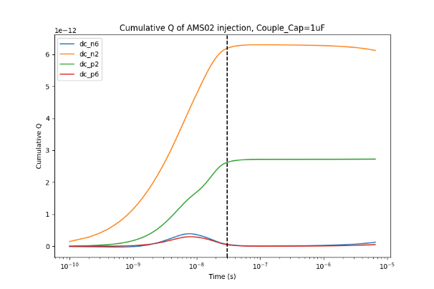
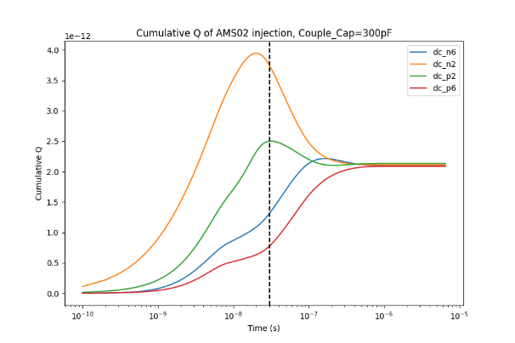
Background
When TCAD simulating AMS02 with various coupling capacitance, we found the cumulative charge tend to slowly equalize. With smaller coupling capacitance, the charge equalization is stronger.
Simulation of AMS02 with 1uF coupling capacitance
Simulation of AMS02 with 50pF coupling capacitance

Slide 3
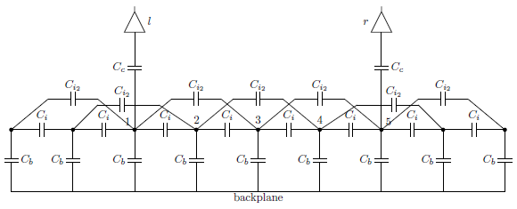
Charge equalization
Readout channels
Coupling capacitance
Interstrip capacitance
Bulk capacitance
Equivalent circuit of AMS-02
There are only interstrip capacitances connecting the two neighboring readout channels.
Capacitance is conductive for fast signal, but non-conductive for slow signal. So the slow charge equalization is hard to understand.

Slide 4
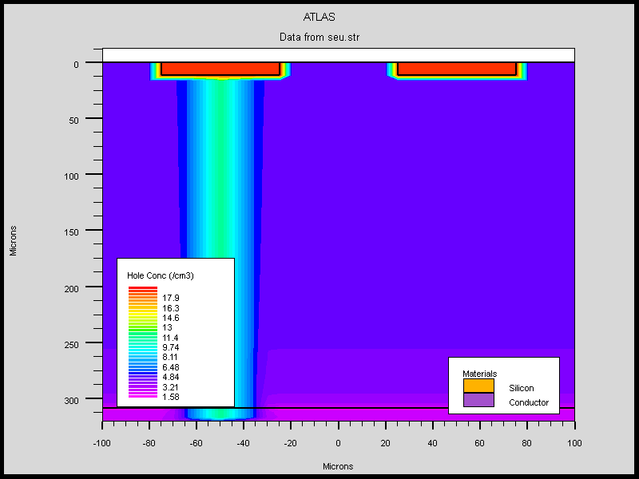
TCAD simulation with simple structure
Simulation with only two strips.
Parameter | TCAD | AMS02
Strip occupancy | 50% | 50.9%
Strip Gap [um] | 10->100 | 13.5
Coupling Cap. [pF] | 100->1000 1E6 | 700
TCAD charge injection into two-strips detector

Slide 5
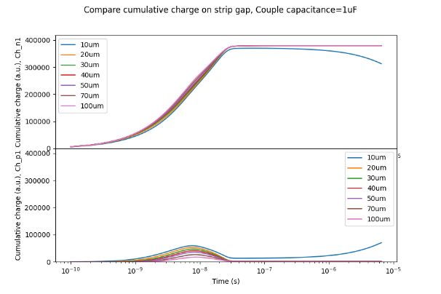
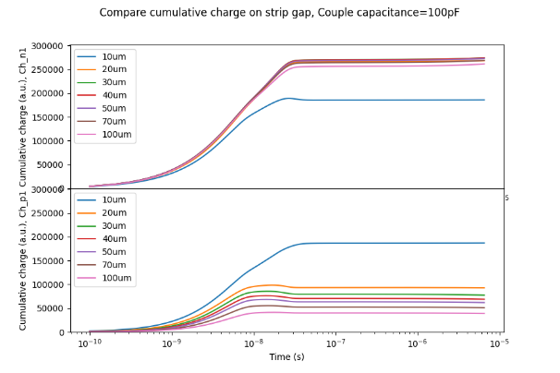
TCAD simulation with different strip gap
Strip
Gap
10um
SEU Strip
SEU Strip
Neighboring Strip
Neighboring Strip
Cumulative Charge(Y) vs Time(X)
1uF coupling capacitance
Cumulative Charge(Y) vs Time(X)
100pF coupling capacitance
The 10um strip gap behave different from others
Charge equalization is only observed with 10um strip gap.

Slide 6
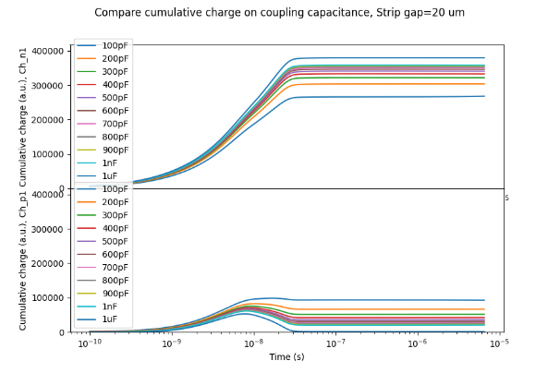
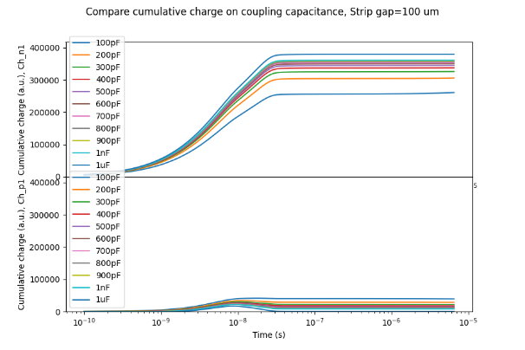
TCAD simulation with different coupling cap
SEU Strip
SEU Strip
Neighboring Strip
Neighboring Strip
Cumulative Charge(Y) vs Time(X)
20um strip gap
Cumulative Charge(Y) vs Time(X)
100um strip gap
With 20um~100um strip gap (excluding 10um strip gap), no charge equalization is observed with all coupling capacitance.

Slide 7
Conclusion
No charge equalization is expected via the equivalent circuit of AMS-02.
No charge equalization is observed in TCAD simulation with
Strip gap: 20~100 um
Coupling capacitance: 100pF~1uF
Charge equalization is only observed in TCAD simulation with strip gap 10um. TCAD is hard to use correctly.

