Slide 1


EuPRAXIA
Building & Machine Layout
Andrea Ghigo
Riunione Giunta Esecutiva INFN A.Ghigo Roma 5 Febbraio 2021

Slide 2
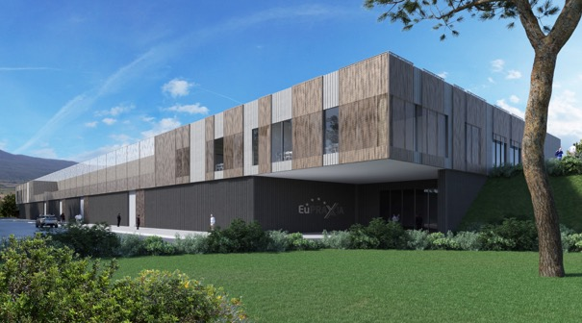
EuPRAXIA Building rendering
(front view)
Riunione Giunta Esecutiva INFN A.Ghigo Roma 5 Febbraio 2021

Slide 3
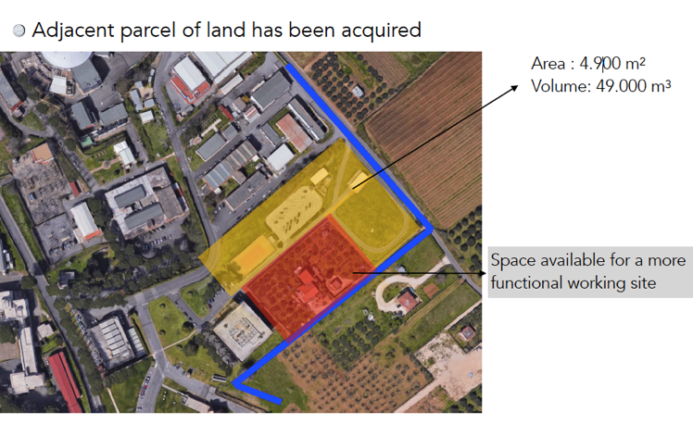


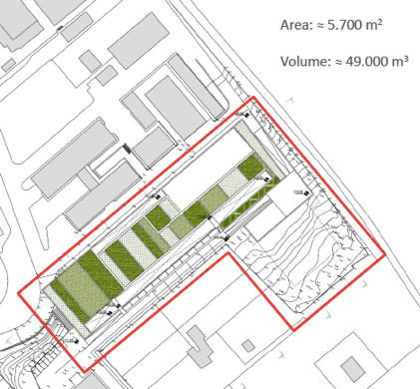
EuPRAXIA Site @ LNF
Riunione Giunta Esecutiva INFN
A.Ghigo Roma 5 Febbraio 2021

Slide 4
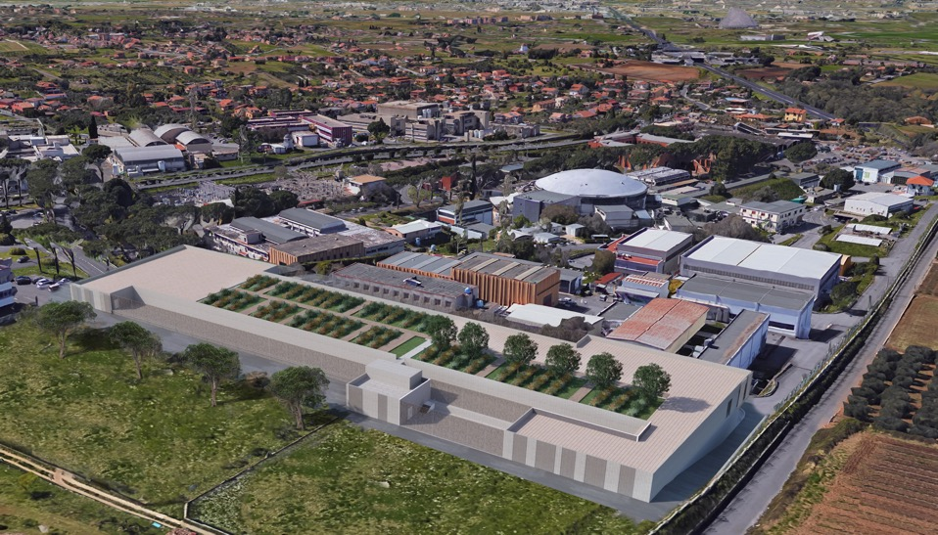
EuPRAXIA Building rendering @ LNF
Riunione Giunta Esecutiva INFN A.Ghigo Roma 5 Febbraio 2021

Slide 5
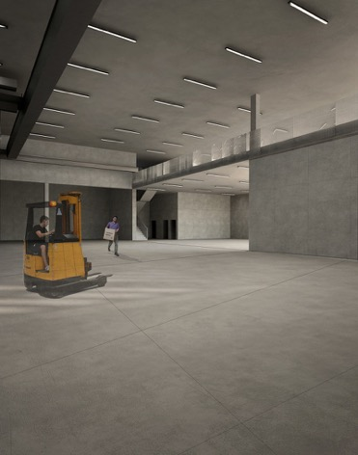
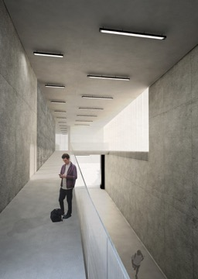
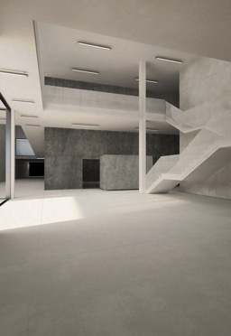
EuPRAXIA Building rendering @ LNF
Main entrance
Control room
corridor
User hall
Riunione Giunta Esecutiva INFN A.Ghigo Roma 5 Febbraio 2021

Slide 6
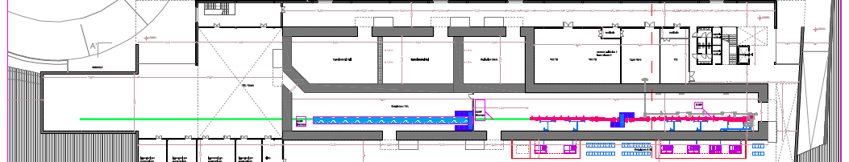
The layout legend of the rooms
Laser & THz clean rooms
Particle experimental halls
Photon user experimental hall
Undulators tunnel
Plant gallery
Accelerator tunnel
Klystron&modulators
Power supplies gallery
Riunione Giunta Esecutiva INFN A.Ghigo Roma 5 Febbraio 2021

Slide 7
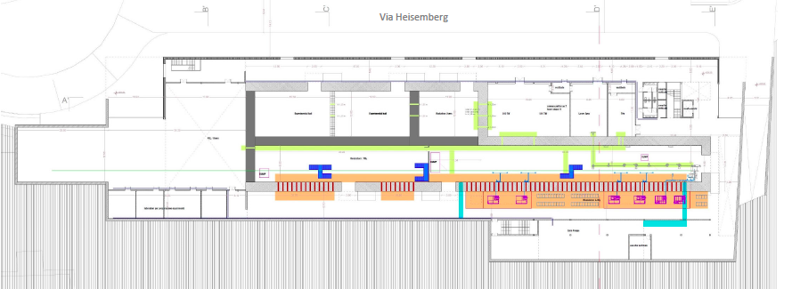
Plants distribution
The design now focuses on electrical distribution, air conditioning,
temperature stabilization, clean rooms, main water cooling systems
Laser shaft
Cavity for cooling tubes
holes for cables
Water collection area
Riunione Giunta Esecutiva INFN A.Ghigo Roma 5 Febbraio 2021

Slide 8
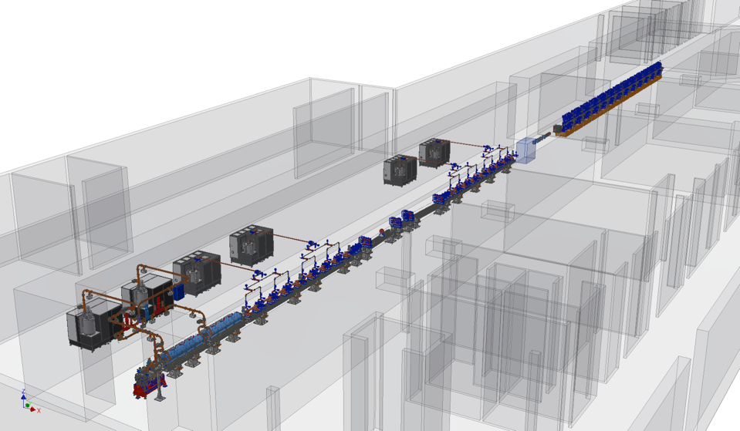
Linac & undulators 3D layout
Riunione Giunta Esecutiva INFN A.Ghigo Roma 5 Febbraio 2021

Slide 9
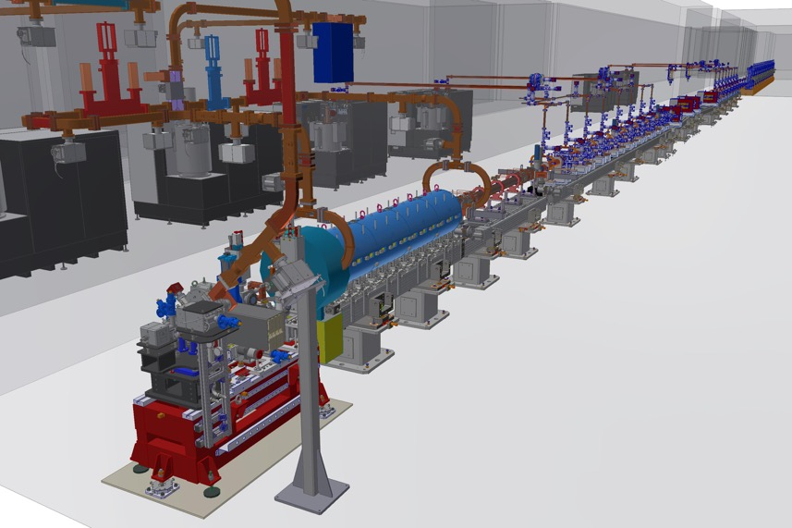
EuPRAXIA Linac
Riunione Giunta Esecutiva INFN A.Ghigo Roma 5 Febbraio 2021

Slide 10
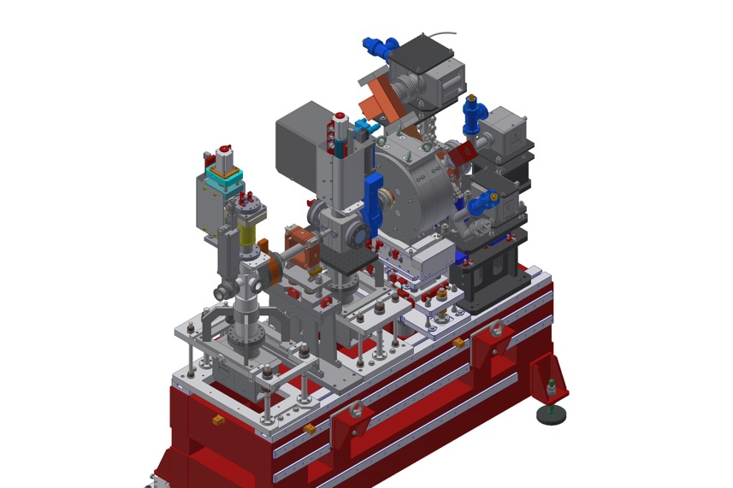
New SPARC Gun
Riunione Giunta Esecutiva INFN A.Ghigo Roma 5 Febbraio 2021

Slide 11
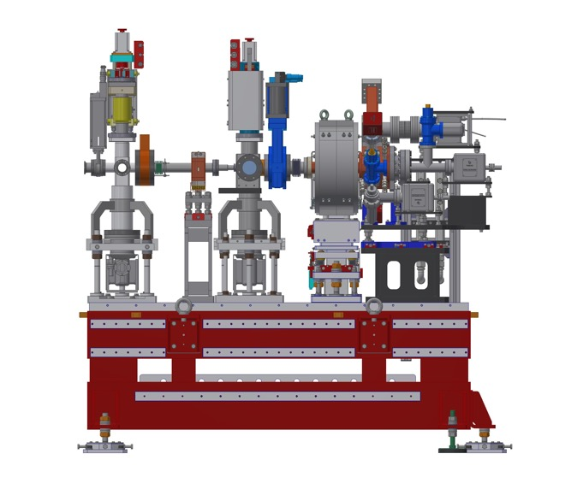
New SPARC Gun Components
Cathode
RF Cavities
Waveguide
Solenoid
Valve
Laser ports
Corrector
Current transformer
Farady cup
Flag
Fast valve
Riunione Giunta Esecutiva INFN A.Ghigo Roma 5 Febbraio 2021

Slide 12
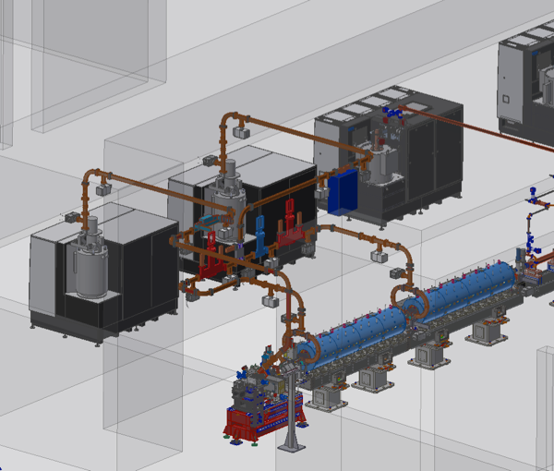
RF photoinjector
Photoinjector:
Two S-Band Klystron&modulator power stations.
RF Gun
Two 3m S-Band RF accelerating structures
Solenoids x gun and two accelerating structure
RF pulse compressor (SLED)
Riunione Giunta Esecutiva INFN A.Ghigo Roma 5 Febbraio 2021

Slide 13
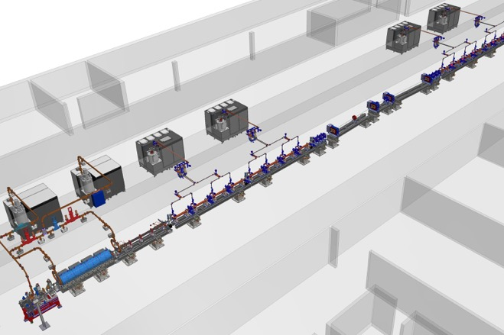
X-band Linear accelerator
Linac:
7 X-Band Klystron and modulator power stations.
18 X-band accelerating structures 0.9 m long
2 RF deflectors and 1 RF power station
6 RF pulse compressors (BOC)
Bunch compressor:
4 Dipoles magnetic chicane
+ quads
Riunione Giunta Esecutiva INFN A.Ghigo Roma 5 Febbraio 2021

Slide 14
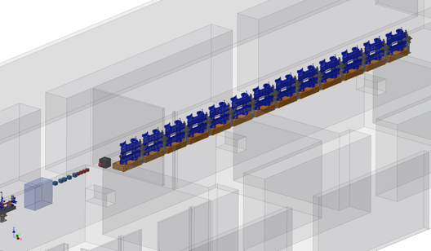
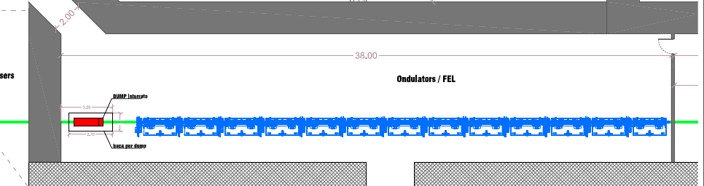
Undulators &
beam dump studies
Permanent magnet Undulators & Diagnostics
33 m total lenght
undulator module 2.3 m long
Combination of SC and NC undulator is under study
Riunione Giunta Esecutiva INFN A.Ghigo Roma 5 Febbraio 2021

Slide 15
SUMMARY OF THE INTEGRATION STATE:
New tools
To do
done
CAD
LAY-OUT GENERAL
LINAC optic ✓
Diagnostics
LINAC ✓
Injector
Diagnostics
nomenclature
LAY-OUT INIETTORE
SPARC like ✓
ONDULATORs
MAGNETs
MODULATORs,
GUIDE & RF
✓
✓
ready

Slide 16
New Lay-out setting
positions and orientation of elements from file 200pC_1GeV_X_90cm_update_short_LH_4b_up_check_new_Oct_20_flr.xlsx
dipoles and quadrupoles = cubes with side equal to the magnetic length
RF sections = full size sketches
A lay-out definition meeting is being planned: find the status quo of the layout (visible on web browser) at the link https://autode.sk/2XRyIQV
the updated link will be made available for collaboration on TEAMS
When available, the 3D CADs will gradually replace the cubes.
The same general assembly will always be available also in "lightened" view to be able to interact quickly on positions and new entries.
REASONABLE IMMEDIATELY: insert the injector in the "new SPARC-like" status.
EASY NOW: integration of nomenclature from WBS and application to the automatic numbering of drawings

Slide 17
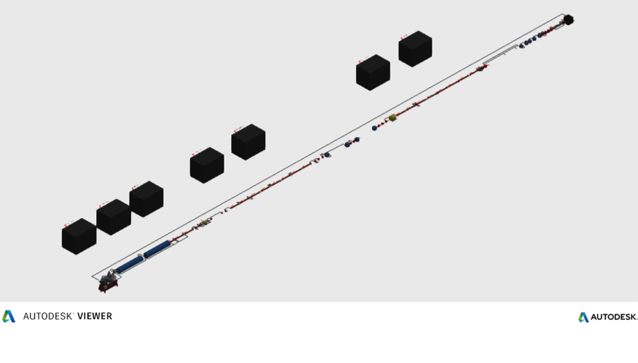
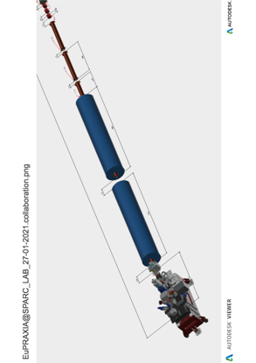
Mechanical implementation tool
Simplified 3D CAD version
AUTODESK VIEWER environment on
WEB browser
L. PELLEGRINO – E. DI PASQUALE
Riunione Giunta Esecutiva INFN A.Ghigo Roma 5 Febbraio 2021

Slide 18
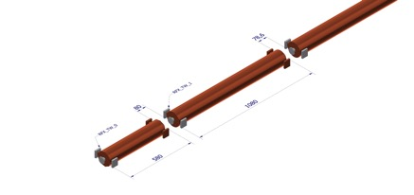
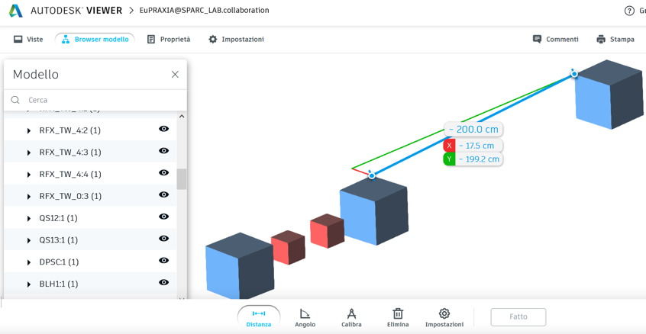
Possible to take measurements, identify components, etc.
Zoom view with dimension
Riunione Giunta Esecutiva INFN A.Ghigo Roma 5 Febbraio 2021

Slide 19
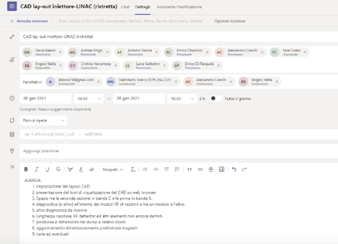
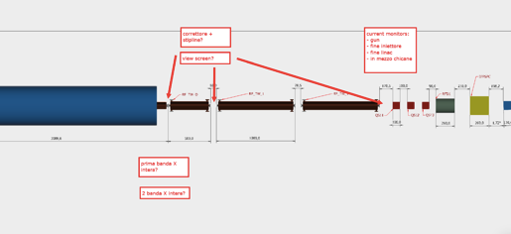
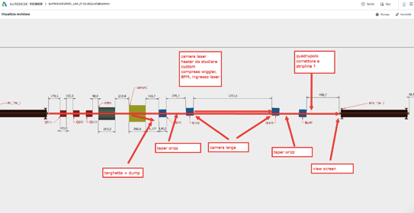
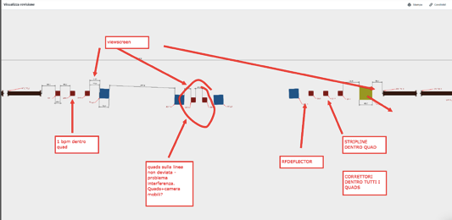
interact quickly with the design team
L. PELLEGRINO – E. DI PASQUALE

Slide 20
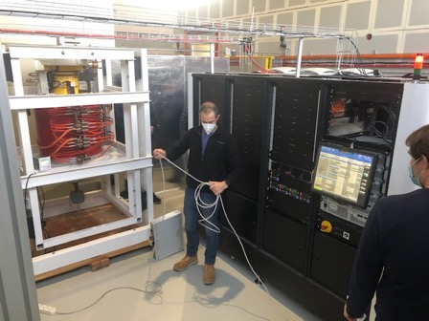
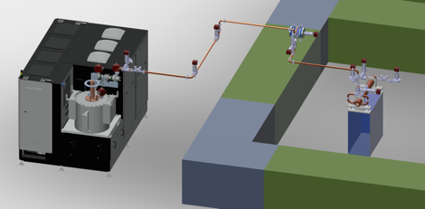
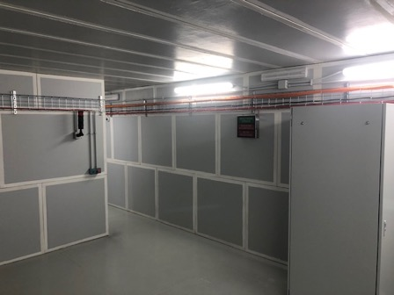
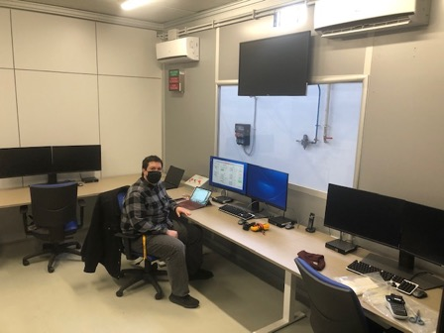
R&D Activities
TEX: X-band test stand
EuPraxia/CERN collaboration
S.Pioli

Slide 21
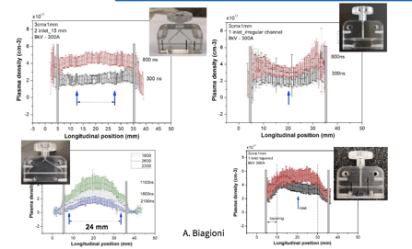
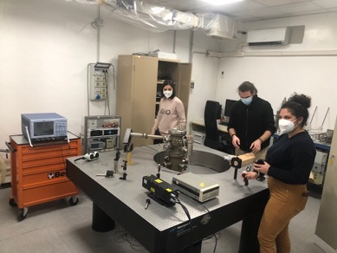
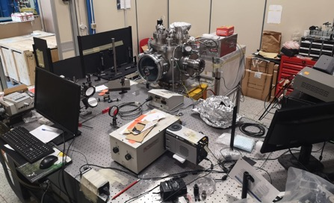
R&D Activities
Cathode-lab
Plasma-lab
New capillary shapes test
Discharge circuit test
Quantum efficiency measurements of new emitter material
Cathode test
Riunione Giunta Esecutiva INFN A.Ghigo Roma 5 Febbraio 2021

Slide 22
Thanks for the attention
Riunione Giunta Esecutiva INFN A.Ghigo Roma 5 Febbraio 2021

