Slide 1
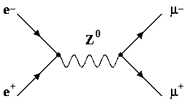
University La Sapienza of Rome
PhD Course on «Accelerator Physics»
Low Emittance Muon Accelerator (LEMMA)
Study of the features of a multiple targets system for the LEMMA project.
June 10, 2022
Supervisors:
Prof. Gianluca CAVOTO
Dr. Francesco COLLAMATI
Student:
Fausto CASABURO

Slide 2
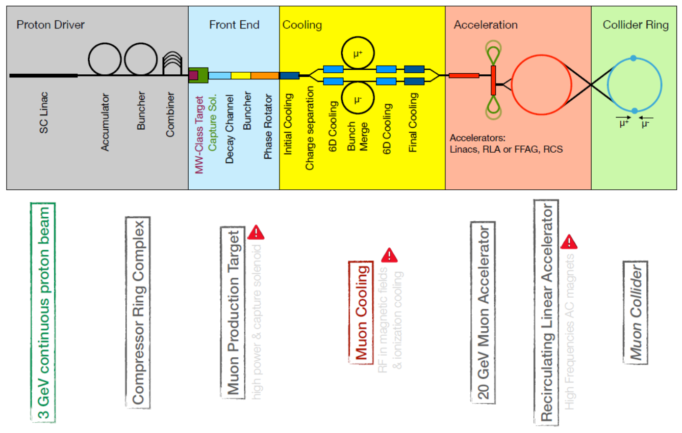
Muon colliders
Muon colliders:
Muons are elementary particles.
Synchrotron radiation is higly suppressed (m_{μ} ≈207m_{e}).
Unique potential for HEP investigation.
Challenges of muon colliders:
Limited muons life-time (τ ≈ 2µs)
Need of low muons emittance.
Proton driven scheme (MAP):
Large number of muons (10¹³-10¹⁴µ/s)
Large emittance
Cooling is needed.
Introduction
LEMMA
TB 2018
Multi-target proposal
Deposited energy
Primary positrons
Secondary muons
Theoretical model
Plannig of test at MAMI
Conclusions
Proton driven muon accelerator scheme

Slide 3
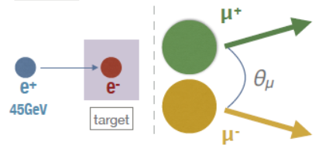
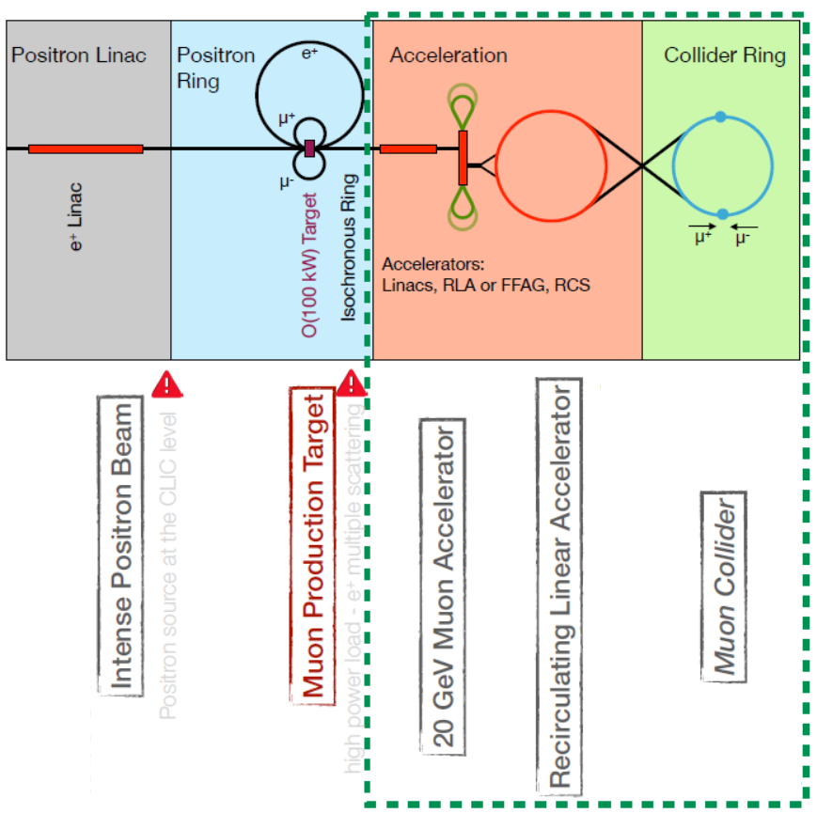
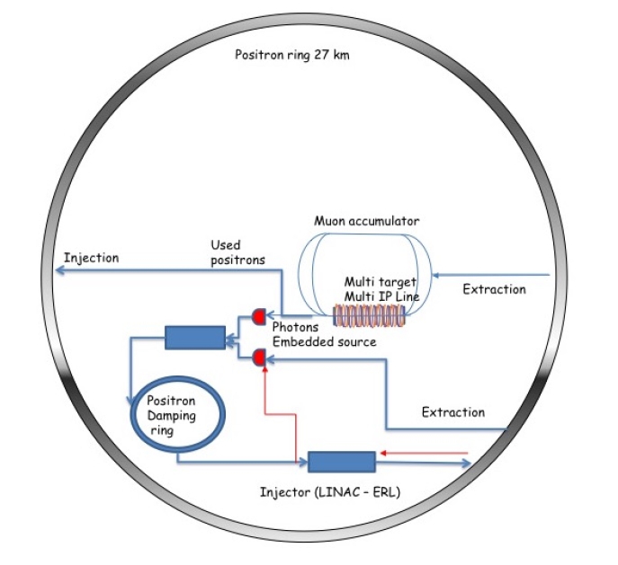
Low EMittance Muon Accelerator (LEMMA)
LEMMA novel approch:
Muon pair production in electron-positron annihilation.
45 GeV positron beam.
Low Z fixed target (Be or C).
LEMMA advantage:
Low emittance,
No cooling is needed.
LEMMA disadvantage:
Low cross-section (1μb)
High intensity positron beam is needed.
Introduction
LEMMA
TB 2018
Multi-target proposal
Deposited energy
Primary positrons
Secondary muons
Theoretical model
Plannig of test at MAMI
Conclusions
Muon production in e⁺ e⁻ annihilation
LEMMA concept
One of the LEMMA proposed layouts

Slide 4
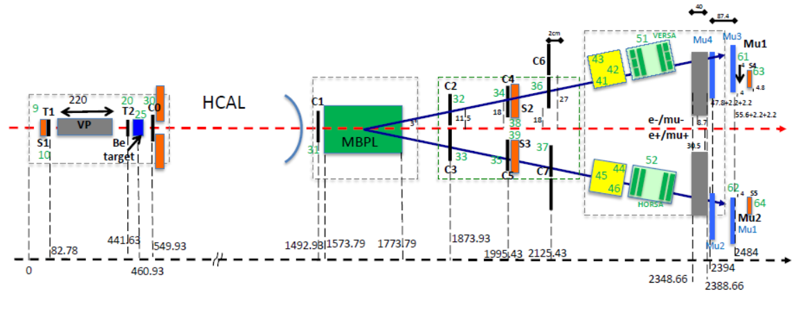
Muon production in LEMMA scheme
Test Beam 2018:
22 GeV e⁻, µ⁻ beams.
45GeV e⁺ on carbon targets.
Data analysis of data stored by an absorber system.
μ⁻/e⁻ results:
Not usual measurement.
Agreement with MC simulation
Encouraging for muon production in electron-positron annihilation.
Introduction
LEMMA
TB 2018
Multi-target proposal
Deposited energy
Primary positrons
Secondary muons
Theoretical model
Plannig of test at MAMI
Conclusions
Experimental setup
Tracker 37
Scintillator
Lead Glass block
Scintillator
HORSA absorber
Experimental ratio of produced 22GeV muons over electrons
MC ratio of produced 22GeV muons over electrons

Slide 5
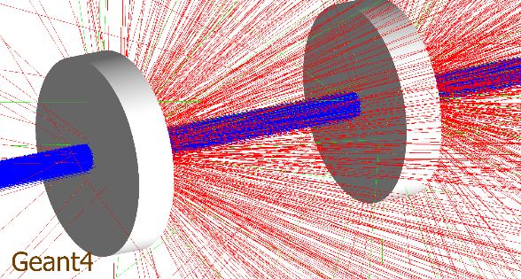
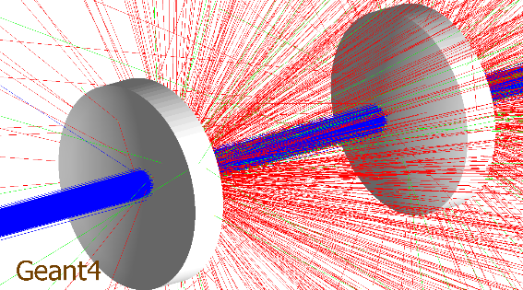
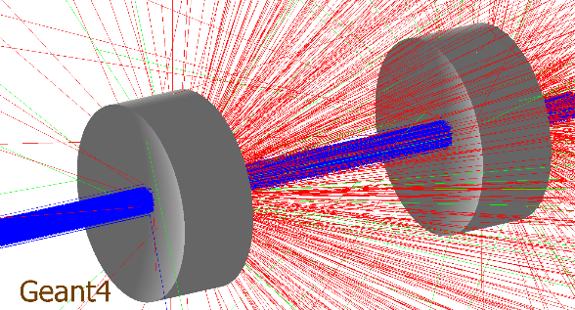
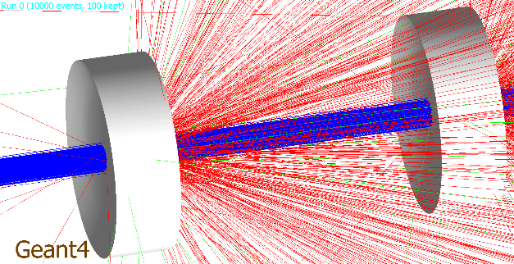
The multi-target system proposal
Multi-target idea:
Reduce the energy deposition.
Multi-target simulation geometries:
Cylindrical;
Meniscus;
Hourglass
Linear-hourglass
Beam:
45 GeV e⁺ beam;
Gaussian beam (σ=300µm)
Bunch: 3*10¹¹ e⁺ .
Introduction
LEMMA
TB 2018
Multi-target proposal
Deposited energy
Primary positrons
Secondary muons
Theoretical model
Plannig of test at MAMI
Conclusions
Cylindrical
x
Meniscus
Hourglass
Proposed geometries
Linear-hourglass

Slide 6
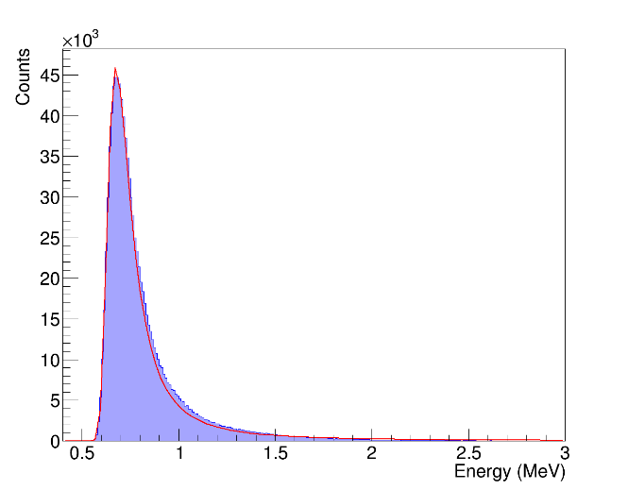
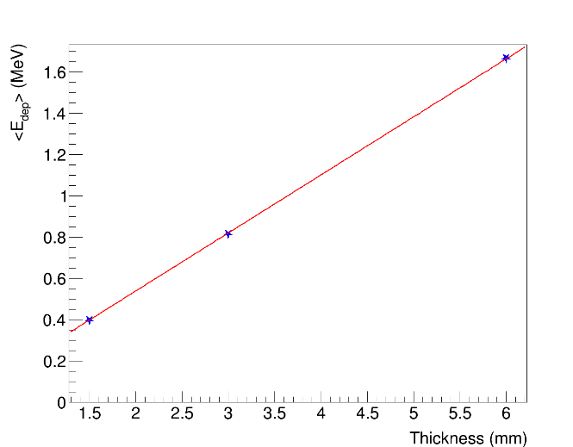
Deposited energy in the multi-target
Total deposited energy:
The energy spectrum is described by a Landau function.
The total deposited energy is approximately equal in each slice.
Linerarly increasing with the target thickness.
x
~1.6MeV
Introduction
LEMMA
TB 2018
Multi-target proposal
Deposited energy
Primary positrons
Secondary muons
Theoretical model
Plannig of test at MAMI
Conclusions
~0.7MeV
~0.8MeV
~0.4MeV
Energy spectrum- Be 6 mm total thickness cylindrical targets – I target
Dependency of <E_{dep}> on the thickness- Be 6 mm total thickness cylindrical targets – I target
<E_{dep}> in Be multi-target

Slide 7
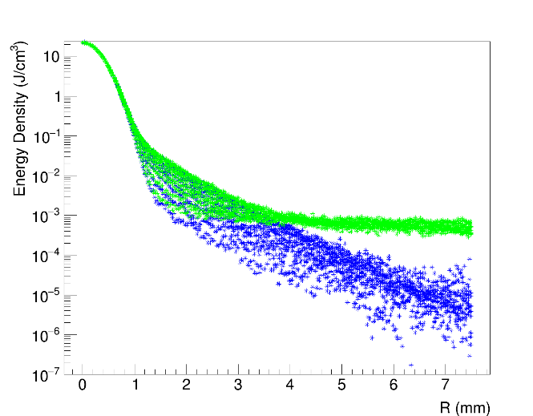
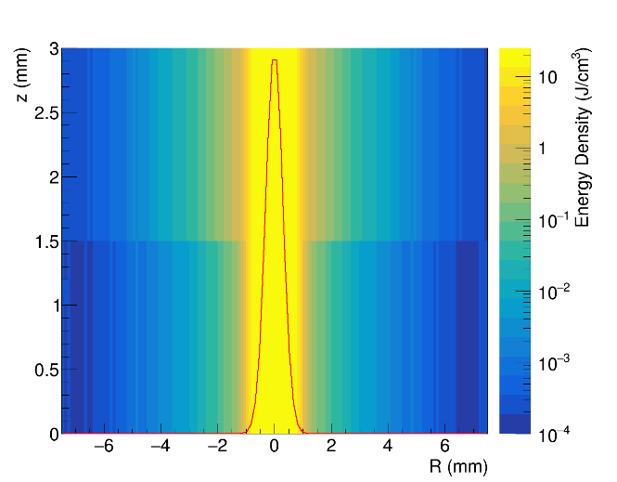
Deposited energy in the multi-target
Total deposited energy:
PEDDs are approximately equal in each slice.
Dependency on the position on the radius.
Negligible dependency on z.
The PEDDs by 3*10¹¹ primary positrons with beam spotsize 300µm are approximately 22J/cm³ (Be) and 27J/cm³ (C).
PEDD, ~22J/cm³
x
Introduction
LEMMA
TB 2018
Multi-target proposal
Deposited energy
Primary positrons
Secondary muons
Theoretical model
Plannig of test at MAMI
Conclusions
Second target
First target
Deposited energy density by 3*10¹¹ primary positrons- Be 6 mm total thickness cylindrical targets

Slide 8
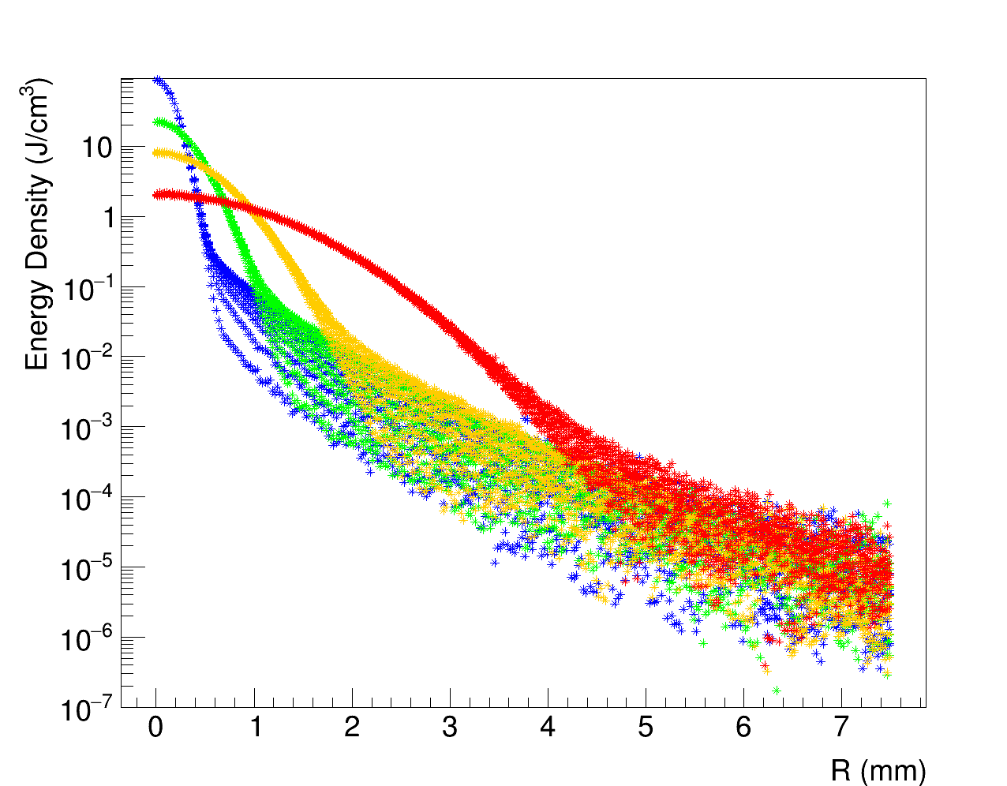
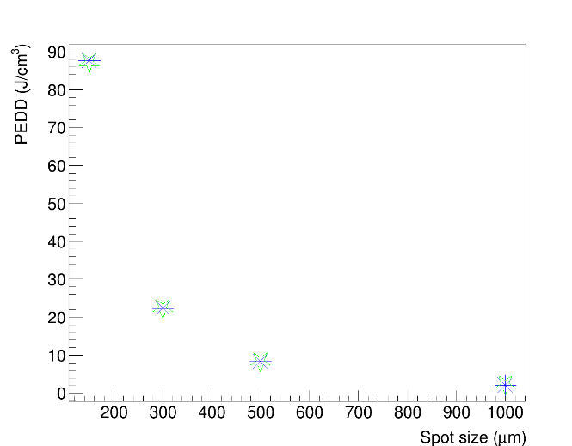
Deposited energy in the multi-target
Other parametric studies:
Beam spot size [150µm;1000µm].
Relative distance between targets [0.5cm;4cm].
Beam energy [44GeV;48GeV].
Number of targets [2;5]
Results:
Negligible dependency of total deposited energy for thermomechanical stress studies.
The dependency of the deposited energy density is relevant only on the spot size.
150 µm
300 µm
500 µm
Introduction
LEMMA
TB 2018
Multi-target proposal
Deposited energy
Primary positrons
Secondary muons
Theoretical model
Plannig of test at MAMI
Conclusions
1000 µm
PEDD by 3*10¹¹ primary positrons- Be 3 mm thickness cylindrical targets for several spot sizes
Second target
First target
PEDD by 3*10¹¹ primary positrons- Be 3 mm
thickness cylindrical targets as a function of spot size

Slide 9
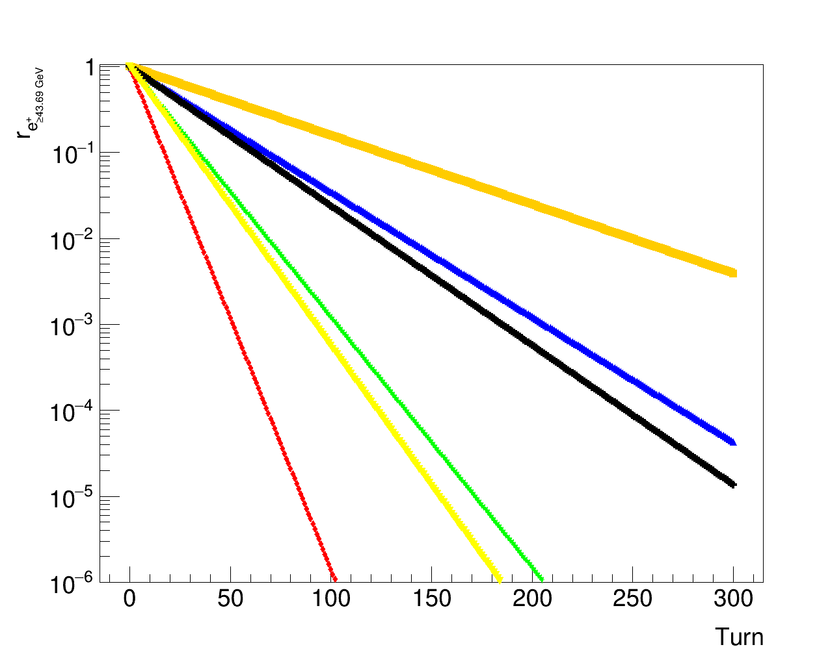
Primary positrons
Kinematical properties:
Beam energy and intensity loses energy and intensity have been estimated:
Results:
Surving positrons number and their mean energy, decreasing with the thickness of the multi-target.
C 1mm
Introduction
LEMMA
TB 2018
Multi-target proposal
Deposited energy
Primary positrons
Secondary muons
Theoretical model
Plannig of test at MAMI
Conclusions
x
C 2mm
Be 3mm
Be 12mm
C 4mm
Be 6mm
Ratio of surviving positrons with energy over muon pair production threshold for several turns
Ratio of surviving positrons with energy over muon pair production threshold and energy values

Slide 10
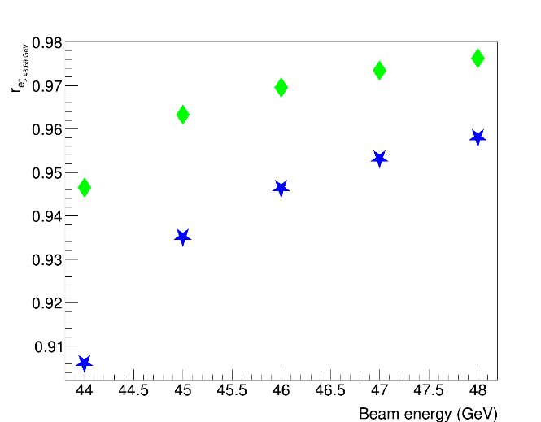
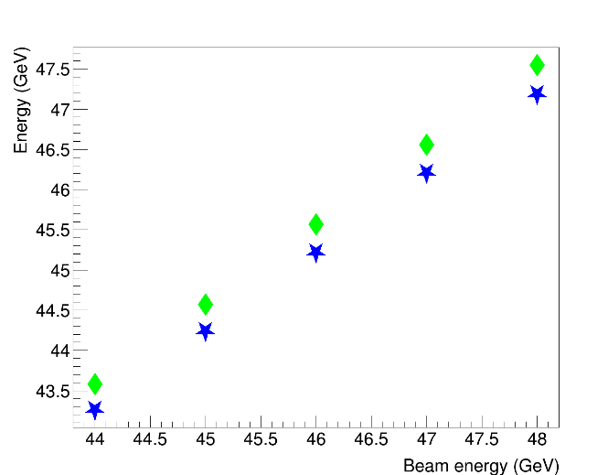
Primary positrons
Carbon
Other parametric studies:
Beam energy [44GeV;48GeV].
Results:
Surving positrons number and energy increasing with the beam energy.
x
Introduction
LEMMA
TB 2018
Multi-target proposal
Deposited energy
Primary positrons
Secondary muons
Theoretical model
Plannig of test at MAMI
Conclusions
Beryllium
Carbon
Beryllium
Normalized number with energy over threshold (left) and energy (right) of positrons after hitting the multi-target as function of beam energy. Slices sizes 3mm Be and 1mm C.

Slide 11
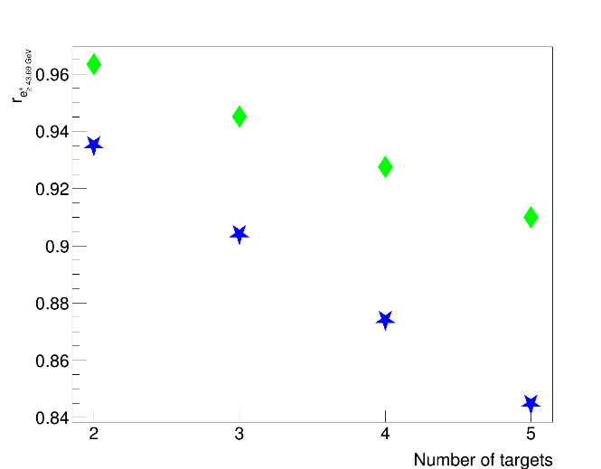
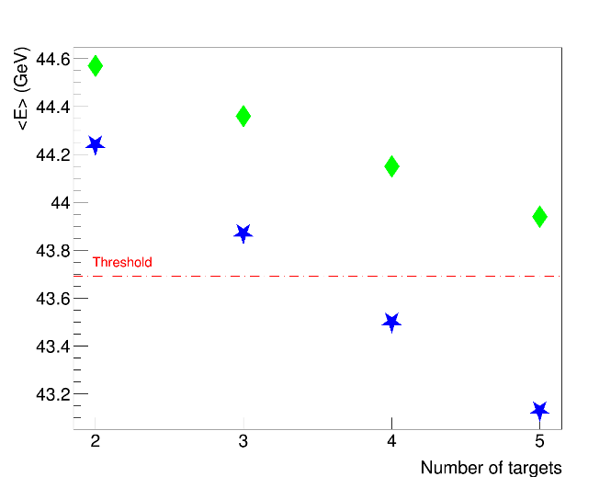
Primary positrons
Other parametric studies:
Number of targets [2;5]
Results:
Surving positrons number and energy increasing with the number of slices.
Carbon
Introduction
LEMMA
TB 2018
Multi-target proposal
Deposited energy
Primary positrons
Secondary muons
Theoretical model
Plannig of test at MAMI
Conclusions
Beryllium
Carbon
Beryllium
Normalized number with energy over threshold (left) and energy (right) of positrons after hitting the multi-target as function of number of targets. Slices sizes 3mm Be and 1mm C.

Slide 12
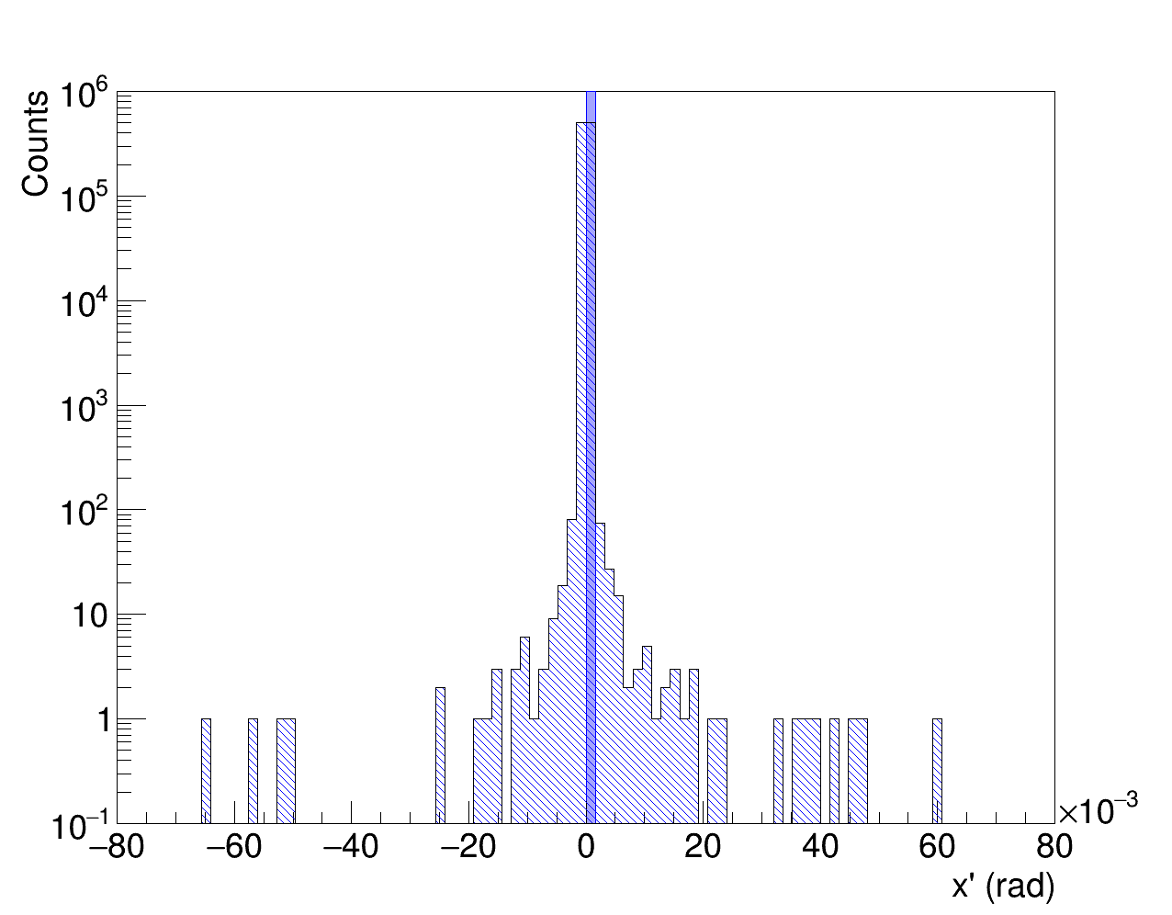
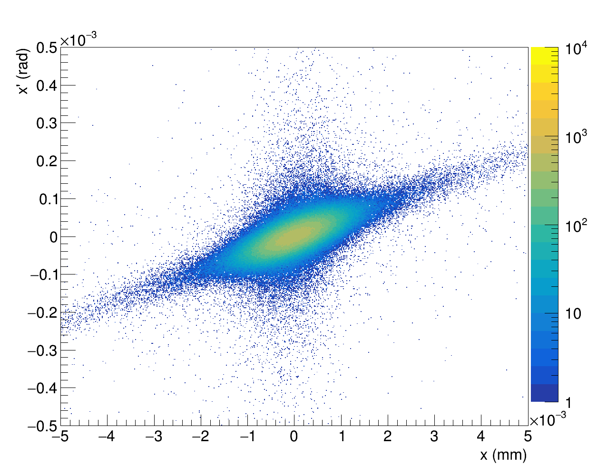
Primary positrons
Emittance:
Exiting angle of the beam:
Defining
the emittance is:
Uncertainty estimated by the Bootstrap method.
Results:
Few nm*rad for all the considered thicknesses.
Emittance increasing ith the thickness.
Entering
Introduction
LEMMA
TB 2018
Multi-target proposal
Deposited energy
Primary positrons
Secondary muons
Theoretical model
Plannig of test at MAMI
Conclusions
x
Outgoing
Angular distribution x’ of primary positrons entering and outgoing a 6 mm total thickness Be meniscus multi-target
x-x’ correlation of primary positrons entering and outgoing a 6 mm total thickness Be meniscus multi-target
Emittance results of primary positrons outgoing a cylindrical multi-target

Slide 13
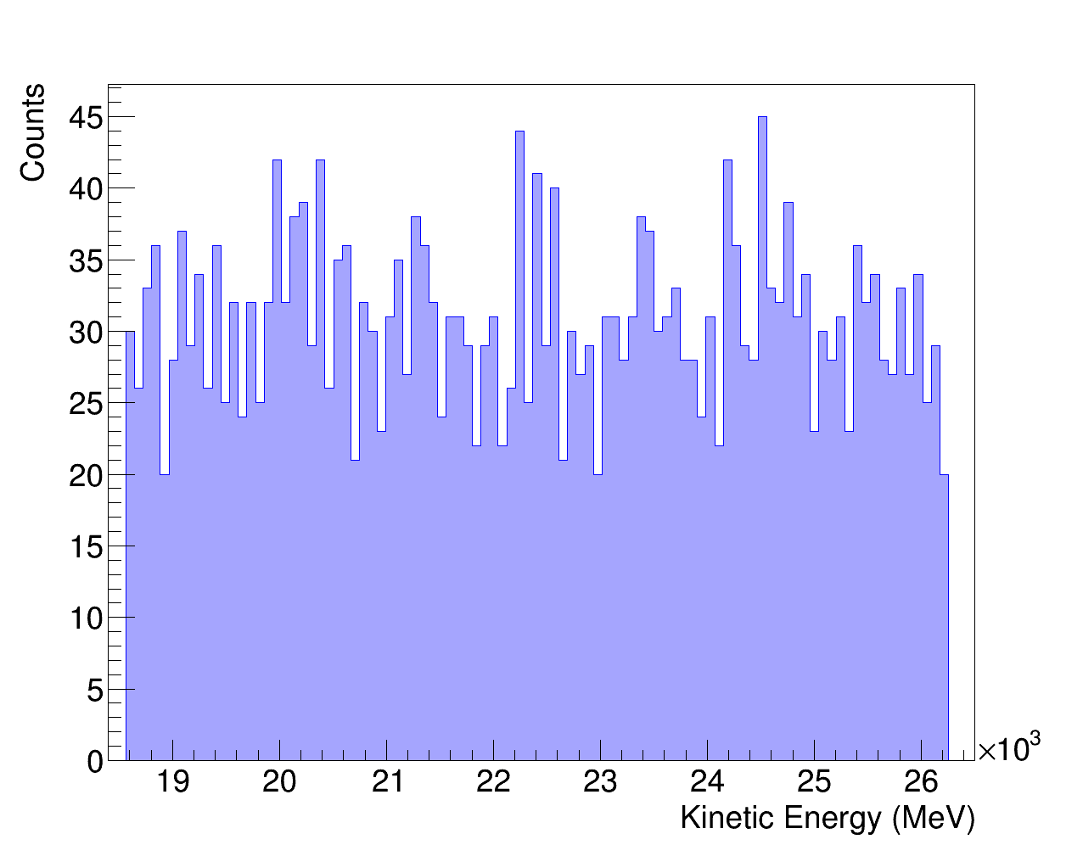
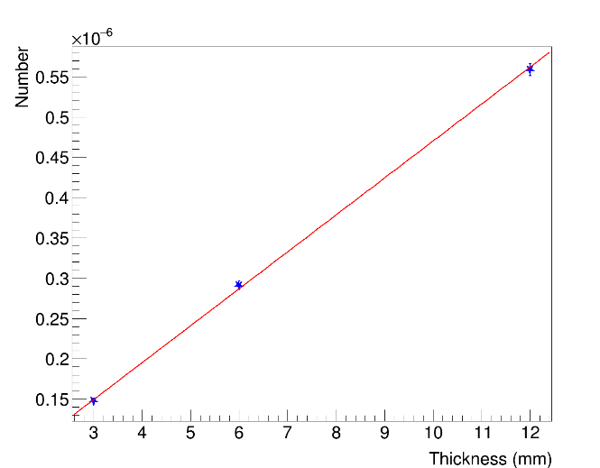
Secondary muons
22GeV
~0.55*10⁻⁶
Kinematical properties results:
Energy range [18.6GeV;26.2GeV] (45 GeV positrons).
22GeV mean energy Muons number increasing with the thickness.
Introduction
LEMMA
TB 2018
Multi-target proposal
Deposited energy
Primary positrons
Secondary muons
Theoretical model
Plannig of test at MAMI
Conclusions
x
~0.28*10⁻⁶
18.6 GeV
26.2 GeV
~0.15*10⁻⁶
Energy spectrum of muons produced in a 6mm total thickness Be cylindrical multi-target
Dependency on thickness of number of muons produced in Be cylindrical multi-target
Muon production n Be cylindrical multi-target

Slide 14
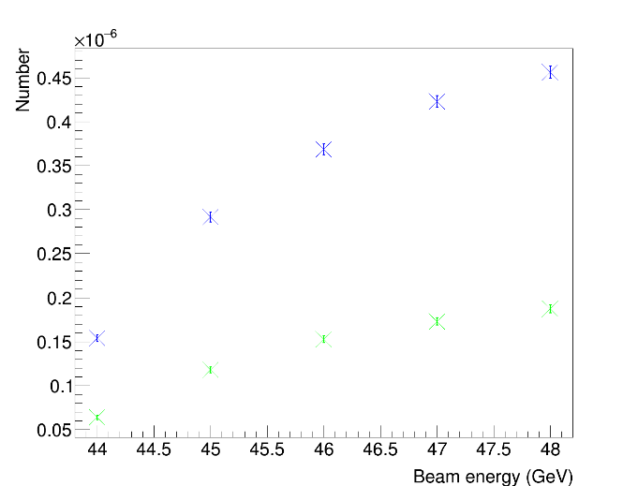
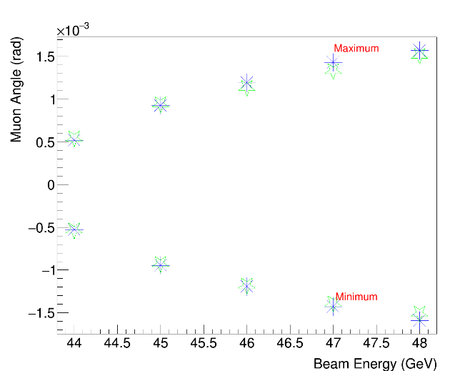
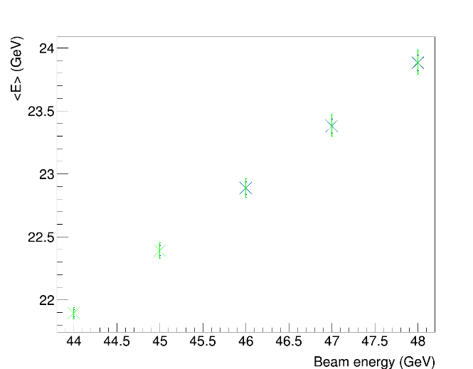
Secondary muons
Other parametric studies:
Beam energy [44GeV;48GeV].
Results:
Muons number, energy spread and the angular divergence increasing with beam energy.
Introduction
LEMMA
TB 2018
Multi-target proposal
Deposited energy
Primary positrons
Secondary muons
Theoretical model
Plannig of test at MAMI
Conclusions
Beryllium
Beryllium
Carbon
Carbon
Carbon
Muons number. Slices sizes 3mm Be and 1mm.
Beryllium
Carbon
Scattering angle. Slices sizes 3mm Be and 1mm C.
Beryllium
Mean energy. Slices sizes 3mm Be and 1mm C.

Slide 15
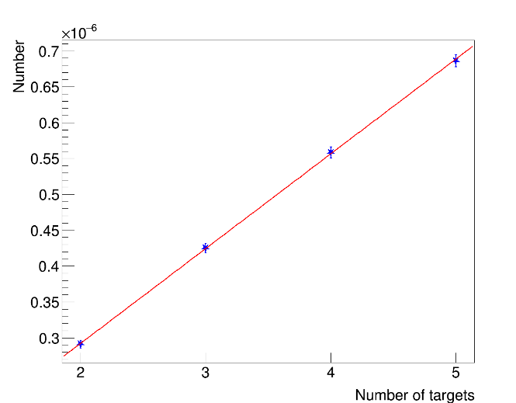
Secondary muons
Other parametric studies:
Number of targets [2;5].
Results:
Muon number increasing with the number of slices.
Introduction
LEMMA
TB 2018
Multi-target proposal
Deposited energy
Primary positrons
Secondary muons
Theoretical model
Plannig of test at MAMI
Conclusions
~0.68*10⁻⁶
~0.56*10⁻⁶
~0.42*10⁻⁶
~0.28*10⁻⁶
Dependency on number of targets of produced muons in Be multi-target. Slices sizes 3mm Be and 1mm C.

Slide 16
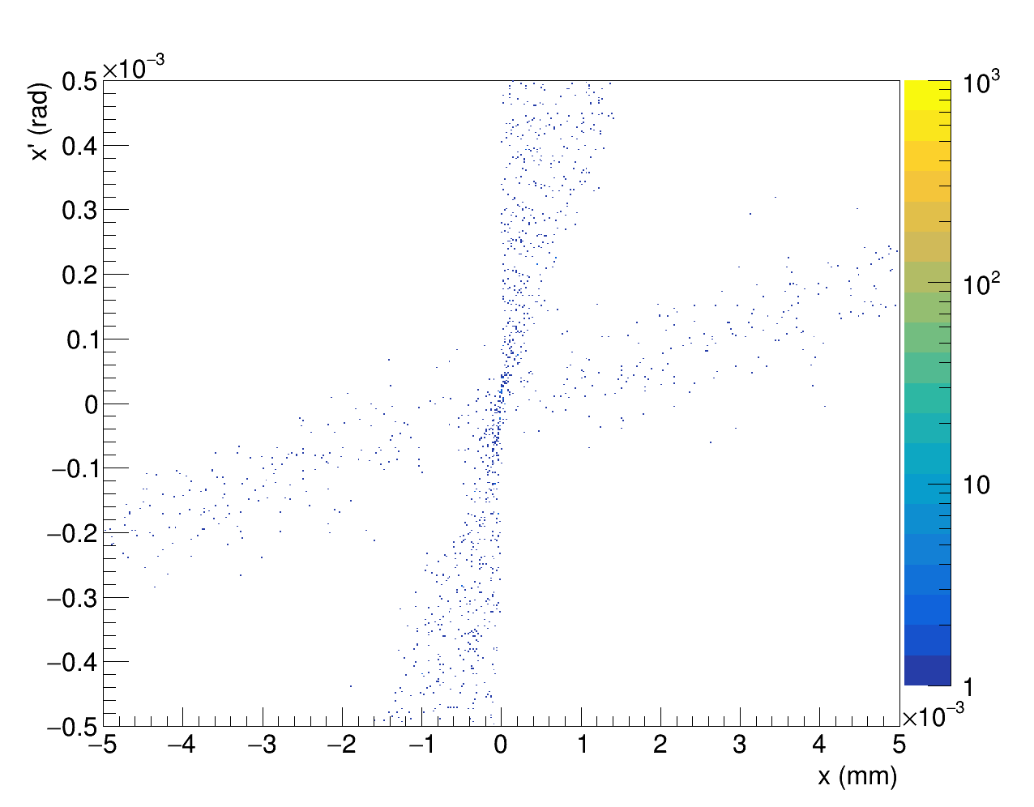
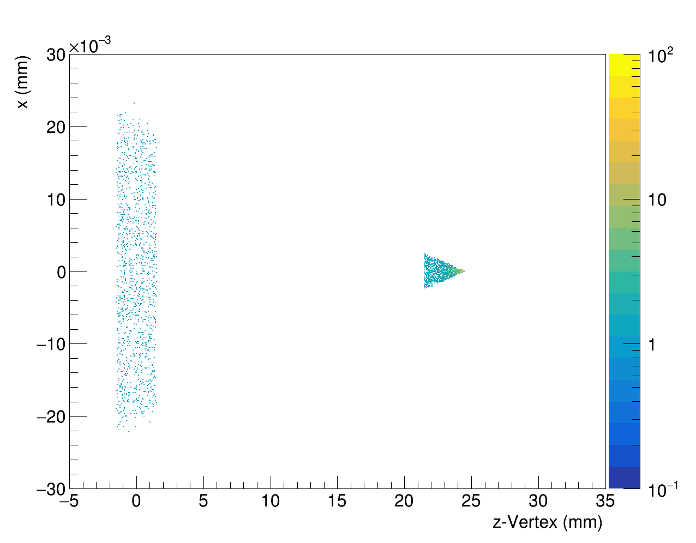
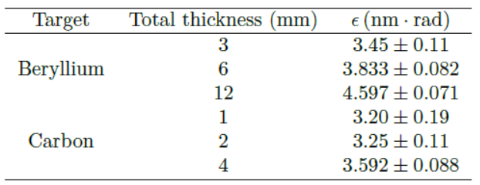
x
Secondary muons
Emittance:
Muons exit the multi-target with an angle:
Defining:
the emittance is:
Uncertainty estimated by the Bootstrap method.
Results:
Few nm*rad for all the considered thicknesses.
Emittance increasing ith the thickness.
Second target
Introduction
LEMMA
TB 2018
Multi-target proposal
Deposited energy
Primary positrons
Secondary muons
Theoretical model
Plannig of test at MAMI
Conclusions
Second target
First target
First target
x-x’ correlation of of muons produced in a 6mm total thickness Be cylindrical multt-target
Angle-vertex correlation of muons produced in a 6mm total thickness Be cylindrical multi-target
Emittance of muons produced in cylindrical multi-target

Slide 17
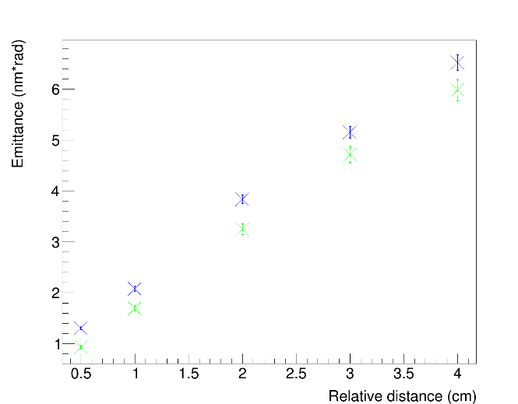
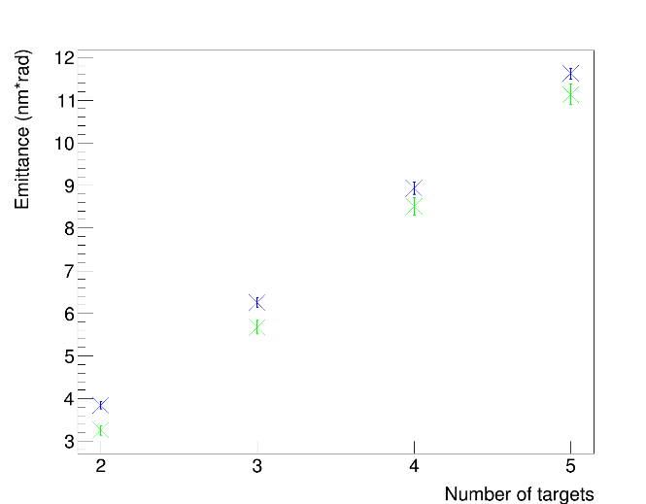
Secondary muons
Other parametric studies:
Relative distance between targets [0.5cm;4cm].
Number of targets [2;5]
Results:
Emittance increasing with relative distance and number of slices.
Beryllium
Introduction
LEMMA
TB 2018
Multi-target proposal
Deposited energy
Primary positrons
Secondary muons
Theoretical model
Plannig of test at MAMI
Conclusions
Carbon
Dependence on relative distance of emittance. Slices sizes 3mm Be and 1mm C.
Beryllium
Carbon
Dependence on number of targets of emittance. Slices sizes 3mm Be and 1mm C.

Slide 18
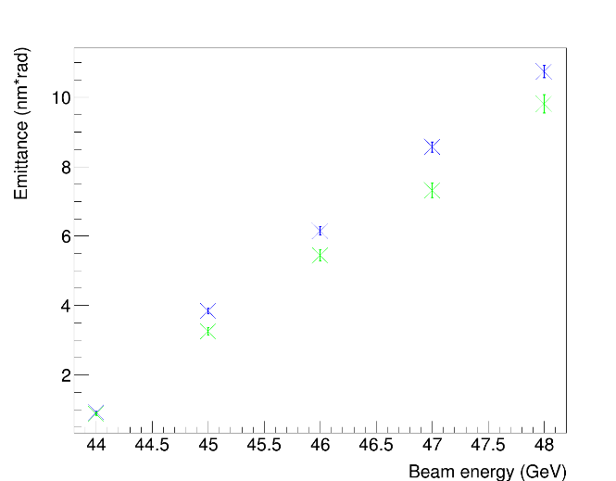
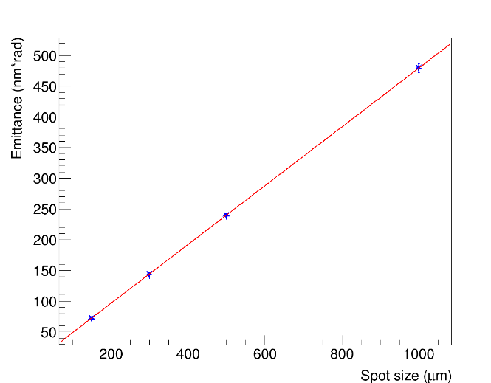
Secondary muons
Other parametric studies:
Beam spot size [150µm;1000µm].
Beam energy [44GeV;48GeV].
Results:.
Emittance increasing with the beam energy.
Total emittance (i.e. taking into account the vertex) increasing with the beam spotsize.
Beryllium
Introduction
LEMMA
TB 2018
Multi-target proposal
Deposited energy
Primary positrons
Secondary muons
Theoretical model
Plannig of test at MAMI
Conclusions
Carbon
Dependence on beam energy of emittance. Slices sizes 3mm Be and 1mm C.
~480nm*rad
~240nm*rad
~140nm*rad
~70nm*rad
Dependence on spot size of emittance of muons produced in in Be cylindrical multi-target considering the vertex. Slices sizes 3mm Be and 1mm C.

Slide 19
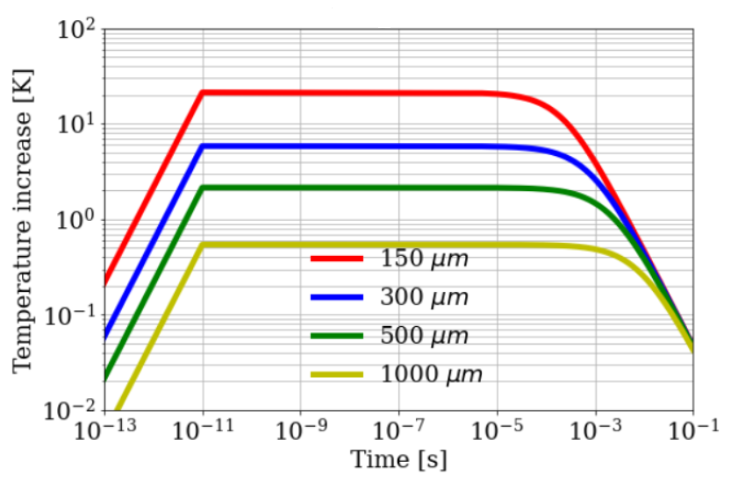
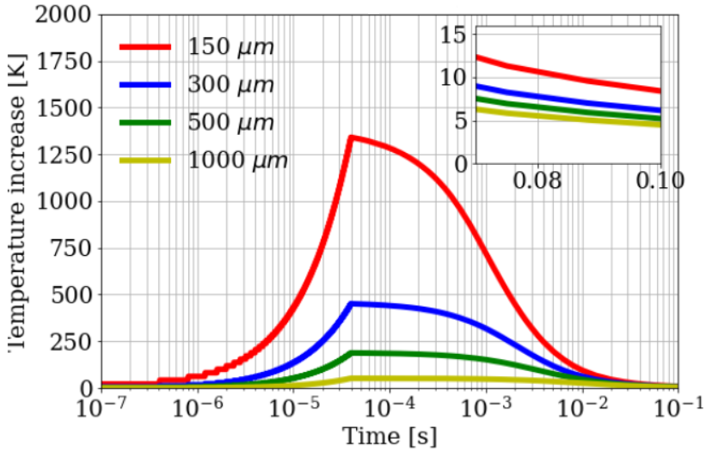
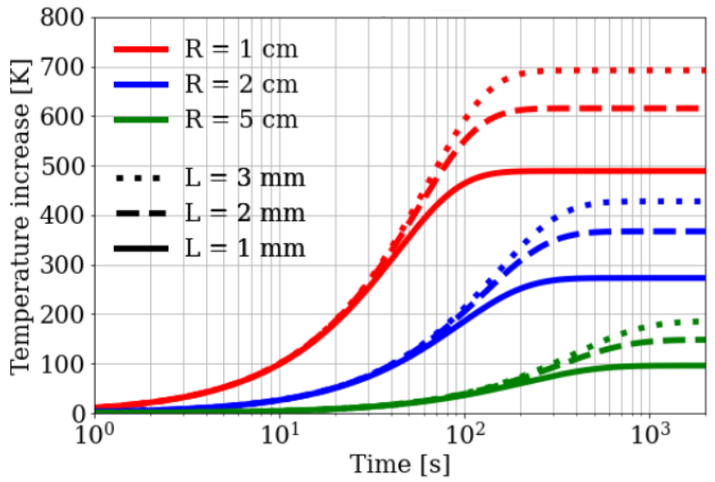
Theoretical modelling for thermal evolution
Bunch
No diffusion
Diffusion
Finite-Difference Time Domain (FDTD)- based:
Deposited energy estimated by Geant4 simulation.
Fourier’s equation:
solved by FDTD-based algorithm.
FDTD in 2D space (R,z),
Long computational time.
Approximate-fast method:
Based on emitted energy via Infra-Red radiation
where P_{cw}=E_{d}/t_{rep} (conitnuos wave power).
Solved by Runge-Kutta method.
Introduction
LEMMA
TB 2018
Multi-target proposal
Deposited energy
Primary positrons
Secondary muons
Theoretical model
Plannig of test at MAMI
Conclusions
Train
Temperature rise at center due to single bunch. Be target (R=5cm, L=3mm ).
No Train
Temperature rise at center due to
a single train. Be target (R=5cm, L=3mm ).
Temperature rise at long
time scale (fast method). Be target.

Slide 20
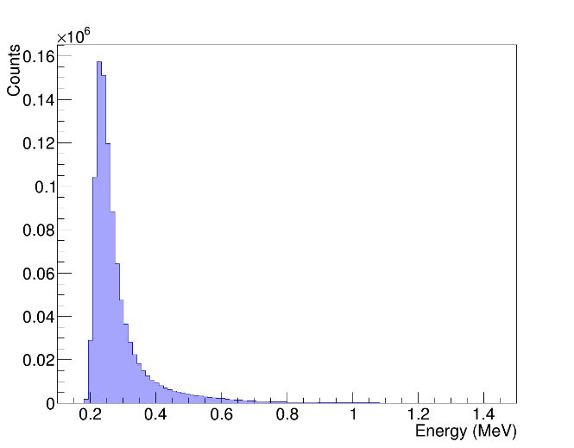
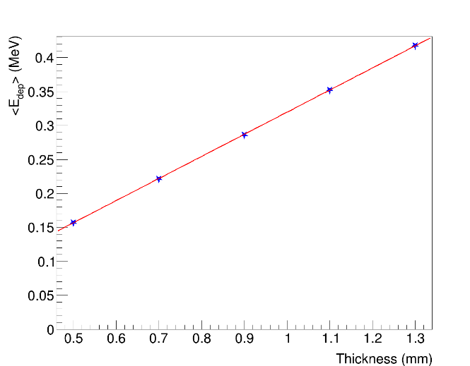
Planning of thermal studies @MAMI
Features:
800MeV electron beam.
C target with radius [3cm;5cm] and thickness [0.5mm;1.3mm]
3*10¹³ electrons,
Spot size 10µm
Angular spead 1µrad,
Energy spread 13keV.
Deposited energy:
Deposited energy increasing linearly with the target thickness,
Negligible dependency on radius size and beam spot size.
~0.23MeV
Introduction
LEMMA
TB 2018
Multi-target proposal
Deposited energy
Primary positrons
Secondary muons
Theoretical model
Plannig of test at MAMI
Conclusions
Deposited energy in a 0.9 mm thickness target with radius 4cm
~0.42MeV
~0.34MeV
~0.28MeV
~0.21MeV
~0.16MeV
Dependence of mean deposited energy <E> by thickness. The radius is 4cm

Slide 21
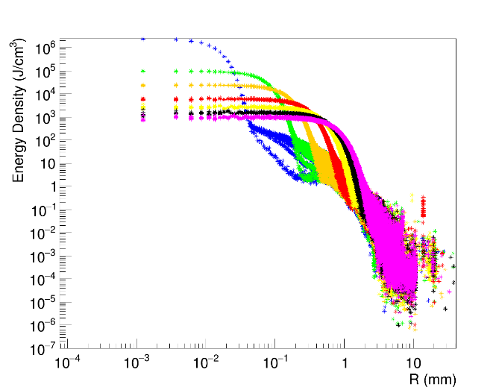
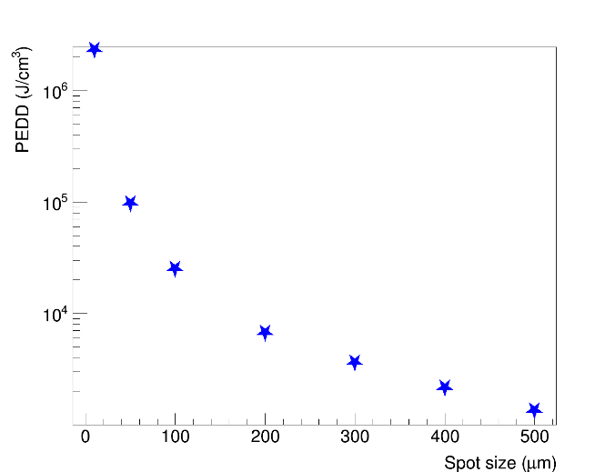
Planning of thermal studies @MAMI
Features:
800MeV electron beam.
C target with radius [3cm;5cm] and thickness [0.5mm;1.3mm]
3*10¹³ electrons,
Spot size [10µm; 500µm];
Angular spead 1µrad;
Energy spread 13keV.
Deposited energy density:
Dependency on the position on the radius.
Negligible dependency on z.
The PEDDs by 3*10¹³ primary electrons with beam spotsize 10µm is approximately 2*10⁶J/cm³.
10 µm
50 µm
100 µm
200 µm
Introduction
LEMMA
TB 2018
Multi-target proposal
Deposited energy
Primary positrons
Secondary muons
Theoretical model
Plannig of test at MAMI
Conclusions
300 µm
400 µm
500 µm
Dependence of energy density on position on the radius by 3*10¹³ electrons in a 1.3 thickness target
~2.3*10⁶J/cm³
~1.4*10³J/cm³
Dependence of PEDD of 3*10¹³ electrons in a 1.3mm thickness target

Slide 22
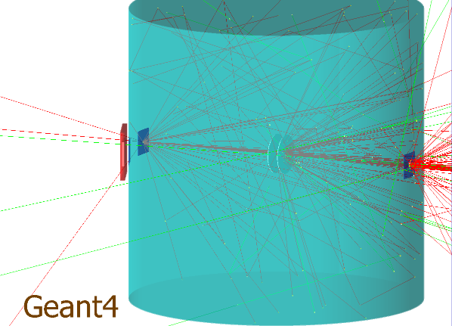
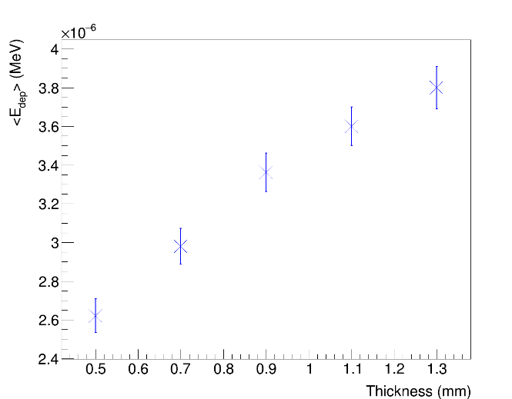
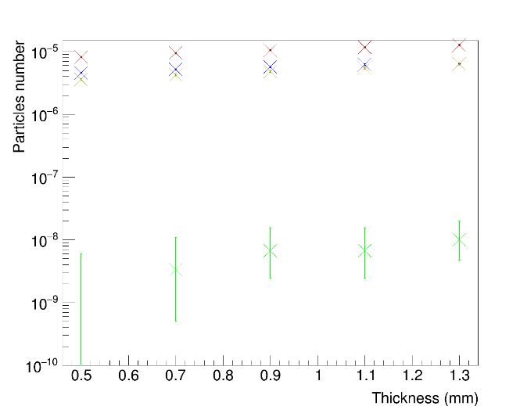
Radiation estimation @MAMI
Features:
Responsivity damage of IR sensrors:
Simulation of a steel vacum chamber 1mm thickness with 3 mylar windows and 5cmx5cmx5mm scintillator.
Results:
Particle flux and deposited energy increasing with the thickness of the target.
Introduction
LEMMA
TB 2018
Multi-target proposal
Deposited energy
Primary positrons
Secondary muons
Theoretical model
Plannig of test at MAMI
Conclusions
Shield
~3.8*10⁻⁶MeV
Scintillator
Chamber
Vacuum chamber and scintillator
~10⁻⁵MeV
~2.6*10⁻⁶MeV
e⁻
γ
Total
Mean values of deposited energy in scintillator.
e⁺
Particles hitting the scintillator.

Slide 23
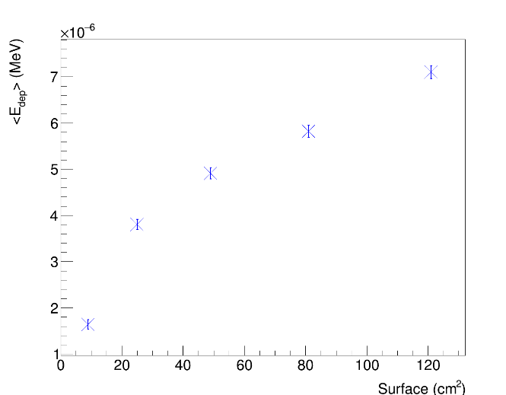
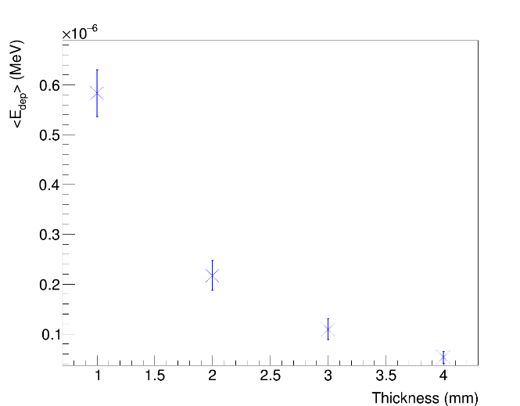
Radiation estimation @MAMI
Other parametric studies:
Beam spot size [10µm; 500µm];
Scintillator surface [9cm²;121cm²].
Proposal of a IR-transparent shield:
Sapphire (Al₂O₃);
Quartz (SiO₂ );
Zinc sulfide clertran (ZnS).
Results:
Negligible dependency on the spot size.
Deposited energy increasing with the surface.
The shield reduces both particle number and deposited energy (Best results for Al₂O₃).
~7.10*10⁻⁶MeV
Introduction
LEMMA
TB 2018
Multi-target proposal
Deposited energy
Primary positrons
Secondary muons
Theoretical model
Plannig of test at MAMI
Conclusions
~1.64*10⁻⁶MeV
Mean values of deposited energy in scintillator as a function of surface area. Thickness 1.3mm.
~5.83*10⁻⁷MeV
~0.53*10⁻⁷MeV
Deposited energy in the scintillator as function of wall thickness of the shield Al₂O_{3.}

Slide 24
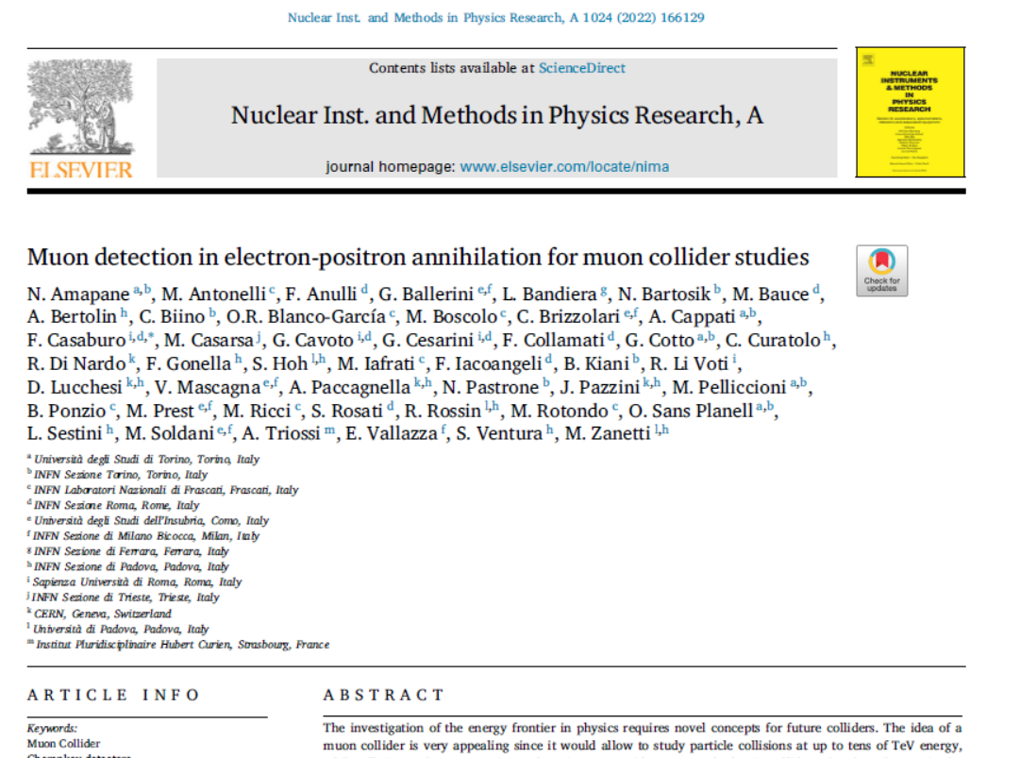
Conclusions and planning
Conclusions
The LEMMA project overcame the cooling problem of the proton-driven muon coollider.
A first test beam in 2018 is encouraging regarding of the muon production in electron-positron annihilation.
Due to the need of high intensity beam in LEMMA scheme a single thick target would melt.
Need of target optimization to maximise the muon production and minimise both the deposited energy and the muon emittance.
The multi-target could be a solution to easily cooling the targets.
Introduction
LEMMA
TB 2018
Multi-target proposal
Deposited energy
Primary positrons
Secondary muons
Additional materials
Theoretical model
Plannig of test at MAMI
Conclusions

Slide 25
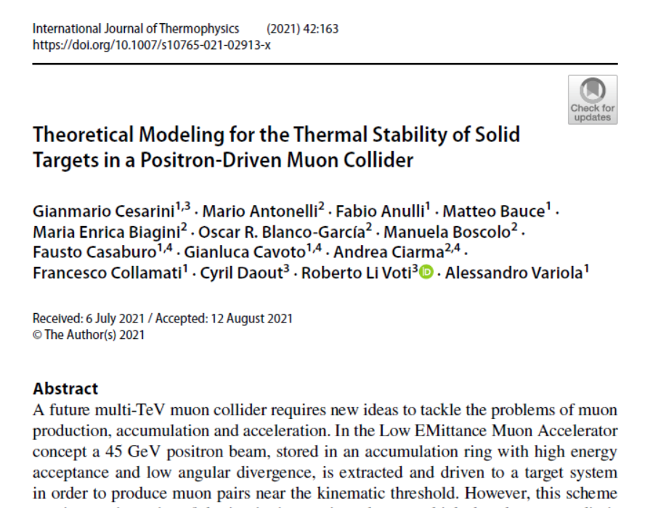
Conclusions and planning
Conclusions
I implemented a Geant4 simulation to study the deposited energy in the multi-target and kinematical properties of both primary and secondary particles for several target features.
Results obtained for different shapes and both for beryllium and carbon are comparable between them.
A thermal model has been developed based upon the deposited energy but currently applied to a single target.
Future experimental test are needed to test the termal model and to find the best optimisation between kinematical properties of particles and thermomechanical stress of the target.
Introduction
LEMMA
TB 2018
Multi-target proposal
Deposited energy
Primary positrons
Secondary muons
Additional materials
Theoretical model
Plannig of test at MAMI
Conclusions

Slide 27
BACKUP

Slide 28
Secondary photons
Features:
Hitting the target, the beam produces many photons (bremsstrahlung, electron/positron annihilation, etc.)
Radiated energy:
Results:
Photon number increase with the thickness.
The energy for unit of thickness is approximately 1.7 times higher for carbon targes.
~0.24*10⁻⁹J
~0.12*10⁻⁹J
~0.06*10⁻⁹J
Dependence of energy on the thickness of photons outgoing a Be hourglass multi-target
Produced photons and radiated energy using hourglass multi-target

Slide 29
Positron regeneration
Features:
Photons could be use to regenerate positrons hitting a tungsten regenerator.
Acceptance conditions:
-r<0.5cm (z-axis)
-angle range [-0.5rad;0.5rad]
-E range [5MeV;20MeV]
Results:
The number of regenerated positrons increases with the thickness of the target.
x
Positron regeneration scheme
Energy spectrum of regenerated positrons produced by photons produced in a 6 mm total thickness Be hourglass multi-target
Normalized number of photons produced in hourglass multi-target and hitting the regenerator (n_{γreg}), regenerated positrons (n_{e}⁺_{reg}) and regenerated positrons passing the acceptance conditions (n_{e}⁺_{regcut})

Slide 30
Deposited energy in the regenerator
Deposited energy in the regenerator:
Hitting the regenerator photons release energy in it,
Results:
The deposited energy in the regenerator increase with the target thickness;
Higher deposited energy than in the multi-target.
x
Deposited energy in the regenerator by photons produced in a 6 mm total thickness Be multi-target
~114MeV
~64MeV
~34MeV
Dependency of deposited energy in the regenerator by photons produced on the total thickness Be multi-target

Slide 31
Deposited energy in the regenerator
12 mm
Deposited energy in the regenerator:
Hitting the regenerator photons release energy in it,
Results:
The deposited energy density in the regenerator depends both by the position on the radius and along the beam axis.
Higher deposited energy density in the regenerator is higher than in the multi-target.
6 mm
3 mm
Deposited energy density in the regenerator by photons produced by a single bunch of 3*10¹¹ positrons in Be multi-target. On the right, the total thickness is 6mm.

Slide 32
Secondary electrons/positrons
Features:
Main background for muon production;
Mainly produced by Bhabha scattering;
Positrons could be recirculated in the beam;
Results:
Low energy;
The number increase with the thickness of the target.
x
Energy spectrum of secondary electrons/positrons produced in a 6mm total thickness Be linear-hourglass multi-target
Normalized number n_{e}± and mean kinetical energy <E> of produced electrons/positrons in linear-hourglass multi-target

Slide 33
Additional materials
Second target
Additional materials:
Liquid hydrogen, 36 mm;
Liquid helium, 39 mm;
Liquid lithium, 9 mm;
Results:
The deposited energy for unit of thickness and the PEDD in these additional material are apporximately one order of magnitude lower than in carbon and beryllium.
Results of surviving positrons, comparable with the ones for Be 3 mm and C 1mm
First target
Mean deposited energy for unit of thickness for several materials
H 72mm
C 2mm
He 78mm
Be 6mm
Li 9mm
Ratio of surviving positrons with energy over muon pair production threshold for several turns

Slide 34
Additional materials
Additional materials:
Liquid hydrogen, 36 mm;
Liquid helium, 39 mm;
Liquid lithium, 9 mm;
Results:
Lower muon production than using Be and C.
Higher emittance than using Be and C.
Muon production for several materials
Muon emittance for additional materials

Slide 35
Planning
Planning ahead:
Apply the thermal model to the more than one target and to other proposed target shapes (meniscus, hourglass, linear-hourglass) to check if different shapes can minimise the heat exchange..
Measurement of target thermo-elastic properties in a wide temperature range.
Mearument of thermal diffusivity and IR emissivity via photo-thermal radiometry and IR thermography.
Detection of demage and thermo-mechanical stress when the target is subjected to intense LASER radiation.
Thermomechanical test with electrons at MAMI.
Example of targets produced at LNL
Thermomechanical stress test with LASER scheme
Layout of the proposed vacuum chamber for LASER thermomechanical stress test.

