Slide 1
Study of Novel Devices for Compact Accelerating Structures
24.05.2022
Hikmet Bursali
hikmet.bursali@cern.ch
Dept. of Basic and Applied Sciences for Engineering (SBAI), Sapienza University of Rome
SY-RF-MKS, CERN
(Co)Supervisors
Prof. Mauro Migliorati
Dr. Nuria Catalan-Lasheras
Prof. Andrea Mostacci
Notes:
Hello everyone, I will make my presentation on ‘Study of novel devices for compact accelerating structures’

Slide 2
Outline
Introduction
Wakefield Monitors (WFM) as Beam Position Monitors: Accuracy Measurements and Simulations
Beam Experiments at CERN Linear Electron Accelerator for Research (CLEAR) Facility
3D Electromagnetic Simulations in Response to Probe Beam
Results
Design and Construction of a 3D Printed X-Band Spiral RF Load
RF Design Steps
RF Performance of Manufactured Loads
Results
Conclusions
1
Notes:
I would like to show you outline of my presentation. I will give the introduction first. Then I will continue with wakefield monitors study as beam position monitors. I will explain the beam experiments at CLEAR facility and CST simulations in response to probe beam. In the second part of the presentation I will explain the design and construction of 3d printed x band spiral RF load, I will introduce the rf design steps and rf performance of manufactured loads. Then I will finish with conclusions.

Slide 3
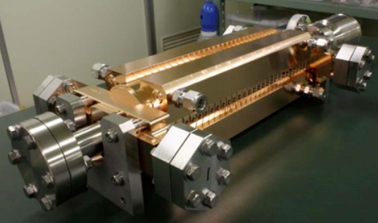
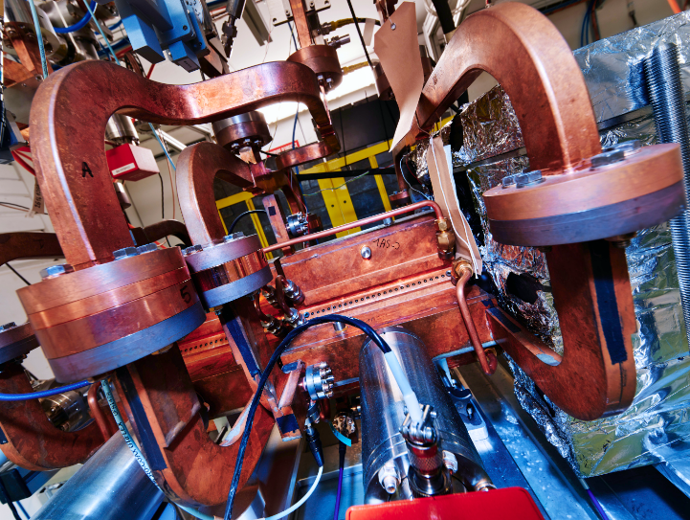
Introduction – X-Band Acceleration Technology
X-Ray Free Electron Laser
CompactLight
The ‘X-Band acceleration technology’ is highly demanding and becoming more popular among the facilities/projects which require high gradient acceleration in a compact place.
X-Band allows reducing size, weight and cost of the linacs with higher acceleration gradient, 100 MV/m (compare the ones in L, S and C band [5] , 25-40 MV/m).
These features enable significant cost reduction for large projects.
CompactLight X-Band 12 GHz Structure [1]
Beam Manipulation and Diagnostics
DESY [9]
Advanced Acceleration
AWAKE [4]
EuPRAXIA [5]
Thompson/Compton/Inverse Compton Scattering Sources
Smart*Light
Thomson Scattering X-ray Source at Tsinghua University
Medical Applications
New generation cancer therapy facilities [7, 8]
high energy electrons (VHEE)
ultra-high dose rate (FLASH) radio therapy
Applications [3]
High Gradient Test Facilities
X-Band HG Test Facility, CERN
TeX Lab, INFN-LNF [6]
X-Lab, University of Melbourne
And many more…
Also, there are research and expertise background from previous studies (SLAC, KEK).
The progress on the improvement of this technology is strictly ongoing at CERN with Compact Linear Collider (CLIC) Study [2].
2
Notes:
X band acceleration..
X band allows..
These features…
Like the applications of. … also, tehre are research and expertise background from previous studies at SLAC. And the progress on the improvement of this technology…

Slide 4
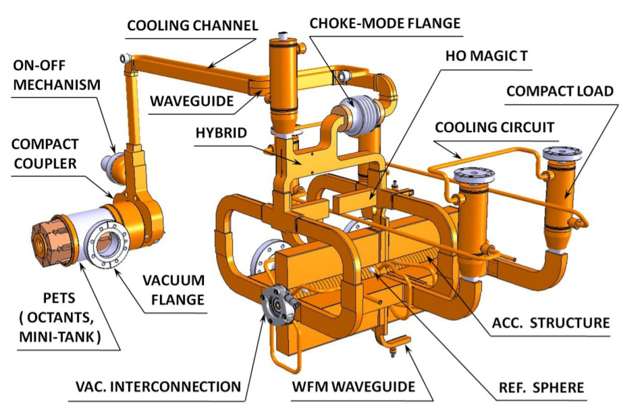
Introduction – Thesis Work
All the RF network components of the X-Band module has to be as small as possible to keep the compact footprint with high power handling capability.
The CLIC Module RF System [1]
In this work, we aimed to contribute the knowledge of X-Band acceleration technology with the study of two novel compact devices planning to be used in the CLIC Study:
Wakefield Monitors (WFM) as Beam Position Monitors: Accuracy Measurements and Simulations
Design and Construction of a 3D Printed Spiral Load
[1] Aicheler, M., Burrows, P., Draper, M., Garvey, T., Lebrun, P., Peach, K., Phinney, N., Schmickler, H., Schulte, D., & Toge, N. (Eds.). (2012). A Multi-TeV Linear Collider Based on CLIC Technology: CLIC Conceptual Design Report. https://doi.org/10.5170/CERN-2012-007
3
Notes:
All the RF network…
In this work, …

Slide 5
Wakefield Monitors (WFM) as Beam Position Monitors: Accuracy Measurements and Simulations
WFMs in CLIC Study
To achieve the luminosity goals for CLIC, 5 μm accuracy is required for the WFMs used as beam position monitors. [1]
To reduce the emittance growth, groups of structures in the linac are realigned with movers to the location where the net measured transverse wakefields are minimum, the process is called ‘RF alignment’.
The WFMs had been installed in the first cell of every second structure in the CLIC module RF system for the feasibility studies.
And, the WFMs characterisation experiments with beam are ongoing at CERN Linear Electron Accelerator for Research (CLEAR) Facility.
RF Alignment in CLIC [2]
[1] Aicheler, Markus, et al. A Multi-TeV linear collider based on CLIC technology: CLIC Conceptual Design Report. No. SLAC-R-985. SLAC National Accelerator Lab., Menlo Park, CA (United States), 2014.
[2] W. Wuensch, Normal conducting RF, Linear Collider School Lecture Series: "RF Technology", Turkey, 2013.
The CLIC Module RF System [1]
4
Notes:
I want to continue with the wfms study…

Slide 6
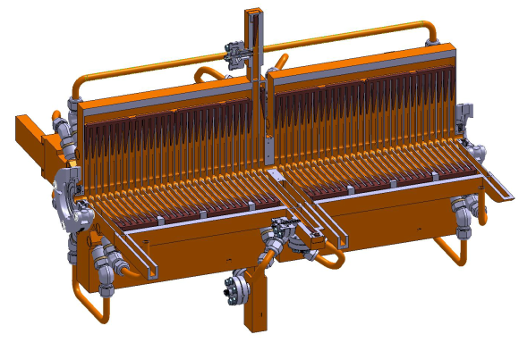
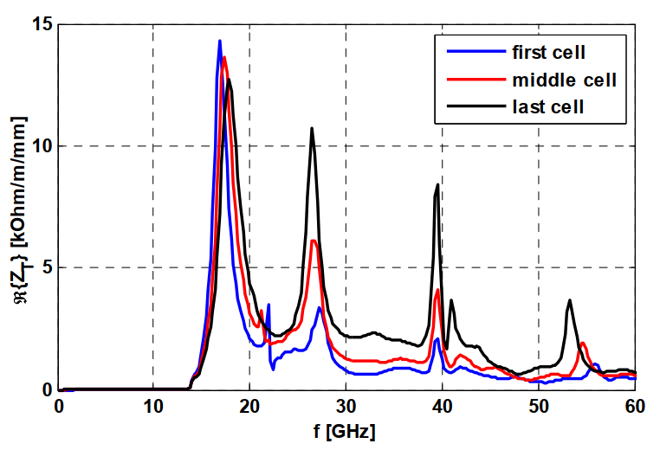
Superstructure with WFMs
The Super-Accelerating-Structure (SAS) is composed of two brazed TD26 (Traveling wave type, damped, 26 cells) structures.
In the wakefield simulations the TM (Transverse Magnetic) and TE (Transverse Electric) modes obtained as 16.9 and 27.3 GHz for the first regular cell. However, the signals are observed at 18 and 24 GHz during a multi bunch operation with an offset (1.5 GHz-bunch spacing- harmonics).[3]
Superstructure [2]
WFM waveguide (first cell)
16.9 GHz (TM like)
First cell->WFM cell
Last cell
Middle cell
27.3 GHz (TE like)
Beam Direction
1st Structure
2nd Structure
Lowest dipole mode transverse impedances of first, middle and last cells [1]
WFM TE and TM antennas are located on the narrow and wide edges of the extended HOM waveguides, respectively.
[1] Grudiev, Alexej, and Walter Wuensch. Design of the CLIC main linac accelerating structure for CLIC conceptual design report. No. EuCARD-CON-2010-073. 2010.
[2] Lehti, S., et al. "arXiv: The Compact Linear Collider (CLIC)-2018 Summary Report." CERN Yellow Rep. Monogr. 2.CERN-2018-005-M (2018).
[3] R. L. Lillestol, “The CLIC Wakefield Monitor Study”, CERN-ACC-2021-0001 ; CLIC-Note-1169
HOM->Higher order mode
5
Notes:
I want to show you the super accelerating structure which is the main linac of the CLIC RF module.
In the wakefield simulations the TM and TE like modes obtained as 16.9 and 27.3 GHz for the first regular cell.
However, during the multi bunch operations, the signals observed with an offset at bunch harmonics. So, the bandpass filters frequencies were chosen at 18 and 24 GHz bunch harmonics for TM and TE modes, respectively.
TE and TM antennas are located on the narrow and wide edges of the extended HOM waveguides of the first cell of second structure.

Slide 7
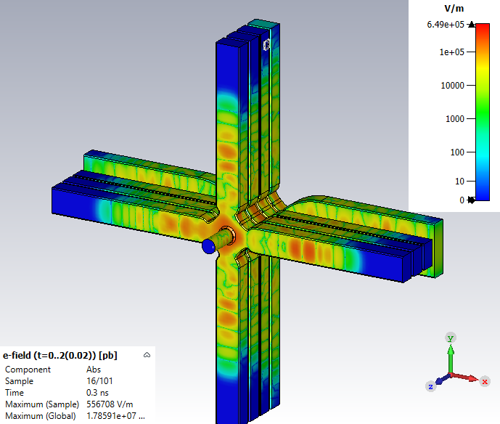
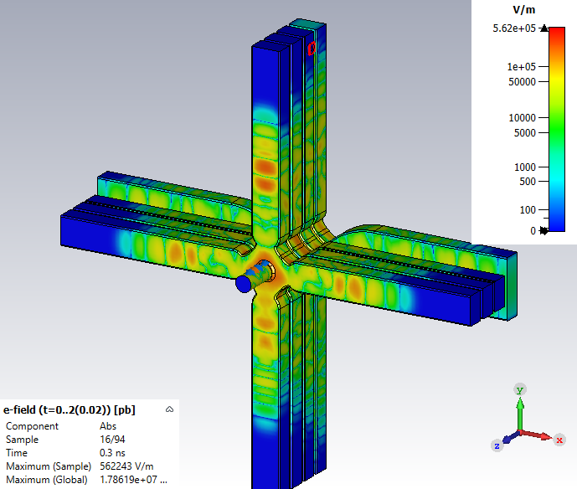
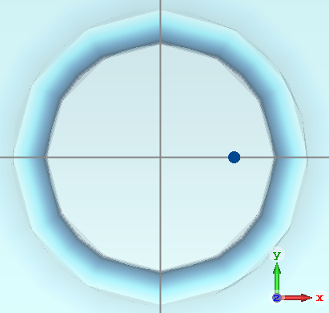
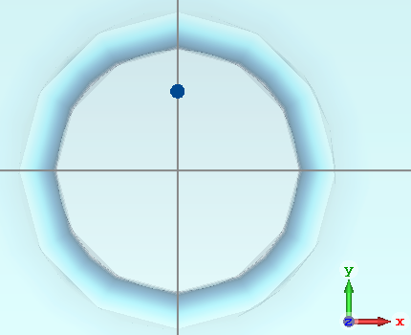
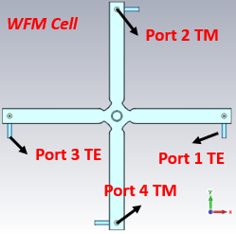
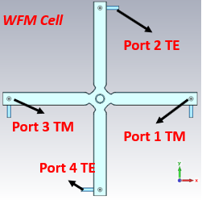
WFM signals for vertical/horizontal beam offsets
Vertical Beam Offset
Horizontal Beam Offset
y=+2 mm
x=+2 mm
Beam
Beam
6
Notes:
In the TD26 structure, we expect to see the excited wfm signals related to beam offset axis.
For the vertical beam offset, we expect to read high signals from the TM antennas on the top and bottom and TE antennas placed on the left and right.
And vice versa for the horizontal beam offset.

Slide 8
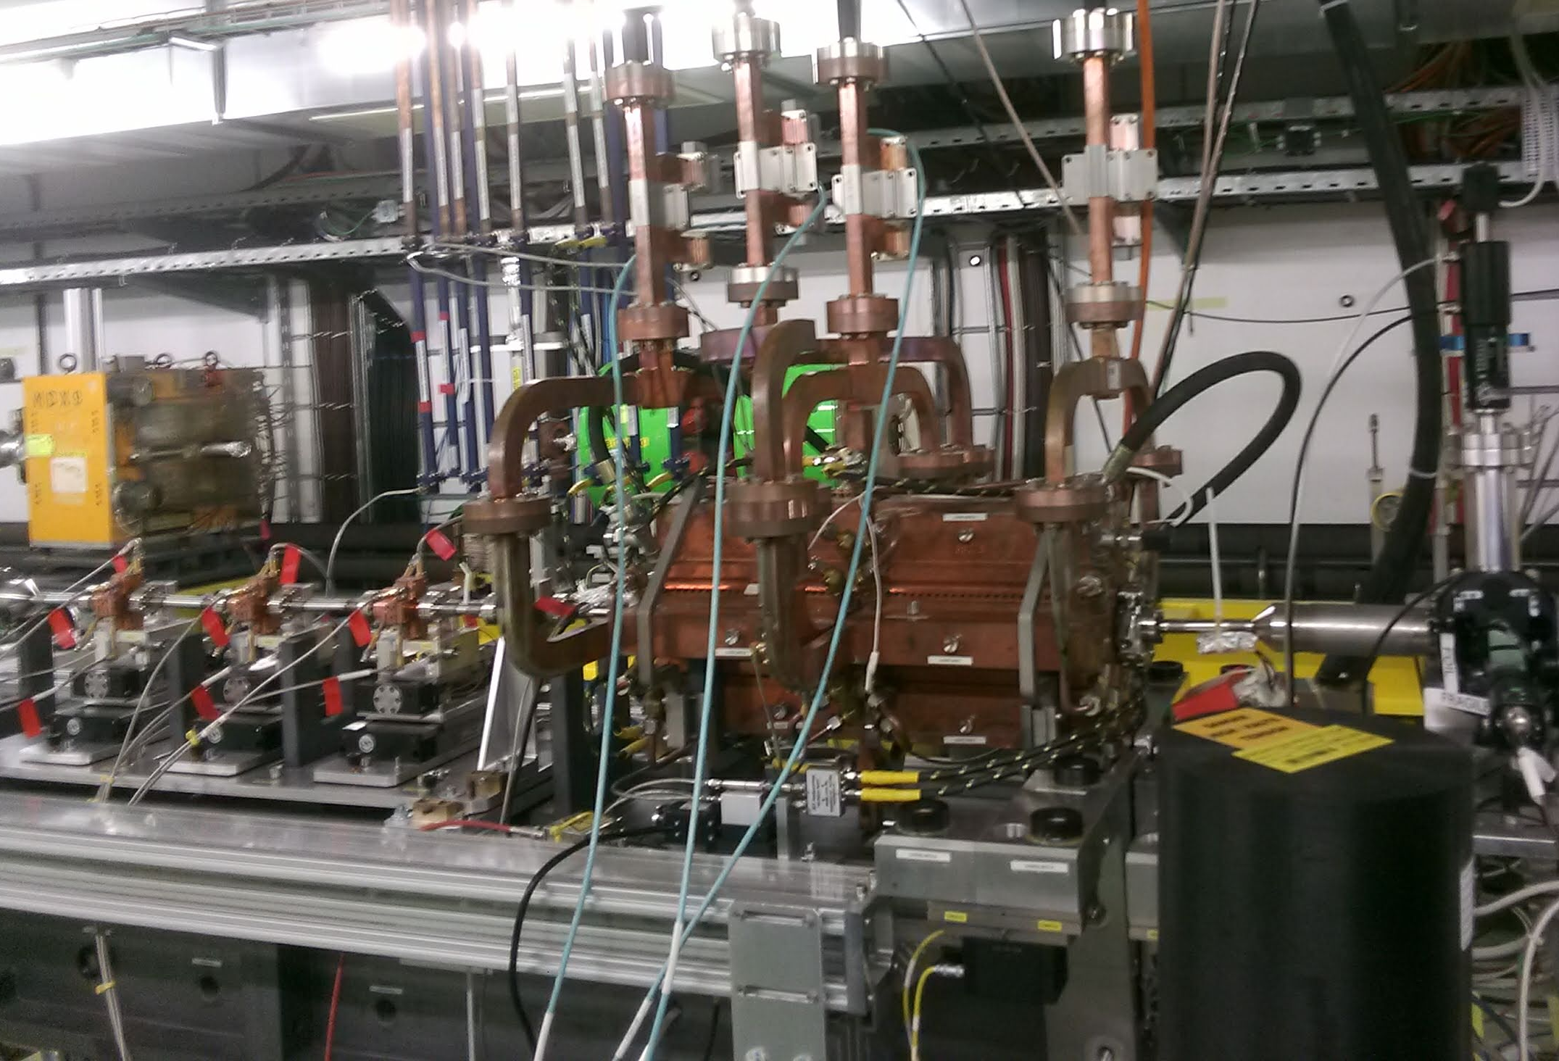
WFM Beam Experiments at CLEAR Facility
CERN Linear Electron Accelerator for Research (CLEAR) is an R&D electron beam facility for existing and future accelerator studies.
It includes experimental areas for beam characterisation of accelerator components and one for CLIC WFM experiments also [1].
Legend for Layout
Superstructure was installed with WFM data acquisition electronics.
[2]
1-Gamba, D., et al. "The CLEAR user facility at CERN." Nuclear Instruments and Methods in Physics Research Section A: Accelerators, Spectrometers, Detectors and Associated Equipment 909 (2018): 480-483.
2-CLEAR Beam Line Description (https://clear.cern/content/beam-line-description)
7
Notes:
Now, I want to describe you the wfm beam experiments at clear facility.
CLEAR facility is a research and development electron beam facility for existing and future accelerator studies.
It includes experimental areas for plasma technology, irradiation tests, characterization of accelerator components, medical applications and also includes a CLIC prototype for studying the response of wakefield monitors to the beam.
And superstructure equipped with wakefield monitors was installed to the beamline with wfm data acquisition electronics.

Slide 9
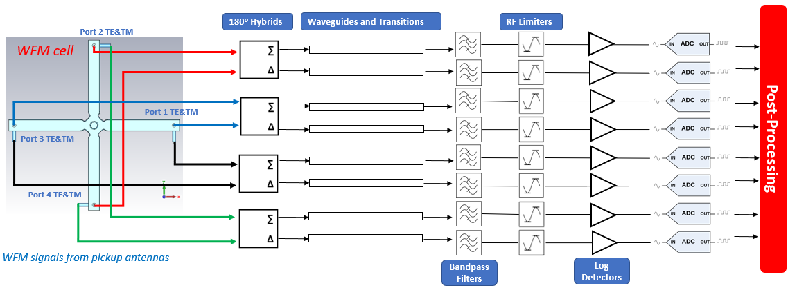
WFM Data Acquisition Electronics Chain
WFM Data Acquisition Electronics in Experimental Area
[1]
1-K. N. Sjobak, “Wakefield Monitors and Wakefield Mitigation”, Nanobeam Technologies Workshop, February 1-3 2021, CERN
8
Notes:
I want to mention about the wfm data acquisition electronics installed to the experimental area. The wfm signals are coming from the pickup antennas by coaxial cables to the 180 deg hybrids to perform sum and subtraction of the signals. Then those signals are sent to the bandpass filters using waveguides. There are also +10 dB RF limiters to protect the logarithmic amplifiers and the rest of the chain. The logarithmic amplifiers are being used for the linearization of the filtered wfm signals. (Meanwhile the signals are being observed on scopes.)
Then, the digitalization is done by analog to digital converters for post processing.

Slide 10
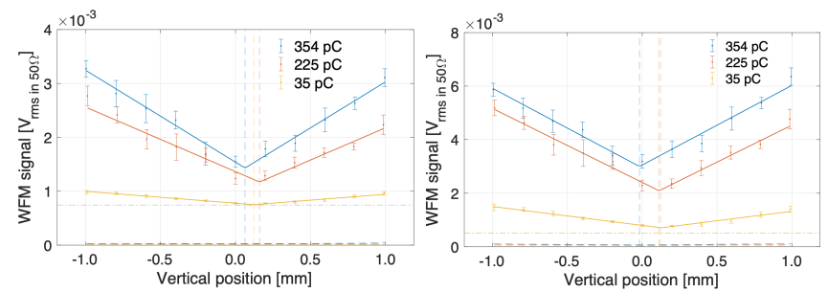
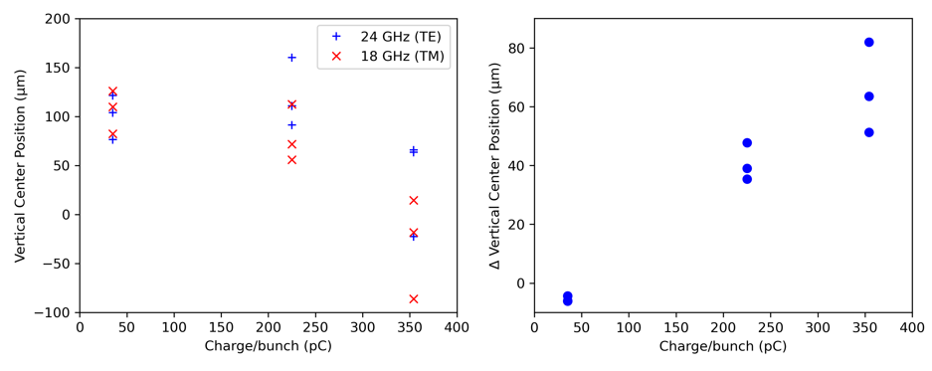
Observed Discrepancy During The Experiment
WFM Beam Experiment Parameters
Bunch Length (mm) | 1
Number of bunches in train | 20
Charges (pC) | 35, 225, 354
Energy (MeV) | 212.5, 214, 212
The minimum signal positions for TE and TM are different (w.r.t. the zero kick location)
This discrepancy increases with charge.
[1]
Magnetic bump to scan (accuracy better than 1% [2]) the transverse space with keeping the CLIC structure stable.
WFM signals are observed from log detectors on scopes.
TE Vertical ∑ (@24 GHz)
TM Vertical ∆ (@18 GHz)
TE and TM mode signals’
measured vertical center positions
The difference between measured positions of
TE and TM signals
[2]
[1] K. N. Sjobak, ‘Tests of Wakefield Monitors (WFMs) at CLEAR’, CLIC Workshop 2019
[2] A. Gilardi, ‘Measurements of wakefields and bunch length with beam in linear electron accelerators: A case study at the CLEAR Facility’, PhD Thesis, University of Naples Federico II, 2021
[2]
9
Notes:
During the experiments the structure was not powered, and a scan of transverse axis was done by using magnetic bump without moving the superstructure.
And the wakefield monitor signals through RF logarithmic amplifiers were observed on the scopes.
During the experiments we observed a discrepancy between the minimum positions of TE and TM characteristic V plots and zero-kick locations of the structure.
And this discrepancy varies between the same charges but increases for higher charges.
this difference that can be as high as 80 microns, challenges the possibility of having a final accuracy of 5 microns in CLIC Study. My work here consists of probing the possible sources for this discrepancy through simulations so that the affecting factors can be corrected if possible.

Slide 11
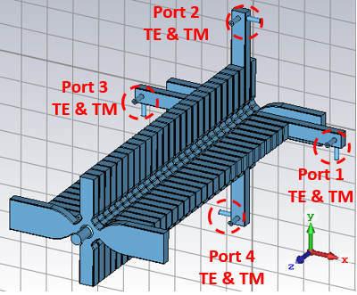
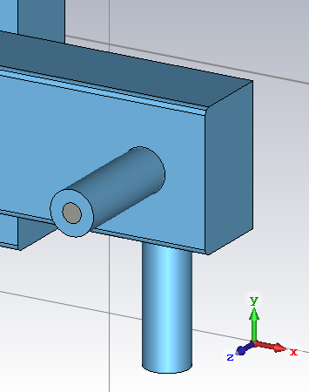
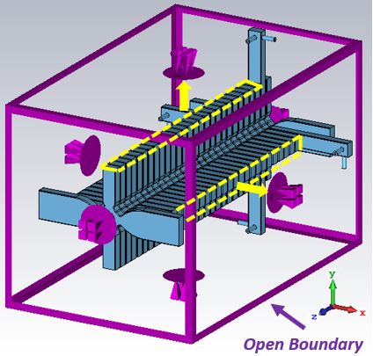
Simulation Model to Investigate Discrepancy
TD26 with WFMs
WFMs
TM Antenna
HOM waveguides are not touching the open boundary condition in the calculation domain.
TE Antenna
Signal cumulation from the end of HOM waveguides on the WFM antennas.
The RF model of TD26 was created for simulations.
WFM antennas were added to the extended Higher Order Mode (HOM) waveguides of the first regular cell.
Solution
Extending HOM waveguides to connect open boundary (WFM antennas must be shorter to fit the distance between adjacent cells)
10
Notes:
To investigate this behaviour during the experiments, we created a simulation model starting with modifications on the CST model of second structure of the module which has wfms.
The first regular cell of 2nd TD26 is equipped with coaxial antennas to extract TE/TM WFM signals.
TE/TM antenna pairs are labelled as Port 1, 2, 3 and 4 TE & TM for easier identification.
However, the model should be modified to obtain WFM signals with less reflection from the following cells which have HOM damping waveguides but no connection to ‘open boundary’ in calculation domain.
In the model, there are no SiC dampers in HOM damping waveguides.
This causes accumulation of reflected signals on the WFM antennas since HOM waveguides are not touching to the open boundary.
There are 2 possible solutions;
Inserting SiC dampers in HOM waveguides (denser meshing, longer simulation time)
Extending HOM waveguides to connect open boundary (WFM antennas must be shorter to fit the distance between adjacent cells)

Slide 12
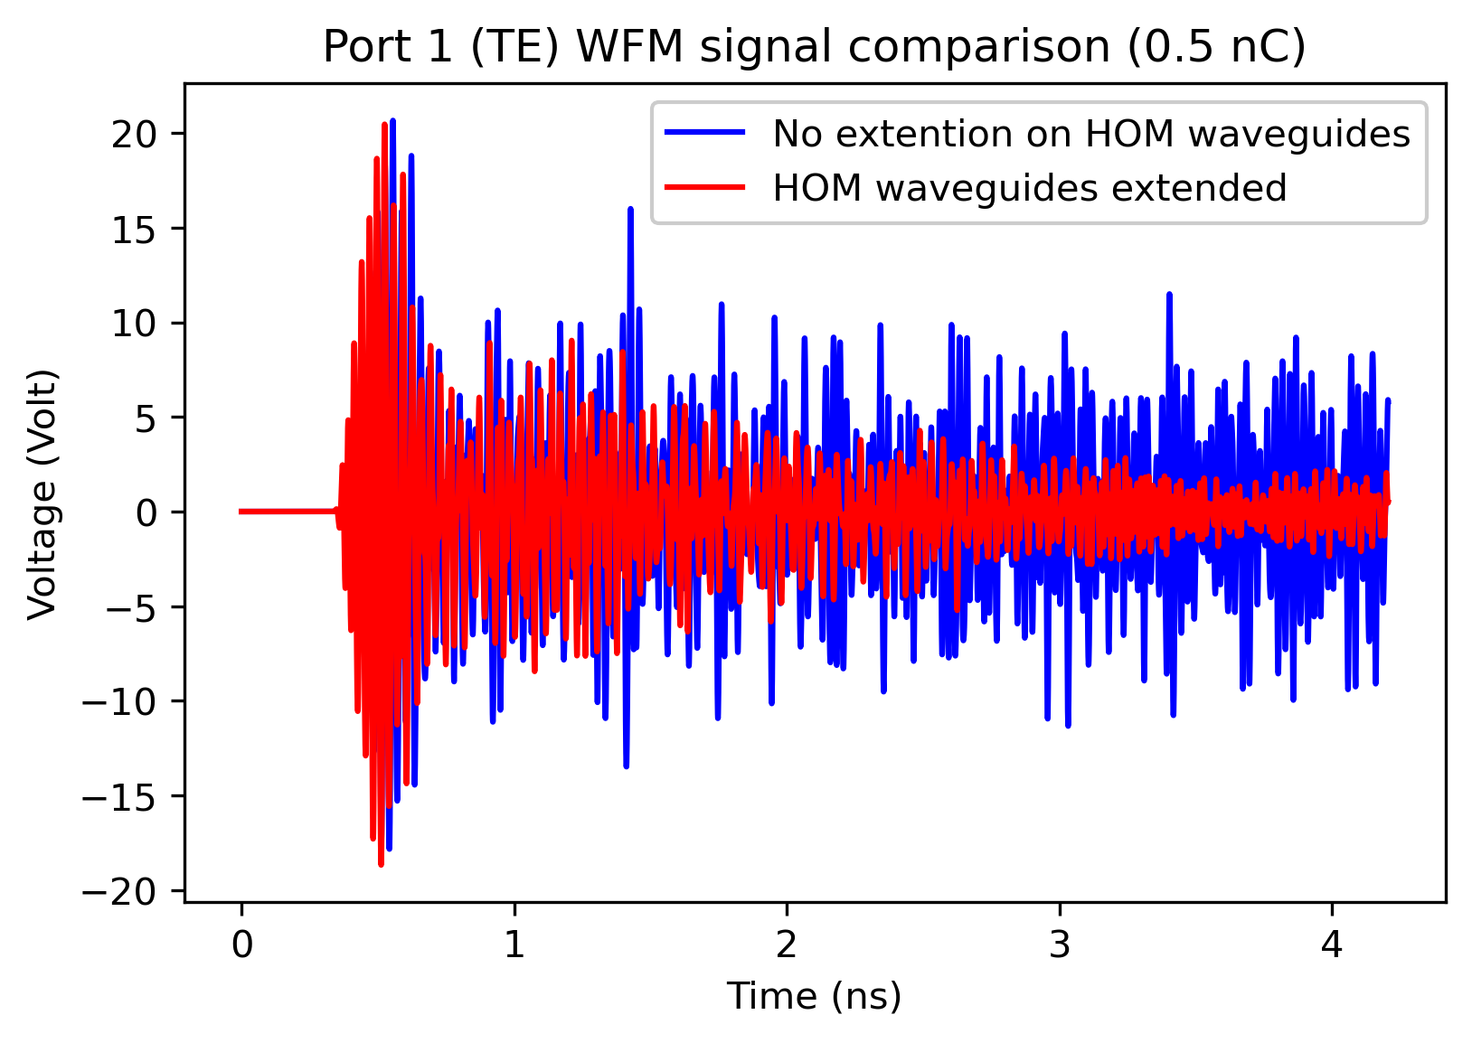
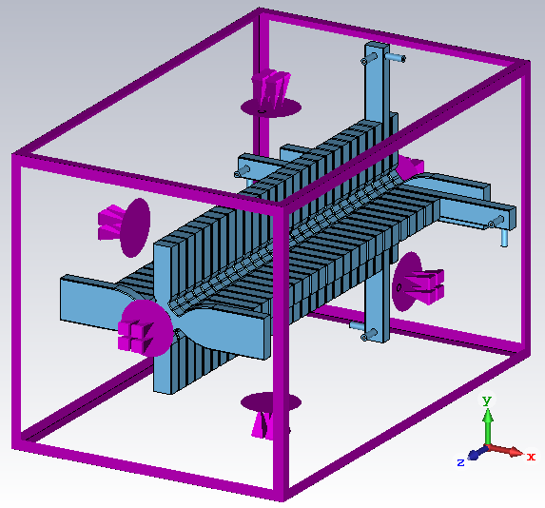
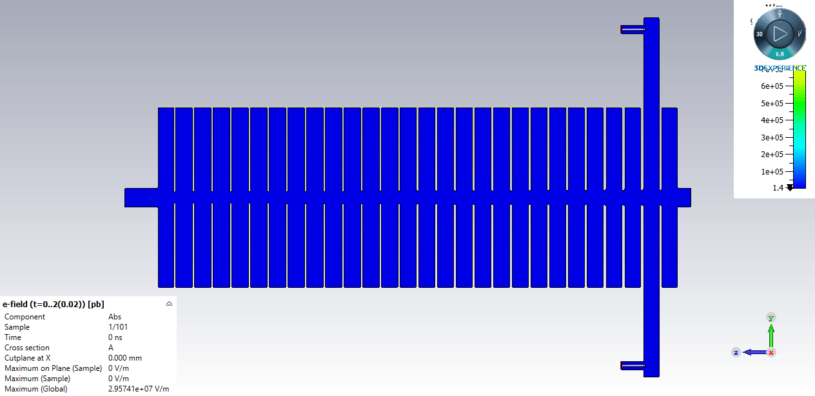
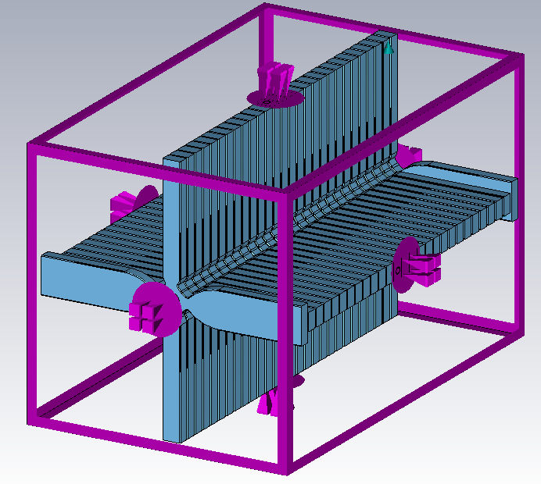
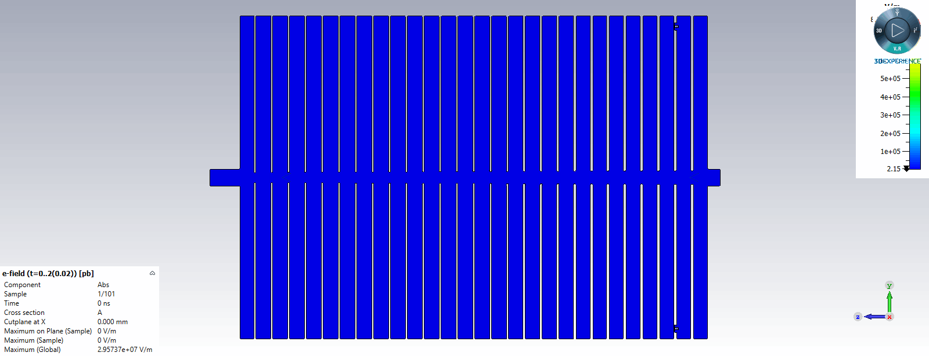
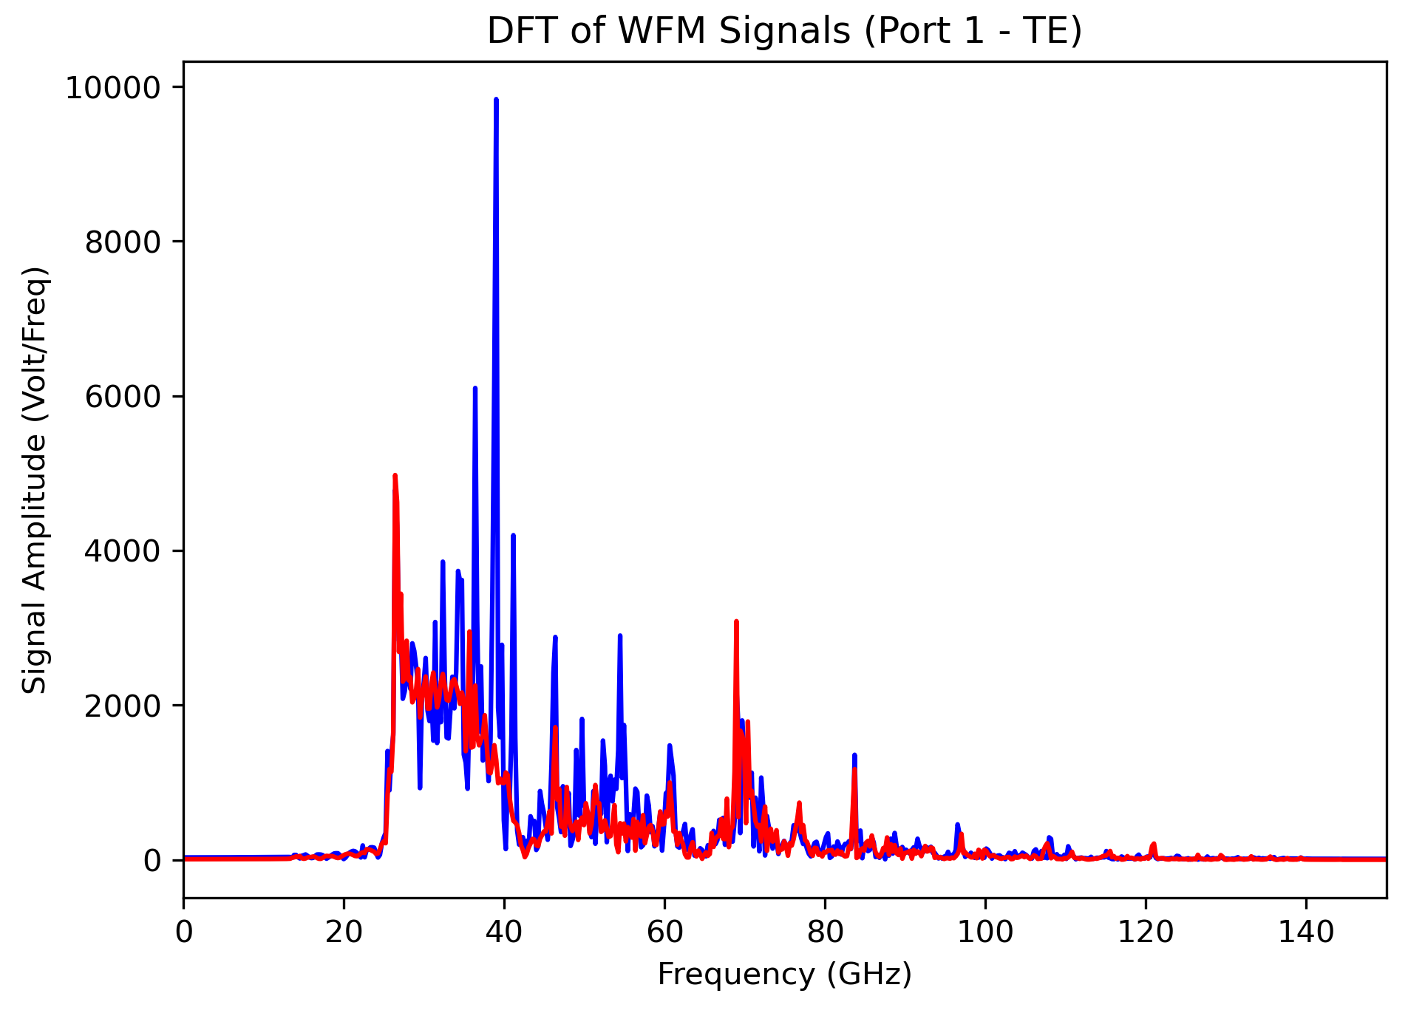
Signal Cumulation Reduction on WFM Antennas
Previous Model
(no extension)
WFM Antenna
Open Boundary
Time Domain
After HOM waveguides extension
Discrete Fourier Transform
Open Boundary
Frequency Domain
Beam is located at z=0.
Shortened WFM Antenna
11
Notes:
I want to show you the open boundary effect with these animations. The open boundary condition absorbs the coming signals with small reflections. Before the extension of hom waveguides, the reflections from the sequential cells do cumulation on the WFM antennas. After extension and connection to open boundary, the reflections are reduced as indicated with red curves.

Slide 13
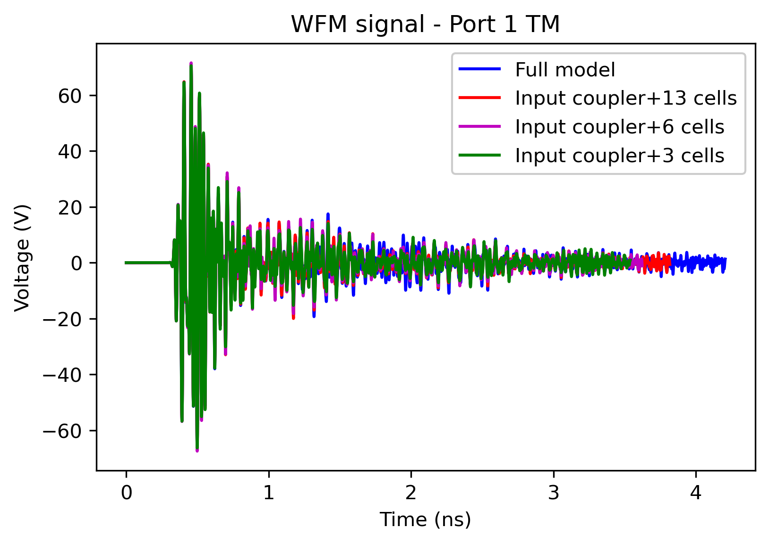
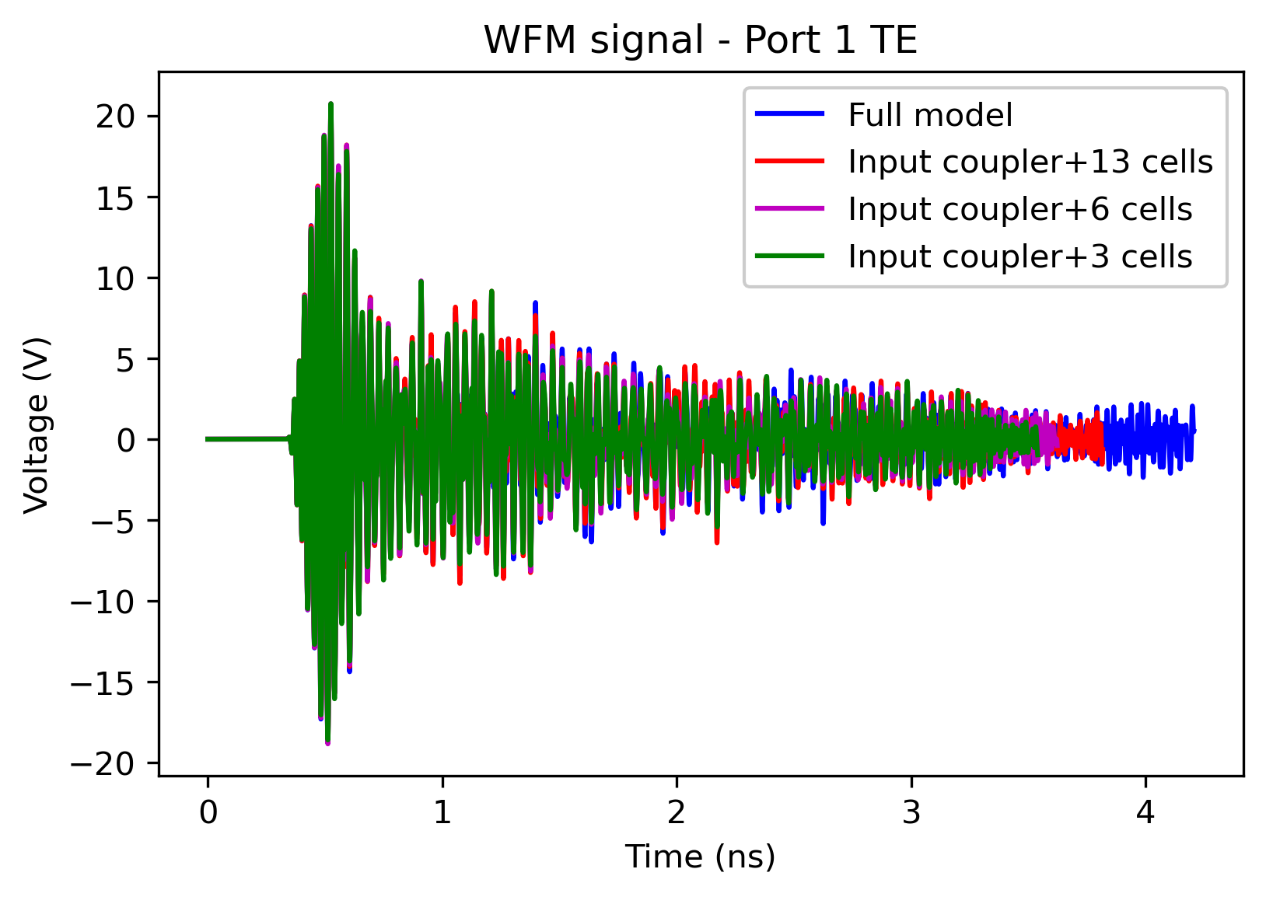
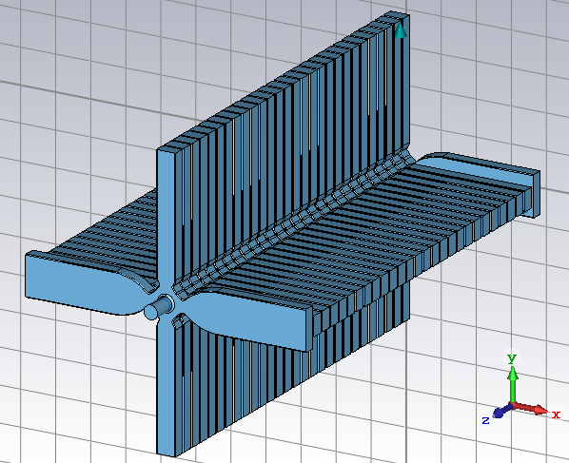
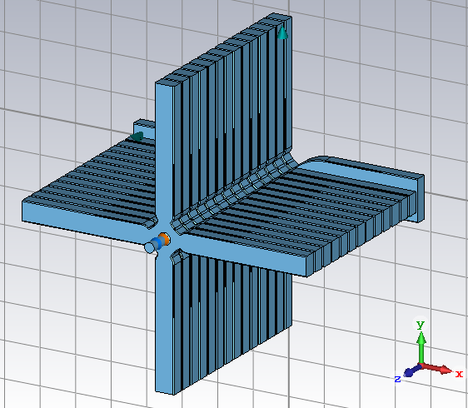
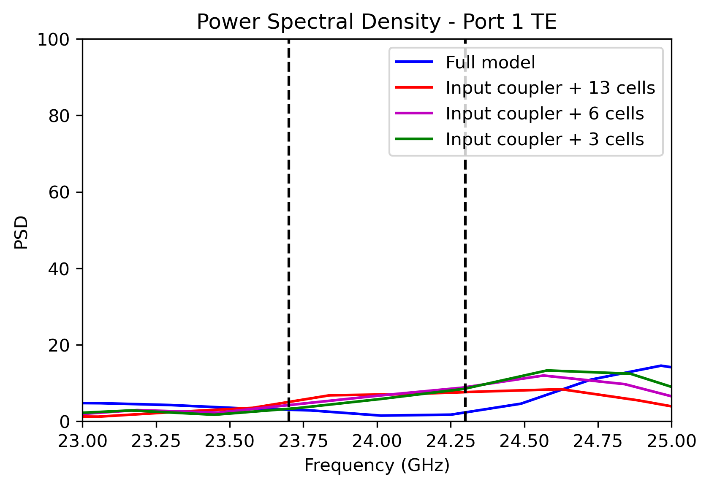
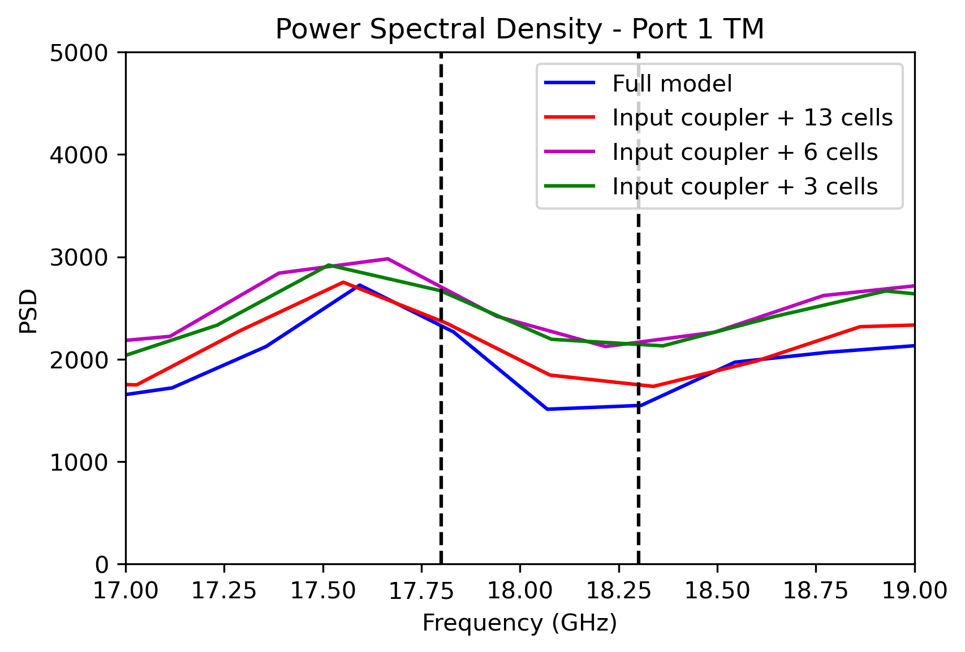
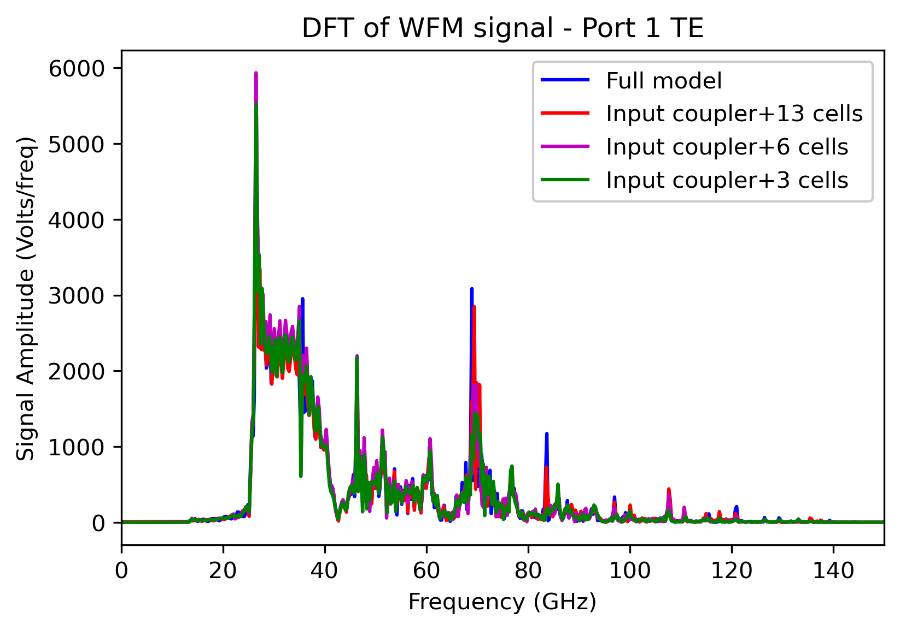
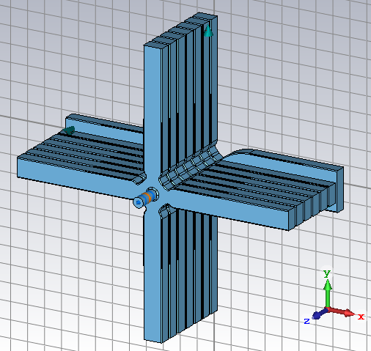
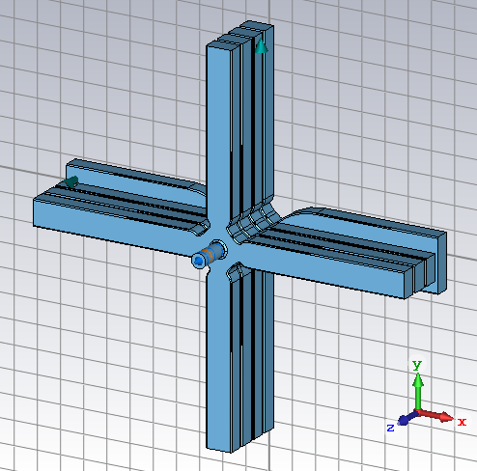
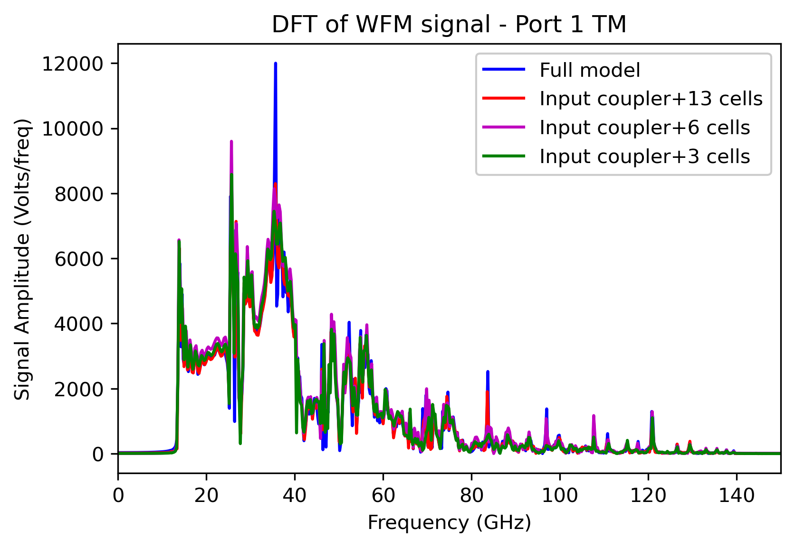
Simulation Model – WFM Signal Convergence Check
Full model
(input/output couplers+26 cells)
Input coupler + 13 cells
Input coupler + 6 cells
Input coupler + 3 cells
0.5 nC, single bunch
No beam offset.
12
Notes:
The modification of the CST model continued with the convergence study of the signals. The simulations were carried out for full structure, input coupler +13, 6 and 3 cells. The time domain signals changed a bit related to simulated structure length. But in frequency domain the signals are close to each other, especially the target mode frequencies we interested in.

Slide 14
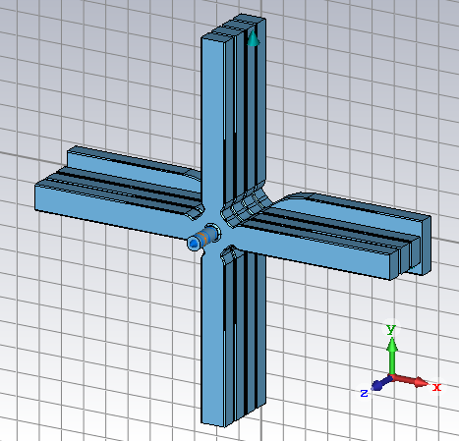
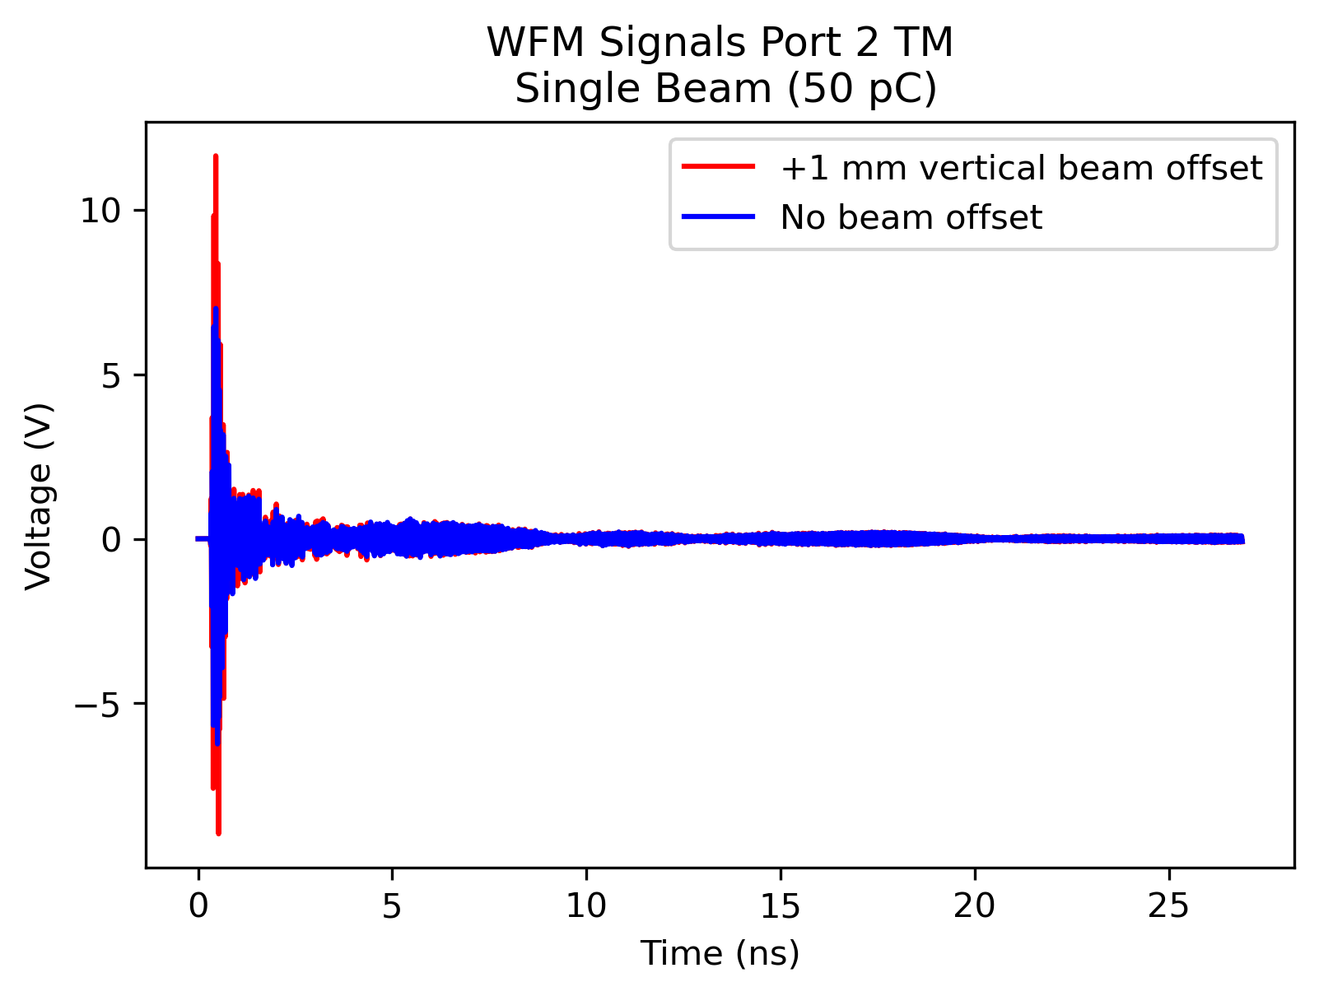
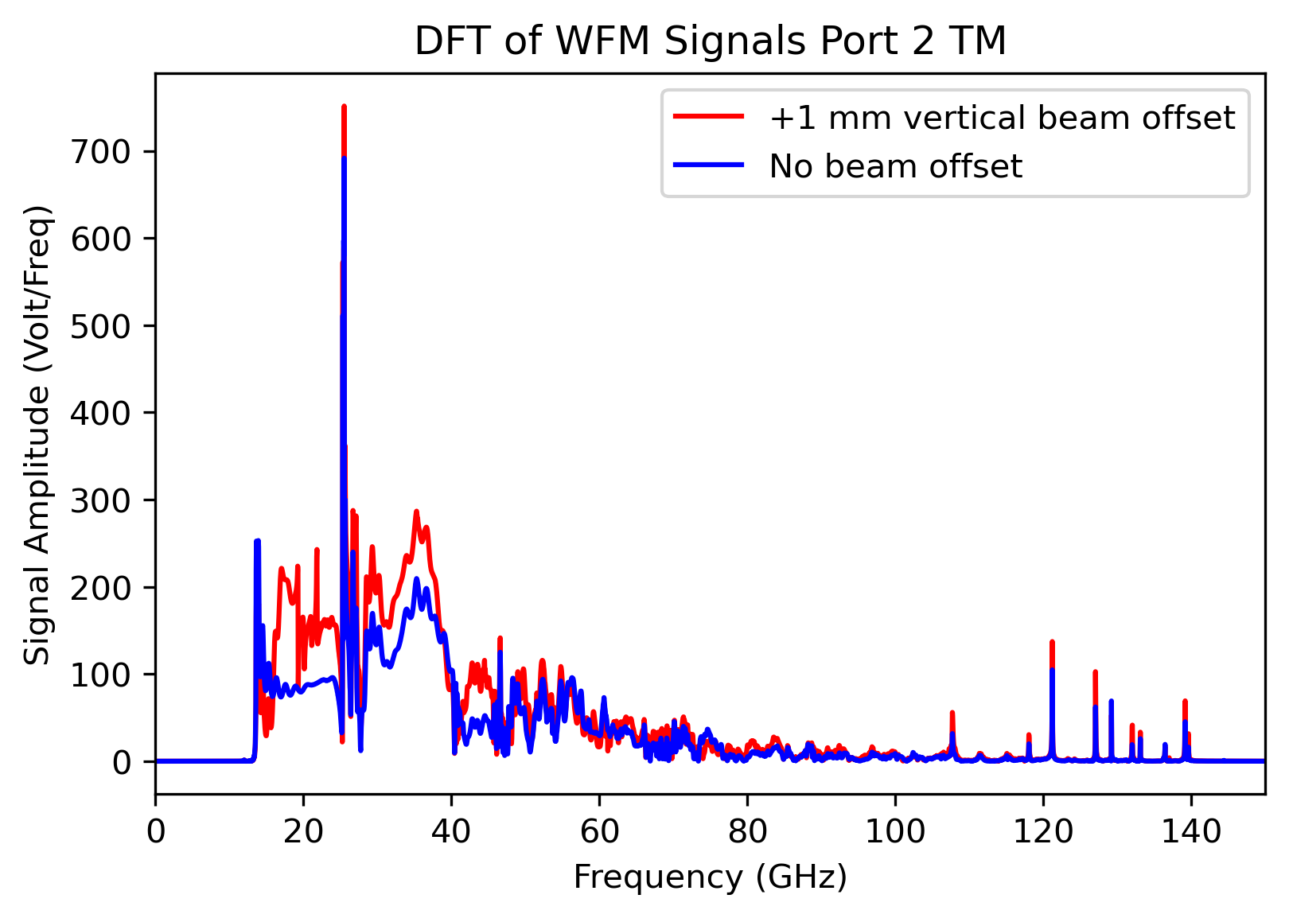
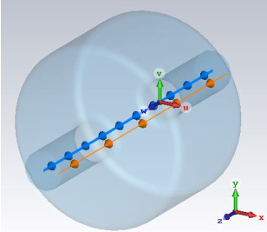
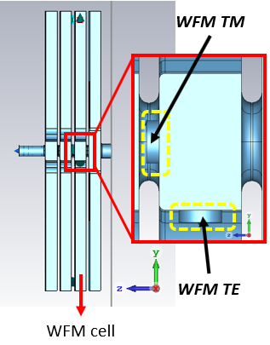
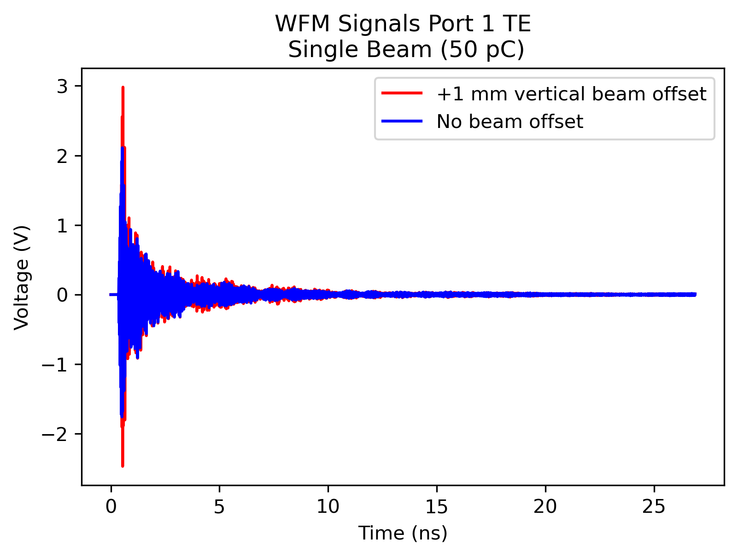
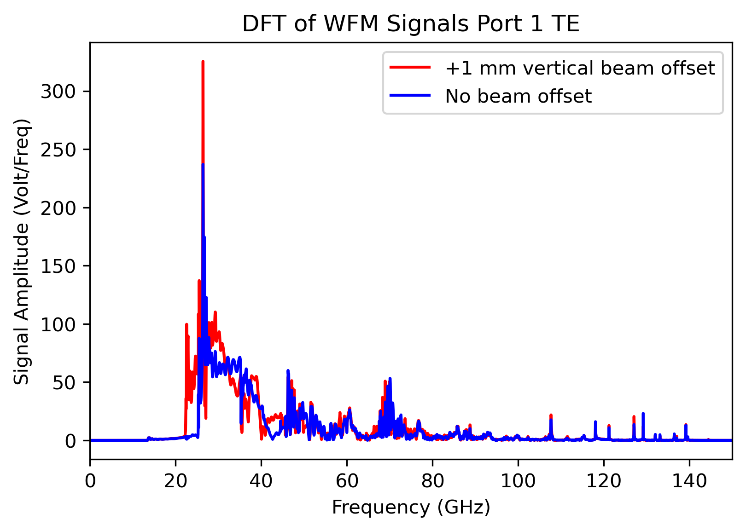
TE and TM Signals’ Response to Beam Offset
Simulation Model
Port 2 TM - WFM Signal
Discrete Fourier Transform
Gaussian shaped bunch with line charge density approximation
Simulation with single bunch
Single bunch -> excitation in wide range of spectrum
WFM signal changes with a beam offset
Port 1 TE - WFM Signal
Discrete Fourier Transform
13
Notes:
After that, the cst model modified to 3 cells + input coupler, shortened wfm antennas and longer hom waveguides. Then, preliminary simulations carried out for the no beam offset and +1 mm vertical beam offset. For the vertical beam offset case, tm antenna of port 2 and te antenna of port 1 were excited with a single bunch which has 50 pC charge. Discrete Fourier Transform has applied to the time domain signals to observe the frequency domain spectrum of the signals.
CST uses Gaussian shaped bunch with line charge density approximation with single bunch
Single bunch excites the wide range of the spectrum and wfm signals change with an offset.

Slide 15
Analysis of WFM Signals In Response to Data Acquisition Chain
WFM Signals from CST
Scripting by Python
Exporting the WFM signals related to beam offset.
∑ and ∆ of signals
Bunch train creation
Filtering
TM @ 17.8-18.3 GHz
TE @ 23.7-24.3 GHz
Power spectral densities
Calculating
$$\sqrt{PSD}$$
$$\frac{{X(f)}^{2}}{N}$$
(Ideal filter approach)
[1]
1- R. N. Bracewell, ‘The Fourier Transform and Its Applications’, McGraw-Hill Higher Education, 3rd Edition, 2000
14
Notes:
The analysis of the wfm signals was done according to the data acquisition electronics installed in CLEAR facility.
After exporting the signals, the sum and subtraction of the signals were applied and this process followed by bunch train creation in frequency domain.
The ideal filter approach applied to the signals in the specified bandpass filter bandwidths for TM and TE modes.
The power spectral densities calculated with taking root and division to number of DFT points.
After that, output response of RF logarithmic detectors that is the square root applied to the signal sequences for the linearization of the signals.
All this will become clearer in the next slides.

Slide 16
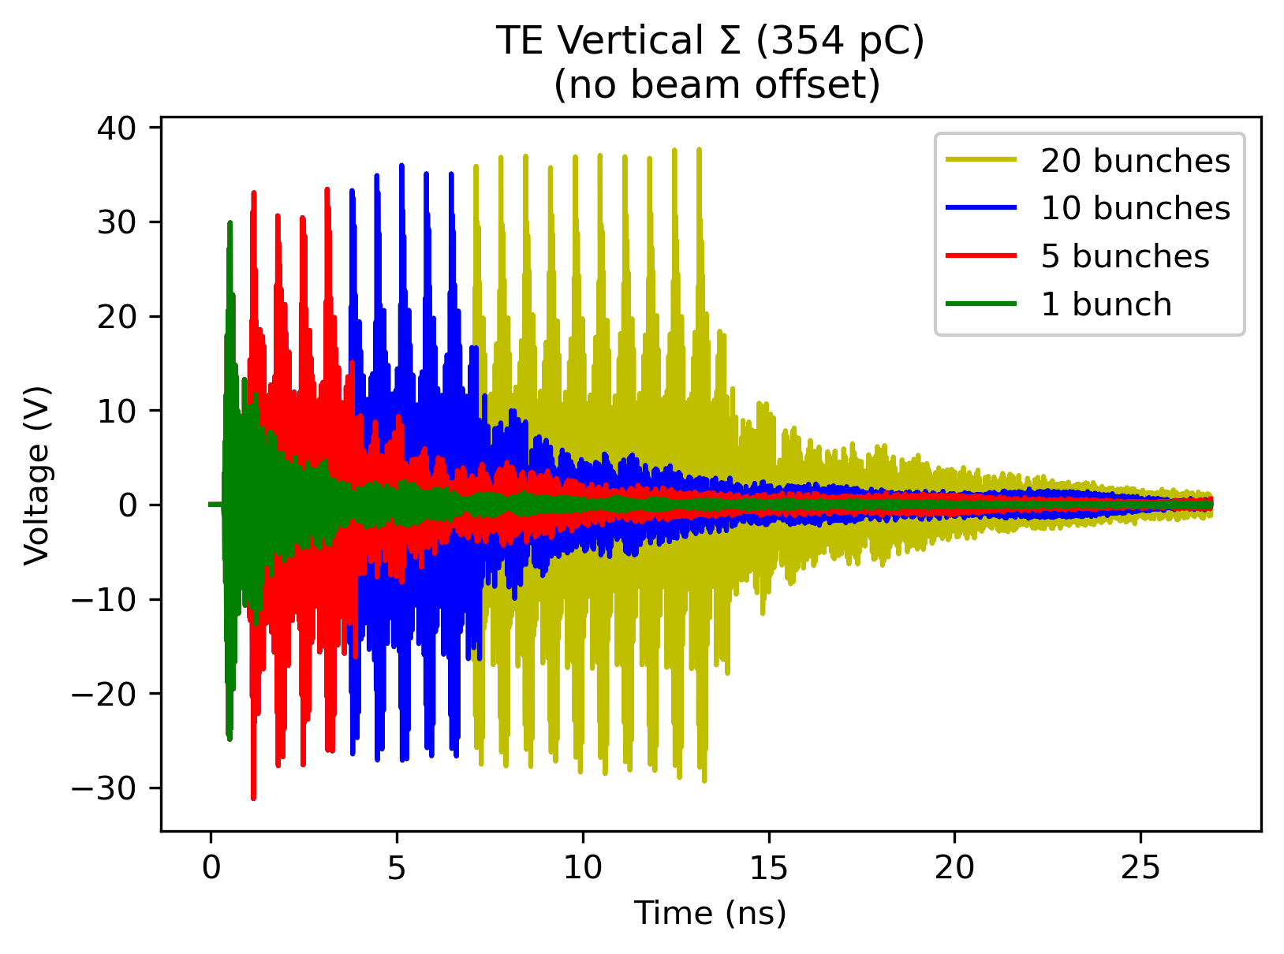
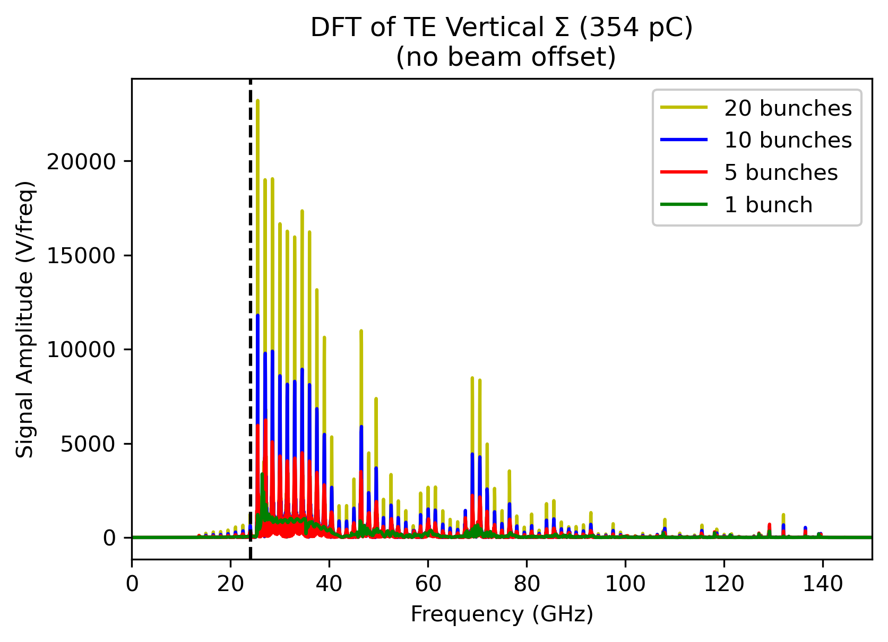
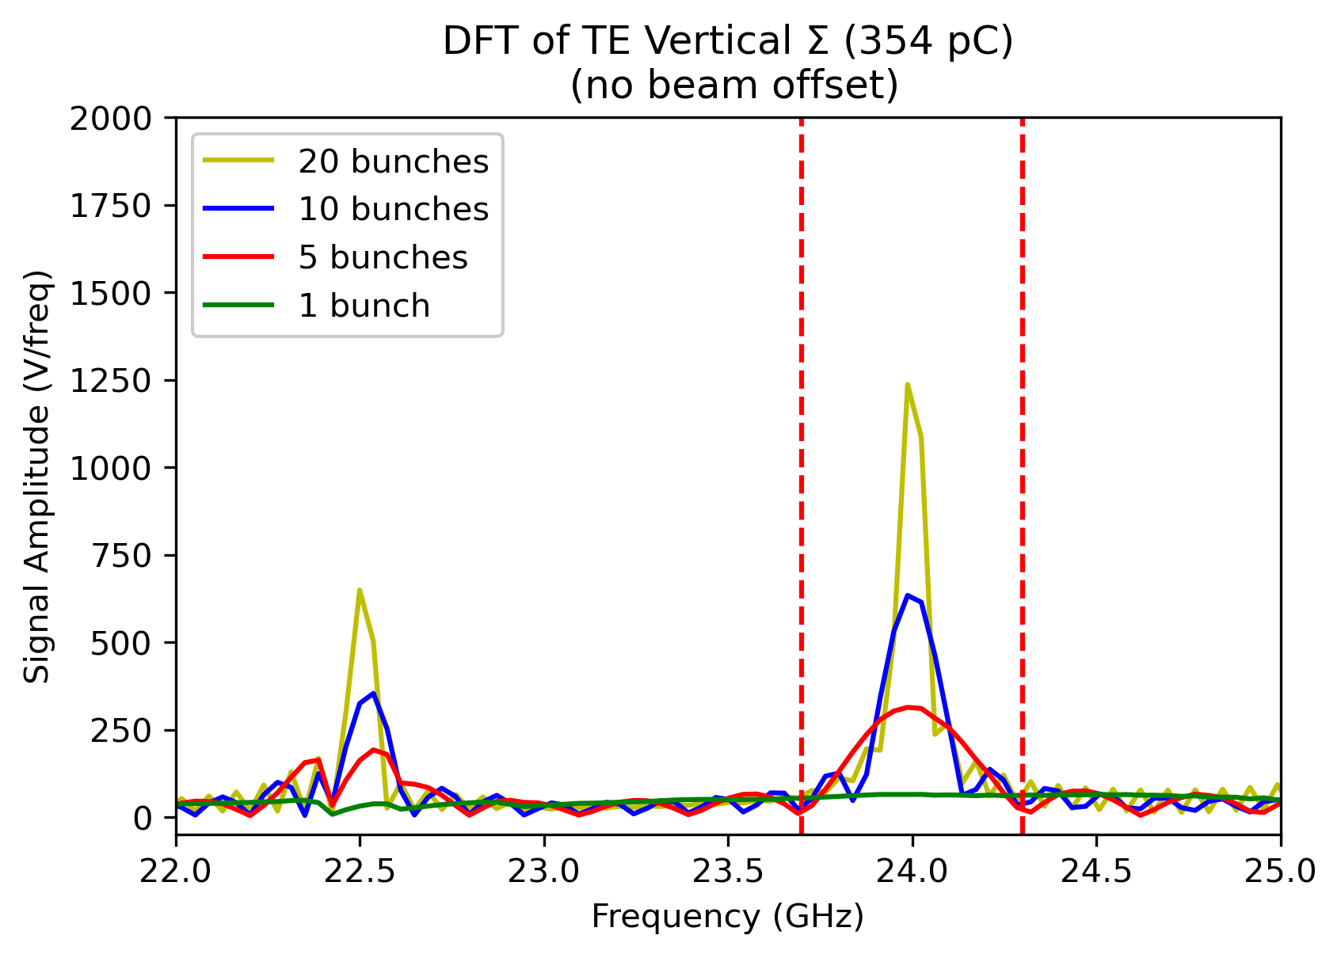
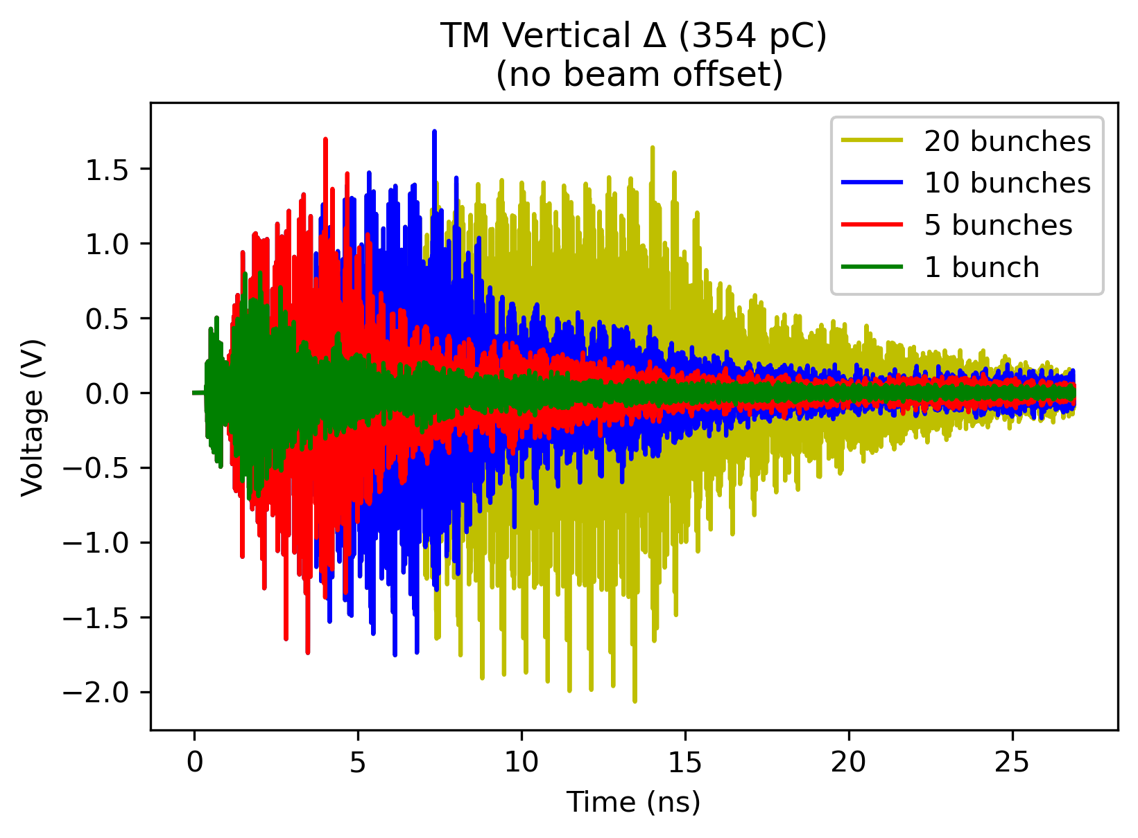
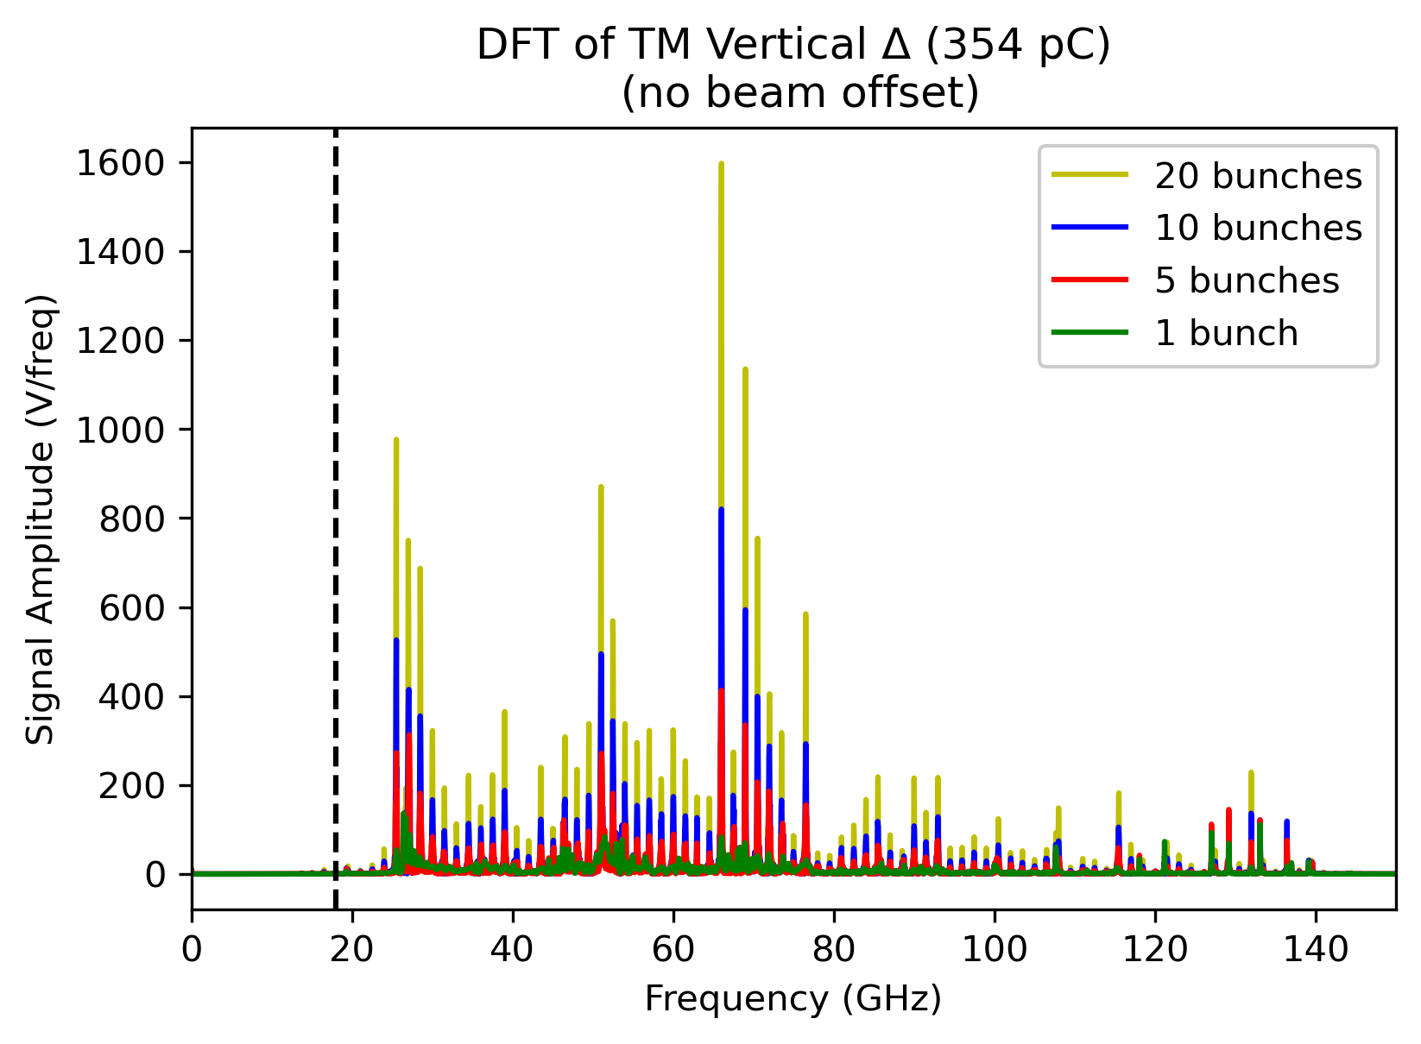
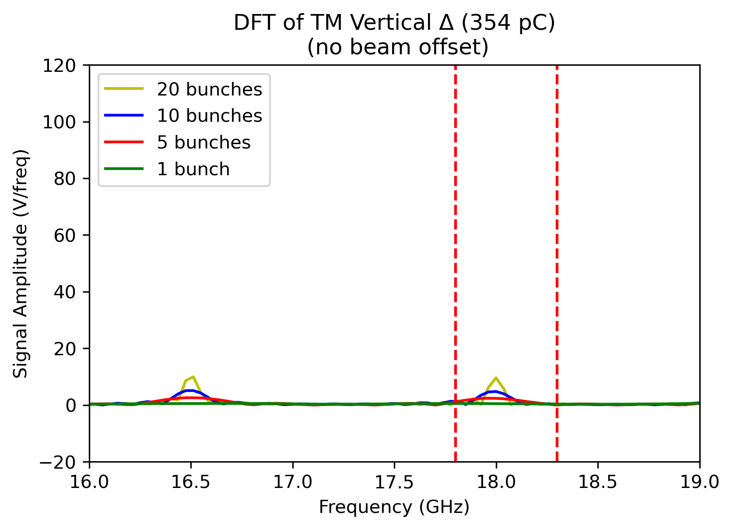
TE and TM Signals’ Response for Bunch Trains – Without Beam Offset
TE Vertical ∑ (Port 1 + Port 3)
Bunch harmonic at 24 GHz
Simulation Parameters
Bunch Length (mm) | 1
Charge/Bunch (pC) | 354
Bunch Spacing (GHz) | 1.5
Bandpass Filter Bandwidth
23.7-24.3 GHz
Same charge as in the experiment
Assuming perfect bunch trains
Bunch trains are created by using Discrete Fourier Transform time-shifting property.
TM Vertical ∆ (Port 2 - Port 4)
Bunch harmonic at 18 GHz
$$x\left[n−n_{0}\right]\underset{↔}{DFT}e^{−jωn_{0}}X(e^{jω})$$
[1]
Bandpass Filter Bandwidth
17.8-18.3 GHz
Bunch harmonics are more visible by increase on the number of bunches in the bunch train.
1- Signals and Systems, Oppenheim, Willsky, 2nd edition, Wiley
15
Notes:
The bunch trains are created manually after exporting the signals with assuming perfect bunch trains.
Time domain signals are transformed to frequency domain by Discrete Fourier Transform.
The bunch trains are created by applying time shifting property of DFT, that is rotating phase in frequency corresponds to shift in time domain.
The plots show the wfm signals of bunch trains without any beam offset. The beam is located at the center of the structure for these signals.
The TE vertical sum and TM vertical difference signals are computed.
Also, the bunch harmonics are getting more visible when we increase the number of bunches in the train.
The signals were filtered by the ideal filter approach in the same filter bandwidths as in the acquisition chain, 23.7-24.3 GHz and 17.8-18.3 GHz intervals for TE and TM modes respectively.

Slide 17
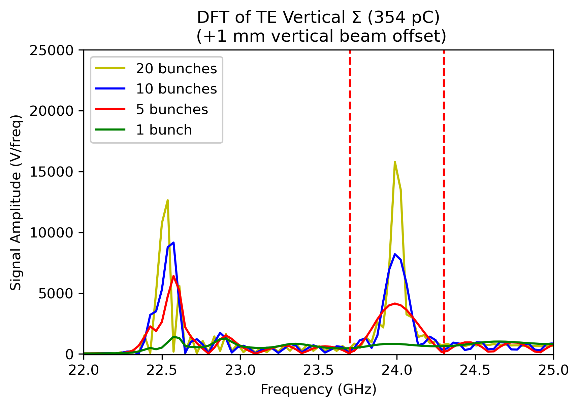
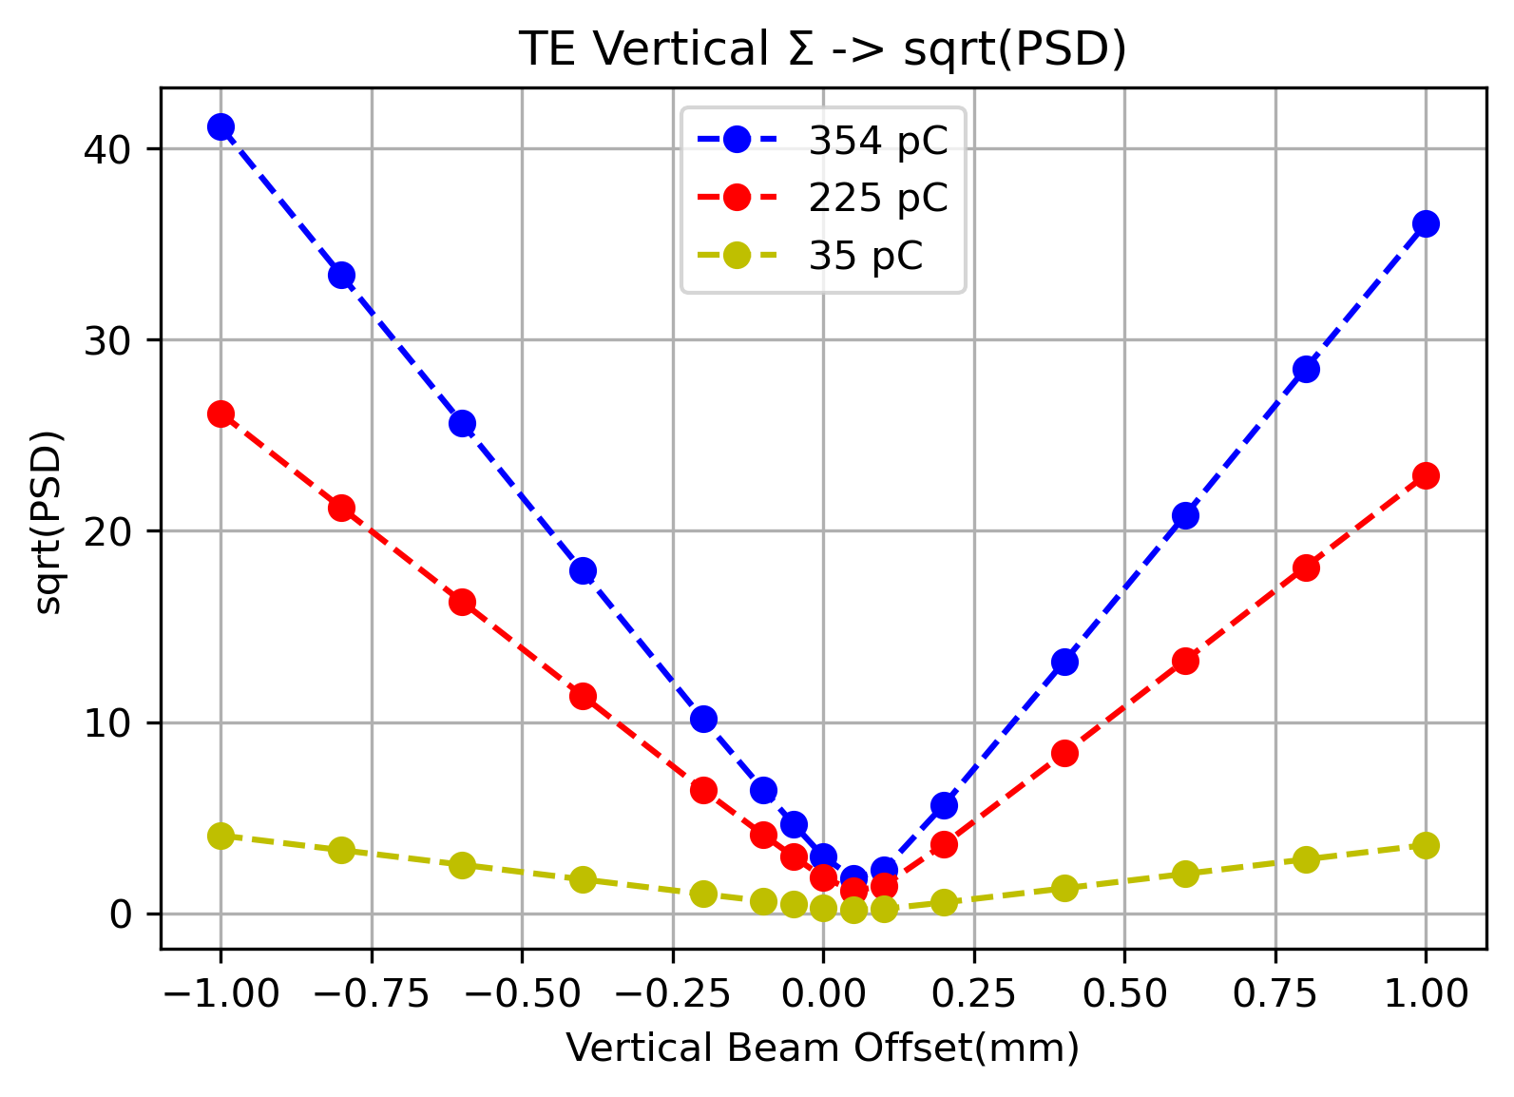
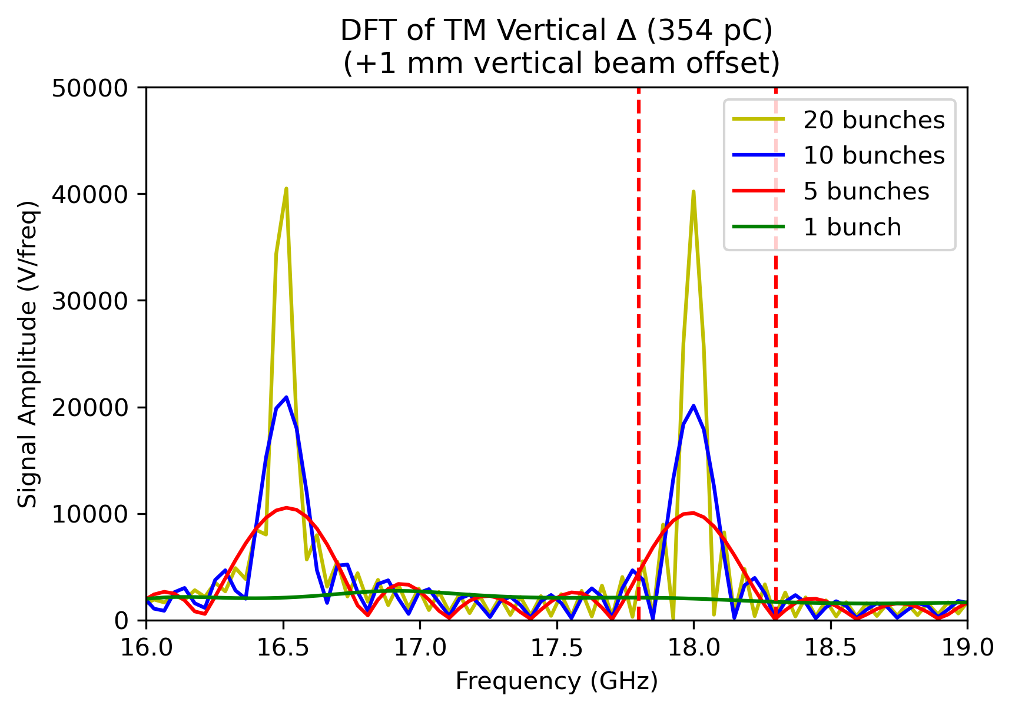
TE and TM Signals’ Response for Bunch Trains – With Beam Offset
No beam offset
+1 mm vertical beam offset
Experiment
Simulation
Dashed red lines- > Bandpass Filter Bandwidths
16
Notes:
Here I want to show you the TE and TM signal’s behaviour in the case of the beam offset. TM vertical difference signals show bigger response in magnitude than TE sum signals.
Assuming perfect bunch trains for each beam shift point.
The same procedure applied to the vertical beam shifts from -1 to +1 mm with 0.2 mm step width.
WFM signals show strong V shape response depending on charge (same behaviour as beam experiments).
And what I would like to notice here is that;
-TM signals show minimum point where beam offset is ‘0’. However, TE signals do not. TE sum signals tend to give minimum point on the positive side of vertical beam scan axis.

Slide 18
Investigation on TE Antenna Orientation Effect to V-plot
Original Model
After modification, the minimum position of the TE signals is at the center of the structure.
∑ -> ∆ because of Port 3 TE antenna rotated 180º.
Port 3 TE
Port 1 TE
Updated Model
Port 3 TE
Port 1 TE
17
Notes:
After several tries on the modal the reason of this behaviour of TE vertical sum signals’ was found as the antenna orientation and location on the port 3.
After flipping the port 3 te antenna, the minimum position of te signals obtained at the center of the structure.
Also for the rest of the process, te vertical sum turned to difference because of the rotation of the antenna by 180deg.

Slide 19
TE &TM V-plots’ Response to Possible Signal Attenuation
WFM signals for 354 pC, 20 bunches
Updated Model
Port 2 TM
Port 3 TE
Port 1 TE
Port 4 TM
Center of the structure -> Minimum position of V-plot
Attenuation applied one of the arms of each antenna pairs.
Minimum position of TM V plot shifts to the attenuation applied side.
TM signals are more sensitive to an attenuation.
18
Notes:
Next, we investigate the possibility that the “moving center” is originated by a different attenuation in each arm acquisition channel.
Attenuation applied one of the arms of each antenna pairs.
What we observed is the shift of the minimum position of TM V plot goes through the attenuation applied side.
However, there is no so significant change on the minimum points of TE signals for the same attenuation level.
And the TM signals show more sensitive behaviour then TE signals.

Slide 20
Response of WFM Signals to Distorted Bunch Trains
σ=110 μm
σ=110 μm
σ=110 μm
σ=540 μm
σ=290 μm
σ=110 μm
Discrete random probability distribution of the WFM signals used to create distorted bunch trains.
1.5 GHz bunch spacing kept the same since there was no significant change on the laser pulsing system of the photo-injector during the experiment.
Bunch train creation was done in the same way as perfect bunch trains except using probability distribution while choosing the WFM signal in the train.
The WFM response is simulated as the statistic result for 1000 sequences for each scan.
σ=110 μm
σ=110 μm
σ=110 μm
σ=540 μm
σ=290 μm
σ=110 μm
Least squares polynomial regression ($R^{2}>0.9$) was applied for each beam scan sequence and minimum position estimation. Same procedure for 1000 iterations.
The minimum position differences between TE and TM signals showed close results for the same distortion and increased with an increasing distortion.
19
Notes:
It was observed in the CLEAR machine that the spot left in the screens was bigger for high charge beams. Even if the effect has not been fully quantified, we suspect that the incoming beam train was distorted with different bunches having a different transverse position when passing through the structure and thus generate different wakefield patterns.
To investigate this;
Discrete random probability distribution of the WFM signals used to create distorted bunch trains.
1.5 GHz bunch spacing kept the same since there was no significant change on the laser pulsing system of the photo-injector during the experiment.
Bunch train creation was done in the same way as perfect bunch trains except using probability distribution while choosing the WFM signal in the train.
The WFM response is simulated as the statistic result for 1000 sequences for each scan.
Least squares polynomial regression was applied for each beam scan sequence and minimum position estimation.
Same procedure applied for 1000 iterations.
The minimum position differences between TE and TM signals showed close results for the same distortion and increased with an increasing distortion.

Slide 21
Results
The TM vertical difference signals show 3 times larger magnitude than TE signals for the same charge per bunch.
The locations of the WFM antennas are crucial for the minimum position of V shape response.
TM signals are more sensitive than TE signals to an attenuation.
The difference between minimum positions of TE and TM signals are increasing with an increasing distortion on the bunch train.
Most probably the combination of the effects (antenna location, attenuation, distorted bunches) studied is the reason of the discrepancy we observed in the experiment.
WFMs
20
Notes:
After this study we observed:
The TM vertical difference signals Show 3 times larger magnitude than te signals for the same charge.
The locations of the WFM antennas are crucial for the minimum position of V shape response.
TM signals are more sensitive to an attenuation tan TE signals for the same attenuation level.
The difference in minimum positions of TE and TM signals are increasing with an increasing distortion.
And, most probably the combination of the effects studied is the reason of the discrepancy we observed in the experiment.

Slide 22
Design and Construction of a 3D Printed Spiral Load
RF Loads Usage in CLIC
The CLIC RF Unit
X-Band RF Loads Studied for CLIC [3]
The type of the CLIC main linacs is constant gradient traveling wave.
They require RF loads to absorb the remaining power at the end of the linac.
Also, hybrids in the network require RF loads for termination.
Compact Load
Spiral Load
High Power Load
Due to the compact design dimensions of X-Band linacs and RF network of CLIC unit, limited space is available for the other RF system components like loads.
Several RF loads had been manufactured and tested successfully at CERN.
The recent study was the ‘spiral load’.
Every RF Unit includes 5 loads.
CLIC includes 71406 RF Units. (Requires 357030 RF loads in total) [2]
Constant Gradient Traveling Wave Linac [1]
[1] Wangler, T. P. (2008), ‘RF Linear Accelerators’, John Wiley&Sons
[2] Aicheler, Markus, et al. A Multi-TeV linear collider based on CLIC technology: CLIC Conceptual Design Report. No. SLAC-R-985. SLAC National Accelerator Lab., Menlo Park, CA (United States), 2014.
[3] N. Catalán Lasheras et al., “High Power Conditioning of X-Band RF Components”, in Proc. 9th Int. Particle Accelerator Conf. (IPAC'18), Vancouver, BC, Canada, Apr. 4, pp. 2545-2548, doi:10.18429/JACoW-IPAC2018-WEPMF074
21
Notes:
And in this section of my presentation, I will continue with the design and construction of a 3D printed spiral load work.
The CLIC study uses constant gradient traveling wave type X-Band linacs as main linac. And these linacs require RF loads to absorb the remaining RF power.
And every clic rf unit includes 5 rf loads which the most common component in the units. The clic final stage includes around 350 thousand rf loads in total.
Due to the compact design dimensions of X-Band linacs and RF network of CLIC unit, limited space is available for the other RF system components like loads.
Several rf loads had been manufactured and tested successfully at CERN.
The recent study was the ‘spiral load’.
And this spiral design should be placed with 45º angle to allow additive 3D printing., because of the layer by layer manufacturing.
This placement allows to produce only 1 load during an additive manufacturing cycle. Also, causes material loss which is the most expensive case of the additive printing.
The aim of this study is optimizing the cross-section of the spiral loads allowing direct horizontal placing and stackable design to decrease the material consumption
and increase the number of produced loads in one run in the case of serial production.

Slide 23
Aim of The New Spiral Load Design
Spiral Load Placement in 3D Printing Machine
Proposed Waveguide Cross-Section Change for Direct Horizontal Placing
The spiral load should be placed with 45º angle to allow additive 3D printing.
This placement allows to produce only 1 load during an additive manufacturing cycle. Also, causes material loss.
The aim of this study is optimizing the cross-section of the spiral loads allowing direct horizontal placing and stackable design to decrease the material consuming and increase the number of produced loads in one run in case of serial production.
22

Slide 24
RF Load Straight Model
Previous Dimensions
The design process had started with creating the sections of the straight version of the load.
Working principle : Conductor Loss
Simulated material: Ti6Al4V alloy (conductivity -> 6.10⁵ S/m)
The previous design [1] dimensions had been applied and several simulations performed by HFSS.
The spiral version had been created after fixing the straight dimensions.
WR90 waveguide dimensions
Optimized Dimensions
[1] D’Alessandro, G. L. (2015). Development of X-band high-power RF load for CLIC applications using additive manufacturing techniques [BSc Thesis]. Salento U.
23
Notes:
The design process had started with creating the sections of the straight version of the load with an optimized cross-section; first part is the wr90 input transition, middle section is the tapered part which is getting narrower from the connection between input transition part and last section is the straight part which has the same dimensions and constructs the end of the load.
Then, turning the flat corners to the triangulars, 90deg on the edges.
Working principle of the load is conductor loss which absorbs the electromagnetic signals on the lossy inner surfaces.
The simulated material is Ti6Al4V alloy (conductivity -> 6.10⁵ S/m) which is already commercial material using in aerospace applications.
The previous design dimensions had been applied to the design with optimized cross-section and several simulations performed by HFSS to obtain the appropriate electric field distribution and reflection value below -30dB at 12 GHz.
After fixing the straight model dimensions, the work continued with the spiral RF design.

Slide 25
Spiral Model
After fixing the basic dimensions of the straight load model, a CATIA spiral model was created as an Archimedes spiral geometry on the straight part, while with keeping constant the gap between spiral surfaces on tapered part.
Parallel progress on RF and mechanical design (parametric model).
The spiral model showed reflection under -30 dB at 12 GHz close to the straight model after several interactions.
Archimedes Spiral Geometry [1]
Fixed Spiral Model Dimensions
$$r\left(φ\right)=r_{0}+s(φ)$$
$$s=[M_{1}M]$$
$$s\left(φ\right)=\frac{1}{2}\left(w\left(φ\right)+w\left(φ+1\right)\right)+g$$
$$r\left(φ\right)=r_{0}+\left(w_{1}+g\right)φ+\frac{1}{2N}(w_{2}−w_{1})φ^{2}$$
(where N is real number)
r; radius, s; the pitch of the spiral, g; distance between spiral surfaces, ϕ; spiral measuring angle, w-w₁-w₂; thickness parameters of spiral surfaces
[1] Lockwood, E. (1961). Spirals. In Book of Curves (pp. 173-176). Cambridge: Cambridge University Press. DOI: https://doi.org/10.1017/CBO9780511569340.026
24
Notes:
For the work on the spiral model, a CATIA model was created based on an Archimedes spiral geometry on the straight part,
while keeping the gap constant between spiral surfaces on tapered part.
Parallel progress was carried out with alternating RF and mechanical design parametric model.
After several interactions, the spiral model obtained with reflection under -30 dB at 12 GHz. Although, there is a slight change on reflection between straight and spiral model, the reflection is still acceptable.

Slide 26
Pumping Integration & Mechanical Design
Design process continued with implementing the internal vacuum pumping holes.
The cut-off frequency of the load shifted by 350 MHz due to the vacuum holes and compensated by 0.3 mm increase on H2 parameter, width of straight part.
Occurred peak on reflection at 12 GHz recovered by a 3 mm diameter tuning hole placed under input transition.
The mechanical design was completed by integrating cooling channels and a CF16 vacuum flange in CATIA.
The final RF design (with/without roughness) and vacuum model extracted from CATIA showed reflection below -30 dB at 12 GHz.
H2
Cooling circuits
RF Design
Mechanical Design
CF16 vacuum flange
Prototypes
Cut-off frequency shift and signal peak at 12 GHz
Reflection of final RF design (with/without roughness) and vacuum model extracted from CATIA
25
Notes:
After fixing the spiral model RF dimensions, the design process continued with implementing the internal vacuum pumping holes inside the load.
-The cut-off frequency of the load shifted by 350 MHz due to the vacuum holes which causes decrease on the frequency effective length.
-And this situation compensated by 0.3 mm increase on H2 parameter which is the width of the straight part and determines the cut-off frequency of the load.
-After this frequency shift recovery, signal peak occurred on the reflection at 12 GHz due to the lack of vacuum holes at the outer surface of the structure which causes an asymmetric behaviour for the electric field distribution.
-This occurred peak on reflection at 12 GHz recovered by a 3 mm diameter tuning hole placed under input transition of the load.
-Next, the mechanical design was completed by integrating cooling channels and a CF16 vacuum flange in CATIA.
-The final RF design (with/without roughness) showed reflection below -30 dB at 12 GHz. Also for the cross-check, the model extracted from mechanical design was simulated and showed reflection below -30dB indicated as red curve on the plot in the middle.
And the prototypes manufactured.

Slide 27
Low Power-Level RF Tests of Produced Loads
S-parameter Measurement Setup (Semi-clean Room, ~21 ºC)
Simulations
Measurements
8 prototypes had been received (3 from CERN, 5 from vendor company).
The low power-level RF tests of the loads had been performed after confirming the vacuum leak tightness tests.
The measurement bandwidth was applied as the same used in the simulations 11-13 GHz.
Loads #5-6-7 have reflection values between -20 to -28 dB, rest showed below -30 dB.
Although the measured S-parameters are different from the simulations due to the manufacturing tolerances of the additive 3D printing and possible blockage inside the RF area during the production, they all below -20 dB reflection (-> only one percent of power reflecting back).
Load no. | S₁₁ (dB) at 11.994 GHz, ~20 ºC
1 | -38.462
2 | -38.904
3 | -36.462
4 | -39.904
5 | -20.758
6 | -24.928
7 | -28.612
8 | -30.61
26

Slide 28
CERN vs Vendor Company Prototypes Comparison
CERN print loads (#1-2-3) showed consistent results. However, vendor company prints don’t.
The possible reason is the unknown material cumulation inside the RF area, but still needs detailed investigation.
27
Notes:
….
Knowledge transfer between CERN additive manufacturing group and vendor companies can be considered for better products in the case of mass production.

Slide 29
Results
Stackable design
The cross-sectional optimization of the new X-Band RF spiral load had been completed by using parametric models and alternating between in CATIA and HFSS design softwares [1].
Due to the lightweight, high strength, formability and corrosion resistance properties of Ti6Al4V alloy, it was used for all the prototypes.
Stackable manufacturing achieved as planned (for #2 and 3).
The low power-level RF tests of the prototypes confirmed acceptable reflection values (<-20 dB) after manufacturing and allow high-power tests. Two of the prototypes were installed to X-Band High Gradient Test Facility (CERN) for high power testing.
The new design has reduced the material consumption by factor 2.
#2
#3
RF Load under High Power Test
It will be effective on cost and time savings in case of mass production.
CLIC includes 71406 RF Units (Each includes 5 loads).
(Requires 357030 RF loads in total)
[1] H. Bursali et al., “X-Band RF Spiral Load Optimization for Additive Manufacturing Mass Production,” JACoW, vol. IPAC2021, pp. 1143–1146, 2021, doi: 10.18429/JACoW-IPAC2021-MOPAB370.
28

Slide 30
Conclusions
In this thesis, two novel devices were studied for the X-Band compact accelerators:
Wakefield monitors as integrated beam position monitors
Design and construction of 3D printed RF spiral loads
The behaviours of TE-like and TM-like WFM signals were investigated with CLEAR probe beam and simulations were carried out to study the observation on increasing minimum point difference between TE and TM modes with an increasing beam charge.
The antenna location, signal attenuation and distorted bunch trains’ effects studied and showed the possible combined effects on the minimum position differences between the TE and TM mode WFM signals. (Publication in progress for PRAB: CLIC Wake Field Monitors as a detuned Cavity Beam Position Monitor: Explanation of center offset between channels)
Usage of TM signals has an advantage since they are more robust to asymmetry of the antenna locations and show larger magnitude for the same charge per bunch. However, the attenuation of the system must be controlled.
The design, construction and low power-level RF tests of 3D printed X-Band spiral RF loads completed as the last part of the loads’ optimization study in CLIC. (Published at IPAC’21: X-Band RF Spiral Load Optimization for Additive Manufacturing Mass Production, DOI: 10.18429/JACoW-IPAC2021-MOPAB370)
The study of RF loads will be continued with high-power tests at X-Band High Gradient Test Facility at CERN.
Thanks to the parametric design of the load, it can be scaled to other frequency bands and can be used other RF network applications like space[1] or communications.
[1] B. Mena, ‘High Average Power Test of 3-D Printed Load’, International Workshop on Breakdown Science and High Gradient Technology (HG2019), Chamonix, 14-16 June 2019
29

Slide 31
Thank you for your attention!

Slide 32
Backup Slides

Slide 33
References for Slide #2
[2.1] CompactLight Project, http://www.compactlight.eu/Main/Accelerator
[2.2] The CLIC Study, https://clic.cern/
[2.3] Wuensch, W. (2017, March 9). Summary of the X-band applications day. CLIC Workshop 2017, CERN. https://indico.cern.ch/event/577810/timetable/?print=1&view=standard
[2.4] K. Pepitone et al., “The electron accelerators for the AWAKE experiment at CERN—Baseline and Future Developments,” Nuclear Instruments and Methods in Physics Research Section A: Accelerators, Spectrometers, Detectors and Associated Equipment, vol. 909, pp. 102–106, Nov. 2018, doi: 10.1016/j.nima.2018.02.044.
[2.5] R. W. Assmann et al., “EuPRAXIA Conceptual Design Report,” Eur. Phys. J. Spec. Top., vol. 229, no. 24, pp. 3675–4284, Dec. 2020, doi: 10.1140/epjst/e2020-000127-8.
[2.6] S. Pioli et al., “TEX - an X-Band Test Facility at INFN-LNF,” Aug. 2021, pp. 3406–3409. doi: 10.18429/JACoW-IPAC2021-WEPAB314.
[2.7] “Very High Energy Electron Radiotherapy Workshop (VHEE’2020),” Indico. https://indico.cern.ch/event/939012/
[2.8] “CERN and Lausanne University Hospital collaborate on a pioneering new cancer radiotherapy facility,” CERN. https://home.cern/news/news/knowledge-sharing/cern-and-lausanne-university-hospital-collaborate-pioneering-new-cancer
[2.9] B. Marchetti and others, “Experimental demonstration of novel beam characterization using a polarizable X-band transverse deflection structure,” Sci. Rep., vol. 11, no. 1, p. 3560, 2021, doi: 10.1038/s41598-021-82687-2.

Slide 34
CLEAR Beam Parameters
https://clear.cern/content/beam-line-description

Slide 35
Superstructure at CLEAR Facility
TD26 Parameters
Average loaded accelerating gradient | 100 MV/m
Operating Frequency | 12 GHz
RF phase advance per cell | 2π/3
Input, output iris radii | 3.15, 2.35 mm
Input, output group velocity | 1.65, 0.83% of c
First and last cell Q-factor (Cu) | 5536, 5738
Number of regular cells | 26
Structure length including couplers | 230 mm (active)
Filling time | 67 ns
Peak input power | 61.3 MW
RF-to-beam efficiency | 28.5 %
[1]
1- Grudiev, Alexej, and Walter Wuensch. Design of the CLIC main linac accelerating structure for CLIC conceptual design report. No. EuCARD-CON-2010-073. 2010.

Slide 36
WFM WG dimensions
6.6749 mm
TM-like modes
TM pickup
TE-like modes
11 mm
TE pickup
GHz
17
18
24
25.7
Harmonics of 1.5 GHz
WFM wg dimensions EDMS No: 1182237

Slide 37
Mesh Views of Current Model (1)
These parts have this meshing shape due to coaxial antenna dimensions.
Automatic meshing applied.
Beam length affects the meshing.

Slide 38
Mesh Views of Current Model (2)

Slide 39
Preliminary Results
Plots for 35, 225 and 354 pC
(WFM signals for single bunch)
WFM - TM Port 1 signals
No beam offset (top) and +2 mm horizontal beam offset (bottom)
WFM signal amplitude changes linearly with charge

Slide 40
Response of WFM Signals to Distorted Bunch Trains
Example: 1st sequence ($R^{2}\sim 0.94$)
20 bunches, 50 pC charge/bunch
Least squares polynomial regression ($R^{2}>0.9$) for each beam scan sequence and minimum position estimation.
Same procedure for 1000 iterations.
Increase on minimum position differences between TE and TM signals with an increasing distortion.
Notes:
The polynomial regression applied to each
The difference between minimum positions are increasing with an increasing distortion.
Polynomial fitting equation can be added.

Slide 41
Response of WFM Signals to Distorted Bunch Trains

Slide 42
Difference Between Minimum Positions

Slide 43
1 nC
4 nC
7 nC
Ideal case train parameters:
1/4/7 nC train charge with 20 bunches
Resulting error in linear fit

Slide 44
Response of WFM Signals to Distorted Bunch Trains (2)
Minimum Position Differences
Between TE and TM Signals
Discrete random probability distribution of the WFM signals used to create distorted bunch trains.
1.5 GHz bunch spacing kept the same since there was no significant change on the laser pulsing system of the photo-injector during the experiment.
Bunch train creation was done in the same way as perfect bunch trains except using probability distribution while choosing the WFM signal in the train.
The WFM response is simulated as the statistic result for 1000 sequences for each scan.
20 bunches, 50 pC charge/bunch
Least squares polynomial regression ($R^{2}>0.9$) for each beam scan sequence and minimum position estimation.
Same procedure for 1000 iterations.
The minimum position differences between TE and TM signals increased with an increasing distortion.

Slide 45
No vacuum holes at outer surface
Vacuum holes at both sides

Slide 46
Spiral Load by Additive Manufacturing at CERN
Printed load in Titanium powder
After removing powder
Supports
Photos from R. L. Gerard
For more information on Additive Manufacturing at CERN:
https://home.cern/news/news/engineering/additive-manufacturing-opens-new-prospects-cern

Slide 47
Support Usage Comparison
Previous Model
New Model
Supports
Photos from R. L. Gerard

Slide 48
Stackable Design and Printing at CERN
#2
#3
Photos from R. L. Gerard

Slide 51
Spial Loads under High Power Test
X-Band High Gradient Test Facility (CERN)
 | Klystron | Acc. Structure
Peak power | 50 MW | 16 MW
$$f_{rep}$$ | 50 Hz | 50 Hz
$$τ_{p}$$ | 1500 ns | 242 ns
$$P_{av}=F_{rep}P_{pk}τ_{p}$$
$$P_{av, klystron}=3750 W$$
$$P_{av, acc str}=193.6 W$$
[1] D’Alessandro, G. L. (2015). Development of X-band high-power RF load for CLIC applications using additive manufacturing techniques [BSc Thesis]. Salento U.

Slide 52
B. Mena, ‘High Average Power Test of 3-D Printed Load’, International Workshop on Breakdown Science and High Gradient Technology (HG2019), Chamonix, 14-16 June 2019

Slide 53
B. Mena, ‘High Average Power Test of 3-D Printed Load’, International Workshop on Breakdown Science and High Gradient Technology (HG2019), Chamonix, 14-16 June 2019

Slide 54
CompactLight

Slide 55
EuPRAXIA
R. W. Assmann et al., “EuPRAXIA Conceptual Design Report,” Eur. Phys. J. Spec. Top., vol. 229, no. 24, pp. 3675–4284, Dec. 2020, doi: 10.1140/epjst/e2020-000127-8.

Slide 56
EuPRAXIA

