Slide 1
Presentazione CIF 6-Giugno-2022
Progettazione PP1.
Definizione della Power Table distribution;
Mockup;
Organizzazione Camera Pulita
definizione pianta
spostamento tavoli di granito
Camera Climatica
Trasporto
Installazione e collaudo
OpenLabs: Organizzazione Openday 2022 (MakerLab)

Slide 2
Progettazione piping PP1 Definizione della Power Table distribution

Slide 3
OB Manifold Production: are we able to produce it in our labs?
Quantity: 4
PRODUCTION
Parts production
ASSEMBLY
Prototypes and Qualification Process
Welding Certification
Pipes assembly
Test
Table of components
Group | Quantity | Production site | Weld Qty
Inner Manifold | 3 | Company/Internal Lab ?
Outer Manifold | 3 | Company/Internal Lab ?
Pipe Exhaust | 4 | Company/Internal Lab ?
Pipe Inlet | 6 | Company/Internal Lab ?
3-HE | 2 | Company/Internal Lab ? | 6
T 1/2" - 8mm | 23 | Company/Internal Lab ? | 69
Elbows 8mm | 19 | Company/Internal Lab ? | 19
Elbows 1/2" | 4 | Company/Internal Lab ? | 8
Elbows 3/8" | 8??? | Company/Internal Lab ? | 16
Temp Sensors | 4 | Company/Internal Lab ? | 8
Electric Breaks 1/2" | 4 | Company/Internal Lab ? | 4
Electric Breaks 3/8" | 6 | Company/Internal Lab ? | 6
TOT |  |  | 136
Meeting with a company for pipes production and assembly:
https://www.cinel.com/cinel/
Documents for price quotation

Slide 4
OB Capillary Manifolds: 2 scenarios
1
Install the Capillaries Manifolds together with the OB Manifolds and weld all the capillaries in situ.
40 weldings and test per quarter on 4mm.
2
Do the capillaries welding and test before the transport and do the weldings in SR1 as indicated in the picture.
32 welding and tests per quarter on 3/8 inch.
Both scenarios :19 weldings pipe exhaust-manifolds

Slide 5
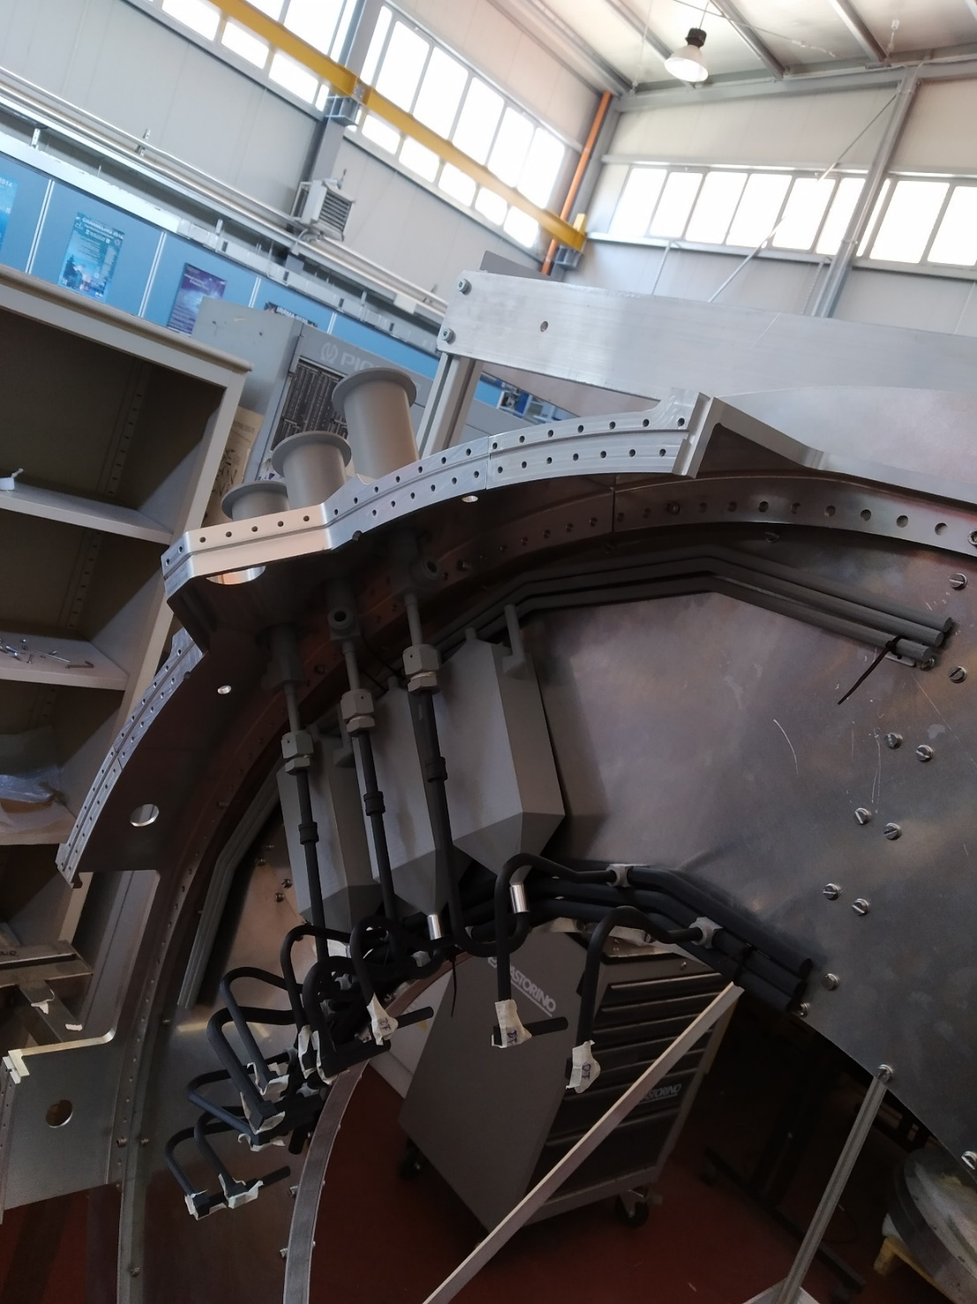
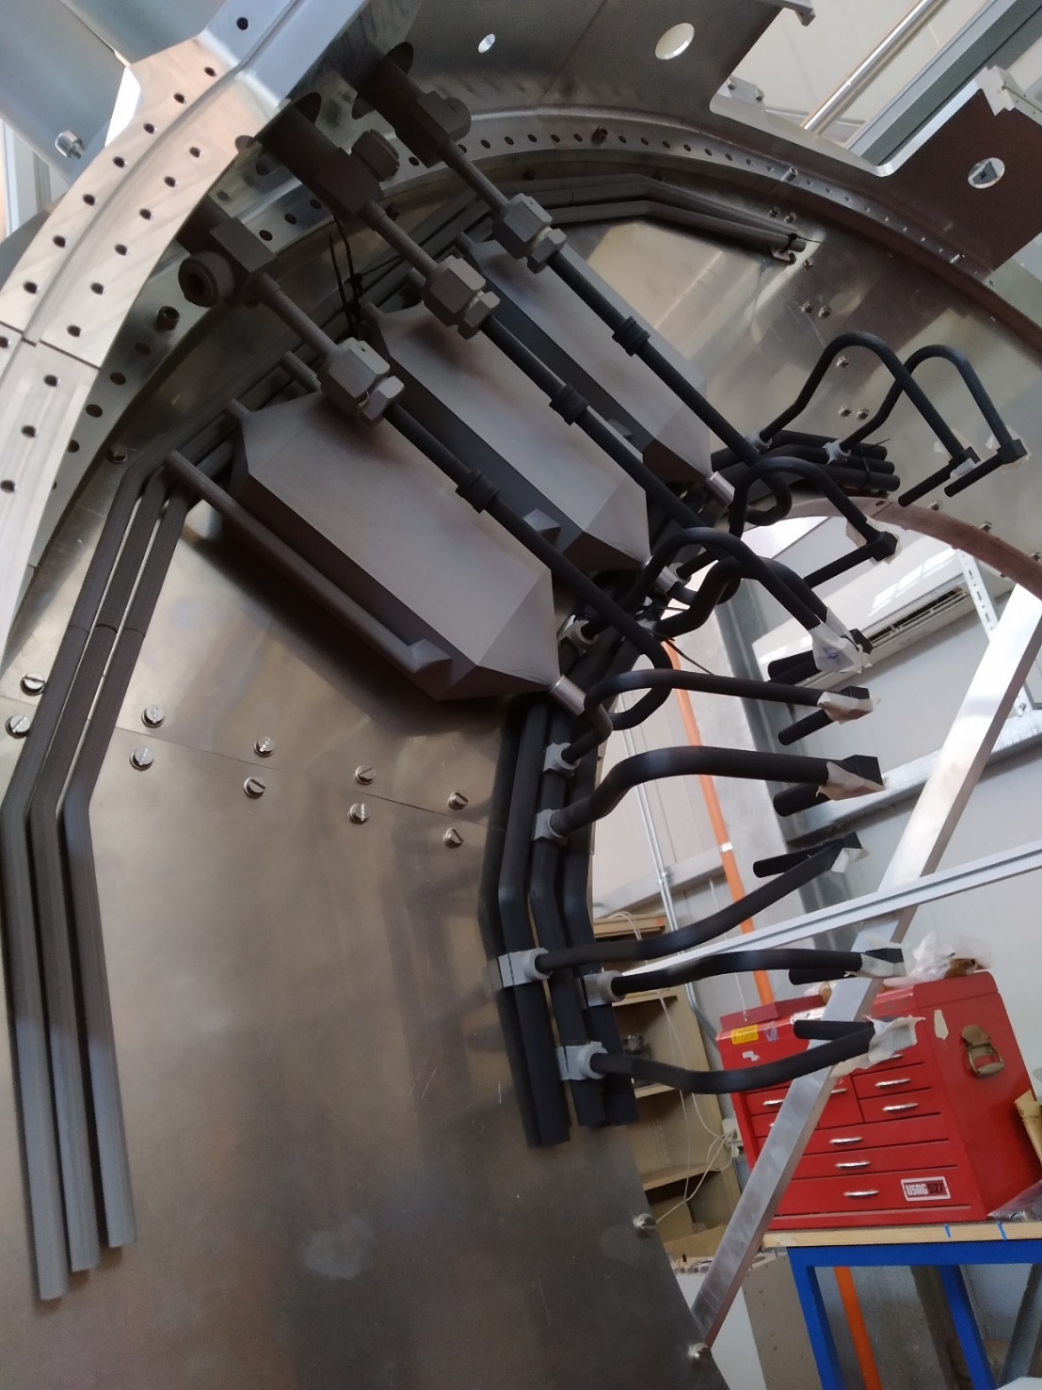
Progettazione piping PP1 PP1 piping Mockup

Slide 6
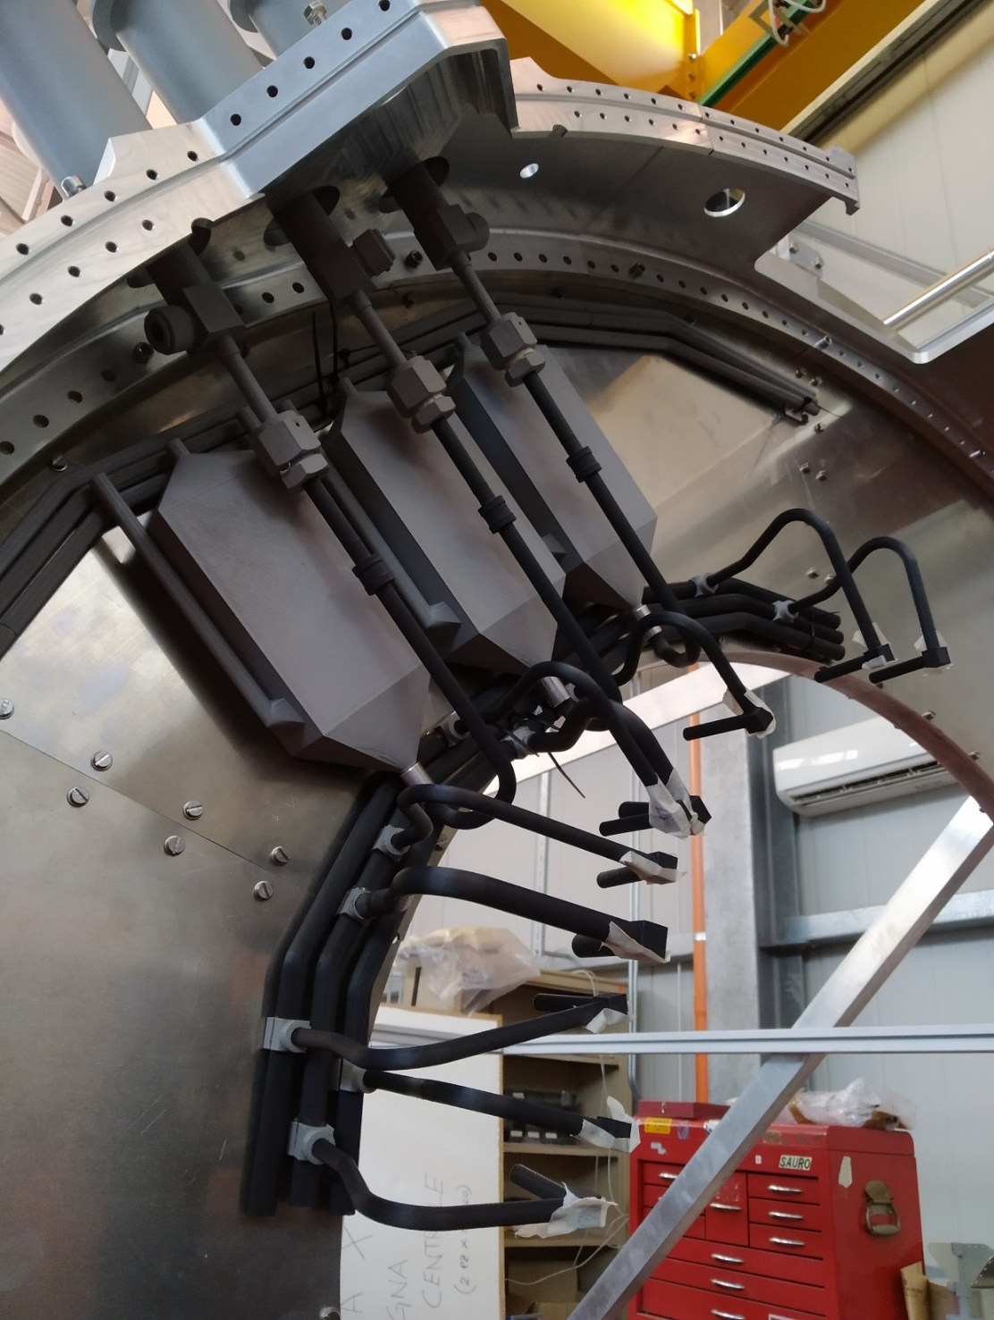
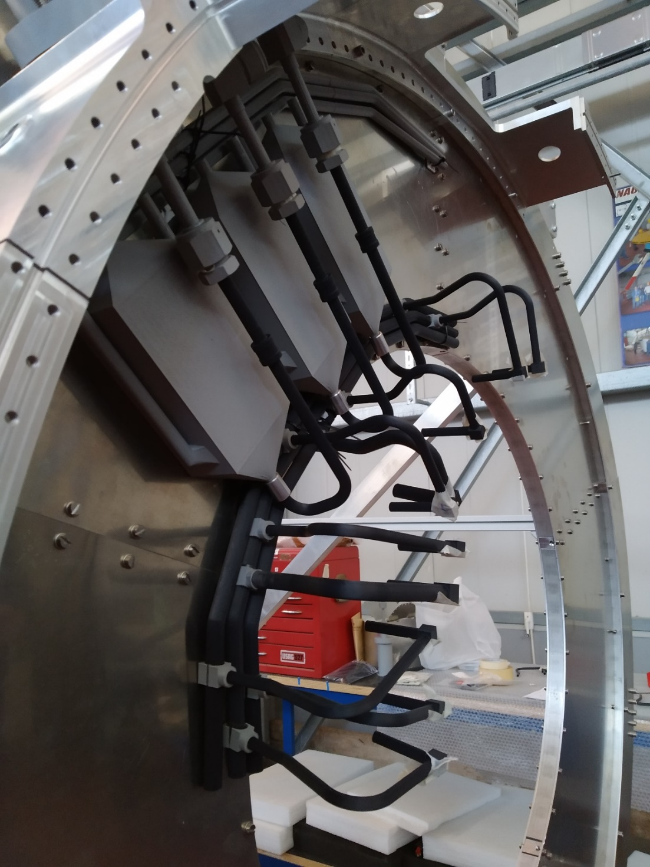

Slide 7
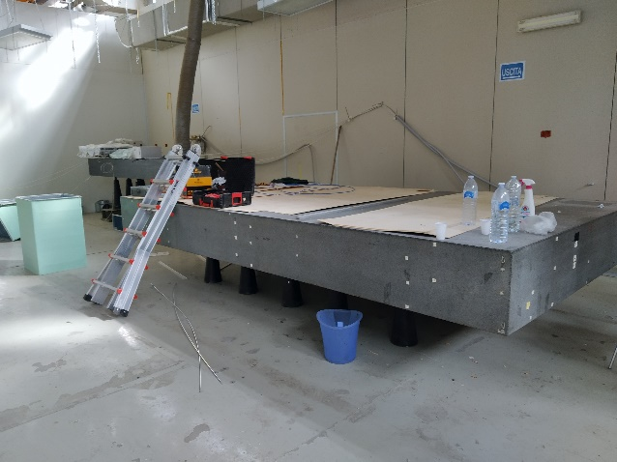
Organizzazione Camera Pulita definizione pianta e spostamento tavoli di granito

Slide 8
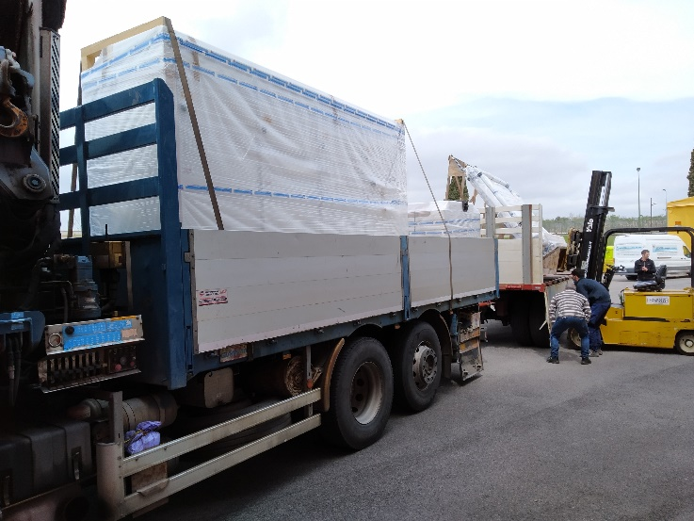
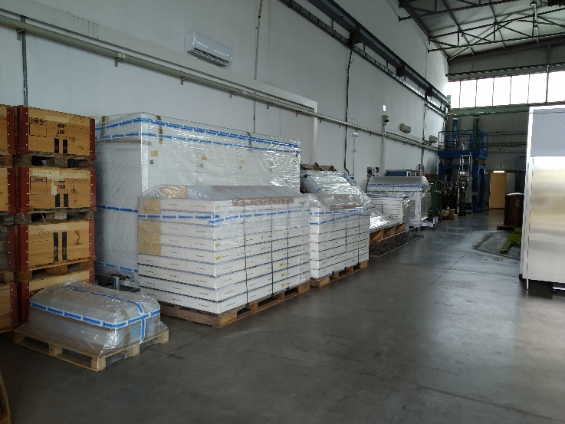
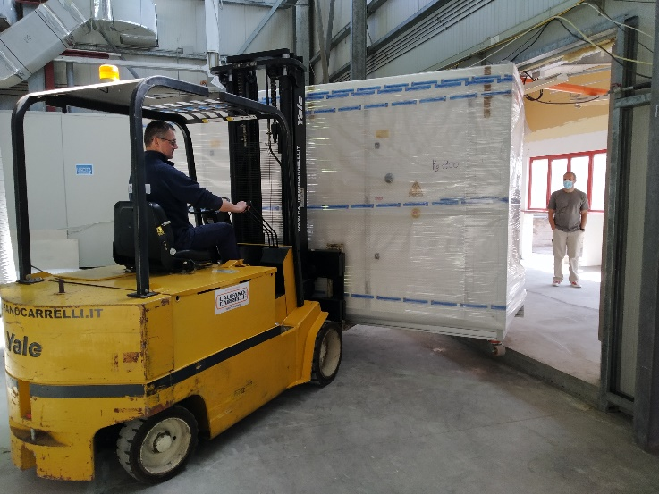
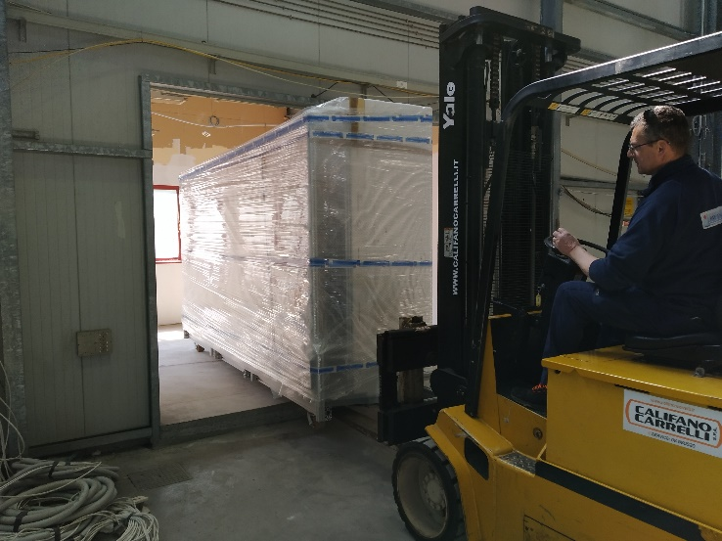
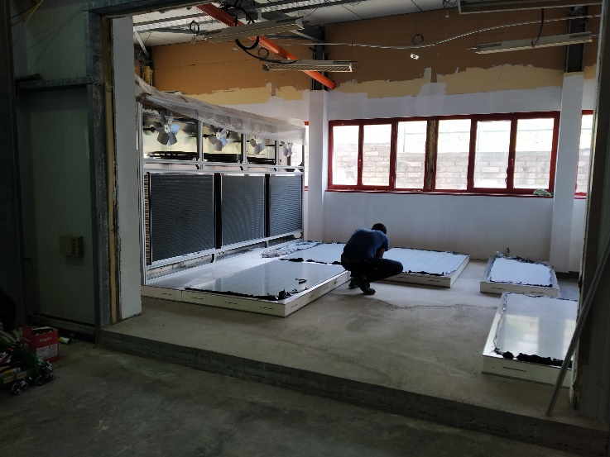
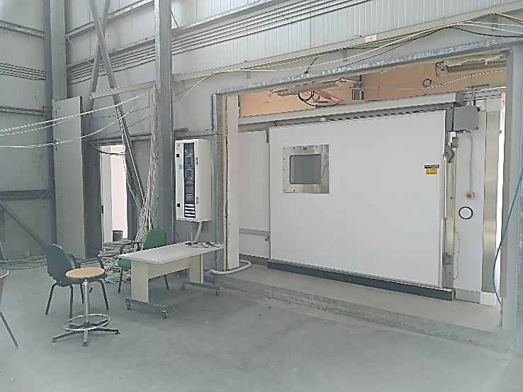
Camera Climatica Trasporto, stoccaggio, installazione e collaudo

Slide 9
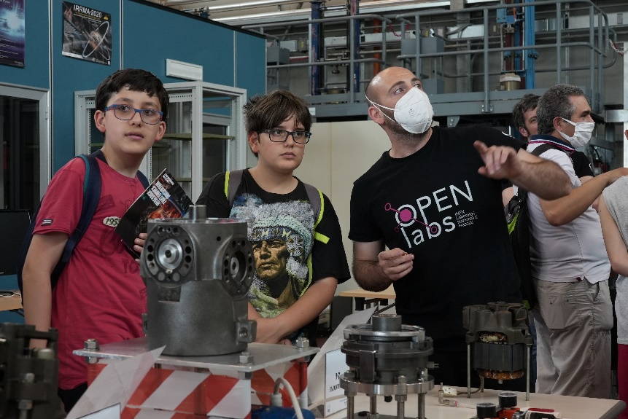
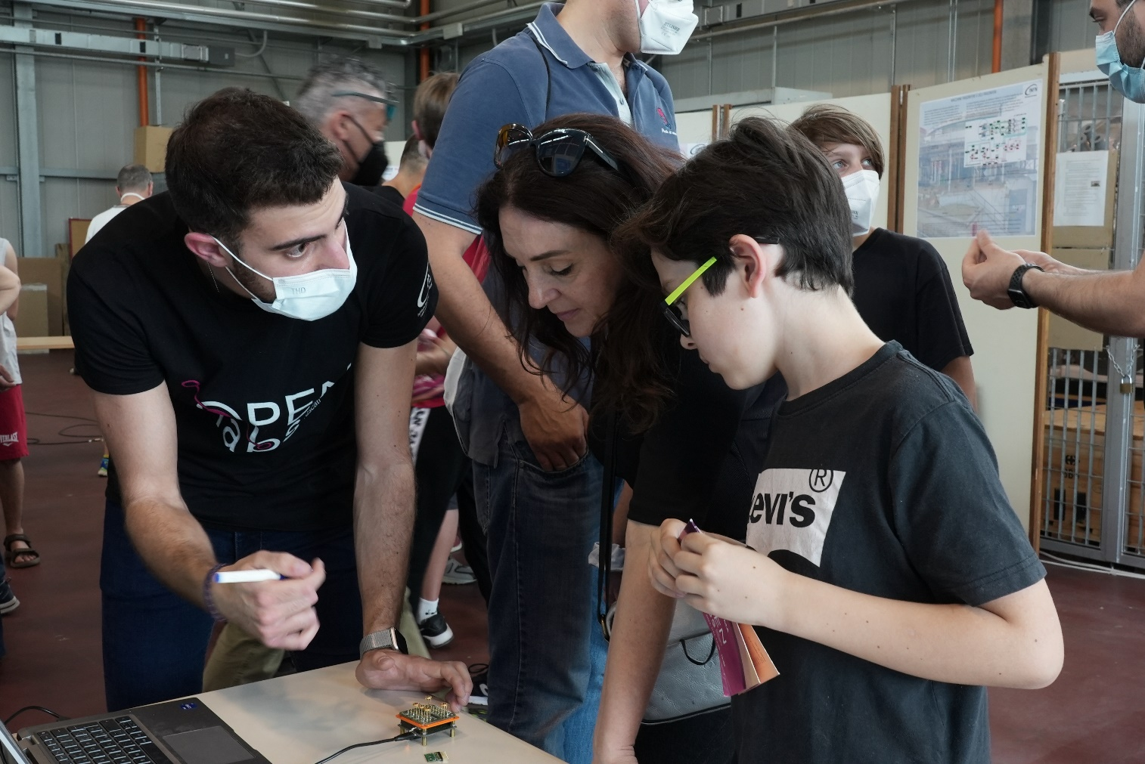
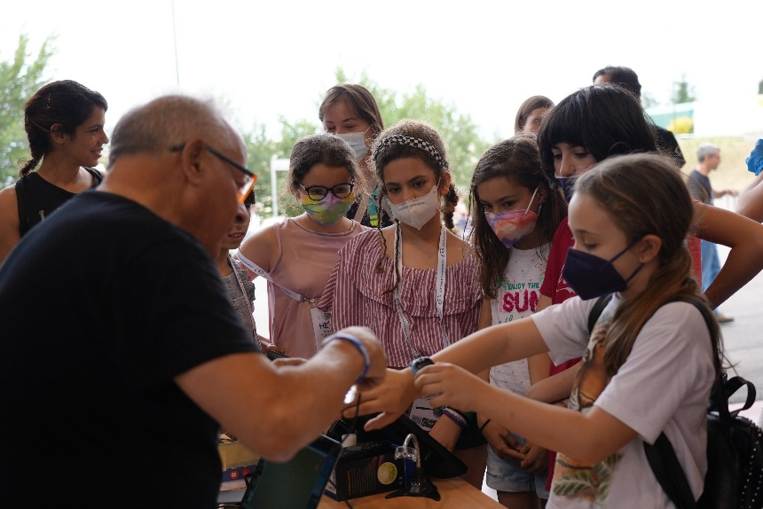
Organizzazione MakerLab 2022

