Slide 1

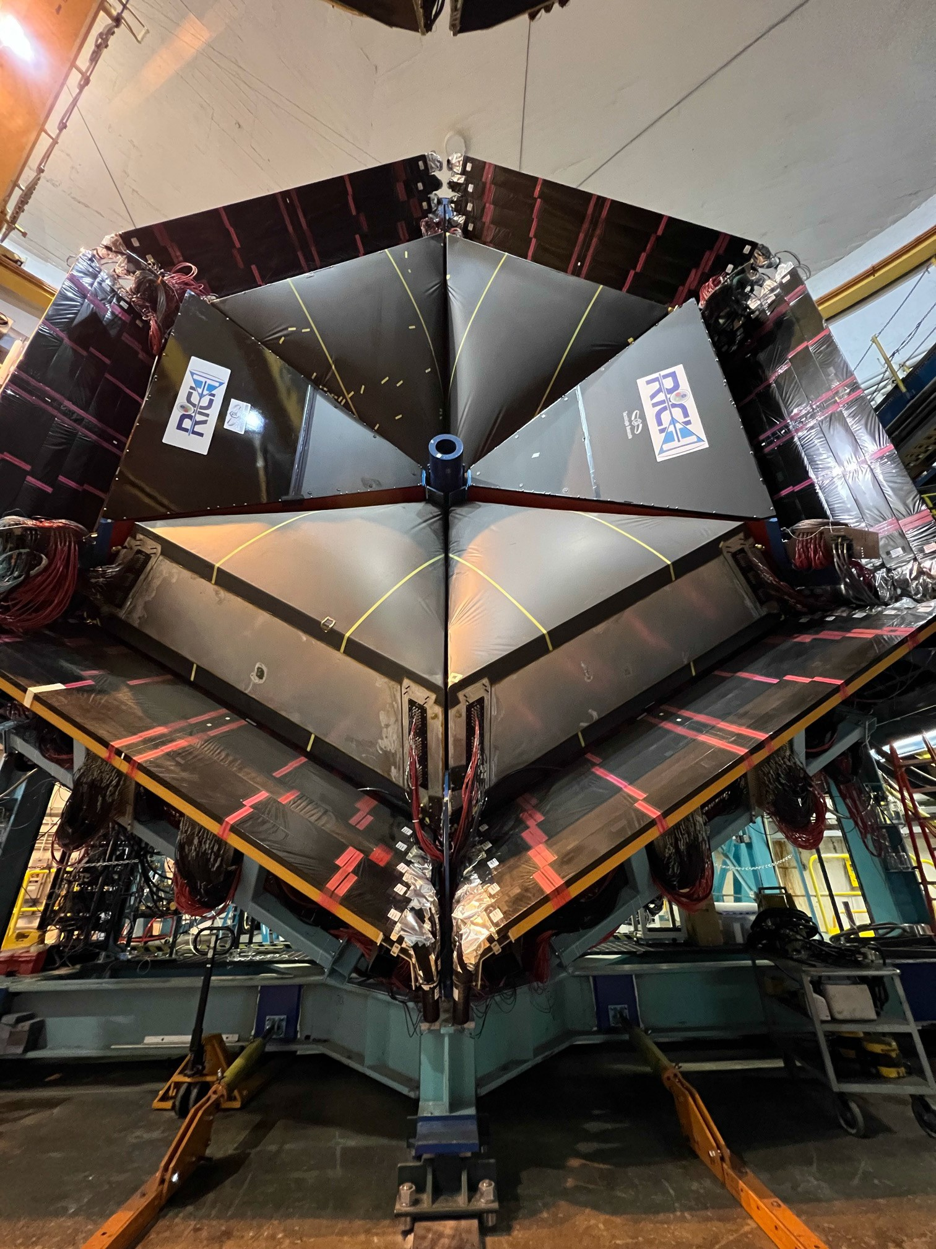


RICH Status Report
Valery Kubarovsky
Monday June 6, 2022 Hall-B meeting

Slide 2
RICH-II Installation and Commissioning
Tuesday. Detector was assembled in the EEL clean room
－Mechanical construction
－Electronic panel with 391 H12700 MaPMTs, home-made front-end electronics and DAQ boards
－Aerogel radiator
－Spherical mirrors
－Flat mirrors
Wednesday. RICH detector was moved to Hall-B
Thursday. RICH was installed to Forward Carriage
Friday. All cables are connected: HV, LV, DAQ fibers, slow control.
Saturday. Commissioning of the detector subsystems done.
INFN (Italy), ANL, and JLAB, with the help of fast electronics, detector support, and Hall-B engineering groups, completed the construction, installation, and commissioning of the second Ring Imaging Cherenkov (RICH-II) counter.

Slide 3
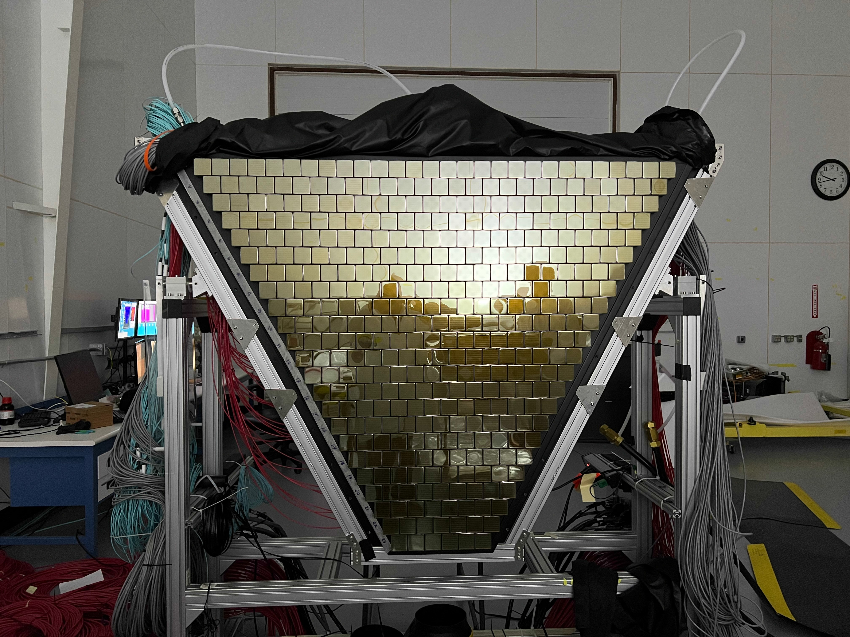
Electronic Panel: 391 H12700 MaPMTs

Slide 4
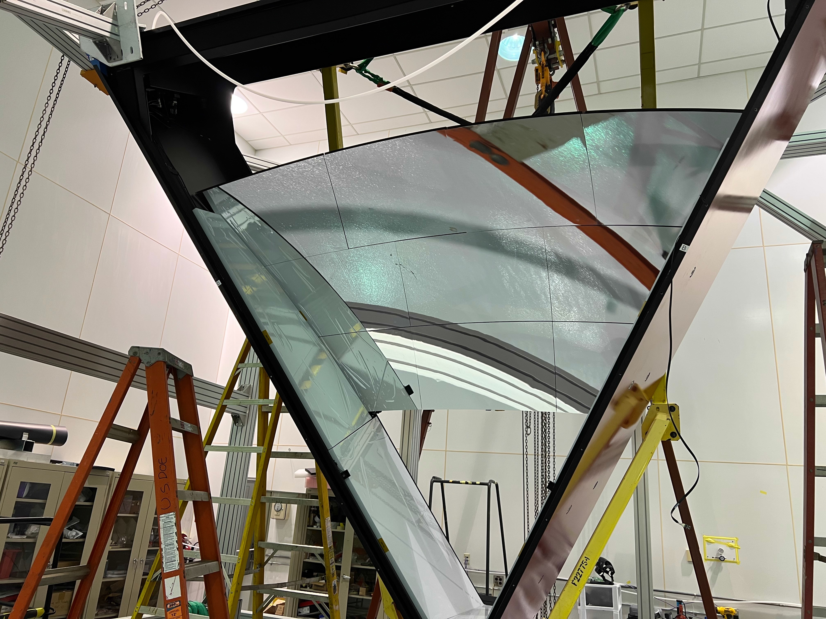
Installation and alignment of the spherical mirrors

Slide 5
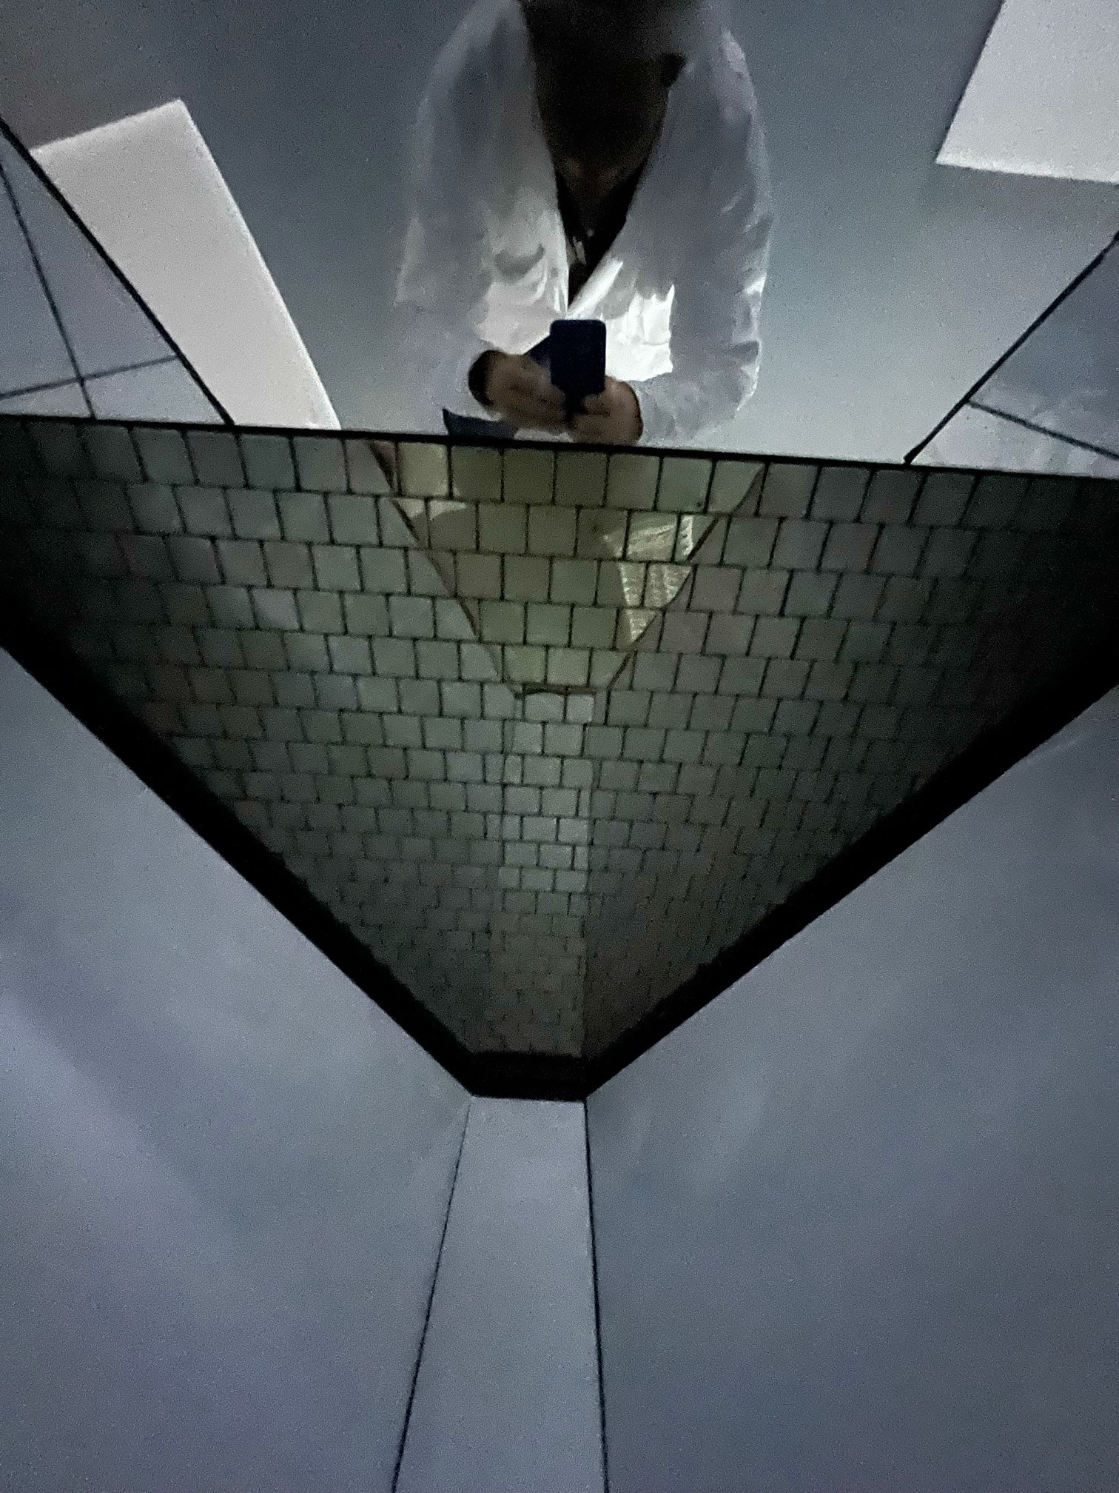
Photomatrix installation

Slide 6
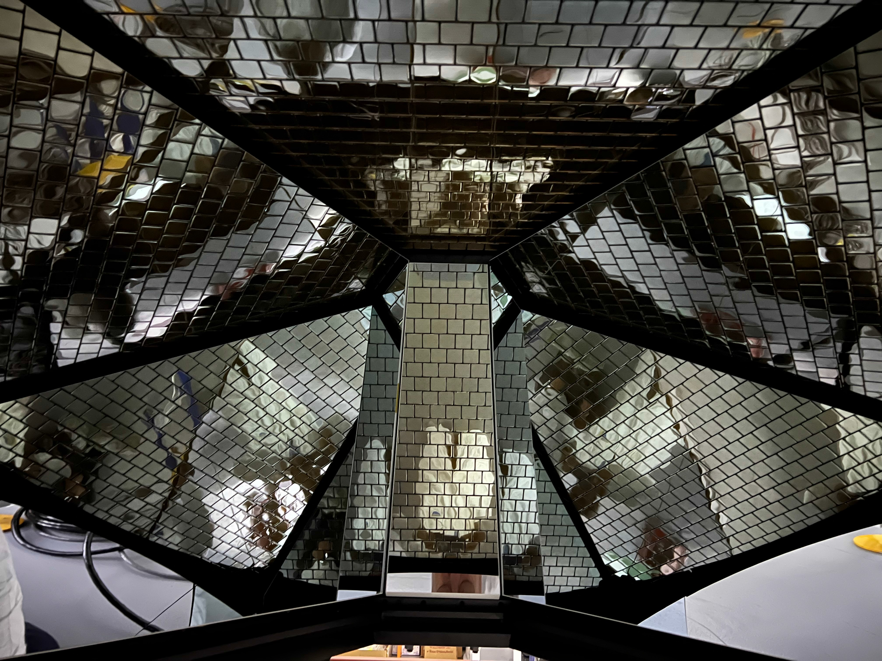
Inside the RICH detector

Slide 7
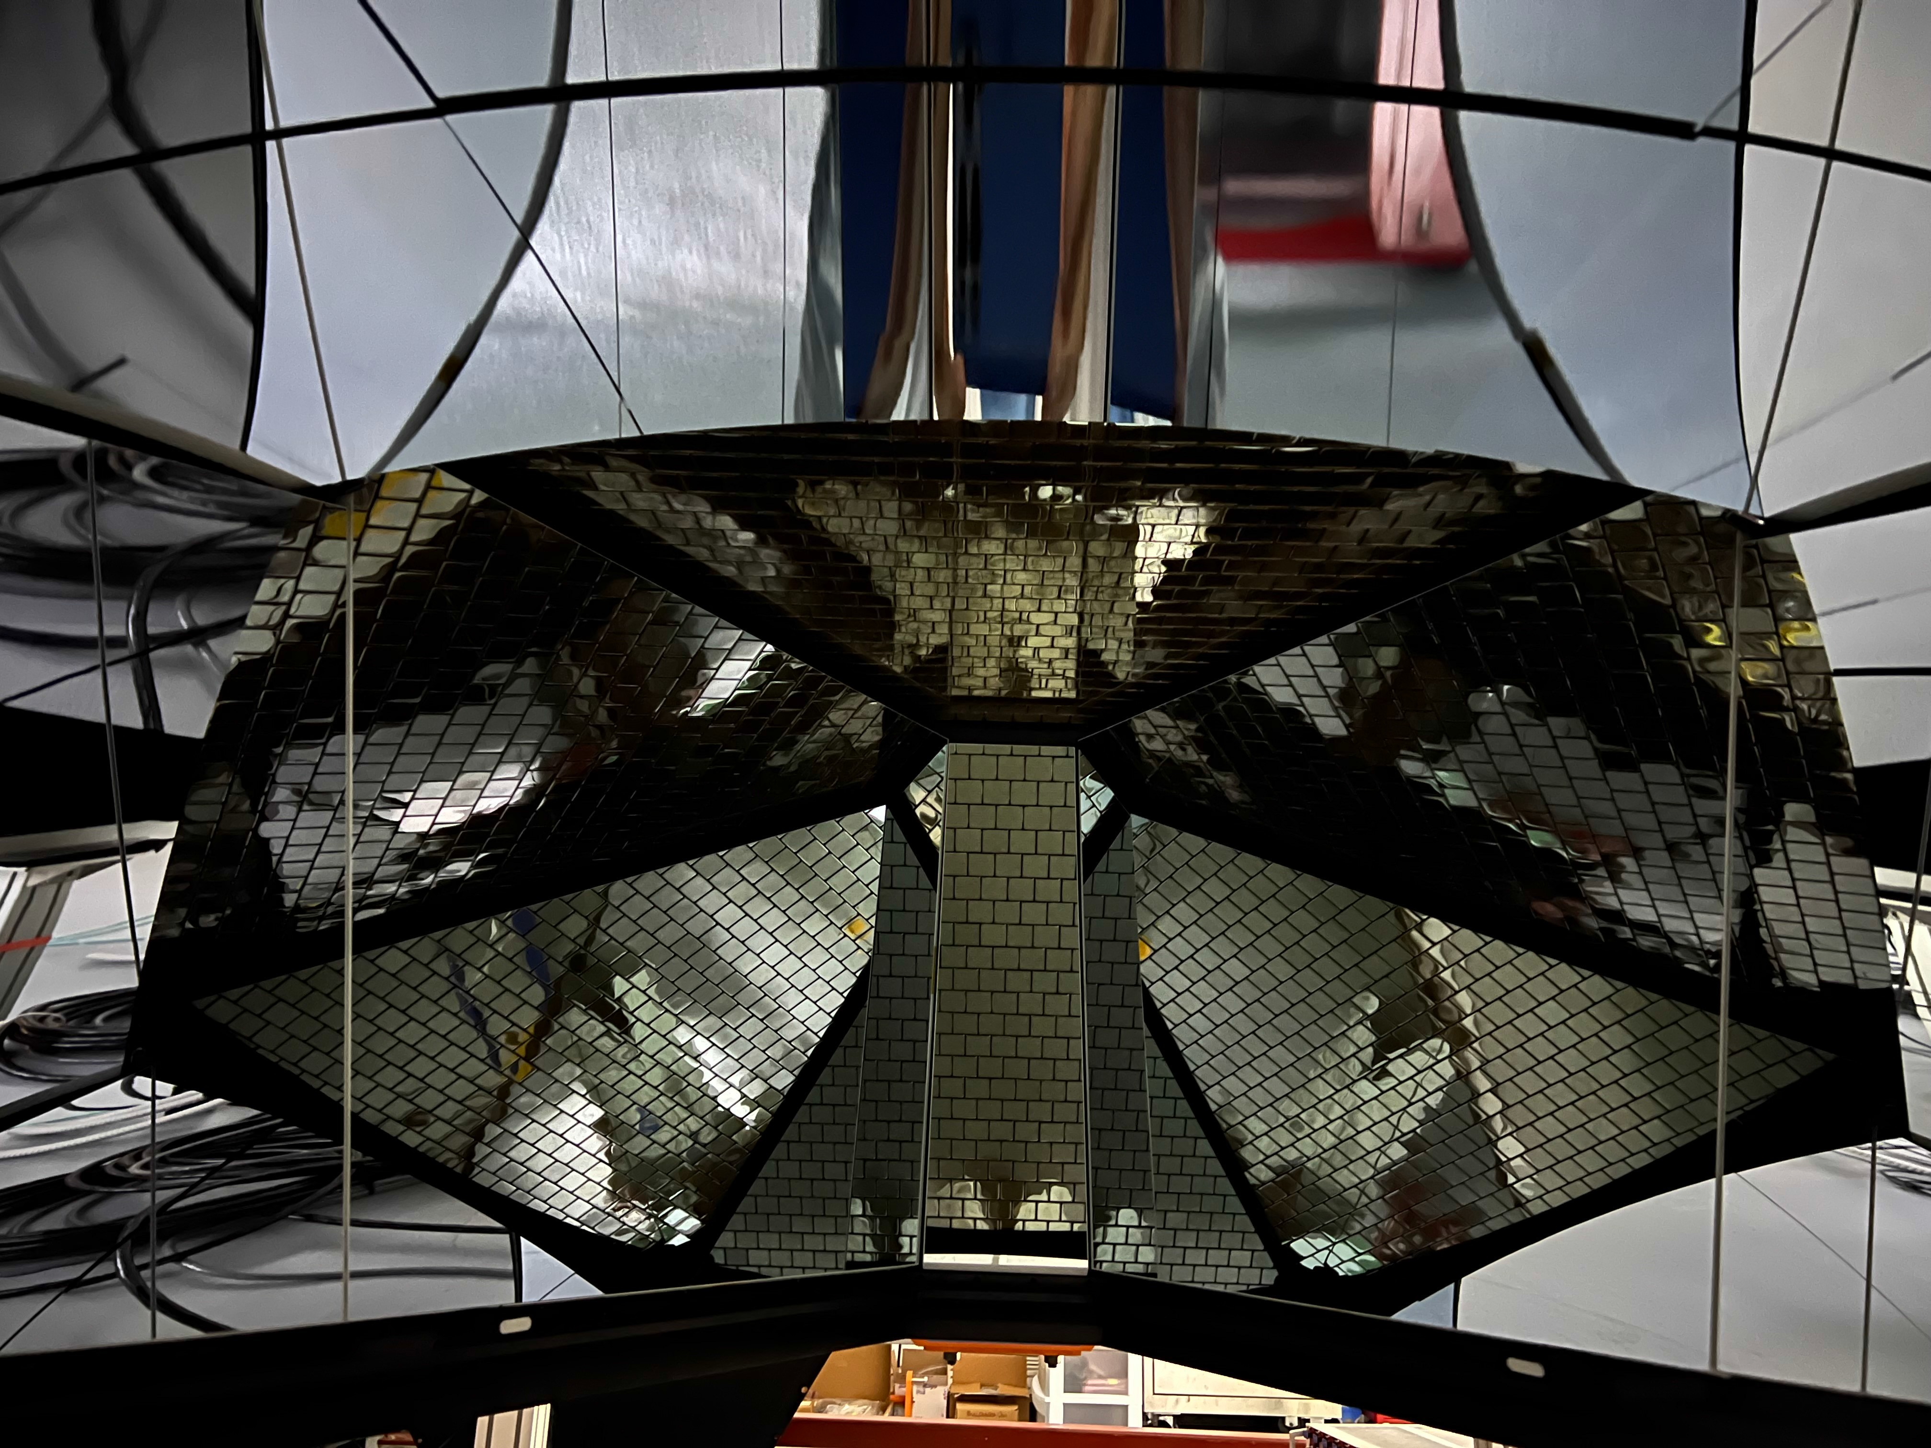
RICH from inside
7

Slide 8
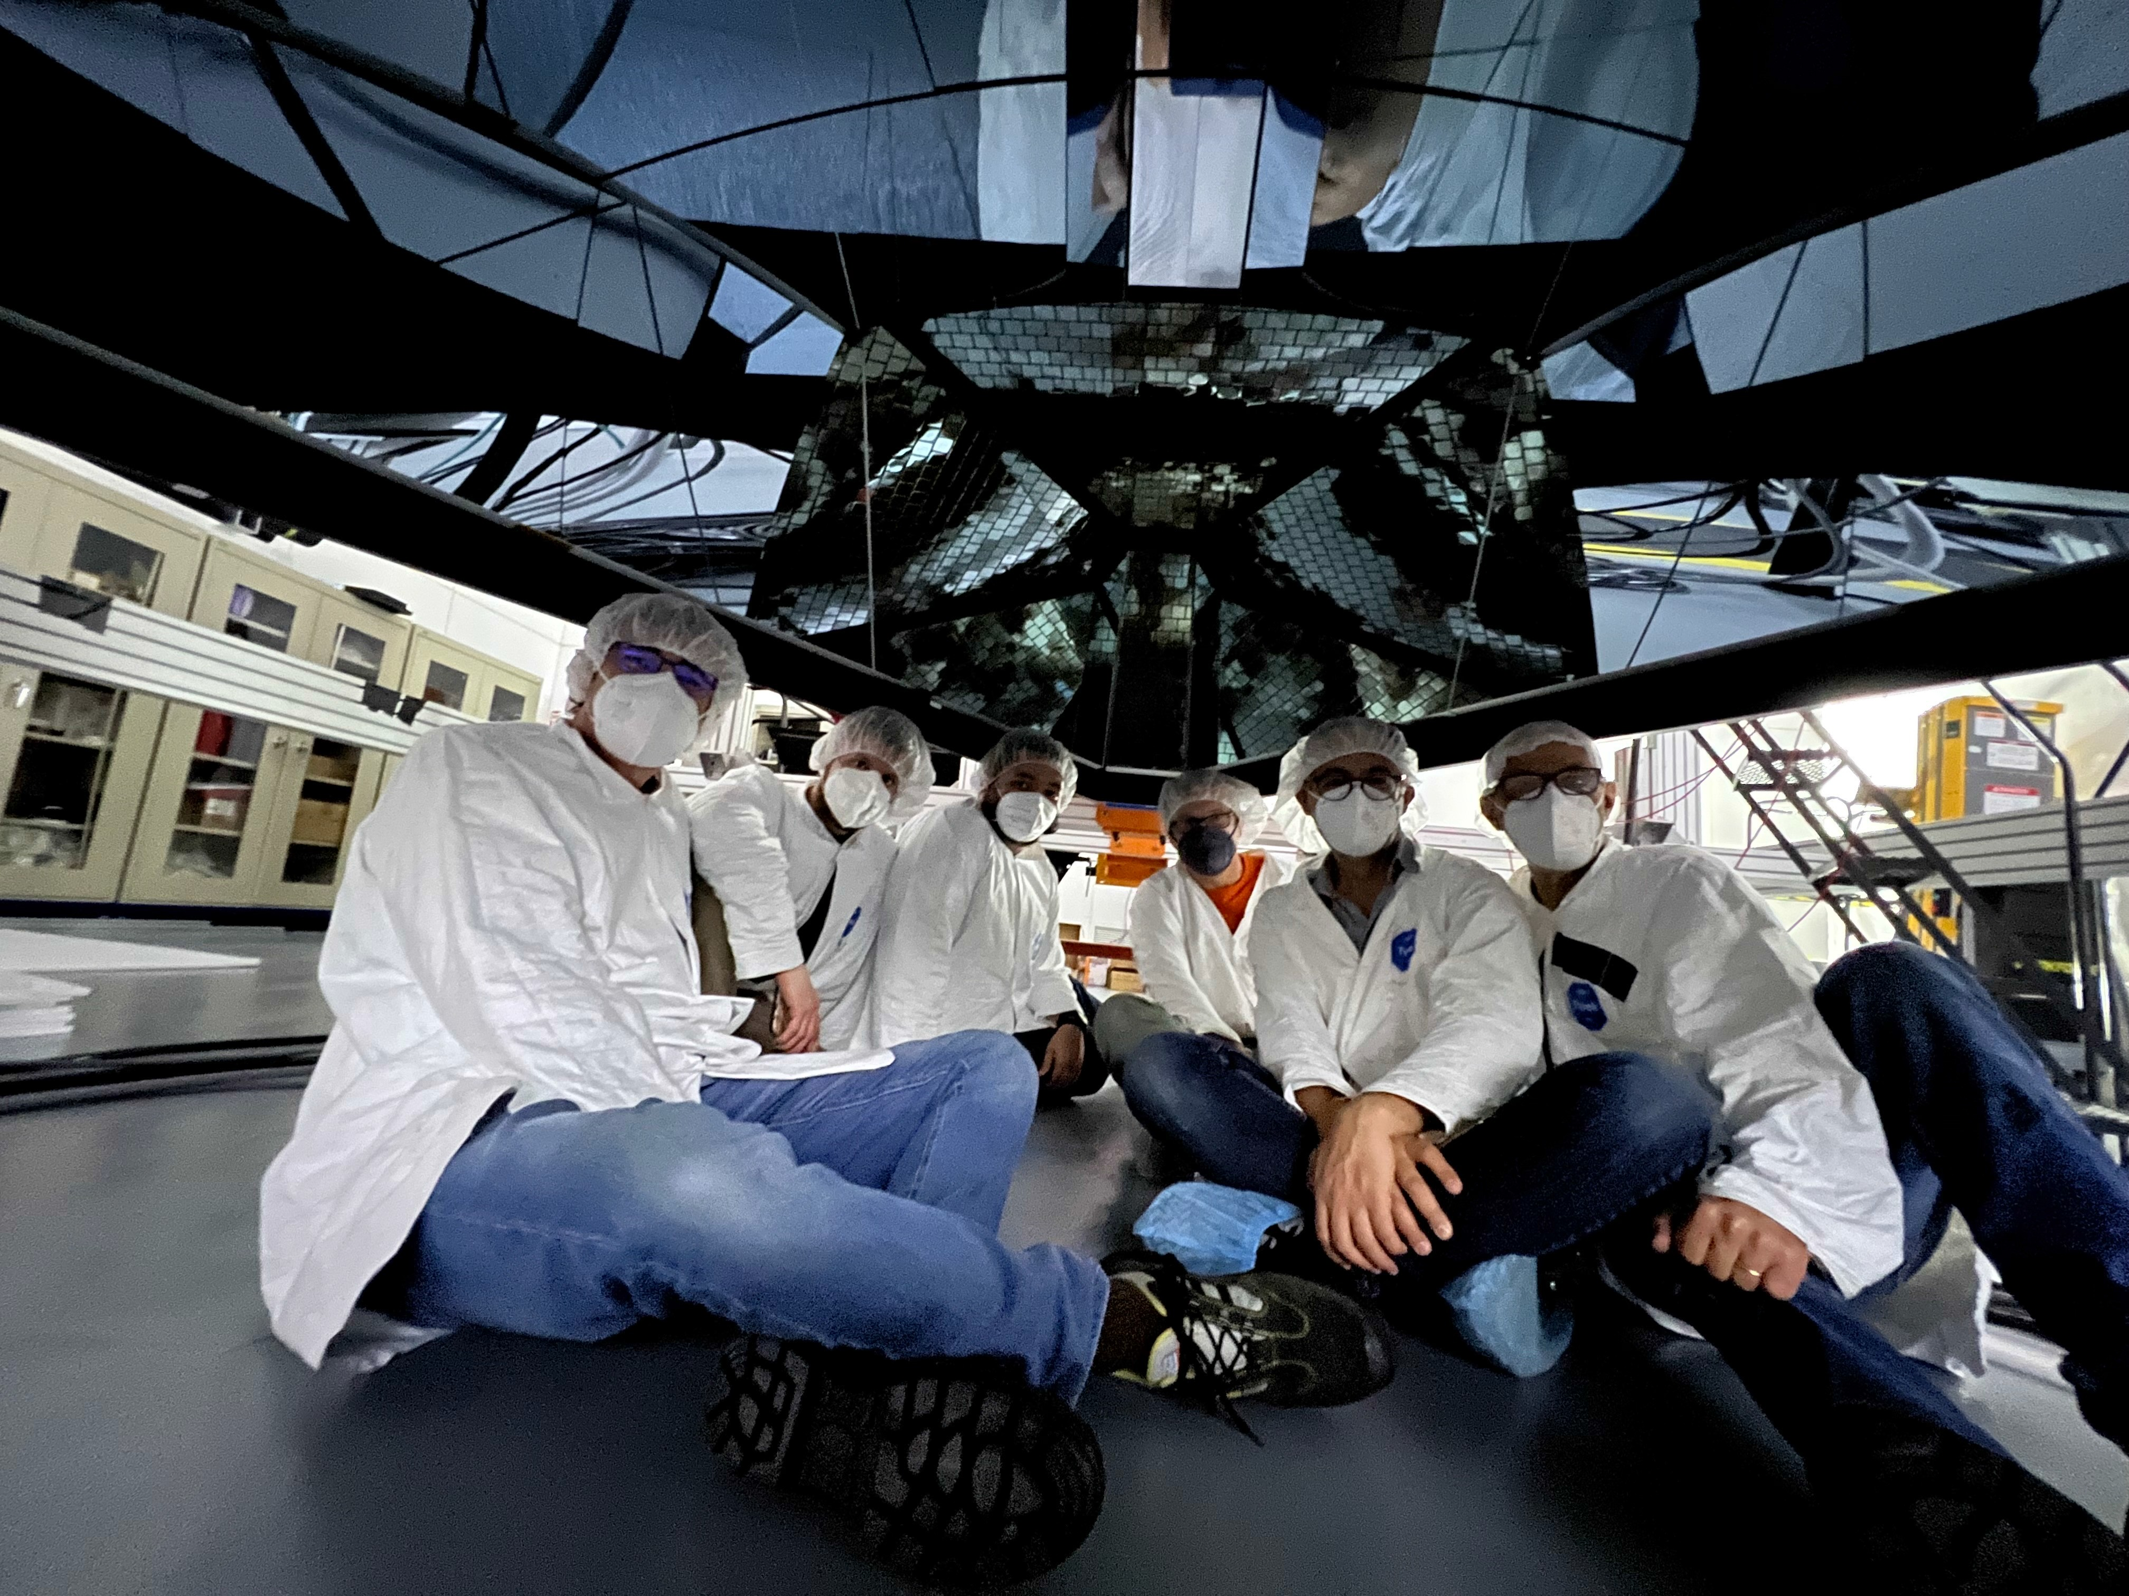
Italian team

Slide 9
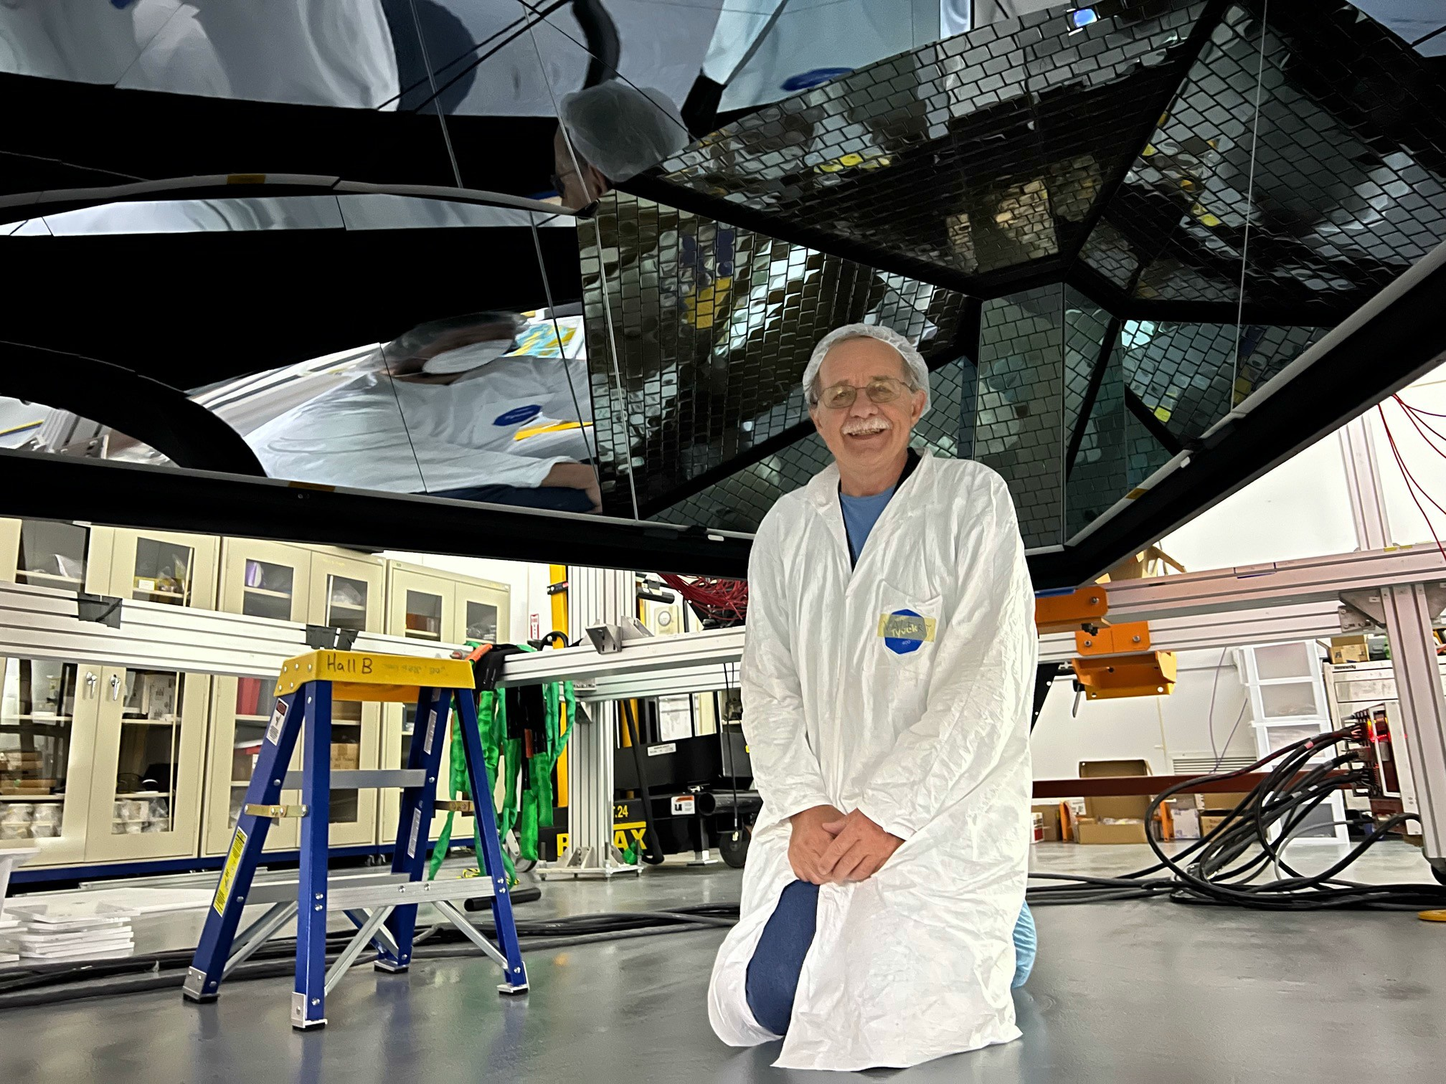
Still open from bottom side

Slide 10
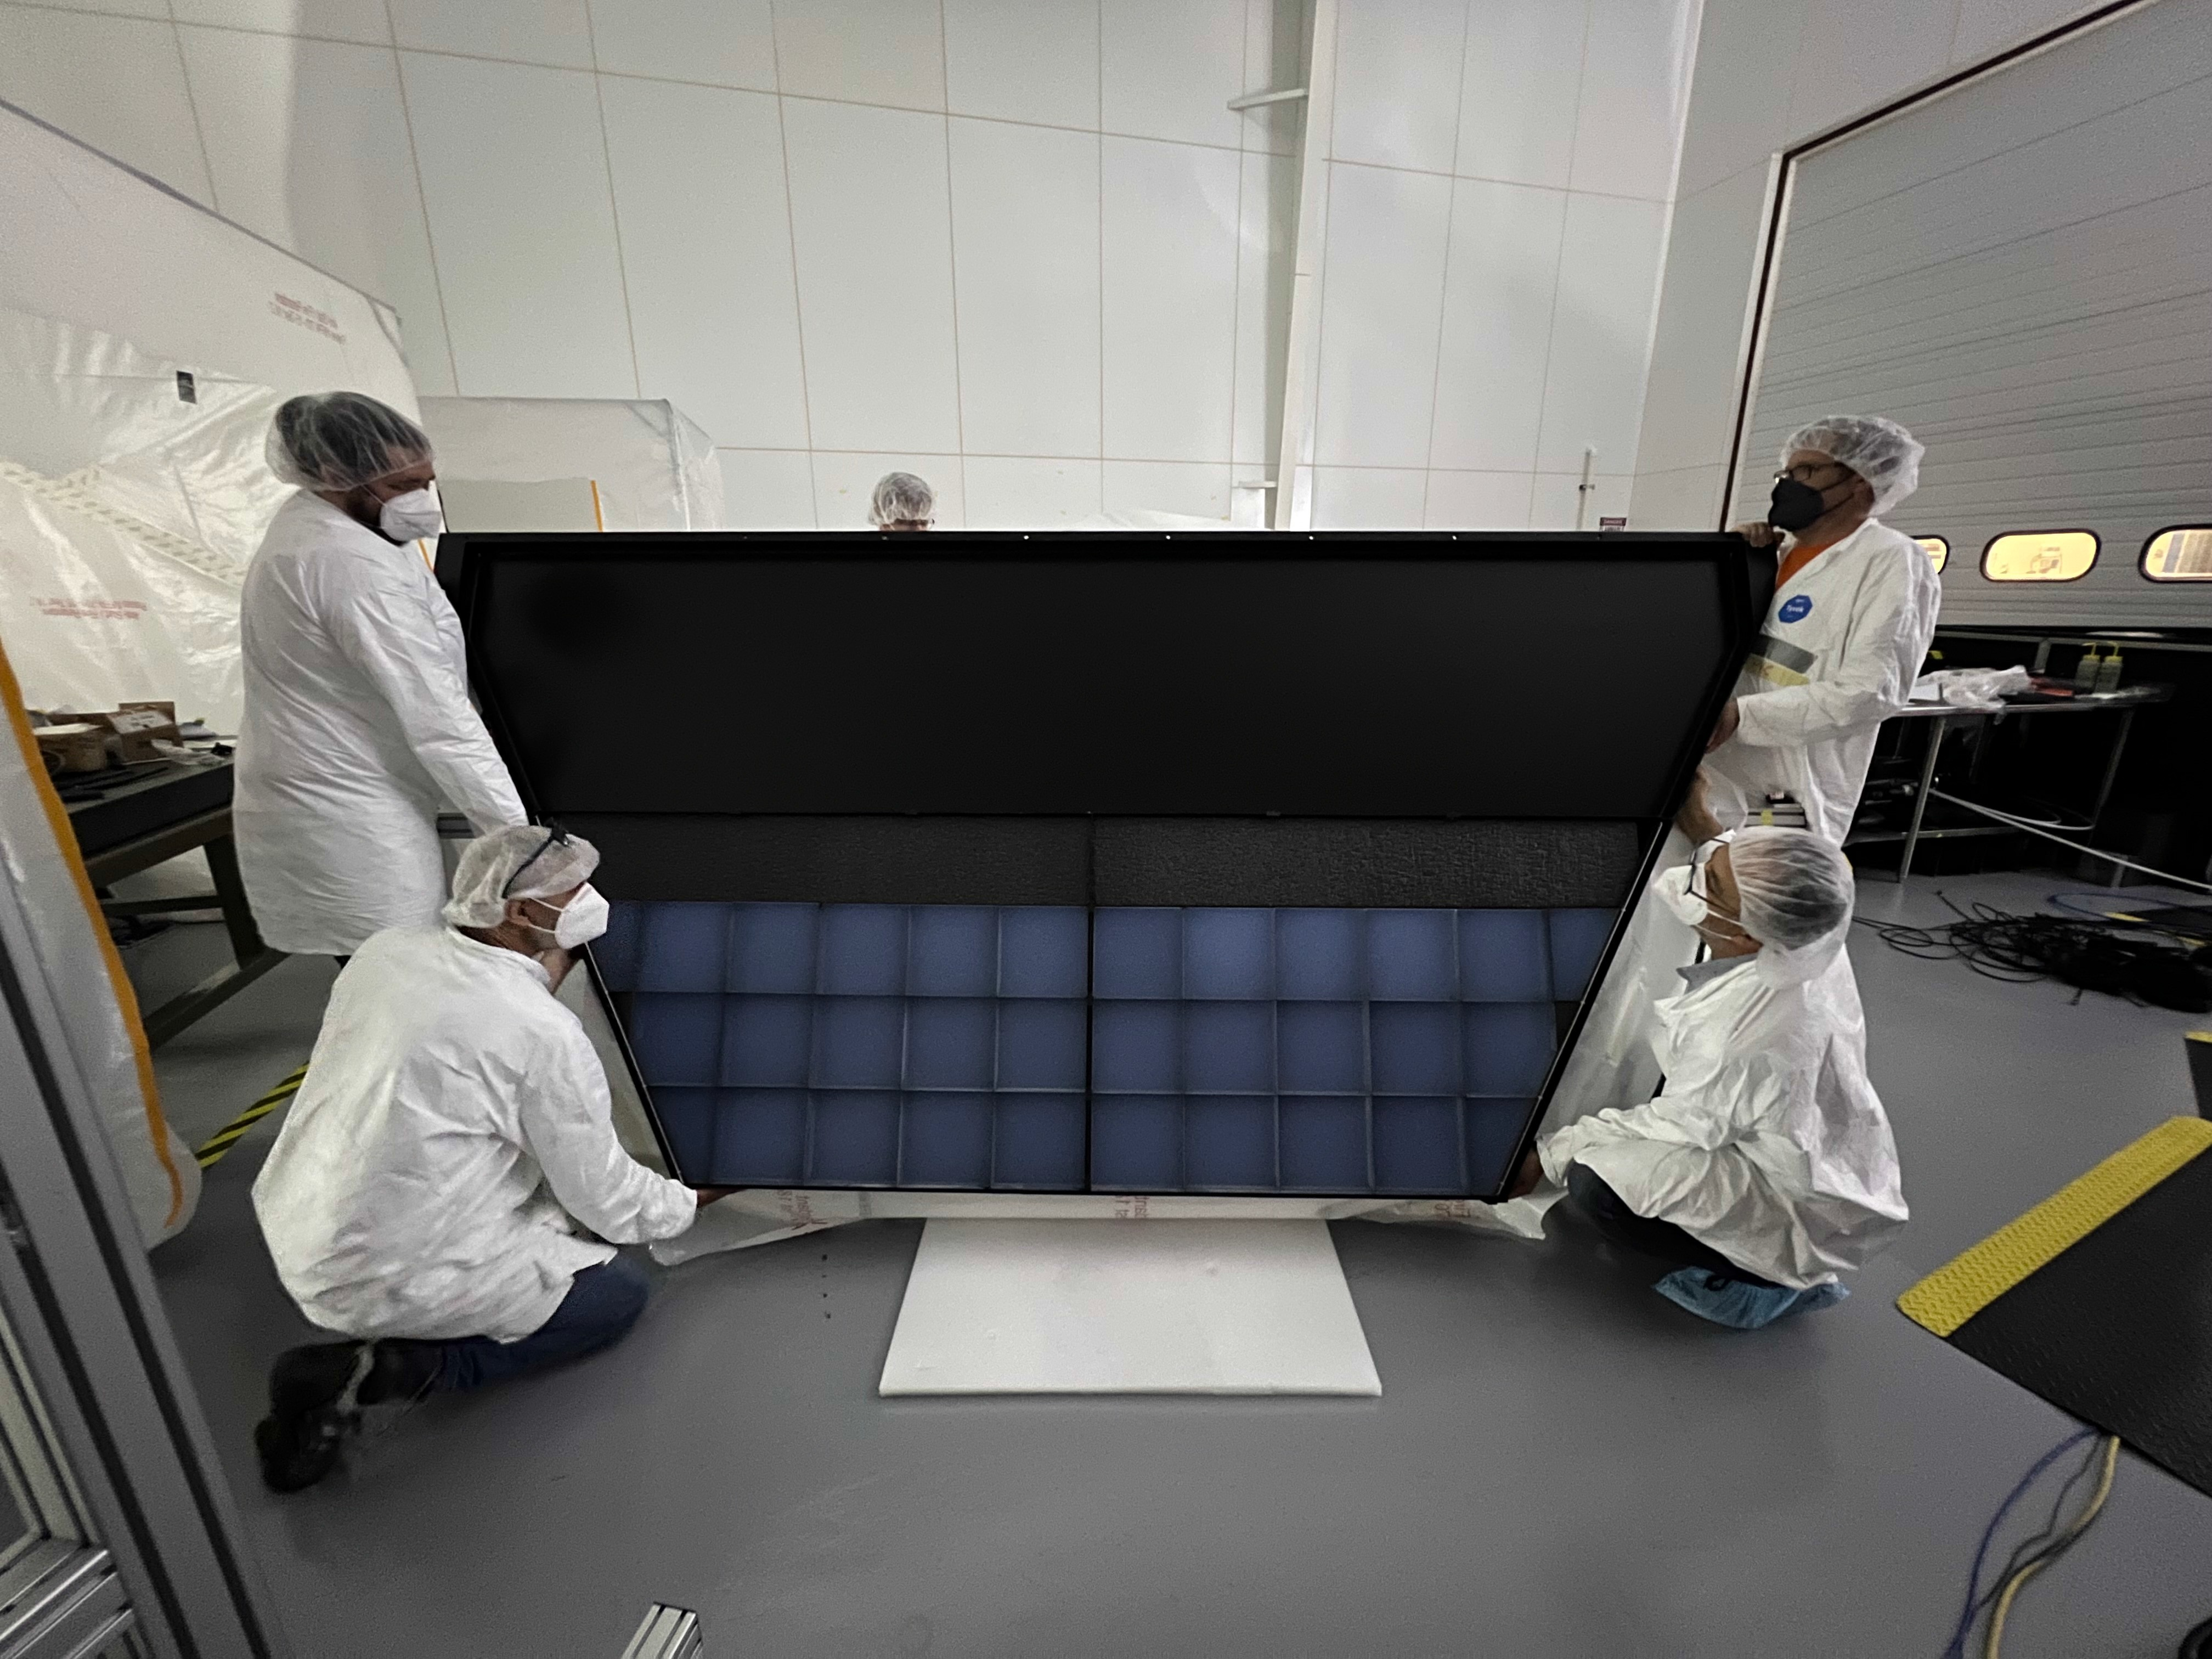
2x3 cm Aerogel wall
10

Slide 11
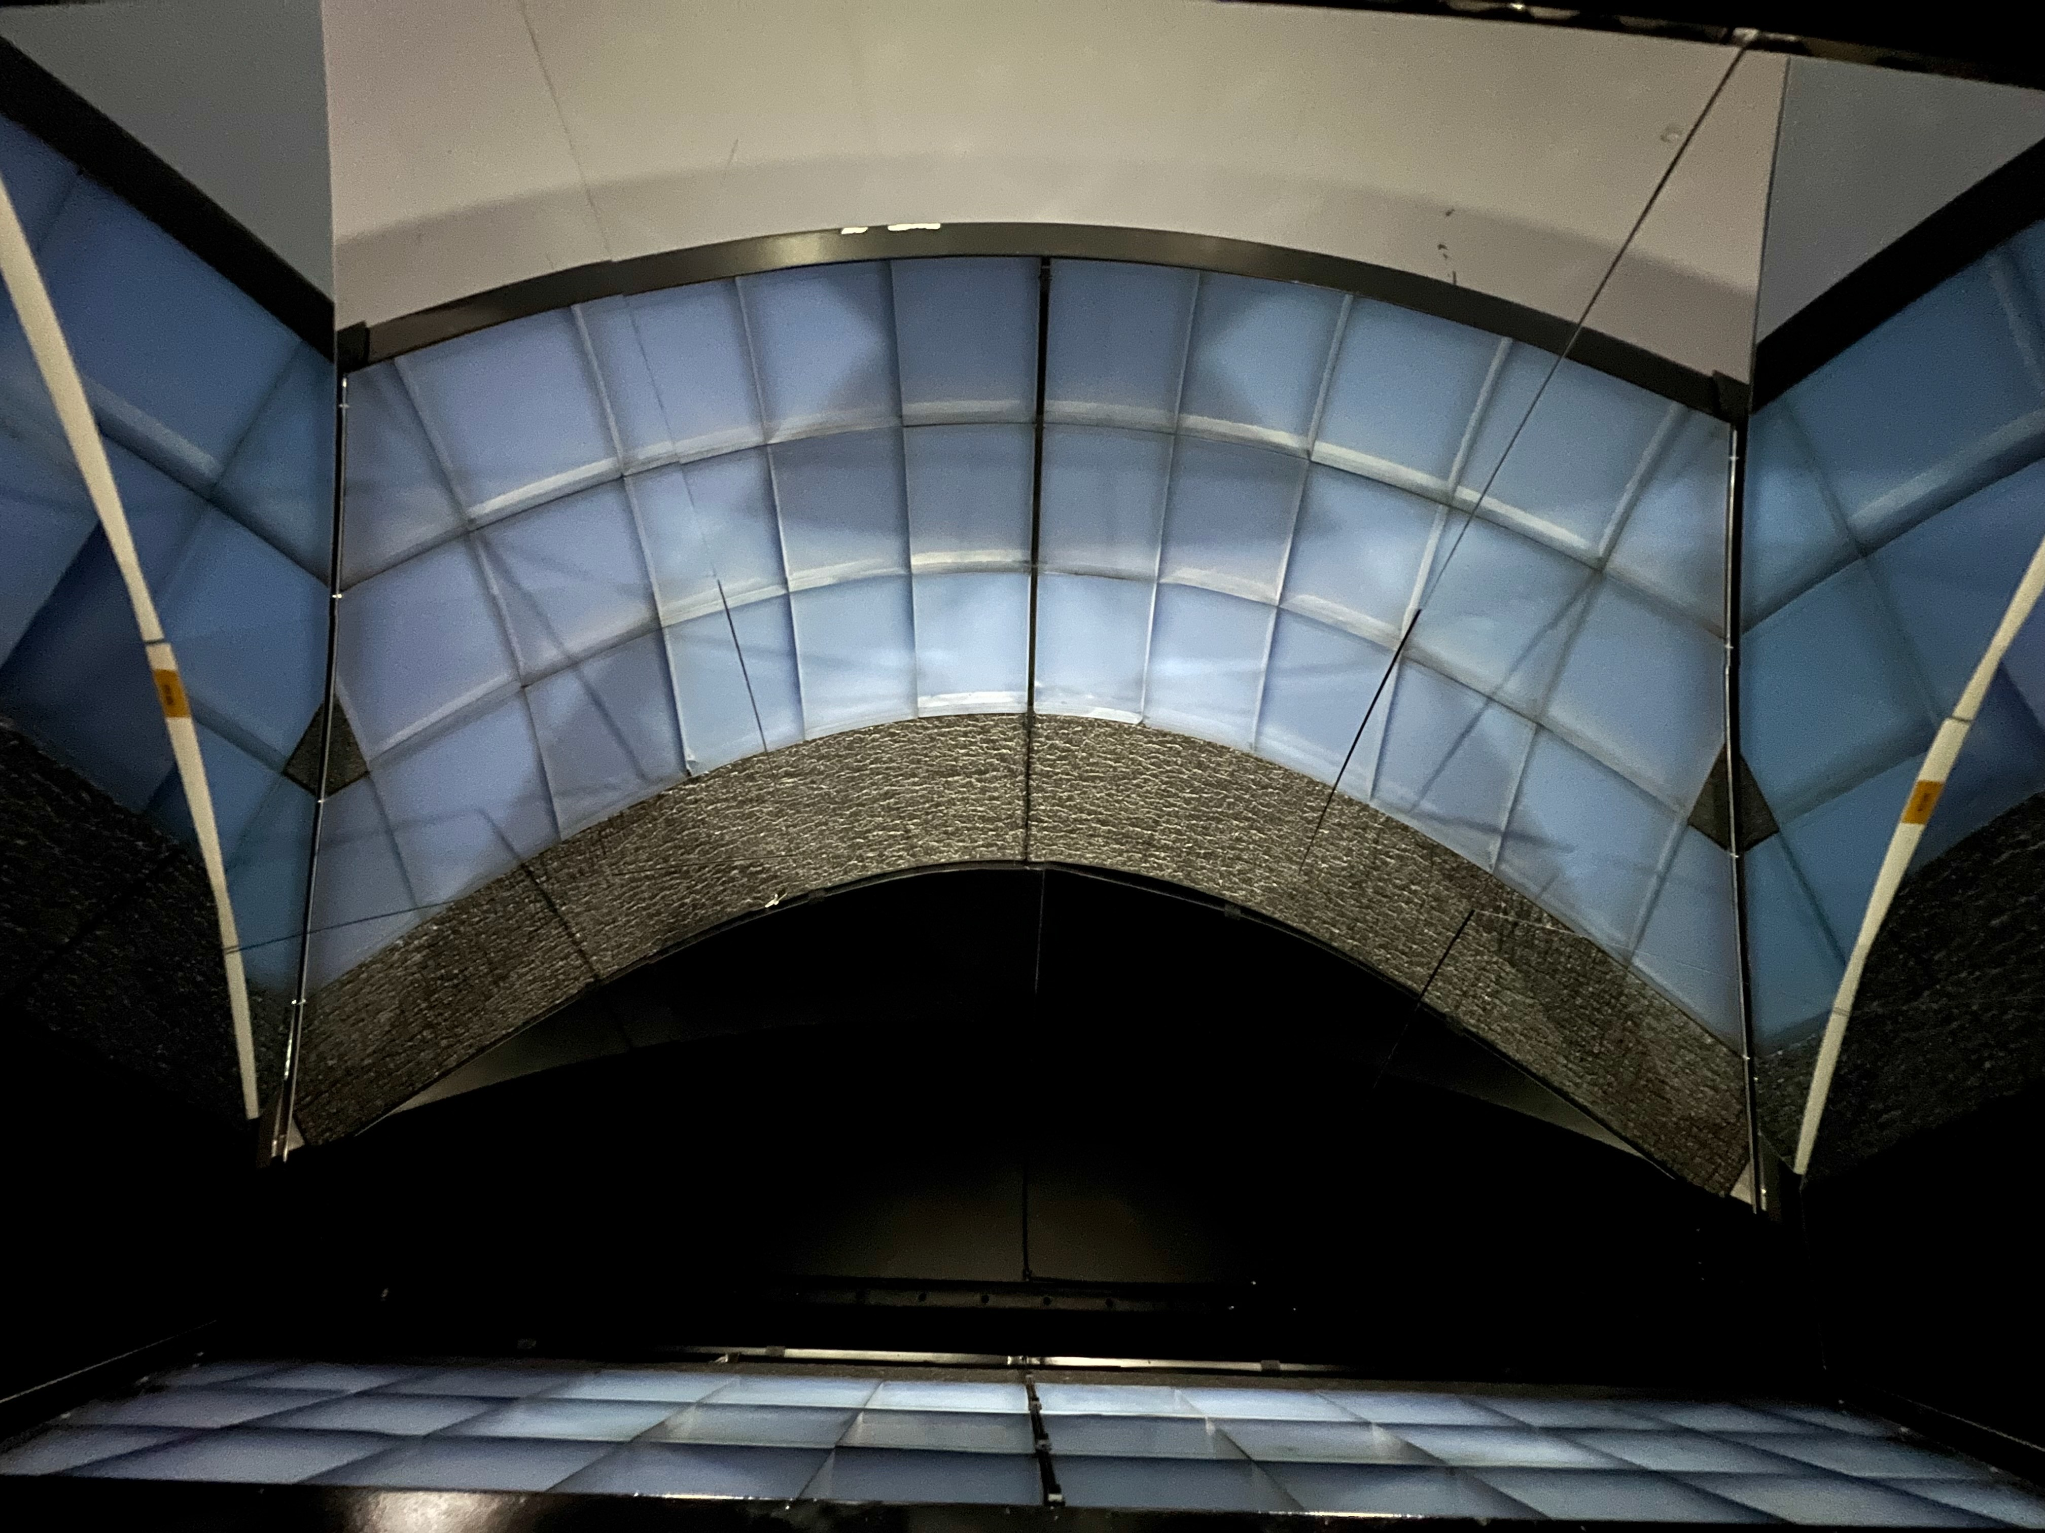
3 cm Aerogel wall installed
11

Slide 12
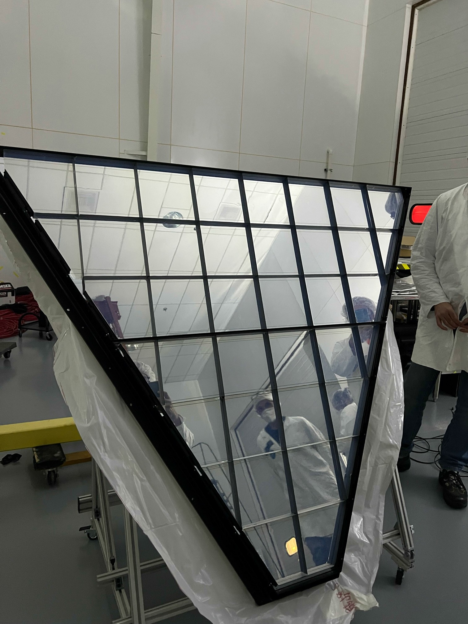
Aerogel Wall – 2 cm tiles
12

Slide 13
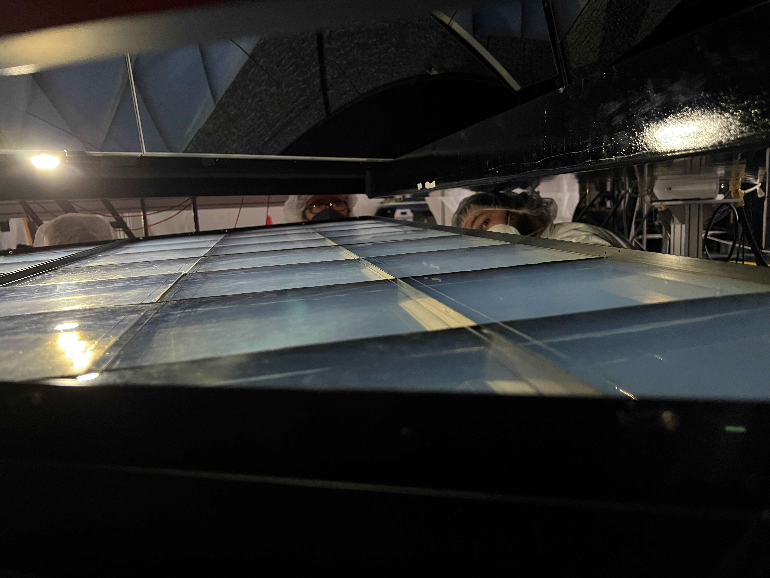
Last View Inside RICH

Slide 14
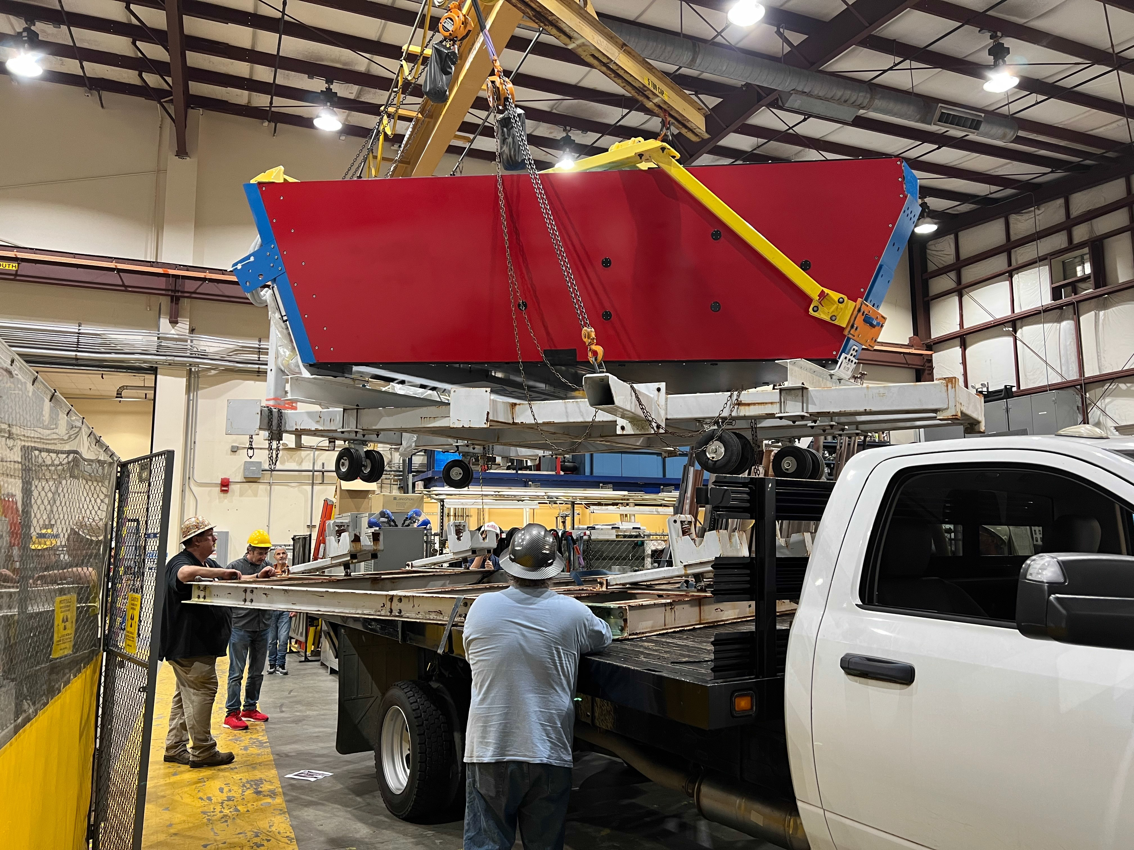
Load on Track

Slide 15
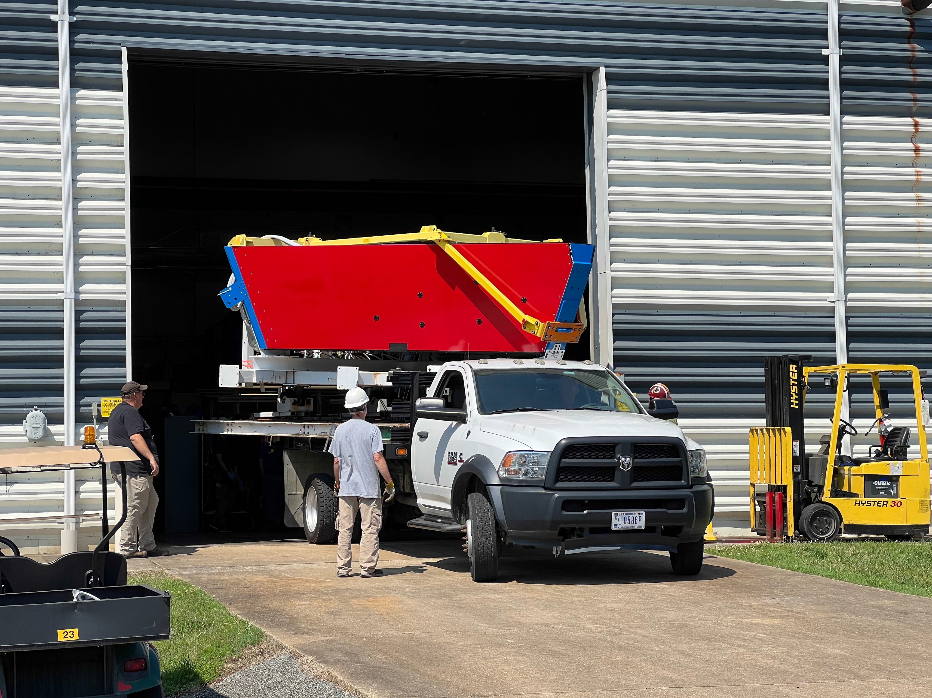
Go to Hall-B

Slide 16
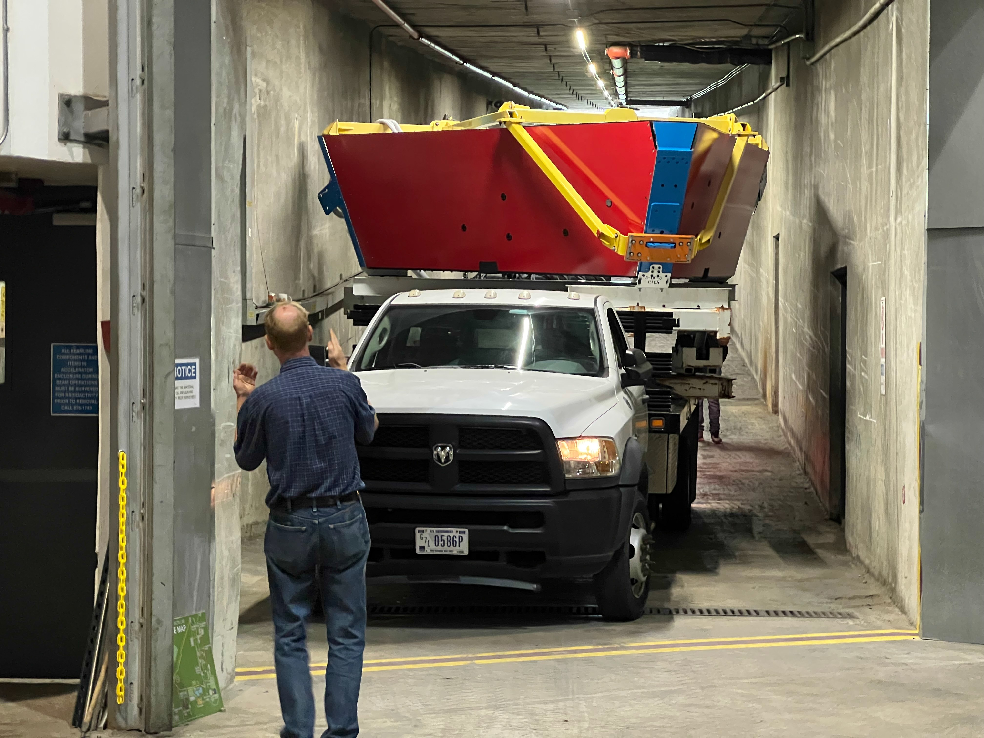
Tough Fit

Slide 17
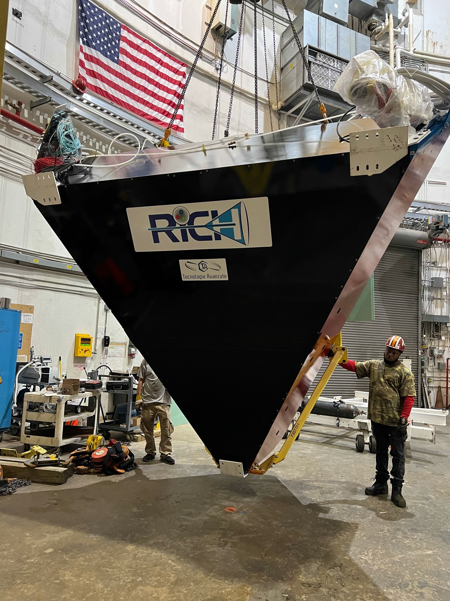
In Hall-B

Slide 18
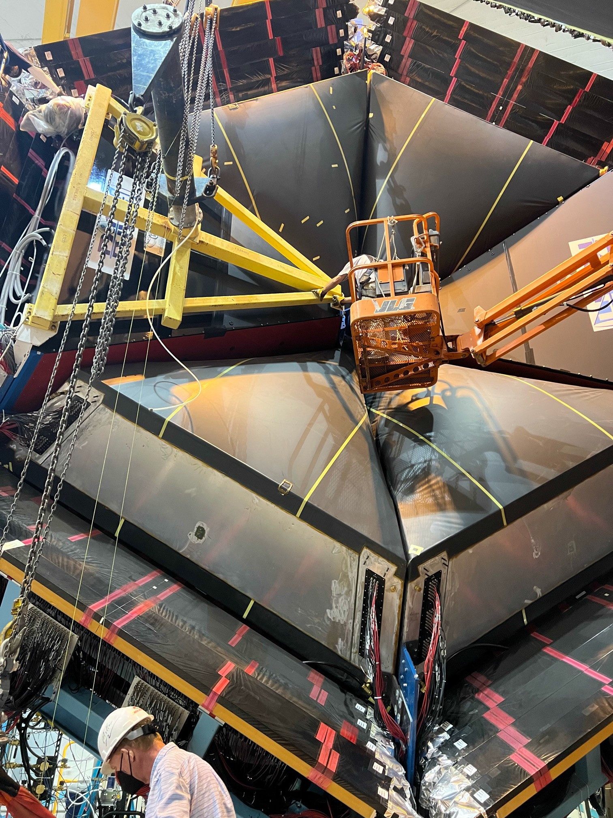
Final installation moment

Slide 19
RICH-I and RICH-II are in place

Slide 20
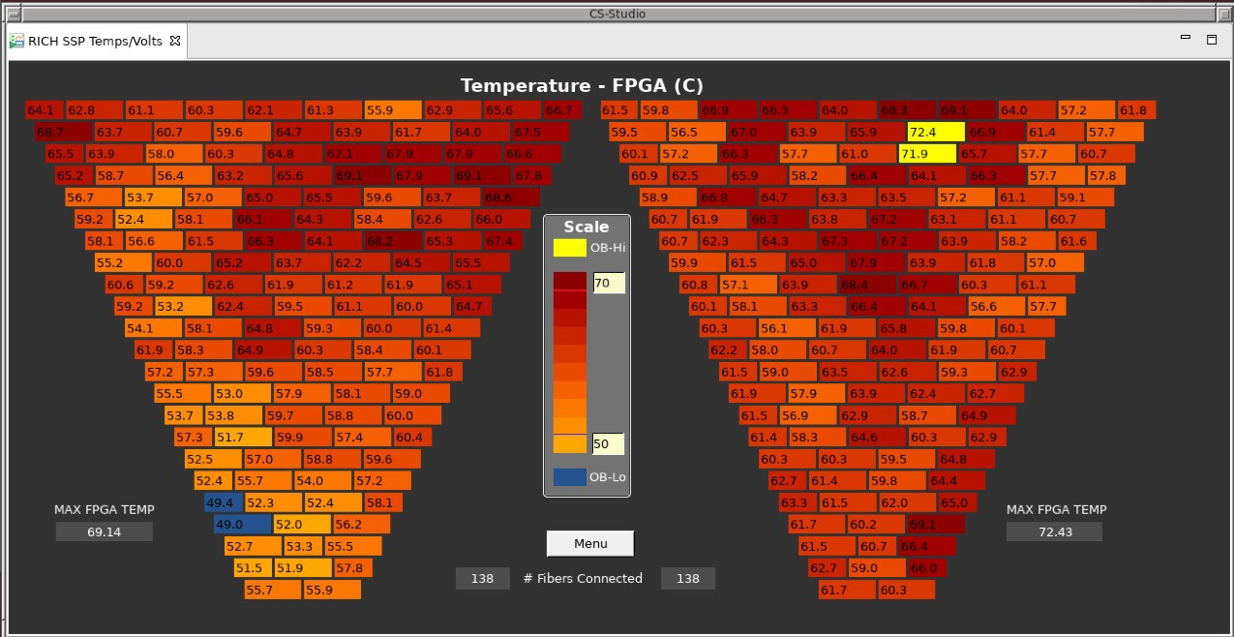
Two RICH Detectors: temperature
RICH1 – 138 tiles
RICH1I – 138 tiles
20

Slide 21
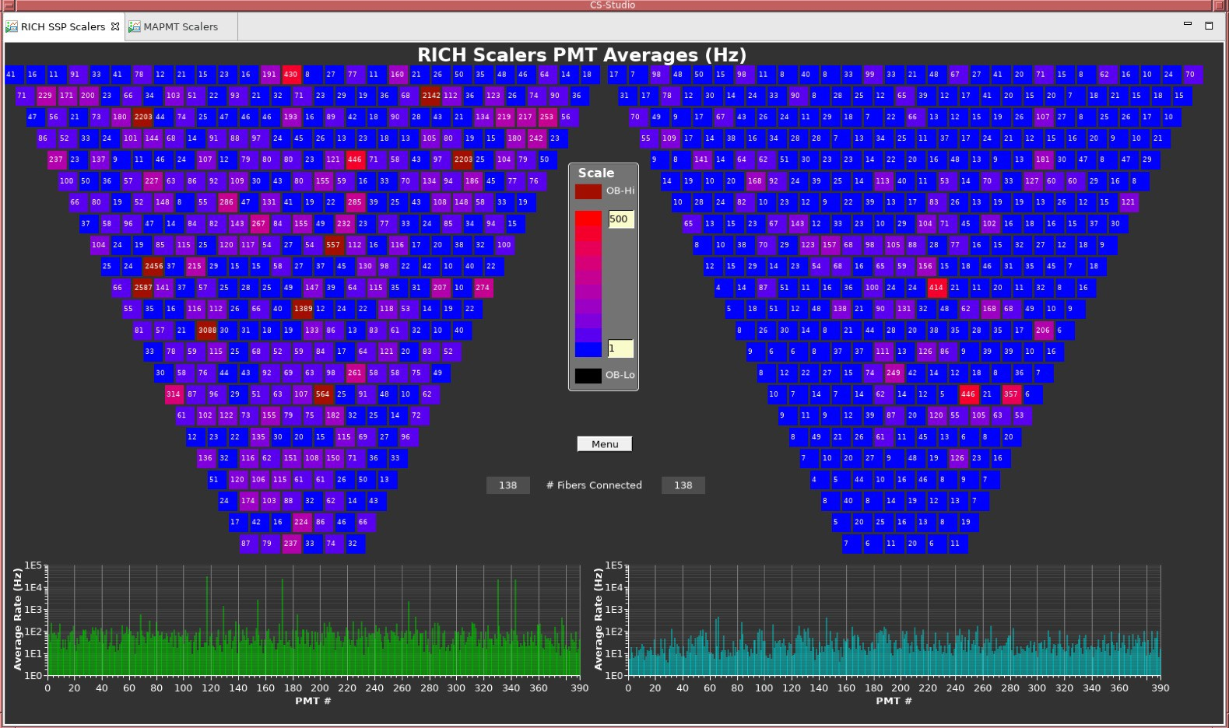
Two RICH Detectors – 50,048 channels
RICH1 - 391 H12700 MaPMTs: 25,024 channels
RICH1I - 391 H12700 MaPMTs: 25,024 channels
21

