Slide 1


SEM Meeting
INFN-LNF
Filippo Rosatelli
06/06/2022

Slide 2

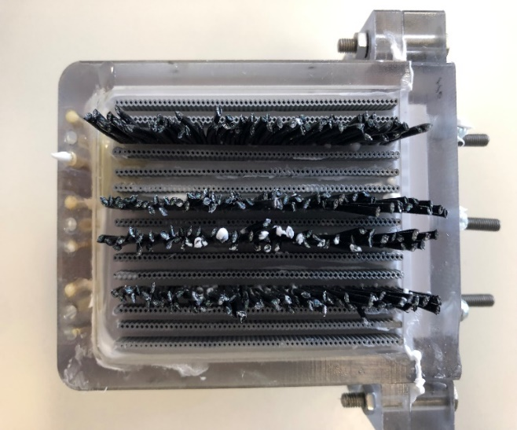
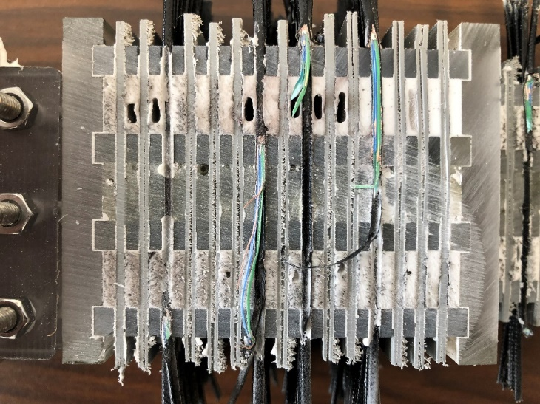
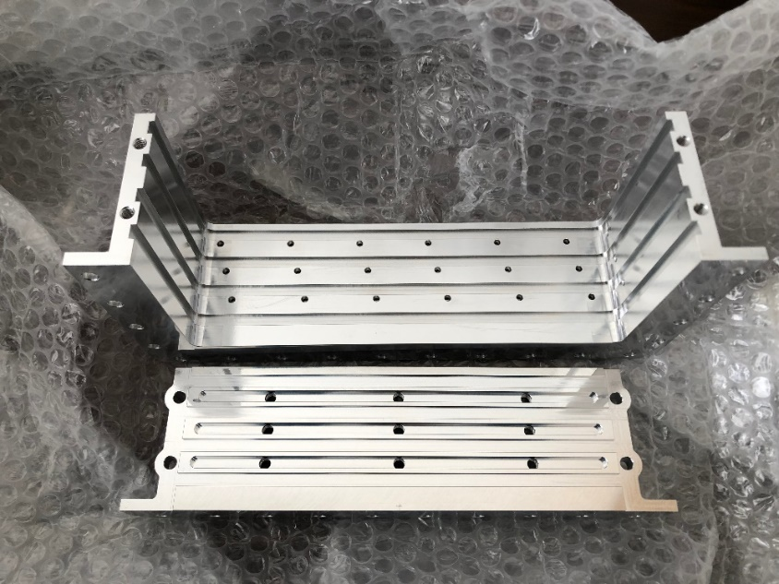
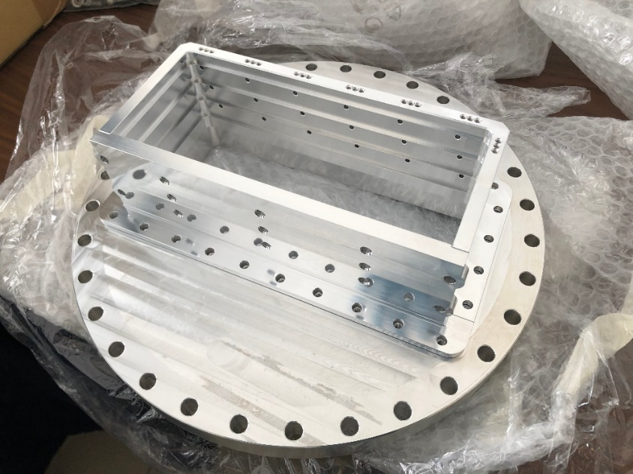
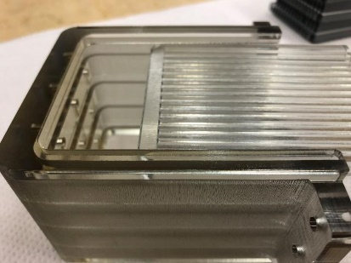
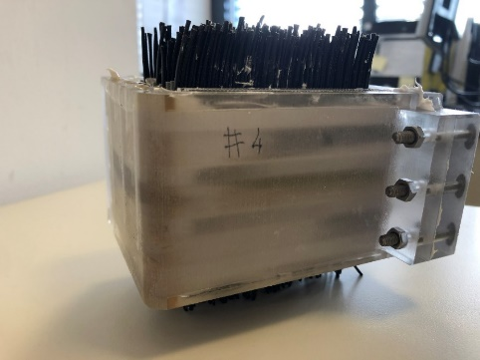
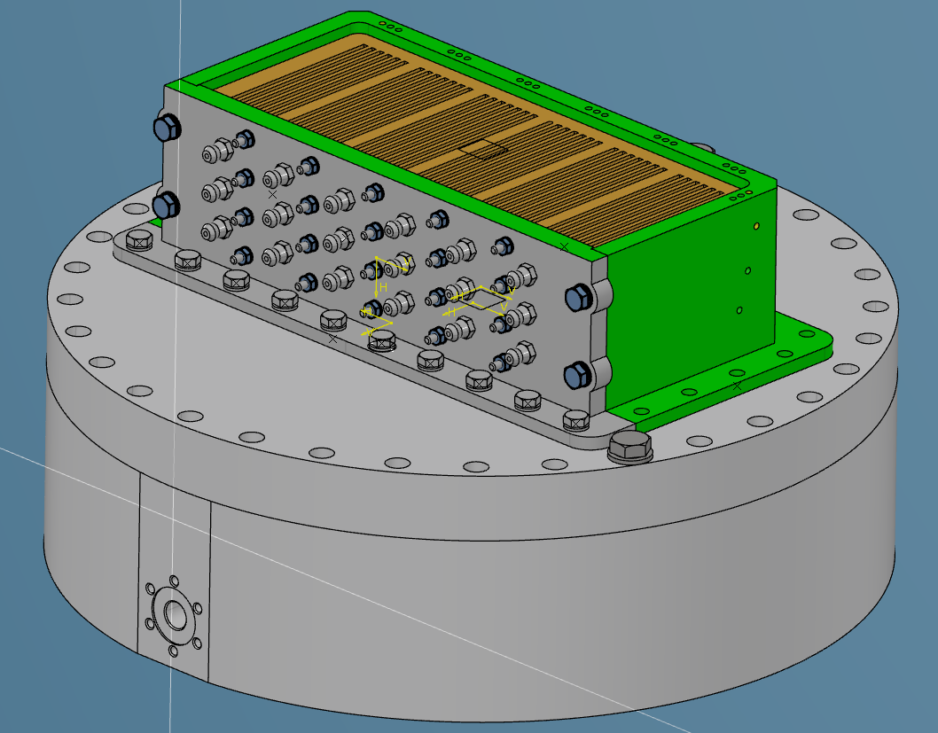
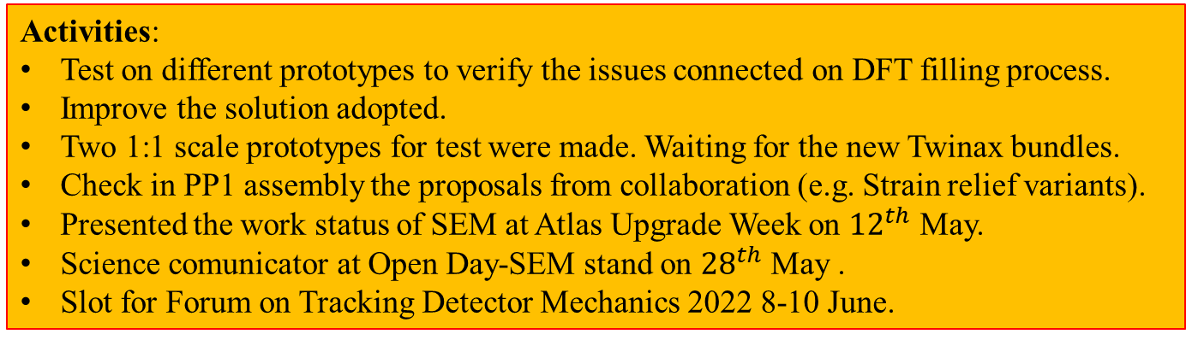
ATLAS ITk –Data feedthrough
2
2
Activities:
Test on different prototypes to verify the issues connected on DFT filling process.
Improve the solution adopted.
Two 1:1 scale prototypes for test were made. Waiting for the new Twinax bundles.
Check in PP1 assembly the proposals from collaboration (e.g. Strain relief variants).
Presented the work status of SEM at Atlas Upgrade Week on ${12}^{th}$ May.
Science comunicator at Open Day-SEM stand on ${28}^{th}$ May .
Slot for Forum on Tracking Detector Mechanics 2022 8-10 June.

Slide 3
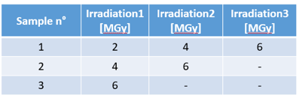
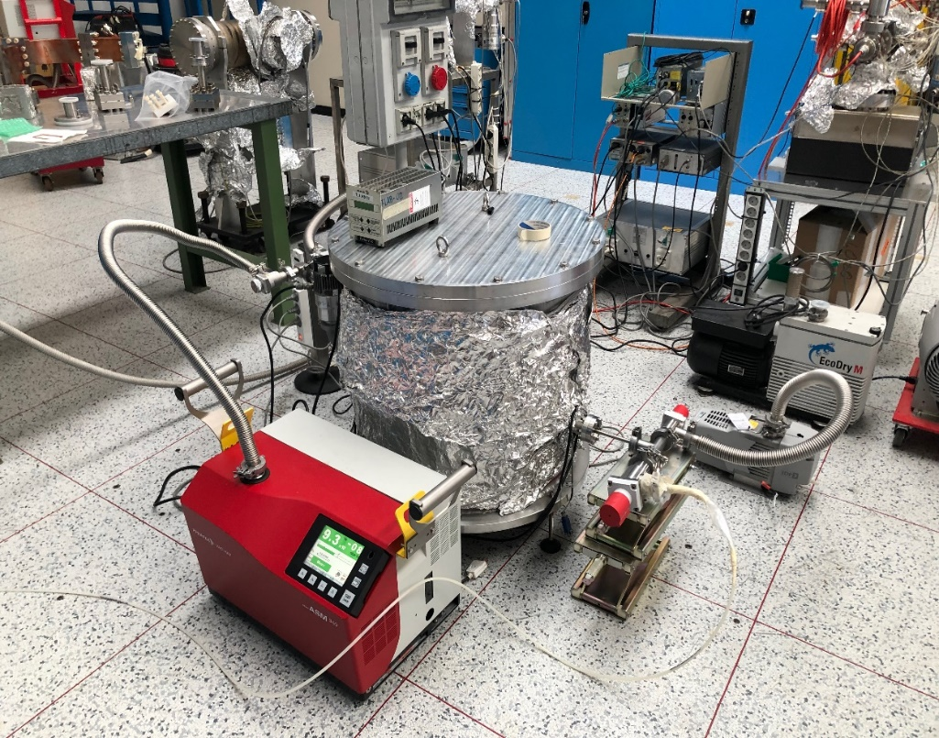
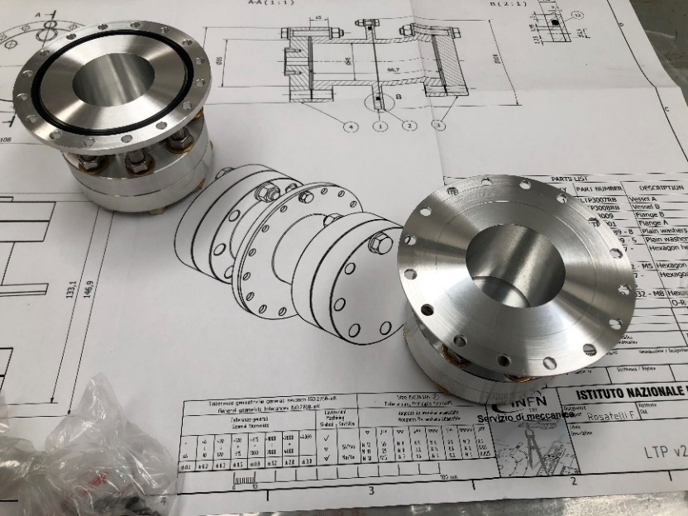
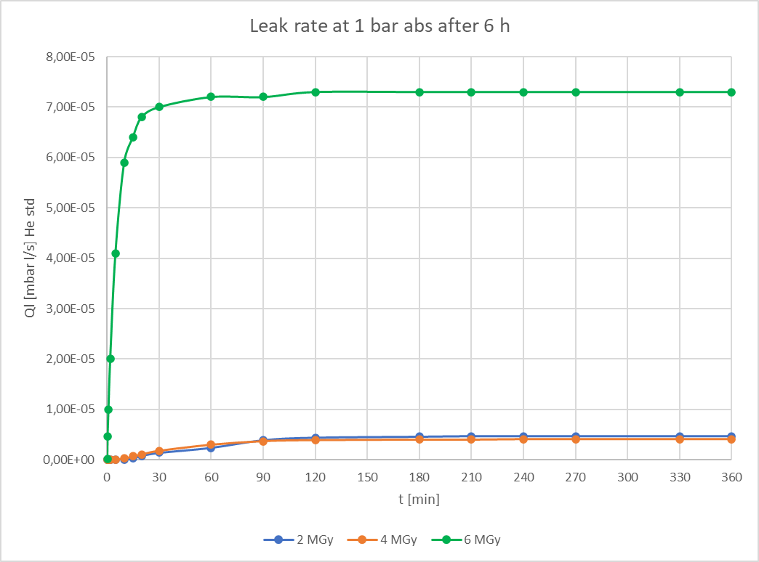
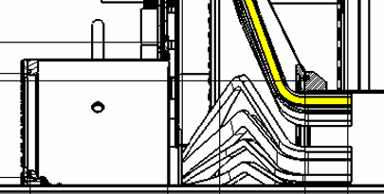
ATLAS ITk –Leak test
Thanks to Lollo & Liedl.
Prototype tested
LINE 1
LINE 2
4MGy
6MGy
4MGy
6MGy
Activities:
O-ring Leak check test performed. Material qualification to use it in the detector critical areas.
Sent the two samples to US facility for irradiation up to 6 MGy.
Migration from Inventor 202X to 3D Experience platform (CAD)

Slide 4
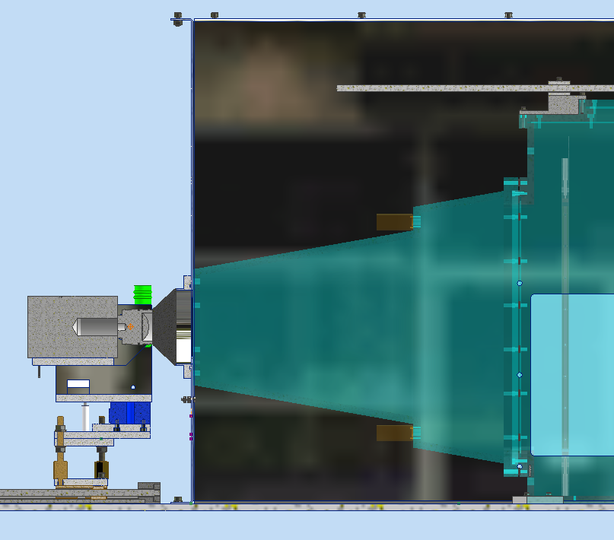
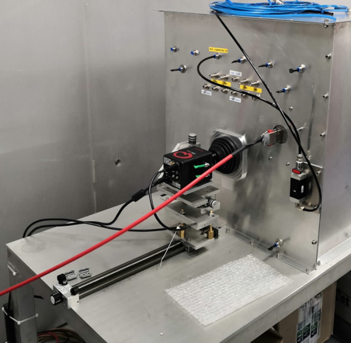
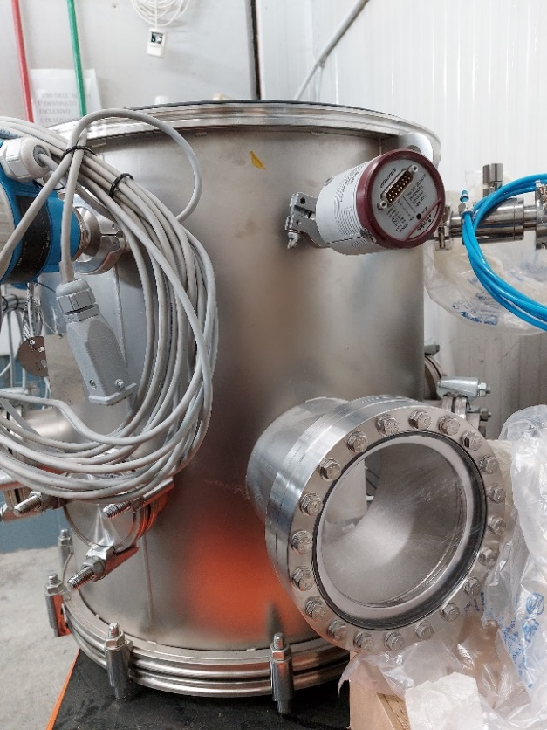
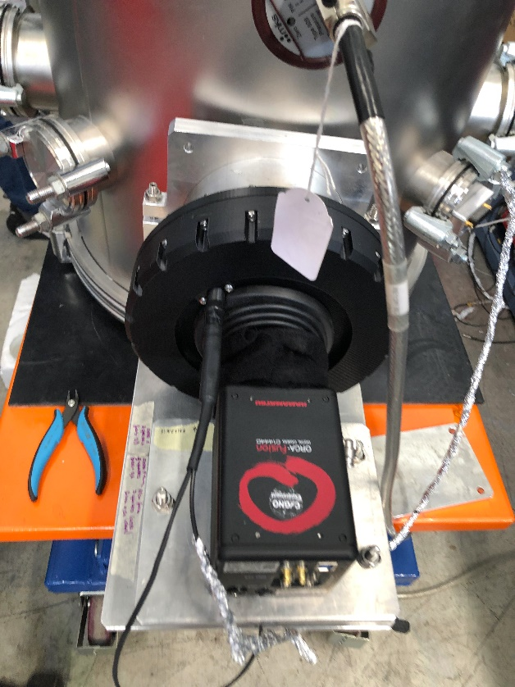
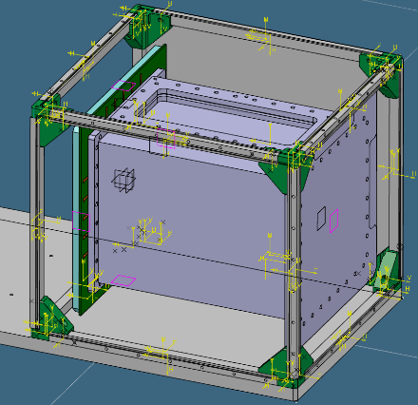
CYGNO – LIME/MANGO/GIN
GEM
Activities:
Production of components for LIME 2 – Camera regulation system.
Support to the experiment.
Orders of commercial parts.
LIME @ LNGS Underground
LIME 2 @ ASTRA
Begin the design of GIN Faraday cage.
Design the support system for CMOS camera placed in front of the vacuum window .

