Slide 1
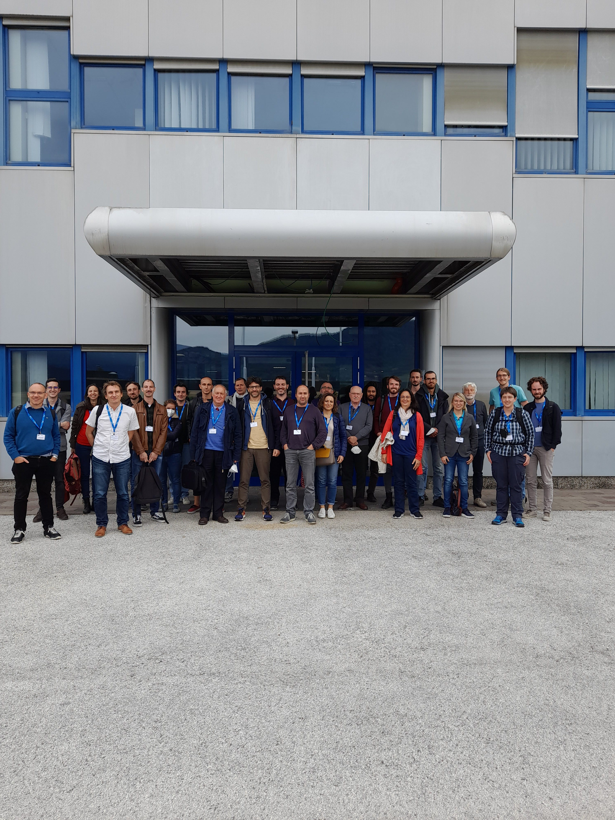

cQED@Tn - From Quantum Devices to Analogues on Superconducting Circuits
C Gatti, I Carusotto, P Falferi, A Vinante, B Margesin, F Mantegazzini, D Babusci

Slide 2
Sensing
Hybrid Systems
Quantum Information
Amplifiers
Analogues

Slide 3
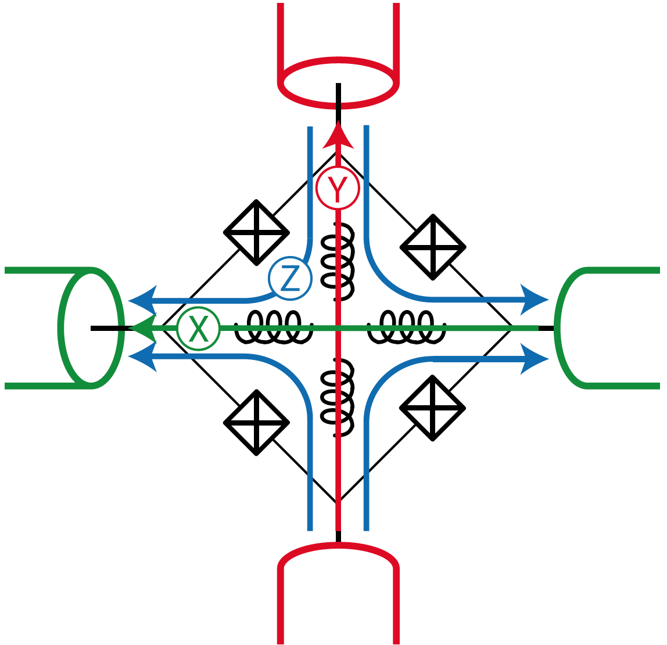
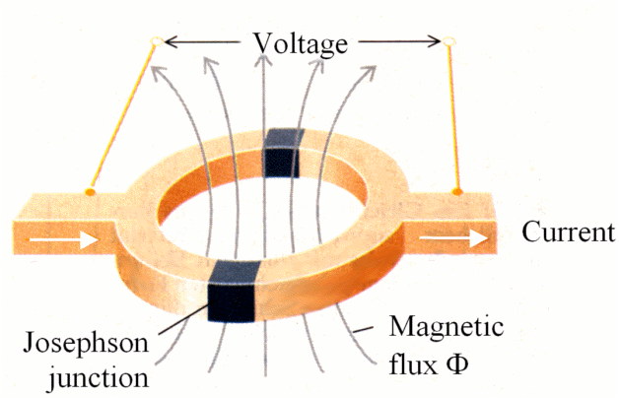
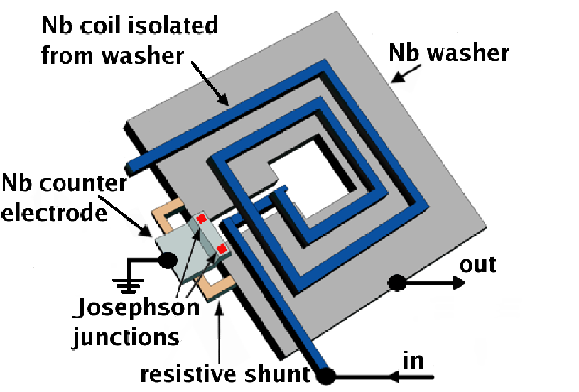
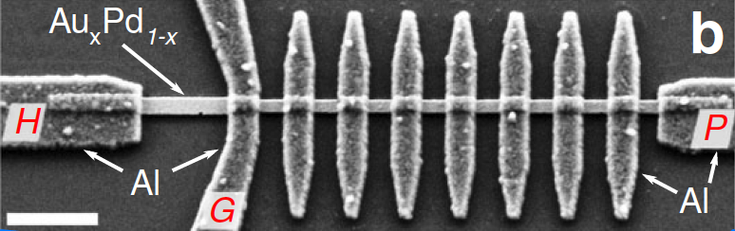
Intro – why single photon detection in the microwaves
A. Rettaroli
Linear-amplifier noise is prohibitively increased by standard quantum limit above 10-20 GHz while bolometers and photon counters are not sensitive enough (or too noisy) below the THz
The physics case: search for light dm (axions, ALPs, hidden photons…)
Preferred axion window
250 MHz
250 GHz
Bolometers,
photon counters
Quantum limit
$$T_{noise}\left[mK\right]≈50 × ν\left[GHz\right]$$
NEP=20 zW/√Hz → 400 GHz
SQUID (→1 GHz)
MSA SQUID (→ few GHz)
JPA (→ 10-20 GHz)
Kokkoniemi et al. Nat. Com. Phys.
https://doi.org/10.1038/s42005-019-0225-6

Slide 4
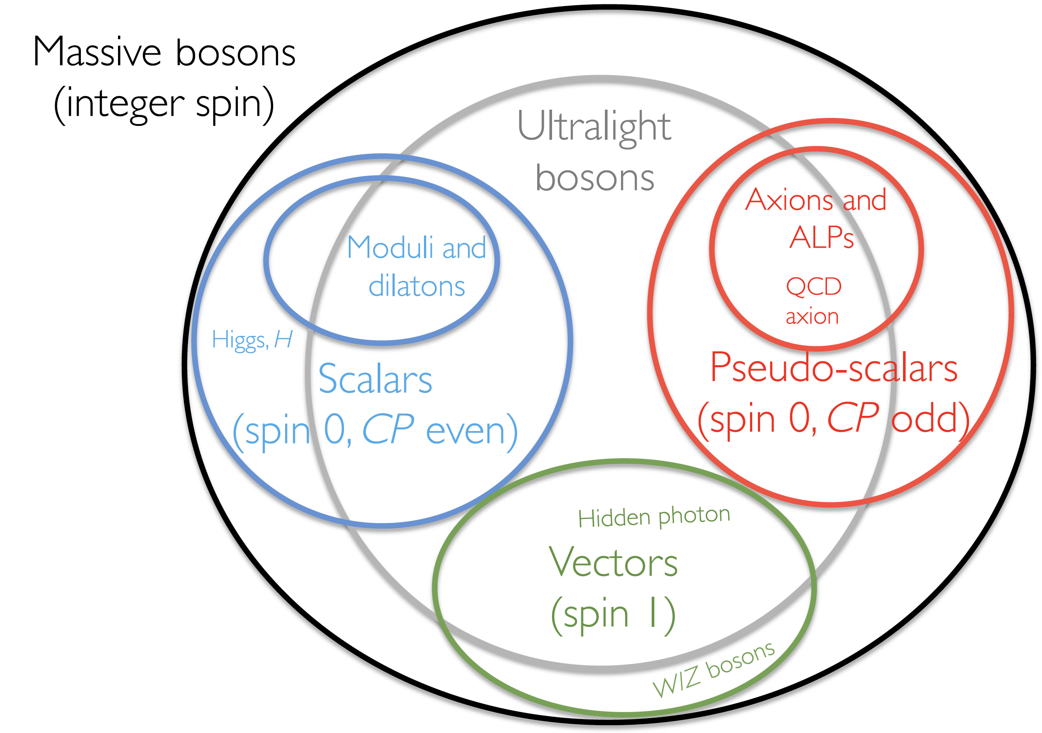
Chadha-Day et al., Sci. Adv. 8 eabj3618 (2022)

Slide 5
Quantum Sensing and Hybrid Systems
Recent progresses in the ability to measure and manipulate individual quanta such as microwave-photons, phonons and magnons are opening new directions in the detection of Dark Matter and of Fifth Forces, in tests of Quantum Gravity and of Quantum Mechanics in macroscopic objects.
Photons
Magnons
Phonons

Slide 6
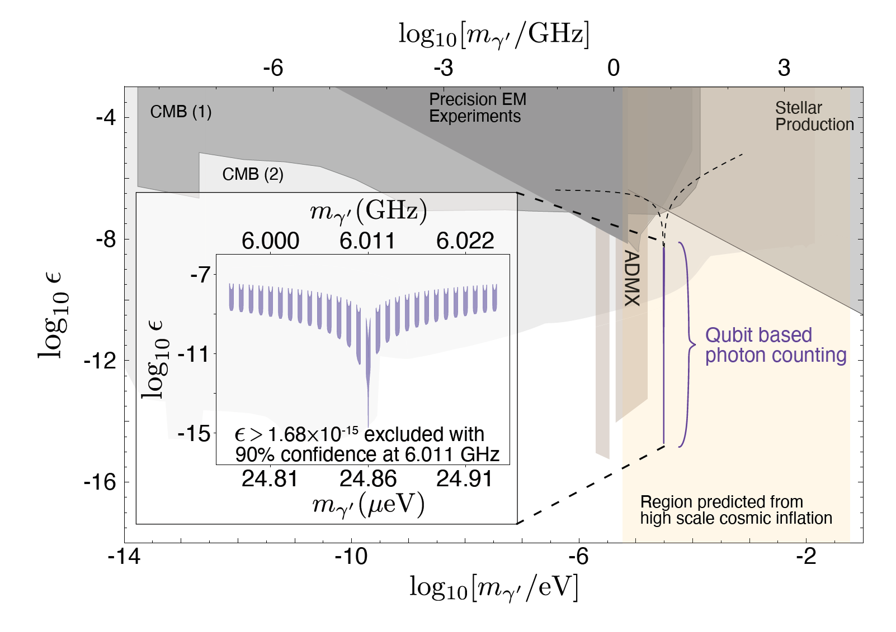
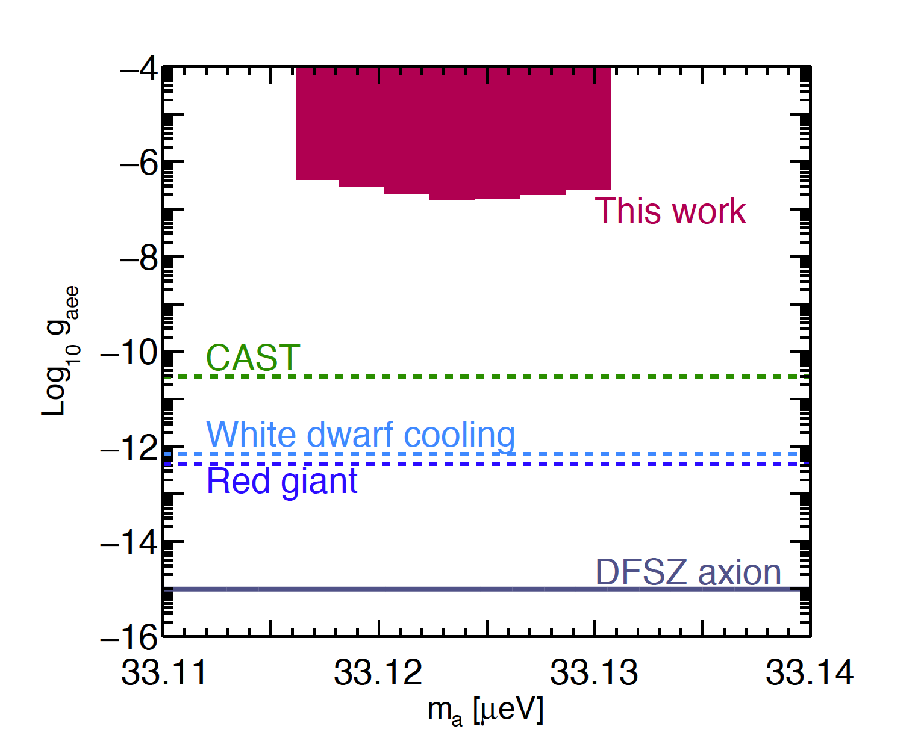
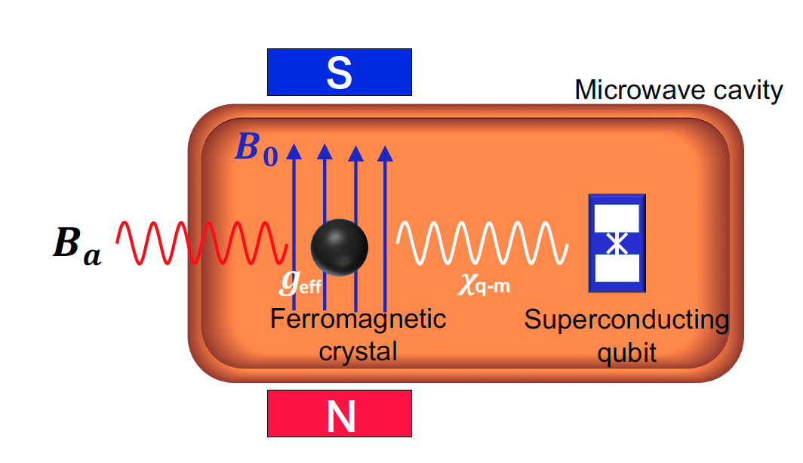
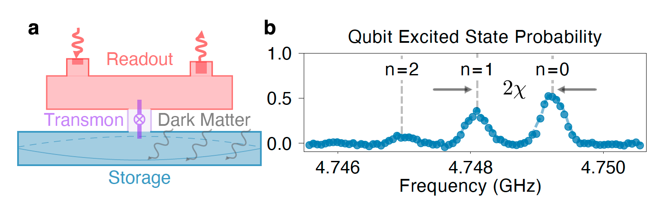
Dark Matter Searches with SC Qubits - State of Art
Photon Sensing - Dark Photons
Magnon Sensing - Axions
Photon sensing with qubit recently used to search dark matter composed of Dark Photons.
Magnon sensing with qubit recently used to search dark matter composed of axions, via axion-spin coupling.
A V Dixit et al., “Searching for Dark Matter with a Superconducting Qubit,” Phys. Rev. Lett. 126, 141302 (2021).
T Ikeda et al. “Axion search with quantum nondemolition detection of magnons,” arXiv:2102.08764.
See talks of Albertinale, Corti, Felicetti, Rettaroli, Lisitskiy
See talks of Albertinale, Affronte, Leo

Slide 7
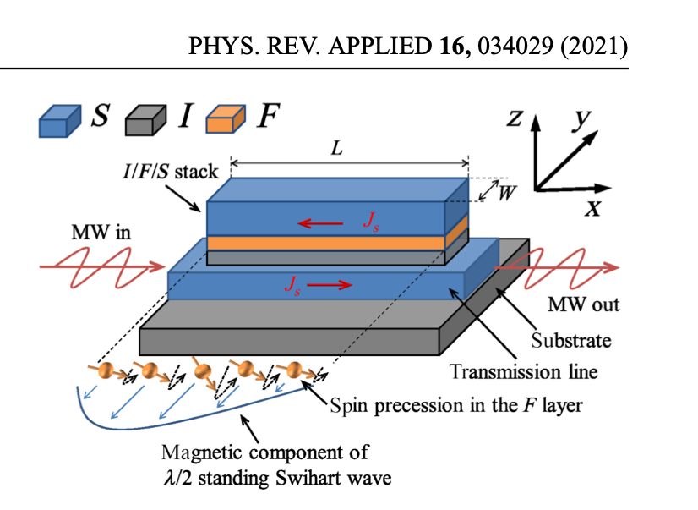
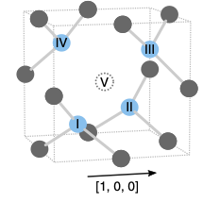
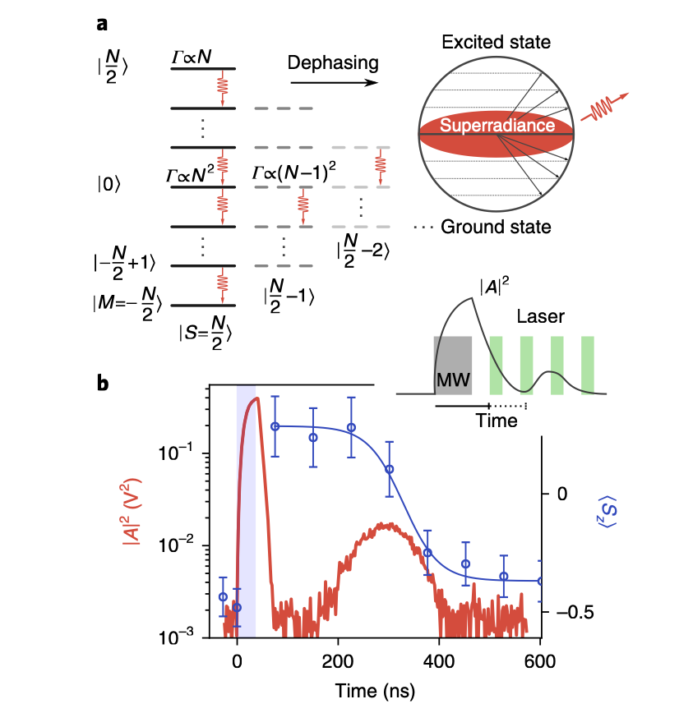
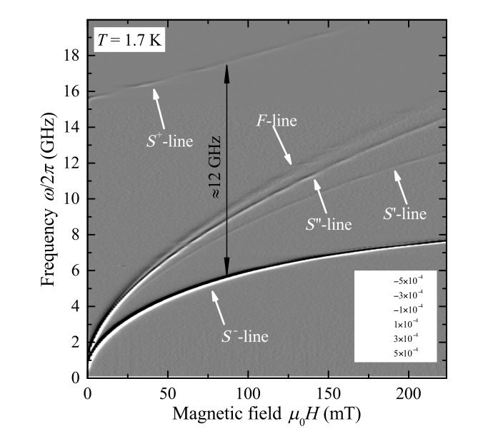


New Phenomena & Applications with Hybrid-Spin Systems
fast and protected QIP
nonlinear optics
superradiance
enhancement of quantum phenomena
g/ω = 0.6 !
M Affronte

Slide 8
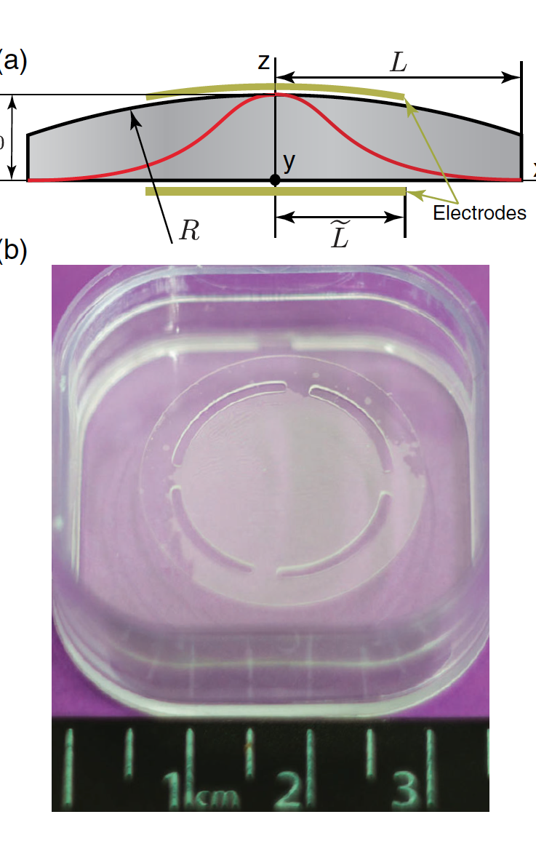
Light Dark Matter and GW with Mechanical Resonators
Light Dark Matter or high frequency GW can induce oscillation (from MHz to GHz) of piezoelectric quartz bulk acoustic wave (BAW) resonators cooled at mK temperatures.
M Goryachev and M E Tobar, “Gravitational wave detector with high frequency phonon trapping acoustic cavities ”PHYSICAL REVIEW D 90, 102005 (2014)
D Carney et al, “Mechanical quantum sensing in the search for dark matter,” Quantum Sci. Technol. 6 (2021) 024002.
A Arvanitaki et al, “The sound of dark matter: searching for light scalars with resonant-mass detectors”, Phis Rev Lett 116 031102 (2016).

Slide 9
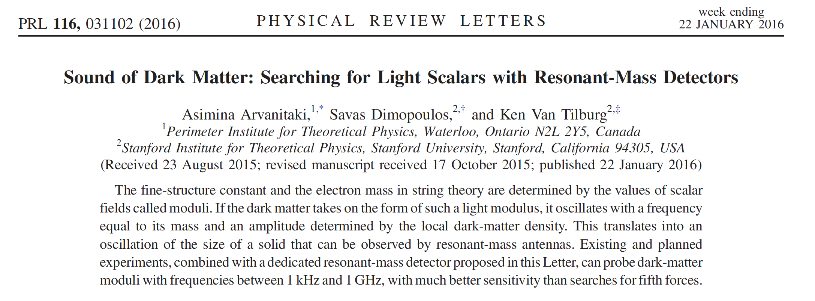

Slide 10
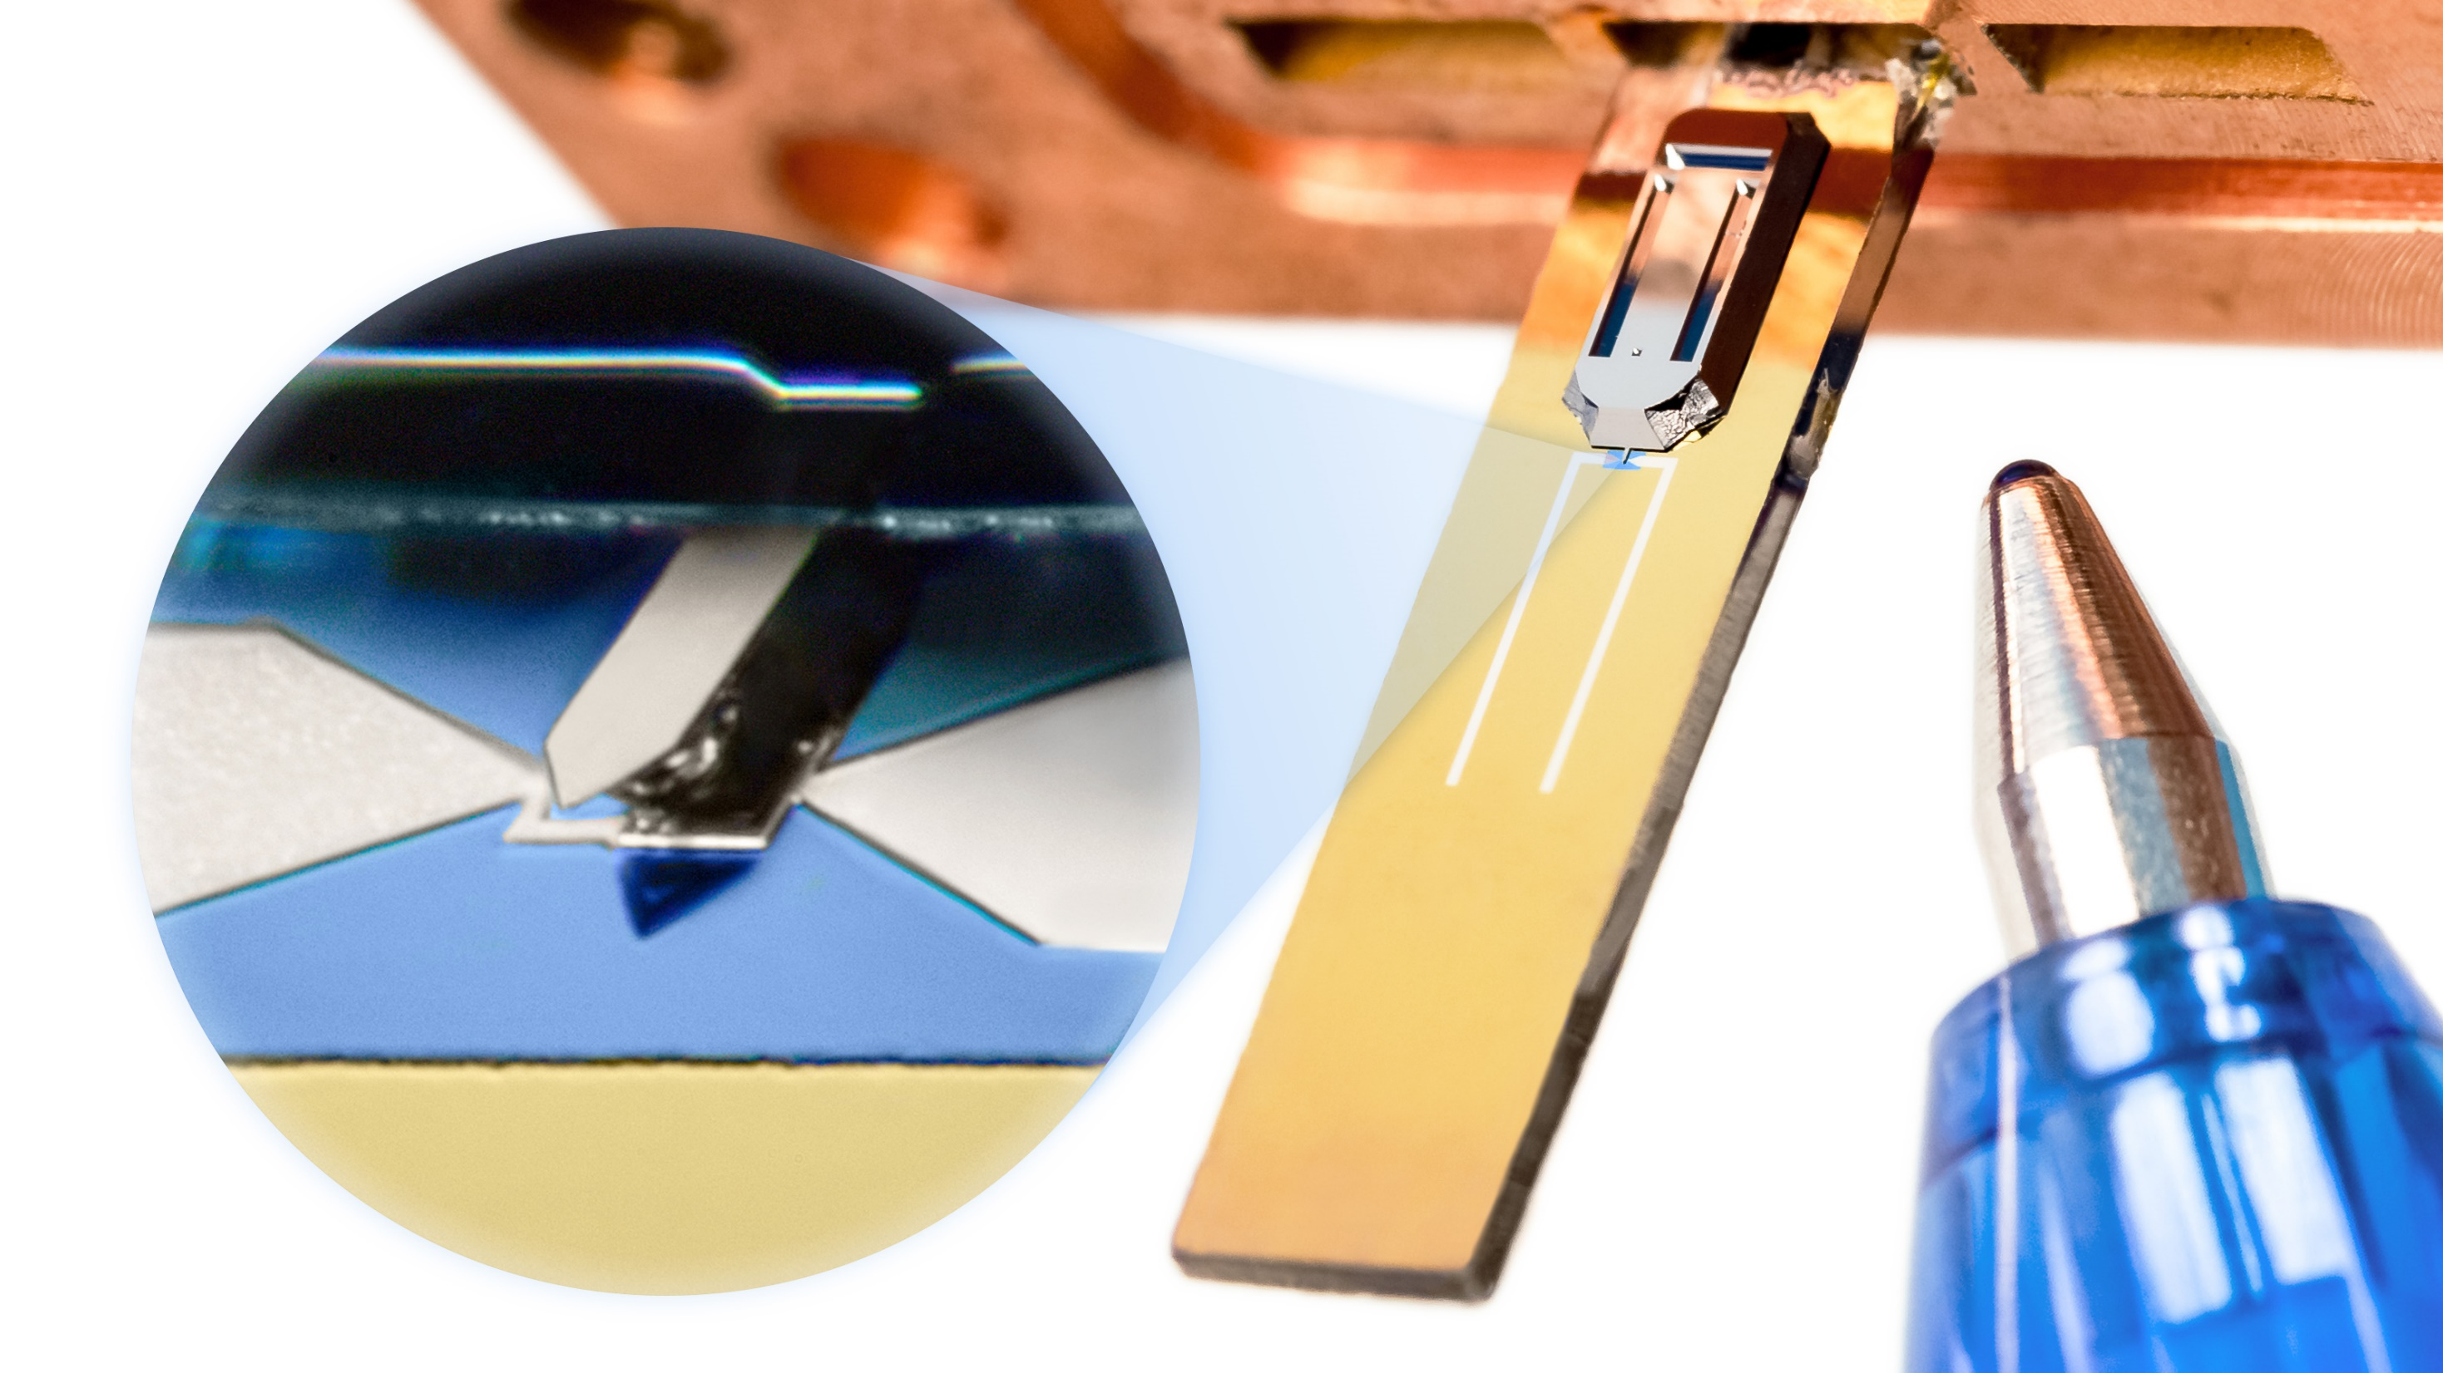
Kirchmair talk
Cantilever
pen
50 µm
Cavity
3 mm

Slide 11
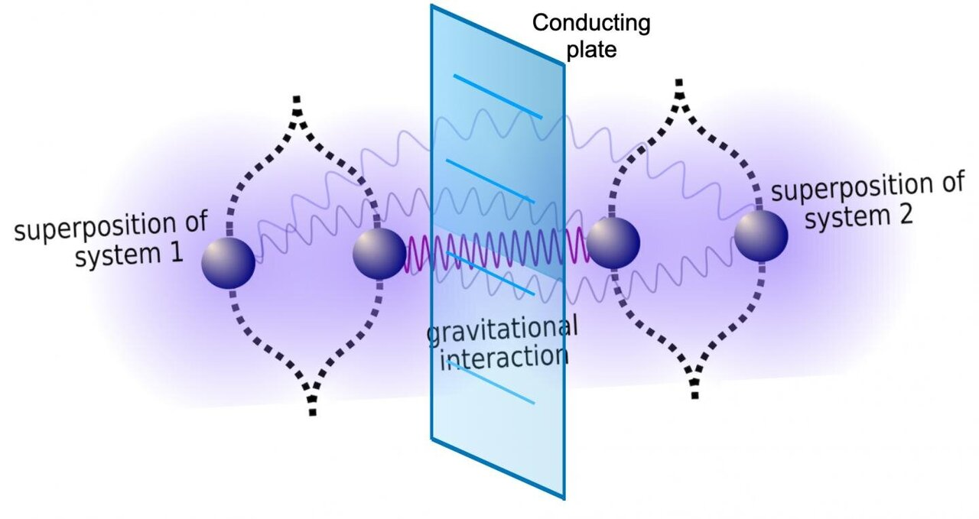
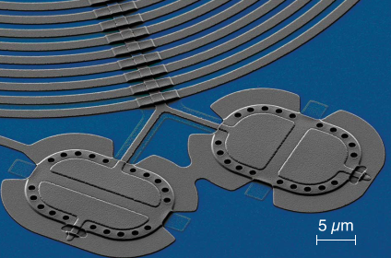
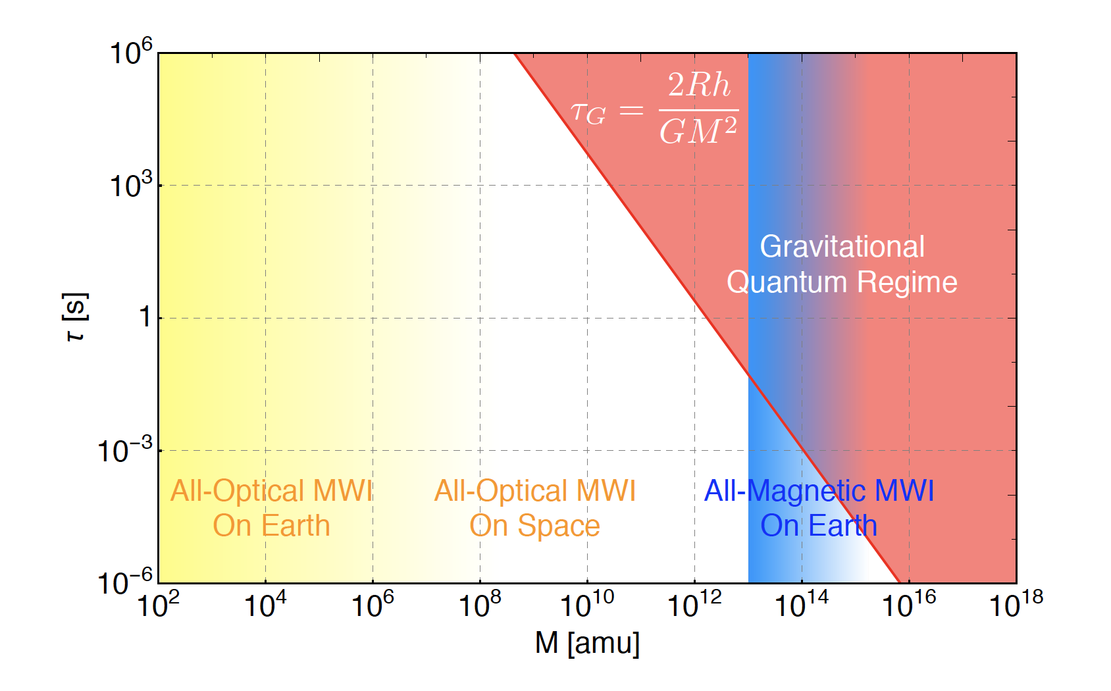
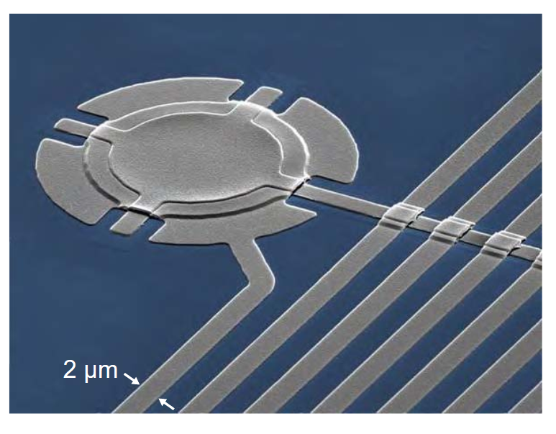
arXiv:1603.01553v3
See Kirchmair talk

Slide 12
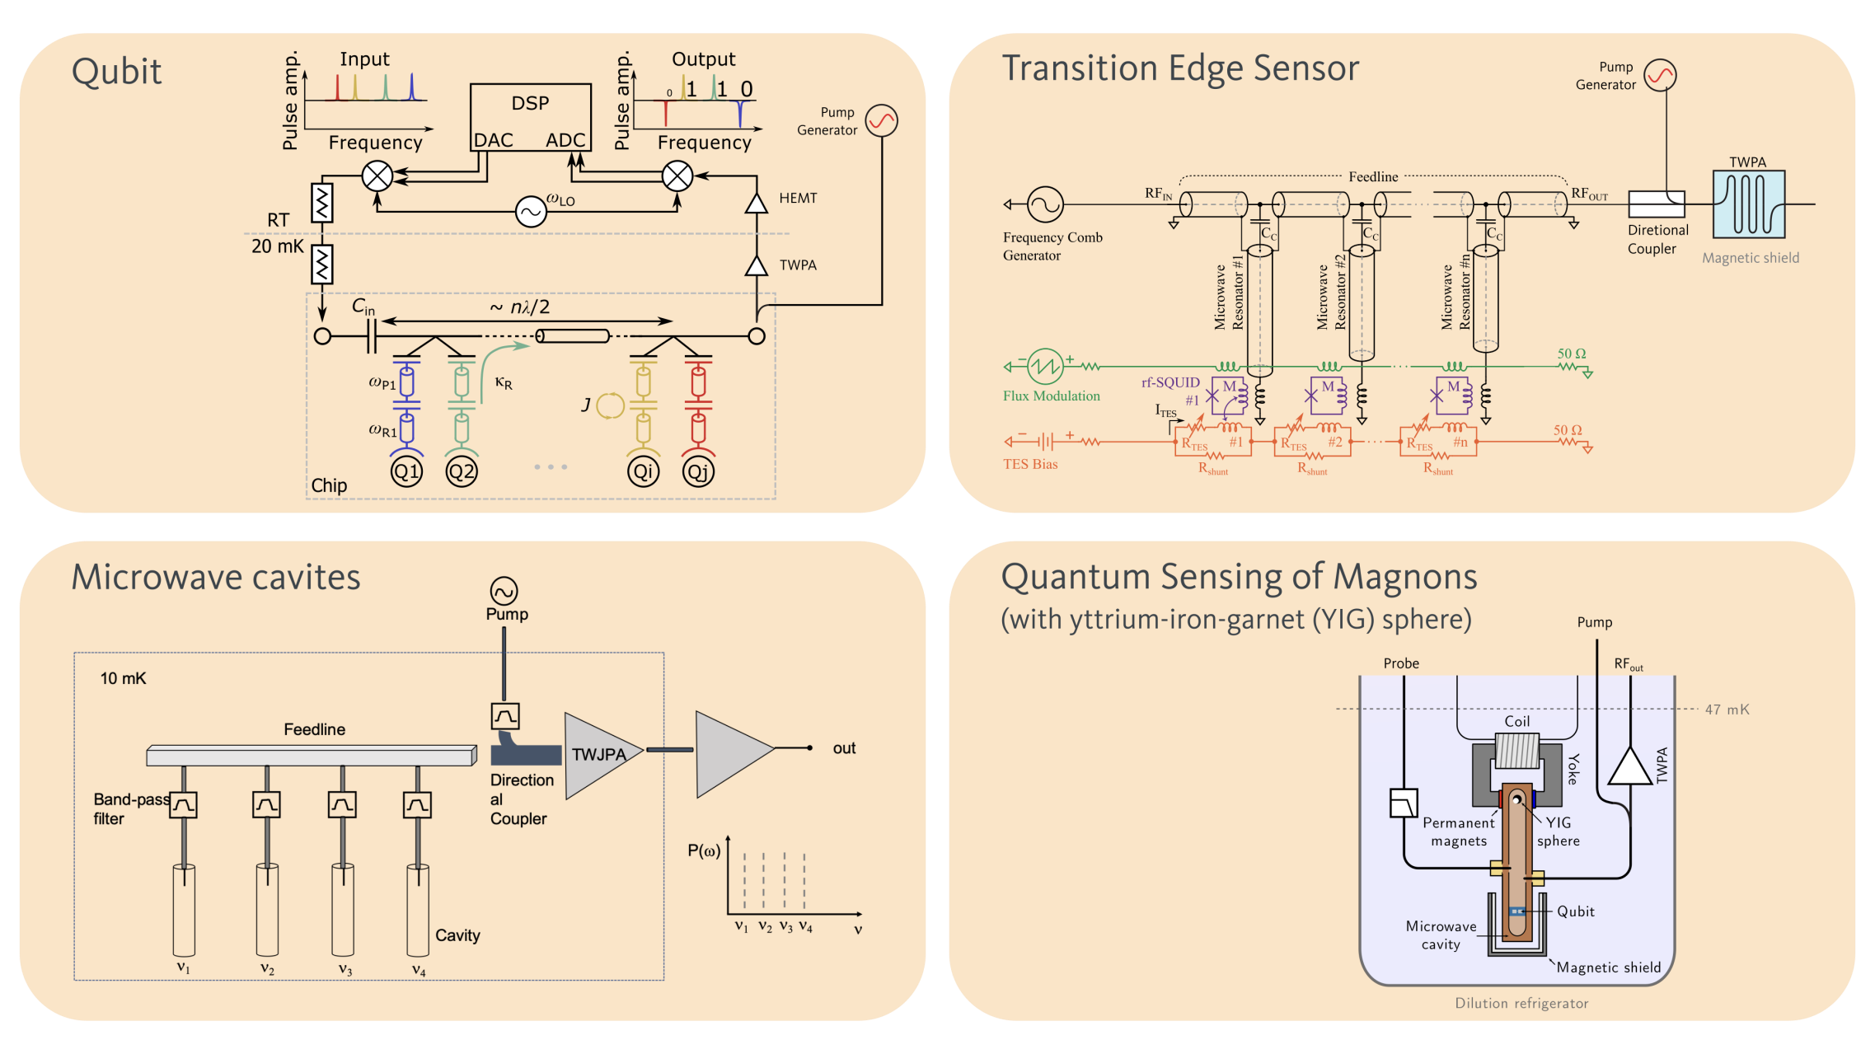
Amplifiers
M Faverzani
See talks by Guarcello, Faverzani, Granata, Enrico, Esposito

Slide 13
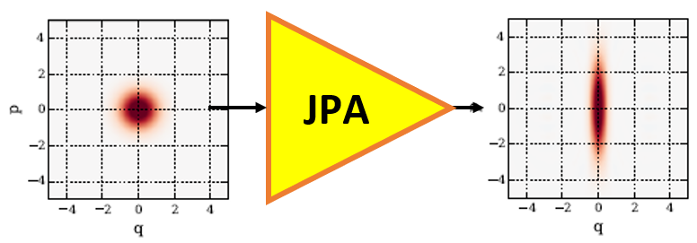
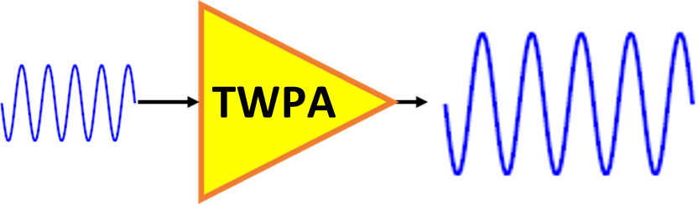
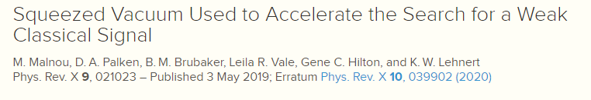

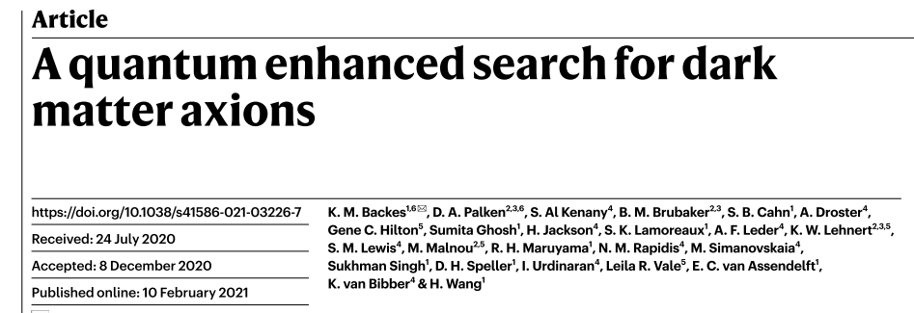
Quantum Optics experiments with TWPAs - Motivations
Not only amplification…..
M Esposito
TWPA
Quantum Microwave Photonics
Microwave frequencies:
Single-mode and Two-mode squeezing in JPAs
Quantum enhanced detection
2021
1
Notes:
The single mode and two mode squeezing generation in the last decay became established also in the MW regime, TWO-mode squeezing can be generated with JPA and also with DCE in transmission lines

Slide 14
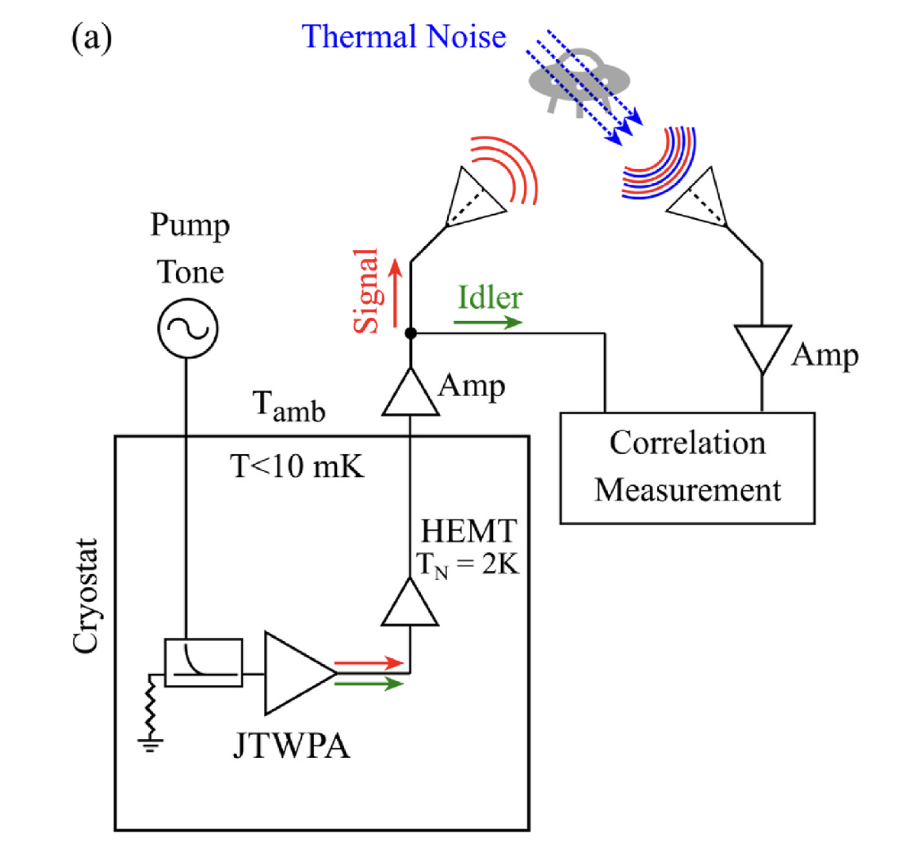
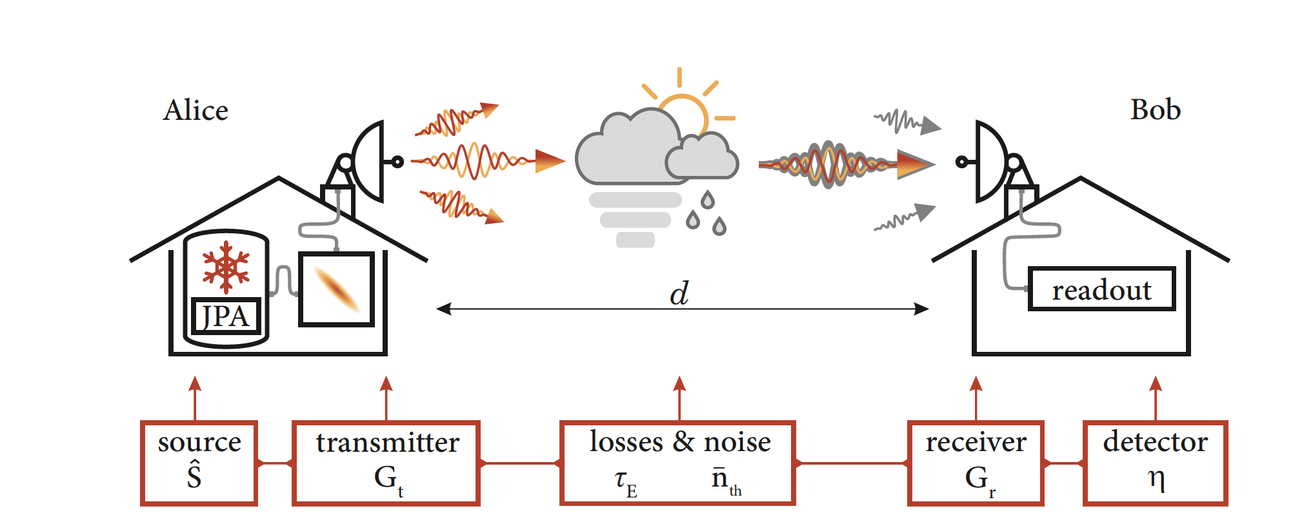
Microwave Quantum Communication
Quantum Radar
arXiv:2203.05530
Measurement: Sensors 18 (2021) 100349

Slide 15
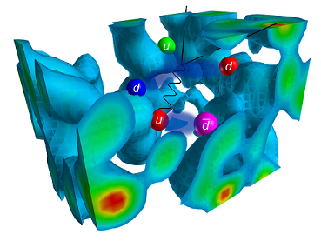
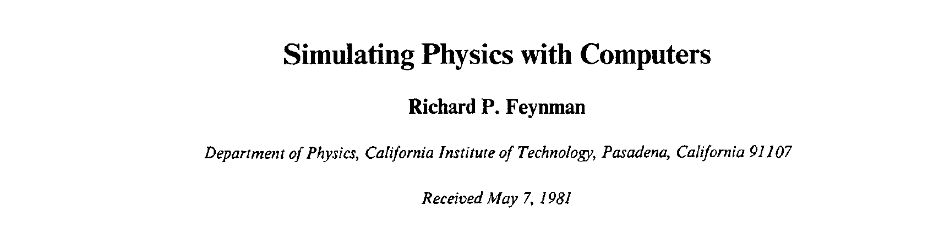
“The physical world is quantum mechanical, and therefore the proper problem is the simulation of quantum physics”
Quantum Information

Slide 16
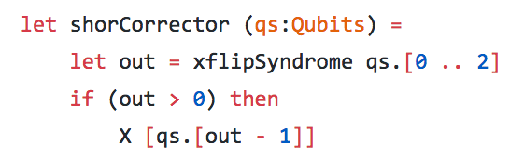
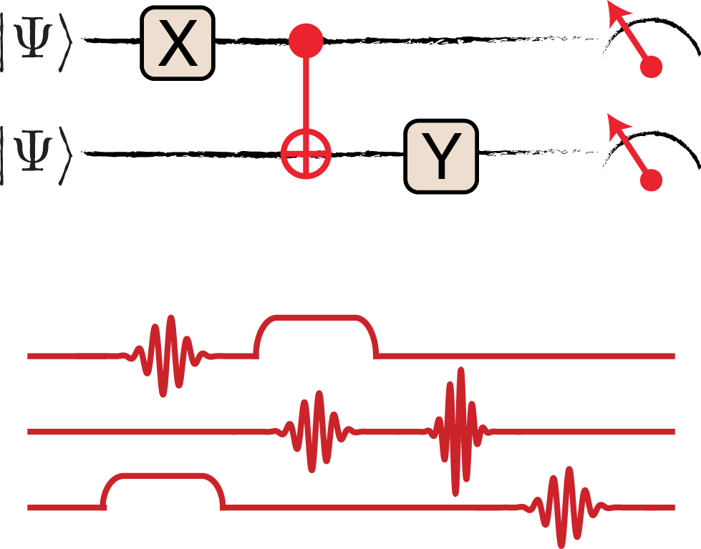
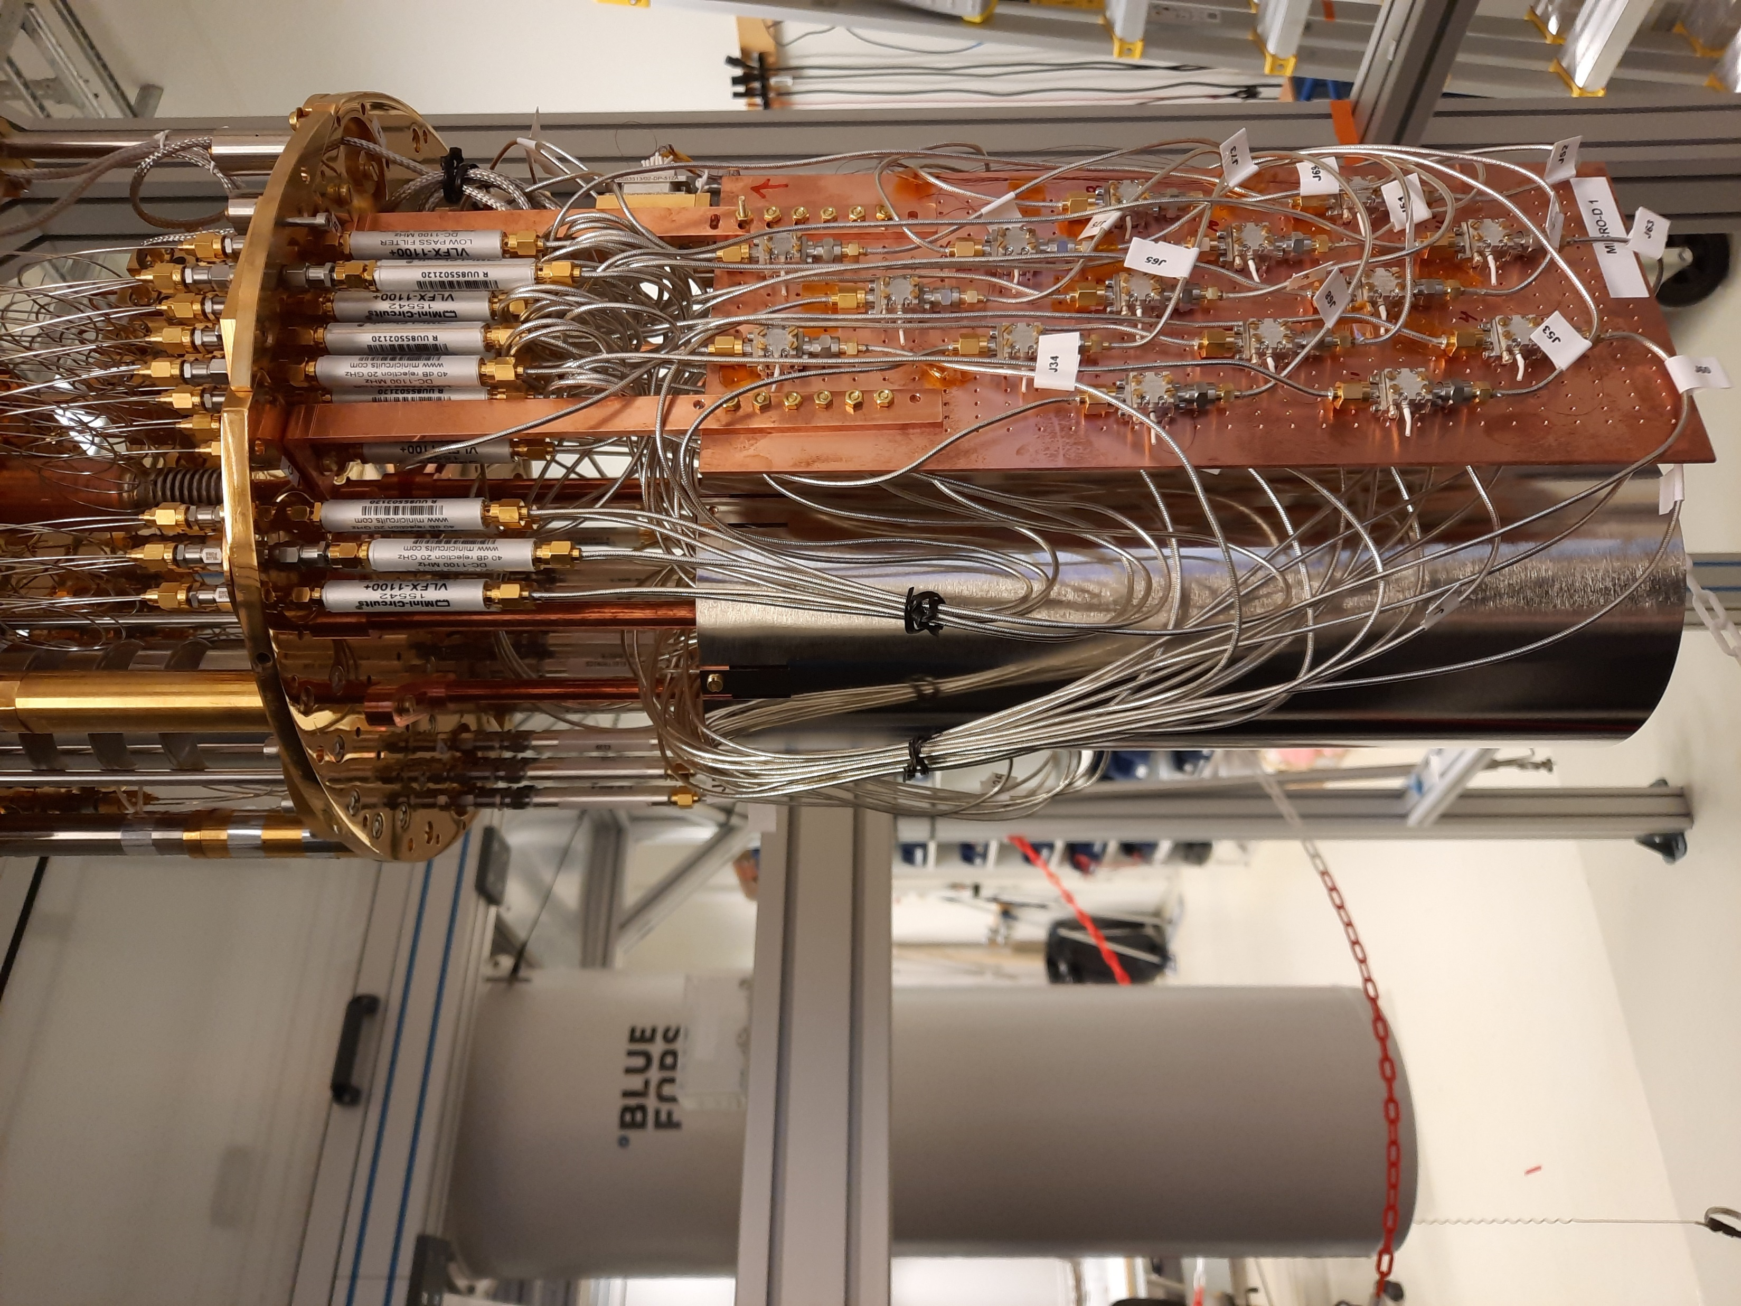

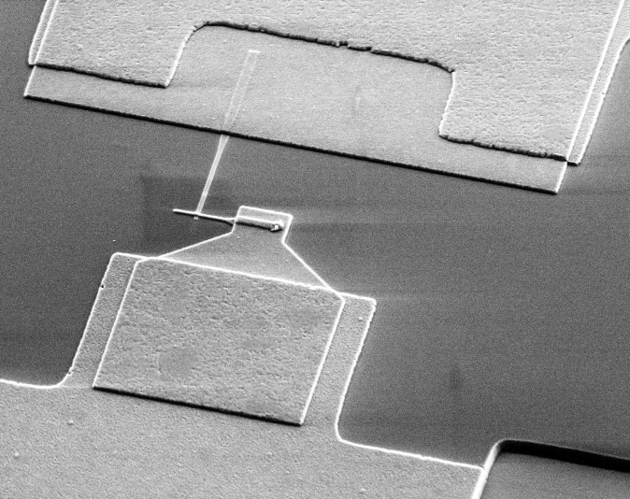
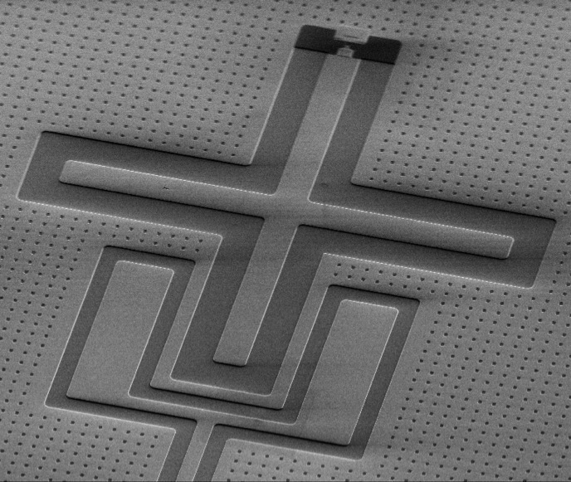
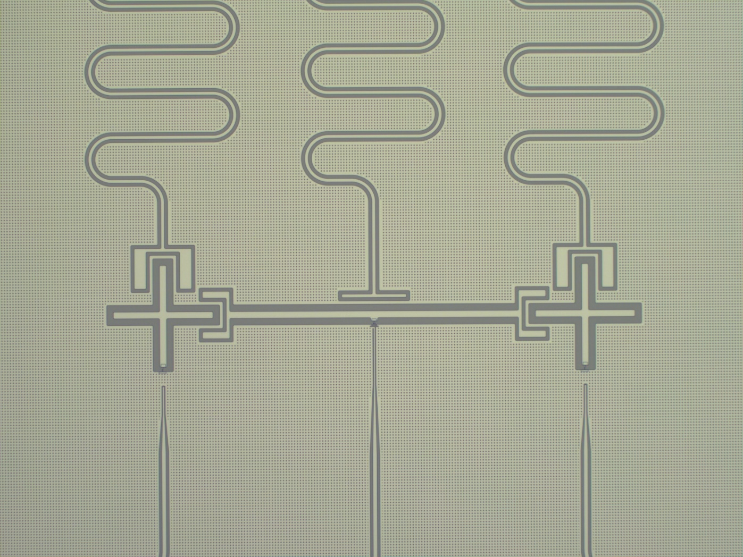
A superconducting quantum processor
See talks by Corti, Tancredi, Preti
A Swedish quantum computer
Application to use cases within
optimization and quantum chemistry
Full stack HW and SW development
Collaboration within EU Flagship
G Tancredi
SW stack and FW
Measurement system
Quantum HW
cQED@Tn – 04/10/ 2022

Slide 17
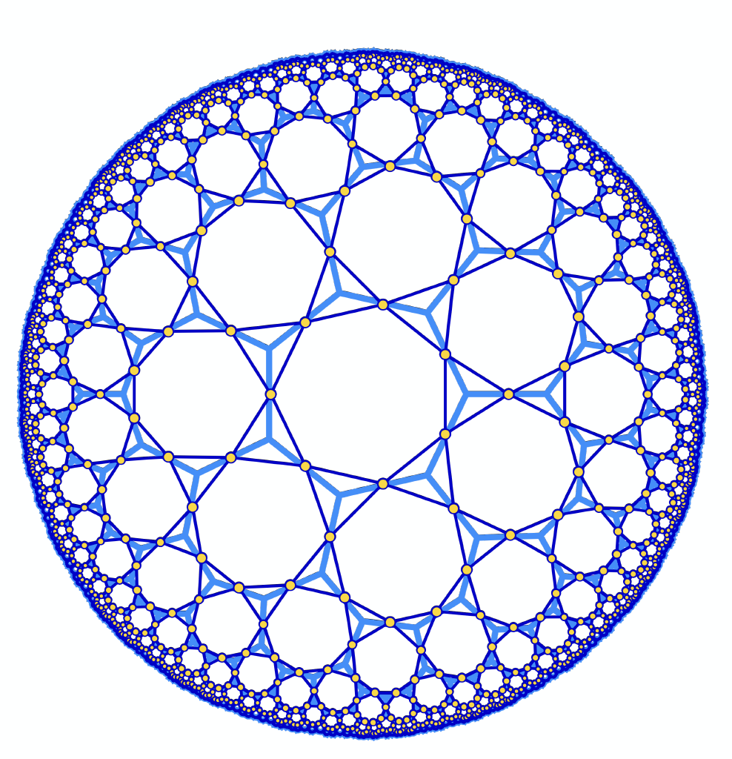
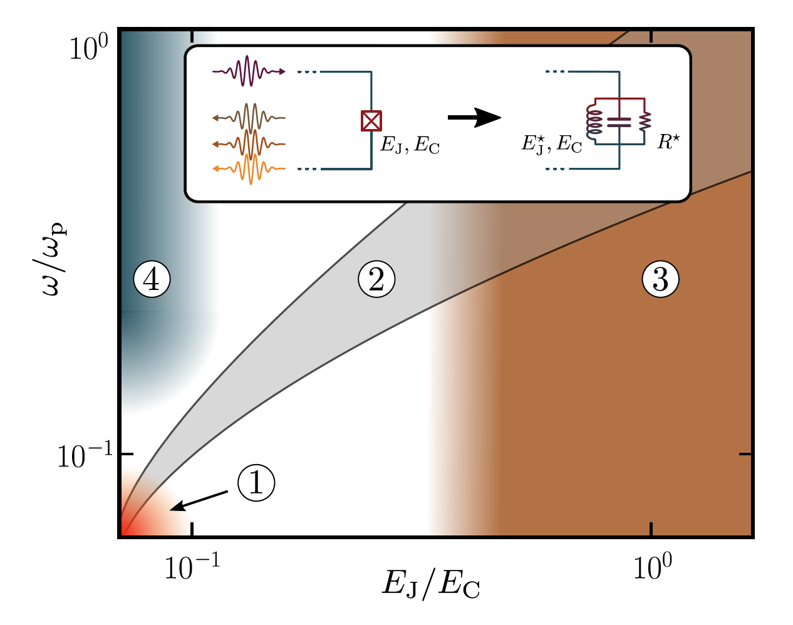
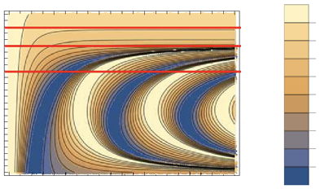
Analogues
Non Euclidean Geometries
Violations of discrete symmetries such as Charge and Parity Conjugation and Time Reversal
Many body effects
PT violation
See talks by Kollar, Roch, Paraoanu, Crescini, Rastelli

Slide 18
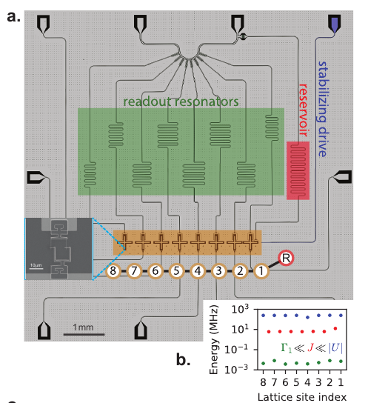
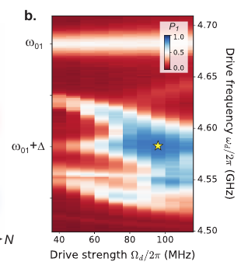
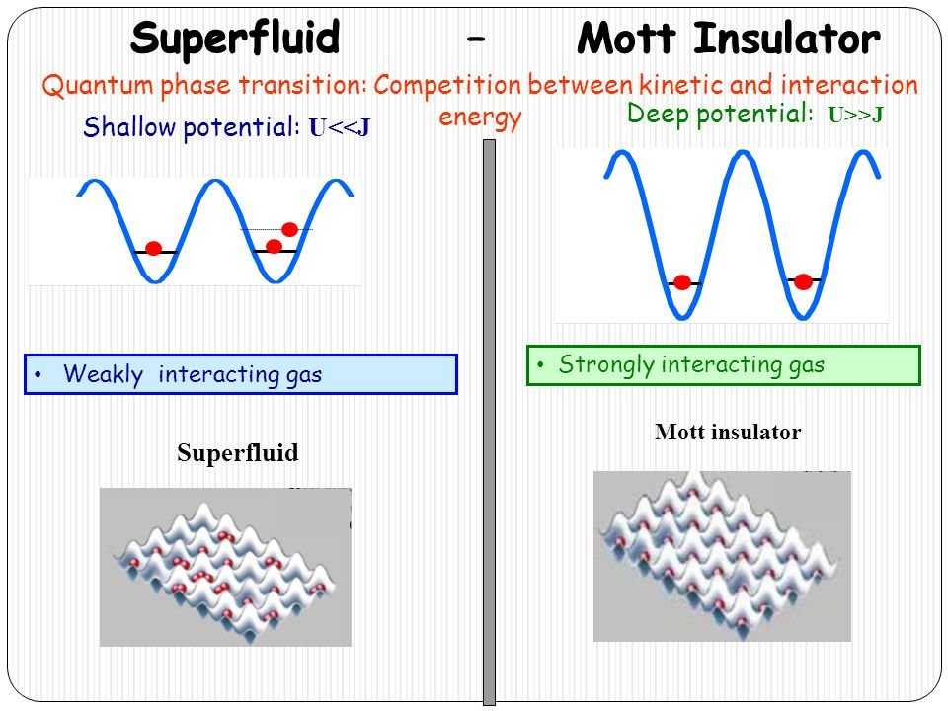
Future challenges: Quantum fluids of light in arrays of cavities/qubits
First expt: Ma et al. Nature 2019
Mott insulator of impenetrable photons – all the contrary we have learnt in undergrad e.m.
Review: IC,… A. J. Kollar, … Photonic materials in circuit QED, Nature Physics 2020

Slide 19
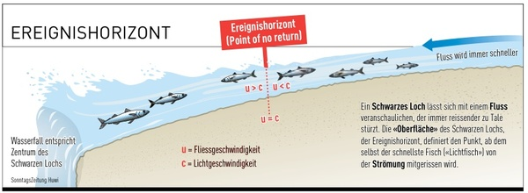
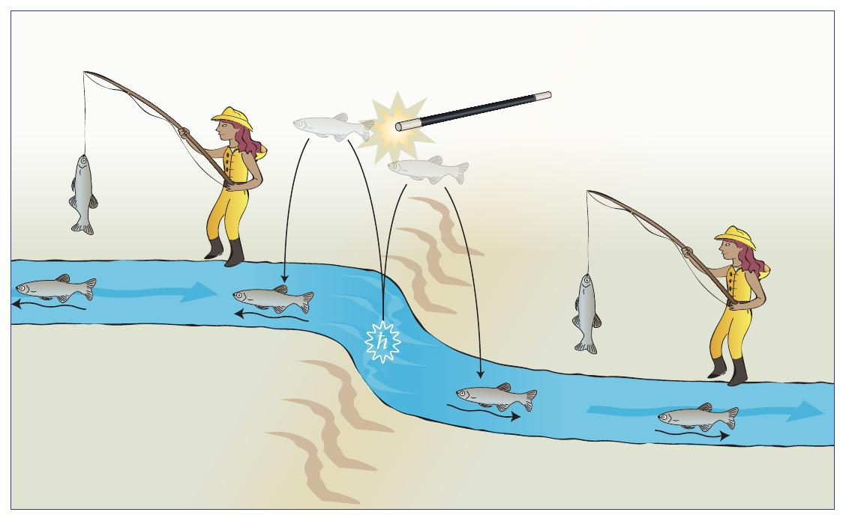
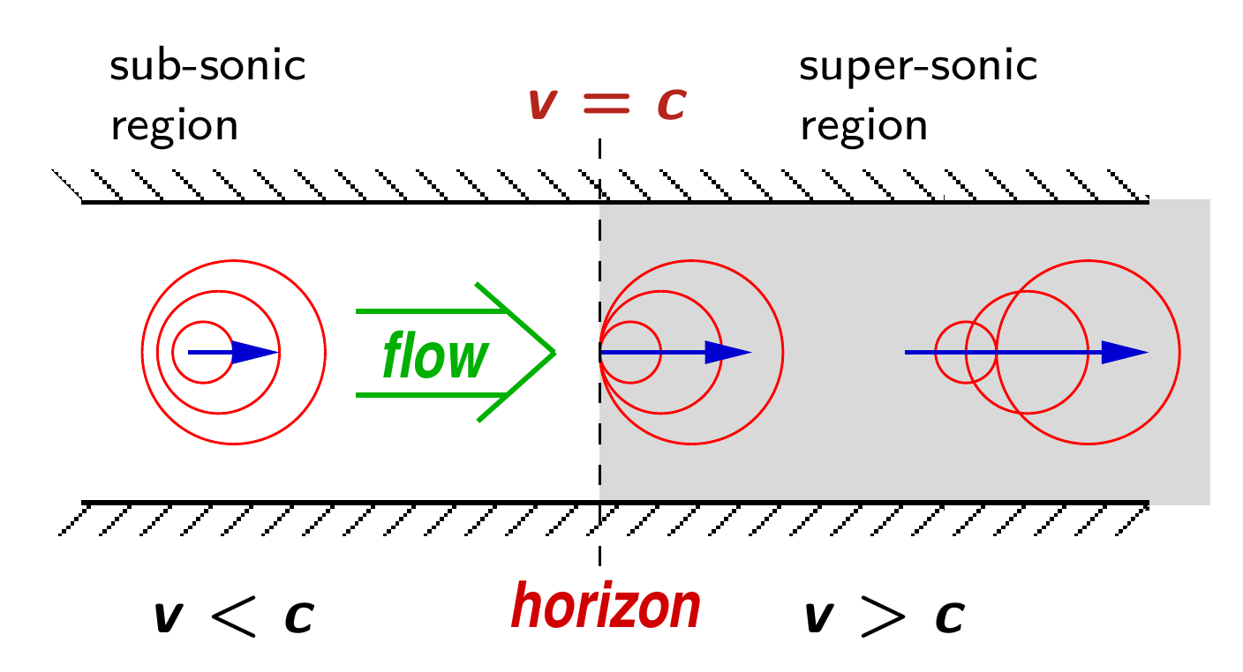
Future challenges: analog gravity, a.k.a. quantum simulation of QFTs on curved space-time
From Ulf Leonhardt's website
Quantum emission of fish via Hawking mechanism ?
Quantum emission of phonon from the sub- to super-sonic
horizon in flowing fluid ?

Slide 20
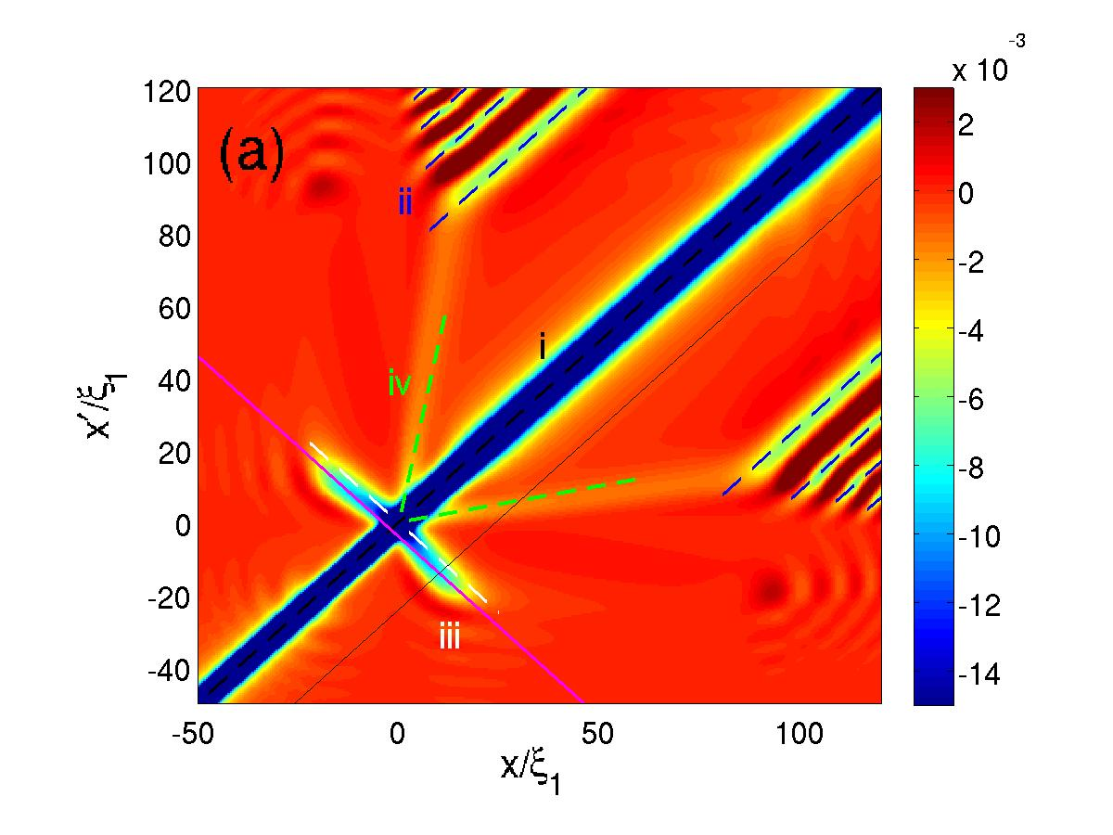
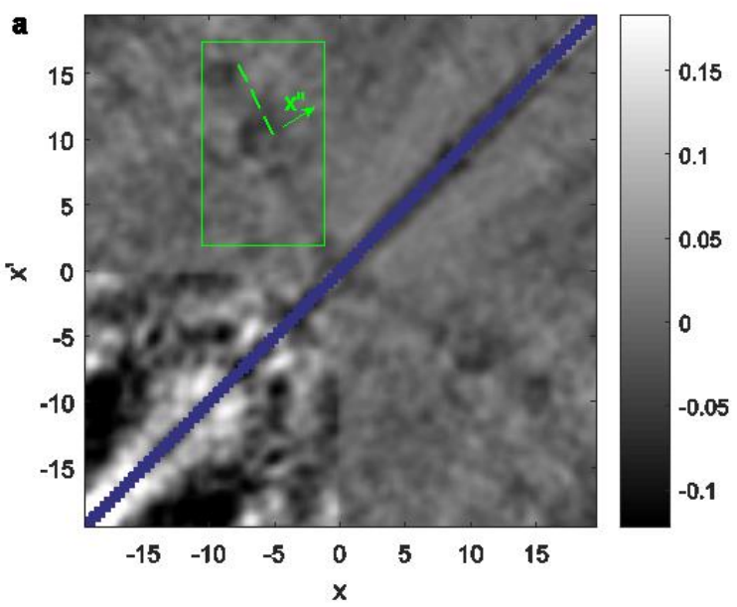
Theory: IC et al., NJP 2008
Expt: Steinhauer Nat. Phys. '16
Balbinot-Fabbri moustache

Slide 21
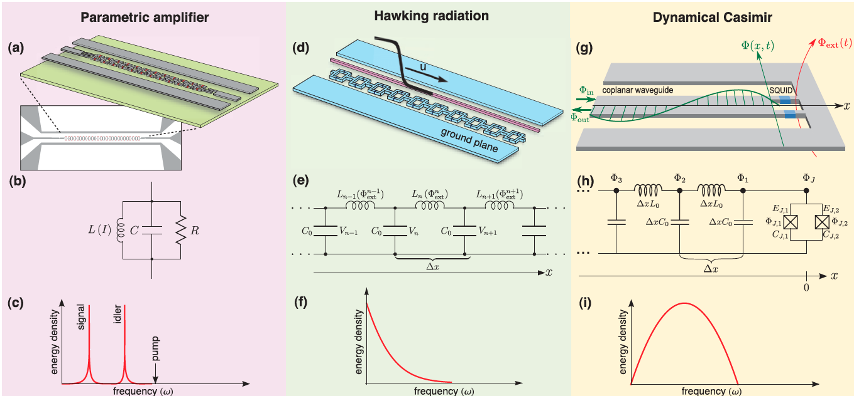
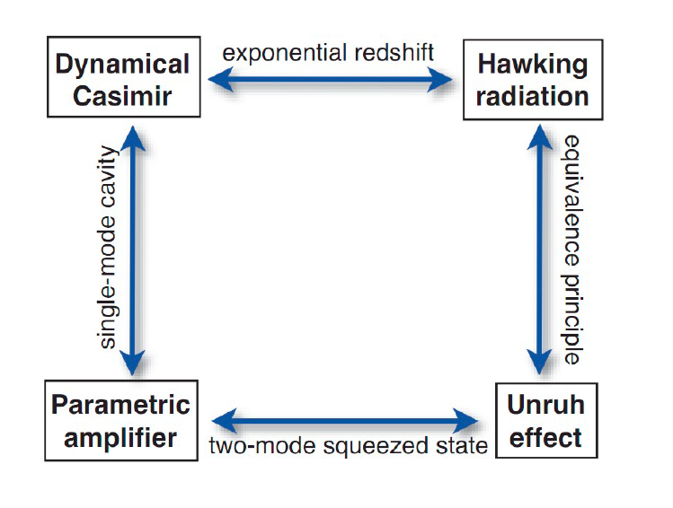
IN SUPERCONDUCTOR SYSTEMS
REVIEWS OF MODERN PHYSICS, VOLUME 84, JANUARY–MARCH 2012
Expts. Wilson-Delsing
& Paraoanu

Slide 22
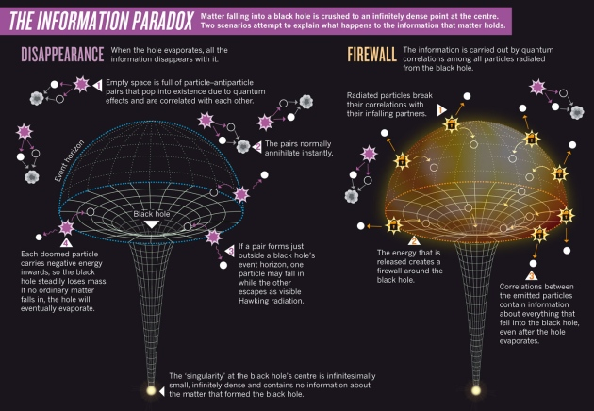


Big question: what is long-time fate of a BH ?
Baby toy model: friction force on dynamical Casimir emission
(extends Wilson-Delsing & Paraoanu’s expts)
S. G. Butera & IC, Quantum fluctuations of the friction force induced by the dynamical Casimir emission, EPL 128, 24002 (2020).

Slide 23
Workshop Round Table
Which are the recent advances in these fields?
What are the offered possibilities?
What kind of physics can be explored through circuit engineering?
Which are the future technologies for fundamental and applied physics?
….

