Slide 1



Modeling of the nonlinear dynamics of Josephson Traveling-Wave Parametric Amplifiers
Dr. C. Guarcello
Physics Department “E.R. Caianiello”, University of Salerno, Fisciano (Sa), Italy
cQED@Tn - "Circuit QED: From Quantum Devices to Analogues on Superconducting Circuits"
Oct 3 – 5, 2022
FBK (Trento, Italy)

Slide 2



C. Guarcello, G. Avallone, C. Barone, M. Borghesi, S. Capelli, G. Carapella, A.P. Caricato, I. Carusotto, A. Cian, D. Di Gioacchino, E. Enrico, P. Falferi, L. Fasolo, M. Faverzani, E. Ferri, G. Filatrella, C. Gatti, A. Giachero, D. Giubertoni, V. Granata, A. Greco, D. Labranca, A. Leo, C. Ligi, G. Maccarrone, F. Mantegazzini, B. Margesin, G. Maruccio, C. Mauro, R. Mezzena, A.G. Monteduro, A. Nucciotti, L. Oberto, L. Origo, S. Pagano, V. Pierro, L. Piersanti, M. Rajteri, A. Rettaroli, S. Rizzato, A. Vinante, and M. Zannoni
The DARTWARS collaboration
University of Salerno, Department of Physics, Fisciano, Salerno, Italy
INFN - Napoli, Salerno group, Fisciano, Salerno, Italy
University of Milano Bicocca, Department of Physics, Milan, Italy
INFN - Milano Bicocca, Milan, Italy
University of Salento, Department of Physics, Lecce, Italy
INFN Sezione di Lecce, Lecce, Italy
INO-CNR BEC Center, Povo, Trento, Italy
University of Trento, Department of Physics, Povo, Trento, Italy
INFN - Trento Institute for Fundamental Physics and Applications, Povo, Trento, Italy
Fondazione Bruno Kessler, Povo, Trento, Italy
INFN - Laboratori Nazionali di Frascati, Frascati, Rome, Italy
INRiM - Istituto Nazionale di Ricerca Metrologica, Turin, Italy
IFN-CNR, Povo, Trento, Italy
Polytechnic University of Turin, Turin, Italy
University of Sannio, Departments of Science and Technology and Engineering, Benevento
INFN - Torino, Turin, Italy
https://dartwars.unimib.it/

Slide 3
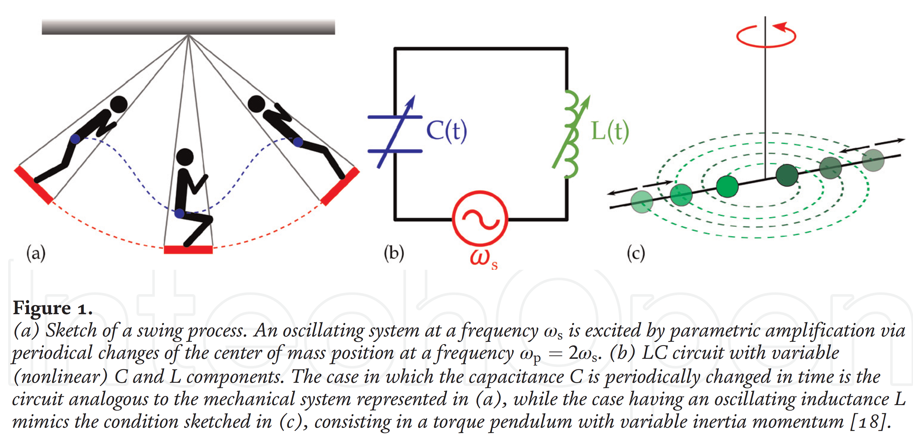
Josephson Traveling-Wave Parametric Amplifiers (JTWPA)
A weak signal traveling in a metamaterial can interact with a strong pump tone at a different frequency, activating the so-called parametric amplification.
The class of devices where these phenomena are promoted is commonly known as Josephson traveling-wave parametric amplifiers (JTWPA)
L. Fasolo, et al. "Superconducting josephson-based metamaterials for quantum-limited parametric amplification: A review." Adv. Condensed-Matter Materials Physics–Rudimentary Res. Topical Technol.. IntechOpen, 2019.

Slide 4

Layout of a TWJPA Chip TWJPA_X52
Layout of a the Traveling Wave Josephson Parametric Amplifiers (TWJPA) Chip TWJPA_X52 (size 10x10 mm2) based on a sequence of 990 elementary cells each formed by an RF-SQUID in series and an interdigital capacitor to ground.
Equivalent circuit of 3 elementary cells
S. Pagano et al., ”Development of Quantum Limited Superconducting Amplifiers for Advanced Detection,” in IEEE Transactions on Applied Superconductivity, 32, 4, 1-5 (2022)

Slide 5
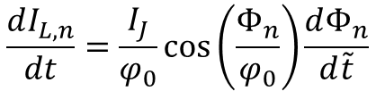
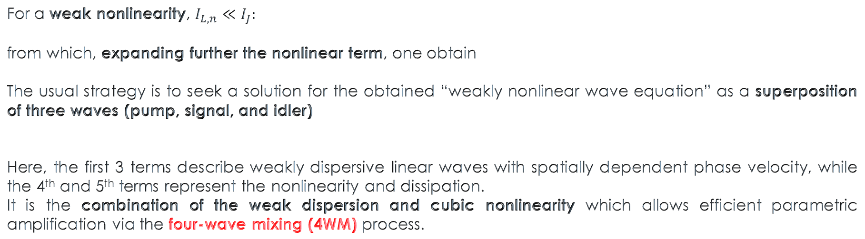
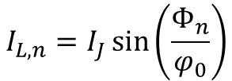
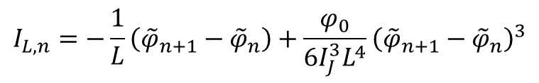

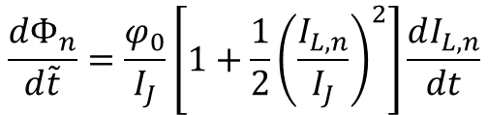
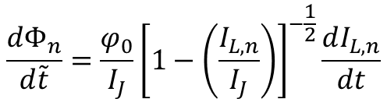
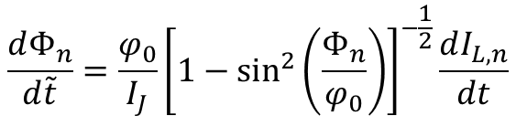
State of the art: the theoretical model
The TWJPA is a series of current-biased JJs with an input voltage control, used to amplify a weak signal.
$$V_{n+1}−V_{n}=−\frac{dΦ_{n}}{d\tilde{t}}$$
$$I_{L,n}=I_{J}\sin\left(\frac{Φ_{n}}{φ_{0}}\right)$$
$$\frac{dI_{L,n}}{dt}=\frac{I_{J}}{φ_{0}}\cos\left(\frac{Φ_{n}}{φ_{0}}\right)\frac{dΦ_{n}}{d\tilde{t}}$$
$$\frac{dΦ_{n}}{d\tilde{t}}=\frac{φ_{0}}{I_{J}}{\left[1−\sin^{2}\left(\frac{Φ_{n}}{φ_{0}}\right)\right]}^{−\frac{1}{2}}\frac{dI_{L,n}}{dt}$$
$$\frac{dΦ_{n}}{d\tilde{t}}=\frac{φ_{0}}{I_{J}}{\left[1−\left(\frac{I_{L,n}}{I_{J}}\right)\right]}^{−\frac{1}{2}}\frac{dI_{L,n}}{dt}$$
$$\frac{dΦ_{n}}{d\tilde{t}}=\frac{φ_{0}}{I_{J}}\left[1+\frac{1}{2}{\left(\frac{I_{L,n}}{I_{J}}\right)}^{2}\right]\frac{dI_{L,n}}{dt}$$
For a weak nonlinearity, $I_{L,n}≪I_{J}:$
from which, expanding further the nonlinear term, one obtain
The usual strategy is to seek a solution for the obtained “weakly nonlinear wave equation” as a superposition of three waves (pump, signal, and idler)
Here, the first 3 terms describe weakly dispersive linear waves with spatially dependent phase velocity, while the 4th and 5th terms represent the nonlinearity and dissipation.
It is the combination of the weak dispersion and cubic nonlinearity which allows efficient parametric amplification via the four-wave mixing (4WM) process.
$$I_{L,n}=−\frac{1}{L}\left({\tilde{φ}}_{n+1}−{\tilde{φ}}_{n}\right)+\frac{φ_{0}}{6I_{J}^{3}L^{4}}{\left({\tilde{φ}}_{n+1}−{\tilde{φ}}_{n}\right)}^{3}$$
$$\tilde{φ}\left(x,t\right)=\left[{\tilde{A}}_{p}\left(x\right)e^{iψ_{p}}+{\tilde{A}}_{s}\left(x\right)e^{iψ_{s}}+{\tilde{A}}_{i}\left(x\right)e^{iψ_{i}}+c.c.\right]/2$$
Yaakoby, et al., PRB 87, 144301 (2013)

Slide 6
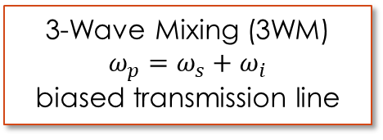
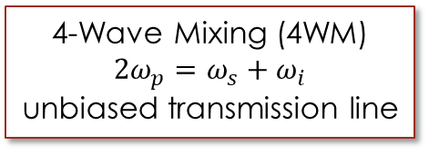
State of the art: the amplification mechanisms
Two different operative modes:
3-Wave Mixing (3WM)
$$ω_{p}=ω_{s}+ω_{i}$$
biased transmission line
4-Wave Mixing (4WM)
$$2ω_{p}=ω_{s}+ω_{i}$$
unbiased transmission line
Zorin showed that by embedding a chain of rf-SQUIDs into a coplanar waveguide, it is possible to tune both the 2nd and 3rd order nonlinearities of their CPR. This is a novel approach to the TWJPA, for the possibility to use a quadratic term as a source of nonlinearity allows to work in the so called 3-Wave Mixing (3WM) regime.
Zorin, PRAppl. 6, 034006 (2016) Yaakoby, et al., PRB 87, 144301 (2013)
Zorin, PRAppl. 12, 044051 (2019)

Slide 7



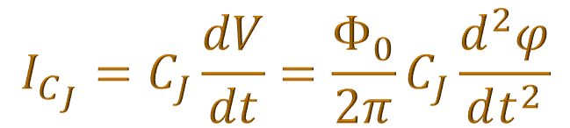

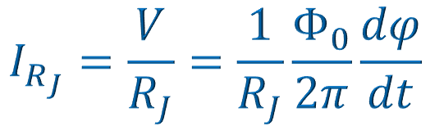


The Resistively Capacitance
Shunted Junction (RCSJ) model
V
Short Josephson junction
I_{b}
I_{b}
$\left|I_{b}\right|>I_{c}$
finite voltage state
$φ(t)$ evolves in time – dynamic state of the JJ
The total current is composed by
Josephson «dissipationless» channel
Resistive channel
Capacitive channel
Noise contribution
I_{b}
I_{J}
I_{RJ}
I_{CJ}
I_{f}
I_{J}
V
At $T>0$, there is a finite probability for Cooper pairs to be broken up by thermal excitation thereby generating unpaired “normal” electrons (i.e., quasiparticles). If $V≠0$, these normal electrons contribute to the current. In contrast to the Josephson current, this normal current channel is resistive.
An SIS tunnel JJ just represents a parallel plate capacitor.
In the presence of $V(t)≠0$ we have a finite displacement current across this capacitor.
A temperature-dependent fluctuating current contribution
I_{RJ}
R_{J}
C_{J}
JJ
$$I_{J}=I_{c}\sin{φ}$$
$$I_{f}=White noise$$
I_{CJ}
$$I_{C_{J}}=C_{J}\frac{dV}{dt}=\frac{Φ_{0}}{2π}C_{J}\frac{d^{2}φ}{dt^{2}}$$
$$I_{R_{J}}=\frac{V}{R_{J}}=\frac{1}{R_{J}}\frac{Φ_{0}}{2π}\frac{dφ}{dt}$$
I_{f}
$${I_{b}+I_{f}=I}_{J}+I_{R_{J}}+I_{C_{J}}$$

Slide 8
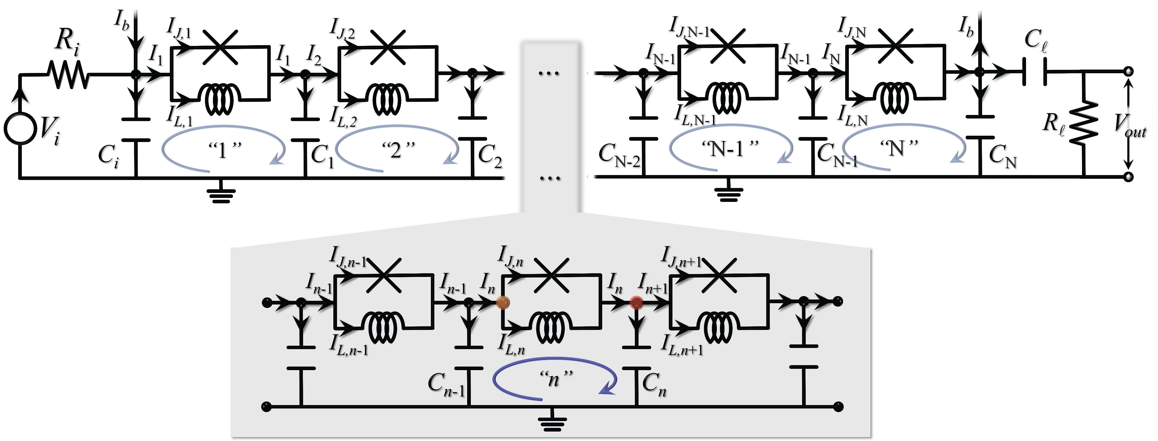
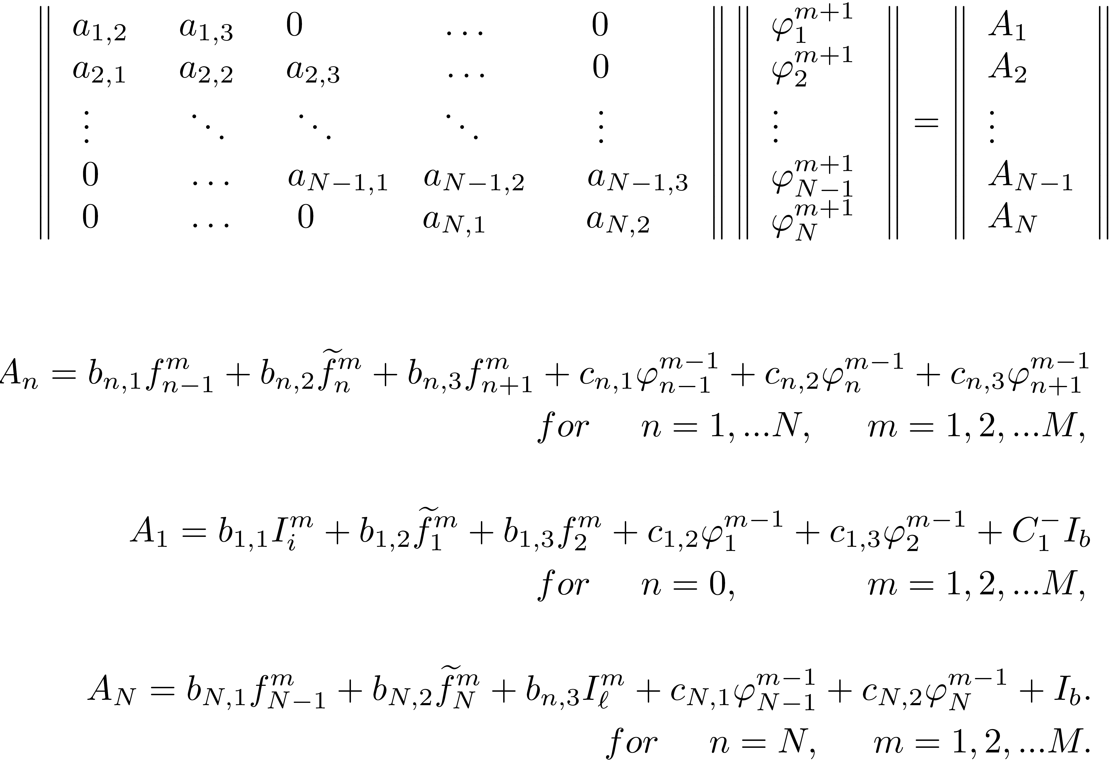


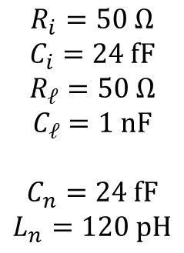
The TWJPA: the design
The TWJPA: the design and the modelling
$$≡$$
Chip TWJPA_X52
specifics
$$R_{i}=50 Ω$$
$$C_{i}=24 fF$$
$$R_{ℓ}=50 Ω$$
$$C_{ℓ}=1 nF$$
$$C_{n}=24 fF$$
$$L_{n}=120 pH$$
$N=990$JJs
$$R_{J}=20 kΩ$$
$$C_{J}=200 fF$$
$$I_{c}=2 μA$$

Slide 9
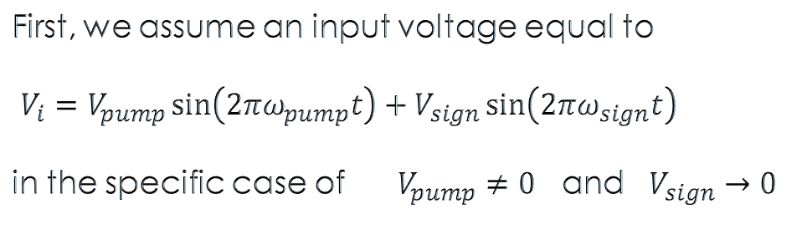
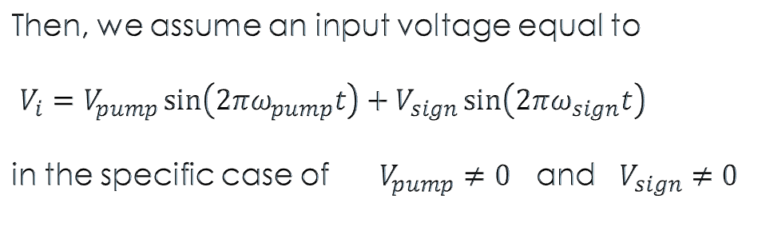
1) Transmission Line
First, we assume an input voltage equal to
$V_{i}=V_{pump}\sin\left({2πω}_{pump}t\right)+V_{sign}\sin\left(2πω_{sign}t\right)$
in the specific case of $V_{pump}≠0$ and $V_{sign}→0$
2) TWPA
Then, we assume an input voltage equal to
$V_{i}=V_{pump}\sin\left({2πω}_{pump}t\right)+V_{sign}\sin\left(2πω_{sign}t\right)$
in the specific case of $V_{pump}≠0$ and $V_{sign}≠0$

Slide 10
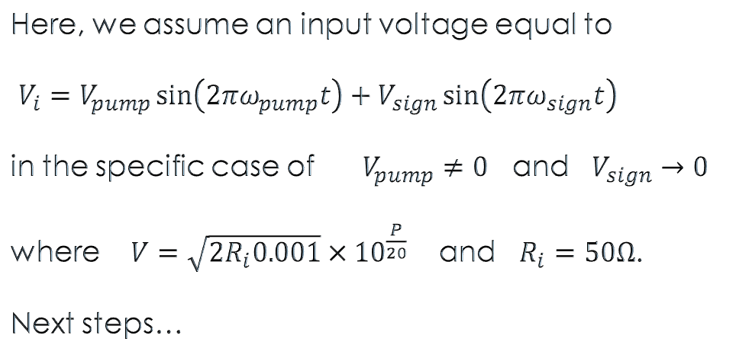
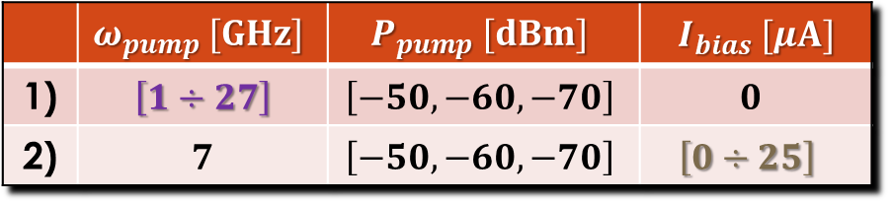
Transmission Line with Josephson elements
Here, we assume an input voltage equal to
$V_{i}=V_{pump}\sin\left({2πω}_{pump}t\right)+V_{sign}\sin\left(2πω_{sign}t\right)$
in the specific case of $V_{pump}≠0$ and $V_{sign}→0$
where $V=\sqrt{2R_{i}0.001}{×10}^{\frac{P}{20}}$ and $R_{i}=50Ω$.
Next steps…
 | $$ω_{pump} [GHz]$$ | $$P_{pump} [dBm]$$ | $$I_{bias} [μA]$$
1) | $$\left[1÷27\right]$$ | $$\left[−50,−60,−70\right]$$ | $$0$$
2) | $$7$$ | $$\left[−50,−60,−70\right]$$ | $$\left[0÷25\right]$$

Slide 11
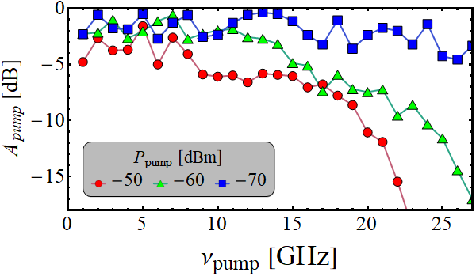
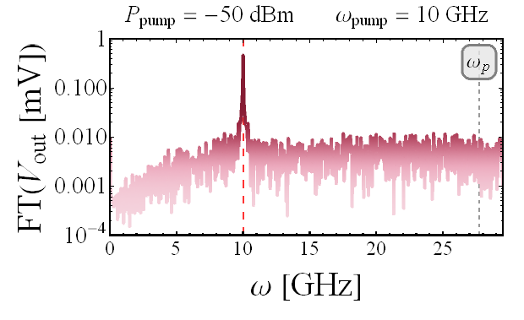
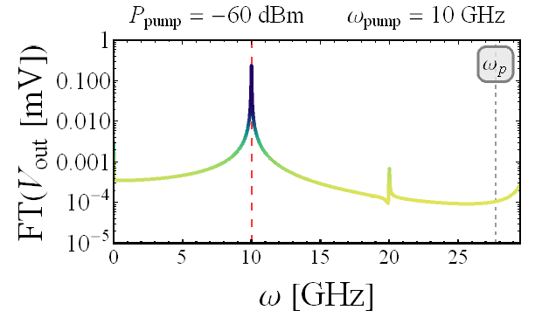
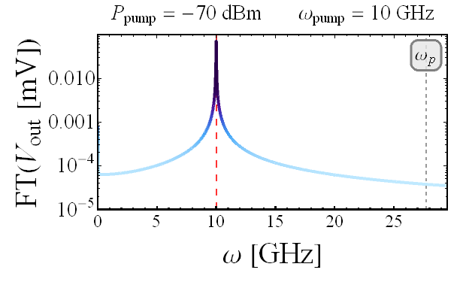
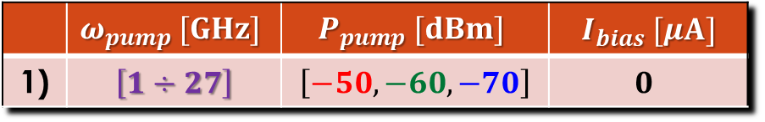

The limit response vs $ν_{pump}$
 | $$ω_{pump} [GHz]$$ | $$P_{pump} [dBm]$$ | $$I_{bias} [μA]$$
1) | $$\left[1÷27\right]$$ | $$\left[−50,−60,−70\right]$$ | $$0$$
The attenuation is calculated as
$A_{pump}=20\log_{10}\left(\frac{V_{out}}{V_{pump}}\right) dB.$

Slide 12
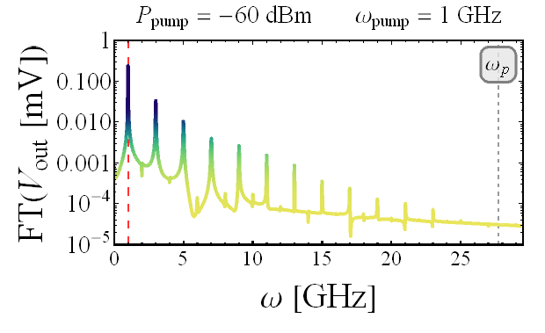
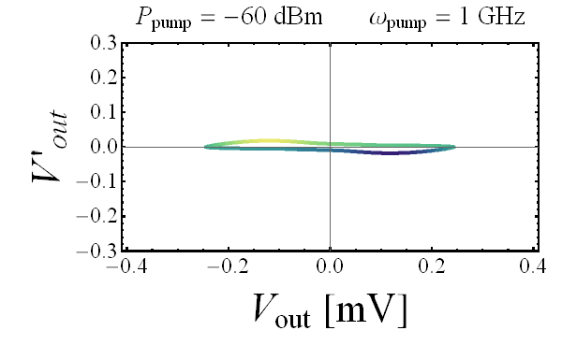
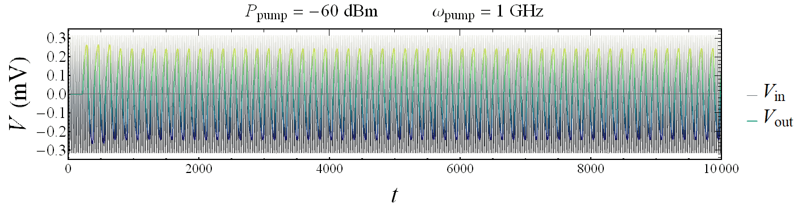
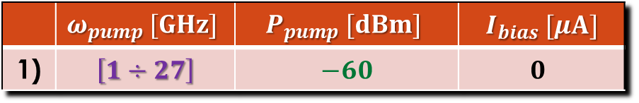
The limit response vs $ν_{pump}$
 | $$ω_{pump} [GHz]$$ | $$P_{pump} [dBm]$$ | $$I_{bias} [μA]$$
1) | $$\left[1÷27\right]$$ | $$−60$$ | $$0$$
$A_{pump}=20\log_{10}\left(\frac{V_{out}}{V_{pump}}\right) dB$
t_{thr}

Slide 13
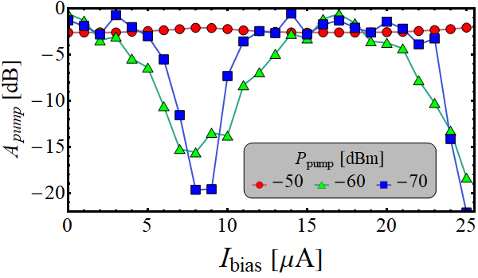
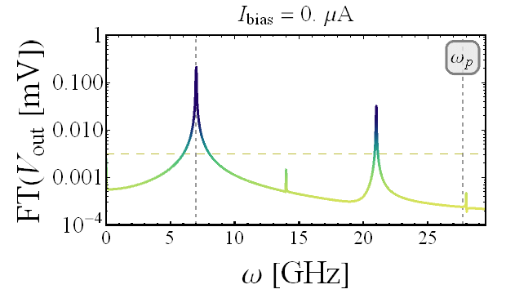
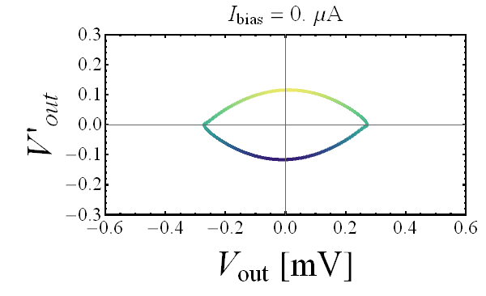
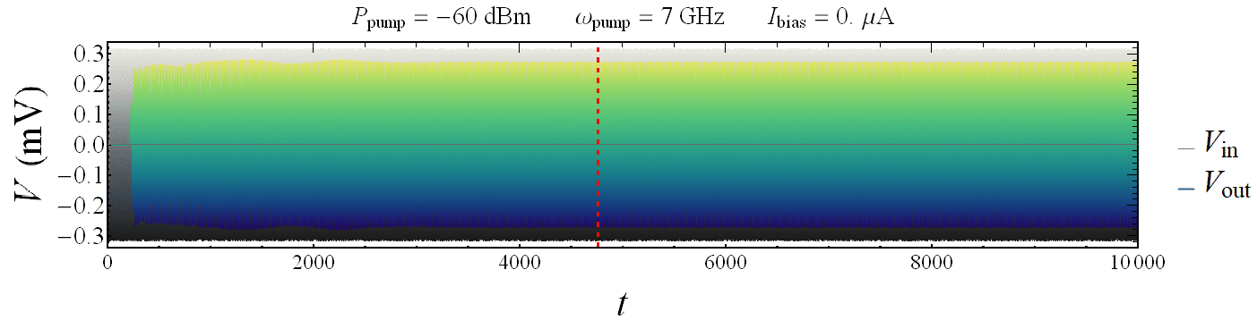
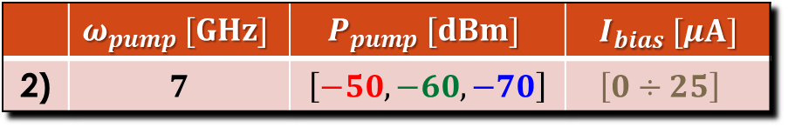
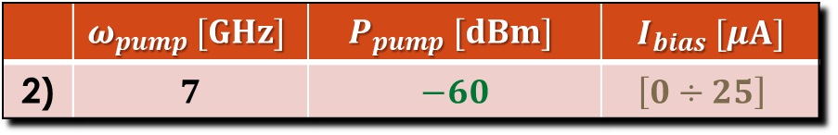
The limit response vs $I_{bias}$
 | $$ω_{pump} [GHz]$$ | $$P_{pump} [dBm]$$ | $$I_{bias} [μA]$$
2) | $$7$$ | $$\left[−50,−60,−70\right]$$ | $$\left[0÷25\right]$$
 | $$ω_{pump} [GHz]$$ | $$P_{pump} [dBm]$$ | $$I_{bias} [μA]$$
2) | $$7$$ | $$−60$$ | $$\left[0÷25\right]$$
$A_{pump}=20\log_{10}\left(\frac{V_{out}}{V_{pump}}\right) dB$
t_{thr}

Slide 14
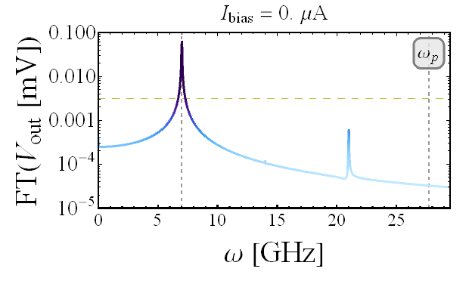
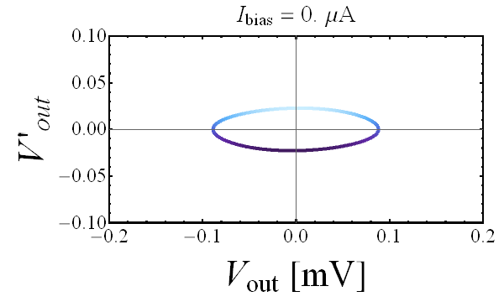
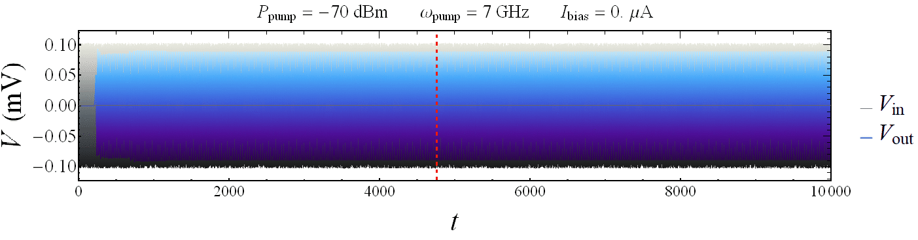
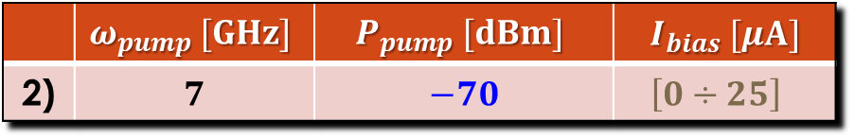
The limit response vs $I_{bias}$
 | $$ω_{pump} [GHz]$$ | $$P_{pump} [dBm]$$ | $$I_{bias} [μA]$$
2) | $$7$$ | $$\left[−50,−60,−70\right]$$ | $$\left[0÷25\right]$$
 | $$ω_{pump} [GHz]$$ | $$P_{pump} [dBm]$$ | $$I_{bias} [μA]$$
2) | $$7$$ | $$−70$$ | $$\left[0÷25\right]$$
$A_{pump}=20\log_{10}\left(\frac{V_{out}}{V_{pump}}\right) dB$
t_{thr}

Slide 15
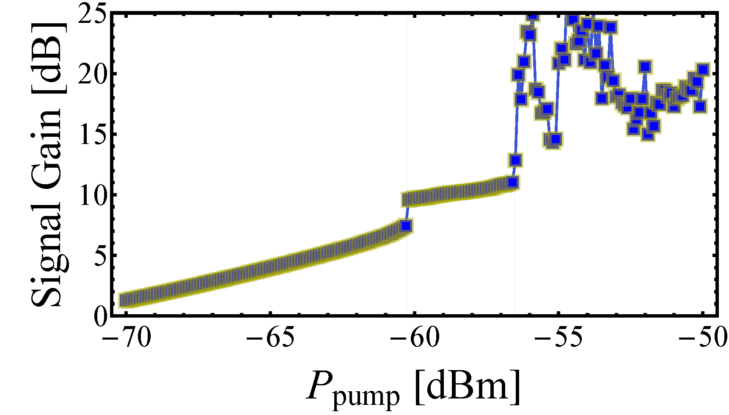
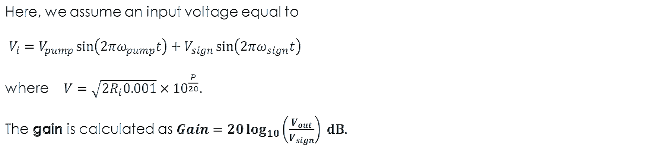
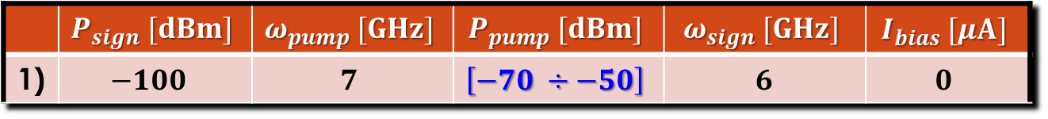
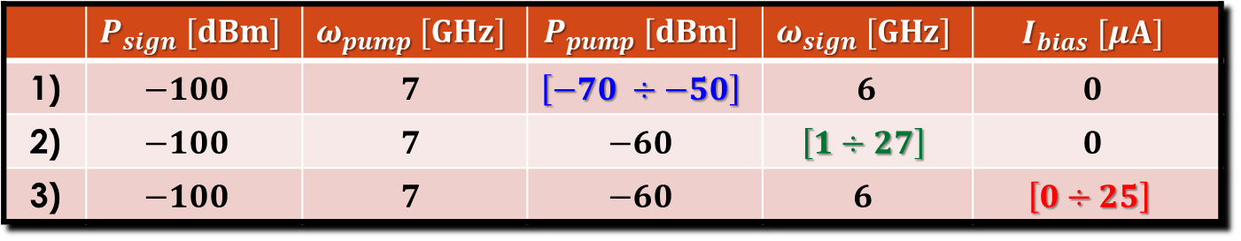
 | $$P_{sign} [dBm]$$ | $$ω_{pump} [GHz]$$ | $$P_{pump} [dBm]$$ | $$ω_{sign} [GHz]$$ | $$I_{bias} [μA]$$
1) | $$−100$$ | $$7$$ | $$\left[−70 ÷−50\right]$$ | $$6$$ | $$0$$
JTWPA
Here, we assume an input voltage equal to
$V_{i}=V_{pump}\sin\left({2πω}_{pump}t\right)+V_{sign}\sin\left(2πω_{sign}t\right)$
where $V=\sqrt{2R_{i}0.001}{×10}^{\frac{P}{20}}$.
The gain is calculated as $Gain=20\log_{10}\left(\frac{V_{out}}{V_{sign}}\right) dB.$
 | $$P_{sign} [dBm]$$ | $$ω_{pump} [GHz]$$ | $$P_{pump} [dBm]$$ | $$ω_{sign} [GHz]$$ | $$I_{bias} [μA]$$
1) | $$−100$$ | $$7$$ | $$\left[−70 ÷−50\right]$$ | $$6$$ | $$0$$
2) | $$−100$$ | $$7$$ | $$−60$$ | $$\left[1÷27\right]$$ | $$0$$
3) | $$−100$$ | $$7$$ | $$−60$$ | $$6$$ | $$\left[0÷25\right]$$

Slide 16
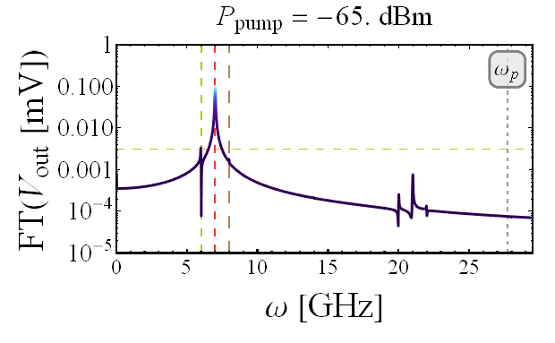
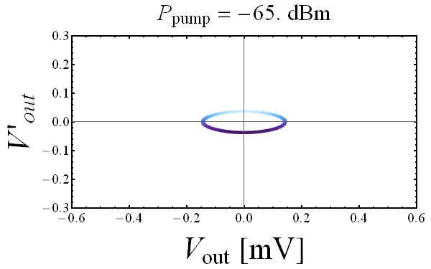
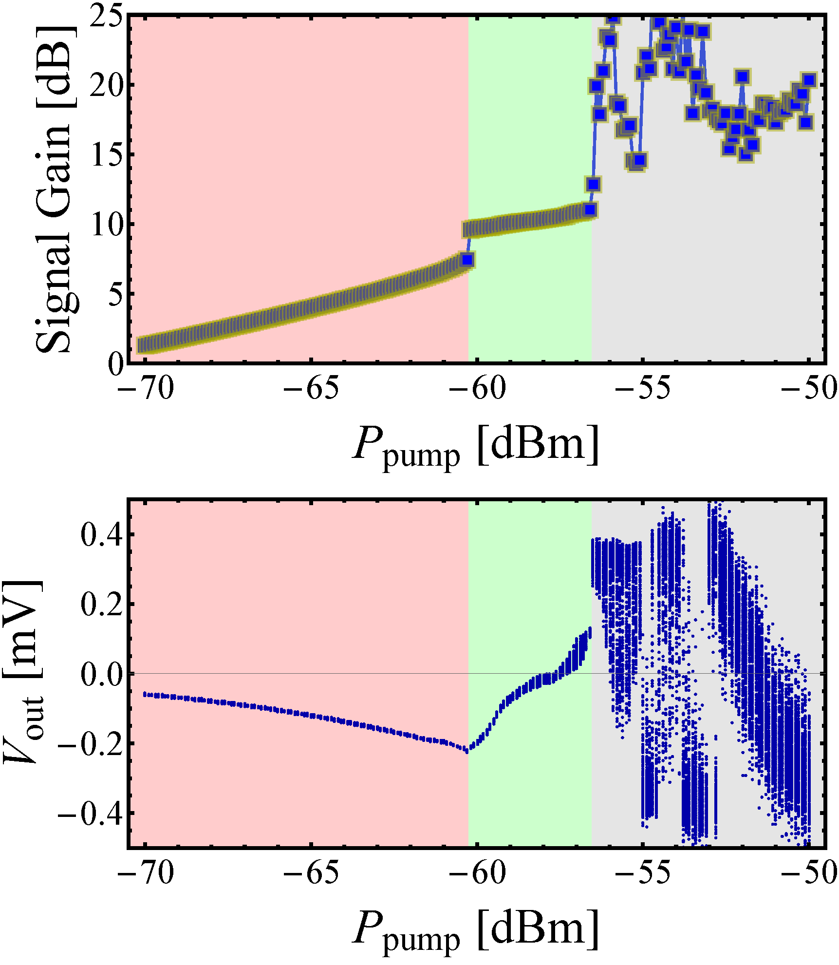
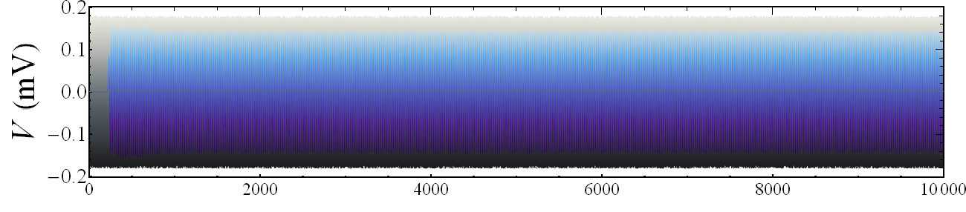
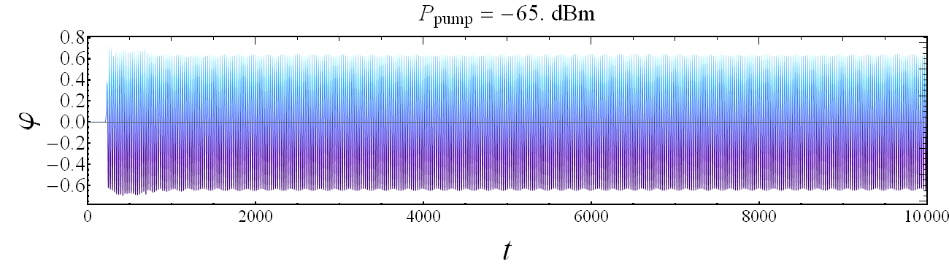


 | $$P_{sign} [dBm]$$ | $$ω_{pump} [GHz]$$ | $$P_{pump} [dBm]$$ | $$ω_{sign} [GHz]$$ | $$I_{bias} [μA]$$
1) | $$−100$$ | $$7$$ | $$\left[−70 ÷−50\right]$$ | $$6$$ | $$17$$
 | $$P_{sign} [dBm]$$ | $$ω_{pump} [GHz]$$ | $$P_{pump} [dBm]$$ | $$ω_{sign} [GHz]$$ | $$I_{bias} [μA]$$
1) | $$−100$$ | $$7$$ | $$−65$$ | $$6$$ | $$0$$
Gain vs P_{pump}
t_{thr}
N

Slide 17





 | $$P_{sign} [dBm]$$ | $$ω_{pump} [GHz]$$ | $$P_{pump} [dBm]$$ | $$ω_{sign} [GHz]$$ | $$I_{bias} [μA]$$
1) | $$−100$$ | $$7$$ | $$\left[−70 ÷−50\right]$$ | $$6$$ | $$17$$
 | $$P_{sign} [dBm]$$ | $$ω_{pump} [GHz]$$ | $$P_{pump} [dBm]$$ | $$ω_{sign} [GHz]$$ | $$I_{bias} [μA]$$
1) | $$−100$$ | $$7$$ | $$−60$$ | $$6$$ | $$0$$
Gain vs P_{pump}
t_{thr}
N

Slide 18





 | $$P_{sign} [dBm]$$ | $$ω_{pump} [GHz]$$ | $$P_{pump} [dBm]$$ | $$ω_{sign} [GHz]$$ | $$I_{bias} [μA]$$
1) | $$−100$$ | $$7$$ | $$\left[−70 ÷−50\right]$$ | $$6$$ | $$17$$
 | $$P_{sign} [dBm]$$ | $$ω_{pump} [GHz]$$ | $$P_{pump} [dBm]$$ | $$ω_{sign} [GHz]$$ | $$I_{bias} [μA]$$
1) | $$−100$$ | $$7$$ | $$−55$$ | $$6$$ | $$0$$
Gain vs P_{pump}
t_{thr}
N

Slide 19






 | $$P_{sign} [dBm]$$ | $$ω_{pump} [GHz]$$ | $$P_{pump} [dBm]$$ | $$ω_{sign} [GHz]$$ | $$I_{bias} [μA]$$
1) | $$−100$$ | $$7$$ | $$\left[−70 ÷−50\right]$$ | $$6$$ | $$17$$
 | $$P_{sign} [dBm]$$ | $$ω_{pump} [GHz]$$ | $$P_{pump} [dBm]$$ | $$ω_{sign} [GHz]$$ | $$I_{bias} [μA]$$
1) | $$−100$$ | $$7$$ | $$−65$$ | $$6$$ | $$17$$
Gain vs P_{pump}
t_{thr}
N

Slide 20





 | $$P_{sign} [dBm]$$ | $$ω_{pump} [GHz]$$ | $$P_{pump} [dBm]$$ | $$ω_{sign} [GHz]$$ | $$I_{bias} [μA]$$
1) | $$−100$$ | $$7$$ | $$−60$$ | $$6$$ | $$17$$
Gain vs P_{pump}
t_{thr}
N

Slide 21





 | $$P_{sign} [dBm]$$ | $$ω_{pump} [GHz]$$ | $$P_{pump} [dBm]$$ | $$ω_{sign} [GHz]$$ | $$I_{bias} [μA]$$
1) | $$−100$$ | $$7$$ | $$−55$$ | $$6$$ | $$17$$
Gain vs P_{pump}
t_{thr}
N

Slide 22






 | $$P_{sign} [dBm]$$ | $$ω_{pump} [GHz]$$ | $$P_{pump} [dBm]$$ | $$ω_{sign} [GHz]$$ | $$I_{bias} [μA]$$
2) | $$−100$$ | $$7$$ | $$−60$$ | $$\left[1÷27\right]$$ | $$0$$
Gain vs ω_{sign}
t_{thr}

Slide 23






 | $$P_{sign} [dBm]$$ | $$ω_{pump} [GHz]$$ | $$P_{pump} [dBm]$$ | $$ω_{sign} [GHz]$$ | $$I_{bias} [μA]$$
3) | $$−100$$ | $$7$$ | $$−60$$ | $$6$$ | $$\left[0÷25\right]$$
Gain vs I_{bias}
t_{thr}

Slide 24




 | $$P_{sign} [dBm]$$ | $$ω_{pump} [GHz]$$ | $$P_{pump} [dBm]$$ | $$ω_{sign} [GHz]$$ | $$I_{bias} [μA]$$
3) | $$−100$$ | $$7$$ | $$−60$$ | $$6$$ | $$\left[0÷25\right]$$
Gain vs I_{bias}
t_{thr}

Slide 25




 | $$P_{sign} [dBm]$$ | $$ω_{pump} [GHz]$$ | $$P_{pump} [dBm]$$ | $$ω_{sign} [GHz]$$ | $$I_{bias} [μA]$$
3) | $$−100$$ | $$7$$ | $$−60$$ | $$6$$ | $$\left[0÷25\right]$$
Gain vs I_{bias}
t_{thr}

Slide 26




TWJPA – Gain vs $δIc$
Here, we assume the critical currents to be distributed
according to
$I_{c,n}=\overline{I_{c}}\left(1+{δI}_{c}\right)$
with ${δI}_{c}$ being a Gaussianly distributed number with
zero average and variance $σ_{I_{c}}^{2}$.
I_{bias}= 0
I_{bias}= 17μA

Slide 27



TWJPA – Gain vs $δIc$
Here, we assume the critical currents to be distributed
according to
$I_{c,n}=\overline{I_{c}}\left(1+{δI}_{c}\right)$
with ${δI}_{c}$ being a Gaussianly distributed number with
zero average and variance $σ_{I_{c}}^{2}$.
I_{bias}= 2.5 μA
I_{bias}= 15 μA

Slide 28


Perspectives: Resonant Phase Matching strategy
This new design is specifically made to reduce higher harmonics generation and unwanted mixing products, by lowering the Josephson plasma frequency and making the dispersion relation highly nonlinear with the introduction of elements to induce resonant phase matching
K. O’Brien, et al., Resonant Phase Matching of JJ TWPAs, PRL 113, 157001 (2014)
C. Macklin, et al., A near-quantum-limited JTWPA, Science 350, 307 (2015)

Slide 29

Conclusions
We demonstrated:
the amplification of a weak signal in the presence of a strong pump tone in a TWJPA, obtaining a Gain up to ~10 dB for a specific device configuration;
the robustness of the effect against unavoidable fluctuations in the main Josephson parameter, i.e., the critical current.
Perspectives:
Optimization of the system parameter to maximize the amplification;
Study of impact of fluctuations of the various system parameters;
Study of the impact of thermal noise;
Implementing the “resonant phase matching strategy”;
Change the specifics of the devices forming the transmission lines, e.g., the CPR of the junction or including dc-SQUID.

Slide 30
Conclusions
We demonstrated:
the amplification of a weak signal in the presence of a strong pump tone in a TWJPA, obtaining a Gain up to ~10 dB for a specific device configuration;
the robustness of the effect against unavoidable fluctuations in the main Josephson parameter, i.e., the critical current.
DARTWARS publications
C. Guarcello, et al., Modeling of Josephson Traveling Wave Parametric Amplifiers, accepted on IEEE TAS, 2022
M. Borghesi, et al., Progress in the development of a KITWPA for the DARTWARS project, under review on NIMA, 2022
V. Granata, et al., Characterization of Traveling-Wave Josephson Parametric Amplifiers at T = 0.3 K, under review on IEEE TAS, 2022
A. Rettaroli, et al., Ultra low noise readout with travelling wave parametric amplifiers: the DARTWARS project, under review on NIMA, 2022
A. Giachero, et al., Detector Array Readout with Traveling Wave Amplifiers, J Low Temp Phys, 2022
S. Pagano, et al., Development of Quantum Limited Superconducting Amplifiers for Advanced Detection, IEEE TAS, 32, 4, 1-5, 2022

