Slide 1




A preliminary study of Traveling-wave Josephson parametric amplifiers (TWJPA)
V. Granata°, C. Mauro°, C. Barone°, G. Carapella°, L. Fasolo*, E. Enrico* and S. Pagano° for the DARTWARS collaboration
°Physics Department, University of Salerno, Italy
*INRiM, Turin, Italy
INFN, Italy

Slide 2
Outline
Low noise microwave detection
Principle of operation of JTWPA
The DARTWARS project
Samples description
Experimental setup
Preliminary results
Conclusions and outlook

Slide 3
Low noise microwave detection
Superconducting quantum computing and several fundamental physics experimental demand quantum limited and wide bandwidth cryogenic amplifiers in the microwave frequency range
Cryogenic semiconductor based amplifiers can achieve a minimum noise temperature of 2 - 5 K*
Superconducting amplifiers, being almost non dissipative, can be a good alternatives
JPA
Josephson parametric amplifier
JTWPA
TL based on nonlinear inductance of Josephson junctions
KITWPA
TL based on nonlinear kinetic inductance of SC
Large gain
Quantum limited noise
Wide BW (4-5 GHz)
Quantum limited noise
Wide BW (4-5 GHz)
Quantum limited noise
Shorter length devices
Narrow bandwidth (∼100 MHz): One JPA per cavity or few qubit per read out per line
TL lengths in the order of one meter are required
Design and fabrication more complex
J. Aumentado, IEEE MICROWAVE magazine 1527-3342 (2020)
*J.Schleeh et al., Solid-State Electron. 91, 74–77 (2014)
Notes:
because of circuit based design

Slide 4
Josephson Traveling Wave Parametric Amplifiers (JTWPA)
Josephson Traveling Wave Parametric Amplifiers (JTWPA) has an architecture of a discrete microwave transmission line made of periodically repeated sections, including either single Josephson junctions or superconducting quantum-interference devices (SQUIDs)
JTWPA employ the nonlinear dependence of the Josephson inductance L_{J} on current I(t), enabling time variation of L_{J}(I(t)) following a pump signal at frequency ω_{p}

Slide 5
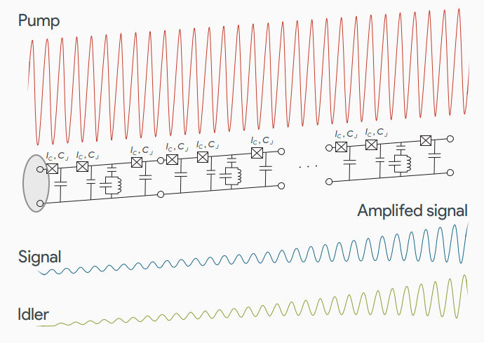
Josephson Traveling Wave Parametric Amplifiers (JTWPA)
JTWPA transfers power from a strong microwave tone (PUMP) to a weak one (SIGNAL)
A large pump tone modulates this inductance, coupling the pump (ω_{p}) to a signal (ω_{s}) and idler (ω_{i}) tone via frequency mixing.
The relation between the frequencies depend on the type of nonlinearity and can be:
4WM
3WM
JTWPA in principle provide a larger bandwidth with respect to JPA and possibly allow a higher gain and dynamic range

Slide 6


The DARTWARS Collaboration
Detector Array Readout with Traveling Wave AmplifieRS
Development of wideband superconducting amplifiers with noise at the quantum limit and the implementation of a quantum-limited read-out in different types of superconducting detectors and qubit
Involved Institutions
University of Salerno, Department of Physics, Fisciano, Salerno, Italy
INFN - Napoli, Salerno group, Fisciano, Salerno, Italy
University of Milano Bicocca, Department of Physics, Milan, Italy
INFN - Milano Bicocca, Milan, Italy
University of Salento, Department of Physics, Lecce, Italy
INFN Sezione di Lecce, Lecce, Italy
INO-CNR BEC Center, Povo, Trento, Italy
University of Trento, Department of Physics, Povo, Trento, Italy
INFN - Trento Institute for Fundamental Physics and Applications, Povo, Trento, Italy
Fondazione Bruno Kessler, Povo, Trento, Italy
INFN - Laboratori Nazionali di Frascati, Frascati, Rome, Italy
INRiM - Istituto Nazionale di Ricerca Metrologica, Turin, Italy
IFN-CNR, Povo, Trento, Italy
Polytechnic University of Turin, Turin, Italy
University of Sannio, Department of Science and Technology, Benevento
University of Sannio, Department of Engineering, Benevento, Italy
INFN - Torino, Turin, Italy

Slide 7
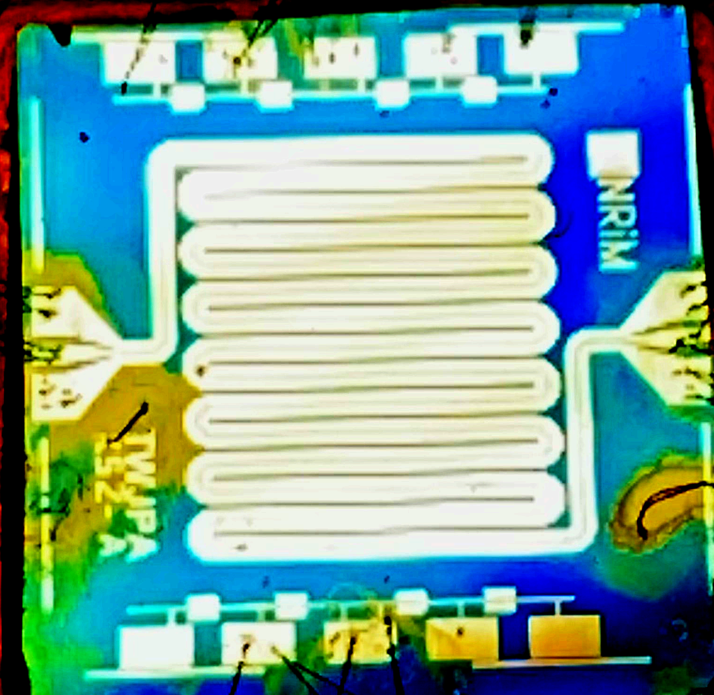
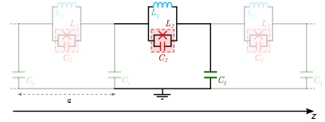
JTWPA: initial design
JTWPA is a two-port superconducting device consisting in a coplanar waveguide in which is embedded a repetition of hundreds of elementary cells
One unit cell consists of RF-Superconducting Quantum Interference Device (RF-SQUID) coupled to ground through C_{g}.
Each RF-SQUID consists in a superconducting loop containing a geometrical inductor L_{g} and Josephson junction (JJ) characterized by an intrinsic inductance L_{J}, an intrinsic capacitance C_{J} and an intrinsic resistance R_{j} (assumed very large at the operating temperature and therefore neglected).

Slide 8
JTWPA: samples description
Design and production by the Istituto Nazionale di Ricerca Metrologica (INRiM, Turin, Italy)
Repetition of N = 990 elementary cells
Cell size a = 63 μm,
Total length l = a · N ≈ 6.25 cm
To make this device as compact as possible the coplanar waveguide is folded in 15 segments
L_{g} has been engineered in the form of a bi-dimensional meander inductor
Ground capacitance C_{g} has been divided in two interdigitate capacitors C_{g}/2
An array of 8 preliminary characterization units (PCU) is present on both sides of the chip

Slide 9
JTWPA: sample fabrication process
Substrate: p-doped, 100 oriented, Si/SiO2(300nm)
The geometry is defined by a single-step Electron Beam Lithography (EBL) process.
JJs: Al(30 nm)/Al-Ox/Al(80 nm) deposited by a ultra-low pressure electron beam evaporator, equipped with a tiltable sample holder that ensure the possibility to create exploiting the Niemeyer-Dolan technique.

Slide 10
JTWPA: sample properties
The nominal values of the individual components of the circuit are:
Critical current of Josephson junctions: 𝐼_{𝐶} = 2 μA
Josephson junction capacity: 𝐶 = 200 fF
Inductance of the Josephson junction at the working point: 𝐿_{𝐽} = 258.5 pH
Geometric inductance: 𝐿_{𝑔} = 120 pH
Plasma frequency: 𝜈_{𝑝} = 38 GHz
Resonator quality factor: 𝑄 = 100

Slide 11
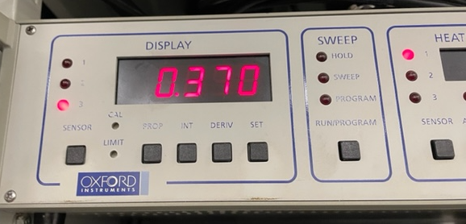
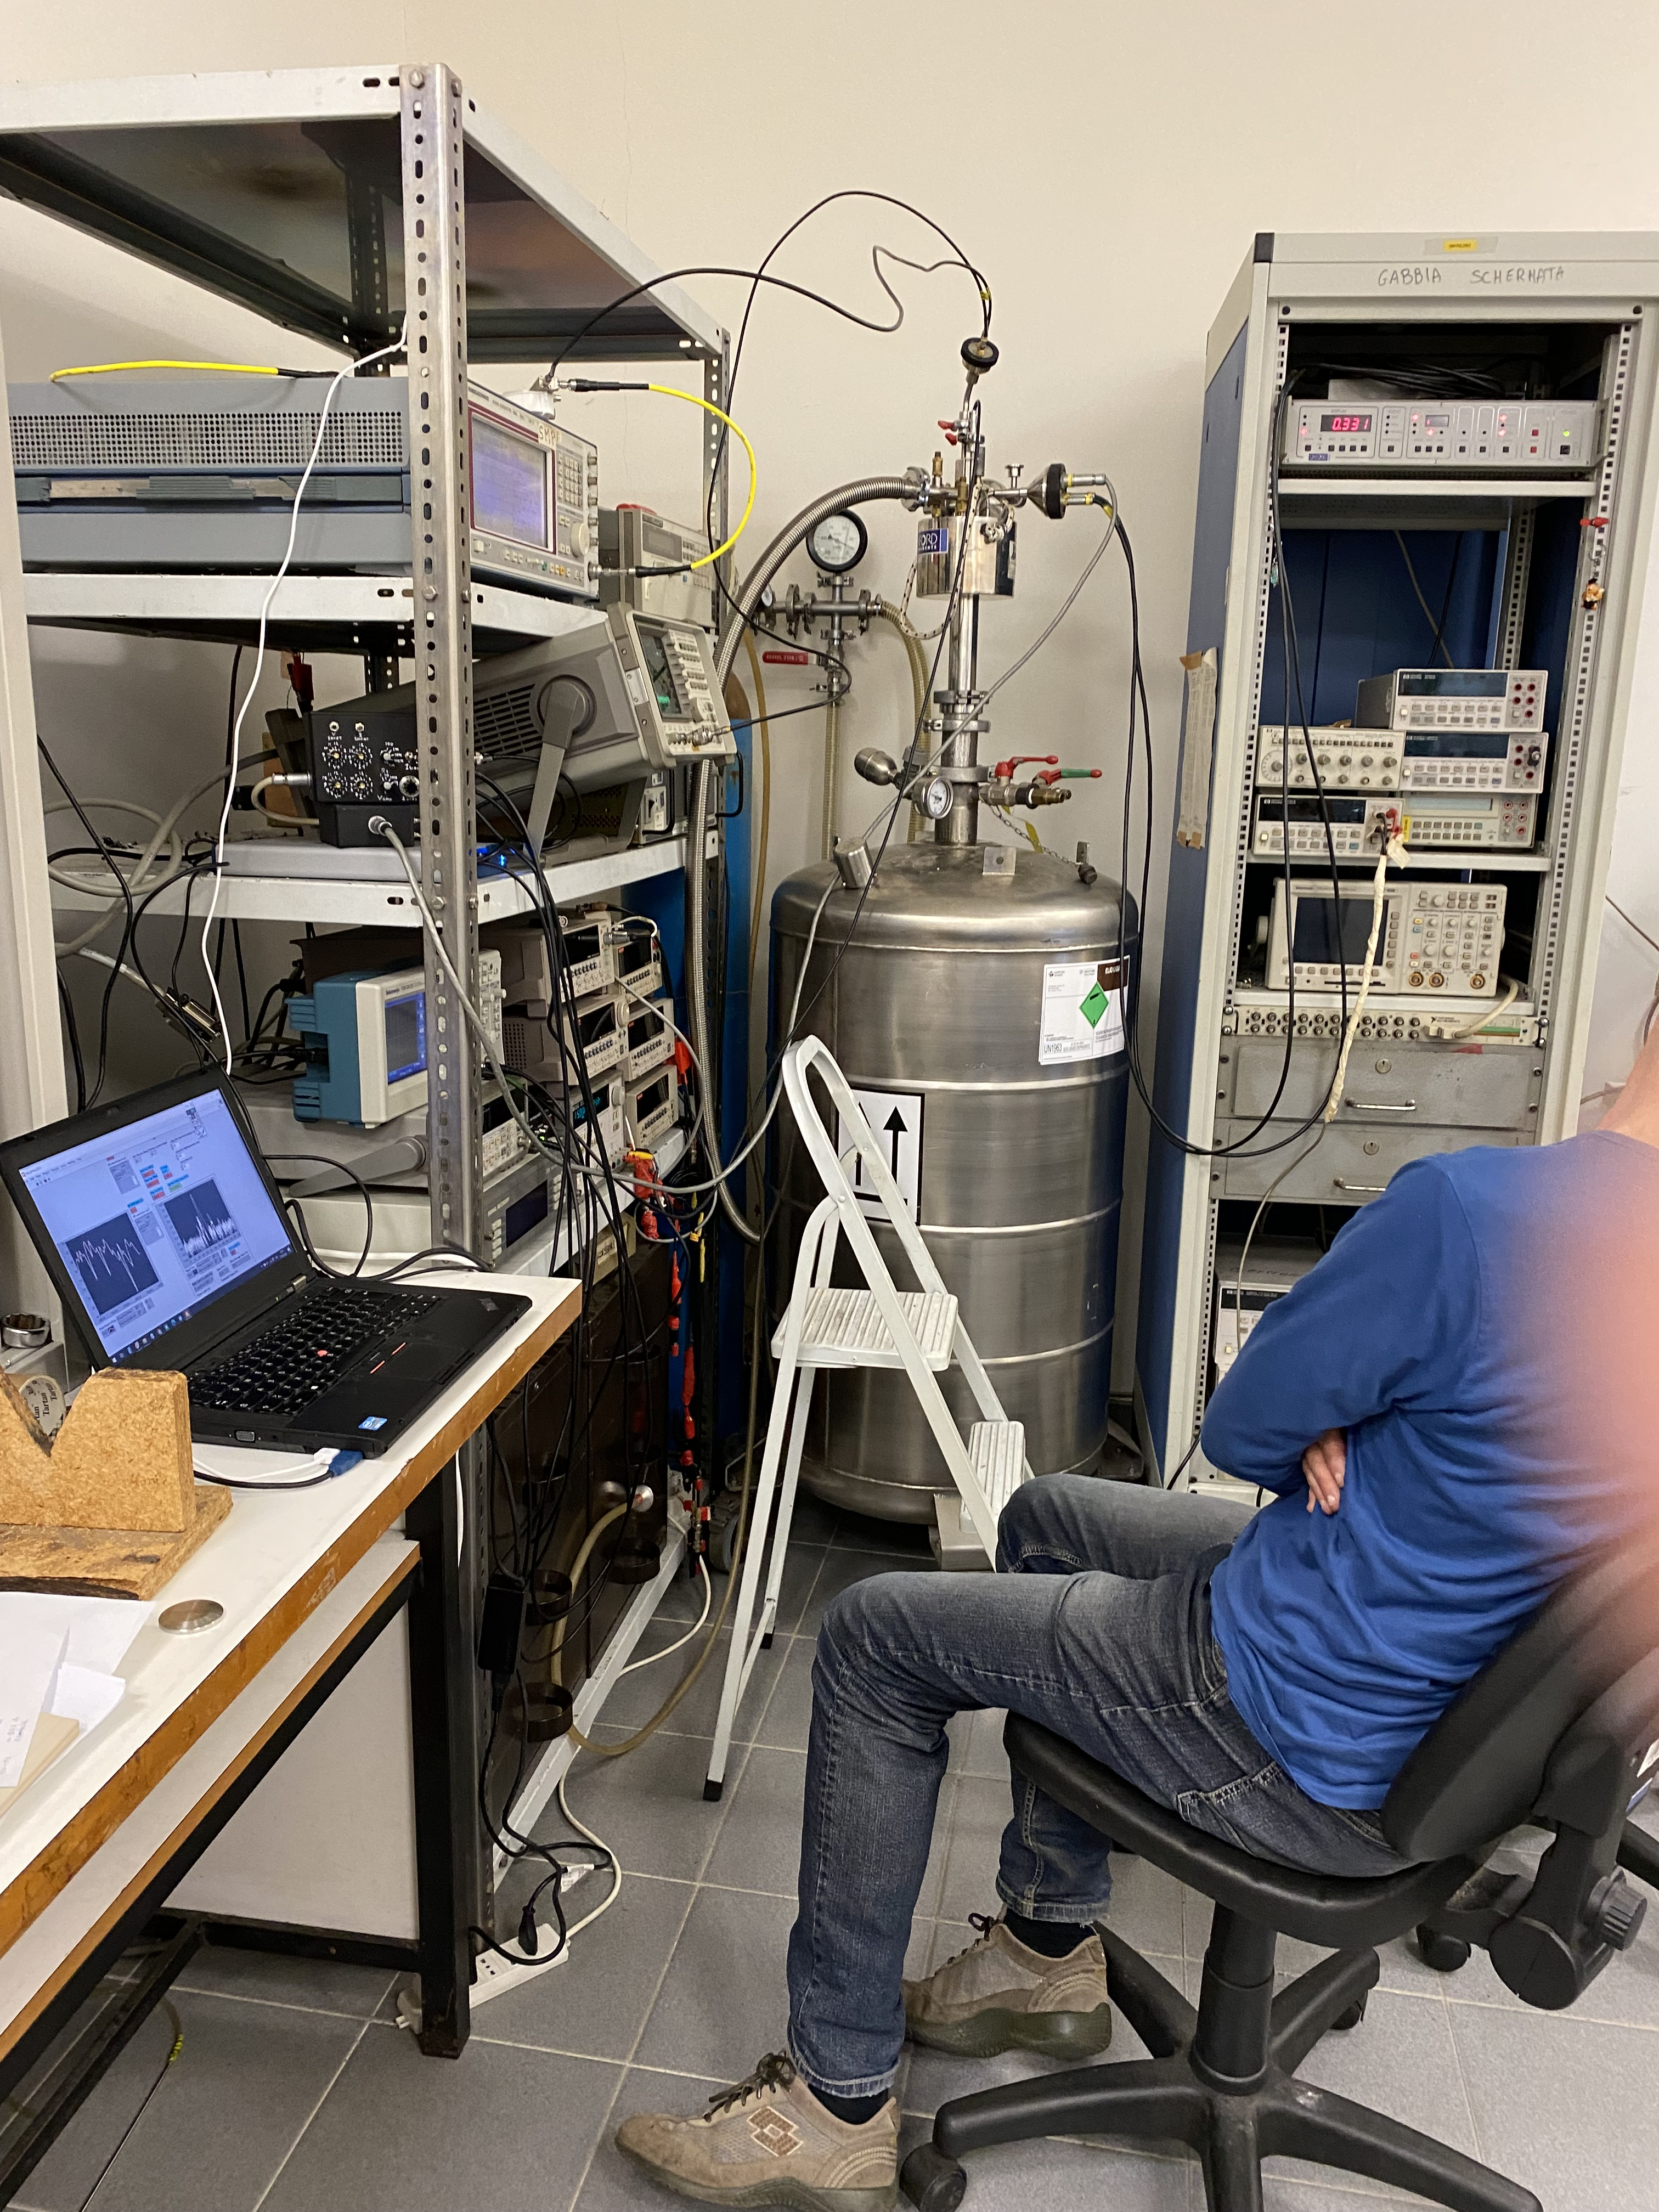
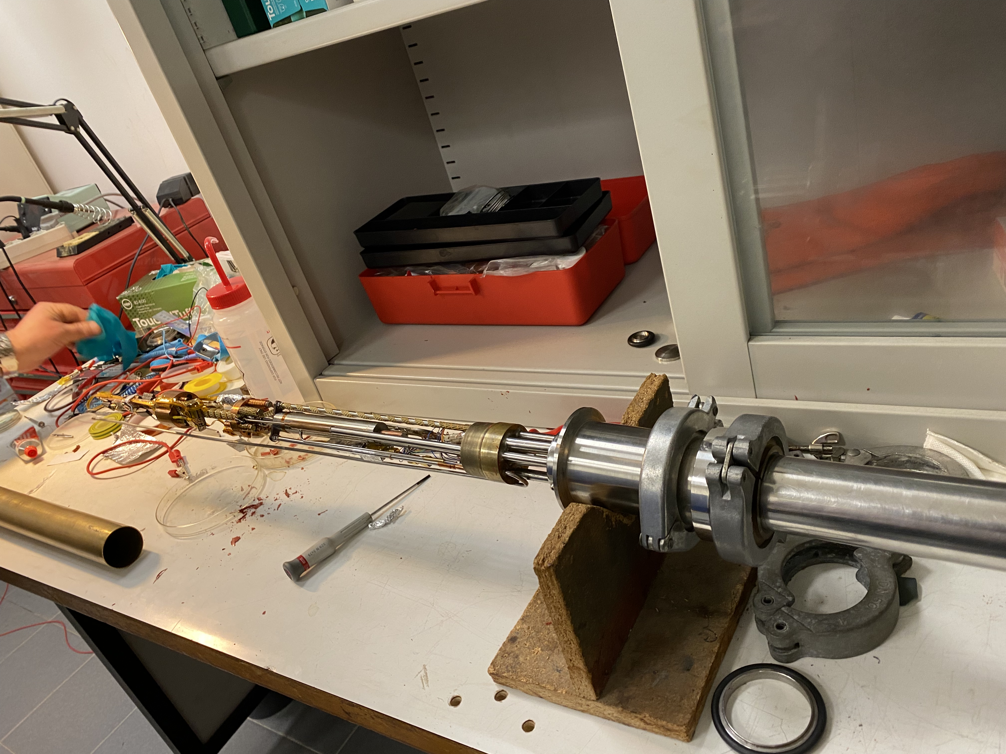
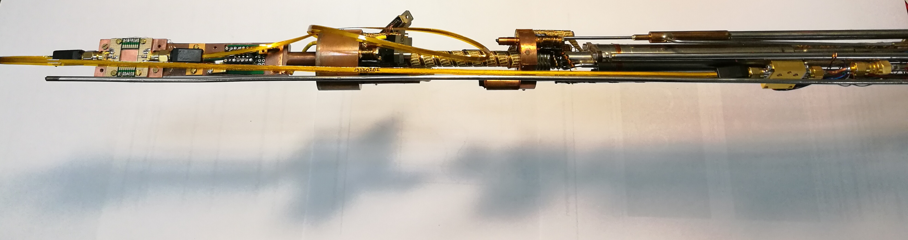
Cryogenic setup
Oxford Heliox VL ³He cryostat
Base T = 245mK Cooling Power = 40 μW at T < 290 mK
Hold time = several hours Recycle time = 1h
OK for testing Al based junctions
Needed adaptations for MW signals
shield
⁴He stage
Cryogenic
Amplifier @ 4.2K
Sample stage
³He stage
1K pot
RF in
RF out

Slide 12
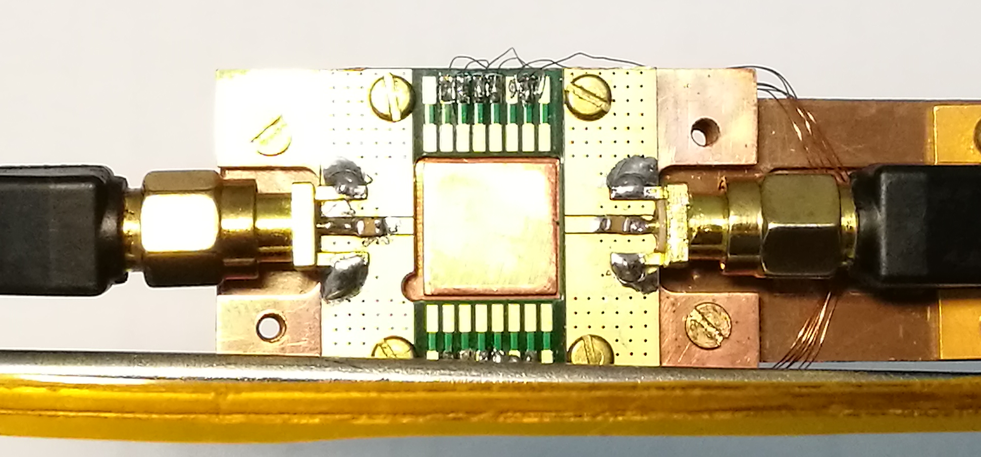
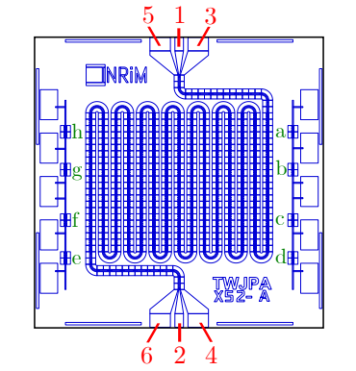
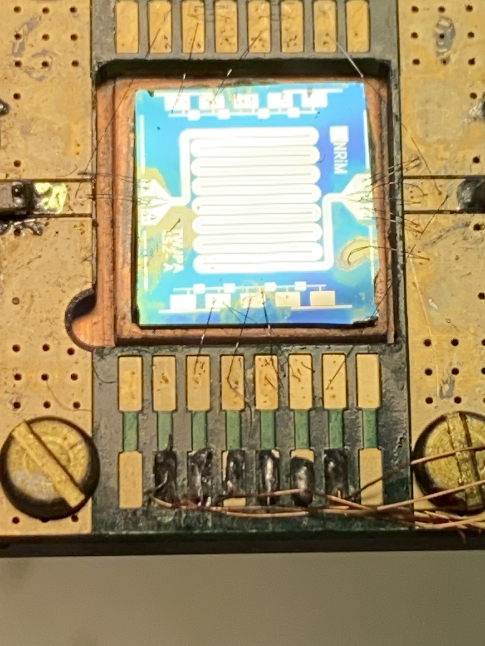
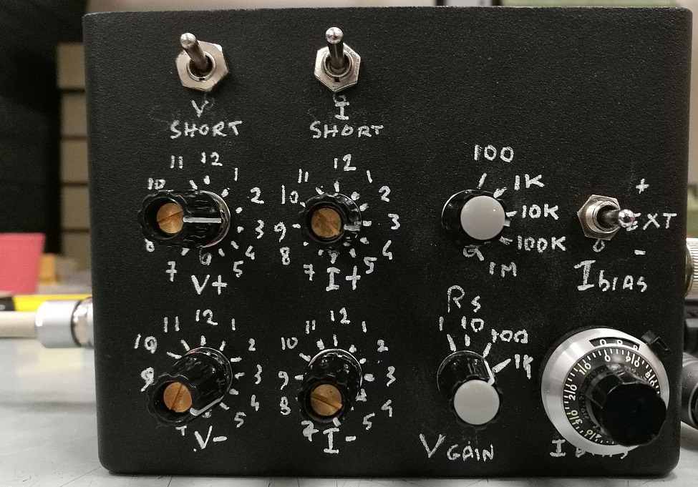
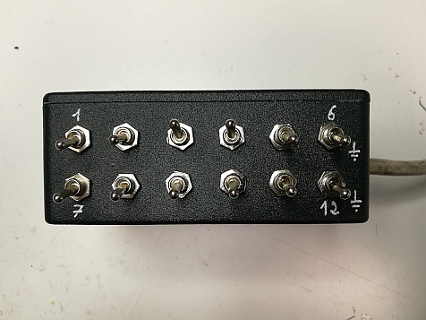
DC Setup
Sample holder
PC
TWJPA X52-A
Ultrasonic bonding
RF out
RF in
DAC/ADC
DC bias and test lines
Filtering and grounding box
Low Noise DC readout

Slide 13
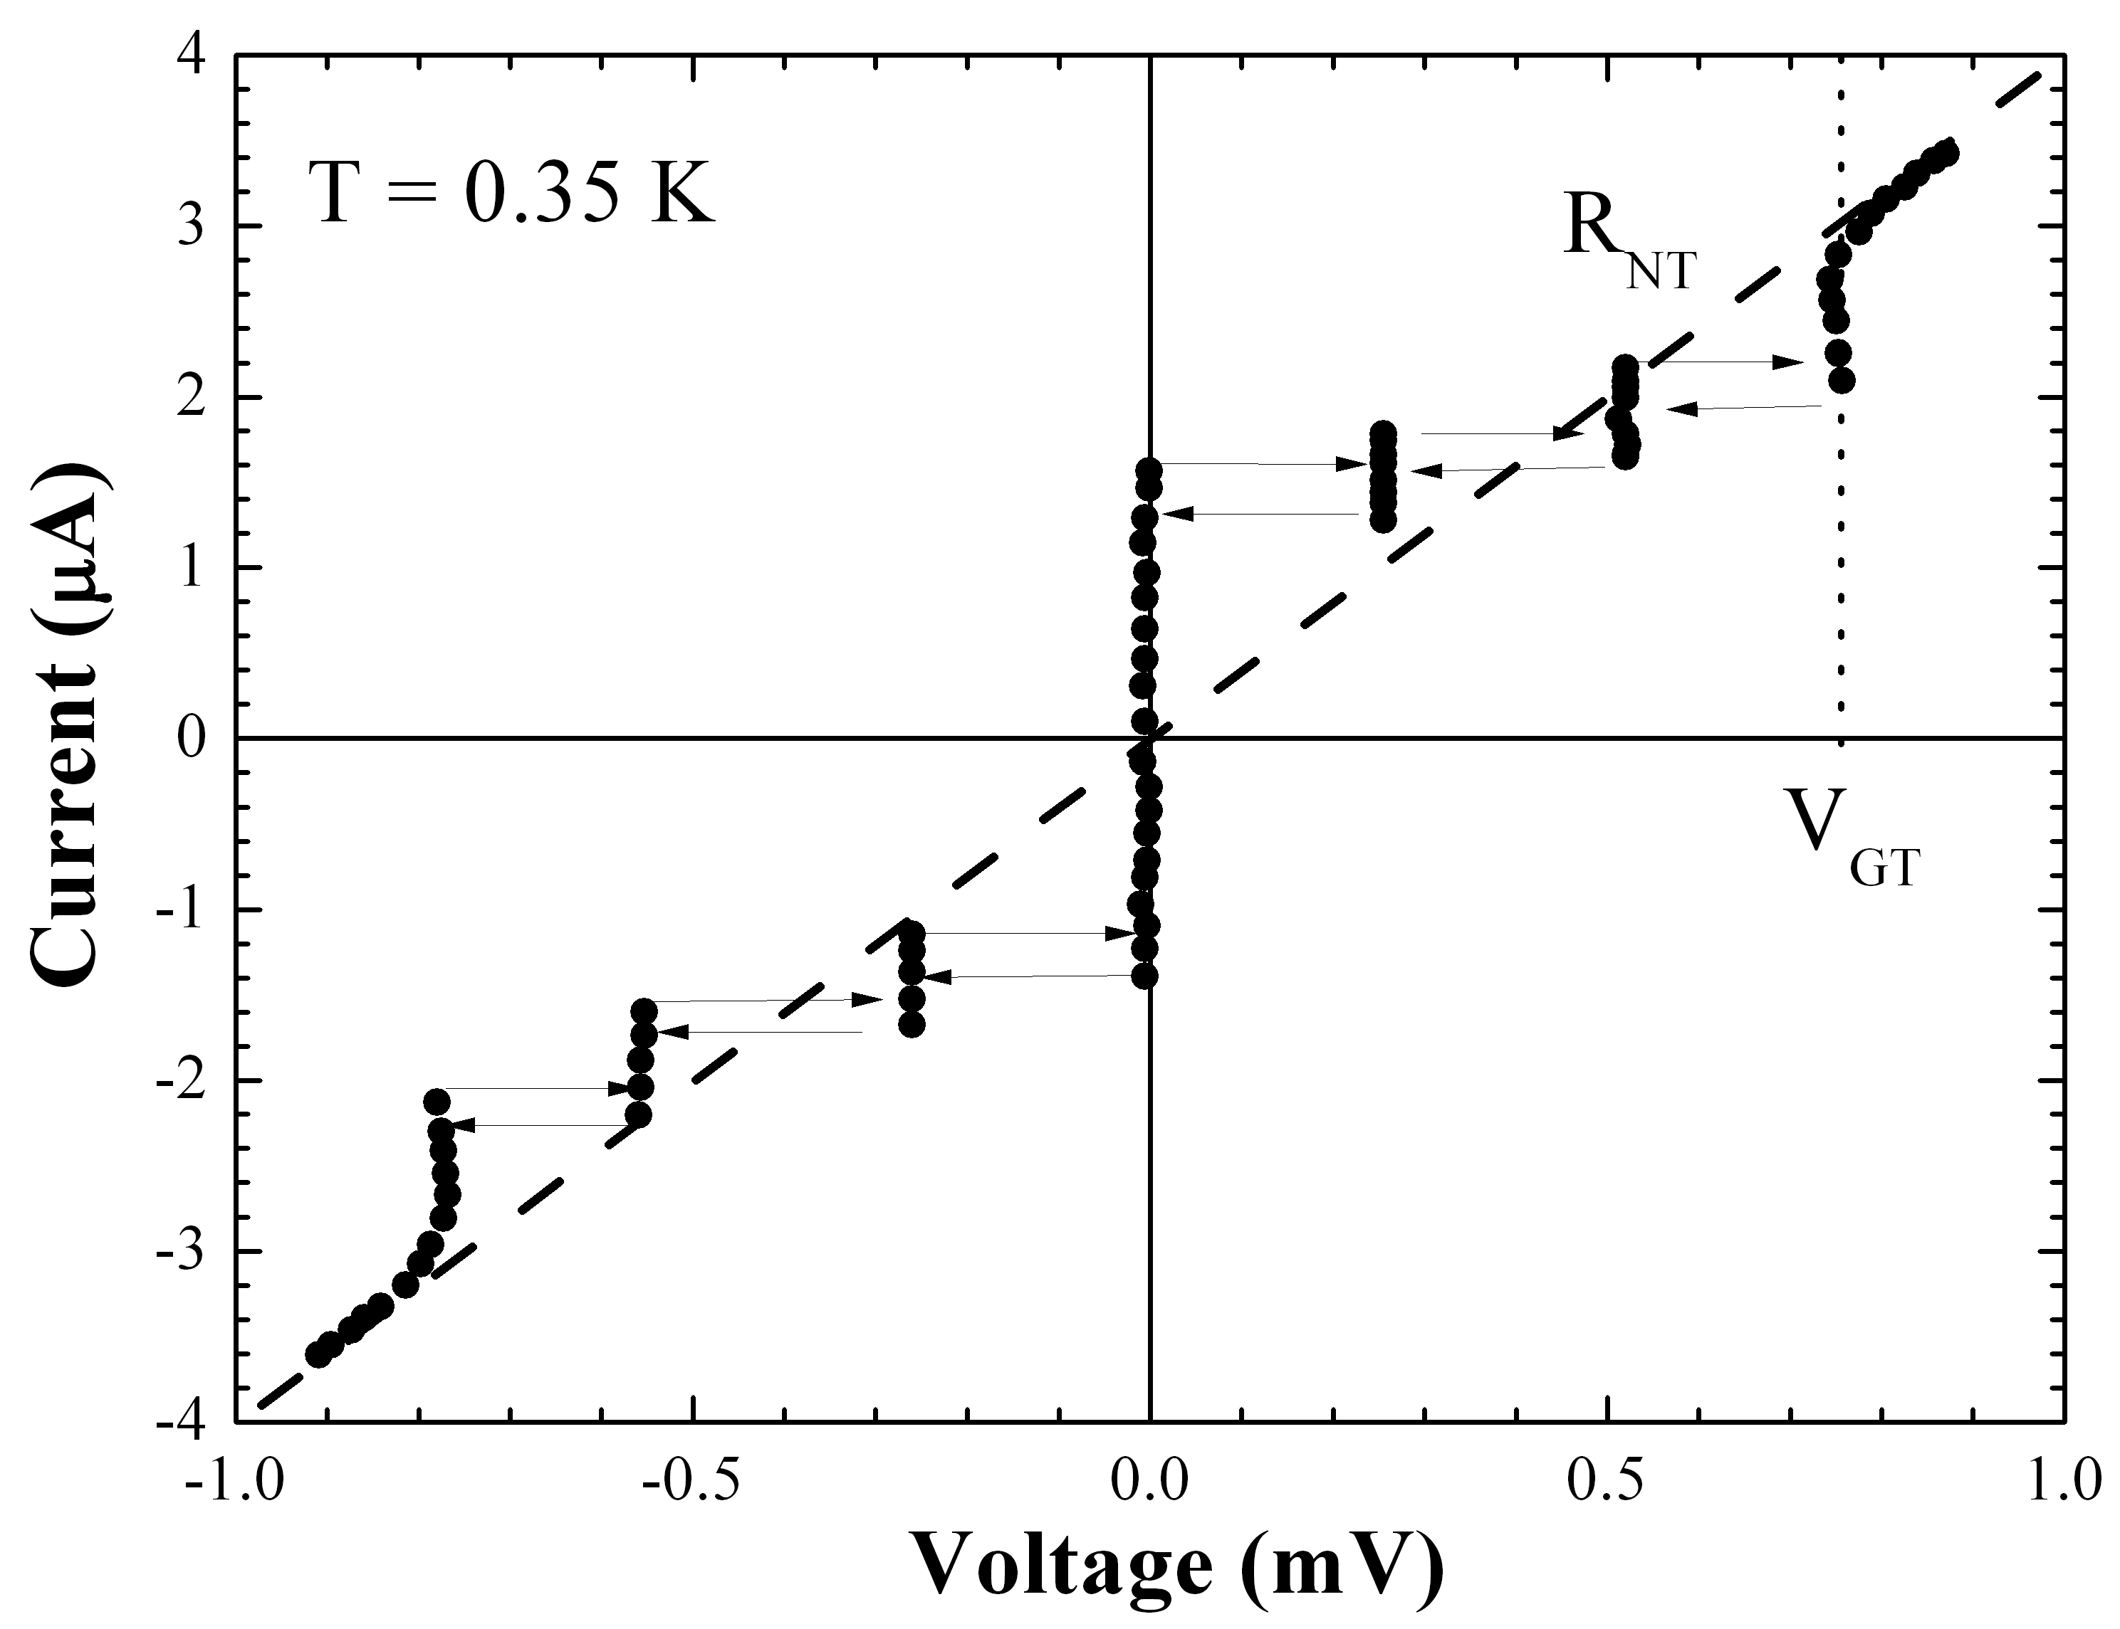
DC Measurement Results
3 Junction array
X52-A c Sample
T = 0.350 K
I_{c} = 1.6 μA, 1.9 μA and 2.3 μA
R_{n} = 237 Ω → 79 Ω/junction
The measurements of other test junction in the same chip give open or short circuits, due to damaged JJs. The damage of the JJs is most probably due to ESD during the chip mounting procedure (bonding, chip and sample holder handling).
This procedure has to be revised to eliminate the problem
V. Granata et al., submit to IEEE Transactions on Applied Superconductivity (TAS)

Slide 14
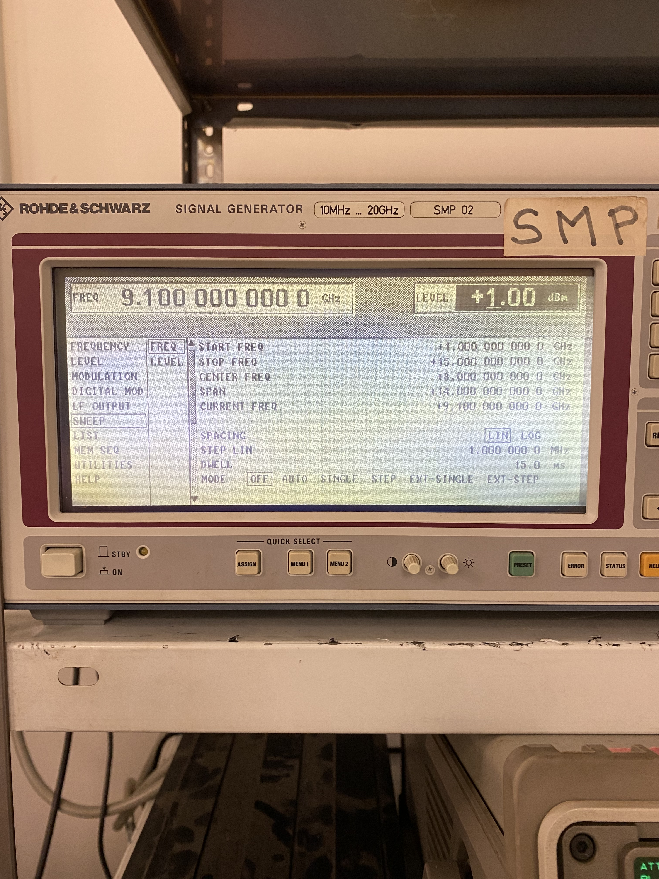
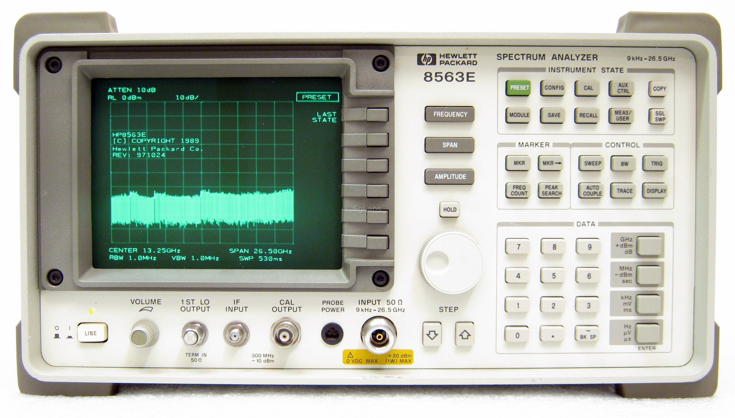
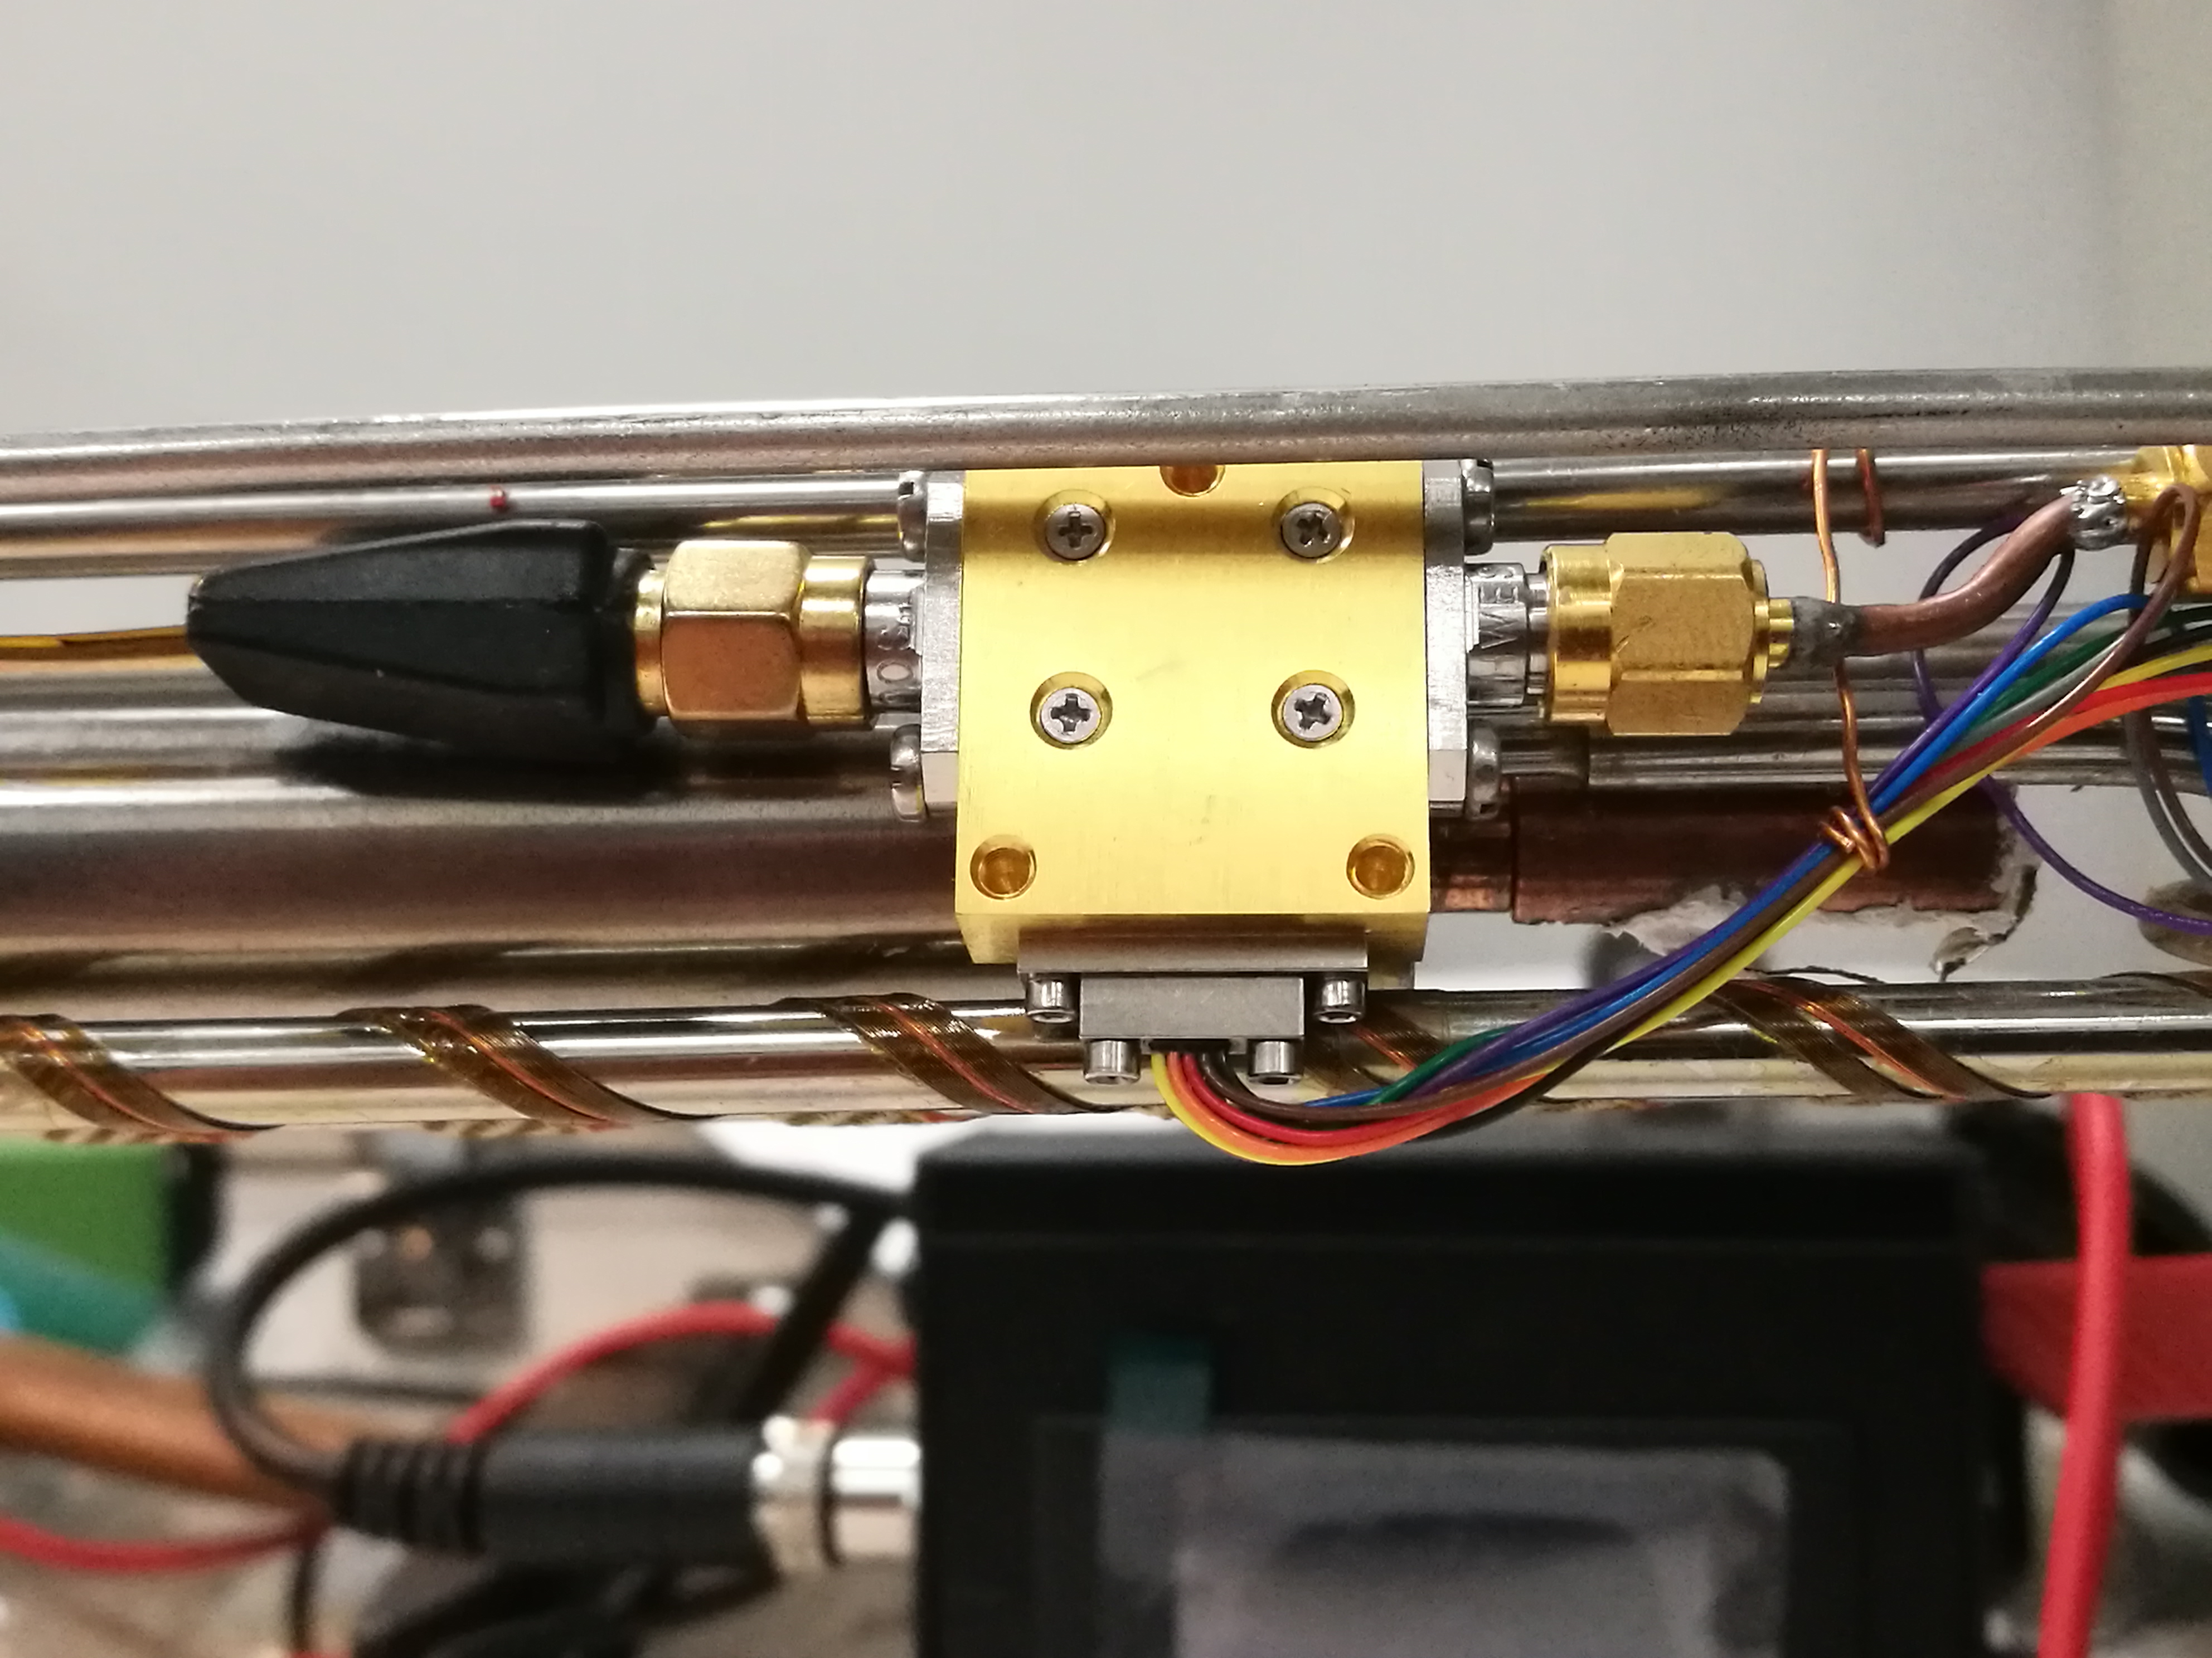
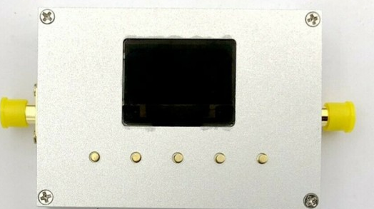

RF setup
0-20 GHz generator (Pump)
20 dB dir coupler
0-10 dB var attenuator
0-19 GHz generator (Signal)
TWJPA (0.3 K)
Cryogenic amplifier (4.2 K)

Slide 15
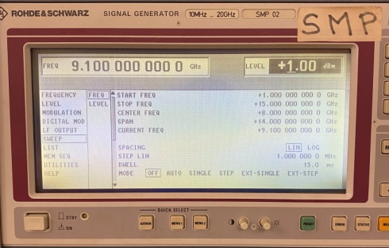
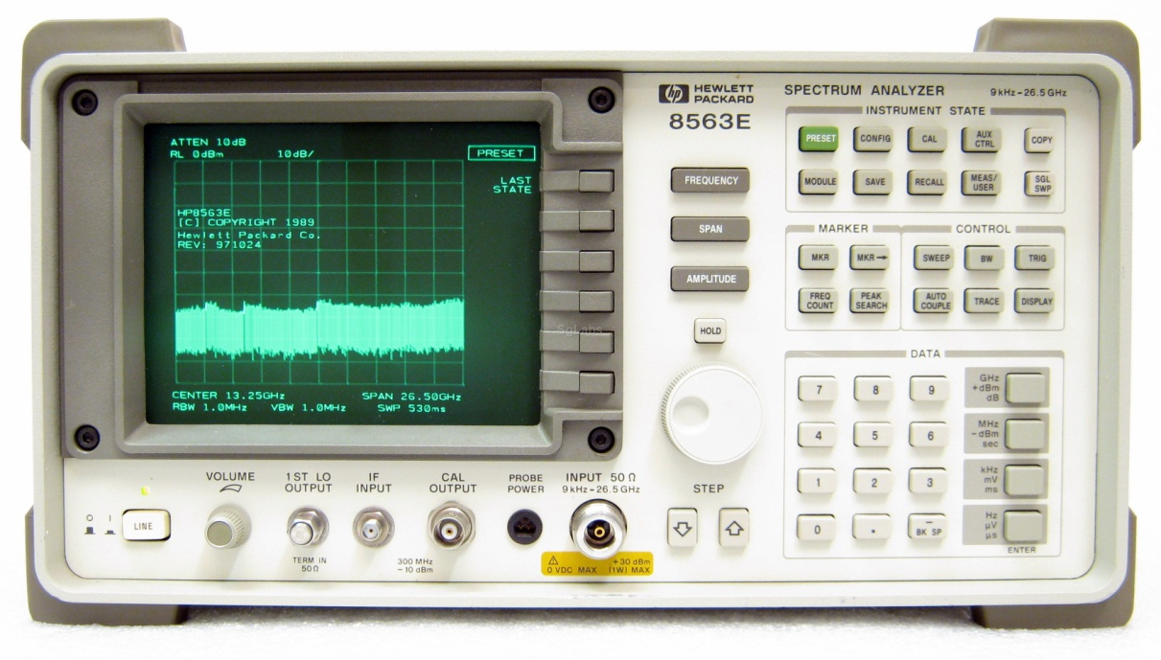
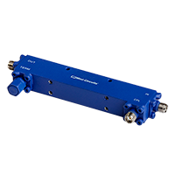
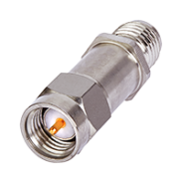
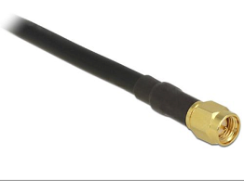
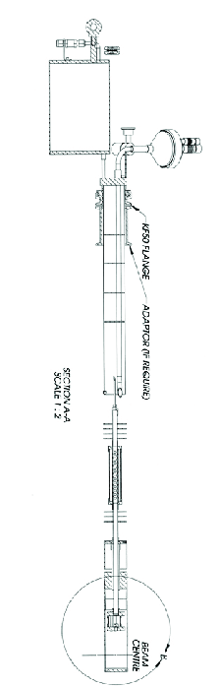

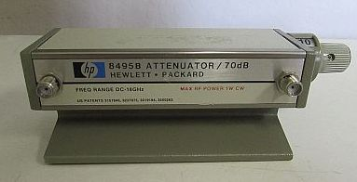
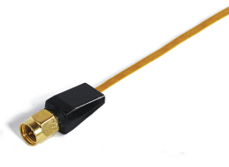
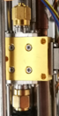
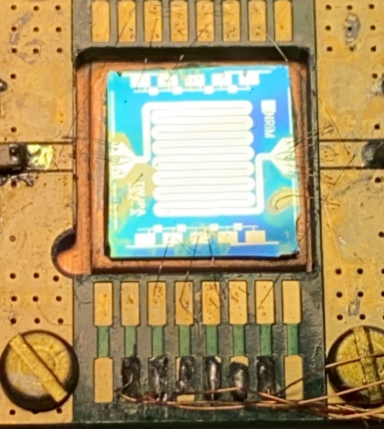


RF setup
System calibration
0-20 GHz generator (Pump)
9 kHz -26.5 GHz spectrum analyzer
20 dB attenuator
20 dB dir. coupler
Heliox ³He insert
RF in
RF out
T = 1.5K
T = 4.2K
0-19 GHz generator (Signal)
0-10 dB var. attenuator
Cryogenic Low Noise Amplifier
LNF 0.3-14 GHz Gain ∼36 dB
Cri/oFlex 2 (CF2)
Cri/oFlex 2 (CF2)
TWJPA (0.3 K)

Slide 16

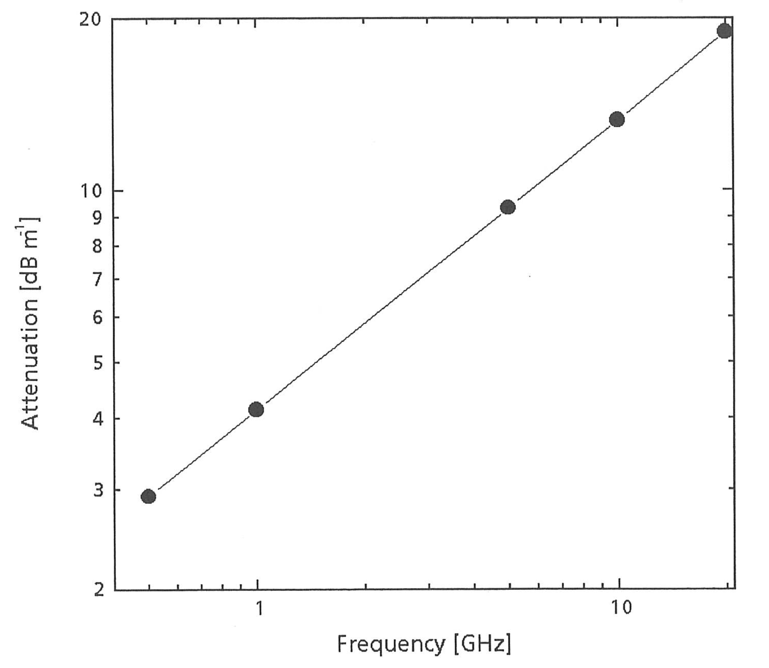
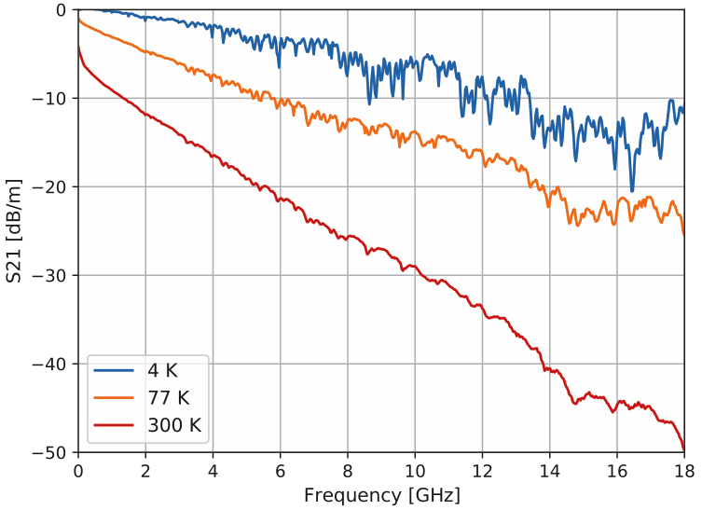
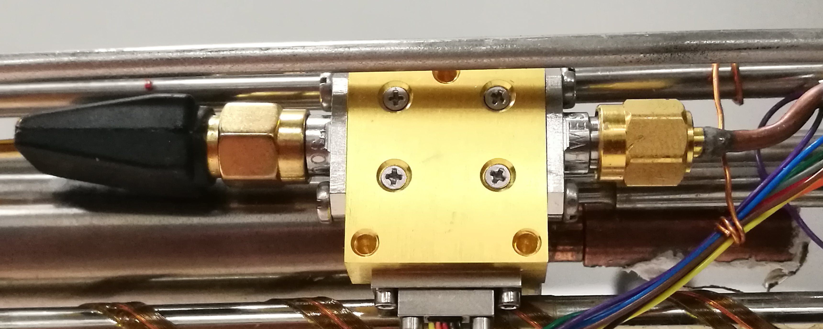
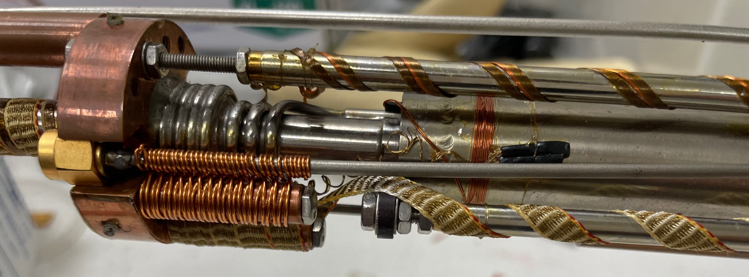
Setup Attenuation
Cryogenic amplifiers
T = 4 K
Heliox ³He rf cable
CrioFlex 2 (CF2) cabling

Slide 17
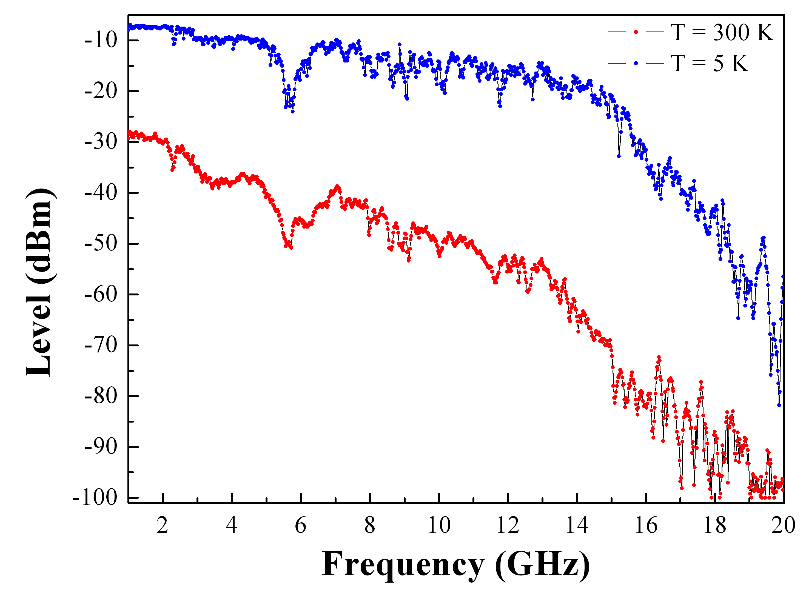
RF setup
IN/OUT measurement of frequency response without sample
Input Power = -30 dBm
Geometrical resonance

Slide 18
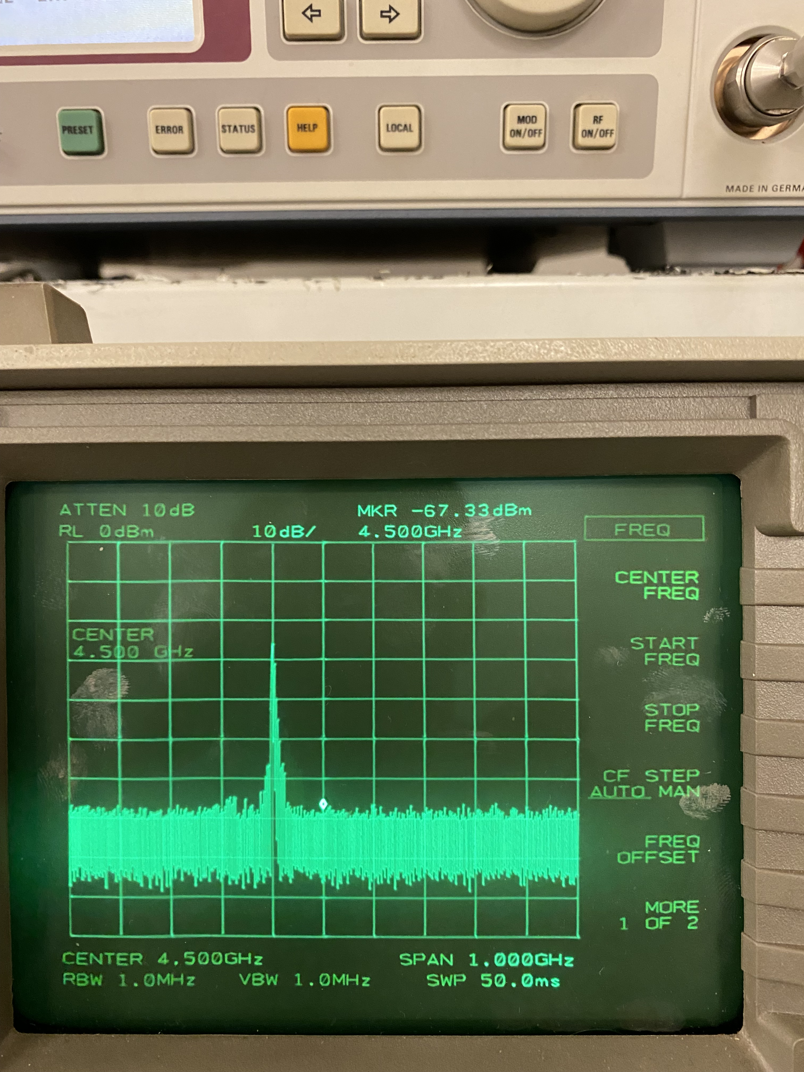
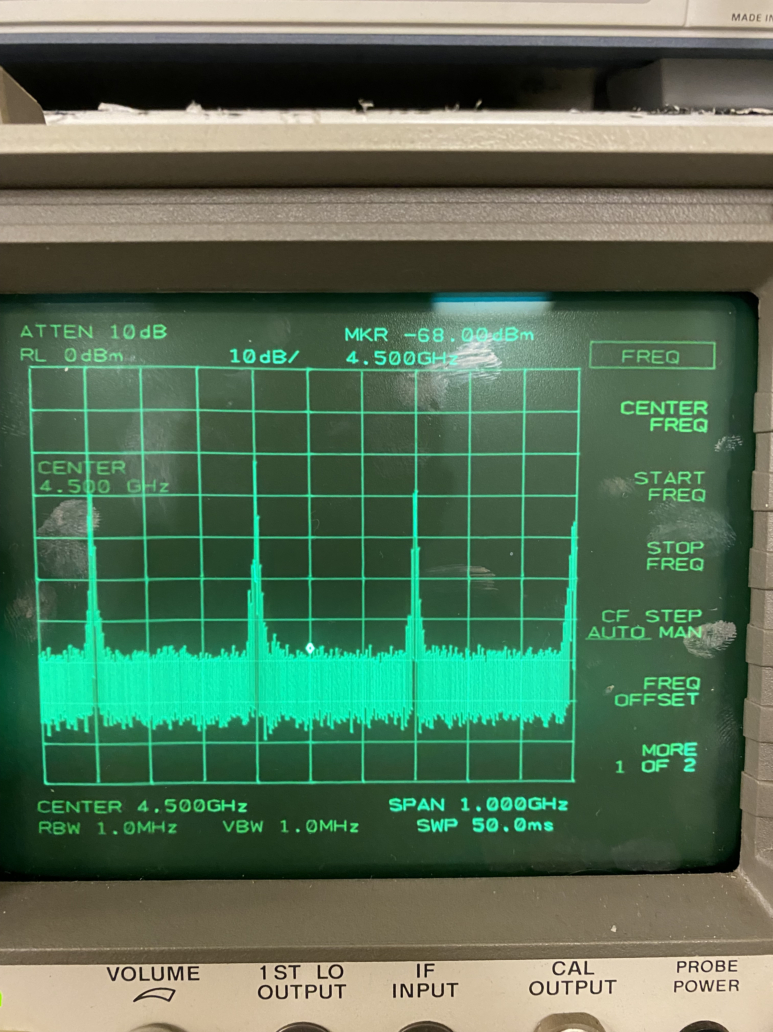
RF preliminary Results
Fpump = 9.10 GHz RF OFF
Fsignal = 4.40 GHz
Fpump = 9.10 GHz RF ON
Fsignal = 4.40 GHz
Fsignal
Fpump/2
Fsignal
Fidle
Fpump/2
1 GHz

Slide 19
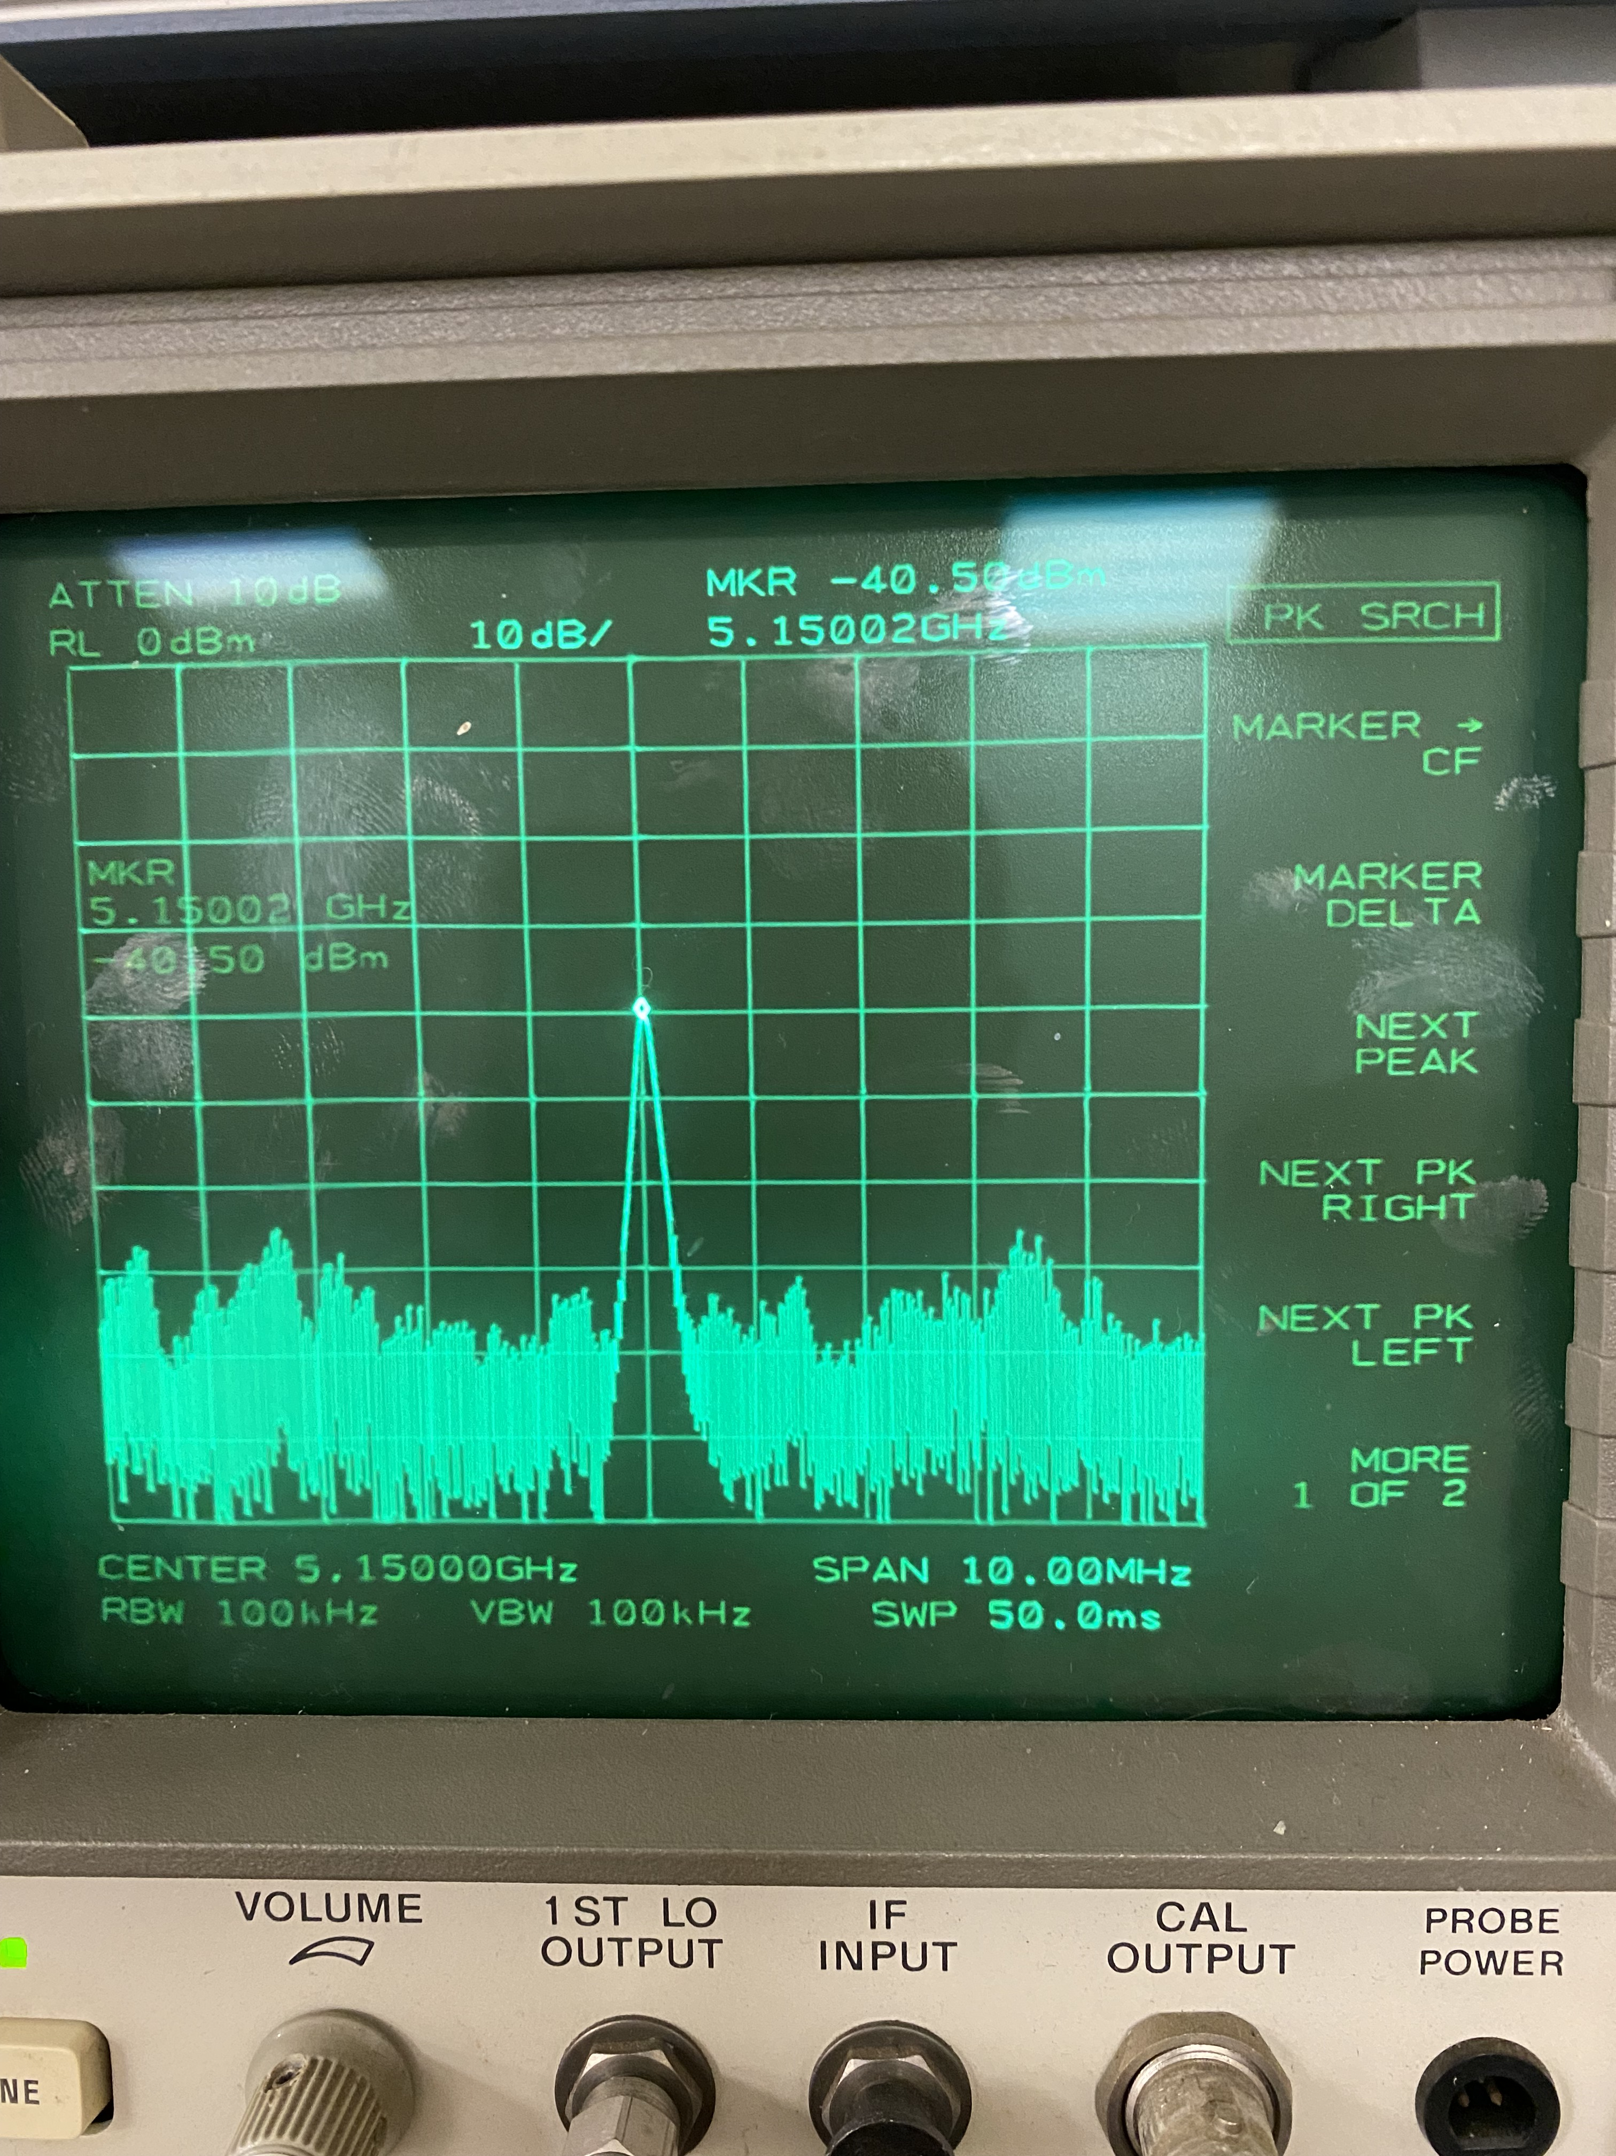
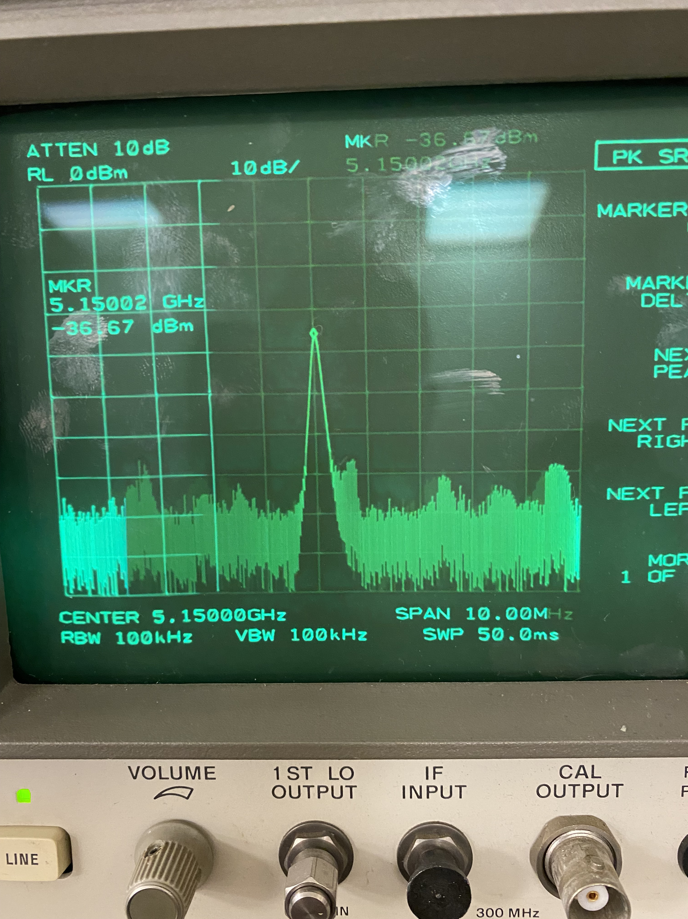
RF preliminary Results
Fpump = 10.0 GHz RF OFF
Fsignal = 5.15 GHz
Asignal = -40 dBm
Fpump = 10.0 GHz RF ON
Fsignal = 5.15 GHz
Asignal = -36.7 dBm ≈ + 3 dB
1 MHz

Slide 20



RF preliminary Results
The same effect is visible at T > T_{c}(Al)
→ It is not due to the JTWPA
Effect due to a direct coupling between the cables in / out of the device and cryogenic amplifier
cable connectors have been shielded

Slide 21
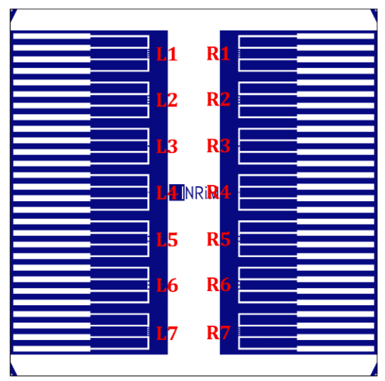
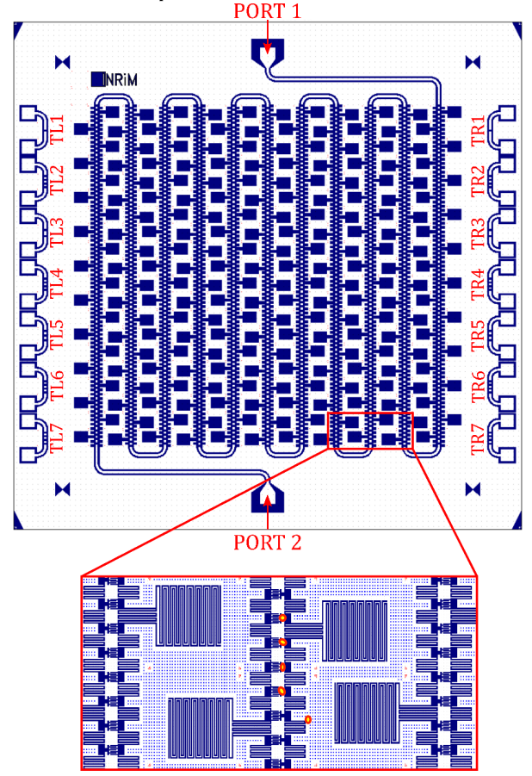
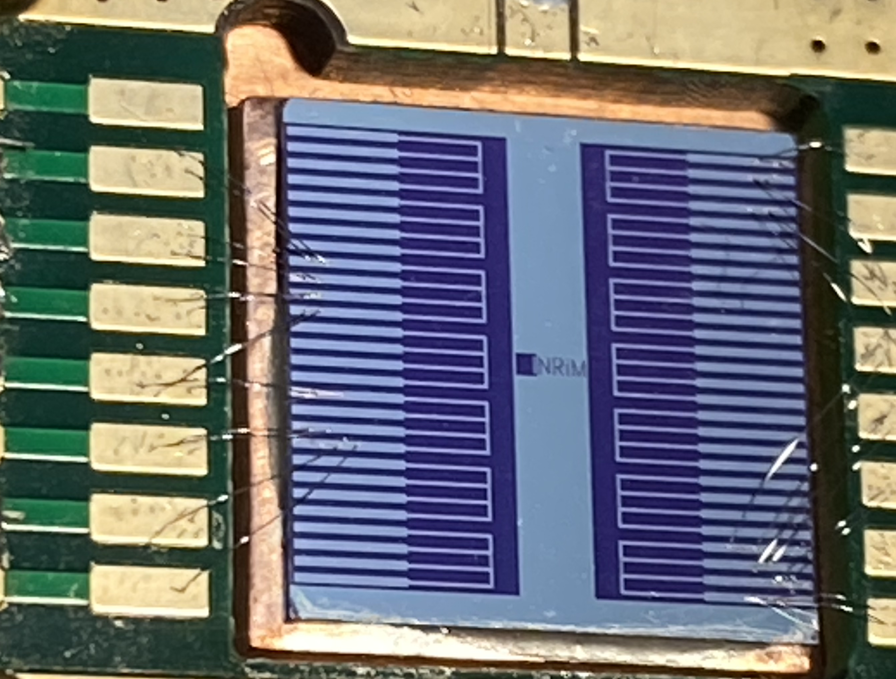
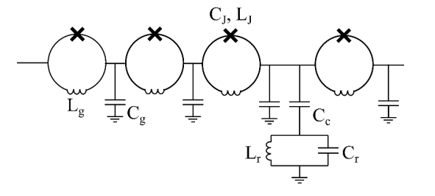
JTWPA: samples description – 2nd generation
ID_013_01 JTWPA
Complete redesign of TW
Added lumped resonant structure for resonant phase matching
No EBL lithography (faster turnaround)
Added Ti underlayer for base electrode to improve surface uniformity
SUB_02 Test chip
Test chip with several JJ arrays with 1 to 5 junctions
JJ resistance measured at MIB at room temperature
SUB_02
ID_013_01
Chips delivered
ID_013_01_A JTWPA
ID_013_01_B JTWPA
SUB_02_F test JJ arrays
SUB_02_J test JJ arrays

Slide 22
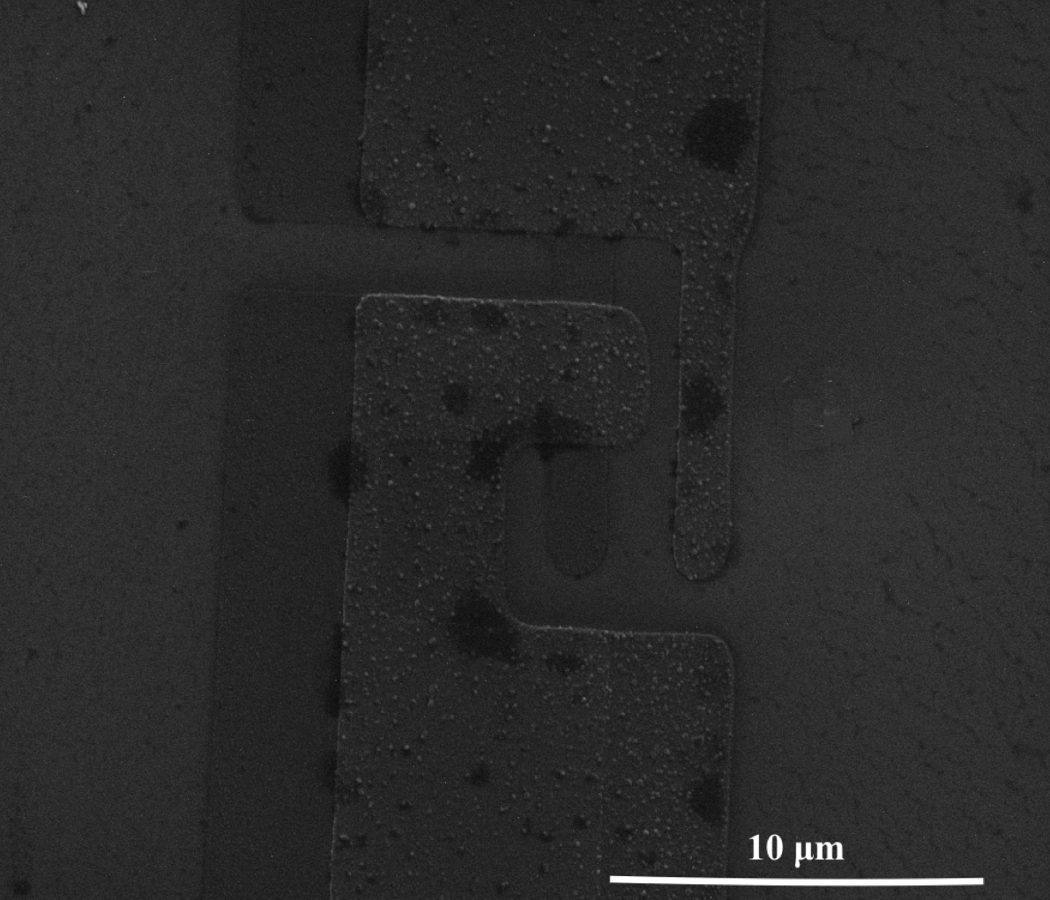
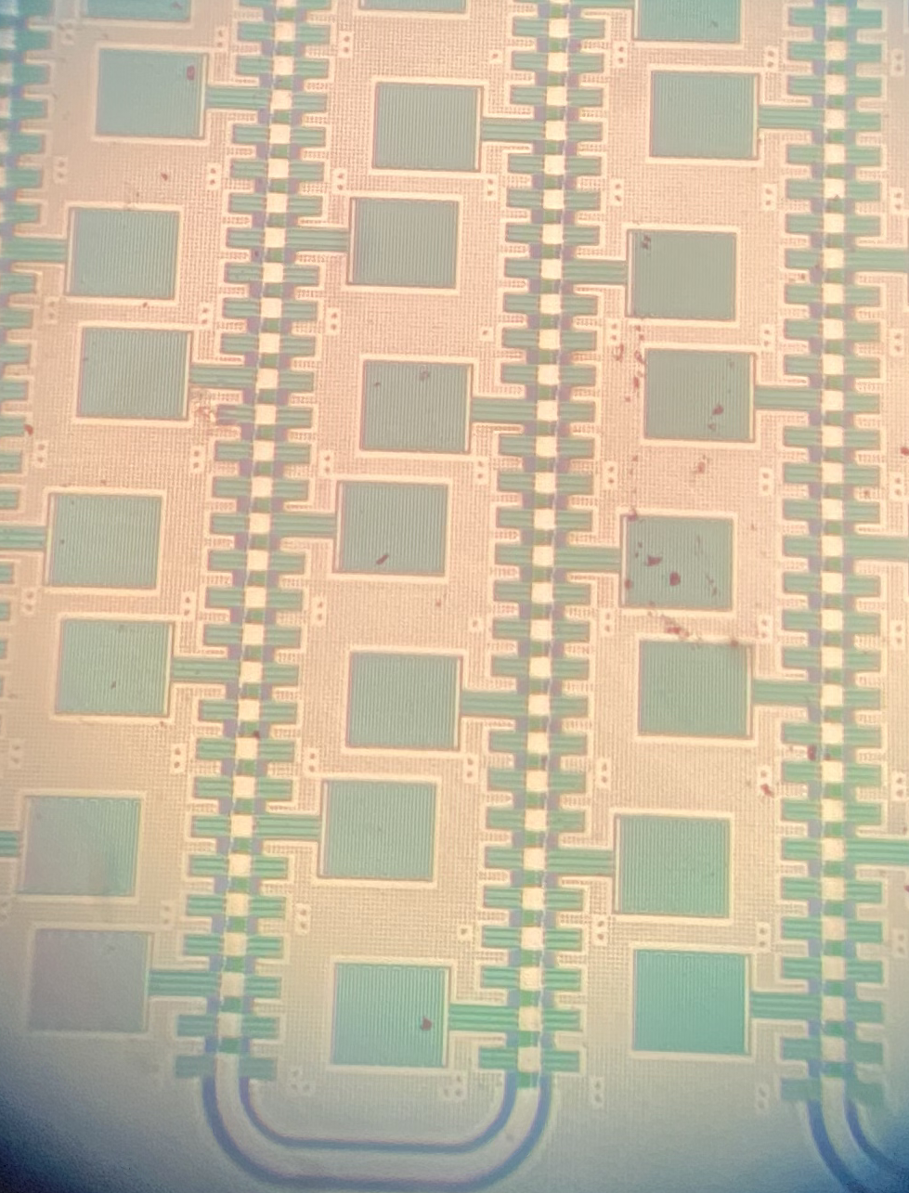
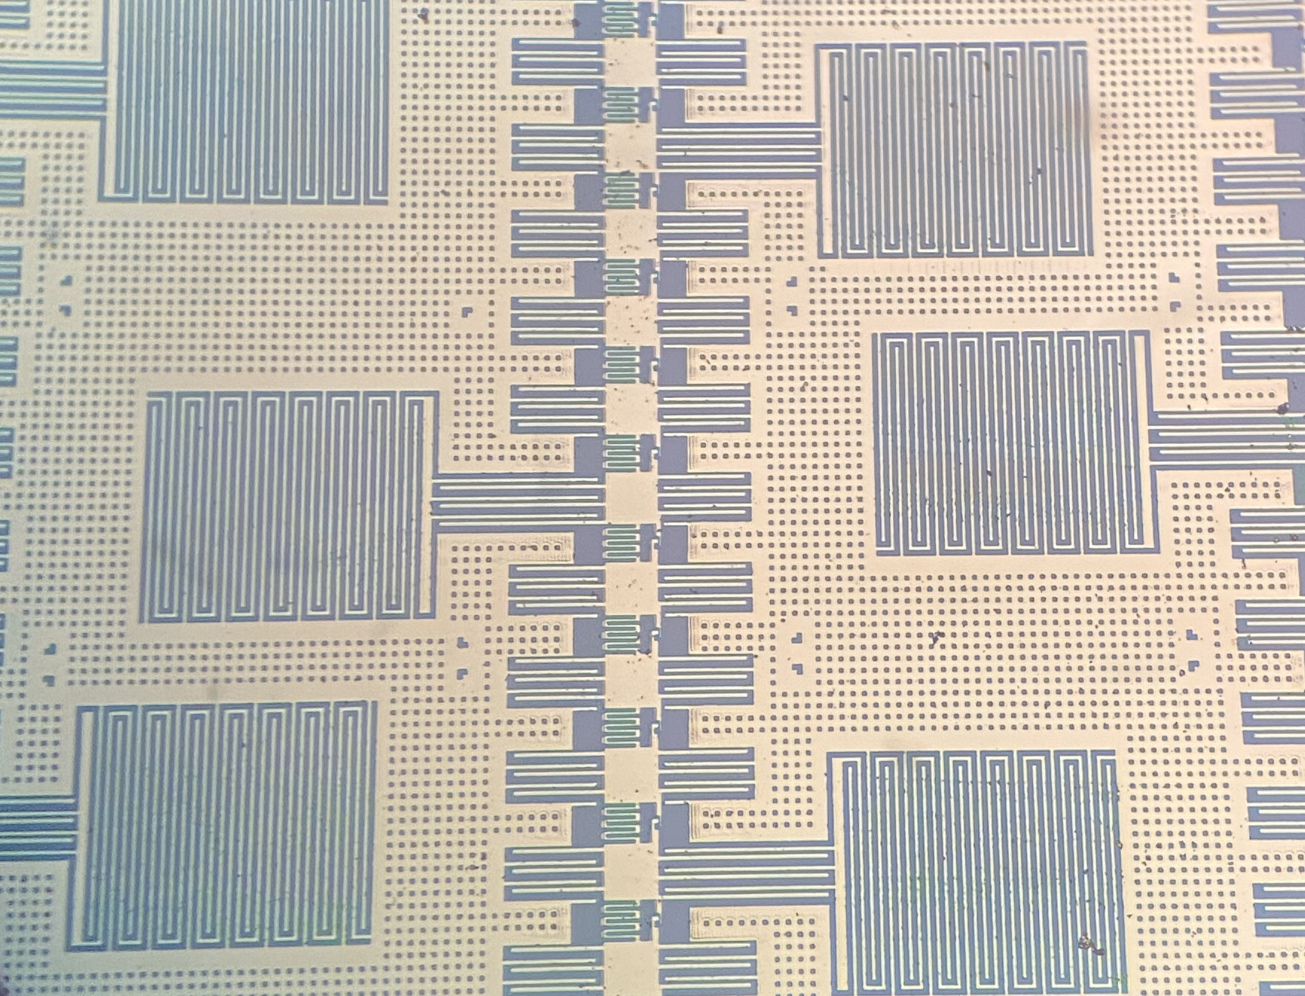
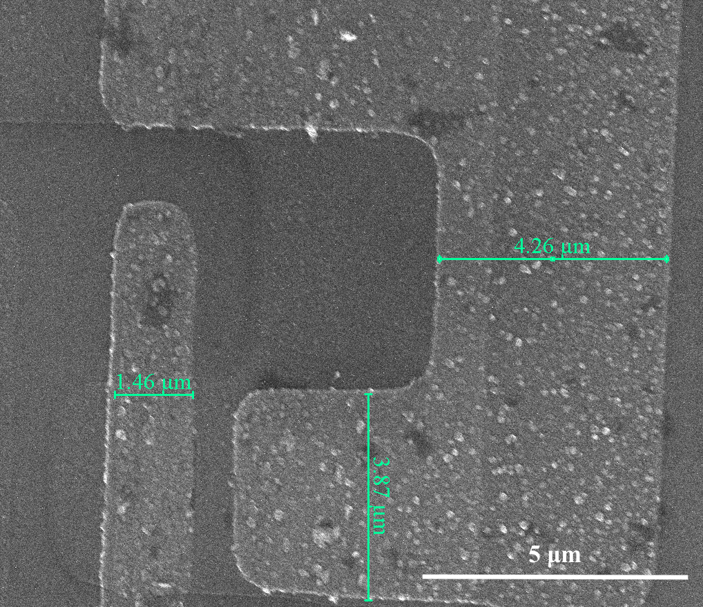
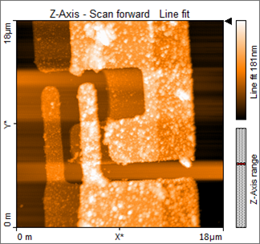
JTWPA: samples description – 2nd generation
Optical and SEM Images

Slide 23
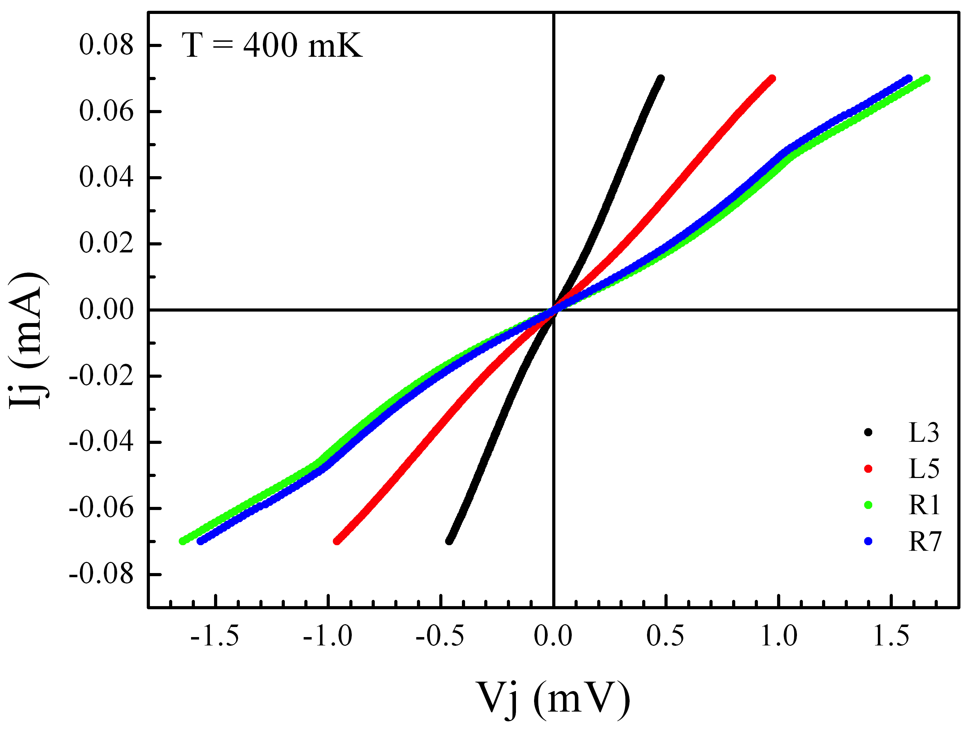
DC Measurement Resultsof JTWPA 2nd generation
Chip SUB_02F
The I-V curves show signatures of superconducting gap
No critical current visible.
At T = 400 mK one at least of the junction electrodes is still in the normal state.
This is most probably due to the bilayer Ti(5nm)/Al(25nm) used as base electrode which has decreased its T_{c} below 400 mK
Therefore it is not possible to test the RF properties of JTWPA

Slide 24
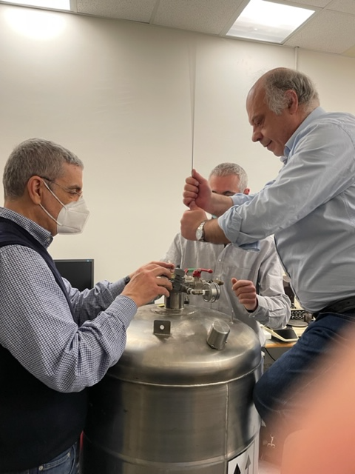
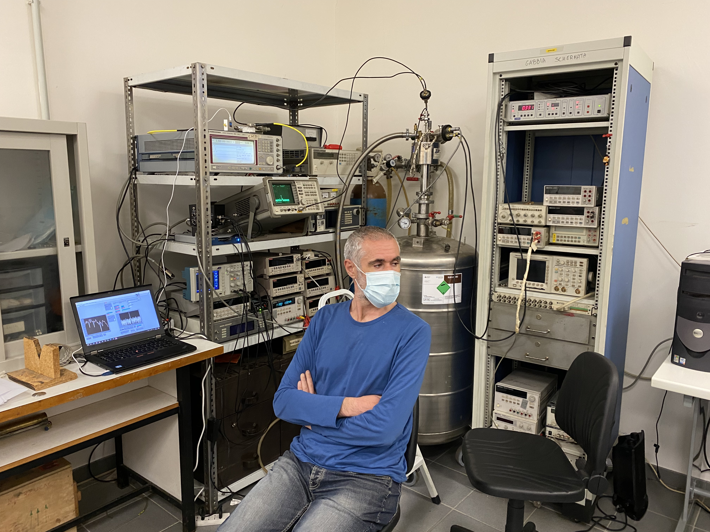
Preliminary Results
The Salerno group

Slide 25
Conclusions and Outlook
JTWPA are promising candidates as quantum limited microwave amplifiers for applications in fundamental physics experiments and quantum computing
Within the DARTWARS collaboration we are developing JTWPA with different designs
We have setup a cryogenic and RF system to test the amplifier, operating at 0.3 K and based on a relatively easy to use cryostat with fast turn around
The preliminary results show that the system is operating; further work to optimize it is in progress
The DC measurements of the 1nd generation JTWPA (X_52) show JJ with critical current in the correct range, but with a relatively high dispersion, the chip is very sensitive to ESD and a more accurate handling procedure is necessary
The 2_{nd} generation chips do not show critical currents down to 350 mK. The opening of superconducting gap is evident at 400 mK but at least one of the electrodes is still in the normal state. After discussion with colleagues at INRIM, we have concluded that this is due to the presence of a bi-layer Ti/Al as base electrode in the 2nd generation chips, which strongly decreases its critical temperature. Such bilayer will be eliminated in next chips

Slide 26
Thanks for your attention

