Slide 1



Running a flavour experiment at the LHC
Patrick Robbe, IJCLab Orsay, 19/05/2022

Slide 2
Introduction
How to maximise data taking of a flavour physics experiment
  Example of LHCb at the LHC
The LHCb experiment is finishing operation before its first upgrade:
  Almost 10 fb⁻¹ were collected since 2011
  Pushing the limits of the detector in order to maximize the data taking efficiency

Slide 3
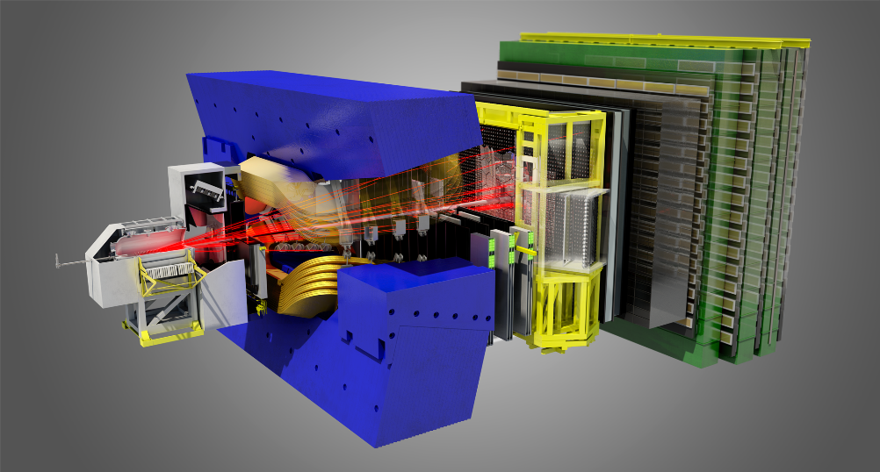
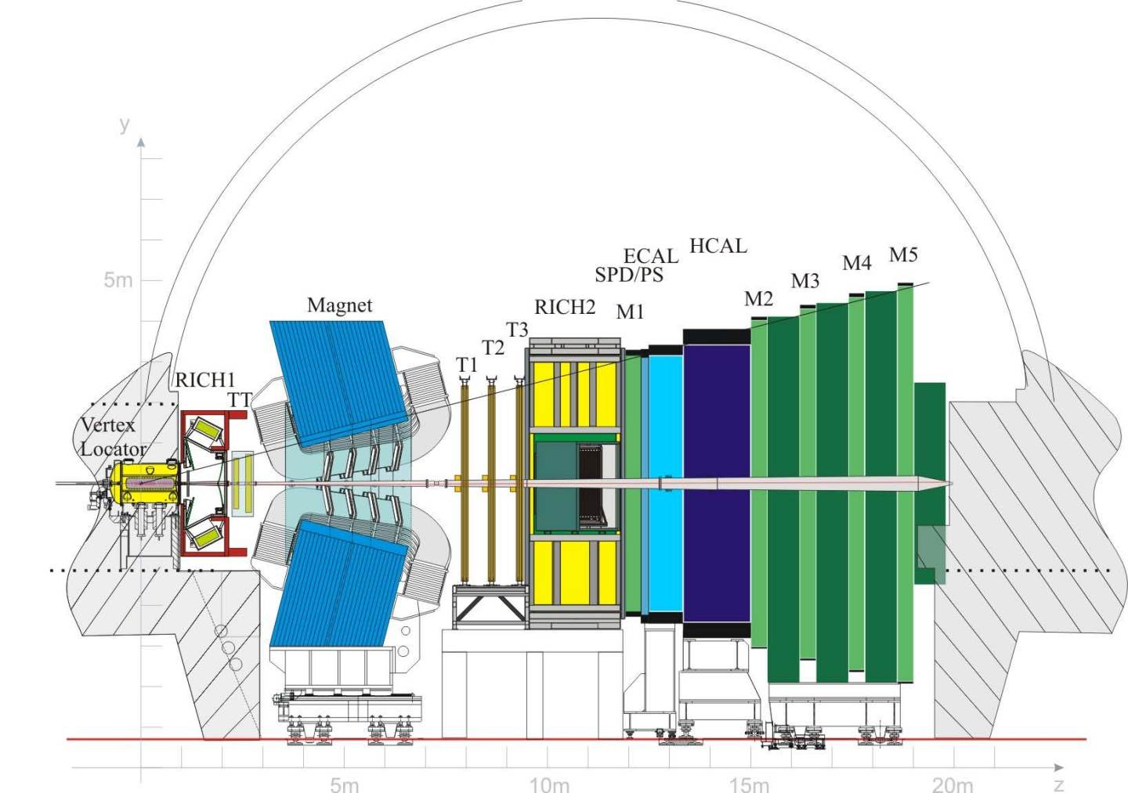
LHCb Detector
Interaction Point

Slide 4
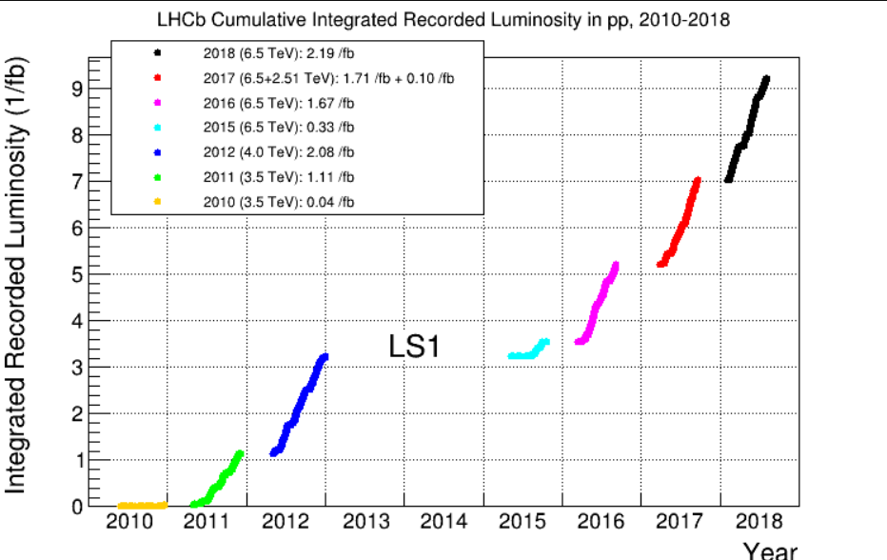
LHCb Data taking
13 TeV
7 TeV
8 TeV
Run 1
Run 2

Slide 5
LHCb Physics Program
Study of rare decays of beauty and charm hadrons:
  Search for New Physics
  Require a lot of statistics
Precision measurement of CP violation parameters in B decays:
  Test of CKM formalism in the Standard Model
  Requires well-known and calibrated data

Slide 6
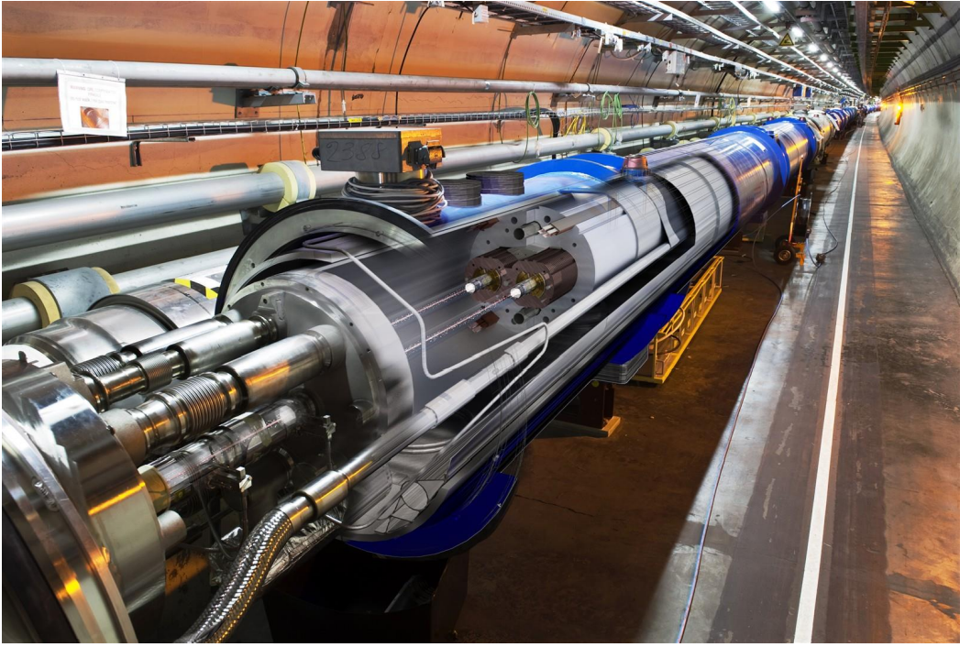
LHC

Slide 7
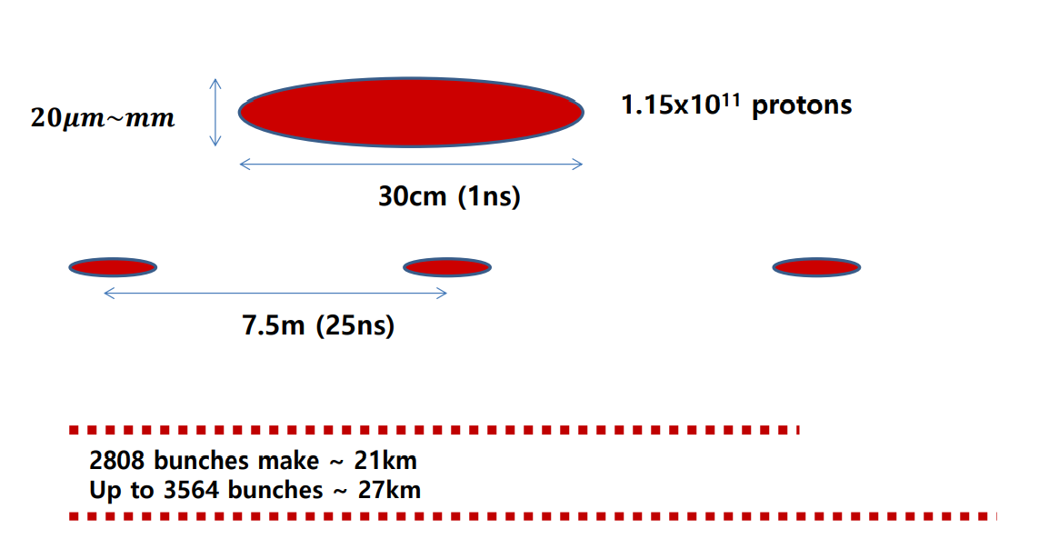
LHC Beam Parameters
One bunch
Separated by 25 ns
Nominal filling scheme
Theoretical capacity

Slide 8
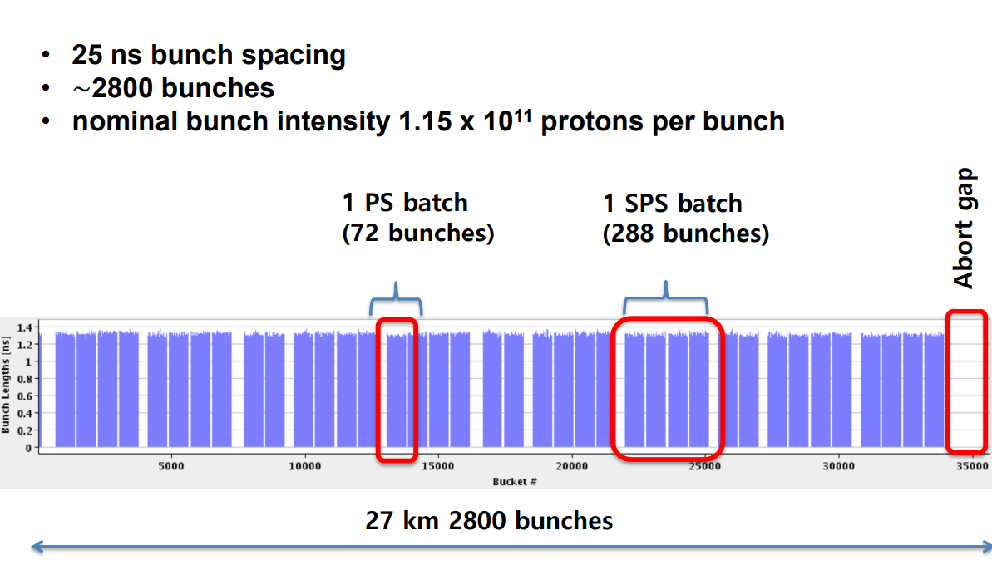
LHC Bunch Structure
The bunch structure is driven by the acceleration steps: PS then SPS then LHC

Slide 9
Constraints
How to push up statistics of recorded events:
  LHC:
    Increase luminosity per bunch: does not work for LHCb

Slide 10
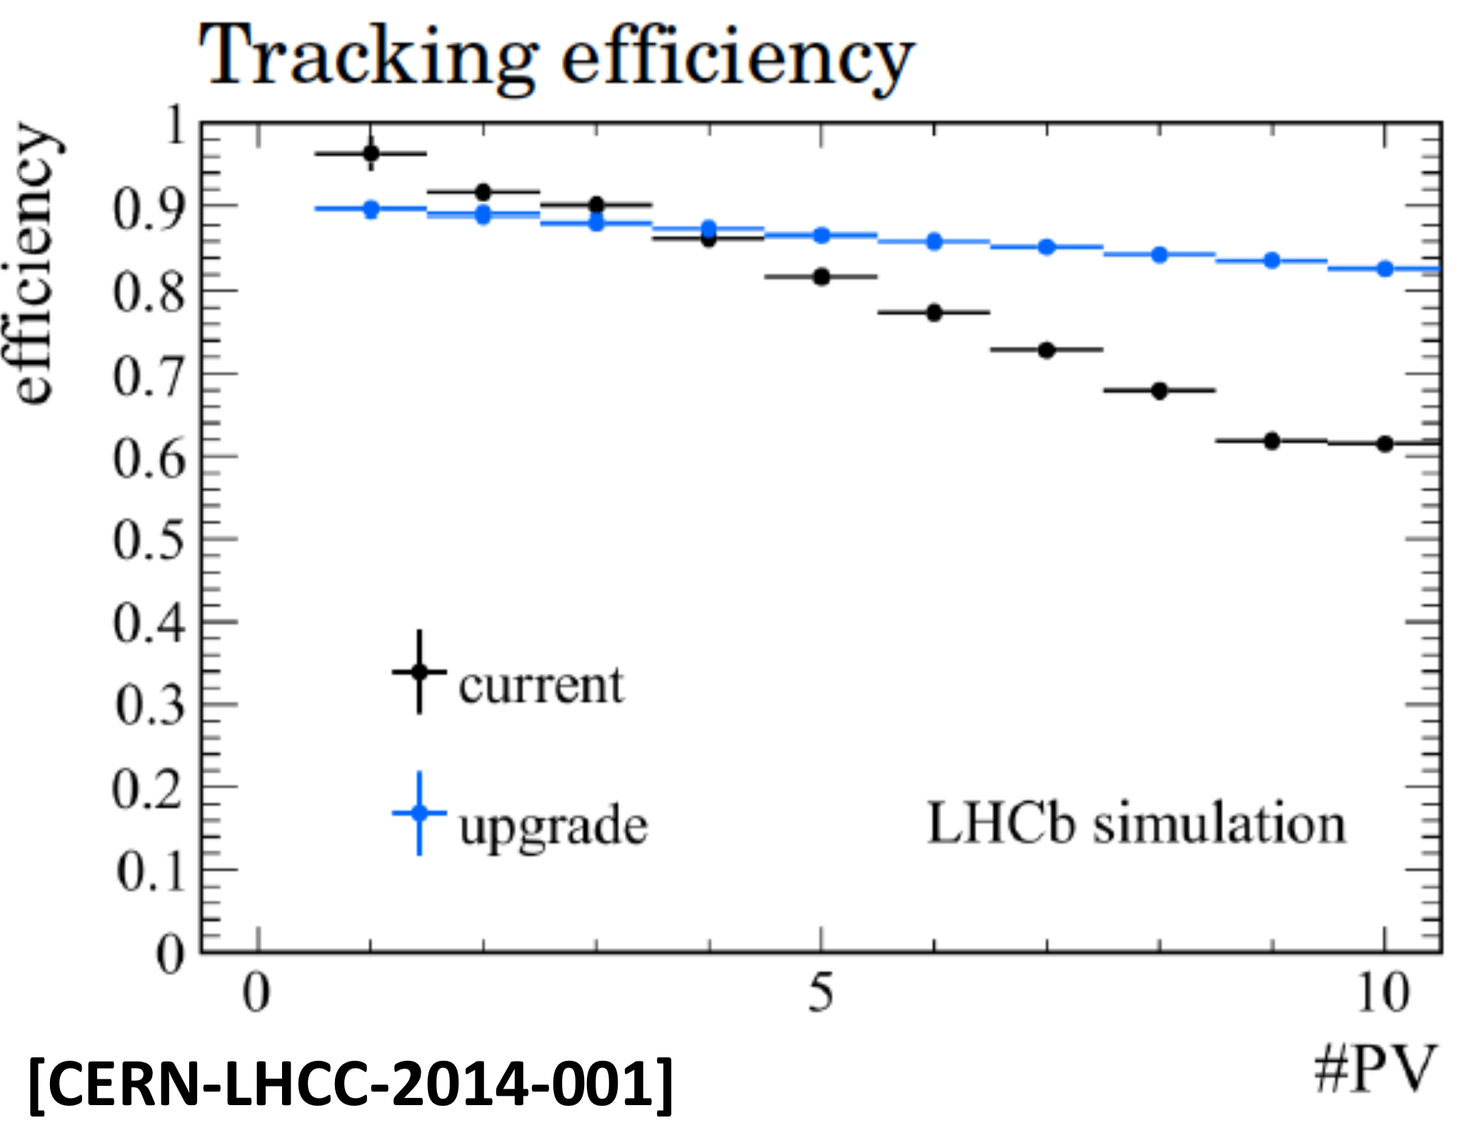
Constraints
The LHCb detector is built to run with low multiplicities, the performances of the detector degrade with high multiplicity.
The multiplicity is proportional to μ = average number of interactions per crossing. This is determined by the instantaneous luminosity per bunch.
Since the performance of the detector depends on multiplicity, keep the average multiplicity constant over time to have uniform datasets.
Number of interactions

Slide 11
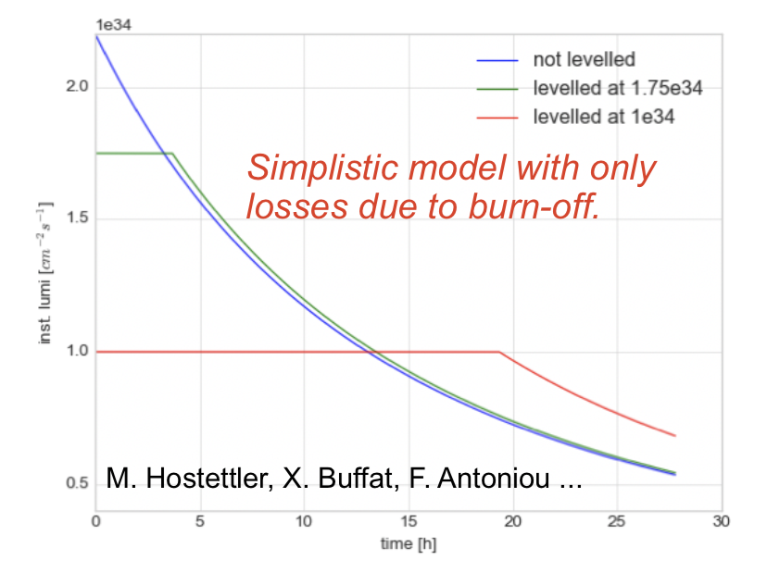
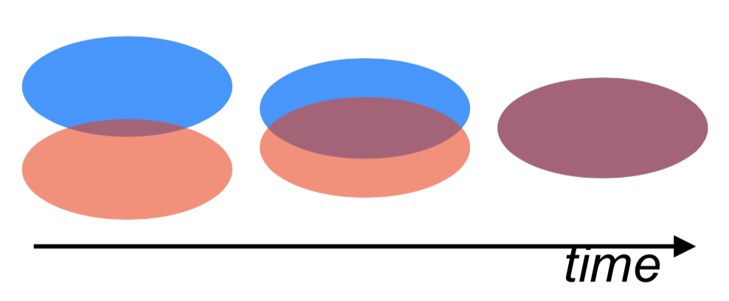
Luminosity levelling
Naturally the luminosity decreases because of burn-off
Luminosity levelling: beams are displaced with respect to each other continuously to keep the instantaneous luminosity per bunch constant, i.e. μ (and thus the multiplicity)
An interaction in LHCb is defined as a collision visible in the calorimeter (ECAL + HCAL).
The average number μ is measured from the rate of non-empty beam crossings with 0 interaction in the calo and sent as feedback to the LHC: allows it to maintain a constant luminosity.
In Run I (2012), μ was kept to 1.7. Because of the change in center-of-mass energy (8 TeV to 13 TeV), to keep a constant multiplicity, μ in Run II (2015-2018) was 1.1

Slide 12
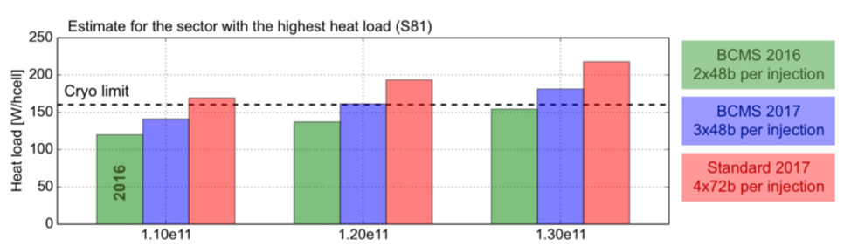
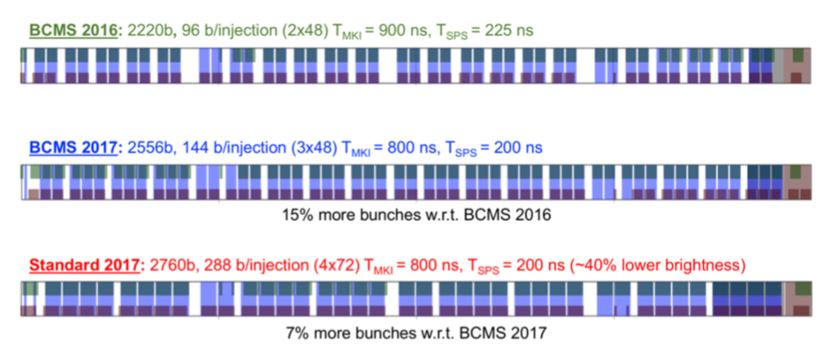
Constraints
How to push up statistics of recorded events:
  LHC:
    Increase luminosity per bunch (does not work for LHCb)
    Increase number of bunches (ultimately the only possibility for LHCb)
      The maximum number of bunches in the LHC is 2808. Because the LHCb interaction point is displaced with respect to the center of the cavern, less bunches collide in LHCb, about 90%
      This maximum was never reached:
        During Run I, the spacing between bunches was 50ns: maximum of 1400 bunches
        During Run II,
          In 2016, vacuum leak in the SPS
          In 2017, frozen air in one LHC magnet
          In 2018, ultimately limited by cryogenics

Slide 13
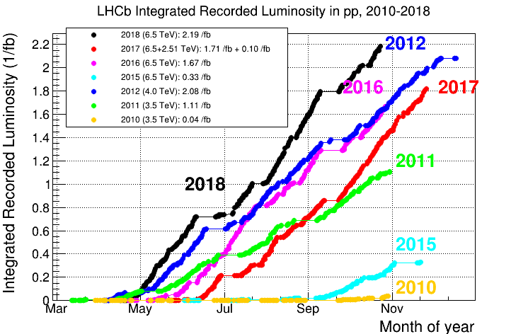
Luminosity
Year | Max # bunches | Energy | μ | Lumi
2011 | 1320 | 7 TeV | 1.4 | 3.5x10³² cm⁻²s⁻¹
2012 | 1262 | 8 TeV | 1.7 | 4.0x10³² cm⁻²s⁻¹
2015 | 2036 | 13 TeV | 1.1 | 3.5x10³² cm⁻²s⁻¹
2016 | 2036 | 13 TeV | 1.1 | 3.5x10³² cm⁻²s⁻¹
2017 (before summer) | 2332 | 13 TeV | 1.1 | 4.4x10³² cm⁻²s⁻¹
2017 (after summer) | 1749 | 13 TeV | 1.1 | 3.3x10³² cm⁻²s⁻¹
2018 | 2332 | 13 TeV | 1.1 | 4.4x10³² cm⁻²s⁻¹
NB: the heavy-flavour cross-section is ~twice at 13 TeV compared to 8 TeV

Slide 14
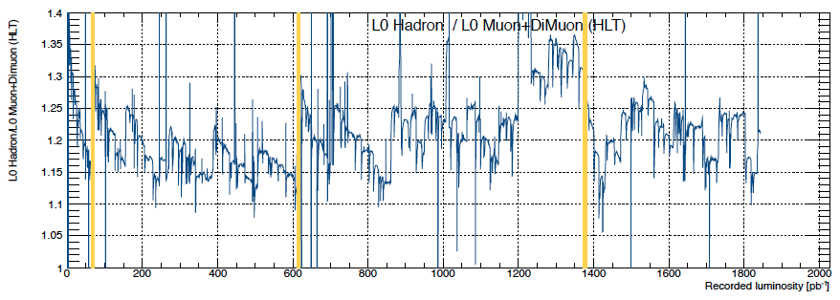
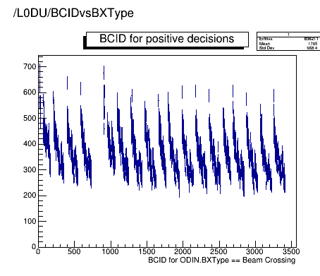
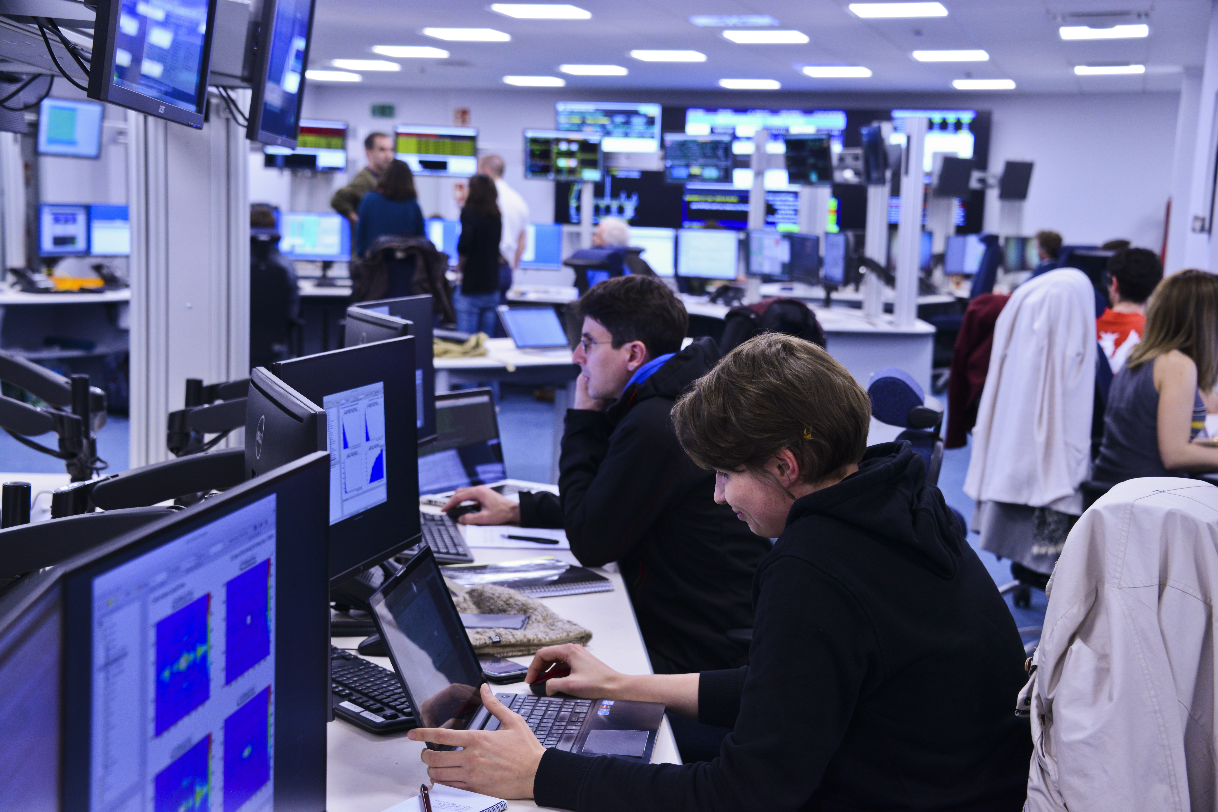
Luminosity levelling
Because of radiation, the calorimeter response changes as a function of time: ageing. The optical fibers collecting the scintillation light of the HCAL loose transparency. This is compensated by calibrating with a LED system to maintain response constant.
This system does not exist for the ECAL (well it exists but it ages also), and is replaced by the monitoring of occupancy.
The High Voltage of the calorimeter photo-multipliers are adjusted every day, but sometimes it is not enough and can vary during long fills.
Also the value of μ can vary a lot bunch by bunch
2011

Slide 15
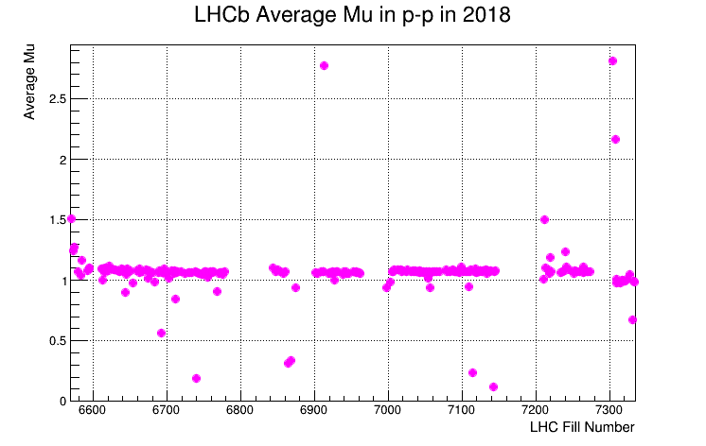
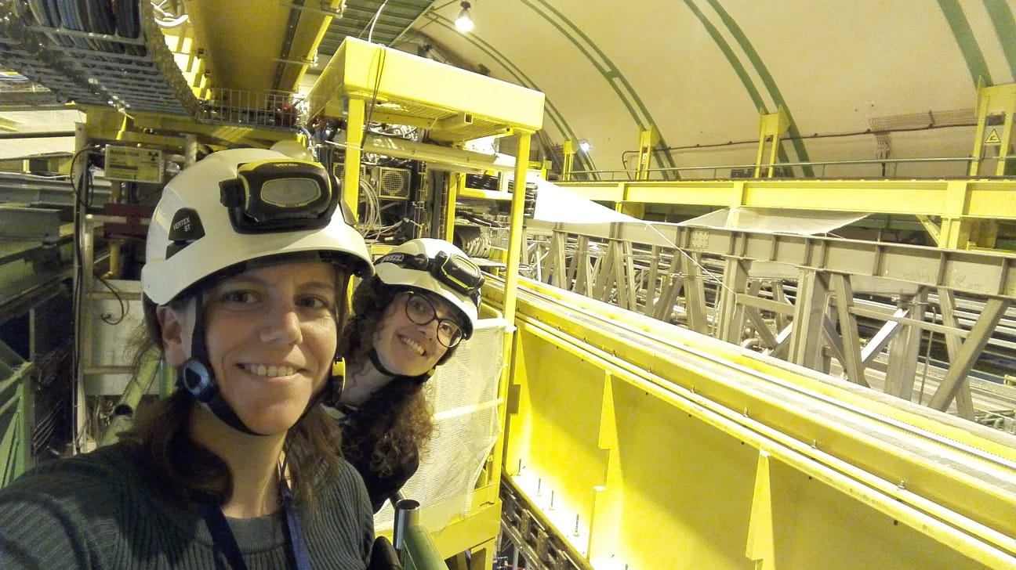
Luminosity levelling
Worked perfectly during 7 years, based on calorimeter measurement, except during the very last week of running...
One cooling turbine of the calorimeter electronics failed and had to be replaced during an emergency access, and after that the calorimeter measurement changed….

Slide 16
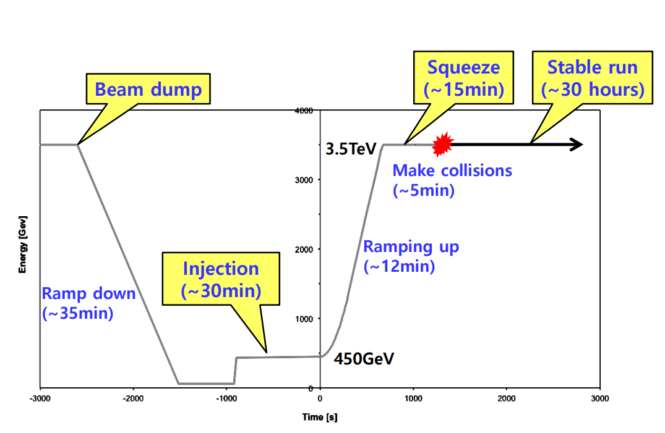
A typical LHC cycle

Slide 17
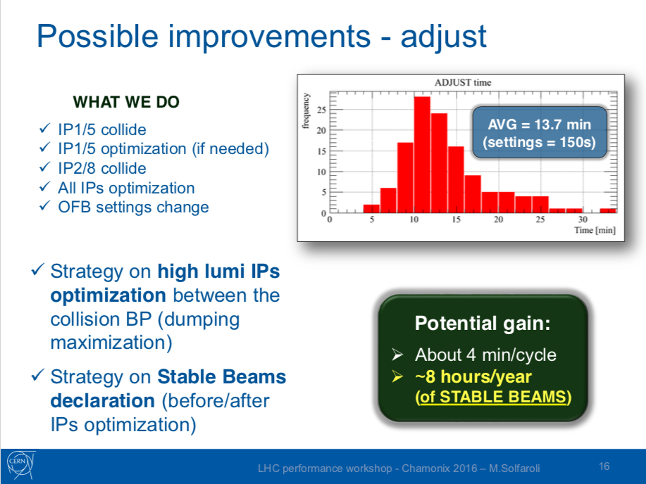
Interplay with the LHC
The number of colliding bunches in LHCb is not the only handle from the LHC side to increase the statistics:
  The time in collisions for physics (stable beam) and the LHC running efficiency plays an important role.
Every minute counts:
  For example, optimization of the collision sequence in ATLAS/CMS gained 8 h of Stable Beams per year

Slide 18
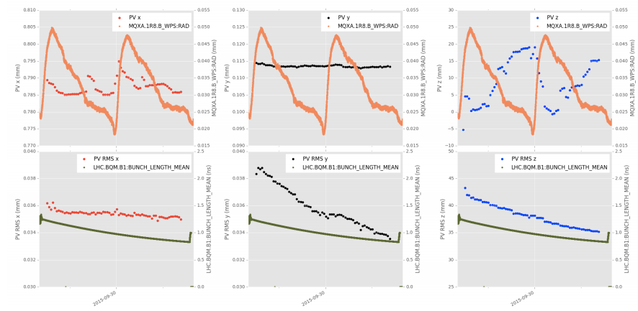
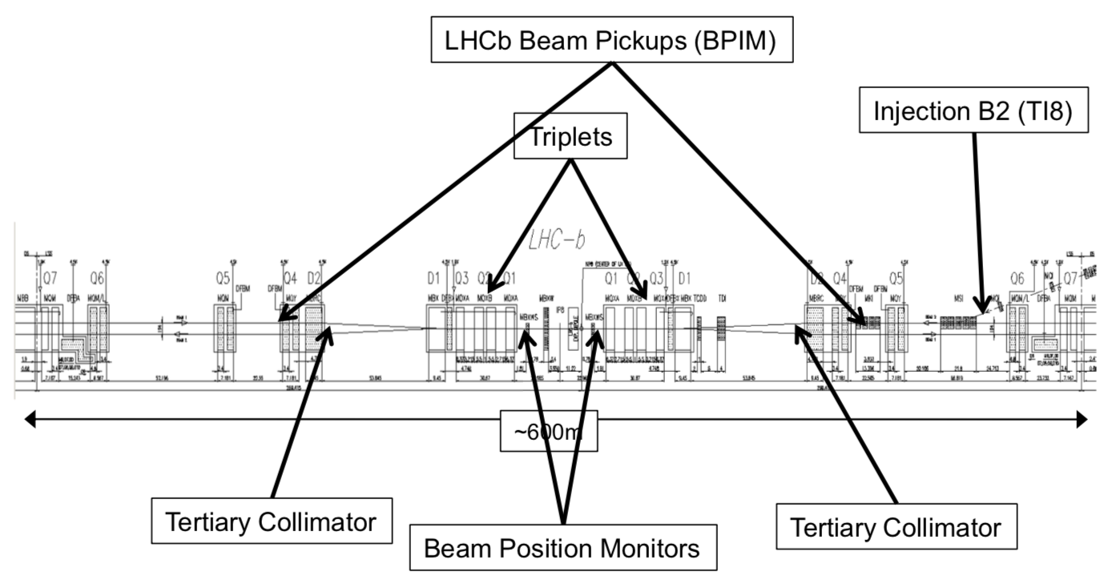
Interplay with the LHC
The position of the interaction moves because of the LHC magnets (triplets)
PV = Primary Vertex (position of the interaction)
LHCb PV z position (mm)
IR8 triplet position
16 hours

Slide 19
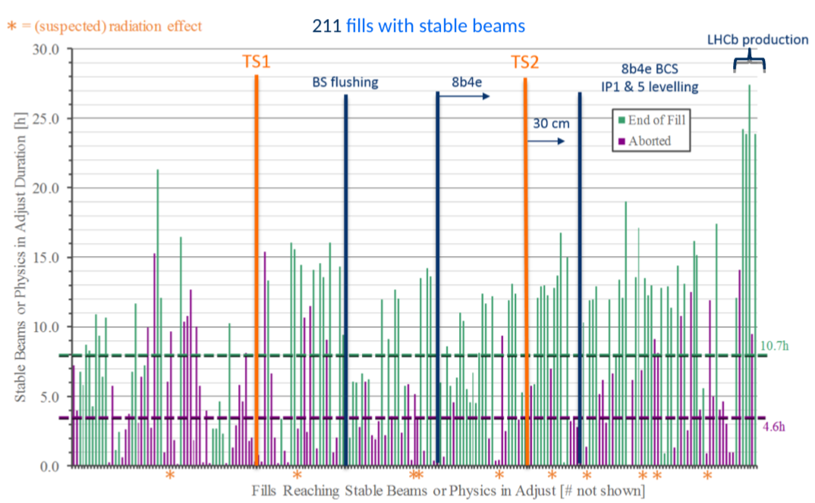
Interplay with other experiments
ATLAS and CMS loose luminosity when the duration of the fill is too long (because of luminosity decay), optimal around 12h of stable beams.
This is in conflict with LHCb where long fills are preferable
2017

Slide 20
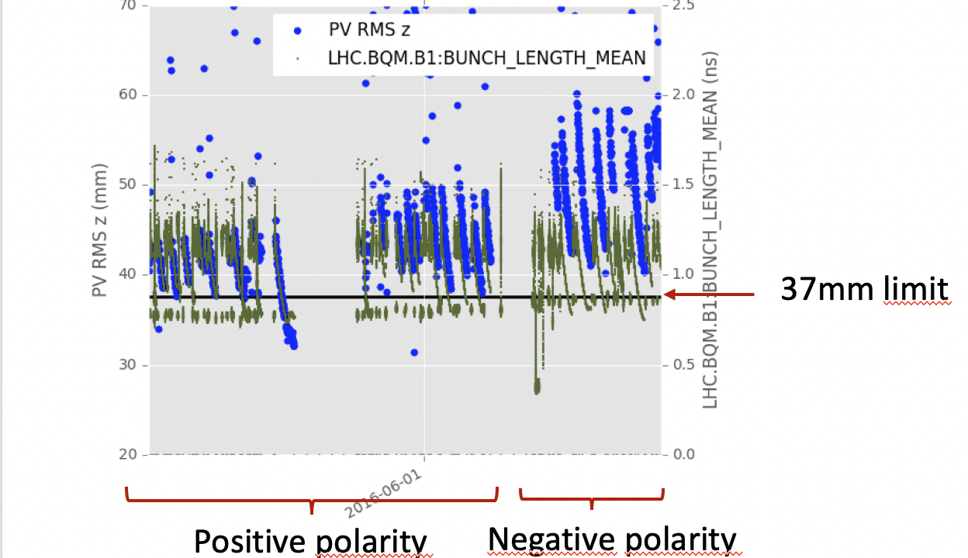
Interplay with other experiments
Bunch length decreases over time because of proton synchrotron radiation
When the interaction region is too small, more difficult to find the PV associated to the particles of interest
When the length is below 37mm, the fraction of mis-associated PV increases by 10%
Asked the LHC to keep this length above 37mm
Bunch length
LHCb PV z size (mm)
16 hours

Slide 21
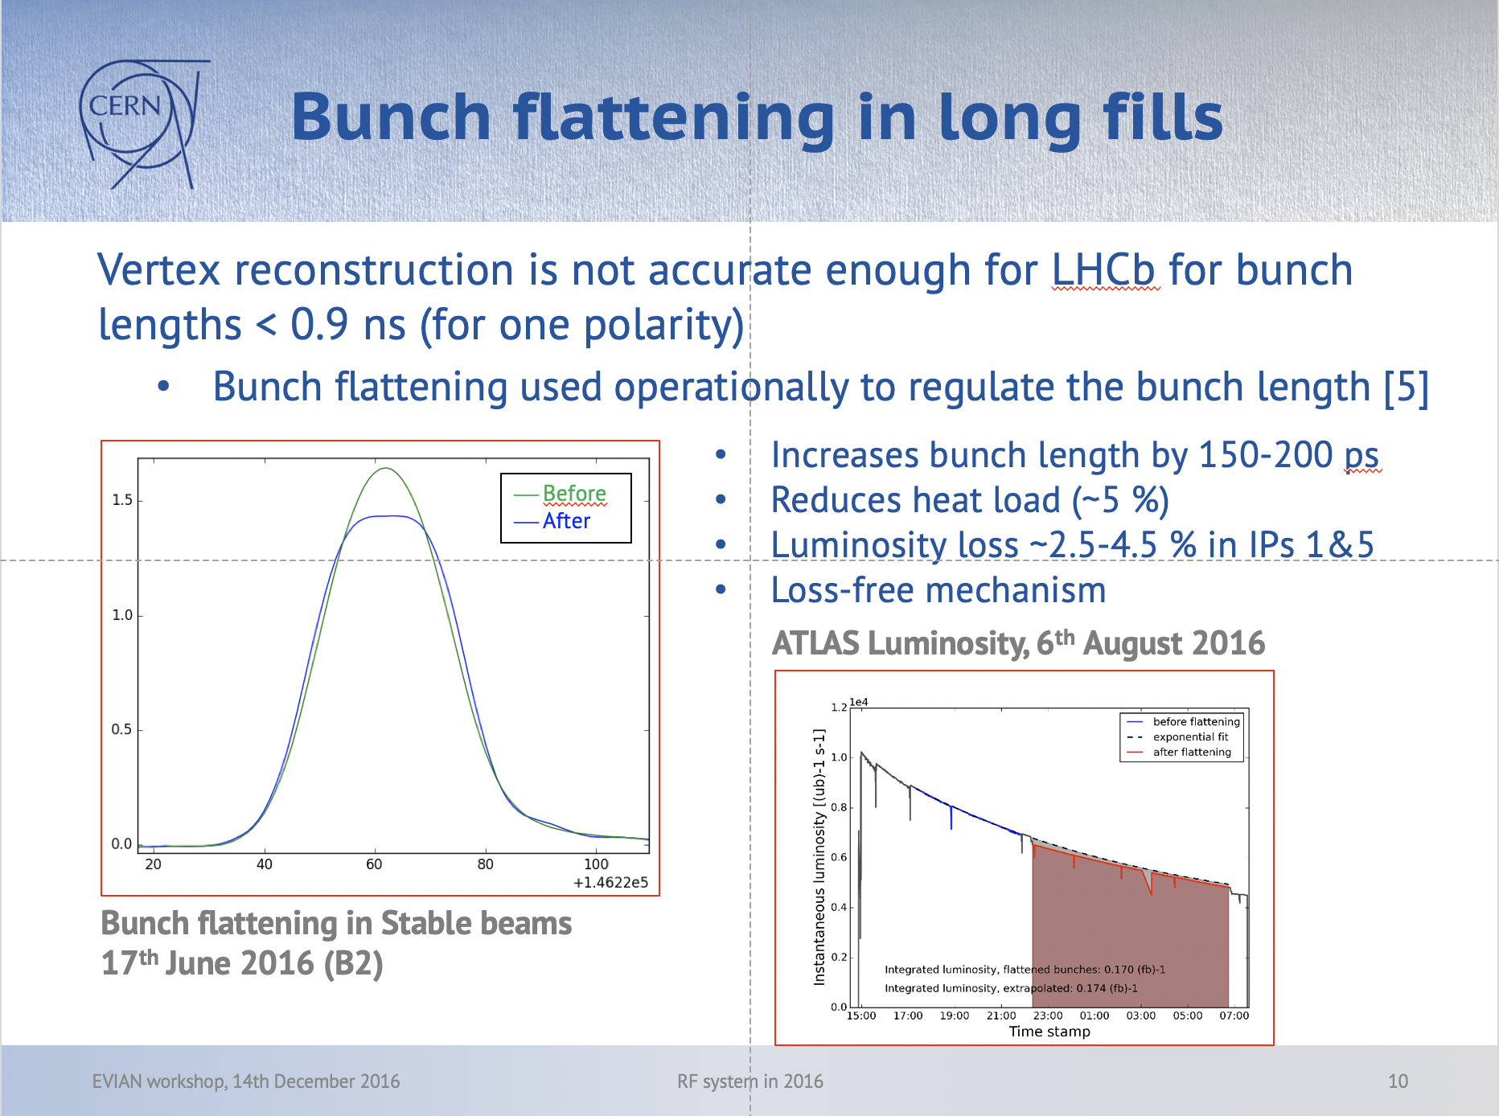
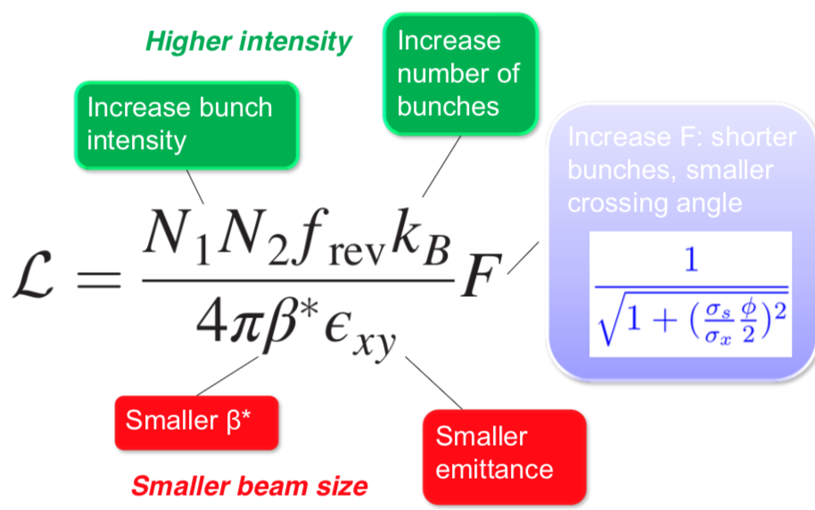
σ_{z}=bunch length

Slide 22
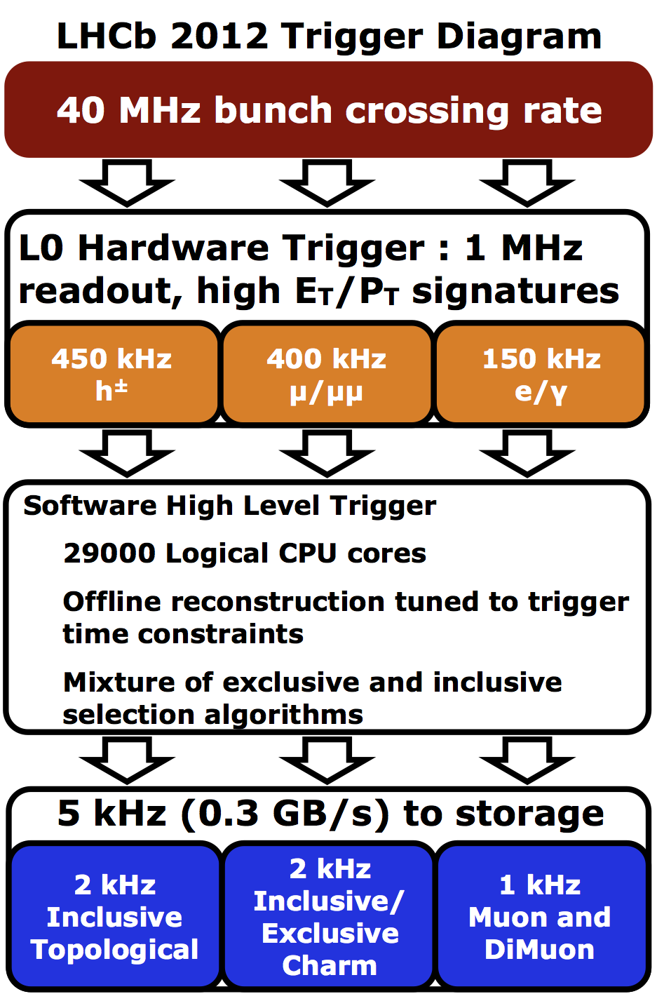
Trigger and reconstruction (Run 1)
Detector readout was limited by construction to 1 MHz
Collision rate reduced by a hardware trigger based on calorimeter and muon informations
Because it is done in electronics, not very precise: main goal is to optimize as much as possible the input bandwidth not to loose what is gained from beam operation
Other bottleneck is the rate to storage system

Slide 23

Trigger and reconstruction
The output rate is controlled by the software trigger, closer to physics analysis and more flexible
It can however be dangerous: each CPU should process one event within ~30ms but some events can take very long, timing increases exponentially with multiplicity:
  The number of interaction distribution is a Poisson distribution, some events can have many interactions
  Upstream beam gas interactions also can produced showers of particles in the detector
Software trigger tasks get stuck one after the other and the entire acquisition chain is blocked within few minutes:
  “St Petersburg Crisis” in 2010
  Apply cuts on event multiplicity in the software trigger
In order not to waste input bandwidth, apply also multiplicity cuts at hardware trigger, on SPD hit multiplicity: 450 for calo triggers, 900 for muon triggers

Slide 24
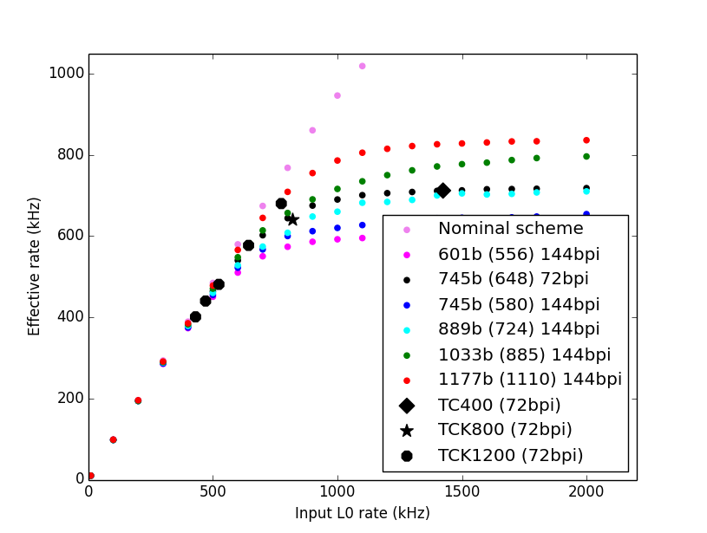
Hardware trigger optimization
Features of readout electronics
  Cannot read out two consecutive bunch crossings (25ns),
  Buffer limited in the Front-End electronics,…
  When these limits are reached, the events are rejected: deadtime
Deadtime depends then on hardware trigger rate and can be predicted precisely with a known filling scheme.
What is important to maximize is the final number of “interesting B events”
Decide the hardware trigger cut on optimal value: we found out it is better to run with non-zero deadtime (up to 10%) with looser cuts
(1-deadtime) x input rate =

Slide 25
Hardware trigger optimization
The ultimate bottelneck for the hardware trigger is due to the size of the events: when the events are too big, there is not enough bandwidth to send them to the software trigger.
The detector reaching this limit first is the Outer Tracker, because it sends information about several consecutive bunch crossings.
It can be reduced requiring events where the previous crossing had low multiplicity:
  Introduce a new cut in the trigger level which is the multiplicity of the previous crossing
Ultimate trigger rate of LHCb: 970 kHz with 8% deadtime (with one magnet polarity, with the other the maximum rate was 950 kHz)

Slide 26
Trigger…
Playing with the trigger was really the way to optimize data taking once the environmental conditions were fixed
In total, 175 hardware trigger configurations used during the lifetime of the experiment
Mainly small variations around common main features to keep analysis easy:
  Cannot rely on simulation to describe all possible configurations
  Need of calibration or unbiased trigger lines to determine efficiencies

Slide 27
Calibration
Since
  conditions can vary even if all is done to keep them stable
  Monte Carlo simulation cannot cover all possible conditions.
Need to calibrate using data directly to reduce systematic uncertainties.
Most of them are automatic (one of them is rather manual: MUON detector is moved and aligned physically by hand at the beginning of every year to correct for mis-alignment in the trigger):
  They are done in the software trigger

Slide 28
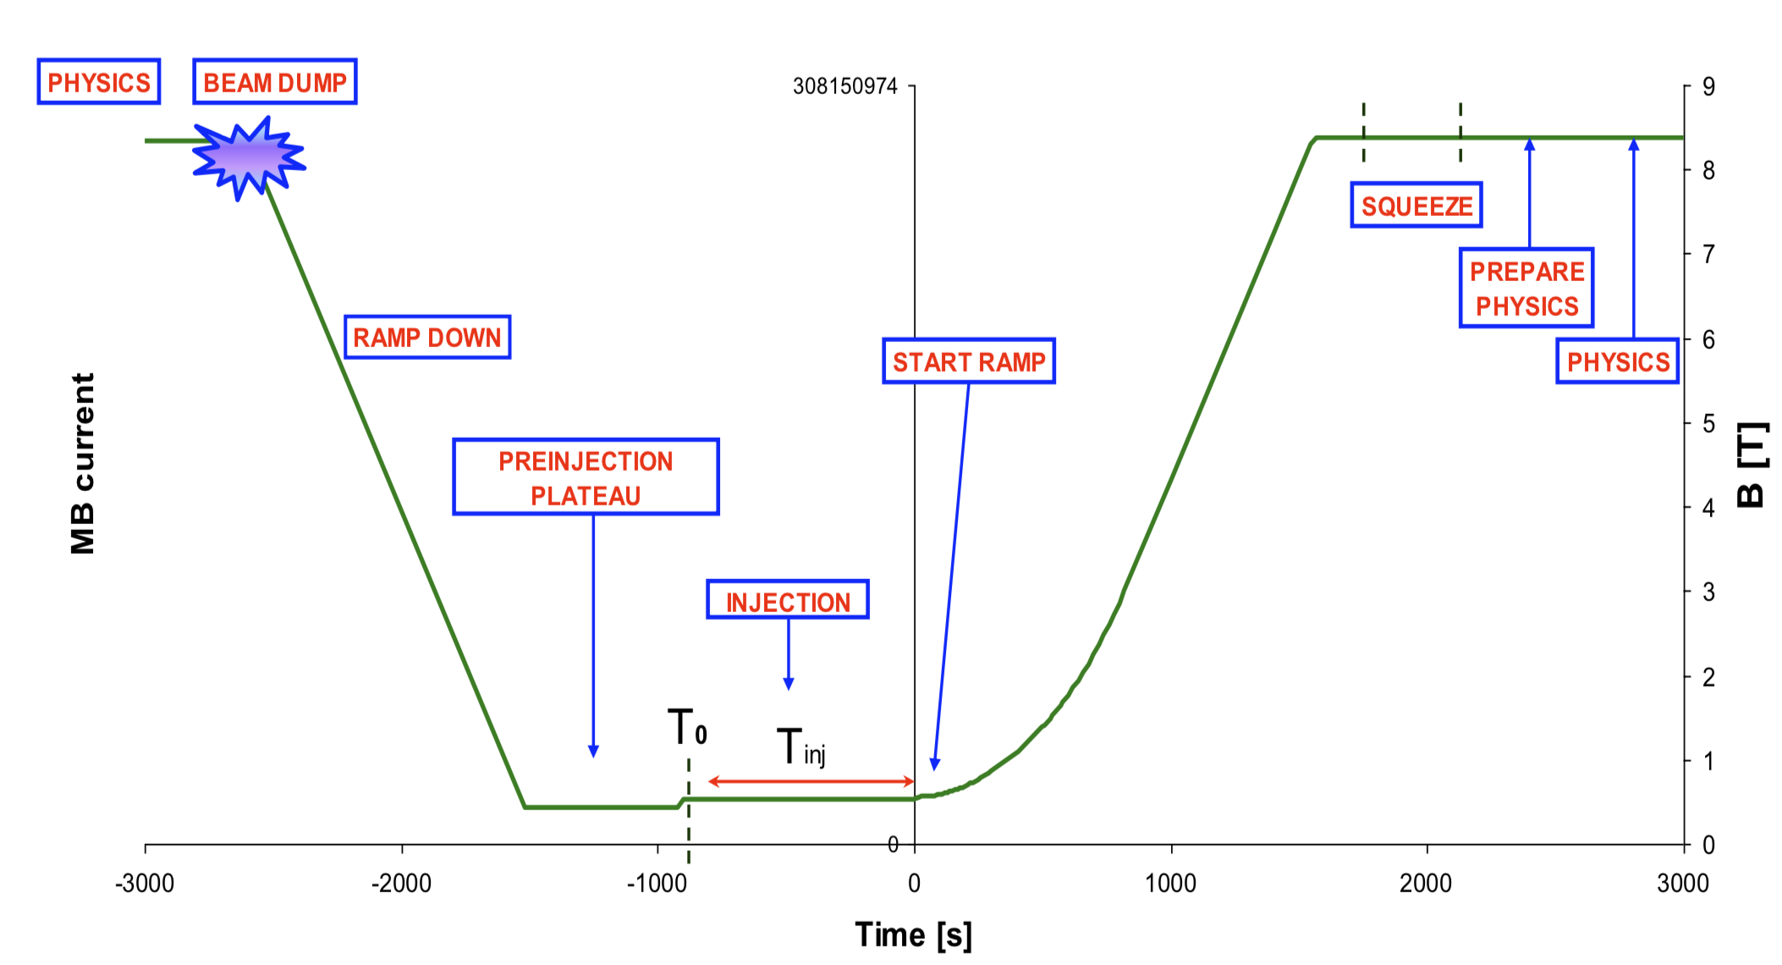
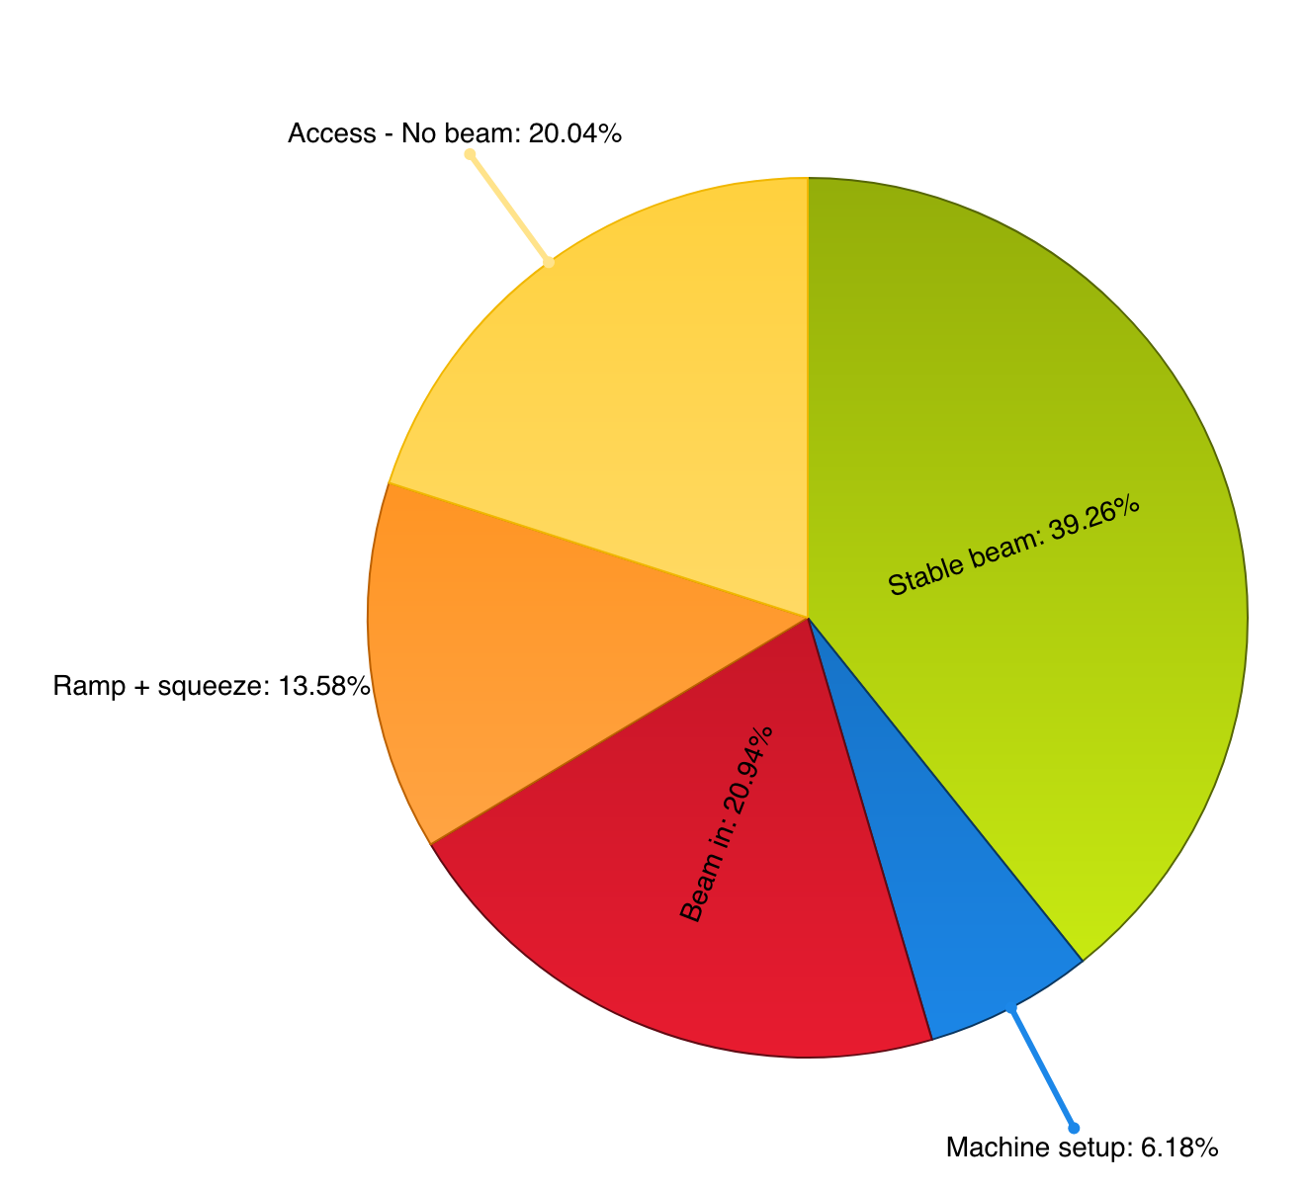
LHC sequence
Instead of running the software trigger during stable beams, run it also when there is no collision. This will allow to increase the effective output rate.

Slide 29
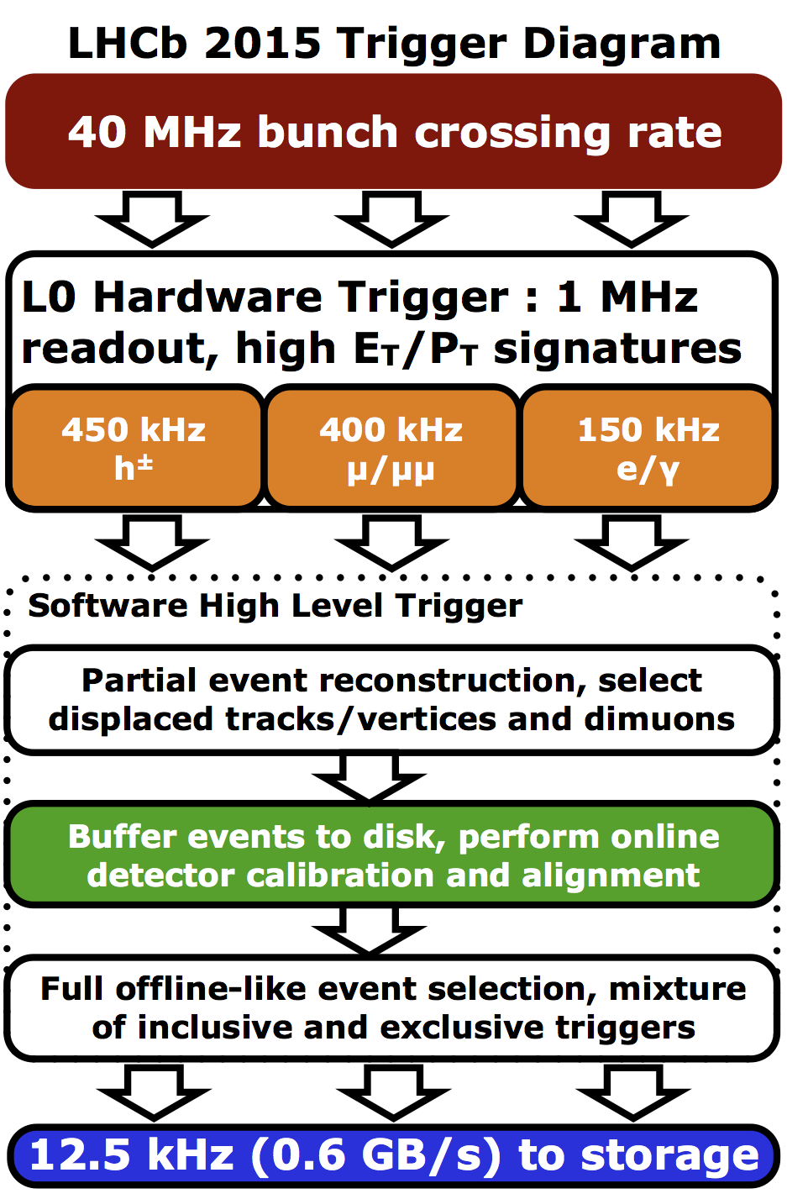
Run II Trigger Scheme
After the hardware trigger, a loose software selection is applied, and events are written to disks attached to the CPU (access is much faster than central storage).
Second part of software trigger is ran continuously (at full speed when there is no collision, and at reduced speed when there are collisions) but not anymore synchronized to the first part
Take advantage of the delay between the two software stages to perform calibration and alignment:
  More and better quality data

Slide 30
Run II Trigger Scheme
Another constrain is then the size of the buffer disks: 5 PB. Should not be filled otherwise data taking is impossible.
Filling speed must be predicted but depends on many factors:
  Main one is the time the LHC spends in collisions, which is unpredictable
Write to disk buffer at 130 kHz out of the 1st software trigger stage
LHC performing better than expecting: reduce rate to 115 kHz
Reduce to 85 kHz
Relax to 105 kHz
3.
4.
1.
2.

Slide 31
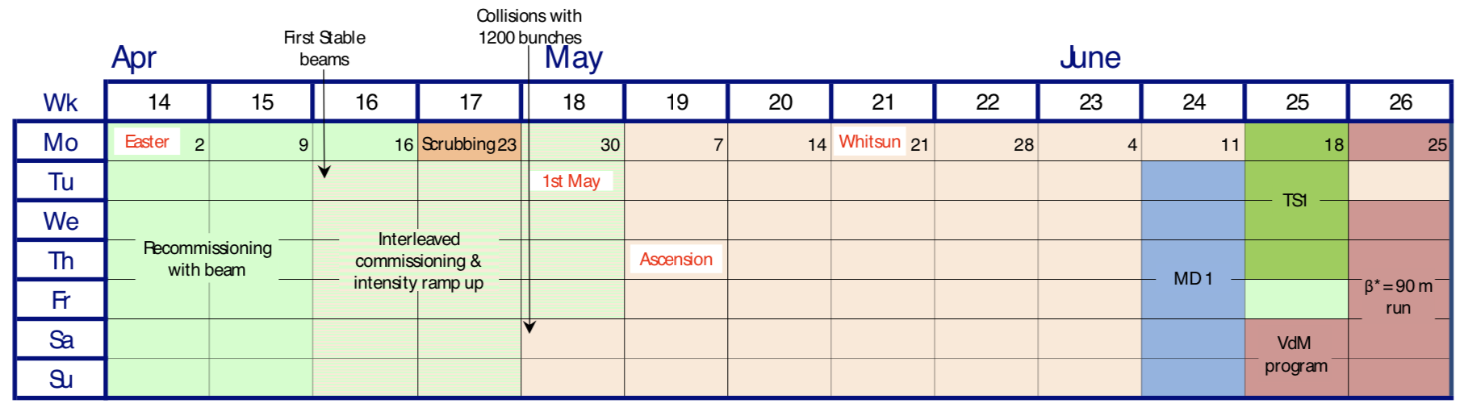
Simulation
Large need of simulation: usually simulate each type of event for every data taking year and magnet polarity.
Simulation events are mainly produced on the grid.
Use also the time with no beam to simulate events on the trigger computing farm.

Slide 32
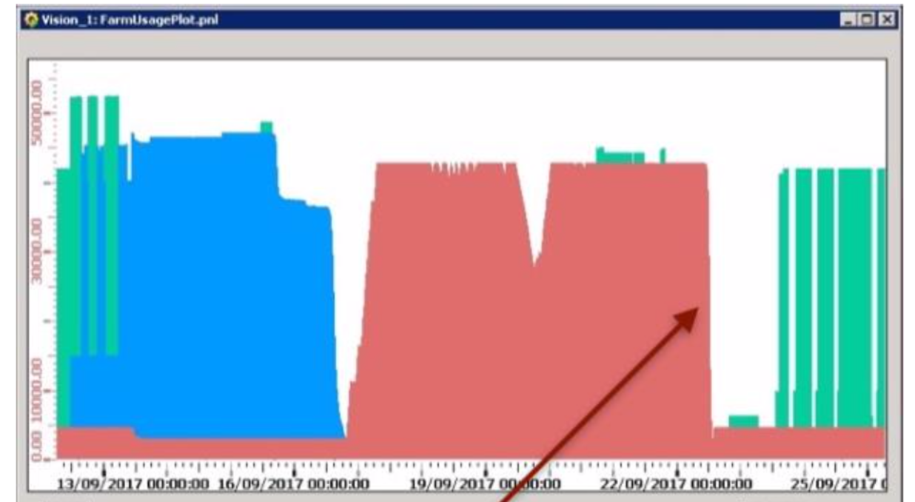
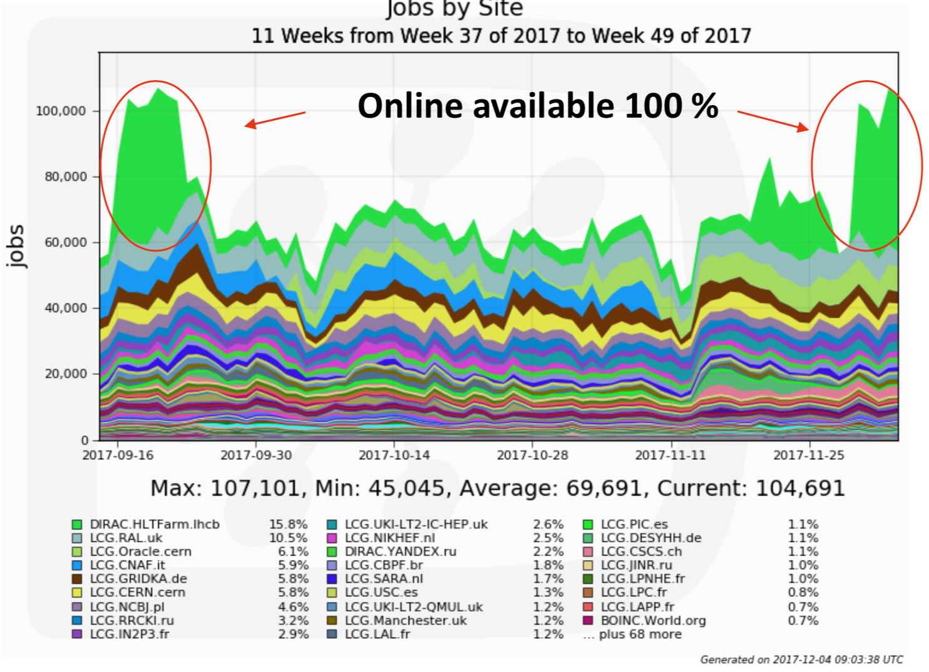
Simulation
HLT1
HLT2
Simulation
Example here: profit from a 2 day unforeseen stop of the LHC to produce simulation events and stop production when beams come back
There is also a small continuous simulation production running
It is not a gadget: when trigger farm is fully available, it doubles the computing capacities for simulation (compared to the grid alone)

Slide 33
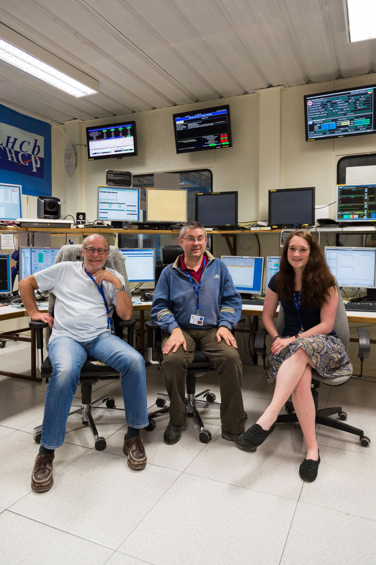
Shifts
The last parameter in the optimisation of the data taking is the operation efficiency. It is 97.6% over the LHCb lifetime.
Large level of automatisation: two persons on shift:
  Shift Leader
  Data Manager: essential role, in a flavour physics experiment, data where one detector is not working properly has to be discarded
And 12 piquets (detector expert on site for 1 week)

Slide 34
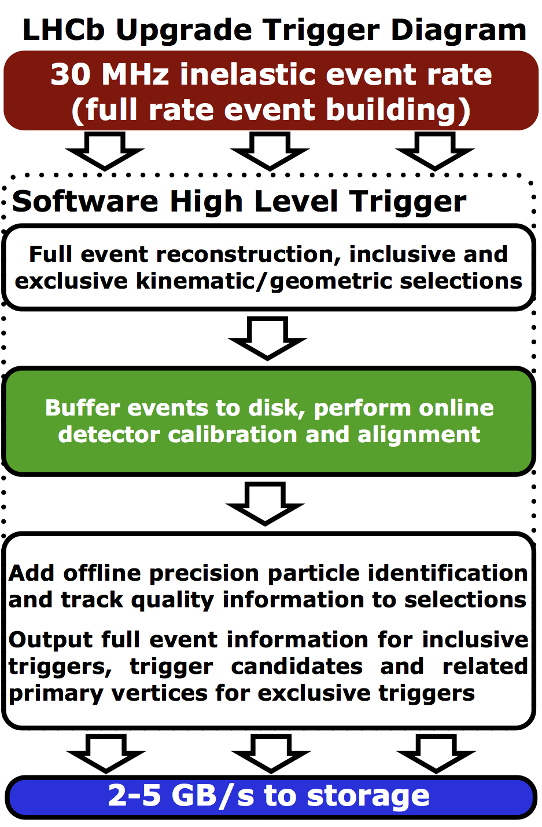
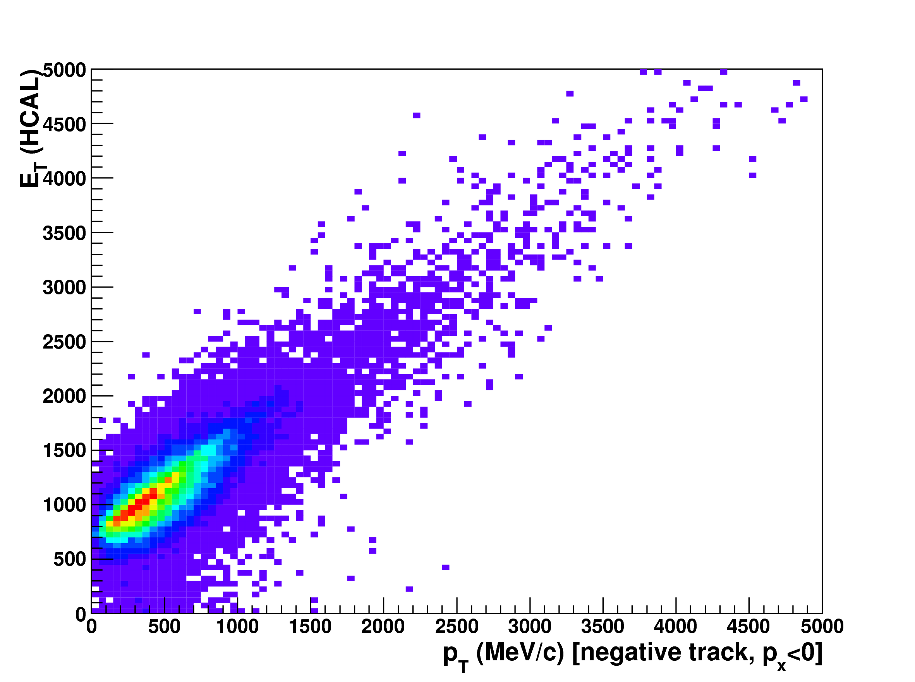
Upgrade
Now that we reached the optimal operation working point, it is time to replace the detector to do better.
To increase statistics, the only way now is to increase the instantaneous luminosity per bunch, and reach in total 2x10³³ cm⁻²s⁻¹ (μ=5.5). But the gain in statistics would be lost because of the imprecision of the hardware trigger -> remove hardware trigger

Slide 35
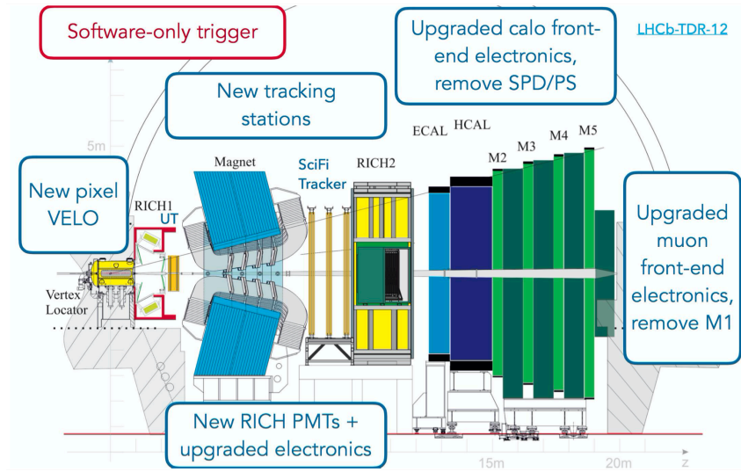
Upgrade I detector
But this implies building new tracking detectors to cope with higher multiplicities

Slide 36
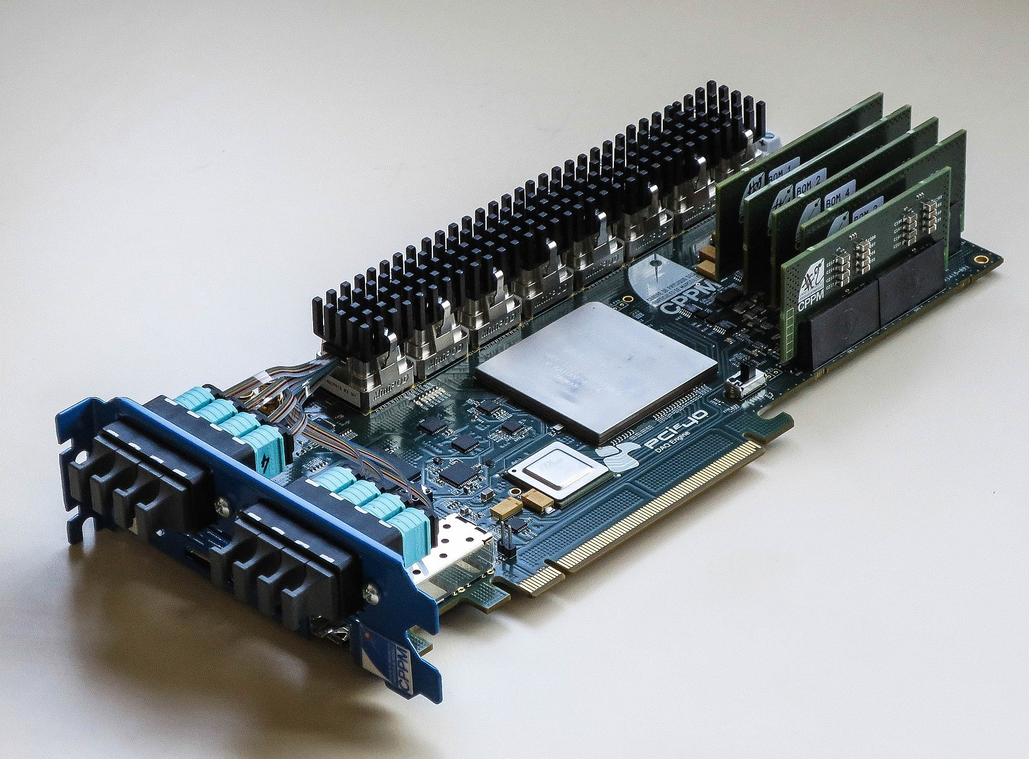
Upgrade
And designing new readout Front-End and backends boards.
PCIe40 boards made to fulfill this new backend role: 500 in total will be produced. Bandwitdh of 100 Gb/s

Slide 37
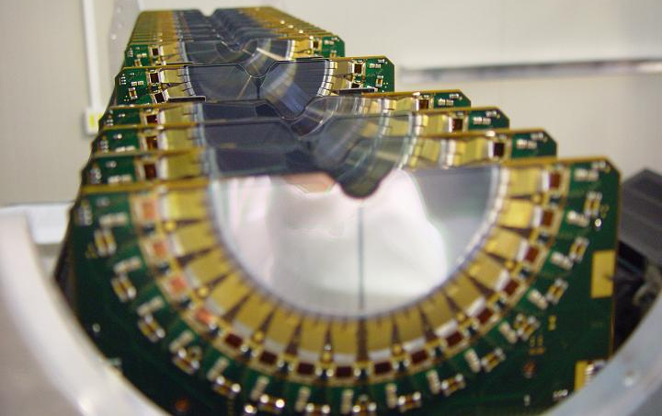
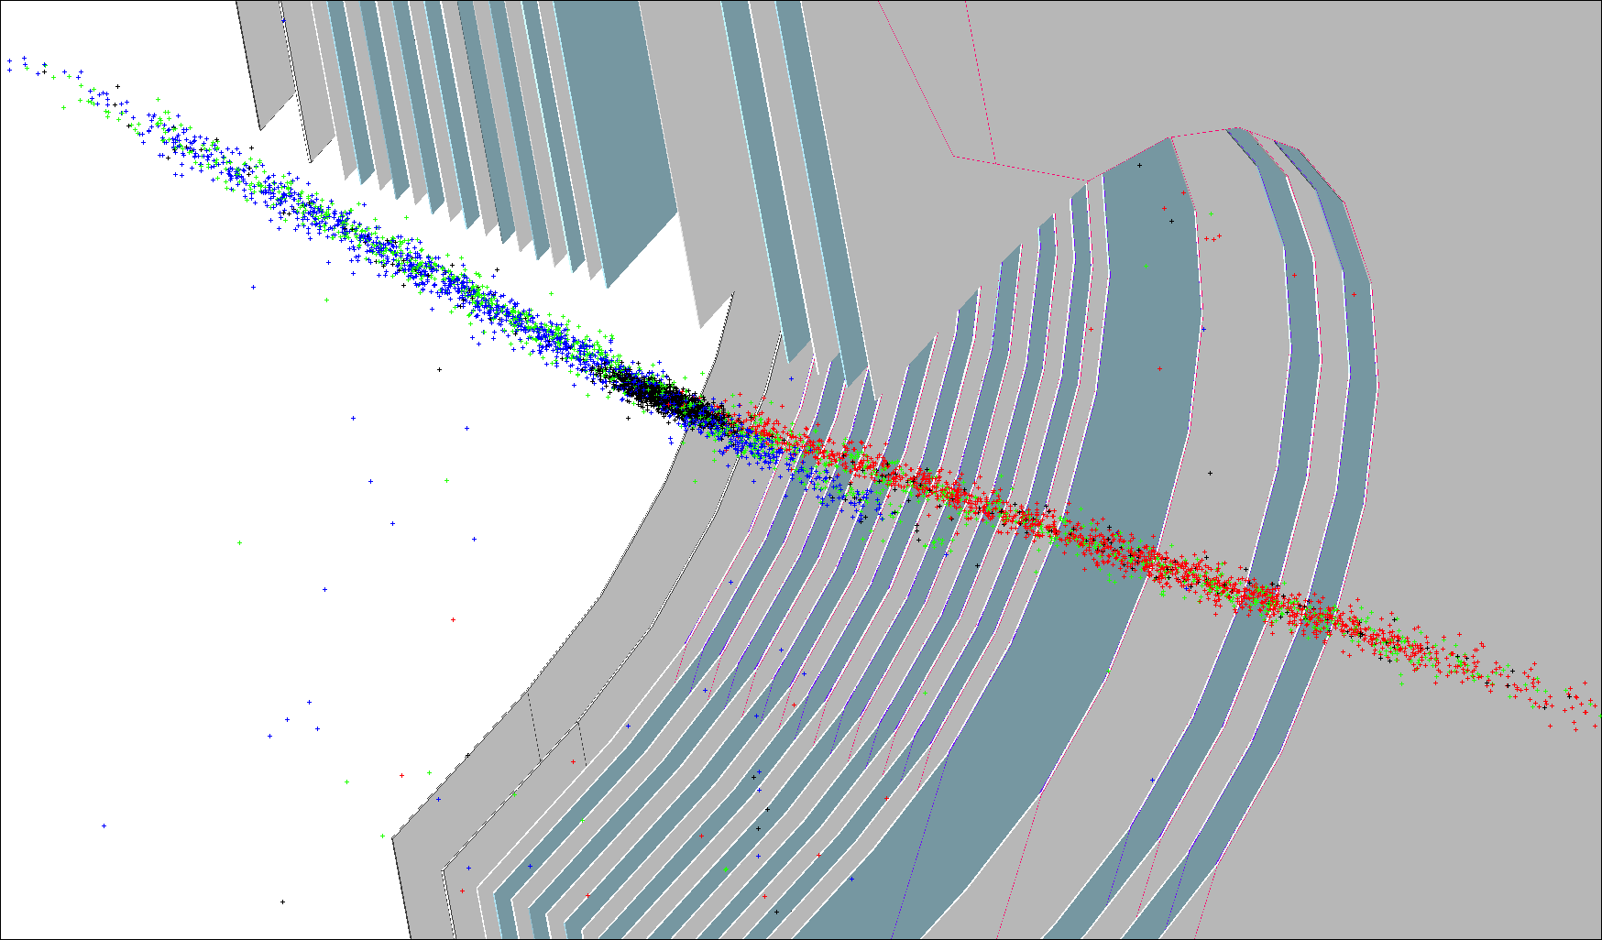
LHCb fixed target – SMOG
Gas can be injected in the interaction region of LHCb, in the VELO vaccuum (ie the LHC vaccuum).
Initially this was designed to measure the luminosity of LHCb, by measuring the beam images with beam-gas vertices: used during LHC van der Meer scan sessions: 1.2% precision on integrated luminosity.
Other use cases emerged:
  Measure LHC ghost charge (proportion of particles outside the colliding buckets) for the ALICE, ATLAS and CMS luminosity.
  Fixed target physics interesting at the LHC [S. Brodsky, F. Fleuret, C. Hadjidakis, J.P. Lansberg, Phys. Rep. 522 (2013) 239].

Slide 38
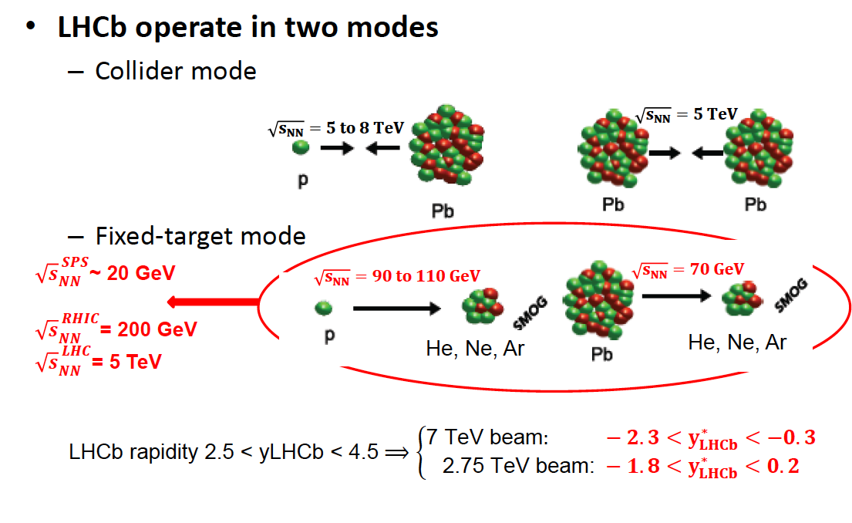
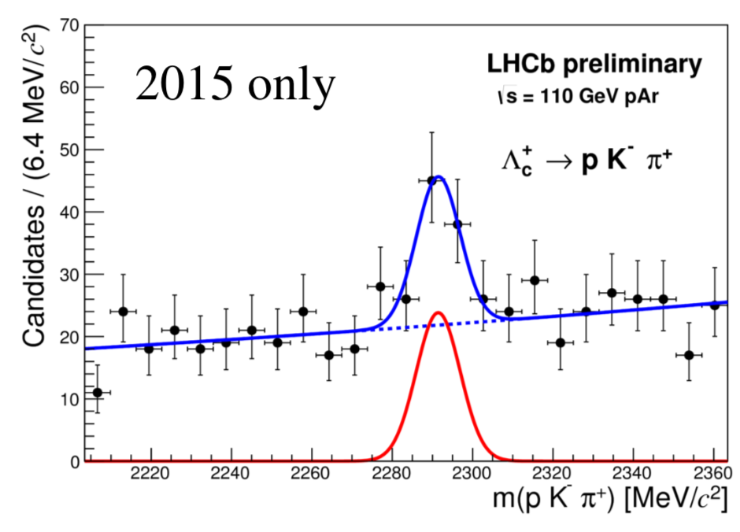
LHCb fixed target operation
During Run II, the possibility to operate in parallel LHCb in fixed target mode and in collision mode was established.
This proves more generally that fixed target experiments can be run without interfering with the normal LHC running. This opens possibilities for dedicated experiments, ideally with larger statistics than what is possible now. For example, measurement of charm or τ MDM.

Slide 39
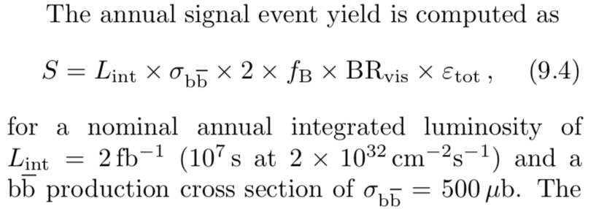
Conclusions
LHCb TDR stated:
A lot of creativity and innovations were needed to achieve the goals set, which will benefit to the LHCb upgrades and other experiments
A large part of the success is due to the LHC which also surpassed all predictions.
This is not by chance:

Slide 40
