Slide 1
News from IHEP
Rui Qiao; Wenxi Peng; Ke Gong

Slide 2
Outline
Install precision
Plan for test beam
Brief introduction to the SCD structure

Slide 3


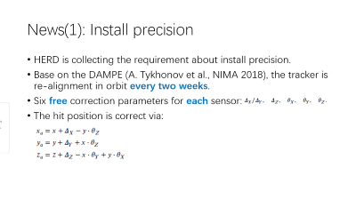
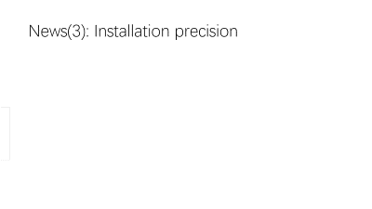
News(1): Install precision
HERD is collecting the requirement about install precision.
Base on the DAMPE (A. Tykhonov et al., NIMA 2018), the tracker is re-alignment in orbit every two weeks.
Six free correction parameters for each sensor:
The hit position is correct via:

Slide 4
New(2): Test beam plan from IHEP&PMO SCD
Contribution | Ladder | Sensor | Purpose
IHEP | Short *2 | MICRON(25 & 60 um) *1 | Charge Measurement
PMO | Long *2 | DAMPE *7 | Assembling Qualification

Slide 5
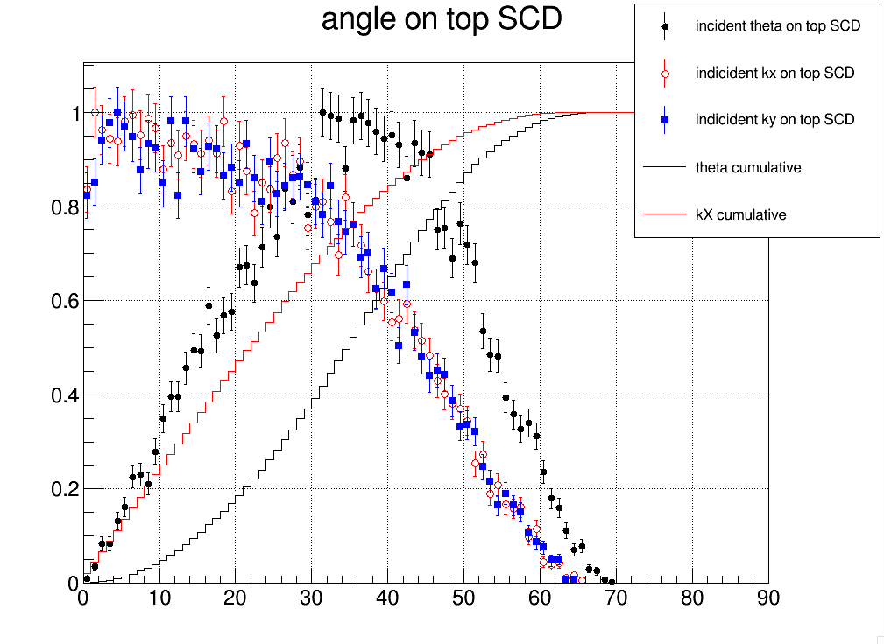
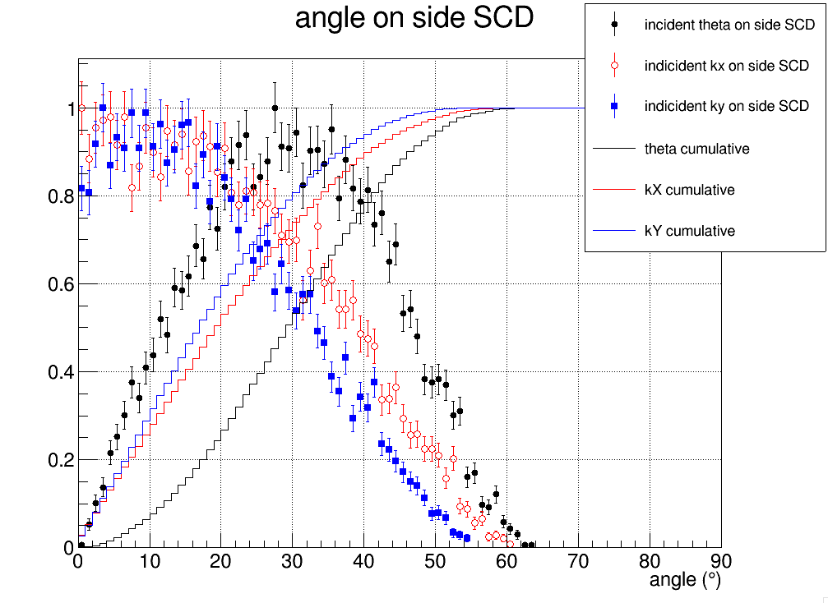
Incident angle requirement
TOP
SCD
Side
SCD
From simulation, 95% cumulative events corresponds to 0~50deg in X-Z or Y-Z plane.
HERD want to expand SCD dynamic range to Z=28.
HERD suggests SCD detector to incline 50deg (along strip direction) during test beam for the extreme performance.

Slide 6
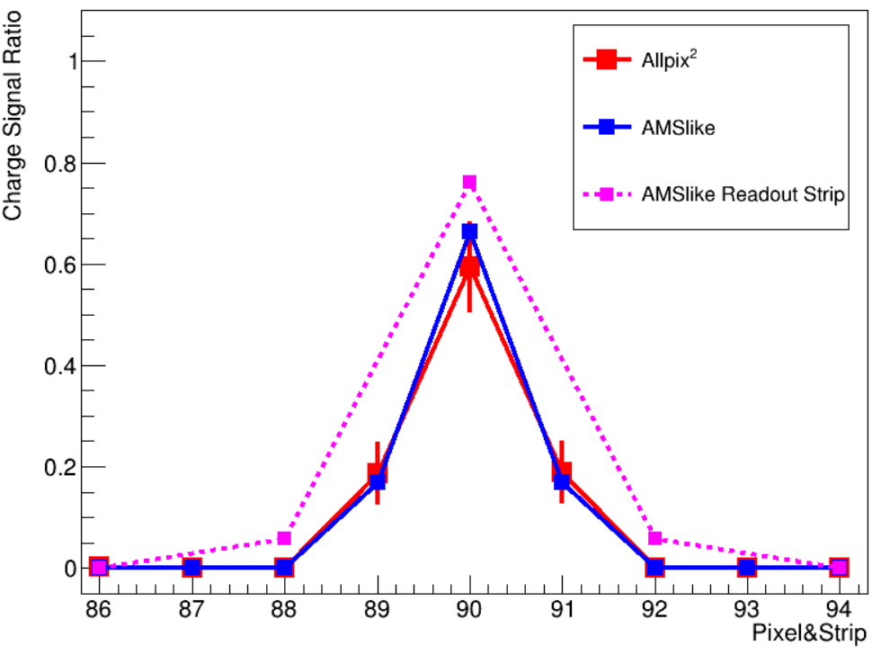
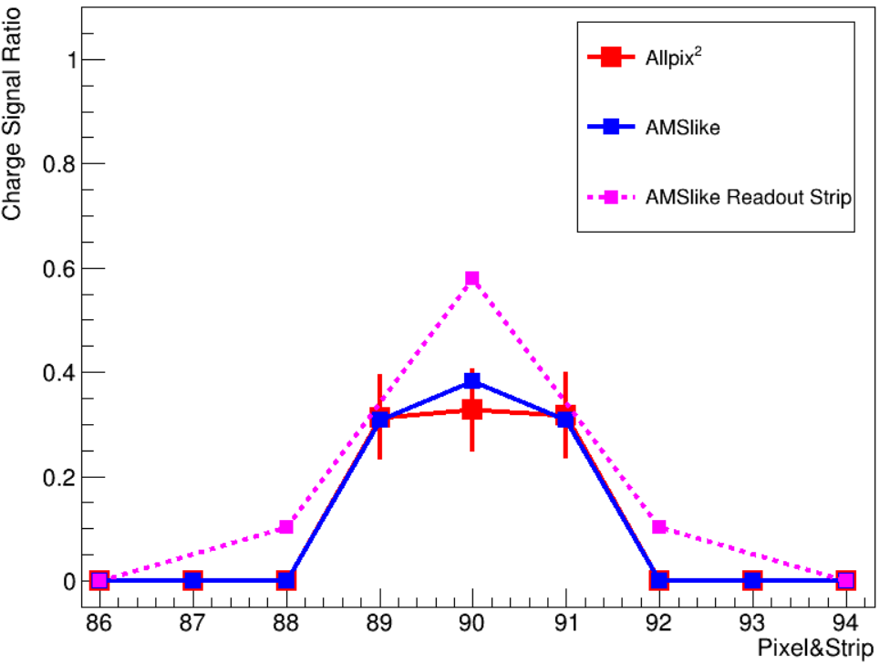
Incident angle requirement
45 deg
60 deg
A student is study Allpix2 silicon pixel simulation tools. The result differ from the AMS02 simulation algorithm in large incident angle(perpendicular to strip direction).

Slide 7
Incident angle requirement
Objective | Incident angle | Purpose
Primary | 50 deg along strip direction | Dynamic range Charge sharing
Secondary | 50 deg perpendicular to strip direction | Verify simulation
320um * tan(50) = 380um

Slide 8
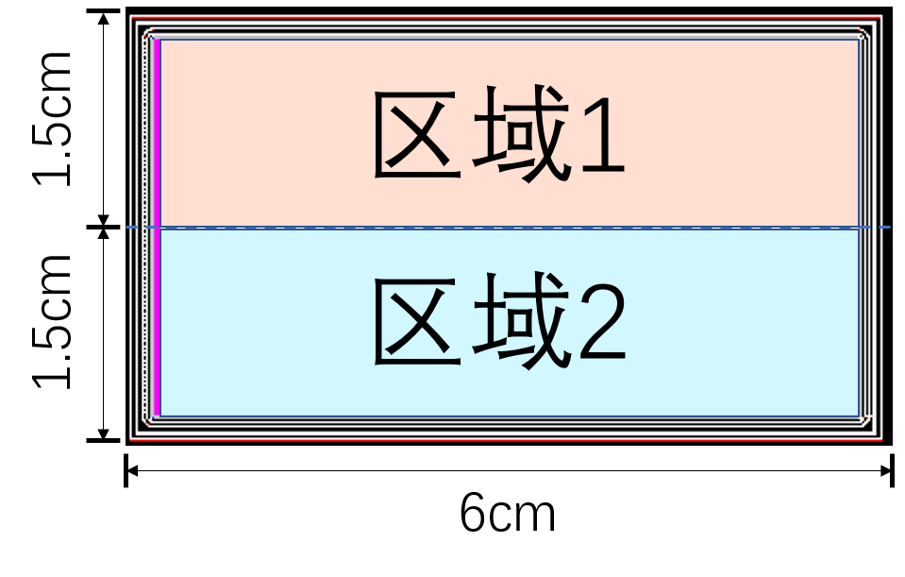
Incident position requirement
IHEP SCD, pitch 80um
Width 25um
Want to study the performance of different width & external capacitor.
Width 60um
Ext. Cap.
Beam1
25um
60um
Rely on mobile platform to change incident position
60um
25um
Beam2

Slide 9
Test beam trigger
HERD provide two trigger type as the last test beam:
TTL (Traditional)
DI2C (Flight model)
SCD contribution | Prefer trigger type
IHEP | TTL
PMO | TTL
Perugia | ??

Slide 10
Man power
Due to Omicron variant, stronger restriction for Chinese Academy of Science (including IHEP & PMO) to send employees and students abroad.
Can Perugia team help:
Install & uninstall IHEP & PMO SCD and DAQ
IHEP & PMO team can help remote control & logging

Slide 11
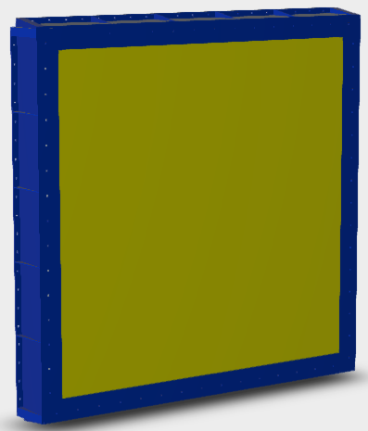
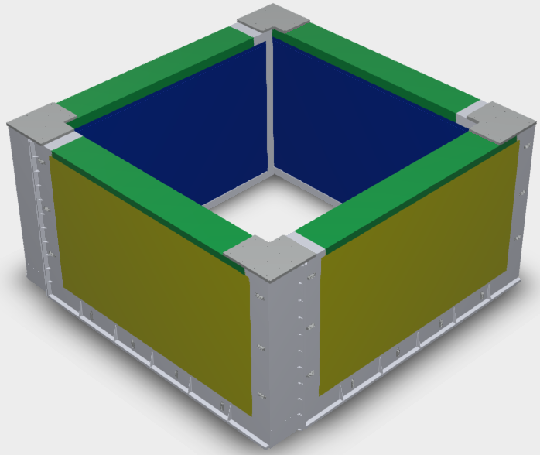
New(3): Brief introduction to the SCD structure
SCD & PSD
cover
Support
&
Fanout
Top SCD
4 sides SCD

Slide 12
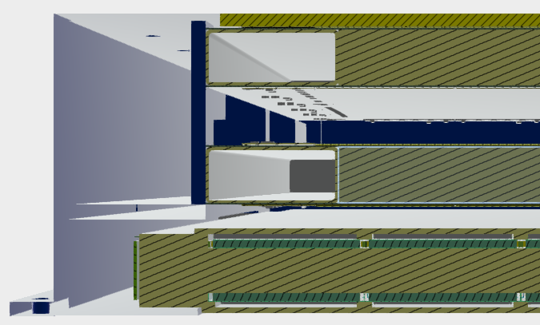
General structure
Cover
honeycomb & 4 layers SCD
Support
&
Fanout
*2
honeycomb & PSD

Slide 13
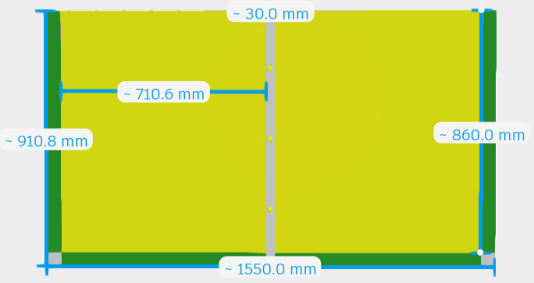
Preliminary size of side SCD
Module | Width (m) | Height (m)
SCD | 1.55 | 0.91
Sensor | 0.71*2= 1.42 | 0.86
TFH | 0.05
Center Support | 0.03

Slide 14
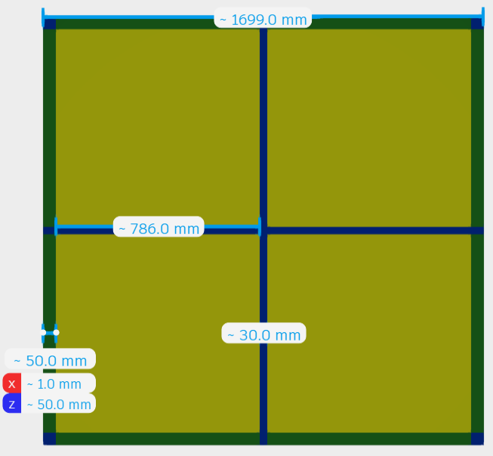
Preliminary size of Top SCD
Module | Width (m) | Height (m)
SCD | 1.7 | 1.7
Sensor | 0.786*2= 1.572 | 0.786*2= 1.572
TFH | 0.05
Center Support | 0.03

