Slide 1
Update on the dRICH activities
Chandradoy Chatterjee

Slide 2
Pattern Recognition meeting and its Follow-ups
RICH Pattern Recognition Challenges (6 April 2022) and its follow-up meeting:
We had presentations from:
a) ALICE
b) CLASS12
c) COMPASS
d) Hall-A Jlab
e) Hermes
f) LHCb
And PID challenges in EIC
The outcome is (in my understanding to develop) at least in the first place to develop a pattern recognition and PID based on chi2 test (in parallel to keep option open for more sophisticated methods).
To deal this we need a common path where we can corroborate progress in ECCE and ATHENA frameworks rather easily. We have started our activities in this direction.

Slide 3
Software side situation and plan
On the ATHENA framework the issues to fix the Juggler is ongoing. In order to be ready for the tutorial and to start the simulation.
In the first place we will try to recapitulate all the benchmark plots and then switch to multiparticle events to retrieve the benchmark plots.
Then we will move towards the PR studies.
All work will be done with exchange of ideas and meetings with ECCE colleagues (Jin and Sebastian?) and asking Alexander for help and supervision.

Slide 4
Kick-off Meeting on SW for dRICH
We are organizing a kick-off meeting with our ECCE colleagues and Software experts from both ATHENA and ECCE. We will discuss about the geometry and available features from ATHENA and ECCE side.
There will be an open discussions where we will try to understand the direction where we must move so that we can work together independently but consistently.
The meeting will not foresee the assessment on the pros-cons of the either software frameworks but to understand from ECCE colleagues how did they can use ATHENA geometry in Fun4All and how advanced their studies are and how can we bridge easily our work from one platform to the other without porting the entire software. According to Chris D. for instance the geometry can be translated and has been translated. But we will understand the technicalities.
To discuss about organizing a set of tutorials of the existing software frameworks and to keep developers aware of the both working software frames.
Main Goal: To prepare a concrete working path, in order not to develop the reconstruction algorithm that later becomes incompatible to the finally adopted framework.
Link: https://indico.bnl.gov/event/15567/
May 4th 18:00-20:00 CEST

Slide 5
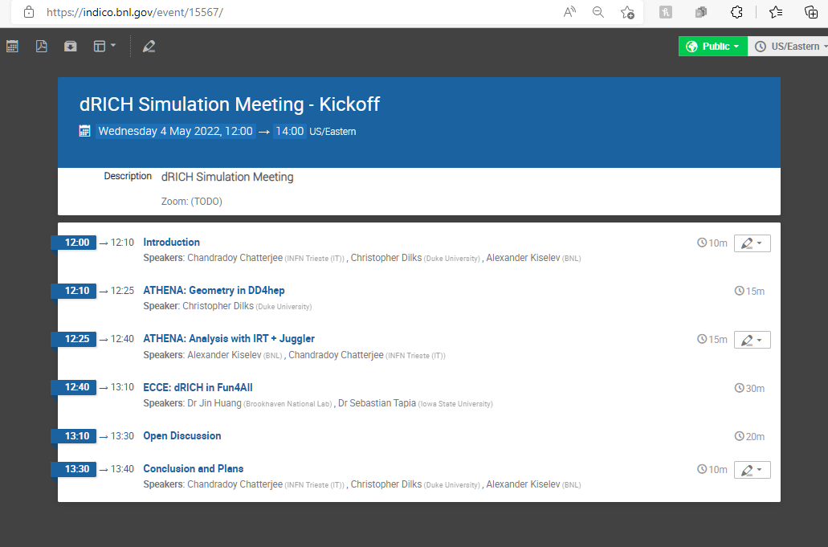

Slide 6
Tentative work plan
To set up a tutorial program if agreed upon (most likely yes!) on a suitable date and with help of Chris to make sure the benchmark plots (proposal) ones are reproduced. This means we have a software working after the last changes made in ATHENA framework and no essential updates were made after DPAP. To make our software up to date and fix one version as a back-up. (Tentatively: End of May)
To start debugging and make sure the software can handle the multiparticle events and can perform similar studies. (Tentatively: End of June)
To have a clear idea on the pattern recognition and PID methodology and to start really working on it. (Tentatively starting from end of June!)
Don’t take the dates too seriously now! A lot dependence on the next days. But we hope some positive outcome will happen on May 4th meeting.

