Slide 1
Rate and bandwidth measurements
Antonio Bergnoli, Riccardo Brugnera, Vanessa Cerrone, Alberto Coppi, Alberto Garfagnini, Marco Grassi, Beatrice Jelmini, Ivano Lippi, Andrea Serafini, Andrea Triossi, Riccardo Triozzi, Katharina von Sturm
6 May 2022

Slide 2
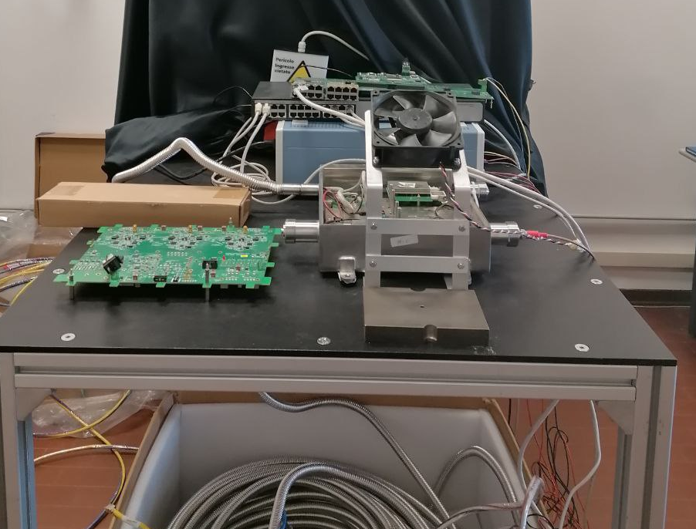
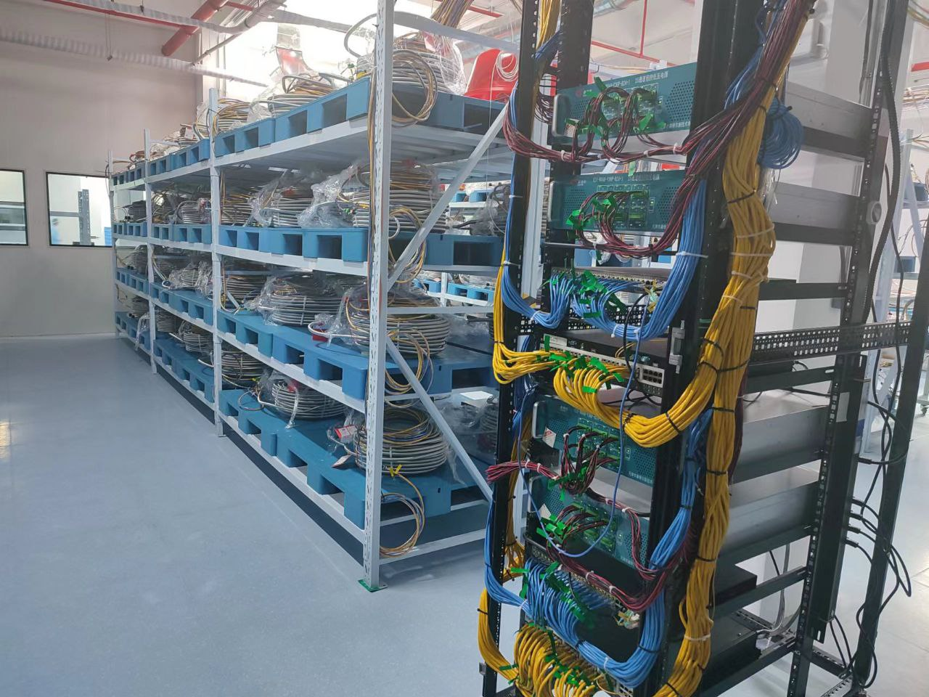
Overview
IPbus and its implementation implementation
Data acquisition performances for a single GCU
Parallel acquisition with multiple GCUs

Slide 3
The IPbus suite
JUNO challenge: acquire and transfer data in parallel to the remote monitoring and control of the electronics.
IPbus suite of software and firmware implements a reliable high-performance control link specifically suited for particle physics electronics.
IPbus is a hardware and firmware solution that communicates over Ethernet using UDP/IP and consists of:
A firmware module implementing the IPbus protocol within end-user hardware (e.g. JUNO's Kintex-7 and Spartan-6 FPGAs)
A micro Hardware Access Library (uHAL) providing an end-user C++/Python library for read/write operations on IPbus.
A software application called ControlHub, which mediates simultaneous hardware access from multiple uHAL clients.
While the UDP protocol does not include any native reliability mechanism, the use of ControlHub assures the duplication and re-ordering of any lost IPbus UDP packet, providing a reliability mechanism at software level.

Slide 4
IPbus implementation
Spartan-6
GCU
Server
Ethernet
interface
Firmware updates
Xilinx Vivado Suite
Xilinx Virtual Cable server IPbus uHAL client
IPbus slave
XVC
JTAG
Slow control scripts IPbus uHAL client
IPbus ControlHub
Flash memory
Kintex-7
IPbus Controller
Slow control
TCP/IP
UDP/IP
DAQ script IPbus uHAL client
FIFO IPbus DAQ slave
L1 cache
Data acquisition
TCP/IP

Slide 5
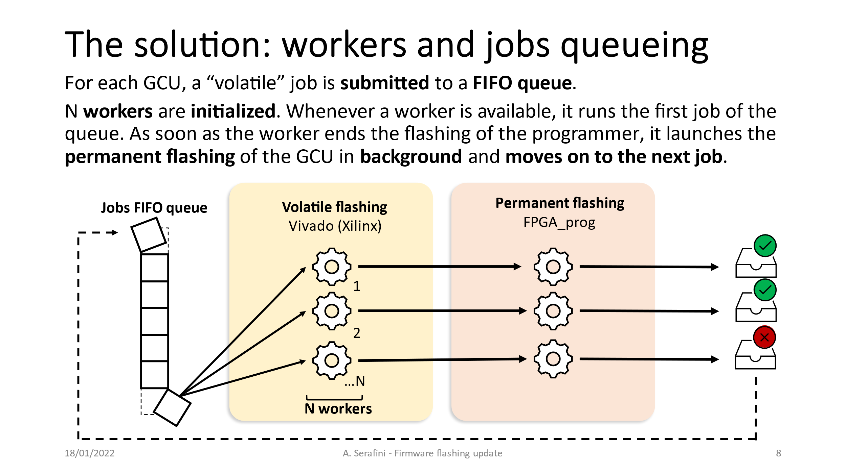
IPbus implementation
Spartan-6
GCU
My talk at Jan 2022 Collaboration Meeting (DocDB 7827)
Server
Ethernet
interface
Firmware updates
Xilinx Vivado Suite
Xilinx Virtual Cable server IPbus uHAL client
IPbus slave
XVC
JTAG
Slow control scripts IPbus uHAL client
IPbus ControlHub
Flash memory
Kintex-7
IPbus Controller
Slow control
TCP/IP
UDP/IP
DAQ script IPbus uHAL client
FIFO IPbus DAQ slave
L1 cache
Data acquisition
TCP/IP

Slide 6
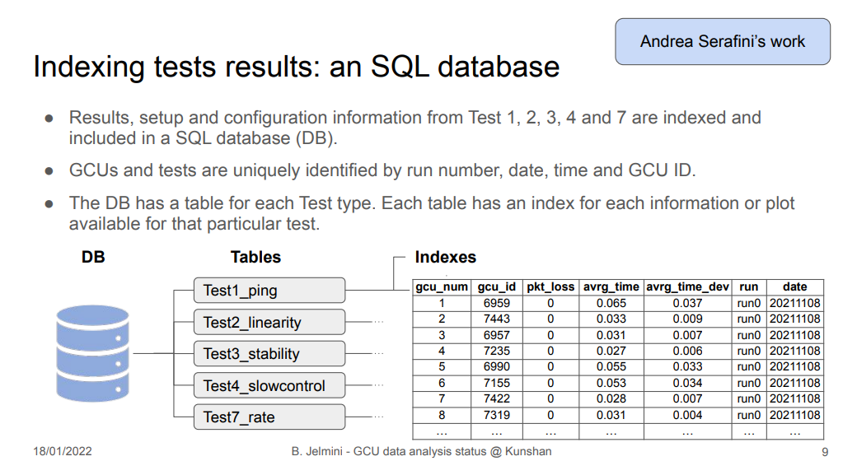
IPbus implementation
Spartan-6
GCU
Beatrice’s talk at Jan 2022 Collaboration Meeting (DocDB 7829)
Server
Ethernet
interface
Firmware updates
Xilinx Vivado Suite
Xilinx Virtual Cable server IPbus uHAL client
IPbus slave
XVC
JTAG
Slow control scripts IPbus uHAL client
IPbus ControlHub
Flash memory
Kintex-7
IPbus Controller
Slow control
TCP/IP
UDP/IP
DAQ script IPbus uHAL client
FIFO IPbus DAQ slave
L1 cache
Data acquisition
TCP/IP

Slide 7
IPbus implementation
Spartan-6
GCU
Server
Ethernet
interface
Firmware updates
Xilinx Vivado Suite
Xilinx Virtual Cable server IPbus uHAL client
IPbus slave
XVC
JTAG
Slow control scripts IPbus uHAL client
IPbus ControlHub
Flash memory
Kintex-7
IPbus Controller
Slow control
TCP/IP
UDP/IP
DAQ script IPbus uHAL client
FIFO IPbus DAQ slave
L1 cache
Today’s talk!!!!
Data acquisition
TCP/IP

Slide 8
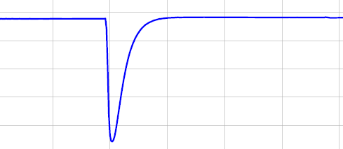
The structure of a waveform data packet
A waveform data packet is composed of a header, a trailer and the actual waveform data.
Each waveform contains 1 μs of data sampled with 1GHz frequency, for a total of 1000 samples.
Data packet
Header
Waveform data
Trailer
Fixed header start
Channel number (0,1,2)
Trigger window
Trigger count Timestamp
1000 ADC samples
Fixed trailer starting sequence GCU ID
Fixed trailer end
1 waveform packet = 16 header bytes + 16 trailer bytes + 1 μs x 1000 ADC/μs x 2 bytes/ADC = 2032 bytes
The FIFO has a dimension of 8192 bytes and can therefore contain ∼4 waveforms.

Slide 9
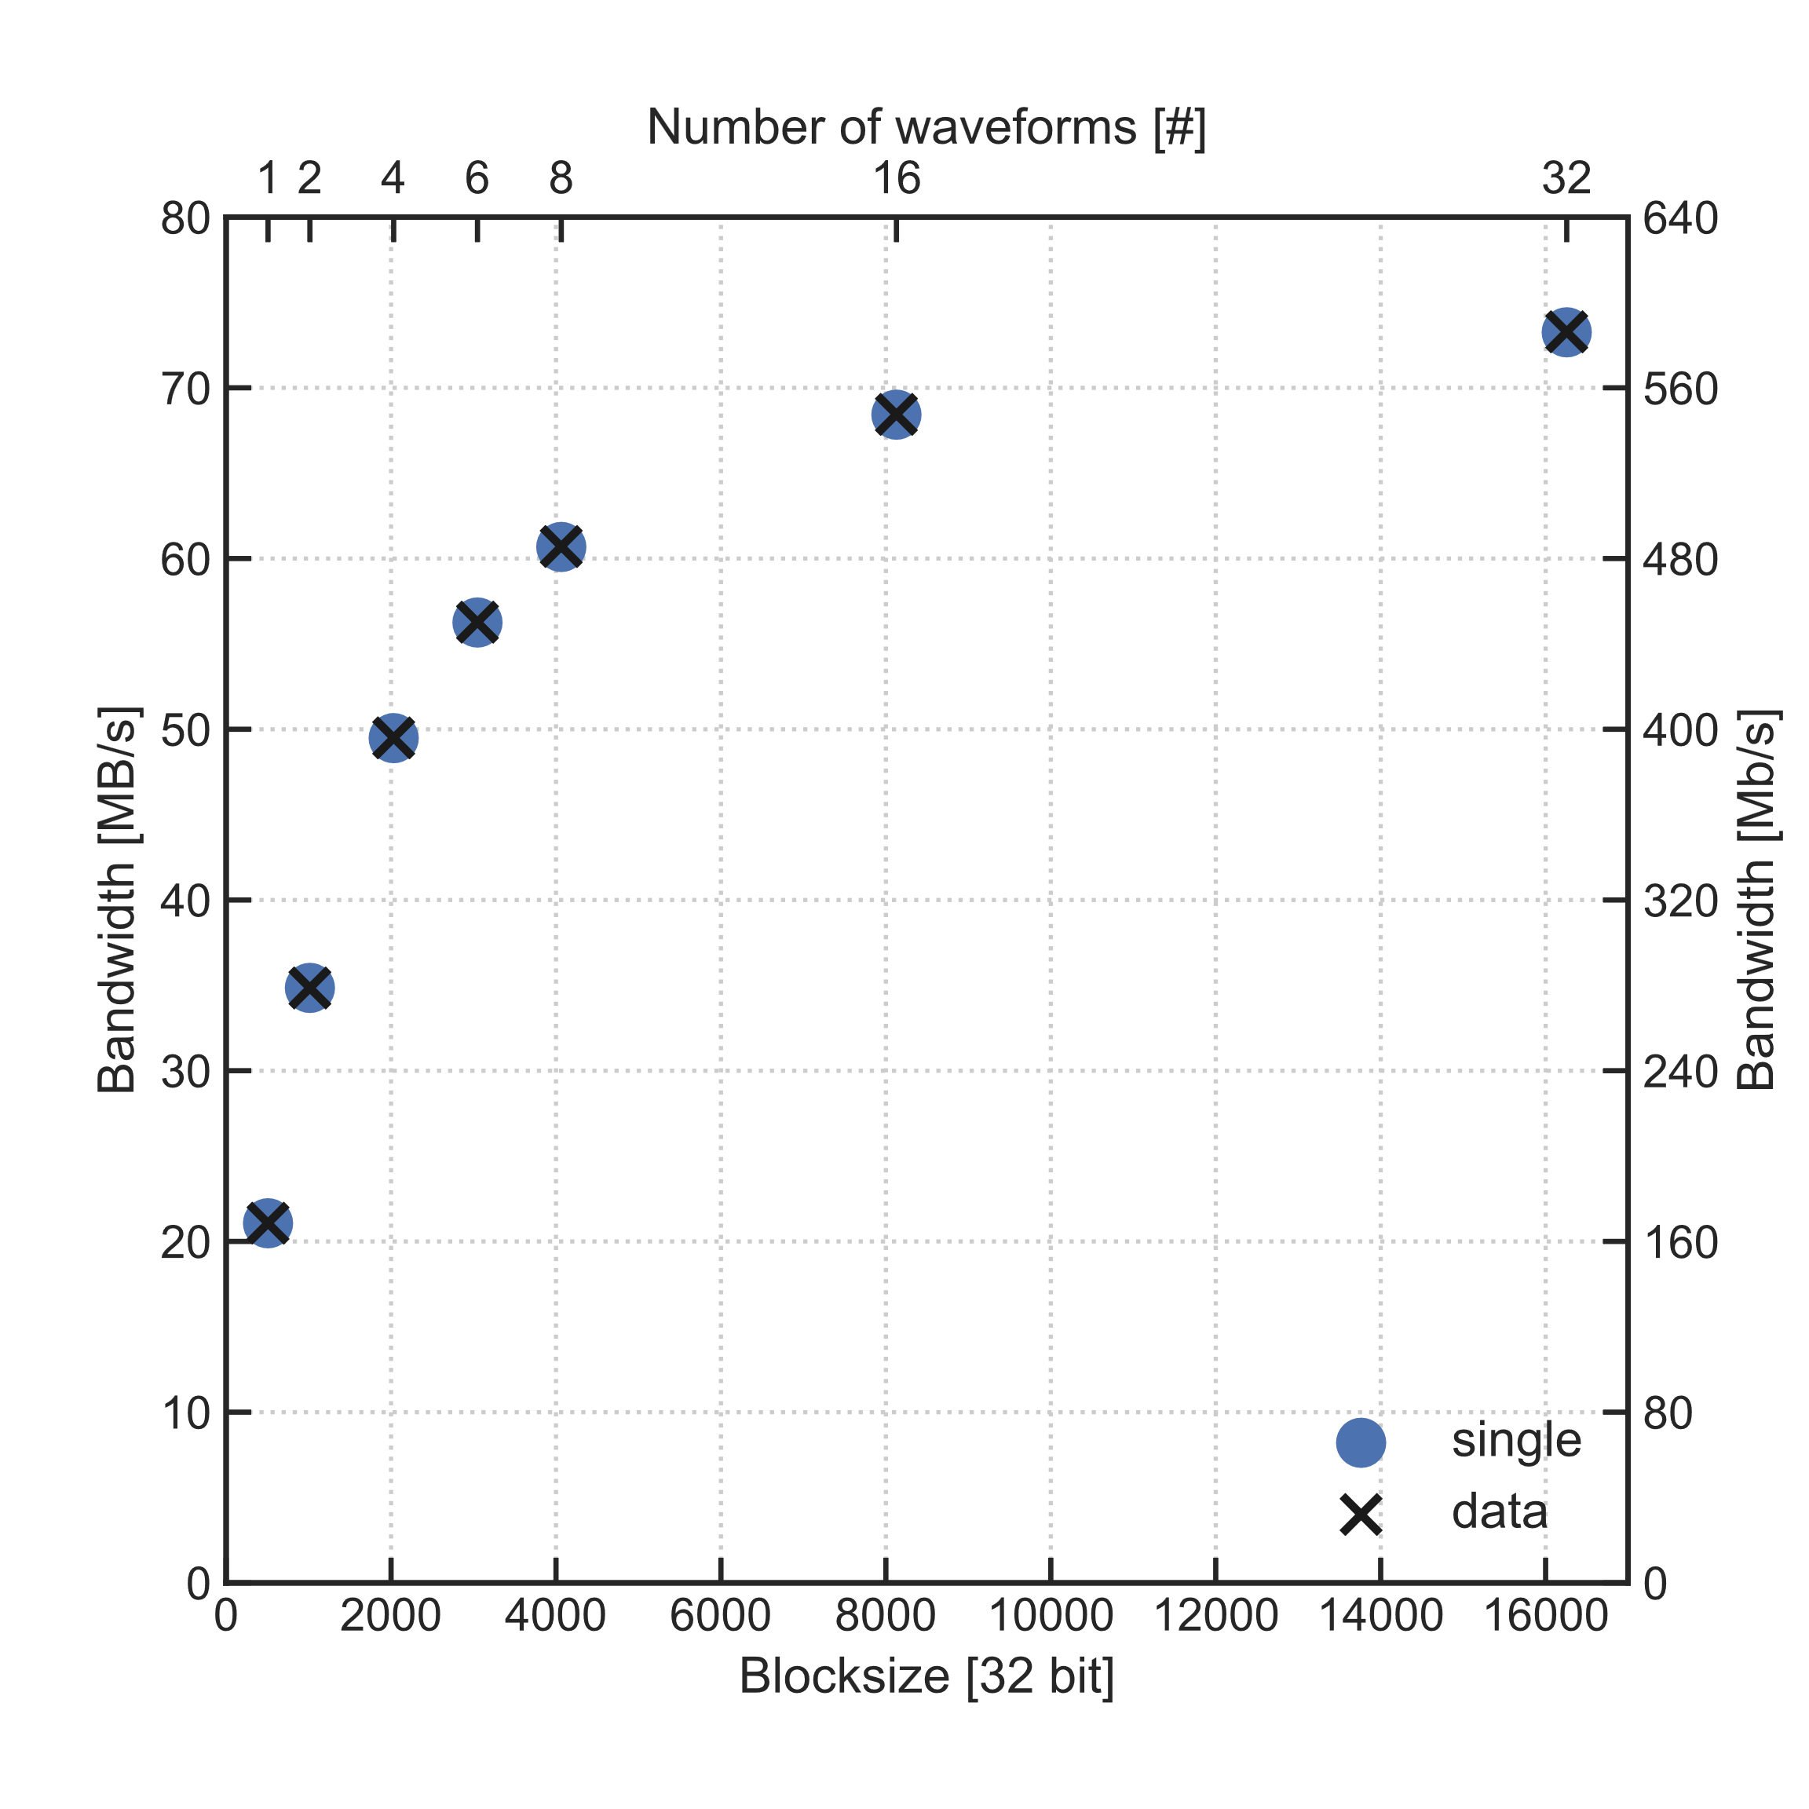
Maximum transferrable bandwidth for 1 GCU
Via IPbus it is possible to specify the “blocksize” with which read the waveform data from the GCU.
Higher blocksize → less data packets → higher bandwidth
We performed a scan of the transferrable bandwidth as a function of the blocksize.
We logged both the network bandwidth (single) and the bandwidth used by valid waveform data (data).
For large payloads it is possible to reach ∼0.5 Gbit/s → maximum permitted by IPbus protocol
“single” bandwidth and “data” bandwidth correspond → all transferred packets are waveform data packets

Slide 10
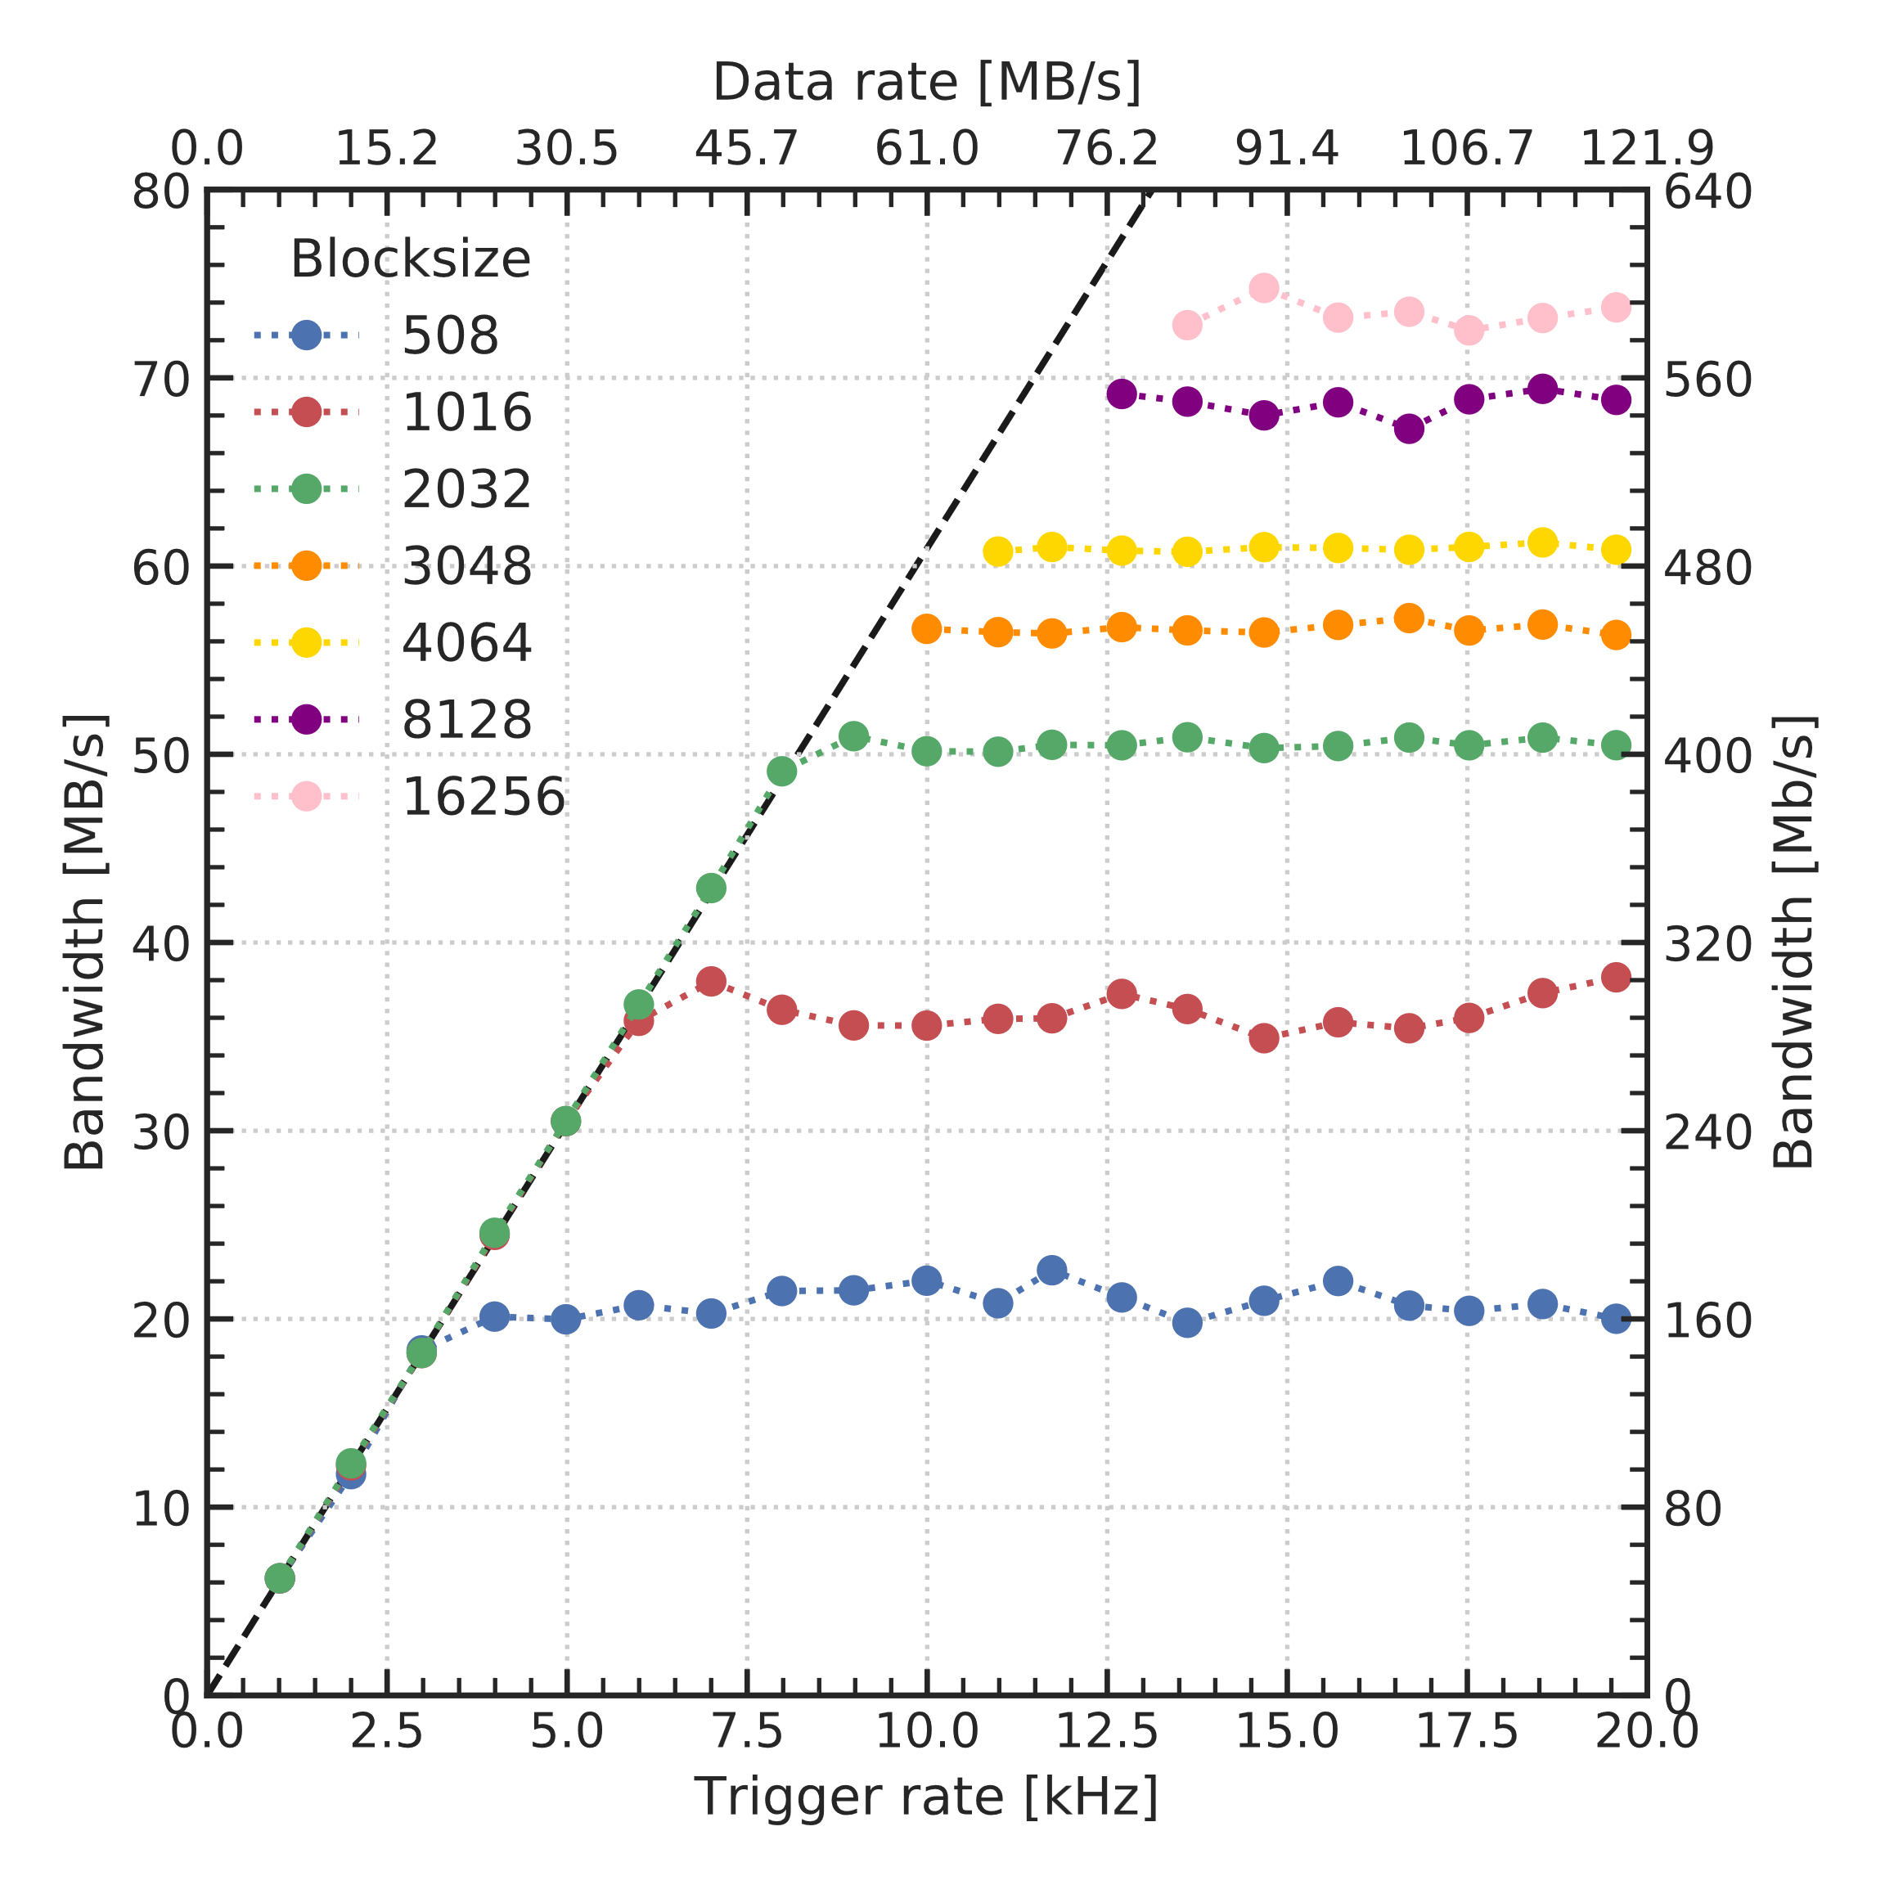
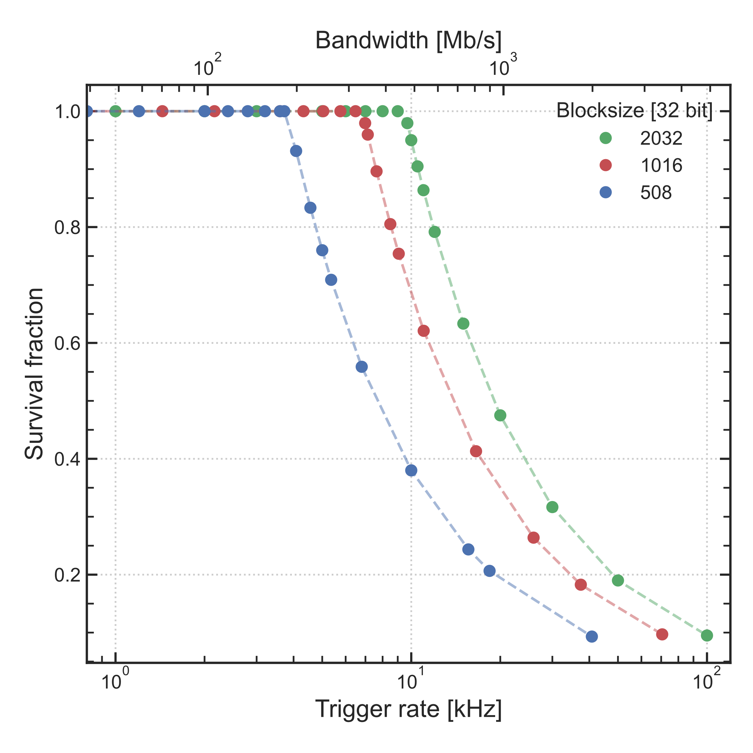
Maximum transferrable bandwidth for 1 GCU
Blocksize determines the maximum transferrable bandwidth for a GCU. When bandwidth saturates, we are not able to transfer all waveforms (wf) collected by the GCU.
# wf transferred
survival fr. =
# wf generated

Slide 11
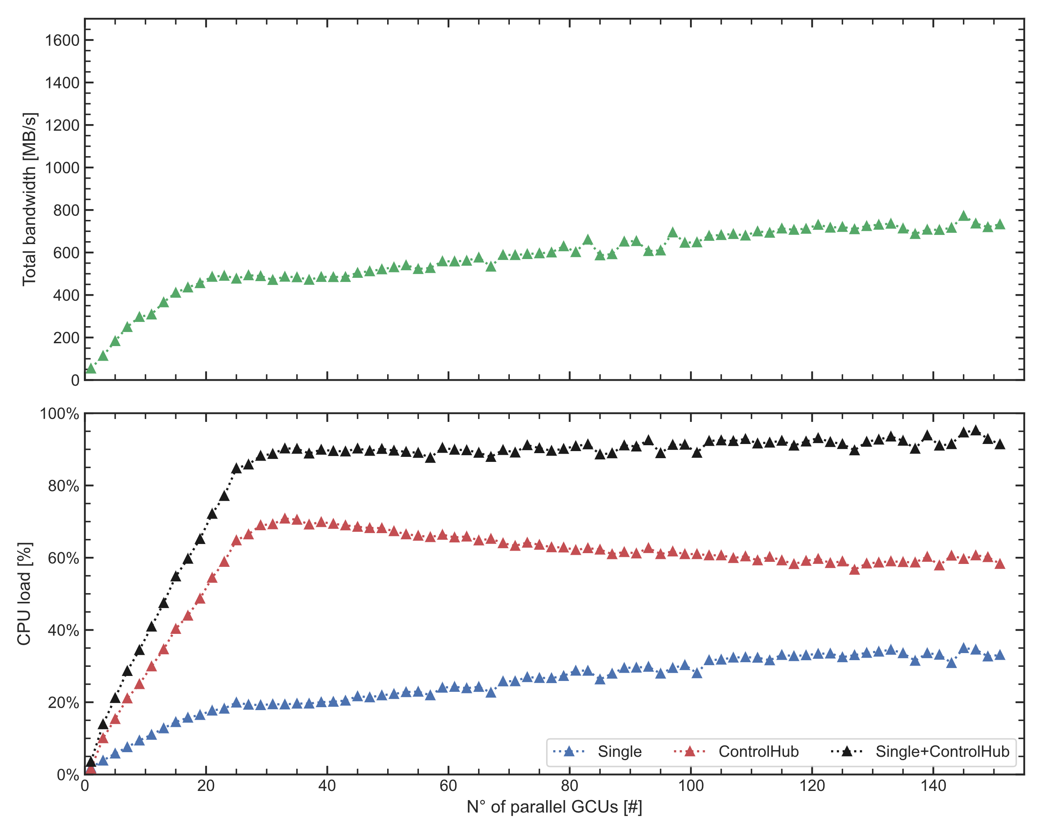
Managing several GCUs in parallel
At Kunshan we have a CentOS server having an Intel Xeon Gold 6226 CPU @ 2.70GHz for a total of 24 cores (48 threads). We can test up to 344 GCUs in parallel.
We logged the transferred bandwidth as a function of the number of GCUs read in parallel for a blocksize of 2048.
Server resources saturate for ∼30 GCUs. Afterward, transferred bandwidth slowly continue to grow.
Most resources are used by the ControlHub.
Looking at the bandwidth transferred per GCU (total bandwidth/ # GCUs), it is still possible to manage a 1kHz trigger rate with 90-100 GCUs.

Slide 12
Reducing CPU usage with Jumbo Frames
Standard ethernet packets are designed to carry 1500 bytes of payload. This payload is also called Maximum Transferrable Unit (MTU).
Most modern network interfaces can support MTUs up to 9000 bytes. Suck ethernet packets are usually referred to as Jumbo Frames.
STANDARD FRAME (1500 MTU)
JUMBO FRAME (9000 MTU)
BANDWIDTH
PAYLOAD OVERHEAD
BANDWIDTH
PAYLOAD OVERHEAD
DATA FLOW
DATA FLOW
The rationale:
higher payloads → less packets → lower CPU utilization

Slide 13
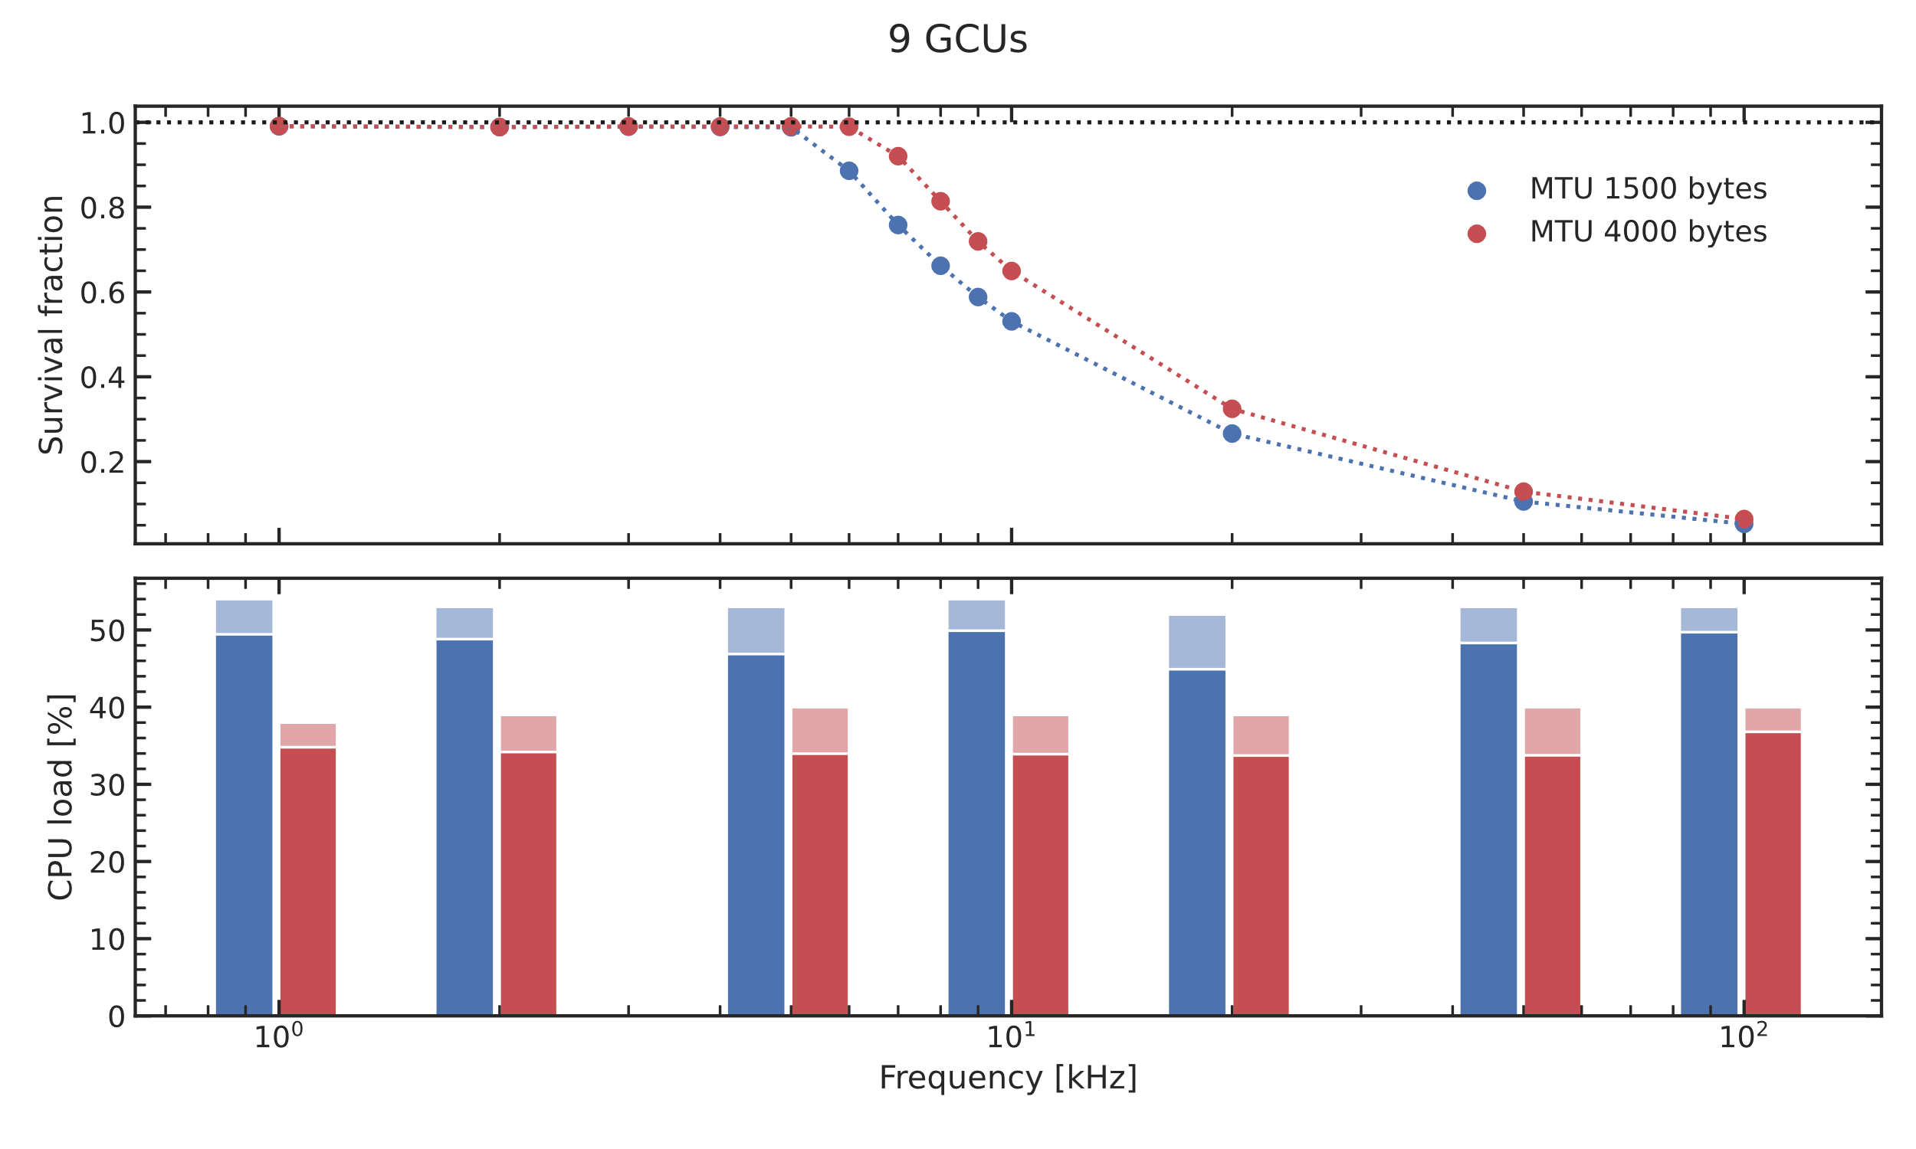
Testing Jumbo Frames @ LNL

Slide 14
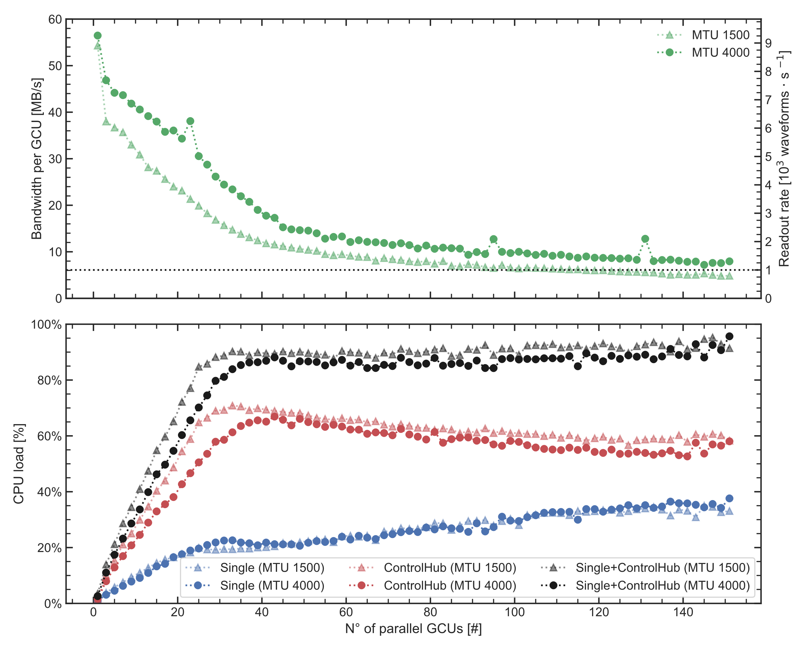
Testing Jumbo Frames @ Kunshan
Jumbo Frames permit to lower ControlHub’s CPU utilization by 20%
As a consequence, it is now possible to manage a 1kHz trigger rate with 150 GCUs!
A rough estimate for JUNO setup:
17612 L-PMTs → 17612/3 = 5871 GCUs
5871/150 = 40 servers
Needs to be carefully checked! Needs additional measurements!!

Slide 15
Final remarks
At GCU level we can manage trigger rates up to 10 kHz.
When dealing with multiple GCUs, the bottleneck is represented by the CPU usage of the ControlHub. However, keep in mind that ControlHub is crucial to permit the simultaneous access to data and slow control parameters.
Jumbo Frames can help in reducing ControlHub’s CPU usage. It is possible to sustain a trigger rate of 1kHz when managing 150 GCUs in parallel.
We are condensing all our tests and measurements in an article under preparation!

Slide 16
16

Slide 17
