Slide 1
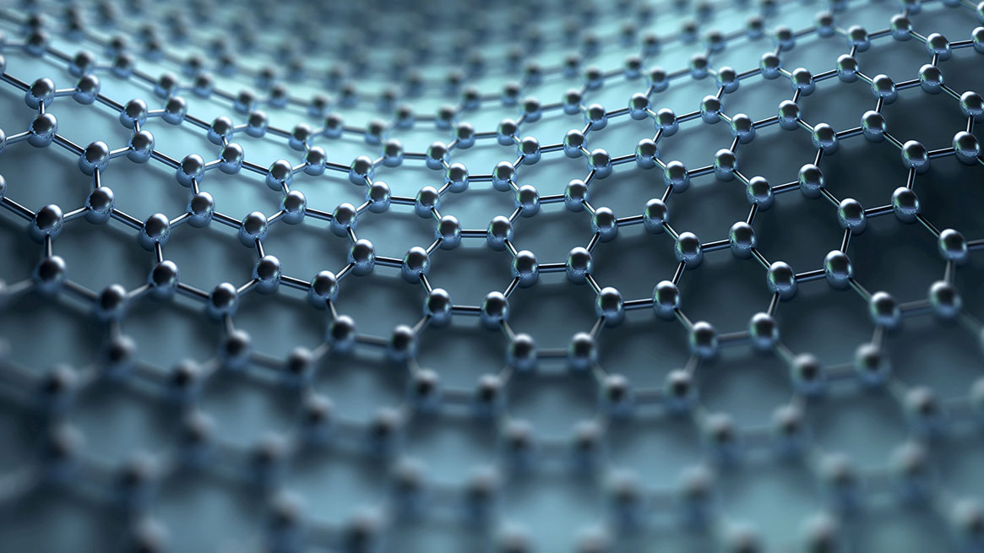
SiPM@Catania
Measurements and mass test
Claudio Lombardo^{ab}
ª Dipartimento di Fisica ed Astronomia “E. Majorana” Università degli Studi di Catania
^{b} INFN Sezione di Catania
JUNO-Ita meeting 06/05/2022

Slide 2
Catania SiPMs test
Preliminary measurements on SiPM
Mass test
Mass test station

Slide 3
Preliinary measurement on SiPM
Recap on last 2 years measurements at Catania

Slide 4
Catania and SiPMs
Preliminary measurements on SiPM
Procedure for mass testing
Building of mass test system

Slide 5
Catania and SiPMs
Preliminary measurements on SiPM→2020-2022
Procedure for mass testing→2021-2022 (FDR ny the end of May)
Building of mass test system→2022-???

Slide 6
Preliminary measurements on SiPM
Measurements inside and outside climatic chamber
Staircase, Curve I-V, Dark count, charge spectrum
Different setup to test different conditions for final setup(measurements with and without lens, dark box, in air...)

Slide 7
Experimental Setup
Optical Fiber
lens
SiPM
Pitch Adapter Board

Slide 8
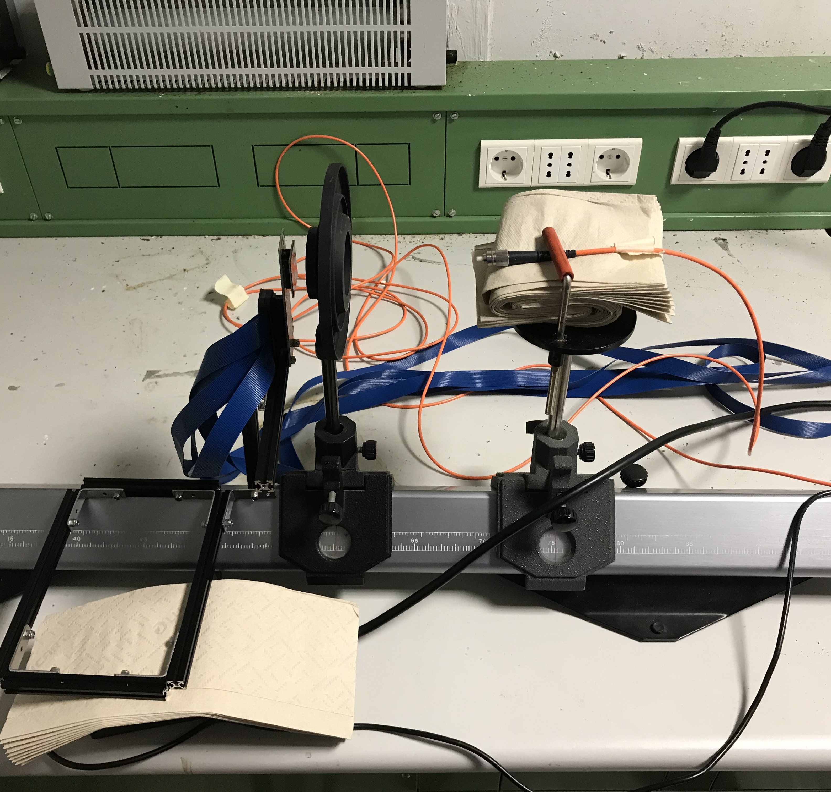
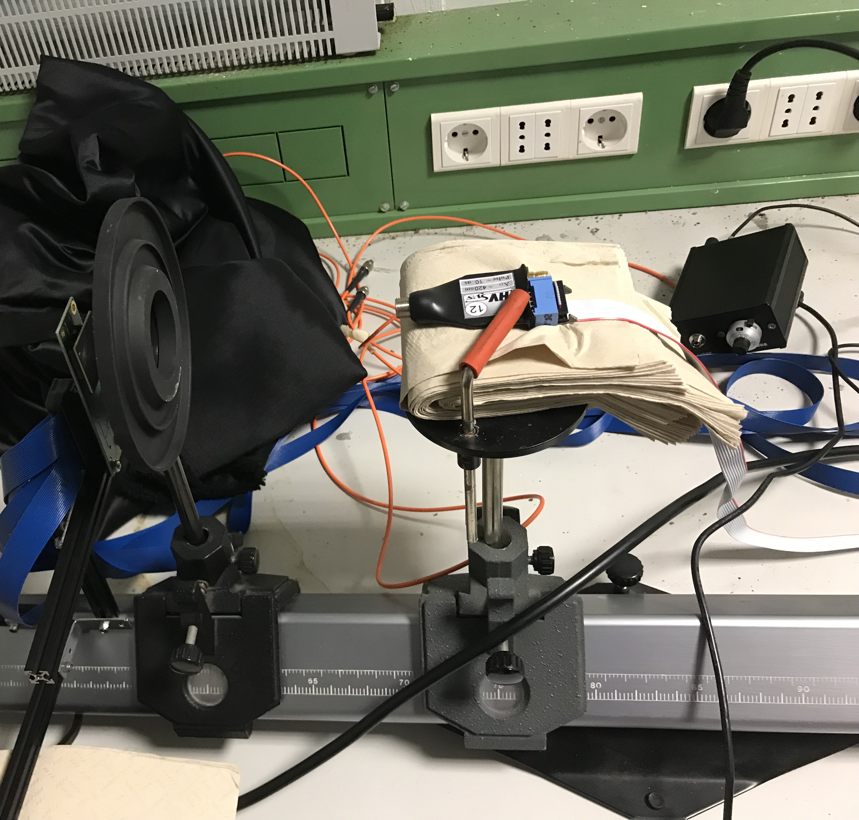
Experimental Setup
LED Dubna

Slide 9
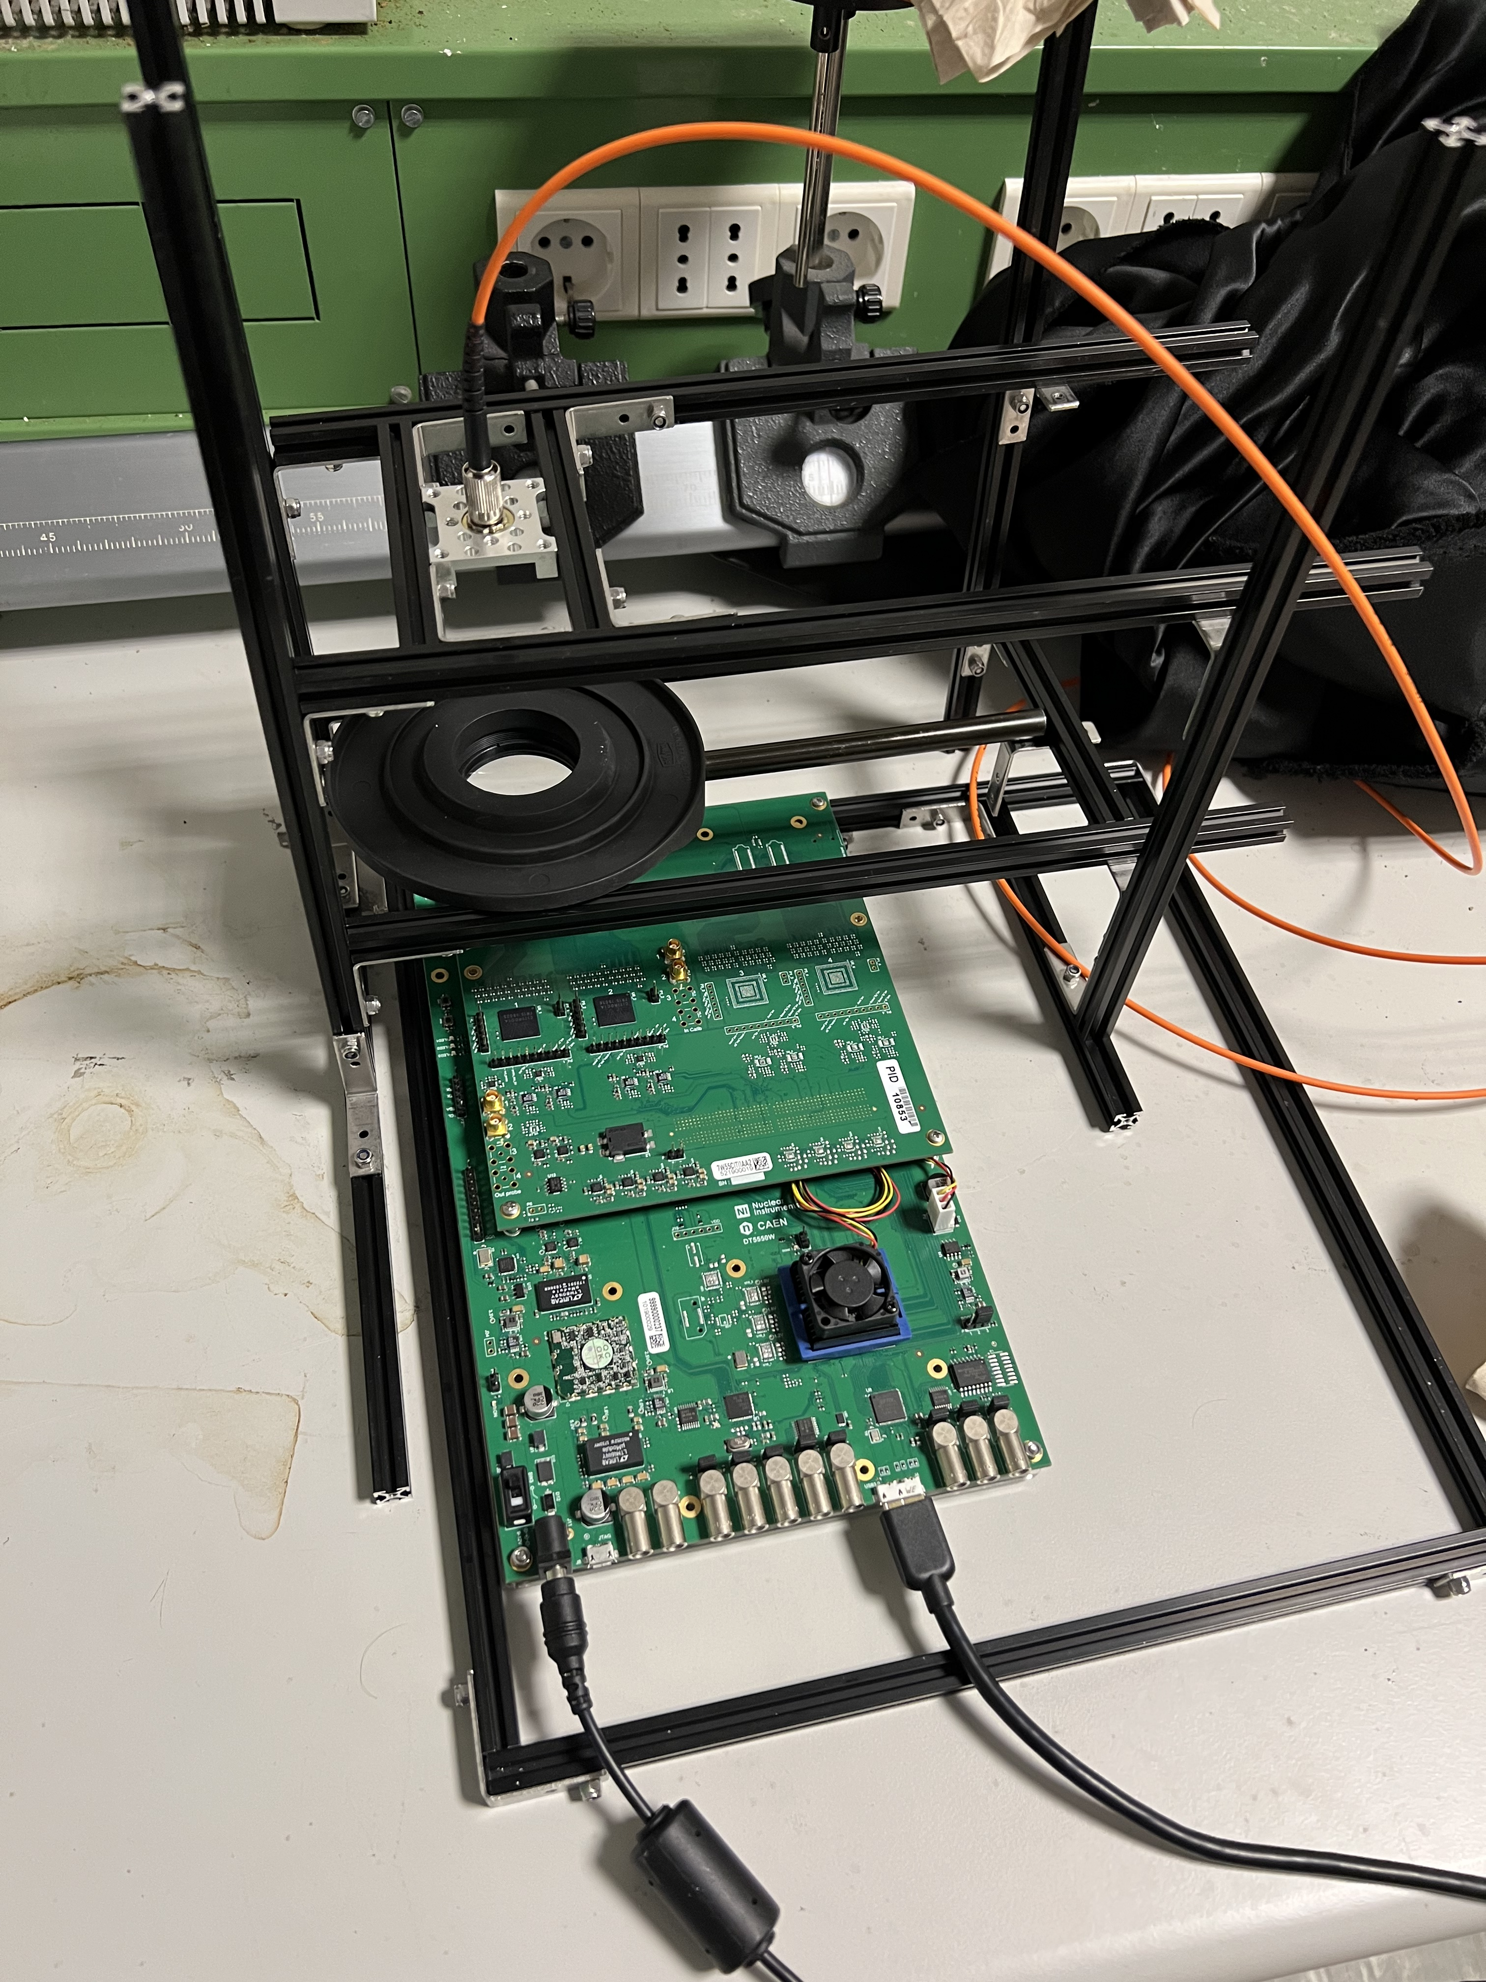
Experimental Setup

Slide 10
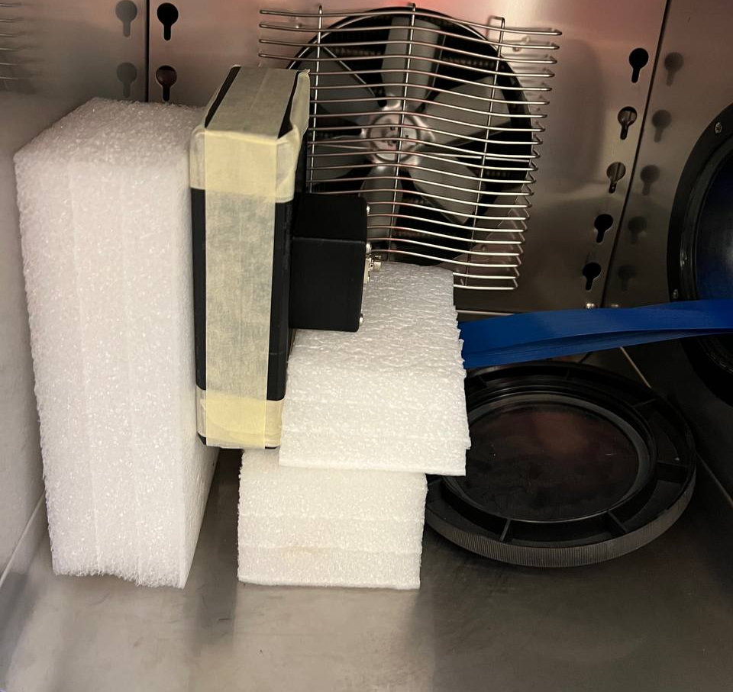
Experimental Setup
Dark Box “Custom 1”
Dark Box “Custom 2”

Slide 11
Mass test

Slide 12
Mass test
Over 4000 SiPMs will be tested:
Optical test
Burning test
Massive test

Slide 13
Mass test
Over 4000 SiPMs will be tested:
Optical test
Burning test
Massive test

Slide 14
Mass test@Catania
Writing the FDR before end of May
We studied different hardware setups
We studied the optical part of the mass station

Slide 15
Mass test@Catania
At the end we decided to use PS and Digit designed by Dubna and produced by Marathon in Russia
3 x24 bit ADC on chip
Thanks to Arsenij

Slide 16
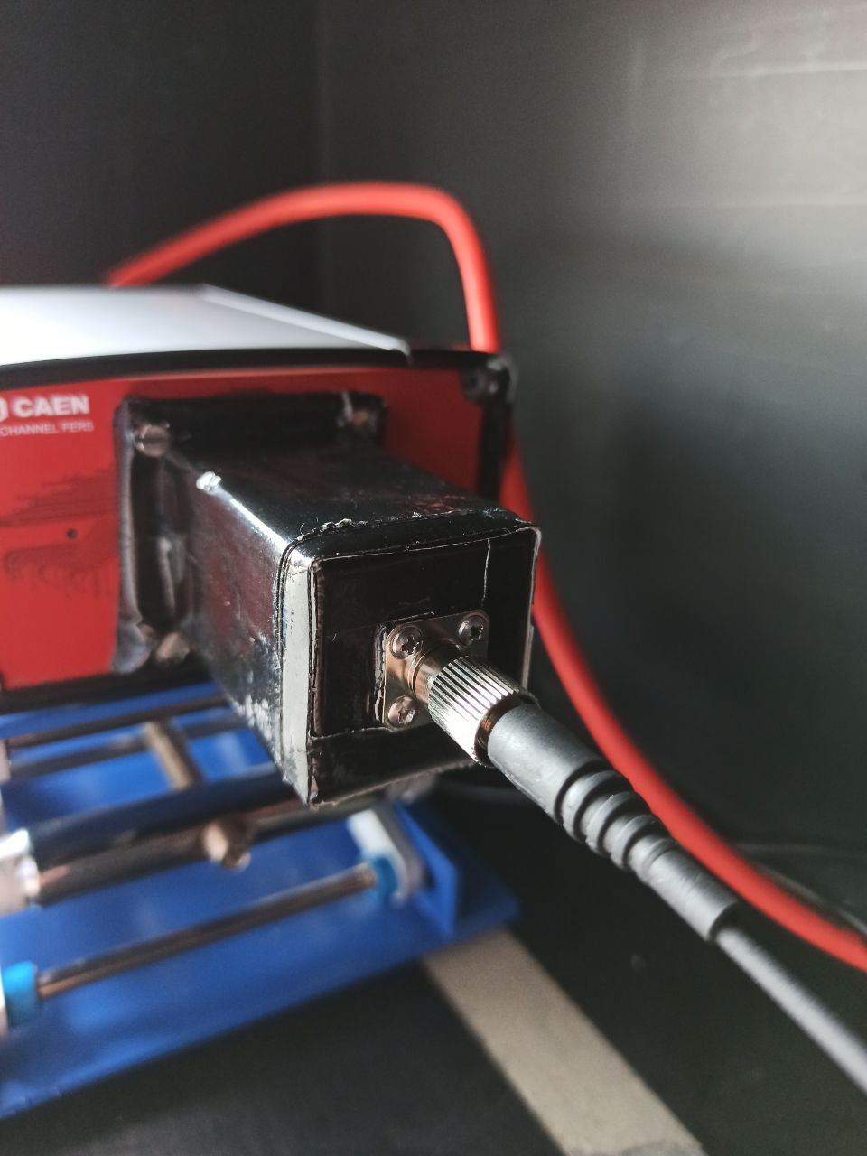
Mass test@Catania
In the last 6 months we focused on a plan B for the hardware setup using two CAEN solutions
CAEN DT5202
CAEN DT5550W
Common:
Citiroc1A;
SiPM monocanale
HPK S131361-3050-AE08;
Measurements:
at 20 °C and -20 °C
Different optical setups

Slide 17
HPK S13 8x8
# p.e.

Slide 18
Mass test@Catania
DT5202 better than DT5550W however PS + digit option is the best solution (acquiring the waveform for further studies, offline integration?)
How can we get the supplies from Russia?(Hard problem for Chinese colleagues)

Slide 19
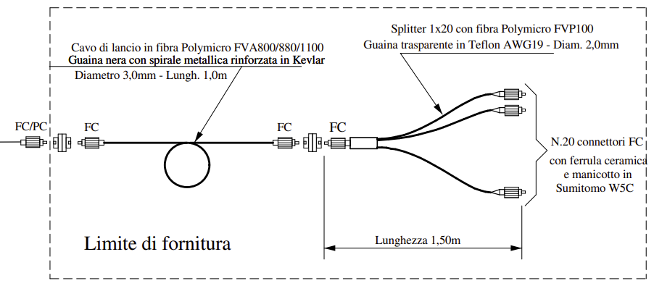
Mass test@Catania
Similar but different from the Russian proposal
Environmental Chamber
LED

Slide 20
Mass test@Catania
Similar but different from the Russian proposal
To be tested at -50 °C
Diffusers at the end?

Slide 21
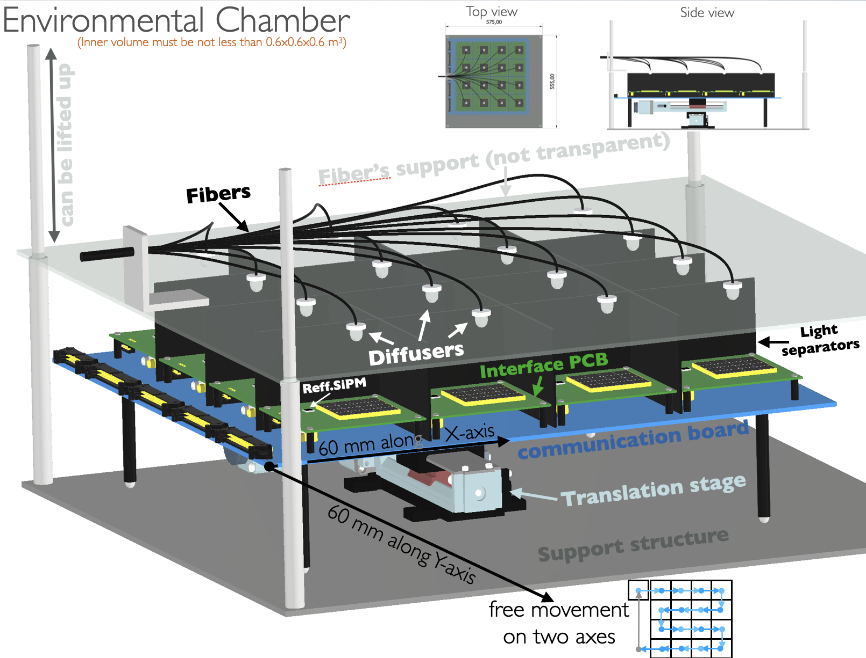
Mass test@Catania

Slide 22
Mass station

Slide 23
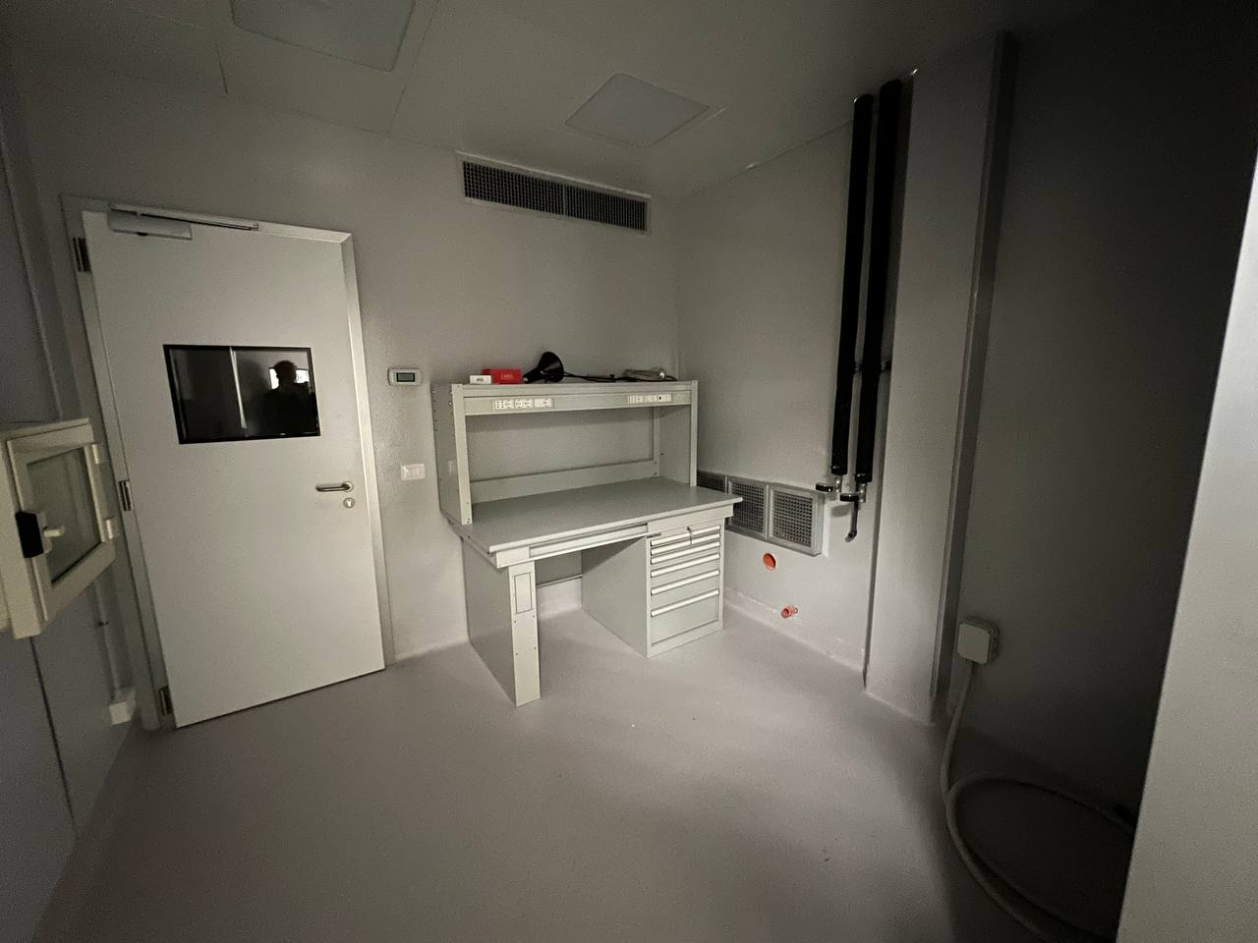
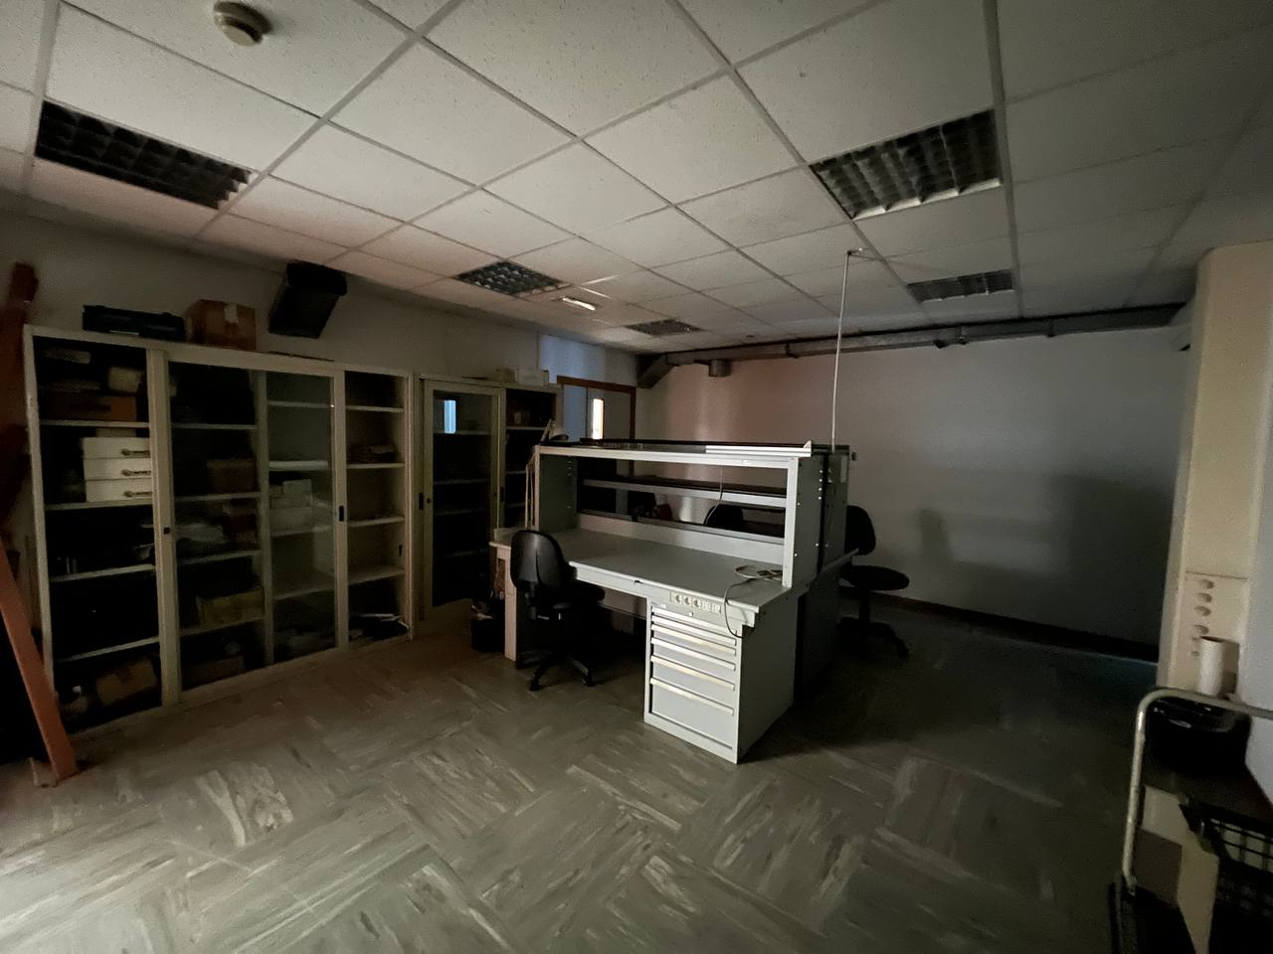
Mass station
New lab @ Dipartimento di Fisica e Astronomia “E.Majorana” in Catania
Environmental chamber room
Lab JUNO

Slide 24
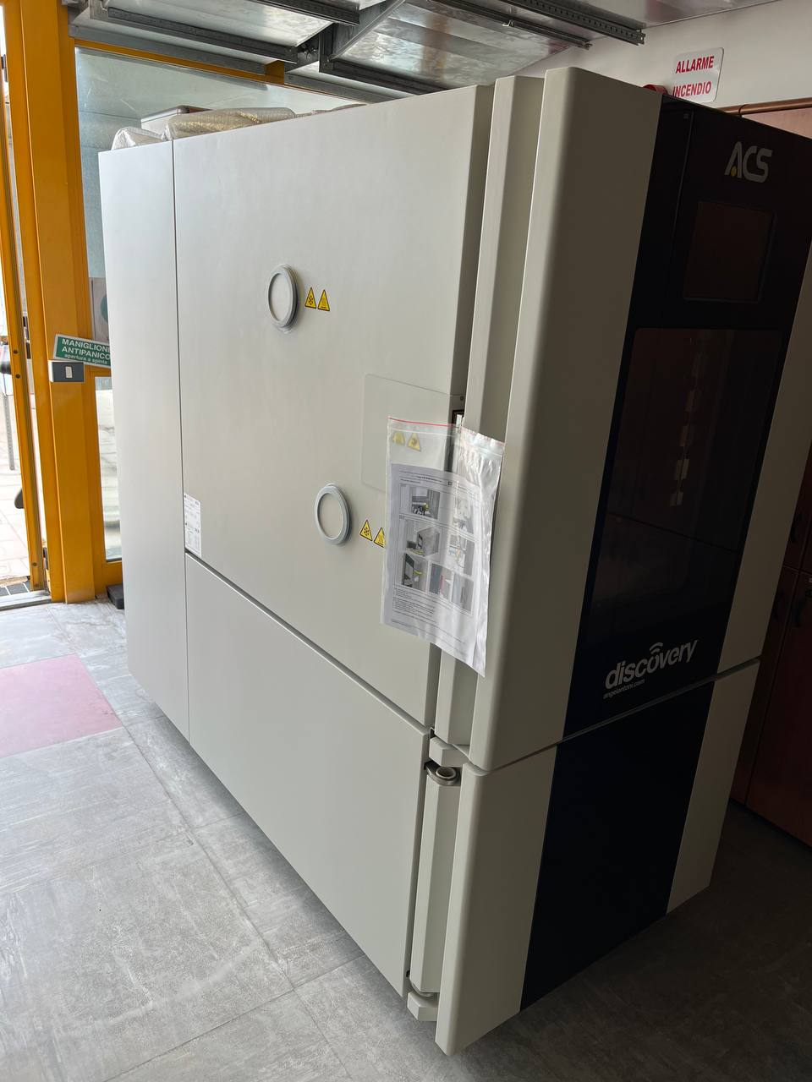
Mass station
Environmental Chamber Room
Environmental Chamber

Slide 25
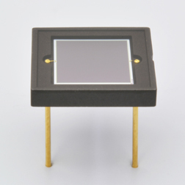
Mass station
16 matrices to test + 16 ref SiPMs:
Single channel
HPK S13360-6050CS

Slide 26
Mass Station

Slide 27
Conclusions

Slide 28
Conclusions
Done:
Different plan B have been studied
Draft of FDR
First characterization of ref. SiPM
To Do:
Dark box and mechanical structure
Light field with our splitter
FDR
Characterization of all the ref. SiPM

Slide 29
Thank You!

Slide 30
backup

Slide 31
Spettro a -20 °C HPK S12 8x8

Slide 32
Prima caratterizzazione HPK S13
CAEN DT5202
CAEN DT5550W

Slide 33
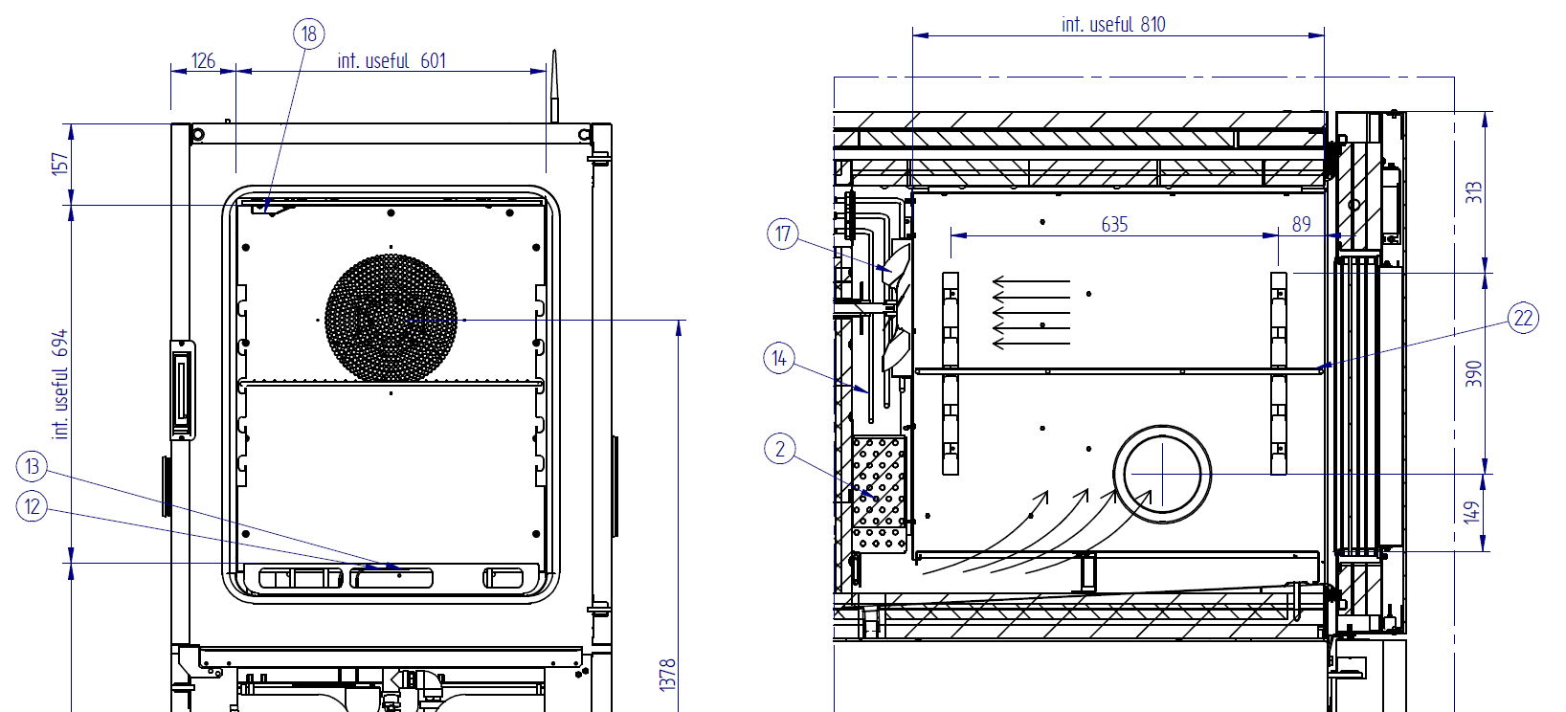
Cella climatica

Slide 34
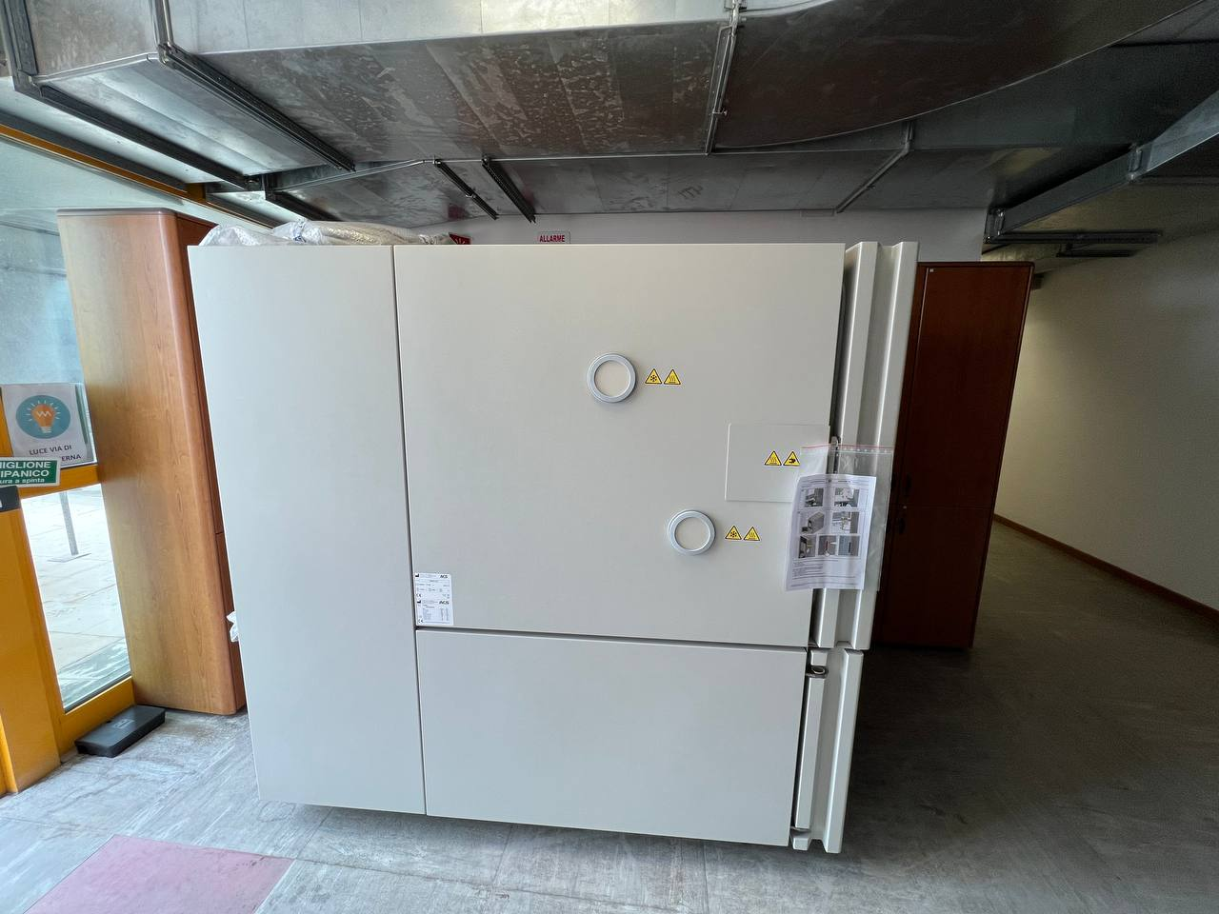
Cella climatica

