Slide 1
Geophysical and geochemical data for antineutrinos from reactors and the Earth
Andrea Maino Physics and Earth Science Department University of Ferrara & INFN – Italy
maino@fe.infn.it
Together with Fabio Mantovani, Andrea Serafini, Virginia Strati and Michele Montuschi
5th – 6th May 2022 JUNO Italy Meeting

Slide 2
Summary
Neutrino oscillations in matter
Rock samples from JUNO: density and composition
Electron density from a reference rock
Implications on reactor antineutrino spectrum

Slide 3
How does electron density affect neutrino oscillations?
$$P_{mat}^{3ν}≃c_{13}^{4}P_{mat}^{2ν}+s_{13}^{4}+2s_{13}^{2}c_{13}^{2}\sqrt{P_{mat}^{2ν}}w\cos\left(2Δ_{ee}+αφ\right)$$
$$P_{mat}^{2ν}=1−4{\tilde{s}}_{12}^{2}{\tilde{c}}_{12}^{2}\sin^{2}{\tilde{δ}}$$
$s_{ij}^{n}=\sin^{n}{θ_{ij}}$, $c_{ij}^{n}=\cos^{n}{θ_{ij}}$
$Δ_{ee}=\frac{[Δm^{2}+α/2\left(c_{12}^{2}−s_{12}^{2}\right)δm^{2}] L}{4E}$
$$w≃1−2{Δ_{ee}}^{2}\sum_{n}{w_{n}λ_{n}^{2}}$$
$\sum_{n}{w_{n}λ_{n}^{2}}=2.16·{10}^{−5}$
$$Δm^{2}=\frac{1}{2}\left|Δm_{31}^{2}+Δm_{32}^{2}\right|$$
$δm^{2}=Δm_{21}^{2}$, $δ=\frac{{δm}^{2}L}{4E}$
$α=1$ if NH, $α=−1$ if IH
$φ≃2s_{12}^{2}δ\left(1−\frac{\sin{δ}}{2δ\sqrt{P_{vac}^{2ν}}}\right)$
$G_{F}$ = 1.16637 · 10⁻⁵ GeV⁻²
${\tilde{s}}_{12}^{2}{\tilde{c}}_{12}^{2}=\frac{1}{4}\sin^{2}{2{\tilde{θ}}_{12}}≃\frac{1}{4}\sin^{2}{2θ_{12}{\left(1−μ_{12}\cos{2θ_{12}}\right)}^{2}}$
$\tilde{δ}=\frac{{δ\tilde{m}}^{2}L}{4E}≃{δm}^{2}\left(1+μ_{12}\cos{2θ_{12}}\right)\frac{L}{4E}$
$$μ_{12}=\frac{2\sqrt{2}G_{F}N_{e}E}{Δm_{12}^{2}}$$
From Capozzi et al., 2014

Slide 4
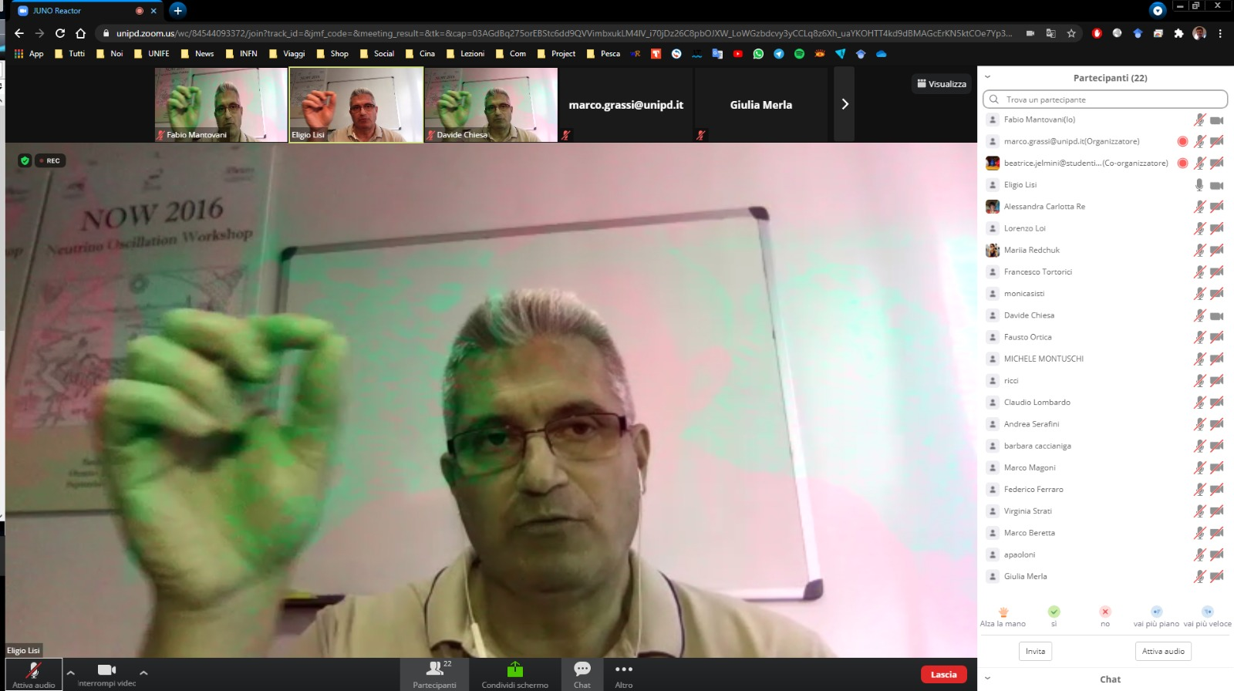
Electron density $N_{e}$
$$N_{e}\left(c,ρ\right)=\frac{\sum_{i}{{ρ_{Ox}}_{i}f_{i}}\frac{{e^{−}}_{{Ox}_{i}}}{N_{{Ox}_{i}}}}{\sum_{i}{{ρ_{Ox}}_{i}f_{i}}}ρ_{nat}$$
$i$: oxide index
${ρ_{Ox}}_{i}$: density of the i-th oxide
$f_{i}$: weight fraction of the i-th oxide
${e^{−}}_{{Ox}_{i}}$: number of electrons in the i-th oxide
$N_{{Ox}_{i}}$: number of nucleons in the i-th oxide
$ρ_{nat}$: average rock density
Elements are considered in terms of oxides, compounds of one or more metallic elements combined with oxygen
 | Composition | ρ [g/cm³] | N_{e} [mol/cm³]
Capozzi et al., 2014 | Not specified | 2.6 | 1.3
Li et al., 2016 | Not specified | 2.6 | 1.3
Khan et al., 2020 | Not specified | 2.6 | 1.3
Our study
Generally, the ratio ${{e^{−}}_{{Ox}_{i}}}/{N_{{Ox}_{i}}}$ is approximated with 0.5. This gives the simplified formula $N_{e}\left(ρ\right)≃0.5 ρ_{nat}$
$N_{e}\left(ρ\right)≃0.5 ρ_{nat}$
‘‘JUNO will make the first precise measurement of neutrino oscillations’’
We need more precise values

Slide 5
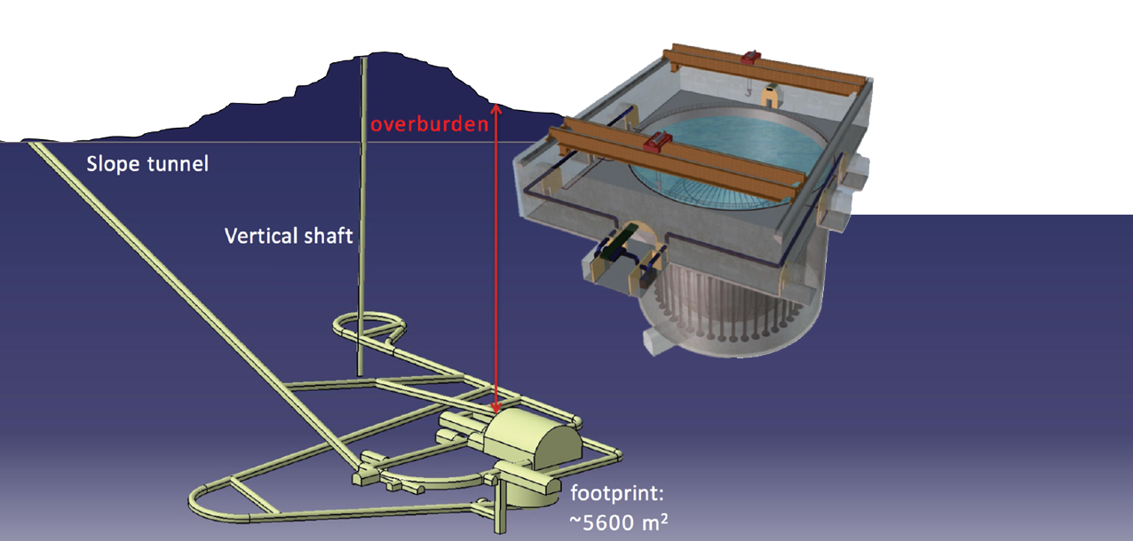
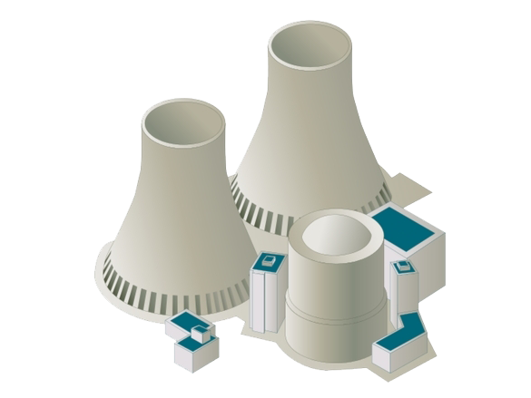
Rock samples from JUNO site
TOTAL NUMBER OF SAMPLES: 18
TYPE OF ROCK: GRANITES
MEASUREMENTS: density, XRF
~ 700 m
7 samples from an exploration well of the vertical shaft
[-10 m ; - 464 m]
53 km
11 samples from the experimental hall and the water pool
[- 430 m ; - 475 m]

Slide 6
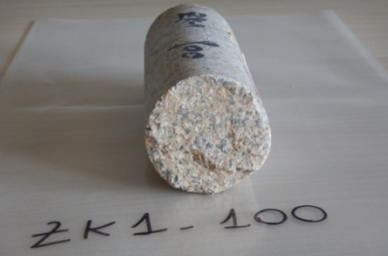
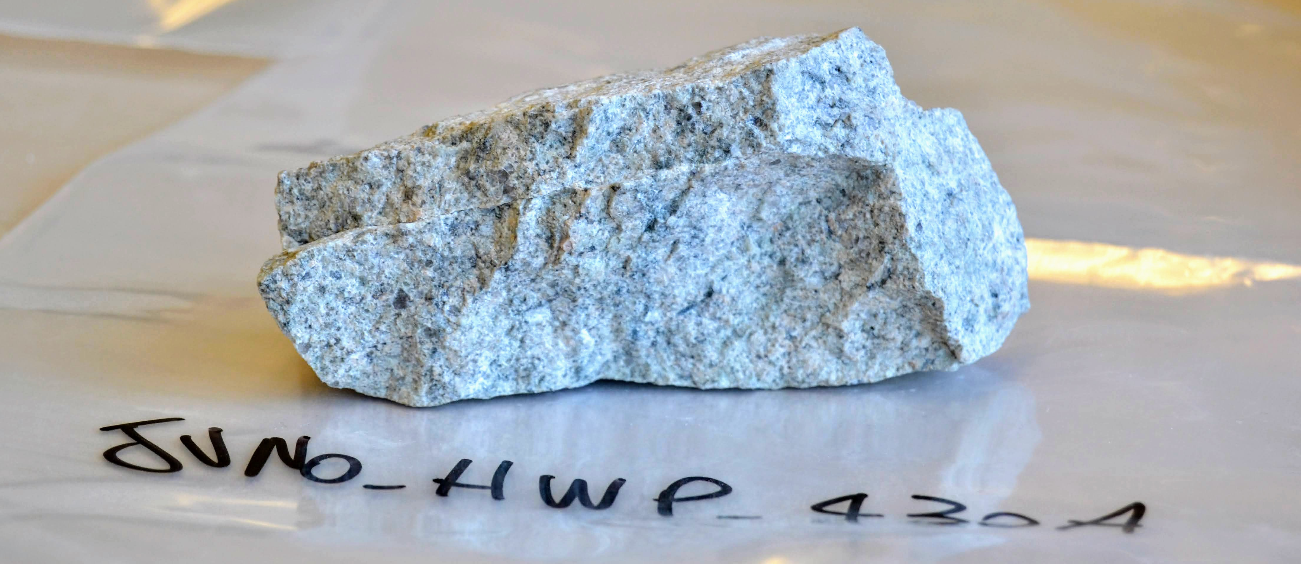
Rock samples’ location
ID | Sample | Depth (m) | Notes
1 | JUNO FRESH | 10 | Exploration well
2 | JUNO ZK1 100 | 36 | Exploration well
3 | JUNO ZK1 200 | 64 | Exploration well
4 | JUNO ZK1 300 | 164 | Exploration well
5 | JUNO ZK1 400 | 264 | Exploration well
6 | JUNO ZK1 500 | 364 | Exploration well
7 | JUNO 2 HWP 430 A | 430 | Hall/water pool
8 | JUNO 2 HWP 430 B | 430 | Hall/water pool
9 | JUNO HWP 430 A | 430 | Lower part of the water pool
10 | JUNO HWP 430 B | 430 | Above the water pool
11 | JUNO HWP 460 | 460 | Hall/water pool
12 | JUNO 2 HWP 464 | 464 | Exploration well
13 | JUNO ZK1 600 | 464 | Lower part of the water pool
14 | JUNO HWP 465 | 465 | Hall/water pool
15 | JUNO 2 HWP 467 | 467 | Hall/water pool
16 | JUNO HWP 467 | 467 | Lower part of the water pool
17 | JUNO HWP 474 | 474 | Hall/water pool
18 | JUNO 2 HWP 475 | 475 | Hall/water pool

Slide 7
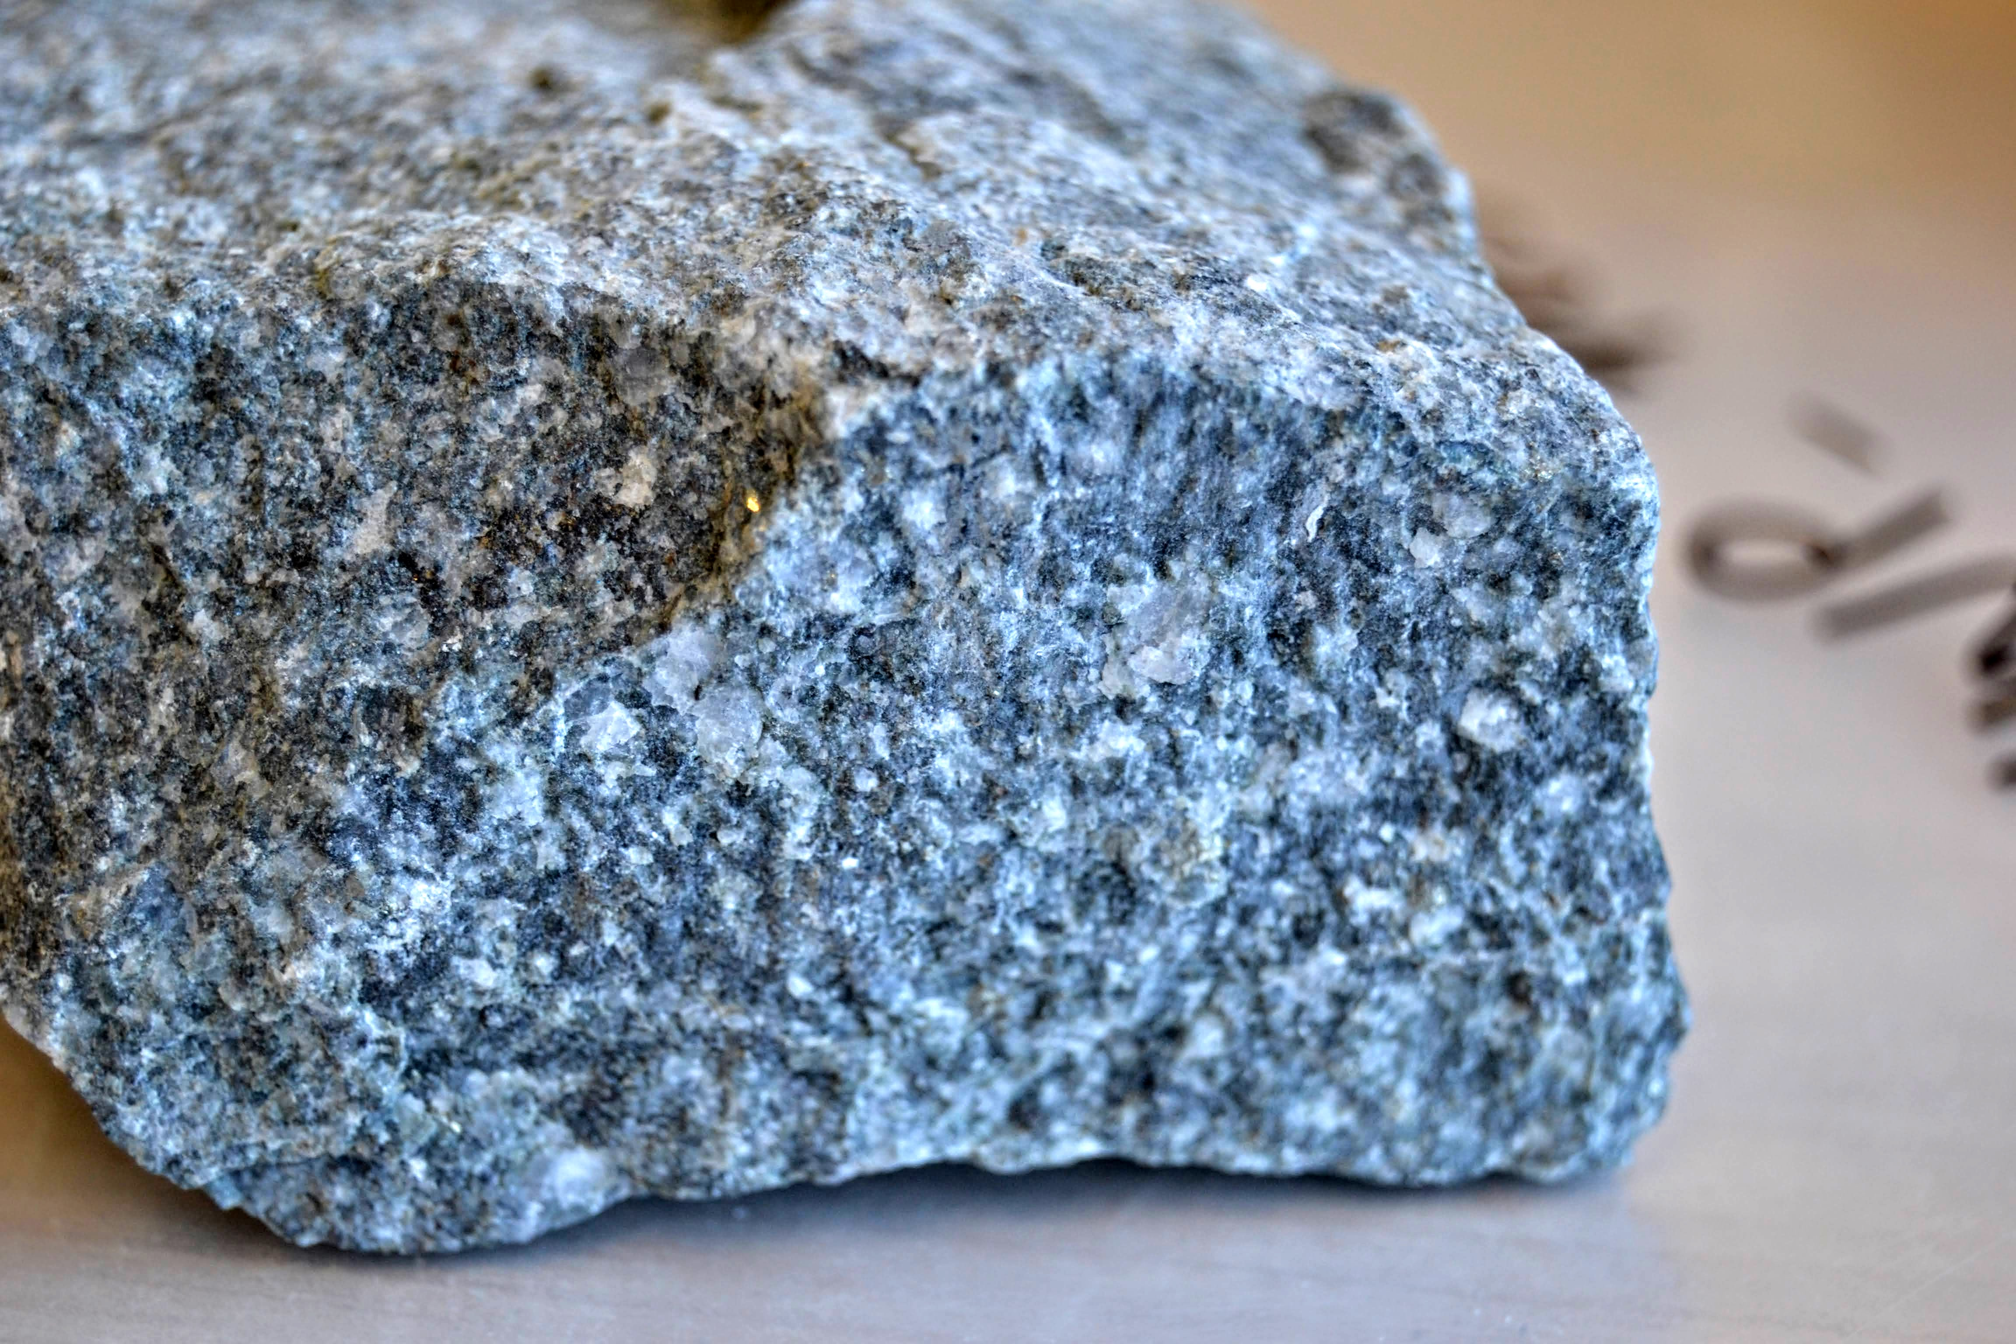
Results of density measurements
ID | Depth [m] | ρ [g/cm³]
1 | 10 | 2.6185
2 | 36 | 2.6218
3 | 64 | 2.6363
4 | 164 | 2.6344
5 | 264 | 2.6162
6 | 364 | 2.6251
7 | 430 | 2.6267
8 | 430 | 2.6284
9 | 430 | 2.6500
10 | 430 | 2.6319
11 | 460 | 2.6489
12 | 464 | 2.6438
13 | 464 | 2.6695
14 | 465 | 2.7832
15 | 467 | 2.6233
16 | 467 | 2.6257
17 | 474 | 2.6209
18 | 475 | 2.6205
Experimental relative uncertainty ~ 10⁻⁴ g/cm³
<ρ> = 2.6403 ± 0.0382 [g/cm³]
Std. dev. ~ 1.4% -> homogeneity
JUNO HWP 465
The appearance of the rock is certainly different from the others. The darker color suggests that more mafic minerals are present

Slide 8
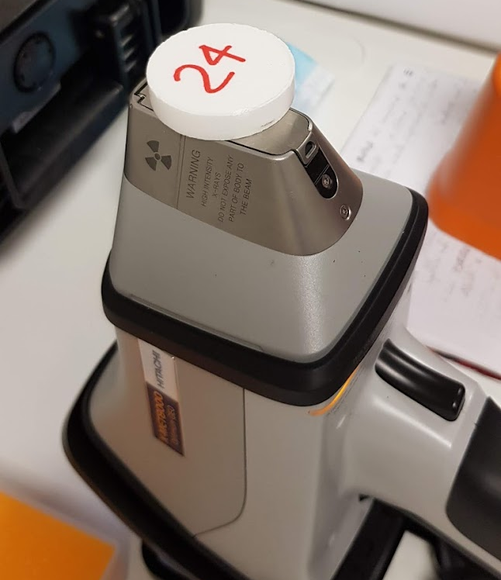
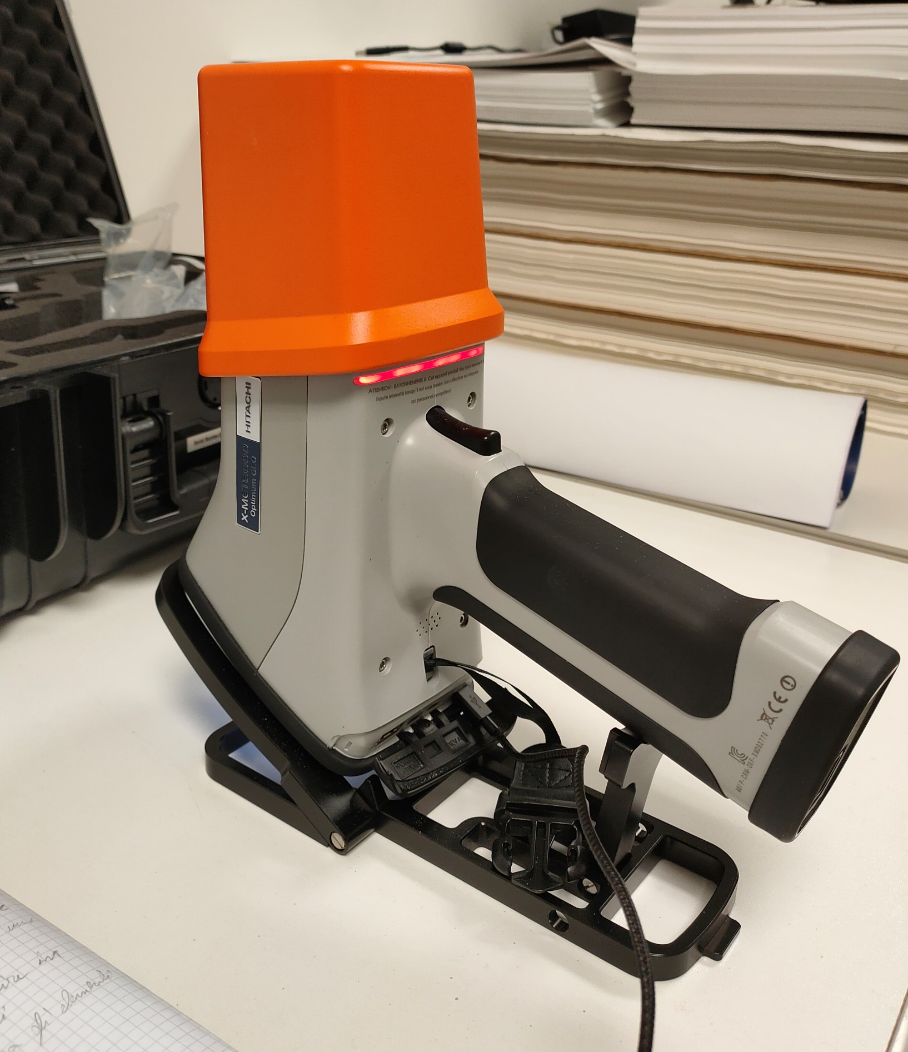
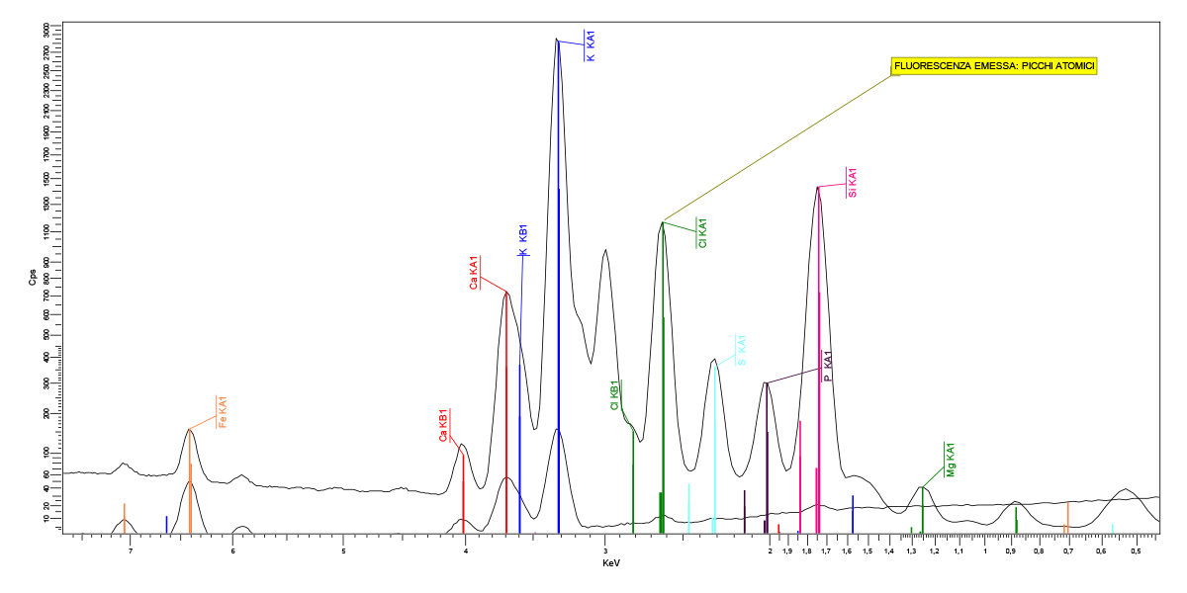
XRF technique for compositional analysis
The XRF technique (X-Ray Fluorescence) permits to identify the chemical elements constituting a sample thanks to the emitted X-rays following an induced atomic excitation.
The qualitative analysis is made by identifying the X-emission lines associated with each element.
The quantitative analysis requires a study of the intensity of the X-emission lines.
The XRF technique permits to analyze both major and trace elements.
Major elements, expressed as equivalent oxides:
SiO₂, TiO₂, Al₂O₃, Fe₂O₃, MnO, MgO, CaO, Na₂O, K₂O, P₂O₅
Trace elements (ppm or µg/g):
Ba, Ce, Co, Cr, Cu, Ga, Hf, La, Nb, Nd, Ni, Pb, Rb, Sc, Sr, Th, V, Y, Zn, Zr

Slide 9
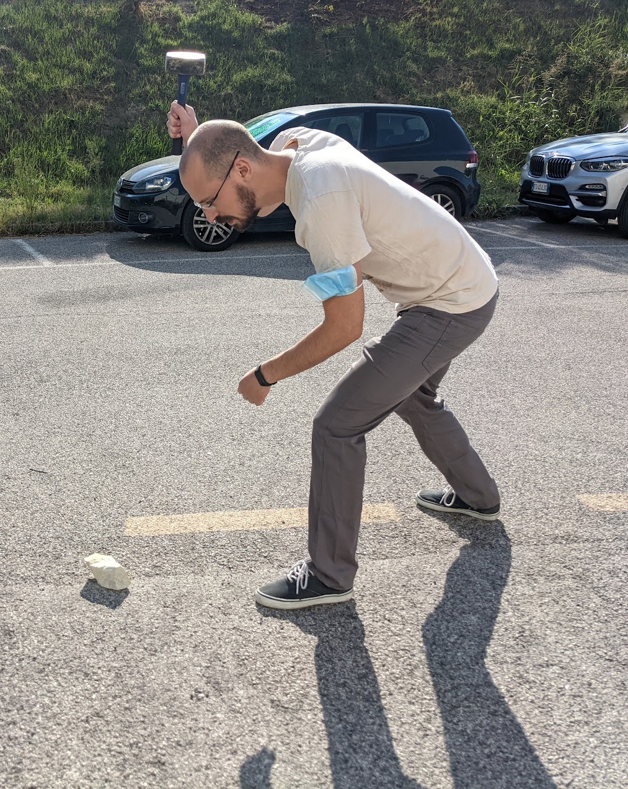
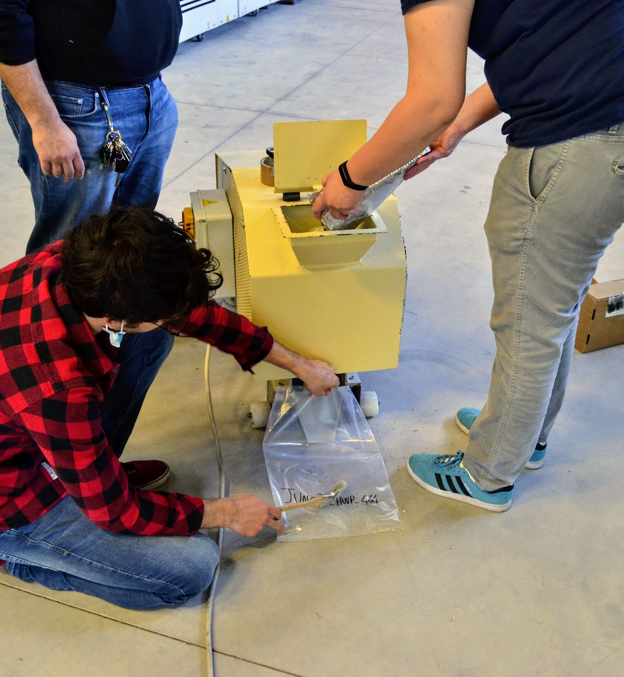
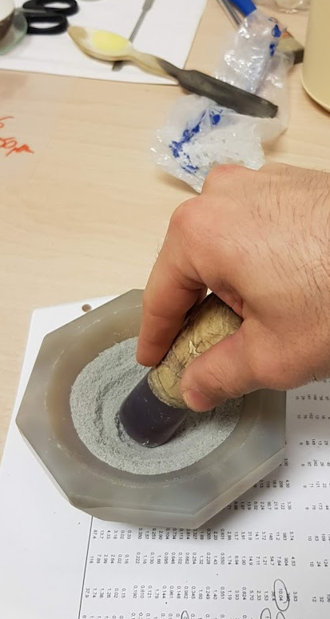
Sample preparation
Shattering of the sample by means of a hammer
Grinding of the sample into small pieces
Redundant crushing (grain size < 0.15 mm)
Paste preparation: ~ 5 g of sample with organic glue
Press filling with an additional ~20 g of boric acid
Compression with a hydraulic press
Drying
4 cm
~ 2 mm
Campione
~ 1 cm
Acido borico

Slide 10
Results of XRF measurements
 | Sample | Depth [m] | Si ± σSi [%] | Al ± σAl [%] | K ± σK [%] | Ca ± σCa [%] | Fe ± σFe [%] | S ± σS [ppm] | Mn ± σMn [ppm] | Zn ± σZn [ppm] | Pb ± σPb [ppm]
 | JUNO_FRESH | 10 | 35 ± 2 | 6.8 ± 0.4 | 3.7 ± 0.1 | 0.62 ± 0.02 | 0.8 ± 0.1 | N/A | 507 ± 60 | 30 ± 9 | 55 ± 12
 | JUNO_ZK1_100 | 36 | 34 ± 2 | 7.0 ± 0.4 | 3.8 ± 0.1 | 0.76 ± 0.02 | 0.9 ± 0.1 | 441 ± 51 | 358 ± 58 | 27 ± 9 | 46 ± 12
 | JUNO_ZK1_200 | 64 | 34 ± 2 | 7.1 ± 0.4 | 4.2 ± 0.1 | 0.60 ± 0.02 | 1.0 ± 0.1 | 723 ± 51 | 1574 ± 76 | 101 ± 12 | 115 ± 12
 | JUNO_ZK1_300 | 164 | 34 ± 2 | 7.1 ± 0.4 | 3.9 ± 0.1 | 1.18 ± 0.03 | 0.9 ± 0.1 | 466 ± 51 | 565 ± 60 | 25 ± 9 | 51 ± 12
 | JUNO_ZK1_400 | 264 | 34 ± 2 | 6.8 ± 0.4 | 4.0 ± 0.1 | 0.86 ± 0.02 | 0.7 ± 0.1 | N/A | 511 ± 56 | 44 ± 9 | 46 ± 12
 | JUNO_ZK1_500 | 364 | 34 ± 2 | 7.2 ± 0.4 | 4.0 ± 0.1 | 0.56 ± 0.02 | 1.2 ± 0.1 | 1529 ± 57 | 643 ± 64 | 30 ± 12 | 55 ± 12
 | JUNO_2_HWP_430_A | 430 | 34 ± 2 | 7.2 ± 0.4 | 3.7 ± 0.1 | 0.64 ± 0.02 | 1.1 ± 0.1 | 532 ± 51 | 444 ± 58 | 27 ± 9 | 46 ± 12
 | JUNO_2_HWP_430_B | 430 | 34 ± 2 | 7.1 ± 0.4 | 3.8 ± 0.1 | 0.54 ± 0.02 | 1.0 ± 0.1 | 917 ± 51 | 474 ± 56 | 22 ± 9 | 44 ± 8
 | JUNO_HWP_430_A | 430 | 33 ± 2 | 7.7 ± 0.4 | 3.7 ± 0.1 | 0.77 ± 0.02 | 1.3 ± 0.1 | 463 ± 47 | 681 ± 56 | 103 ± 12 | 44 ± 8
 | JUNO_HWP_430_B | 430 | 34 ± 2 | 7.7 ± 0.4 | 3.9 ± 0.1 | 0.61 ± 0.02 | 1.0 ± 0.1 | 614 ± 49 | 494 ± 54 | 34 ± 9 | 48 ± 8
 | JUNO_HWP_460 | 460 | 34 ± 2 | 7.5 ± 0.4 | 3.8 ± 0.1 | 0.73 ± 0.02 | 1.3 ± 0.1 | 594 ± 49 | 736 ± 62 | 35 ± 9 | 38 ± 8
 | JUNO_2_HWP_464 | 464 | 34 ± 2 | 7.1 ± 0.4 | 3.7 ± 0.1 | 0.83 ± 0.02 | 1.3 ± 0.1 | 1506 ± 55 | 846 ± 62 | 182 ± 15 | 91 ± 12
 | JUNO_ZK1_600 | 464 | 33 ± 2 | 7.6 ± 0.4 | 2.7 ± 0.1 | 0.64 ± 0.02 | 1.5 ± 0.1 | 5257 ± 70 | 3145 ± 98 | 78 ± 12 | 33 ± 12
 | JUNO_HWP_465 | 465 | 32 ± 2 | 7.0 ± 0.4 | 3.4 ± 0.1 | 0.64 ± 0.02 | 4.2 ± 0.1 | 7584 ± 74 | 2779 ± 88 | 375 ± 21 | 88 ± 12
 | JUNO_2_HWP_467 | 467 | 34 ± 2 | 7.4 ± 0.4 | 3.9 ± 0.1 | 0.63 ± 0.02 | 1.0 ± 0.1 | 662 ± 49 | 484 ± 58 | 24 ± 9 | 40 ± 8
 | JUNO_HWP_467 | 467 | 34 ± 2 | 7.0 ± 0.4 | 3.7 ± 0.1 | 0.58 ± 0.02 | 1.0 ± 0.1 | 426 ± 49 | 496 ± 56 | 25 ± 9 | 39 ± 8
 | JUNO_HWP_474 | 474 | 34 ± 2 | 6.9 ± 0.4 | 3.9 ± 0.1 | 0.57 ± 0.02 | 1.1 ± 0.1 | 482 ± 51 | 717 ± 62 | 30 ± 9 | 43 ± 8
 | JUNO2_HWP_475 | 475 | 34 ± 2 | 7.0 ± 0.4 | 3.8 ± 0.1 | 0.79 ± 0.02 | 1.2 ± 0.1 | 451 ± 49 | 558 ± 60 | 27 ± 9 | 44 ± 12
Average ± st.dev |  |  | 34 ± 1 | 7.2 ± 0.3 | 3.8 ± 0.3 | 0.70 ± 0.16 | 1.3 ± 0.8 | 1258 ± 1960 | 890 ± 801 | 68 ± 87 | 54 ± 22
Si, Al and K contents are homogeneous: relative standard deviation < 8 %
Ca and Fe are less abundant and are characterized by higher variabilities
Trace elements (S, Mn, Zn, Pb) present some relevant outliers

Slide 11
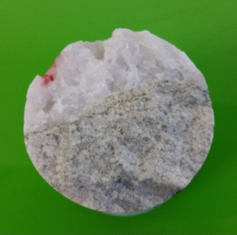
Anomalous samples
 | Sample | Depth [m] | Si ± σSi [%] | Al ± σAl [%] | K ± σK [%] | Ca ± σCa [%] | Fe ± σFe [%] | S ± σS [ppm] | Mn ± σMn [ppm] | Zn ± σZn [ppm] | Pb ± σPb [ppm]
 | JUNO_FRESH | 10 | 35 ± 2 | 6.8 ± 0.4 | 3.7 ± 0.1 | 0.62 ± 0.02 | 0.8 ± 0.1 | N/A | 507 ± 60 | 30 ± 9 | 55 ± 12
 | JUNO_ZK1_100 | 36 | 34 ± 2 | 7.0 ± 0.4 | 3.8 ± 0.1 | 0.76 ± 0.02 | 0.9 ± 0.1 | 441 ± 51 | 358 ± 58 | 27 ± 9 | 46 ± 12
 | JUNO_ZK1_200 | 64 | 34 ± 2 | 7.1 ± 0.4 | 4.2 ± 0.1 | 0.60 ± 0.02 | 1.0 ± 0.1 | 723 ± 51 | 1574 ± 76 | 101 ± 12 | 115 ± 12
 | JUNO_ZK1_300 | 164 | 34 ± 2 | 7.1 ± 0.4 | 3.9 ± 0.1 | 1.18 ± 0.03 | 0.9 ± 0.1 | 466 ± 51 | 565 ± 60 | 25 ± 9 | 51 ± 12
 | JUNO_ZK1_400 | 264 | 34 ± 2 | 6.8 ± 0.4 | 4.0 ± 0.1 | 0.86 ± 0.02 | 0.7 ± 0.1 | N/A | 511 ± 56 | 44 ± 9 | 46 ± 12
 | JUNO_ZK1_500 | 364 | 34 ± 2 | 7.2 ± 0.4 | 4.0 ± 0.1 | 0.56 ± 0.02 | 1.2 ± 0.1 | 1529 ± 57 | 643 ± 64 | 30 ± 12 | 55 ± 12
 | JUNO_2_HWP_430_A | 430 | 34 ± 2 | 7.2 ± 0.4 | 3.7 ± 0.1 | 0.64 ± 0.02 | 1.1 ± 0.1 | 532 ± 51 | 444 ± 58 | 27 ± 9 | 46 ± 12
 | JUNO_2_HWP_430_B | 430 | 34 ± 2 | 7.1 ± 0.4 | 3.8 ± 0.1 | 0.54 ± 0.02 | 1.0 ± 0.1 | 917 ± 51 | 474 ± 56 | 22 ± 9 | 44 ± 8
 | JUNO_HWP_430_A | 430 | 33 ± 2 | 7.7 ± 0.4 | 3.7 ± 0.1 | 0.77 ± 0.02 | 1.3 ± 0.1 | 463 ± 47 | 681 ± 56 | 103 ± 12 | 44 ± 8
 | JUNO_HWP_430_B | 430 | 34 ± 2 | 7.7 ± 0.4 | 3.9 ± 0.1 | 0.61 ± 0.02 | 1.0 ± 0.1 | 614 ± 49 | 494 ± 54 | 34 ± 9 | 48 ± 8
 | JUNO_HWP_460 | 460 | 34 ± 2 | 7.5 ± 0.4 | 3.8 ± 0.1 | 0.73 ± 0.02 | 1.3 ± 0.1 | 594 ± 49 | 736 ± 62 | 35 ± 9 | 38 ± 8
 | JUNO_2_HWP_464 | 464 | 34 ± 2 | 7.1 ± 0.4 | 3.7 ± 0.1 | 0.83 ± 0.02 | 1.3 ± 0.1 | 1506 ± 55 | 846 ± 62 | 182 ± 15 | 91 ± 12
 | JUNO_ZK1_600 | 464 | 33 ± 2 | 7.6 ± 0.4 | 2.7 ± 0.1 | 0.64 ± 0.02 | 1.5 ± 0.1 | 5257 ± 70 | 3145 ± 98 | 78 ± 12 | 33 ± 12
 | JUNO_HWP_465 | 465 | 32 ± 2 | 7.0 ± 0.4 | 3.4 ± 0.1 | 0.64 ± 0.02 | 4.2 ± 0.1 | 7584 ± 74 | 2779 ± 88 | 375 ± 21 | 88 ± 12
 | JUNO_2_HWP_467 | 467 | 34 ± 2 | 7.4 ± 0.4 | 3.9 ± 0.1 | 0.63 ± 0.02 | 1.0 ± 0.1 | 662 ± 49 | 484 ± 58 | 24 ± 9 | 40 ± 8
 | JUNO_HWP_467 | 467 | 34 ± 2 | 7.0 ± 0.4 | 3.7 ± 0.1 | 0.58 ± 0.02 | 1.0 ± 0.1 | 426 ± 49 | 496 ± 56 | 25 ± 9 | 39 ± 8
 | JUNO_HWP_474 | 474 | 34 ± 2 | 6.9 ± 0.4 | 3.9 ± 0.1 | 0.57 ± 0.02 | 1.1 ± 0.1 | 482 ± 51 | 717 ± 62 | 30 ± 9 | 43 ± 8
 | JUNO2_HWP_475 | 475 | 34 ± 2 | 7.0 ± 0.4 | 3.8 ± 0.1 | 0.79 ± 0.02 | 1.2 ± 0.1 | 451 ± 49 | 558 ± 60 | 27 ± 9 | 44 ± 12
JUNO_2_HWP_464, JUNO_ZK1_600 and JUNO_HWP_465 (outliers) come from the same depth
JUNO_HWP_465 is the already spotted density outlier
JUNO_ZK1_600 is characterized by the presence of a quartz vein
JUNO_ZK1_600
JUNO_HWP_465

Slide 12
Building a reference rock
Major elements’ average concentrations have been used to build a reference rock representative of the local rock composition
The composition in terms of equivalent oxides have been obtained using the element-to-stoichiometric oxide conversion factors (CF)
Fe concentration has been divided evenly between FeO and Fe₂O₃ oxides
The sum of the obtained oxides equate to ∼ 94 % so oxide concentrations have been rescaled to sum at 100%
Trace elements have been neglected
Element | Element wt% | CF | Oxide | Oxide wt% | Normalized Oxide wt%
Si | 34 ± 1 | 2.139 | SiO₂ | 72 | 77
Al | 7.2 ± 0.3 | 1.889 | Al₂O₃ | 14 | 15
K | 3.8 ± 0.3 | 1.205 | K₂O | 5 | 5
Ca | 0.70 ± 0.16 | 1.399 | CaO | 1 | 1
Fe | 0.65 ± 0.40 | 1.286 | FeO | 0.8 | 1
Fe | 0.65 ± 0.40 | 1.430 | Fe₂O₃ | 0.9 | 1

Slide 13
Electron density from geophysical and geochemical data
 | Composition | ρ [g/cm³] | N_{e} [mol/cm³]
Capozzi et al., 2014 | Not specified | 2.6 | 1.3
Li et al., 2016 | Not specified | 2.6 | 1.3
Khan et al., 2020 | Not specified | 2.6 | 1.3
Our study | Reference rock | 2.640 ± 0.038 | 1.311
Our estimations are based on geophysical and geochemical analysis of local rock samples
Our density estimation differs from literature by 1.5%, comparable with standard deviation
Estimation on $N_{e}$ differs by 0.8% from literature
With the complete measurement dataset, we will estimate the uncertainty on $N_{e}$

Slide 14
$N_{e}$ and ${\overline{ν}}_{e}$ survival probability in JUNO
Preliminary
${\overline{ν}}_{e}$ survival probability as a function of antineutrino energy has been calculated for a baseline L = 52.5 km with mixing parameters from ParticleDataGroup 2021
At this scale the effects of a different electron density are not visible

Slide 15
Impact of a precise $N_{e}$ estimation
Preliminary
The relative difference between $P_{ee}^{(2)}$(obtained with $N_{e}$ = 1.311 mol/cm³) and $P_{ee}^{(1)}$ (obtained with $N_{e}$ = 1.300 mol/cm³) is plotted as a function of antineutrino energy
The maximum relative difference is of order of 4 · 10⁻⁴, at ∼ 3.5 MeV
The average relative difference is ∼ 1.7 · 10⁻⁴
The effect of $N_{e}$ obtained from geochemical and geophysical local data is small, but should be considered for precise spectral calculation

Slide 16
Conclusions and next steps
We’ve made density and compositional measurements on 18 rock samples from JUNO site
From measurement results we’ve estimated an electron density of 1.311 mol/cm³, to be compared with the value 1.300 mol/cm³ from literature
This estimation modifies the ${\overline{ν}}_{e}$ survival probability at the order of 10⁻⁴
Next steps are the evaluation of $N_{e}$ uncertainties with a full dataset, the characterization of rock and sediment types crossed by antineutrinos and the reconstruction of reactor $\overline{ν}$spectrum in JUNO
Thank you

