Slide 1
How to fit the first year of reactor data
Investigating different fitting approaches
5 May 2022
Andrea Serafini on behalf of the Padova group

Slide 2
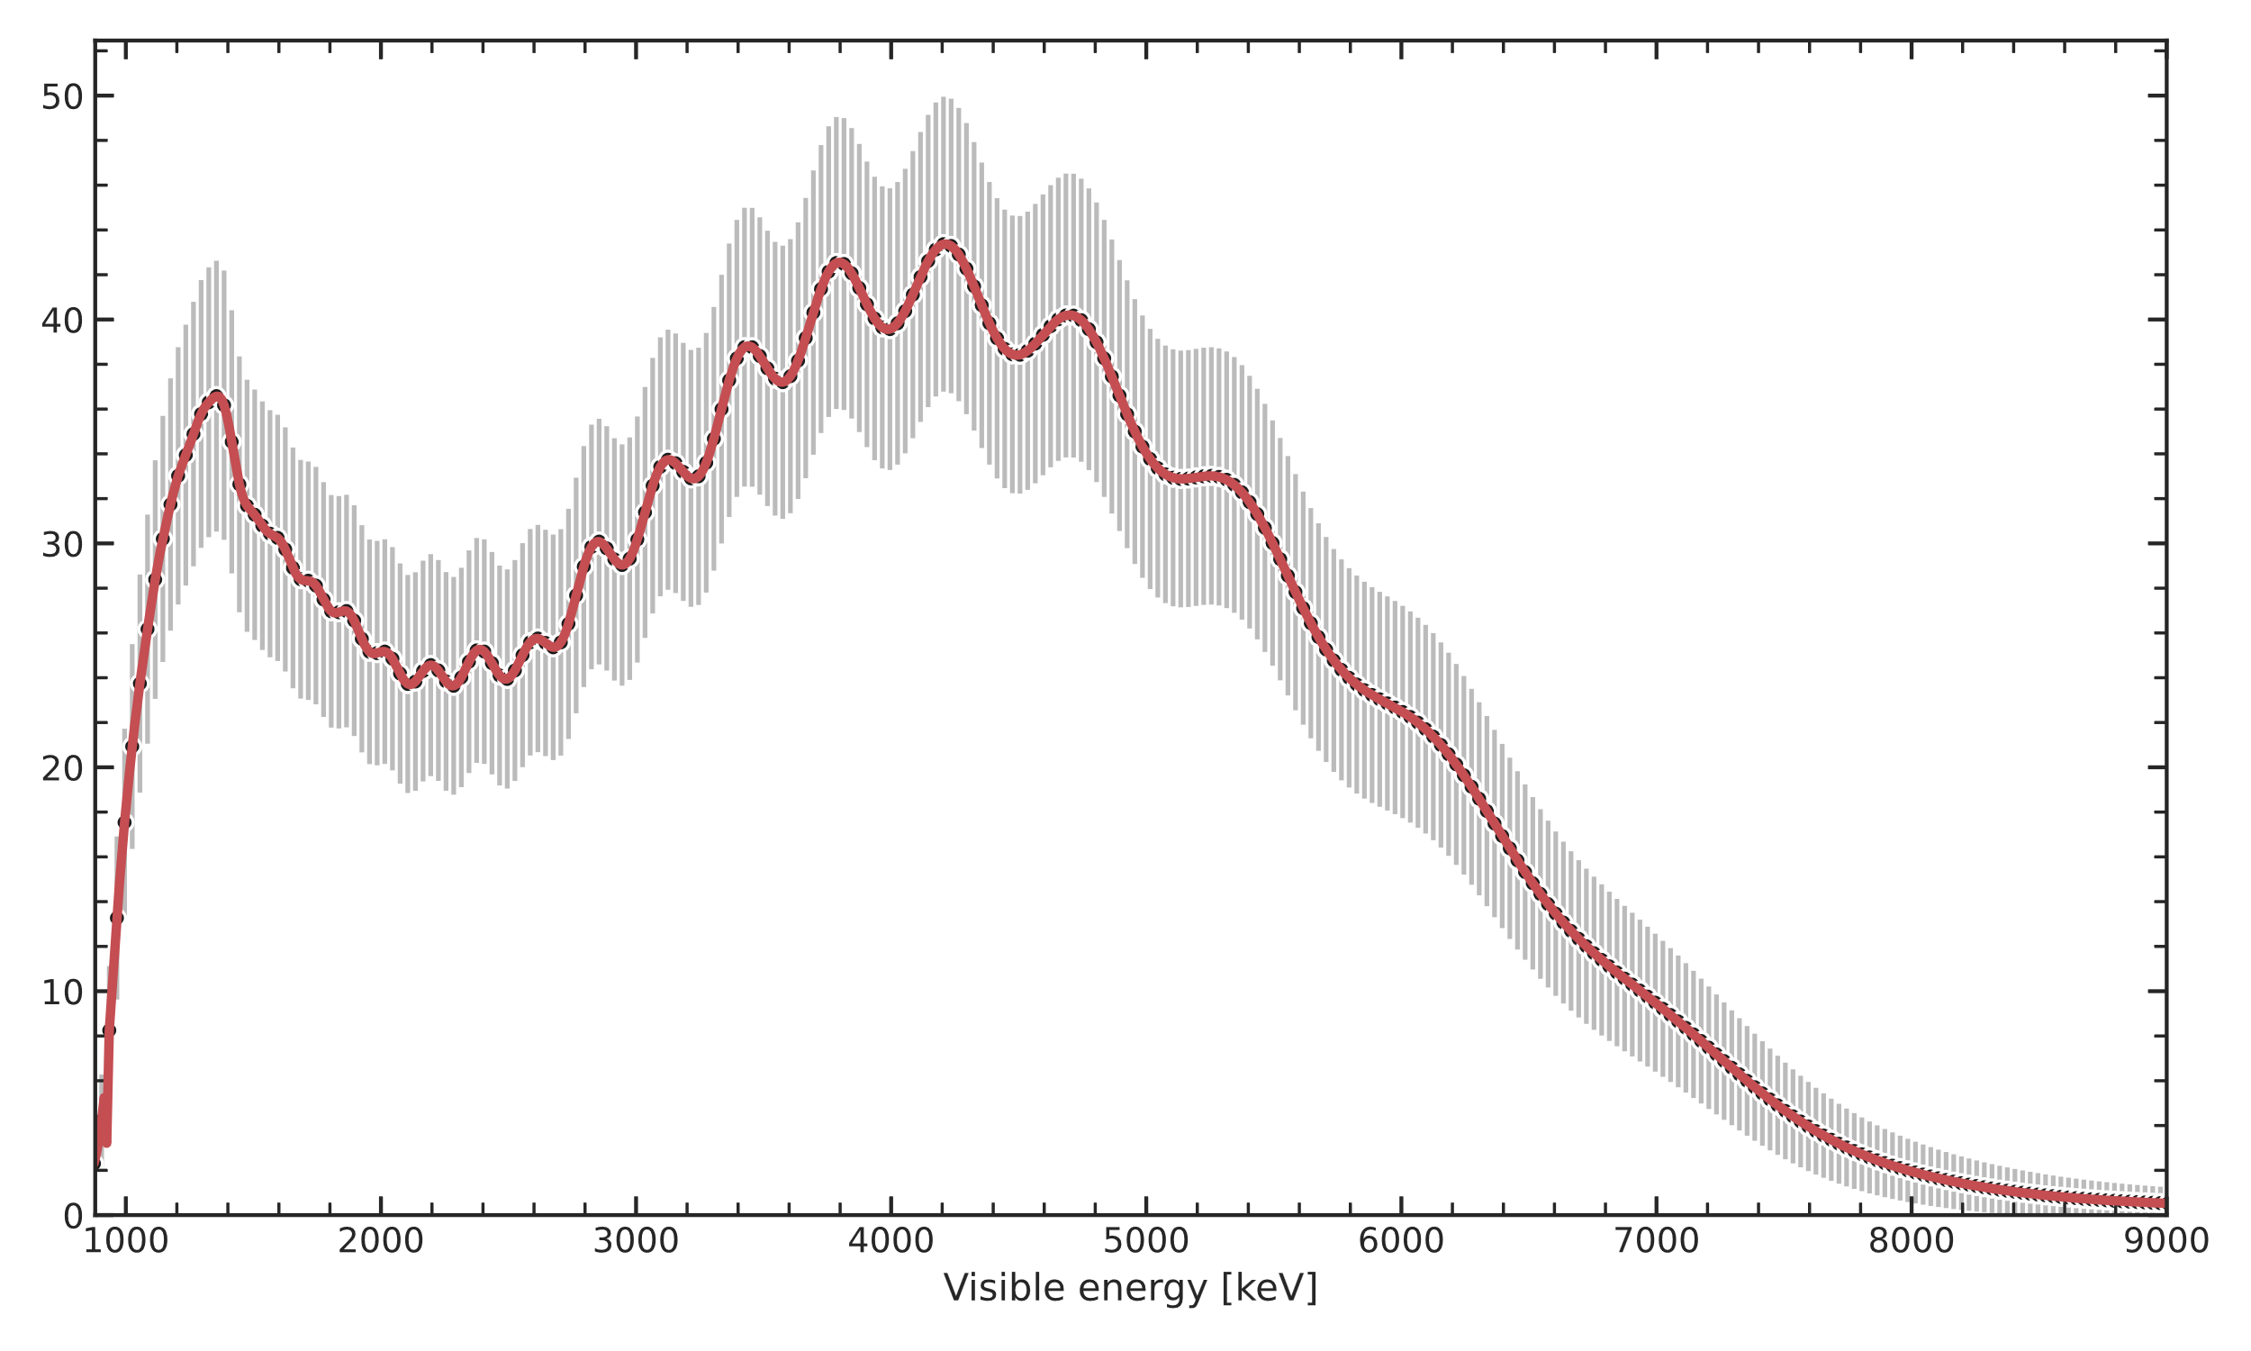
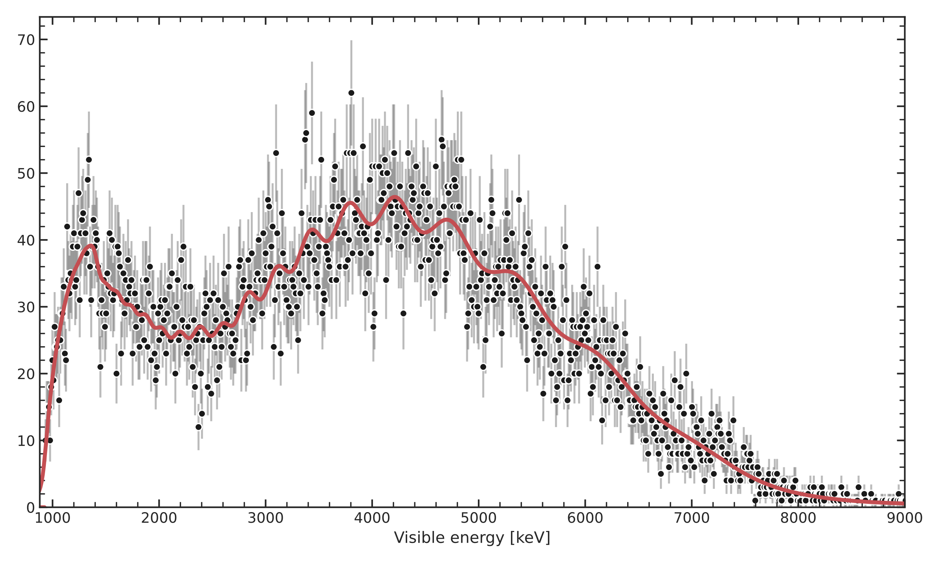
What we want to discuss
Juno sensitivity studies - standard paradigm:
- Asimov datasets
- binned likelihood or χ² minimized using Minuit
Goals:
- investigate pros and cons of standard paradigm when analyzing 1 year of data
Methods:
- use pseudo-experiments instead of Asimov datasets
- study alternative statistical tools: unbinned likelihood and Markov Chain Monte Carlo (MCMC)
Asimov dataset of 1 year
(~17000 reactor events)
A pseudo-experiment of 1 year
(~17000 reactor events)
Events per bin [#]
Events per bin [#]
Reconstructed energy $E_{rec}$ [keV]
Reconstructed energy $E_{rec}$ [keV]

Slide 3
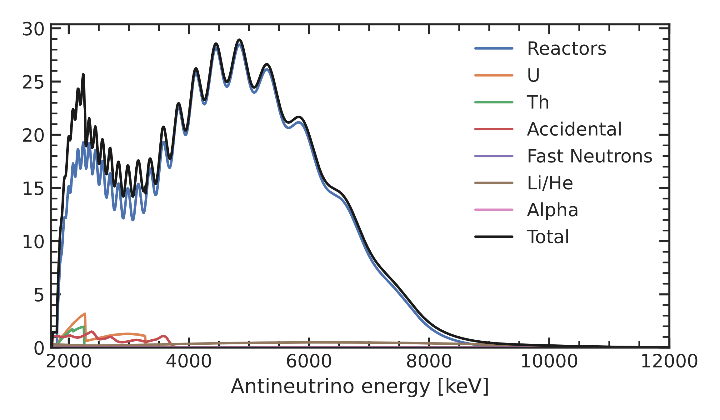
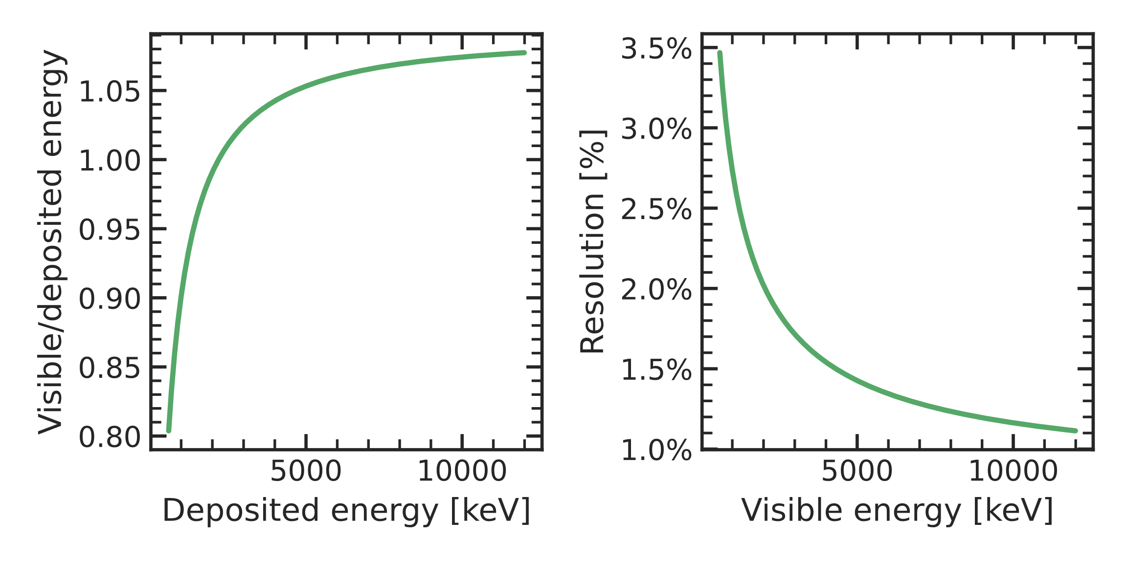
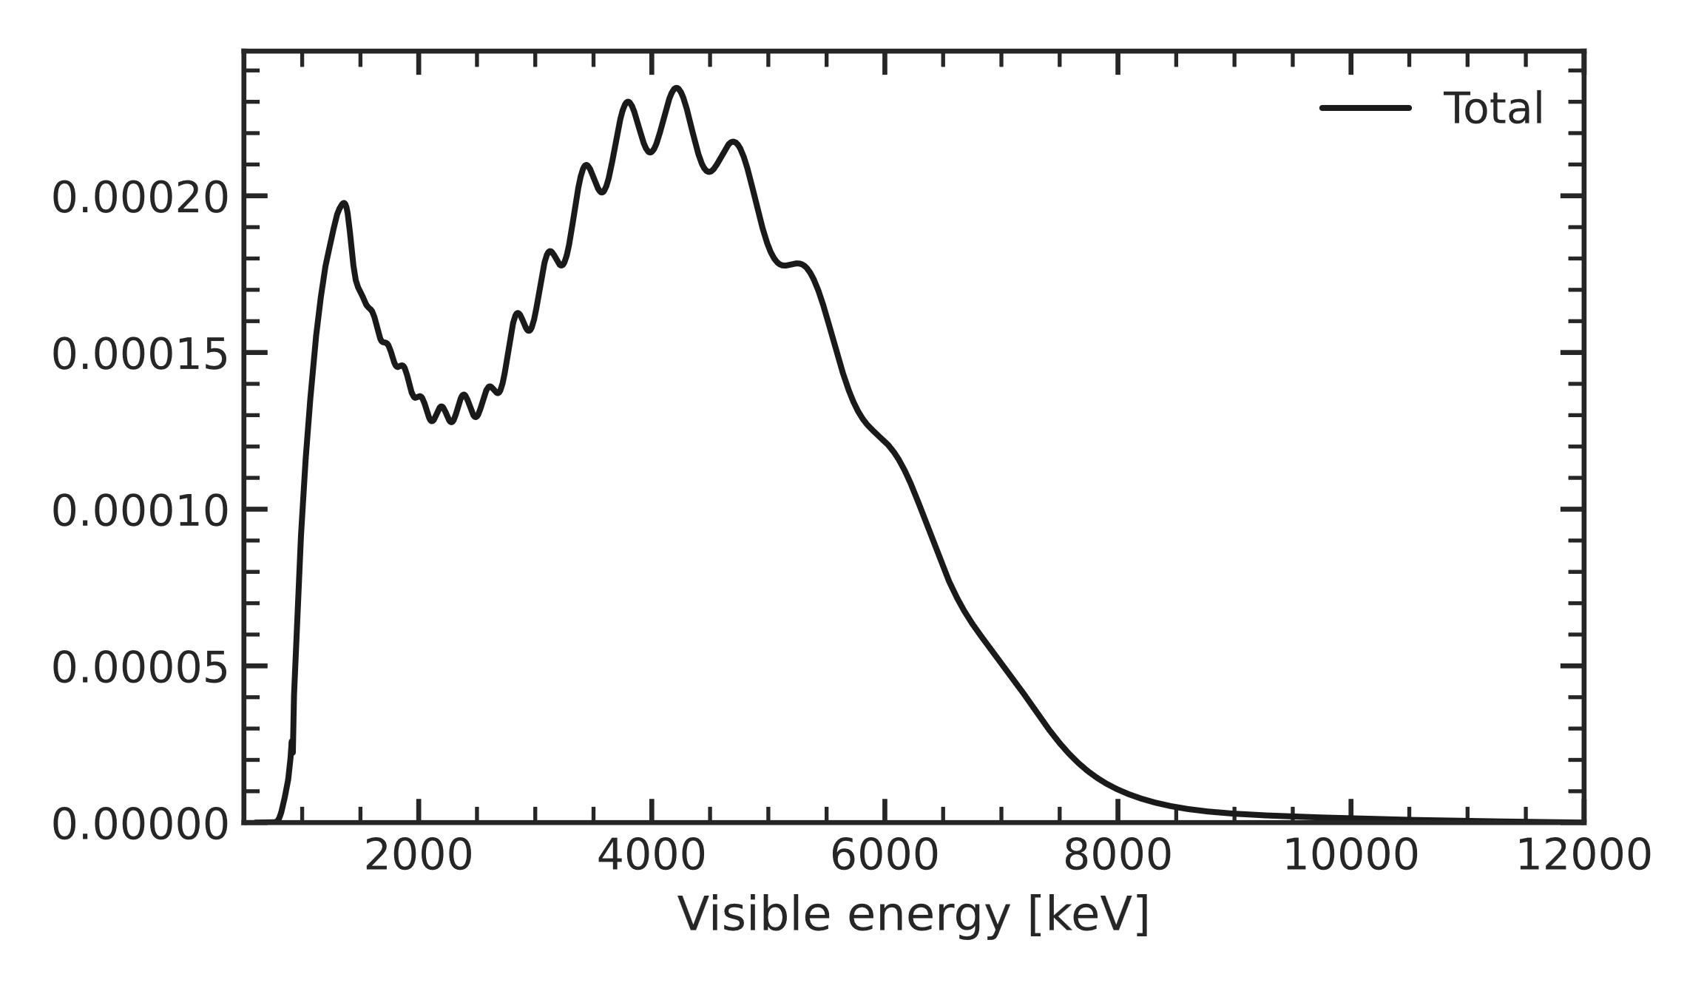
A simplified model
Included components:
Reactor antineutrinos (now only for 50km-baseline cores)
Geoneutrinos (U + Th)
Backgrounds (from common inputs):
Accidental coincidences
Fast neutrons
⁹Li/⁸He
¹³C(α,n)¹⁶O
Included effects:
Neutrino vacuum oscillations
Energy non-linearity (from common inputs)
Energy resolution
Antineutrino energy [keV]
Energy resolution
Visible/deposited en.
Deposited energy [keV]
Visible energy [keV]
Reconstructed energy [keV]

Slide 4
Likelihood: comparing model to data
$E$ = variable
$E$’ = number
kinematics
non-linearity
resolution
$$E_{ν}$$
$$E_{dep}\left(E_{ν}\right)$$
$$E_{vis}\left(E_{dep}\right)$$
$$E_{rec}(E_{vis})$$
Binned
Likelihood
$$Model\left(θ,E_{ν}\right)$$
$$Model\left(θ,E_{dep}\right)$$
$$Model\left(θ,E_{vis}\right)$$
$$Model(θ,E_{rec})$$
$$−$$
$$−$$
$$−$$
$$Data(E_{rec}^{′})$$
kinematics
non-linearity
resolution
$$E_{rec}^{′}$$
$$E_{ν}(E_{dep})$$
$$E_{dep}\left(E_{vis}\right)$$
$$E_{vis}\left(E_{rec}\right)$$
Unbinned
Likelihood
$$Model\left(θ,E_{ν}\right)$$
$$−$$
$$−$$
$$−$$
$$Data\left(E_{rec}^{′},E_{ν}\right)$$
$$Data\left(E_{rec}^{′},E_{dep}\right)$$
$$Data\left(E_{rec}^{′},E_{vis}\right)$$
$$Data(E_{rec}^{′})$$

Slide 5
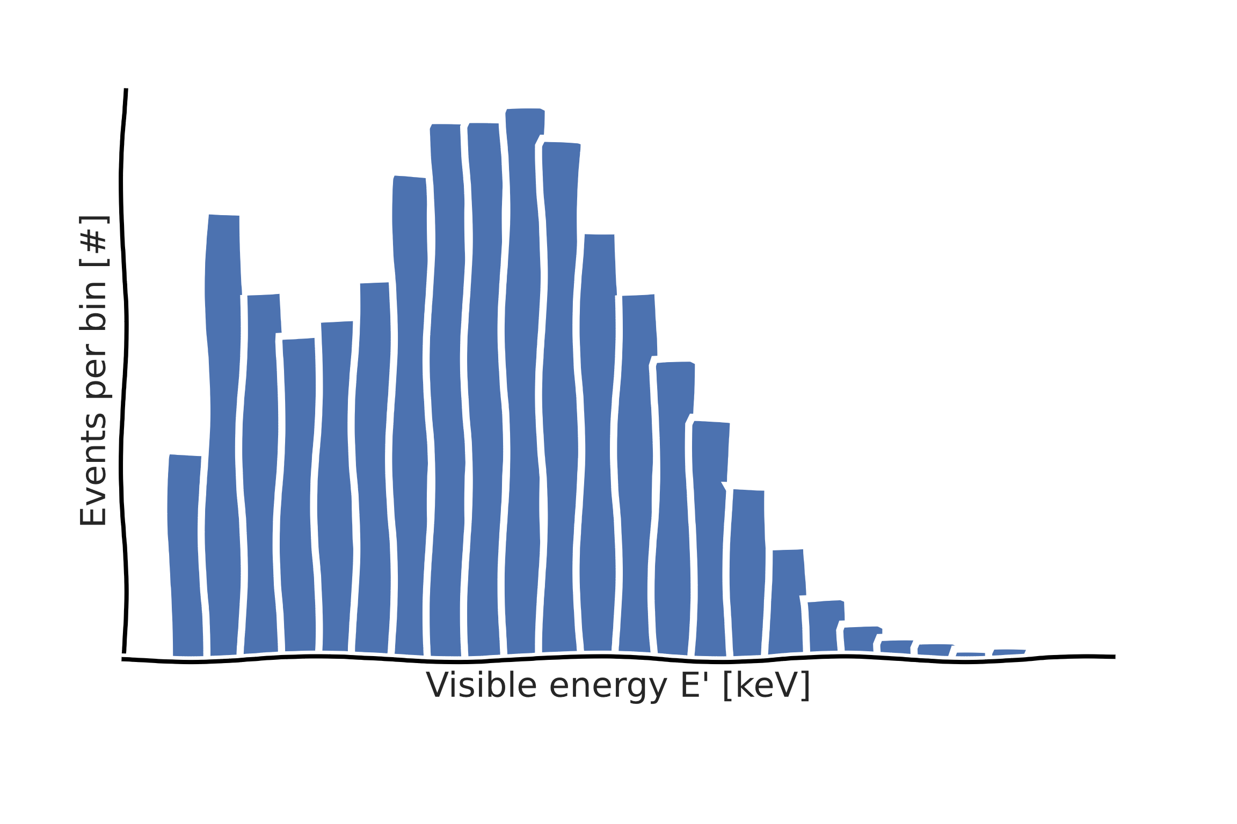
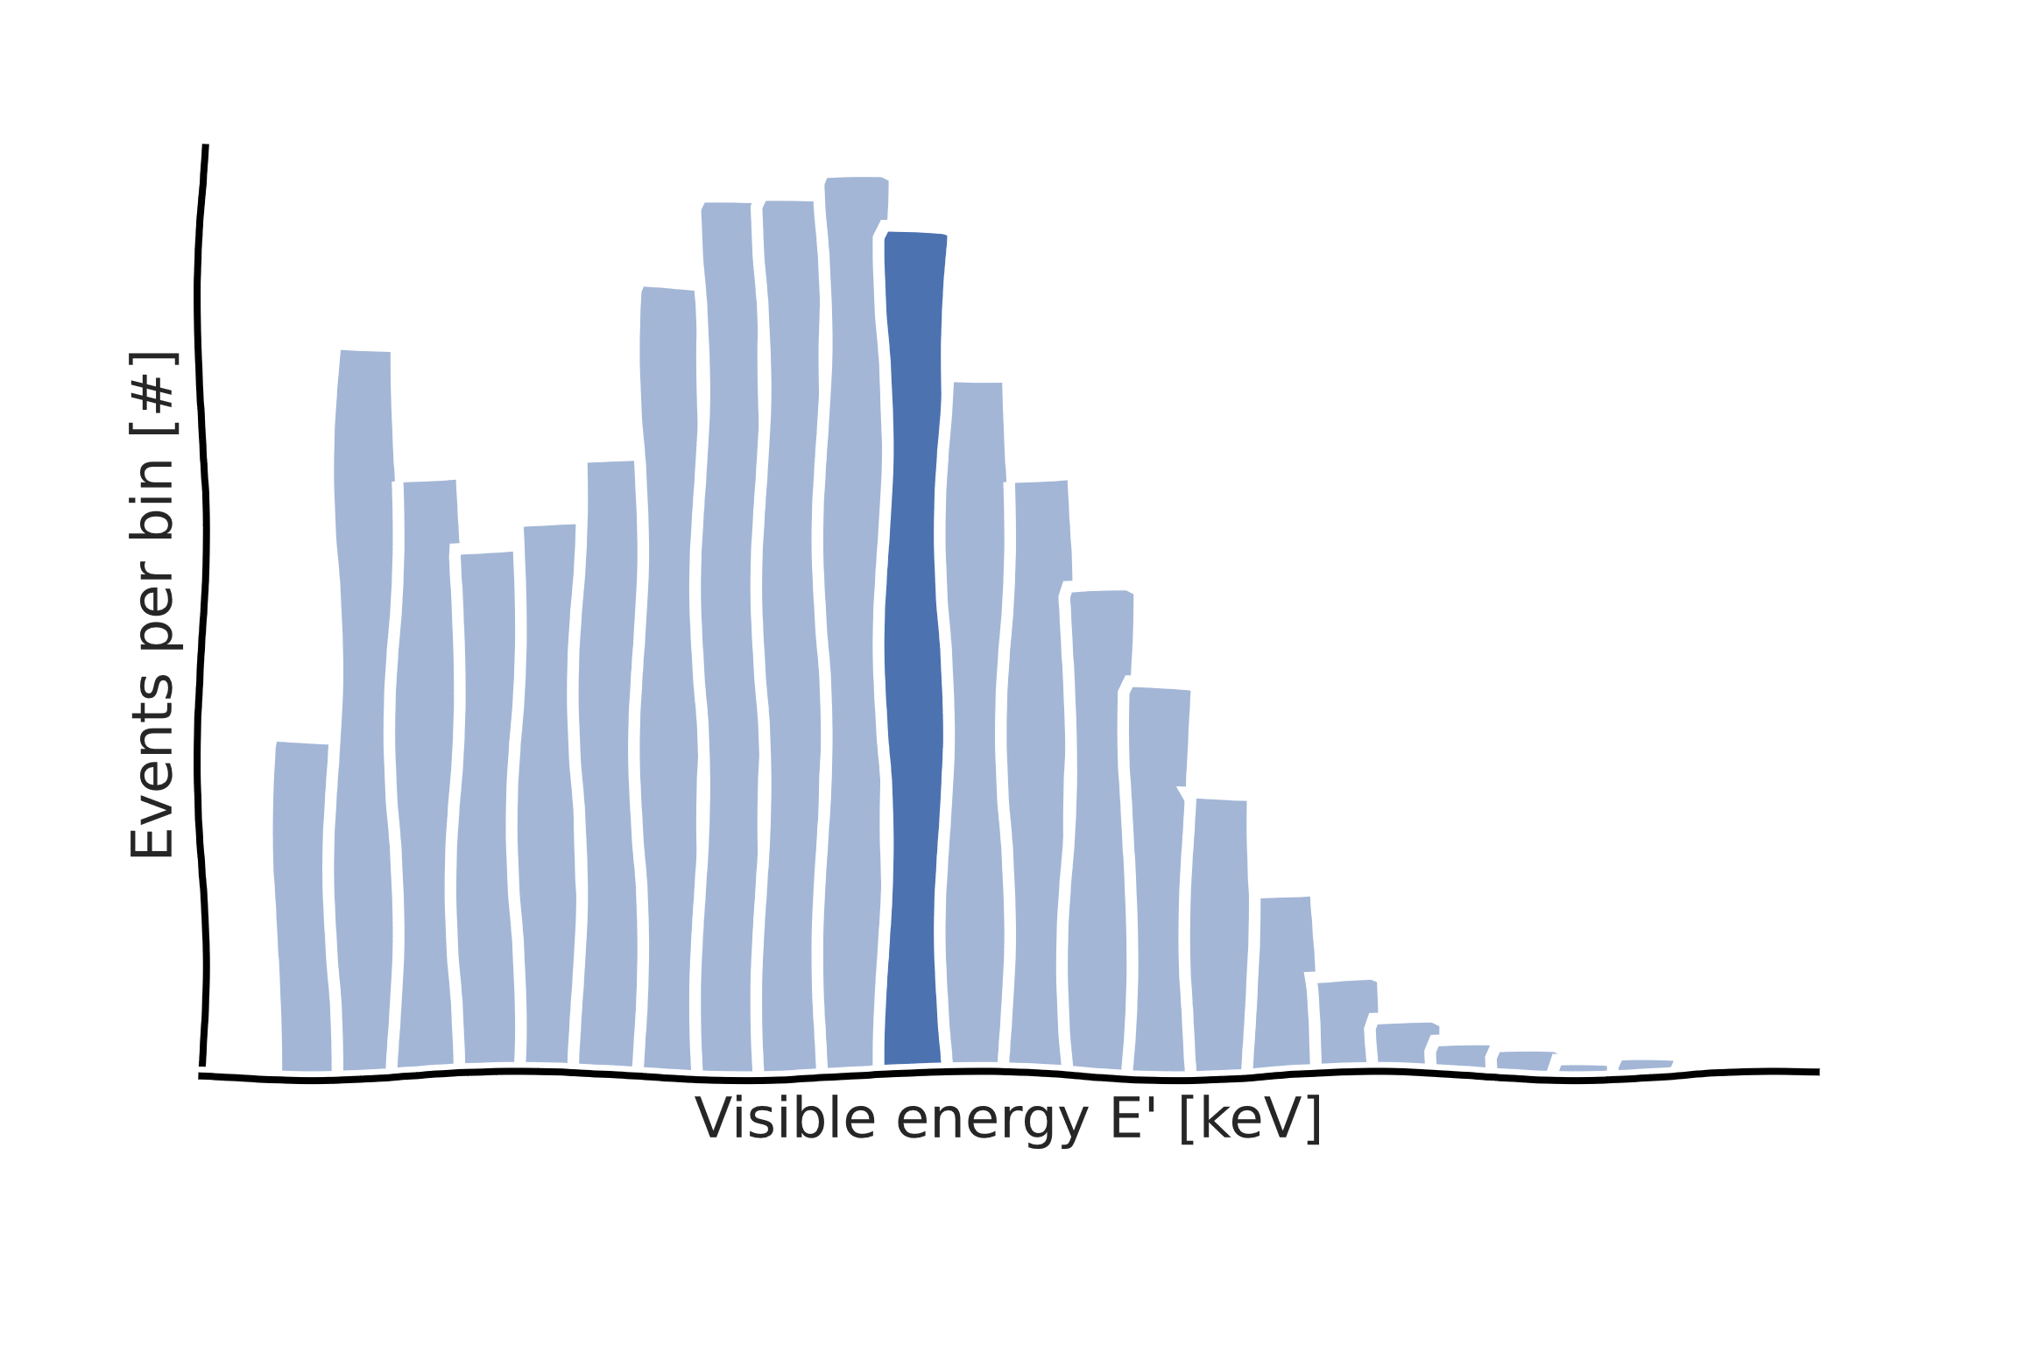
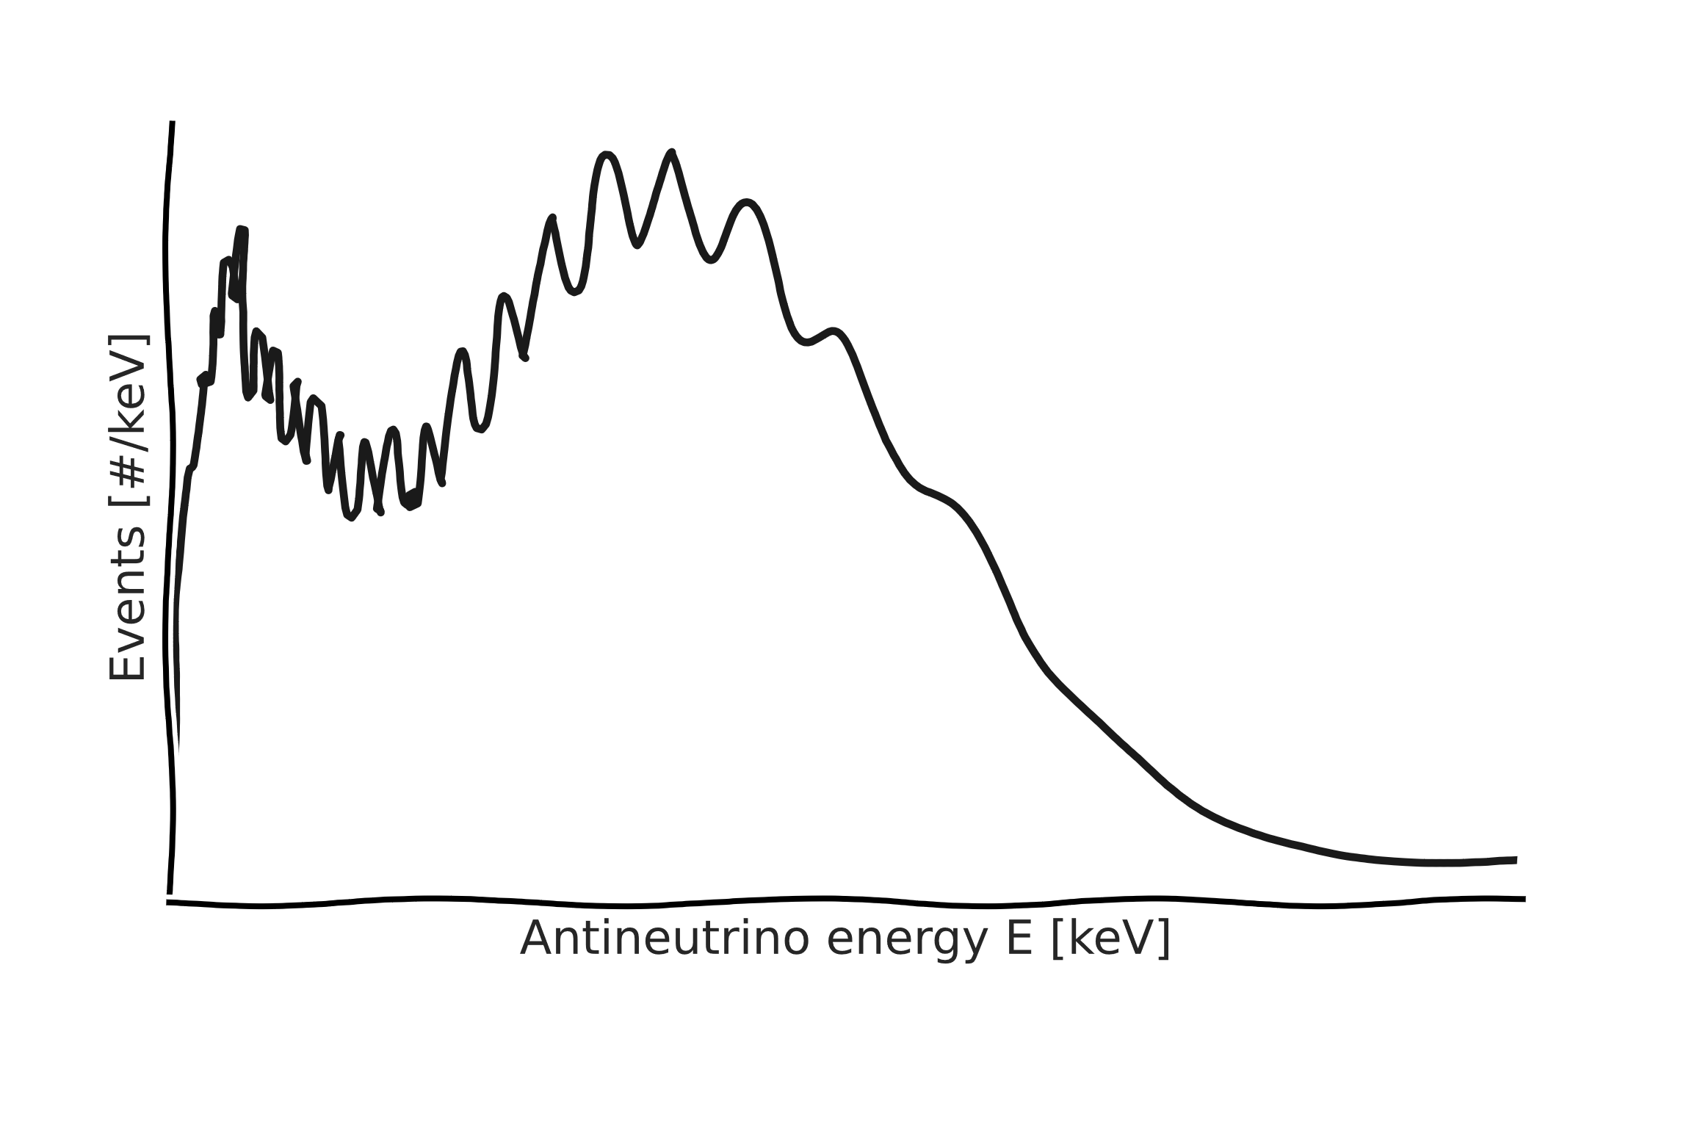
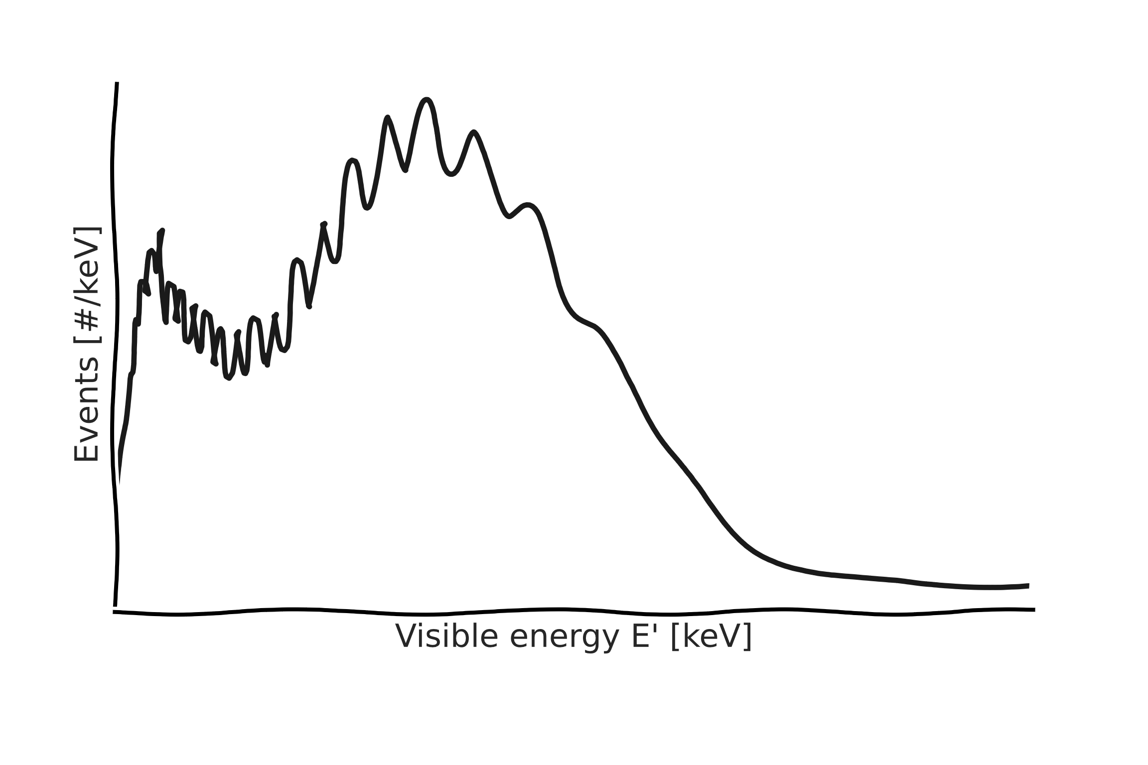
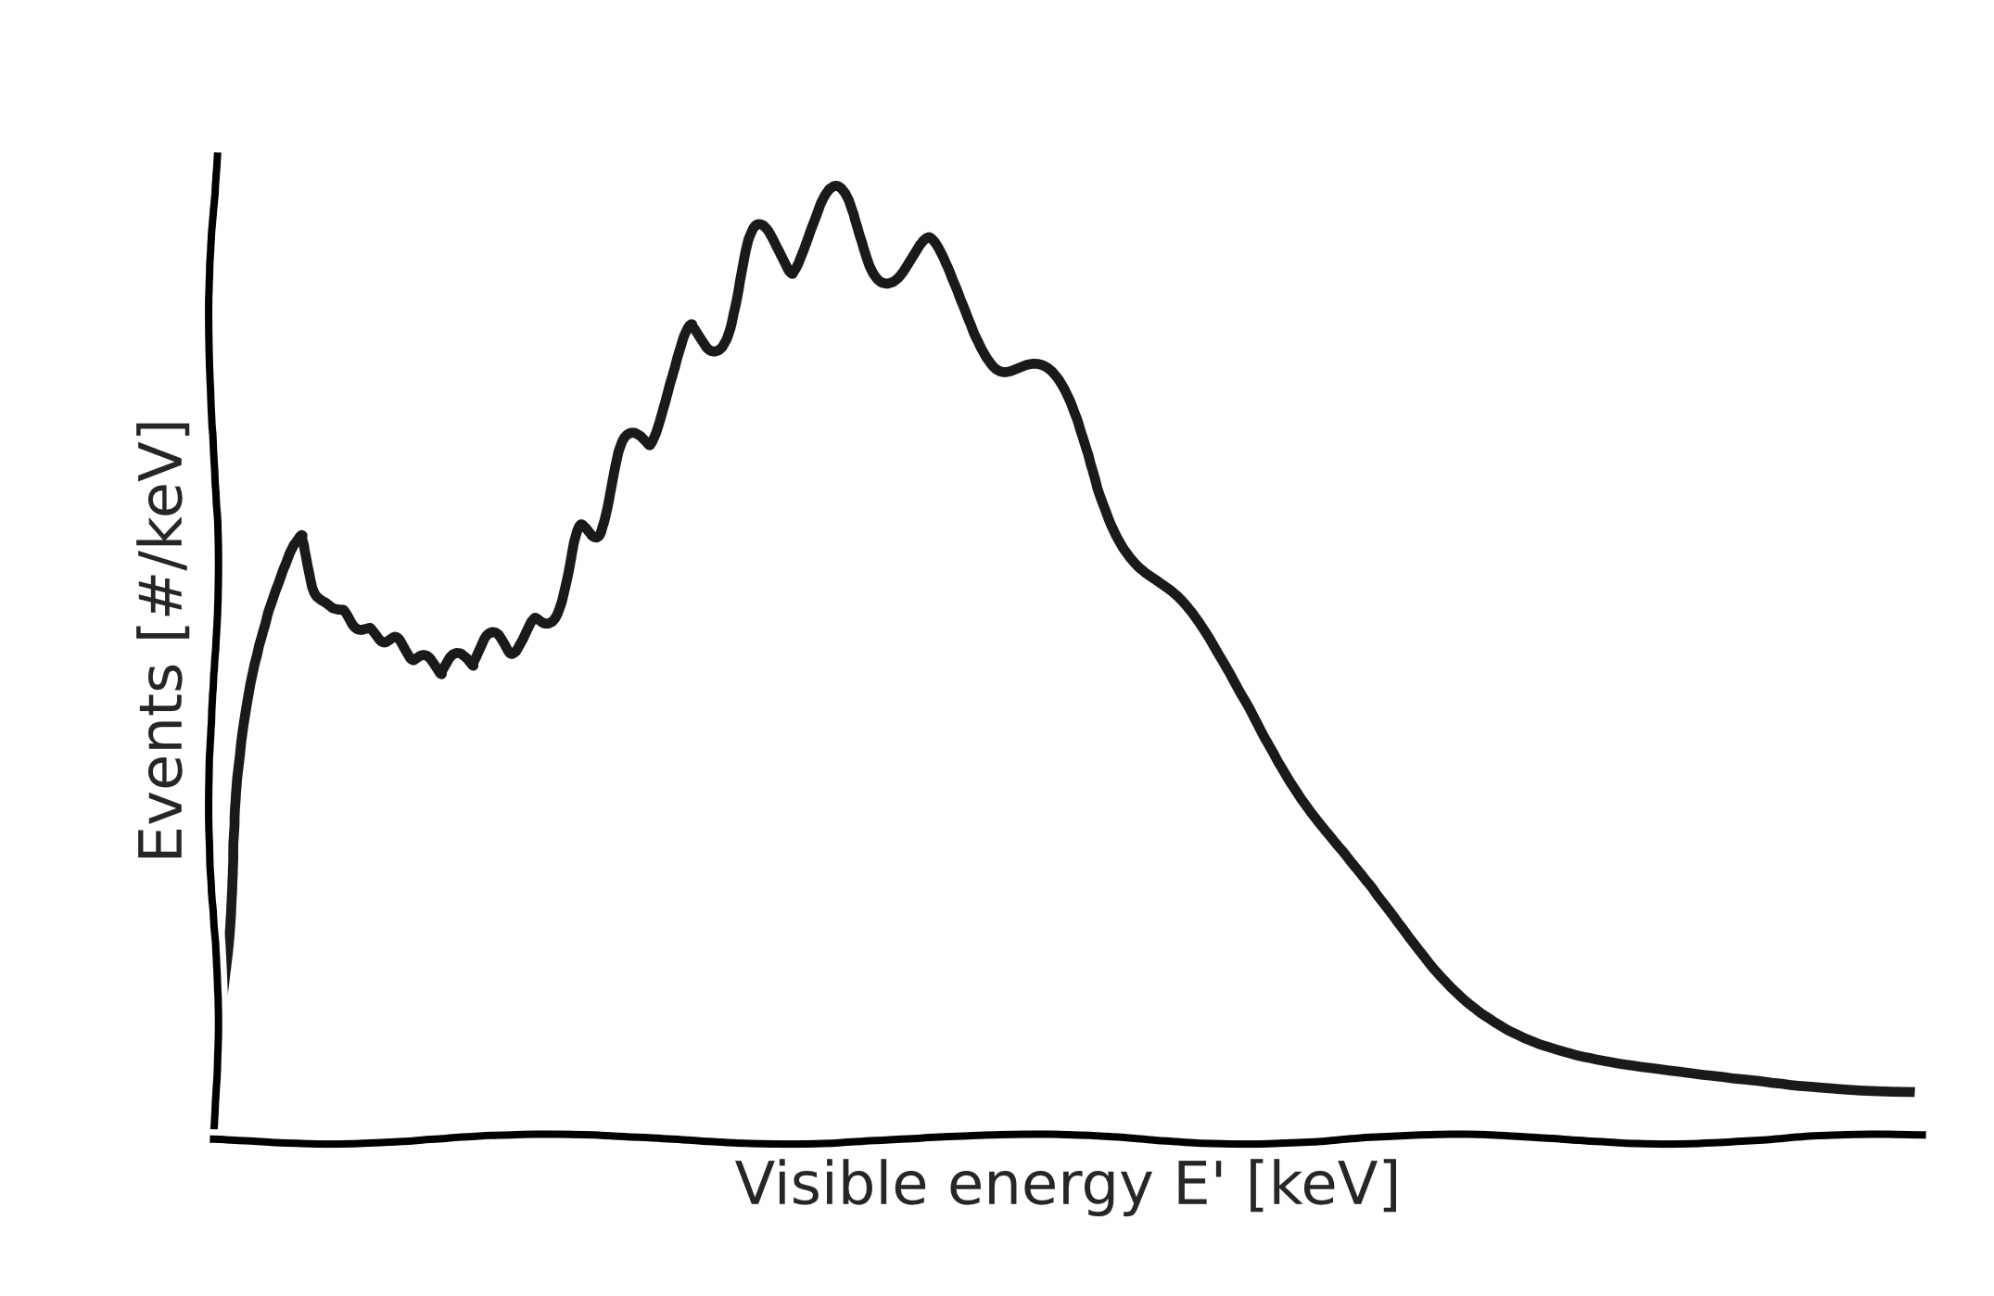
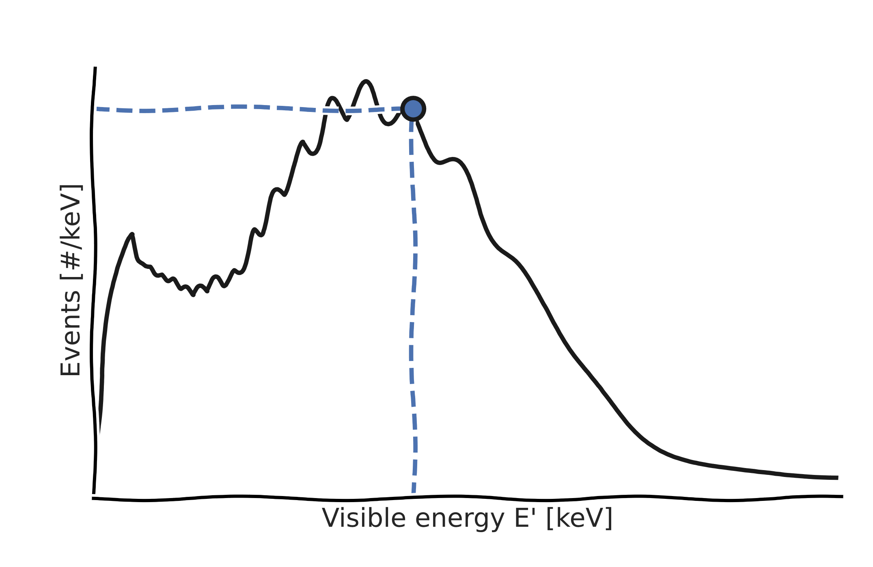
Binned likelihood
$$[k_{1}, k_{2}…k_{i}…k_{M}]$$
Data
Calculating the Poisson likelihood (or χ²):
Binning
$$L\left(θ|k\right)=\prod_{bins i}{\frac{{\text{λ}}_{i}{\text{(}\text{θ}\text{)}}^{k_{i}} e^{−{\text{λ}}_{i}\left(θ\right)}}{k_{i}!}}$$
List of reconstructed energies for measured events:
Events per bin [#]
$$[E_{1}^{′}, E_{2}^{′},E_{3}^{′}…E_{i}^{′}…E_{N}^{′}]$$
Reconstructed energy $E_{rec}$ [keV]
Model (θ)
Non-linearity
Resolution
$${\text{λ}}_{i}\left(θ\right)$$
Events [#/keV]
Events [#/keV]
Events per bin [#]
Deposited energy $E_{dep}$ [keV]
Visible energy $E_{vis}$ [keV]
Reconstructed energy $E_{rec}$ [keV]

Slide 6
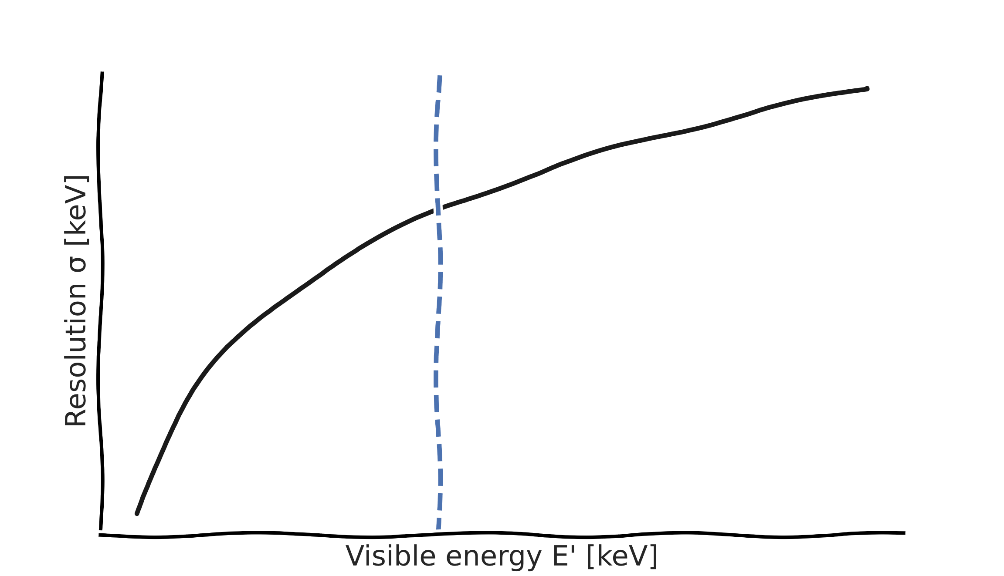
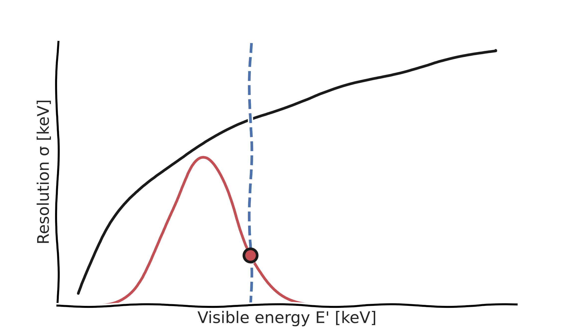
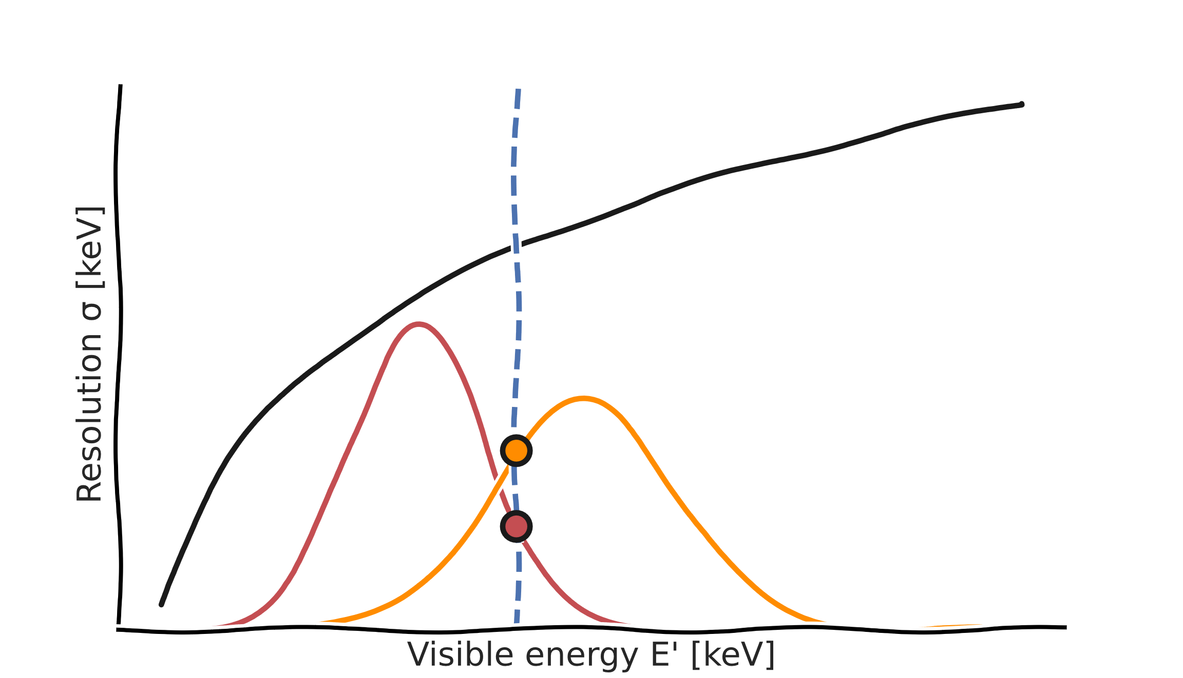
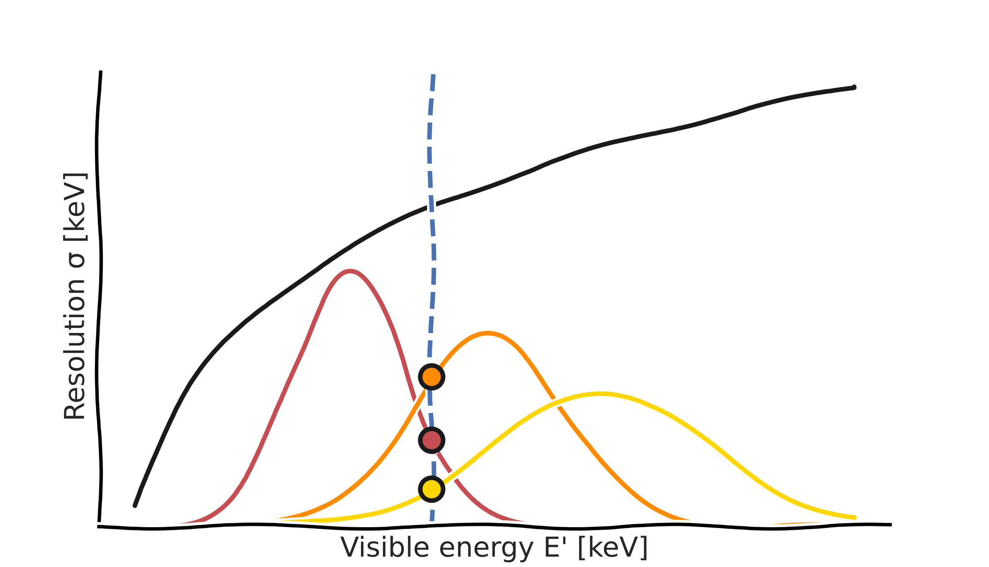
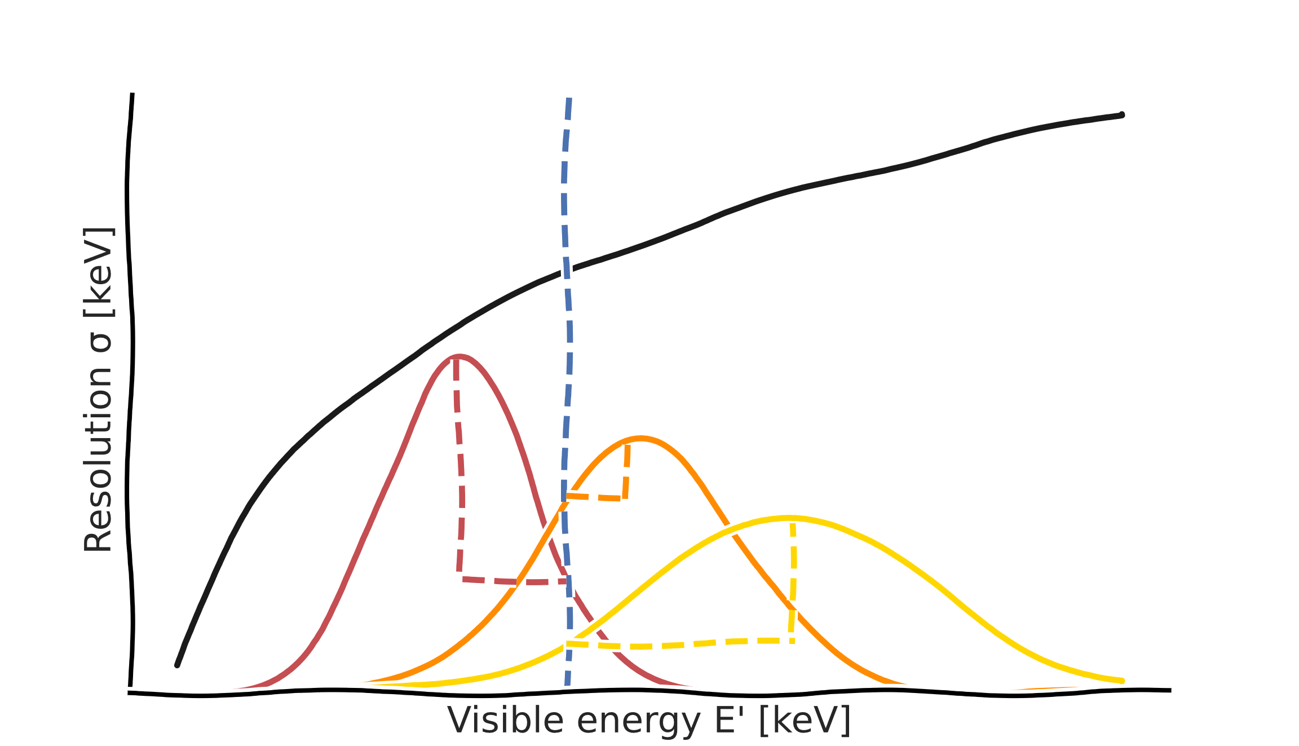
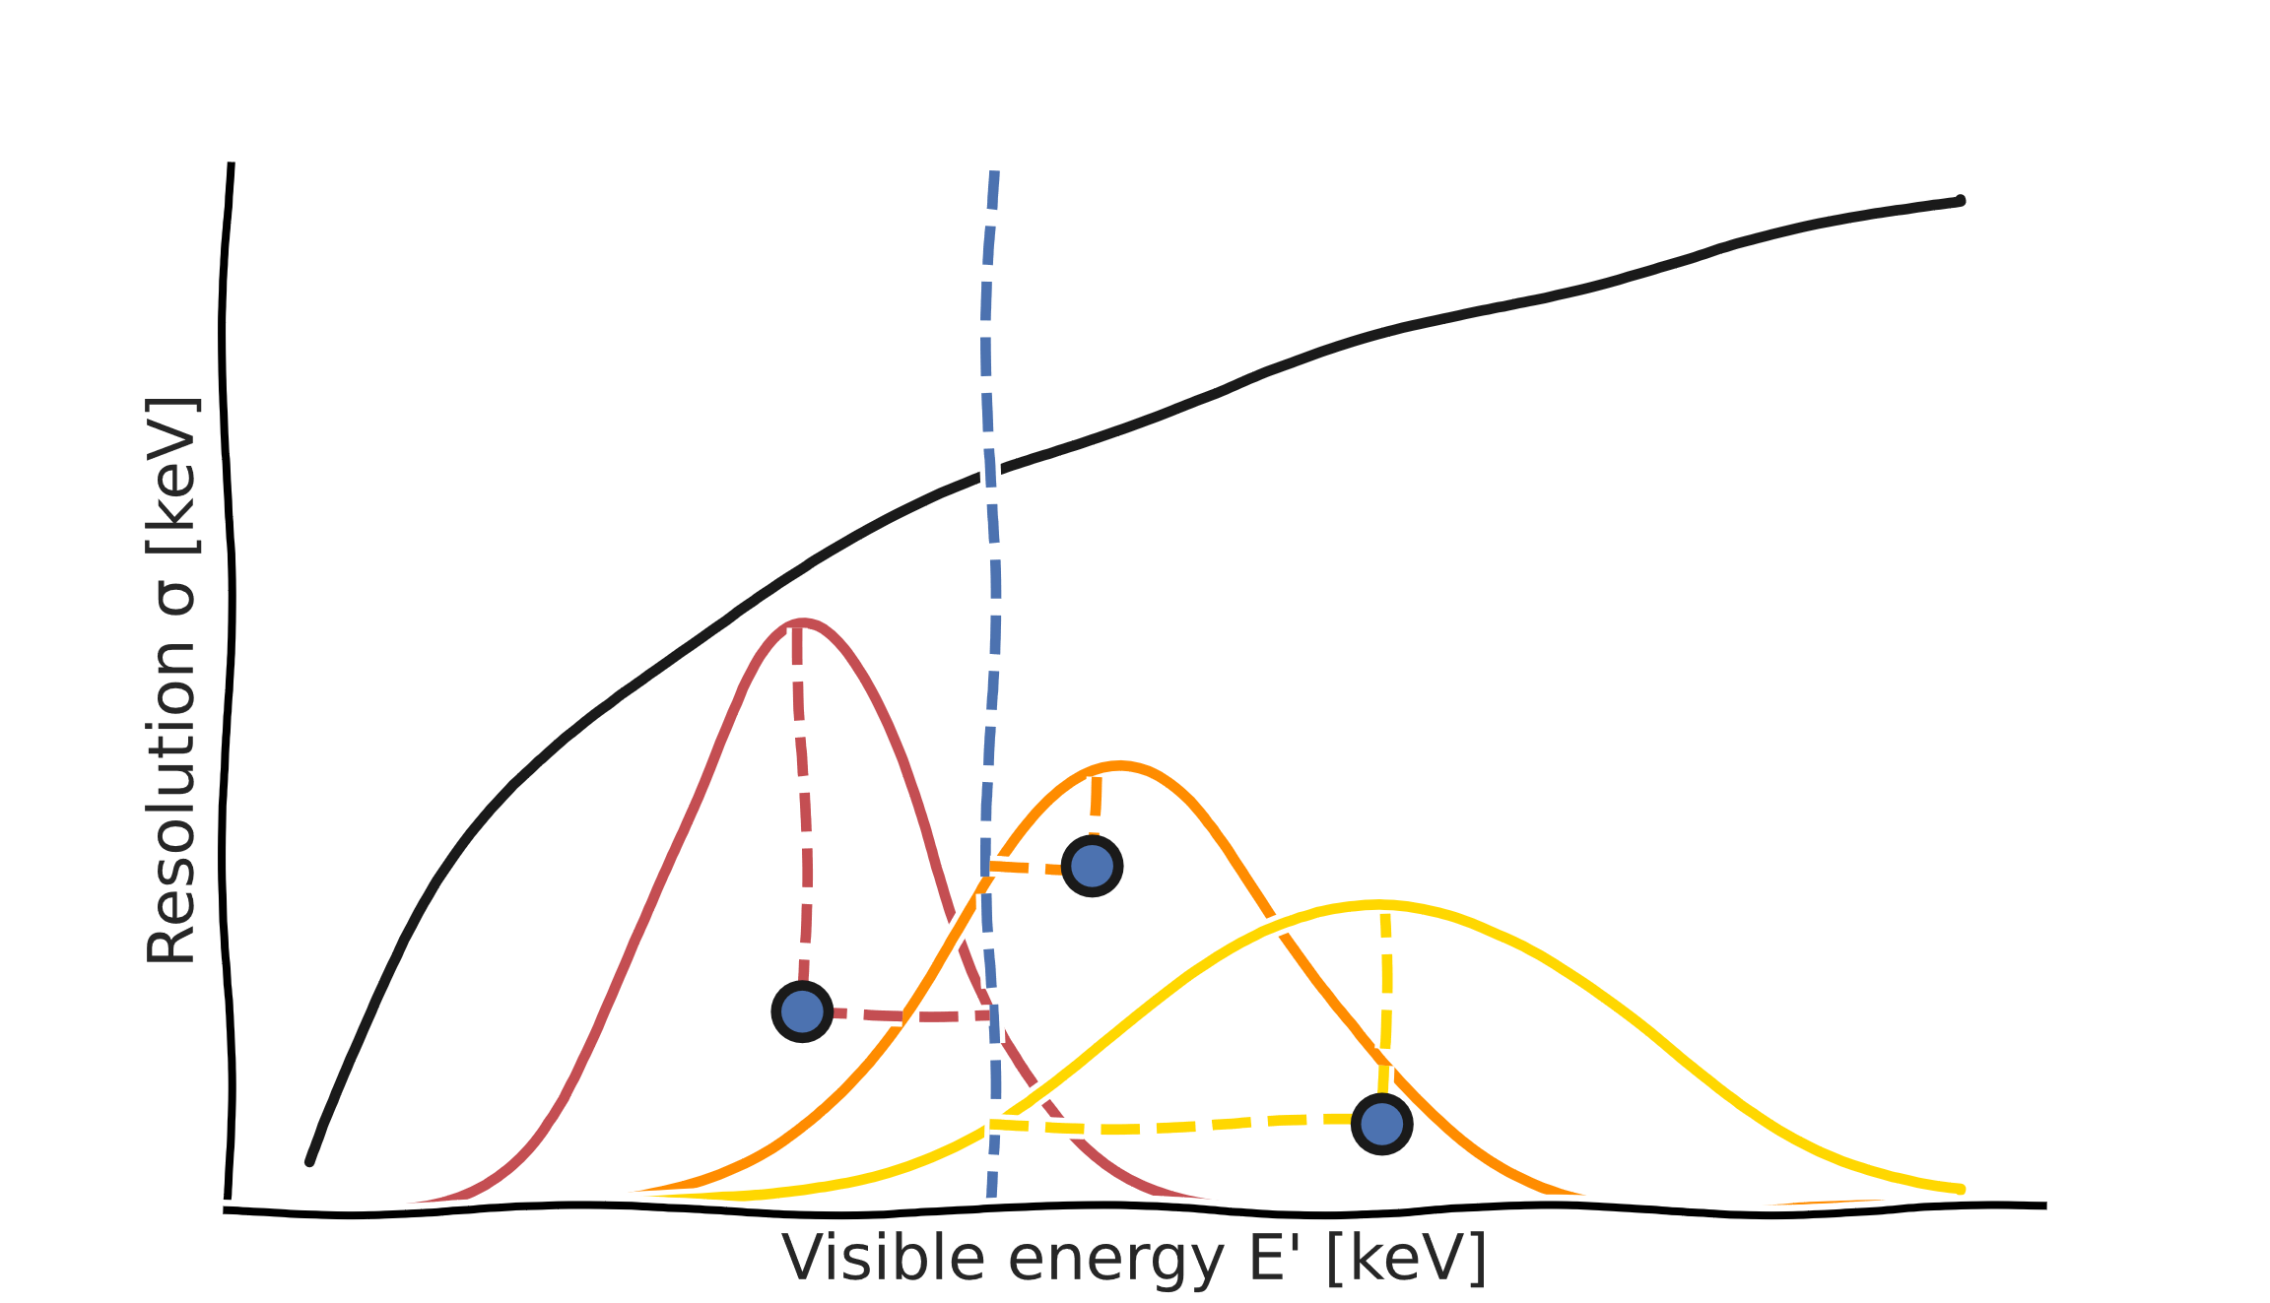
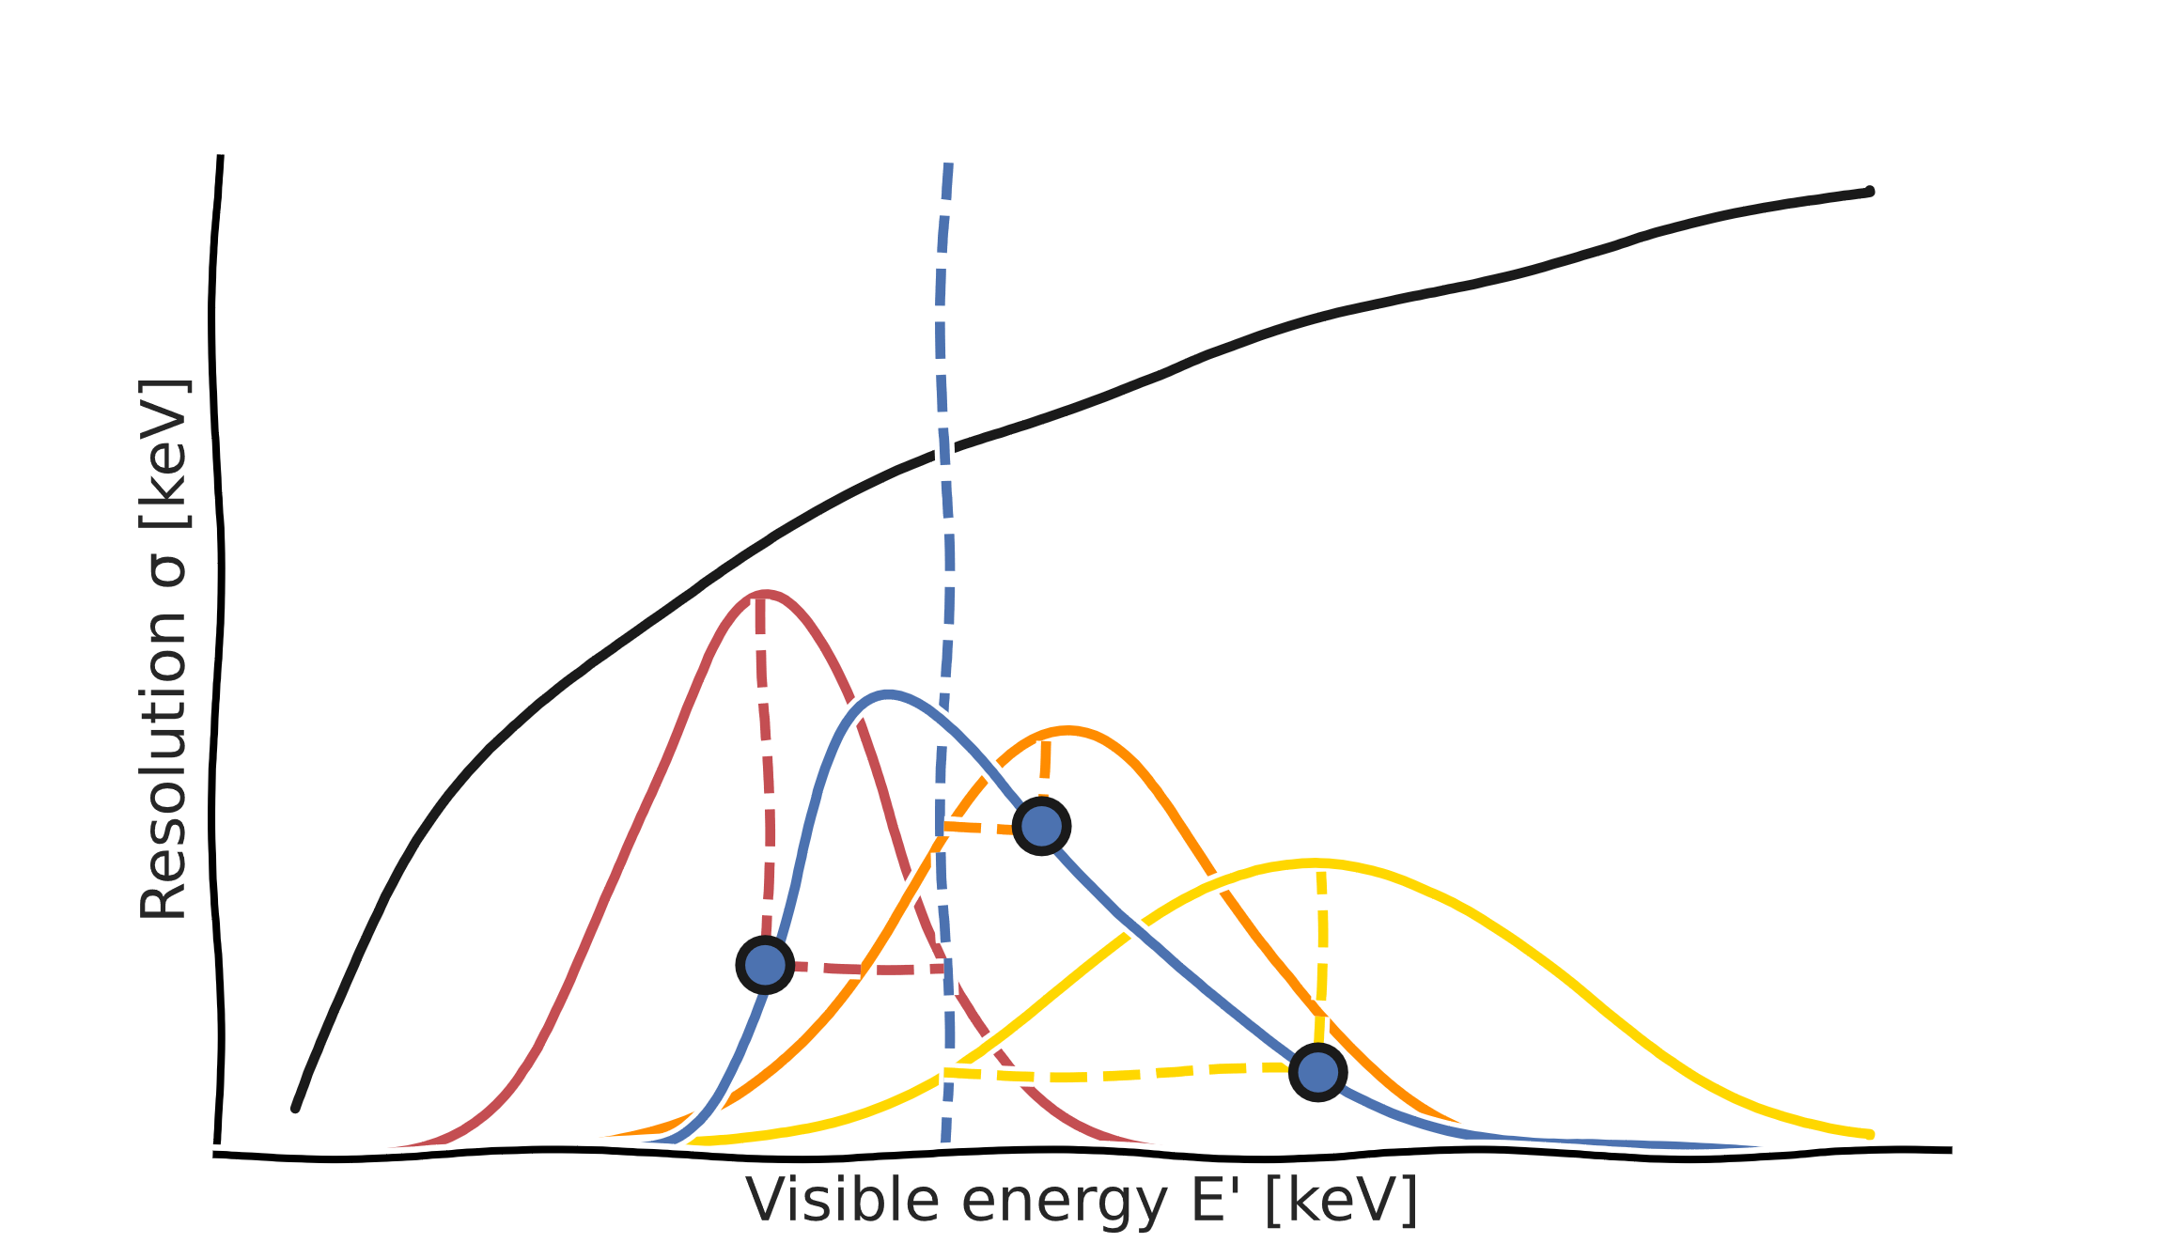
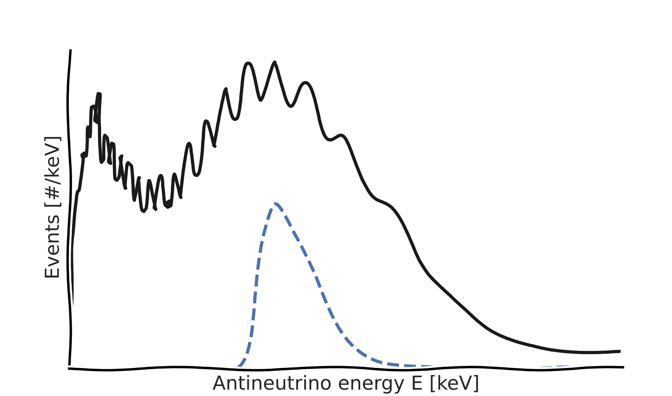
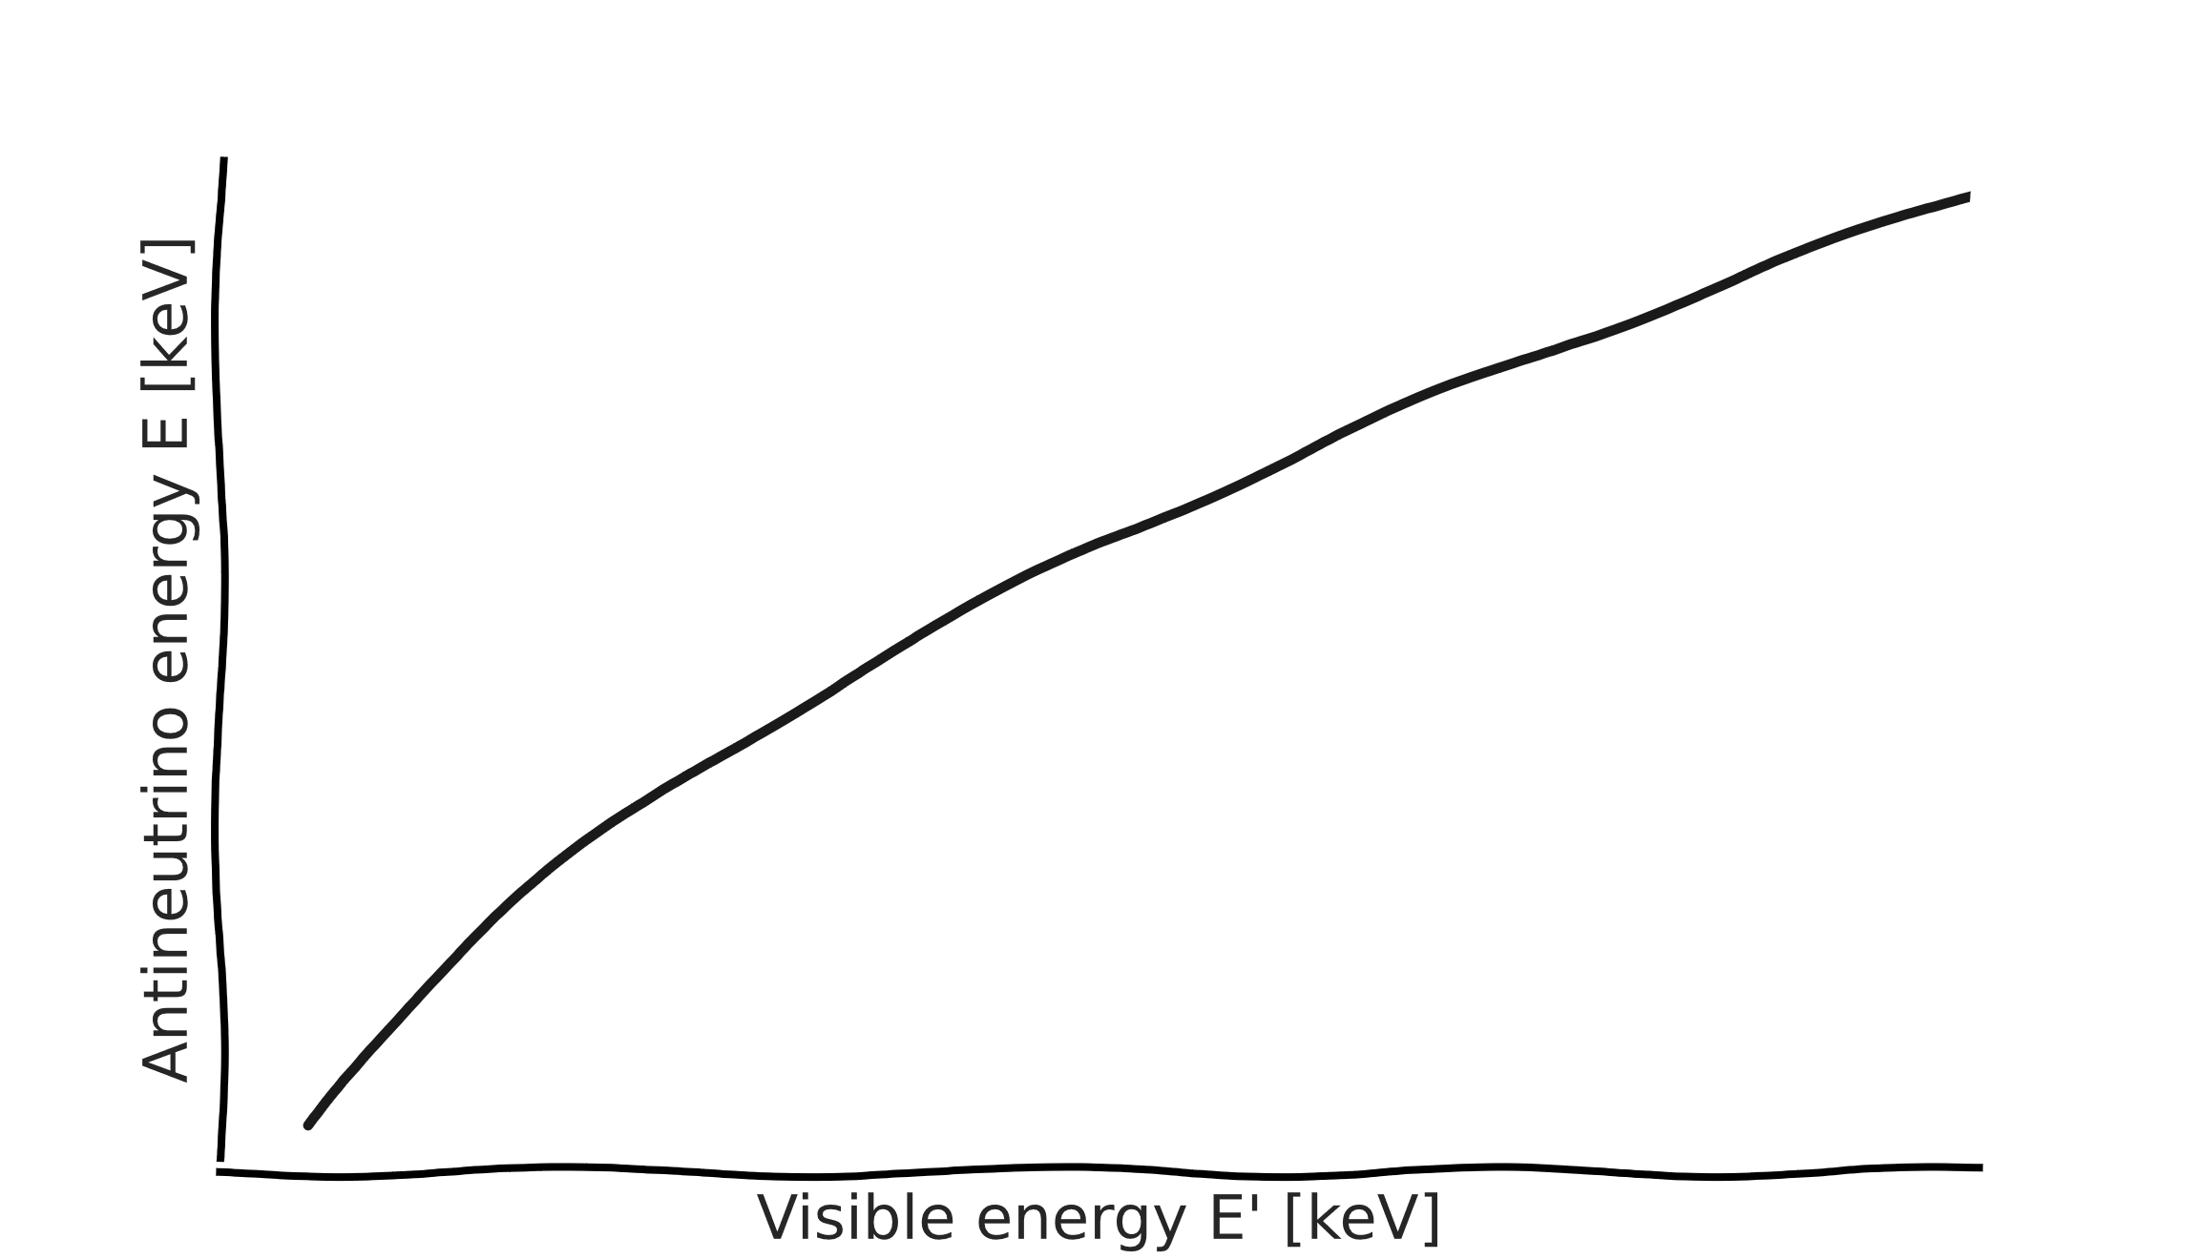
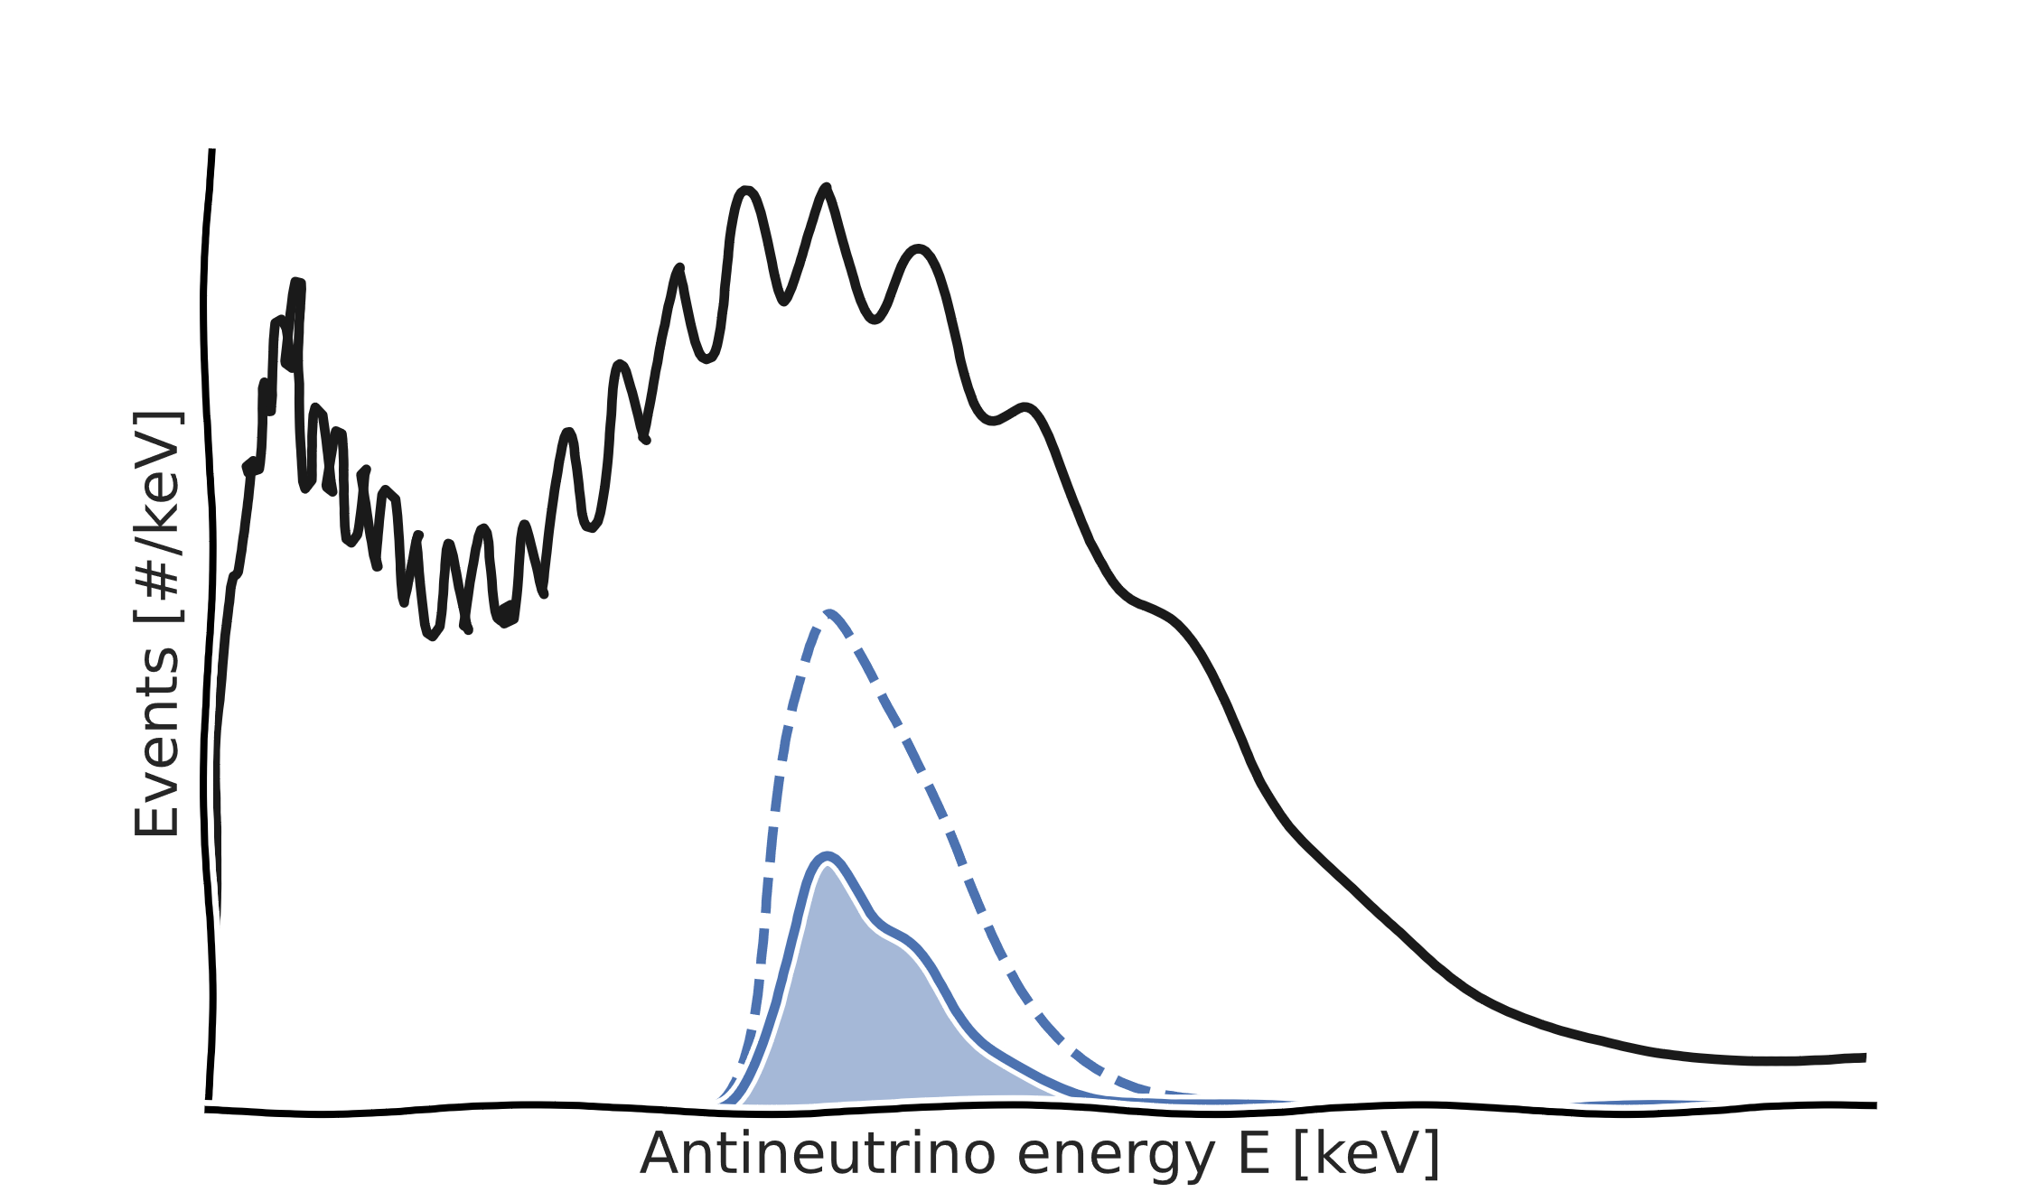
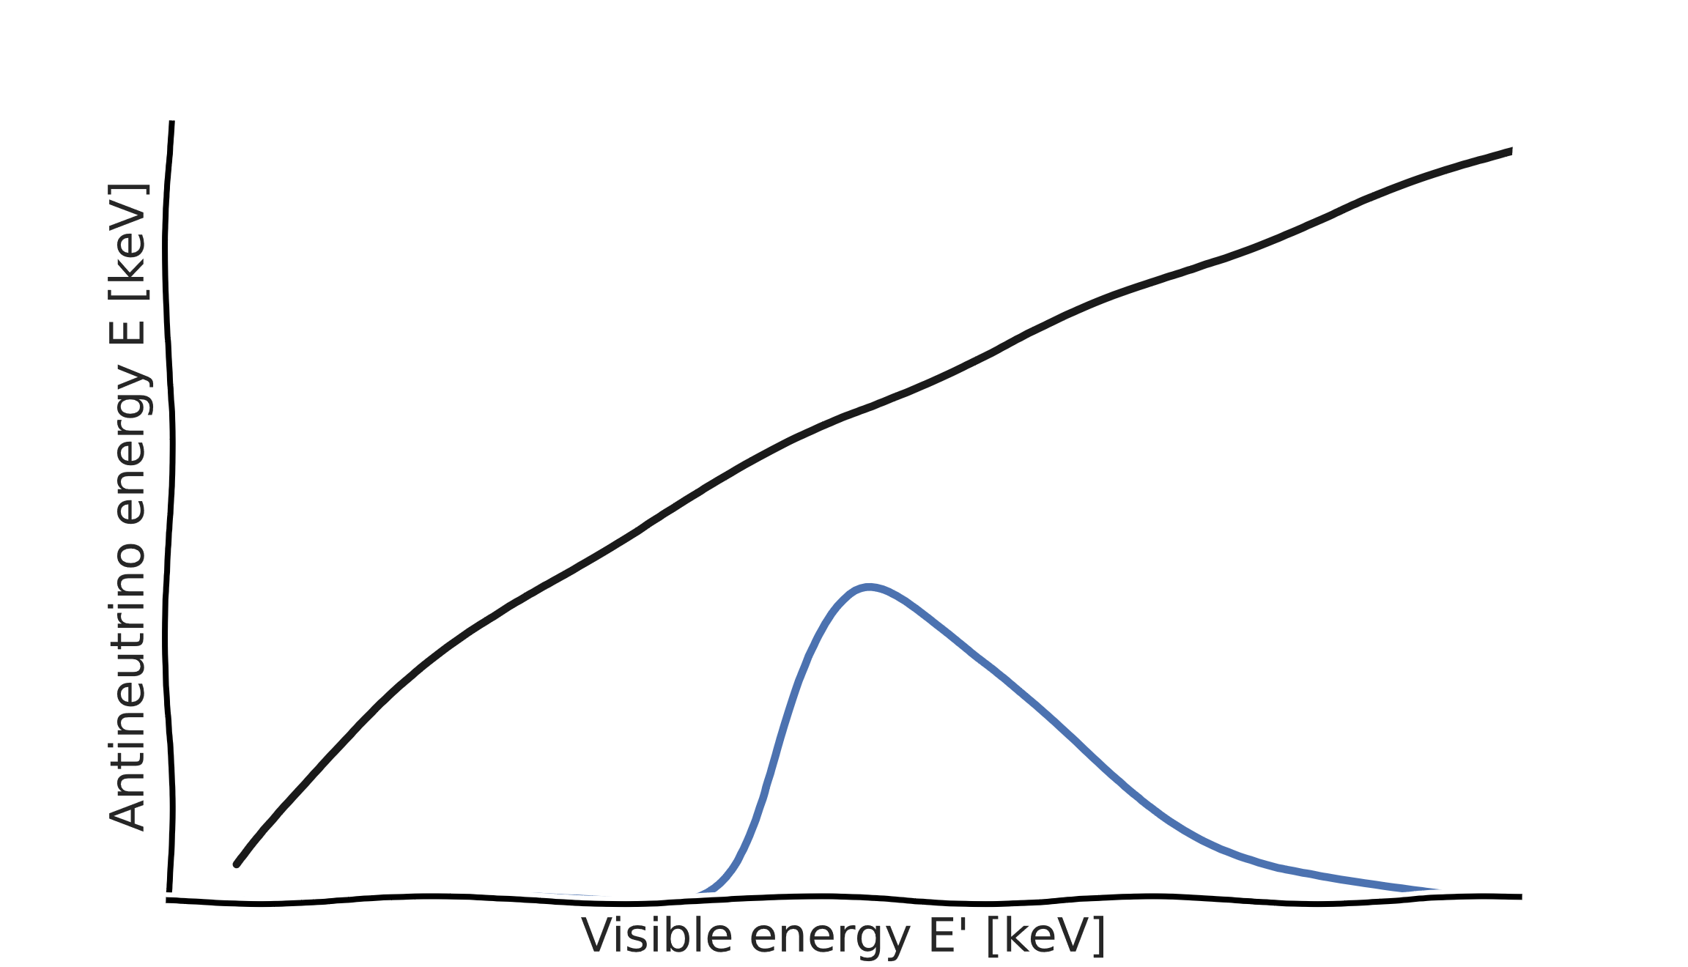
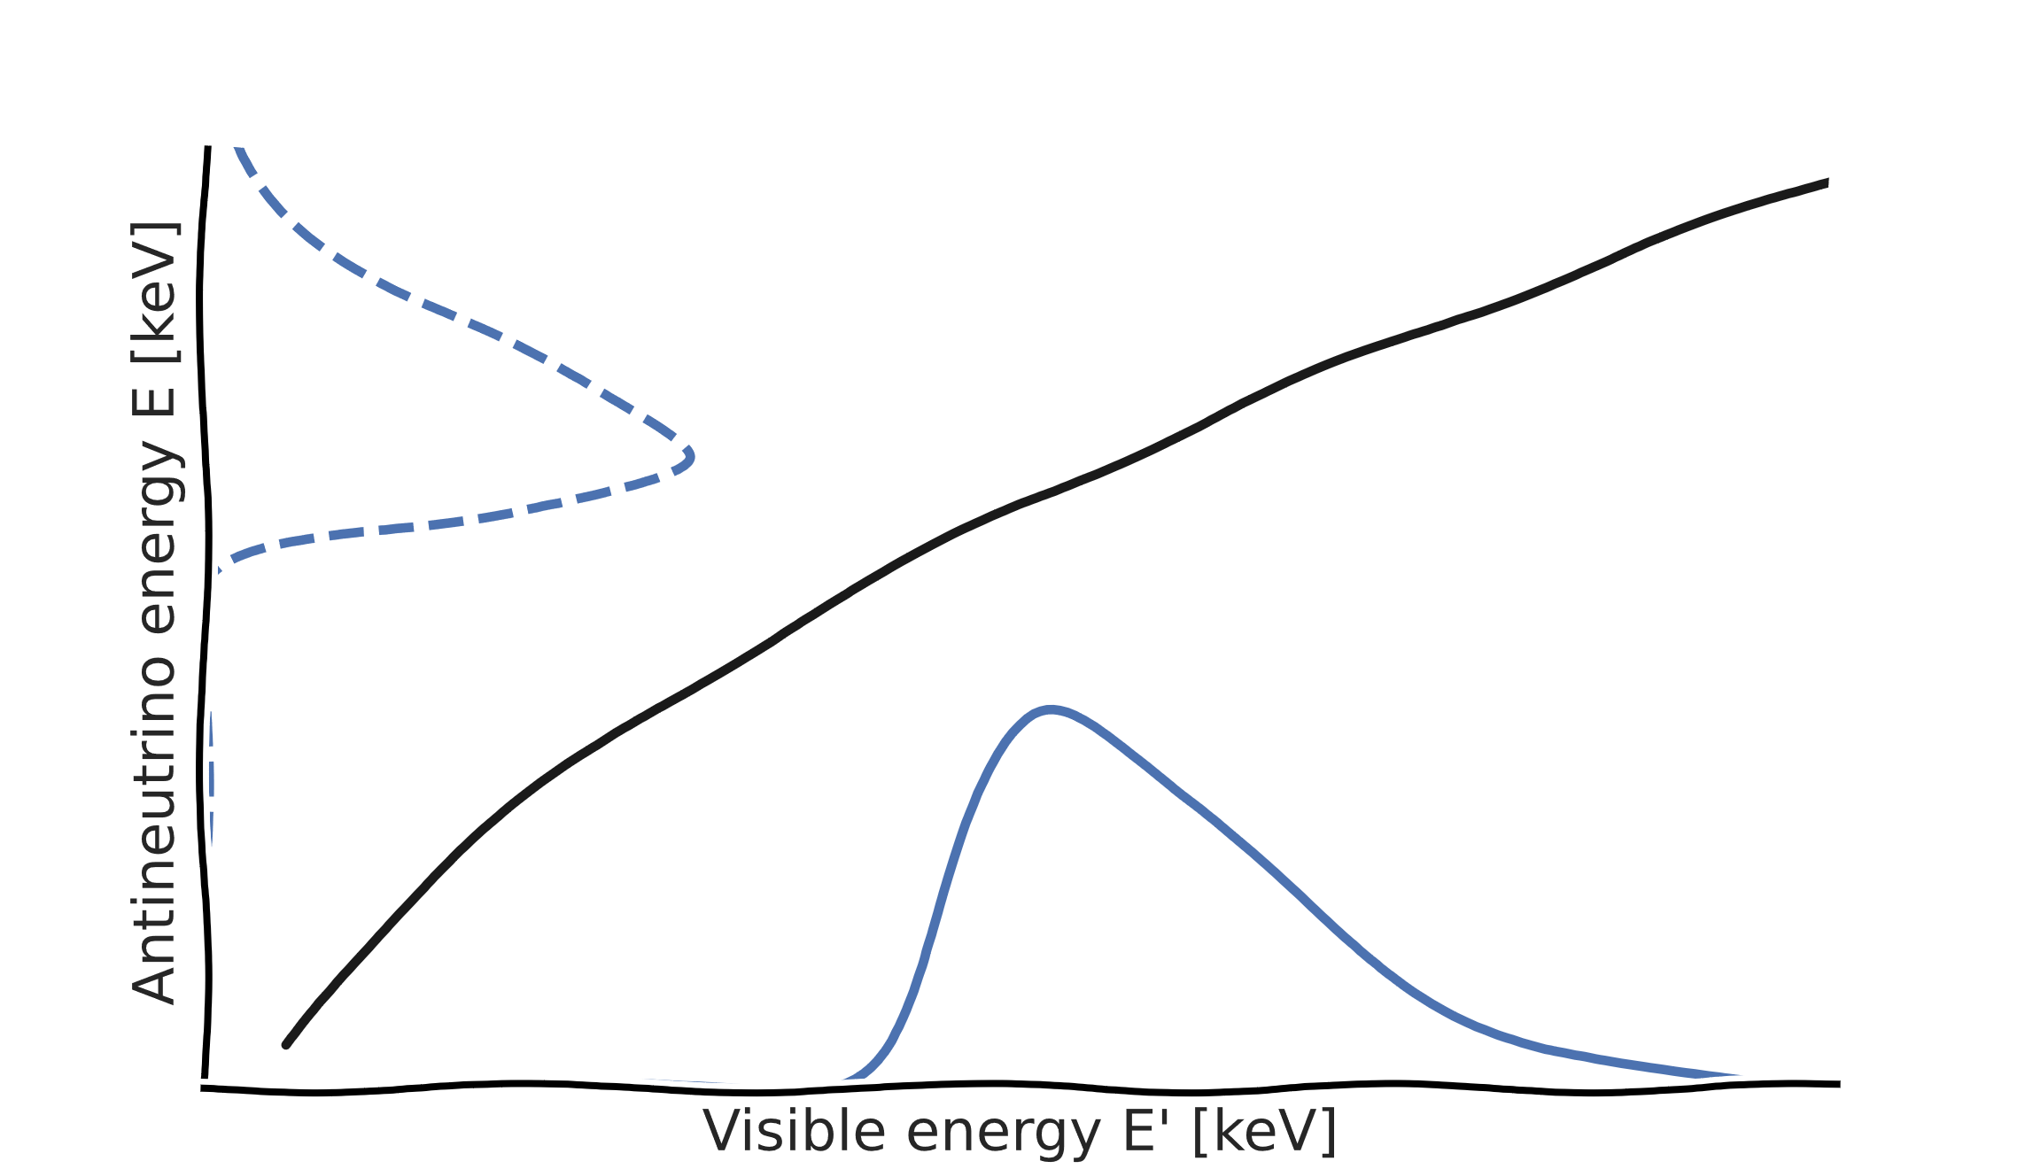
Unbinned likelihood
Data
Finally, we calculate the likelihood as:
List of reconstructed energies for measured events:
$$L\left(θ|E′\right)=\prod_{events i}{P_{i}(θ|{E′}_{i})}=\prod_{events i}{\left(\int{S\left(E_{dep}\right)⋅G\left(E_{i}^{′},E_{dep}\right) dE_{dep}}\right)}$$
$$[E_{1}^{′}, E_{2}^{′},E_{3}^{′}…E_{i}^{′}…E_{N}^{′}]$$
We can express the obtained PDF as a function of the deposited energy using our non-linearity model
The observed reconstructed energy can be caused by positive/negative energy fluctuations of a given visible energy
Model (θ)
We can thus build a PDF for the visible energy that generated the observed reconstructed energy
We can calculate the total probability $P_{i}$multiplying the PDF of the event by the PDF of our model
$$G(E_{i}^{′},E_{dep})$$
Non-linearity
$$E_{i}^{′}$$
$$E_{dep}$$
$$S\left(E_{dep}\right)$$
Resolution 𝜎 [%]
Deposited energy [keV]
Probability
$$G(E_{i}^{′},E_{vis},σ(E_{vis}))$$
$$G(E_{i}^{′},E_{vis})$$
$$G(E_{i}^{′},E_{dep})$$
$$E_{vis}$$
$$P_{i}$$
Reconstructed energy $E_{rec}$ [keV]
Visible energy $E_{vis}$ [keV]
Deposited energy $E_{dep}$ [keV]

Slide 7
Unbinned likelihood → Extended likelihood
Data
We introduce a Poisson term to account for the overall normalization:
List of reconstructed energies for measured events:
$$L\left(θ|E′\right)=\prod_{events i}{P_{i}(θ|{E′}_{i})}→\frac{λ{\text{(}\text{θ}\text{)}}^{N} e^{−λ\left(θ\right)}}{N!}⋅\prod_{events i}{P_{i}(θ|{E′}_{i})}$$
$$[E_{1}^{′}, E_{2}^{′},E_{3}^{′}…E_{i}^{′}…E_{N}^{′}]$$
Model (θ)
$$G(E_{i}^{′},E_{dep})$$
Non-linearity
$$E_{i}^{′}$$
$$E_{dep}$$
$$S\left(E_{dep}\right)$$
Resolution 𝜎 [%]
Deposited energy [keV]
Probability
$$G(E_{i}^{′},E_{vis},σ(E_{vis}))$$
$$G(E_{i}^{′},E_{vis})$$
$$G(E_{i}^{′},E_{dep})$$
$$E_{vis}$$
$$P_{i}$$
Reconstructed energy $E_{rec}$ [keV]
Visible energy $E_{vis}$ [keV]
Deposited energy $E_{dep}$ [keV]

Slide 8
Choosing an appropriate minimizer
Now that we managed to express the likelihood $L\left(θ|E′\right)$ for our model, we can use a log-likelihood cost function –ln(𝐿) to estimate the parameters of interest. There are two ways in which we can use –ln(𝐿) .
Optimizers
Samplers
Optimizers such as Minuit, look for the minimum of the provided cost function (i.e., the Maximum Likelihood ML).
They converge to a set of parameters.
Samplers such as Monte Carlo Markov Chains (MCMC), use the provided cost function to explore the parameter space.
They converge to a set of distributions. *ML values can then be extracted from the mode of the obtained distributions
Let’s visualize their behavior in a simple 2-parameter likelihood landscape…

Slide 9
Behavior of optimizers and samplers
Optimizer (as Minuit)
Sampler (as MCMC)
Likelihood landscape
PDF of parameter 1
True minimum
Parameter 2
PDF of parameter 2
Parameter 2
Converges to ML set of parameters
Converges to the params PDF
Parameter 1
Parameter 1

Slide 10
Behavior of optimizers and samplers (with local minima)
Optimizer (as Minuit)
Sampler (as MCMC)
Likelihood landscape
PDF of parameter 1
Local minimum
True minimum
Parameter 2
PDF of parameter 2
Parameter 2
Prone to local minima!!!
Not prone to local minima
Parameter 1
Parameter 1

Slide 11
Back to our goal
Study biases in oscillation parameters when fitting pseudo experiments worth 1 year of reactor data:
using standard paradigm: binned likelihood + Minuit
using binned likelihood + MCMC
using unbinned likelihood + Minuit
using unbinned likelihood + MCMC
Preliminary check - validate absence of intrinsic biases among methods:
exploit Asimov dataset as a known reference
apply all methods (Minuit/MCMC) to Asimov
Use pseudo experiments to check if biases arise when dealing with a realistic case:
different methods might show different resilience to low stats
identify method resulting in smallest bias
Not shown (backup slides)

Slide 12
Asimov dataset
NOT
A pseudo-experiment of 1 year
(~17000 reactor events)
Exposure: 1 year
N° pseudo-experiments: 200
For each pseudo-experiment, the SAME
spectrum is fitted with:
Minuit – binned likelihood (10 keV)
Minuit – unbinned likelihood
MCMC – binned likelihood (10 keV)
MCMC – unbinned likelihood
We are interested in the residuals' distribution only for the 6 free parameters:
Events per bin [#]
Reconstructed energy $E_{rec}$ [keV]
Resolution
Non-linearity
Osc. parameters
Backgrounds
0 | 1 | 2 | 3 | 4 | 5 | 6 | 7 | 8 | 9 | 10 | 11 | 12 | 13 | 14 | 15
$$a$$ | $$b$$ | $$c$$ | $$k_{B}^{1}$$ | $$k_{B}^{2}$$ | $$dm_{21}^{2}$$ | $$dm_{31}^{2}$$ | $$s_{12}^{2}$$ | $$s_{13}^{2}$$ | $$N_{rea}$$ | $$N_{U}$$ | $$N_{Th}$$ | $$N_{acc}$$ | $$N_{fn}$$ | $$N_{lihe}$$ | $$N_{α}$$
Constrained with prior at 0.5%
Constrained with DayaBay prior
Constrained with prior at 5%

Slide 13
Standardized residuals - pseudoexperiment
Minuit struggles to correctly recover the parameters and their uncertainties both in the binned and unbinned approach.
MCMC seems to correctly estimate both the parameters and their uncertainties. The distribution of residuals is perfectly compatible to the expected normal distribution.
Std. residuals $Δm_{21}^{2}$
Std. residuals $Δm_{21}^{2}$
Minuit – binned likelihood
Minuit – unbinned likelihood
MCMC – binned likelihood
MCMC – unbinned likelihood
Gauss(0, 1)
Std. residuals $Δm_{21}^{2}$
Std. residuals $Δm_{21}^{2}$

Slide 14
Standardized residuals - pseudoexperiment
Wrong uncertainty
Wrong value
Relative bias $Δm_{21}^{2}$
Wrong uncertainty
Std. residuals $Δm_{21}^{2}$
Std. residuals $Δm_{21}^{2}$
Pseudo experiment ID [#]
Minuit – binned likelihood
Minuit – unbinned likelihood
MCMC – binned likelihood
MCMC – unbinned likelihood
Gauss(0, 1)
Std. residuals $Δm_{21}^{2}$
Std. residuals $Δm_{21}^{2}$

Slide 15
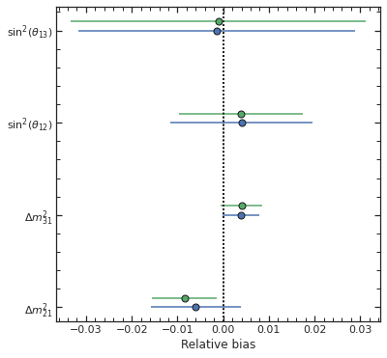
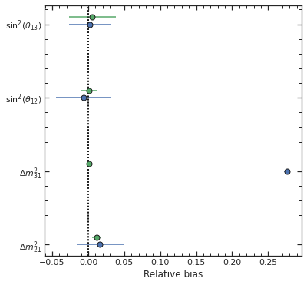
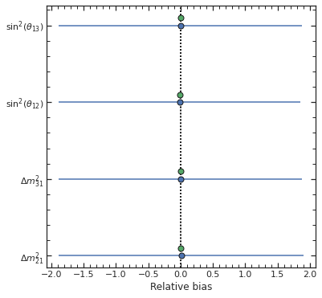
MCMC binned
Type of Minuit errors
Minuit binned
Correct
Type 1
Type 2
$$\sin^{2}{θ_{13}}$$
$$\sin^{2}{θ_{13}}$$
$$\sin^{2}{θ_{13}}$$
$$\sin^{2}{θ_{12}}$$
$$\sin^{2}{θ_{12}}$$
$$\sin^{2}{θ_{12}}$$
$$Δm_{31}^{2}$$
$$Δm_{31}^{2}$$
$$Δm_{31}^{2}$$
$$Δm_{21}^{2}$$
$$Δm_{21}^{2}$$
$$Δm_{21}^{2}$$
Relative bias
Relative bias
Relative bias
MCMC and Minuit produce comparable results, both for the best fit value and the estimated uncertainty.
Minuit fails in estimating a parameter (e.g., $Δm_{31}$) and consequently uncertainties for other parameters can be incorrect.
Minuit fails in estimating all uncertainties for all parameters. Despite this, best fit values can be correct.

Slide 16
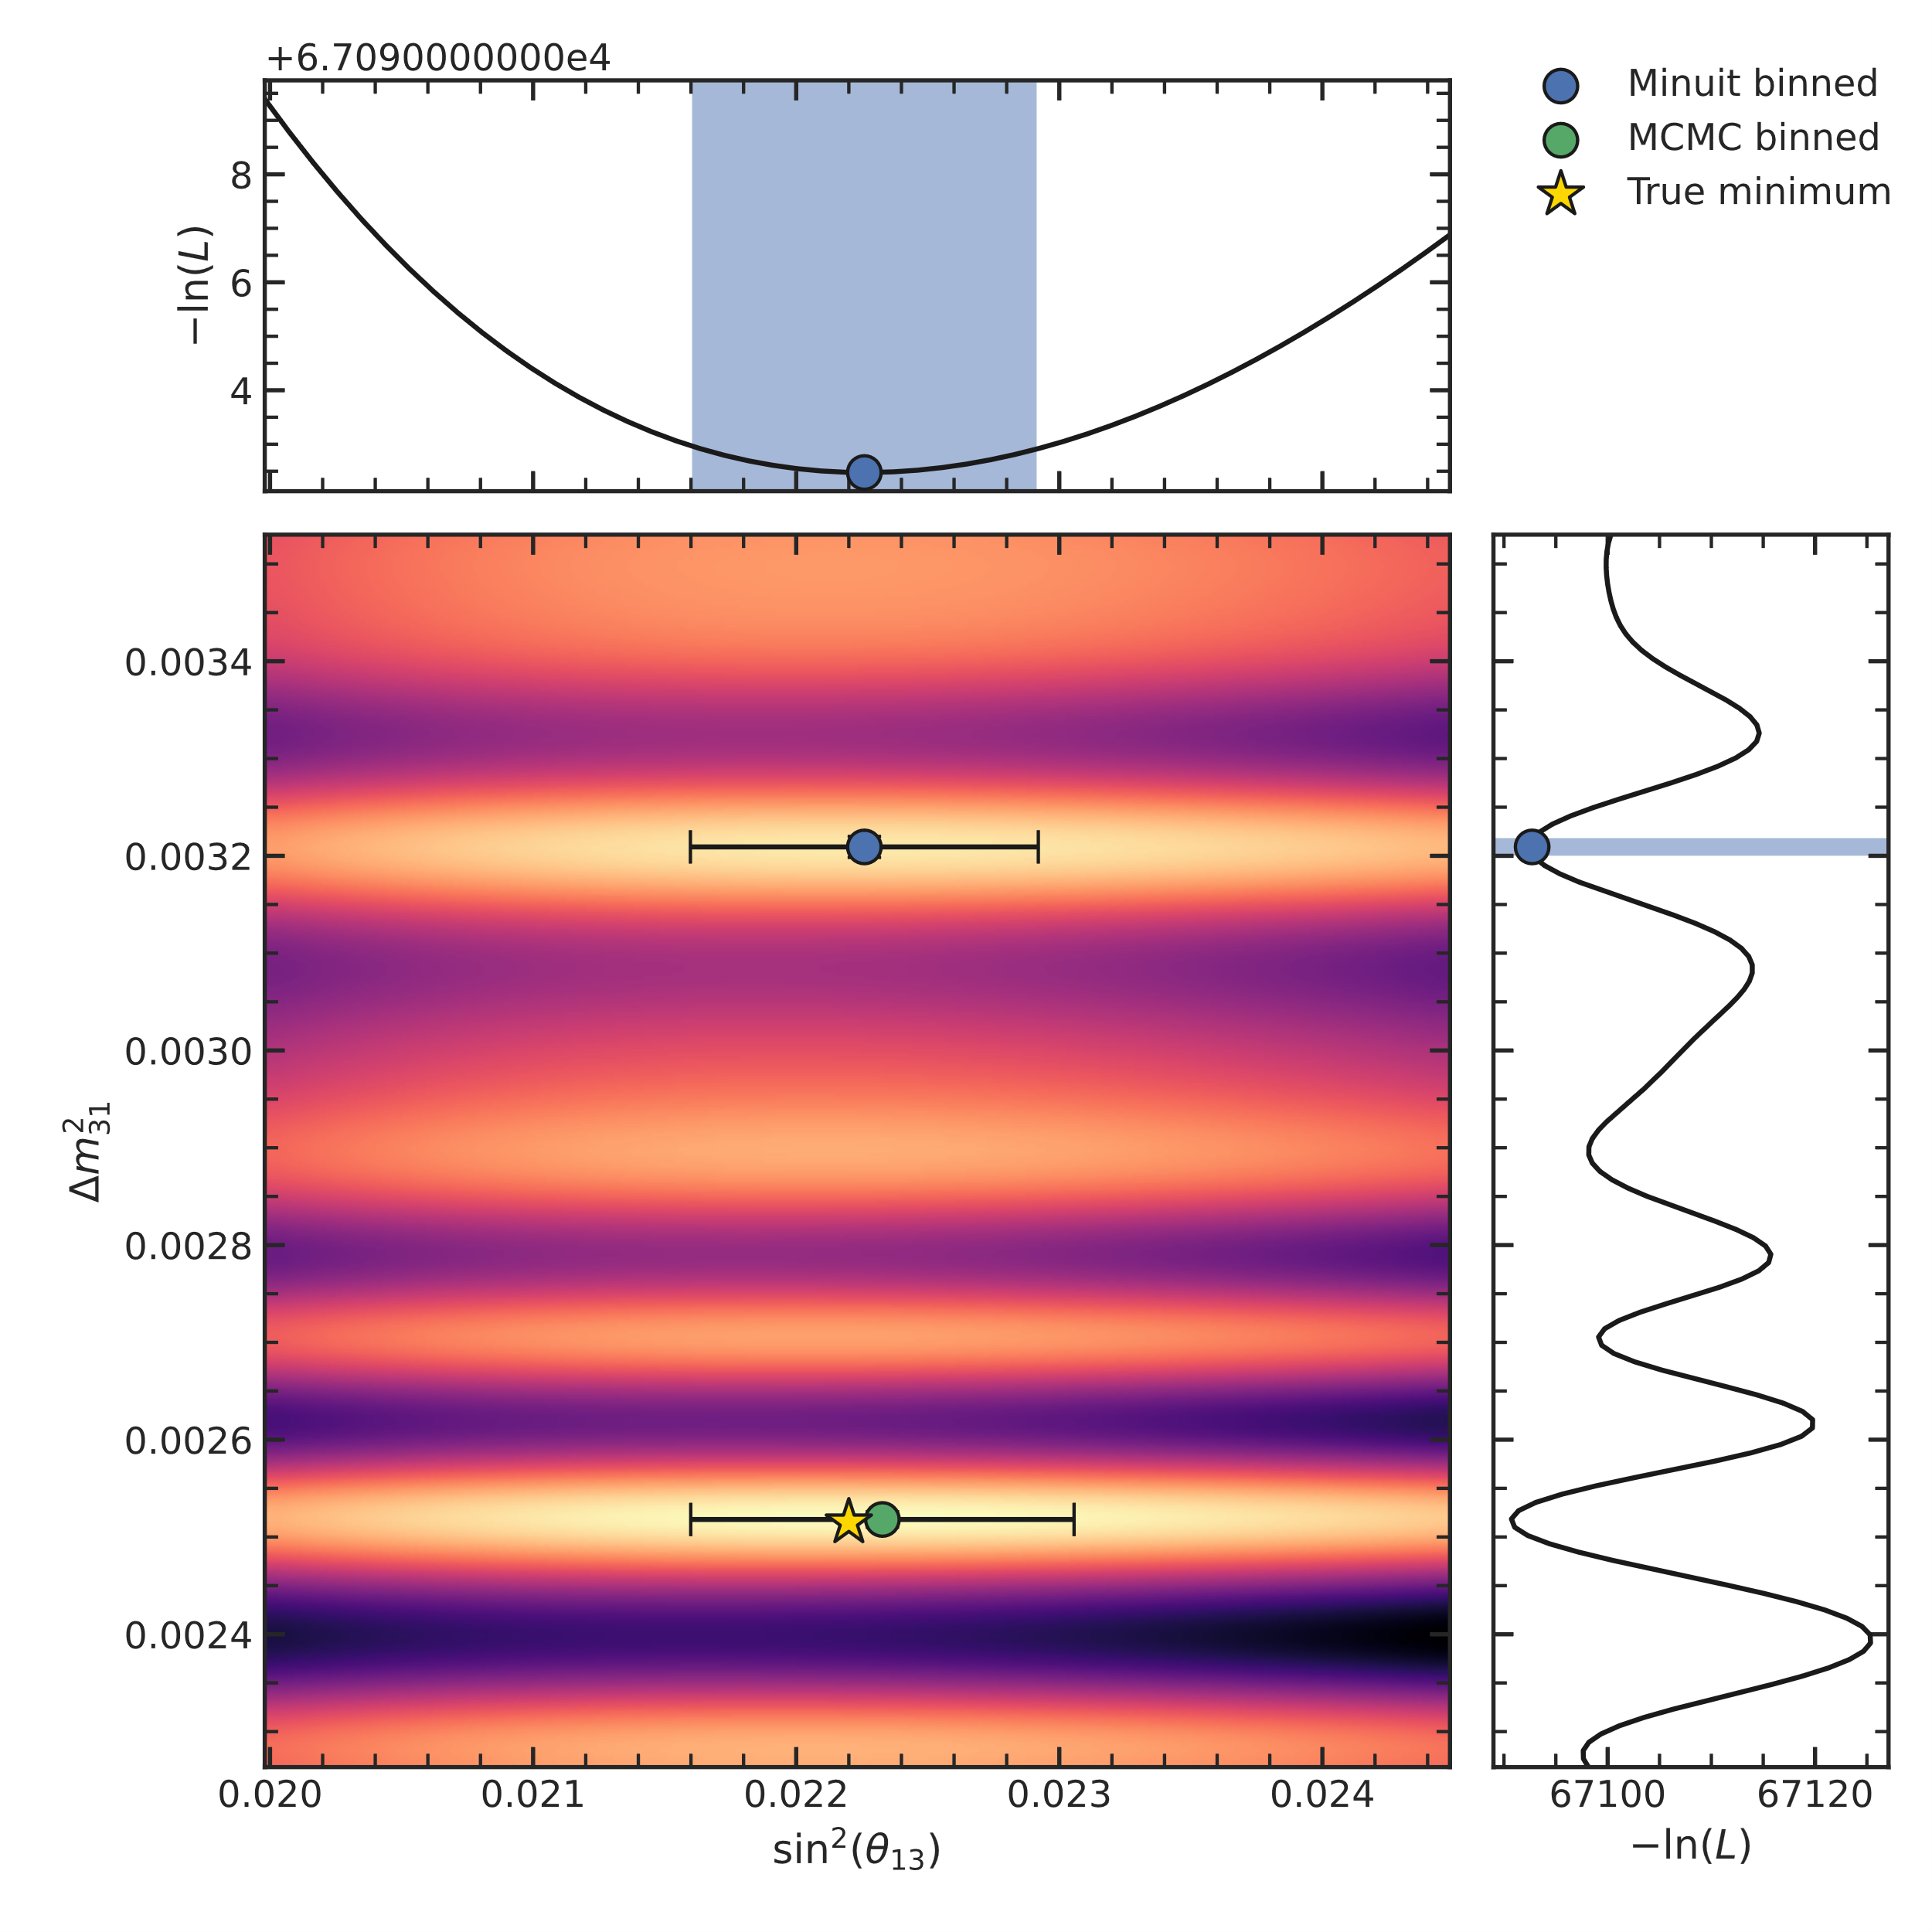
Type 1 errors
$$−\ln{L}$$
I performed a 2D likelihood scan around the minimum found by Minuit
→ Minuit is stuck in a local minimum
→ MCMC more robust to these problems
$$\sin^{2}{θ_{13}}$$
$$\sin^{2}{θ_{12}}$$
$$Δm_{31}^{2}$$
$$Δm_{31}^{2}$$
$$Δm_{21}^{2}$$
Relative bias
$$\sin^{2}{θ_{13}}$$
$$−\ln{L}$$

Slide 17
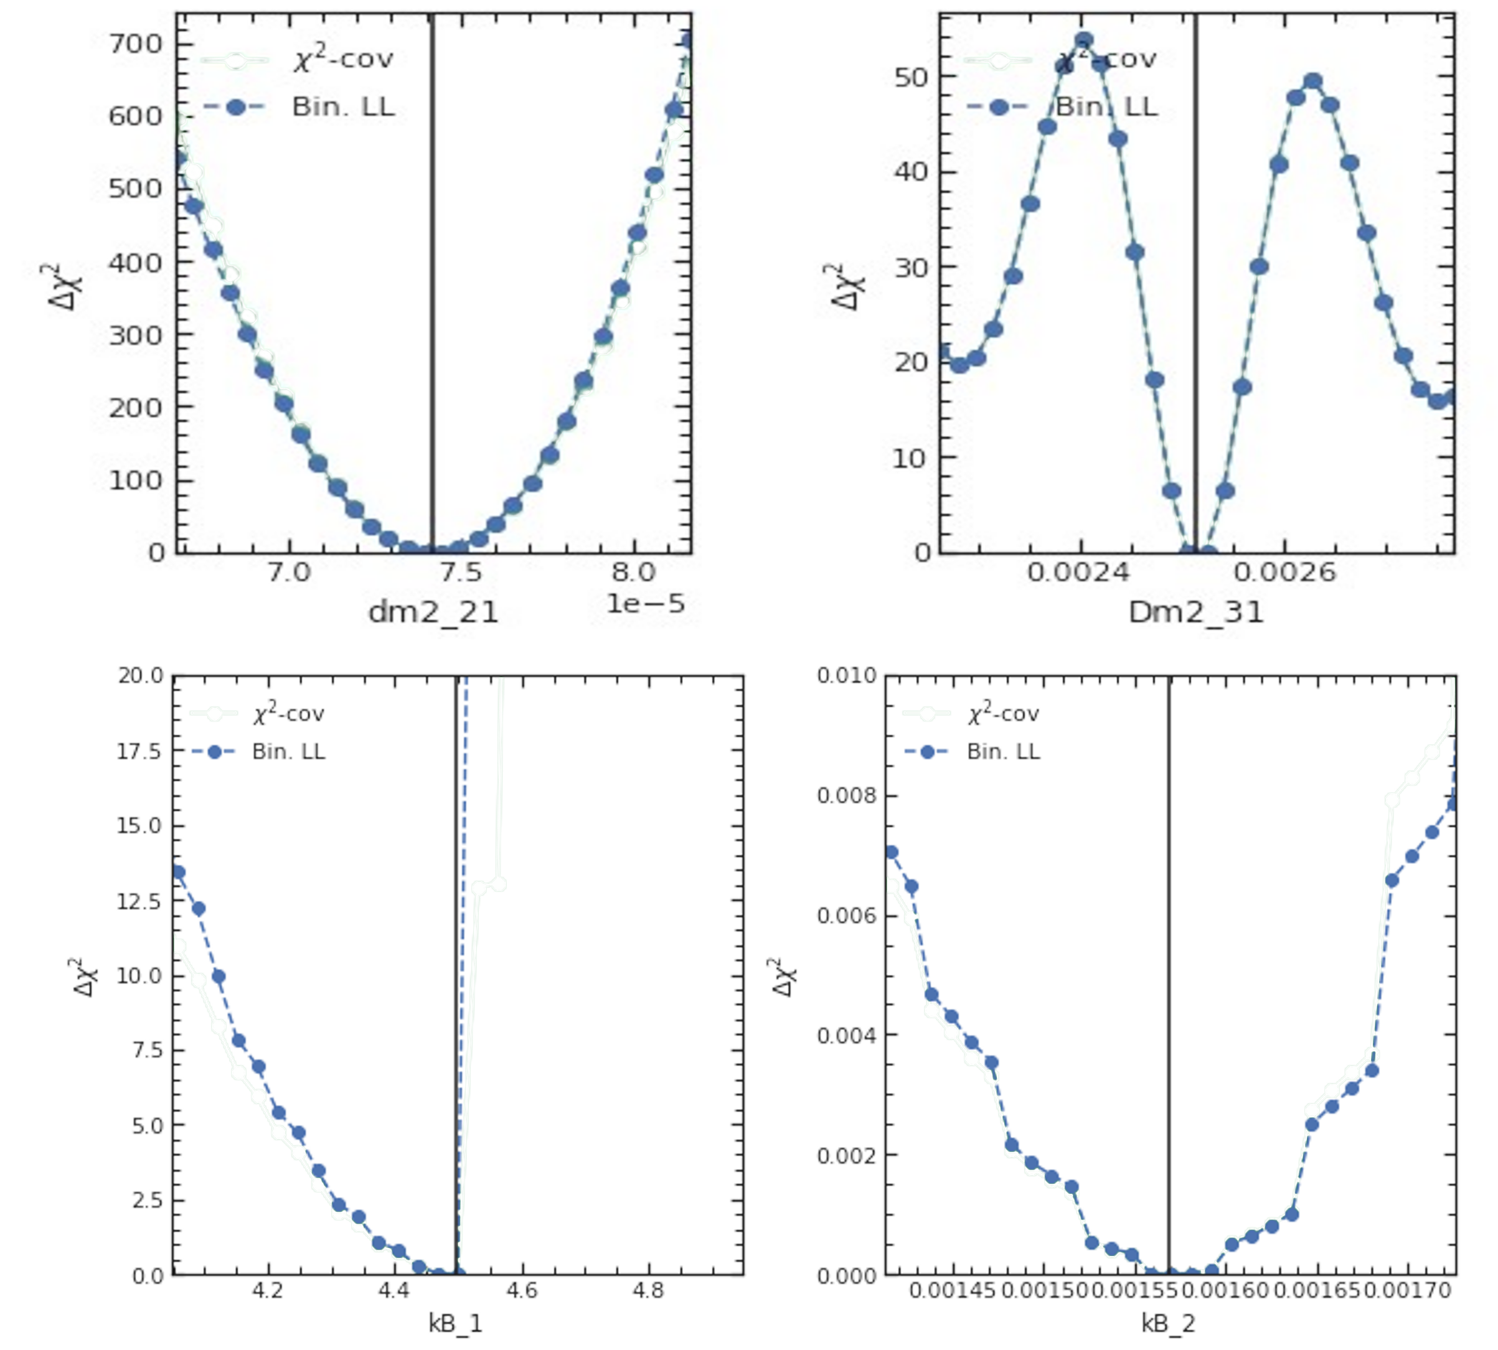
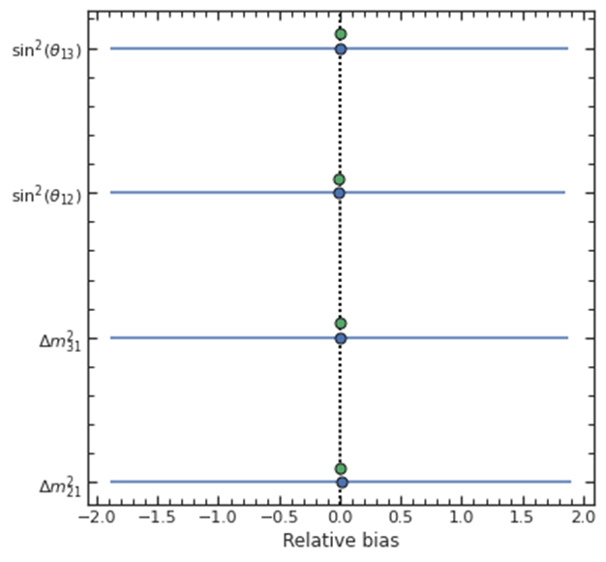
Type 2 errors
I calculated the likelihood profile around the minimum found by Minuit
$$Δχ^{2}$$
$$Δχ^{2}$$
→ discontinuity in likelihood for nonlinearity parameters while investigating the param space!
$$\sin^{2}{θ_{13}}$$
$$Δm_{21}^{2}$$
$$Δm_{31}^{2}$$
$$\sin^{2}{θ_{12}}$$
Not smooth
$$Δχ^{2}$$
Discontinuity
$$Δχ^{2}$$
$$Δm_{31}^{2}$$
$$Δm_{21}^{2}$$
Relative bias
$$k_{B}^{1}$$
$$k_{B}^{2}$$

Slide 18
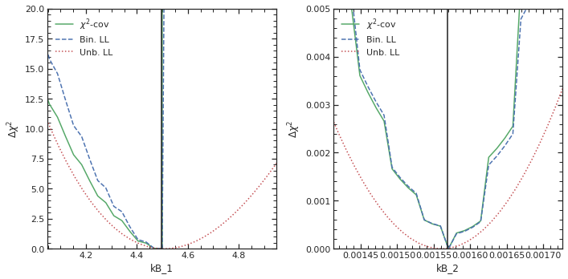
Comparing different cost functions
To understand if problems were associated to the model or the cost function, I investigated different cost functions:
$$Δχ^{2}$$
$$Δχ^{2}$$
Binned likelihood – Poisson(M, T)
Unbinned likelihood – Π P(M|T)
χ²-covariance approach – (M-T)^{T} V⁻¹ (M-T)
$$Δm_{21}^{2}$$
$$Δm_{31}^{2}$$
$$Δχ^{2}$$
$$Δχ^{2}$$
Problems are related to my modeling of the binned spectrum!
$$k_{B}^{1}$$
$$k_{B}^{2}$$

Slide 19
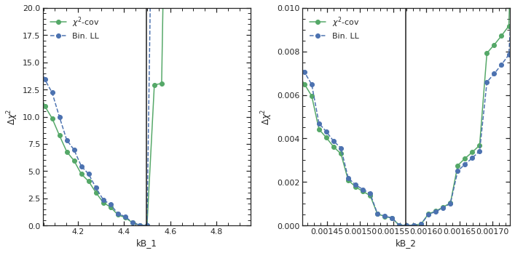
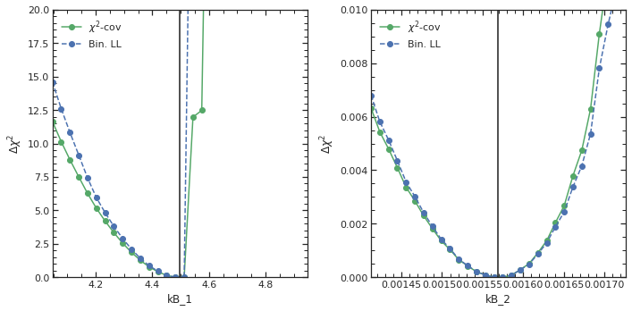
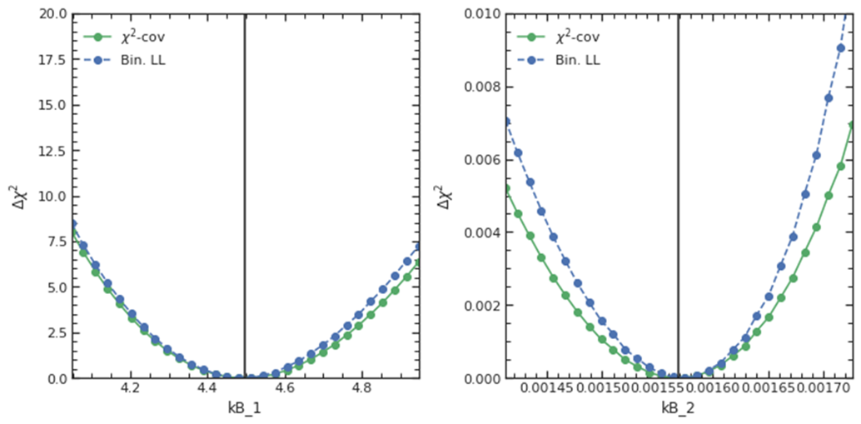
Refining my model
The “smoothness” problem was caused by the finite size of the integration:
Bin size: 10 keV Sampling size: 1 keV
→ solved by lowering the integration step from 1 keV to 0.1 keV.
$$k_{B}^{1}$$
$$k_{B}^{2}$$
The “discontinuity” problem was caused by a model misspecification (bins in which the model predicts 0 counts, but I observe >0 events).
Bin size: 10 keV Sampling size: 0.1 keV
→ solved by changing the way in which backgrounds are handled! Still WIP
$$k_{B}^{1}$$
$$k_{B}^{2}$$

Slide 20
Exposure-dependent biases (a single pseudo experiment)
10 years
1 years
0.5 years
1 month
$$\sin^{2}{θ_{12}}$$
$$Δχ^{2}$$
$$Δχ^{2}$$
$$Δχ^{2}$$
$$Δχ^{2}$$
$$\sin^{2}{θ_{12}}$$
$$\sin^{2}{θ_{12}}$$
$$\sin^{2}{θ_{12}}$$
$$\sin^{2}{θ_{12}}$$
$$Δm_{21}^{2}$$
$$Δχ^{2}$$
$$Δχ^{2}$$
$$Δχ^{2}$$
$$Δχ^{2}$$
$$Δm_{21}^{2}$$
$$Δm_{21}^{2}$$
$$Δm_{21}^{2}$$
$$Δm_{21}^{2}$$

Slide 21
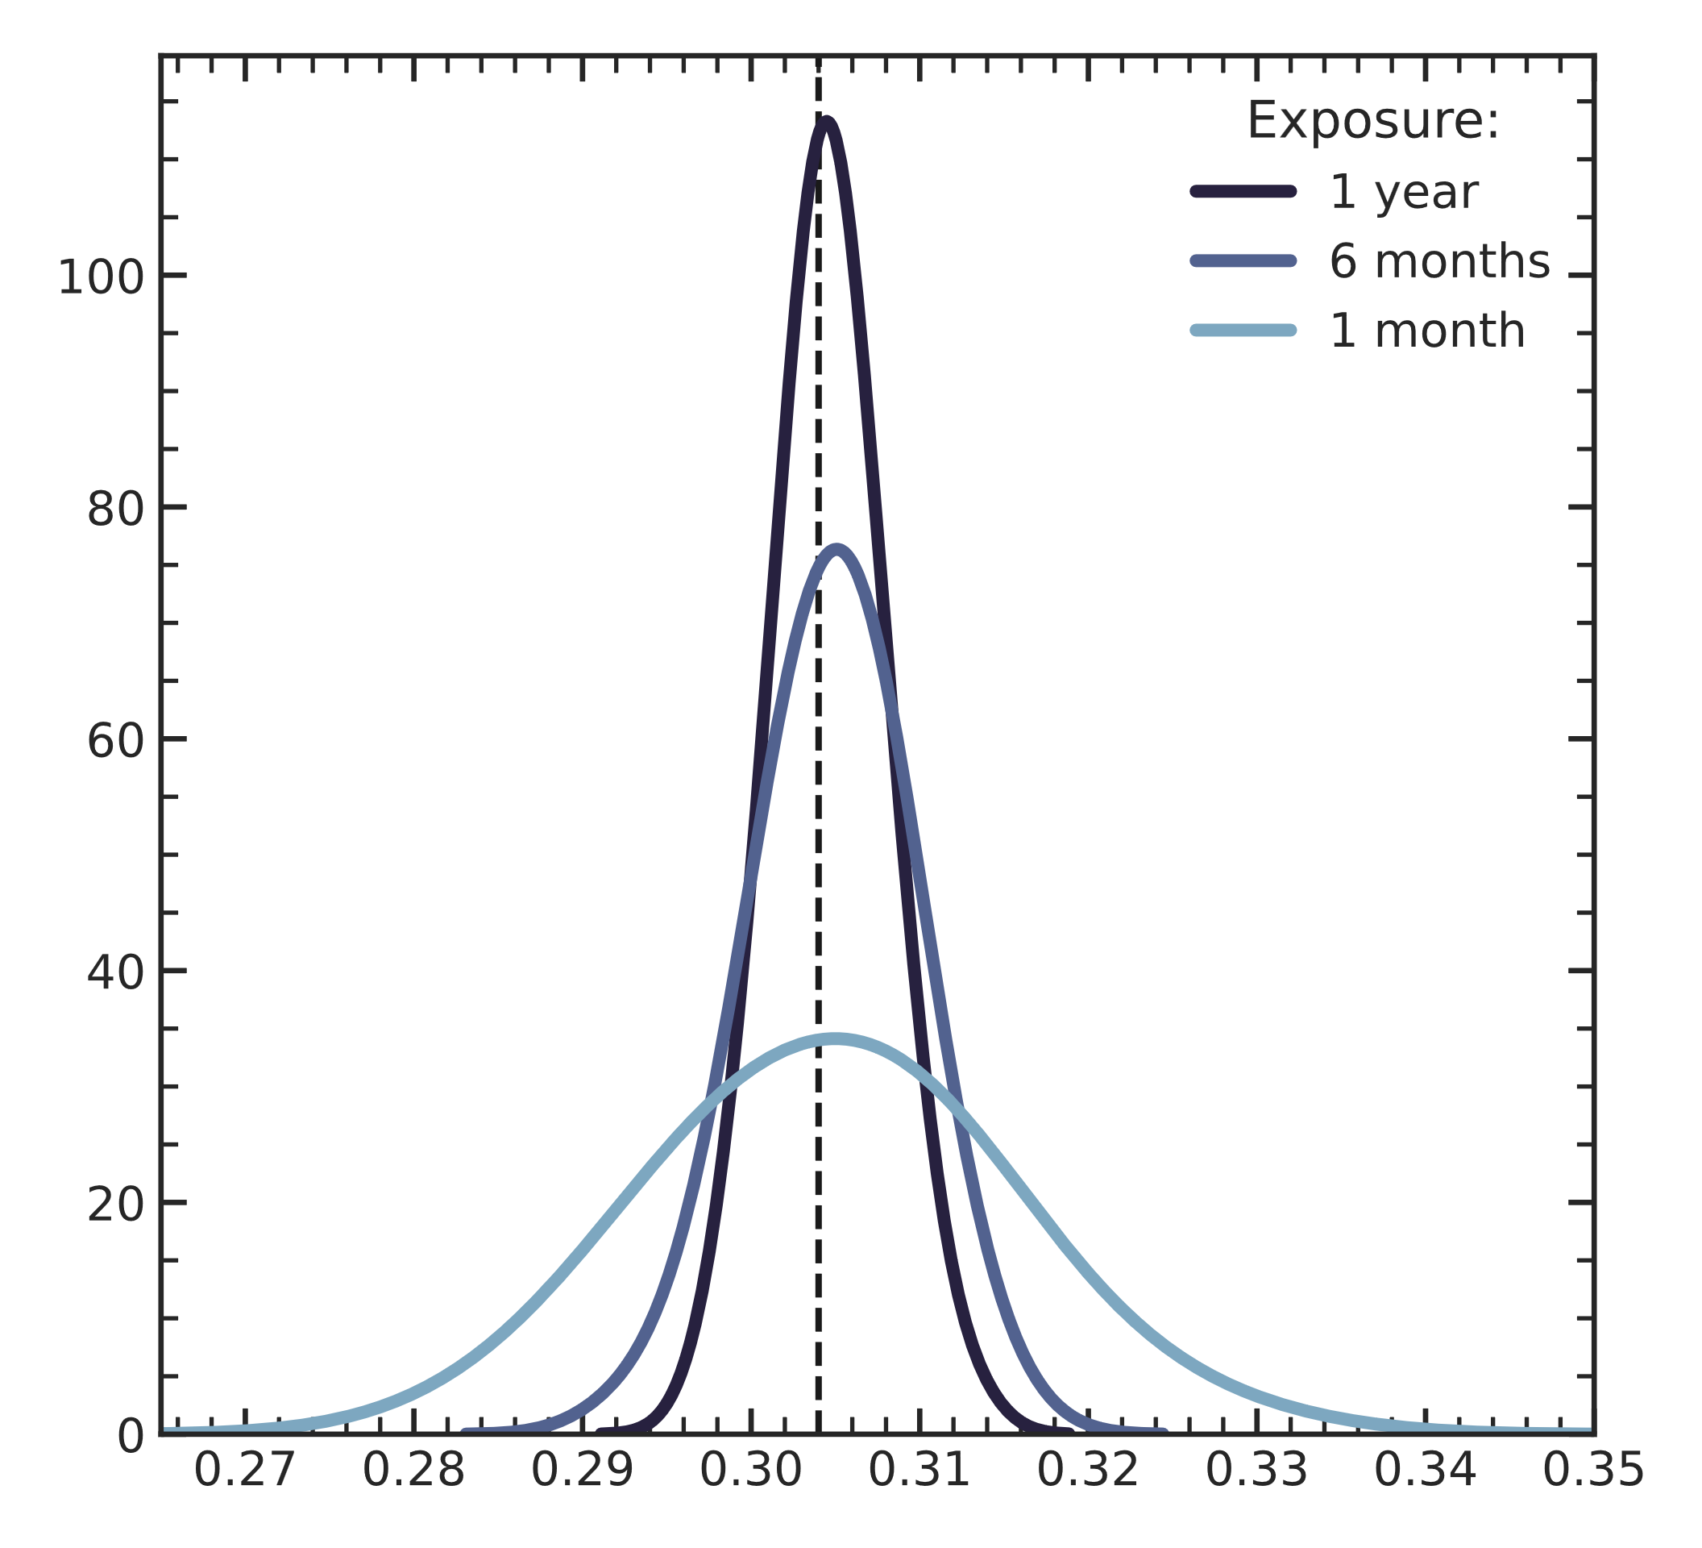
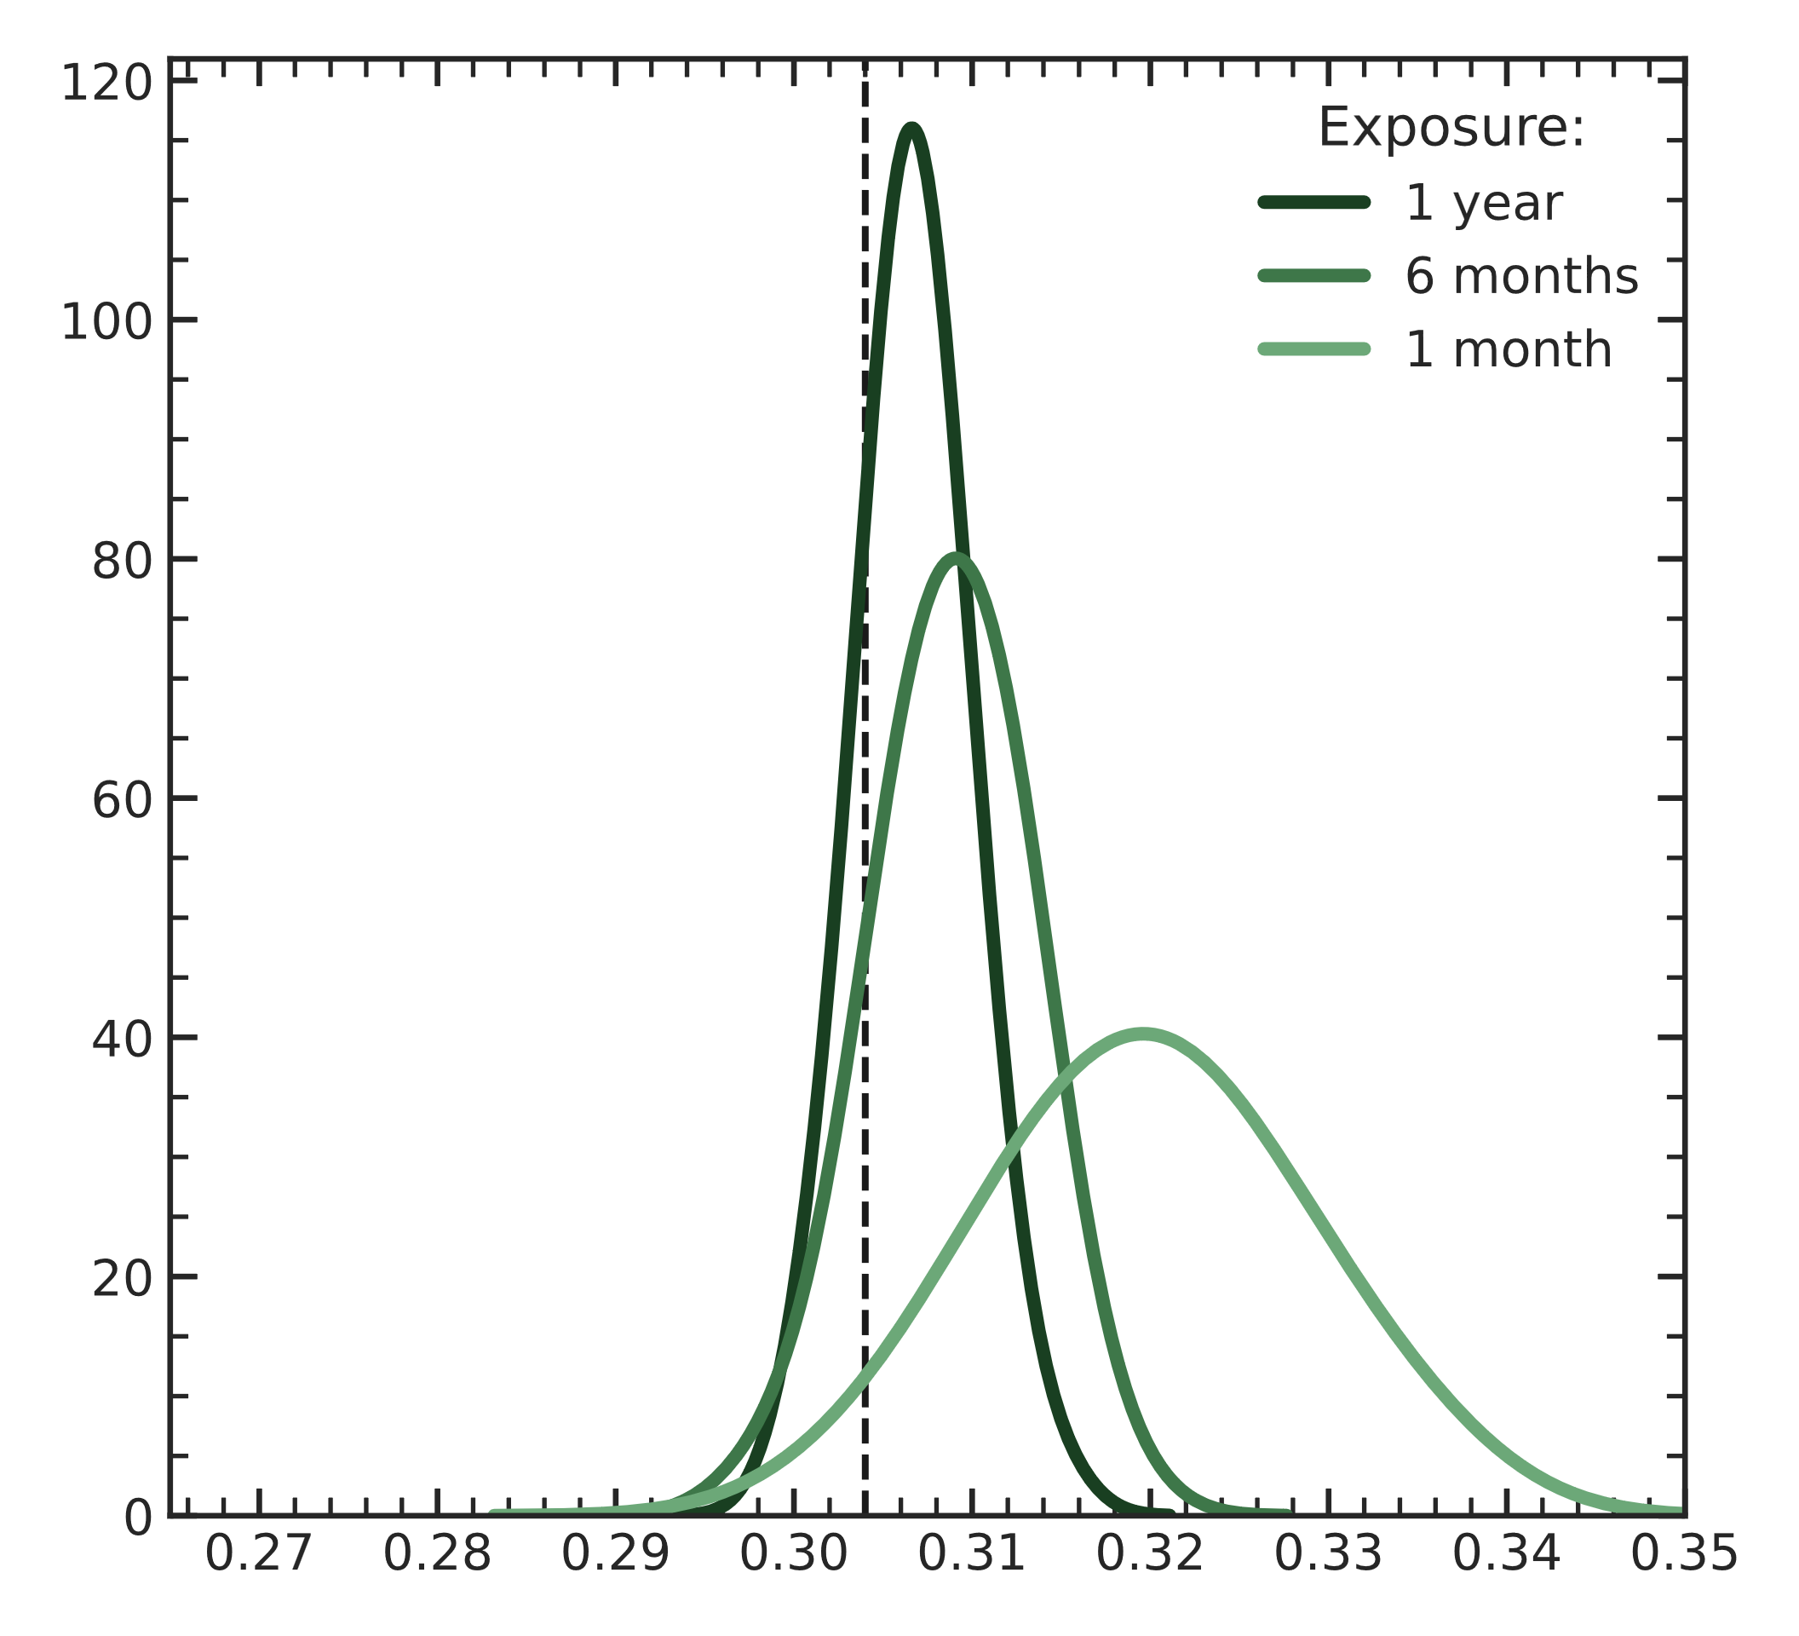
Appropriately choosing the cost function
I studied the distribution of the minima of the cost functions for different exposures on 200 pseudo exp.
Log-Likelihood
χ²
A.U.
A.U.
$$\sin^{2}{θ_{12}}$$
$$\sin^{2}{θ_{12}}$$
→ standard χ² can be biased in low statistics regime. Biases are expected when counts/bin <20 (source), i.e., for exposures <= 1 year with a 10 keV binning!

Slide 22
Final remarks
Juno sensitivity studies are usually based on a standard paradigm: (i) Asimov datasets and (ii) a binned likelihood or χ² minimized using Minuit.
We should start investigating the performances of our analyses on actual pseudo experiment datasets (after checking Asimov)
When fitting a realistic pseudo experiments worth <1 year of reactor data, the binned-Minuit approach can struggle in evaluating parameters and uncertainties.
Fitters based on samplers such as MCMC and unbinned likelihood show a better resilience to low statistics induced problems (e.g., local minima).
Next steps
Replicate oscillations parameters sensitivity results obtained by the collaboration.
Inclusion of time-dependence in the theoretical model and in the likelihood.

