Slide 1
Status of DCI and how to use it
Giuseppe Andronico
05 Maggio 2022
Milano

Slide 2
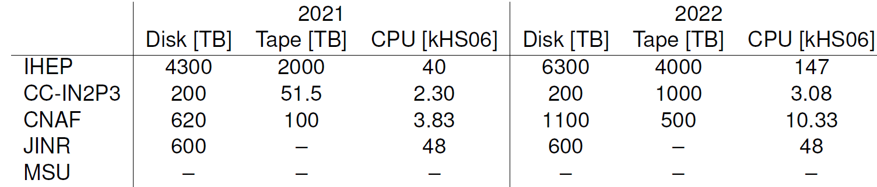
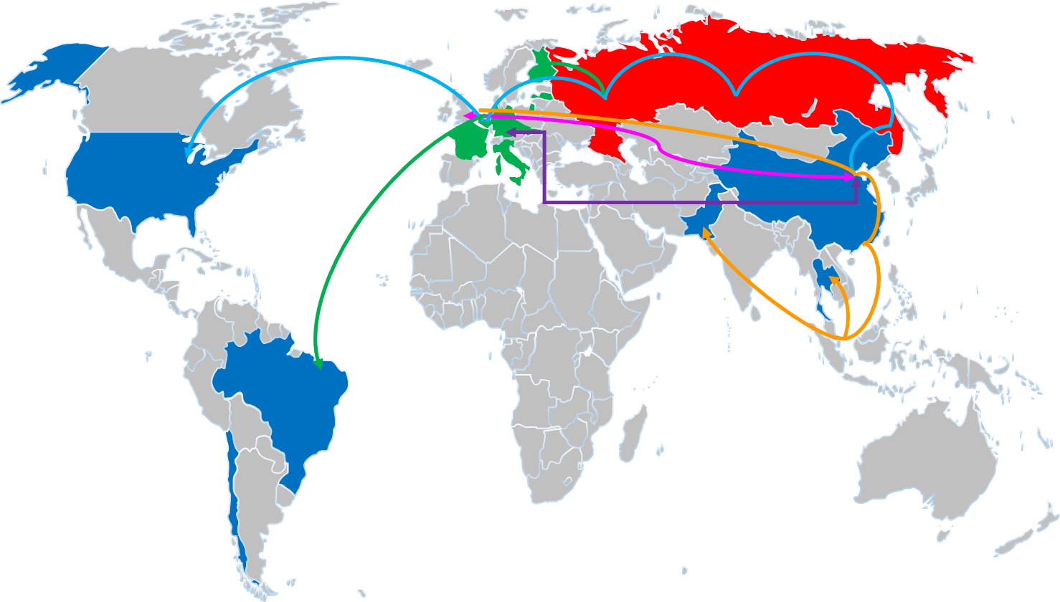
DCI overview
DCI is made from resources, services and protocols and standards
Resources
4 data centres active, 1 upcoming
Network to connect centres and users
Services
Data and SW distribution: CernVMFS, Frontier
Authentication and Authorization: VOMS, IAM (upcoming)
Job management system: WMS
Computing Element: HTCondorCE
Data Management System: DFC(Dirac File Catalogue) and RFC (Rucio File Catalogue)
Storage Element: dCache, StoRM, EOS
File Transfer Service: FTS
Web interface: DIRAC
Protocols and standards
Authentication and Authorization: X509
Data management: SRM
Data transfer:
Gridftp (End Of Life)
http (webdav)
XRootD

Slide 3
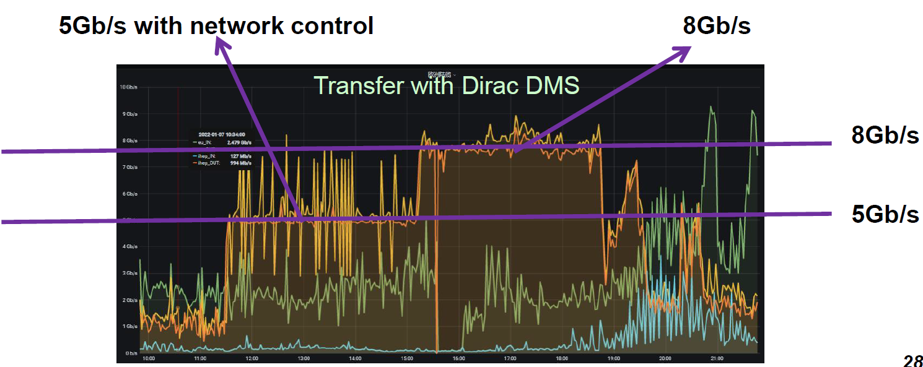
Using and testing DCI
First Data Challenge
Large transfers has been done between data centers with high quality and good speed in 2021
30TB Machine Learning examples transferred to JINR in ~17 hours,~4.7Gb/s
29TB Atmospheric neutrino transferred from CNAF to JINR in ~32 hours, ~3Gb/s
100TB calibration data, ~ 772055 files from IHEP to CNAF and JINR, ~5Gb/s
More test upcoming to be sure all is working properly:
Tape test: to verify that raw data migration to tape will happen flawlessly
Network test: to better understand networks we are going to use and be sure configurations fit with our needs
Readiness for data taking: to simulate data taking and check that all the parts will work properly
Atmo examples transferred from CNAF to JINR
ML examples transferred to JINR

Slide 4
Upcoming
Some more new services needed to have DCI fully operational:
Monitoring: to keep all the several parts under observation
User support: to be ready to react when users or monitoring detect problems
Operations: to fix problems found from monitoring and users; to improve DCI
DCI is been kept updated with WLCG
To this aim we are working to integrate:
RUCIO, improved Data Management System with more features, already used from several other HEP experiments like ATLAS, BELLE II
IAM, an improved authentication and authorization model that will replace VOMS (End Of Life)

Slide 5





Data flows proposal
IHEP will receive data from experimental site and store them in master repository. At IHEP will run fast calibration and prompt reconstruction
IHEP main repository will be automatically replicated at CNAF
From CNAF data will be copied also to JINR
CC-IN2P3 will maintain a copy of part of the data at CNAF with the chance to access data physically at CNAF
JINR data will be accessed from MSU resources
Flows are bidirectional: data produced in European data centers (secondary reconstruction, analysis, simulations,…) will be replicated in the other European data centers and at IHEP

Slide 6
JUNO data volume
Estimated:
Raw data: 2PB/year
Reconstructed data: 200 TB/year
Analysis data: 20 TB/year

Slide 7
Registering in DCI
Registering in JUNO VO managed by VOMS.
Needed steps ¹:
Obtain a X509 certificate
  You have to use your personal browser
  For INFN follow instructions here: https://wiki.infn.it/cn/ccr/x509/home/utenti/personale
Extract certificate from browser and prepare to use it ¹
Register on JUNO VO hosted on https://voms.ihep.ac.cn:8443
¹ https://juno.ihep.ac.cn/cgi-bin/Dev_DocDB/ShowDocument?docid=7295

Slide 8
Using DCI: where I can access it
Command Line Interface
  User Interface: Computer you can access at data centres configured to be accessed via ssh
  You have to copy your certificate here: then, obtain a proxy, a sort of pass to access DCI resources
    source /cvmfs/dcomputing.ihep.ac.cn/dirac/IHEPDIRAC/v0r2-dev11/bashrc
    voms-proxy-init --voms juno or dirac-proxy-init –g juno_user
  Here you can browse files and submit jobs
  Details and examples in ² and in ³
Web interface (DIRAC)
  In the same document on Slack some examples on how to use DIRAC web interface
² Slack JUNO Italia (in channel Sniper, look for Riccardo Bruno slides posted on March 24, 2021)
³ https://juno.ihep.ac.cn/cgi-bin/Dev_DocDB/ShowDocument?docid=5105

Slide 9
Using DCI: data management
Files in DCI are composed from:
Physical File Name, that specify where physically the file is
Logical File Name, a sort of short name that can refer to several PFN ( the different copies in data centres)
LFN can be searched in file catalog to obtain PFN
PFN are used to actually perform file operations: listing, creating directory, changing directory, changing permissions and ownerships, copying files, remove replicas, remove all
Metadata can be implemented to provide additional info, also to improve search capabilities
⁴ https://juno.ihep.ac.cn/cgi-bin/Dev_DocDB/ShowDocument?docid=7288 slides and video

Slide 10
Using DCI: job management
When submit a job, DCI looks in all available resources; in this moment this means 4 data centres
Usually you have to describe your job using a jdl file like this ²:
Submission return a job identifier needed afterwards to check status and retrieve output
In this example a very simple job, much more complex submissions are possibile using all jdl capabilities
Xiaomei Zhang developed a tool suited to simply submit JUNO jobs, called JSUB ⁵
JobName = "mysimplejob";
Executable = "/bin/bash";
Arguments = "test.sh";
StdOutput = "stdout.out";
StdError = " stderr.err ";
InputSandbox = { "test.sh" };
OutputSandbox = {"stdout.out","stderr.err" };
VirtualOrganisation = "vo.juno.ihep.ac.cn";
⁵ https://juno.ihep.ac.cn/cgi-bin/Dev_DocDB/ShowDocument?docid=7303 slides and video

Slide 11
Training activities
Hands on training in Nantes, the day before EU JUNO Collaboration Meeting, May 16

Slide 12
Next improvements
Capability to open a data file from DMS without download it
  But it requires to have a copy of the data in all data centers
Move AAI from VOMS to IAM
Add Rucio DMS
Monitoring
Operations
User support

Slide 13
Manpower required
People involved in DCI are not any more enough
DCI group is urgently looking for sysadmins and developers
DCI will mainly rely on data centres collaboration to find people need to operate in production
Also, we need volunteers for deploying and testing user support and operations:
  Physicist, interested in better understand how DCI works, are more than welcome
  People already involved in other shifts that can dedicate some of their time
  Distributed in different time zones
  In parallel with principal activity
  To be trained (also this must be developed and tested)
  To operate in shifts
    6 to dispatch tickets
    6 to handle known and tracked problems or to allert experts

Slide 14
Thank you
Any question?

