Slide 1
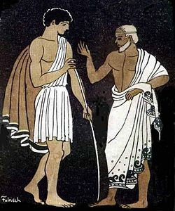

Fellini Meeting
30-31 May 2022 Ferrara
A FELLINI Mentoring Programme (MP)
Maria Rosaria Masullo – INFN Napoli

Slide 2

Why a mentoring program inside FELLINI project
From Fellini GRANT Agreement: “The FELLINI fellowship programme is a new, high-quality fellowship scheme based on a modern research and training approach, which aims at research excellence and promoting researcher mobility and training. FELLINI combine best practice found across the EU with a number of innovative elements that shall provide all Fellows with an ideal basis for their future careers, preparing them for a wide range of career options.»
Providing advice on career paths, helping and developing career paths, and more
Managerial experience
Scientific training
Inclusive leadership training
Secondment in a different institute
INFN supervisor + External contact person
Project managing training
Soft skills: communication& outreach training, others
MENTORING PROGRAM
mentor

Slide 3
Mentors/Tutors
The word itself was inspired by the character of Mentor in Homer's Odyssey. In ancient Greek (Μέντωρ) he is a character of Greek mythology, son of Alcimo. Though the actual Mentor in the story is a somewhat ineffective old man, the goddess Athena takes on his appearance in order to guide young Telemachus in his time of difficulty.
Mentor is different from a supervisor/tutor
A mentor intentionally focuses on building quality relationships, sharing life experiences and positive views on making the most out of a person’s future.
A tutor focuses on short term outcomes whereas mentoring improves the young person’s capabilities for life long learning.
Mentoring is multidimensional and involves more than the academic part of a person the way tutoring does—it concerns a young person’s life.
A tutor assists someone with learning a new process or concept, whereas a mentor goes far beyond the role of a tutor.

Slide 4
Mentoring programs: support the career of young people
Formal or informal, mentoring was born as a practice to support and guide young people (mentees) in their professional and personal development through the direct relationship with a senior person (mentor) who acts as a guide, from which to collect information, get in touch with new networks
Over time, in some realities, especially in Germany, it has become a tool to change some ways of working, where seniors, by supporting young people, change something in their way of being managers of groups, departments, etc (in a certain sense the institution generates itself).
Mentors have a central role
Many progams are now devoted to women: gender mentoring
Very new: gender transformative mentoring (like the INFN program for women and now also for young men where the goal is to trigger transformative practices towards gender equality in academia and research institutions)

Slide 5
Mentoring programmes
Several different approaches
Instrumental mentoring programmes focus strictly on people’s careers; they assist young people to manage their paths within existing parameters that fit the needs of the organisation without interfering with its gendered structures. The mentors transfer their knowledge and experience and/or advise the mentee.
Several mentoring models
No-one is wrong
The choice will depend on the program purpose
Different relations: One-to-one
Peer mentoring
One to many
Developmental mentoring programmes favour collaborative and equal relationships. The mentor’s role is similar to that of a guide, supporting the development of a critical stance by the mentee, without providing predefined answers to their dilemmas. They are centred on mentee needs. Both mentor and mentee are involved in a reflective process aimed at exploring attitudes, risk-taking choices and autonomy.

Slide 6
The starting rules
Clear rules in the relation between mentors and mentees:
Respect Active listening Confidentiality
Openness and honesty also in feedbacks
Not hierarchical relation, but open Offer time Mentor is not a tutor, not a teacher
Patience Mentor has to follow the goal of the mentee
No-judgemental

Slide 7
A FELLINI Mentoring Programme (MP)
Group mentoring – One to many
Developmental mentoring
Centered on mentee needs
The MP will last 10/12 months with the aim of achieving the own professional development goals of the mentee and developing wider career skills.
The main benefits of MP will be:
  to develop personal skills and potential
  to grow participants networks
  gaining and appreciation for diverse perspectives
  life and career exploration
  in addition, in an attempt to make a real impact on the careers of female researchers, great attention will be devoted to training courses on gender diversity management.
  Fellows will have a training course on inclusive leadership (no women are among the fellows)

Slide 8
A FELLINI Mentoring Programme (MP)
The objective of MP is to support young researchers in the acquisition of the following skills:
Leadership development in research
Diversity management
National evaluation criteria of research
European evaluation criteria of research
Ability to apply as leader for funding programmes in research
Liaising between the university and private industry
Balancing work/life and leisure
Inclusive communication
Fundamental concepts of diversity and inclusion
Communicate science
Writing projects
Create networks

Slide 9
Mentors
It is a volunteer role and two-way commitment
Willingness to share personal and work experiences, knowledge, networks, commitment to the role, to reflect on own role …….
Benefits also for mentors: new impulses, new stimuli in the work and in the life, new experiences

Slide 10
Mentees and mentors in FELLINI
The Fellini CB proposed to Fellow Supervisors to have also the role of mentors
We asked Fellow Supervisors to share with mentees a small file (1500 characters) with description of their expertise, skills (look at MP objectives - page 8), remembering that they will be a guide, more than an expert in a different physics field. They added also a picture of themselves
n.b. we will put the files on a private platform (access with username/password)

Slide 11
Mentees and mentors in FELLINI
The fellows will be around 23, because some of the 30 Fellini fellows are ending their 3year- period
Some of them just started the FELLINI program, others are at the second year.
On the base of their needs and looking at the mentor description,
mentees will choose a mentor or more mentors
As Fellini CB we will collect the requirements from mentees for the general meetings

Slide 12
Mentoring inside FELLINI
The meetings:
  One mentor with multiple mentees in a meeting where mentees bring their ideas, goals, or challenges to the group and the mentor guides a group discussion around finding a solution. The mentor doesn’t lead the discussion but will support and encourage the group to help each other.
  One mentee-one mentor : the mentee can have questions for one mentor
The time is important: the meetings will be organized with a clear goal and they will have a defined duration
The program will last 1 year, during which we will organize:
  On-line meetings, each mentor could be involved in one/two group meetings in the period (two hours each)
  One-to-one meeting on a specific item (two hours)
  In the platform there is the possibility to ask questions to mentors and also to discuss among mentees

Slide 13
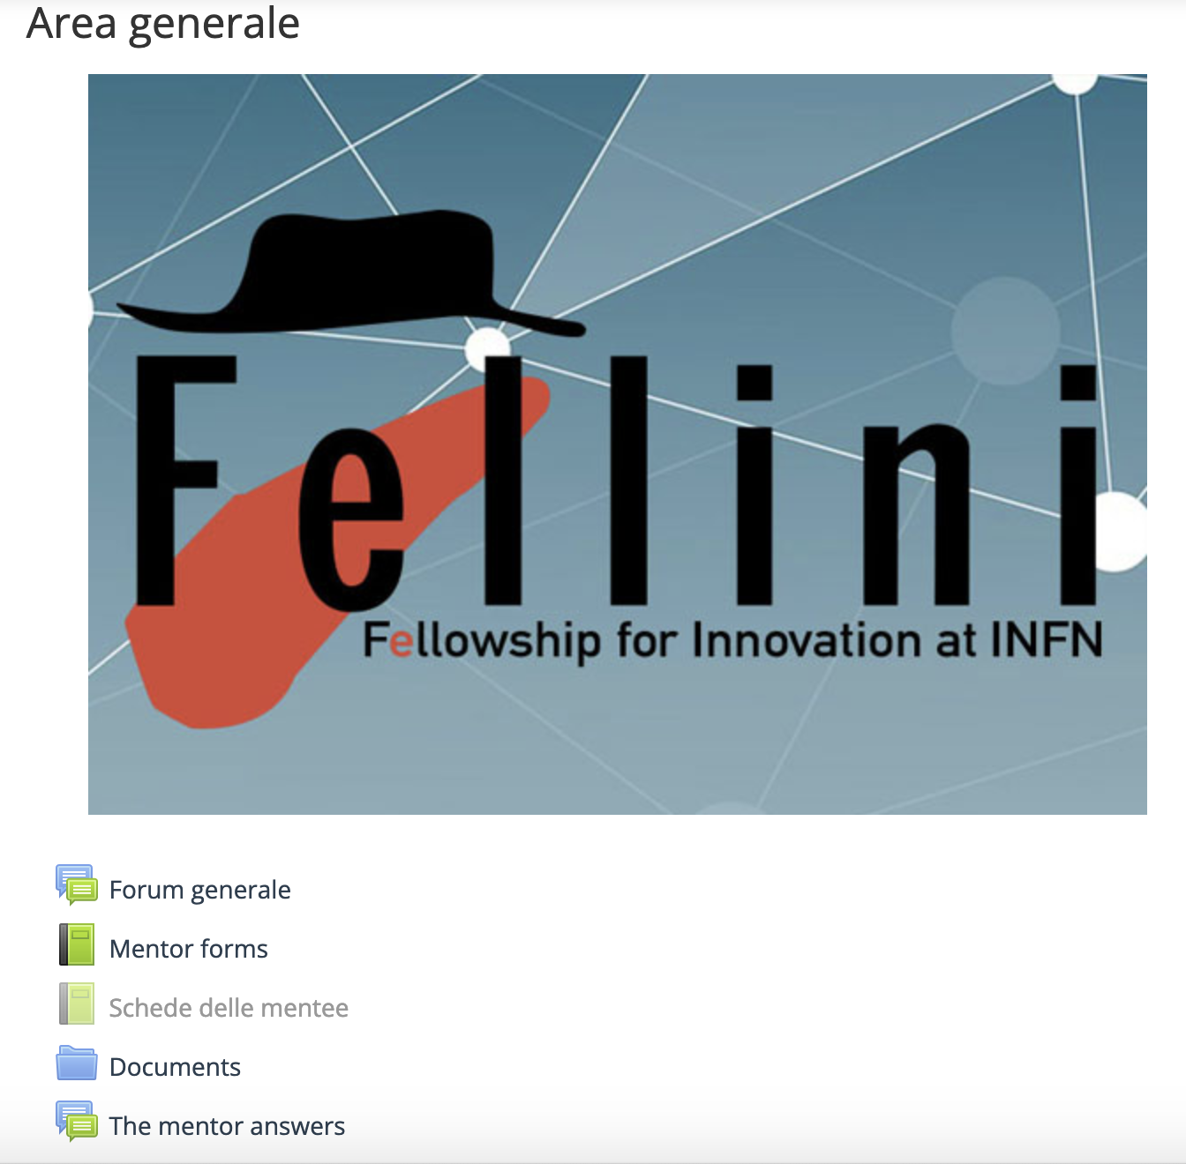
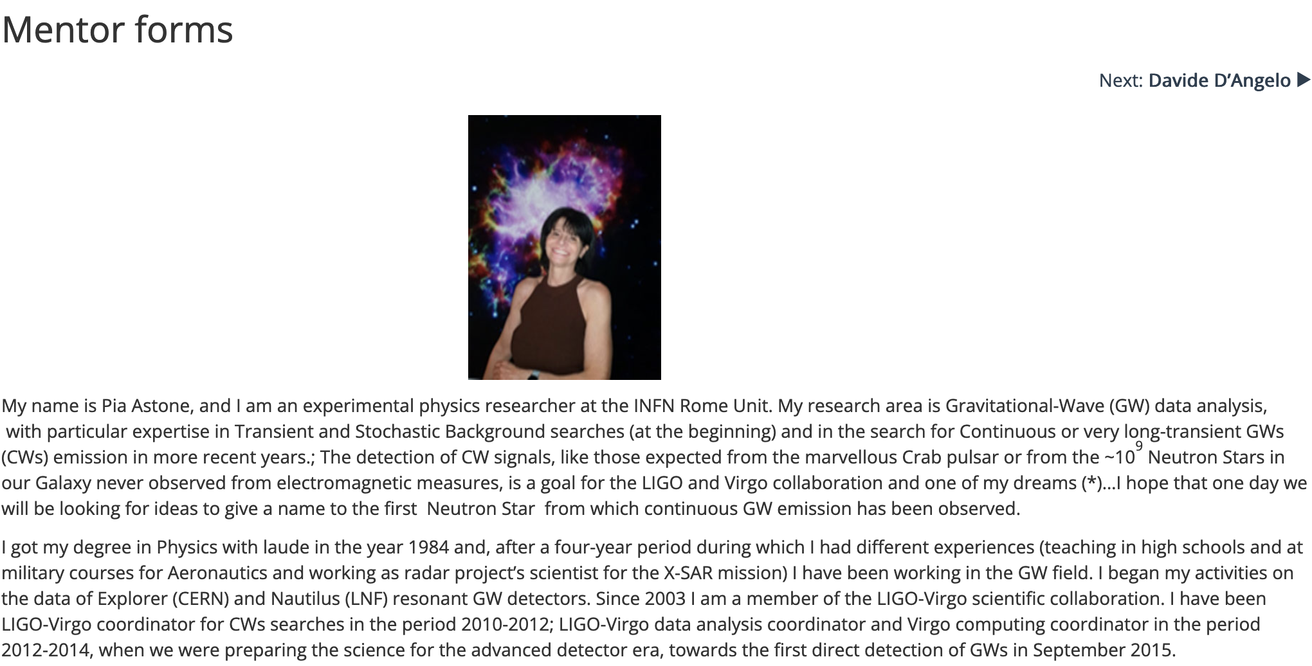
https://elearning.infn.it/course/view.php?id=282
Questions for mentors
forum for general discussion

Slide 14
Bibliography
Daniele Archibugi - CHOOSING YOUR MENTOR: A LETTER TO CREATIVE MINDS
https://www.eument-net.eu/eument-net-guideline-manual/
Antony Brewerton,(2002) Mentoring. Liber quarterly, Vol. 12, pp.361–380
Ilenia Picardi, Maria C. Agodi, (2021) Gender perspective in the mentoring relationships. A case study of GENOVATE@UNINA. In New Perspectives in Gender, Science & Innovation Edward Elgar Publishing Edited by Helen Lawton Smith, Colette Henry, Henry Etzkowitz & Alexandra Poulovassilis.

Slide 15
Thanks for the attention

