Slide 1
FastCaloGAN: a fast simulation for the ATLAS calorimeter system using GANs
Michele Faucci Giannelli

Slide 2
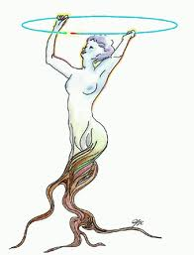
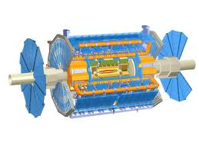
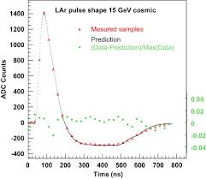
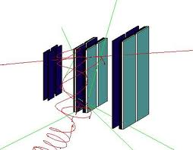
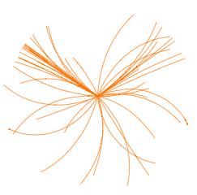
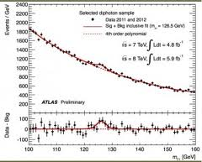
What is Simulation?
Simulation Group Responsibility
Event
Generation
Detector
Simulation
Digitization
Reconstruction
Rootification
EVGEN
HITS
DIGITS
ESD/AOD
TTree/THist
RDOs
Analysis
µ times

Slide 3
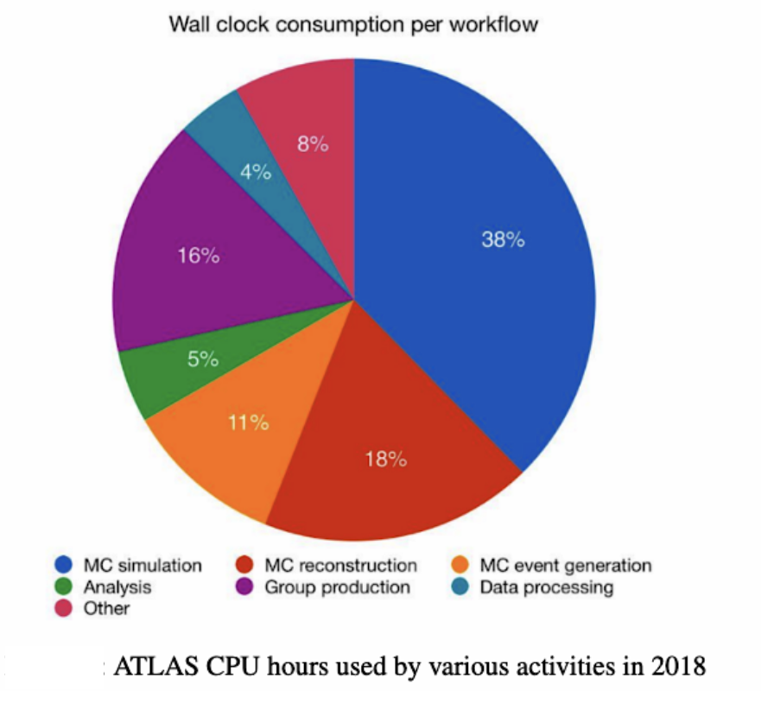
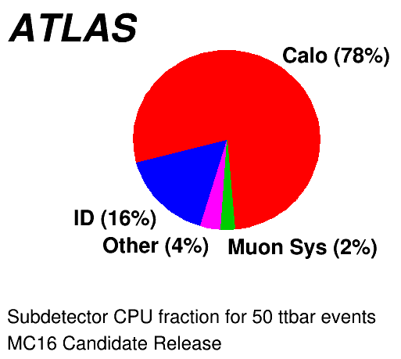
Status of simulation
Monte Carlo production takes almost 70% of the GRID CPU time used by ATLAS on the GRID: this is dominated by full simulation
Great success: so far ~30B events were generated with full simulation
The rapid increase in luminosity of LHC will not allow us to provide a similar ratio of MC using only Geant4 for the simulation step
For measurement in the Run 3 data-taking period we will need to rely on Fast Simulation
Specifically on Fast Calorimeter simulation

Slide 4
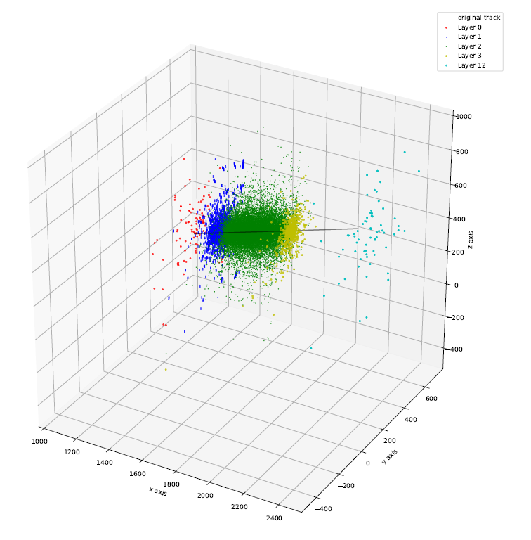
Why using GANs?
Image by NVIDIA
A. Suresh’s thesis
Geant4 hits
Detector response can be displayed as an image
Images where successfully generated using GANs

Slide 5
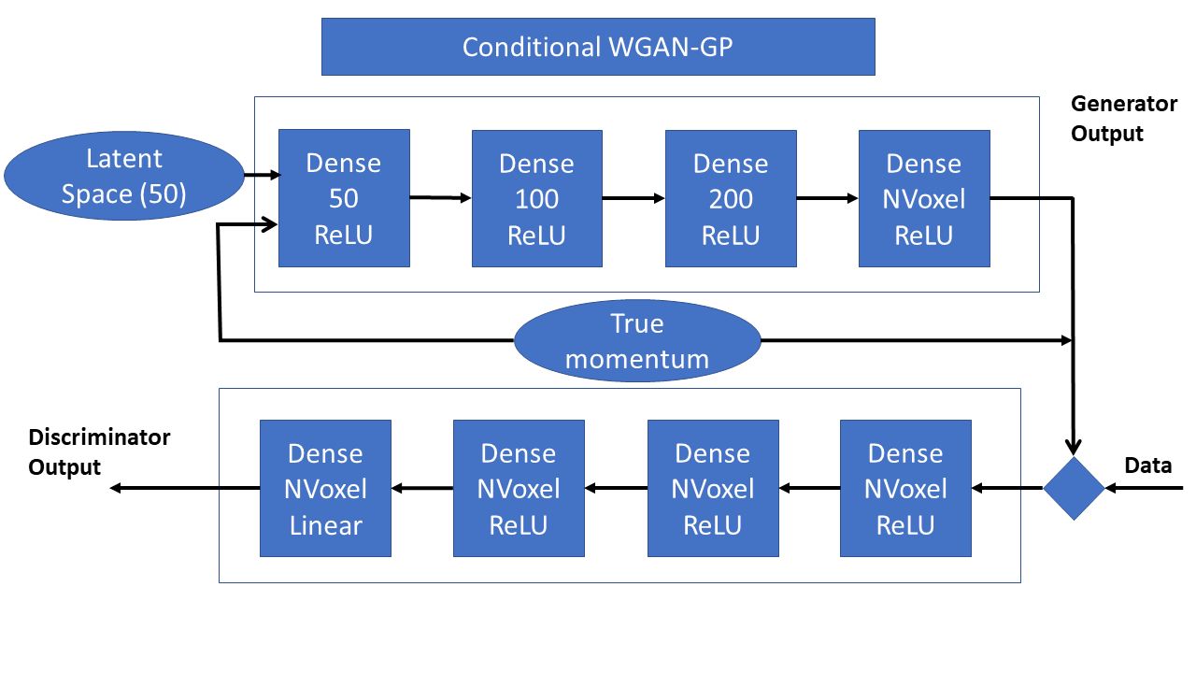
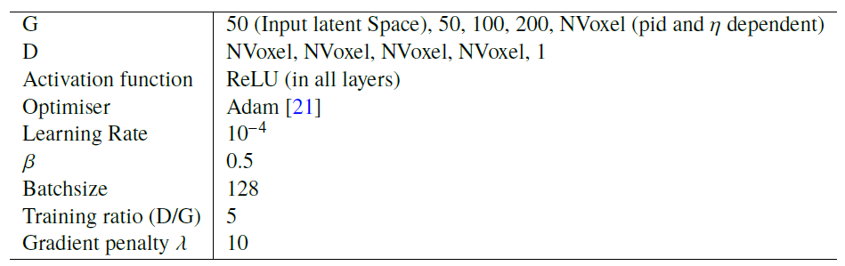
The GAN
NVoxel depends on PID and η

Slide 6
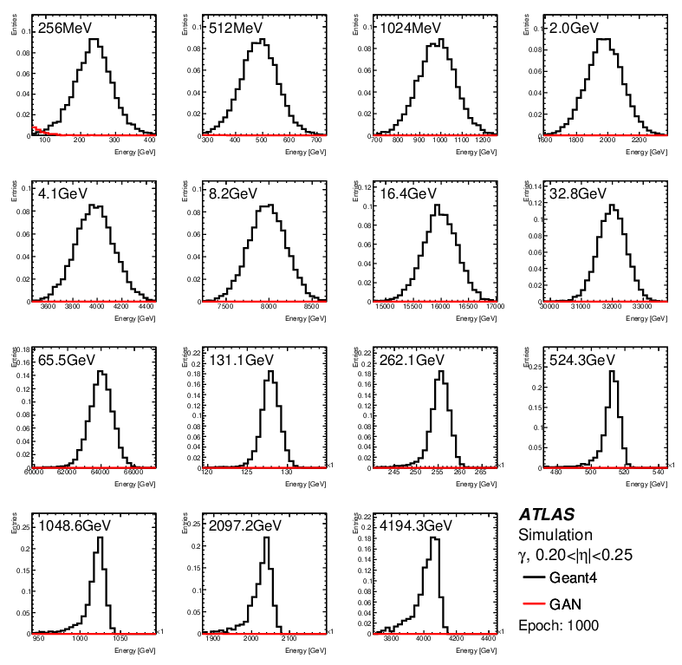
Training

Slide 7
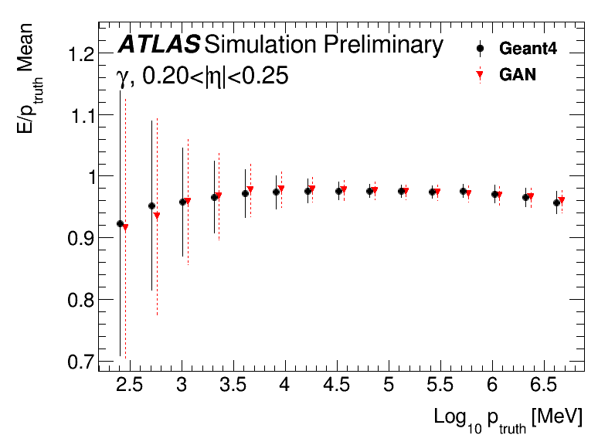
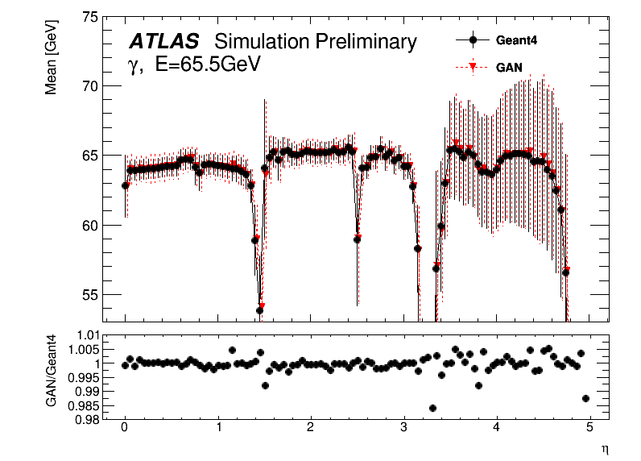
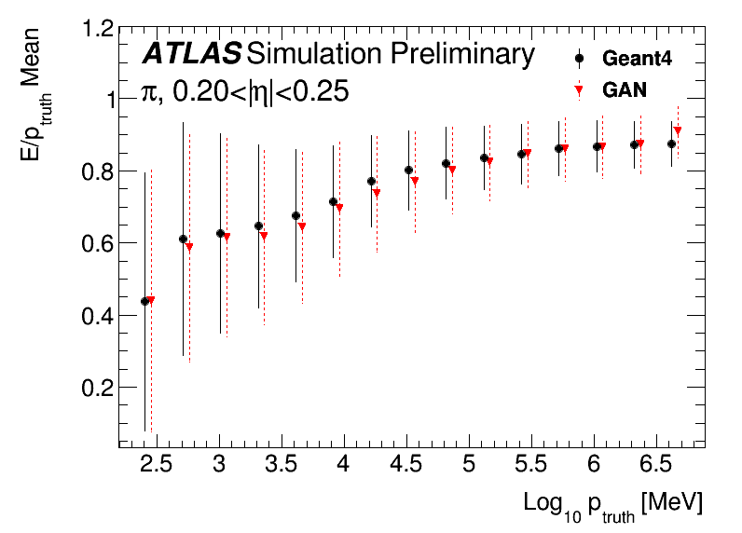
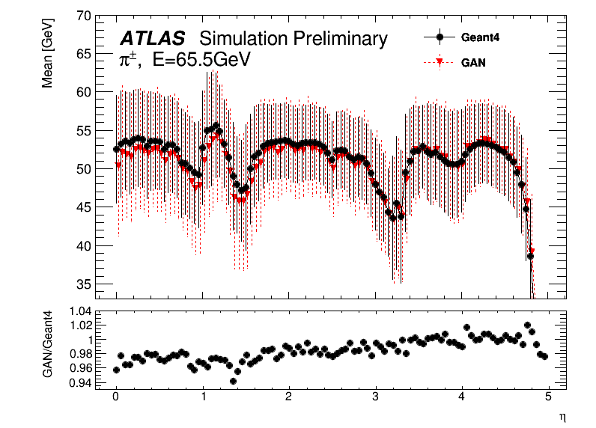
Performance of the GANs
Differences within a few %

Slide 8
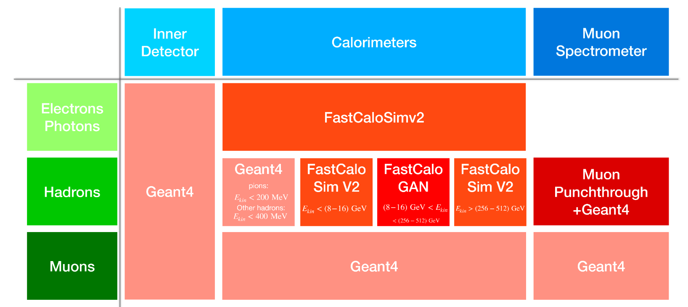
AtlFast3: the new fast simulation tool
Comput Softw Big Sci 6 (2022) 7

Slide 9
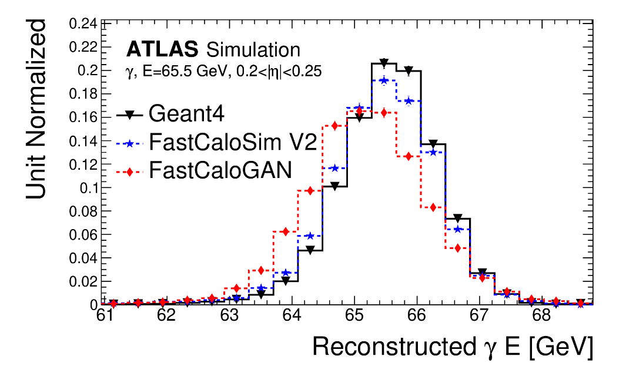
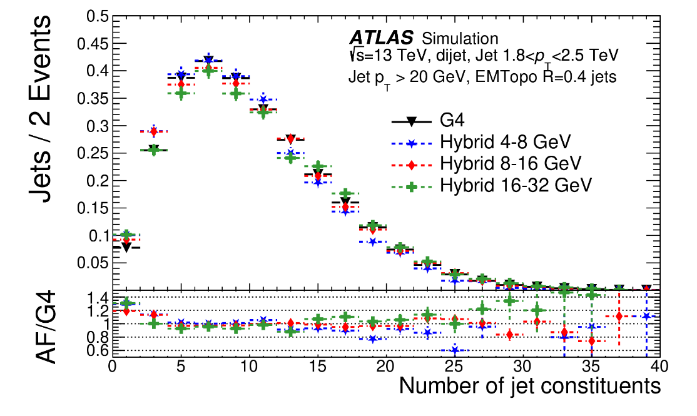
Combination of FCSV2 and FastCaloGAN
FCS/G4 hits difference and the missing φ modulation correction prevented the use of FastCaloGAN for e/gamma showers
For pions, several transition points between FCV2 and FastCaloGAN were tested.
The number of jet constituents was the main figure of merit.

Slide 10
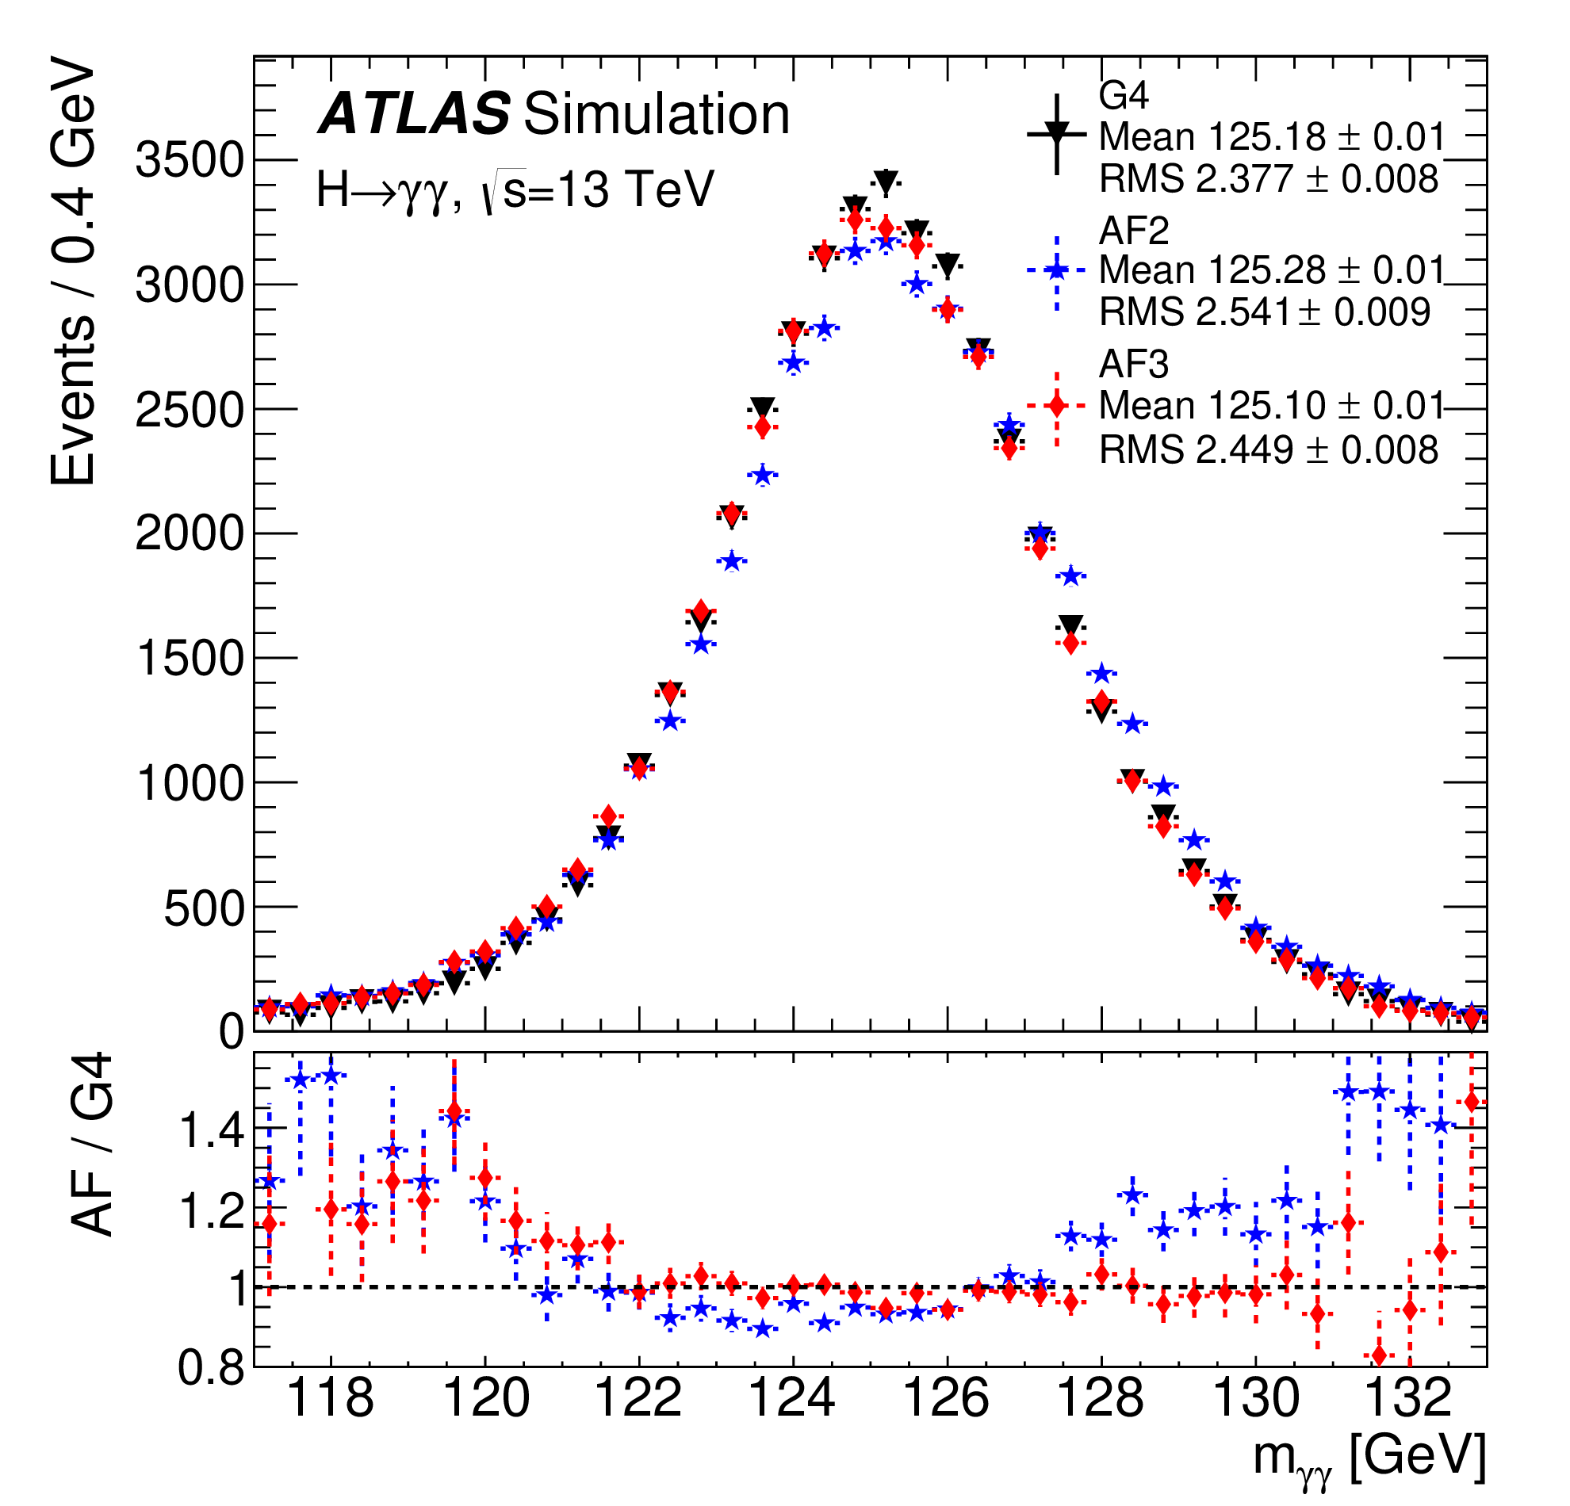
AF3 performance: Higgs

Slide 11
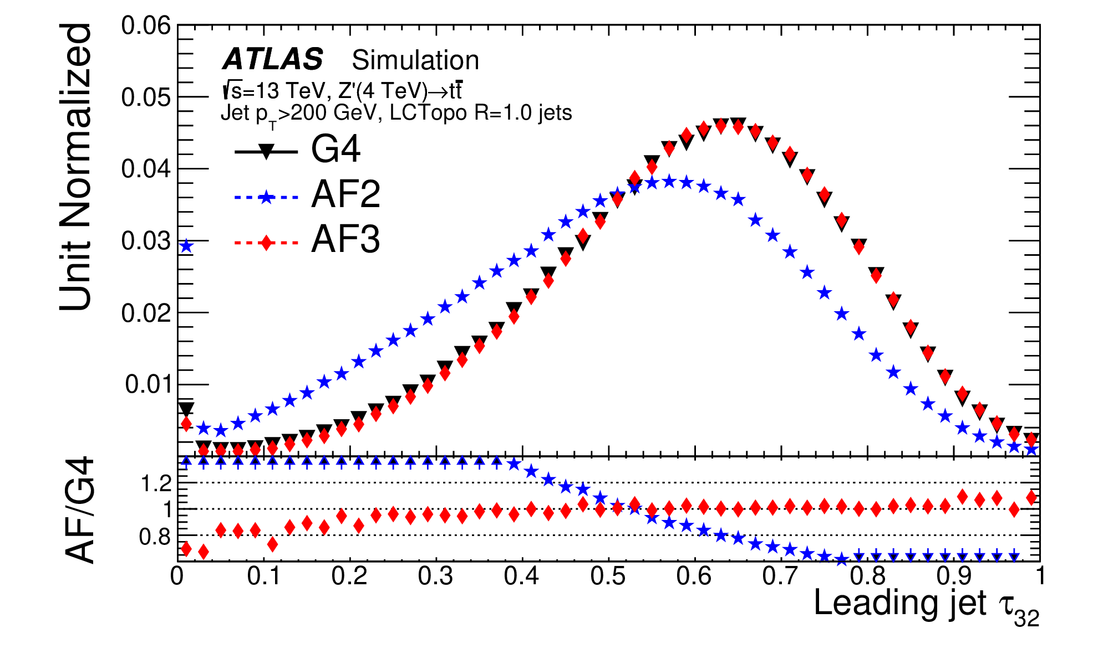
AF3 performance: jets

Slide 12
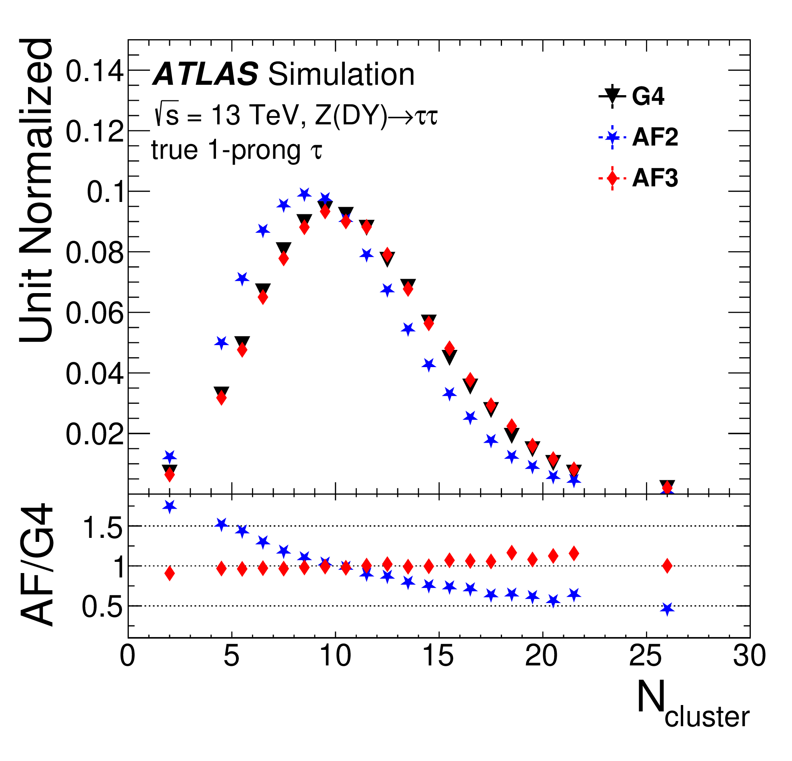
AF3 performance: taus

Slide 13
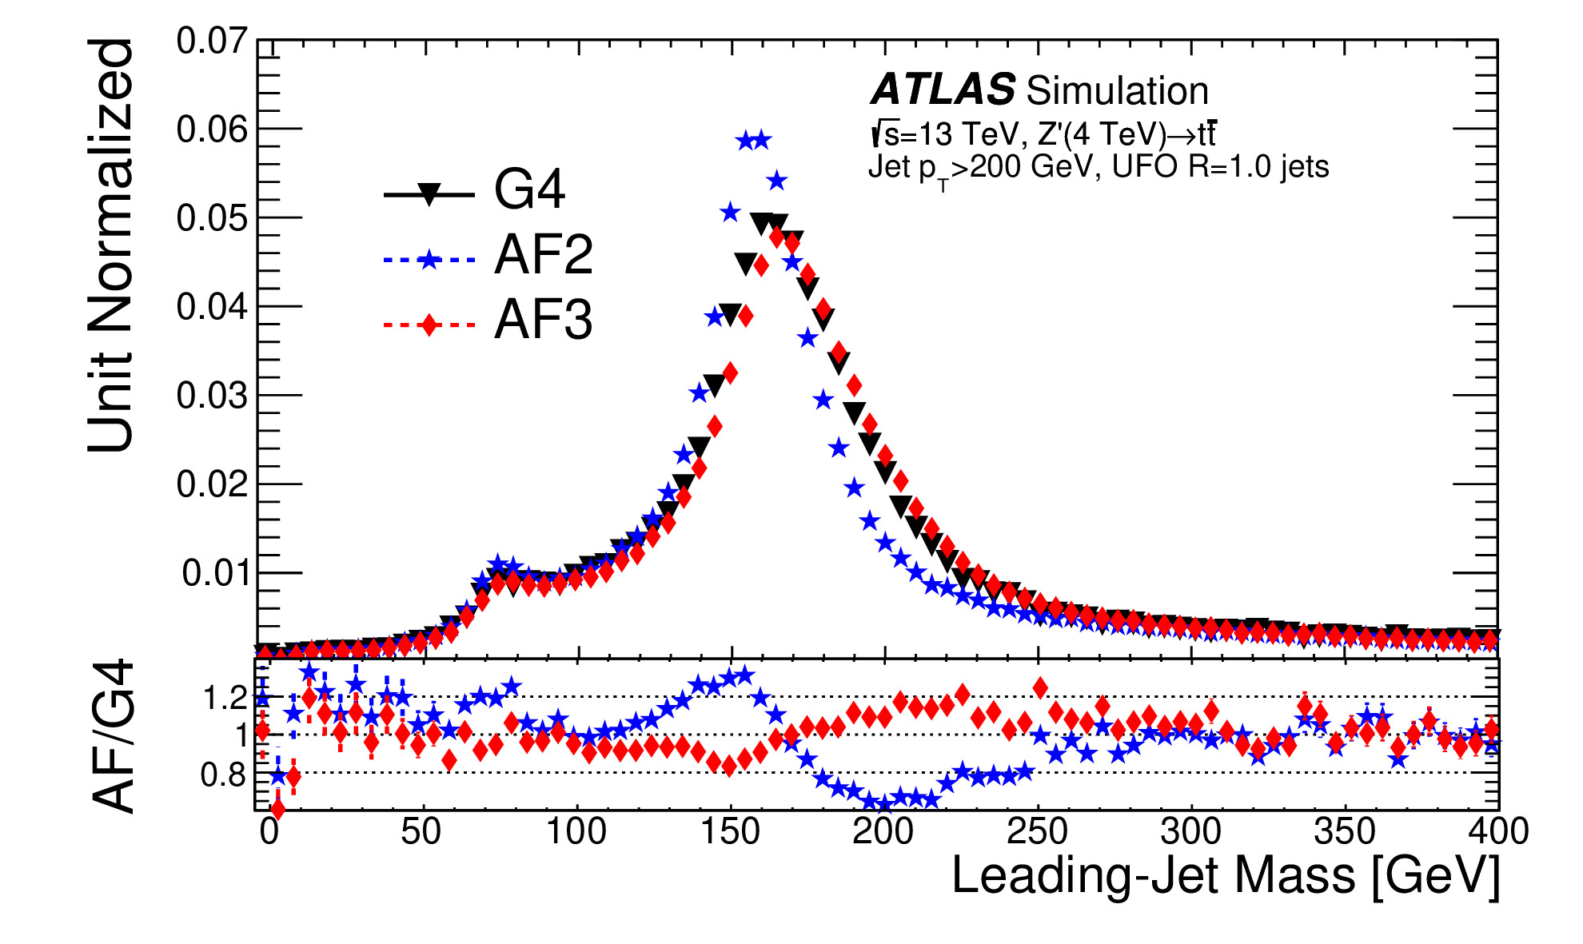
AF3 performance: jet mass

Slide 14
FastCaloGAN in Run3

Slide 15
From prototype to mature tool
Optimisation of voxelisation
Optimisation of GAN HP and architecture
Exploit new development in TF
  Moving from TF1 to TF2
  Strategies to reduce the training time
Improve hit-to-cell energy assignment

Slide 16
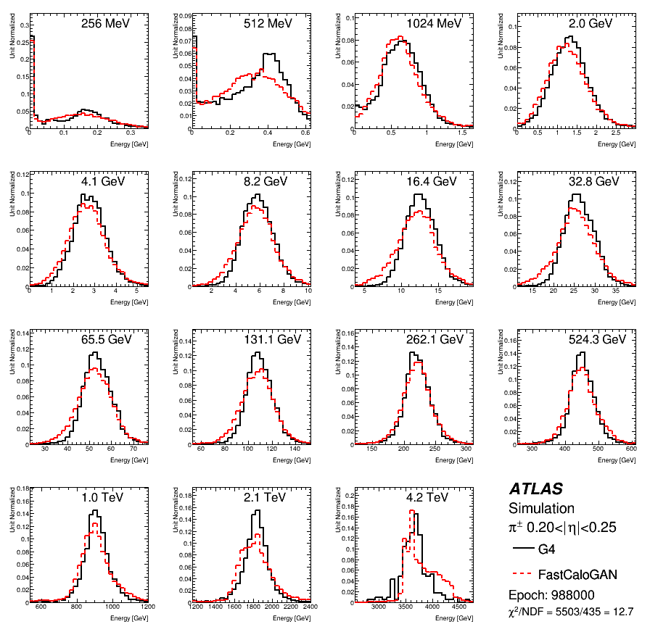
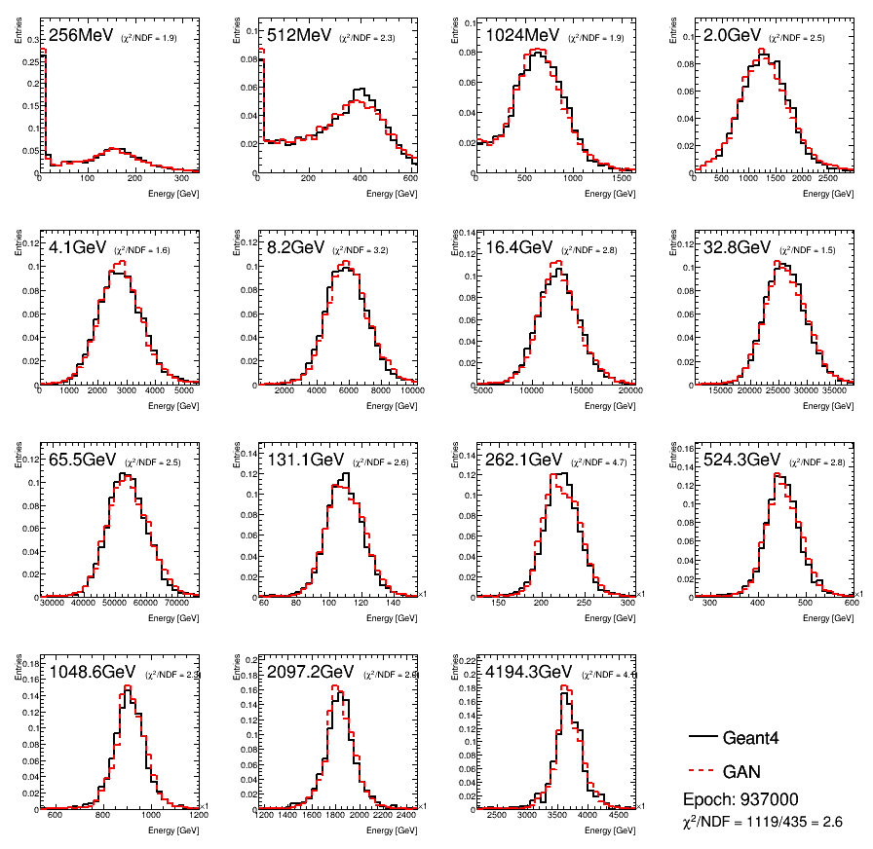
Optimisation of FastCaloGAN HP
FastCaloGAN v1
FastCaloGAN v1.5, M. Barber
Chi2 improved from 12.7 to 2.6, similar training time, double voxels
New architecture and training strategy

Slide 17
Additional publication
The GAN code is now public on zenodo
The datasets used to train two GANs (one pion and one photon) were also made public in the CERN OPENData
  New procedure, took some time to get all the approvals
This will allow to get the wider community help ATLAS with better generative models
The datasets are used in the #calochallenge, the latest ML challenge proposed to the HEP and ML communities (part of ML4Jet conference)

Slide 18
Conclusion
FastCaloGAN was successfully deployed in the new ATLAS fast simulation tool (AtlFast3) for the simulation of medium energy pions
  Work published in Comput Softw Big Sci 6 (2022) 7
I am still working on FastCaloGAN for the upcoming Run3 LHC data-taking period
  Significant improvements already achieved
  Plan to deliver the tool in the Fall and then write a paper
Work on top physics analysis still ongoing, no public results yet

Slide 19
Backup

Slide 20
Fast Simulation overview
ATLAS has a FastSimulation developed in Run 1 called ATLFASTII (AFII)
  FastCaloSim for calorimeters fast simulation, Geant4 for everything else
  It was validated in September 2017 for Run 2
AFII has some limitations which we plan to overcome with a new generation of fast simulation tools
  It is calibrated with different scale factors w.r.t. Geant4
    Double work for all calibration teams
  It cannot be used in some regimes, so more computing resources are needed to have G4 samples
    Boosted topologies
    Forward region

Slide 21
ATLAS efforts
FCS v2 is currently being developed, more information can be found here and an update will be presented at CHEP
  In a very advanced stage, soon to be deployed
Three DNN approaches for the longer term:
  2 GANs and a VAE
  Today I will discuss about the two GANs
Both approaches aim to simulate the shower of single particles (e⁻, γ and π)

Slide 22
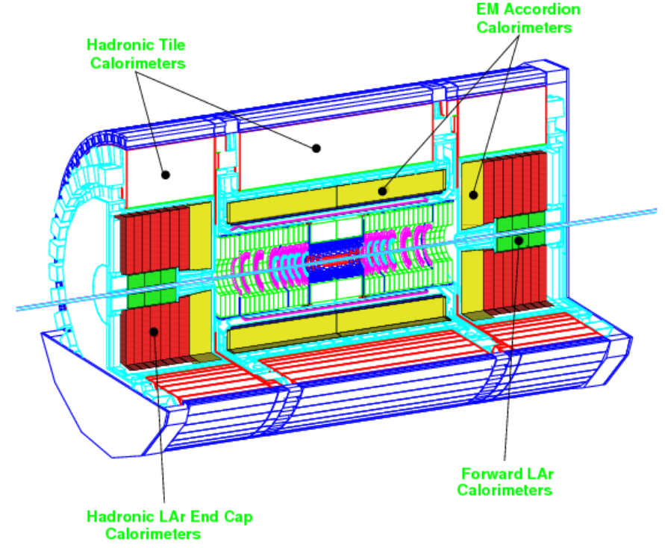
The ATLAS calorimeters
From ATLAS Calo TDR
Complex geometry

Slide 23
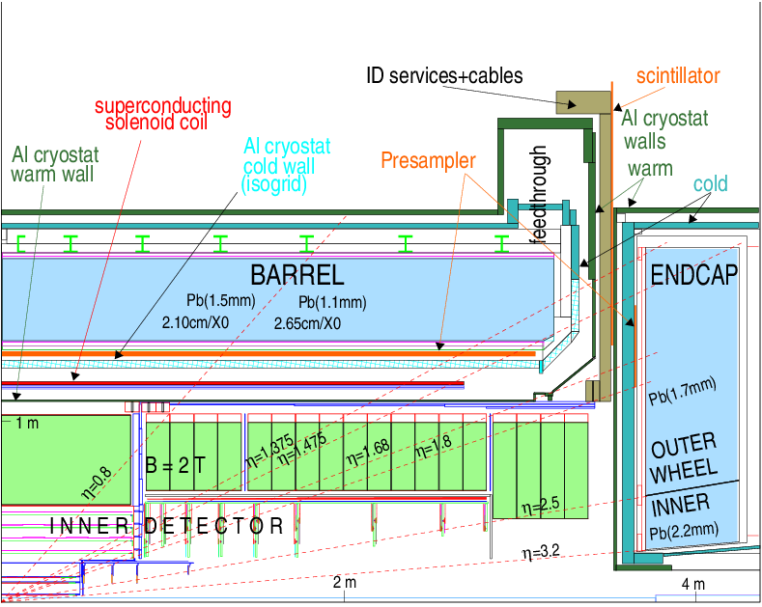
The ATLAS EM calorimeters
From ATLAS Calo TDR
Each line represent a discontinuity

Slide 24
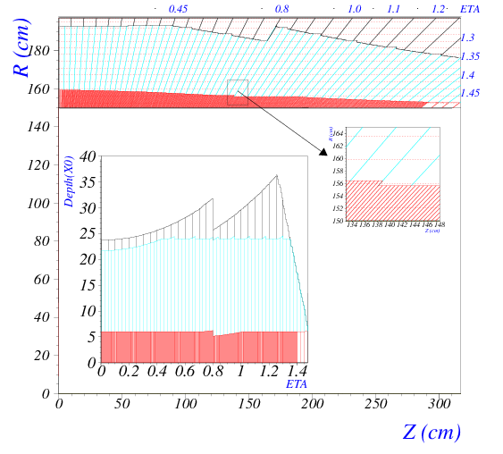
The barrel
4 layers:
Pre-sampler
EMB1
EMB2
EMB3
Sampling fraction depends on eta
From ATLAS Calo TDR

Slide 25
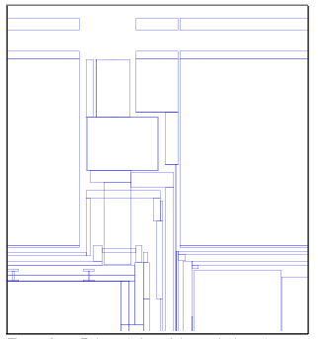
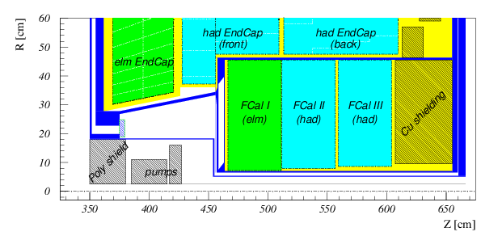
The hadronic calorimeter system
Complex transition region between barrel and endcap
Forward region
From ATLAS Calo TDR

Slide 26
Going beyond other GANs
All images looks like humans
But are the features preserved from the training sample?
  Distance between eyes
  Length and width of nose
  Mouth width
  Forehead height
Not just the average but also the distribution
  Are faces too rounded?
Image by NVIDIA

Slide 27
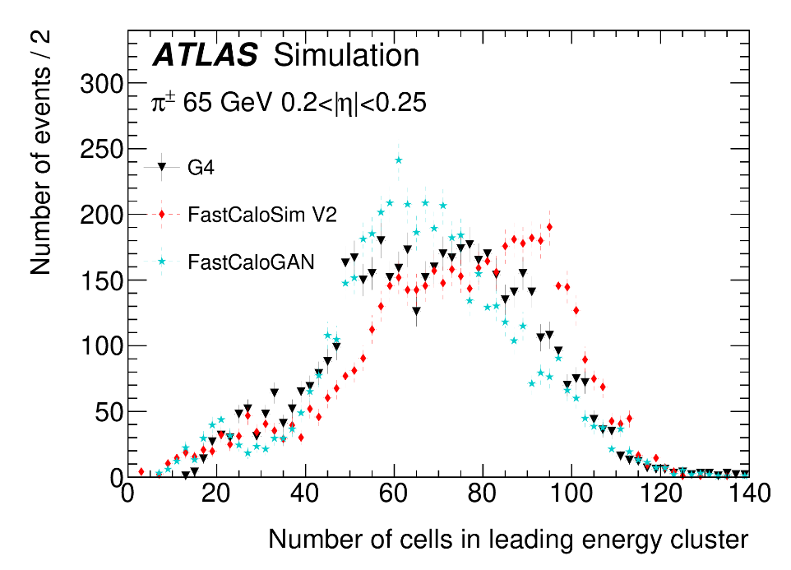
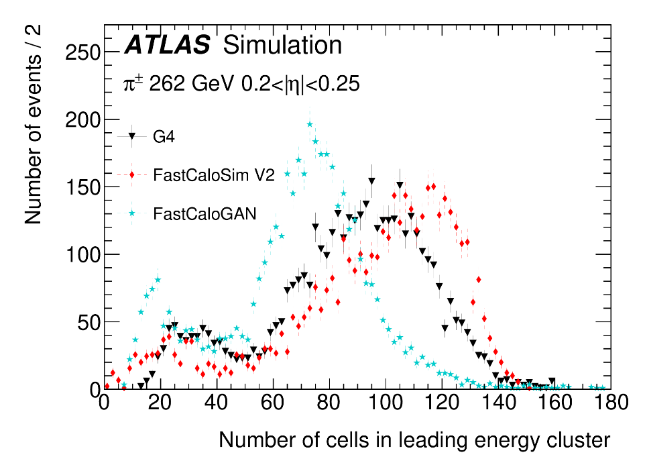
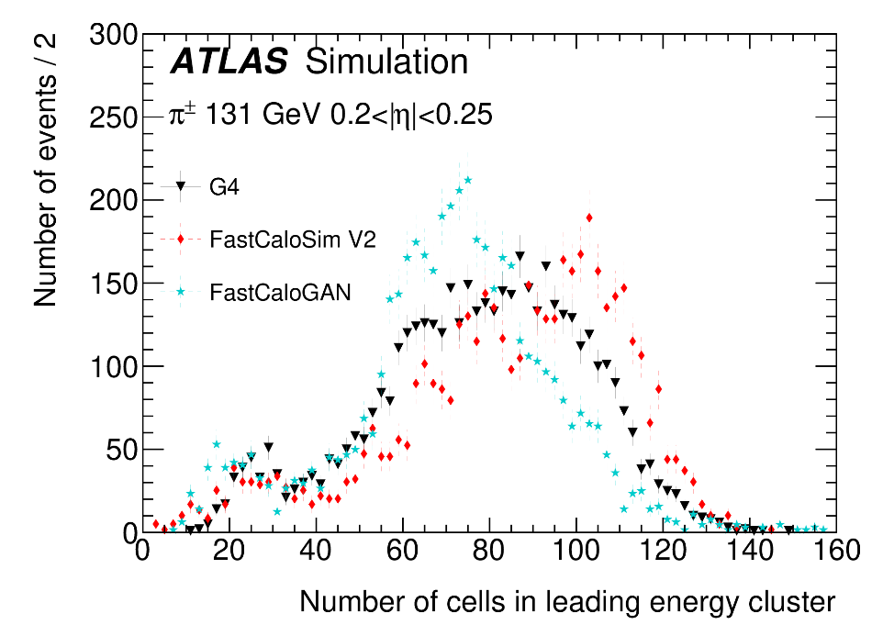
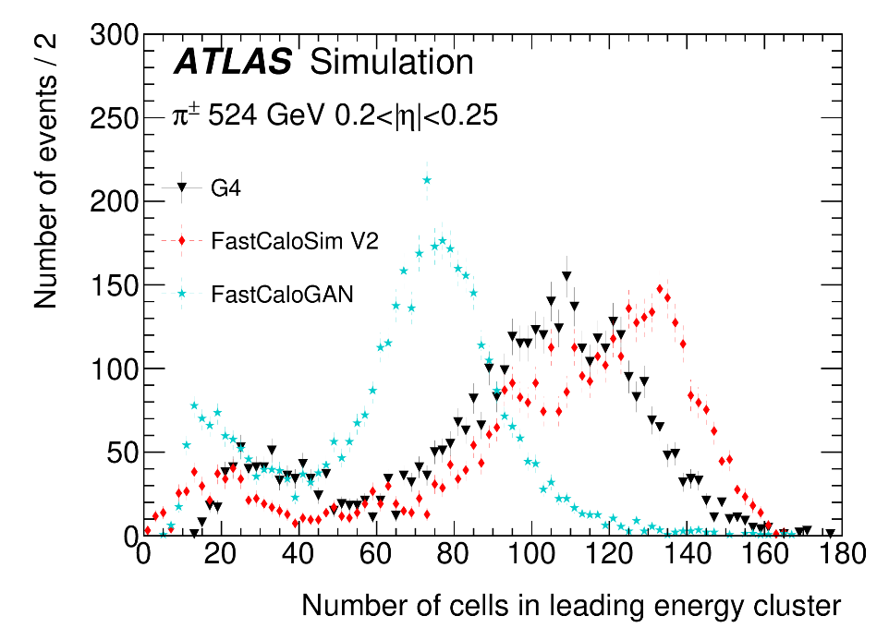
High energy pions

Slide 28
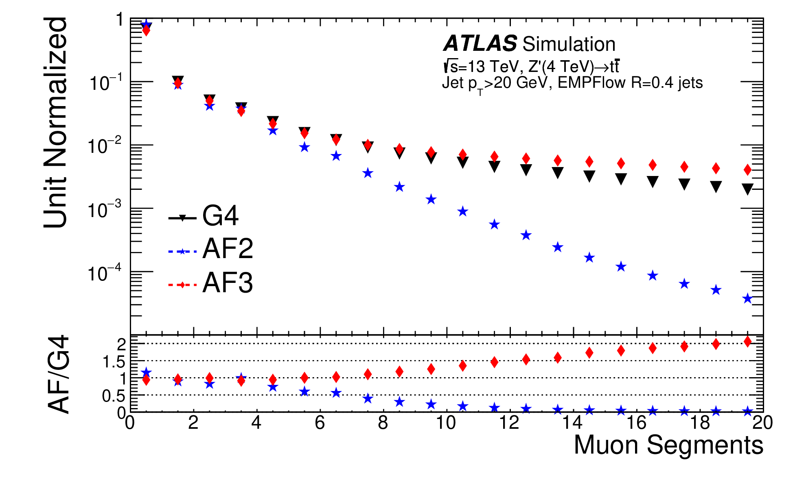
MPT

Slide 29
The training sample
The single-particle samples have
  detailed hits to better map ATLAS cells
  without z-vertex spread
  without noise
  without parts of the electronic cross talk
Events generated by momentum
  But used the Ekin for the simulation
The statistics in the high energy region is lower than at low energies
  10k events up to 256 GeV
  Drop to 1k events for 4 TeV samples

Slide 30
Strategy of FastCaloGAN
To simulate all shower in the detector we need to parametrise photons, electrons and pions
  All hadrons share the pion parametrisation with a correction for the mass
The ATLAS calorimeter system is divided in 100 slices in η
  In each slice we have 15 energy points from 256 MeV to 4 TeV (in powers of two)
For each particle and η slice we define a GAN → 300 GANs
Train the GANs on voxelised hits
  Because cell structure is not homogeneous and would require different GAN architectures, the voxelisation reduces the differences and allows for a single, generic, GAN structure
Select best epoch based on total energy distribution of each sample
Convert the selected generator into LWTNN
Simulate hits in Athena inverting voxelisation
Compare with Geant4 using high-level observables for single-particle and di-jet samples after reconstruction

Slide 31

Voxelisation
Hits are transformed from ATLAS (x,y,z) coordinates to cylindrical (r, α, R) coordinates
  R is not use, as hits are grouped in layers
GAN cannot be trained on hits, so they are grouped in areas in the (r, α) plane in each layer
  each volume in the (r, α, layer) space defines a voxel
Voxels are optimised to:
  Have enough energy to avoid large event-by-event fluctuations
    Binning in α only for layers with a large energy deposits (i.e. EMB1 and EMB2)
  Contain all the energy in a shower
  Reproduce the Energy Centroids in η and φ
$$EC_{η}=\frac{\sum_{i}{E_{i}η_{i}}}{E}$$

Slide 32
Voxelisation: different binning
Layers with no binning in α
Layers with binning in α (10 bins used)
Hits in layer

Slide 33
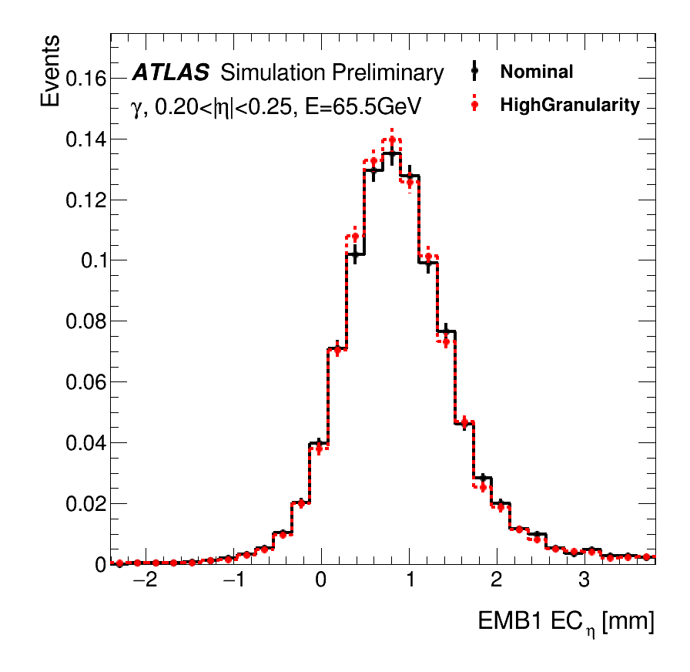
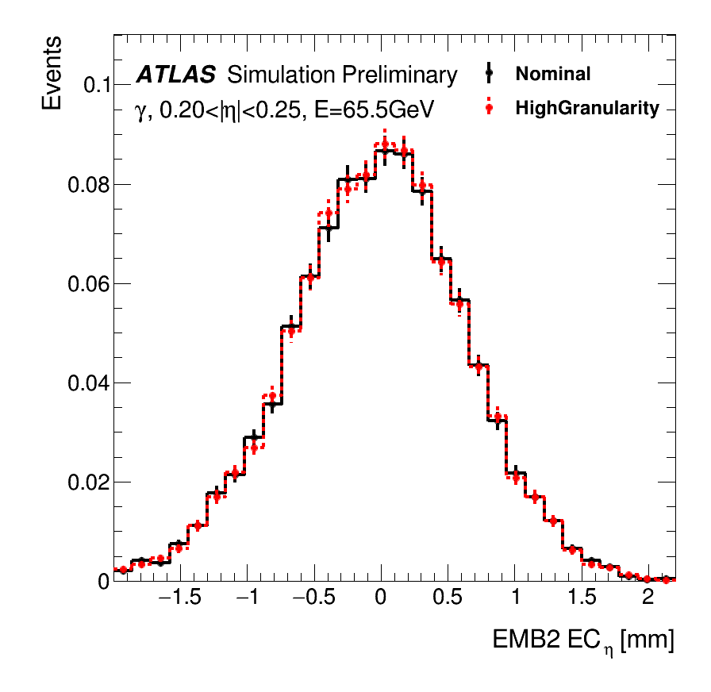
Plots from PUB note
Energy centroids well reproduced for both layers

Slide 34
Shift of EMB1 EC_{η}
The larger volume on the right of the direction of photon causes the shift observed in the EC. EMB2 less affected because there is a compensation between early excess on the left and deeper volume on the right

Slide 35
Additional training information 1/1
Normalised all events by the true momentum
Normalised all labels by the highest momentum
  Momentum is used as conditioning label
Training using all samples together was not producing good results
  But we could train a GAN on a single sample
We decided to use a training strategy in which a single sample is trained for 50k epoch and then additional samples are added to the training mix every 20k epochs
Training order:
  32 GeV, 64 GeV, 16 GeV, 128 GeV,…

Slide 36
Additional training information 2/2
Training is carried out for 1M epochs
Checkpoints are saved every 1k epochs
  Allows the selection of the best epoch in a second step for a flexible selection criteria
We used the GPUs on HTCondor and the training time was ~8h per GAN → 100 day GPU time to train the full detector

Slide 37
Choice of best epoch
The training of a GAN is not a minimisation process, so there is no assurance that a later epoch will give a better result than an earlier one
  You could see “fluctuations” during the training
Choosing an epoch is non-trivial, we have to compromise on many distributions
For this version of FastCaloGAN, we used the total energy of the 15 samples. The χ² between G4 and the generated events is calculated for all sample. The sum of the χ² is used as figure of merit.
The epoch with the smallest χ² is used

Slide 38
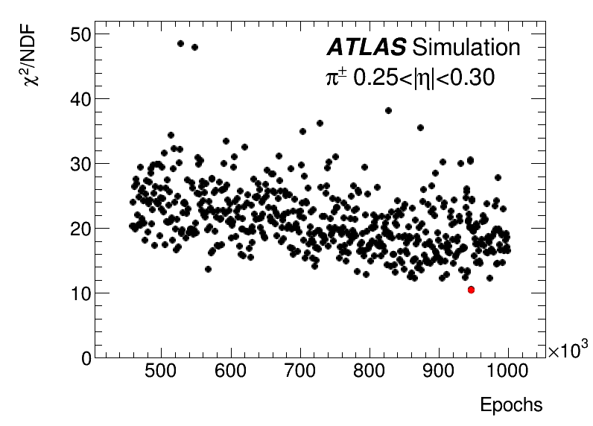
A summary of the training
Chosen epoch

Slide 39
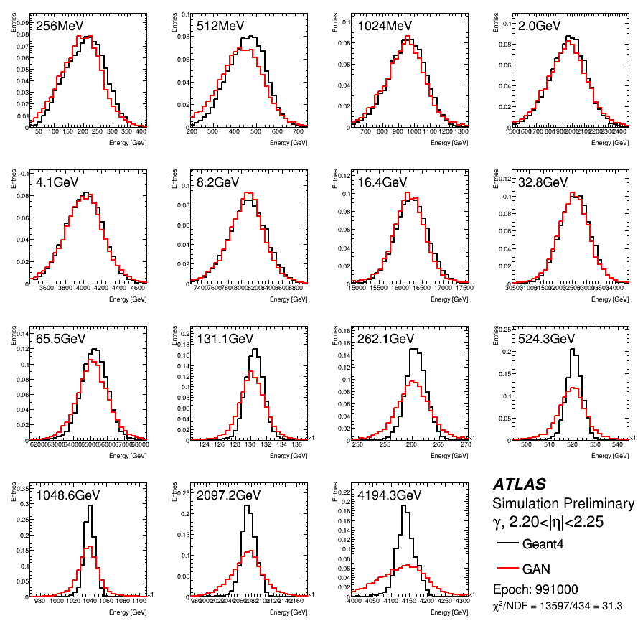
Photons in endcap region

Slide 40
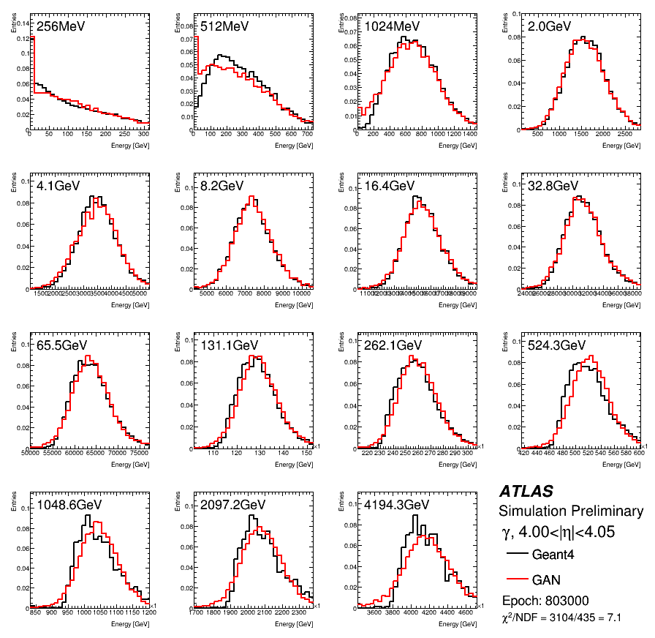
Photons in FCAL

Slide 41
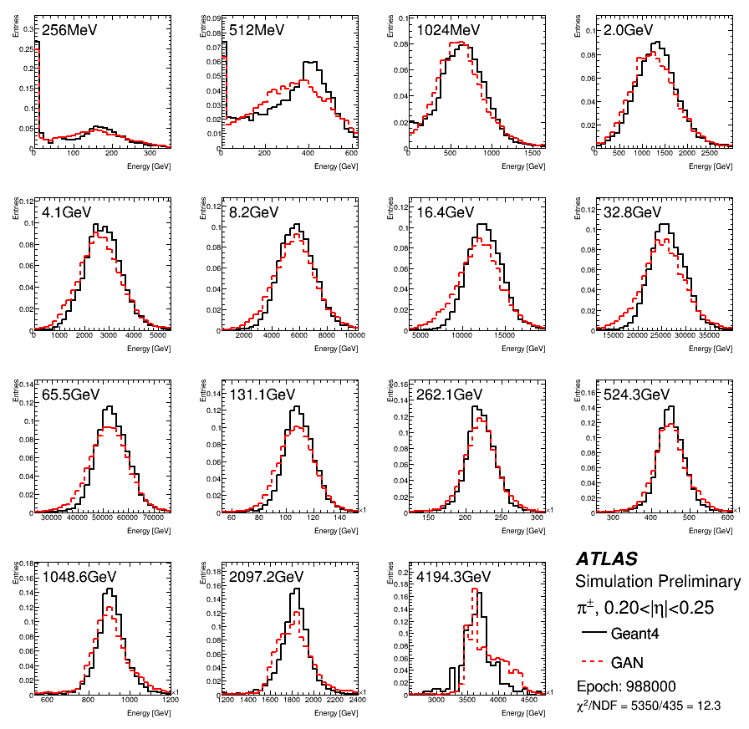
Pions in barrel

Slide 42
Integration in Athena
NB: All figures until now are done at voxel level
To assess the real performance of FastCaloGAN, integration in the ATLAS Athena is required
This is done through a conversion of the generators from TF to Keras and then LWTNN
The LWTNN inputs are open by the FastCaloGAN simulation service
Simulation time for a pion at the calo surface is 2-3 orders of magnitude smaller than Geant4
  70ms vs 6s for 65 GeV or 162s for 2 TeV
Memory consumption is small
  We could easily add more GANs, i.e. other hadrons

Slide 43
Voxel to hit
The voxelisation must be inverted in the Athena service by producing hits
Hits are generated by sampling the area of each voxel
Depending on the layer, the areas is divided in step of 1 or 5mm along both r,α coordinates
  A maximum of 100 hits are produced to reduce the simulation time
The energy in the voxel is divided uniformly among the different hits

Slide 44

Voxelisation inversion
The total energy in a voxel is divided in grid so that it is better mapped to the cells of the calorimeter
ATLAS Calorimeter cells

Slide 45
Comparison of physics objects
Single particle and di-jet events are used to assess the performance of FastCaloGAN
The same events were simulated with both Geant4 and FastCaloGAN
  Di-jets samples (2.5 TeV jets) are without pile-up
Both Geant4 and FastCaloGAN events were reconstructed with the same way
Between e/gamma, cluster and jet variable there are 100+ variables that can be compared, a handful were selected to give some highlights

Slide 46
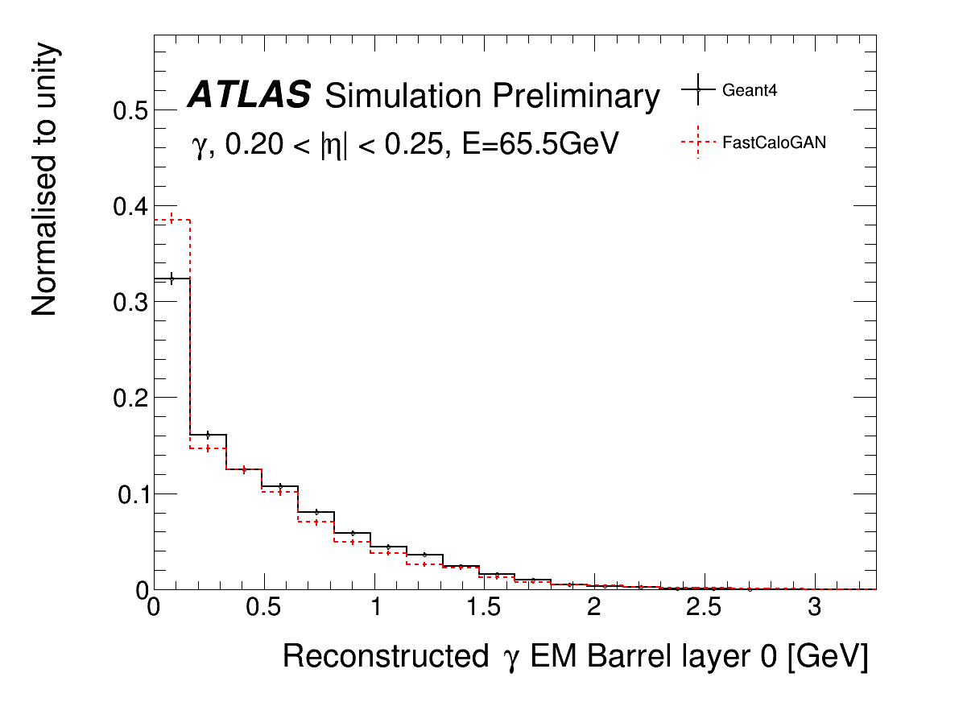
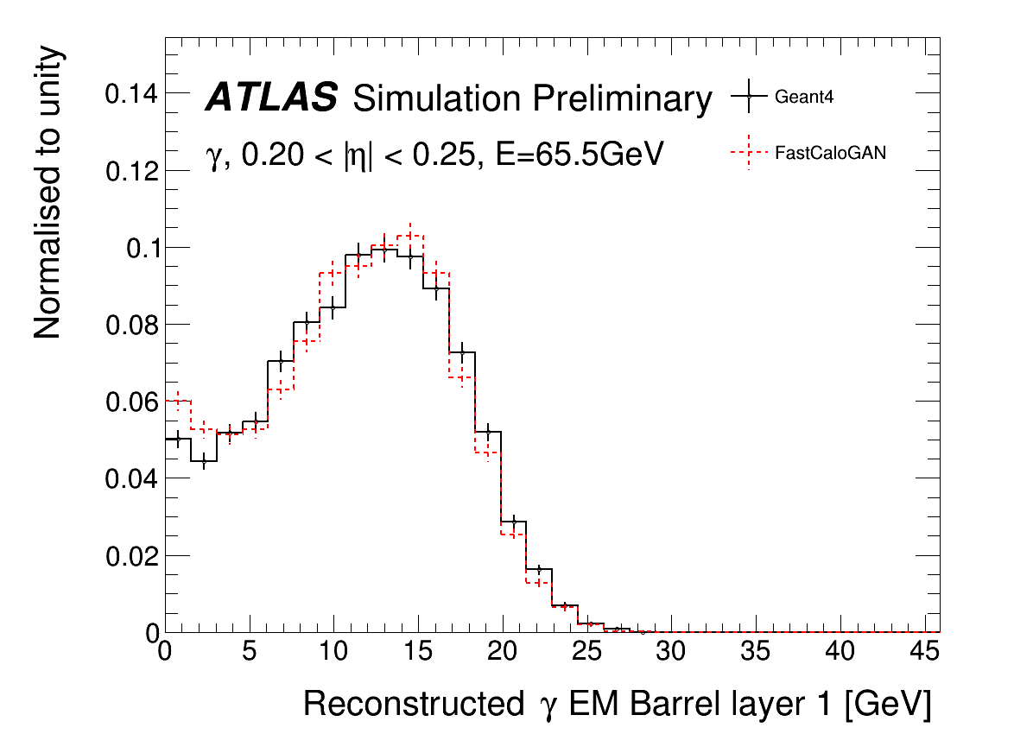
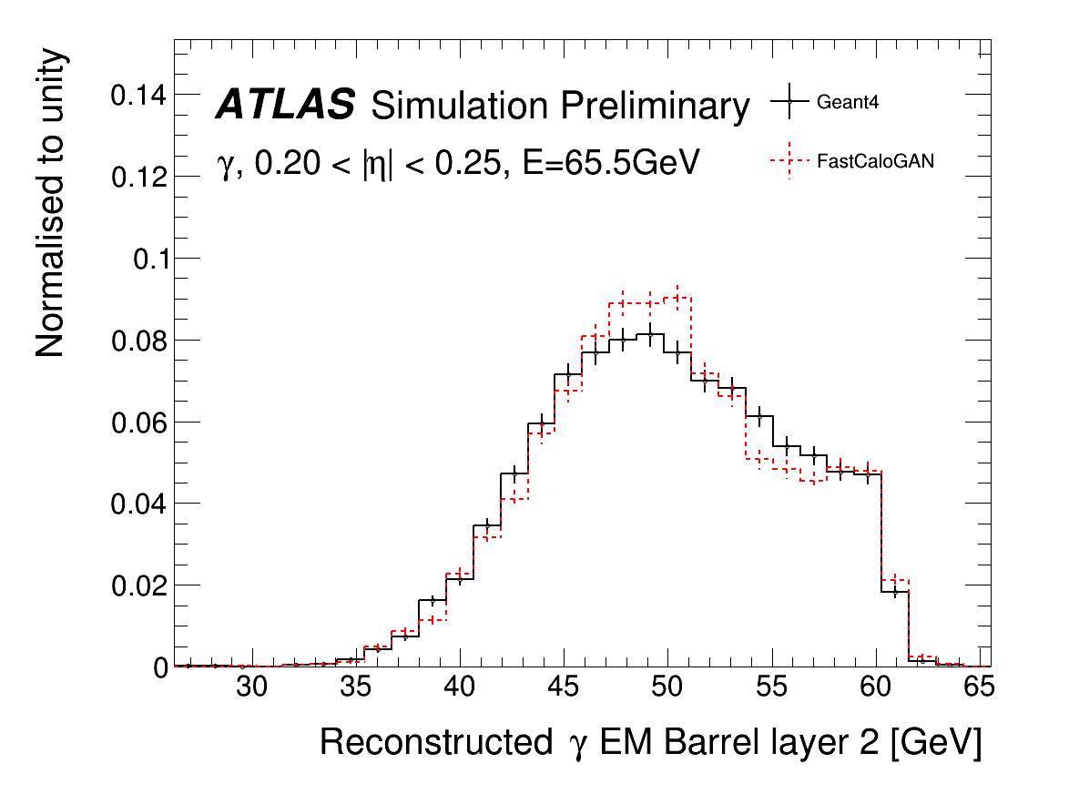
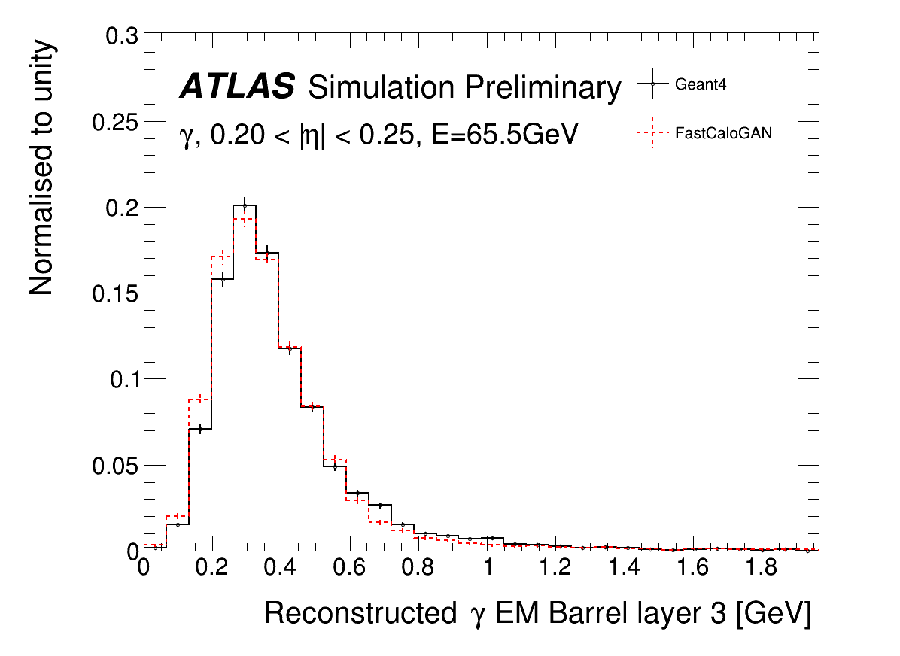
Photons: energy per layer

Slide 47
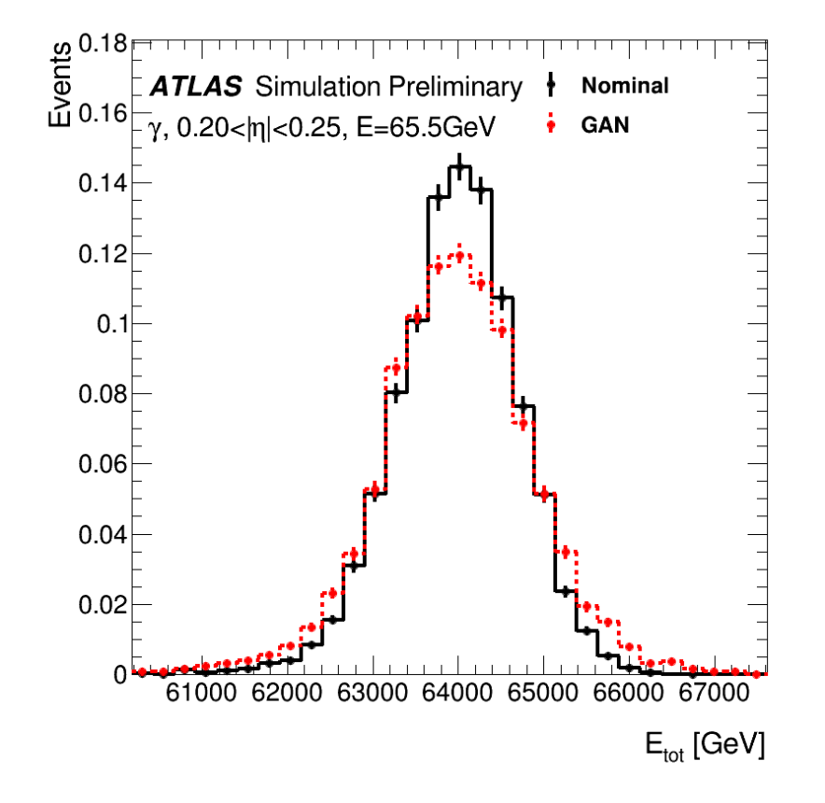
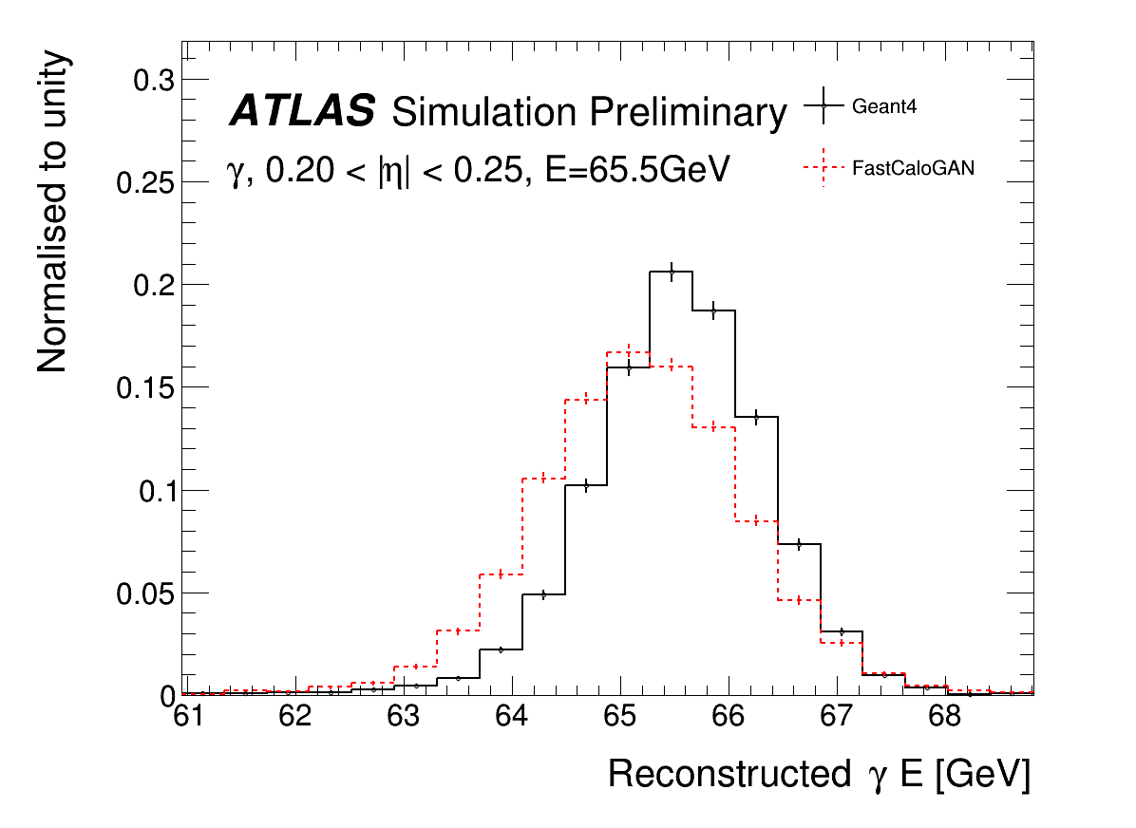
Photons total energy
Reconstruction
Energy of sum of voxels
Energy of cluster
The discrepancy is due to a difference in the energy deposited between the “standard” Geant4 hits used in ATLAS and the detailed hits used in FCS
  Easy to fix by rescaling the total energy, implemented in Run3

Slide 48
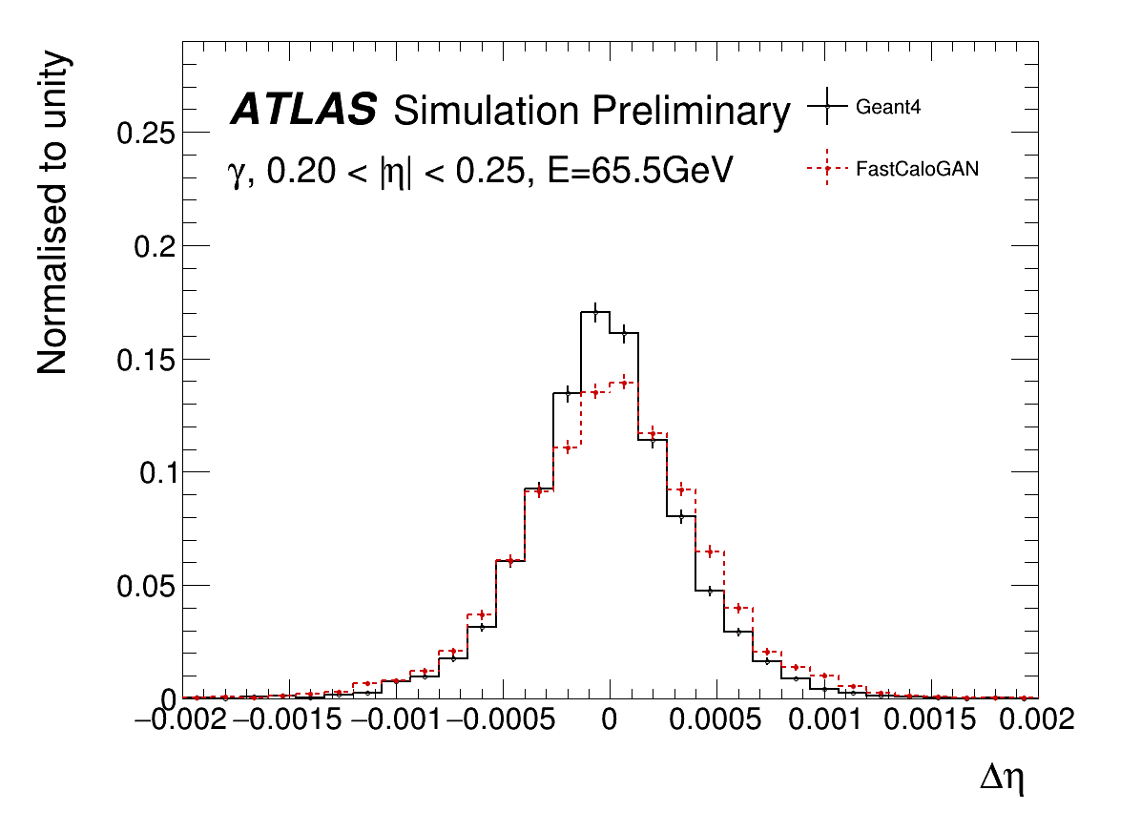
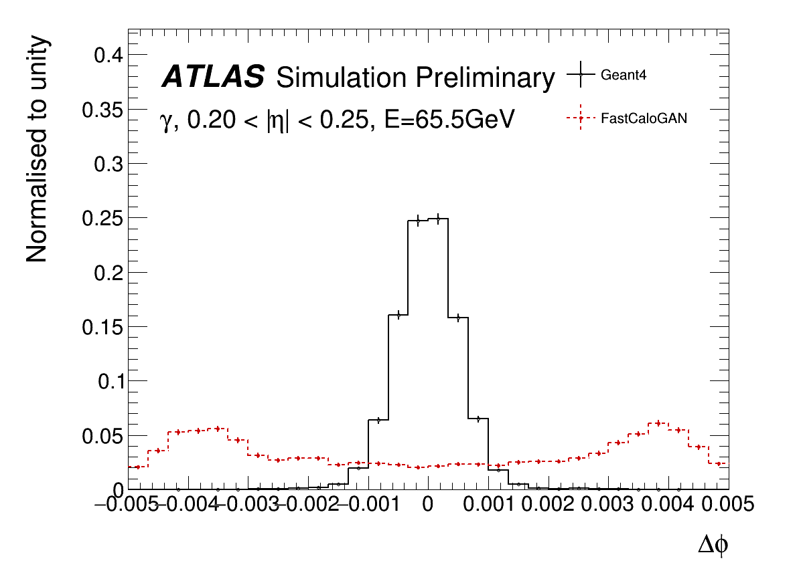
Position resolution
Resolution along eta is very good
Along phi the agreement is poor due to the missing correction for the accordion structure of the LAr calo, but this is corrected in AF3

Slide 49



Pions
Good position resolution
The total energy is wider but compatible with voxel-level performance

Slide 50



Pions: sub-structure
All distributions are similar to Geant4
The discrepancy at small λ² is the only significant difference

Slide 51




Performance on di-jets events

Slide 52






FCSV2 in one slide
PCA for energy parametrisation
Probabilistic reweight
PhiMod correction
Energy interpolation
FCSHit to G4Hits energy correction
Lateral shape parametrisation
Weights hits

Slide 53


Energy correction due to accordion
There is a small dependence on the impact position in the accordion structure of the LAr
This cannot be emulated as we do not use the detailed geometry in AF3
The dependence is considered in the Full simulation (Geant4) reconstruction.
AF3 deposit directly the corrected energy, hence requires a dedicated calibration

Slide 54


Other hadrons
Pions are used to simulate all hadrons, an additional energy correction is applied to correct the energy deposited in the calorimeters

Slide 55



Simplified geometry correction
The simulated hits are assigned to cells using a simplified geometry that does not match the detector geometry
The probability for a cell mis-assignment is used to displace a hit before assigning to a cell
Hit shift

Slide 56
New voxelisation: more bins!
AF3 paper
FCS use similar strategy
(2x bins thanks to sim in phi)
New binning
Better to map the cells when inverting the voxelisation in the service
More difficult to learn for the GANS as there are more voxels
Better to parametrise the shower shape

Slide 57
FastCaloGAN optimisations
I moved away from the FastCaloGAN v1 simplification of having identical GANs for all particles in all detector regions
  It was good for a prototype!
Now several parameters are optimised for each GAN:
  Generator size (much bigger for pions)
  Activation functions (swish for e/gamma)
  New training strategy using two-step approach
  Lambda
  Batchsize
  Learning rate
  Split e/gamma showers in high and low energies samples, so now 2 GANs are trained
Interestingly, the particle and energy range have more impact than the detector region
Most GAN code was rewritten for TF2, while the FastCaloGAN framework and scripts improved significantly

Slide 58
Using GANs in the Athena SW
Inference and hit generation has a significant impact on performance of reconstructed objects
Improving voxel-to-cell energy assignment has an impact
Hits are no longer generated in a grid;
  the alpha direction is randomised
  Along the radial direction hits are generated according to a pdf

