Slide 1
a network approach to Quantum state discrimination
Alessandro Laneve, Quantum Optics group
Sapienza Università di Roma

Slide 2
Outline
Introduction to the problem of Quantum State Discrimination
Strategies for Quantum State Discrimination
Quantum Network approach

Slide 3
The problem of quantum state discrimination
From theory to technology

Slide 4
Indistinguishability of quantum states
Quantum superposition is a defining property of quantum objects
A 2-D system can occupy a wide variety of states
This can be exploited in computational tasks: the qubit
We can encode much more information in a qubit than a bit
Drawback: decoding of information
We can recognize via projective measurements only orthogonal states
For the other cases, we need to perform a quantum tomography
Can we devise clever strategies to avoid this?

Slide 5
Quantum State Discrimination (QSD)
Development of strategies for optimization of quantum state identification
We want to spare resources, maximize success probability, maximize the rate of exchanged information
Two main approaches: minimum error discrimination (MED) and unambiguous state discrimination (USD)
Intermediate approach is possible: maximum confidence discrimination (MFD)
General orientation towards application to quantum communication
Mostly optical implementation
Coherent states or single-photon ones (flexibility vs security)
Bae, J., & Kwek, L. C. (2015). Quantum state discrimination and its applications. Journal of Physics A: Mathematical and Theoretical, 48(8), 083001

Slide 6
Various applications
No-go theorem
Dimension witness
Quantum channel discrimination

Slide 7
QSD strategies
Different theoretical and experimental approaches

Slide 8
Minimum error Discrimination
Useful if we pursue QSD of N states of a D-dimensional system where N>D
We apply N projectors to the system, each one associated with one of the states
The projectors are such that probability of correct guess is maximized (error probability is minimized)
There are theoretical bounds limiting minimum error probability
Since N>D, strategies must include ancillary systems or degrees of freedom
Crucial feature: every measurement provides a significant answer, but it could be wrong

Slide 9
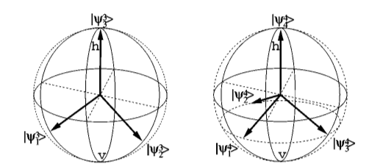
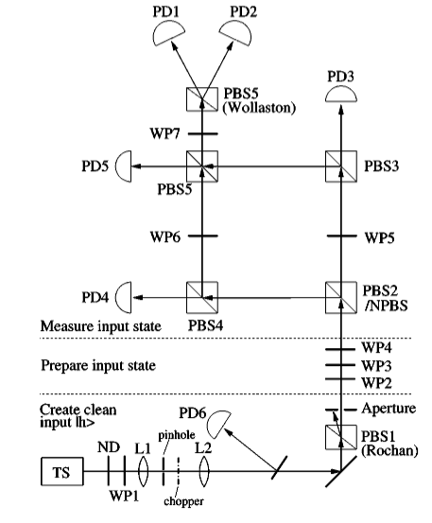
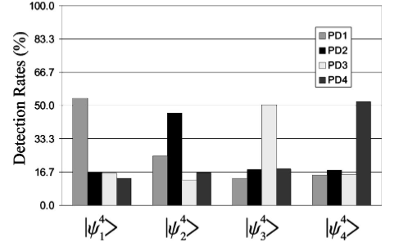
Experimental example
Single photon polarization: 2D system
Minimum error discrimination of 3 states (trine ensemble) and 4 states (tetrad ensemble)
Bulk-optics implementation
One detector for outcome, very straightforward and expensive approach
Laser light simulation
Optimal results!
Not easily scalable to higher dimensions
Clarke, R. B., Chefles, A., Barnett, S. M., & Riis, E. (2001). Experimental demonstration of optimal unambiguous state discrimination. Physical Review A, 63(4), 040305

Slide 10
Unambiguous state discrimination
Useful if don’t want errors to be possible
It is only possible if the states are linearly independent (N=D)
We apply N+1 projectors to the system
N projectors on the N orthogonal subspaces of the (N-1) states subsets, further one collects unconclusive measurements
Strategies must minimize the probability of unconclusive measurements
Crucial feature: every significant measurement provides a correct result, but it is possible to have unconclusive measurement

Slide 11
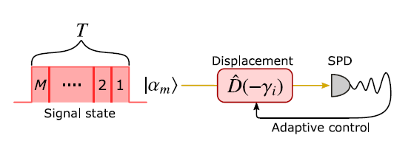
Experimental example
Encoding of states in Quaternary Phase-Shift- Keying (QPSK)
Alphabet of 4 coherent states:
$$\left|α_{m}\right\rangle =| \left|α\right| e^{\left(2m+1\right)iπ/4}⟩$$
Phase displacement $D(−γ_{m})$ sends $\left|α_{m}\right\rangle$ in vacuum state
Signal is split and counting combination gives unambiguous answer or unconclusive
Adaptive variation allows increasing of conclusive results
Signal is split in time and phase displacement is performed considering past results
Enhanced performance but tons of signal needed!
Izumi, S., Neergaard-Nielsen, J. S., & Andersen, U. L. (2021). Adaptive generalized measurement for unambiguous state discrimination of quaternary phase-shift-keying coherent states. PRX Quantum, 2(2), 020305

Slide 12
Quantum Discrimination through a quantum network
Theoretical approach, experimental implementation and results
Laneve, A., Geraldi, A., Hamiti, F., Mataloni, P., & Caruso, F. (2022). “Experimental multi-state quantum discrimination through optical networks”. Quantum Science and Technology 7.2 (2022), p. 025028

Slide 13
The idea
In order to discriminate $N>D$states, a further degree of freedom is needed
The way the system to be analyzed evolve in a network can be exploited for QSD purposes [1]
We impose a dynamics, we observe the state in time
We measure the state after travelling through the network for a certain amount of time
The time of detection can be the supplemental degree of freedom
[1] Dalla Pozza, N., & Caruso, F. (2020). Quantum state discrimination on reconfigurable noise-robust quantum networks. Physical Review Research, 2(4), 043011

Slide 14
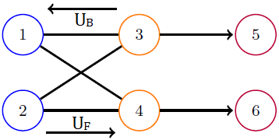
Theoretical framework
Very simple network, the state to be discriminated is the initial state encoded in {1,2} nodes
System is extracted in nodes {5,6} (sinks)
The forward and backward unitaries $U_{F}, U_{B}$ determine the evolution of the initial state
We consider a round-trip in the network as an evolution step
Pairing of extraction time step with the presence of a certain initial state

Slide 15
Experimental implementation
Information carrier is a single photon
The state is encoded in polarization
Nodes of same layer are encoded in polarization
Different layers are encoded different positions
${\hat{U}}_{P}$ preparation stage
${\hat{U}}_{φ_{A/B}}$ phase shifting compensation
1
2
3
4
1
2
5
3
6
4

Slide 16
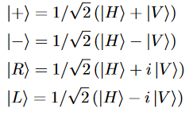
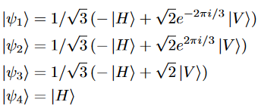
Our Task: four state discrimination
We develop a minimum error QSD protocol for $N=4$states in $D=2$
The unitary operations $U_{F}$ and $U_{B}$are set in such a way that each of the four states features a unique probability distribution in time
Two different sets
Set of geometrically uniform states: Compass Set
Set of maximally distant states: Tetrad Set
$$P_{guess}≤0.5$$
$$P_{guess}≤0.5$$
Optimal evolution unitaries are different for different sets!

Slide 17
Fully Theoretical Dynamics (Node 5)
Compass
Tetrad

Slide 18
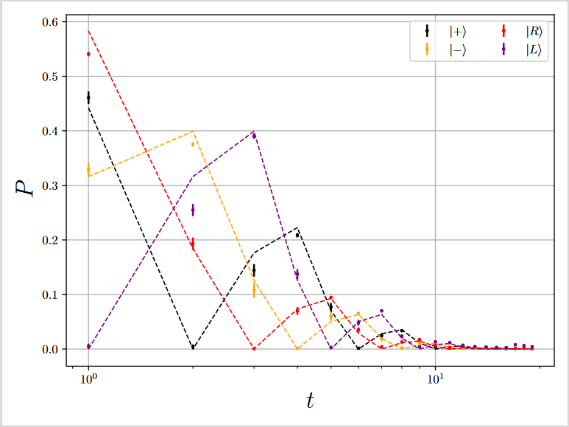
Experimental results:Time-wise distributions (Node 5)
Compass
Tetrad

Slide 19
Conclusion
Further developments and summary

Slide 20
We use time bins as the supplemental degree of freedom
No need for auxiliary systems or complex modal structure in the input
Actual single-photon states
Only two detectors needed (or even one) plus one for triggering
Optimal discrimination in the geometrically uniform case
The choice of states can also improve robustness to decoherence
The receiver can be used for different states sets
Under investigation: increasing the dimensionality of the encoding system, in order to perform more powerful protocols
Further improvements: adaptivity towards random states discrimination

Slide 21
Thank you for your attention!
Time for questions

