Slide 1


A testbed for the SuperB computing model
G. Russo, S. Pardi, D. Del Prete
1
G. Russo, S. Pardi, D. Del Prete
Bologna, 2010 november 16th-17th

Slide 2
The rationale
Following the Ferrara and Frascati meeting, we decided to setup a testbed for SuperB applications
The testbed is based on 12 servers (8 core, 32 GB, 8 disks), connected with a 2x10 GbE
A further server (48 core) under order
The tests will be based on:
  RoCE, MPI, data access, dataset distribution, monitoring tools
G. Russo, S. Pardi, D. Del Prete
Bologna, 2010 november 16th-17th

Slide 3
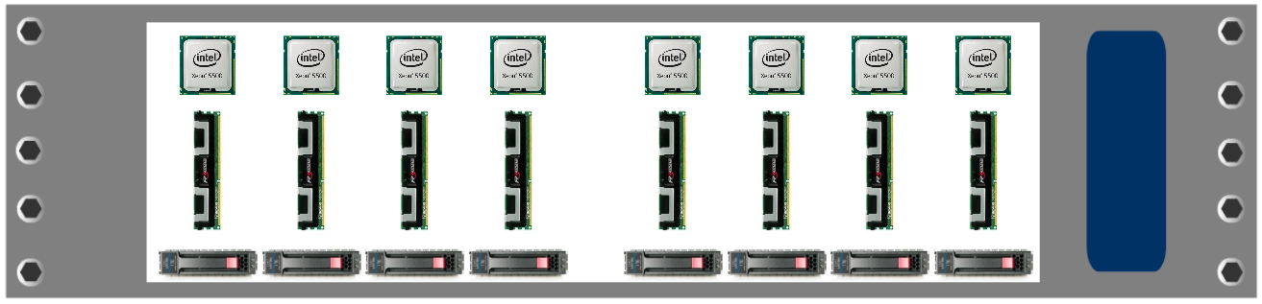
The configuration of each node
2x CPU 2,13GHz 4Core, 4,80GT/s + 4,80GT/s QPI
8x 4GB Dual Rank 1066MHz
8x HDD 500GB 7200rpm SATA Hot-Plug 3,5”
1 Gbps
10 Gbps
1 Gbps
10 Gbps
Twinax
UTP
2
G. Russo, S. Pardi, D. Del Prete
Bologna, 2010 november 16th-17th

Slide 4
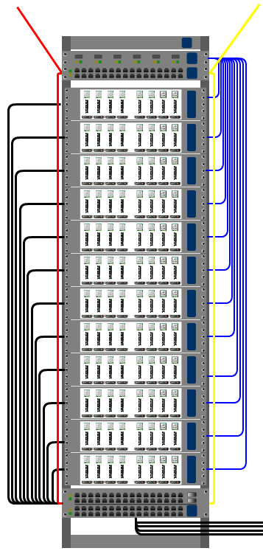
Optical fiber Lan2
10Gbps
Rack 24
Optical fiber Lan1
10Gbps
Swirch 1Gb 48p
Twinax 10Gbps connection
Swirch 10Gb 24p
4x Twinax 10Gbps connection for Rack Next door
3
G. Russo, S. Pardi, D. Del Prete
Bologna, 2010 november 16th-17th

Slide 5
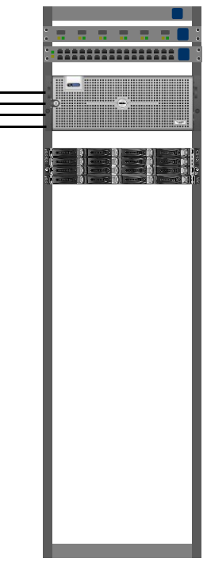
Rack 25
4x Twinax 10Gbps connection
Server 48 Core
128GB di RAM
Storage 16x 3TB
4
G. Russo, S. Pardi, D. Del Prete
Luogo, 16 – 17 novembre 2010

Slide 6
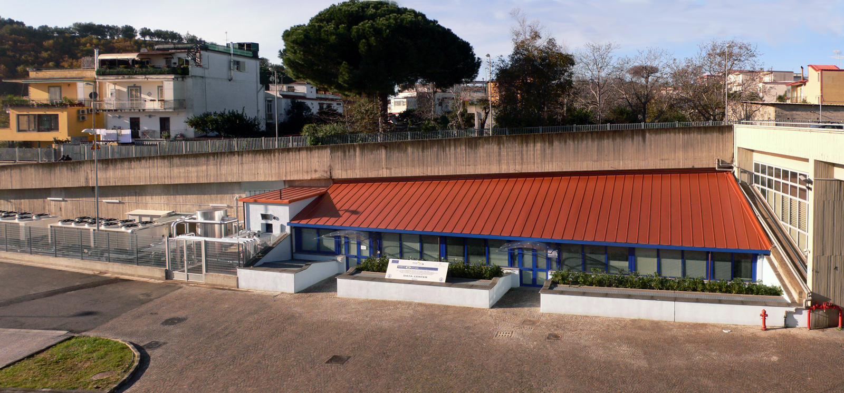
Location: Data Center SCoPE
4
G. Russo, S. Pardi, D. Del Prete
Luogo, 16 – 17 novembre 2010

Slide 7
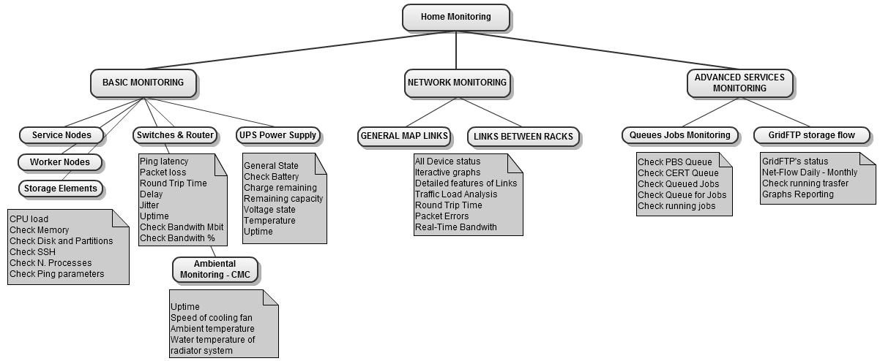
Monitoring tools
We are re-engineering a tool realized during 2009-2010 for the ATLAS TIER2 in Naples. The tool is based on a Enterprise Integration Portal (EIP) [Liferay], integrating a lot of functions already available in other sites, and implementing several additions. The re-engineering will allow to monitor a distributed TIER 1.
5
G. Russo, S. Pardi, D. Del Prete
Bologna, 2010 november 16th-17th

Slide 8
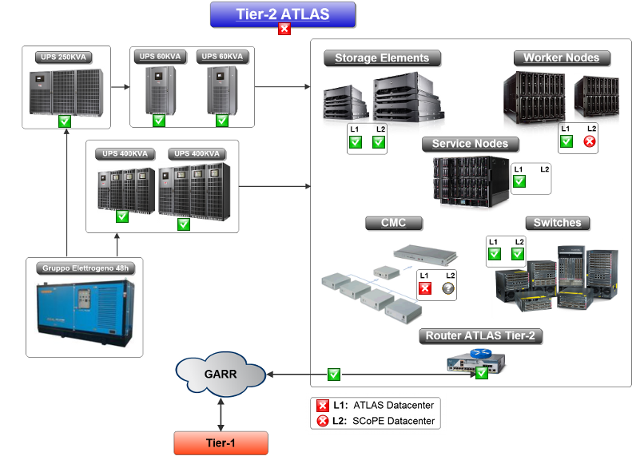
Liferay as a portlet container
Using Liferay as a portlet container, we could integrate several etherogeneous tools, allowing an integrated vision of all devices and all services
6
G. Russo, S. Pardi, D. Del Prete
Bologna, 2010 november 16th-17th

Slide 9
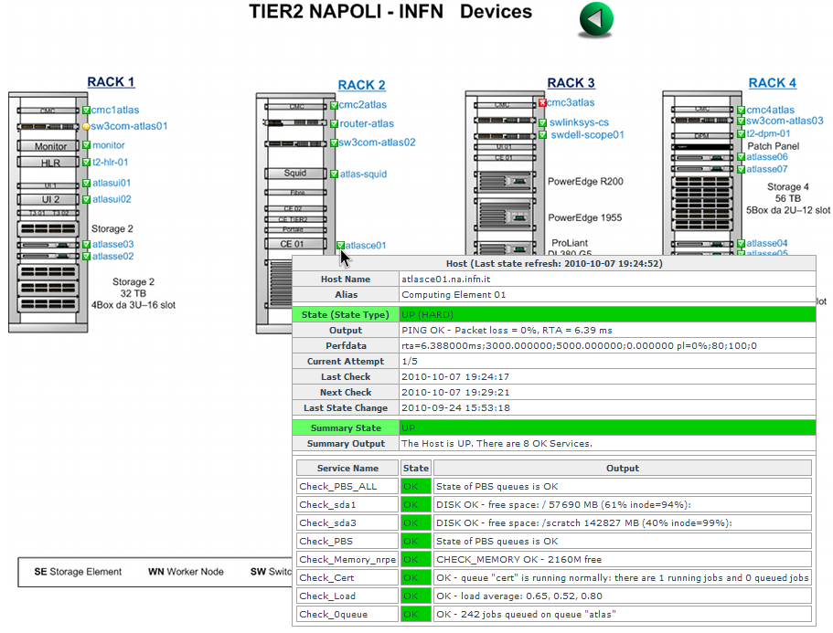
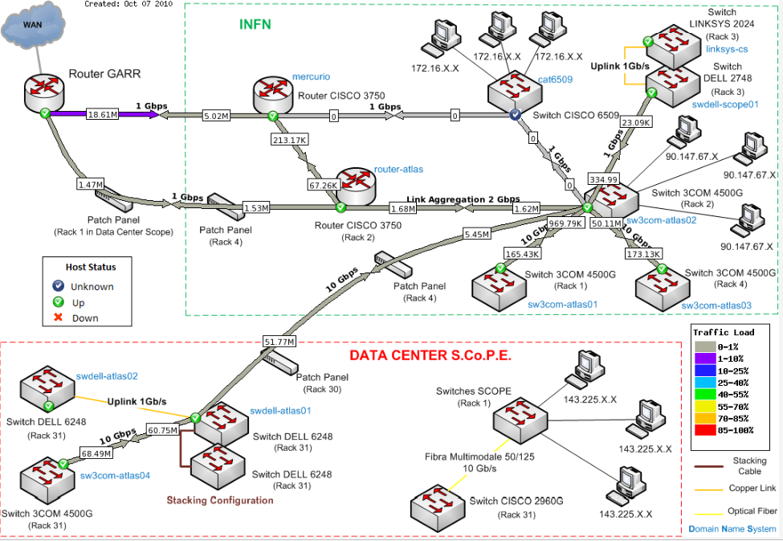
Examples (tier2.na.infn.it)
We can monitor hosts, storage, devices, data transfers, services, with a single tool
7
G. Russo, S. Pardi, D. Del Prete
Bologna, 2010 november 16th-17th

Slide 10
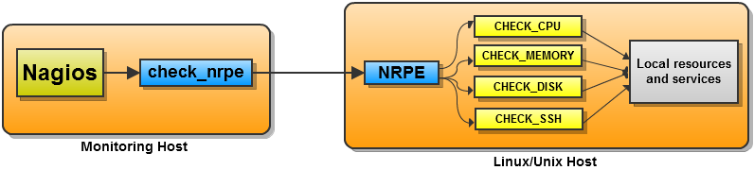
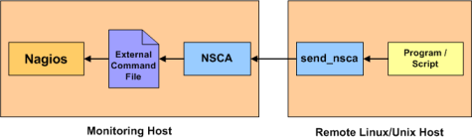
The collection of monitoring data
We used NRPE (Nagios Remote Plugin Executor) on each node, avoiding too much load on the central monitoring station
When the server cannot be reached (e.g. because of a firewall) we used NSCA (Nagios Service Check Acceptor) that is, is the server to send data to the central monitoring station
8
G. Russo, S. Pardi, D. Del Prete
Bologna, 2010 november 16th-17th

Slide 11
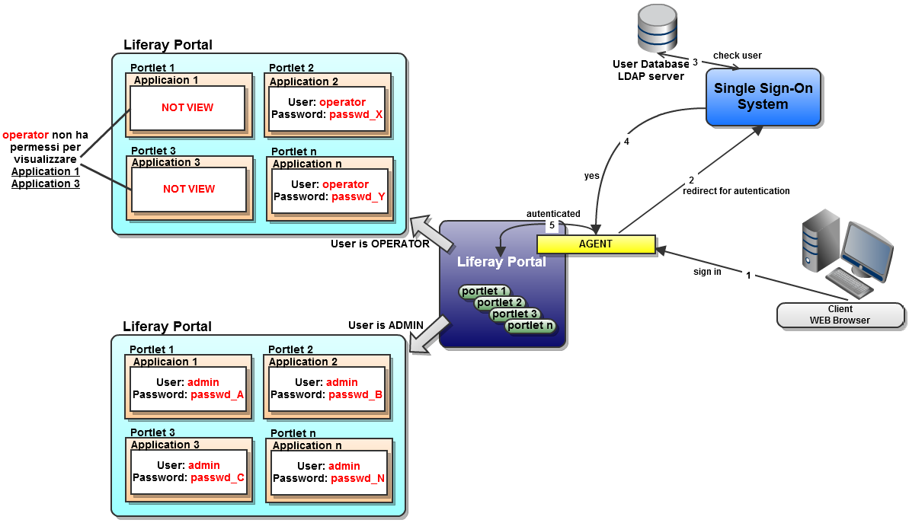
Architecture of the monitoring portal
Liferay integrates all tools, and will provide base services (like SSO)
9
G. Russo, S. Pardi, D. Del Prete
Bologna, 2010 november 16th-17th

Slide 12
The software we used
Nagios for monitoring all services
Nagvis for interactive navigation
NaReTo for the reporting
Centreon for advanced services
Cacti for monitoring the network devices
Weathermap for a topological navigation of the network
Integration of the following applications: GRIDICE, GANGLIA e POWERFARM
10
G. Russo, S. Pardi, D. Del Prete
Bologna, 2010 november 16th-17th

