Slide 1
HADOOP Experience @Naples
Dr. Silvio Pardi
INFN-Naples

Slide 2
OUTLINE
Motivation
What is Hadoop/HDFS
Current TestBed setup in Naples
Preliminary Test
Possible Scenarios
Conclusion and future Works

Slide 3

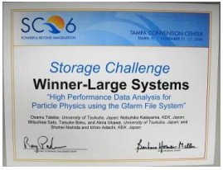
GFARM-MODEL
IN THE FERRARA SuperB COMPUTING MEETING
OF MARCH 2010
Masahiro Tanaka Present GFARM
• File Affinity Job Scheduling
– Move and execute program instead of moving large-scale data at Worker Node Level
This approach the WINS THE STORAGE CHALLENGER In Super Computing 2006

Slide 4
INVESTIGATION GOAL
Understand the state of art of GFARM-like approach
Study the scalability, reliability and performance of the already available solutions that implement the File Affinity Job Scheduling
Understand if File Affinity Job Scheduling is suitable for HEP and for the SuperB Computing Model.
Understand the possible relations/integration with gLite

Slide 5
COLABORATION
Collaboration among the INFN-Naples, the University of Naples Federico II and the INFN, Bari and Pisa Unit – People Involved S.Pardi, G.Russo, G.Donvito, A. Fella, incoming people are welcome.
We have 3 Thesis on the SuperB computing Model (Prof. G.Russo realtor, and Silvio Pardi tutor).
The first framework that we want evaluate is HADOOP.
Students are a great resource for unfunded activities!

Slide 6
HADOOP
What Is Hadoop?
Hadoop is a complete solution open-source for reliable, scalable, distributed computing, is totally write in JAVA. Hadoop is distributed by APACHE includes a set of subprojects, the main component are:
Hadoop Common: The common utilities that support the other Hadoop subprojects.
HDFS: The hadoop distributed file system
MapReduce: A software framework for distributed processing of large data sets on compute clusters.
MapReduce Framwork
Block File Affinity Scheduling
SERVER
SERVER
SERVER
SERVER
HDSF FILE SYSTEM

Slide 7
HDSF CARACTERISTICS
HDSF is the Hadoop File system.
HDFS is designed to be highly fault-tolerant with commodity hardware
An HDFS instance may consist of hundreds or thousands of server machines, each storing part of the file system’s data
The detection of faults and quick, automatic recovery is a core architectural goal of HDFS.
HDFS doesn't provide a native POSIX interface, but we have a fuse module
HDFS doesn't provide multi-streaming writing and random-writing but just append.

Slide 8
HDSF
HDSF provide 2 main component:
Name Node (metadata node)
DiskNode (server that share disk space)
The files in HDSF are split in block of 64MB and distributed on the DiskNode. Each part of file is replicate 3 time (configurable) in different node in order to guarantee the filesystem access in case of accident or DiskNode downtime.

Slide 9
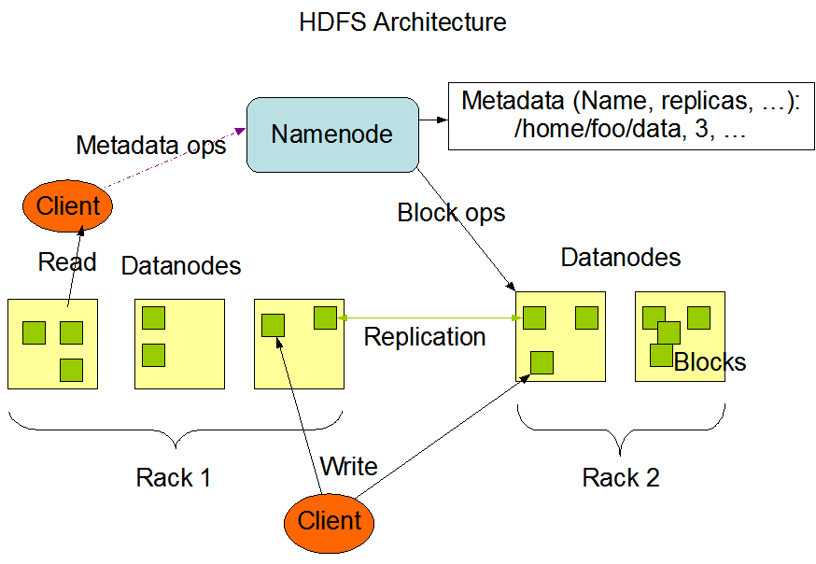
HDSF Architecture
A Rack is a collection of DataNode.
HDSF manage
automatically
The blocks file replica: inter-rack and intra-rack

Slide 10
HDSF data placement
“The placement of replicas is critical to HDFS reliability and performance. Optimizing replica placement distinguishes HDFS from most other distributed file systems.”
HDFS block placement
Today the algorithm for placing a file's blocks across datanodes in the cluster is hardcoded into HDFS.
HDFS declare to support pluggable block placement algorithms.

Slide 11
Map/Reduce
Map/Reduce is a programming model and a framwork implemented in Hadoop.
The Map/Reduce framework and the HDFS work together on the same set of nodes.
This configuration allows the framework to effectively schedule tasks on the nodes where data is already present, resulting in very high aggregate bandwidth across the cluster.

Slide 12
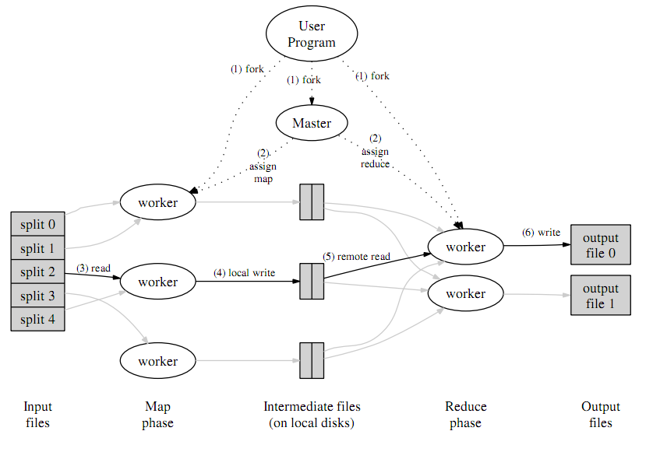

Slide 13
HADOOP vs gLite
Map/Reduce work at cluster level as gLite at Site Level.
gLite Data Affinity Scheduling among the Site
Map/Reduce File Block Affinity Scheduling in the cluster
Are we able to Converge this two Technologies in a Single middware?

Slide 14
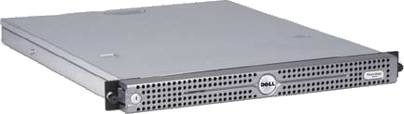
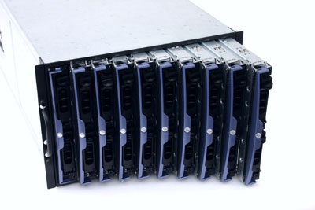
CURRENT Gbit/s TESTBED IN NAPLES
TESTBED WITH COMMODITY HARDWARE
4 SERVER R200 WITH 1 GigabitETH
250GB OF DATA DISK AVAILABLE
10 SERVER BLADE WITH 1 GigabitETH AND 100GB OF DATA DIKS AVAILABLE
THE SERVER ARE CONNECTED ON A 1Gbit/s SWITCH

Slide 15
HDSF-HADOOP IMPLEMENTATION
HDSF Name Node
GIGABIT SW
1 NAME NODE
1 SCONDARY Name Node
8 WORKER NODE / DATANODES that share
the local disk
All the DataNode mount
HDSF Posix Inferface through
Fuse module
HDSF Secondary Name Node
WN1/DataNode
WN2/DataNode
WN../DataNode
WN8/DataNode
CLIENT

Slide 16
HDSF-HADOOP IMPLEMENTATION
HDSF Name Node
GIGABIT SW
1 NAME NODE
1 SCONDARY Name Node
8 WORKER NODE / DATANODES that share
the local disk
All the DataNode mount
HDSF Posix Inferface through
Fuse module
HDSF Secondary Name Node
HDFS FILE SYSTEM
WN1/DataNode
WN2/DataNode
WN../DataNode
WN9/DataNode
CLIENT

Slide 17
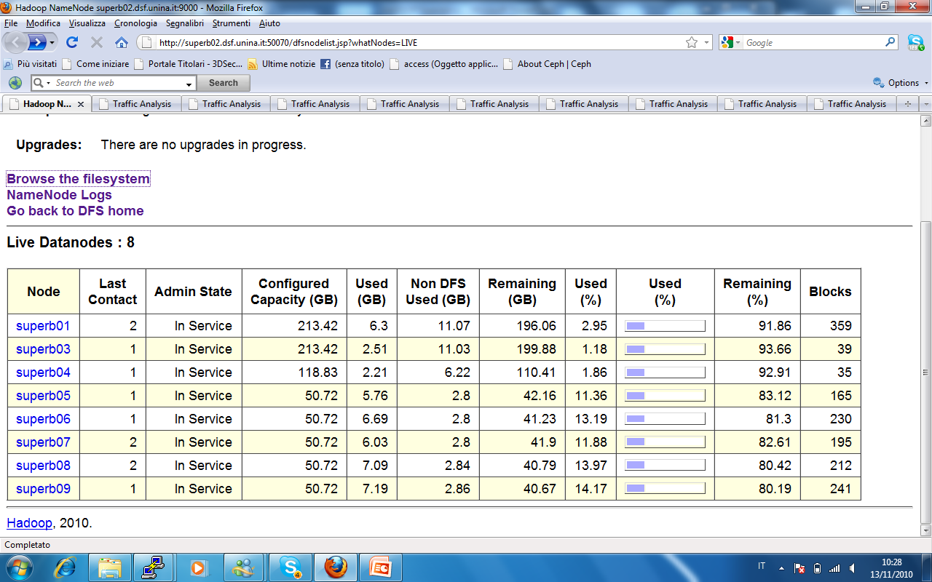
HADOOP CLUSTER IN NAPLES
http://superb01.dsf.unina.it:50075/browseDirectory.jsp?namenodeInfoPort=50070&dir=/

Slide 18
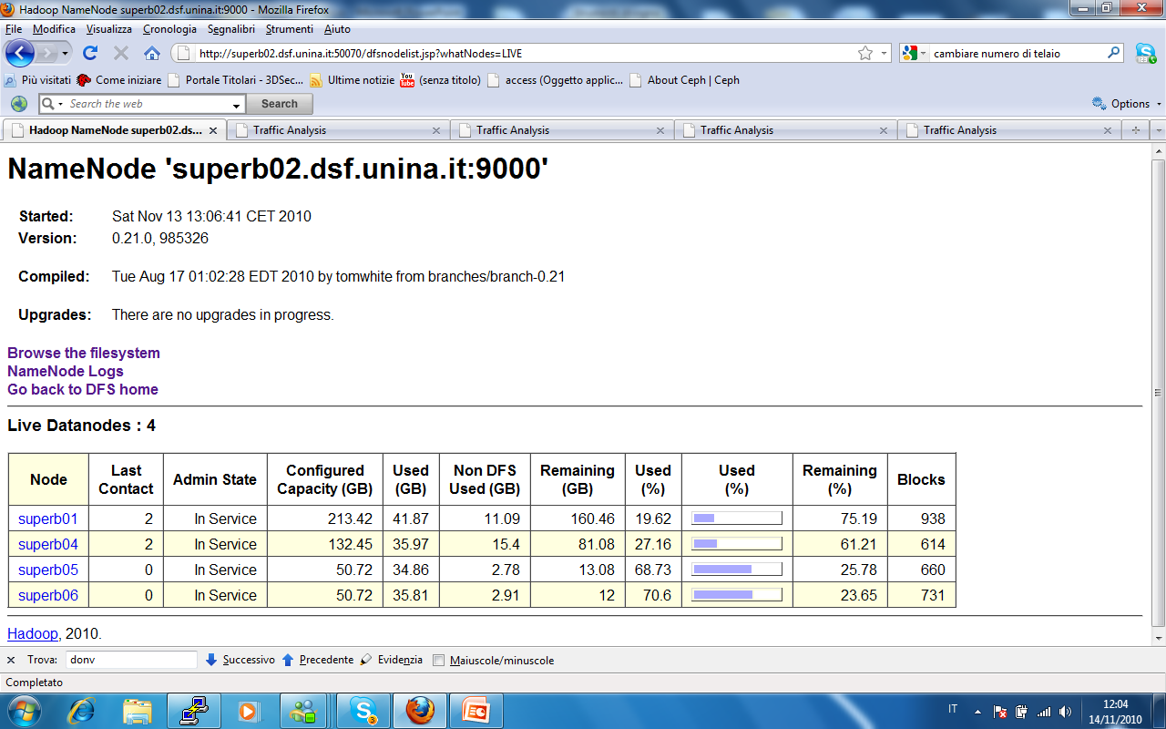
RELIABILITY TEST: DataNode in Fault
RELIABILITY TEST: The file system is still fully accessible after the stop (in sequence) of 4 DataNode and application reading the files doesn't stop to work.

Slide 19
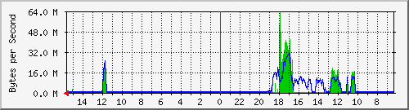
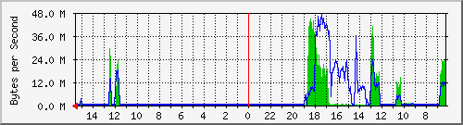
RELIABILITY TEST: DataNode in Fault
When the HDSF Name Node detect a fault of some Data Node, it take care to automatically replicate the blocks present in the dead DataNodes in order to maintain the same number of file replica in the filesystem.

Slide 20
RELIABILITY TEST: NameNode in Fault
In the current implementation HDSF use a single NameNode server and a Secondary NameNode synchronized with the primary every 60s (configurable)
RELIABILITY TEST: By switching off the primary NameNode, the file system is correctly recovered by using the secondary NameNode server.
NOTE AT THE STATE OF ART THIS OPERATION REQUIRE A RESTART OF HDFS SERVICE ON THE DATANODE

Slide 21
HOW TEST HADOOP PERFORMANCE?
In the HDFS the standard benchmark bonnie++ or IOZONE cannot be esecuted because some posix call are not implemented (for example random write).
To test the performance on our implementation we have used
A Test ad HOC on the file system mounted by fuse
The Hadoop/MapReduce Standard Benchmark provided by APACHE
During the test we monitor the network activities among the nodes

Slide 22
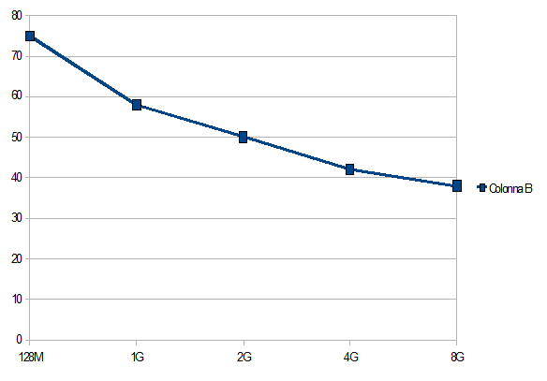
WRITE PERFORMANCE
Write Bernchmark using the fuse module from a single client
THE BENCHMARK COPY A SET OF FILE OF DIFFERENT SIZE THROUGH THE POSIX INTERFACE
MEAN VALUE OF 40GB/s
HADOOP SEEM THAT IS
NOT ABLE TO SATURATE THE NETWORK
MB/S
FILE SIZE

Slide 23
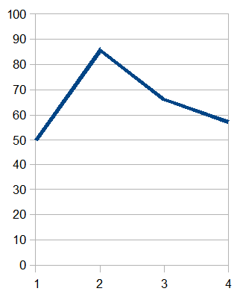
WRITE PERFORMANCE
Write Bernchmark using the fuse module from a single client
THE BENCHMARK COPY A SET OF FILE OF 2G WITH MULTIPLE PROCESS
HADOOP SEEM THAT IS
NOT ABLE TO SATURATE THE NETWORK
MB/S
NUMBER OF PROCESS

Slide 24
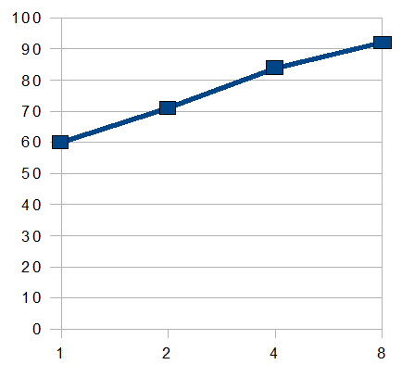
READ PERFORMANCE
Read Bernchmark using the fuse module (1 to 8 client in the same host)
THE BENCHMARK COPY READ A SET OF 1GB FILE THROUGH THE POSIX INTERFACE
MAX VALUE IS 93GB/s WITH 8 CLIENT
MB/S
Number of client

Slide 25
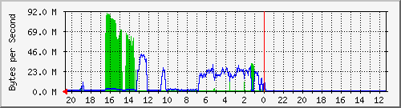
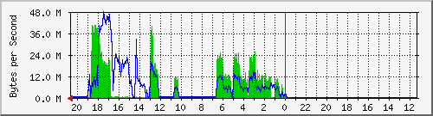
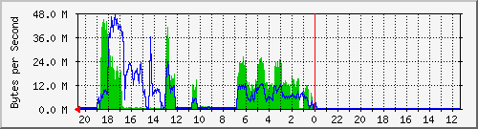
NETWORK USAGE
Client
Data Node
Data Node

Slide 26
NETWORK TRAFFIC
WRITE TEST
Client
Data Node
Data Node

Slide 27
NETWORK TRAFFIC
READ TEST
WRITE TEST
Client
Data Node
Data Node

Slide 28
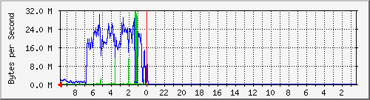
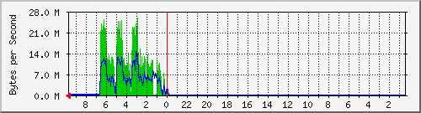
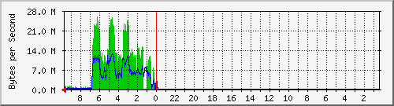
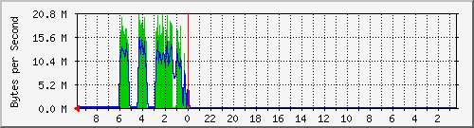
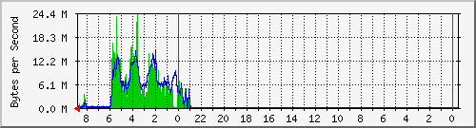
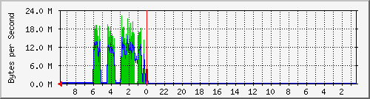
DATANODE NETWORK USAGE
Writing: All the node participate during the writing activities

Slide 29
HADOOP BENCHMARK
In the Writing Test we achieve a maximum I/O throughput of 42.1MB/s
Reading Test , we achieve a maximum I/O throughput of 110MB/s.
The benchmark use a MapReduce job to estimate reading performance.
The benchmark schedule a single read task per file block, send the each task to the DataNode which contain the block, then calculate the aggregate throughput.

Slide 30




HDFS – Geographic testbed
Geographical distributed Storage Element
Pisa
Caracterizing HDFS for high throughput data transfer is an issue arised at CHEP2010 in Taipei by the CMS Group
HDFS

Slide 31
HDFS – Geographic testbed
500GB of SuperB simulate data are replicated from Pisa to Naples in order to test analisys job with hadoop,
The same data can be shared with INFN-Bari hadoop Rack through the distribute HDFS . We are ready to test in the next month.
Pisa
HDFS
IS HDFS SUITABLE FOR A DISTRIBUTED COMPUTER
FACILITY TIER1-LIKE?

Slide 32
Consideration
HDSF reach the best performance if used toghether with the map/reduce framework.
Moreovre the possibility to porting HEP code in the Map/Reduce framework using the Block File Affinity Job Scheduling seem a promitent issue to investigate
Although the Hadoop framework is implemented in Java Map/Reduce applications need not be written in Java.
Hadoop Streaming is a utility which allows users to create and run jobs with any executables (e.g. shell utilities) as the mapper and/or the reducer.
Hadoop Pipes is a SWIG- compatible C++ API to implement Map/Reduce applications (non JNITM based).

Slide 33
ISSUE IN ADOPTING HADOOP
Is possible wrap a HEP job analisys as a Map/Reduce application?
Can an HEP application take advantage from the file block affinit schedulig in term of jobexecution throughput?
MapReduce use a private queue, is possible integrate/interface MapReduce with gLite framework?

Slide 34
HADOOP Scenario
EVOLUTION
CLASSIC Scenario
HDSF Name Node
10 GIGABIT SW
ISCSI-FC
10 GIGABIT SW
SE
HDFS FILE SYSTEM
SE
WN1
WN1/DataNode
WN2/DataNode
Strorage Controller
WN2
WN../DataNode
WN..
WN9/DataNode
WNn

Slide 35
EVOLUTION
HADOOP Scenario
CLASSIC Scenario
HDSF Name Node
10 GIGABIT SW
ISCSI-FC
10 GIGABIT SW
SE
HDFS FILE SYSTEM
SE
WN1
WN1/DataNode
WN2/DataNode
Strorage Controller
WN2
WN../DataNode
WN..
WN9/DataNode
WNn
ISCSI-FC
10 GIGABIT SW
WN1/DataNode
10 GIGABIT SW
SE
WN2/DataNode
SE
WN1
WN../DataNode
Strorage Controller
WN2
WN9/DataNode
WN..
WNn

Slide 36
Conclusion and future work
HDSF provide a reliable and resilient distributed file system, the technology seem mature and useful for consolidation with certain margin of improvement.
HDSF is design to support the MapReduce framework, so the best performance can be reach by the computational jobs that can be wrap in this environment.

Slide 37
Conclusion and future work
TEST HDFS ON THE NEW 10Gbit CLUSTER IMPLEMENTING IN NAPLES.
CARACTERIZING HDFS FOR GEOGRAPHIC HIGH THROUGHPUT DATA TRANSFER
INVESTIGATE THE POSSIBILITY TO WRAP AN HEP DATA ANALISYS JOB IN THE MAP/REDUCE FRAMEWORK
COMPARE THE HDFS WITH OTHER FILESYSTEM THAT SUPPORT SIMILAR FACILITY: CEPH, GLUSTER, NFS4.1

Slide 38
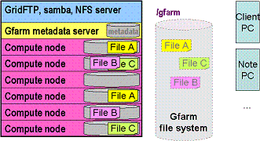
GFARMFS vs HDSF
GFARMFS STORE AND REPLICATE FILES WHERE HDFS STORE AND REPLICATE BLOCK FILE AMONG THE DATANODE

Slide 39
RISERVA

Slide 40
Additional ISSUE
Map/Reduce over other Filesystem like CHEP, GLUSTER or similar
GFARM over CEPH of GLUSTER
Is possible configure PBS/LSF to provide file affinity job scheduling on the topo of HDFS or other file system?

Slide 41
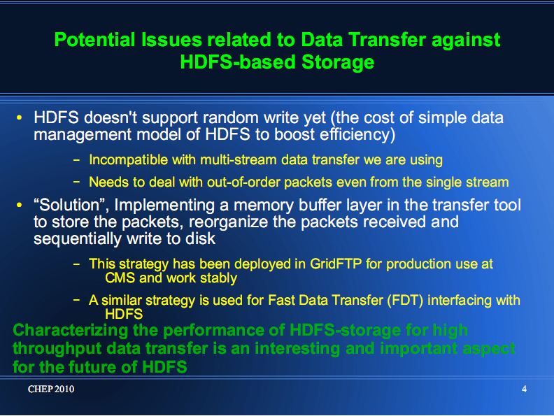

Slide 42
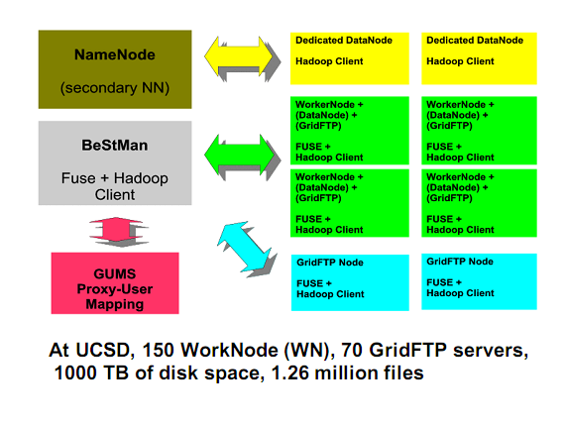
HDSF EXPERIENCE IN HEP

Slide 43
Map/Reduce
A Map/Reduce job usually splits the input data-set into independent chunks which are processed by the map tasks in a completely parallel manner. The framework sorts the outputs of the maps, which are then input to the reduce tasks. Typically both the input and the output of the job are stored in a file-system. The framework takes care of scheduling tasks, monitoring them and re-executes the failed tasks.

Slide 44
Map/Reduce
Typically the compute nodes and the storage nodes are the same, that is, the Map/Reduce framework and the Hadoop Distributed File System (see HDFS Architecture ) are running on the same set of nodes. This configuration allows the framework to effectively schedule tasks on the nodes where data is already present, resulting in very high aggregate bandwidth across the cluster.

Slide 45
Map/Reduce
The Map/Reduce framework consists of a single master JobTracker and one slave TaskTracker per cluster-node. The master is responsible for scheduling the jobs' component tasks on the slaves, monitoring them and re-executing the failed tasks. The slaves execute the tasks as directed by the master.

Slide 47
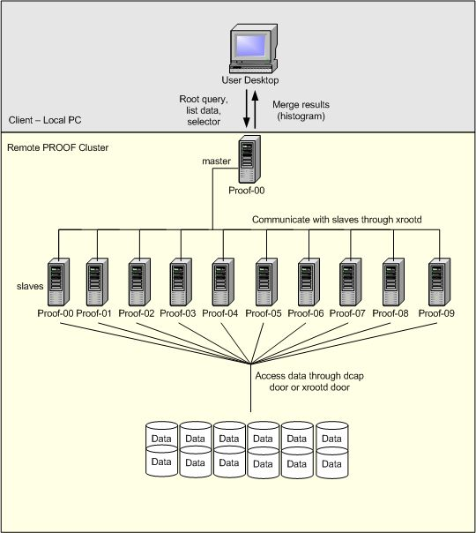
PROOF

