Slide 1


Project Manager Report
Emmanuel Clément (GANIL)
AGATA Pre-PAC meeting 2022

Slide 2
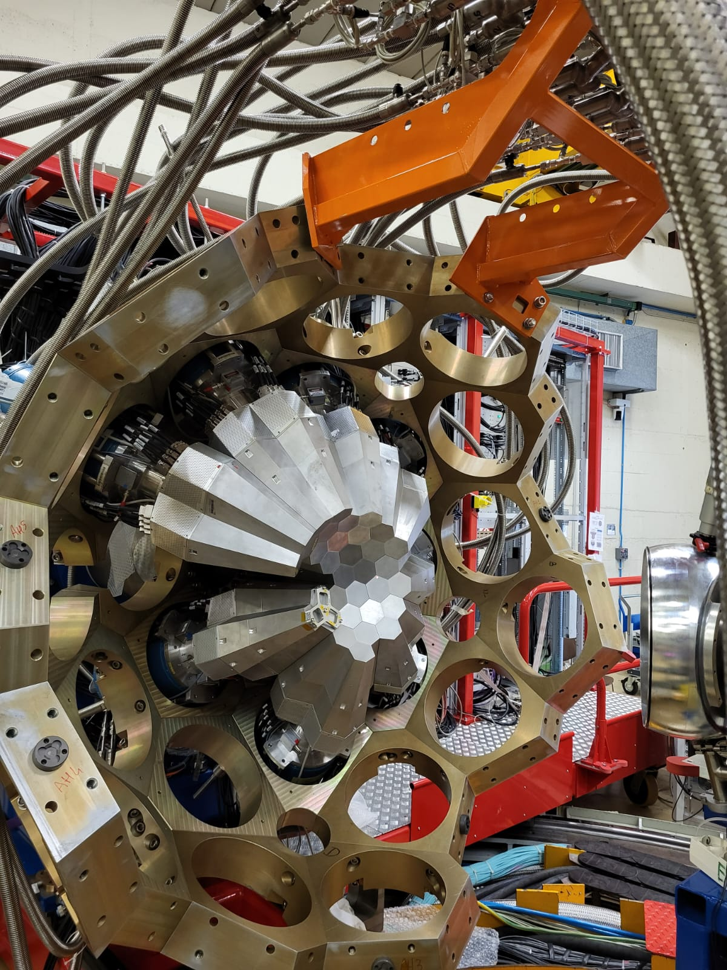

Congratulations to all AGATA WG and Teams,
to the Local Team
for the AGATA transfer,
installation
and first data taking

Slide 3
We are starting a new phase of the Project : Phase 2
The objectives of Phase 2 funded by the MoU are :
Acquiring 78 Asymmetric segmented HPGe capsules – 3π available for experiments
Acquiring 26 AGATA Triple cryostats
Acquiring 1 Po storage disk
Acquiring Data Acquisition Infrastructures such as network switches and blades for services
Acquiring a computer farm (HPC) for the PSA on-line treatment of 135 capsules
Acquiring a Detector Support System for 135 capsules, Low and High voltages supplies, LN2 auto-fill system and related cables.
Maintaining An up-to-date Data Base
Developing and maintaining a set of software algorithms for on-line and off line data processing
Developing, maintaining and distributing a framework for Data Analysis
Designing and constructing a unique mechanical structure holding 45 AGATA Triple cryostats
Developing and maintaining a unique Front and back electronic for 135 capsules (Analog preamps, digitizer DIGOPT12, Processing PACE-STARE with clock and trigger functionalities (GTS/SMART)) and its software control.
Developing, maintaining and distributing a state of the art simulation package and performances control.
The AGATA Project includes a continuous R&D activities which is included in each Working Group structures but not funded by the MoU.

Slide 4

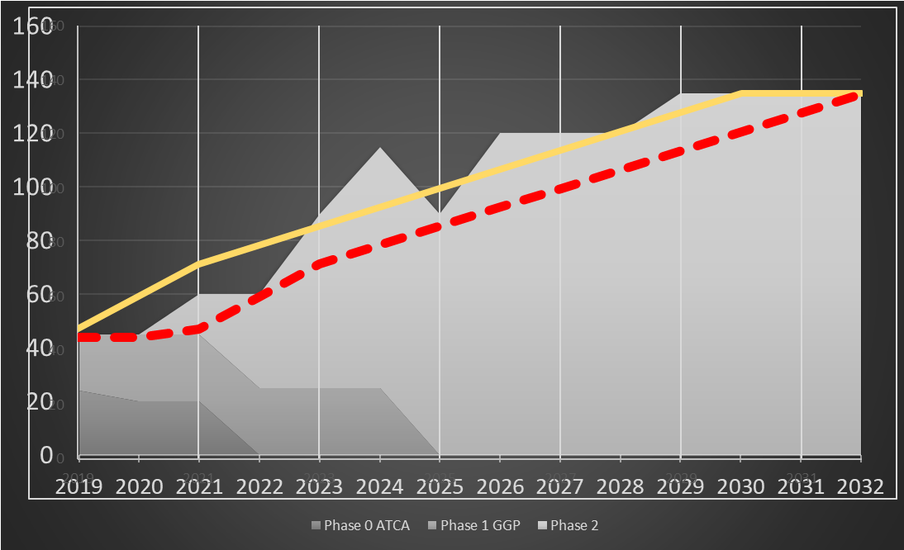
Project Plan Phase 2
The detailed Project Plan : ATRIUM-563607, ATRIUM-563609
MoU funding scheme (section 3.6)
The present project plan, conceived technically for a 4π array,
foresees the construction of a 3π array with capital investment from 2021 to 2030, consistent with the MoU,
22M€ investment
The production of the Triple Clusters constrains the project
The project plan is based on an annual production of 2-3 Triple Clusters (ordered, produced, assembled and tested)
→ A 2π system available by the end of the LNL campaign ( ~ 2025-2026) and for the start of the next campaign >2026 (FAIR, GANIL, ISOLDE …)
Close to the 3π system delivered by the end 2028-2029
The project plan will evolve to the construction of the 4π array
Main milestone
Capsules order placed
Clusters in operation
Electronic channels ordered

Slide 5

→League change
15k channels of High Resolution
150 k parameters for LLP setting
~100 To / week if traces …
Summer 2020 – International review

Slide 6

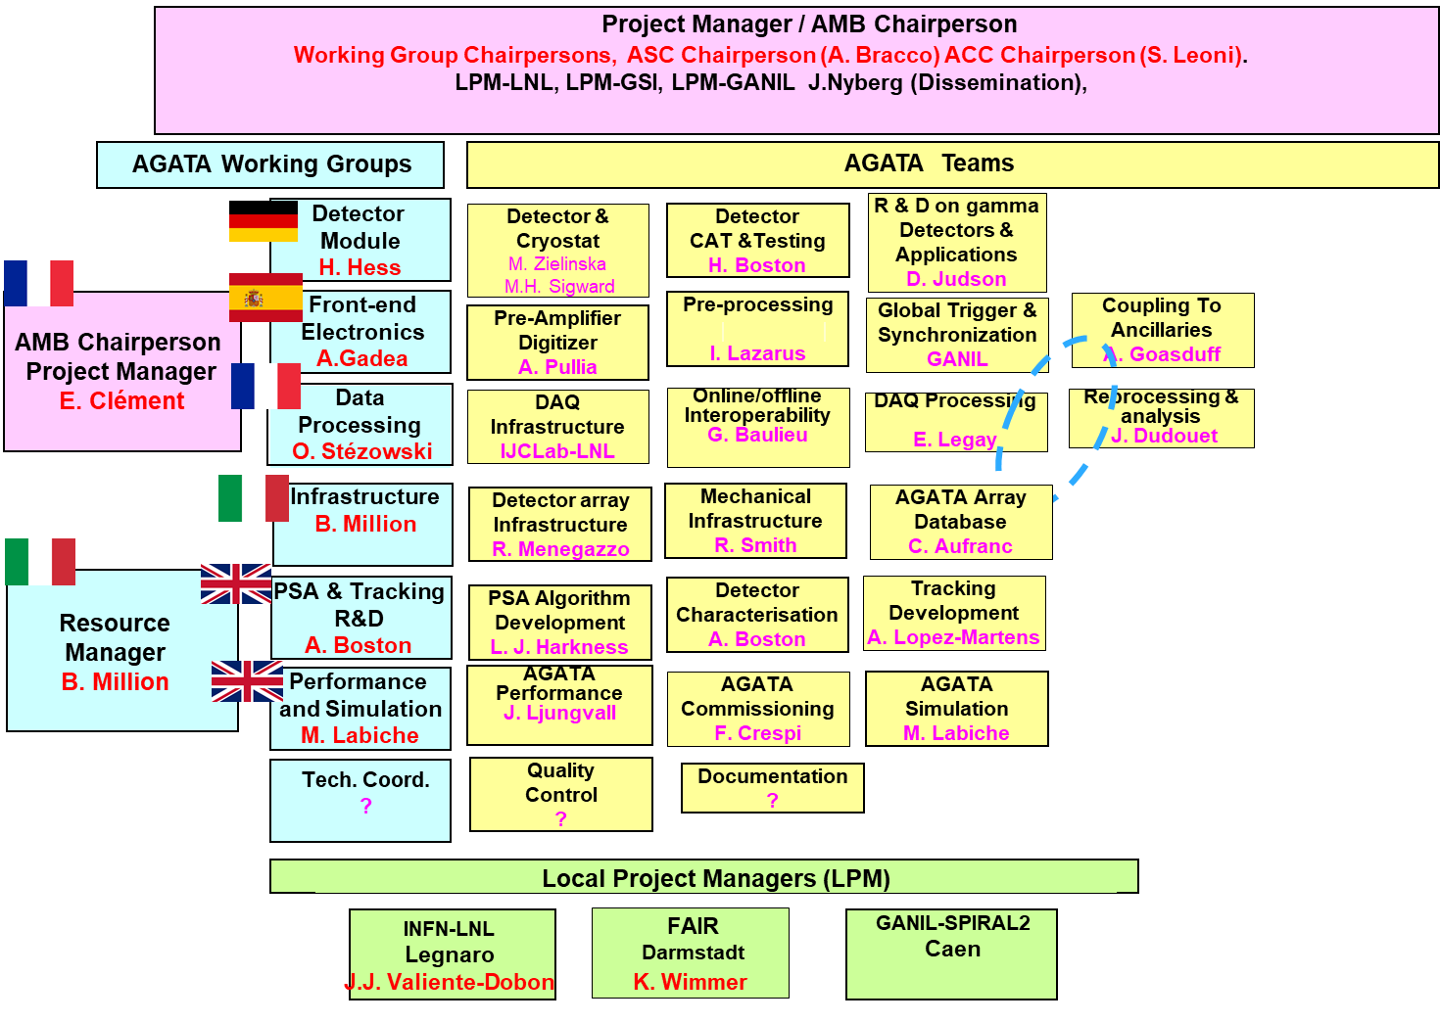
AGATA Management Board and Teams Phase 2
https://atrium.in2p3.fr/
Detailed task distribution and responsibilities : ATRIUM-620936
Risk analysis : ATRIUM-563604

Slide 7
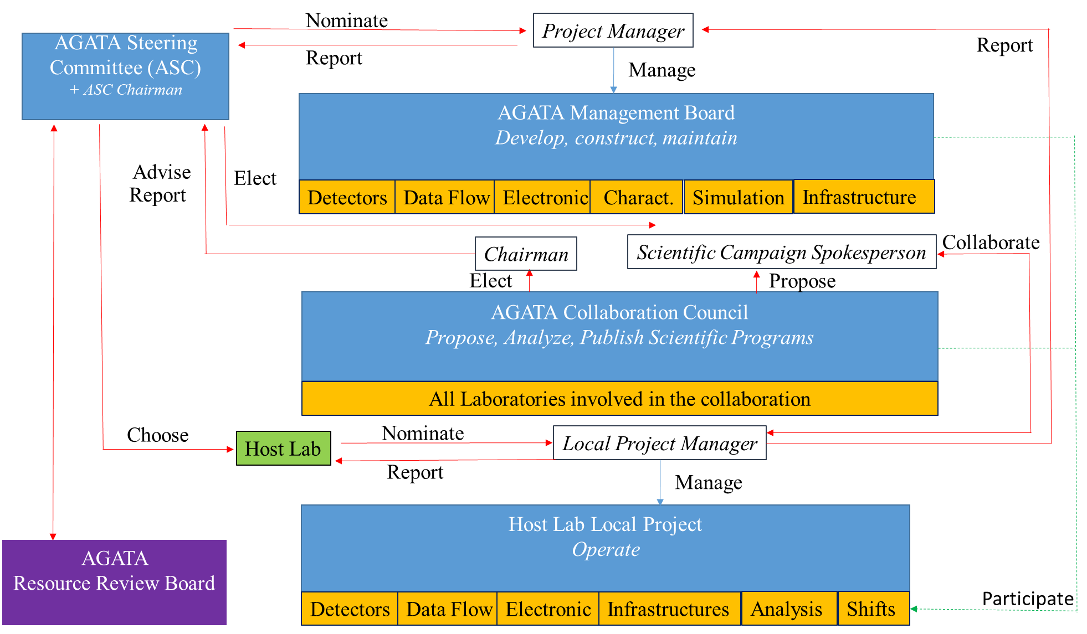
Phase 2 Management
Part of the management portfolio : ATRIUM-563598

Slide 8
Data Policy & DMP
Data Policy & DMP
Access to the data is to be controlled by the AGATA collaboration.
The AGATA Spokesperson delegates this control to P.I for 5 years
The data for exploitation will be then made available to the wider AGATA collaboration
All bona-fide members of the AGATA collaboration will have access to the data to improve the operation of the instrument, for example to monitor and improve detector performance
CCIN2P3 – CNAF (40To/week -2017 ; 100 To/week - 2030)
Evolution on-going of the DMP toward « FAIR » & « Open science »
The ACC must be informed of the reference for publications relating to AGATA within three months of the publication date.
The experimental collaboration should acknowledge the work of the wider AGATA collaboration and the host laboratory in any publication.
.
Scientific submission must include the Core List Authors
All AGATA technical and instrumentation manuscripts must be sent to the AMB for review before being submitted to a journal.
https://www.agata.org/physics_publication_submission
https://www.agata.org/acc/data_policy

Slide 9
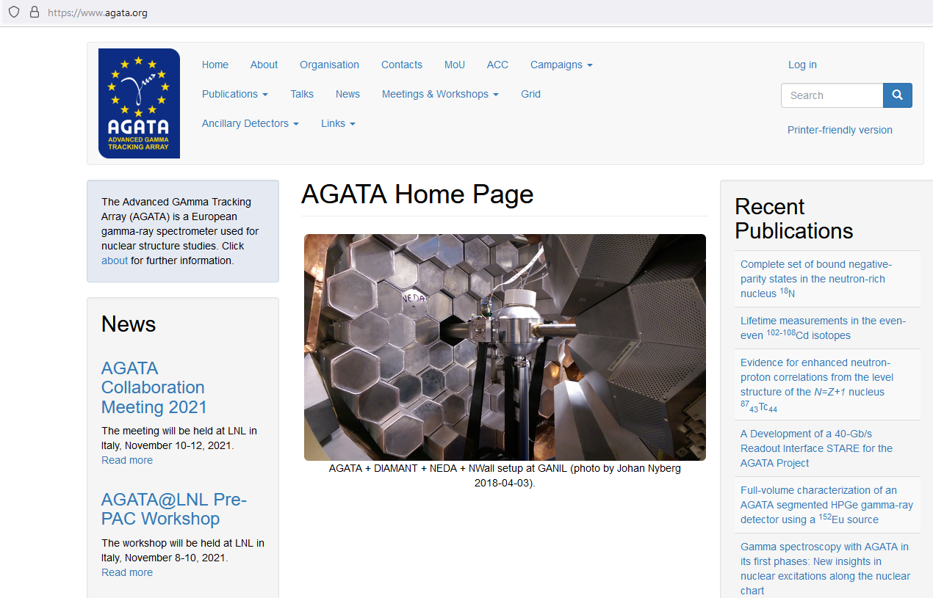
Dissemination
Technical Papers –
Scientific Papers
PhD – Master etc …
Contact : J. Nyberg

Slide 10
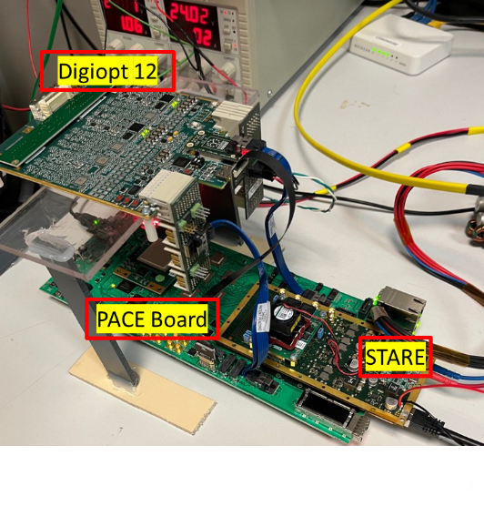
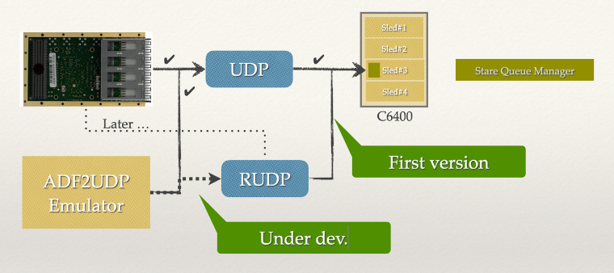
AGATA@LNL [2022-2023[
AGATA is running presently on the phase 1 resources
GGP-DIGOPT12 FEBEE (AGATA+GALILEO Loan)
39 Capsules taking data
As soon as phase 2 FEBEE is considered operational, we will progressively improve the efficiency
Phase 2 development is progressing fast
    AGATA owns 60 Asym-Capsules
    Delivery of the first LVPS phase 2
    Delivery of the first batch of phase 2 ATC
    Phase 2 resources foreseen to replace by ~2025 the phase 1 FEBEE
    Meanwhile, mix Phase 1 & Phase 2 will coexist

Slide 11
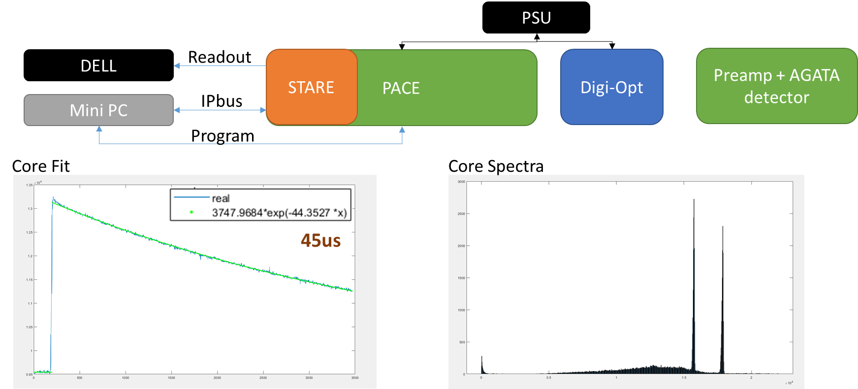
AGATA@LNL [2022-2023[
Courtesy Javier Collado
    First ⁶⁰Co spectrum of a Phase 2 DIGOPT12-PACE-STARE electronic chain

Slide 12
