Slide 1

The Neutrino Factory
K. Long,
17Mar11
for the IDS-NF
collaboration

Slide 2

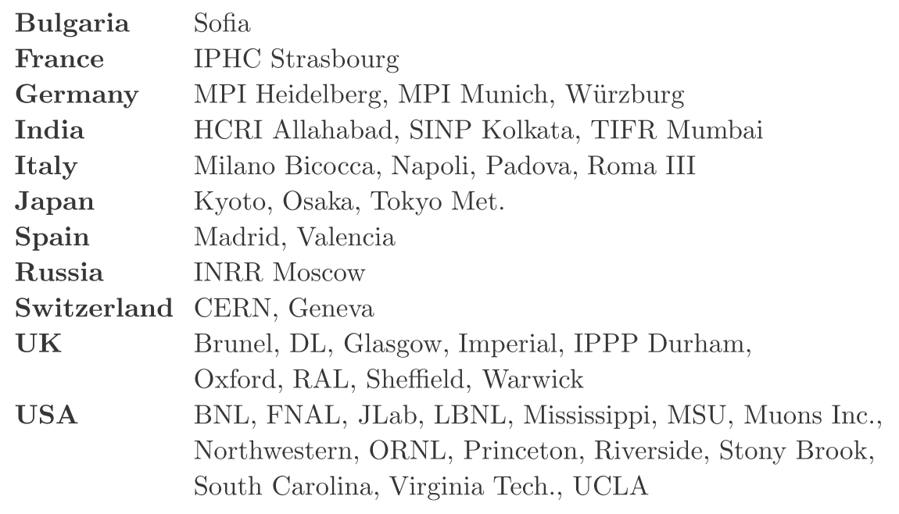
Acknowledgements:
Many thanks to those who provided information or material:
  And in particular the International Design Study for the Neutrino Factory (the IDS-NF) collaboration and the EUROnu collaboration

Slide 3
Prologue
The Neutrino Factory:

Slide 4
The case for exquisite sensitivity:
Implications of neutrino oscillations:
  Neutrino mass and mixing; the Standard Model is incomplete;
  CP-invariance violation via (Dirac) phase in the mixing matrix;
  Neutrino may be a Majorana fermion—a new state of matter;
  The tiny neutrino mass may be a unique window on physics at extremely high energies scales;
  The neutrino may make a significant contribution to:
    The generation of the matter-dominated Universe (leptogenesis);
    Dark matter
Precision measurements are essential to:
  Search for (and discover?):
    Leptonic CP-invariance violation;
    The mass hierarchy
  Determine the degree to which:
    θ ₂₃ differs from π/4
    θ ₁₃ differs from 0

Slide 5
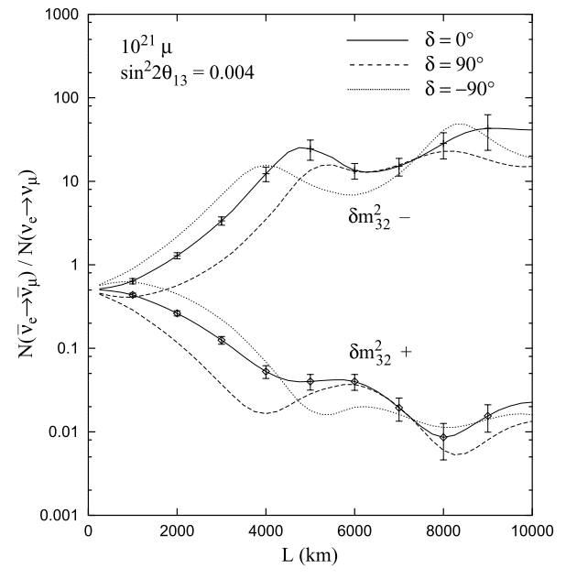
The Neutrino Factory:
Optimise discovery potential for CP and MH
  Requirements:
    Large ν_{e} (ν_{e}) flux
      Detailed study of
      sub-leading effects
    (Large) high-energy
    ν_{e} (ν_{e}) flux
      Optimise event rate at
      fixed L/E
      Optimise MH sensitivity
      Optimise CP sensitivity
MH
CP
CERN-2004-002

Slide 7
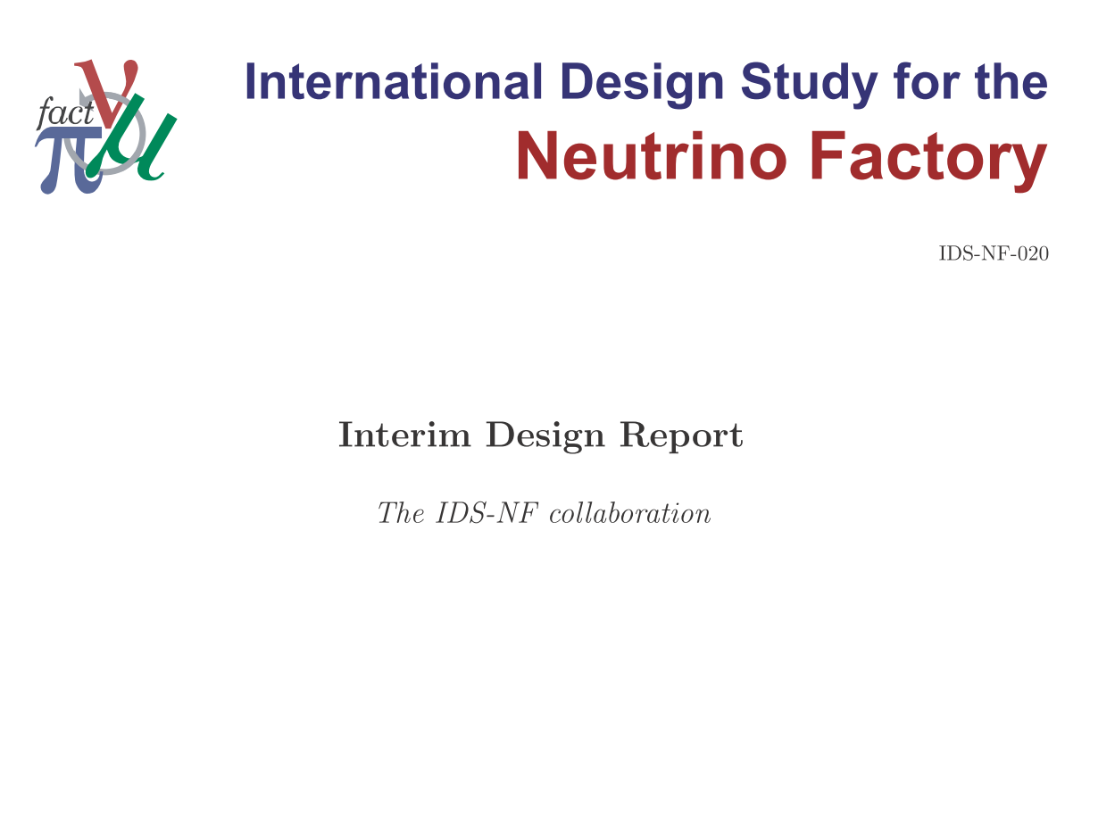
To be released this week
on IDS-NF site: https://www.ids-nf.org/

Slide 8
Contents:
Accelerator facility
Neutrino detectors
Performance
Conclusions

Slide 9
Accelerator facility:
The Neutrino Factory:
IDS-NF IDR; J.S. Berg; IPAC; THXMH02

Slide 10
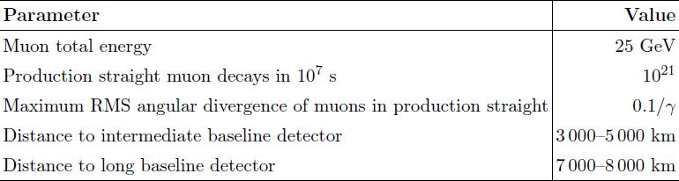

Slide 11
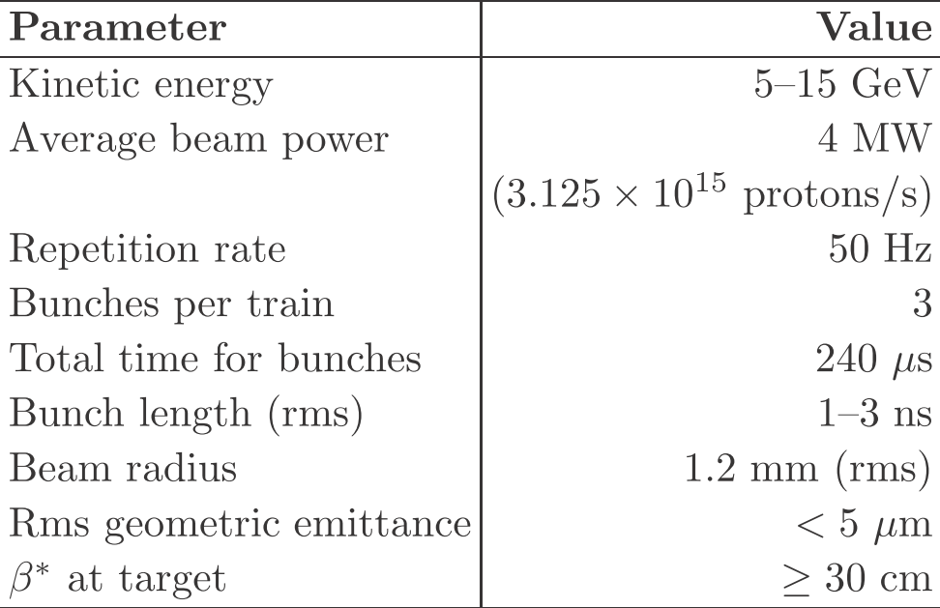
Proton driver:
Garoby, Gollwitzer, Thomason
Challenges:
  High power; short
  proton-bunch length
  at ~10 GeV
IDS-NF approach:
  Consider two
  ‘generic’ options:
    LINAC:
      Possible development
      option for SPL (CERN)
      or Project-X (FNAL)
      Requires accumulator &
      compressor rings
    Rings:
      Development option for J-PARC or RAL or possible ‘green-field’ option
      Requires bunch compression
IPAC10: THPD074,
MOPEC049,
WEPE098

Slide 12
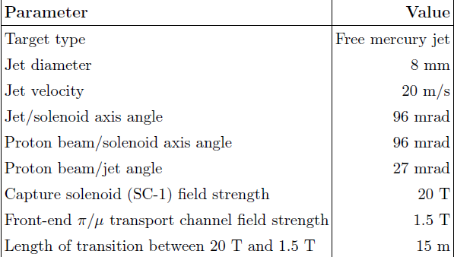
Target/capture:
IPAC10: WEPE101,
THPEC092
Baseline:
  Mercury jet, tapered solenoid for pion capture:
    20 T tapering to 1.5 T in ~13 m
Radiation shielding:
  Found to be inadequate
  Progress towards improved design being made
Alternatives:
  Solid and powder jet maintained to mitigate technical risk
Kirk, Densham, Back, Graves

Slide 13
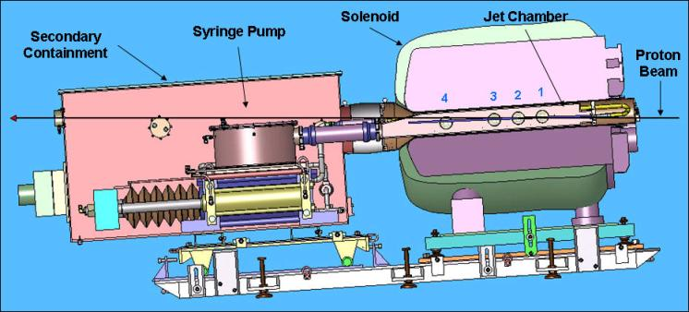

Baseline target: proof of principle: MERIT:
IPAC10: WEPE078
‘Disruption length’: 28 cm
‘Refill’ time: 14 ms
  Corresponds to 70 Hz
Hence:
  Demonstrated operation at:
    60 kJ × 70 Hz = 8 MW
20 m/s liquid Hg jet in 15 T B field
Exposed to CERN PS proton beam:
  Beam pulse energy = 115 kJ
  Reached 30 tera protons at 24 GeV

Slide 14
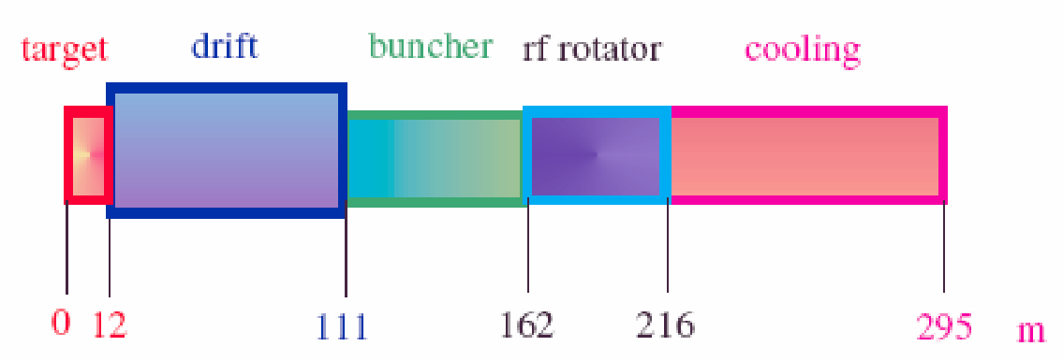
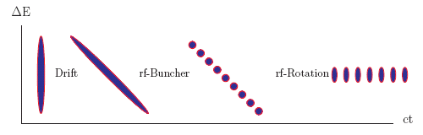
Muon front-end:
Neuffer, Rogers
IPAC10: WEPE050, WEPE051,
WEPE068, WEPE074, WEPE076
Key R&D:
Ionisation cooling:
  MICE;
  proof of principle
RF in magnetic field:
  MuCool in MTA at FNAL

Slide 15
Muon front-end:
Neuffer, Rogers
Optimised bunching,
phase-rotator, and ionisation-cooling lattice is reduced

Slide 16
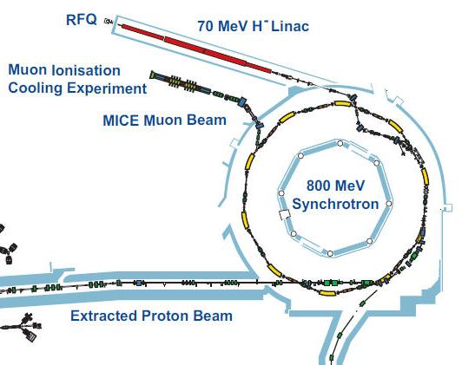
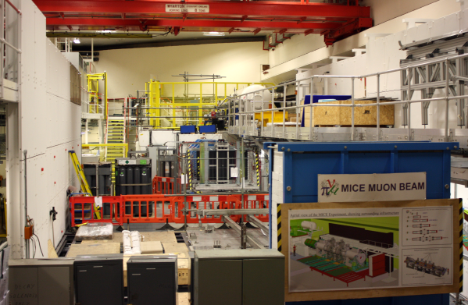
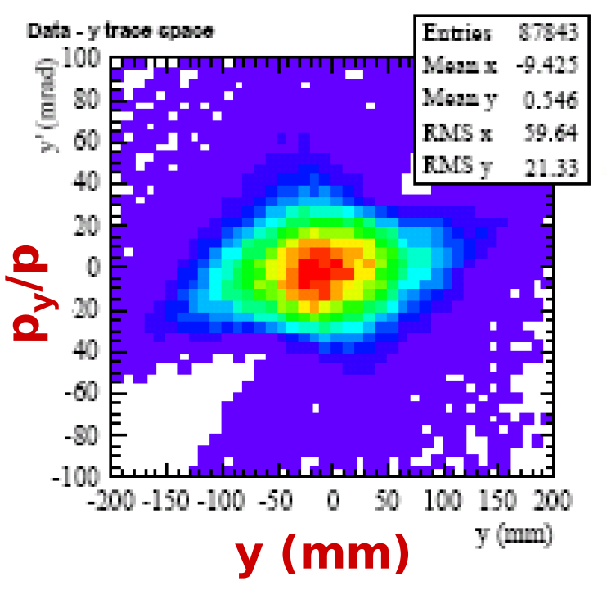
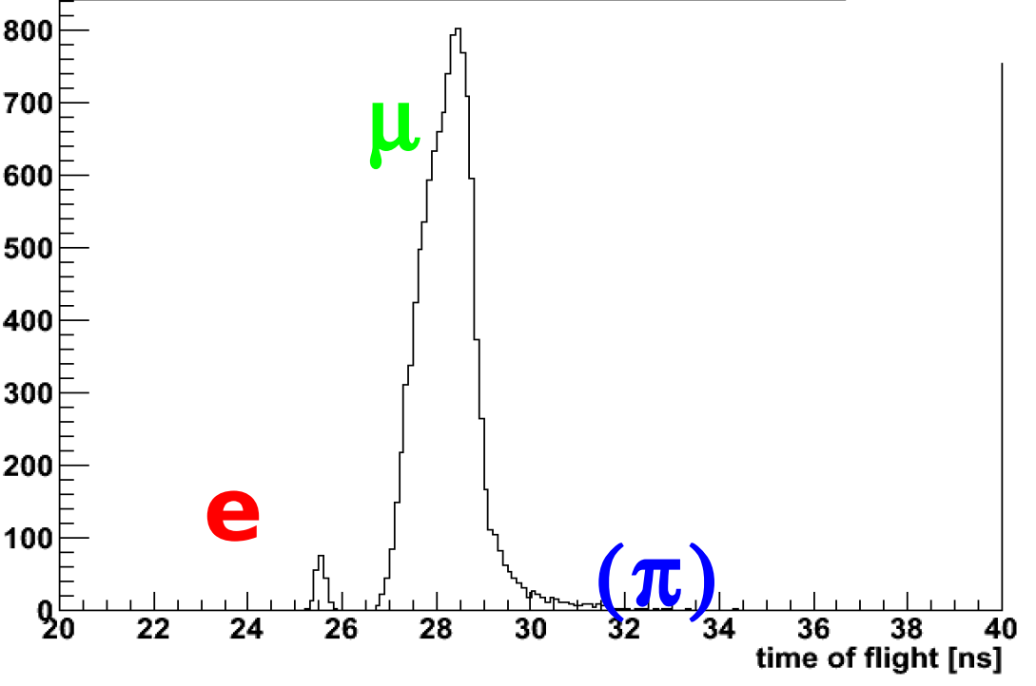
MICE: proof of principle:
  Design, build, commission and operate a realistic section of cooling channel
  Measure its performance in a variety of modes of operation and beam conditions
    Results will allow Neutrino Factory complex to be optimised
Step I complete!
See P. Hanlet poster for details
IPAC10: WEPE054

Slide 17
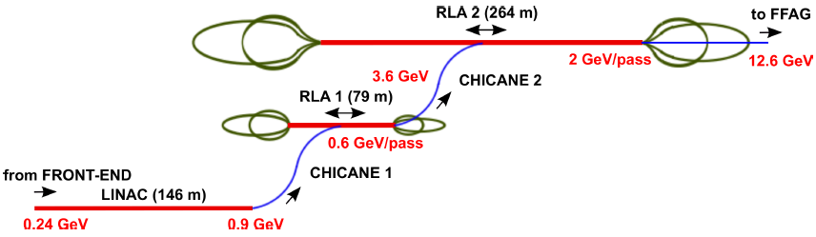
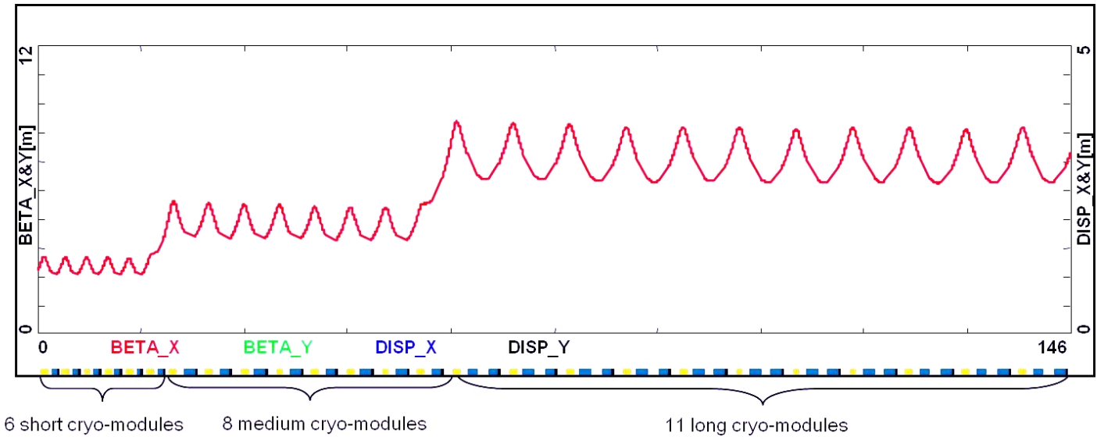
Muon acceleration: [1]:
Bogacz, Bontoiu,
Pozimski

Slide 18
Muon acceleration: [2]:
Berg, Machida, Kelliher, Pasternak

Slide 19
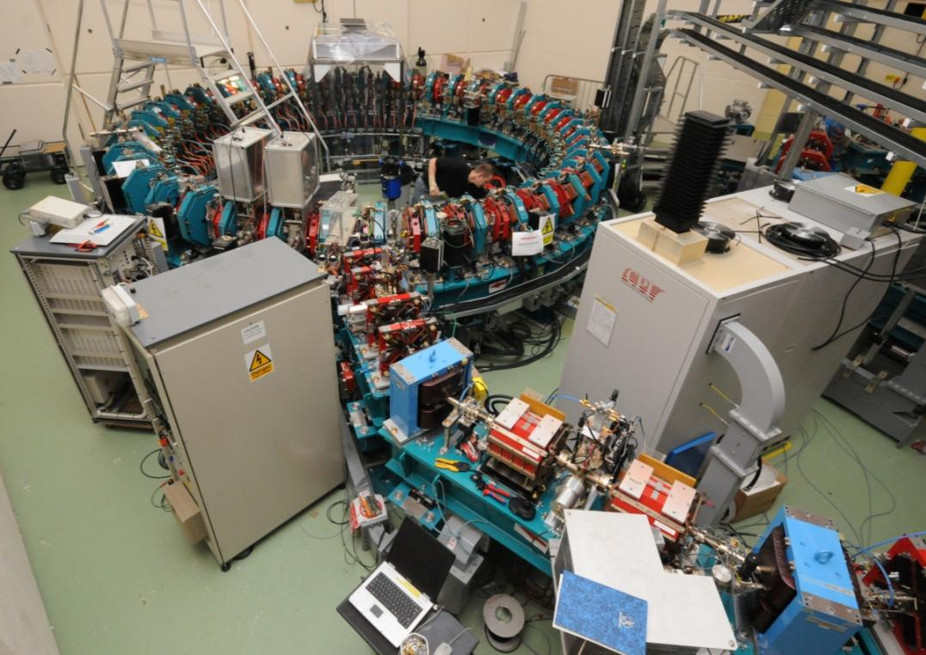
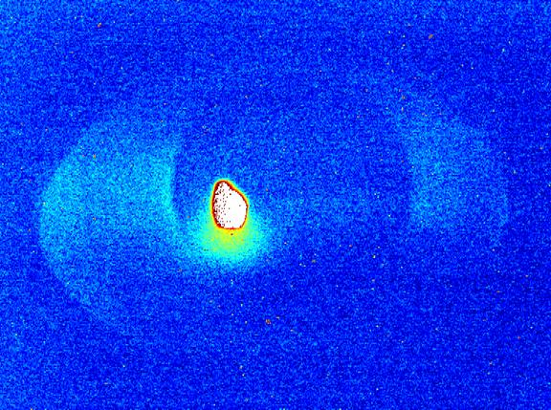
Muon acceleration: proof of principle:
EMMA; almost complete at Daresbury Lab.
  Electron Model of Muon Acceleration
    Aka:
      Electron Model of Many Applications
Installation complete;
Commissioning underway
First extracted beam: 15Mar11

Slide 20
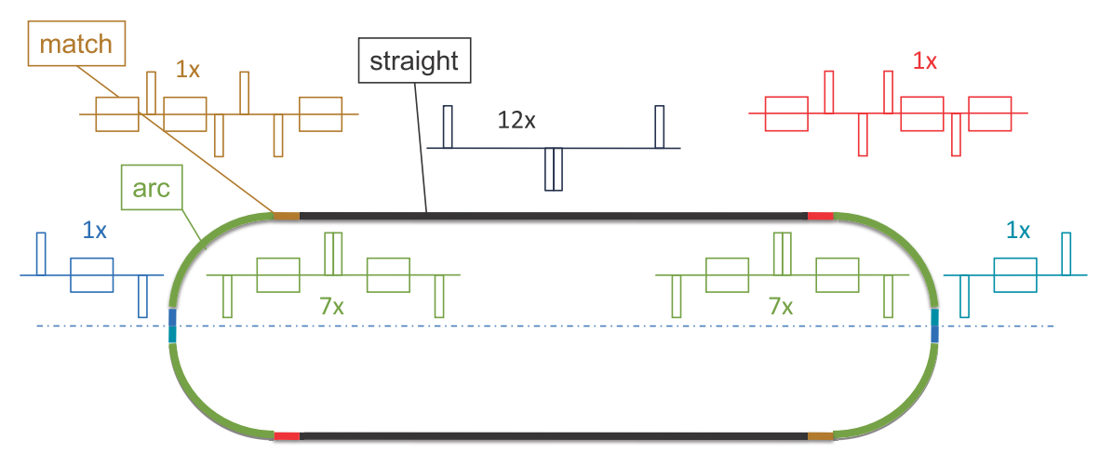
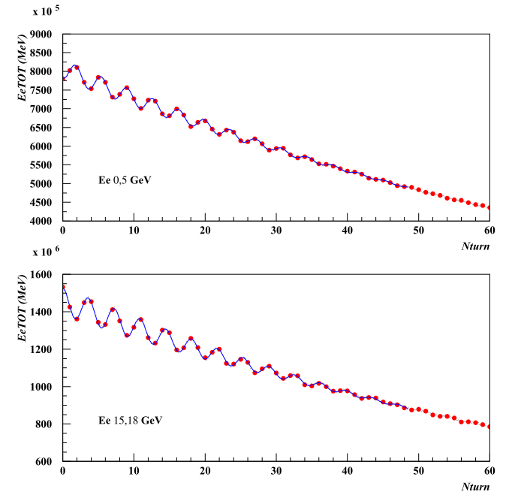
Muon storage ring:
Apollonio, Johnstone
Detailed studies of:
  Dynamic aperture
  Instrumentation:
    Stored muon energy measurement
    via beam polarisation;
    Divergence and current

Slide 21
Neutrino detectors:
The Neutrino Factory:

Slide 22
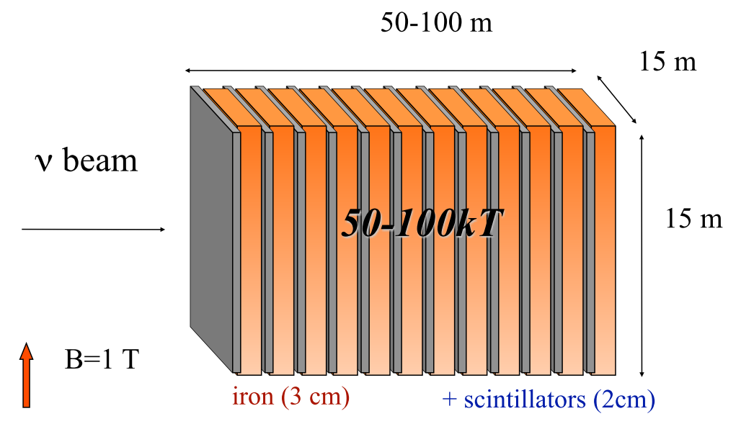
Magnetised Iron Neutrino Detector (MIND):
Cervera, Laing,
Martin-Albo, Soler
MIND:
  Re-optimised sampling: Fe/Sci = 3 cm/2 cm
  Cuboid immersed in 1 T dipole field
    More realistic field configuration in hand
  Detector mass:
    Intermediate detector [2000—4000 km]: 100 kT
    Far detector [7000—8000 km]: 50 kT

Slide 23
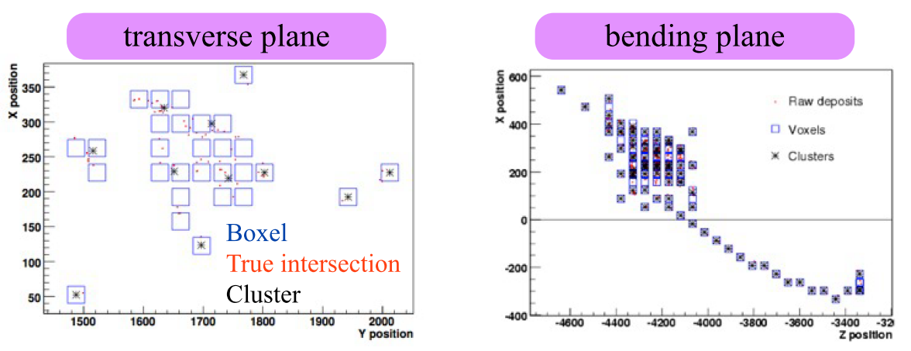
MIND: new simulation:
Cervera, Laing,
Martin-Albo, Soler
Improved simulation:
  Neutrino interactions with Nuance:
    Includes non-DIS processes, important at low E (Q²)
  Detector simulation with Geant4:
    Two layers of orthogonal scintillator bars
      Perfect matching, but light attenuation in WLS
      Energy split between bars and views and smeared
        Low light-yield hits (‘voxels’) rejected
      Voxel clustering implemented

Slide 24
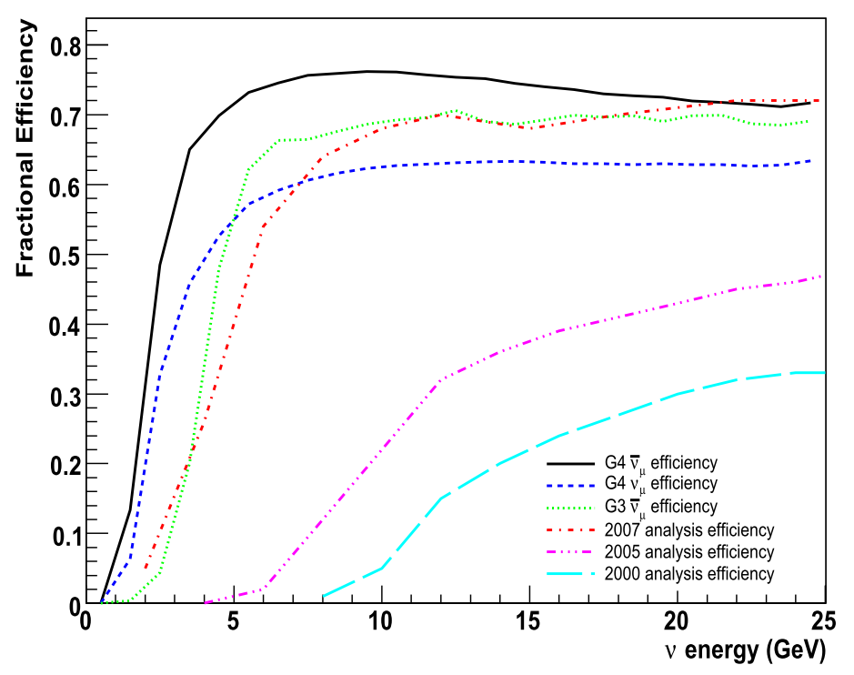
MIND: efficiency:
Cervera, Laing,
Martin-Albo, Soler
Threshold: 50% of plateau at ~2.25 GeV
  Improved by more than 2 GeV compared to
  start of IDS-NF [i.e. ISS Detector W/g report]

Slide 25
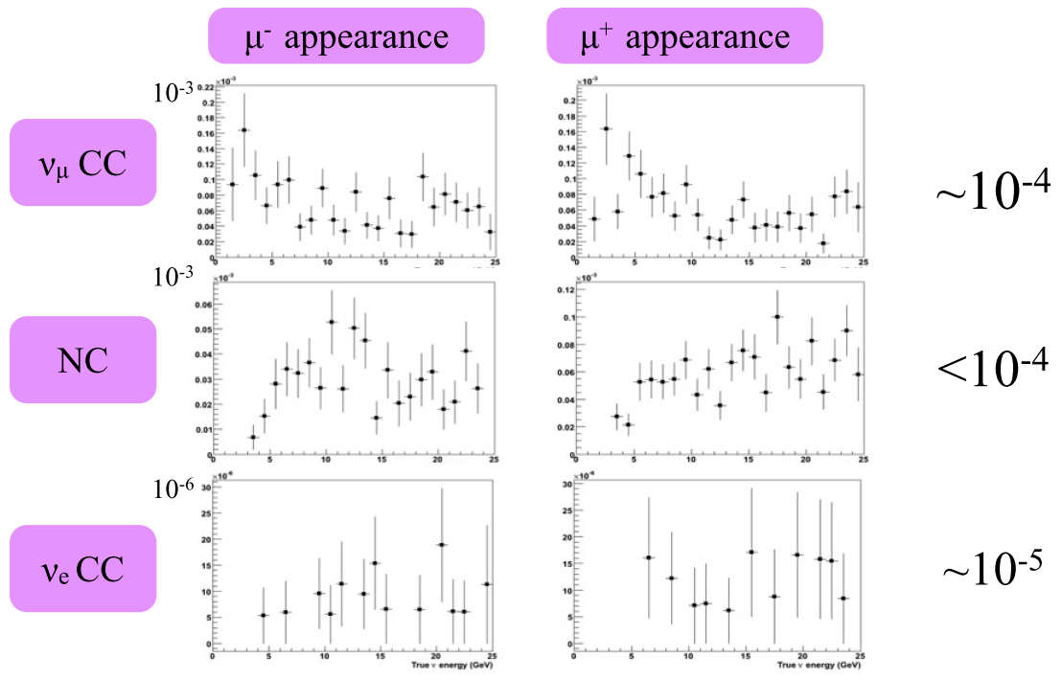
MIND: background rejection:
Cervera, Laing,
Martin-Albo, Soler

Slide 26
IDS-NF baseline 2010-2.0:
Cervera, Laing,
Martin-Albo, Soler
Migration matrices and treatment of taus (see IDR)
  Significant improvement over IDS-NF baseline 2007/1.0

Slide 27
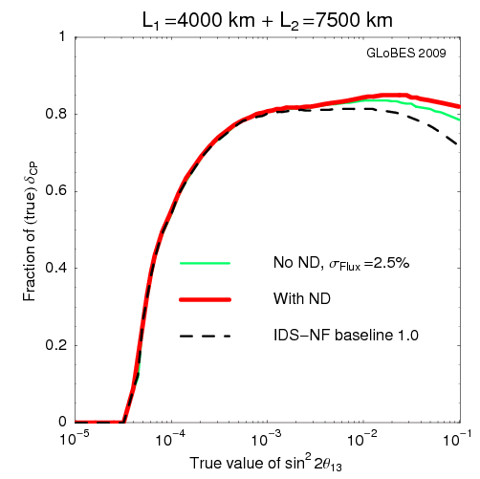
Near detector: motivation:
Oscillation analysis:
  Direct measurement
  of neutrino flux
  Detailed study of charm
  cross sections
  Detailed study of
  neutrino-nucleon
  scattering
    Including deep inelastic,
    quasi-elastic, and
    resonance scattering
Near detector physics programme:
  Search for non-standard interactions
    In particular, require sensitivity to taus
  Neutrino physics:
    Polarised (and unpolarised) structure functions
      Determination of α_{S}
    Electroweak physics: Weinberg angle
    CP violation from D⁰, D⁰ mixing, polarised Λ production, …
Winter, Tang

Slide 28
Near detector: concept:
Morfin, Soler, Tsenov
No near detector specified in initial IDS-NF baseline [i.e. ISS Detector W/g report]:
  Known to be a shortcoming
IDS-NF near detector concept (baseline 2010/2.0)

Slide 29
Performance:
The Neutrino Factory:

Slide 30
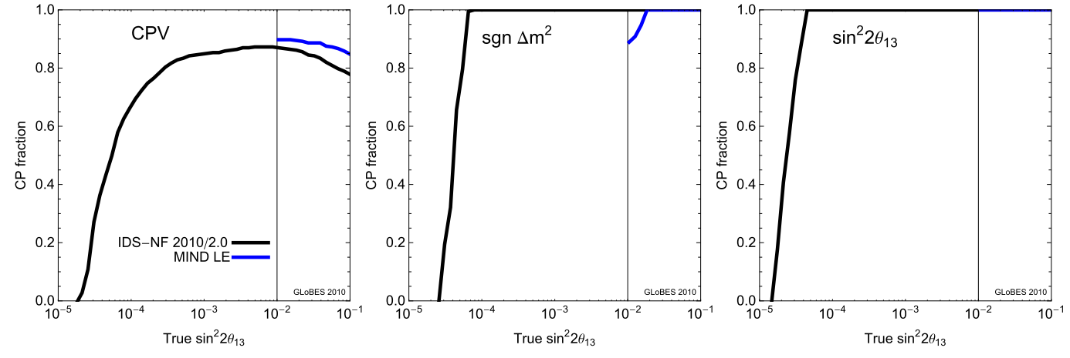
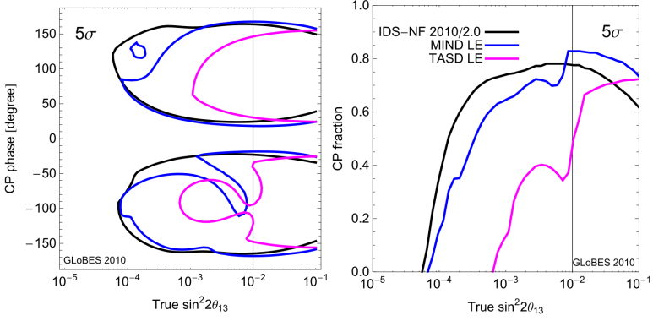
Neutrino Factory performance:
Discovery reach at 3σ extends down to sin²2 θ₁₃ ~ 5 x 10⁻⁵
  Should θ₁₃ to be shown to be > 0 before start of Neutrino Factory project:
    Re-optimisation of baseline:
      10 GeV muon energy serving a single 100 kTon MIND at a baseline of 2000 km
    gives excellent performance

Slide 31
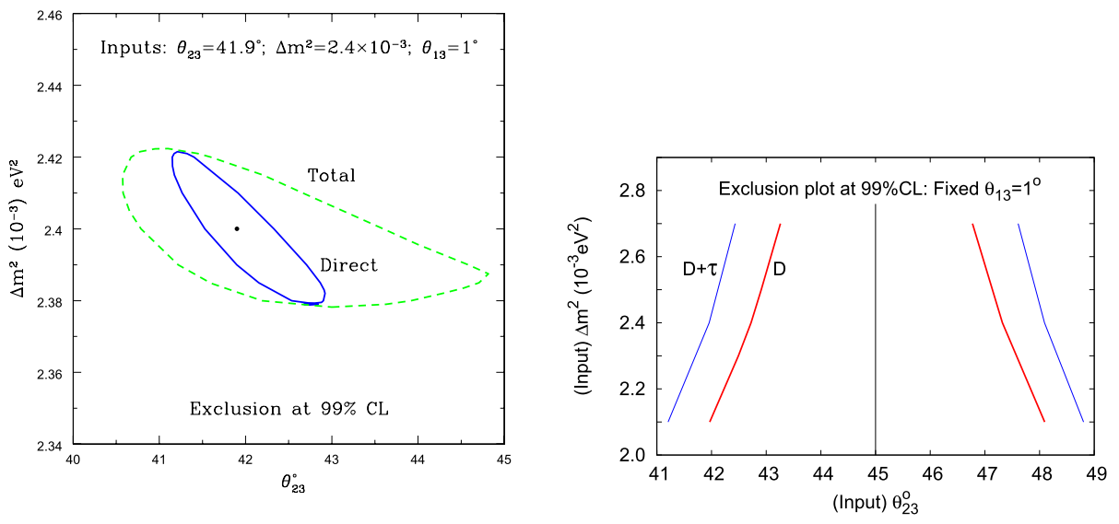
Neutrino Factory performance:
Precision:
  Determination of deviation of θ₂₃ from π/4:
    Uncertainty ~ ±4⁰ at 99% C.L.
D. Indumathi and N. Sinha,
Phys. Rev. D80 (2009) 113012

Slide 32
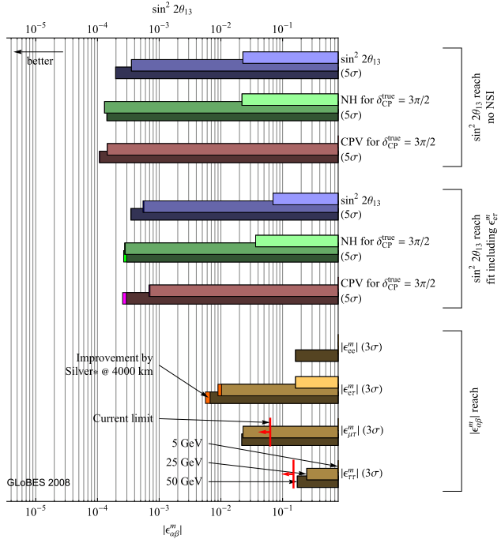
Sensitivity to non-standard interactions:
J. Kopp, T. Ota, and W. Winter,
Phys. Rev. D78 (2008) 053007

Slide 33
Conclusions:
Neutrino Factory:

Slide 35
The Neutrino Factory, the ‘facility of choice’:
  Best discovery reach
  Best precision:
    But need to define agreed figure of merit
  Best sensitivity to non-standard interactions
The IDS-NF baseline established and documented in the IDR
  Alternatives to baseline retain to mitigate risk
The IDS-NF collaboration:
  Energetic and ambitious, working towards IDR 2010/11 and RDR 2012/13:
    EUROnu: encompasses and coordinates European contributions
Scientific imperative:
  Make the Neutrino Factory an option for the field!

