Slide 1
HERD-SCD Readout Electronic
-20220502
Gongke,Qiaorui,Peng wenxi

Slide 2
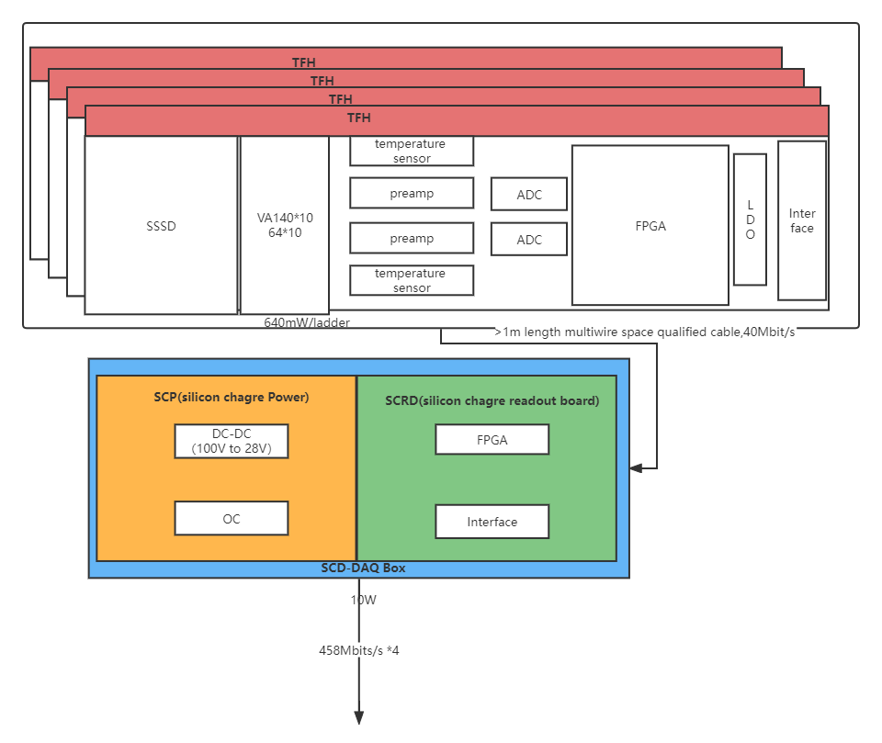
Where to place the FPGA ? Plan A:FPGA on the TFH
Pros：
Front-end fully digitalized
No need for Fanout Board
Cons:
1mW /Ch ~573W for the front-end
（500W max totally）
one cable & Connector(~1.5m)/TFH
896 cables total

Slide 3
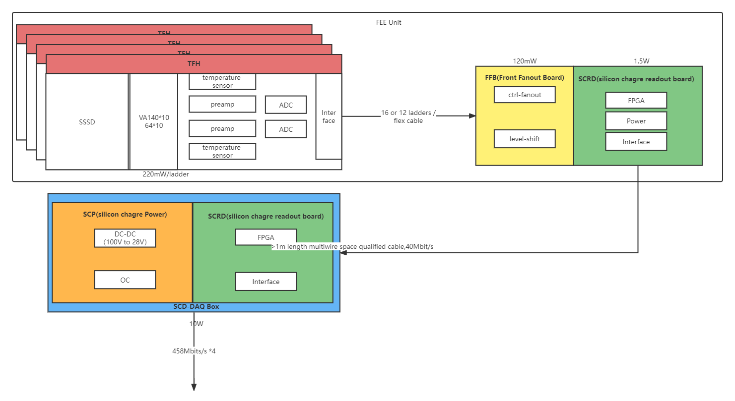
Where to place the FPGA ？ Plan B:Add Front Fanout Board
Pros：
0.55mW/ch ~320W for the front-end
one cable (~1.5m)/FBB
(64 Cables total)
Cons:
Extra Front-end space needed

Slide 4
Data rate and data transmission
RAW data mode
(no data compression outside of the CSS):
With trigger rate of 250 Hz.
Total data rate 2.3Gbits/s
Each data channel is about 573Mbits/s
data compression mode
(data compression in the DAQ box):
With trigger rate of 250 Hz. and data compression efficiency of 2%
Total data rate 46Mbits/s
Each data channel is about 11.4Mbits/s
Excluding Calo, the total bandwidth is 1Gbits/s

Slide 5
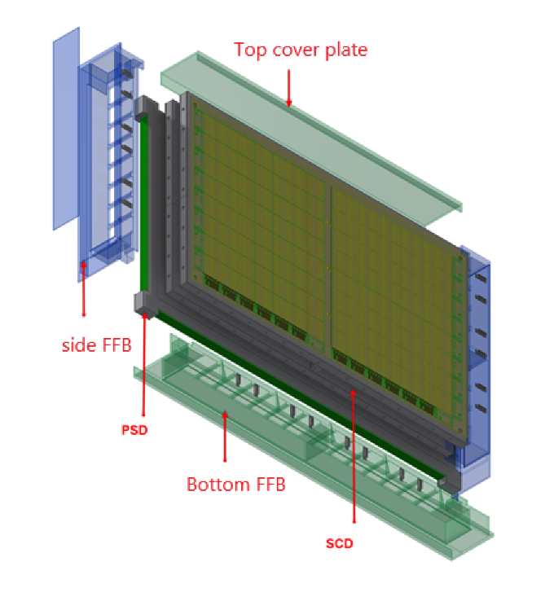
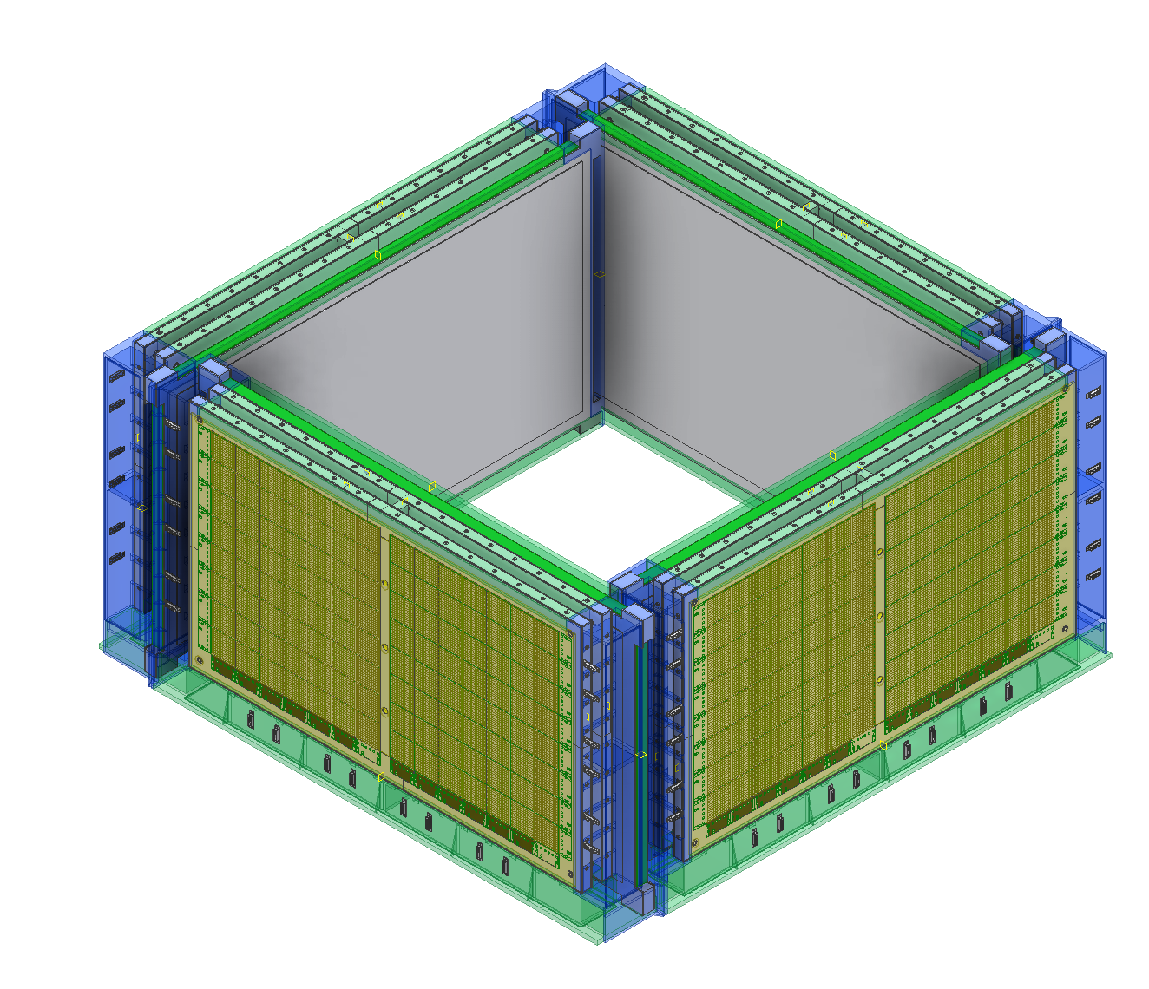
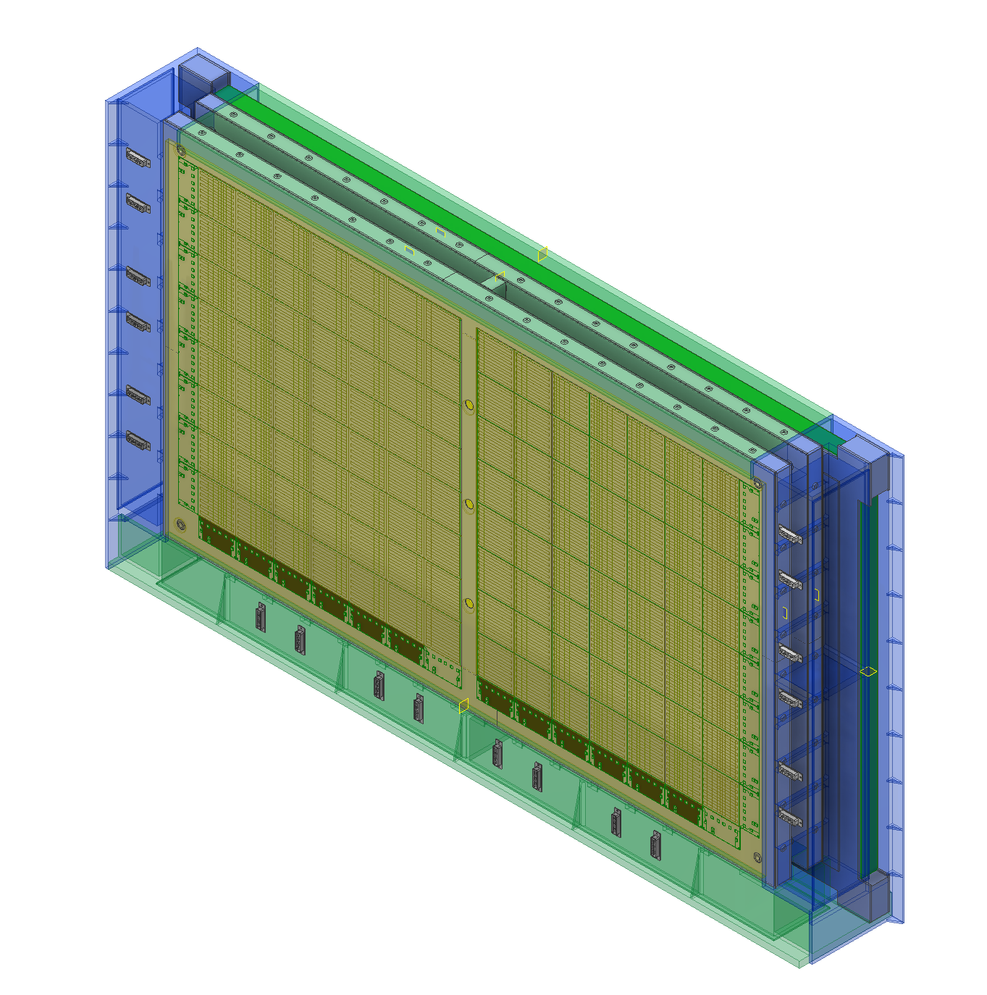
Side SCD and PSD box layout
PSD
SCD

Slide 6
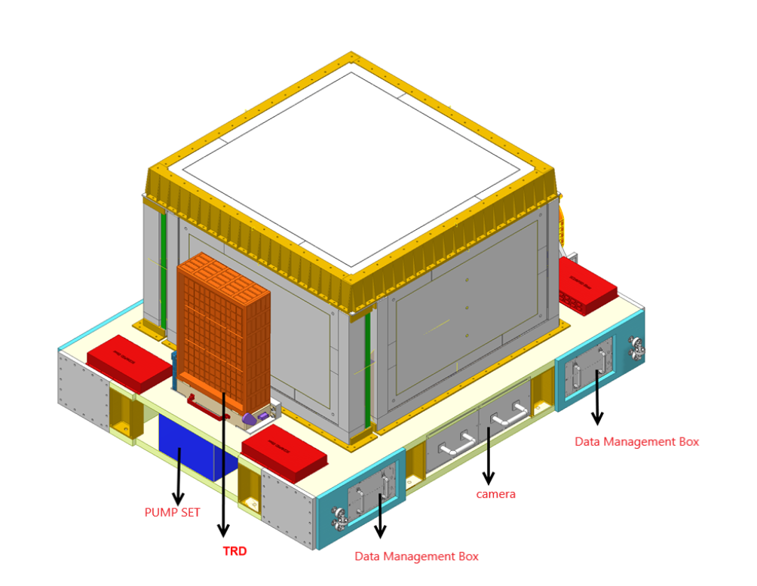
DAQ Box
4 DAQ boxes in 4 corners
Size: ~25cm * 40cm * 8cm
Data summary and compression DC/DC
SCD&PSD DAQ

