Slide 1
News from IHEP
Rui Qiao; Wenxi Peng; Ke Gong

Slide 2
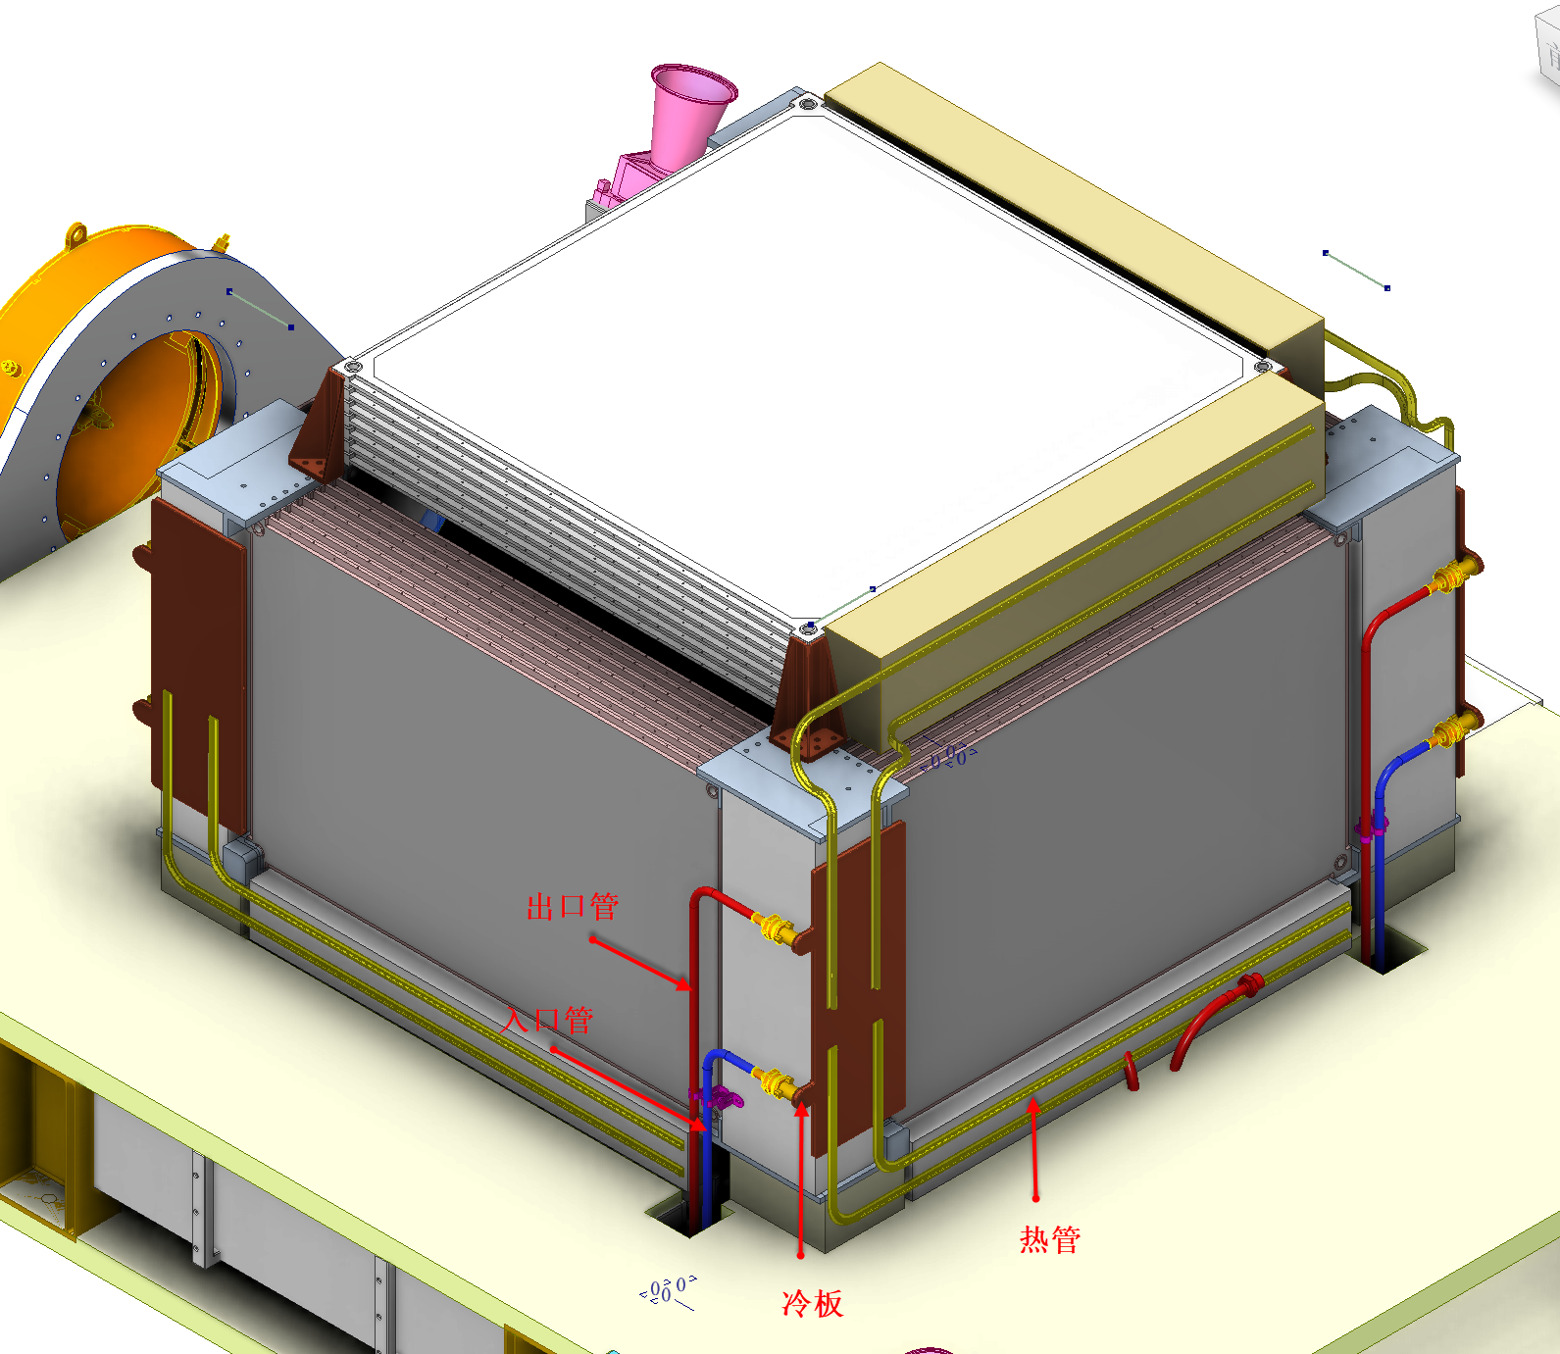
News (1): Larger overall structure & larger SCD
FIT need extra space for installation
For safety, side PSD & SCD move further from CALO
To keep coverage rate, larger side PSD & SCD are need
Additional space for FIT structure
The new design is still under investigation (coverage rate). Waiting for the exact size.

Slide 3
News (2): Installation of the front fanout board (FFB)
Ladder, total ×896
total ×64
Front Fanout Board
DC conversion
Control fanout
Data fanout
total ×4
×12 or ×16
DAQ box
DC conversion
Data compression
Data management
×16
Front Fanout Board
Ke Gong will keep updating the design of FFB

Slide 4
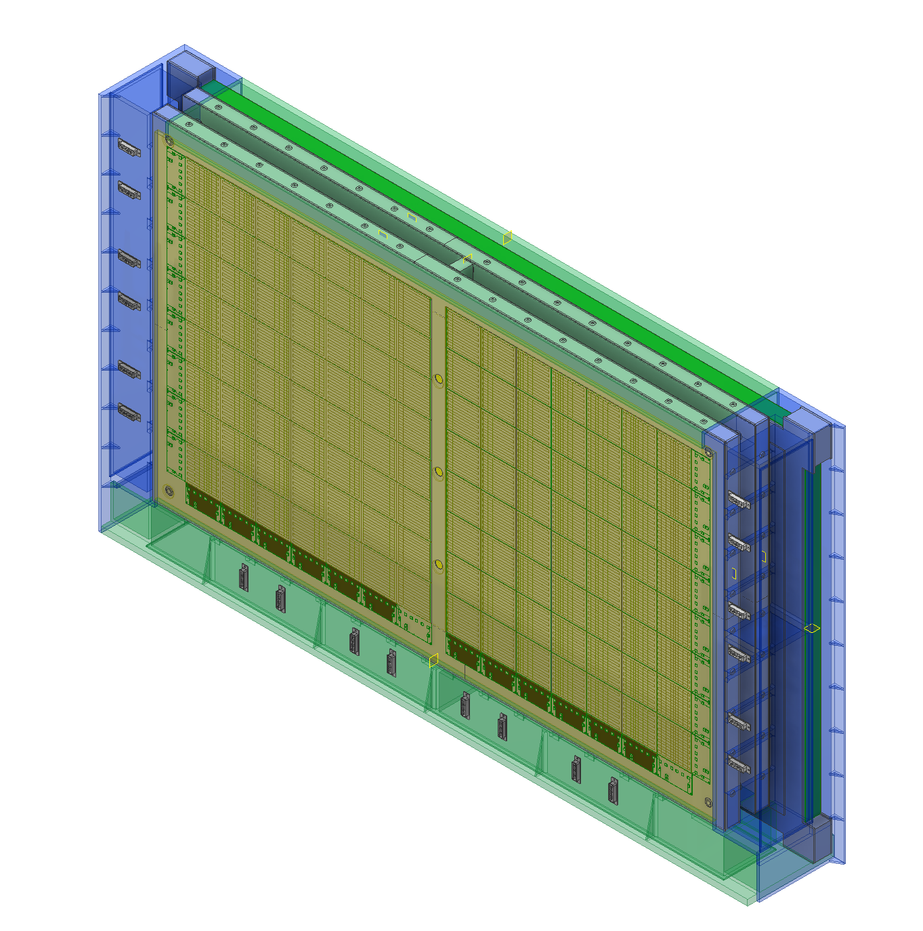
News (2): Installation of the front fanout board (FFB)
PSD, large
3 Extra space to for support structure & FFB
Specifications for extra space
Num for side SCD | 3
Num for top SCD | 4
Width [cm] include support | 9
Depth [cm] include support | 12
Length [cm] | Depend on the exact size
SCD, small
Side PSD & SCD
Ke Gong provide preliminary size of FFB to RuiJie Wang

Slide 5
New(3): Power voltage
The power consumption of SCD is around 400W
If SCD use 28V, the current is around 14A, too much voltage is lost in the long cable.
A meeting between space station and IHEP suggest SCD to use 100V.
×4
Space Station
DAQ box
DAQ box
Front Fanout Board
×12 or ×16
100V
DAQ box
28V
×16
Bias
ASIC
DAQ box
Front Fanout Board

