Slide 1
TCAD simulation of IHEP-60 with narrow AC strip
Rui Qiao; Wenxi Peng; Ke Gong

Slide 2
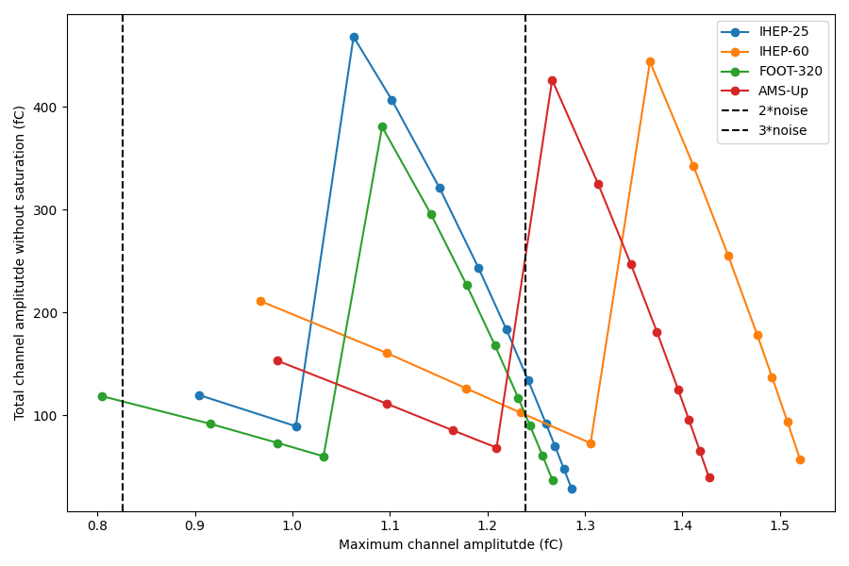
Background: SPICE simulation
Larger signal
For Z=26
2σ
3σ
Best sensor | Coupling cap. [pF]
IHEP-60 | 50
AMS-Upgrade | 35
Higher SNR
For Z=1
Notes:
来源：G:\keyan\科研任务\211212_硅微条模拟\220315_CCE & Charge Sharing vs External Capacitor in HERD SCD.pptx

Slide 3
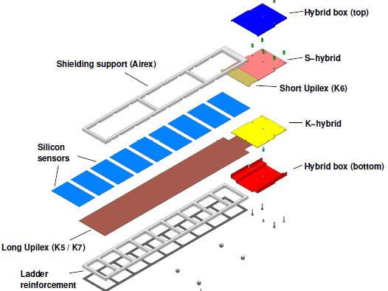
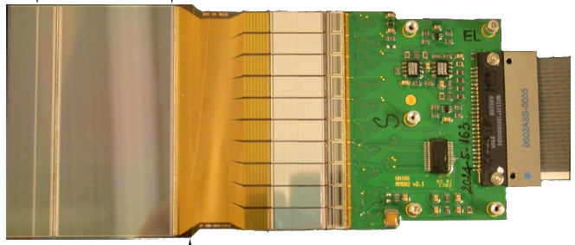
How to vary coupling capacitance (AMS-02)?
Sensor
Ext. Cap.
Schematic of AMS-02 ladder
Picture of external capacitator
Method: DC sensor & external capacitor
Coupling capacitance: external capacitance / num of sensor
Notes:
来源：菲利普AMS博士论文

Slide 4
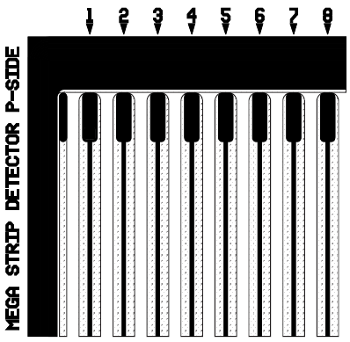
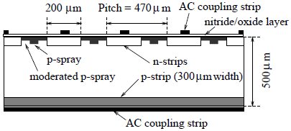
How to vary coupling capacitance (MEGA)?
Section view of MEGA
Top view of MEGA
Method: AC sensor with narrow AC strip
Coupling capacitance: capacitance between AC and implant strips
Notes:
来源：G:\keyan\科研任务\211212_硅微条模拟\资料\小耦合电容\MEGA-SiliconTracker.pdf & Current status of the ComPair silicon.pdf

Slide 5
How to vary coupling capacitance?
Detector | Method | Advantage | Disadvantage
AMS-02 | DC & Ext. cap. | Easy to produce Easy to change params | Extra space Extra bonding
MEGA | Narrow AC strip | Tight layout | Proper design and validation before production

Slide 6
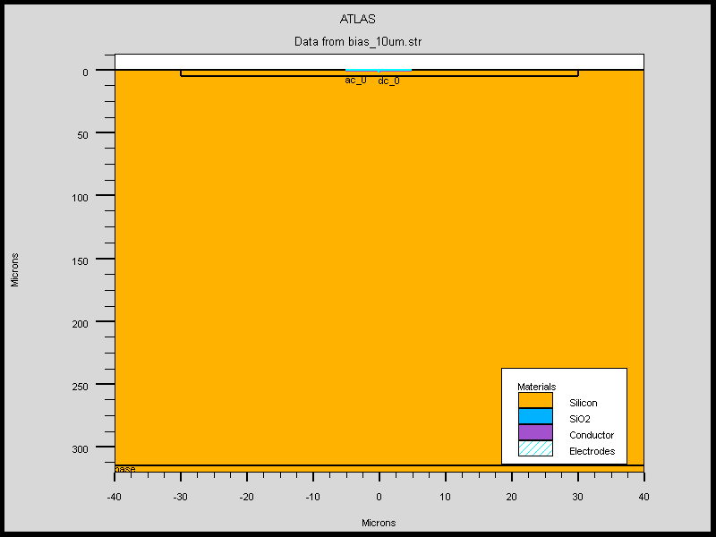
TCAD simulation of coupling capacitance with narrow AC strip (IHEP-60)
Parameters | Values
Bulk thickness [pF] | 320
Pitch [pF] | 80
Implant strip width [pF] | 60
AC strip width [pF] | variable
Sio2 thickness [pF] | 0.3
P+ implant strip
60 um width
Narrow AC electrode
Notes:
来源：G:\keyan\科研任务\211212_硅微条模拟\MyTCAD\220401——IHEP-60um调整AC条宽度\单注入条耦合电容\

Slide 7
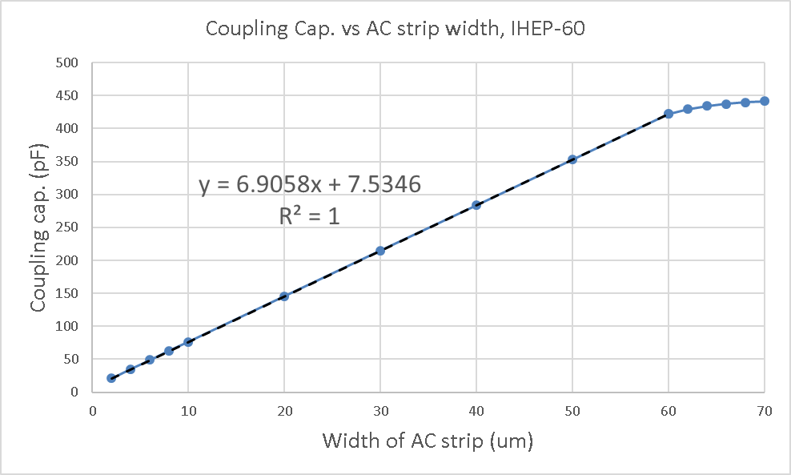
TCAD simulation of coupling capacitance with narrow AC strip (IHEP-60)
The fit slope is 6.91 pF/um, which match theoretical calculation.
Additional intercept (7.5 pF), corresponding to additional 1 um width.
The preferred 50 pF corresponds 6 um AC strip width.
Notes:
来源:G:\keyan\科研任务\211212_硅微条模拟\MyTCAD\220401——IHEP-60um调整AC条宽度\单注入条耦合电容\耦合电容vsAC条宽度_单注入条.xlsx

Slide 8
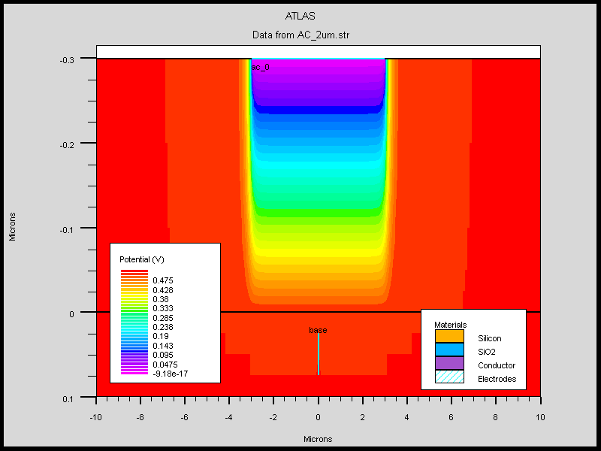
Origin of intercept (~1 um width)
Apply 1V to P+ strip and 0V to AC strip, plot potential distribution.
Within the range of AC strip, potential distributed horizontally.
Outside the range of AC strip, additional 0.5um potential distribution left/right.
Potential distribution
Notes:
来源:G:\keyan\科研任务\211212_硅微条模拟\MyTCAD\220401——IHEP-60um调整AC条宽度\绘制电场线\电势分布_6um宽.png

Slide 9
Simulation procedure comparison
TCAD:
capacitance sim.
TCAD:
charge injection
SPICE:
charge injection
Speed: Fast
Accuracy: Low
Speed: Slow
Accuracy: High(?)

Slide 10
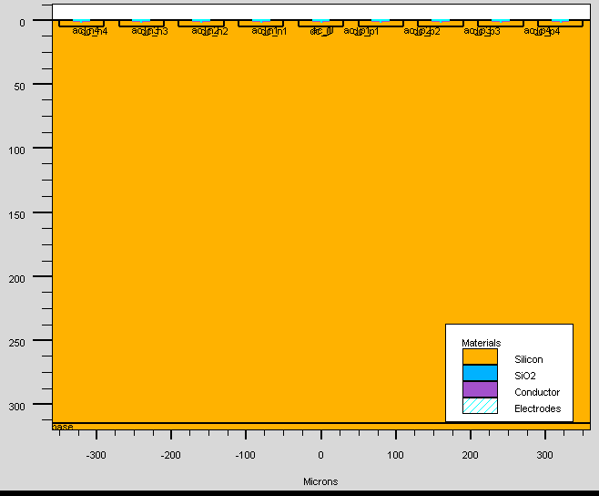
TCAD sensor description
Parameter | Value
Detector ID | IHEP-60
Thickness [um] | 320
Implant Pitch [um] | 80
Implant Width [um] | 60
Readout Pitch [um] | 160 (1/2)
AC Width [um] | Variable
SiO2 thickness [um] | 0.3
Implant strip num. | 9
Readout strip num. | 5
Float strip num. | 4
X grid spacing [um] | 1
Y grid spacing [um] | 2.5
Time step [ps] | 100
PreAmp cap. [pF] | 1E6
Float strip
Sensor
Specification
Readout strip
Readout
Setup
N-type bulk
TCAD
Parameter
TCAD sensor with AC strip 24 um width
Notes:
来源：G:\keyan\科研任务\211212_硅微条模拟\MyTCAD\220401——IHEP-60um调整AC条宽度\SEU_9根注入条_AC_24um_xspace_1um\结构图.png

Slide 11
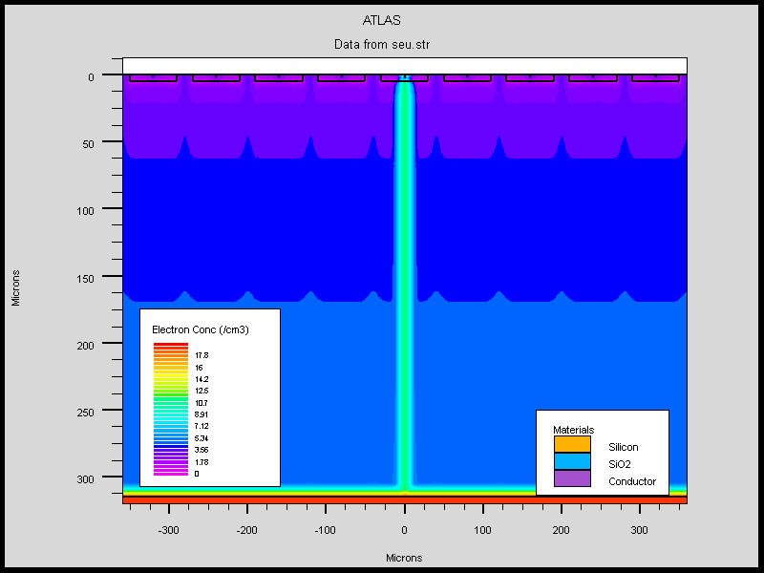
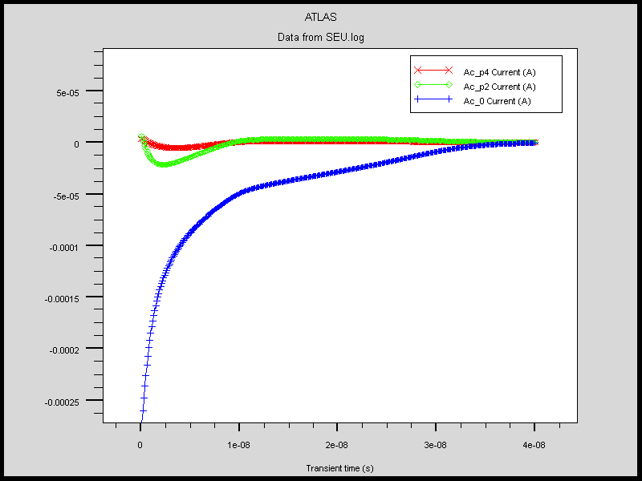
TCAD charge injection
Hit
channel
1st Next
channel
2nd Next
channel
Beam inject in the center
Transient current
Notes:
来源：G:\keyan\科研任务\211212_硅微条模拟\MyTCAD\220401——IHEP-60um调整AC条宽度\SEU_9根注入条_AC_12um_xspace_1um\结果_电流.png
G:\keyan\科研任务\211212_硅微条模拟\MyTCAD\220401——IHEP-60um调整AC条宽度\SEU_9根注入条_AC_6um_xspace_3um\电荷注入.png

Slide 12
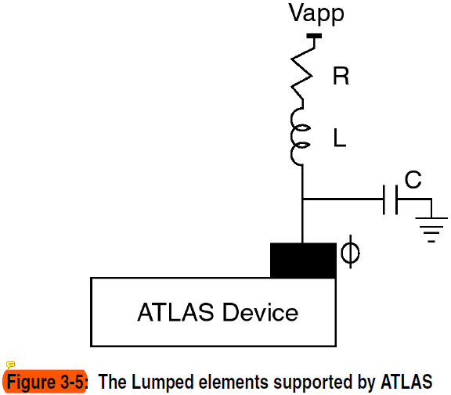

TCAD charge evaluation
TCAD can specified additional contact resistor/capacitor/insulator, as shown left.
For our simulation, we use 1uF contact capacitor for the readout channel.
TCAD can evaluate the voltage of the readout channel.
$$Q=C×V$$
Notes:
来源：E:\keyan\Silvaco TCAD教程\用户手册\atlas_users1.pdf 的147页

Slide 13
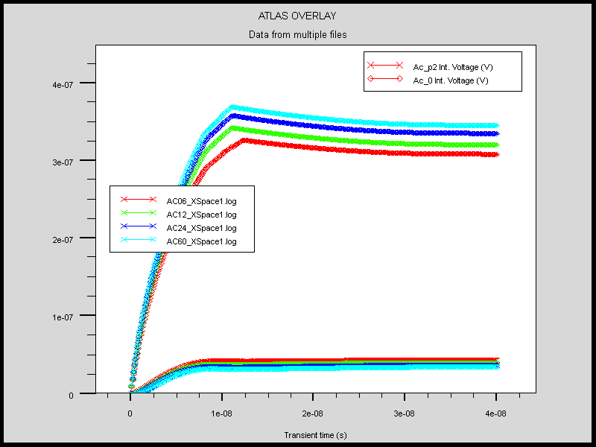
TCAD result: voltage of readout channel
Hit channel
With smaller width of aluminum electrode, the amplitude of hit channel decrease; the amplitude of neighboring channel increase.
Width=6 um
Width=12 um
Width=24 um
Width=60 um
1st Next channel
Notes:
来源：G:\keyan\科研任务\211212_硅微条模拟\MyTCAD\220401——IHEP-60um调整AC条宽度\最终统计\结果图_IntV_XSpace1.png

Slide 14
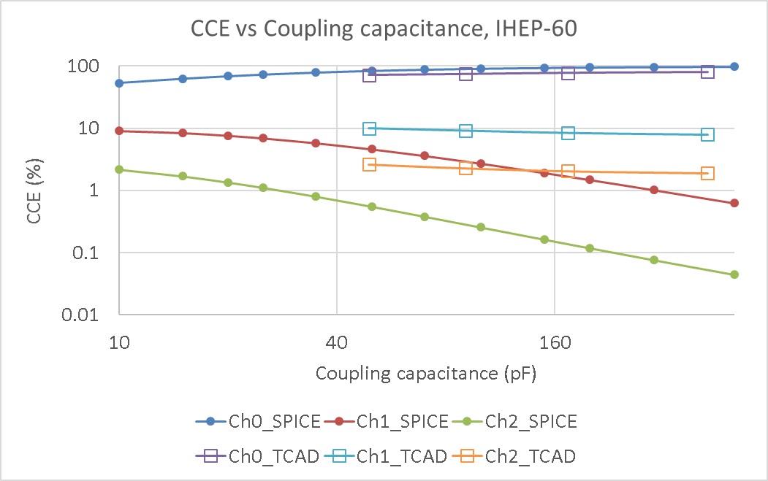
TCAD result: charge sharing
The charge sharing of TCAD differ from SPICE result：
Charge sharing is less sensitive to coupling capacitance than SPICE
Charge sharing is stronger than SPICE.
Notes:
来源：G:\keyan\科研任务\211212_硅微条模拟\MyTCAD\220401——IHEP-60um调整AC条宽度\最终统计\最终结果统计.xlsx

Slide 15
Conclusion
There are two ways to adjust coupling capacitance:
DC sensor + external AC chip (AMS-02)
AC sensor with narrow aluminum electrode (MEGA)
TCAD confirm that coupling capacitance is linear to width of aluminum electrode. Assuming 0.3 um sio₂ thick, 6 um wide aluminum corresponding to 50 pF for IHEP-60.
TCAD result of charge sharing differ from SPICE result:
Charge sharing is less sensitive to coupling capacitance than SPICE
Charge sharing is stronger than SPICE

Slide 16
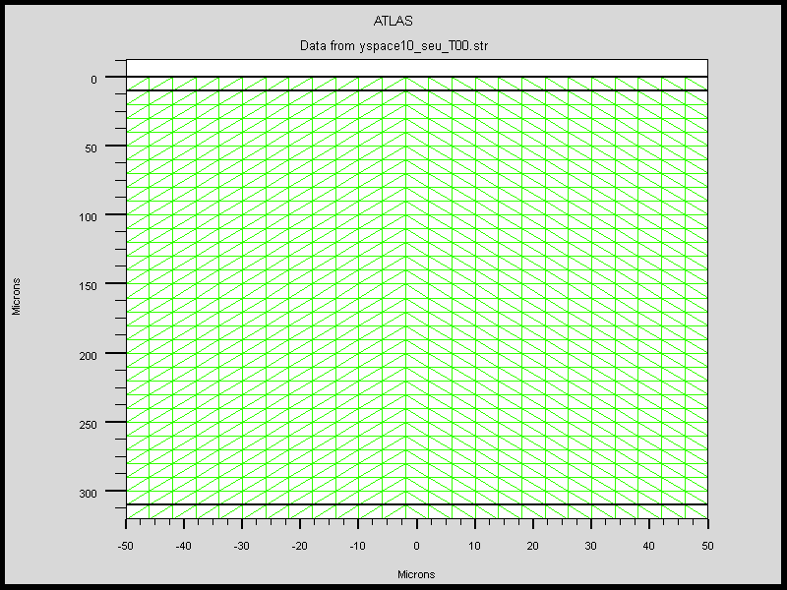
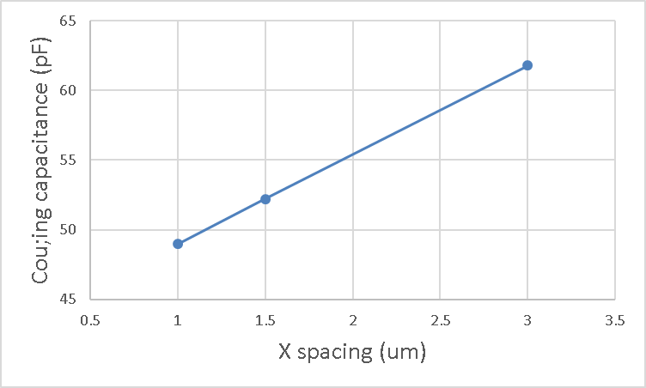
Hard to use TCAD (1): sensitive to grid spacing
Should specify X & Y grid spacing in TCAD
Some TCAD result is sensitive to grid spacing
Notes:
来源：G:\keyan\科研任务\211212_硅微条模拟\MyTCAD\220401——IHEP-60um调整AC条宽度\单注入条耦合电容\耦合电容vsAC条宽度_单注入条.xlsx
G:\keyan\科研任务\211212_硅微条模拟\MyTCAD\220120——DC_PNN结_单粒子辐照\auto_2d_1um_seu_比较网格密度\yspace10.png

Slide 17
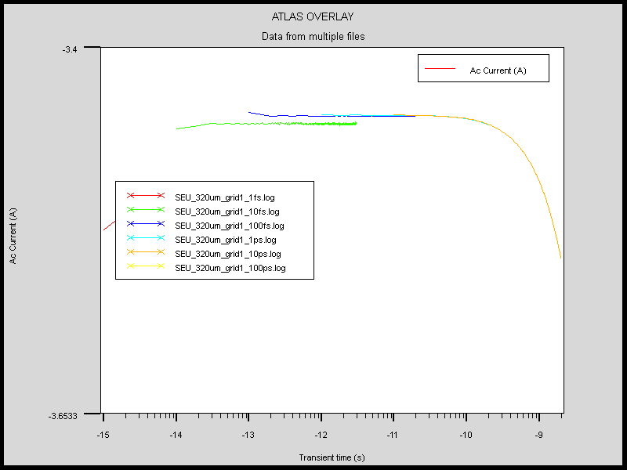
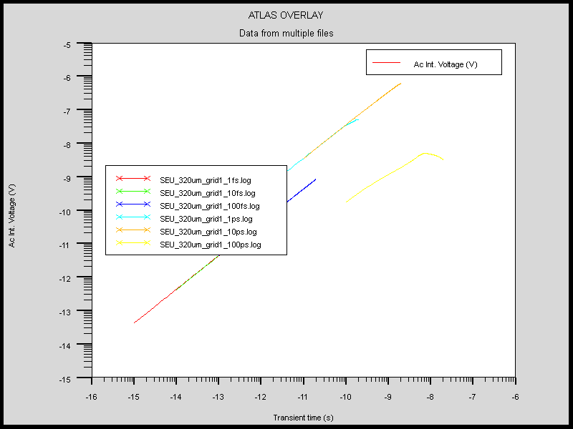
Hard to use TCAD (2): sensitive to time step
Current(Y) vs Time(X)
Voltage(Y) vs Time(X)
Should specify time step in TCAD
Some TCAD result is sensitive to time step
Notes:
来源：G:\keyan\科研任务\211212_硅微条模拟\MyTCAD\220218——精细PNN结_研究正确SEU电流\320um_grid1\比较步长_AC电流.png & 比较步长_IntV.png

