Slide 1
CCE & Charge Sharing vs External Capacitor in HERD SCD
Rui Qiao; Wenxi Peng; Ke Gong

Slide 2
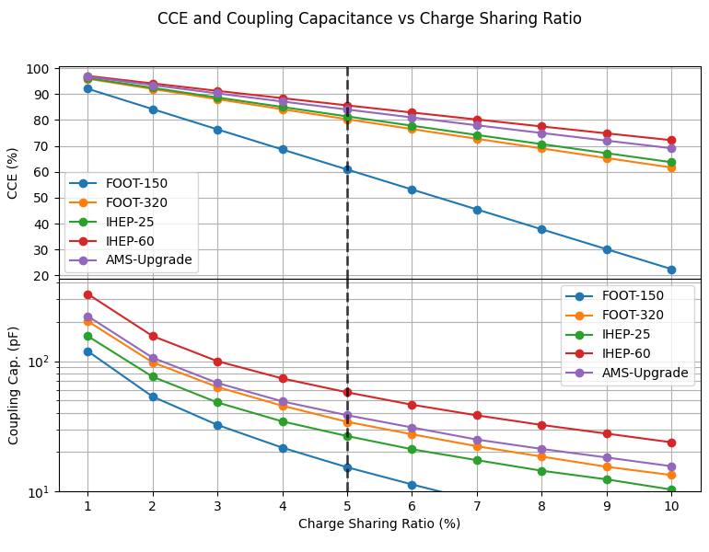
Background: CCE & Charge sharing when hitting readout strip
For 5% charge sharing ratio, FOOT-150 has lowest CCE, IHEP-25/IHEP-60/FOOT-320/AMS has similar CCE around 80~85%.
The coupling cap was around 30~50 pF correspondingly.

Slide 3
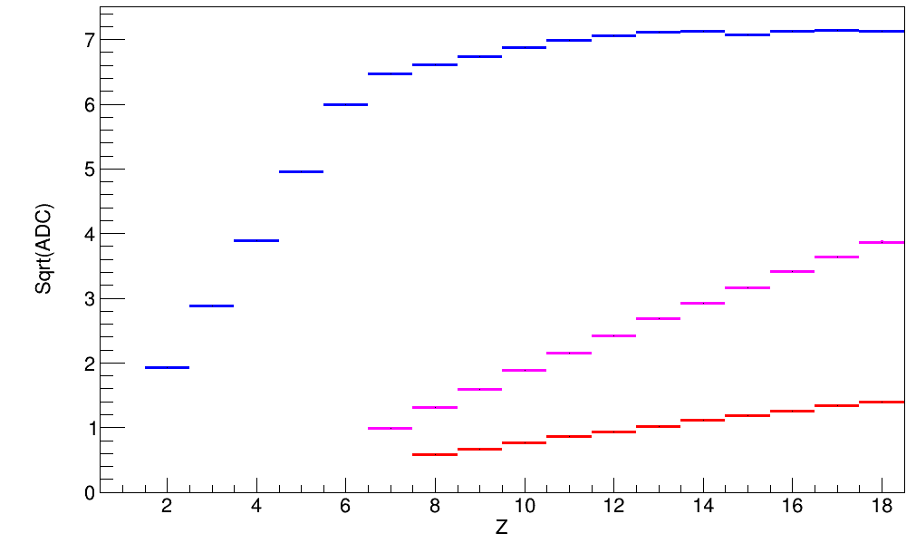
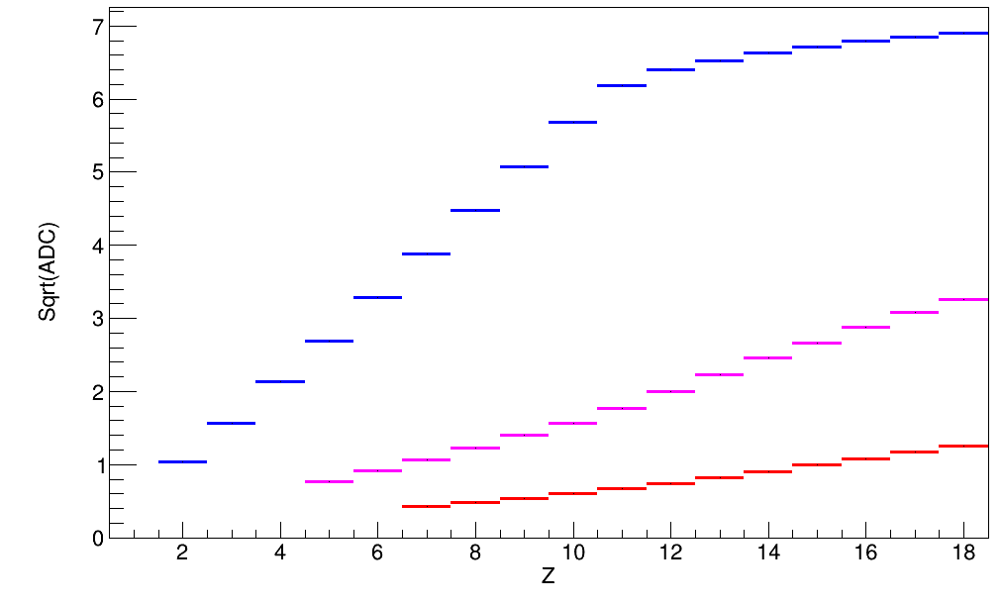
Background: Hitting readout strip and floating strip
Seed ch.
DAMPE:
Hitting
readout strip
Seed ch.
DAMPE:
Hitting
float strip
Seed+1 ch.
Seed+1 ch.
Seed+2 ch.
Seed+2 ch.
Small coupling capacitance can improve charge sharing, but decrease CCE.
Lower CCE with hitting float strip than readout strip.

Slide 4
Requirement of coupling capacitor
Z | Signal
Proton Z=1 | Small signal ~3.67 fC (@ 0 deg)
Iron Z=26 | Large signal ~4270 fC (@ 30 deg)
Z | Impact position | Signal | Requirement
Proton Z=1 | Float strip | Smallest signal | Enough SNR
Iron Z=26 | Readout strip | Largest signal | Large Dynamic
Impact position | Signal
Float strip | Small CCE (60% for DAMPE)
Readout strip | Large CCE (100% for DAMPE)

Slide 5
Analyze procedure:
Channel CCE simulation:
Hitting readout strip
Channel CCE simulation:
Hitting float strip
SPICE
Deposited charge simulation
Interpolation of CCE with different
impact position
PYTHON
Channel amplitude simulation:
interpolated impact position

Slide 6
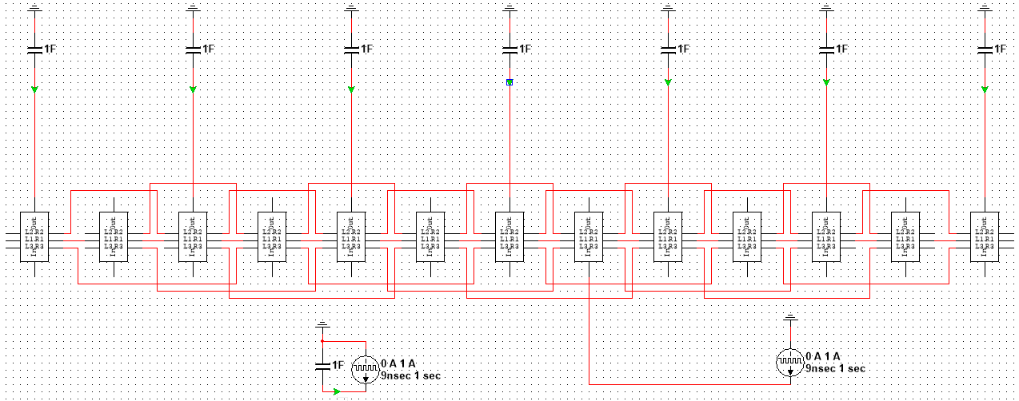
SPICE simulation
Parameter | Value
Readout chn. | 7
Charge inject position | Chn 3 ~ Chn. 4
Notes:
来源：G:\keyan\科研任务\211212_硅微条模拟\MyMultisim\220303_模拟IHEP SCD外接电容的影响_覆盖到Inter3\25um条宽\总电路.png

Slide 7
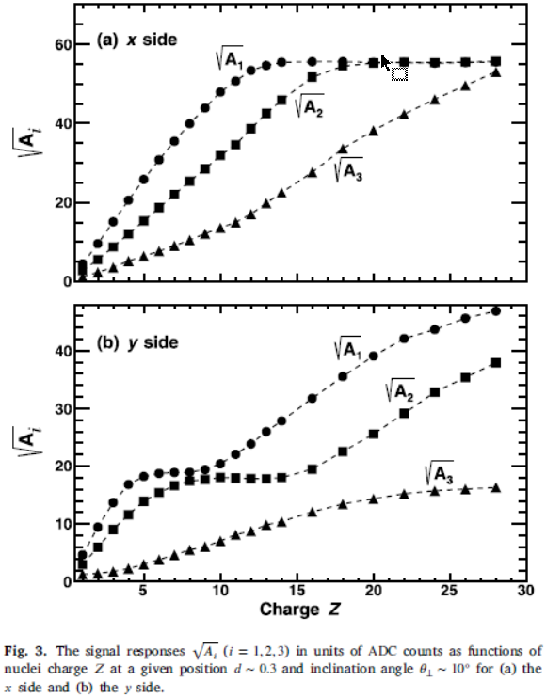
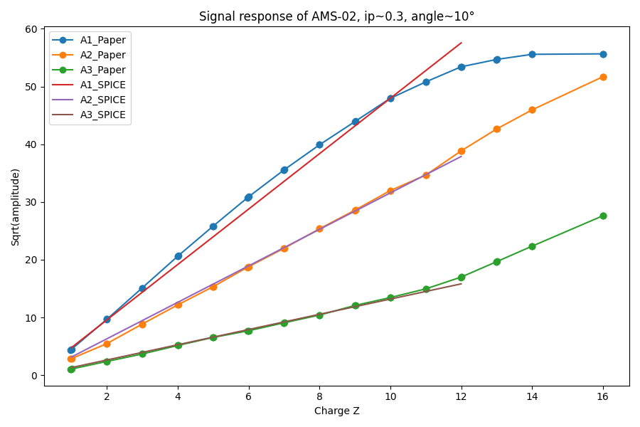
Cross-check using AMS-02 results
The x side of AMS-02 has readout pitch of 110 um, similar to AMS-Upgrade which is 109 um.
IP~0.3; Angle~10°; coupling cap~70pF
Notes:
来源：Y. Jia, Q. Yan, V. Choutko et al. Nuclear Inst. and Methods in Physics Research, A 972 (2020) 164169
G:\keyan\科研任务\211212_硅微条模拟\220315_Channel response vs External Capacitor in HERD SCD\PNG_AMS-02\Check_AMS-02_Result.png

Slide 8
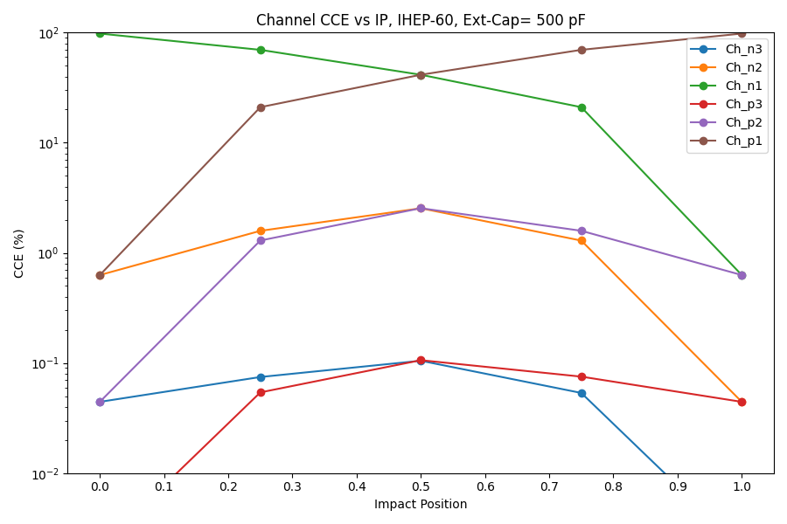
Channel CCE vs impact position: large coupling capacitance
Detector: IHEP-60um
Coupling cap.: 500 pF
IP=0: hitting readout strip
IP=0.5: hitting float strip
Extreme small charge sharing ratio hitting readout strip
Hitting
Readout Strip
Hitting
Float Strip
Hitting
Readout Strip
Notes:
来源：G:\keyan\科研任务\211212_硅微条模拟\220301_Channel response vs External Capacitor in HERD SCD\PNG_channel_vs_ip\IHEP-60_500pF.png

Slide 9
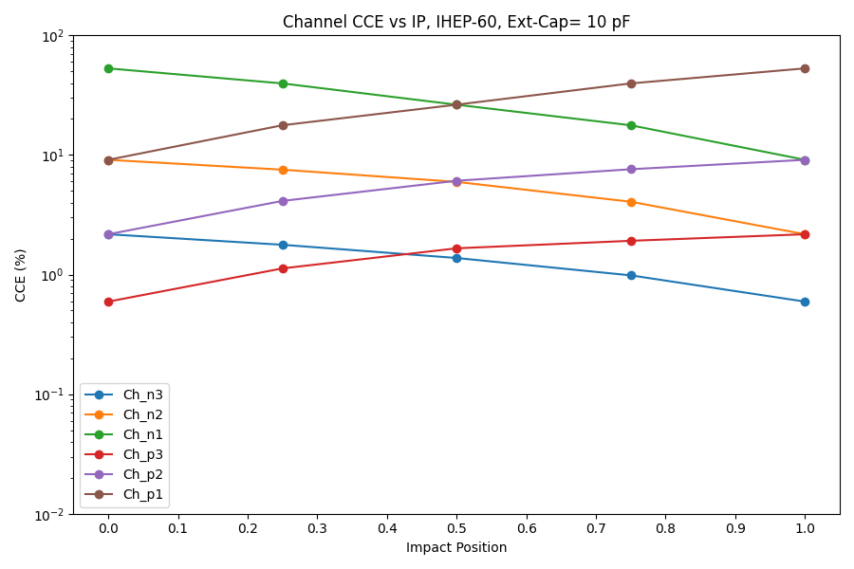
Channel CCE vs impact position: different coupling capacitance
500 pF
Coupling
capacitance
10 pF
Coupling
capacitance
Hitting
Readout Strip
Hitting
Float Strip
Hitting
Readout Strip
Hitting
Readout Strip
Hitting
Float Strip
Hitting
Readout Strip
The impact of small coupling capacitance:
Advantage: larger charge sharing ratio with hitting readout strip.
Disadvantage: smaller CCE with hitting float strip.
Notes:
来源：G:\keyan\科研任务\211212_硅微条模拟\220301_Channel response vs External Capacitor in HERD SCD\PNG_channel_vs_ip\*

Slide 10
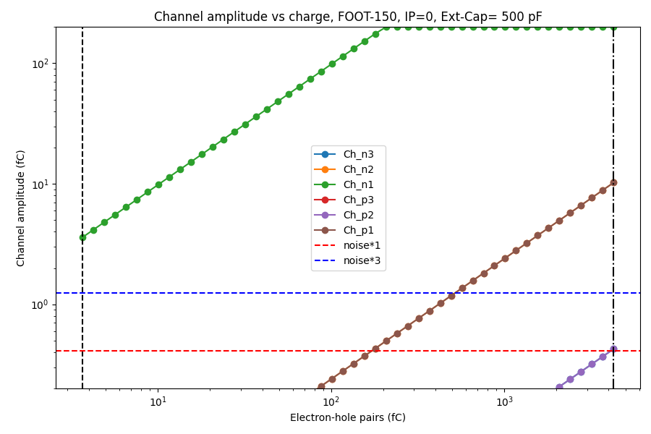
Charge Inject: From proton (Z=1) to iron (Z=26)
Detector: FOOT-150um
Coupling cap.: 500 pF
IP=0, hitting readout st.
Extreme small charge sharing ratio hitting readout strip
Z=1
Z=26
Readout strip
500 pF
Notes:
来源：G:\keyan\科研任务\211212_硅微条模拟\220301_Channel response vs External Capacitor in HERD SCD\PNG_channel_vs_energy\*

Slide 11
 | AMS-02 | AMS升级
厚度 [um] | 320
条宽 [um] | 12
读出pitch [um] | 110 | 109
读出周期 | 每4条读1条
耦合电容 | 单个Ladder 760pF 每个Sensor约70pF | 15~1000 pF可调 选择70 pF

Slide 12
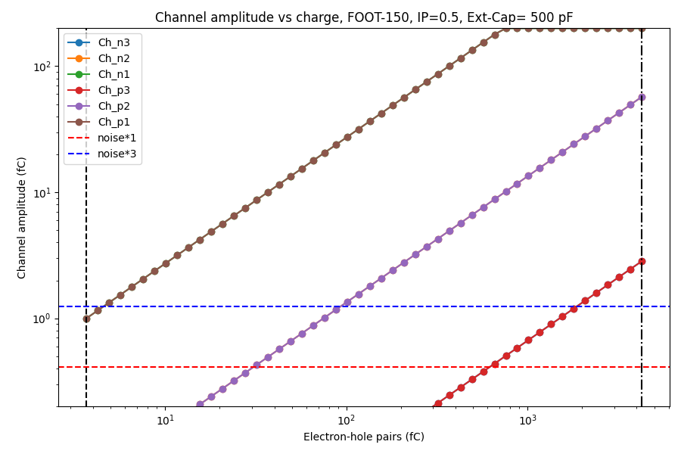
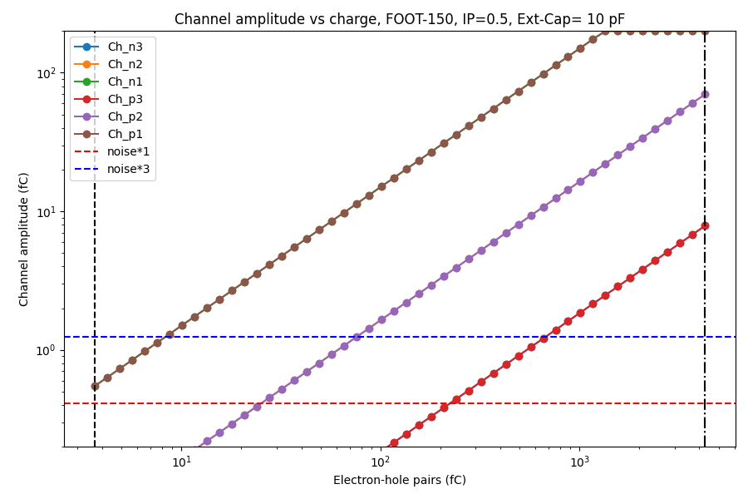
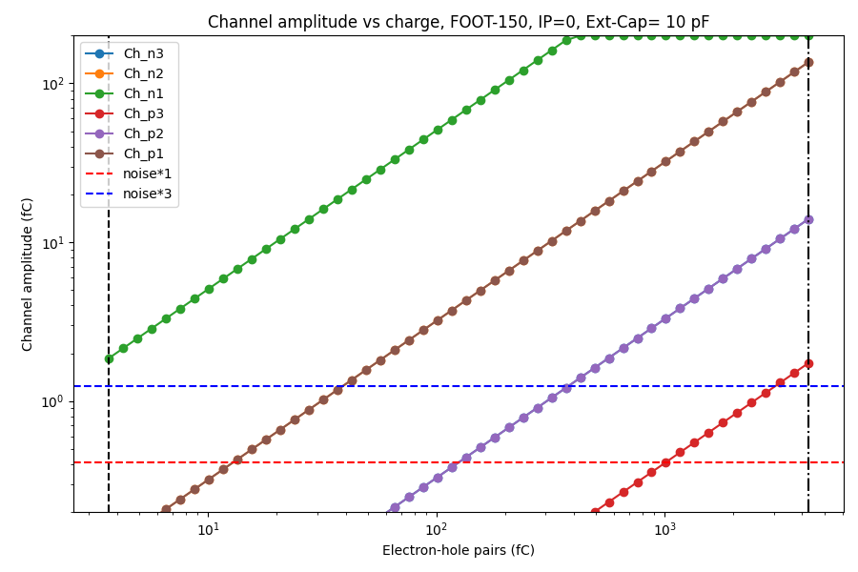
Float strip
500 pF
Float strip
10 pF
Z=1
Z=26
Z=1
Z=26
Read strip
500 pF
Read strip
10 pF
Z=1
Z=1
Z=26
Z=26
Notes:
来源：G:\keyan\科研任务\211212_硅微条模拟\220301_Channel response vs External Capacitor in HERD SCD\PNG_channel_vs_energy\*

Slide 13
CASE 1: Proton(Z=1) hitting float strip
For DAMPE SCD, we use 3.5*sigma to trigger the cluster finding algorithm, and use 1.5* sigma to end the cluster.
For HERD SCD, the SNR of the maximum channel should be large enough for the cluster finding efficiency if data compression is in need.
Proton hitting float strip has the minimum CCE, as well as the minimum cluster finding efficiency

Slide 14
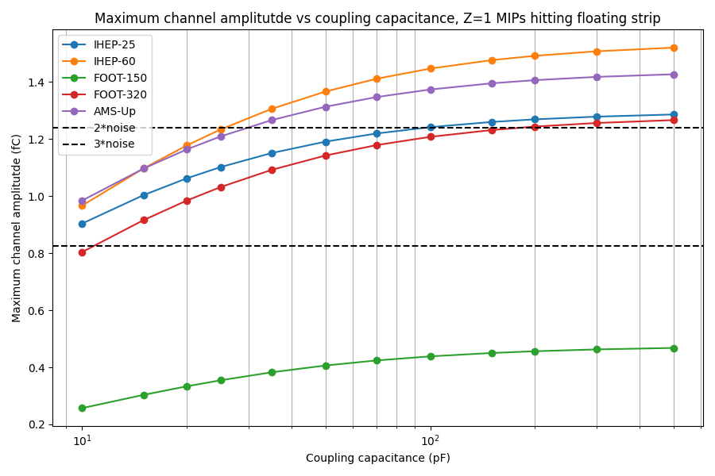
CASE 1: Proton(Z=1) hitting float strip
Project | Ladder length (cm) | Noise Level (fC)
DAMPE STK | 40 | ~0.18
HERD SCD | 90 | ~0.41
3σ
The thin FOOT-150um detector has lowest SNR.
The threshold of SNR puts a lower limit on coupling capacitance.
2σ
Notes:
来源：G:\keyan\科研任务\211212_硅微条模拟\220301_Channel response vs External Capacitor in HERD SCD\PNG_MIPs_Z1_Z26\max_amp_with_floating_Z1.png

Slide 15
CASE 2: Iron(Z=26) hitting readout strip
Read strip
500 pF
Read strip
10 pF
Z=1
Z=1
Z=26
Z=26
The electronics expert suggest the non-linear response is not reliable.
The total signal amplitude without saturation as large as possible.
Notes:
来源：G:\keyan\科研任务\211212_硅微条模拟\220301_Channel response vs External Capacitor in HERD SCD\PNG_channel_vs_energy\*

Slide 16
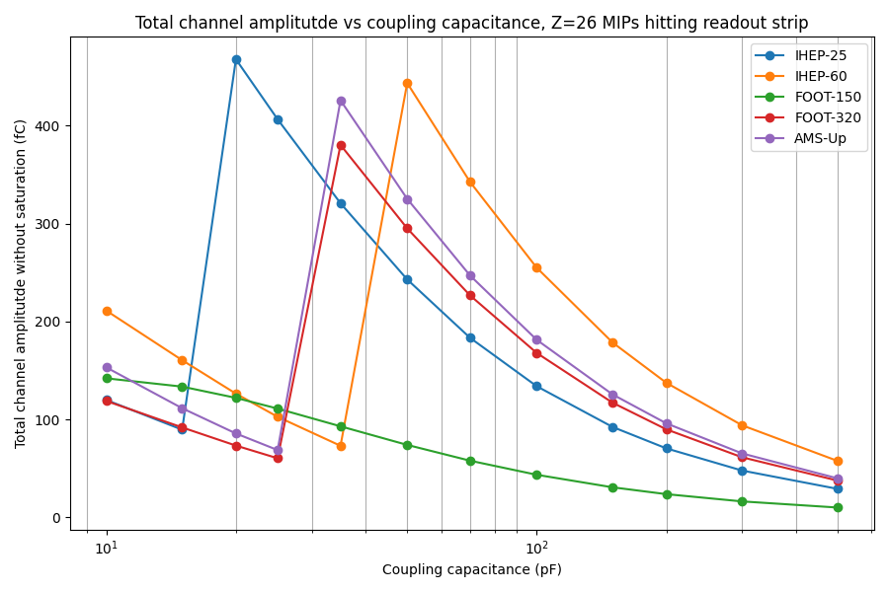
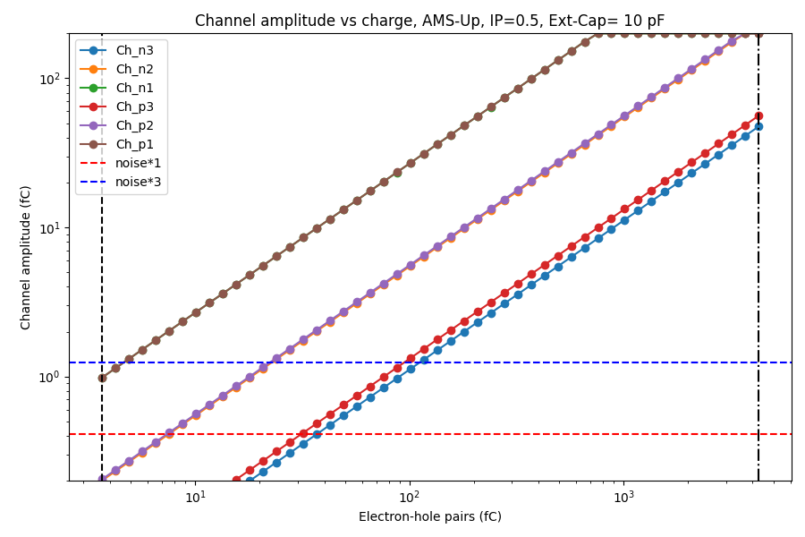
CASE 2: Iron(Z=26) hitting readout strip
Zoom A: total amplitude without saturation increase with smaller coupling capacitance.
Zoom B: total amplitude without saturation drop with extreme small coupling capacitance.
Zoom
B
Zoom
A
Notes:
来源：G:\keyan\科研任务\211212_硅微条模拟\220301_Channel response vs External Capacitor in HERD SCD\PNG_MIPs_Z1_Z26\total_amp_with_readout_Z26.png

Slide 17
Combining Proton(Z=1) and Iron(Z=26)
Z=1, float strip
Z=26, readout strip
Higher SNR
With
Larger capacitance
Larger Signal
With
Medium capacitance
Notes:
来源：G:\keyan\科研任务\211212_硅微条模拟\220301_Channel response vs External Capacitor in HERD SCD\PNG_MIPs_Z1_Z26\*

Slide 18
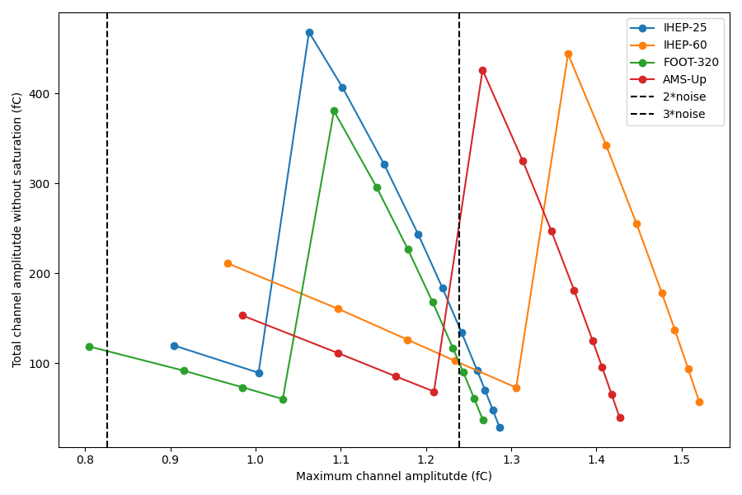
Combining Proton(Z=1) and Iron(Z=26)
Larger signal
For Z=26
2σ
3σ
The IHEP-60 & AMS-Up have better performance to compromise Z=1 & Z=26.
Higher SNR
For Z=1
Notes:
来源：G:\keyan\科研任务\211212_硅微条模拟\220301_Channel response vs External Capacitor in HERD SCD\PNG_MIPs_Z1_Z26\*

Slide 19
Combining Proton(Z=1) and Iron(Z=26)
Detector | Coupling cap. [pF] | SNR of Z=1 | Total non-saturated signal amplitudes of Z=26 [fC]
IHEP-25 | 20 | 2.6 | 468
IHEP-60 | 50 | 3.3 | 444
FOOT-320 | 35 | 2.6 | 380
AMS-Up | 35 | 3.1 | 426
Notes:
来源：G:\keyan\科研任务\211212_硅微条模拟\220301_Channel response vs External Capacitor in HERD SCD\PNG_MIPs_Z1_Z26\ana_Z1_vs_Z26.csv
G:\keyan\科研任务\211212_硅微条模拟\220301_Channel response vs External Capacitor in HERD SCD\PNG_channel_vs_energy\ IHEP-60_IP0_50pF.png & IHEP-60_IP0.5_50pF.png
G:\keyan\科研任务\211212_硅微条模拟\220301_Channel response vs External Capacitor in HERD SCD\PNG_channel_vs_energy\ AMS-Up_IP0_35pF.png & AMS-Up_IP0.5_35pF.png
Noise level: 0.41 fC
Total charges of normal incident proton: 3.67 fC
Total charges of 30deg incident iron: 4270 fC

Slide 20
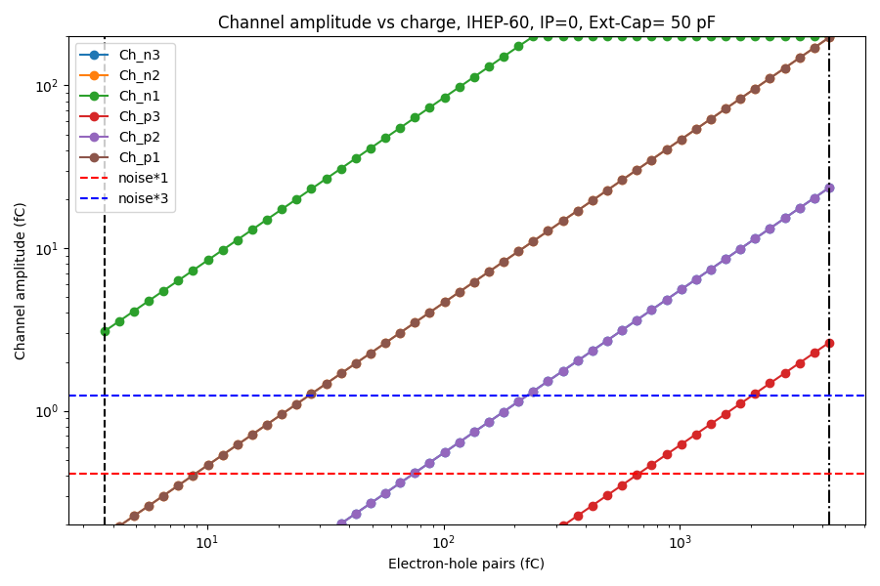
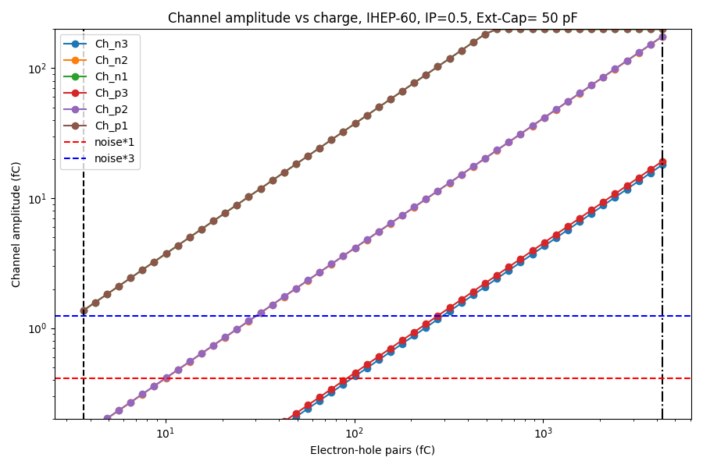
Combining Proton(Z=1) and Iron(Z=26)
Detector | Coupling cap. [pF] | SNR of Z=1 | Total non-saturated signal amplitudes of Z=26 [fC]
IHEP-60 | 50 | 3.3 | 444
Z=26
Z=26
Z=1
Z=1
IHEP-60，Readout strip
IHEP-60，Float strip
Notes:
来源：G:\keyan\科研任务\211212_硅微条模拟\220301_Channel response vs External Capacitor in HERD SCD\PNG_MIPs_Z1_Z26\ana_Z1_vs_Z26.csv
G:\keyan\科研任务\211212_硅微条模拟\220301_Channel response vs External Capacitor in HERD SCD\PNG_channel_vs_energy\ IHEP-60_IP0_50pF.png & IHEP-60_IP0.5_50pF.png
G:\keyan\科研任务\211212_硅微条模拟\220301_Channel response vs External Capacitor in HERD SCD\PNG_channel_vs_energy\ AMS-Up_IP0_35pF.png & AMS-Up_IP0.5_35pF.png
Noise level: 0.41 fC
Total charges of normal incident proton: 3.67 fC
Total charges of 30deg incident iron: 4270 fC

Slide 21

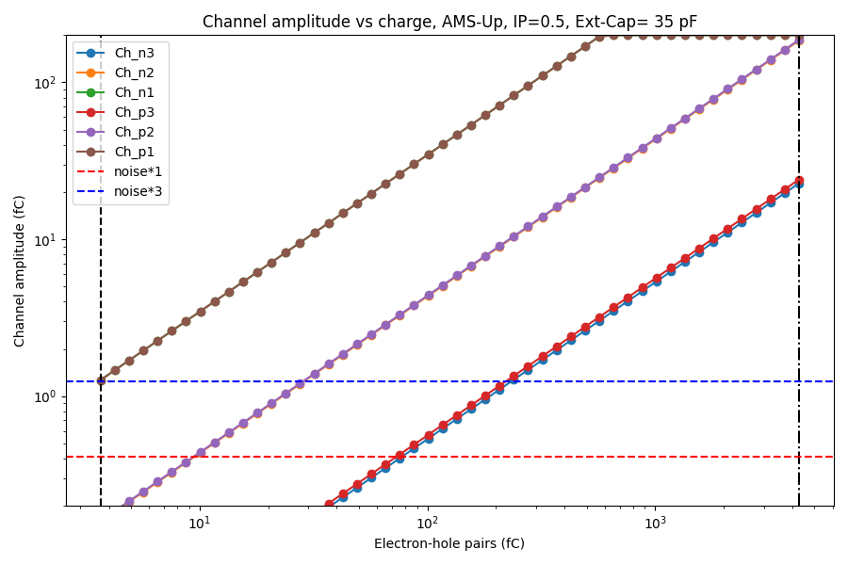
Combining Proton(Z=1) and Iron(Z=26)
Detector | Coupling cap. [pF] | SNR of Z=1 | Total non-saturated signal amplitudes of Z=26 [fC]
AMS-Up | 35 | 3.1 | 426
Z=26
Z=26
Z=1
Z=1
AMS-Upgrade，Readout strip
AMS-Upgrade，Float strip
Notes:
来源：G:\keyan\科研任务\211212_硅微条模拟\220301_Channel response vs External Capacitor in HERD SCD\PNG_MIPs_Z1_Z26\ana_Z1_vs_Z26.csv
G:\keyan\科研任务\211212_硅微条模拟\220301_Channel response vs External Capacitor in HERD SCD\PNG_channel_vs_energy\ IHEP-60_IP0_50pF.png & IHEP-60_IP0.5_50pF.png
G:\keyan\科研任务\211212_硅微条模拟\220301_Channel response vs External Capacitor in HERD SCD\PNG_channel_vs_energy\ AMS-Up_IP0_35pF.png & AMS-Up_IP0.5_35pF.png
Noise level: 0.41 fC
Total charges of normal incident proton: 3.67 fC
Total charges of 30deg incident iron: 4270 fC

Slide 22
Conclusion
SPICE simulation of CCE with readout & float strip incidence.
Verified by AMS-02 results.
Two extremes:
Smallest signal: 0 degree proton (Z=1) hitting float strip
Largest signal: 30 degree iron (Z=26) hitting readout strip
The coupling capacitance affects:
The SNR when proton (Z=1) hitting float strip
The total non-saturated amplitude when iron (Z=26) hitting readout strip
The best sensors are:
IHEP-60 with 50 pF coupling cap., SNR=3.3 for Z=1
AMS-Upgrade with 35 pF coupling cap. , SNR=3.1 for Z=1

