Slide 1
MC studies and Physics Performance
A. Mastroserio, S. Fazio

Slide 2
Montecarlo Simulations - Ongoing Activities
Bi-weekly meetings on Monday mornings
EIC_NET - Simulation activities:
Tracking perfomance studies
dRICH
Physics simulations
Our community (ex ATHENA) gained experience with fun4all and DD4hep, now waiting for further indications on how to proceed
EIC SWG : Dicussions ongoing to define a common strategy /tools for a common software
Discussion decision schedule
End of June : Geometry, Data Format, Reconstruction framework, container
EIC Detector 1 – Software Decision (Geometry)
End of July : Calibration, Data preservation

Slide 3
Geometry : ECCE geometry
MC studies for Detector-1 start from the ECCE geometry

Slide 4
Tracking Performance studies
Studies on Detector-1 geometry
Vertex detector performance optimization
Fast Simulation tools
Validation
Detector geometry modification (e.g.: inner barrel radii)
Performances compared with the Physics Working Group (PWG) requirement
Shyam Kumar

Slide 5
Ecce Geometry
Shyam Kumar

Slide 6
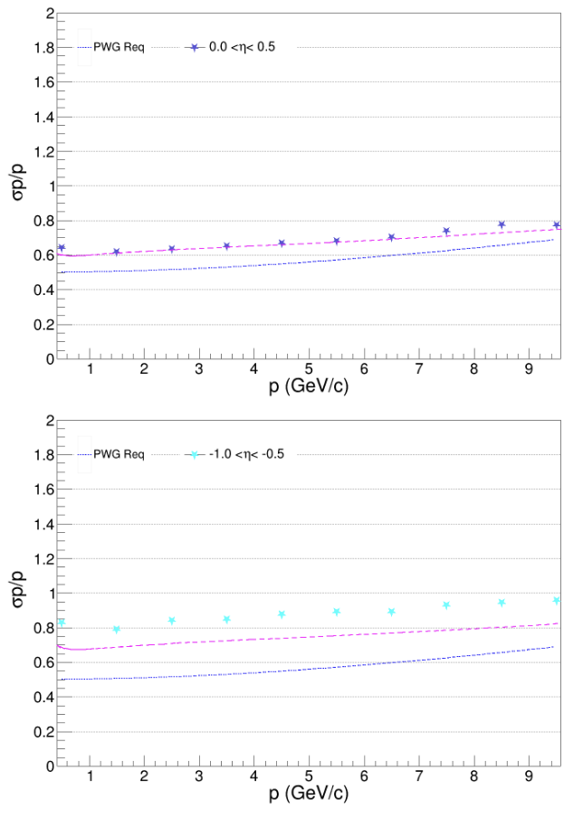
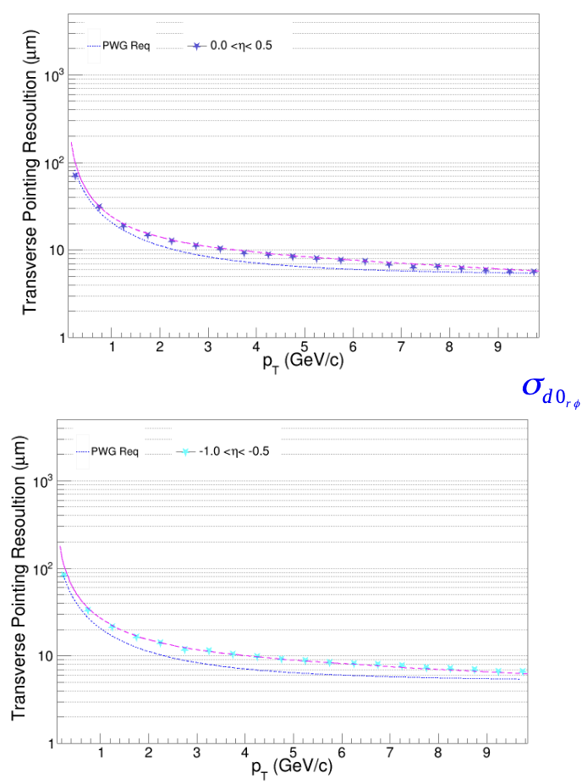
Fast Simulation tool
Barrel layers detector
Internal parameters tuned to the ECCE vertex detectors and B field
Shyam Kumar

Slide 7
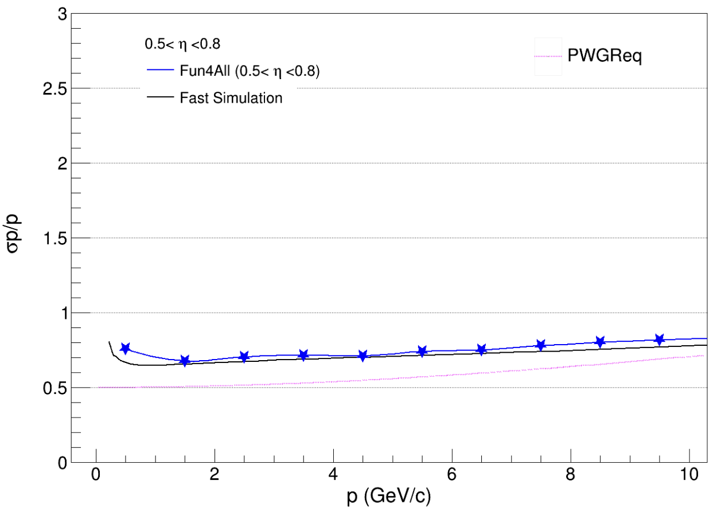
Fast Simulation Tool
FS tool well under control

Slide 8
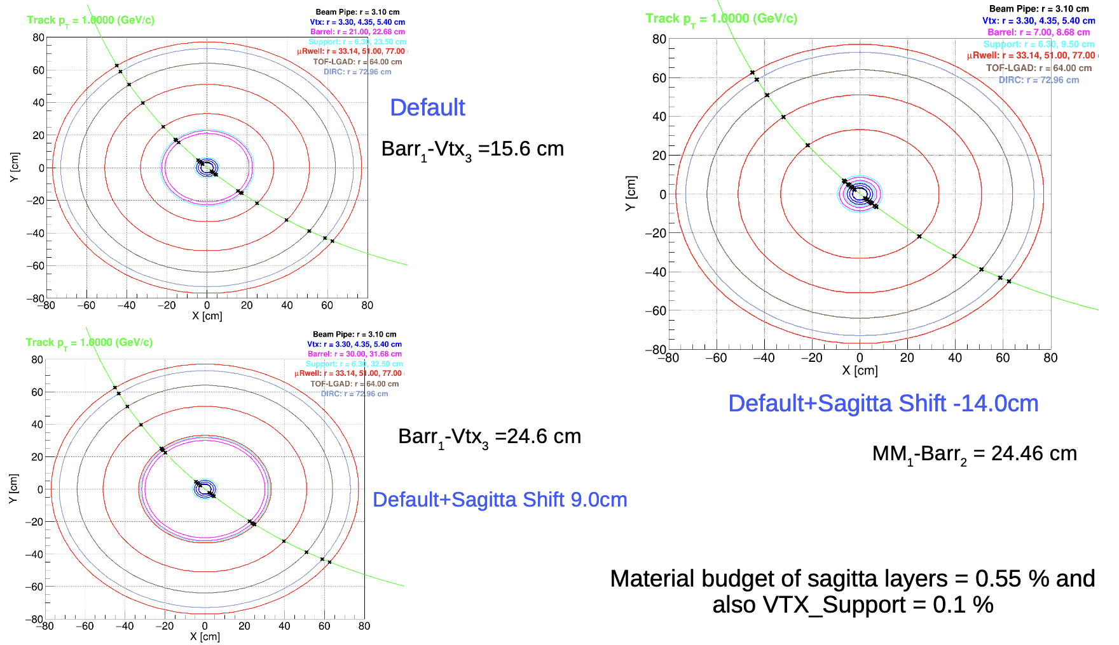
Fast Simulation tool : optimization studies
Shyam Kumar
Several results on
moving internal layers
changing their material budget
Changing detector resolution
-> Shyam’ s talk at the tracking working group meeting on next week

Slide 9
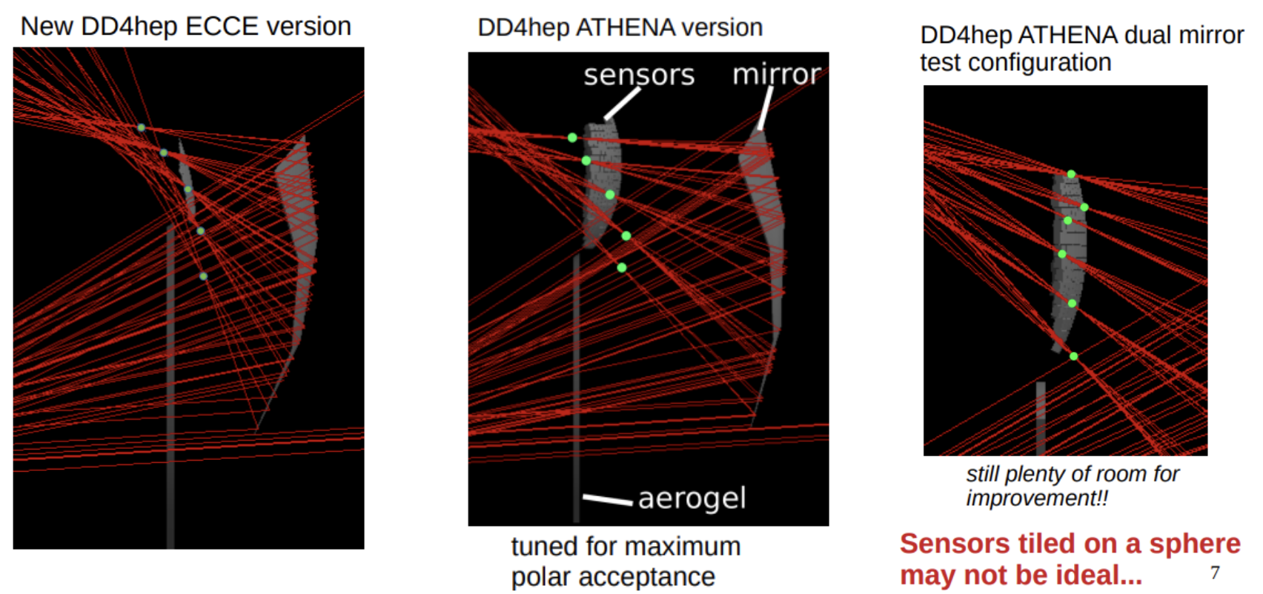
dRICH simulations
Work ongoing on pattern recognition
Inverse Ray Tracing approach
Code developed within dd4hep framework
Issues occurred during this transition period on the general software development
Work ongoing to adapt the algorithm to the new data model
Chandradoy Chatterjee
See Chandra’s talk

Slide 10
Physics Simulations (→ pubblication)
Salvatore one of the authors of the EpIC Monte Carlo event generator for exclusive processes sensitive to generalised parton distributions
https://inspirehep.net/literature/2077191
Slides from Kemal Tezghin

Slide 11
Physics Simulations
Flexible Architecture that utilises a modular programming paradigm

Slide 12
Open Tasks : tracking & PID simulations
Tracking & Vertexing:
Check the tracking performances ( σ_{p}/p and pointing resolution, η dependance) in several scenarios:
Fast simulation in more than one detector configurations
Full simulation in the simulated detector geometry(ies)
Check the same performances with two (or more) B fields
Check the reconstruction performance of particles as physics benchmarks (e.g.: D0)
Both local and MC simulations (generator)
Same checks with different fields
Contact persons : D. Elia, A. Mastroserio
PID : dRICH, development of pattern recognition methods, studies in different configurations and B field
Contact person : C. Chatterjee
Slide from Riunione Nazionale EIC_NET 28/03/2022

Slide 13
Open Tasks : Physics simulations
DVCS: quantify the effect of the ECAL energy resolution on the reconstruction of kinematics using a full simulation of the detector and realistic PID.
Exclusive Processes: investigate the possibility of mitigating the systematic effects due to radiative corrections by measuring initial state radiation photons at zero degree with the Lumi detector. - contact person: S. Fazio
Diffractive PDFs: perform a first EIC impact study. CFNS-Stony Brook Workshop on PDFs at EIC (M. Ruspa organizer) https://indico.bnl.gov/event/14009/ - contact person (M. Ruspa)
HERA4EIC: several analyses at HERA can help tuning EIC Physics Studies and train a younger generation of researchers on data analysis of e+p collisions in collider mode. See also CNFS workshop at Stony Brook: https://indico.bnl.gov/event/9370/ - contact persons: M. Ruspa, M. Capua, S. Fazio
Slide from Riunione Nazionale EIC_NET 28/03/2022

Slide 14
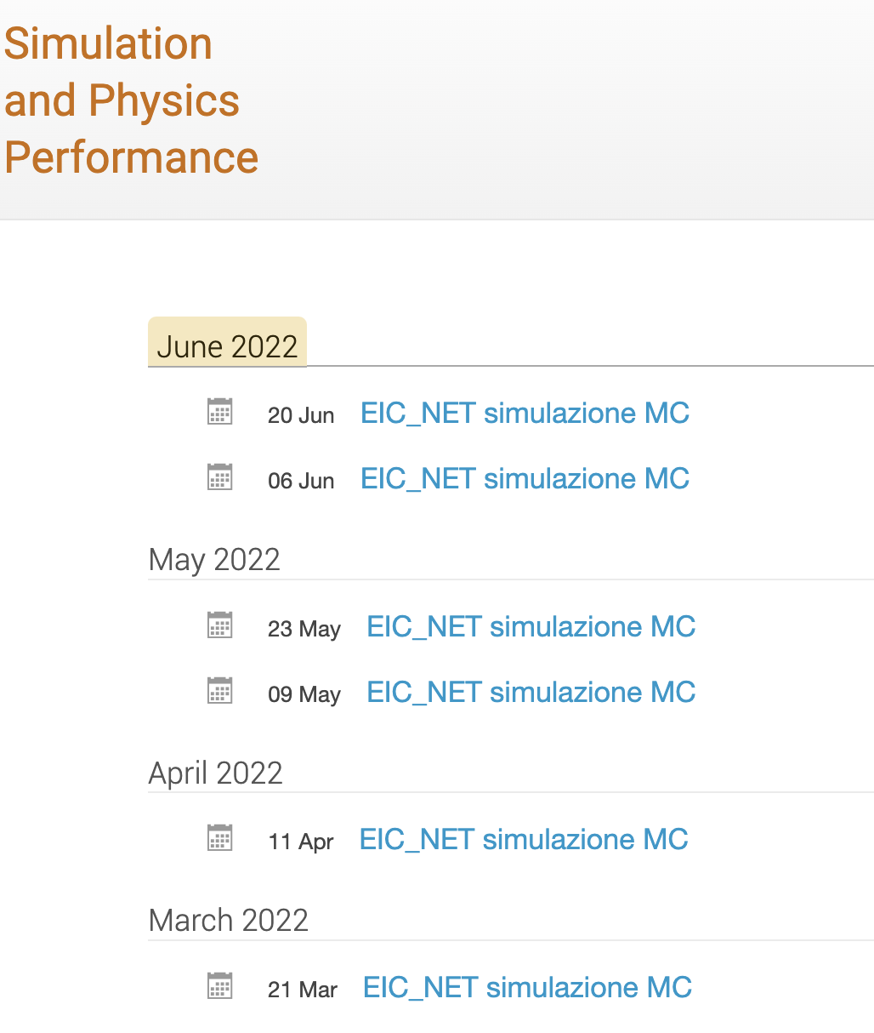
Summary
Work ongoing despite the transition period of the official software framework on several items
People interested are welcome to join our meeting EIC_NET: Simulation and physics performance meeting
https://agenda.infn.it/category/1559/
Several topics from detector simulations to physics simulations are available for further studies

Slide 15
Electron Ion Collider School

Slide 16
EIC School proposal
School dedicated to Electron Ion Collider
[physics and detectors]
Who : students both from master thesis / PhD ( I year)
When : 2023 April/May/summer, -> 3.5 days
Where : Bertinoro/Maratea/Vieste/….
What : lessons from theory, detectors, hands on sessions (MC simulations)

Slide 17
EIC School proposal
Preliminary ideas on lectures
Deep Inelastic Scattering history (from SLAC-MIT to HERA)
Detectors: detectors and technologie chosen for DIS measurements at HERA (ZEUS, H1, HERMES)
Nucleon tomography: longitudinal structure function, TMD e GPD
JLAB e COMPASS: overview of physics results
Diffractive physics
EIC Physics Program - Spin physics - Mass of the nucleon - Hadron spectroscopy
….
→Availability of Abhay Deshpande

Slide 18
Discussion is open

Slide 19
Tracker geometry details

