Slide 1
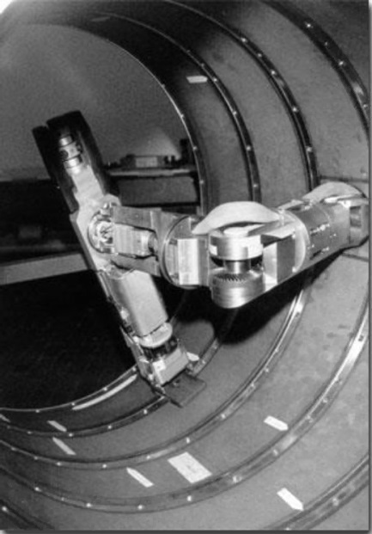
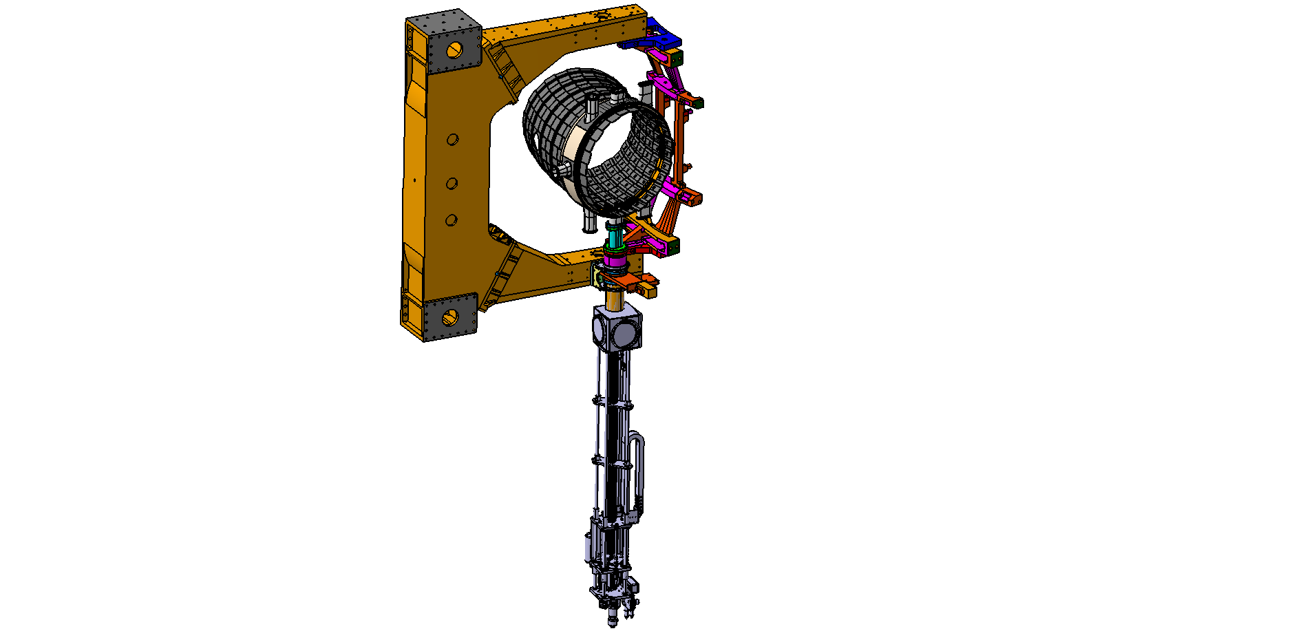
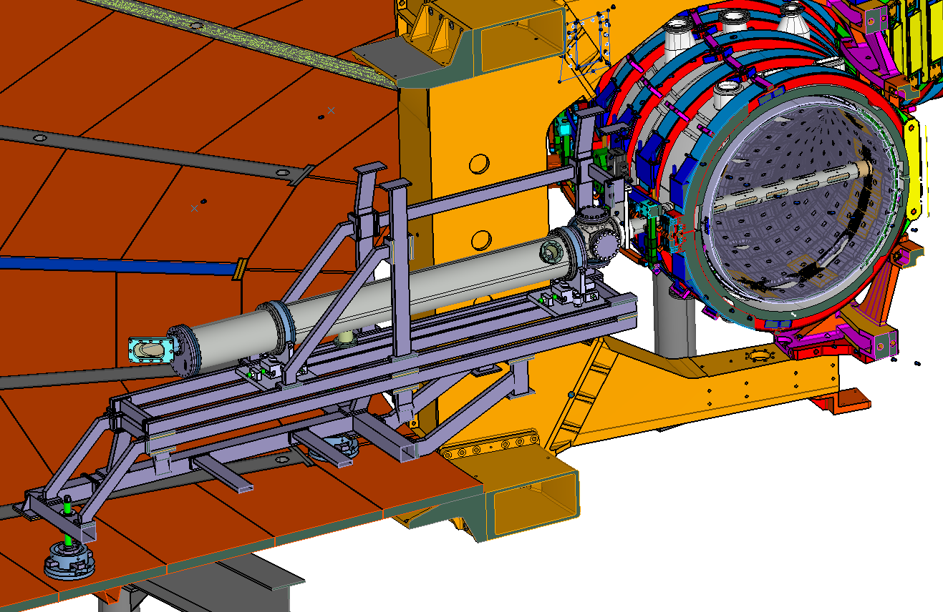
Remote Handling Systems for RFX-mod2 experiment
S. Peruzzo
Technology and Engineering Development Program Manager
INFN Industrial Opportunity Days 2022
(Napoli, 9-10 June 2022)

Slide 2
Outline
Overview of RFX experiment and recent modifications for ‘RFX-mod2’
Prospects for new near term investments

Slide 3
Outline
Overview of RFX experiment and recent modifications for ‘RFX-mod2’
Prospects for new near term investments

Slide 4
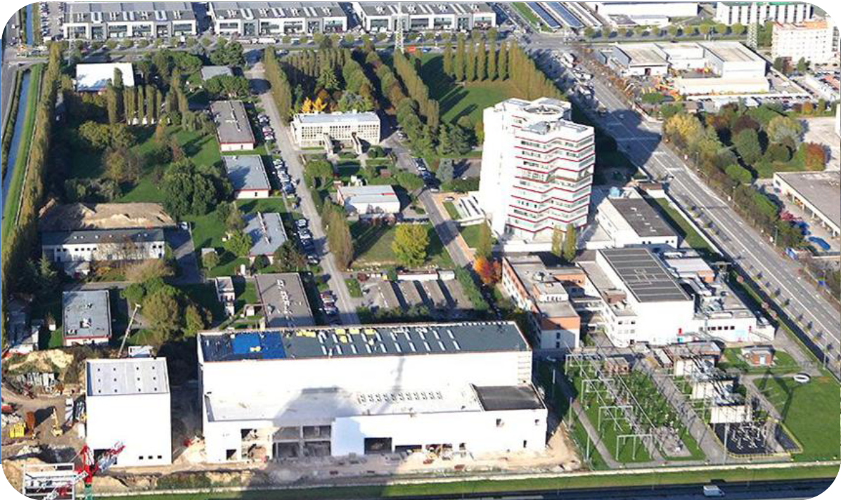





RFX experiment location
Consiglio Nazionale delle Ricerche - Area della Ricerca di Padova
RFX experiment
ITER
Neutral Beam Test Facility
Partners of ‘Consorzio RFX’:

Slide 5
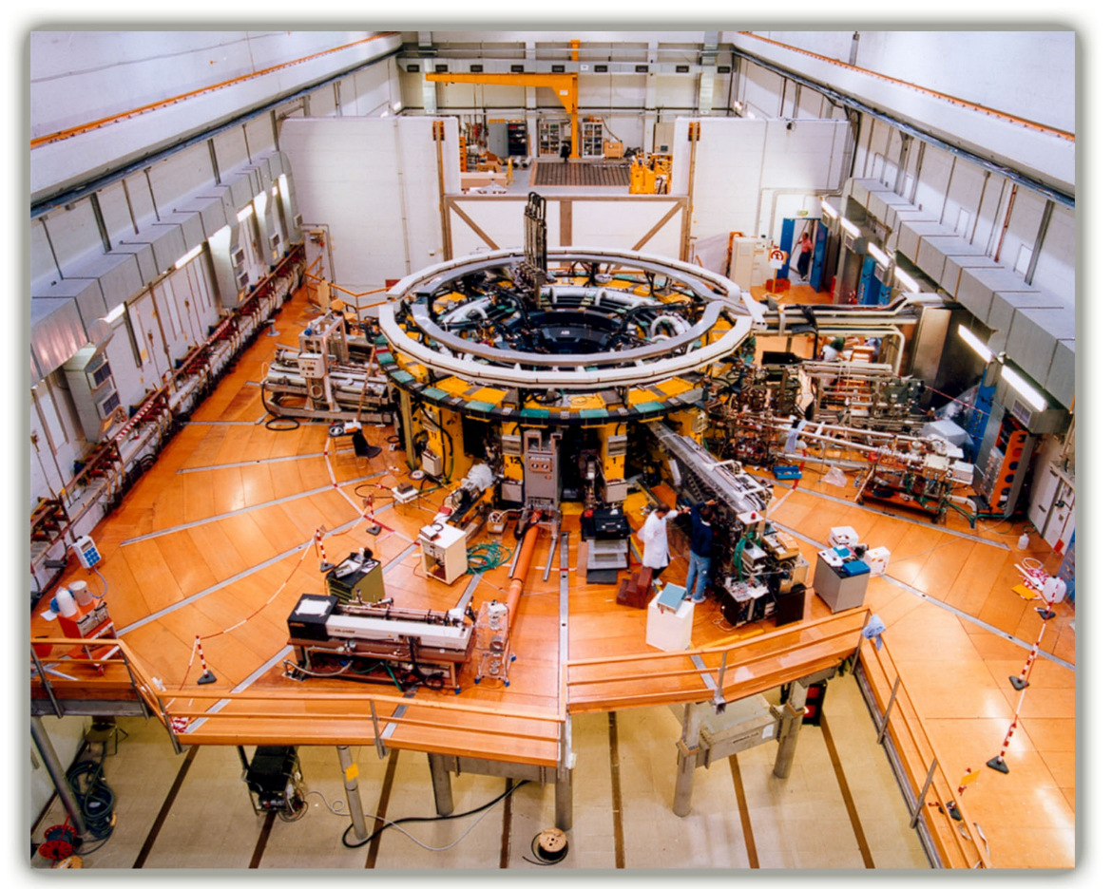
RFX experiment main parameters
Toroidal vacuum chamber
major radius 2 m
minor radius 0.5 m
Max plasma current 2 MA
Max toroidal magnetic field 0.7 T
Heating only ohmic
Plasma electronic temperature 1 keV
Plasma discharge duration 250 ms
Pulse repetition rate 1/15 min
Total installed electrical power 400 MVA

Slide 6
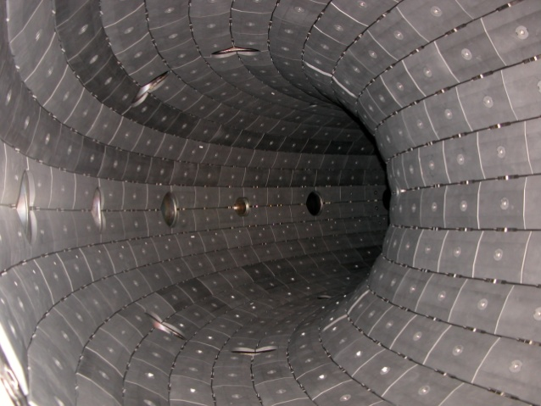
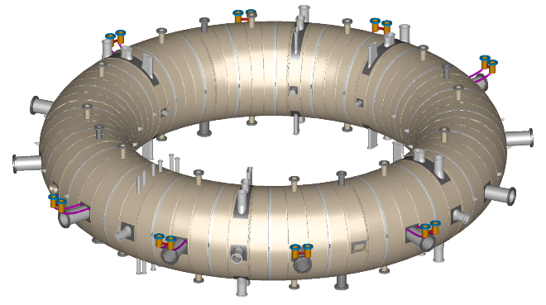
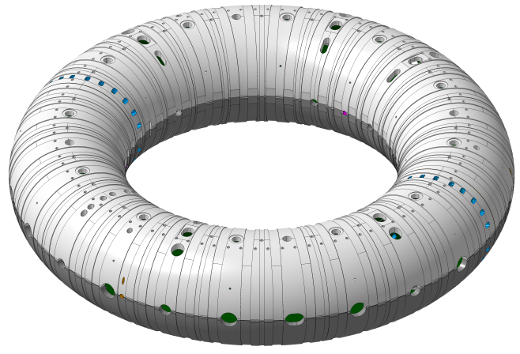
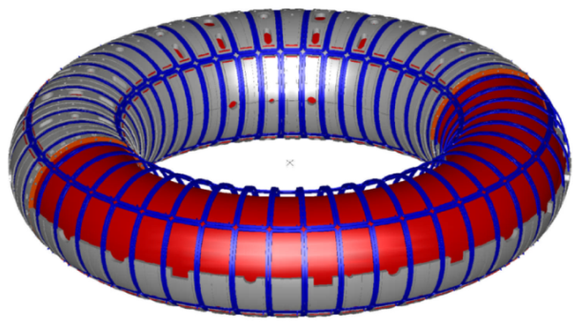
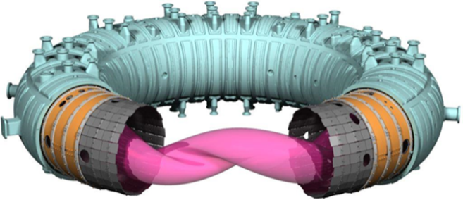
RFX Vessel complex evolution
Vacuum vessel Inconel 625
1 m
First wall
28x72=2016 graphite tiles
5 m
RFX
1991-1999
RFX-mod 2004-2015
RFX-mod2 2023-….
Active + Passive control of MHD:
4x48 saddle coils
thin shell (Cu, 3mm; τ_{Bv}= 50 ms)
enhancement of ‘plasma / shell proximity’
for a better magnetic confinement
(enclosure of stabilizing shell within vessel)
Magnetic configuration dominated by passive stabilizing thick shell surrounding the vessel
(Al; 65mm; τ_{Bv}= 450 ms)

Slide 7
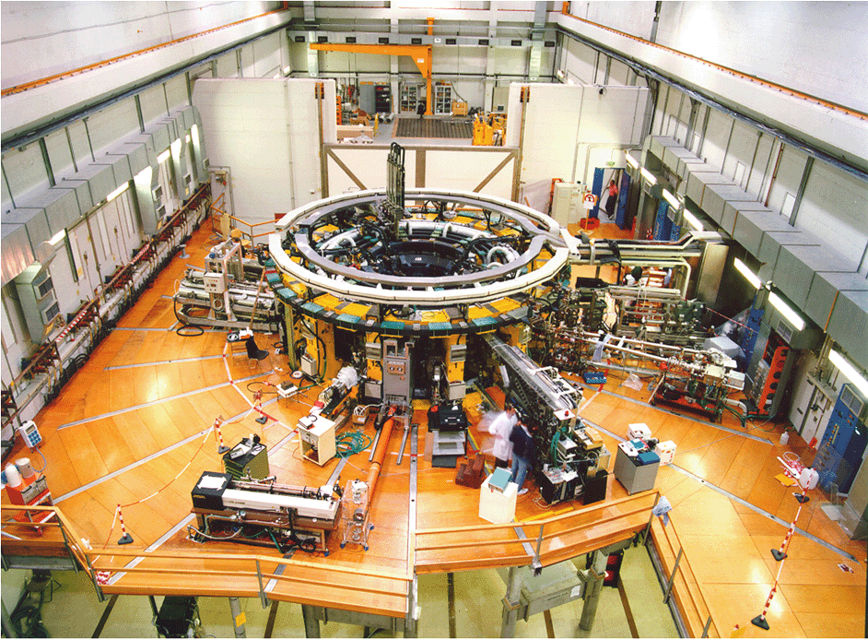
Plasma diagnostic systems
X-ray tomography
Plasma edge probes manipulator
Pellet Injection
Thomson scattering
Reflectometer
Interferometer

Slide 8
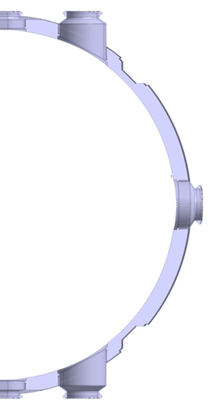
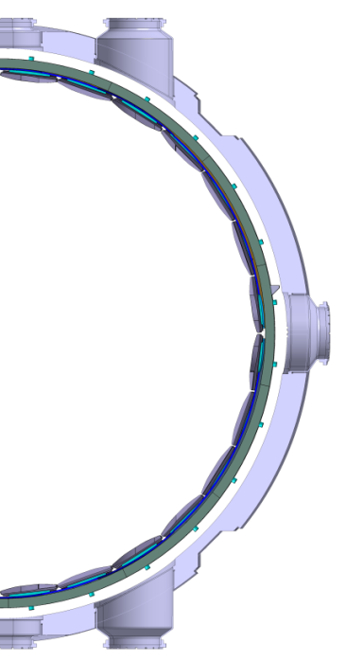
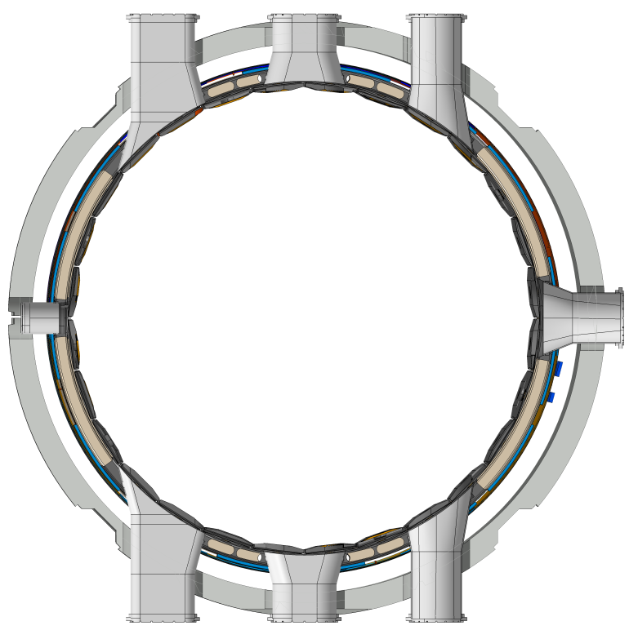

Main modifications implemented from RFX-mod to RFX-mod2
R₀=2.0 m
r_{m} =0.5 m
RFX-mod
RFX-mod2
0,490 m
0,459 m
0,512 m
SS
Toroidal
Support
Structure
th=47mm
Cu Stabilizing Shell
th=3mm
Graphite
1st Wall
th=18mm
Inconel
Vacuum Vessel
th=30mm
r_{shell}/r_{plasma} =
1,11
RFX-mod
1,04
RFX-mod2
RFX-mod2 modifications:
new vacuum boundary
self-sustained
supporting 1st wall
change of shape
attached to shell
removed

Slide 9




POR-FESR Project “MIAIVO” supporting “RFX-mod2”: a successful partnership Research & Business
RFX-mod2 project started in 2018 in the framework of the industrial innovation project “MIAIVO” - Meccanica Innovativa e Additiva Integrata: il VenetO dalla ricerca alle opportunità nel mercato attuale e futuro.
Project aim: development of technologies and innovation of industrial processes for the manufacturing of equipment for energy and environment
Total budget: 4 M€ (50% Co-funded by Regione Veneto)
Duration: 2018 – 2021
Partnership: 1 research institute + 3 companies (Distretto Industriale della Meccanica dell’Alto Vicentino)
Consorzio RFX: (research institute)
ALCA TECHNOLOGY S.r.l.: Technology development for material surface treatment
Zanon Pressure Equipment S.r.l. (formerly Ettore Zanon SpA, now Brembana & Rolle S.p.A.): Technology development for vacuum chamber manufacturing with metal alloys and high performance polymers
Sisma S.p.A.: Technology development for manufacturing of components by means of additive manufacturing technique

Slide 10
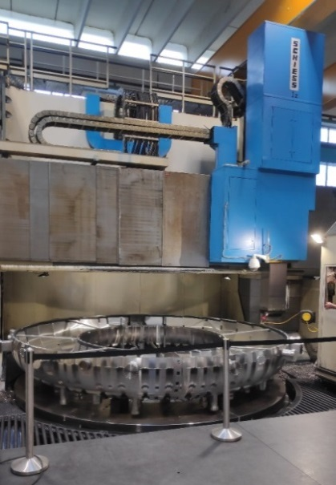
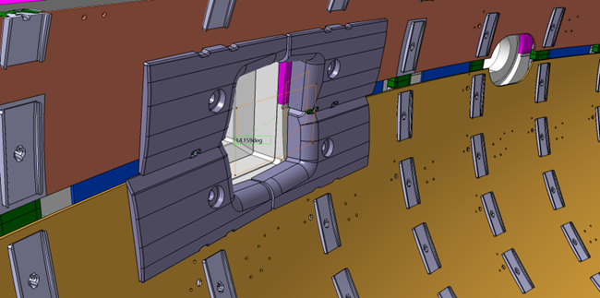
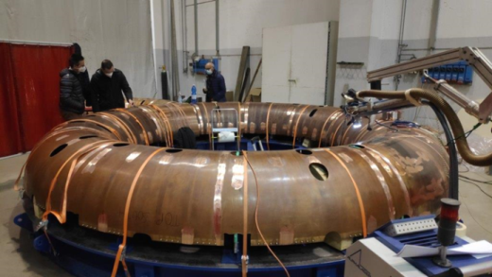

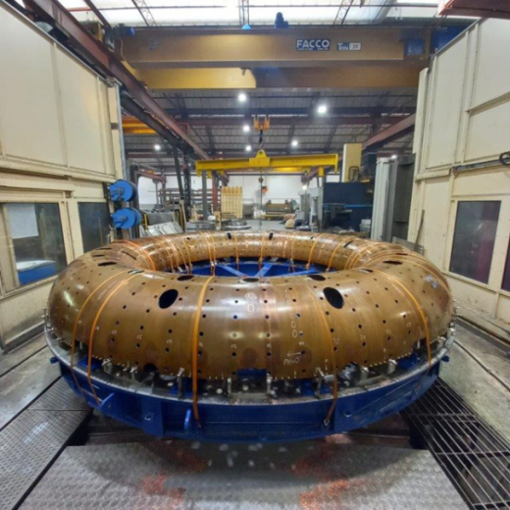

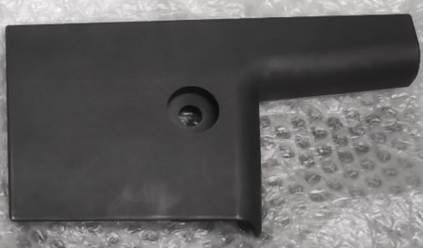

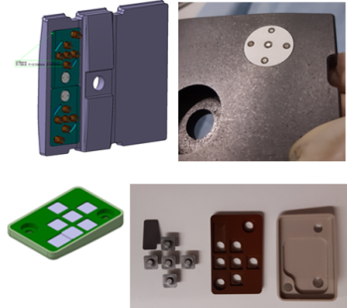
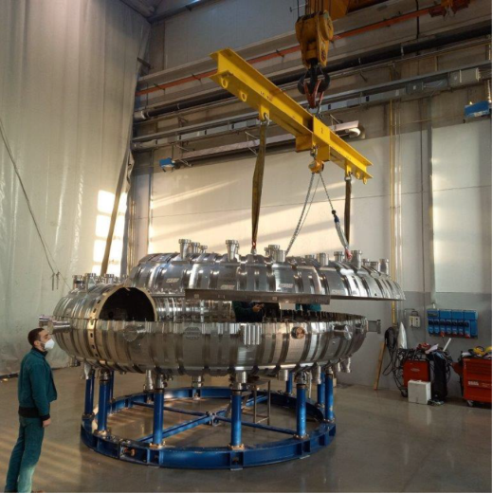





Main components manufactured for RFX-mod2 (+ main sub-suppliers)
Stainless steel vessel
First wall graphite tiles with embedded electro-magnetic sensors
Copper shell and insulating support structure
Vessel complex assembly by end 2022

Slide 11
Outline
Overview of RFX experiment and recent modifications for ‘RFX-mod2’
Prospects for new near term investments

Slide 12
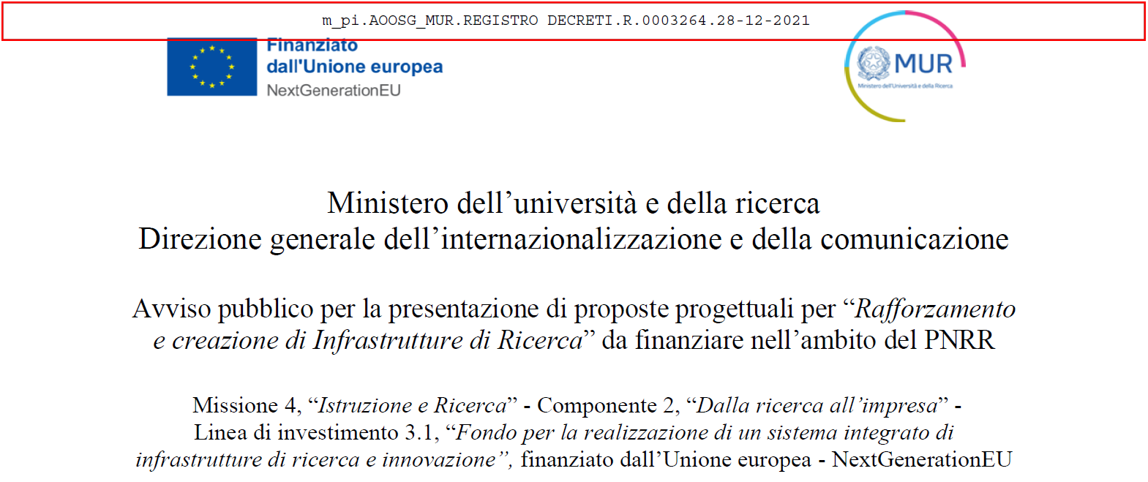
NEFERTARI project proposal / PNRR Research Infrastructures
According to the «Piano Nazionale Infrastrutture di Ricerca 2021-2027 (PNIR)» the RFX experiment has been identified as a high priority research infrastructure eligible for funding in the framework of the PNRR
project proposal NEFERTARI (New Equipment for Fusion Experimental Research & Technological Advancements with Rfx Infrastructure) submitted in response of the call n. 3264, issued by MUR, 28-12-2021
 Project aim: innovation of experimental equipment and diagnostic systems for RFX-mod2
 Proposed budget: 20 M€ (70% dedicated to hardware investment) divided in 10 independent “Work Packages”
 Duration: 30 months (2022 – 2024)
 Partnership: CNR (ISTP BA-MI-PD), UniNA, UniPD
evaluation expected by June ’22

Slide 13
Remote Handling systems for RFX-mod2
NERFERTARI project Work packages
Remote handling system for First Wall maintenance
FAst Reciprocating Manipulator for edge plasma probes
Manipulator for Thomson Scattering diagnostic system
RFX-mod2 Technological Plants
Electromagnetic measurements and feedback control in fusion devices
Innovative diagnostics for edge fusion plasmas
Enhancement of RFX-mod2 main plasma diagnostics
Neutral beams injectors in RFX-mod2
Laboratory of High Voltage insulation in fusion devices
Laboratory for the study of fusion relevant high-density plasmas and materials interaction
Laboratory for innovative diagnostics for imaging of soft X-rays and neutrons
Research and Development of optical plasma diagnostics and modelling for fusion
Management

Slide 14
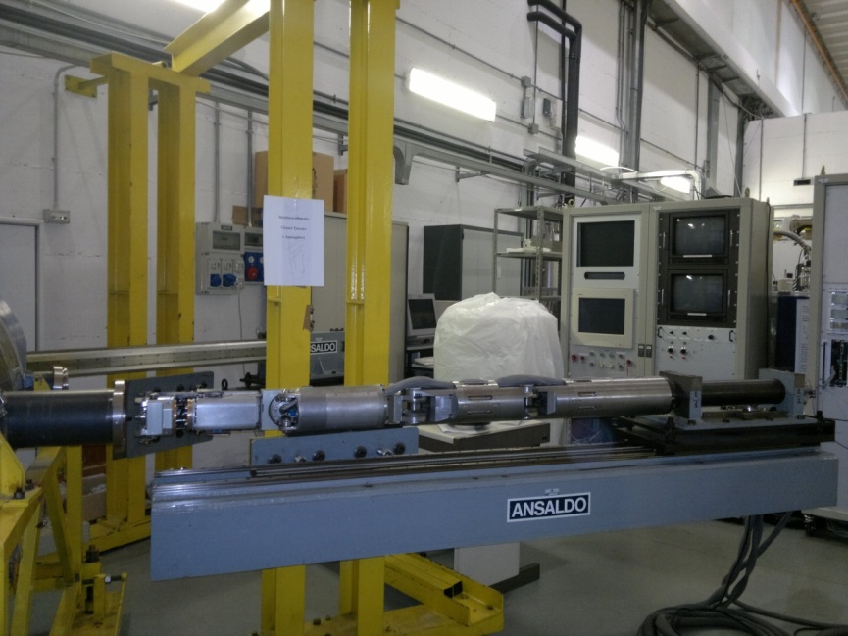
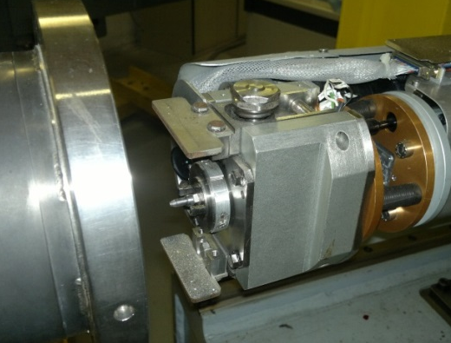
Remote Handling system for First Wall maintenance: functional specifications
largest vessel access (Ø150)
Control system
Original system operated for 2 decades allowing:
  replacement of tiles (automatic or tele-operated mode)
  periodic inspection of the first wall
  removal of fragments and dust due to failure of in-vessel components
Auxiliary manipulator
(sliding transporter)
Main manipulator
(5 DOF articulated arm)
Complete redesign of the system is needed to:
  Comply with new geometry of First Wall
  Overcome obsolescence of some parts (mechanical joints, whole control system hw/sw)
  Increase dexterity with video assisted features
End-effector
for tile replacement

Slide 15
Remote Handling system for First Wall maintenance: forthcoming activities
Revision of the original kinematics of the manipulator arm and development of a new multi-purpose end-effector compatible with both vision and image recognition system
Development of the control software and the tactile Human Machine Interface
Development and implementation of an up-to-date Virtual Reality Simulator
Design and construction of the robotic arm with integration of electronics, vision and control software
Realization of a specific Test and Training Facility for system commissioning, calibration and optimization
Stakeholders:
  UniNA (Federico II): mechanics and VR
  UniPD (DTG): Control and HMI
  C.RFX: functional specifications + integration and commissioning
  Industrial partners: …very welcome! (for both R&D and manufacturing)

Slide 16
FAst Reciprocating Manipulator for edge plasma probes: functional specifications
FARM diagnostic concept: manipulator for rapid insertion in the plasma edge region of electro-magnetic probes for detection of plasma parameters (n, T, V, B)
Reciprocating probe head
New diagnostic system to be manufactured and integrated in RFX-mod2
  Combination of slow & rapid (0.1 ms) movement of probe head in vacuum
  Possible installation of n.1 or 2 identical manipulators
Inspection camera
Slow + rapid motion

Slide 17
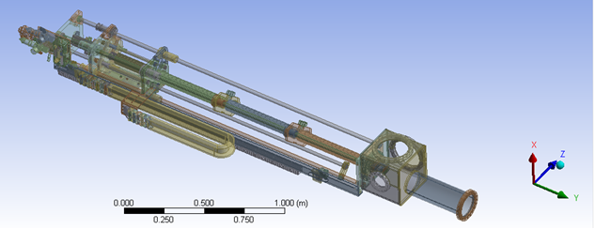
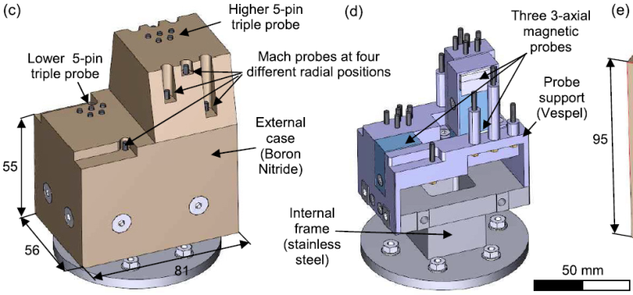
FAst Reciprocating Manipulator for edge plasma probes: technical details
Slow translation:
  1500 ±0.1 mm stroke
  pneumatic motor with endless screw with position feedback control
  Metallic bellow for vacuum boundary
Fast reciprocation:
  100 mm stroke
  Pneumatic piston with 2 electric valves
  Operation time 50 / 50-200 / 50 ms (insertion / positioning / extraction)
  v_{max}= 2 m/s; acc_{max} 150 m/s²
  Short metallic bellow
Design already completed (by C.RFX)
Technical Specifications and call for tender by 2022 Q3
Involvement of industrial supplier requested for
  mechanical structure with feedback control
  multi-sensor probe heads
  front end electronics for data acquisition system
  multi-sensor probe head
  (overall weight 2 kg)

Slide 18
Manipulator for Thomson Scattering diagnostic system:
Functional specifications
Thomson Scattering concept: optical diagnostic system providing information on electron temperature and density from scattered radiation emitted by interaction of a laser beam and plasma particles
Scattered light detectors
Laser input window
Aims of the complete refurbishment of the diagnostic support structure:
  Maintenance of in vessel components of the diagnostics (beam dump / mirror)
  Calibration of detectors
  Maintenance operation integrated with laser system (to preserve machine vacuum conditions)
Beam dump or mirror

Slide 19
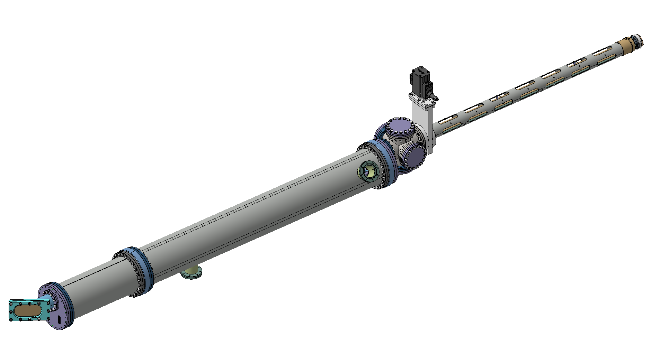
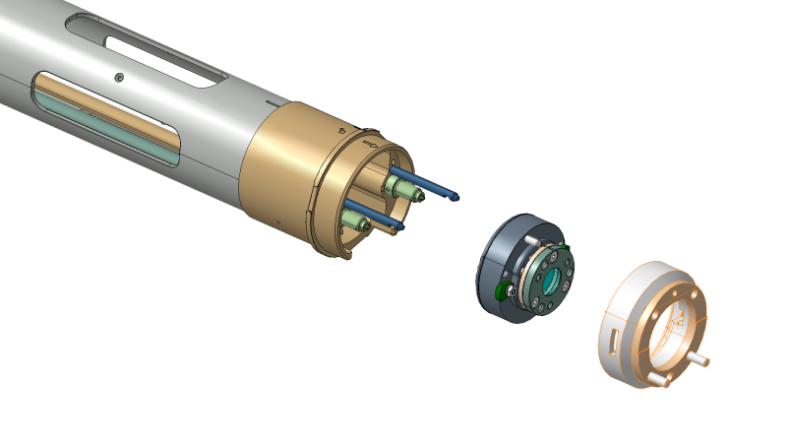
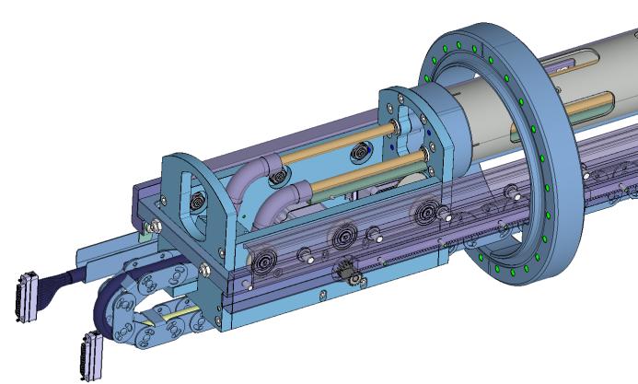
Manipulator for Thomson Scattering diagnostic system: technical details
end effector
Cylindrical vacuum chamber (∅200 x 2000)
Sliding manipulator (1500 length)
replaceable mirror holder
Interface attached to vessel
Design almost completed (by C.RFX)
Technical Specifications and call for tender planned by 2022 Q3
Involvement of industrial supplier requested for manufacturing of the whole mechanical system
Step motors in vacuum for:
manipulator translation (n.1)
end effector / mirror holder engagement (n.2)

Slide 20





Final remarks
Assembly of RFX-mod2 Vessel Complex planned by end 2022
Machine reinstallation (magnets, diagnostics and auxiliary systems) planned by 2023 Q2
Commissioning and restart of experimental campaign expected by 2023
Boost for innovation of experimental equipment and diagnostic systems expected from PNRR-RI for the forthcoming 30 months
https://www.facebook.com/consorziorfx/
For further information:
<https://www.igi.cnr.it> + social media
Direct contact:
<simone.peruzzo@igi.cnr.it>
https://www.instagram.com/consorziorfx/
https://www.linkedin.com/company/consorzio-rfx/
https://twitter.com/ConsorzioRFX
https://www.youtube.com/channel/UCTxf_7S0NjyKzDANDb4qHxA

