Slide 1

DTT RHS
A. Reale (DTT S.c.a r.l.)
Industrial Liaison Officers (ILO) Network Italia
Industrial Opportunity Days 2022
June 9-10, 2022
Istituto Nazionale di Astrofisica - Osservatorio Astronomico di Capodimonte (Napoli)
DTT Consortium (DTT S.C.a r.l. Via E. Fermi 45 I-00044 Frascati (Roma) Italy)

Slide 2
RH systems Andrea Reale
RHI IN-VESSEL
RHO EX-VESSEL
5.1.6.1
HYRMAN
5.1.6.2
Divertor
Handling
5.1.6.3
CASKS
5.1.6.4
IFW Lifting
5.1.6.5
Hot room manipulation
5.1.6.7
RH Control System
5.1.6.6
Training facility
5.1.6.8
cut & Weld tools

Slide 3
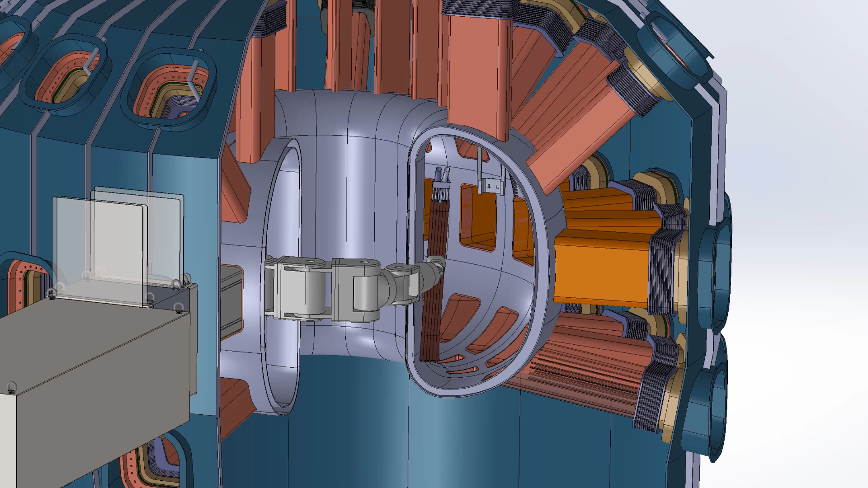
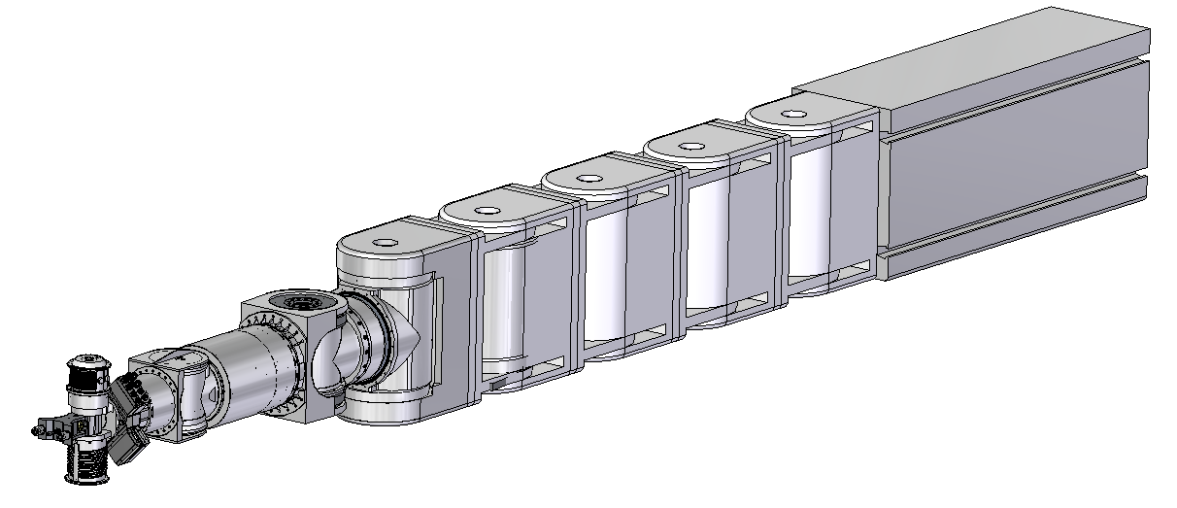
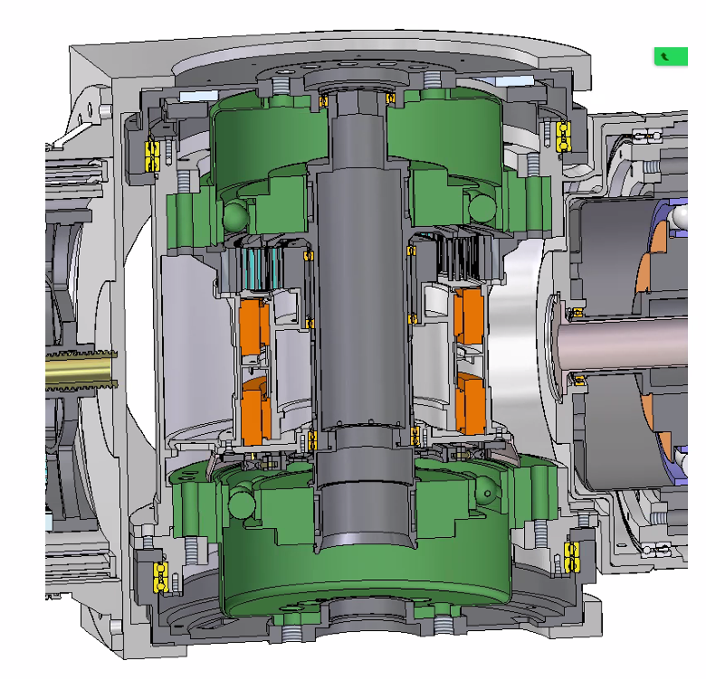
RHS-RHI Hyrman
Functionalities
Gripping and releasing of FW modules
Transportation of FW modules inside the vessel
Auxiliary operations (i.e. bolting/unbolting, inspection, etc.)
Operations on cooling pipes (i.e. cutting, welding, reshaping, smoothing, debris cleaning, weld verification)
Technical Requirements
Payload: 380 kg, (i.e. the weight of IFW module)
Max dimension: width: 680 mm, height: 800 mm
Reachability and dexterity: Adequate for performing operations
Dof: 12

Slide 4
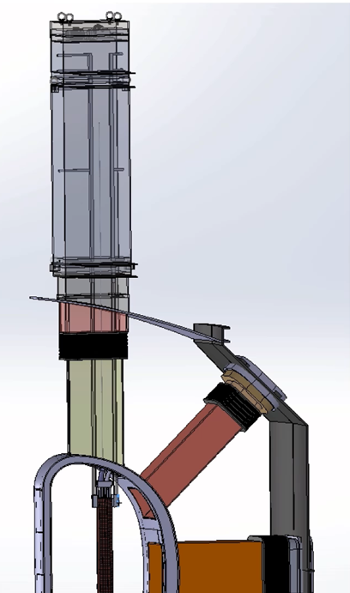
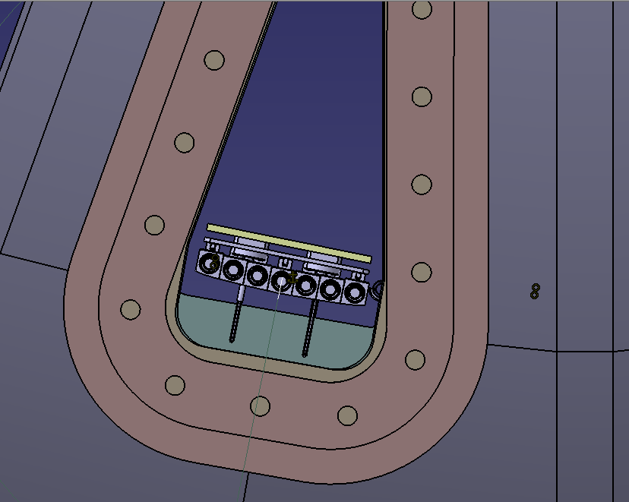
RHS-RHO- IFW Lifting System
  Functionalities
  Lifting of the IFW and transportation to the cask
  Lifting of IFW and TFW cooling pipes
Technical Requirements
Payload: 380 kg, (i.e. the weight of IFW module)
Max dimension: width: 680 mm, height: 900 mm

Slide 5
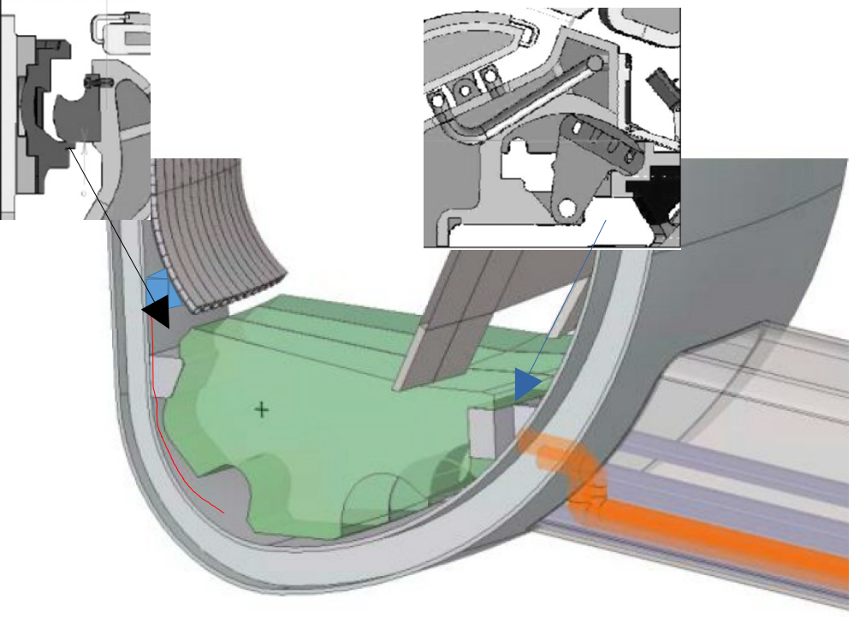
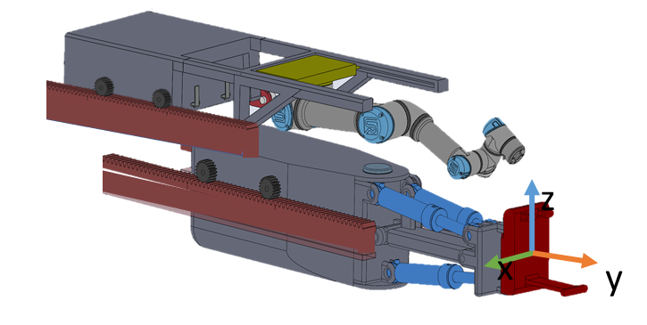
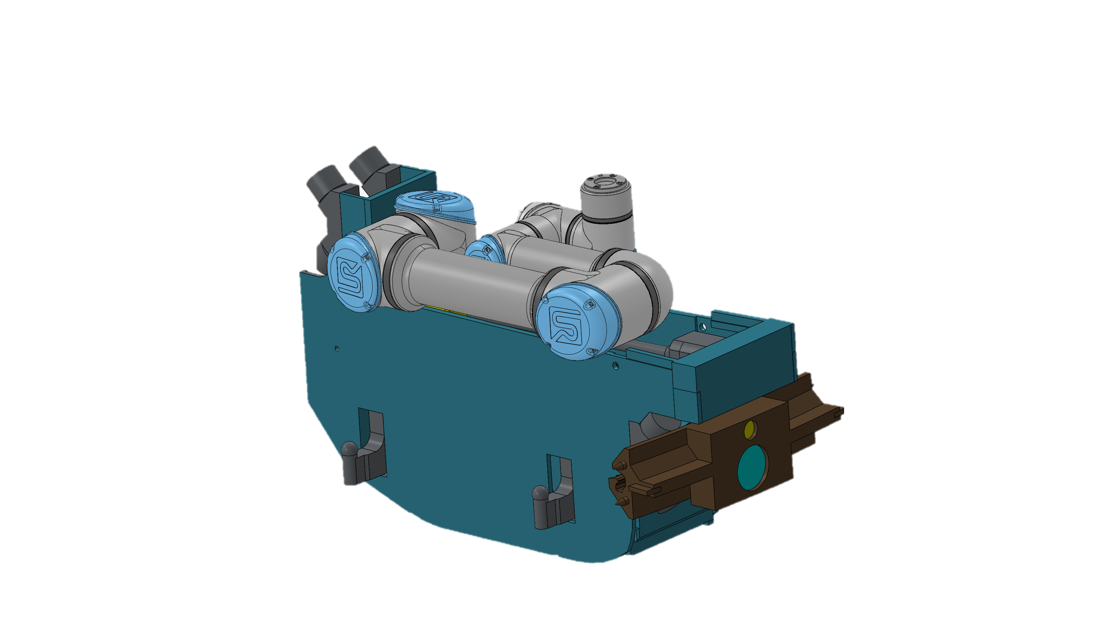
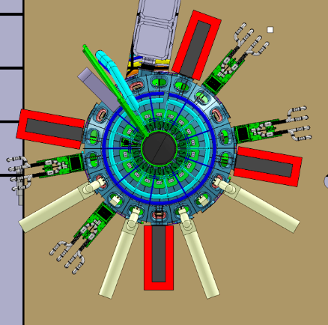
RHS-RHI DIV subsystem port #4
Cassette Multifunctional Mover (CMM)
Cassette Toroidal Mover (CTM)
5
Functionalities
Gripping and releasing of Divertor Cassettes
Connect and Disconnect sensor cable
Transportation of Divertor Cassettes
Auxiliary operations
Operations on cooling pipes (i.e. cutting, welding, reshaping, smoothing, debris cleaning, weld verification )
Technical Requirements
Payload DIV: 400 kg, (i.e. the weight of the divertor cassette)
Payload manipulator: 40kg (TBC)
Velocity: 2 mm/s, for translation and 1 deg/s for rotation
Max dimension: isosceles trapezoid - height 650 mm and bases 430 mm and 256 mm)
Accuracy: better than ±2 mm for translation and ±1 deg for rotation (in the task space)
Dof manipulator : 2 + 7 (vehicle + manipulator)
Dof CMM-DIV : 6
10
1
15

Slide 6
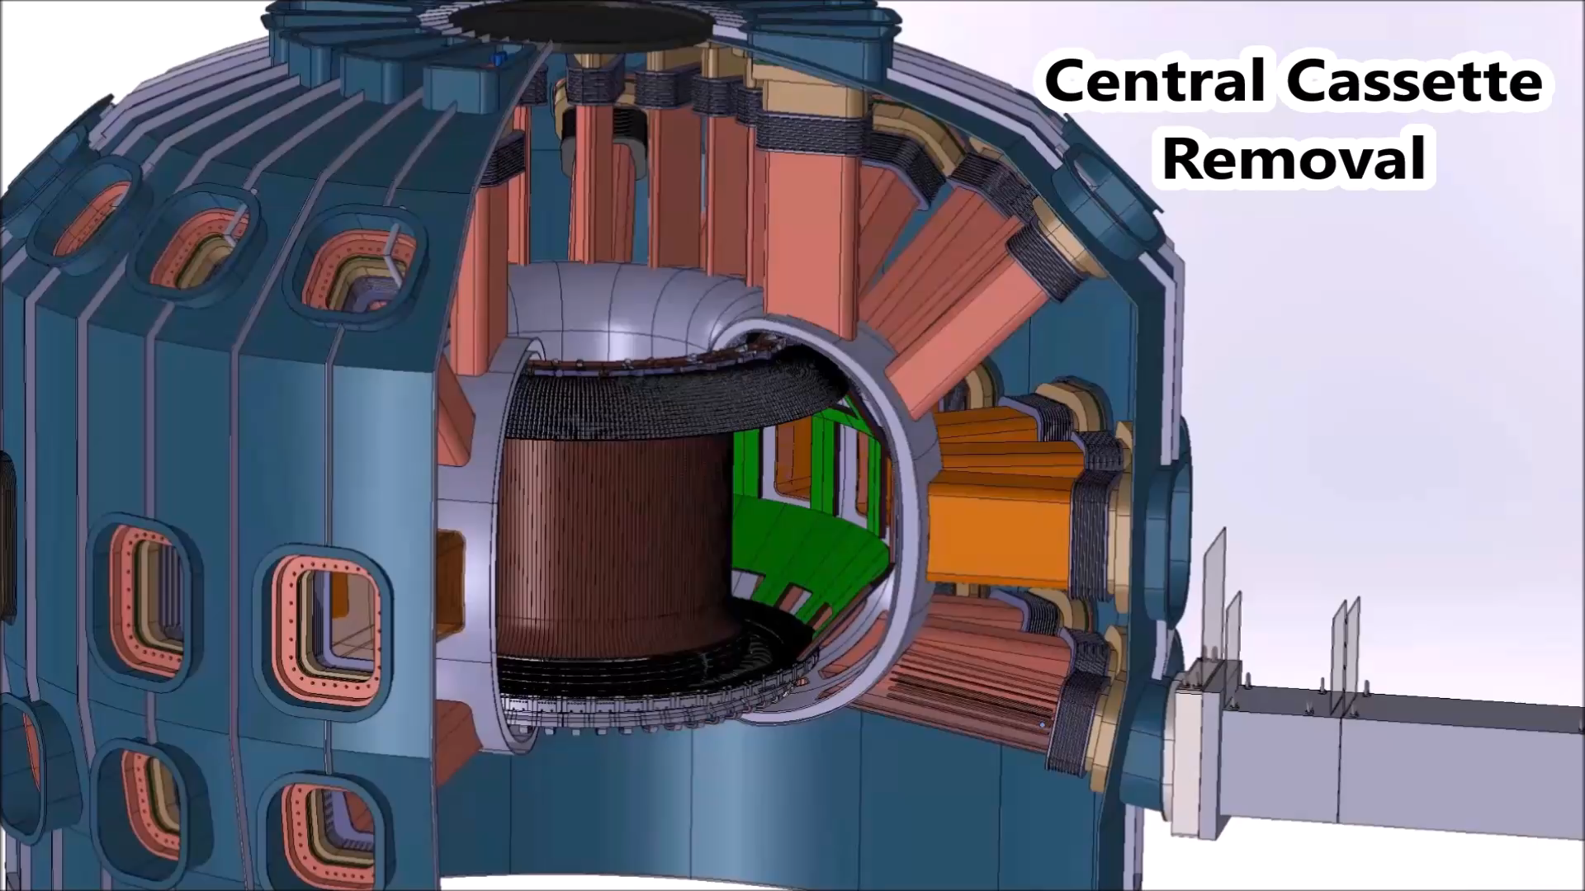
RHS-RHI Div simulations

Slide 7
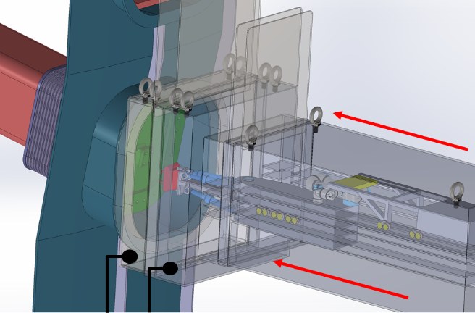
RHO – Casks design status
The RHC (Remote Handling Casks) that aim at
allowing ex-vessel transportation of DTT modules (e.g. divertor cassettes and first wall modules) and equipment for their maintenance
supporting RH equipment, from a mechanical point of view, during maintenance operations.
avoiding the dispersion of radioactive dust during in-vessel modules extraction and transportation outside the tokamak.
Protect operator with shields over the casks from radioactive parts contained.
Div+ Hyrman casks
Start conceptual january 2023

Slide 8
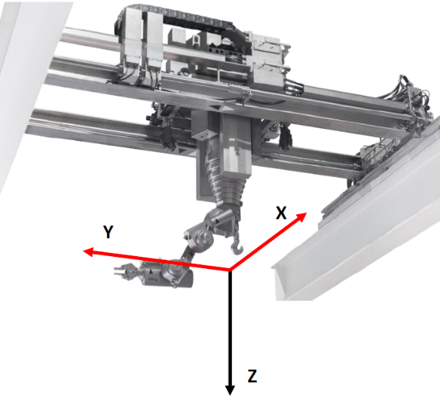
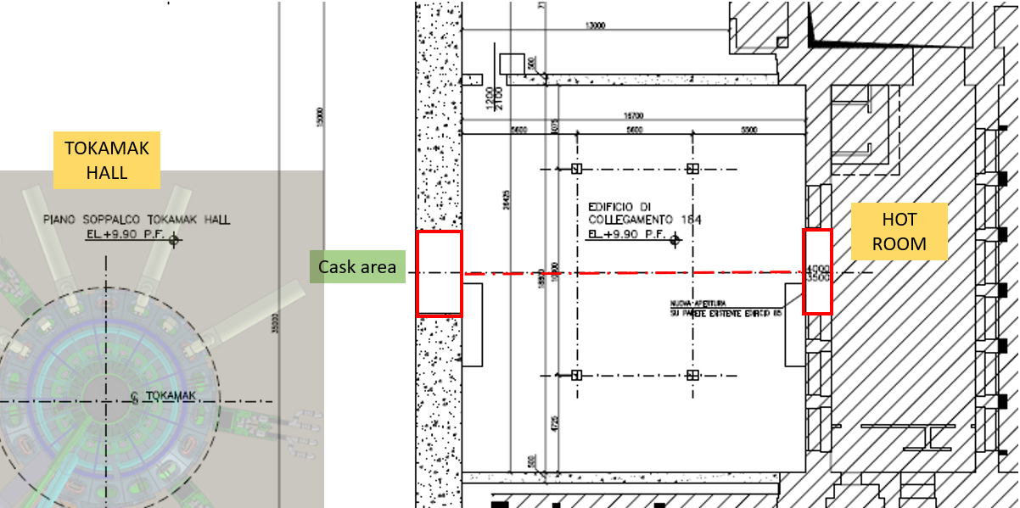
RHO - Hot Room manipulation system design status
The Hot Room manipulation that aim at:
Refurbishment and testing of activated and/or contaminated Tokamak components
Maintenance and testing of contaminated Remote Handling components
Buffer storage
Start conceptual january 2023

Slide 9
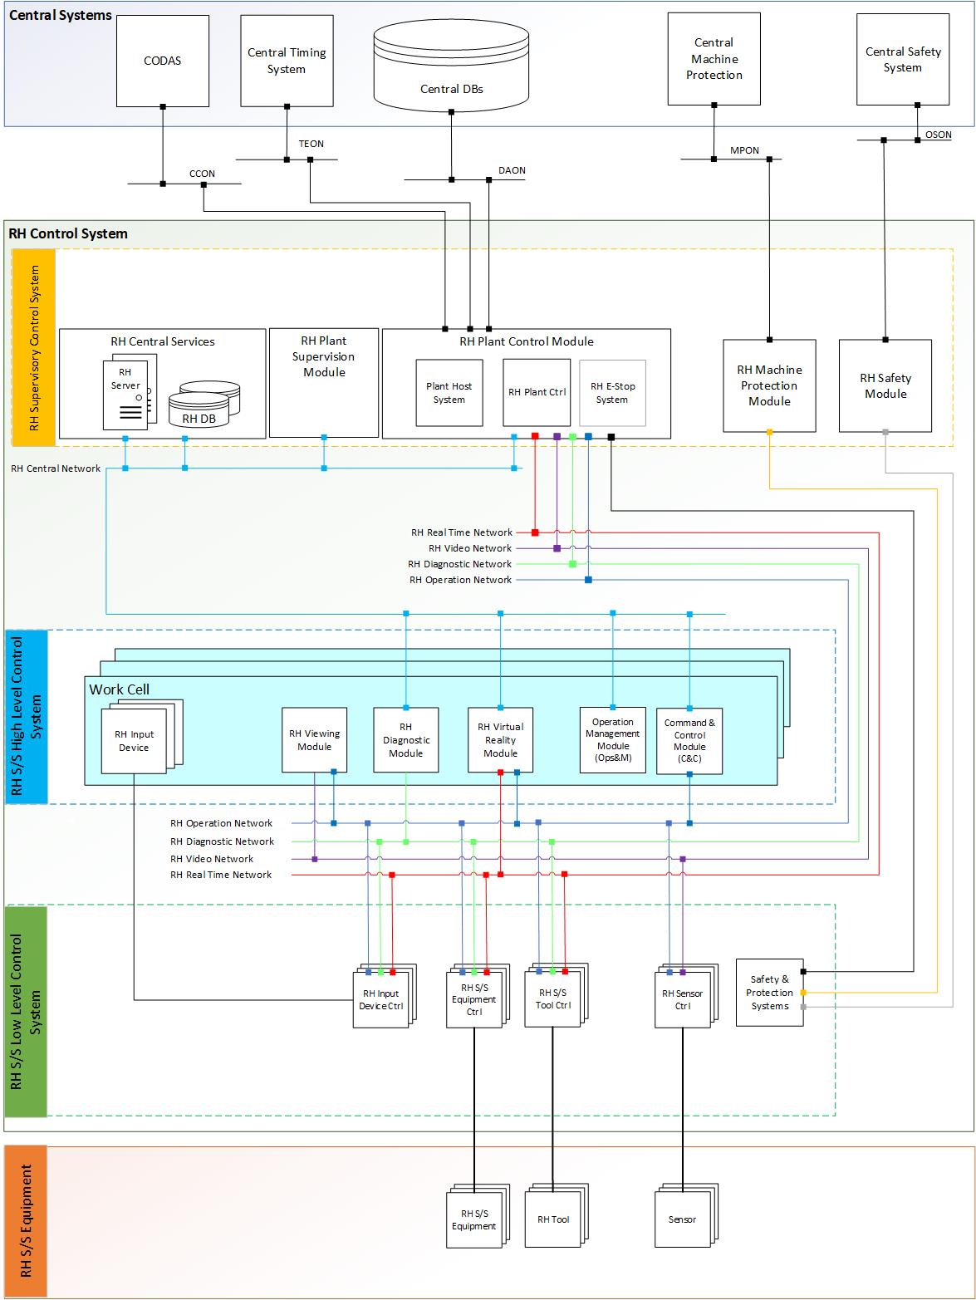
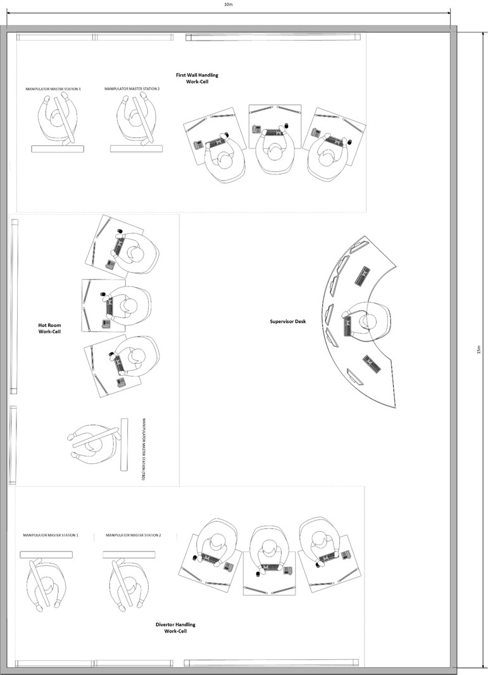
RHS-RHO – Control Systems
The RHS is provided with its own control system for the equipment and operations handling.

Slide 10
RHS- Physical Training Facility
A Physical Training and Test Facility (PT&TF) will be built in support to the development and validation of the remote handling maintenance activities to be performed in the plant and to the design of the RHS as well. The T&TF is aimed at:
Testing and validating all maintenance operations for in vessel components ( Divertor and first wall)
Optimizing of maintenance processes
Testing and validating of rescue and recovery procedures
Testing and validating of RH equipment design and reliability evaluation
Carrying out the commissioning of RH equipment
Studying for the upgrading of the RHS and of maintenance operations
Training for the RH operators
PNRR proposal

Slide 11
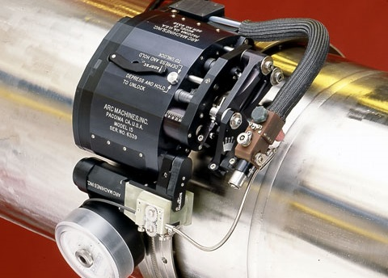
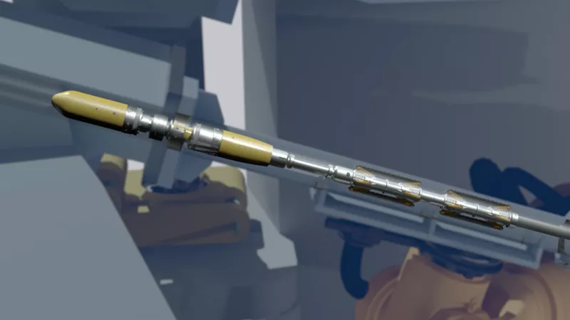
RHS- Cut & Weld tools design status
Among the maintenance operations to be performed for the replacement of the divertor cassettes and of the FW of the VV of the DTT plant there are the cutting and welding (C&W or RHW) of the cooling pipes of such components.
Two basic approaches are under development to perform these operations:
Out-bore Cutting and Welding tools (OC&W)
In-bore Cutting and Welding tools (IC&W)
Inbore ukaea laser welding

Slide 12
Competenze necessarie all’implementazione del RHS:
Progettazione e realizzazione di componenti meccanici di precisione
Progettazione e realizzazione di Elettronica rad-hard
Realizzazione di sistemi di taglio e saldatura laser/tig
Fornitura di Strumenti per PND custom (eddy current)
Sviluppo software
Qual è l'investimento previsto e, se possibile, il volume delle gare?
>10M€
Ci sono possibilità per le aziende di partecipare alle attività di R&S?
Si
Bandi di gara pubblicati da DTT S.C. a R.L. (www.dtt-project.it/index.php/dtt-tenders.html)
Contatti: Andrea.reale@enea.it
DTT Consortium (DTT S.C.a r.l. Via E. Fermi 45 I-00044 Frascati (Roma) Italy)

Slide 13
Thank you for attention and patience
DTT Consortium (DTT S.C.a r.l. Via E. Fermi 45 I-00044 Frascati (Roma) Italy)

